Slide 1



Development of a hybrid technology for treating recalcitrant water contaminants- assessing e-beam potential.
Why we got together?

Slide 2
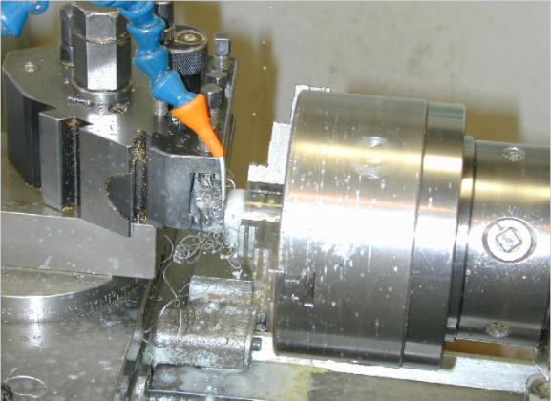
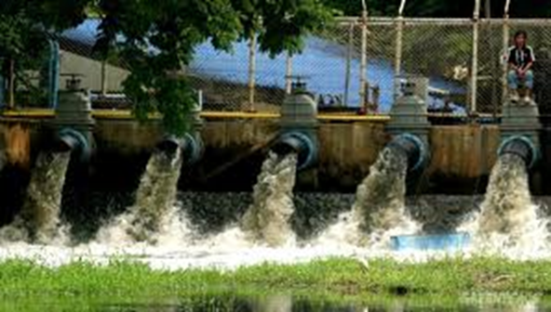
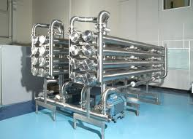
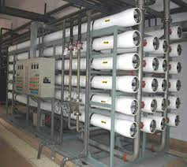
The challenge is resource (organics, metals and water) recovery from industrial waste waters on site.
Current clean-up approaches such as reverse osmosis and ultrafiltration (shown above) are not ideal- concentrate the problem and very energy intensive.

Slide 3
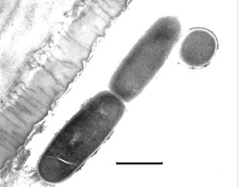
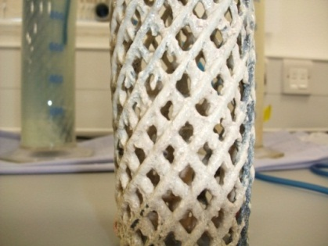
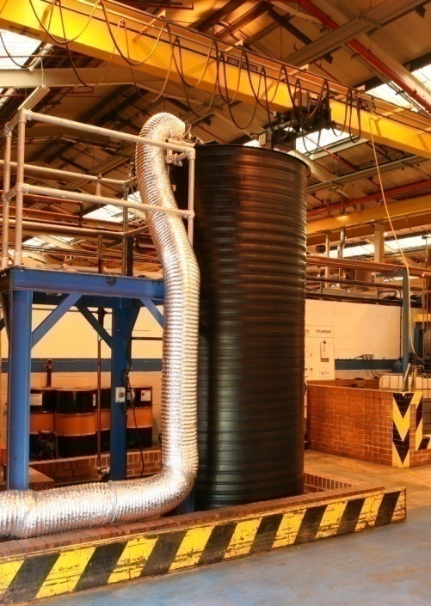
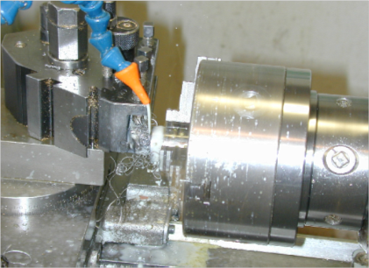
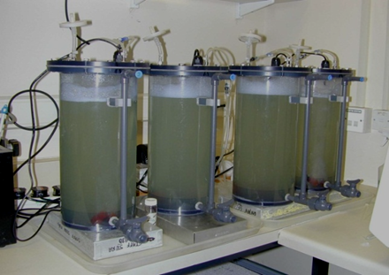
Our experience- microbiological treatment.
Enables: 1) Water recycling on site. 2) Organic converted microbiologically to biogas and bio-plastics. 3) Some metal recovery- but does not always work since biological systems have their limits.
This has been commercialised by the PI- Microbial Solutions Ltd.

Slide 4
Limitation - we do not always get complete degradation.
Waste streams we will test.
Chemically mixed industrial end-of-pipe oily effluent (Biffa).
Refinery wastes provided by BP and Exxon (including heavy oils).
Ground water contaminants such as TCE.
Pharmaceutical waste (GSK).
Diageo brewery effluent (mixed humic and copper).
How can we routinely and sustainably reduce the pollution load (expressed as COD-Carbon Oxygen Demand) to consent levels of <2000 mg L?

Slide 5
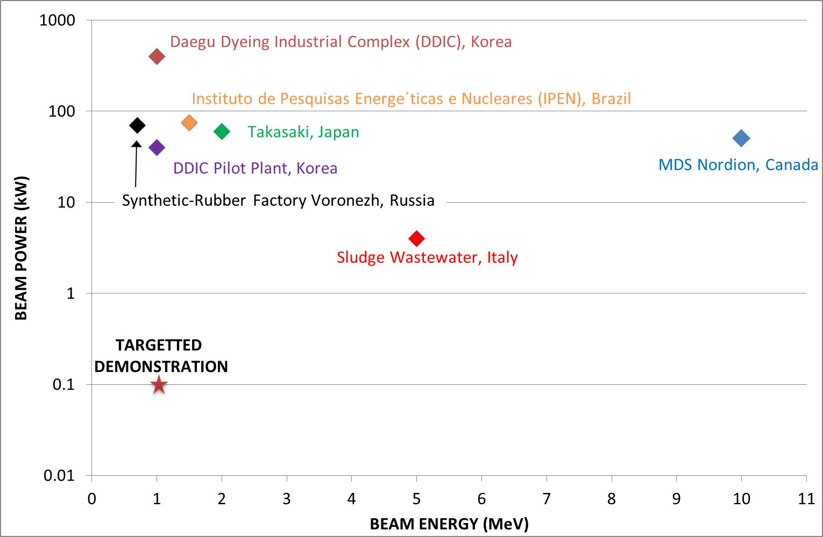
E-Beam Treatment
Anticipate treating ~20 samples.
Optimum e-beam parameters to be determined based upon:
  Duration,
  Regime of exposure,
  Energy,
  Beam intensity.
Shielding
Sample
Carousel
Collimation
Transmission
Window
E-Beam
Engineered solution
to be developed

Slide 6
Drivers and Objectives
Drivers
Our objectives
STFC Futures Programme- “Identifying and meeting unmet needs in the Environment.”
The programme will develop new inter-disciplinary communities.
Water security and smarter systems to reduce pollution and waste.
1. The primary objective of this study is determine the most effective e-beam exposure that enables degradation of
recalcitrant water-borne organic contaminants, resistant to other treatment procedures, and in parallel assess the potential of the e-beam to precipitate metals, so enabling their recovery, end-of-pipe.
2. To determine the most effective e-beam regime which leads to microbial cell inactivation.
3. From these studies determine the key issues that will define the commercial potential of e-beam application for treating problematic contaminated waters.

Slide 7
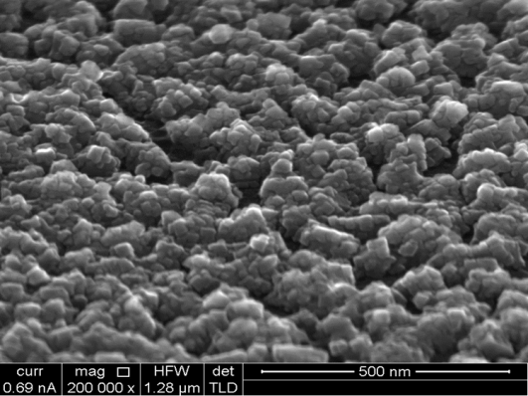
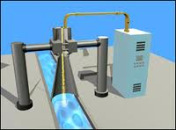
Our proposal- Sequential hybrid treatment.
Microbiological
Advanced Oxidation Processes with nanoscale-Fe oxide
Electron-beam
The order and condition of waste treatment is the key focus of the study.

Slide 8
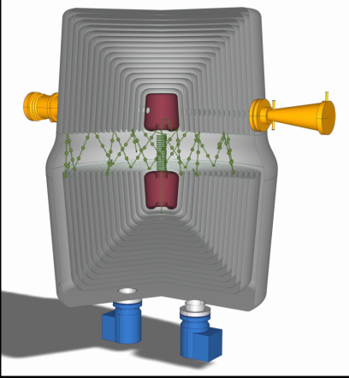
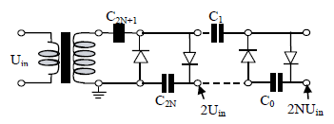
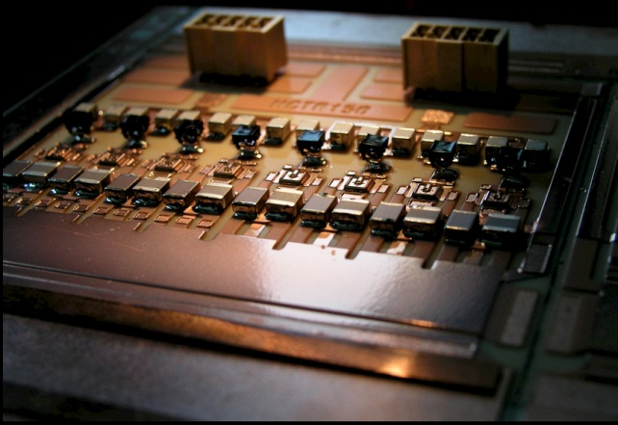
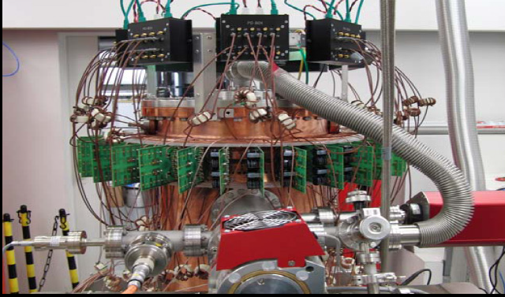
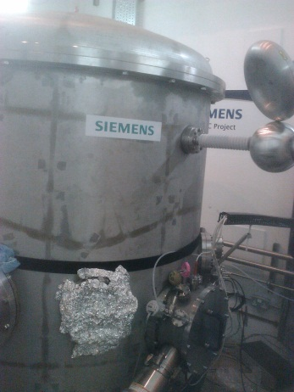
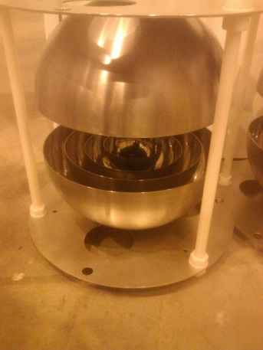
Siemens Technology Development
Oniac:
  Spherical Tandem Accelerator
STFC testing on FETS at RAL.
RELIA:
  SiC transistor drive amplifier.
  Targeting 100W/ € installed cost.
STFC providing consultancy for R&D programme.
50 kW @ 352 MHz

Slide 9
Other opportunities
Oil and water sector
Exxon- Heavy oils.
BP-Castrol and Microbial Solutions Ltd- recalcitrant waste waters.
Hydraulic “fracking” water- Cuadrilla.
Liquid waste
Diageo and Coca Cola- end of pipe organics and metals.
GSK- Pharmaceutical waste.
Green waste
Breakdown of lignin and conversion to bioenergy.

Slide 10
Even more opportunities
End of pipe metal recovery.
Metal recovery for mining systems.
Recovery of radioactive elements from waste.

