Slide 1
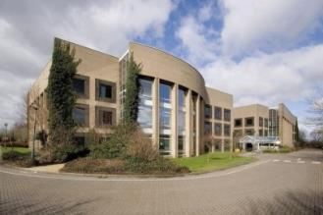
What is the
Technology Strategy Board?
UK’s ‘national innovation agency’
Set up to invest in business innovation
Works across business, universities and government
190 people, mostly come from business backgrounds
Responsible for investing c. £400m a year
Notes:
We should, perhaps, start by telling those of you who aren’t familiar with it just who the Technology Strategy Board are. This is their lovely headquarters building in Swindon

Slide 2
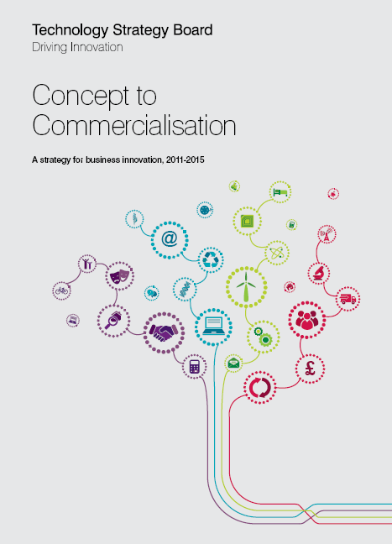
Concept to Commercialisation
A strategy for business innovation, 2011-2015
Our goal is to accelerate economic growth by stimulating and supporting business-led innovation
www.innovateuk.org
Notes:
The strapline is ‘concept to commercialisation’ and you will see copies of this document, along with others, on the table which is .........
With the exception of the case studies there should be enough literature for everyone to take a copy but should they run out or if you require more information, please talk to one of the advisers or myself or else visit the TSB website where you will find all this information. For that very reason I have deciedd not to print speaker notes but if you are interested, I can put the presentations online for you to refer to.

Slide 3
Our 5 Strategic Focus Areas
Accelerating the journey - concept to commercialisation
  Understanding the non-linear journey and how best to support
Connecting the innovation landscape
  Developing the strategic relationships we need in UK, EU & Globally
Turning Government action into business opportunity
  Where Government procures, regulates, standardises...
Investing in theme areas based on global potential
  Building a synergistic programme based on data driven choices
Continuously improving Organisational capability
  Impact assessment, metrics, measures, efficiency, effectiveness..
Notes:
So, moving swiftly along with the agenda, what does the TSB do? There are five main areas of activity, summarised here which cover the whole range of what we might describe as the ‘D’ in R&D. The Research Councils (also in Swindon) are largely responsible for the research – that is, for the science-y bit – and the TSB works on getting the benefits of that research base and combining them with the UK’s entrepreneurial businesses in order to develop the UK economy.

Slide 4
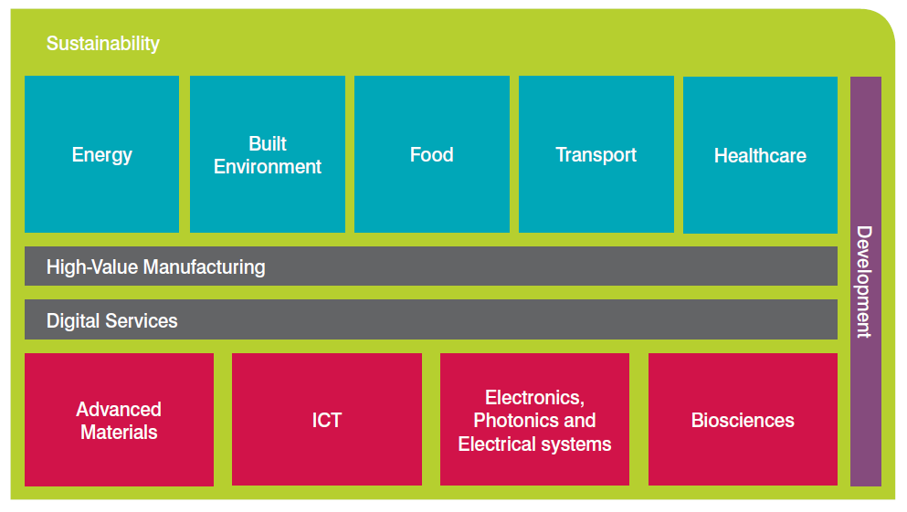
Investing in priority areas based on potential
Space Applications £10M
£25M
£10M
£10M
£20M
£55M
£25M
£15M
£5M
£5M
£5M
£5M
£5M
Notes:
Here’s a nice pictorial showing what the government (and by extension the TSB) thinks we should be concentrating on. You will see that overlying all of the sectors is the theme of Sustainability (by which we mean Environmental Sustainability). If you don’t think that your business fits one of these boxes don’t worry as most businesses will qualify as long as the business need can be demonstrated.

Slide 5
Criteria for investment
UK capacity to develop and exploit the technology
The size of the global market opportunity
The right potential for impact in the right time frame
A clear role for the TSB to add value
Notes:
Any investment must be credible and make a return and it should somehow make use of the special strengths that TSB can bring.

Slide 6







The Toolset
Range of Tools with different objectives / characteristics
Smart
Collaborative R&D
Launchpad
Entrepreneur Missions
Notes:
SO...there is no one-size-fits-all pot of money to dip into. Depending on the stage of development, the needs that a company has, previous funding history and, to a certain extent, size, there are a wide range of different mechanisms through which to engage with the TSB. Today’s meeting will focus on 4 of these – three ‘always-open’ funding tools and the KTNs but will also make mention of the ‘challenge competitions’ and the Catapults.

Slide 7



What are Knowledge Transfer Networks?
Established by the TSB to;
Stimulate innovation in the UK’s key technology sectors
Link different organisations - each playing a part in delivering the objectives
Provide a means of efficiently using the support mechanisms already available
Notes:
I don’t need to read the slide. Essentially we are there to connect and catalyse or facilitate the transfer of knowledge from academia to industry and between companies, all the while referring to the emerging legislative landscape

Slide 8













Environmental Sustainability KTN
Industry led Management Board
Delivered by a strong partnership
8 FTE
5 FTE
Notes:
The ESKTN is delivered jointly by Oxford University and C-Tech Innovation and is overseen by a board of senior industrial and sustainability professionals

Slide 9
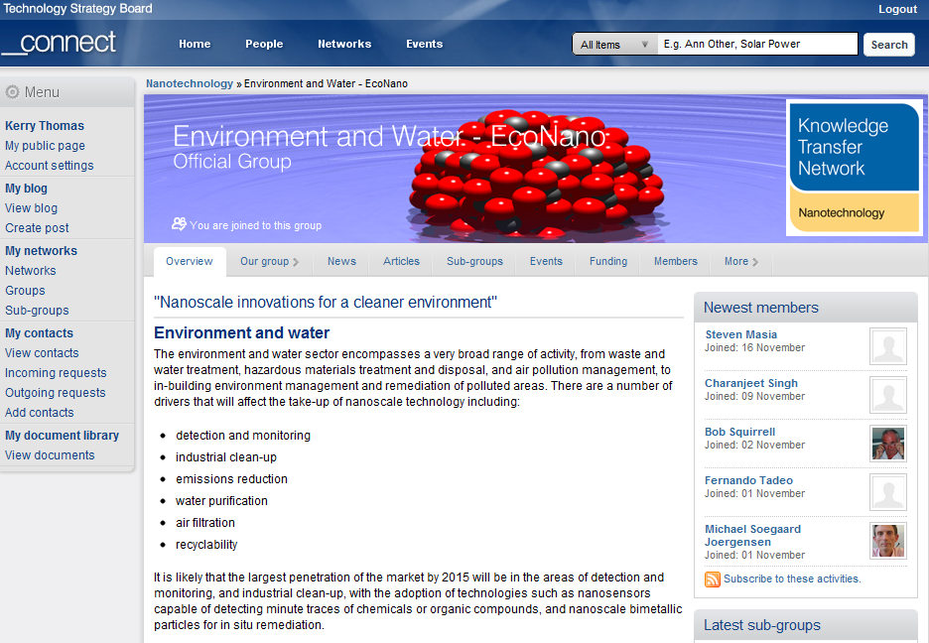
Notes:
The site is quite flexible (the new site will be launched in the next month and promises even greater functionality) with the ability to tailor groups and subgroups to suit all manner of interests

Slide 10

Closing the gap between concept and commercialisation
The vision: a network of world-leading centres
Bringing research and business together – accelerating commercialisation
A £200m investment in the future of the UK economy - for the long term
Notes:
I alluded in the ‘toolbox’ slide to these things called Catapults. Catapults are really rather new – some still in the process of being formed – and in a sense they are emerging as they go but they are a tangible expression of the government’s ambition to integrate business and research

Slide 11
Closing the gap between concept and commercialisation
Connected Digital Economy
Future cities
Transport systems
High Value Manufacturing
Cell Therapy
Offshore Renewable Energy
Satellite Applications
Notes:
These are the seven Catapults and I would encourage you to get involved if you consider that your business can contribute to or benefit from developing products and solutions in these areas (although I can’t tell you quite how just yet!)

Slide 12



Materials innovation for a sustainable economy
Notes:
Collaborative R&D competitions are calls for bids from consortia that must include at least one SME partner for R&D on a specific theme. They are launched from time to time and are publicised through _connect and facebook and twitter and linked in and... They are also preceeded by workshops to explain the competitions and to help build consortia.

Slide 13


Notes:
And so to the second of the ready-when-you-are mechanisms - Smart

Slide 14
Smart
Funding to small and medium-sized enterprises for R&D projects in science, engineering and technology
Previously known as Grant for Research and Development
Three types of grant are available:
  Proof of market
  Proof of concept
  Development of prototype

Slide 15

Proof of market grant
Enables companies to assess the commercial viability of a project, through:
  Market research
  Market testing and competitor analysis
  Intellectual property position
  Initial planning to take the project to commercialisation, including assessing costs, timescales and funding requirements
Projects will last up to 9 months, have a maximum grant of £25k, and up to 60% of total project costs may be funded.
Notes:
Proof of market – a small amount of money to determine whether it is worth going ahead

Slide 16

Proof of concept grant
To explore the technical feasibility and commercial potential of a new technology, product or process, including:
  Initial feasibility studies
  Basic prototyping
  Specialist testing and/or demonstration to provide basic proof of technical feasibility
  Intellectual property protection
  Investigation of production and assembly options.
Also includes pre-clinical research studies
Up to 18 months, maximum grant £100k, up to 60% funded.
Notes:
Proof of concept – A significant amount of money to determine whether it will work

Slide 17

Development of prototype grant
Used to develop a technologically innovative product, service or industrial process, such as:
Small demonstrators
Intellectual property protection
Trials and testing, including clinical
Market testing
Up to 2 years, maximum grant of £250k; up to 35% of total project costs for medium enterprises, or up to 45% for small and micro enterprises.
Notes:
Development of prototype – it works in principle, can we use a reasonably large chunk of funding to make something to trial?

Slide 18

Knowledge Transfer Partnerships (KTP)
Providing resources and expertise through academic collaboration to address businesses’ strategic needs

Slide 19
What is KTP?
Knowledge Transfer Partnerships (KTP) are partnerships involving a company, a knowledge base and a recently qualified person to carry out a strategic project with benefits to all parties.
A different form of University – Industry engagement

Slide 20
How does it work?
Focused team for 6-36 months
Associate works full time on the company premises – but employed by University
Academic supervises Associate ½ day/week (average) at the company
Company supervises as per normal employee
Associate project-manages
Formal project management disciplines imposed
PARTNERSHIP

Slide 21
Assessment dates
The new batch assessment dates for Smart scheme applications during the financial year 2013/14 are:
23 May 2013
18 July 2013
26 September 2013
21 November 2013
30 January 2014
27 March 2014

Slide 22
European Funding Streams
In a ‘state of flux’
H2020 is currently only a feint outline
  Work packages not announced
  Possibility post 2014
Eco-Innovation aimed at close-to-market technologies
Horizon 2020 Initiative (confusingly)
  Euro-mediterranean partners committed to substantially reducing pollution in Med. by 2020
  Funds committed (DG EuropeAid)

Slide 23
A couple of possibilities to consider
ERA-NET
the networking of research activities conducted at national or regional level, and
the mutual opening of national and regional research programs.
COST
financial support for cooperation efforts of scientific groups across Europe and the coordination of these research networks called “Actions”.

Slide 24
ERA-NETs What?
European Research Area Network
Minimum 3 participants in different EU countries (or eligible partner countries)
Up to €2.5M for 3 years (but some flexibility)
Promoting transnational research
Complementary to other EU/national funding

Slide 25
ERA-NET
“facilitating practical initiatives to coordinate regional, national and European research programmes in specific fields, and to pool fragmented human and financial resources, in order to improve both the efficiency and the effectiveness of Europe’s research efforts”

Slide 26
ERA-NETs Why?
Mapping of past and current research funding programs
Regular workshops to improve mutual understanding and trust
Identify gaps, overlaps and possible synergies
Can lead to collaborations of major significance, including the strategic planning and design of joint research programs

Slide 27
COST
Cooperation in Science and Technology
the costs of networking activities such as meetings (e.g. travel, subsistence, local organiser support), conferences, workshops, short-term scientific exchanges, training schools, publications and dissemination activities
Does not fund the research itself

Slide 28
COST How?
Contacts from at least five COST countries
Must have, (or have good reason to expect to have), a national research grant or other research funding
Make a good case that a COST network would make a positive impact over and above the normal benefits of networking
C. €130k per annum

Slide 29
Other...
What stage is the research?
  Early-stage – Research Councils (EPSRC, NERC, STFC)
  Is there something near-market that might attract VC funding?
  Water technology is (slowly) beginning to be recognized as a sector ripe for investment
  VC Market is currently very risk-averse

Slide 30
Other (continued)
Industry itself?
  Veolia Innovation Accelerator, Severn Trent Services, BP Ventures, Siemens...
  What does industry look for?

Slide 31

Jonathan Abra
Knowledge Transfer Manager
Environmental Sustainability KTN
Jonathan.Abra@esktn.org
0754 001 4955

