Slide 1

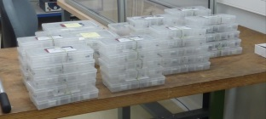


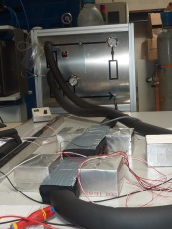

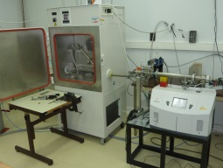


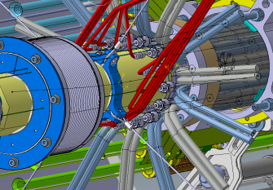

ATLAS Inner detector upgrade
Small size Fitting developments @ LAPP - Annecy
B - The development story
C - How to reach industrial standards ?
A - Why a small custom fitting ?
D - How to go forward ?
LAPP ATLAS ID cooling team
Jacques Ballansat, Patrick Baudin, Pierre Delebecque, Nicolas Massol, Thibaut Rambure, Theodore Todorov,
Notes:
* To start: illustration
* Photo tank which flamed
* Not D ' similar examples for the LAPP
* Drawing: result D ' a simulation
* Simulation carried out afterwards

Slide 2
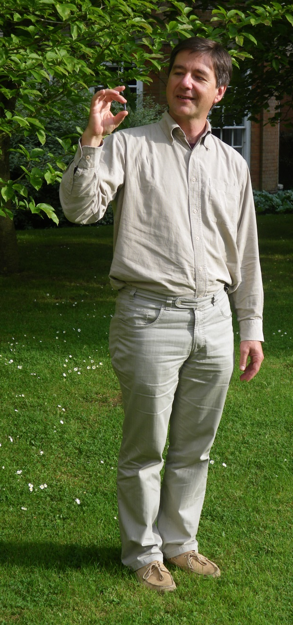
1 – Introduction
A very small fitting
The fitting is here

Slide 3
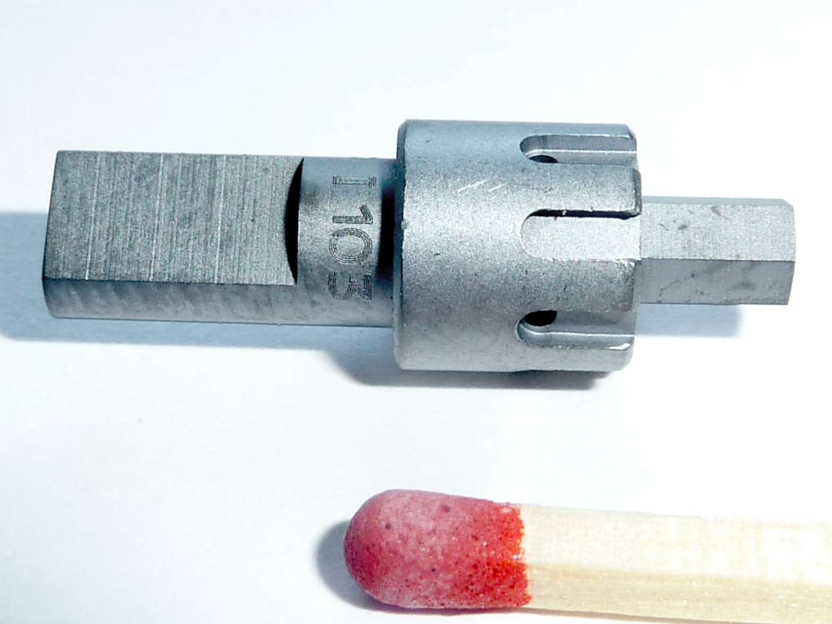
1 – Introduction
A very small fitting

Slide 4
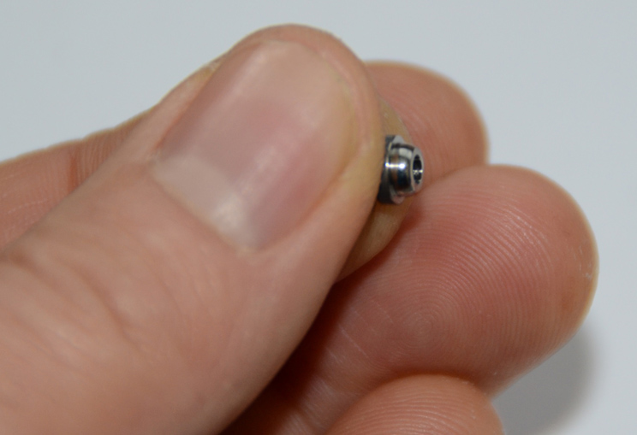
1 – Introduction
A very small fitting
Handling is not so easy !

Slide 5
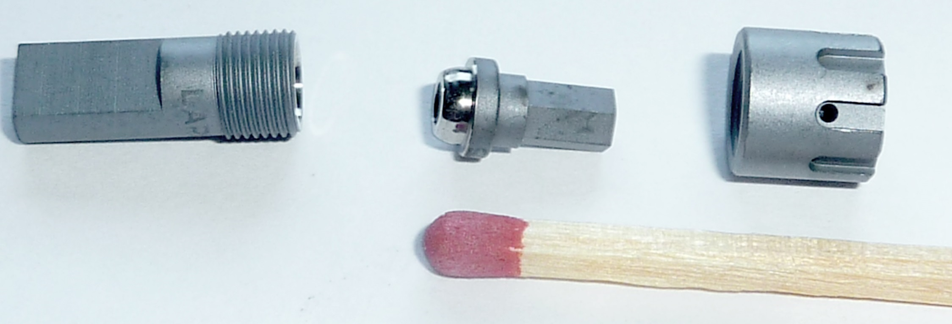
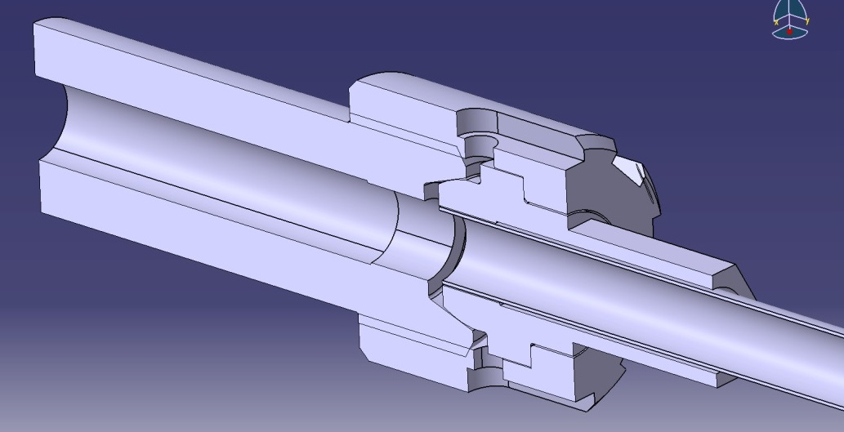
1 – Introduction
φ 8mm
A very small fitting – the 3 components
Female
Male
Nut
Mass=2.2g (IBL version)
Tightening torque ~2N.m

Slide 6
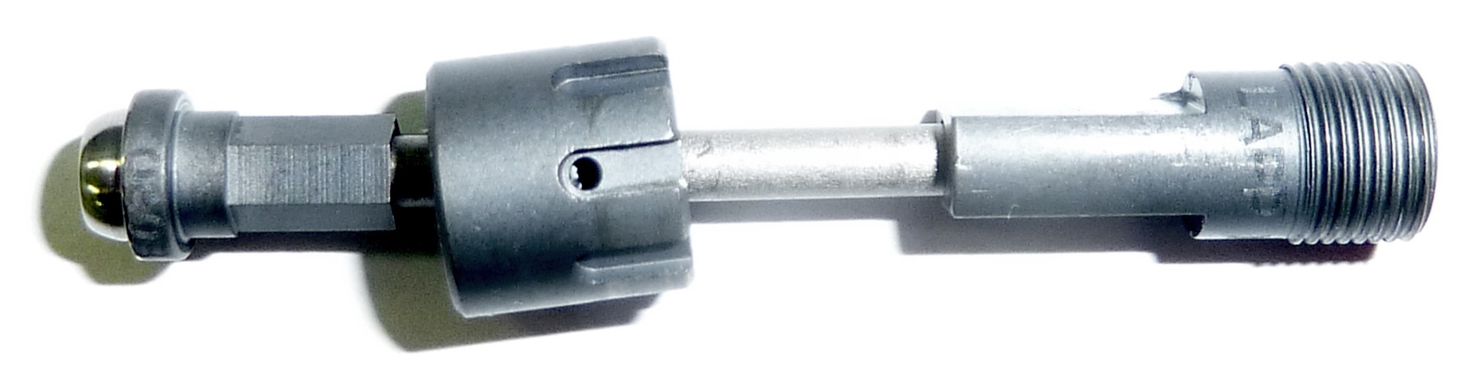
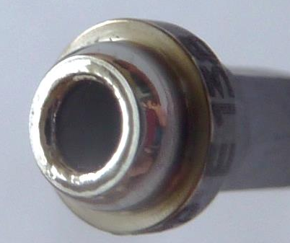
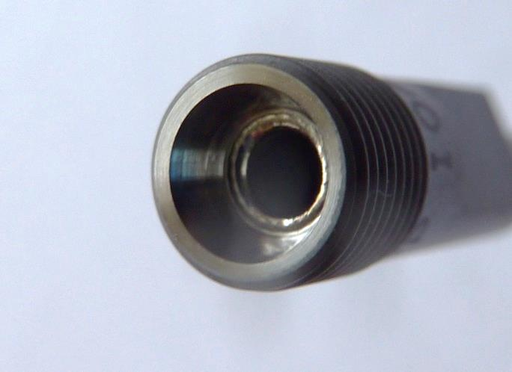
1 – Introduction
Fitting welded on a titanium pipe (sample for qualification)
Electron Beam welds
Pipes outer diameters : φ 1.77 mm and φ 2.27mm (IBL)
Pipes wall thickness: 130 μm (IBL) 70 μm (prototyping)

Slide 7
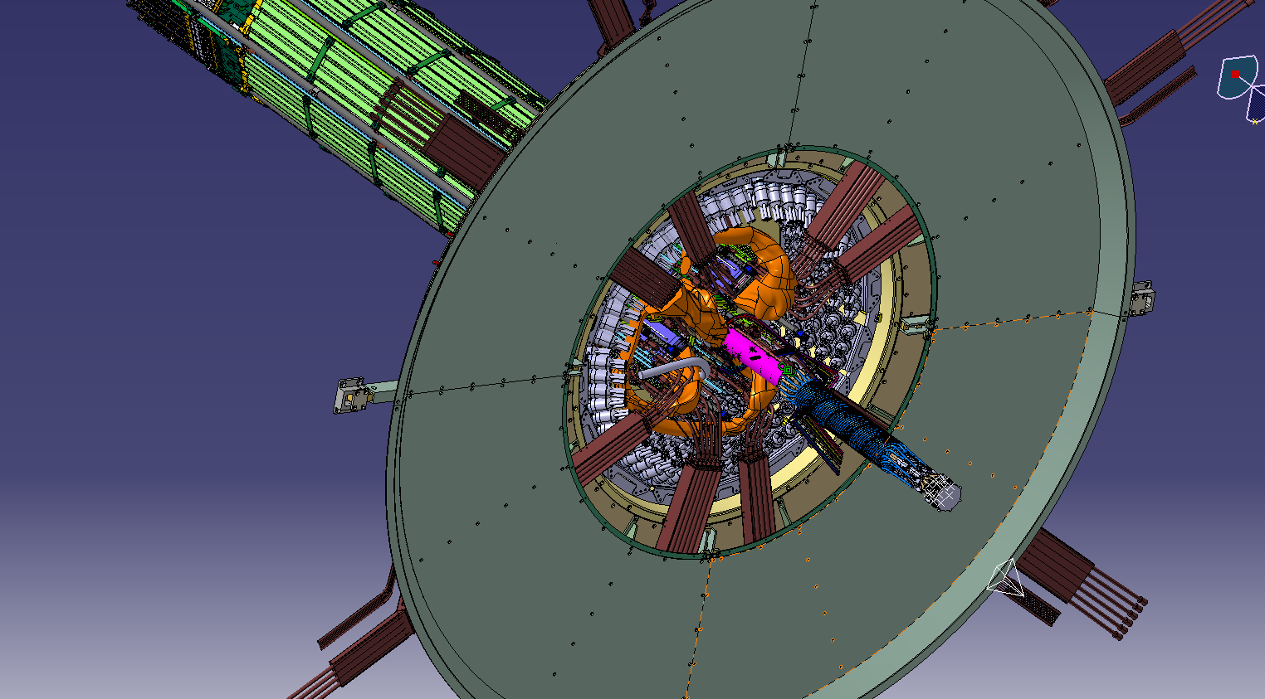
2 – Context
General view of one pixel detector end

Slide 8
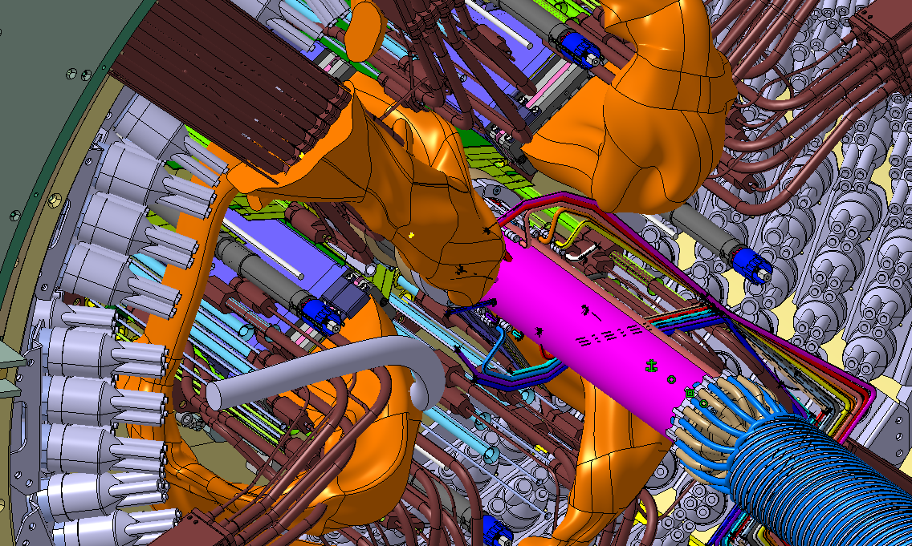
2 – Context
General view of one pixel detector end (zoomed)

Slide 9
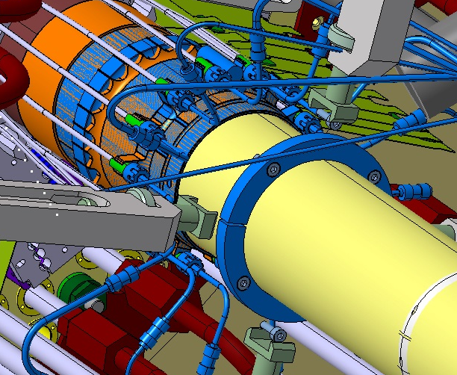
2 – Context
Zoom on IBL end region

Slide 10
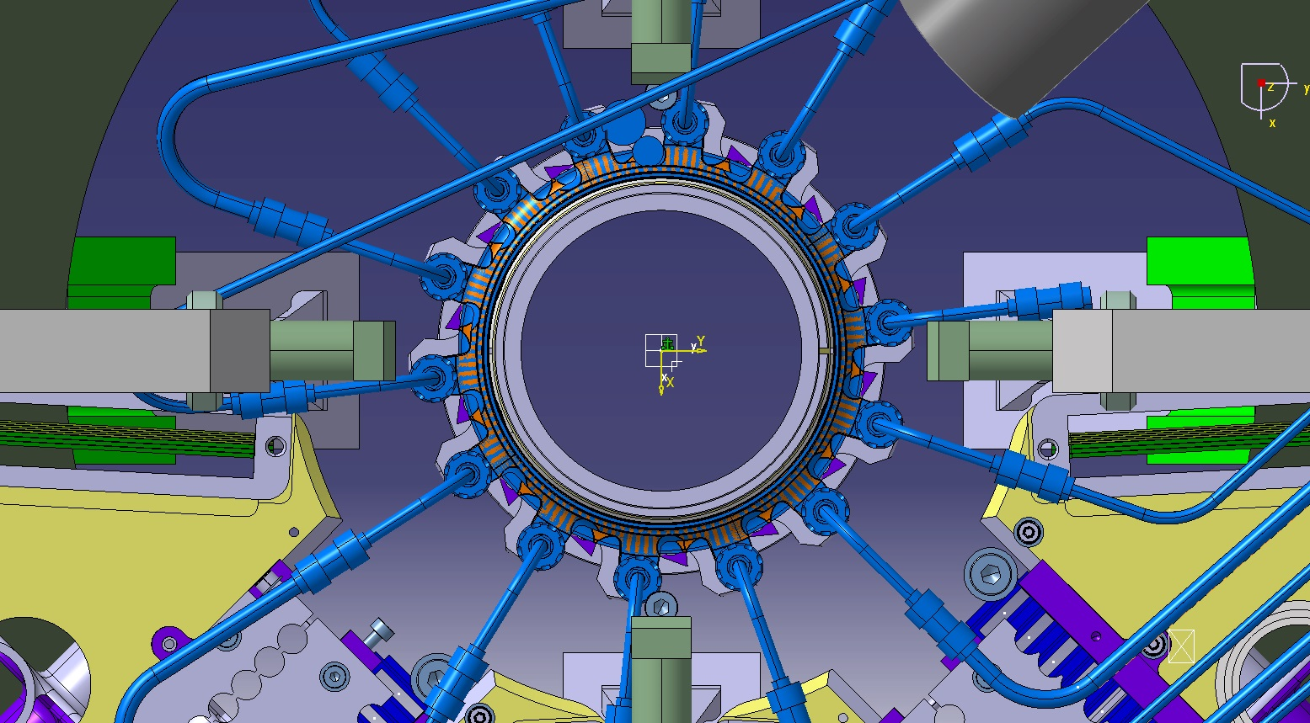
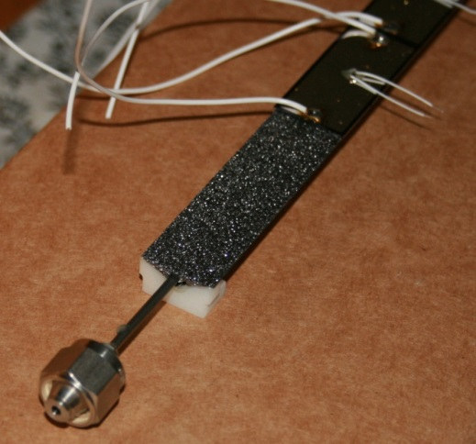
2 – Context
Front view of the IBL end region
10

Slide 11
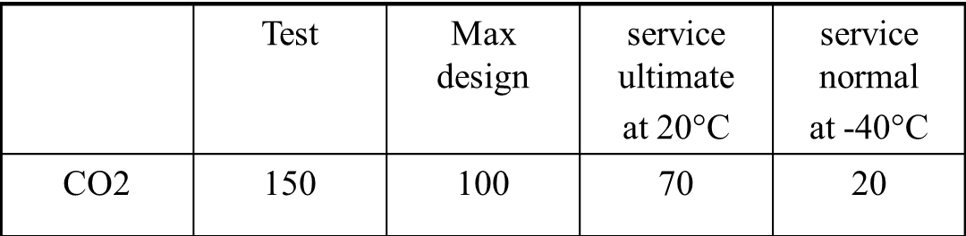
2 – Context - specifications
Specifications
Small fitting, less than ∅8 mm :
  Minimize material budget
  Fit inside a limited volume
Maximum leak rate (He) : 10⁻⁵ mbar.l.s-1 @ 1bar (10⁻⁸ mbar.l.s-1 @ 20bar retained for validation)
Working temperature : mini -40 °C → maxi +20 °C
Pressure (bar):
Radiation level : 1 Grad
Pipe material : Titanium grade 2
20 mountings / dismountings at least
10
11

Slide 12
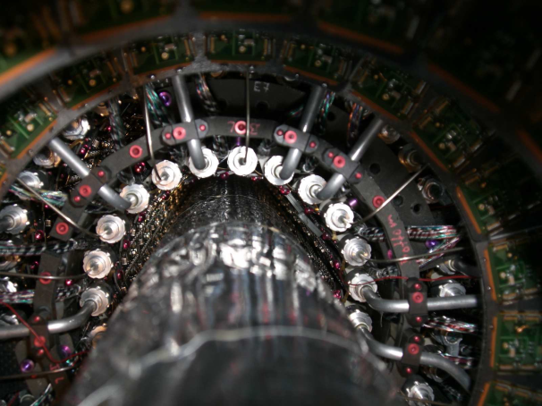
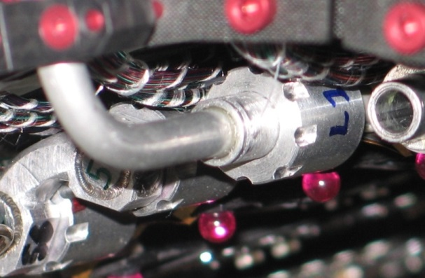
3 – Why a custom fitting?
  Why not using the current end-of-stave Pixel aluminium fittings for IBL ?
  Problems and questions :
Leaks on the current disks,
Uncertainties on the disassembly capability
We want to use of titanium instead of aluminium
  Lessons from pixel detector ? :
Need real quality management
Need qualifications
Need procedures for tests, manufacturing controls and mounting
Need tightening control
The ATLAS tracker community didn’t want any custom fittings !!

Slide 13
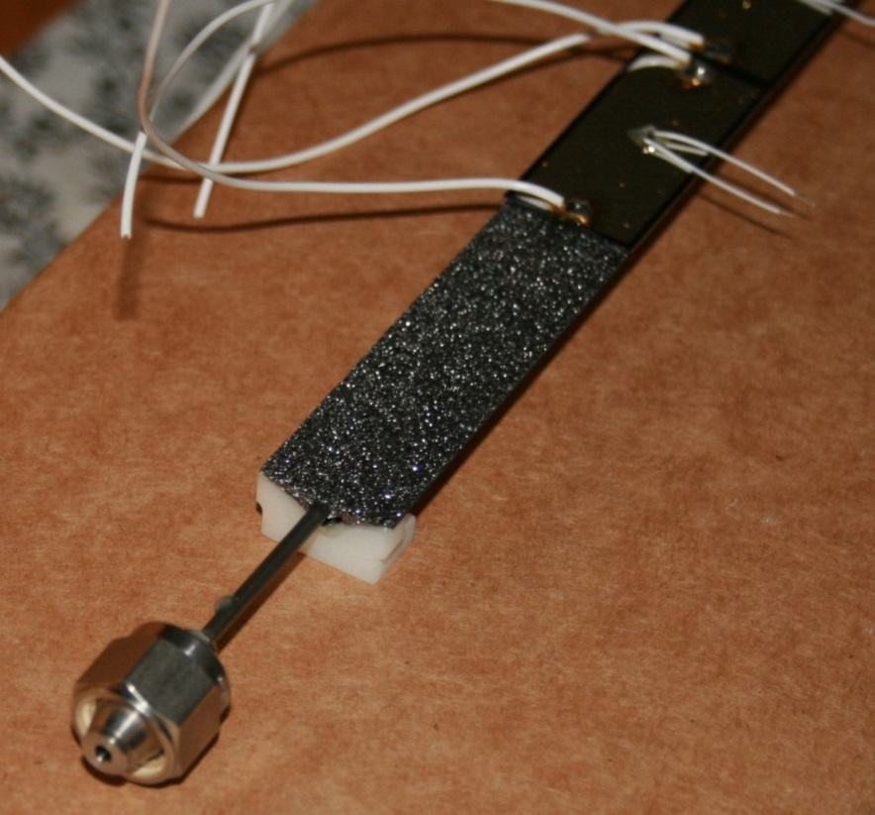
3 – Why a custom fitting?
………………………………but
No industrial standard solution was complying with the IBL specifications (especially the envelope)
  Swagelok: not interested in reducing the size of their connectors
  Staübli : specific design proposed but very costly

Slide 14

3 – Why a custom fitting?
So what could we do ?
Custom developments was the only solution
BUT…it had to be developed according to industrial standards
14

Slide 15
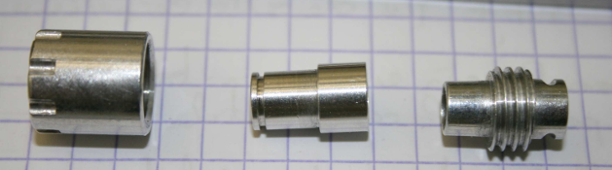
4 – Custom fitting @ LAPP : a brief history
Step 0 : Copy of Luer lock pixel aluminium fitting
  Same material (aluminium EN AW-6063), same design
  Leak rates [2.10-7 - 10-5 ]mbar.l.s-1 @ 2bar He
  Need to put strength to dismount the fittings

Slide 16
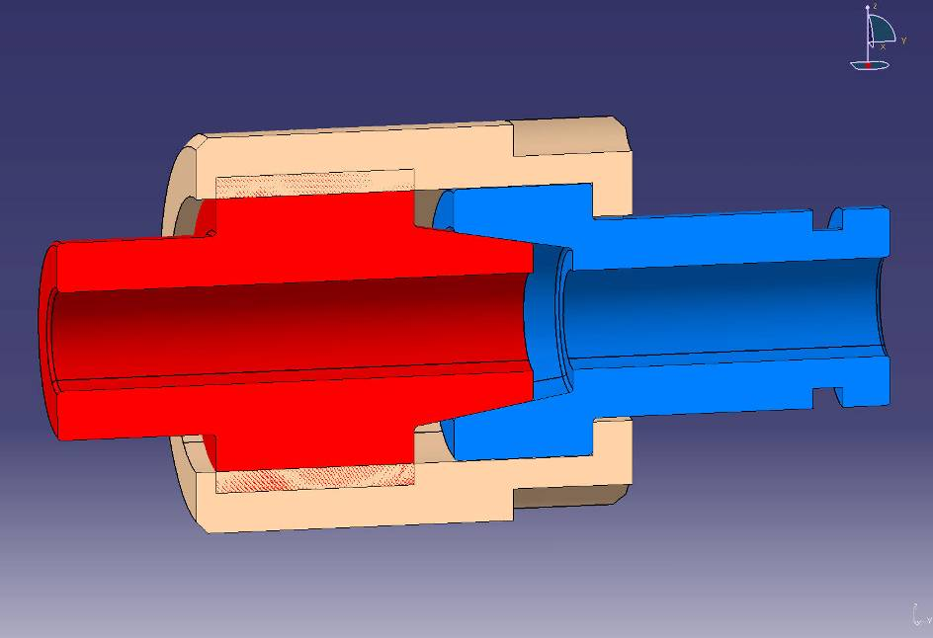
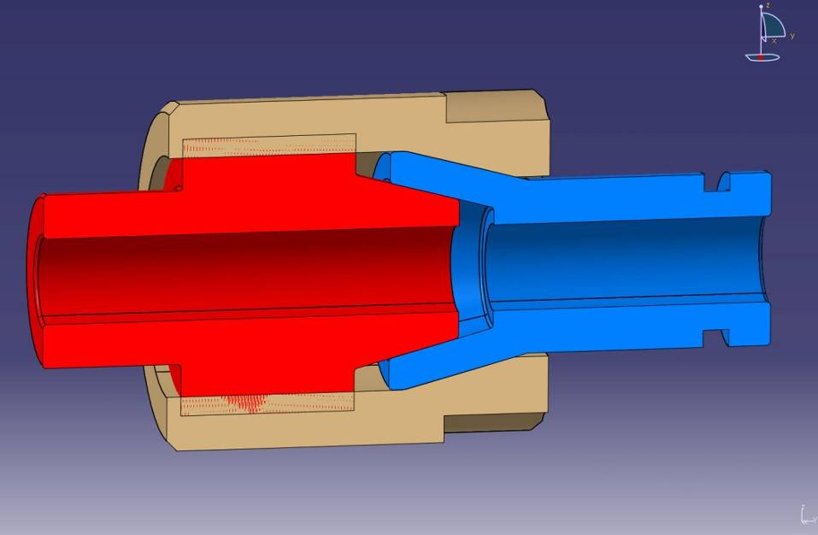
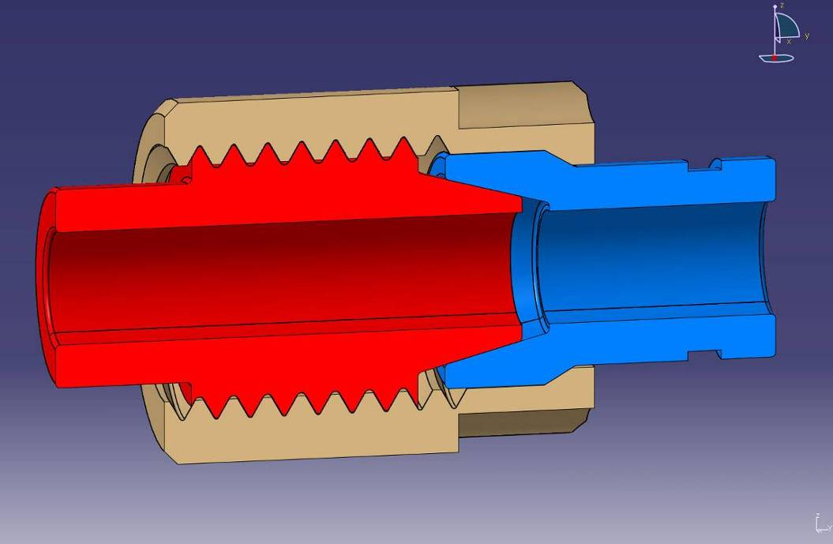
4 – Custom fitting @ LAPP : a brief history
Step 1 : Aluminium Cone/Cone
  Increasing the angle from 3.5 degrees to about 30 degrees
  Changing the nut/female contact
  Leak rates : no major changes comparde to Luer lock
  Higher torque needed
  Improve dismounting

Slide 17
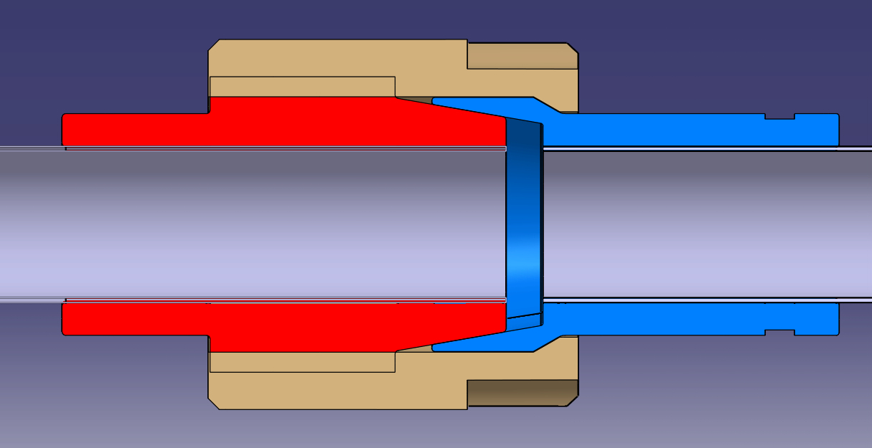
4 – Custom fitting @ LAPP : a brief history
Step 2 : Titanium grade 2 (not alloyed) Cone/Cone design 1
  Material changes Aluminium to Ti grade 2
  Design chosen from first tests on aluminium custom fittings
  Tests done with samples Electron beam welded
  Not sufficiently reliable (some leak tight, some not)

Slide 18
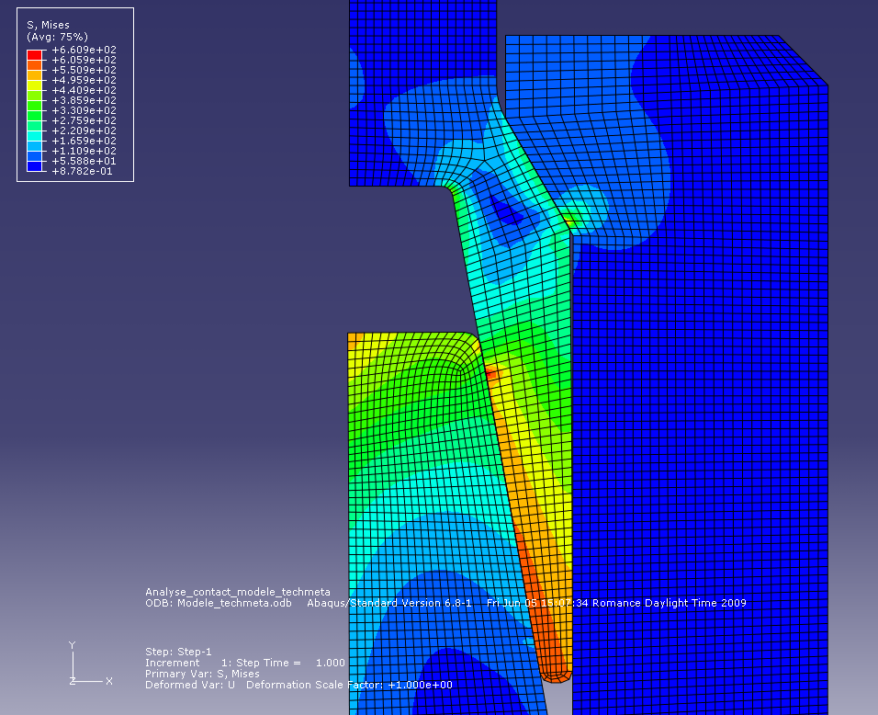

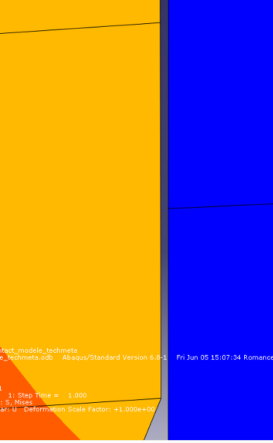
4 – Custom fitting @ LAPP : a brief history
Step 2 : Titanium grade 2 (not alloyed) Cone/Cone design 1
  Analysis of the behavior:
  Extremity of the male too flexible
  Gap between female and nut induces high stresses
Gap

Slide 19
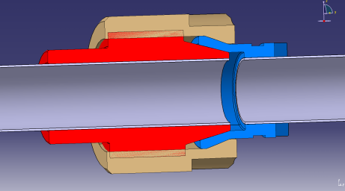
4 – Custom fitting @ LAPP : a brief history
Step 2 : Titanium grade 2 (not alloyed) Cone/Cone design 2
  Change of surface contact between the nut and the female part
  Not sufficiently reliable (some leak tight, some not again)
  Problem of surface quality or/and hardiness suspected (material torn from the surface)
  Use of electropolishing, « tribofinition » and Balinit C (carbon+tungten) coating on the cone surfaces
  Did not improve the leak tightness

Slide 20
4 – Custom fitting @ LAPP : a brief history
Step 2 : Titanium grade 5 (alloyed) Cone/Cone design 3
  Change material to Ti grade 5 (same hardness as stainless steel used for some commercial fittings)
  Better results but still do not fit the specs
  Some samples made of 316 L stainless steel
  Good results (need at least to be tightened at 7N.m

Slide 21




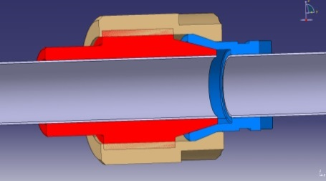


4 – Custom fitting @ LAPP : a brief history

Slide 22
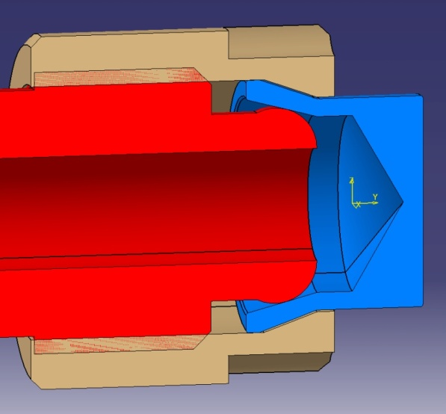
4 – Custom fitting @ LAPP : a brief history
Step 3 : Titanium grade 5 Toroid/Cone
  Machining of a toroid shape instead of a cone
  Improve the friction of the threads and the nut/female contact
  Very good results obtained on about 50 combinations
  Hybride assembly male/TA6V – Female 316L
  good results obtained on few combinations

Slide 23
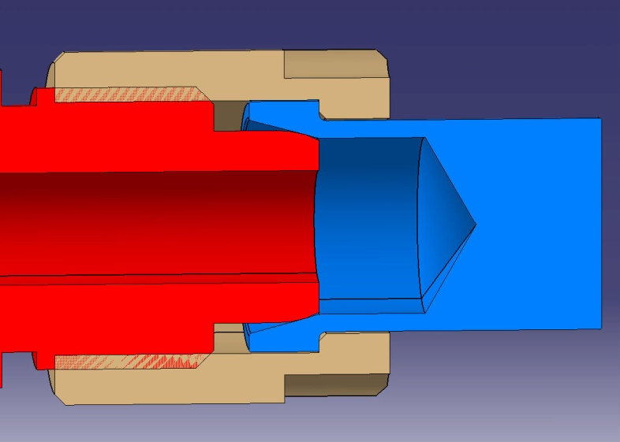
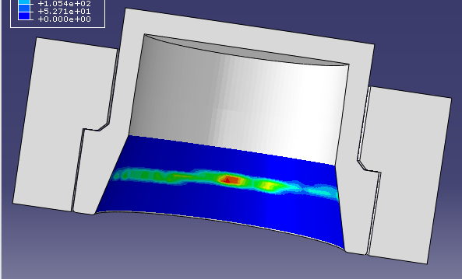
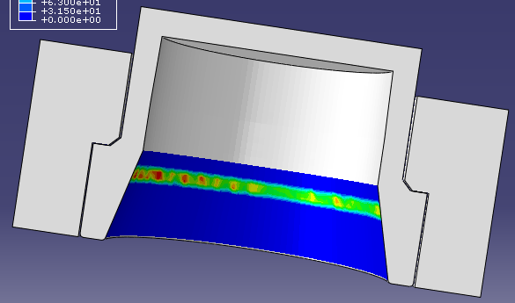
4 – Custom fitting @ LAPP : a brief history
Why a sphere ?
  A spherical shape is less sensitive to angular misalignment
  Same conical female parts as for toroid but a different contact point
Toroïde
Sphere
23

Slide 24
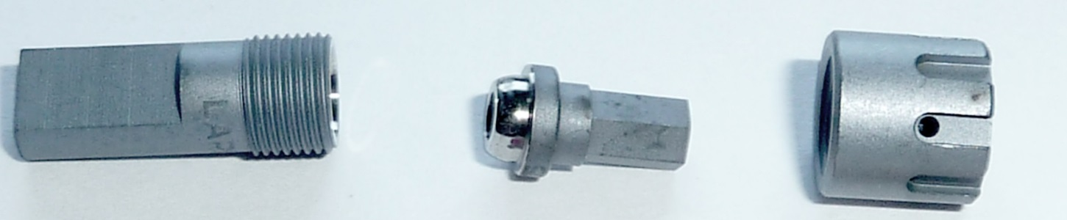
4 – Custom fitting @ LAPP : a brief history
Major improvement of the tightening efficiency
  MOS2 (molybdenum disulphide) coating on friction surfaces (threads, back of female and nut)
  3 times more efficient compared to raw surfaces
  Graphite treatment proposed by the same company is far from being so convincing
  MOS2 is projected at high speed on the surface and remain attached
  Rad-Hard
MOS2 coating
24

Slide 25
5 – Test reception criteria
What is a “good” fitting ?
Leak rate < 10⁻⁸mbar.l.s⁻¹
@ 20 bars He and -50°C
@ 70 bars He / 20°C after a 150 bars pressure test
  After 50 CO2 cool down/warm up in the range of +30°C -50°C / and 6 to 60 bars
After 20 mountings/dismountings
25

Slide 26

6 – Validation of the design – Qualification of the procedures
How to obtain an “industrially qualified” fitting ?
We are able to manage the R&D phases
Industrial validation and qualification must be carried out according to specific rules/standards
Experts (quality management and leak tightness) were asked to audit our project and give advice to define and implement the industrialisation and qualification procedures
Production operations (machining, geometrical and dimensional controls, coating, marking) are made by industrial companies
26

Slide 27
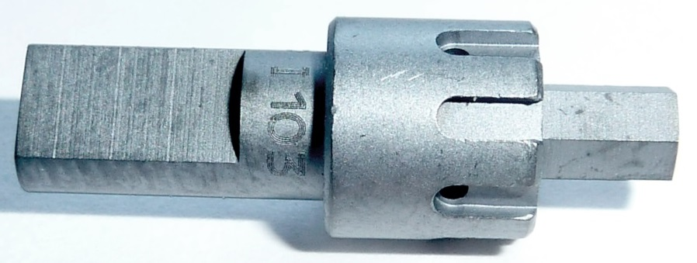
6 – Validation of the design – Qualification of the procedures
Main rules for an “industrially qualified” fitting
A plan must be defined and written to make sure all aspects are considered. This plan has to be checked and validated by an external authority.
Quality control is different from quality management : defining controls is not enough to unsure a good quality product
Tests devices and procedures must be first themselves qualified to be used for tests operations. Devices must be periodically controlled to check their capabilities.
International standards should be used. They can be adapted to the specific context but it has to be validated.
Parameters ( qualification and production) must be strictly recorded and managed. Any detail must be discussed and formalised with subcontractors. All “strategic” elements must be marked and their life must be tracked.
The requirement levels must be adapted in order to be efficient.
27

Slide 28
6 – Validation of the design – Qualification of the procedures
Main technical parameters related to fitting quality
Material characteristics – hardness >
Careful with the thermal treatments
Cone and sphere surface quality and geometry-> machining / control
Tightening must be carefully managed
Pollution and damages-> at any step of operations (cleaning and protection procedures)
28

Slide 29
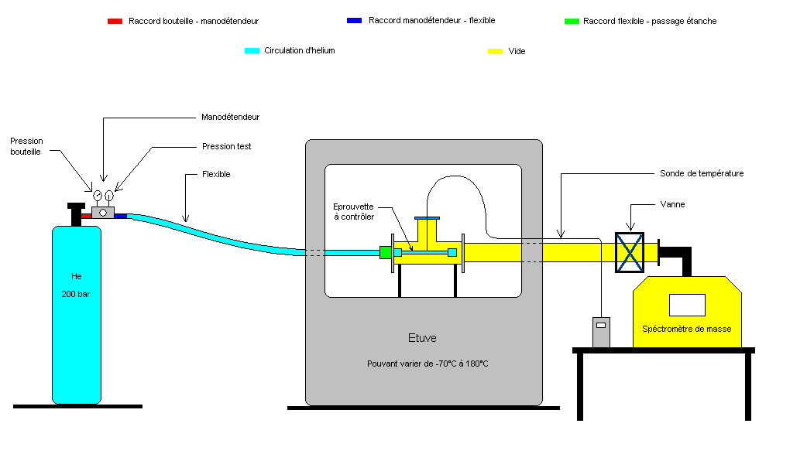
6 – Final validation and qualification – main tests/ Helium leak test
Helium leak test
P
150
He
30
t
20
T
1
2
3
4
5
6
20
t
-50
29

Slide 30
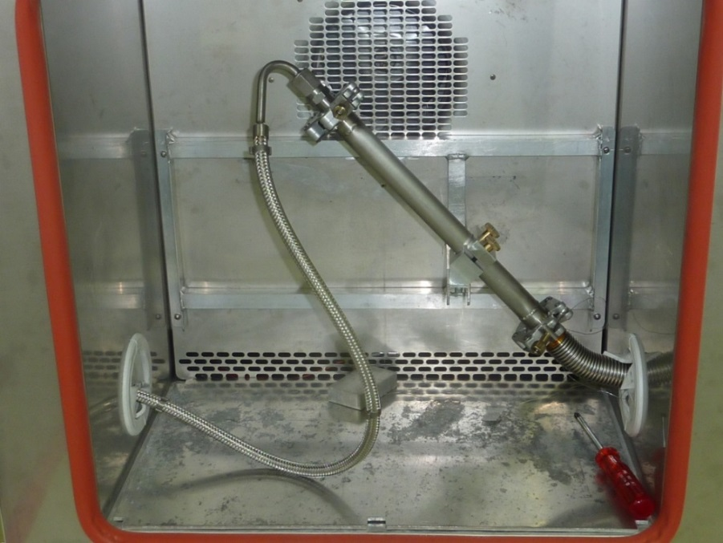
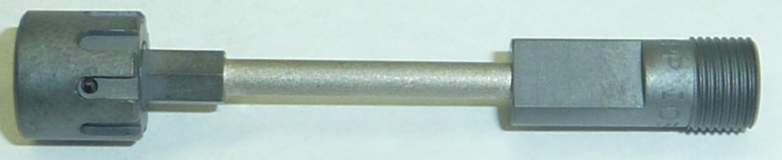

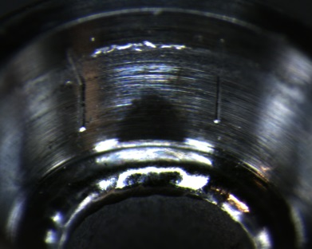
7 – Final validation and qualification – main tests/ Helium leak test
Helium leak test :
  8 samples tested together (9 sphere/cone junctions, 16 weldings)
  2013-06-17
  32/50 samples tested
  31/32 validated
30

Slide 31

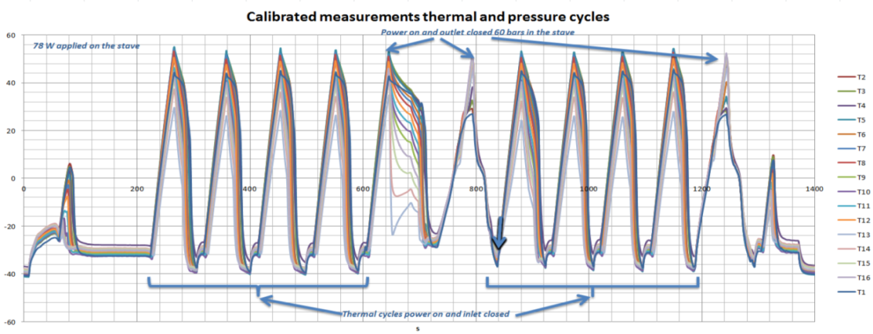
7 – Final validation and qualification – main tests/ Helium leak test
CO2 cycling:
  50 pressure/ temp cycles
  Samples are leak tested before and after cycling
  Temperature are between 20°C and -40°C
  Pressures are between 60 bars and 10 bars
2012-06-17
  15/50 samples tested
  15/15 validated
31

Slide 32
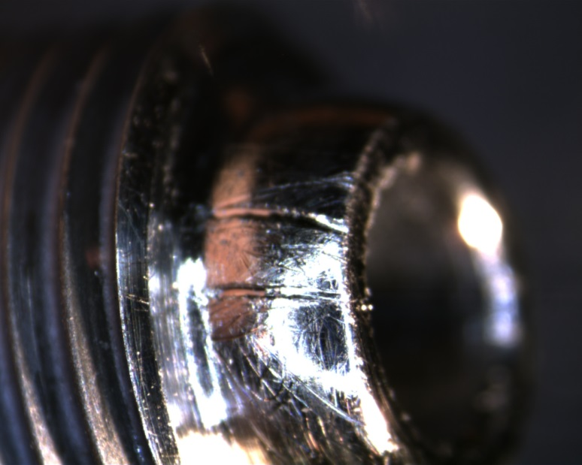
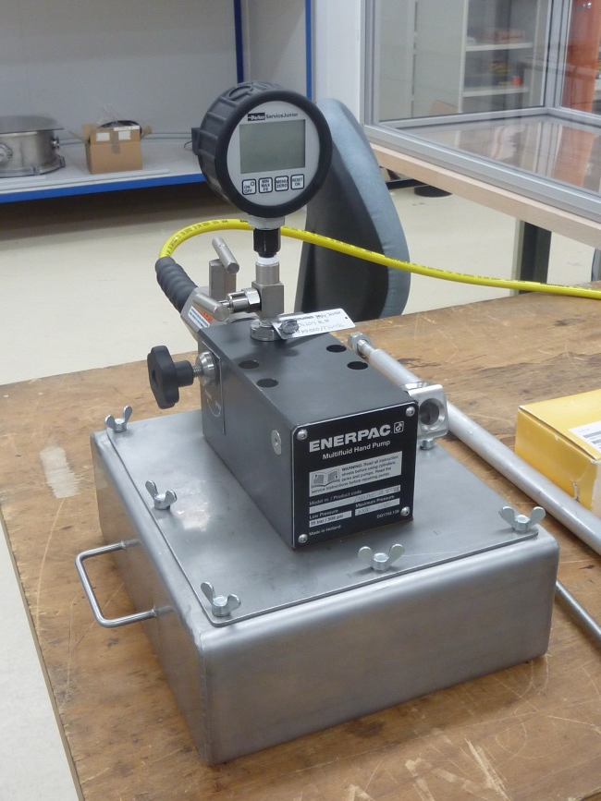
7 – Final validation and qualification – other tests
  Break test : find the ultimate pressure
  Pressure cycle tests : 1 million pressure cycle tests @ 100 bars (done =>leak test to be performed)
  LN2 shock test
  Repair test : "Repair test : damage a fitting by scratching to create a big leak, repair with glue
  Frost test : cool down of a wet fitting
  20 mountings / dismountings test
Repair test
Break test
Multi mountings dismountings test
32

Slide 33

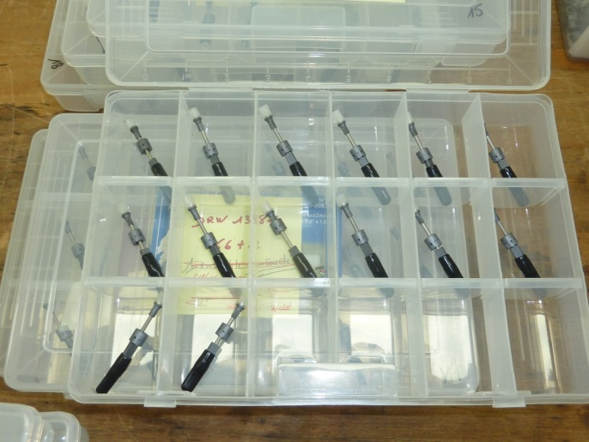
8 – Status - Summary
Programme
  About 300 fittings produced for validation/qualification and production
  200 EB weldings
  All the elements are marked and well protected
  10 different types of tests
Industrial production from “INSTRUVIDE”
IBL status
  Qualification in progress
  First cooling lines part (detector side - PP0 to PP1) to be delivered beginning of july
  Second cooling lines part (PP1 to manifold) to be delivered end of 2013
  Installation in the pit spring 2014
33

Slide 34
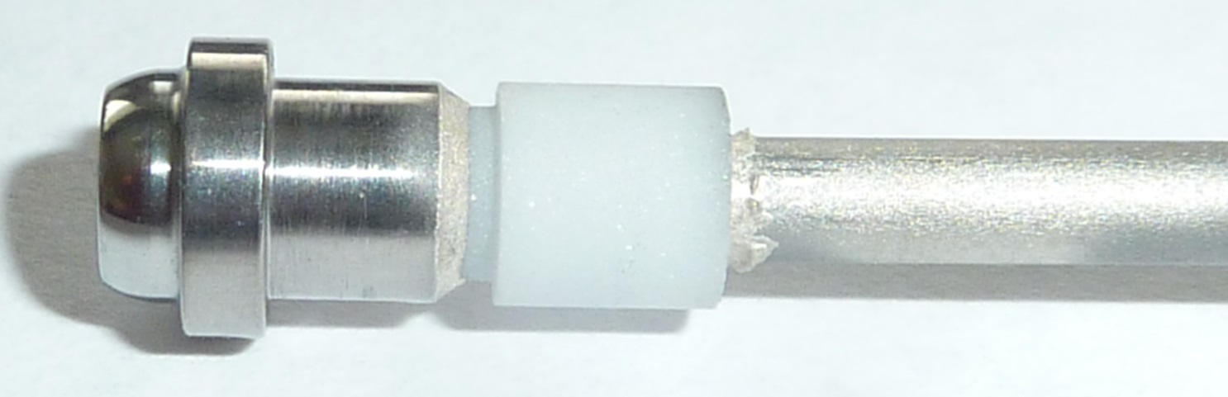
9 – New and further developments
Male
Ceramic
Ti pipe
New developments
  Male fitting and electrical isolator brazed together
  Passed the standard leak test (even at 150 bar pressure)
  Too fragile for IBL (ceramic too thin)
34

Slide 35
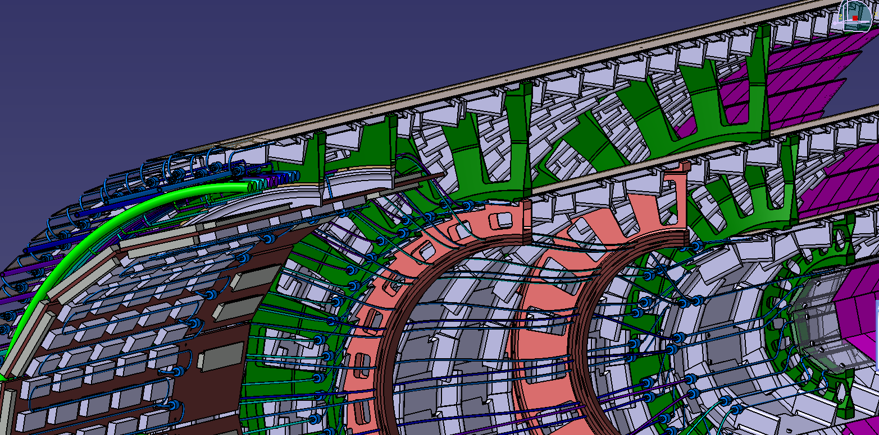
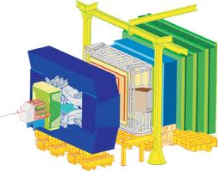
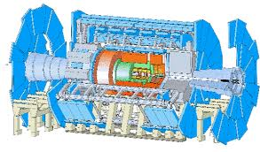
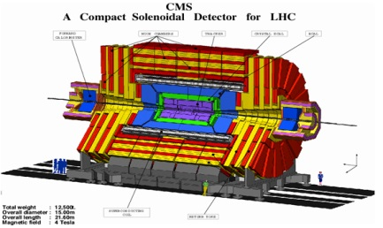


9 – Possible applications beyond IBL
35

Slide 36
10 – Conclusions
A small fitting for LHC tracking detectors was successfully designed and produced
Perspectives
  Qualification according to industrial standards almost complete
  Fitting exists in 8mm OD (IBL) and 10mm OD
  Any pipe diameter below ~3mm can be used
  Any pipe wall thickness below ~300 microns can be used (70 microns- ID 1.2mm pipe prototype under test)
  Hybrid Titanium/stainless steel is possible (first tests are OK)
  Integrated ceramic electrical break promising
36

Slide 37
9 – Further developments
Thank you
37

Slide 38
9 – Further developments
Backup slides
38

Slide 39
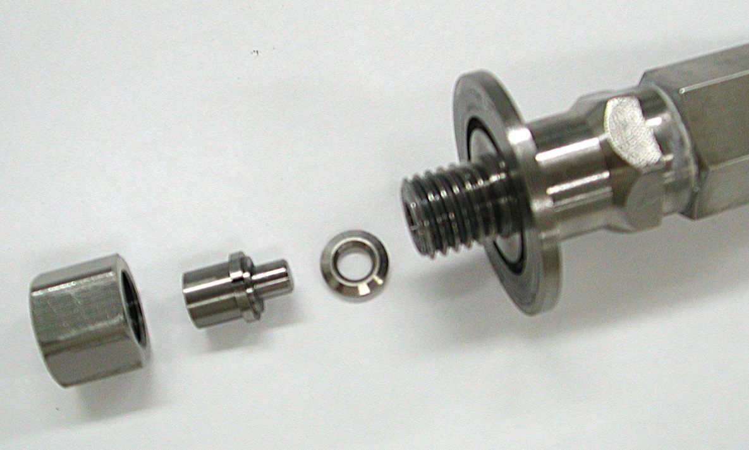


New titanium sealed fitting
Nominal torque : 30 N.m (can probably be reduced)
All elements are made of Titanium
M14 thread
Seal
39

Slide 40


6 – Validation of the design – Qualification of the procedures
Tightening issues
  Torque applied on the nut can be different from the set value
Torque limitation center
Torque application center
Additionnal torque
Strengh
40
Use this instead

