Slide 1
Dimensioning of CO₂ cooling pipes in detector structures
Pipe dimensioning
&
Flow distribution
Detector Mechanics Forum
Oxford, 20 June 2013
Bart Verlaat

Slide 2
Thermal chain in detectors
The design of the cooling is the whole chain between heat source and heat sink
Typical example for IBL
Heatload
Th. paste
Glue
Glue
HTC
ΔP
CF-sheet
CO2 in tube
Silicon
C-foam
Pipe wall
Manifold

Slide 3
Thermal chain in detectors
The design of the cooling is the whole chain between heat source and heat sink
Typical example for IBL
Heatload
Th. paste
Glue
Glue
HTC
ΔP
CF-sheet
CO2 in tube
Silicon
C-foam
Pipe wall
Manifold
Load variations give gradients w.r.t the common sink => Outlet manifold!

Slide 4
Design of cooling:
From source to sink
So the reference should not be at a pipe wall, nor at the liquid temperature as it is generally approached.
  This is similar then taking a reference in the middle of the structure.
Loaded stave temperature: -24.4°C
(0.72 W/cm²)
    Stave conductance ~61%
Atlas IBL
example
    Heat transfer ~ 19%
Unloaded stave temperature: -39°C
    Pressure drop ~20%
Inlet
manifold
Outlet Manifold = temperature reference

Slide 5
How to optimize the cooling as part of the whole thermal chain?
The best thermal solution is not only related to small temperature gradients.
  If so our detectors will be made of copper…☺
  We have to find the balance between the important parameters
    Generally thermal gradients vs mass (rad. Length)
How can we find the optimum cooling tube dimension?
  Depends on the real criteria:
    Lowest mass (Radiation length)?
    Smallest pipe?
    Minimum amount of pipes?
  We should not only look at the pipe but also at the structure around
    A smaller cooling tube is replaced by other material, when embedded.
Where do we have to look at:
  Pressure drop and heat transfer
    As part of the thermal chain
  Flow distribution
    For the proper fluid conditions

Slide 6
First we need to understand what happens inside a cooling tube?
Heating a flow from liquid to gas

Slide 7
Understanding detector evaporator tubes
Outlet manifold: Pressure = fixed
Inlet manifold: Temperature = fixed
In a 2PACL the capillary inlet temperature is a function of the outlet saturation pressure.
The detector inlet is close to saturation.
  But can be liquid due to pressure drop
  Usually ambient heating is enough to overcome sub cooled entry state
  Detectors with high dP have to be designed to cope with liquid at the inlet
    FE: pre heating by electronics (CMS pixel)
Pressure drop of the evaporator tube and outlet tube is part of the thermal resistance chain from heat source to sink!
Inlet manifold
Inlet capillary dP
Detector dP
Outlet line dP
outlet manifold
Temperature exchange

Slide 8
Long branch thermal profile
Liquid
2-Phase
Inlet tube
Evaporator tube
Outlet tube
HTC
Temperature gradient inside detector due to pressure drop and heat transfer
dP
Offset of evaporator temperature due to outlet pressure drop
Liquid entry into evaporator
Manifold temperature = common reference of all branches
Inlet: 2mm x 4m, Detector: 2mm x 4m, Outlet: 2mm x 4m
Heatload on detector: 200 Watt

Slide 9
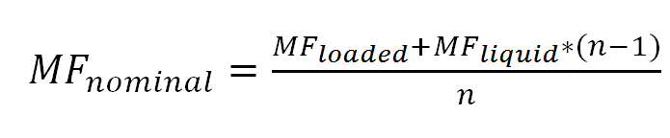
Flow distribution:
Inlet tube reduction
Which flow do we need when 200 Watt to a single stave is applied?
Inlet: 2mm x 4m
Stave: 2mm x 4m
Outlet: 2mm x 4m
Inlet: 1mm x 4m
Stave: 2mm x 4m
Outlet: 2mm x 4m
Pressure drop and dry-out calculated using CoBra
Pumping energy is flow x dP. Adding capillaries can save pumping power (in example 1.61*3.54/2.18*3.75=0.70 => 30% saving)
Figures from: DESIGN CONSIDERATIONS OF LONG LENGTH EVAPORATIVE CO2 COOLING LINES
Bart Verlaat and Joao Noite, GL-209, 10th IIF/IIR Gustav Lorentzen Conference on Natural Working Fluids, Delft, The Netherlands 2012

Slide 10
Influence of the in and outlet-lines on thermal performance
Inlet: 2mm x 4m
Stave: 2mm x 4m
Outlet: 2mm x 4m
Inlet: 1mm x 4m
Stave: 2mm x 4m
Outlet: 2mm x 4m
Inlet: 1mm x 4m
Stave: 2mm x 4m
Outlet: 3mm x 4m
Figures from: DESIGN CONSIDERATIONS OF LONG LENGTH EVAPORATIVE CO2 COOLING LINES
Bart Verlaat and Joao Noite, GL-209, 10th IIF/IIR Gustav Lorentzen Conference on Natural Working Fluids, Delft, The Netherlands 2012

Slide 11
Dealing with environmental heat pick-up
Three important statements:
  Expose return tube to ambient heating
    There is usually enough cooling power left
  Connect as much as possible the inlet to the outlet
    Outlet boils first (lower P), so will take care of heat absorption
  Avoid boiling before the inlet manifold
    Flow separation will feed some channels with vapor only!
Capillary dP makes manifold liquid
Pre capillary heat pickup
Outlet transfer line
Inlet manifold
Outlet transfer line
Remaining cooling power for ambient
outlet manifold
Manifold boiling
outlet manifold
To keep this problem simple: Have the manifold right after the heat exchanging transfer line.

Slide 12
IBL: A detector with very long in and outlet lines
The IBL detector is only 800mm long, but has about 15m long in and outlets.
dT due outlet line pressure drop significantly (ca 3ºC)
Ambient heat load in same order as detector load
Atlas IBL
example
Inlet
Outlet
2
12
Heat exchange
Ambient
Ambient heating
9
4
6
7
IBL

Slide 13
Cooling tube temperature profile (HTC & ΔP)
In detectors the aim of a cooling tube design is:
  Low mass or small diameter
  Low temperature gradient (hottest point wrt outlet reference)
For efficient heat transfer:
  ΔT(ΔP+HTC) and tube diameter or mass as small as possible
Tube temperature
ΔT(ΔP+HTC)
(Reduced
diameter)
ΔT(ΔP+HTC)
Temperature
ΔT(ΔP)
(Reduced
diameter)
ΔT(HTC)
ΔT(ΔP)
Fluid temperature
ΔT(HTC)
(Reduced
diameter)
Tube length
To quantify the optimal diameter we can look either to the mass or tube volume involved
Q
Q
Volumetric heat transfer =
(W/m³*K)
Mass specific heat transfer =
(W/kg*K)
V_{tube}*ΔT(ΔP+HTC))
M*ΔT(ΔP+HTC))

Slide 14
Cooling tube performance example
L=3m, Q=400W, T=-20°C
Optimal
Diameter?
Volumetric heat transfer coefficient
Pressure drop temperature gradient
Overall temperature gradient
Heat transfer temperature gradient
Models used: HTC and dP, Thome 2008

Slide 15
Comparison of fluids
Volumetric heat transfer is also a good method to compare different fluids.
  How can we put as much heat into a small as possible cooling tube??
Models used: HTC-Kandlikar and dP-Friedel
Interesting: Performance almost linear with fluid pressure.

Slide 16

“Drawback” of smaller pipes
In an embedded structure the smaller pipe is replaced by other material.
  ‘Heavy” pipe has a lower weight, but light vapor is also replaced by “something”
The bottleneck in most cooling structures is the glue layer around the pipe.
  Small area
  Bad conductance
Better to judge the whole thermal chain from a fixed volume
D=10mm
D=10mm
What is now an optimal pipe diameter?

Slide 17
Mass related results
(Same case as previous)
Calculation with IBL-like properties:
  T_tube=0.1 mm
  T_glue=0.1 mm
  k_tube=7.2 W/mk
  k_foam=35 W/mk
  k_glue=1.02 W/mk
  d_glue=2400 kg/m3
  d_foam=198 kg/m3
  d_tube=4400; kg/m3

Slide 18
Recalculating the IBL
Selected IBL tube is 1.5mm => good choice!
Next to do: Make similar analyses wrt radiation length
1.5mm
1.5mm

Slide 19
CO₂ heat transfer and pressure drop modeling
Nowadays good prediction models of CO₂ are available.
For detector analyzes we use mainly the models of J. Thome from EPFL Lausanne (Switzerland)
  Cheng L, Ribatski G, Quiben J, Thome J, 2008,”New prediction methods for CO₂ evaporation inside tubes: Part I – A two-phase flow pattern map and a flow pattern based phenomenological model for two-phase flow frictional pressure drops”, International Journal of Heat and Mass Transfer, vol 51, p111-124
  Cheng L, Ribatski G, Thome J, 2008,”New prediction methods for CO₂ evaporation inside tubes: Part II– An updated general flow boiling heat transfer model based on flow patterns”, International Journal of Heat and Mass Transfer, vol 51, p111-124
Models are flow pattern based and are reasonably well predicting the flow conditions and the related heat transfer and pressure drop. Dry-out prediction is included.
The Thome models are successfully used to predict the complex thermal behavior of particle detector cooling circuits.
A simulation program called CoBra is under development at Nikhef/CERN-DT to analyze full detector cooling branches.

Slide 20
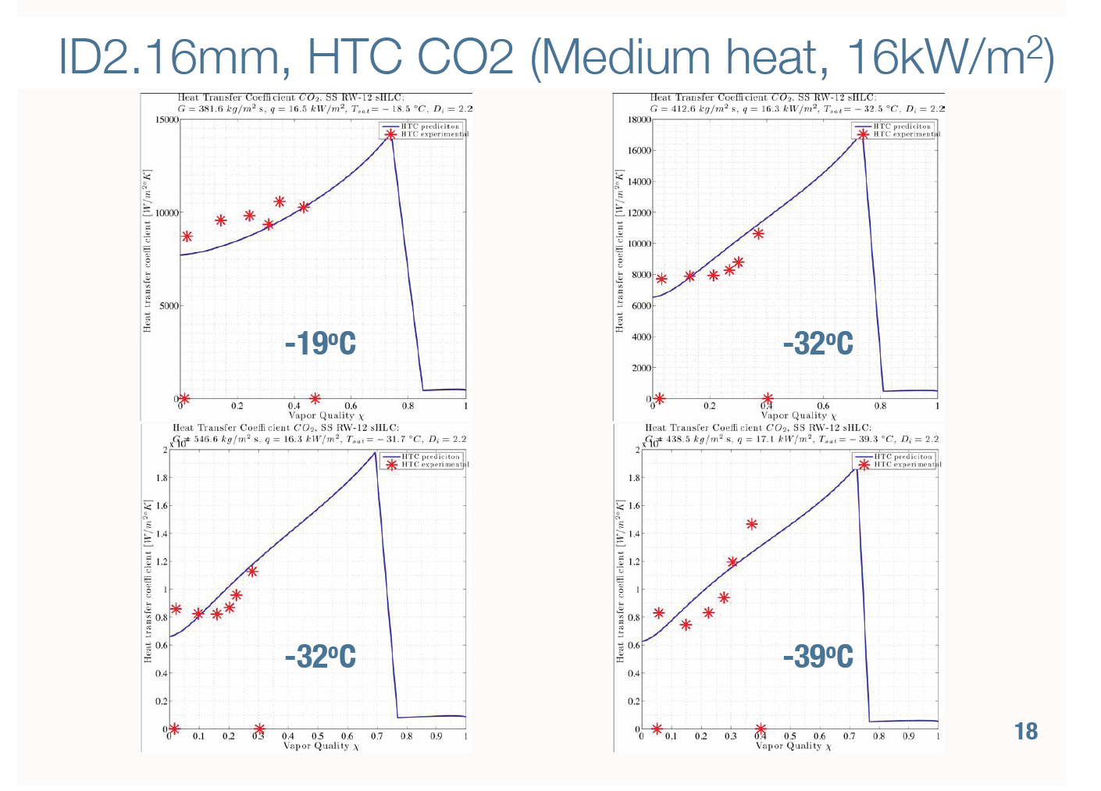
Experimental heat transfer data (measured at SLAC)
Interesting research on heat transfer is done at SLAC in a joint effort with Nikhef.
M. Oriunno (SLAC) & G. Hemmink (Nikhef)

Slide 21
CoBra Model
(CO₂ BRAnch Model)
P_{x+1}=dP_{x+1}+P_{x}
H_{x+1}=dH_{x+1}+H_{x}
P_{x+1},H_{x+1},T_{x+1}
R4
X+1
R4
dH=Q1/MF
Q1 is calculated in the thermal network
y
P_{y},H_{y,},T_{y}
R3
R3
X+!
y
R1
R2
X+1
R5
X+1
R2
R1
X+1
y
y
4
4
R4_{x}
R4_{y+1}
P_{x},H_{x}T_{x}
3
3
R3_{x}
R3_{y+1}
1
2
2
T
P_{y+1},H_{y+1},T_{y+1}
R1_{x}
R2_{x}
R5_{x}
R2_{y+1}
R1_{y+1}
The thermal node network calculates the heat influx in the cooling pipe based on:
  Applied power Q3 on node 3
  Environmental heating from fixed temperature T4 on node 4
  Heat exchange with another pipe section via R5 between nodes 2 and 2 of the connected sections

Slide 22
CoBra example calculation
5mx1.5mmID tube (4m heated), Mass flow=0.3g/s, Q=90Watt , T=-30ºC
Dry-
out
Mist
Bubbly
Annular
Liquid
Dry-out
Slug
Annular
Process path
Slug
Stratified Wavy
Stratified
CoBra is able to analyze complex thermal profiles of CO₂ in long tubes

Slide 23
Cobra example:
Node network for IBL
R₂ ≈ Tube wall
T_{environement}
R₄ +R₃ ≈ Insulation+HTC_{air}
R₁≈ HTC_{CO2}
R_{1b}≈ HTC_{CO2}
R₂ ≈ Tube wall
T_{environement}
R₁≈ HTC_{CO2}
R₄ +R₃ ≈
Insulation+HTC_{air}
T_{CO2}
T_{CO2}
T_{CO2}
T_{CO2}
R_{1a}≈ HTC_{CO2}
R₅≈ Heat exchange
2. Bundled lines
T_{environement}
1. Concentric line
Q₃ ≈ Applied power
R₄≈ HTC_{air}
T_{environement}
R₂ +R₃ ≈ TFoM
R₂ ≈ Tube wall
R₁≈ HTC_{CO2}
R₄ +R₃ ≈ HTC_{air}
R₁ ≈ HTC_{CO2}
T_{CO2}
T_{CO2}
3. Bare tube
4. Stave

Slide 24
Internal heat exchange and ambient heating
Figure 7: CoBra calculation example of the IBL cooling tube. The branch has a 1mm inlet (1-4), a 1.5 mm cooling tube (4-8), a 2mm outlet (8-9) followed by a 3mm outlet (9-12). The dashed temperature profile is the actual sensor temperature taking into account the conductance of the support structure. The graph on the left has no internal heat exchange, the right graph takes internal heat exchange of the in and outlet tube into account.
Figures from: DESIGN CONSIDERATIONS OF LONG LENGTH EVAPORATIVE CO2 COOLING LINES
Bart Verlaat and Joao Noite, GL-209, 10th IIF/IIR Gustav Lorentzen Conference on Natural Working Fluids, Delft, The Netherlands 2012

Slide 25
Comparison to test results
CMS-B-PIX
Atlas-IBL
Figure 8: Temperature and pressure test results of the CMS pixel upgrade cooling branch (left) and the Atlas IBL cooling branch (right). Comparison with the CoBra calculator showed that the calculator is a promising tool for predicting the temperature and pressure gradients over long length cooling branches.
Figures from: DESIGN CONSIDERATIONS OF LONG LENGTH EVAPORATIVE CO2 COOLING LINES
Bart Verlaat and Joao Noite, GL-209, 10th IIF/IIR Gustav Lorentzen Conference on Natural Working Fluids, Delft, The Netherlands 2012

Slide 26
Cooling development philosophy
Whatever the model give as a result:
  Don’t trust them! the models are empirical.
  Use them as a design guideline.
Always verify in a test!
  Not only to quantify heat transfer, but as well to filter out strange behavior

Slide 27
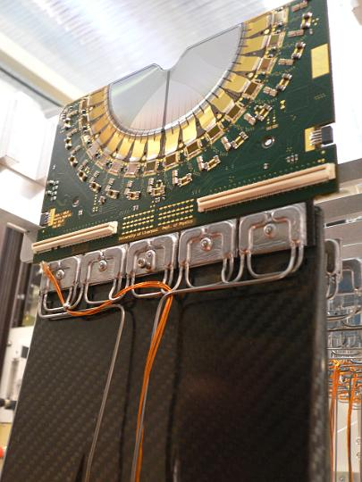
Strange start-up behavior in the Velo
In the Velo the CO₂ does not always start boiling.
It turned out that our bright idea of increasing the tube length wasn’t so brilliant after all.
Tube wall temp.
At startup everything is liquid
Fluid temp.
The outlet starts to boil
The good boiling heat transfer is taking heat away from the inlet
As a result boiling at the inlet is suppressed.
Once boiling is achieved it will not go back to the liquid state
Temperature
Tube length

Slide 28
Conclusions
Things to keep in mind when designing CO₂ cooling loops:
The common temperature boundaries of all parallel systems are:
  The pressure (=saturation temperature) in the outlet manifold.
  The temperature / enthalpy of the liquid in the inlet manifold.
  Normally both temperatures are the same.
Parallel channels need flow distribution by increasing the inlet pressure drop
The in let manifold must be sub-cooled liquid.
Overall performance of the thermal system includes:
  Conductive path in detector structure
  Heat transfer to the evaporative liquid
  Pressure drop in evaporator and outlet tube.
  Full thermal path must be considered in the design optimization
Always verify your models with tests. 2-phase flow has sometimes strange behavior
Avoid tube crosstalk, boiling in 1 channel can suppress boiling in the other

