Slide 1
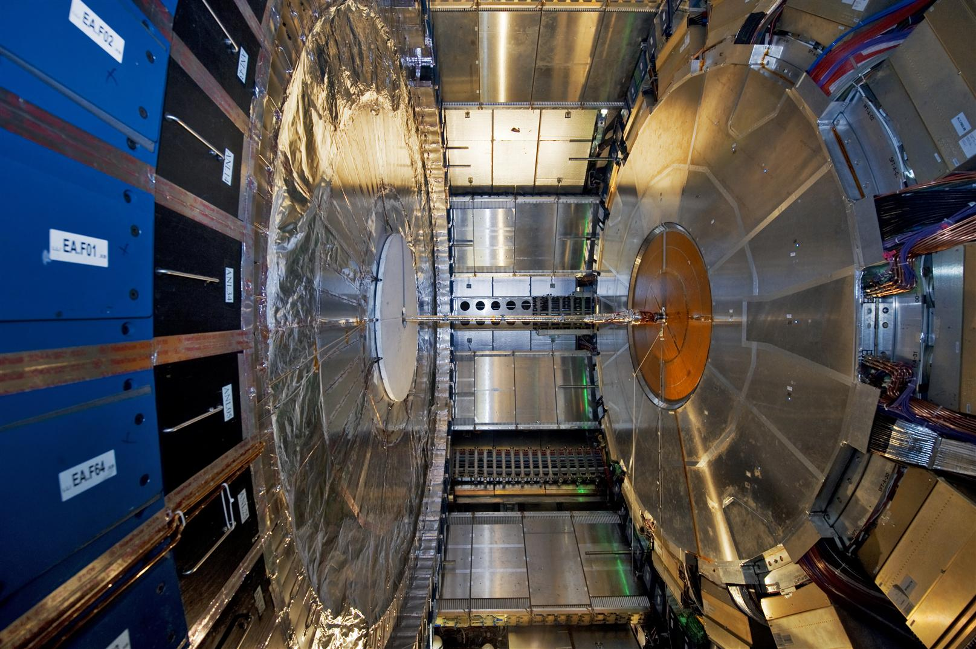
ATLAS Radiation Protection issues and strategy
LS3 and Later
O. Beltramello – 21.06.2013

Slide 2
DOSES measureD at start of Ls1

Slide 3
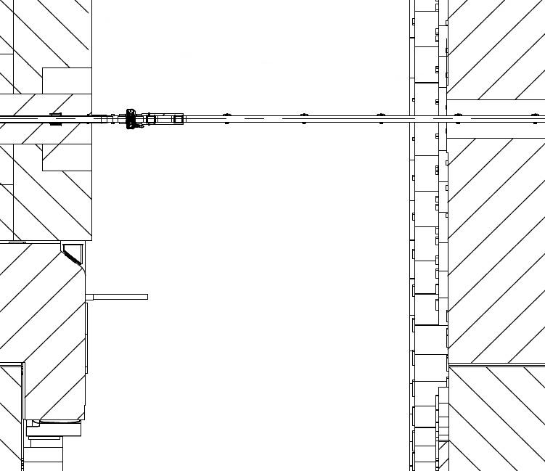
Barrel Calo – EBC side C , 06-Mar-2013
EBC (open), VA (steel)
Distance from Beam Pipe: Contact, 10cm, 20cm, 40 cm, 1 m, 2m
Drawing ATCO_0024
Measurements in μSv/h
RPE: Giancarlo Spigo
Barrel
6680 (EBC)
EBC
3650 (VI)
40 cm
90 cm
70cm
70 cm
40 cm
VI
VA
50
55
96
130
108
103
30
39
32
35
40
52
21
24
26
22
27
28
16
17
11
13
13
15
5.7
5.4
5.8
6.6
6.6
5
2.4
2.3
2.4
2.3
2.3
2.4
3.1 m

Slide 4
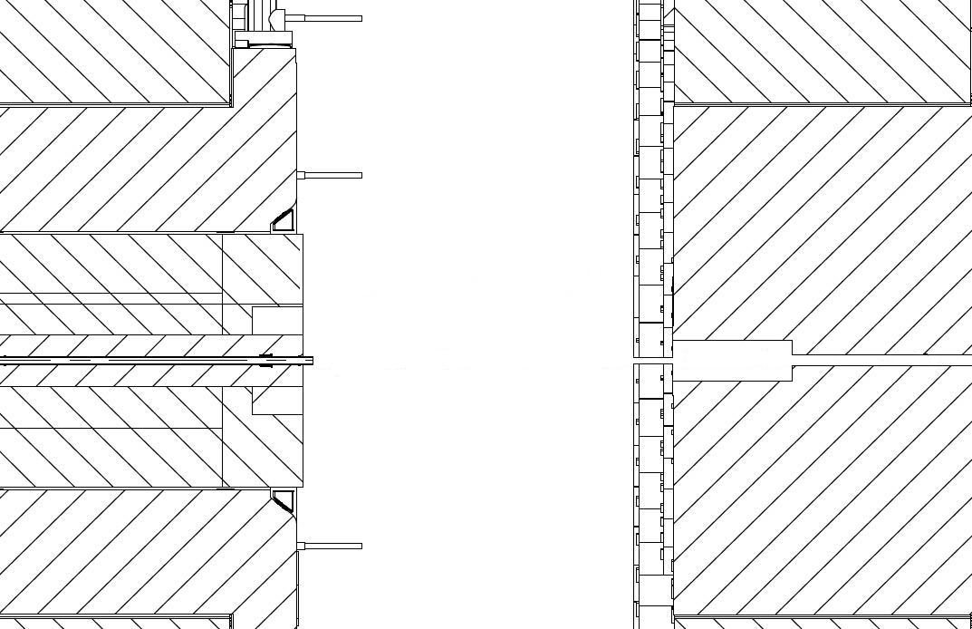
Barrel Calo – EBC side C , 06-Mar-2013
EBC (open), VA (removed), VI flange is cut
Distance from Beam Pipe: Contact, 10cm, 20cm, 40 cm, 1 m, 2m
Drawing ATCO_0024
Measurements in μSv/h
RPE: Giancarlo Spigo
Note : VI flange is measured 3 μSv/h
6680 (EBC)
Barrel
3.1 m
EBC
VI
10 cm
10 cm
20 cm
60 cm
40
40
21
5.5
2.3
xxxxxxxxx
19
15.5
11
5
2.2
14
12
10
5.6
2
8
7.7
6
3.5
2
1
3
2.5
2.5
2
0.8
1
1.1
1

Slide 5
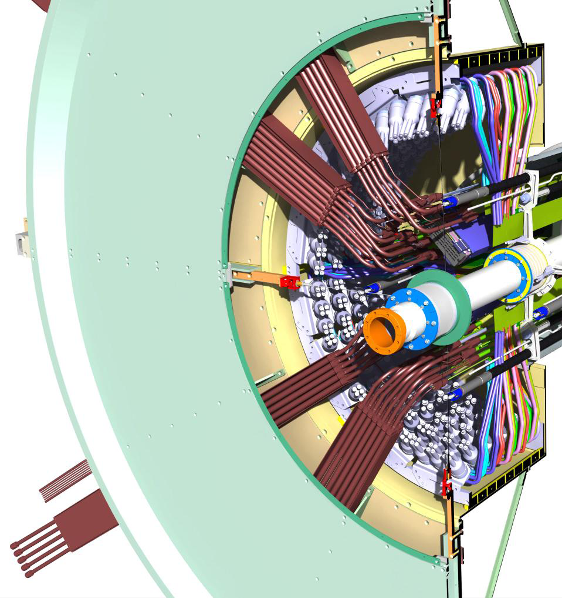
1μSv/h contact
15 μSv/h
contact
1.5 to 3.5 μSv/h at 35 cm
from surface (start of scaffolding)
0.8 to 1 μSv/h at 1 m from surface
15 μSv/h contact
Type I PP1 cables
2 μSv/h contact
20 μSv/h contact
on plate surface
13 μSv/h
Type II PP1 (inside)
23 μSv/h ambiance between plate and BP
10 μSv/h
Type II connector (outside at contact)
38 μSv/h
at below level
BP flange (with bellow) 40 μSv/h
BP flange (without bellow), flange cut : 10 μSv/h
BP flange (without bellow), flange not cut : 15 μSv/h
Type II cables
between 10 and 2 μSv/h (1m)
30 μSv/h
Beam Pipe Lemo connectors

Slide 6
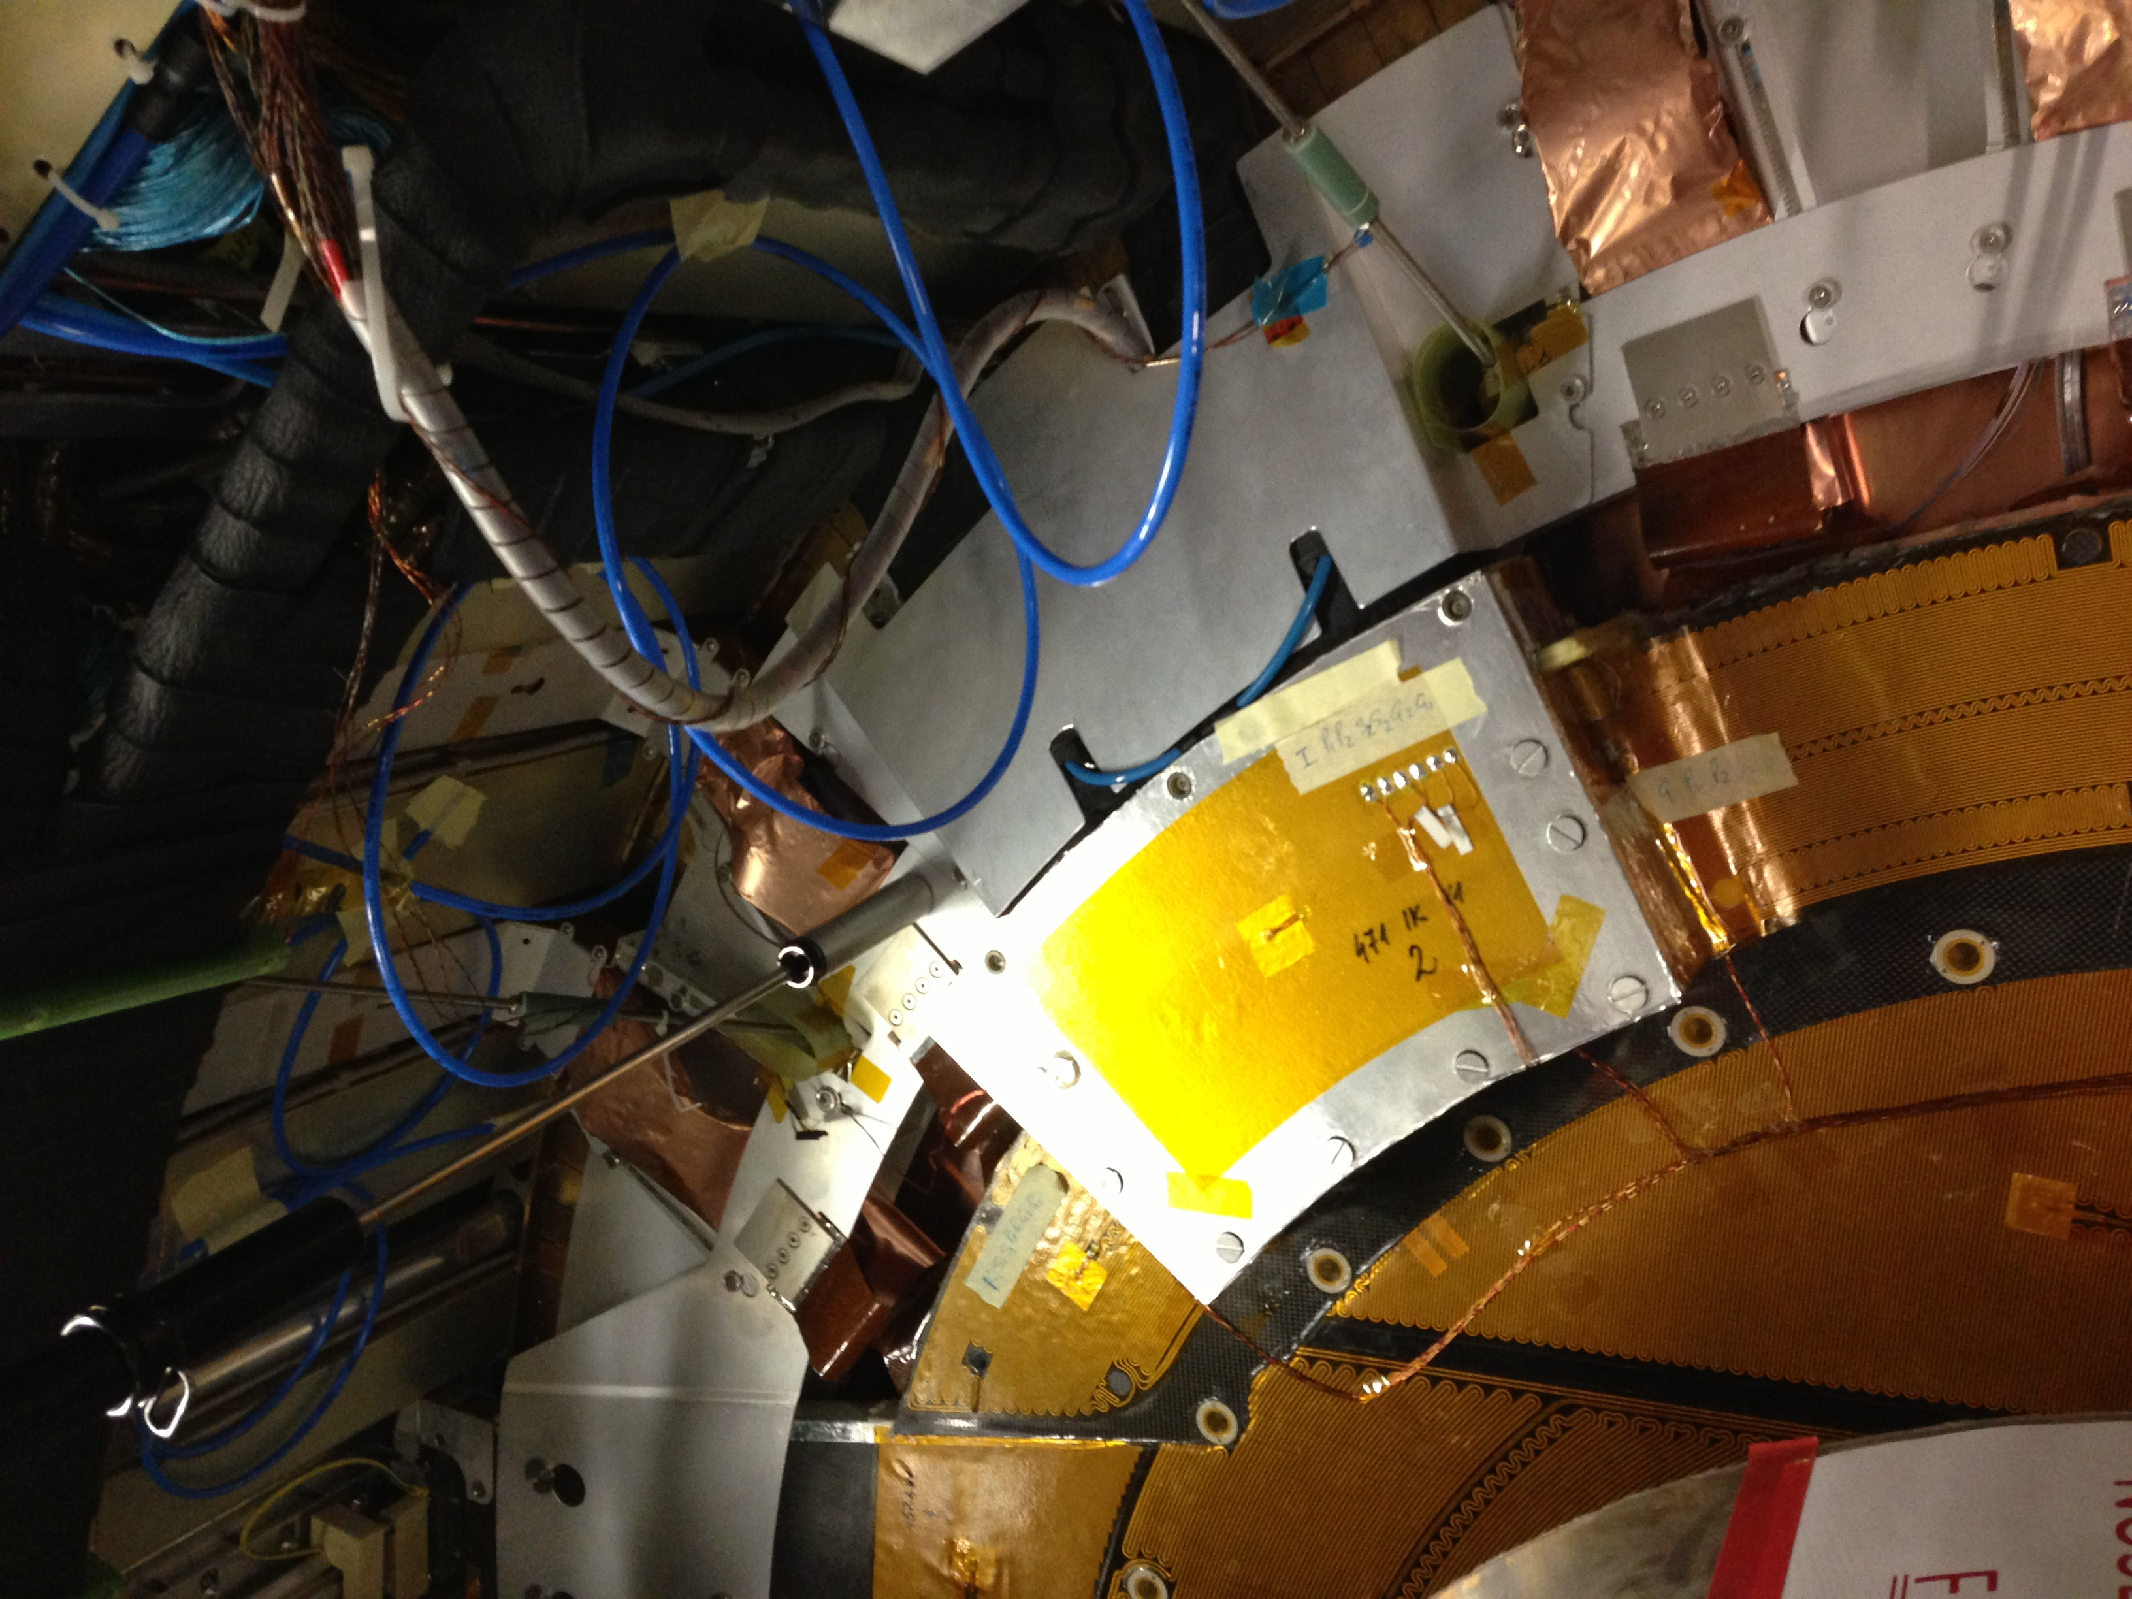
2.5 μSv/h
14.05.2013
Cooling time – 147 d

Slide 7
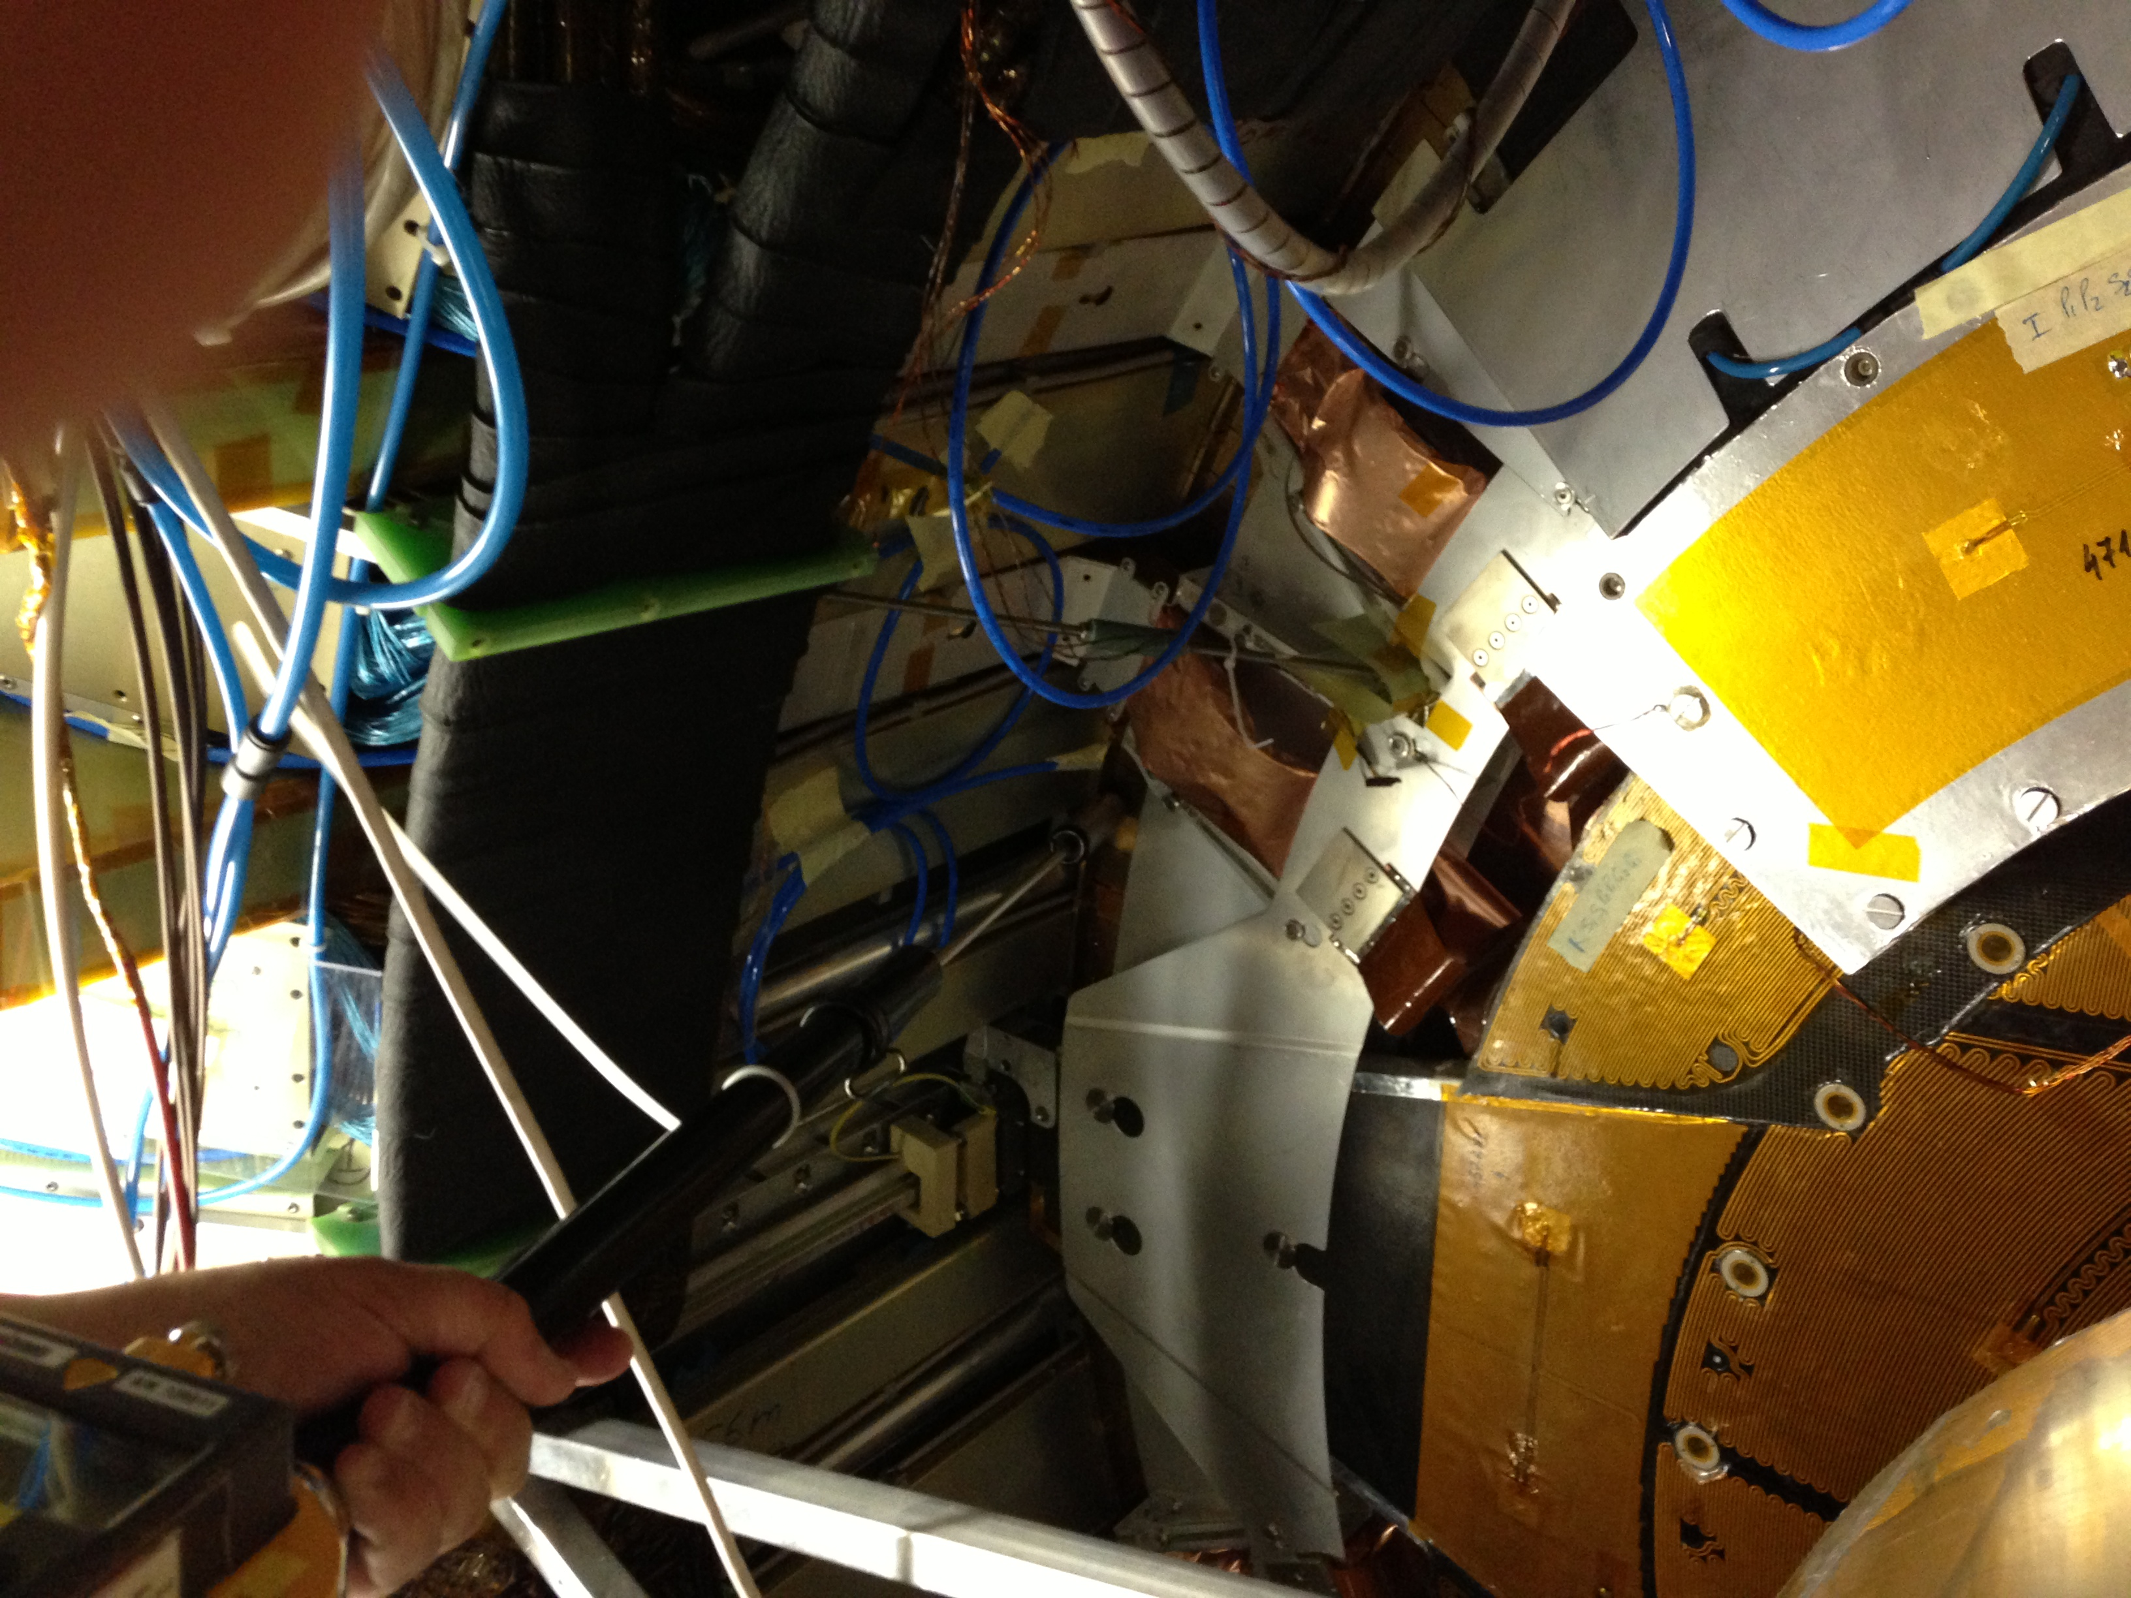
1.9 μSv/h
14.05.2013
Cooling time – 147 d

Slide 8
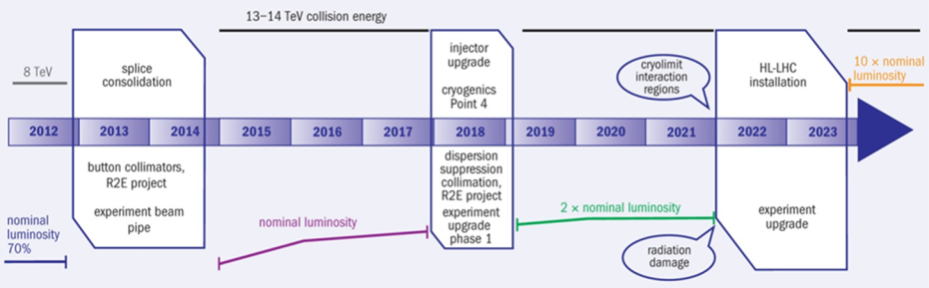
FLUKA Calculations for ATLAS
New calculations have been performed for ATLAS for LS2 and LS3
(G. Mornacchi, C. Urscheler, H. Vincke)
Irradiation profile:
Assumptions on the operational parameters
 |  | 2015 | 2016 | 2017 | LS2 | 2019 | 2020 | 2021 | LS3
ATLAS | L_{int} (fb⁻¹) | 52 | 41 | 41 |  | 83 | 83 | 83
 | L_{peak} (cm⁻²s⁻¹) | 1.0×10³⁴ | 1.0×10³⁴ | 1.0×10³⁴ |  | 2.0×10³⁴ | 2.0×10³⁴ | 2.0×10³⁴

Slide 9
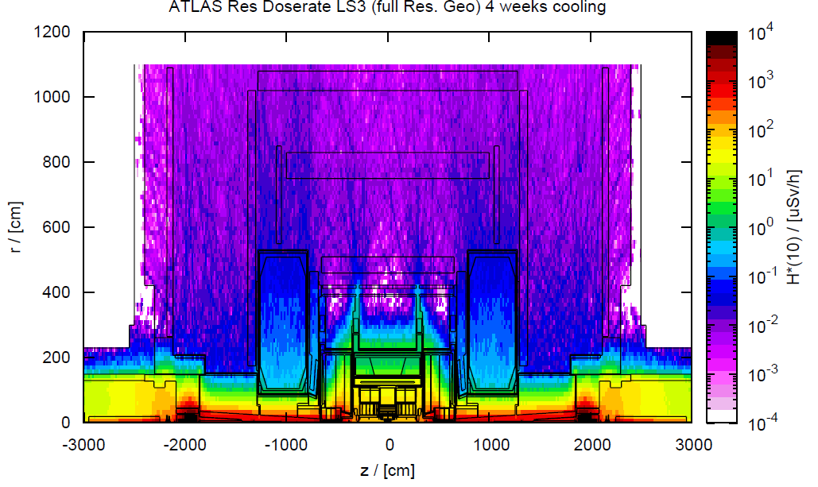
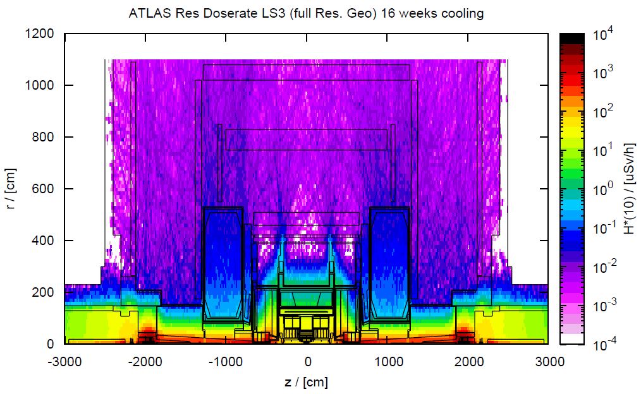
From the calculations, we estimate a scaling factors between LS1 measurements and LS2 and LS3 residual doses,
For Gap between Barrel and End Cap Calorimter and in ID area ...
At T = 4 months At T= 12 months
LS3 / LS1 = 8.5 LS3/LS1 = 12
LS3 – 1 month cooling LS3 – 4 months cooling
Residual doses rates are being transferred for all sub-detectors from LS1 to LS3
on EDMS
➔ A factor of 10 (for 2 months cooling) is considered for ATLAS between LS1 doses measurements and LS3 estimated residual doses

Slide 10
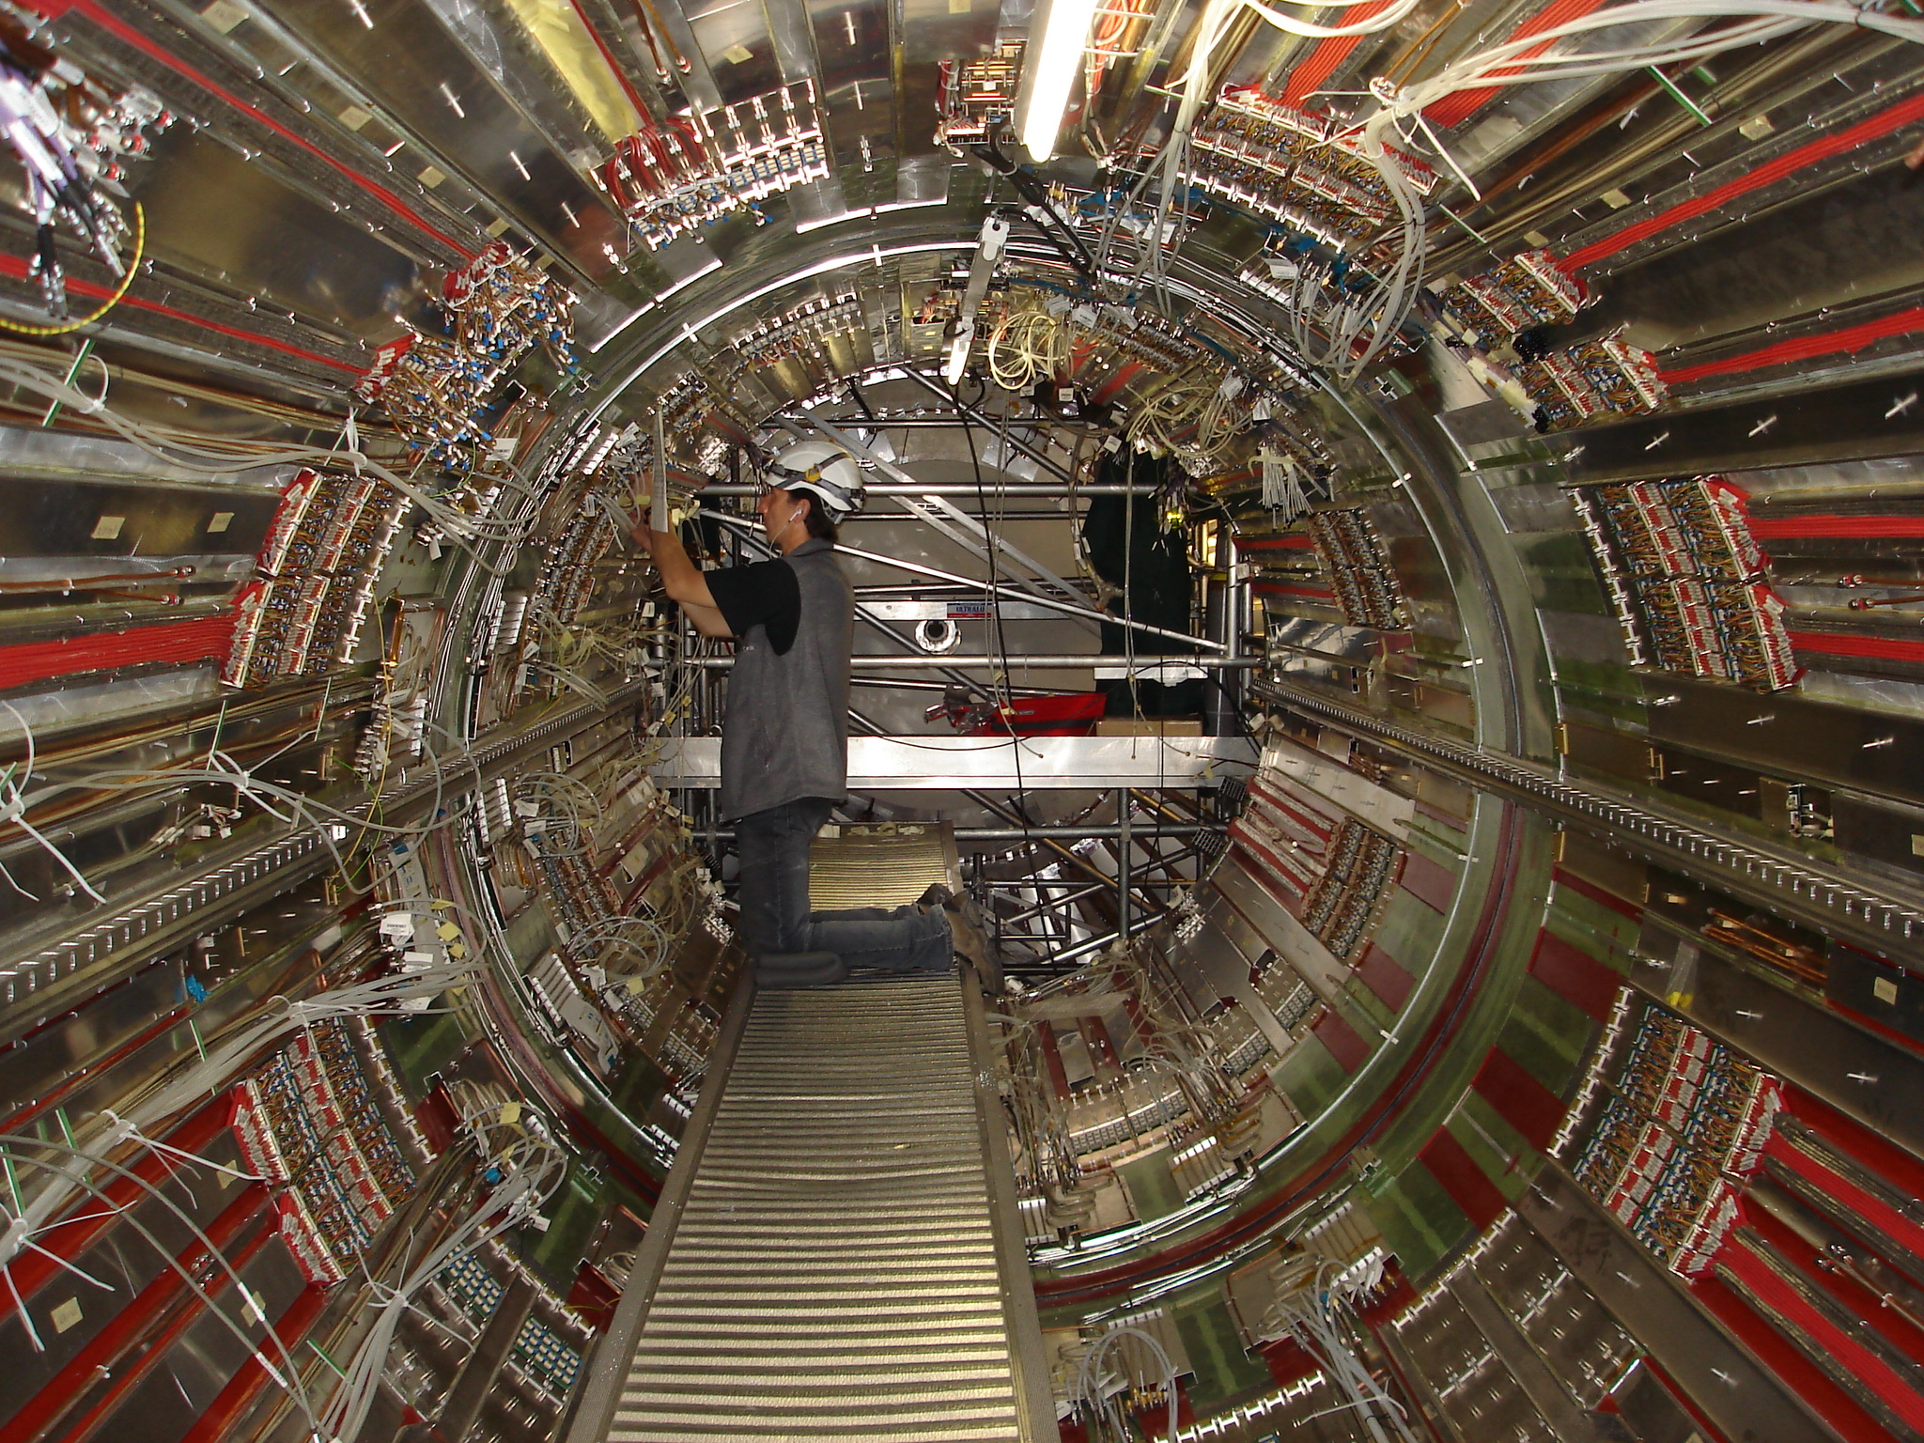
LS3 estimation – Cooling time: 2 months
inside Barrel
10 to 20 μSv/h
6680 (EBC)
Barrel
LS3 estimation – Cooling time: 2 months
from 100 to 400 μSv/h locally
10 to 30 μSv/h at 1 meter
10 μSv/h at 2 meter
After Pixel removal:
20 μSv/h
EBC
VI

Slide 11
A reminder of the ATLAS
Radiation protection policy

Slide 12
Doses Limitations
Permanent work place:
8 hours/day (2000 hours / year)
Low occupancy area:
< 1.6 hours/day
CERN Legislation ➔
And ... we must declare to Swiss Federal Office of Public Health if one person exceed 2 mSv/ month !
( which means 500 μSv / week or 100 μSv /day )
Area Classification | Dose limit | Ambient dose equivalent rate (permanent place) | Ambient dose equivalent rate (low-occupancy areas)
Non-designated area | 1 mSv/y | < 0.5 μSv/h | < 2.5 μSv/h
Supervised area | 6 mSv/y | < 3 μSv/h | < 15 μSv/h
Simple controlled area | 20 mSv/y | < 10 μSv/h | < 50 μSv/h
Limited stay area |  |  | < 2 mSv/h
High radiation area
 |  |  | < 100 mSv/h
Prohibited area
 |  |  | > 100 mSv/h

Slide 13
Doses Limitations – ATLAS Policy
ATLAS dose goal :
➔ Do not exceed 2 mSv for 12 consecutive months
(for info: CERN goal is 3mSv for 12 consecutive months)
➔ No exposure more than 50 μSv / day
➔ Perform detailed ALARA budget and optimization for all upgrade activities starting at design level.
➔ Restrict activities for a few hours (max 20 hours per year) in regions between
20 and 50 μSv/hour and under very strict supervision
➔ Make use of individual shielding if / where possible
➔ Robotize interventions or use remote handling in regions > 50 μSv/hour
If you needs tens of hours of work in regions higher than 20 μSv/hour, we should envisage also remote handling !
The limits criteria defining the use of remote handling / robotics will be carefully studied in the coming months in collaboration with RP group
As for ALARA limits, probably a set of criteria (environmental doses, dose per person or collective, etc..) is required.

Slide 14
The ATLAS Upgrade safety program

Slide 15
An ATLAS Safety Upgrade Program
As a result of the intensive ATLAS Detector Upgrade Program and the increase of the performance of the LHC (luminosity) in the coming years:
➔ the radiations levels and generally the level of risks faced by our personnel in the coming years will increase by a lot.
The ATLAS safety upgrade program
is aiming to assist them and eventually
to replace them to perform these tasks
The ATLAS safety upgrade program is developed in several stages following the ATLAS Upgrade Program

Slide 16
1. Development of the ATLAS Wireless Personal Safety and Supervision system:
We are supervising them, their environment and their activities :
  audio / video connection
  monitoring of environment parameters: dose rates, gases, T, H
  monitoring of health data (heart rate, internal T, detection of fall, etc..)
We are providing to the worker information
  various infrastructure of display: IPAds, Head Mounted Display,...
  from various nature: working procedures, environmental data (dose maps,..)
  using virtual and augmented reality technologies
➔ improve safety of personnel in controlled radiation areas for planned interventions or in case emergency
➔ increase the safety levels, reduce human errors, decrease the time required for interventions and reduce the stress linked to these interventions

Slide 17
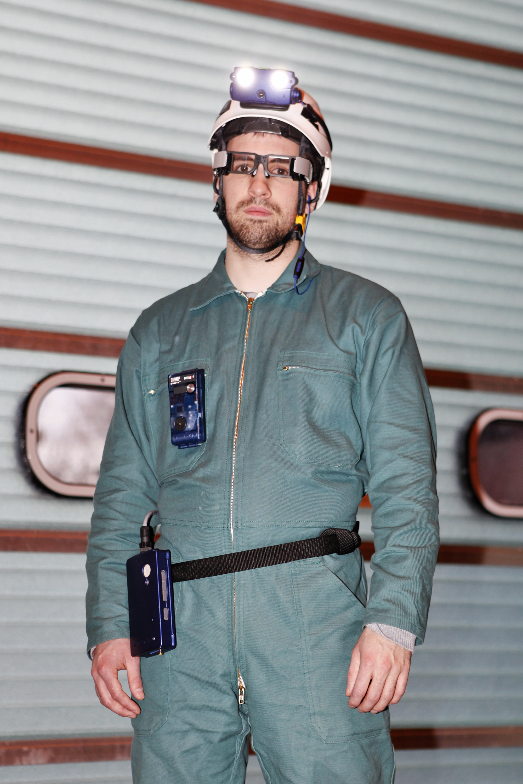
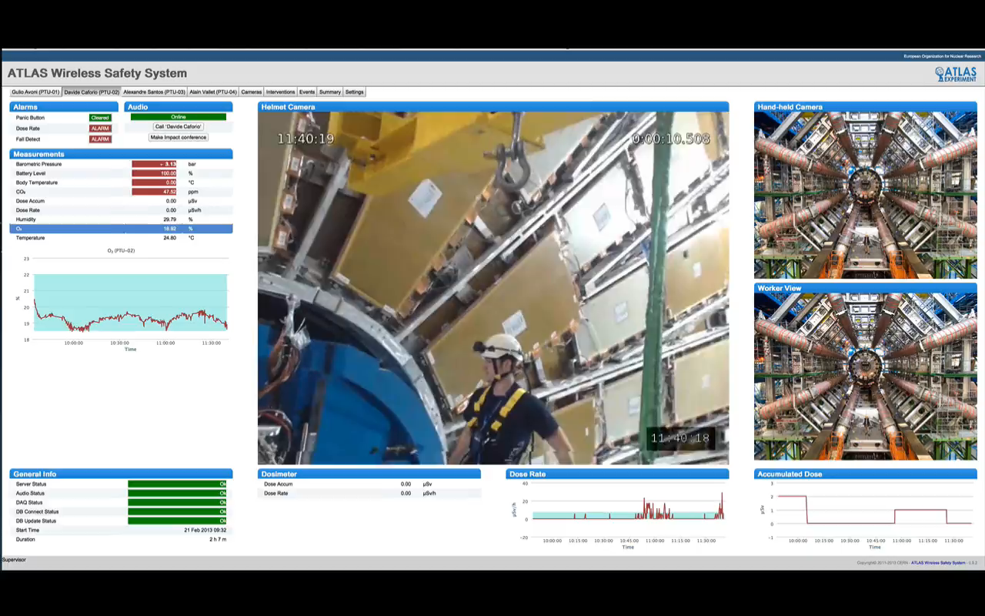
After 3 years of development, several system prototypes are operational
with:
  DMC operational dosimeter
  ODH, CO2 sensors
  Barometers, accelerometers, T
  Heart rate
In use for LS1 critical activities in ATLAS undergrounds
We have already saved radiation doses

Slide 18











2. Development and integration of the Virtual and Augmented Reality technologies in the system:
We want to extend our collaboration to partners external to the ATLAS Collaboration.
This is done within the EDUSAFE FP7 Marie Curie ITN Project
3.2 MEuros, 4 years program (started in Sept. 2012)
CERN / ATLAS is coordinator
10 PhD Fellows
2 Post Doc. Fellows
12 Partners :
Athens University of Economics and Business, Greece
Canberra, France
CERN / ATLAS
EPFL, Switzerland
Novocaptis, Greece
National Technical University Athens, Greece
Prisma Electronics, Greece
Technical University of Munich, Germany
Universita Degli Studi Di Roma Tor Vergata, Italy
Aristotle University of Thessaloniki, Greece
CAEN University, France
Democritus University of Thrace, Greece

Slide 19
3. Development of remote handling and robotics technologies towards the ATLAS/CERN needs for the maintenance and upgrade activities with high radiation risks.
What is the ATLAS Strategy for remote handling/robotics development ?
We need to identify all concerned activities for LS2, LS3 and further shutdowns
:
We need now to go more in details and identify exactly :
  Which type of tasks ? sequence of tasks
  Weight of the objects manipulated, envelope required, interfaces
  Access of the remote handling device, etc...
Already identified activities
LS2 / LS3: Beam Pipes removal
LS3: Inner Detector removal
LS3: Inner Detector services dismounting
After LS3: Annual Inner Detector maintenance

Slide 20
We will contact the key persons to start working on these for each identified detector / activity, working groups will be created
We will create preliminary dose budgets associated to these activities for LS2/LS3 and further in order to quantify the problem.
We are currently internalizing the FLUKA calculations in the ATLAS Technical Coordination (but still in collaboration with the CERN RP group).
New calculations will be run in the coming months for the missing scenarios
or new configurations:
  --- new aluminum beam pipes
  --- new pixel and VI
  --- required upgrades scenarios

Slide 21
In parallel, we analyze the best way to start a remote handling prototype
The goal :
- identify the most suitable company to assist us in our RH developments
(ideally this is done in collaboration with other CERN groups), timescale 1 year ..
- start an ATLAS remote handling prototype in building 180 and start getting experience on the tasks and on the tooling development, training required, ..
In parallel, we participate to a high level CERN collaborative working group (LHC, ISOLDE, Remote Handling group, ATLAS, ..) to identify:
the amplitude of the RH needs
possible solutions, possible collaborations
targeting potential companies,
code of practice,
etc...
The first Remote Handling Workshop has been run the 06.05.2013
The remote handling technologies must be flexible to be adapted to all subsystems requirements:
1 system and several users (various end-tools and supports can be developed

Slide 22
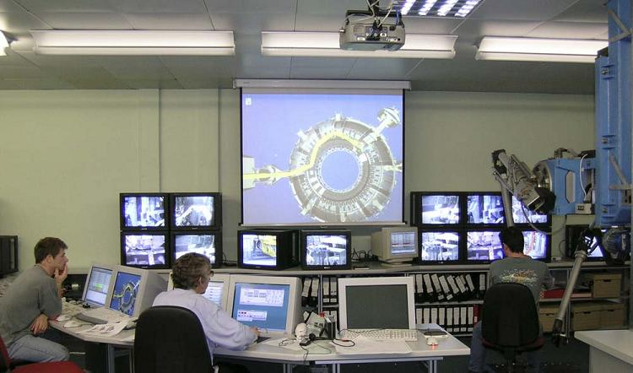
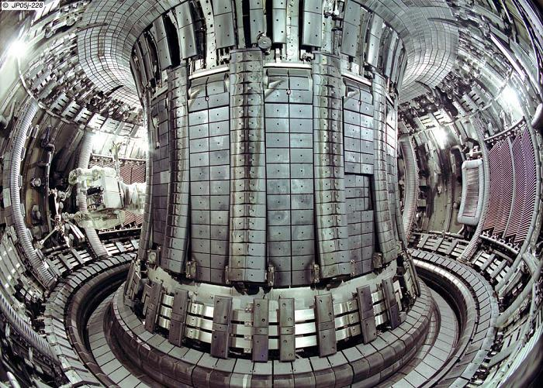
We have contacted some companies:
Shadow Robot, Oxford Technology, Space application, Kuka , ...
In parallel, we are looking for some possible EU fundings
but we have to wait now for Horizon 2020 to develop / adapt technologies for
the “CERN cases”.
We have visited JET last week to discuss possible collaboration with their RH experts

Slide 23
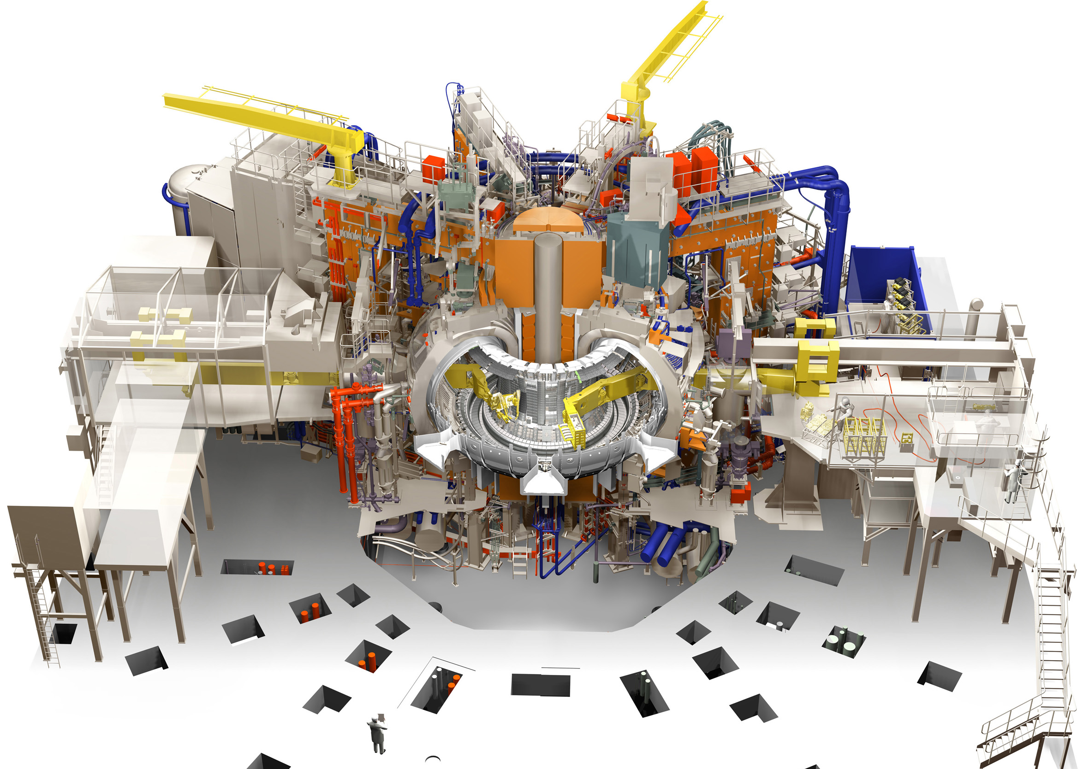
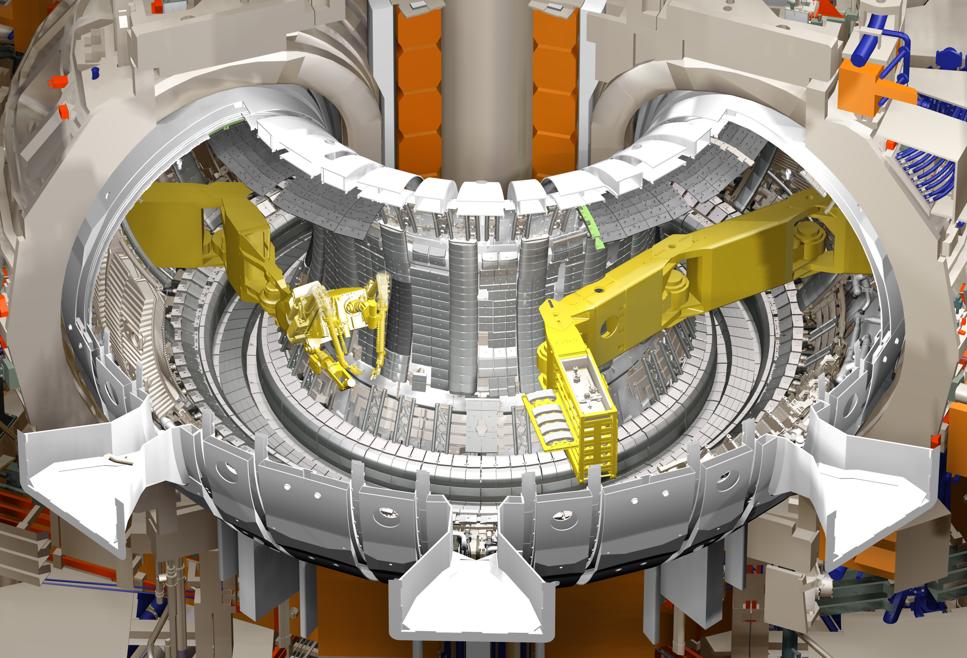
Transport container
Boom enclosure
Boom enclosure
Mascot twin arm servo manipulator
Octant 5 Boom
Octant 1 Boom
Task Module
JET Torus configuration during remote shutdowns (cut-away section)
Notes:
This image shows the configuration of the remote handling system for JET.
A twin arm servo manipulator is deployed through one port on an articulated boom and a Task Module containing tools and components is deployed through the opposite port on a second boom.
The manipulator and task module are at the centre of the system which includes the two boom enclosures with large rails to extend the booms into the vessel and transfer container docking points to allow the manipulator or task modules and components to be exchanged.
Radiation levels currently allow operators to perform tasks in the boom enclosures.
I am using quite a lot of virtual reality images here because it is not possible to see the complete systems in one image. For this reason the JET remote handling system uses VR quite extensively as an aid to operators, showing the status of the system from any angle with components removed that would obscure the view.

Slide 24
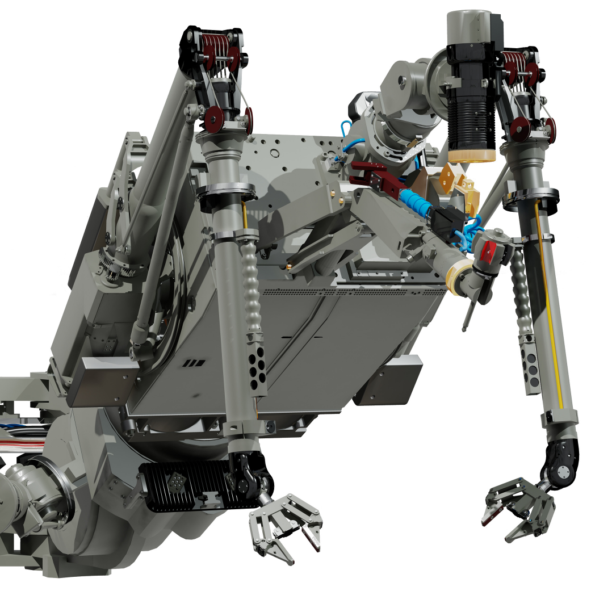
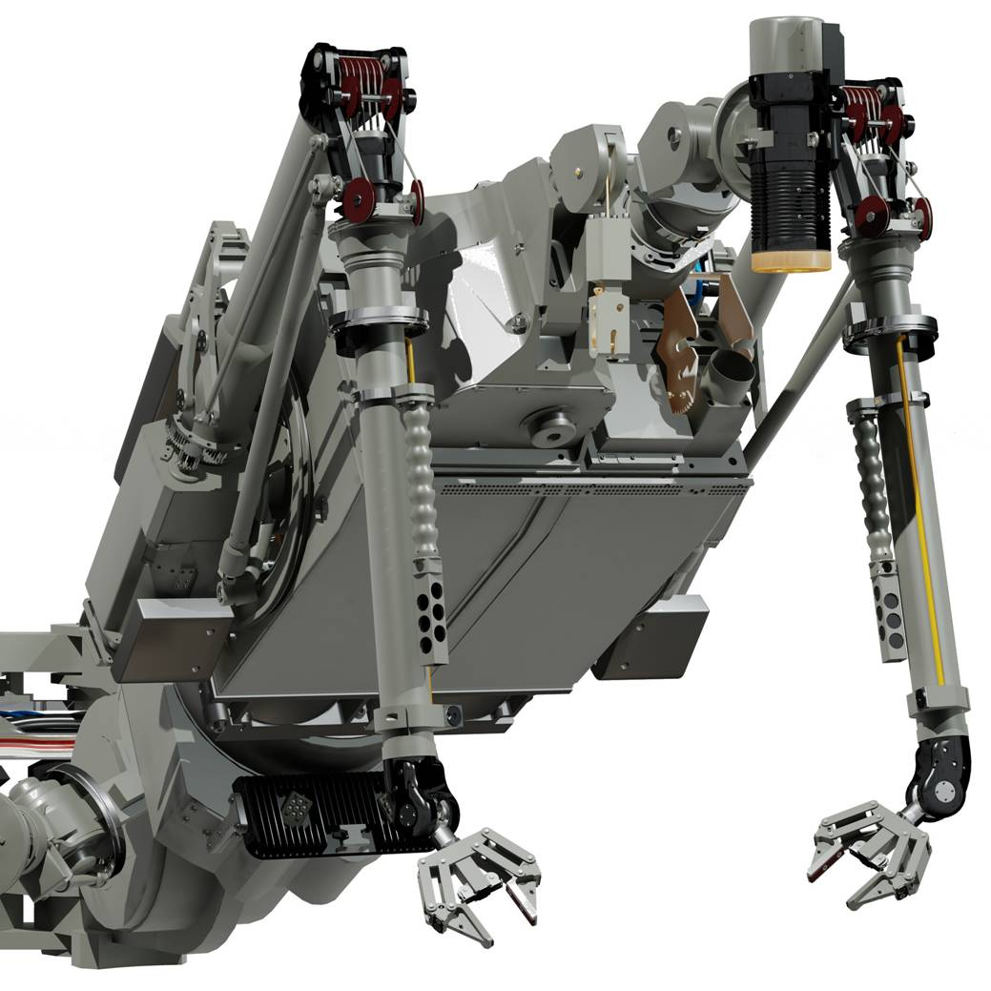
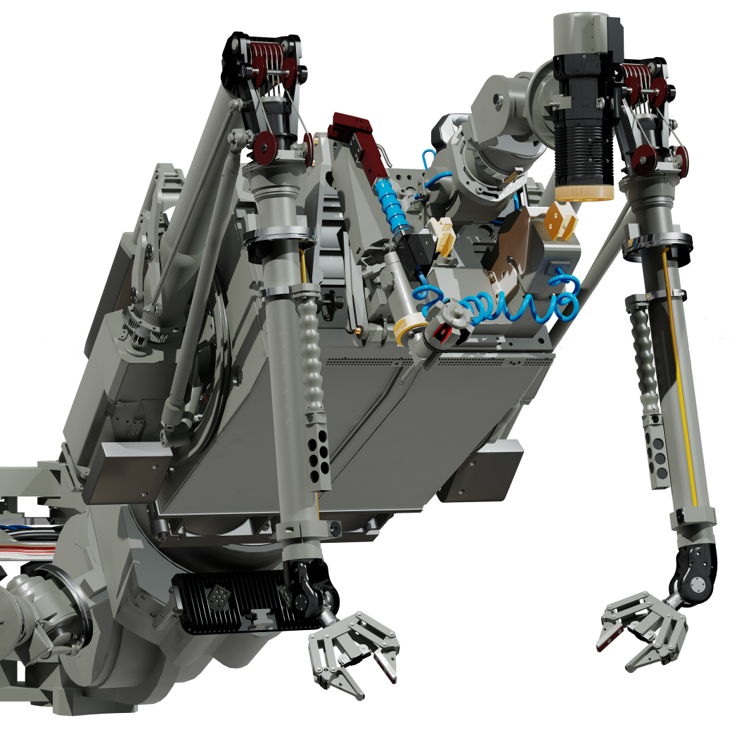
Mascot servo manipulator
High Definition Camera
Mobile Camera
Twin arm force reflecting servo manipulator
Man-in-the-loop operation
20kg payload for each arm
100kg winch that can be replaced by the 3rd Arm
  Additional park for bolt runner
  Mobile camera
Other features include;
  High Definition Cameras
  Wrist cameras
  Additional lighting (LED)
  Self aligning grippers
Wrist Cameras
Bolt Runner and Park Station
LED Lighting
Self Aligning Gripper
Notes:
The Mascot manipulator is a twin arm force reflecting servo manipulator that is used for man-in-the-loop operations.
This means that absolute position control is not required and that most operations are done using visual position feed-back and force feed-back to the operator.
The maximum payload for each arm is 20kg but we like to limit the payload for each arm to 5kg. At higher loads the force feedback is compromised and the life of the tendons connecting the motors to the joints is also reduced.
A 100kg winch is provided to supplement the arm payload and free the arms to provide the final location and fixing operations.
The winch can be replaced by the 3rd Arm when heavy components need to be delivered above the manipulator.
The manipulator also has a high definition camera in the centre, wrist mounted cameras and additional lighting.

Slide 25
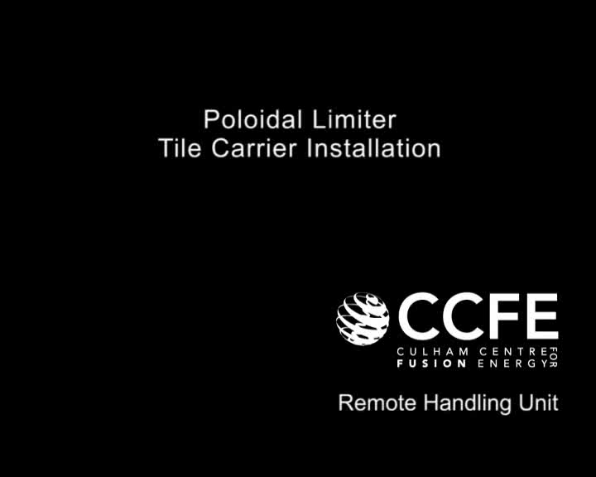

Slide 26
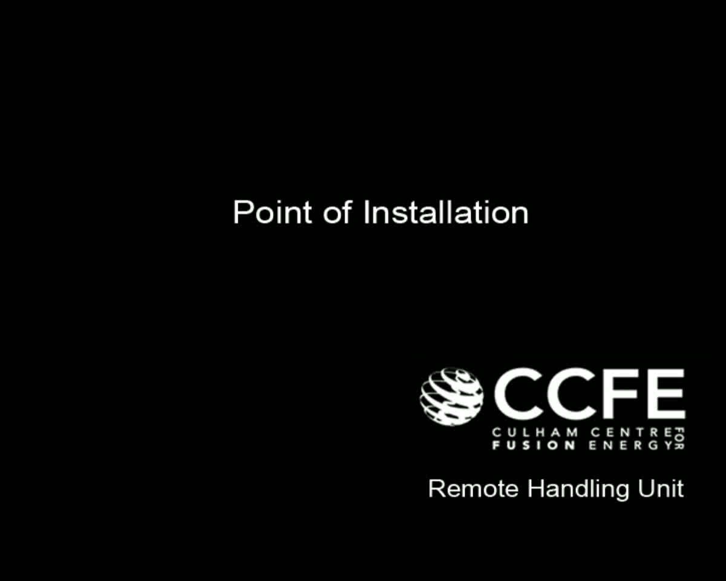

Slide 27
In conclusion :
  The doses expected for LS3 and later are reaching values which makes very difficult (and in some cases impossible) the human interventions at R<1 m.
  Long time interventions (more than few hours) in these areas seem unrealistic due to the doses levels.
  We address the problem via the ATLAS Safety upgrade program developed in several steps:
    We have developed the ATLAS Wireless Supervision and Safety system already in use for LS1
    In parallel, we are scanning the existing solutions on the market for flexible remote handling technologies adapted to the various CERN needs (in collaboration with the CERN concerned groups).
  We need to acquire 1 remote handling system adaptable to several end users
  Timescale to select the company and start a prototype : 1 year
  We want to start with the ID removal case.
  In parallel, we identify the task to be performed remotly and define the specifications

