Slide 1
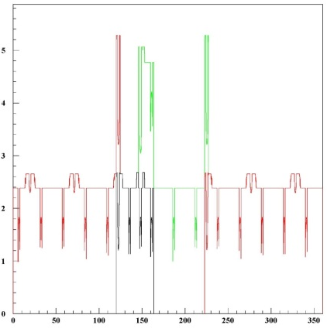
Material evaluation
CNRS – LPNHE Paris
Didier Laporte / Philippe Schwemling
Forum on tracking detector mechanics 21 june 2013

Slide 2
Abstract
Whenever we build a detector, we try to reduce the amount of matter of this detector,
Each part have a contribution on the material budget of a detector :
  screws,
  services,
  electronics,
  ……

Slide 3
Tools
From a CAD model , we can evaluate more precisely the material budget of one system or sub-system.
We can have a cartography (all the parts and theirs contributions )
This application is developped with the CAD system Catia.

Slide 4
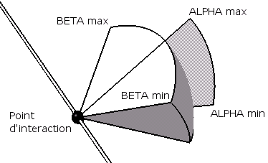
Parameters
Memory size
File name
Alpha min
Alpha max
Alpha step
Beta min
Beta max
Beta step
Position X
Position Y
Position Z
Output file
Axis
14000
C:\centrale_maillon_sym.CATpart
0
360
0,1
65
115
0,1
-100
0
0
centrale_maillon_sym_moins100
x

Slide 5
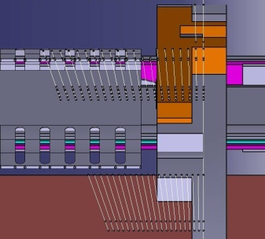
File results
catpart=C:\centrale_maillon_sym.CATpart
alphamin=0
alphamax=360
alphapas=0,1
betamin=65
betamax=115
betapas=0,1
X0=-100
Y0=0
Z0=0
nom_rapport=centrale_maillon_sym_moins100.txt
Axe Faisceau=x
0 111,3 0,519 1
0 111,4 1,068 1
0 111,5 1,613 1
0 111,6 2,154 1
0 111,7 2,691 1
0 111,8 3,13 1
Alpha
Beta
Length
Part number

Slide 6
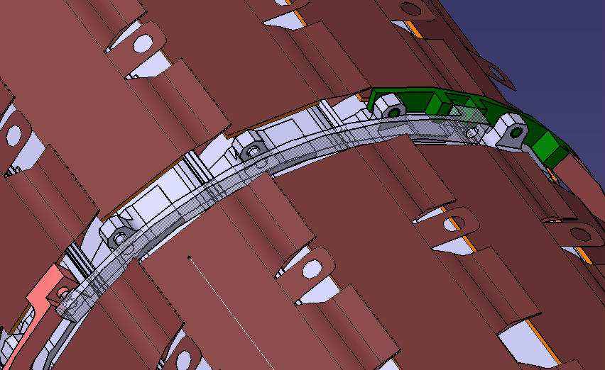
IBL central ring

Slide 7
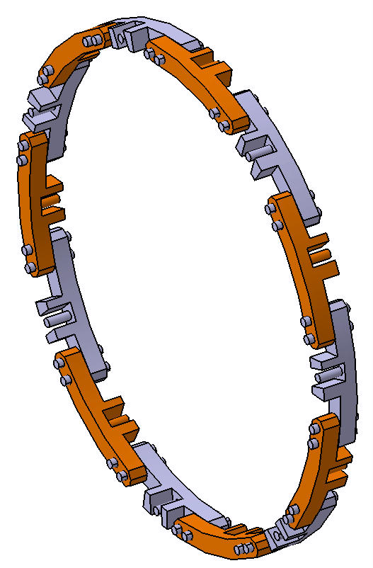

Slide 8
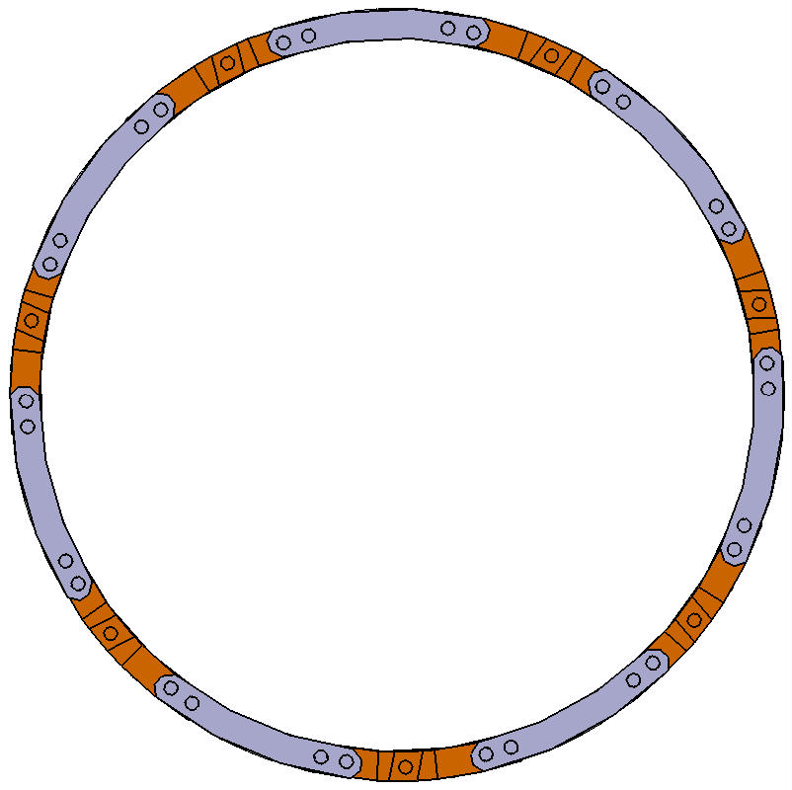
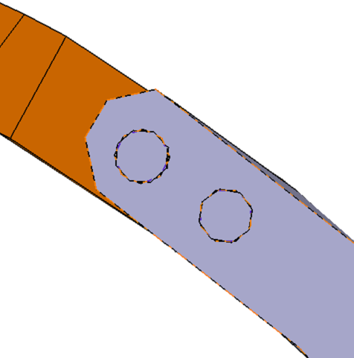
Step α
α2l3
α2l2
α1l3
α2l1
α1l2
α1l1

Slide 9
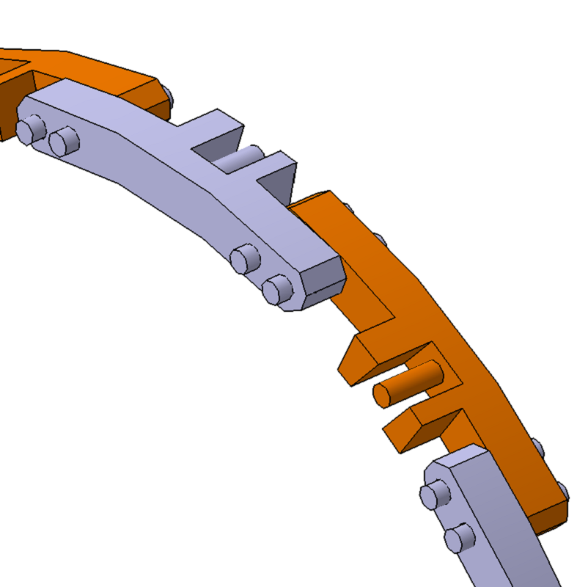
CAD comparaison examples
Central ring with linksym :
  Material :
    Link : PEEK CF (PEEK with carbone) (Polyetheretherketone)
    Axis : Titanium

Slide 10
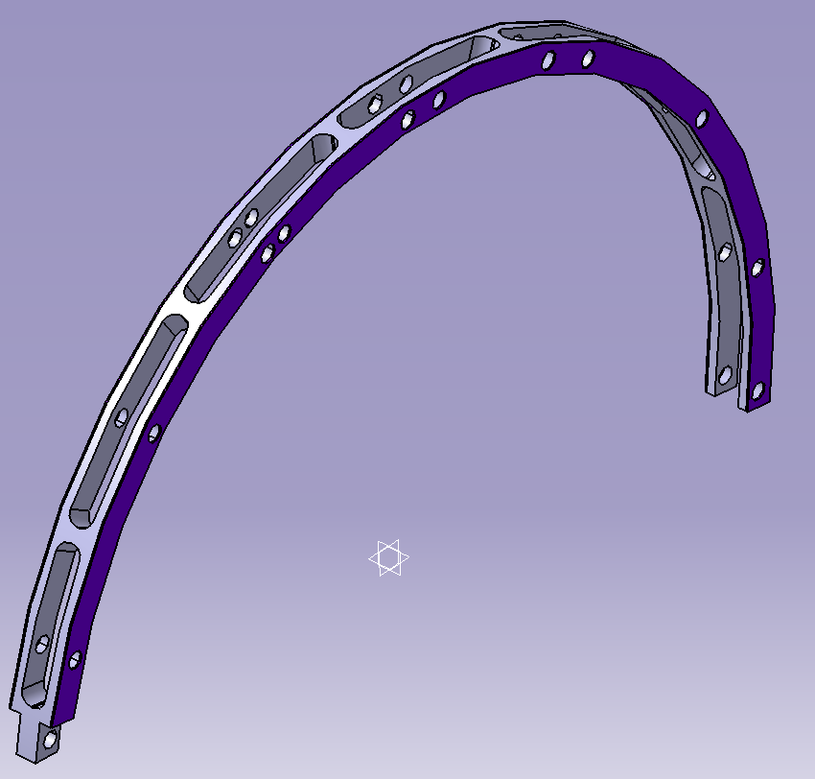
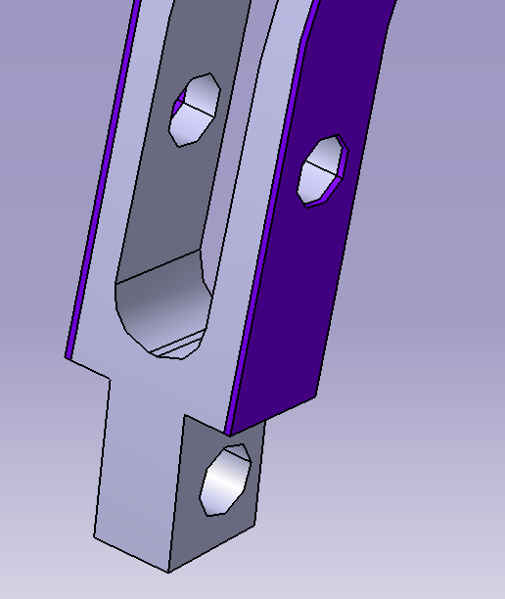
CAD comparaison
Central ring in carbon :
  Material :
    Link : Carbon foam + carbon fiber
    Axis : Titanium
Carbon fiber : 0,145 mm,
Carbon foam : 3,71 mm

Slide 11
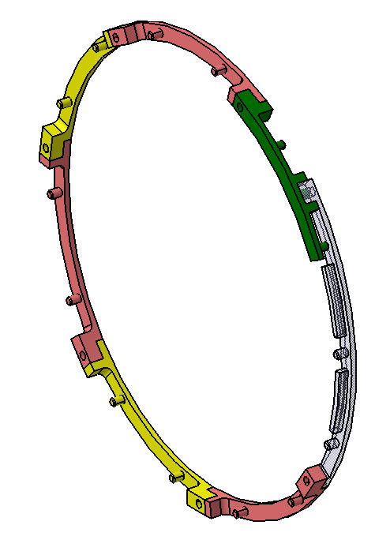
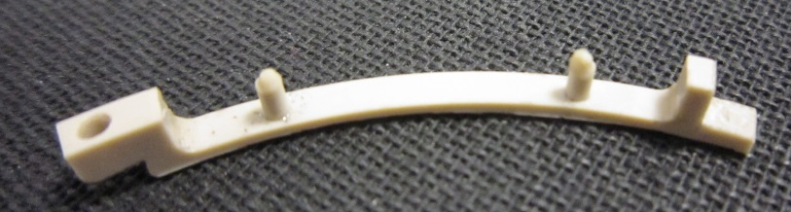
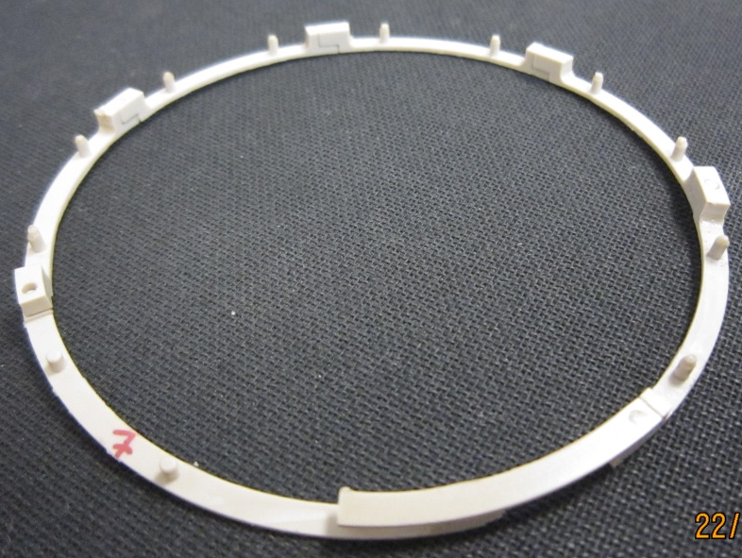
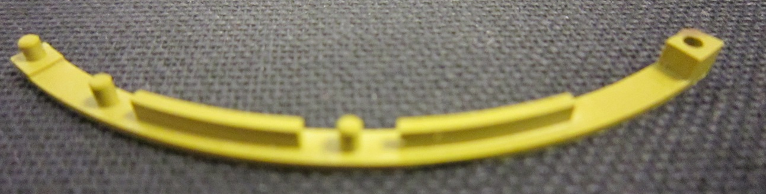
CAD comparaison
Central ring last version :
  Material :
    Link : PEEK CF or PAI (Polyamide-imide)
    Axis : no additional axis

Slide 12
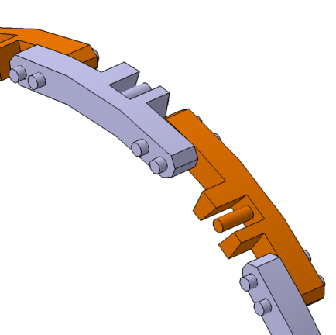
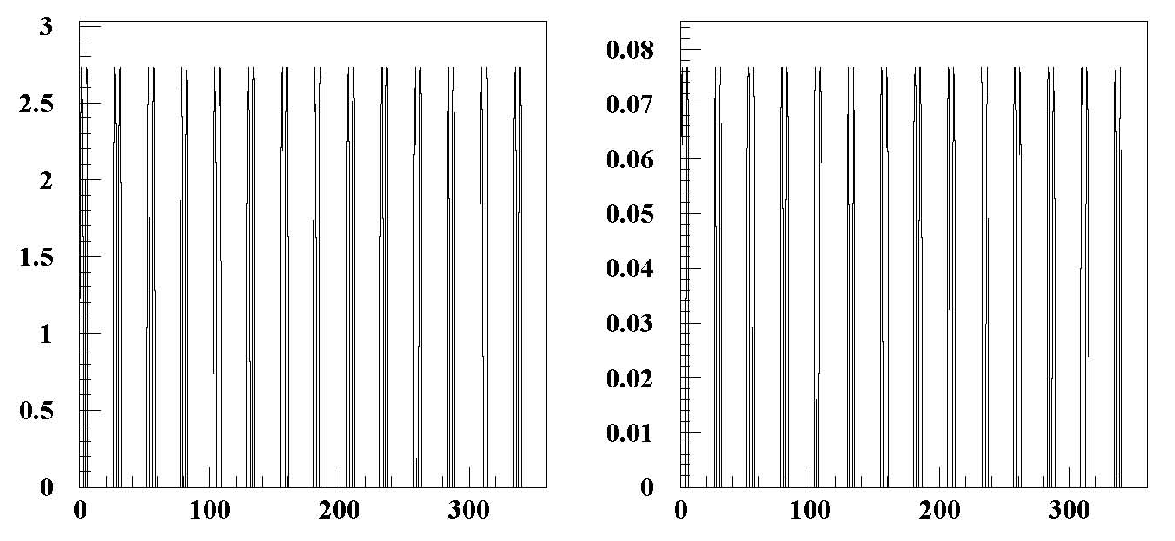
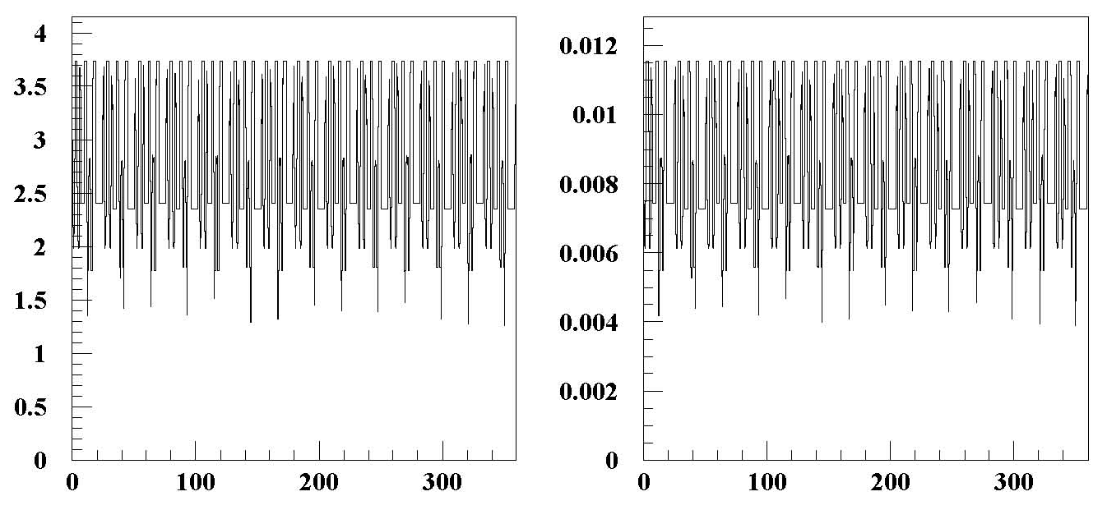
Results
Interaction point -100 mm
length
X0
Axis
0,37
2,8
link

Slide 13
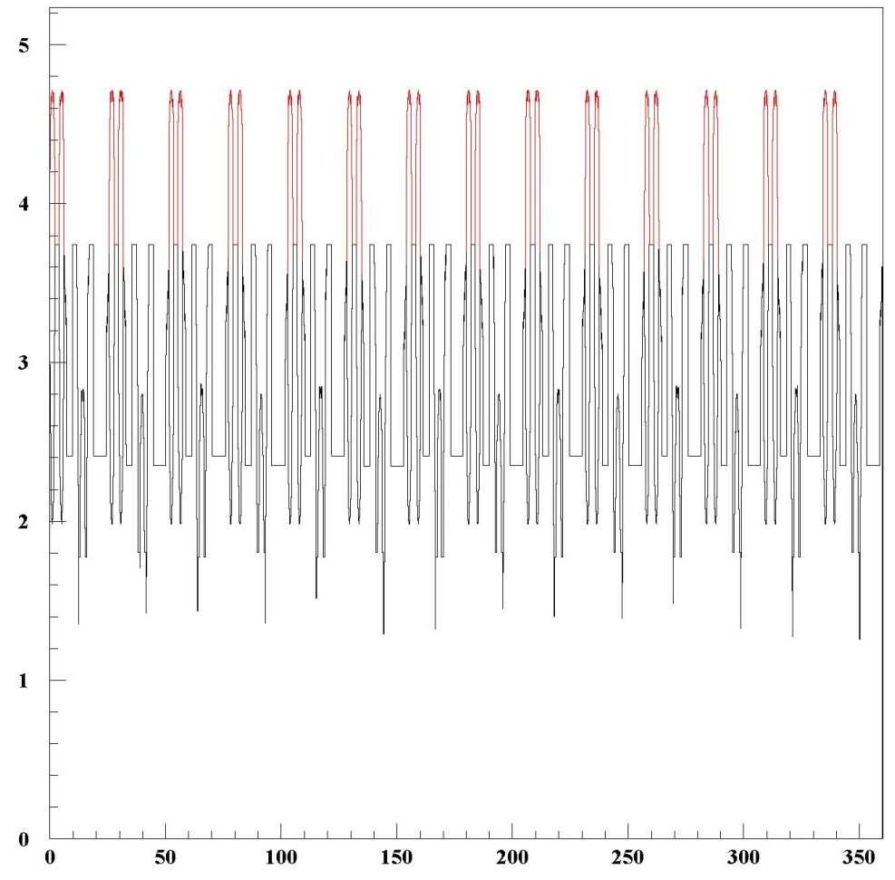
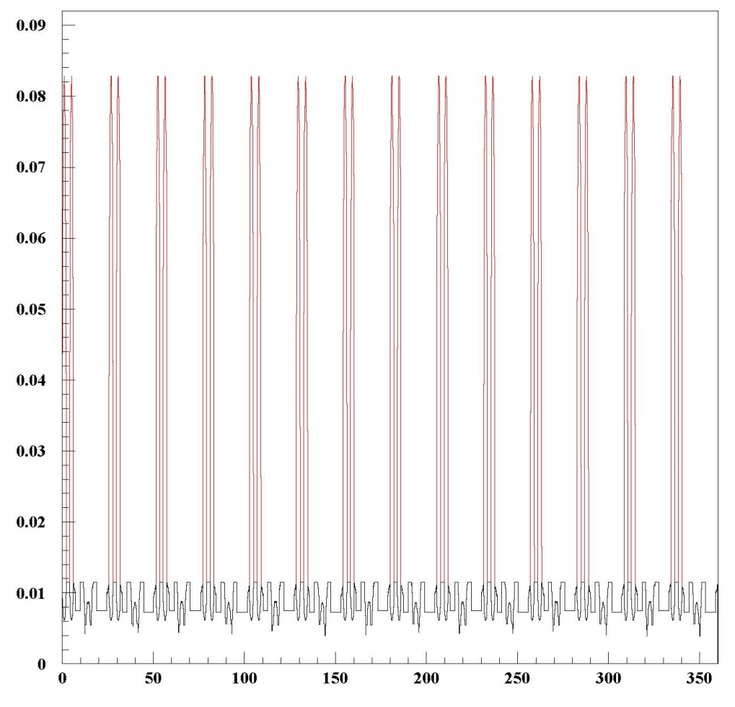
Results
length
Interaction point -100 mm
Length/X0
Axis+link
1 : link (black)
2 : axis

Slide 14
Results
length
Interaction 0 mm
Length/X0
Axis+link
1 : link (black)
2 : axis

Slide 15
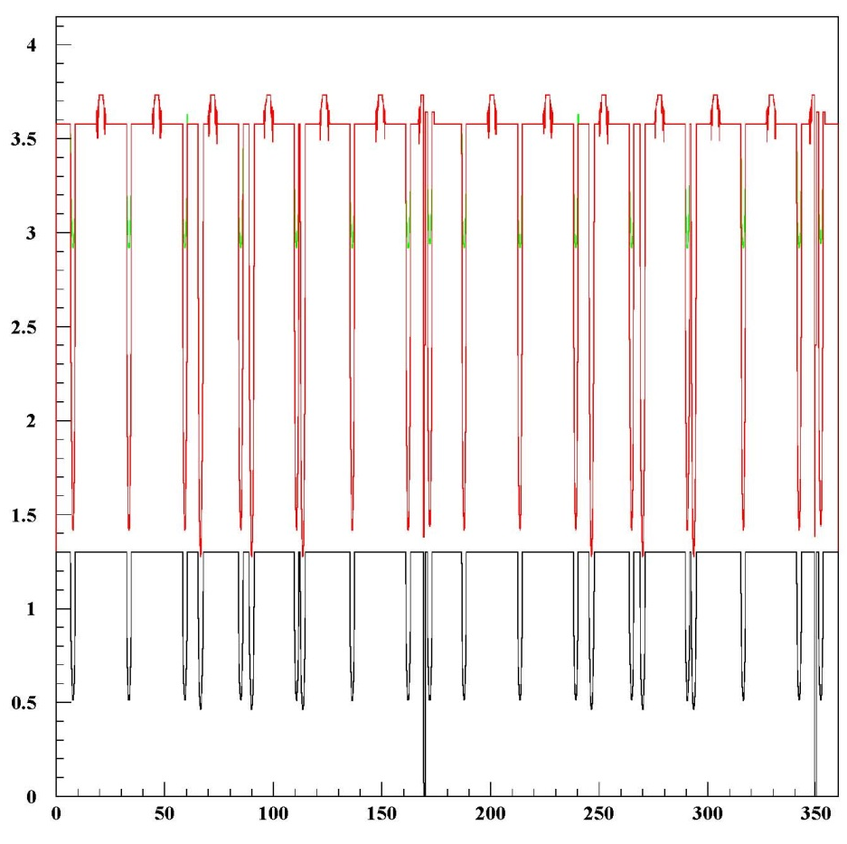
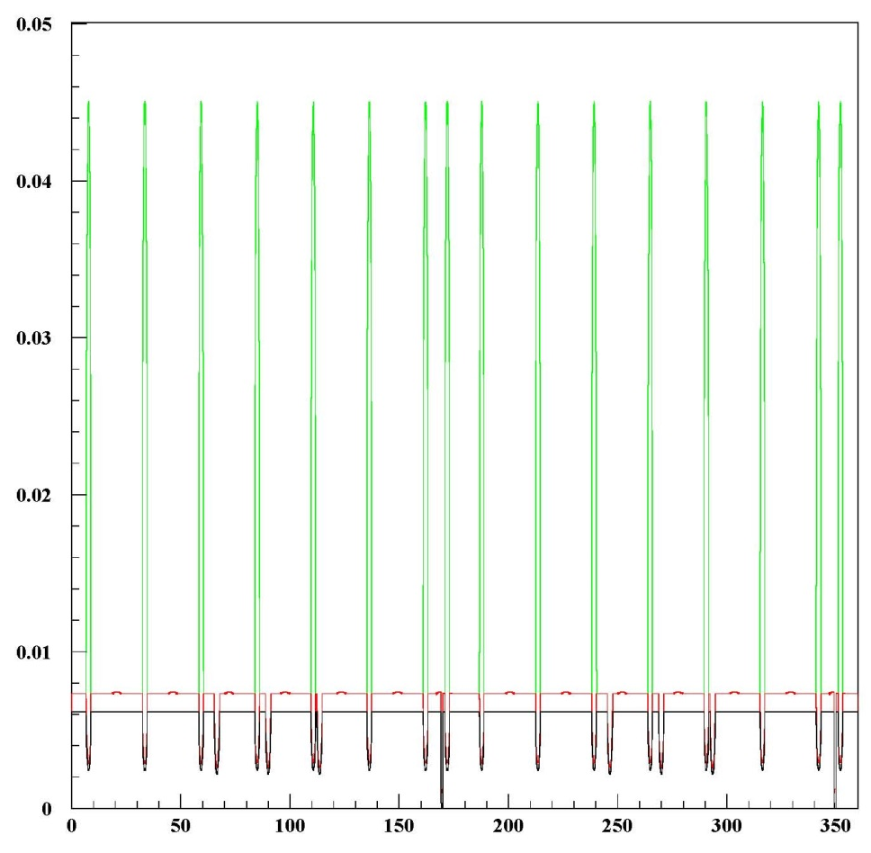
Results
length
Length/X0
Interaction 0 mm
Axis+link
1 : foam (black)
2 : carbon fiber (red)
3 : axis (green)

Slide 16

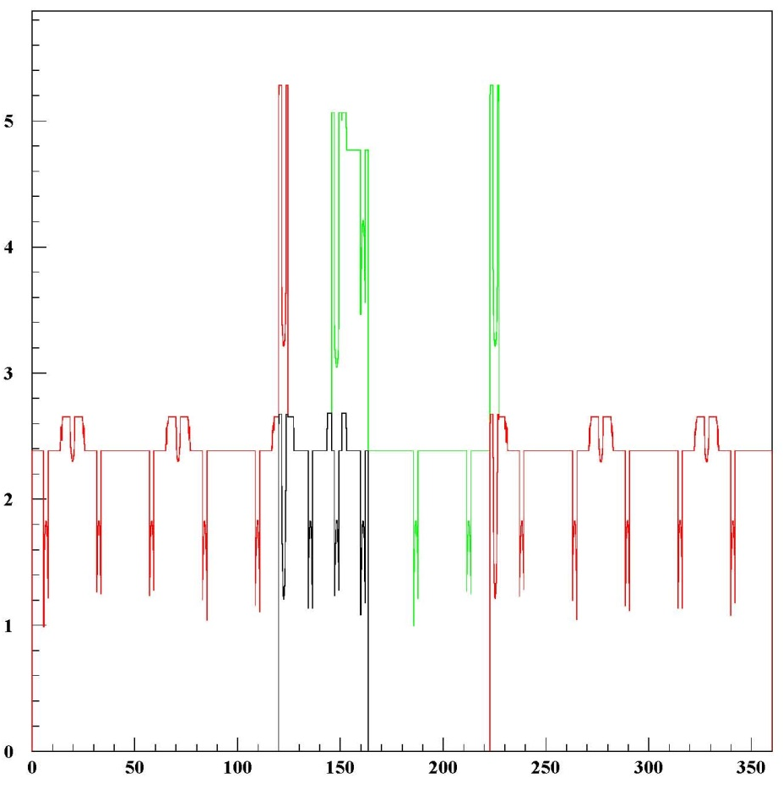
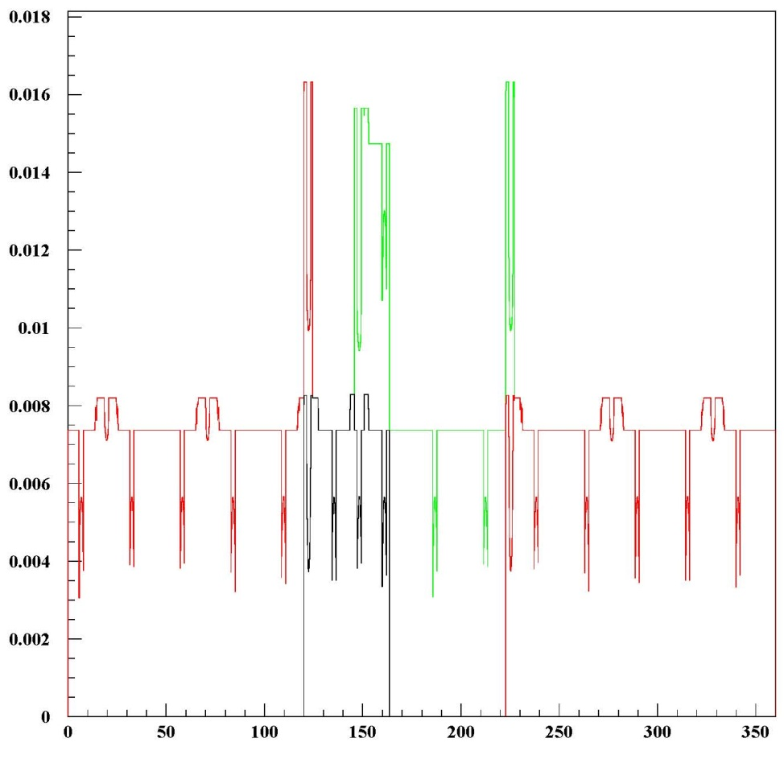
Results
Length (mm)
Length/X0
Only PEEK used
1 : first link
2 : link (2 to 5)
3 : last link

Slide 18
Data information :
IBL values :
  X0 PEEK : 323,6 mm (density 1,3)
  X0 PAI : 299,6 mm (density 1,4)
  X0 Titanium : 35,6 mm (density 5)
  X0 Foam : 1940,95 mm (density 0,22)
  X0 Carbon fiber+glue : 210,67 mm

Slide 19
Another use
It’s possible to use this tool to check the correct position of each sensor for one detector.

Slide 20
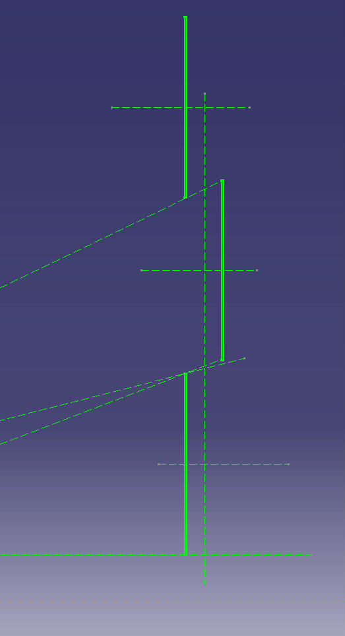
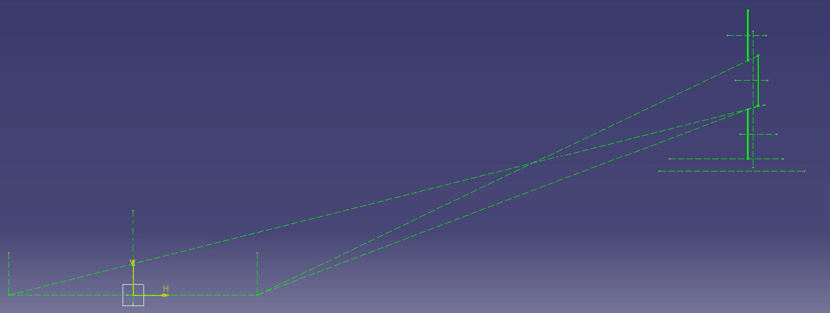
Example : sensor position

Slide 21
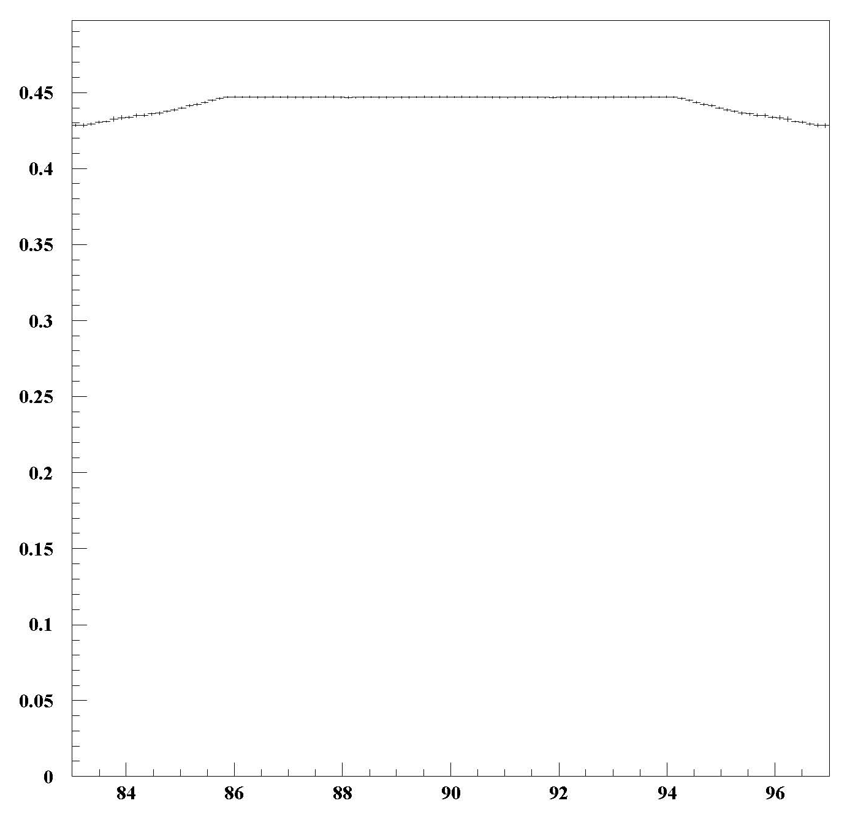
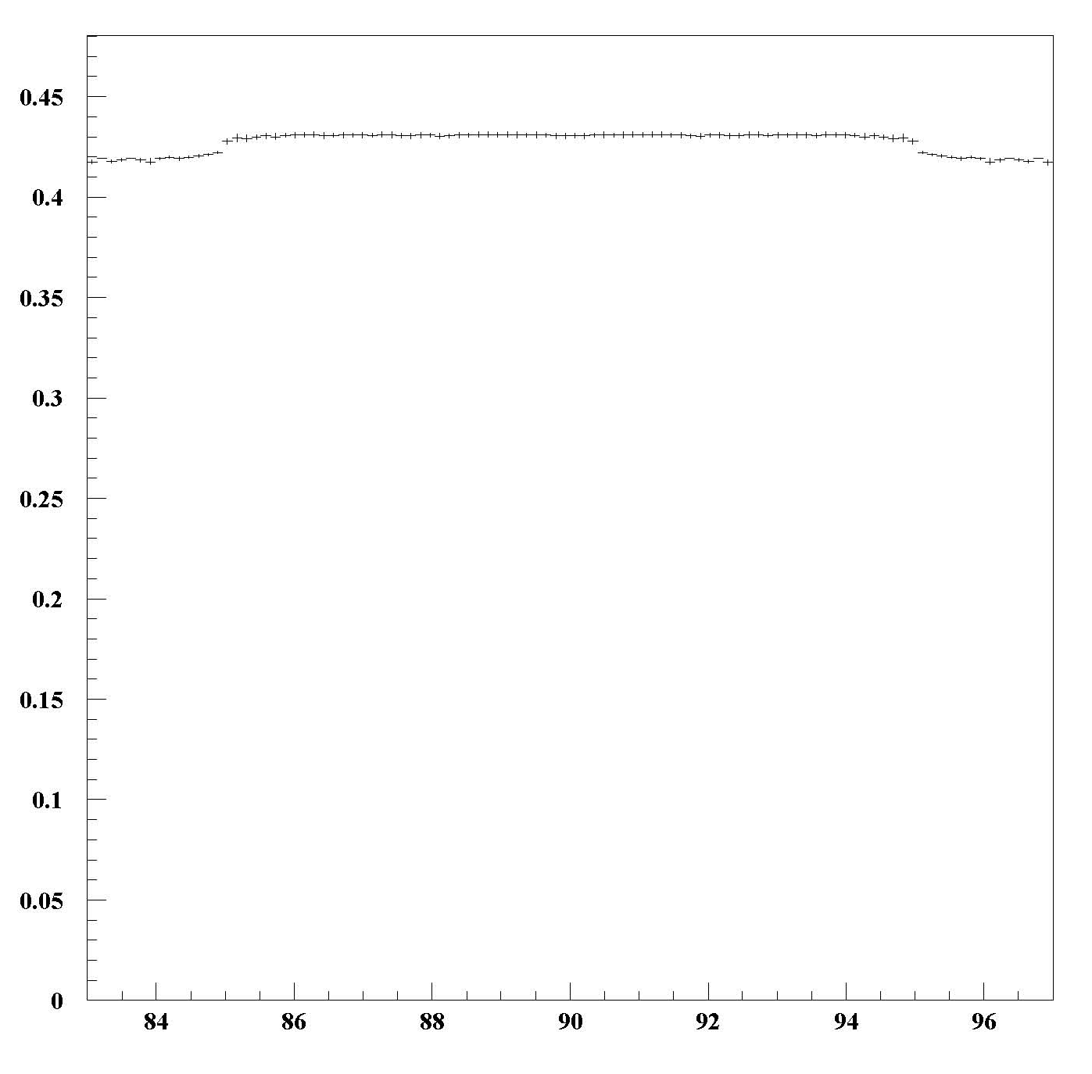
Alpha
discontinuity
Position -100mm
Position +100mm

Slide 22
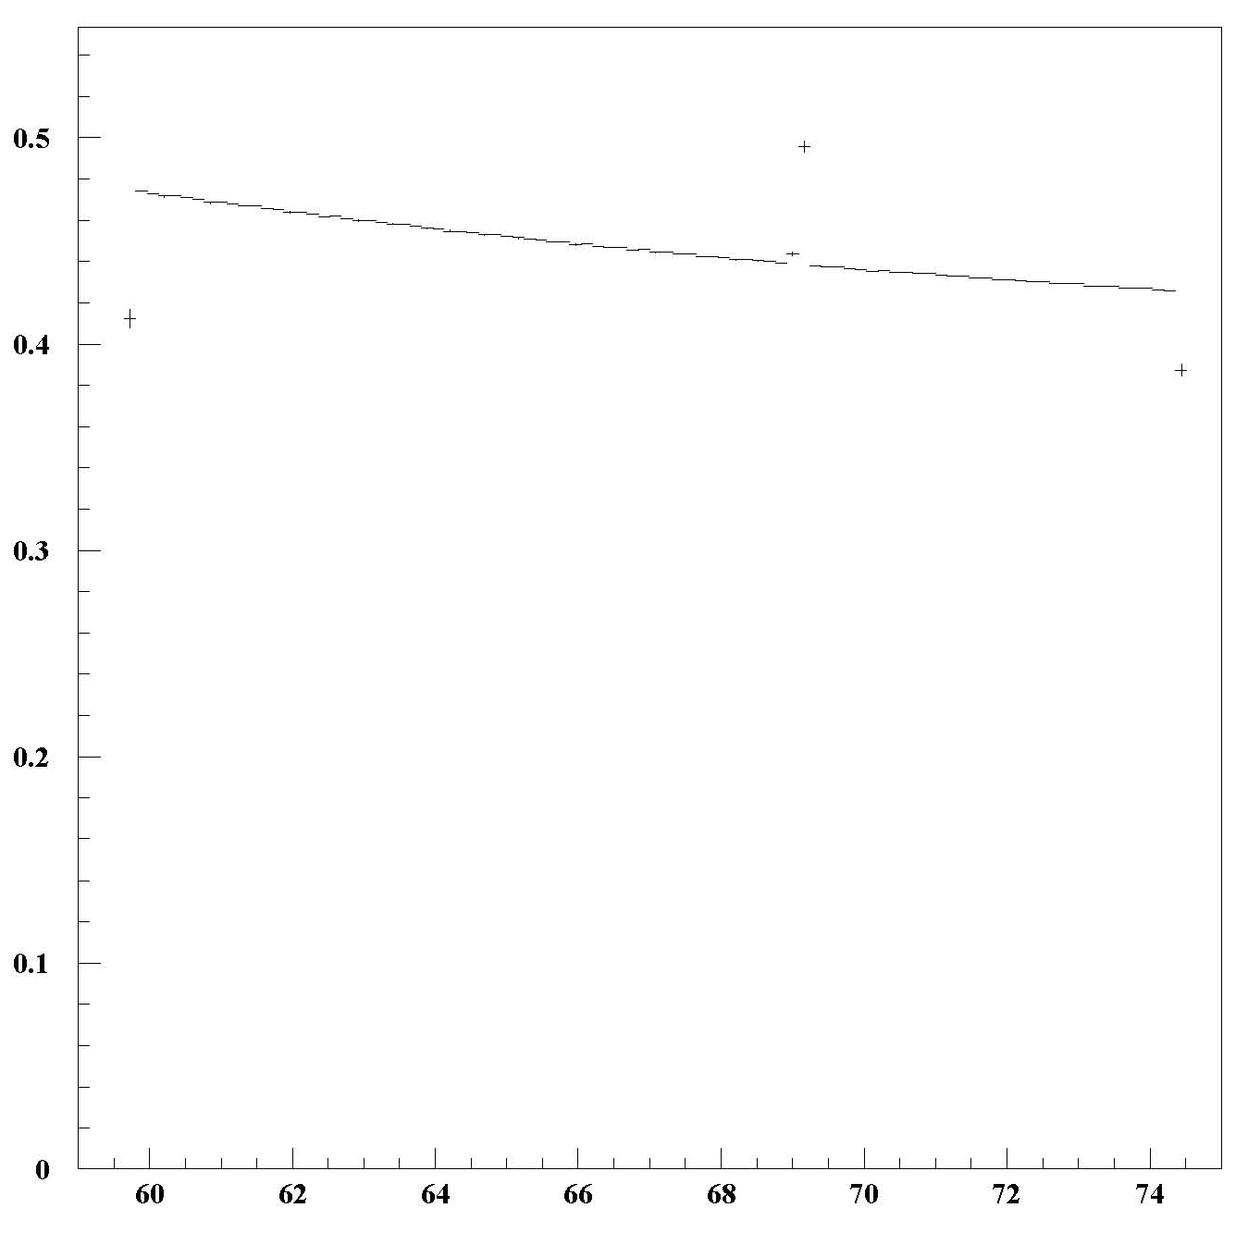
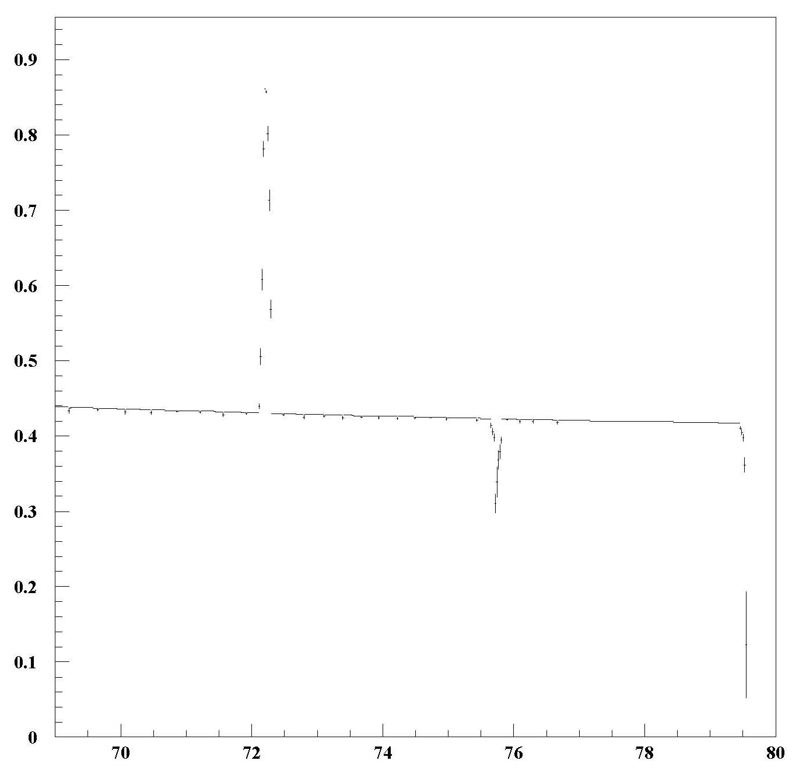
Beta
No sensor
Position -100mm
Position +100mm

Slide 23
Conclusion
All the parts of the detector can be check,

Slide 24
Backup

Slide 26
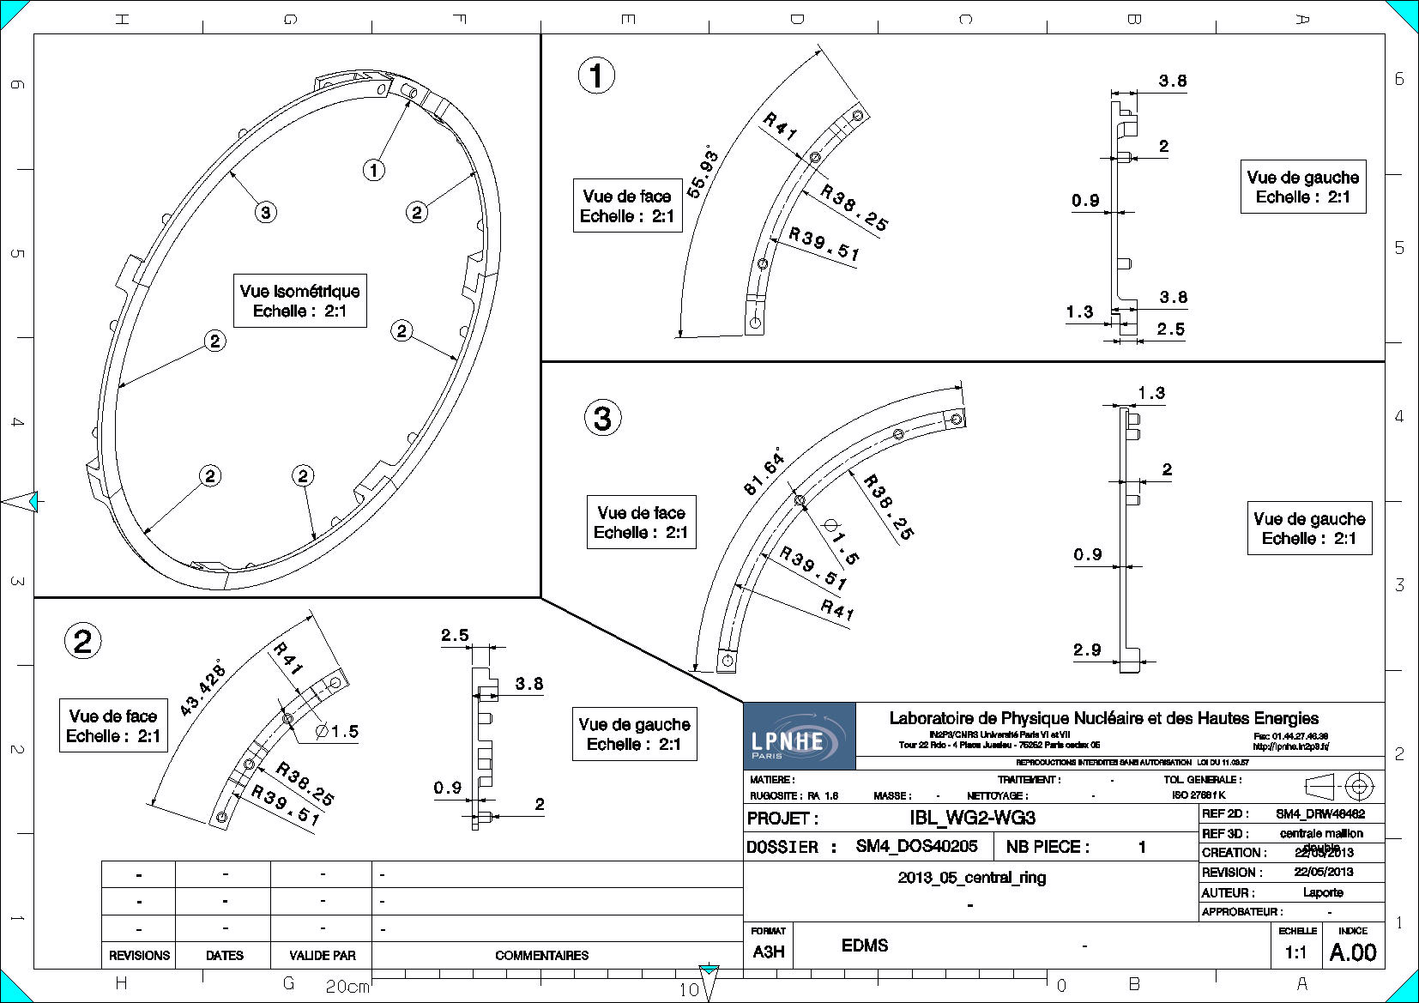

Slide 27
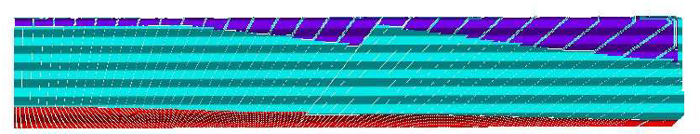
Barrel calorimeter
A
B
Structure des électrodes complexe, difficile à modéliser parfaitement avec Geant4.
θ
η=-ln(tan(θ/2))
Point d’interaction

Slide 28
Distance parcourue (simulation Catia)
Energie déposée (Données)
A
B
A
B
η
η

