Slide 1



FIBER BRAGG GRATING SENSORS FOR SMART-TRACKERS: A REAL-TIME DEFORMATION, TEMPERATURE AND HUMIDITY MONITOR FOR THE BELLE-II VERTEX DETECTOR
Forum on Tracking Detector Mechanics, June 2013
D. Moya, I. Vila, A. L. Virto, E. Currás , A.Ruiz
Instituto de Física de Cantabria
M. Frovel, J.G. Carrión
Instituto Nacional de Técnica Aeroespacial
A. Oyanguren, C. Lacasta, P. Ruiz
Instituto de Física Corpuscular
David Moya Martín, IFCA (CSIC-UC)

Slide 2
_Outline
Introduction to FOS:
  Working principle & advantages.
FBG qualification for particle physics applications.
Application case: Belle II VTX detector
  Introduction to Belle II mechanics
  Real time monitoring for Belle II Vertex.
  FOS-based displacement sensors.
Conclusions and Outlook

Slide 3
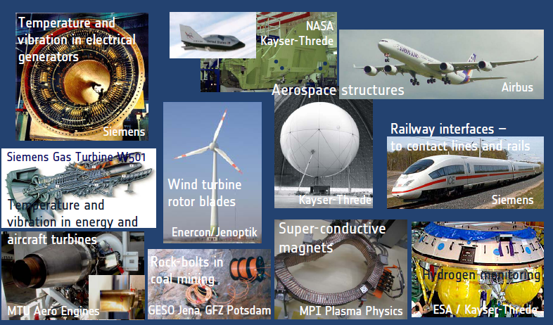
FOS for environmental and structural monitoring industry driven technology
Notes:
Message: FOS (FBG is a established technology)

Slide 4
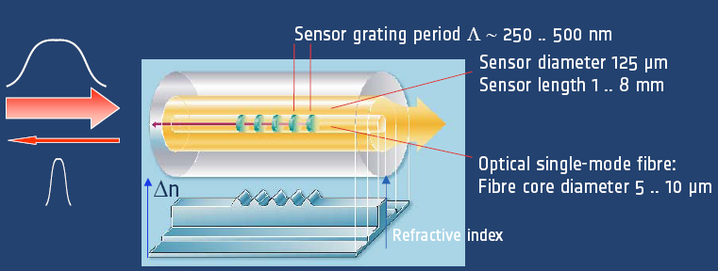


_Bragg grating sensor basics
,
FOS monitoring is an standard technique in aeronautic and civil engineer
Mechanical sensitivity
Thermal sensitivity

Slide 5
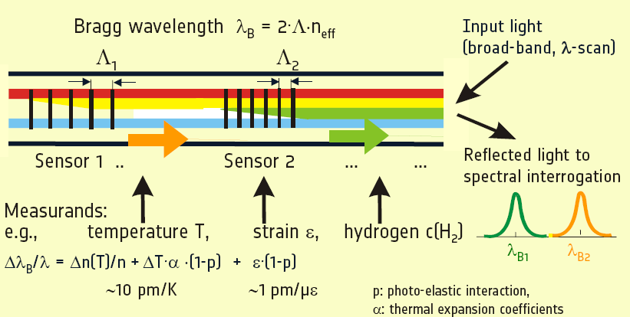
_Bragg grating Multiplexing
Notes:
FBG is a direct transducer for temperarute and strain. Overall sensitivy 10pm/kelvin & 1pm/uepsilon (recall the typical resolution
Scientific quality interrogator is 0.1-0.2 pm

Slide 6
_FOS & FBG advantages
General attributes of Fiber Optic Sensors:
  Immunity against:
    High electromagnetic fields, high voltages.
    High and low temperatures.
    Nuclear radiation environments
    High magnetic fields
  Small footprint, Light-weight, flexible, low thermal conductivity.
  Low-loss, long-range signal transmission(“Remote sensing”)
Specific FBG attributes:
  Multiplexing capability (sensor network) and fast readout (1kHz)
  Embedding in composite materials.
  Wavelength encoded ( neutral to intensity drifts)
  Mass producible at reasonable costs.
Notes:
Highlight the resistance to radiation, high magnetic field and embedding in composite materials.

Slide 7
FBG qualification for particle physics

Slide 8
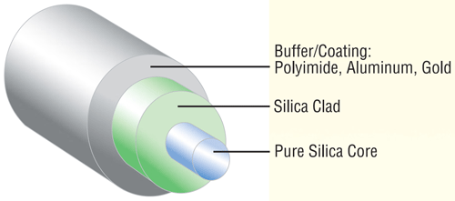
FBG Radiation Resistance Assessment
Aims:
  Find most radiation tolerant FBG sensor.
  Quantify the change in sensors strain sensitivity
  Find main fiber parameters affecting FBG sensor sensitivity
Compare fibers with different Coatings ( polyimide, Ormocer and Acrylate), dopings ( Ge doping concentration, another dopings…) and manufacturing process (draw tower, H2 loading, annealing, etc).
8

Slide 9
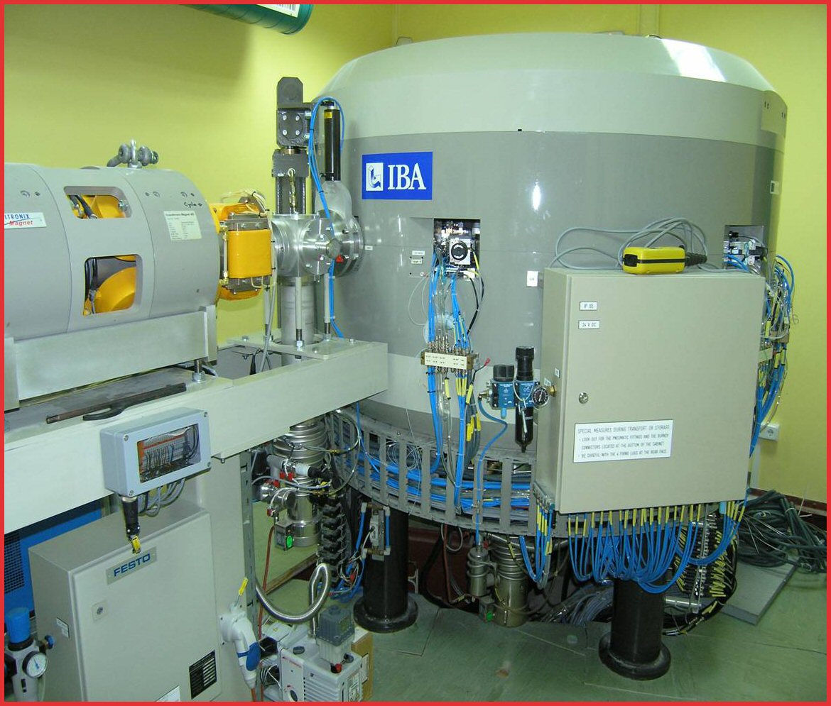
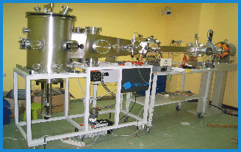
Irradiation campaign with protons: facility
Two Irradiation campaigns at Centro Nacional de Acceleradores in Seville.
Cyclotron facility (max. energy of 18 MeV protons, here 15.5 MeV protons)
9
13th October '10, D. Moya / moyad@ifca.unican.es

Slide 10
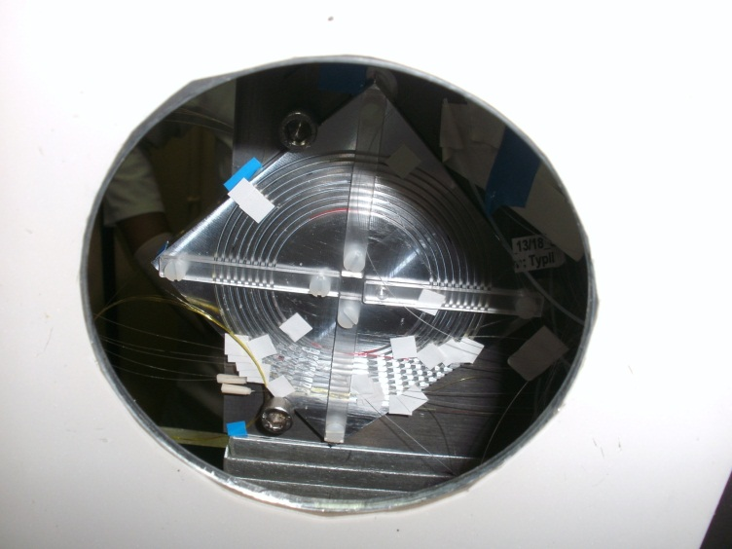
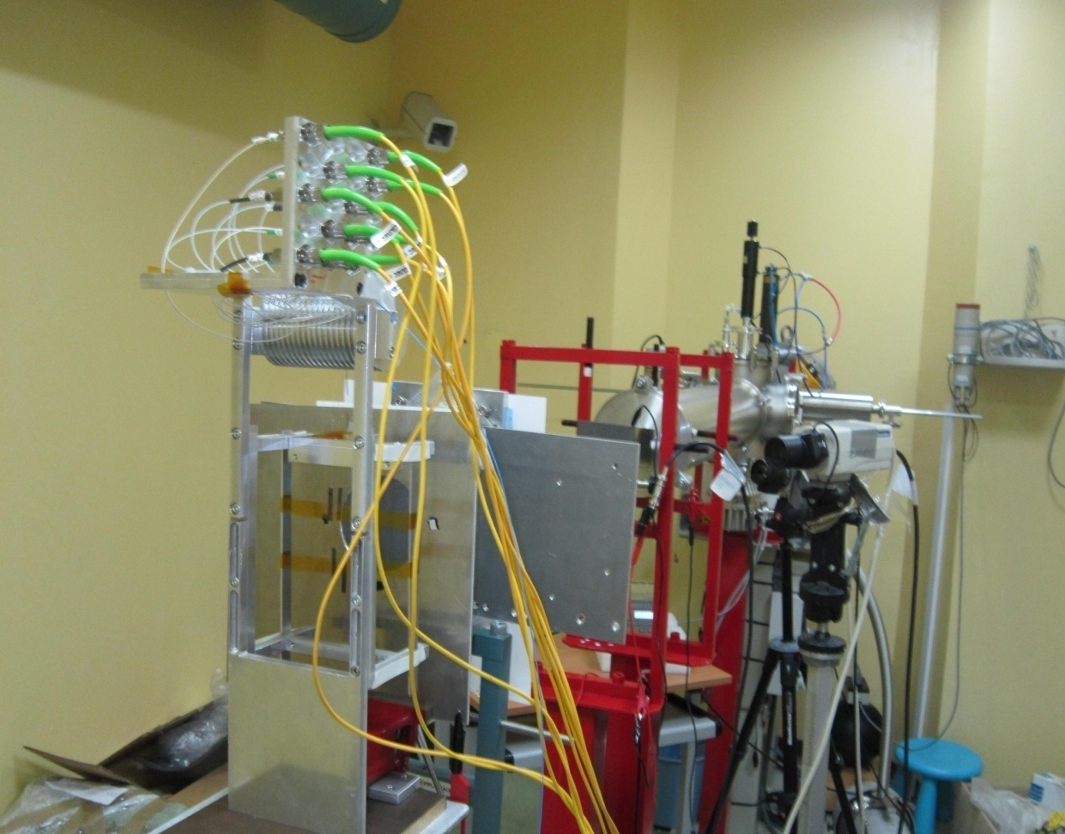
FBG characterization for particle physics
Irradiation of Fiber Grating Sensors
  Two FBG active irradiation campaigns done at “Centro Nacional de Aceleradores” (CNA) with protons up to an absorbed dose of 1.5 GRad and 10 Mrad (Belle II).
Outcome of irradiations:
- Reflected lambda affected by type of coating
Attenuation is affected by the type of core
Annealing observed after irradiation (two weeks). Studying it now in more detail
Acrylate coated fibers displayed no peak shift
Different peak shift of sensors embedded in C.F. structure.
Protons beam
Irradiated sensors
Irradiation Mask
10

Slide 11
First irradiation campaign main results
Irradiation up to a total absorbed dose of 1.5 GRads of seven different fibers.
Sensor code | Coating | Amp. Change, dB | Peak Shift, pm
111 | acrylate | -0.42 | -3
112 | acrylate | -0.15 | -14
212 | polyimide | -6.05 | 140
213 | polyimide | -6.26 | 173
214 | polyimide | -7.16 | 175
221 | polyimide | -7.56 | 158
222 | polyimide | -6.92 | 175
223 | polyimide | -6.92 | 173
021 | ormocer | -6.23 | 308
022 | ormocer | -8.80 | 379
023 | ormocer | -5.00 | 334
03 | ormocer | -0.01 | 206
04 | ormocer | -0.03 | 307
05 | ormocer | -0.21 | 359
Notes:
211 (¿fue irradiada?)

Slide 12
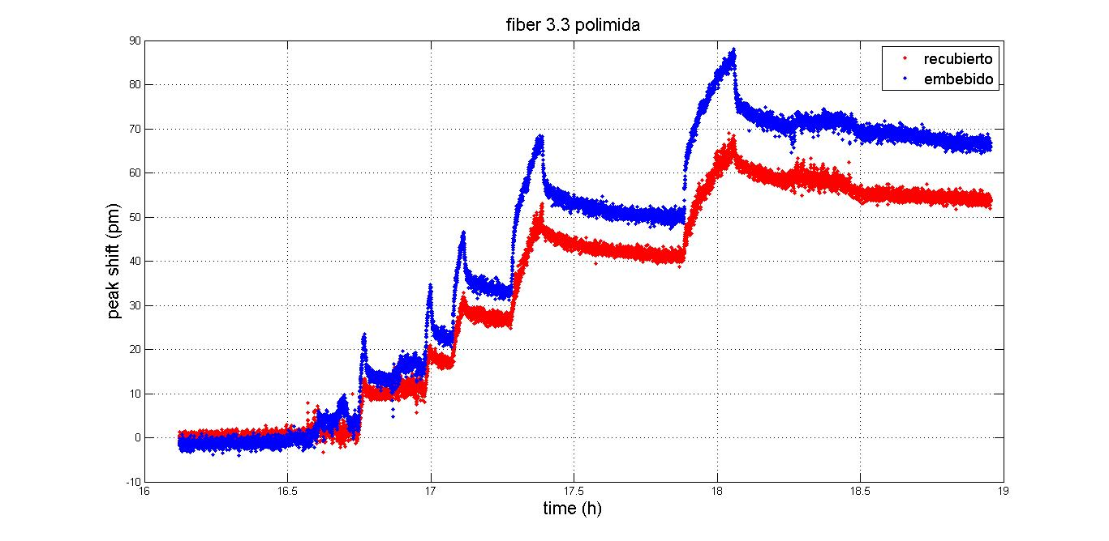
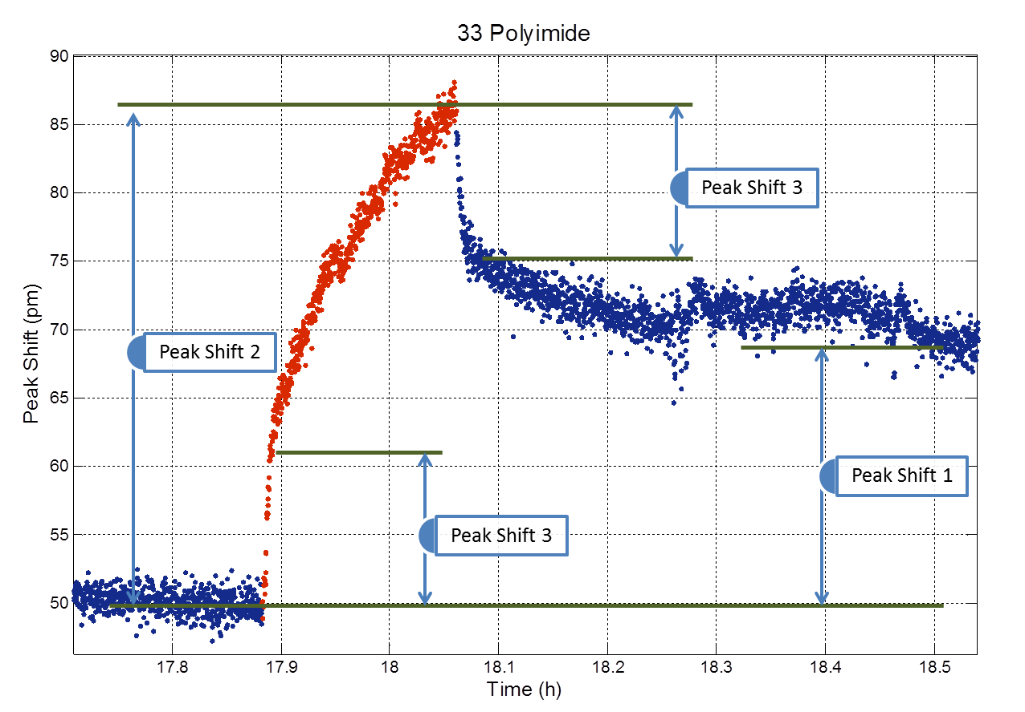
Second irradiation campaign: results
Absorbed dose similar to expected at Belle II for 10 years (10 Mrads)
Five irradiation steps
  Radiation and radiation induced temperature effect can be disentangle
  FBG Annealing after each irradiation step.
12
13th October '10, D. Moya / moyad@ifca.unican.es

Slide 13
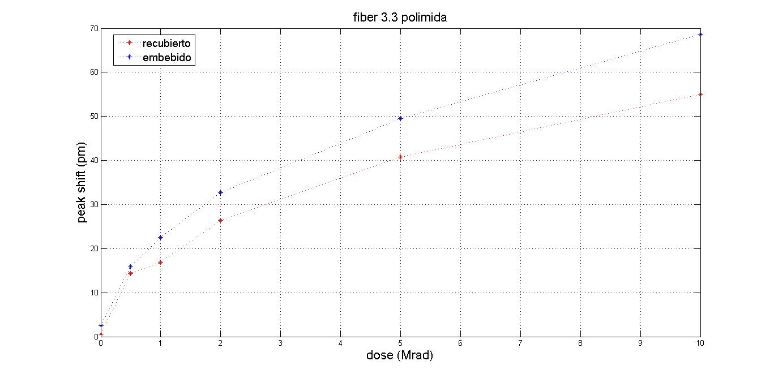
Second irradiation campaign: results
FBGs sensitivity to radiation seems to saturate at higher absorbed doses.
13
13th October '10, D. Moya / moyad@ifca.unican.es
Notes:
Small sensitivity, idea to carry out a pre-burning

Slide 14
A FBG-based Real-time Structural & Environmental monitor for Belle- II

Slide 15
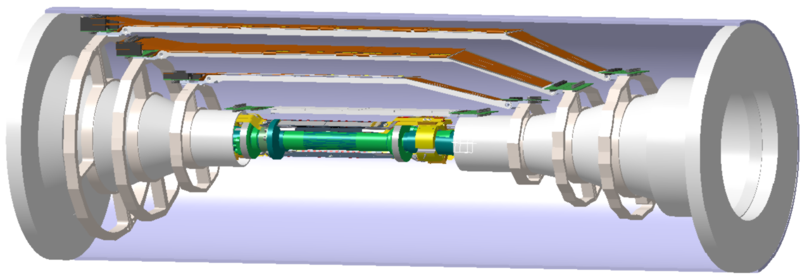
Belle-II Vertex Detector
,
Thermal envelope
Strip Vertex detector
(microstrips)
≈300mm
DEPFET PIXELS (90-122 mm length)
≈900mm
Notes:
Overall geometry and technology
Independent support
Central drift chamber
Thermal envelope
SVD sensors, origami sensors Supported by rips, and endrings.

Slide 16
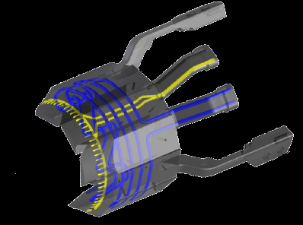
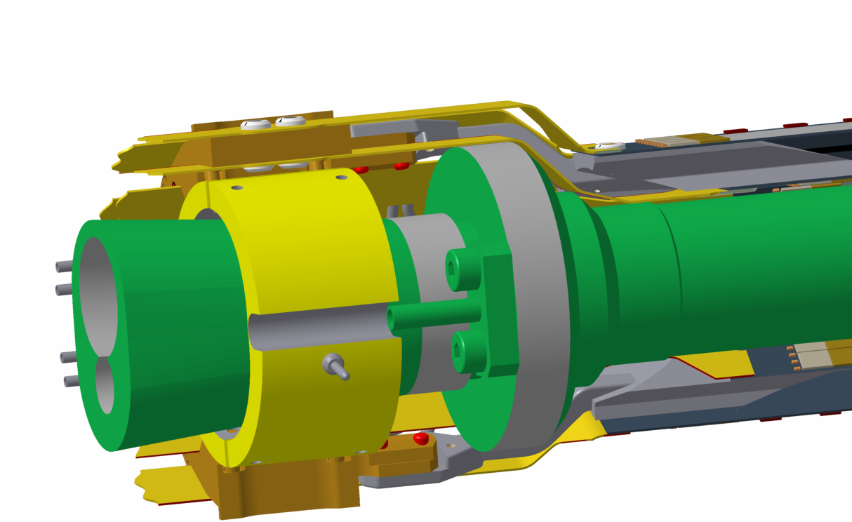
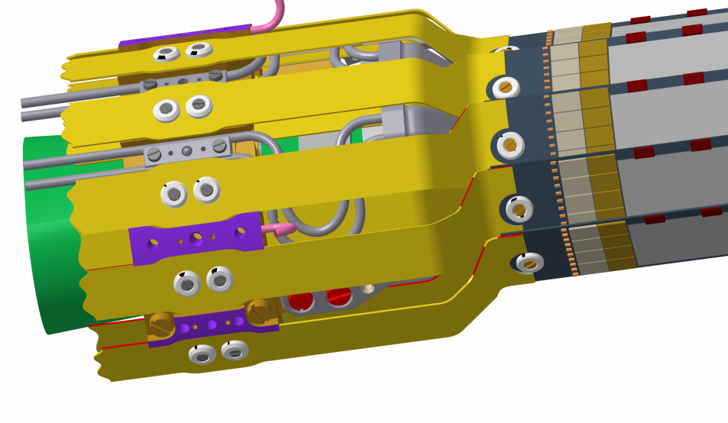
PXD Cooling Strategy
,
Cooling block screwed to ring, attached to the beam pipe
CO2 inlet
Air inlet
Cooling block
DEPFET PIXEL
Notes:
Foto PXD especifica
Cooling PXD (Co2 cooling, beampipe, blowing air)
Support on beampipe
Air cooling
Para el SVd lo mismo.
In consequience thermal gradients, vibrations…..

Slide 17
FBG Real time monitor for Belle II VXD
,
Relative PXD-SVD radial positioning.
  Using displacement FOS-based custom made transducers ( Omega and L-shape)
  Radial compressions and expansions (PXD and SVD are mechanically independent) are a mode to which track-based alignment has a poor sensitivity.
Environmental and deformation measurement inside the PXD-SVD thermal envelope
  PXD & SVD cooled with CO2 and forced air; inside the thermal envelop we will have a dry atmosphere ( Dry air or Nitrogen).
  Distributed FBG network for temperature and humidity monitoring.
  Some FBG sensors to measure cooling-blocks relative displacements
Notes:
L shape, combinable con la anterior. Solo L-shape
Relative PXD-SVD radial positioning. Using displacement – strain transducers ( Omega and L-shape) we will be able to measure online, radial relative displacements between PXD and SVD. This is a degree of freedom of the detector (PXD and SVD are mechanically independent) to which software alignment is blind
Environmental measurement inside PXD-SVD volume. The PXD-SVD will be inside a thermal envelop. PXD will be cooled with CO2, and forced air convection ,and SVD will also need forced air convection. In the thermal envelop we will have a dry atmosphere ( Dry air or Nitrogen). Having a distributed FBG system for temperature and humidity monitoring, will allow us to know what is happening inside the thermal envelop at every moment, and fast detection of possible cooling problems or leakage of the cooling system.

Slide 18
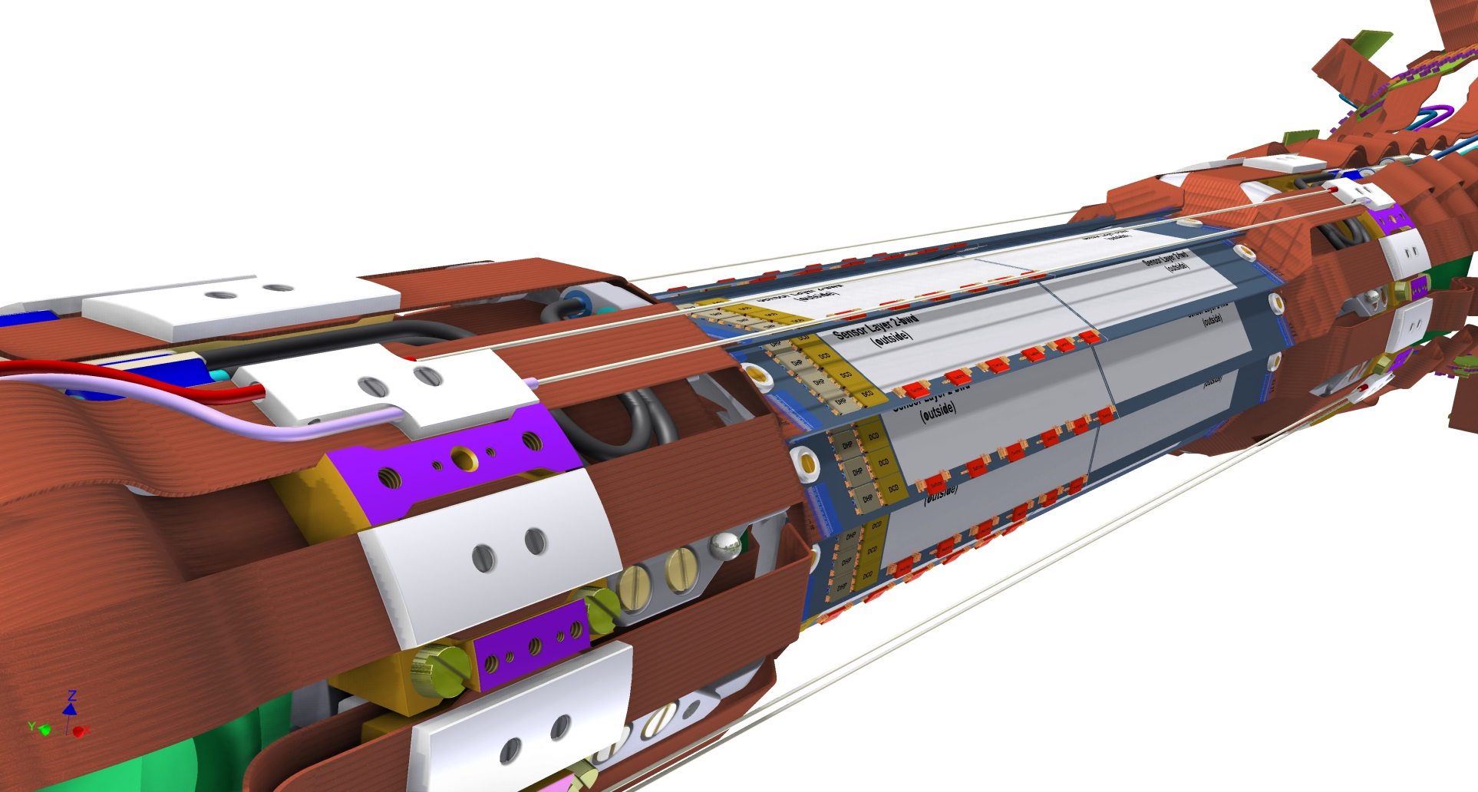
FBG sensors integration in Belle II Vertex detector for environmental monitoring.
,
FBG sensors for Temperature , humidity, vibrations and displacement monitoring
Fiber optic guide and locking ( for displacement, vibrations measurement)
Outer PXD layer (122 mm DEPFET)
Notes:
L shape, combinable con la anterior. Solo L-shape
Relative PXD-SVD radial positioning. Using displacement – strain transducers ( Omega and L-shape) we will be able to measure online, radial relative displacements between PXD and SVD. This is a degree of freedom of the detector (PXD and SVD are mechanically independent) to which software alignment is blind
Environmental measurement inside PXD-SVD volume. The PXD-SVD will be inside a thermal envelop. PXD will be cooled with CO2, and forced air convection ,and SVD will also need forced air convection. In the thermal envelop we will have a dry atmosphere ( Dry air or Nitrogen). Having a distributed FBG system for temperature and humidity monitoring, will allow us to know what is happening inside the thermal envelop at every moment, and fast detection of possible cooling problems or leakage of the cooling system.

Slide 19
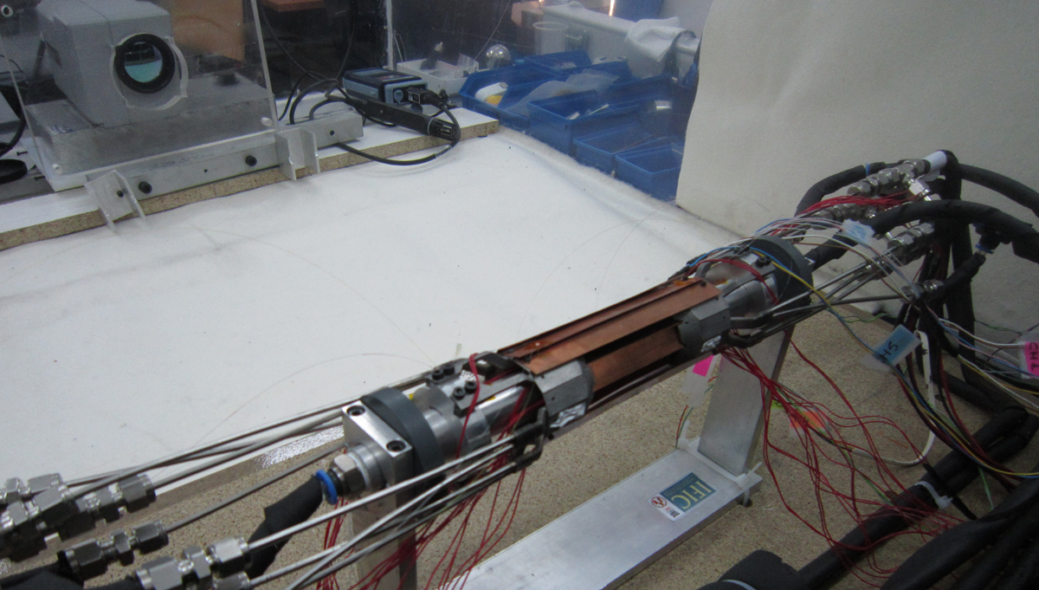
Measurements at IFIC Depfet thermo-mechanical Mock-up
,
Aim:
  Address the utility of FBG sensors for temperature and humidity measurements.
  Study the cooling system in a realistic Depfet mock-up
The whole mock up Is inside a methacrylate box whichs allows contlol of the “environment inside
Humidity low and fixed to avoid condensation
Notes:
L shape, combinable con la anterior. Solo L-shape
Relative PXD-SVD radial positioning. Using displacement – strain transducers ( Omega and L-shape) we will be able to measure online, radial relative displacements between PXD and SVD. This is a degree of freedom of the detector (PXD and SVD are mechanically independent) to which software alignment is blind
Environmental measurement inside PXD-SVD volume. The PXD-SVD will be inside a thermal envelop. PXD will be cooled with CO2, and forced air convection ,and SVD will also need forced air convection. In the thermal envelop we will have a dry atmosphere ( Dry air or Nitrogen). Having a distributed FBG system for temperature and humidity monitoring, will allow us to know what is happening inside the thermal envelop at every moment, and fast detection of possible cooling problems or leakage of the cooling system.
Fibers were optimal for positioning in inaccessible places for any other sensor ( beam-pipe, between ladders, …)

Slide 20
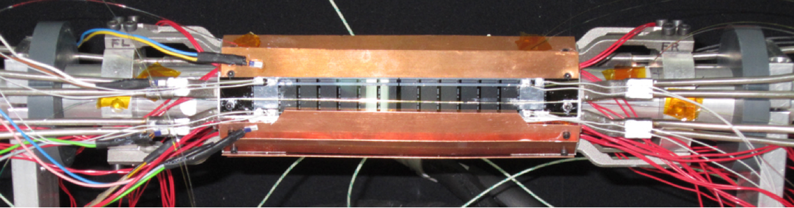
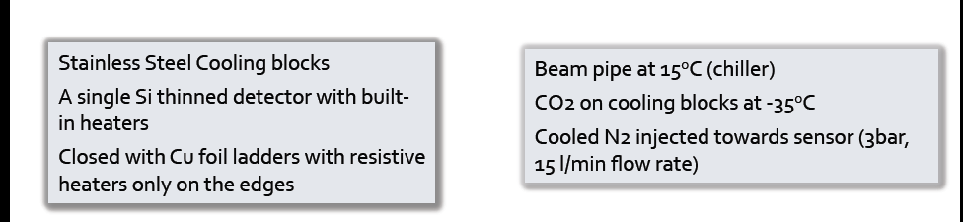
PXD IFIC SET UP
,
Temperature measured with Thermal Camera, FBG ( Temp, humidity) and PT100
Notes:
L shape, combinable con la anterior. Solo L-shape
Relative PXD-SVD radial positioning. Using displacement – strain transducers ( Omega and L-shape) we will be able to measure online, radial relative displacements between PXD and SVD. This is a degree of freedom of the detector (PXD and SVD are mechanically independent) to which software alignment is blind
Environmental measurement inside PXD-SVD volume. The PXD-SVD will be inside a thermal envelop. PXD will be cooled with CO2, and forced air convection ,and SVD will also need forced air convection. In the thermal envelop we will have a dry atmosphere ( Dry air or Nitrogen). Having a distributed FBG system for temperature and humidity monitoring, will allow us to know what is happening inside the thermal envelop at every moment, and fast detection of possible cooling problems or leakage of the cooling system.
Fibers were optimal for positioning in inaccessible places for any other sensor ( beam-pipe, between ladders, …)

Slide 21
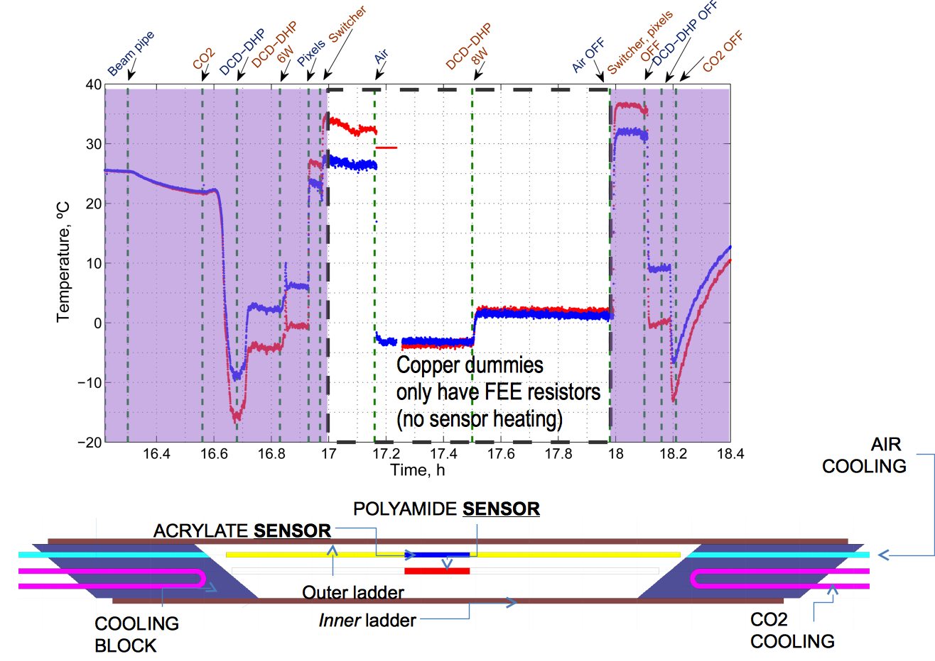
Temperature measurement with FBG sensors
,
Notes:
L shape, combinable con la anterior. Solo L-shape
Relative PXD-SVD radial positioning. Using displacement – strain transducers ( Omega and L-shape) we will be able to measure online, radial relative displacements between PXD and SVD. This is a degree of freedom of the detector (PXD and SVD are mechanically independent) to which software alignment is blind
Environmental measurement inside PXD-SVD volume. The PXD-SVD will be inside a thermal envelop. PXD will be cooled with CO2, and forced air convection ,and SVD will also need forced air convection. In the thermal envelop we will have a dry atmosphere ( Dry air or Nitrogen). Having a distributed FBG system for temperature and humidity monitoring, will allow us to know what is happening inside the thermal envelop at every moment, and fast detection of possible cooling problems or leakage of the cooling system.
Fibers were optimal for positioning in inaccessible places for any other sensor ( beam-pipe, between ladders, …)

Slide 22
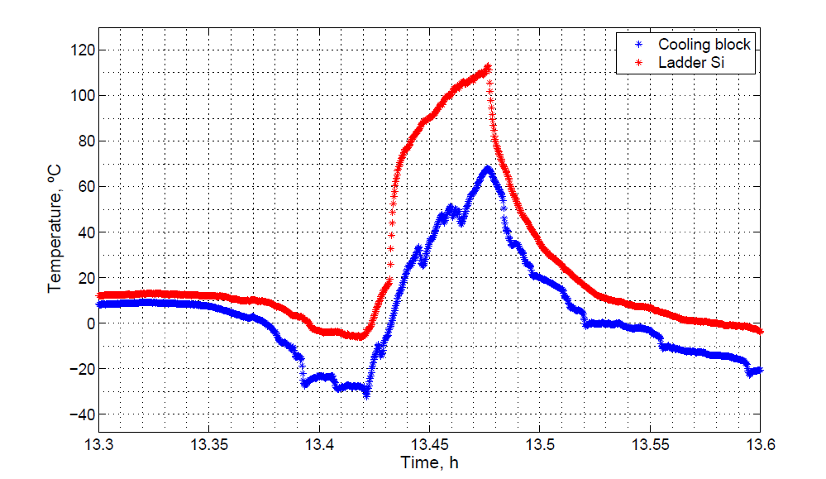
Measurements at thermo-mechanical Set-up
,
Very fast response after a CO2 cooling failure of the mock-up
CO2 system failure
3 min
Notes:
L shape, combinable con la anterior. Solo L-shape
Relative PXD-SVD radial positioning. Using displacement – strain transducers ( Omega and L-shape) we will be able to measure online, radial relative displacements between PXD and SVD. This is a degree of freedom of the detector (PXD and SVD are mechanically independent) to which software alignment is blind
Environmental measurement inside PXD-SVD volume. The PXD-SVD will be inside a thermal envelop. PXD will be cooled with CO2, and forced air convection ,and SVD will also need forced air convection. In the thermal envelop we will have a dry atmosphere ( Dry air or Nitrogen). Having a distributed FBG system for temperature and humidity monitoring, will allow us to know what is happening inside the thermal envelop at every moment, and fast detection of possible cooling problems or leakage of the cooling system.

Slide 23
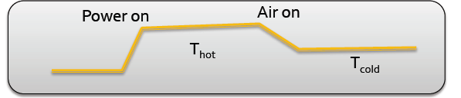
Air cooling at different ambient temperatures
,
FBG to measure sensor and switchers temperature on N₂ atmosphere
  The air cooling was confirmed for sensor temperature and temperature gradient reduction
  Sensors temperature with convective cooling depends on the ambient temperature.
Ambient T ( ±2ºC) | No air cooling T ( ±2 ºC) | Air cooling T ( ±2ºC) | T_{hot}-T_{cool} ( ±3 ºC)
 | Sensor | Sensor | Sensor
25 | 35 | 20 | 15
18 | 28 | 10 | 18
13 | 24 | 7 | 17
Notes:
L shape, combinable con la anterior. Solo L-shape
Relative PXD-SVD radial positioning. Using displacement – strain transducers ( Omega and L-shape) we will be able to measure online, radial relative displacements between PXD and SVD. This is a degree of freedom of the detector (PXD and SVD are mechanically independent) to which software alignment is blind
Environmental measurement inside PXD-SVD volume. The PXD-SVD will be inside a thermal envelop. PXD will be cooled with CO2, and forced air convection ,and SVD will also need forced air convection. In the thermal envelop we will have a dry atmosphere ( Dry air or Nitrogen). Having a distributed FBG system for temperature and humidity monitoring, will allow us to know what is happening inside the thermal envelop at every moment, and fast detection of possible cooling problems or leakage of the cooling system.

Slide 24
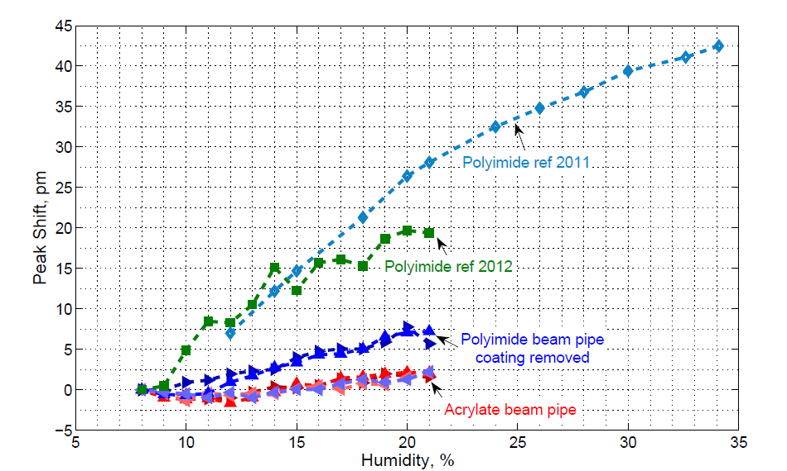
FBG for humidity measurements
,
Some humidity measurements done at IFIC thermo-mechanical Set-up.
Another particle physics group working on this.(G. Berruti et al “Radiation Hard Humidity Sensors for High Energy Physics Applications using Polyimide-coated Fiber Bragg Gratings Sensors” Sensors, 2011 IEEE pages1484 – 1487)
The possibility of use FBGs as Humidity sensors under study
By now only as on/off sensor
Notes:
L shape, combinable con la anterior. Solo L-shape
Relative PXD-SVD radial positioning. Using displacement – strain transducers ( Omega and L-shape) we will be able to measure online, radial relative displacements between PXD and SVD. This is a degree of freedom of the detector (PXD and SVD are mechanically independent) to which software alignment is blind
Environmental measurement inside PXD-SVD volume. The PXD-SVD will be inside a thermal envelop. PXD will be cooled with CO2, and forced air convection ,and SVD will also need forced air convection. In the thermal envelop we will have a dry atmosphere ( Dry air or Nitrogen). Having a distributed FBG system for temperature and humidity monitoring, will allow us to know what is happening inside the thermal envelop at every moment, and fast detection of possible cooling problems or leakage of the cooling system.

Slide 25
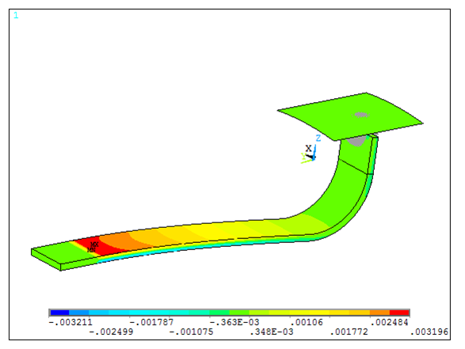
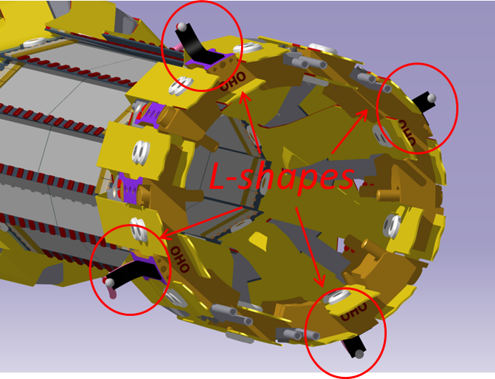
Position transducer: The L-shape
Temperature & strain to displacement transducer with custom geometry for integration in PXD
Readout speed from zero to 1KHz (vibrations)
Currently three demonstrators manufactured
Contact surface
Locked part
FBG sensors
Contact ball

Slide 26
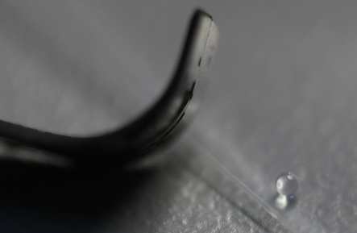
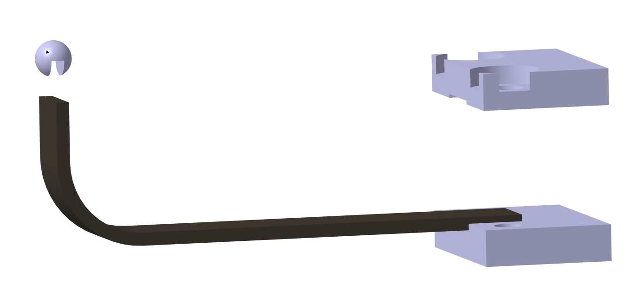
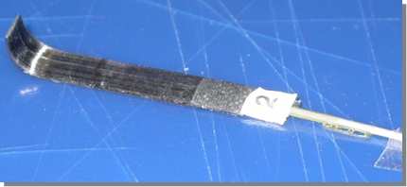
L-Shape Demostrators
One millimiter Diameter Quartz contact ball
Clamping system
ball glued
L-shape tip

Slide 27
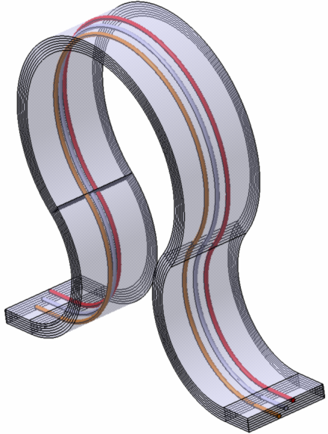
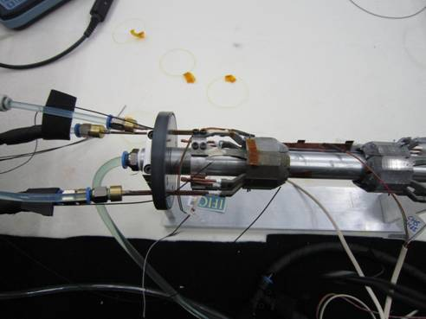
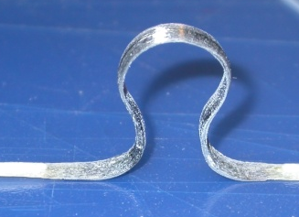
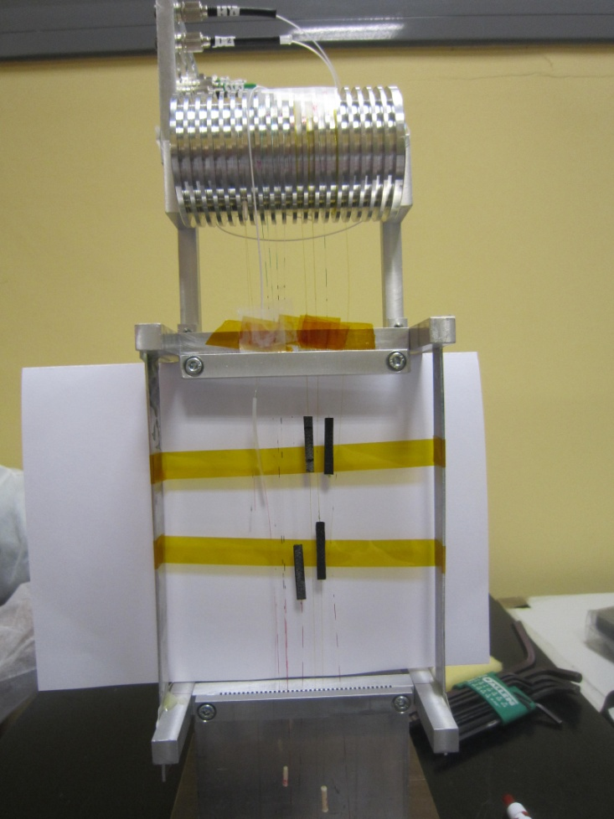
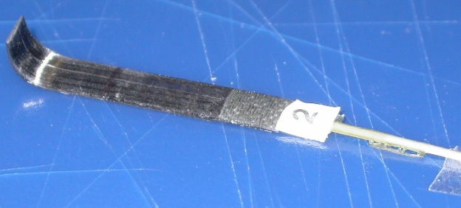
FOS Monitor Timeline
,
2009 Oct FOS Monitor proposal
2010 Jan Omega-shape proposal
2010 Oct. FOS radiation hardness study (1.5 GRads ,3.3 10¹⁵ p/cm2)
2011 January First omega mechanical dummies
2011 Sept. FOS radiation hardness study ( 10 Mrads )
2011 Dec Proof-of-concept-prototype omega
2012 Feb Omega calibration.
2012 March New transducer design L-shape
2012 May Test in depfet mock-up at IFIC
2012 October L –shape calibration
(resolution less 1 um ,accuracy≈10 um )
2013 May Test in mock-up at IFIC (N₂ atmosphere)
2013 June-July Omegas and L-s irradiation ELSA
2014 January commissioning at PXD-SVD common test beam
Notes:
Poner primero el año
Poner omega-shape
Test in first Depfet mock-up
Poner punto de la calibración

Slide 28
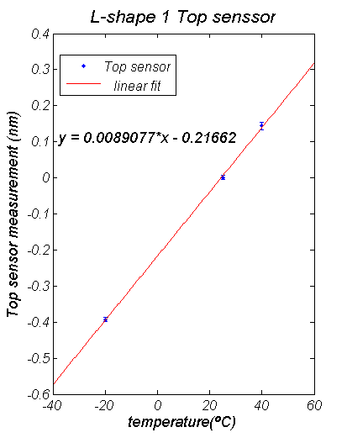
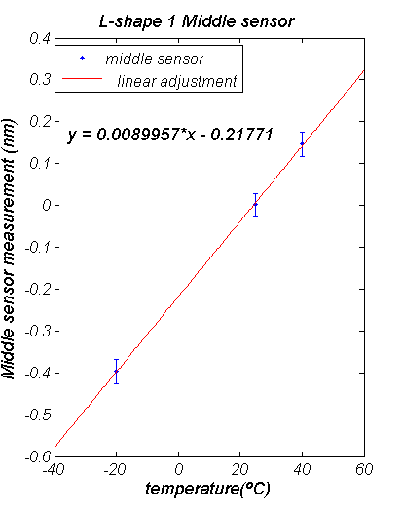
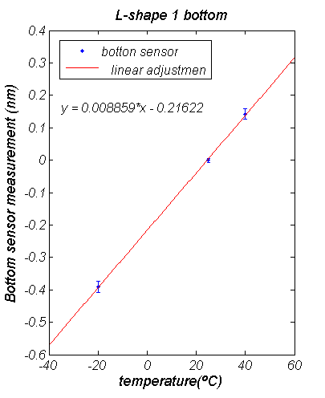
Thermal calibrations & temperature compensation
Calibration using a SIKA thermocouples calibrator.
The sensitivity of three sensors was constant and near the same (difference<0.6%)
Maximum deviation < 3 pm (0.3 ºC)
Error X 10
Error X 10
Error X 10
Trivial approach to temperature compensation

Slide 29
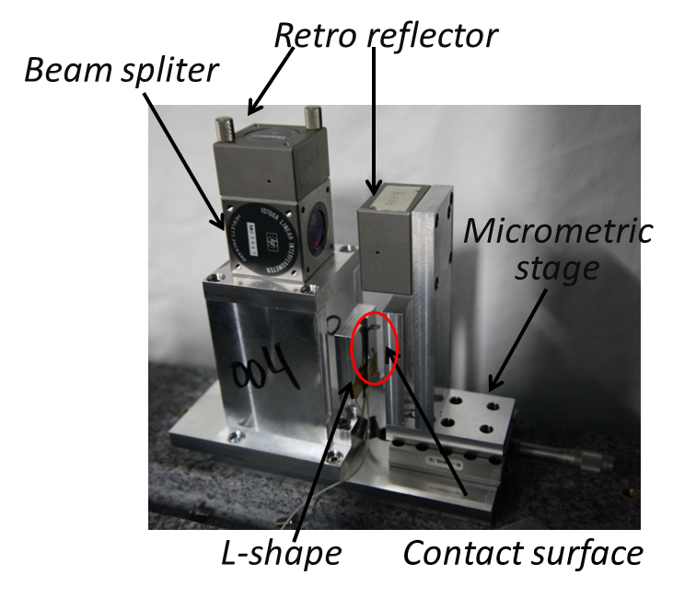
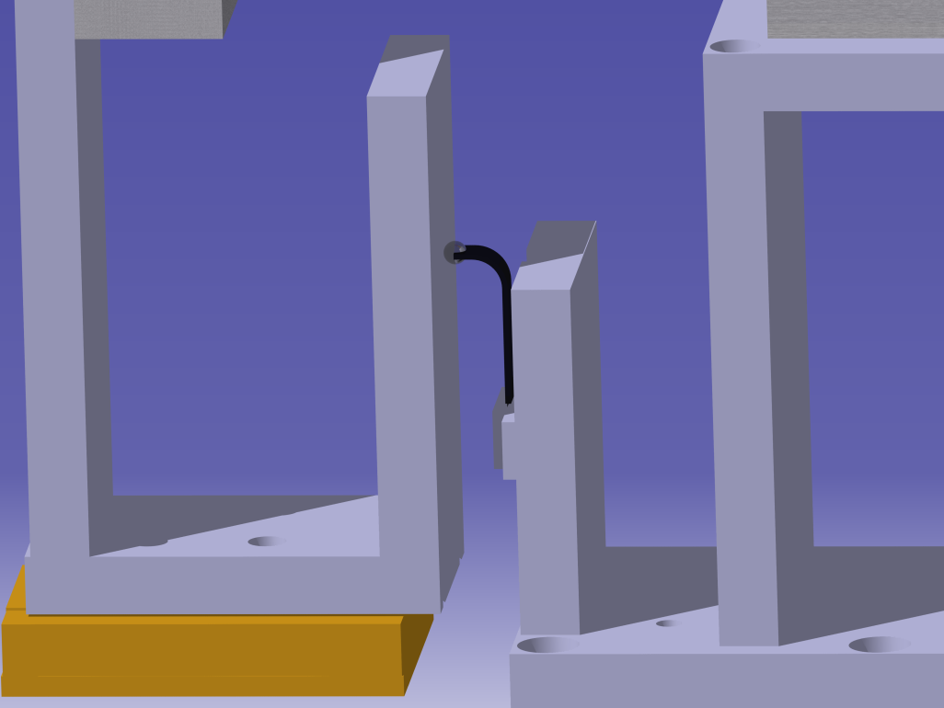
Displacement Calibration
Displacement measured with Michelson interferometer for high precision calibration (tenth of a micron)
Readout of L-shape compared with true position (interferometer)
Contact ball
Micrometric stage
Contact
surface
L-shape

Slide 30
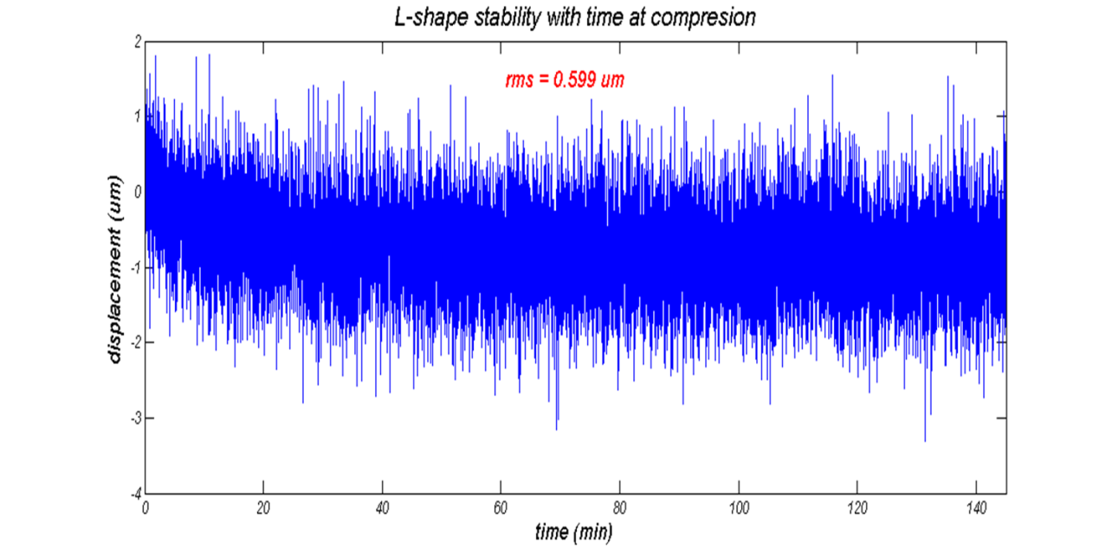
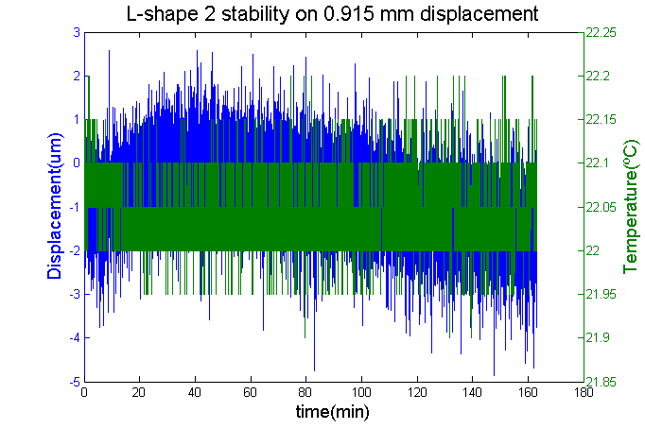
L-shape Output Stability
Short term studies (temperature constant ± 0.1° )
Continuous readout of the sensor output.
Stabilities below or about 1um (convolution with mechanics stability)
RMS ≈ 1.1 um
RMS ≈ 0.6 um

Slide 31
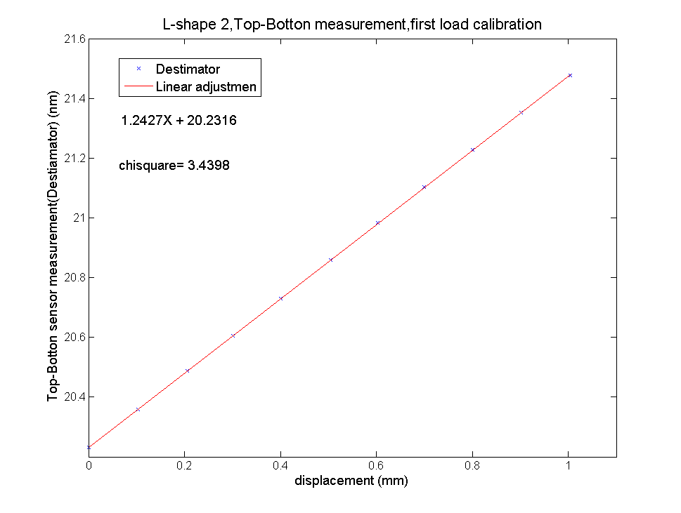
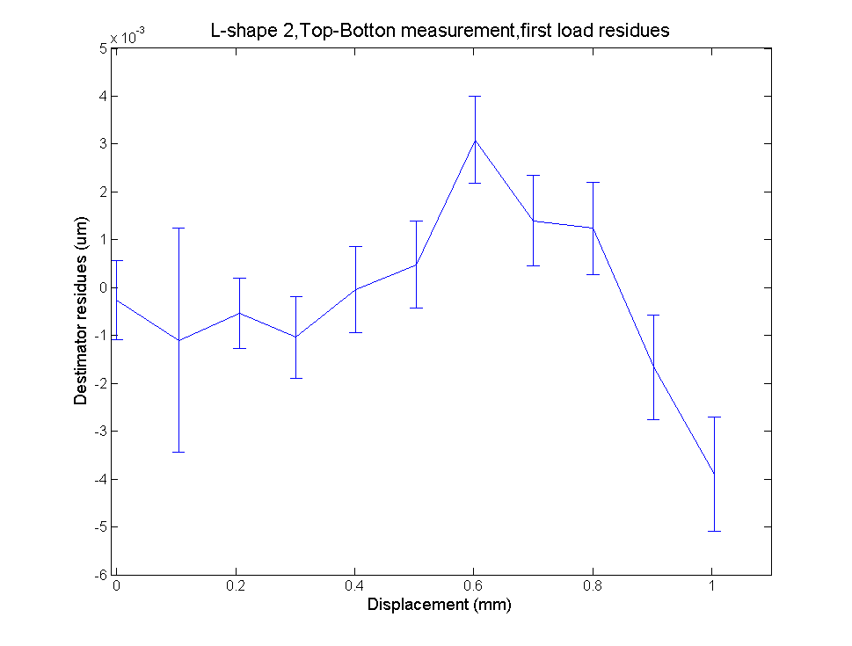
L-shape Linearity vs. Displacement
Calibration over a range of 1mm
Resolution (readout resolution) 0.5 um.
Accuracy (diff. Between inter & L-shape) ≈ 2 um
Sensitivity 1.2 pm/um
Difference load-unload cycle 2 %

Slide 32
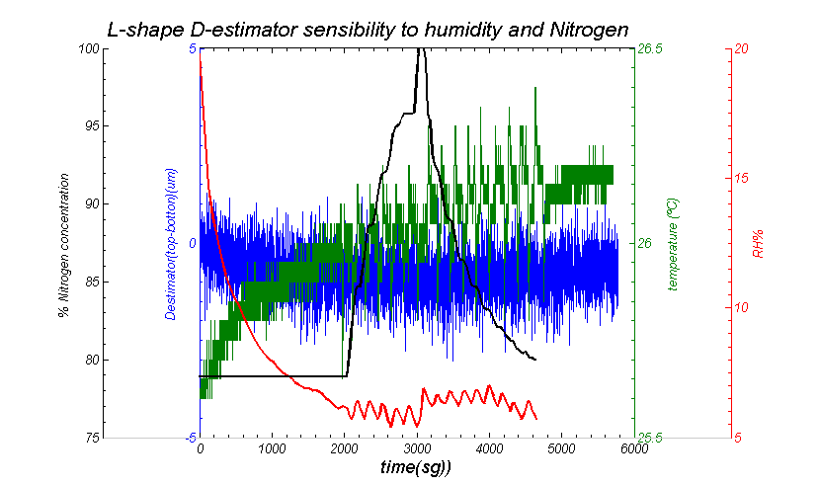
L-Shape sensitivity to enviromental conditions: HR%, T, N₂
No sensitivity to environmental conditions

Slide 33
Summary & Outlook
,
FBG sensors a very attractive monitoring technology for particle physics: radiation resistance, electromagnetic immunity, small footprint and embedding in CFRP
Case of use: FOS monitor for Belle II vertex detector
  Environmental (temperature, humidity) and structural (vibrations, deformations and displacement) monitoring system
  Miniature, application specific displacement transducer ( L-shape ) developed for PXD-SVD relative displacement monitoring in real time.
Started the study of FBGs for humidity sensing.

Slide 34
BACK - UP

Slide 35
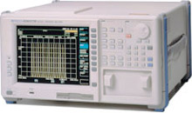
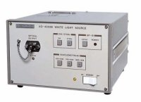
_Basic Interrogating Unit
The number of different Braggs is more than 100; moreover by using an optical switching we can use tens of sensing fiber
Optical Spectrum Analyzer
Large Bandwidth
Light source
1x2 coupler
λ_{B1}
λ_{Bn}
λ_{B2}
λ_{B3}

Slide 36
_ Monitoring requirements for Si-Trackers
Current and future silicon systems need for:
  Real-time monitoring of environment variables: temperature, humidity, CO₂, magnetic field, etc.
  Real time structural monitoring: deformations, vibrations (push & pull operation), movements.
Conventional monitoring technologies based on electric relatively bulky transducers with low multiplexing capability, low granularity, and cooper readout and powering lines (conductive EM noise propagation lines).

Slide 37
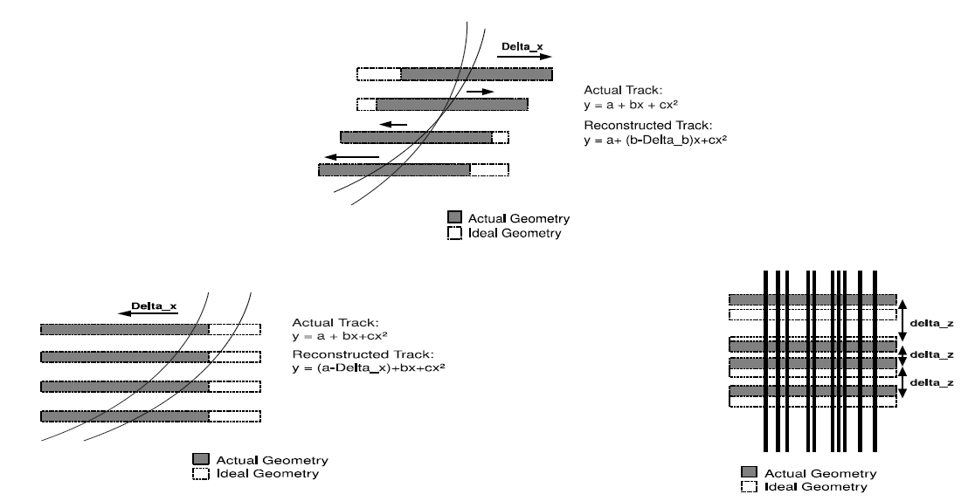
_Monitoring requirements: Weak Modes
First lesson from LHC detectors: position and deformation monitors must cover the weak modes of software (track-based) alignment algorithms.

Slide 38
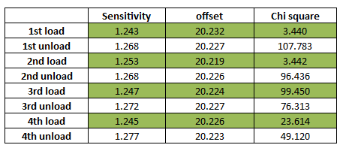
L-shape Linearity (2)
L-shape sensibility presents a small dependence depending of the direction of movement (L-shape specific effect due to its shape)
Sensitivity reproducibility
0.4 %
Difference load-unload cycle
2 %

Slide 39
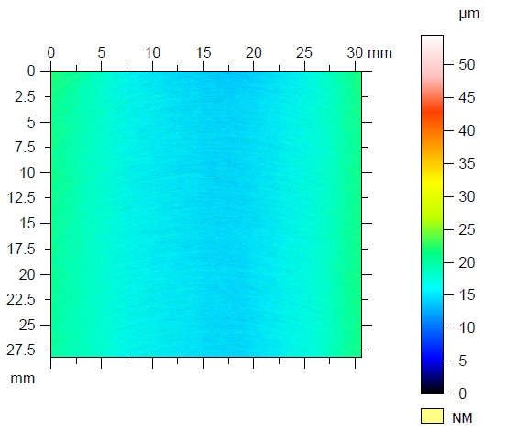
L-Shape Linearity (3)
Investigate the effect of the roughness of the contact surface on the asymmetric load-unload behavior.
POLISHING
OF CONTACT SURFACE
Still sensitivity asymmetry 2 %
More studies in progress
(harder materials than Al)
Still sensitivity asymmetry 2 %
More studies in progress
(harder materials than Al)

