Slide 1
Material Studies for HL-LHC Strip Stave Design
Richard Bates & Tim Jones
Forum on Tracking Detector Mechanics
Oxford, 2013

Slide 2
Contents
ATLAS HL-LHC stave design challenges
ATLAS HL-LHC Strip Tracker “stave” design
Measurements of Thermal Properties
Measurements of Mechanical Properties

Slide 3
ATLAS HL-LHC stave design challenges
What is a ‘Stave’ ?
  Low mass ‘local support’ upon which 26 single-sided modules are mounted
    Mechanical support
    Cooling
Desirable Attributes
  Mechanically stiff and stable - Low thermo-mechanical distortions
    Maintain position of modules over ‘short term’ for track-based alignment algorithms
    Stave will undergo ΔT = 50-60ºC
  Thermally conductive
    Power from modules = 5.6W/module hybrids + 1W from sensor
    CO₂ cooling embedded at the center of the structure
  Low mass - Minimize material in tracker volume
    Single sided silicon module Material = 0.6%X0 (130nm prediction)
    Aim to keep support material less than modules, Present Material = 0.9%X0 (inc tapes)
  Radiation hard
    Inner Barrel layer will experience 30 Mrad and 5x10¹⁴ 1MeVn_{equ}cm⁻² and 8x10¹⁴ 1MeVn_{equ}cm⁻² for the Petals (no safety factors)
  Low cost to build and assemble

Slide 4
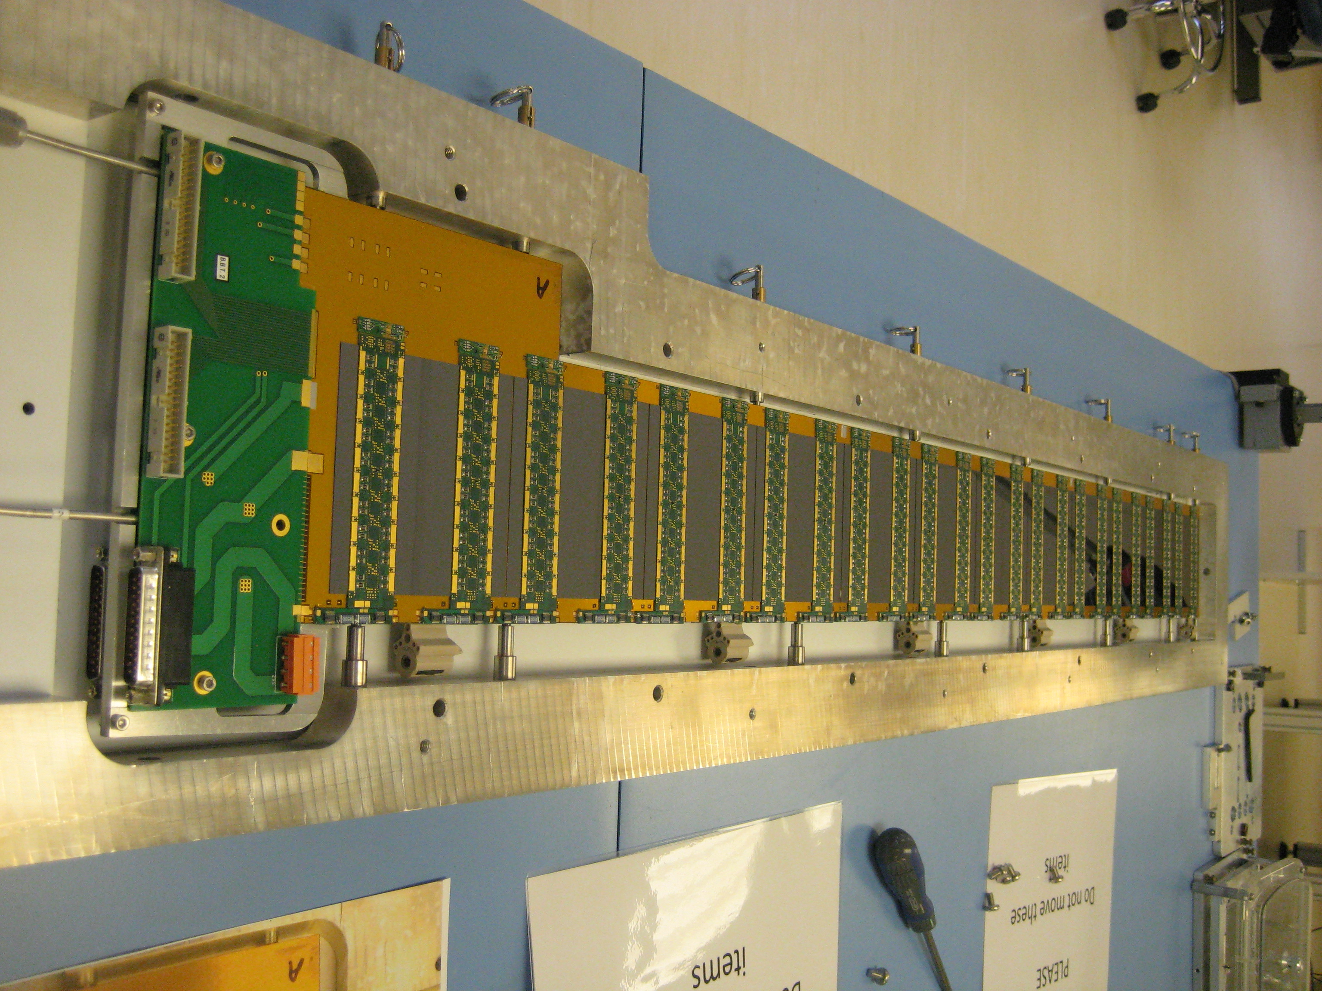
ATLAS HL-LHC Strip Tracker “stave” design
Stave core
  CFRP/low density core sandwich construction
  Embedded cooling tubes surrounded by thermally conducting low density carbon foam provide cooling for modules
  Facing sheet is CFRP with 2-3 layers of very high modules carbon fiber
    Good thermal conductivity and high tensile modulus for stiffness
  Carbon-fibre Honeycomb
    UCF- UCF-126-3/8-2.0
Side mounting brackets
  Designed to be end insertable into final structure
Electrical bus tape
  Copper & Aluminium on Kapton laminated flex bus tape
  Co-cured onto top face of CFRP facing sheet
Modules
  10 x 10 cm silicon sensors with hybrids glued to top surface
  Module glued directly to stave
  Utilizes large thermal contact area
Notes:
You might not need this slide if you just talk to the previous.

Slide 5
Key materials in the design
Ultra-high modulus CFRP
Highest stiffness to material budget
Low density carbon foams
Highest thermal conductivity to material budget
Adhesives
Hold it all together!
CF Honeycomb
To maintain facesheet flatness (module attachment) and separation (beam stiffness)

Slide 6
Motivation for measurements
Design
Understanding the components that make up the stave allows for accurate simulations of the thermo-mechanical performance.
Manufacture
Understanding assembly issues allows for a more robust item to be produced with good yield.
Best performance per %X0 and CHF.

Slide 7
Measurements of Thermal Properties
Methods & Apparatus
  Conductivity (low to high)
  Sample geometry / conductivity direction
  Comparative methods (eg. pre- / post- irradiation)
Thermal conductivity of components
  CFRP
  Foam
  Adhesives
    Pre and post irradiation
Hysol/BN Coefficient of thermal expansion

Slide 8
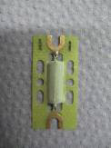
Thermal Conductivity Measurement Apparatus
Measurements of Thermal Properties
Steady State
Transient
Force
Line source thermal conductivity probe method
  ‘Infinite’ long wire to heat sample surrounding wire
  Measure sample temperature
  (R change of heating wire)
Load Cell
Perspex Rod
Heater
Upper Cu bar
T₁
T’₁
X₁
Sample
T’₂
X₂
T₂
Lower Cu bar
TIM tower
Cooling block
Notes:
Through plane is a simple steady state measurement. Two copper rods with a cross-section of 1cm2. Apply heat to top of the upper part with an electrical heater. Hold the bottom end of the lower part at a lower temperature with a water cooled heat sink. Set-up the system so the sample is close to room temperature. Place a thin sample between the two copper rods with thermal grease between them. Apply pressure with a screw to close the sample together and measure the force with a load cell. Measure the temperature at a know point above and below the sample with RTDs. Calculate heat loss along heater wires, radiation from copper bars (both small). Calculate predicted face temperatures from measured conductivity of copper bars and measured temperatures. Measured DT over sample to find thermal conductivity. Alternatively use IR camera to measure temperature gradient over the sample.
Second method is to use a transient measurement. This is faster but has approximations that leads to some reduced accuracy.

Slide 9
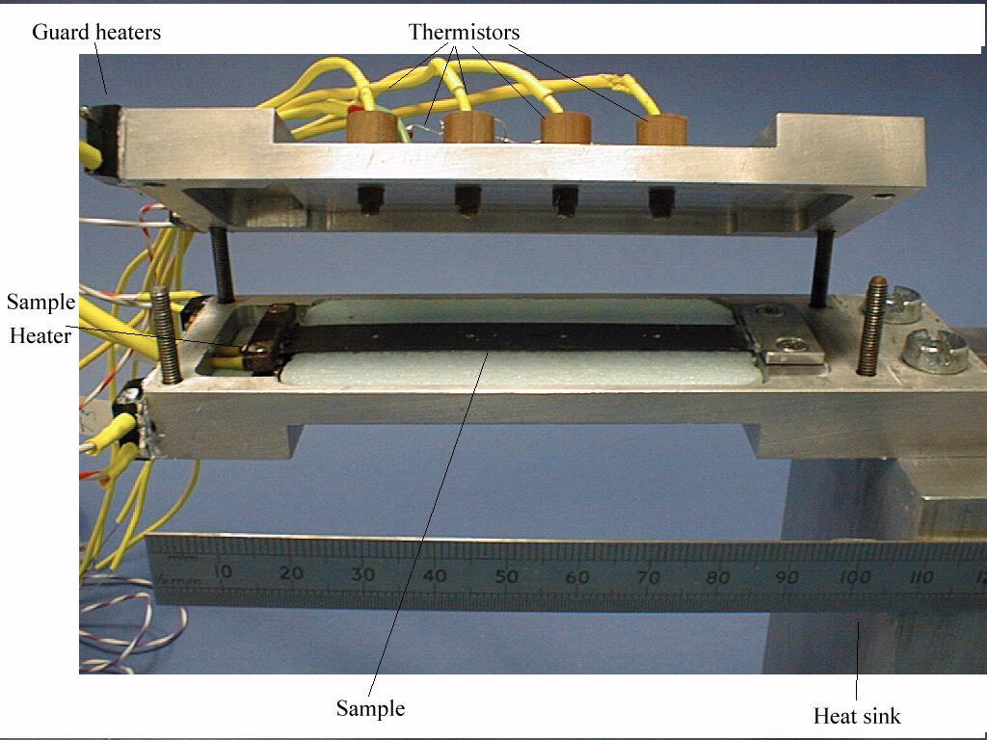
In plane thermal conductivity
Measurements of Thermal Properties
Apparatus
Double-flux measurements
Heat sink
x
P
P=0
l
Heat
T₀
T
ΔT₁
ΔT₂
Guard very important to avoid radiation effects
Make a measurement at zero intentional power to correct for parasitic heat flux
Notes:
Thin long samples not at room temperature are significantly affected by radiation and convection effects.
Apparatus to minimize this requires a vacuum chamber to remove convection effects. A heated radiation shield that is maintained at the same temperature as the sample to reduce the effects of radiation. The heat into the system through the wires to the temperature sensors, via thermal conduction along the wires, was minimized by anchoring the wires thermally to the heat sink coupled with the use of long thin wires.
The double flux measurement is used to correct for any parasitic heat flux in the system not eliminated by the above. Measure the temperature profile along the sample for zero intentional heat at the desired measurement temperature. Then apply desired heat load and adjust heat sink temperature such that the central temperature of the sample is the same as before. K is given as on slide.

Slide 10
Predicted & measured conductivities
Measurements of Thermal Properties
 | K13D2U 0-90-0 100 gsm | K13C2U 0-90-0 100 gsm | K13C2U 0-90-0 45 gsm
Thickness (μm) | 230 | 254 | 172-150
0 – Predicted (rule of mixtures) | 318 | 229 (216 - 247) | 170-180
0 - measured | 280 ± 10 & 294 ± 20 | 297 & 273 | 189
90 – predicted (rule of mixtures) | 159 | 114 (108 – 123) | 74
90 - measured | 144 ± 20 | No data | No data
Through thickness | 1.20 & 0.96 | 1.3 & 1.1 | 1.3
Notes:
There is an issue with the low conductivity measurements that needs to be resolved.
We are almost about to predicted the thermal conductivity measurements of the face-sheets from the data on the carbon fibres

Slide 11
Thermal conductivity of low density carbon foams
Measurements of Thermal Properties
POCOFoam
Allcomp Foam
Measured densities of 0.56 & 0.41 g/cm³
Non-isotropic conductivity
  Higher conductivity in the growth direction, as expected
130 pores per inch material
  Each pore is roughly 200um
  1 mm of material has 5 cells
Measured densities of 0.22 & 0.36 g/cm³
Material has Isotropic conductivity
Conductivity rises with reducing temperature
  9% higher at -30C than at 20C
Allcomp Foam has higher thermal conductivity per unit mass that PocoFoam

Slide 12
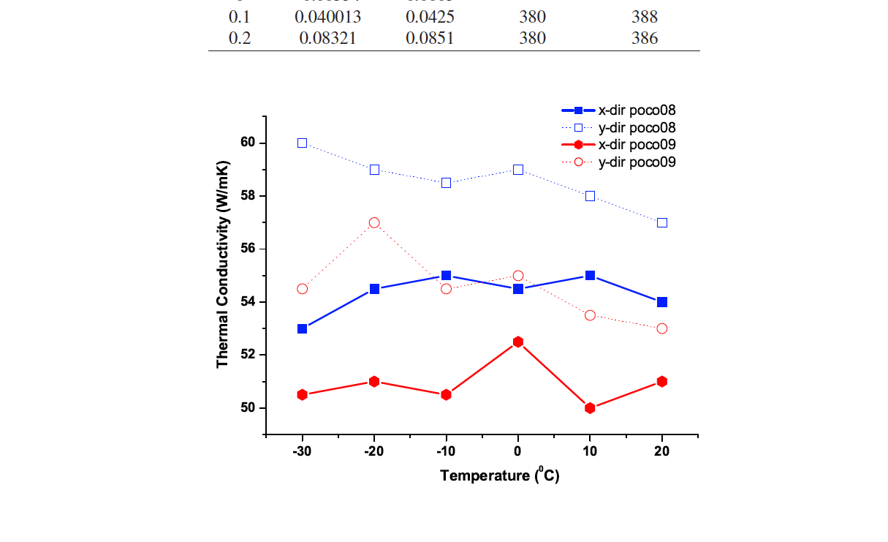
PocoFoam
Measurements of Thermal Properties
In-plane thermal conductivity measurements
Name | Density (g/cm³) | Kx @20C (W/mK) | Ky @20C (W/mK) | Kz @20C (W/mK) “TIM tower”
Poco08 | 0.56 | 54.5 | 57.5 | 135
Poco09 | 0.41 | 51 | 53.5 | 55
Notes:
Results to go with previous slide. Non-isotropic thermal conductivity measured.

Slide 13
Allcomp thermal conductivity
Measurements of Thermal Properties
Measured 10 x 10 x 30 mm samples in all 3 directions close to RT with TIM tower
Measured thin (2.5mm thick) samples with in-plane apparatus over range of temperatures for two directions:
ρ=0.22g/cm³: x= 34W/mK, y=38W/mK, z=34W/mK
ρ=0.36g/cm³: x= 74W/mK, y=62W/mK, z=64W/mK
ρ=0.36g/cm³
Reasonably isotropic (in-plane Kx, Ky difference unexpected)
Scales with density as desired
15% difference between the two techniques – be careful about getting a significant number of cells in a sample – in-plane measurements only 12 cells!
Notes:
It must be noted that the in-plane measurements have a thin section which limits the number of cells that take part in the measurement. The thinner samples (1mm) gave very inconsistent results. The thicker ones (2.5mm and 3.7mm) gave the same results. But these are still different from the TIM tower results with more cuboid samples with 10mm on the smallest side.

Slide 14
Cu-Adhesive-Foam-Adhesive-Cu stack
Measurements of Thermal Properties
IR temperature measurement over foam and glue layers
Interface resistance
IR image to extract glue layer resistance
Interface resistance = 0 K/W
Copper
Foam
Temperature (C)
Copper
Distance (pixels)
Foam conductivity = 73 W/mK for ρ = 0.36 g/cm³
Notes:
Slope in the IR curve where the adhesive layer is, is mainly due to the resolution of the camera. So you cannot fit a curve to this as the x-value is wrong. You need to know the glue thickness really. If you do that you get the thermal conductivity/thermal resistance.
Nice result for the zero interface resistance of the foam to the glue. This is due to the highly conductive carbon ligaments extending into the glue layer.

Slide 15
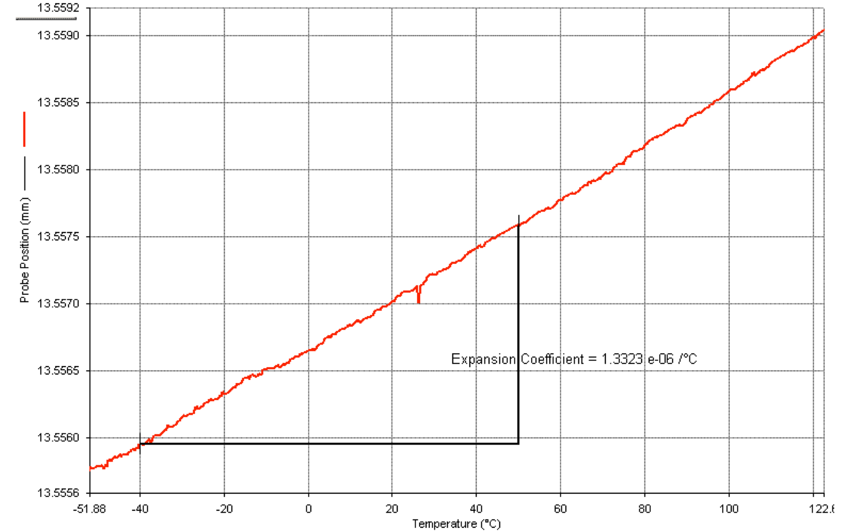
PocoFoam CTE
Measurements of Thermal Properties
Density 0.56 g/cm³
Perkin Elmer thermo-mechanical analyzer (TMA) over temperature range -40C to +50C
CTE measured to be 1.27 ppm/K
Notes:
Note sure if you want to keep this one.

Slide 16
Adhesives
Measurements of Thermal Properties
Thermal conductivity
  Before and after irradiation
CTE
Measurement of degree of cure

Slide 17
BN loaded Hysol 9396
Measurements of Thermal Properties
Different preparation techniques did not affect thermal conductivity
Difference observed in BN type. Japanese SCT against Goodfellows.
But Momentive PTX60 (60um particles) was the same as Goodfellows (10um particles)
Momentive : Goodfellows 50:50 mix gave the same result
Filler | Particle size (μm) | K (W/mK)
Goodfellow | 10 max. | 1.4
Momentive (PTX60) | 55 - 65 | 1.42
50/50 | - | 1.38
Notes:
Understanding what glue conductivity we can expect, if we need to perform any special treatment on preparation, and if choice of BN can enchance conductivity,

Slide 18
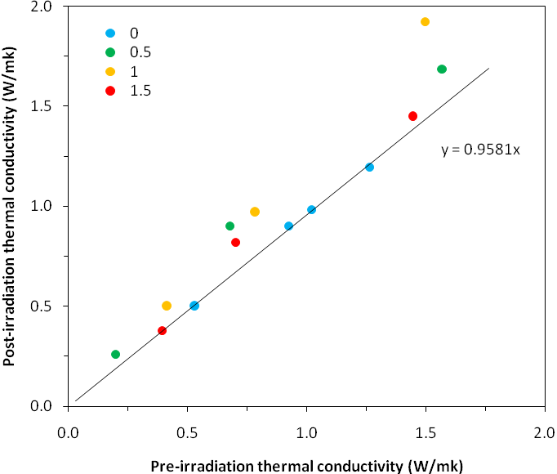
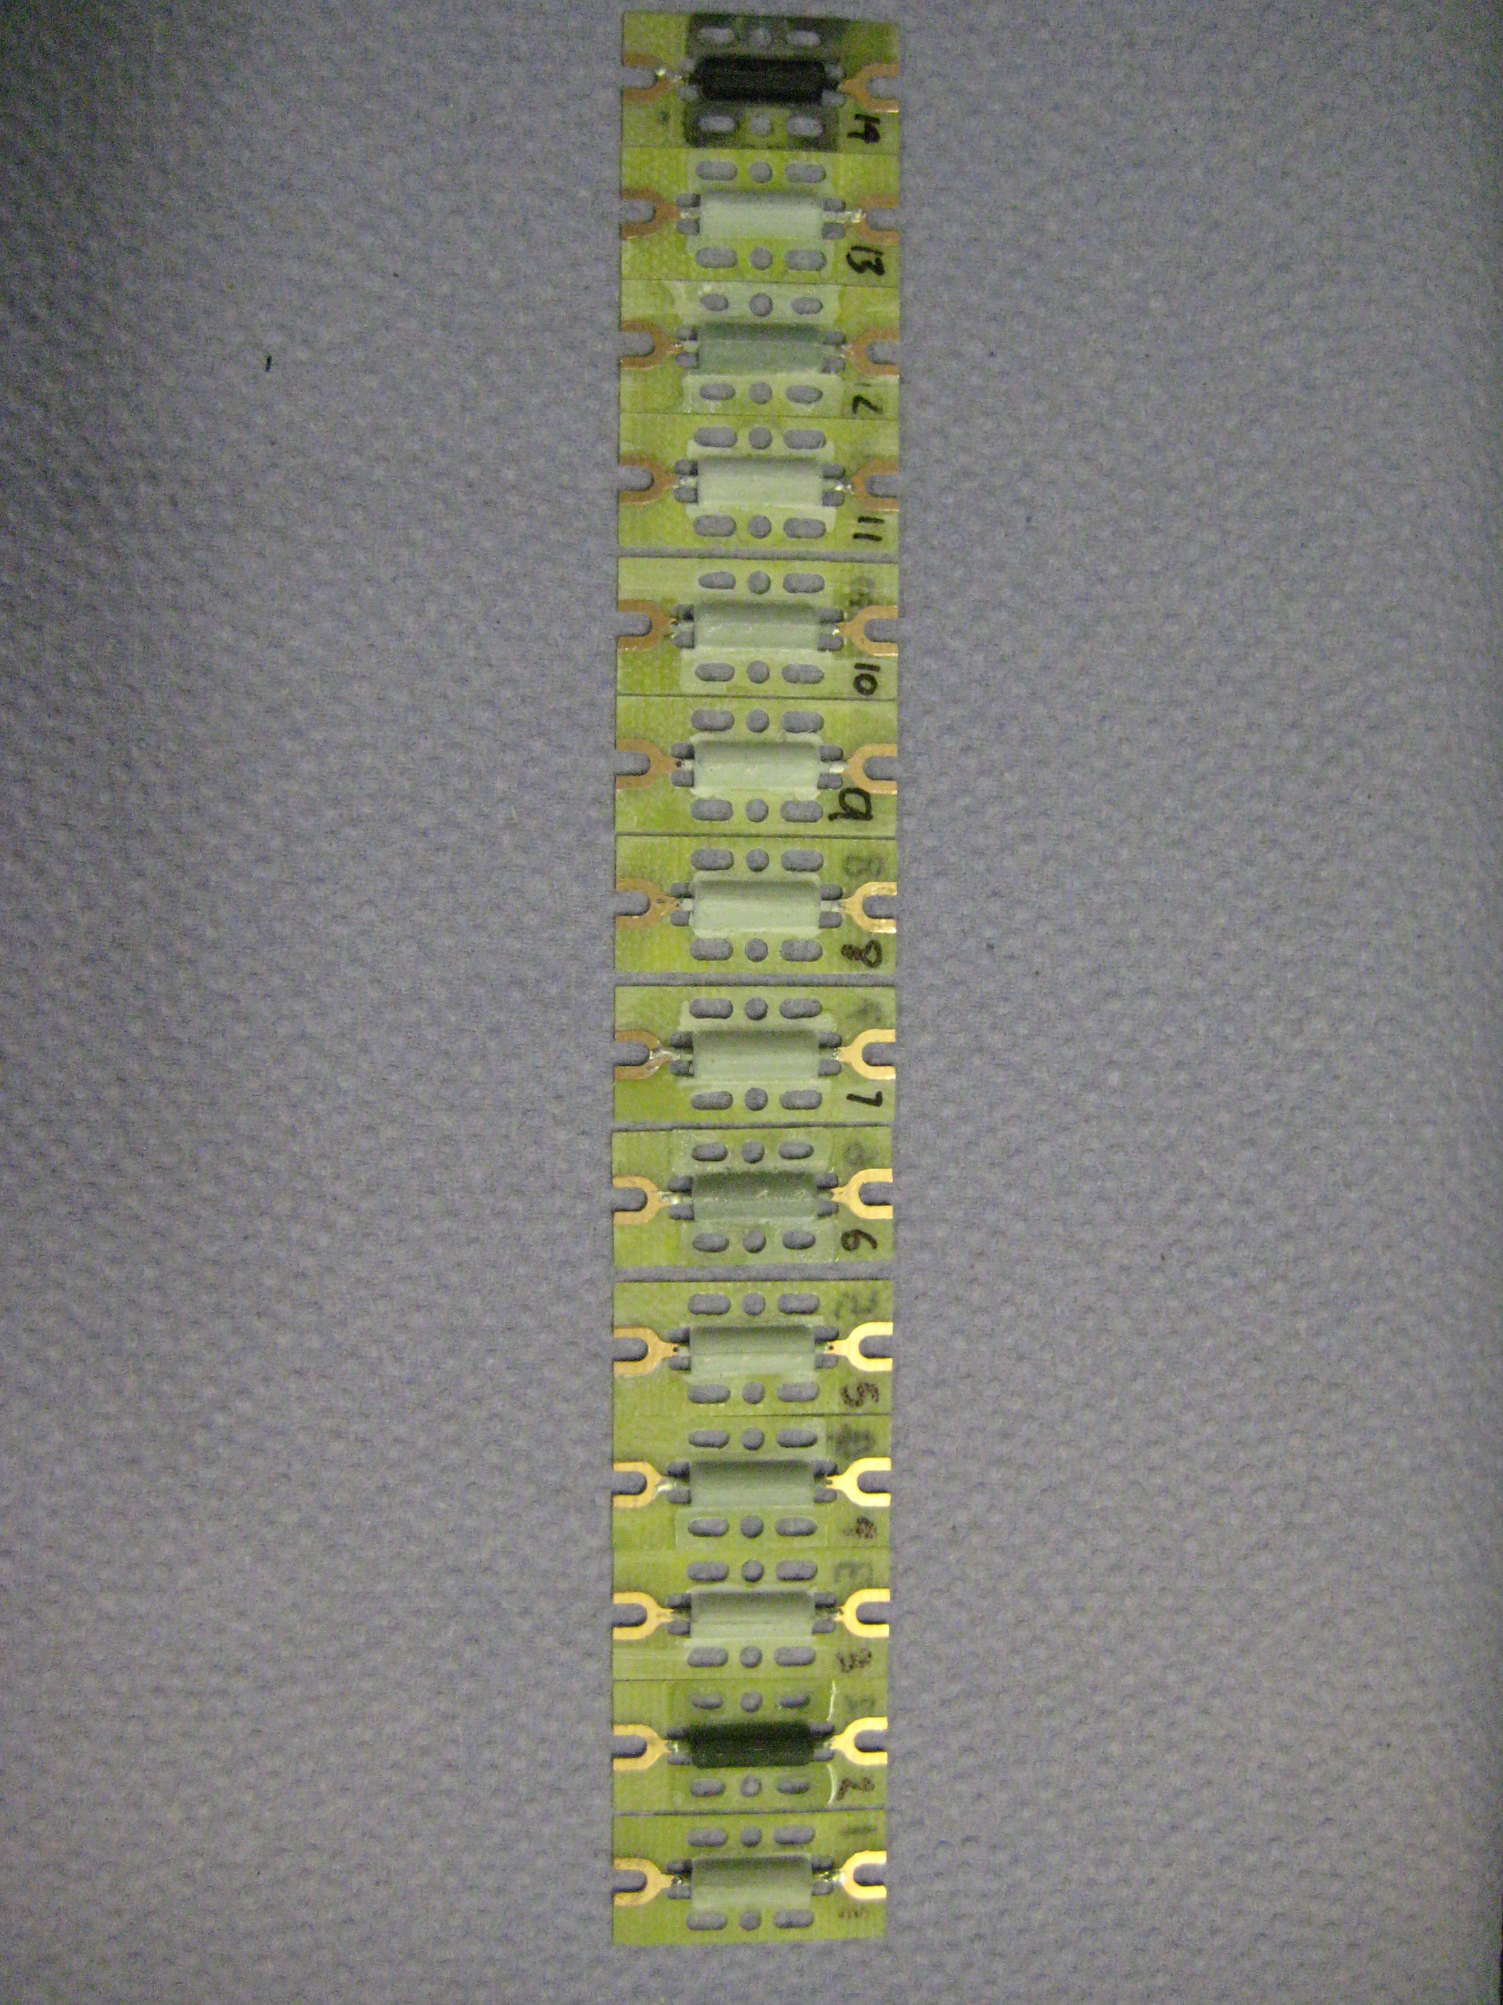
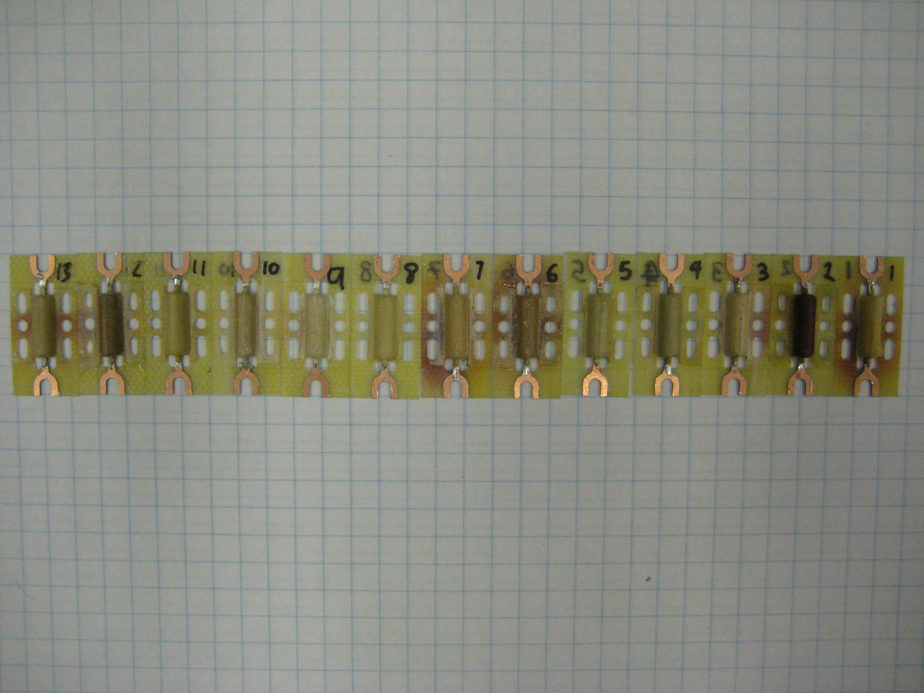
Hysol 9396/BN – after irradiation
Measurements of Thermal Properties
30% BN
29% K increase
13 samples made and 9 irradiated to 3 fluences: 0.5, 1, 1.5 x 10¹⁵ cm⁻² 1MeV n_{eq}
Measurements show increase in conductivity with fluence.
The 0.5 and 1.0 x 10¹⁵ cm⁻² n_{eq} points lie further from the line than 1.5 x 10¹⁵ cm⁻² n_{eq} data suggesting that the thermal conductivity rises and then falls as a function of dose.
Notes:
Does radiation effect the adhesive’s thermal properties

Slide 19
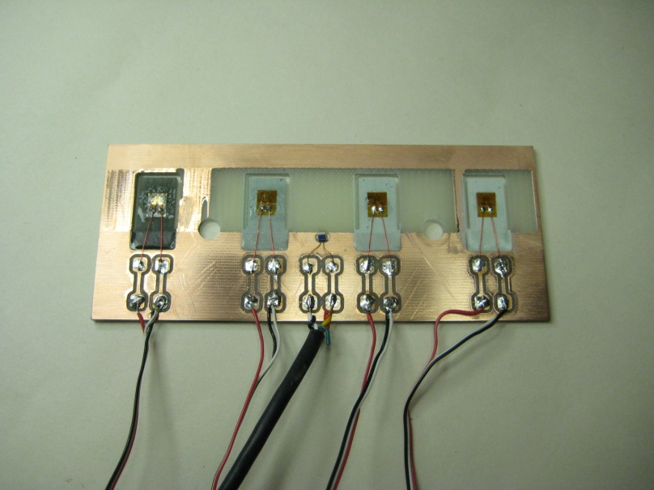
CTE of Hysol/BN
Measurements of Thermal Properties
Test card with 4 samples
  Milled single-sided PCB
  Strain gauges embedded in the middle of glue pad to minimise bending
Samples placed in environmental chamber and measure strain and temperature
% BN | CTE ppm/K 20°C | CTE ppm/K -40°C | -40°C/20°C
0 | 71.8 | 63.1 | 88%
10 | 63.2 | 52.8 | 84%
20 | 50.9 | 39.6 | 78%
30 | 39.1 | 27.1 | 69%
Before embedding strain gauges

Slide 20
Mechanical Measurements
Measurements of Mechanical Properties
Modulus measurements on CFRP low stress and to fracture
Modulus measurements on foams
  Tension, compression and shear
3-point bend tests on face sheet/core/face sheet sandwiches
Fibre Properties
Fibre | Tensile Modulus (GPa) | Tensile Strength (MPa) | Elongation at Failure (%)
K13D2U | 930 | 3690 | 0.4
K13C2U | 903 | 3818 | 2
Notes:
First two sets of measurements are to understand components for the initial simulation of the design. The final set is to allow better design optimisation.

Slide 21
CFRP tensile tests at low strain
Measurements of Mechanical Properties
Difficult measurement - use linear bearing jig
  Removed twist
  Dog-bone sample shape
Technique
  Video Extensometer system to measure strain
  Conventional universal testing machine to apply and measure stress
Essentially looking for low strain non-linearity
Sample | Modulus low strain (GPa) | High strain Modulus (GPa)
0/60/-60 SCT Barrel sample (high strain from SCT build) | 109 | 114
90-0-90 US sample RS-3C/K13C2U FAW=168gsm, 32% resin content | 126 | 125
Notes:
high strain numbers measured during SCT build.
Consistent values between low and high strain modulus values.
Double check to be sure we don’t over/or under design the system using values measured for the incorrect stress.

Slide 22
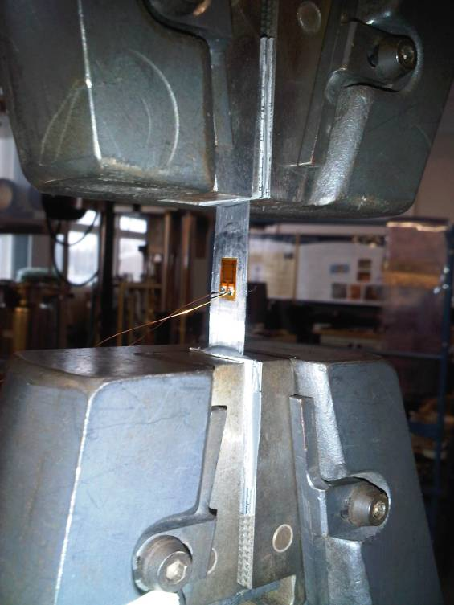
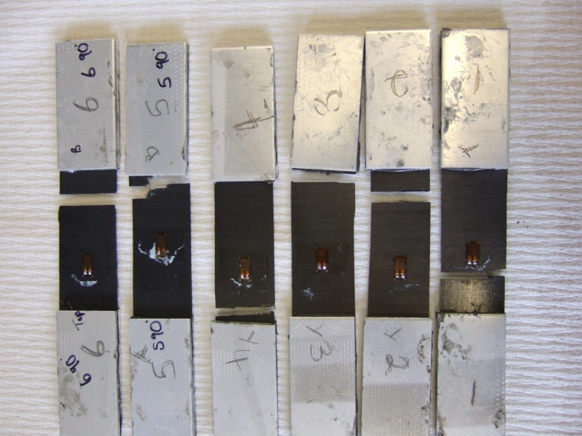
Results – K13D2U
Measurements of Mechanical Properties
Test at 1mm/min displacement
Sample | Modulus (GPa) | Tensile strength (MPa)
0-90-0 | 310 | 946.7
90-0-90 | 163 | 400.7

Slide 23
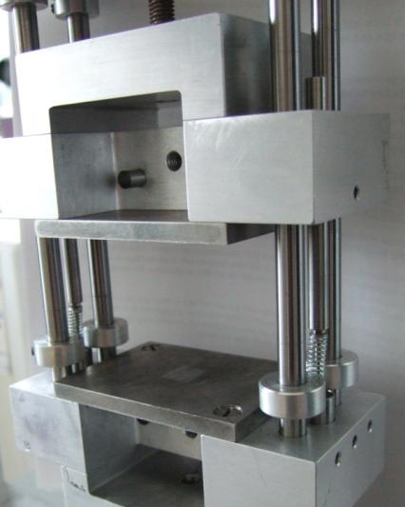
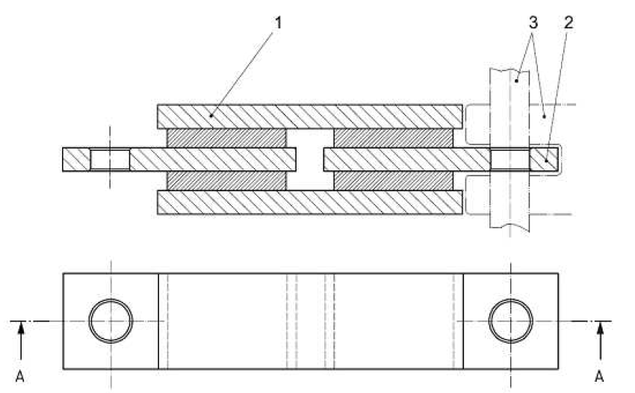
Mechanical measurements on Foams
Measurements of Mechanical Properties
Tension and compression
  Linear bearings jig to remove twist
  Uses dog-bone samples
Shear modules according to BS ISO 1827:2007 for Rubber and thermoplastic
Video Extensometer system to measure strain
Conventional universal testing machine to apply and measure stress

Slide 24
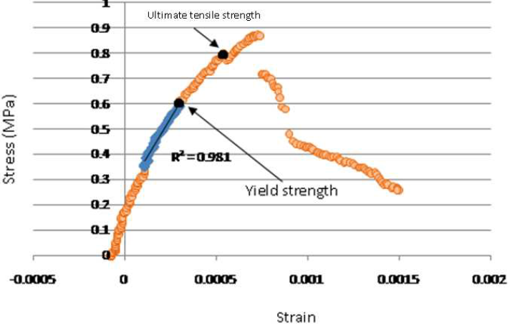
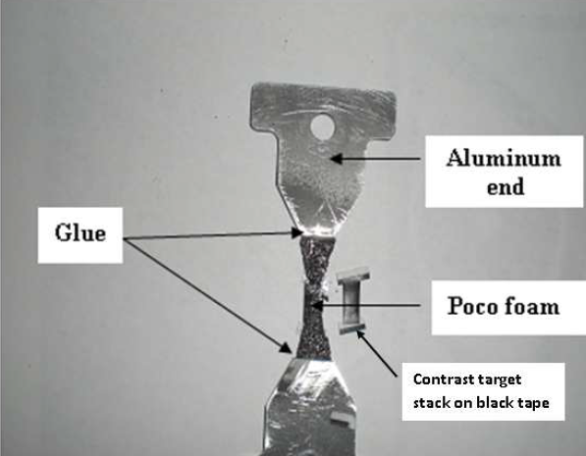
PocoFoam
Measurements of Mechanical Properties
Tension:
  Below 0.3MPa non-repeatable results
  At 0.6MPa plastic deformation takes place
    Sample does not return to original size on release of stress
Notes:
Thin pocofoam sample used here, only ~2mm – not idea as only a few pores are in the test.

Slide 25
PocoFoam Results Summary
Measurements of Mechanical Properties
Test | Direction | Poco08 Density 0.56 (gcm⁻³) |  | Poco09 Density 0.41 (gcm⁻³)
 |  | Modulus (GPa) | Yield Strength (MPa) | Modulus (GPa) | Yield Strength (MPa)
Tension | X | 1.1 | 0.6
 | Y | 1.3 | 0.6
 | Z | 3.8 | 1 | 1.60
Compression | X |  | 1.55 |  | 0.82
 | Y | 1.07 | 1.53 |  | 0.75
 | Z | 2.15 | 1.5 | 1.64 | 0.83
Shear | X | 1.04 |  | 0.94
 | Y | 1.16 |  | 0.88
 | Z | 1.75 |  | 1.75
Notes:
Note the non-isotropic nature of the material is demonstrated again in the z-direction via the mechanical measurements.

Slide 26
Allcomp 100ppi, ρ = 0.227 g/cm³
Measurements of Mechanical Properties
1
Tensile loading of foam
Failure
2
Unloading of foam
Stress (MPa)
Sample size: 10mm x 10mm x 20mm
1
2
Strain
Load curve
The foam was tensile loaded and unloaded several times without removing it from the jig until failure occurred. This is done for the x direction.
Each time the foam is loaded, the stress is intentionally increased compared to that of the previous experience.
Notes:
Bigger sample size used to include many more pores.

Slide 27
Stress-strain curve
Measurements of Mechanical Properties
Plot shows superposition of all data
  Plasticity appears non-existent in the foam
  The Allcomp foam appears linear-elastic in tension up to fracture
Allcomp foam exhibits the characteristics of a brittle foam
  In the brittle foam a crack originates at a weak cell wall or pre-existing flaw and propagates catastrophically, giving fast brittle fracture
Brittle fracture
Stress (MPa)
Strain
Notes:
Trying to understand plastic deformation in the foam. None really found.

Slide 28
Allcomp K9 (100ppi) results
Measurements of Mechanical Properties
Test Density 0.36 (gcm⁻³) | Direction | Modulus (GPa) | Yield Strength (MPa) | Ultimate yield strength (MPa)
Tension | X | 0.65
 | Y | 0.72
 | Z | 0.69
Compression | X | 0.32 | 4
 | Y | 0.51 | 3.9
 | Z | 0.33 | 2.5
Shear | X
 | Y
 | Z
More material required to populate this table
Notes:
More data is required but we ran out of effort.

Slide 29
Honeycomb Testing
Measurements of Mechanical Properties
Investigated different adhesives and adhesive application methods to attach CF honeycomb to CFRP face sheet.
Investigated CF honeycomb alternatives for prototypes
Core Materials
  UCF-136-3/8-2.0 Carbon fibre honeycomb
    Cell size ~ 9.6mm
  Schutz Cormaster N636 (‘Korex replacement’)
    Cell size ~ 4.8 mm
  Custom Corrugation
    13mm pk-pk / 100gsm plain-weave (+/- 45deg)
Notes:
This last section is on how things are put together and how that affects the performance.

Slide 30
Alternative adhesives
Measurements of Mechanical Properties
Hysol EA9396
  Baseline adhesive for face sheet to honeycomb
  RT cure temp, thin layers possible
Hysol 9309.3NA
  Filled adhesive
  Recommended for honeycomb to facesheet glueing
ACG VTA260 & Amber EF8020
  Attractive alternative as easy to handle glue film
  65-120C cure, more material
Manufactured sets of core test tokens with each adhesive
Irradiated sets of Hysol9396 & VTA260 and tested with 3-point bend test
  Fluence PS protons (24 GeV/c) to 1.6 x 10¹⁵ p/cm²
  Load to failure
  Bending stiffness

Slide 31
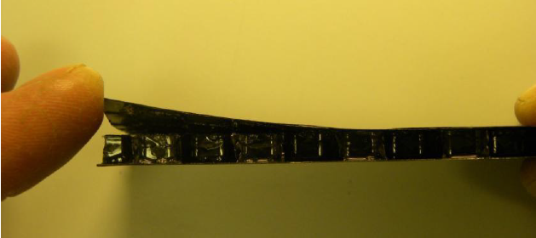
Failure Mechanisms
Measurements of Mechanical Properties
Peak followed by monotonic fall
  Characteristic of single break in top facesheet under roller
  Glue joints intact
Peak followed by ‘staircase’
  Characteristic of progressive failure of glue joints
  Face sheets & honeycomb intact
  Hysol Failure mode

Slide 32
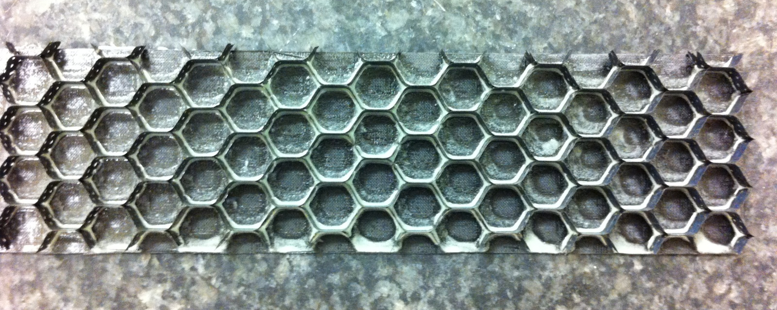
Alternative Hysol distribution
Measurements of Mechanical Properties
Baseline Glue Application
  Dip honeycomb in trough of depth ~ 0.5mm
  Agitate a bit
  Leave for a couple of minutes
Alternative Methods
  Stencil 0.5mm thick with hollow micro-sphere loaded Hysol to increase viscosity
  Uniform thin layer on face sheet and add Honeycomb
Stencil

Slide 33
Properties of CF Honeycomb beams vs glue mass
Measurements of Mechanical Properties
Glue Method | Sample Date | Glue Mass (g/m2) | Bending Stiffness (N/mm) | Failure Load (N)
Dip | 2011 | N/A | 262, 269 | 79,114
Dip | 2012 | 33 | 268 | 100
Stencil | 2012 | 96 | 370 | 218
Even Layer | 2012 | 92 | 284 | 153
VTA260 | 2011 | 188 | 379, 396 | 297,322
Notes
  VTA260 mass can be reduced by cutting out honeycomb pattern
  Loading Hysol with hollow glass spheres seems to stiffen the adhesive

Slide 34
Further irradiation studies
Measurements of Mechanical Properties
Geometry
  120mm x 40mm x 5mm
  K13C2U/EX-1515 (45gsm)
  N636 honeycomb
Adhesives
  Hysol 9396
  Hysol 9309.3NA
  EF8020 (epoxy glue film) x 2
Irradiation at Birmingham
  to dose of 4.3 ± 0.3 x10¹⁴ p/cm²
Both N636 honeycomb and EF8020 epoxy glue films are sufficiently radiation hard for HL-LHC silicon strip tracker

Slide 35
Conclusions
Extensive set of measurements to understand basic ingredients of stave
  Accumulated data the result of extensive work by many people
  Data still incomplete – more work needs to be done (especially post irradiation)
  Many measurements require custom apparatus to be developed & debugged
Assembly issues and core design explored
  Some pointers to cost reduction (N636 vs CF honeycomb) identified
Future work to optimise design for lower material budget and affordability on going

