Slide 1


Mechanics for the CMS Upgrade Forward Pixel Detector
Kirk Arndt, Purdue University
for the FPIX Upgrade Mechanics Group
H. Cheung, S. Gruenendahl, S. Kwan, C.M. Lei, E. Voirin (Fermilab)
D. Bortoletto, I. Shipsey, G. Bolla, (Purdue)

Slide 2
Outline – Review of FPIX Upgrade Mechanics
Project Overview
Half-Disk design
Thermal design and testing
Cooling loop design and testing
Service Cylinder design
Material Budget
Integration into CMS
Schedule

Slide 3
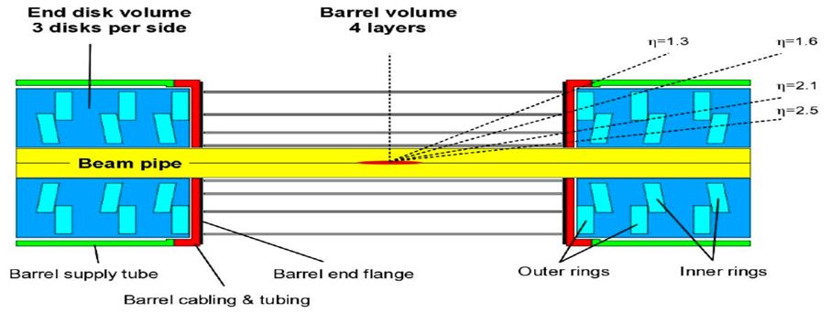
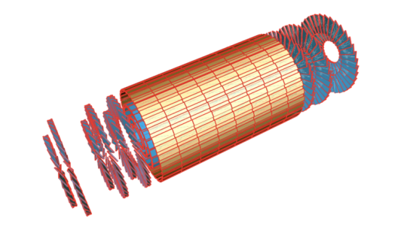
Phase 1 Upgrade Pixel Detector
Survive Integrated Luminosity of 500fb-1 (Barrel Layer 1: 2 × 250fb-1)
Evolutionary upgrade with minimal disruption of data taking
Same detector concept as now but higher rate ROC, data link & DAQ
Robust tracking: 4 hit coverage = 4 Layer Barrel and 3 Forward Pixel Disks
New two-phase CO₂ cooling @ -20C inlet temperature and ultra-light mechanics
New powering system based on DC-DC converters
4 barrel pixel layers
3 forward disks on each side of the IP
Notes:
Handle luminosity of at least 2 x 10³⁴
R&D on rad-tolerant sensors & new pixel readout electronics (chips, optohybrids, front end drivers)
Maximize hit coverage
Providing 4 hits with coverage up to eta of 2.5 to increase the physics performance
Reduce material
Light-weight mechanical support
CO₂ cooling
Move readout electronics further away from active region
Lightweight cables, less connectors
Removable inner layers, easily replaceable
Use existing infrastructure (cables, cooling lines, fibers), DCS/DSS system
Power distribution utilizing DC-DC conversion

Slide 4
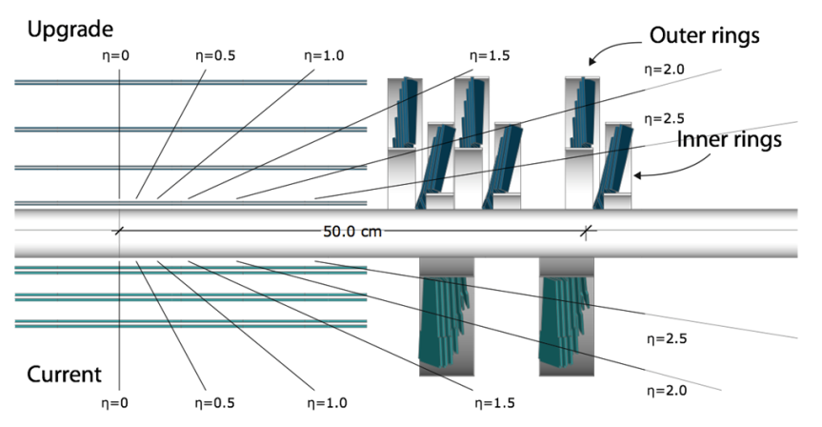
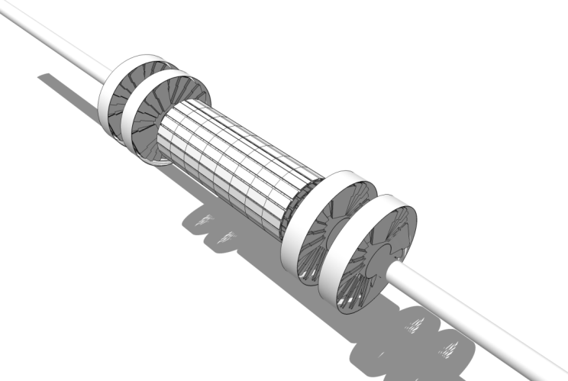
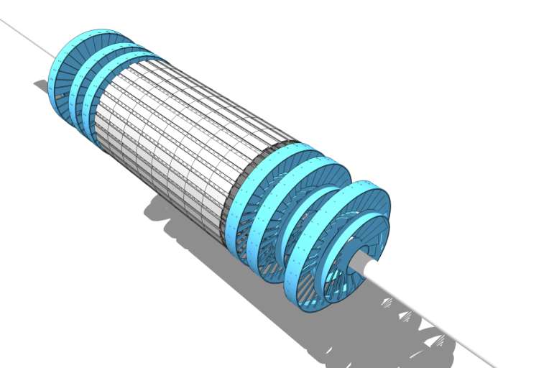
Old and New Pixel Systems
Upgrade
Current

Slide 5
FPIX Mechanics – Project Overview
The FPIX Upgrade replaces the two forward pixel disks on each side of the CMS detector with three new disks each (at Z = 291, 366 and 461 mm from the IP).
The new FPIX increases the number of track measurements while lowering the detector mass and allowing for independent replacement of the sensors closest to the beam.
This is achieved by the following changes to the mechanics:
  Modular construction, with sensors arranged in separate inner & and outer ring assemblies in each half disk
  Pixel sensor modules mounted on low mass Thermal Pyrolytic Graphite (TPG) blades
  Blades supported and cooled by low mass Carbon-Carbon (CC) rings
  CC rings cooled by two-phase CO₂ in embedded stainless steel tubes
  Half-Disks supported by low mass single shell carbon-fiber half cylinders (rear part of service cylinder is double-walled carbon-fiber…identical to current FPIX)

Slide 6
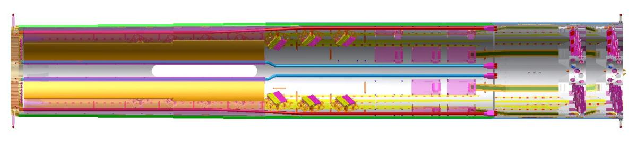
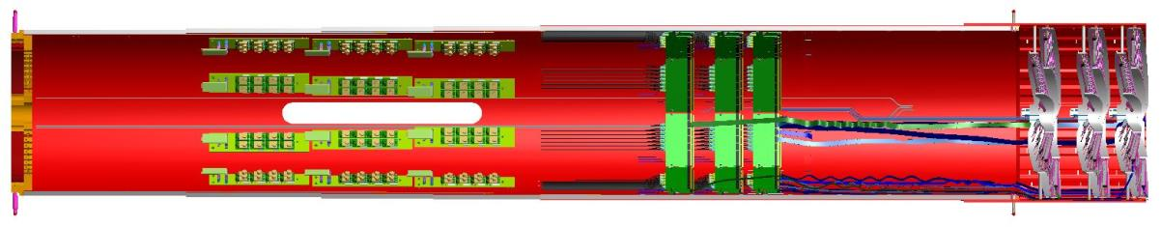
FPIX Mechanics - Comparison Old and New FPIX
2142 mm
~330 mm from IP
Old FPIX
rail supports
291 mm from IP
New FPIX
~2210 mm

Slide 7
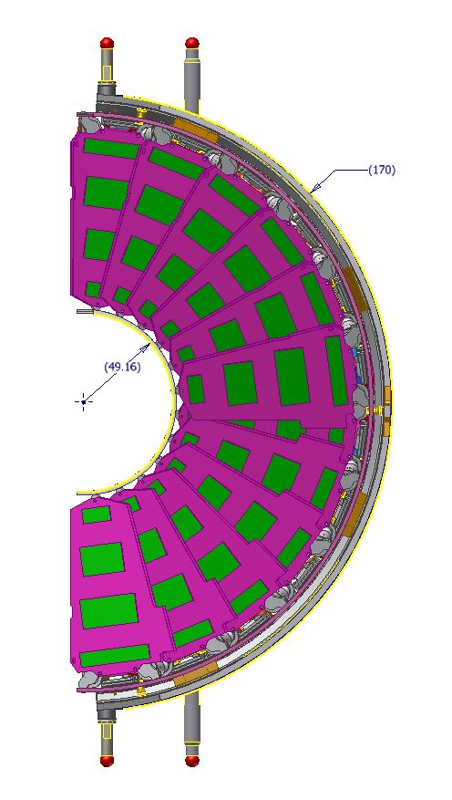
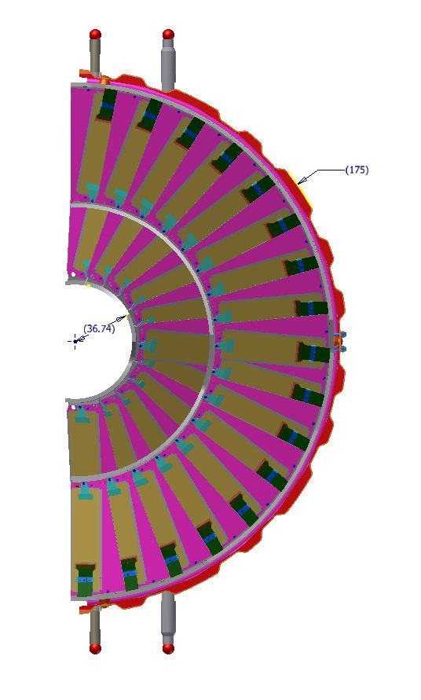
Old FPIX
New
FPIX
New FPIX
outer radius envelope increases by
5 mm
and inner radius envelope decreases by 12.4 mm compared to Old FPIX

Slide 8
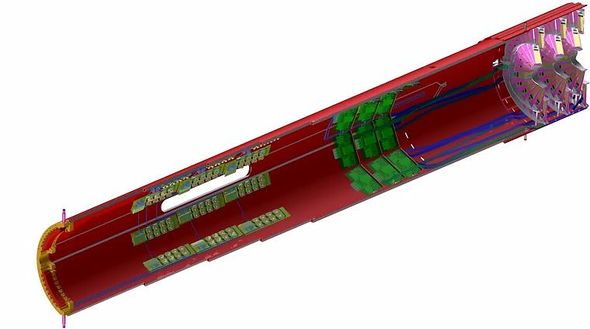
New Parts of the FPIX detector
We install fully loaded service cylinders into CMS. Note the support posts. These slide in grooves for exact positioning.
Service (Half) Cylinder
The Port card is the clearing house for information to and from the Pixel Modules, POH sends fast optical signals off detector.
Note these are at high eta.
Port Cards and POH
Pipes and Cables
3 Half Disks
End Flange
CO2 cooling tubes
and flex cables
Significant material reduction
DC-DC converters
We are increasing the number of pixels (and luminosity) by about 2.5, but the cable plant stays the same

Slide 9
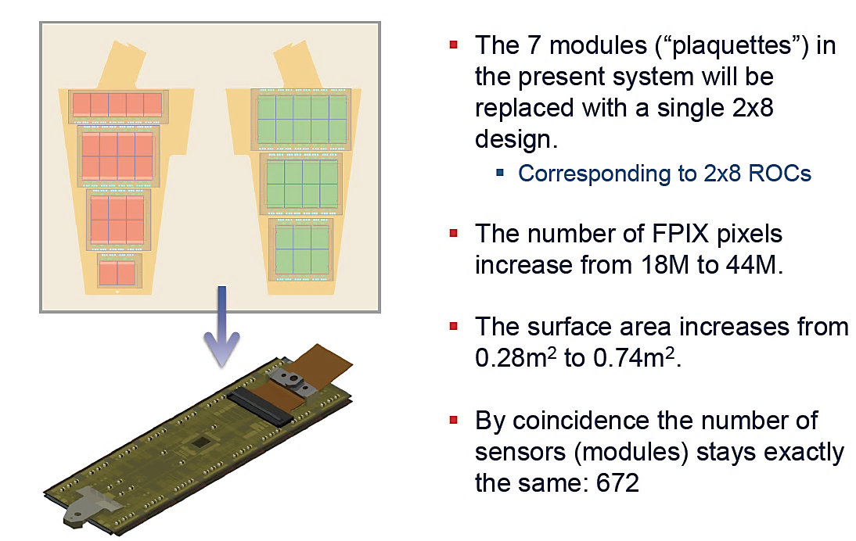
Pixel sensors and modules

Slide 10
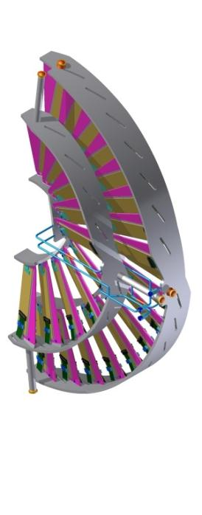
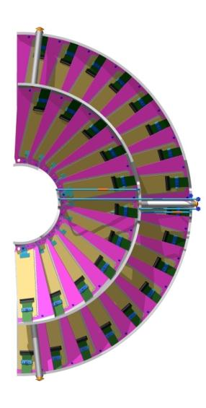
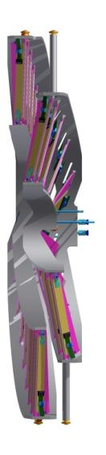
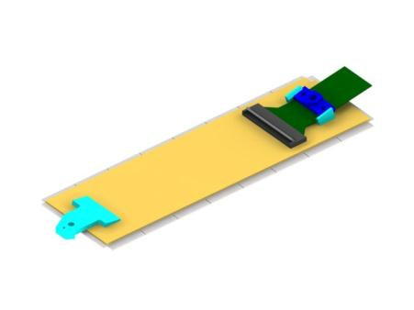
Forward Pixel Upgrade
New FPIX module
outer
ring
Flex cable
inner
ring
HDI flex with connector on top of BBM
2x8 Bump-Bond Module
present detector
upgrade detector
2 disks on each side of the IP
One ring per half disk
672 modules with 18M pixels, 0.28m² sensor area
5 different module sizes (1x2, 1x5, 2x3, 2x5, 2x5 ROCs)
3 disks on each side of the IP
Two concentric rings (inner + outer) for easy replacement
672 modules with 45M pixels, 0.74m² sensor area
Same size module as barrel (2x8 ROCs)
Notes:
FPix Phase 1 Upgrade Main Features
Technical Proposal Baseline: 3 disks in each endcap
Use only ONE kind of module (2x8)
All modules arranged radially and placed between r=45mm to 161mm (total 56 modules per half disk or 896 ROCs)
Modules in half-disks divided into an outer ring of 34 modules and inner ring of 22 modules (with the inner assembly easily removed without affecting the outer assembly)
Same 20 degree rotation of sensors as current FPIX, but add a 12 degree tilt w.r.t. the IP for the inner modules (inverted cone geometry)
Use C02 cooling
Thin‐walled SS tubing routed in loops through ring structures providing enough cooling power for each blade assembly
Use ultra light weight materials for mechanical support and cooling (estimated weight of each half disk is ~400g)
Substrates are permanently glued to half rings in a “turbine‐like” structural support, including cooling tube routed in rings. Allows us to complete and thoroughly test all half disk structures without waiting for the availability of the pixel modules
Modules are fastened on blades and can be easily removed.

Slide 11
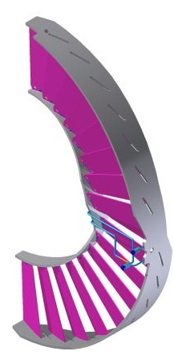
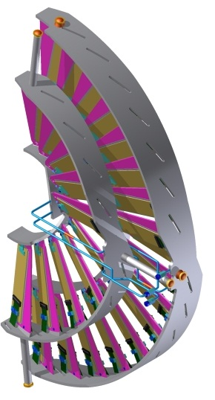
Half Disk design
Outer Assembly Mounts x3
Inner Assembly Mounts x3
A half disk consists of one inner and one outer blade assembly
Both blade assemblies are independently fastened to the half-cylinder by 3 mounts each
Outer assembly contains 34 modules
Inner assembly contains 22 modules
All blades are bonded to two actively cooled half-rings that act as heat sinks
Each blade assembly can be mechanically/thermally tested as a unit prior to mounting modules
SS Tube Coupling x4
Outer Blade Assembly mechanics
ready to take modules
complete Outer and Inner
Blade Assemblies

Slide 12
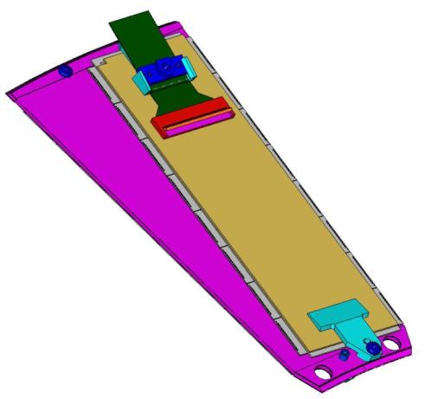
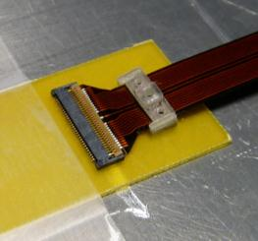
Pixel Blade design
Thermal Pyrolytic Graphite (0.68 mm thick, high thermal conductivity in-plane k = 1500 W/m-K) encapsulated with carbon-fiber facings (0.06 mm thick)
All blades are identical with one removable 2x8 module on each side of each blade
Ends of the blade are structurally and thermally bonded to actively cooled rings
Aluminum threaded inserts glued into blade for module mounting using screws
PEEK holders glued at module ends (holder at outer radial end includes flex cable strain-relief clamp)
Note: blade shown without rings for clarity
Threaded insert
Module holder with Flex cable strain-relief
Flex cable connector
2x8 Module
TPG encapsulated
with CFRP
Module holder
Through hole to access screw on neighboring blade

Slide 13
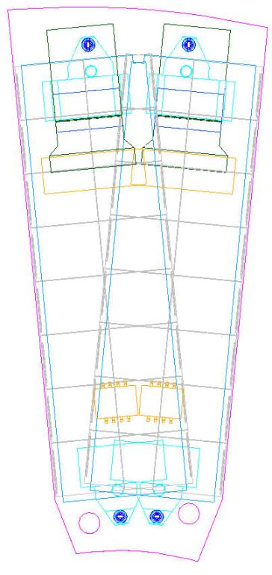
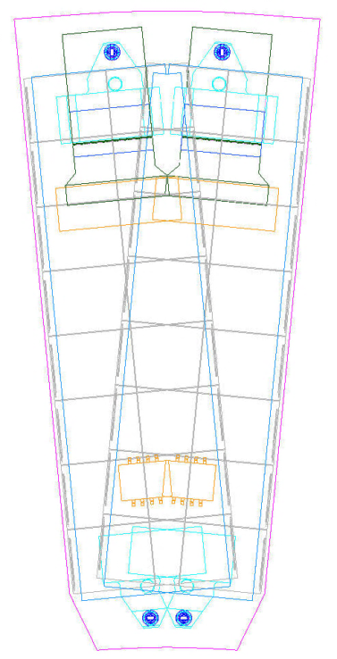
Module Pair and Blade Layouts
Note: blades shown without rings for clarity
30% sensor area overlap
Inner Blade
Outer Blade

Slide 14
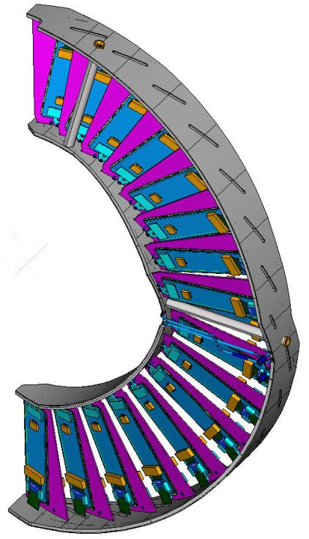
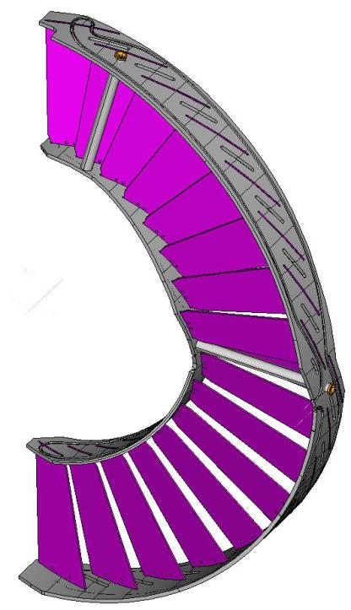
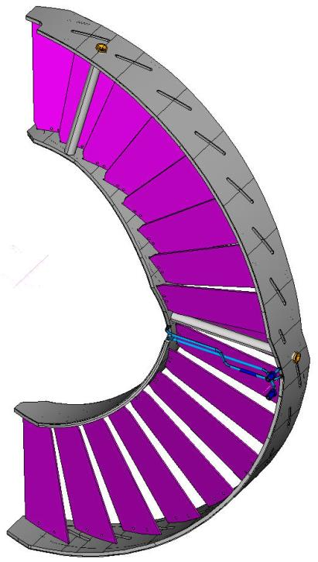
Outer Blade Assembly
17 blades with Y-tilt 20º and Z offset = 2.5 mm, arranged in 2 rows
HD mounts X3
CF Spokes X3
Blades and spokes
bonded to CC rings
Cooling tube and facing
bonded to CC rings
Fully loaded Assembly

Slide 15
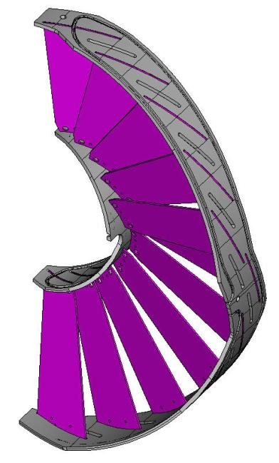
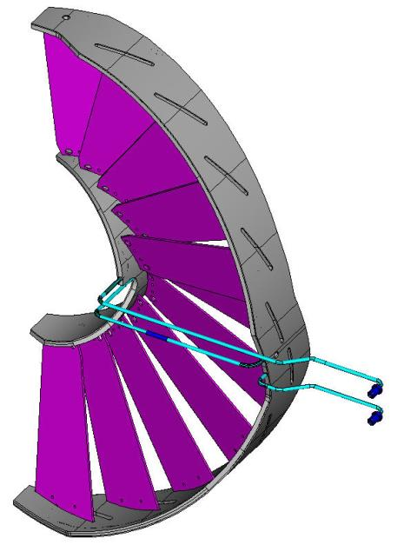
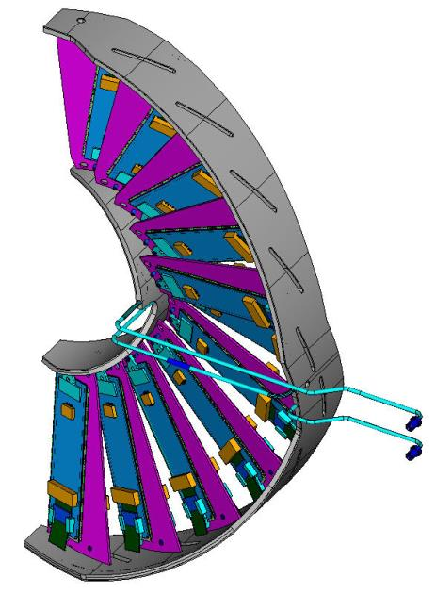
Inner Blade Assembly
11 blades with Y-tilt 20º , X-tilt 12º and Z offset = 4.0 mm, arranged in 2 rows
Blades
bonded to CC rings
Cooling tube and facing
bonded to CC rings
Fully loaded Assembly

Slide 16
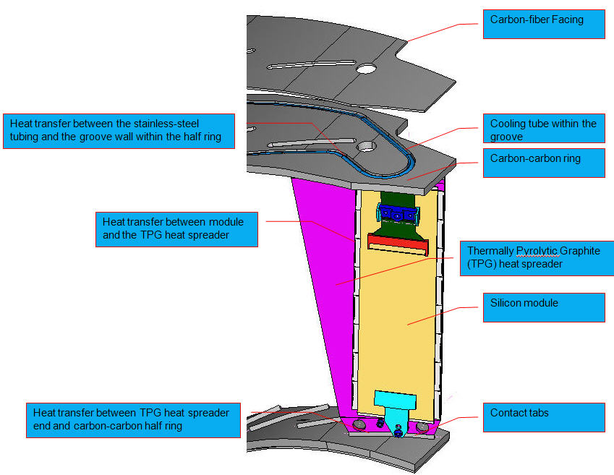
Half Disk cooling
Carbon-Carbon in a half ring shape is the heat-sink (thermal k of C-C = ~200W/m-K)
SS tubing is embedded in C-C rings
Structural CF facing is glued to cover the tubing/cooling channel
Ends of TPG blades are bonded to C-C rings

Slide 17
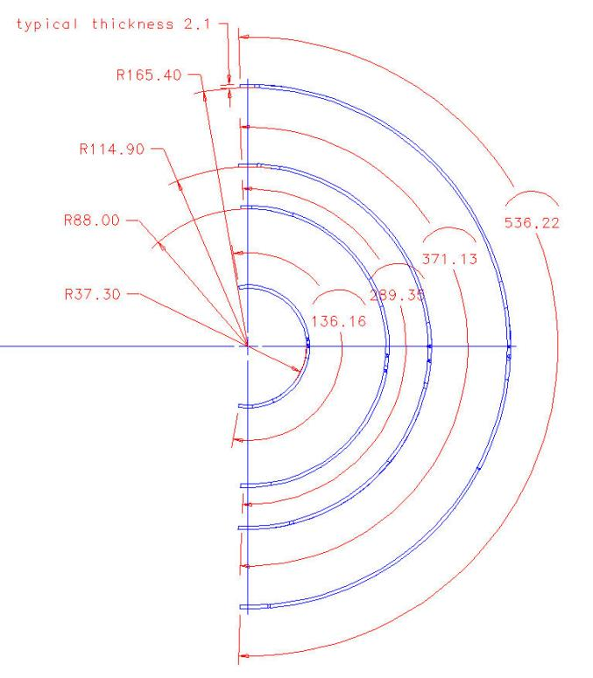
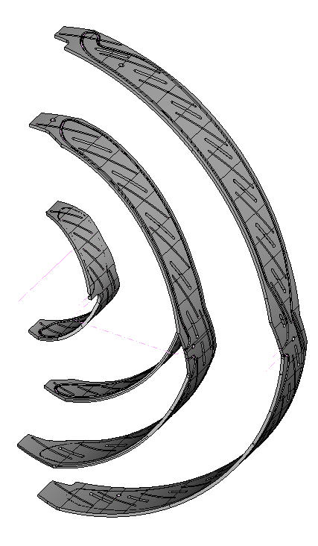
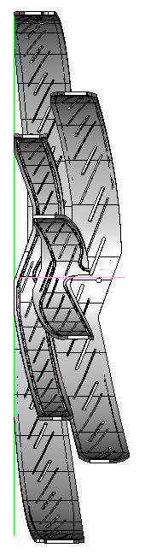
CC Rings
1st HD at Z = 291

Slide 18
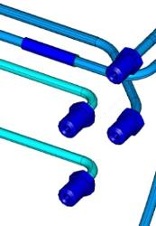
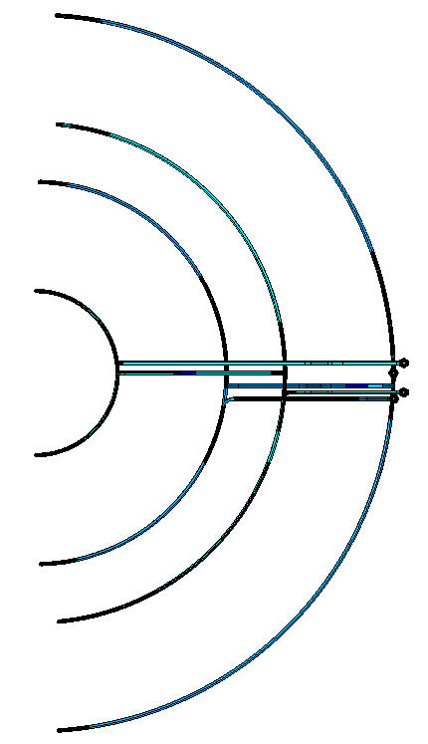
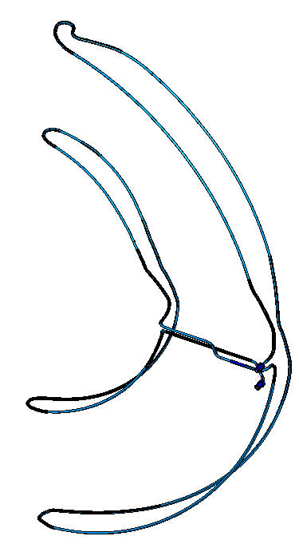
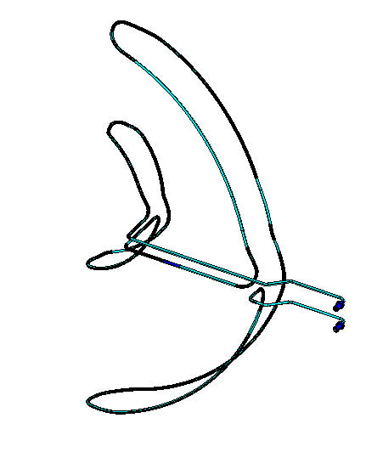
HD Tubing Layout
couplers
Inner Tubing Set
Outer Tubing Set
Both Sets

Slide 19
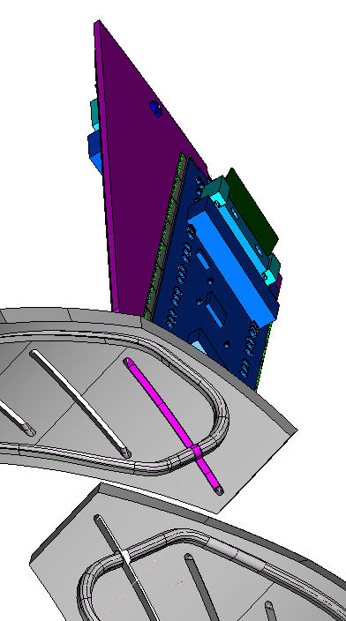
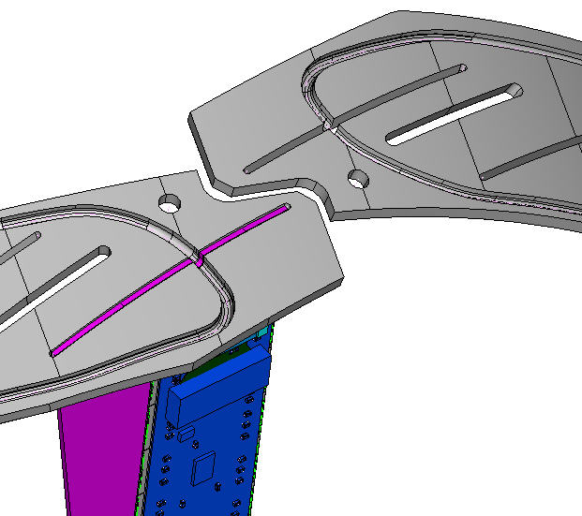
Through-Slot Blade Attachment
HD mounting hole
Inner blade
3 mm clearance
2 mm clearance
Inner Outer Rings
Inner Inner Rings

Slide 20
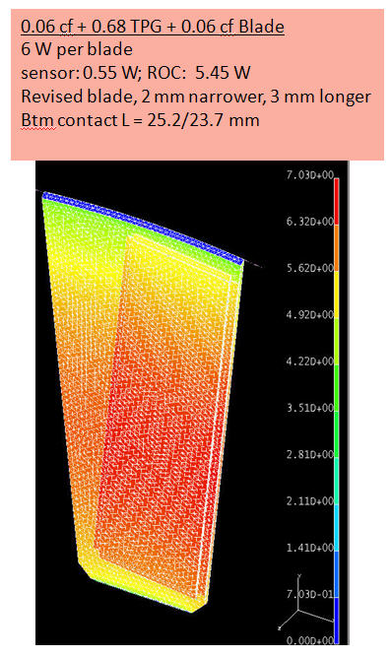
Cooling Performance
Estimate of power per pixel module is 3W (after radiation and with 30% safety margin)
Design goal: temperature difference from coolant to sensor < 10⁰C
Thermal FEA result ∆T ~7C between sensor and blade ends
Thermal k of all interfaces
= 1 W/m-K
Overall ∆T = ~7 C

Slide 21
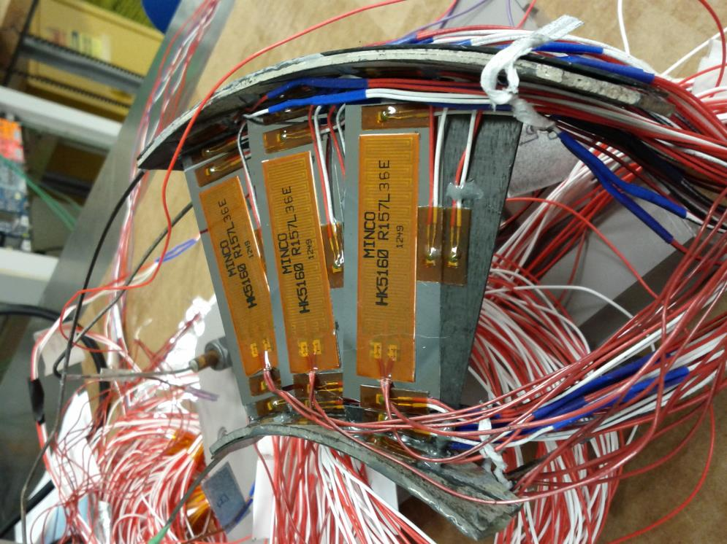
Half-Disk Structure Tests
➔Technology choices for blade – ring joints
Notes:
Insert my pic for 3-blade assembly with cables

Slide 22
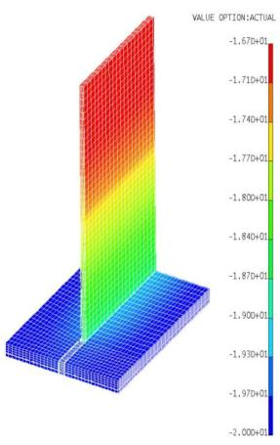
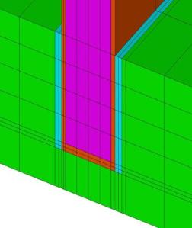
Joint Technology Choices
  TPG bonded to CC through-slot side-wall with solder (48 W/m-K, made by S Bond)
  TPG embedded and bonded within CC pocket-slot with solder (made by S Bond)
  TPG bonded to CC through-slot side-wall with 1 layer of 0.003” thick Laird’s tpcm 583 silicone film (4 W/m-K, made by Fermilab)
  TPG bonded to CC through-slot side-wall with 2 layers of 0.003”-thick silicone film (made by Fermilab)
  TPG embedded and bonded within CC pocket-slot with Dow Corning’s TC-5022 silicone grease (4 W/m-K, made by Fermilab)
  TPG embedded and bonded within CC through-slot with carbon cement then carbonized (~5 W/m-K, made by Allcomp)
  TPG embedded and bonded within CC pocket-slot with carbon cement then carbonized (~5 W/m-K, made by Allcomp)
All modeled thermally and mechanically (distortion and stress) with finite element analysis
Back-of-the-envelope estimate:
  Delta T for connection through TPG end surface
  ~ k*0.5 m K/W
  (k * 3 W/module * 2 modules * 0.1mm joint thickness / 40mm joint length *0.68mm TPG blade thickness / 2 joints)
  With k ~ 4 W/m/K for silicone, thermal compound:
      ➔ Delta T ~ few ºC
∆T = 3.3 C
(4.5C if low modulus thermal filler is used instead of solder
TPG
cf
cf
epoxy
epoxy
Solder at blade end
Notes:
done

Slide 23
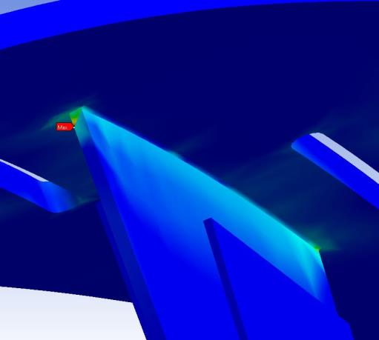
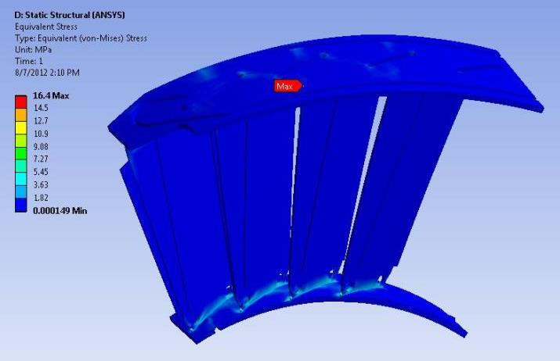
FPIX Mechanics – Half Disk Structural Analysis
Boundary conditions:
-30C fixed temperature in C-C grooves
No heat from modules (so entire assembly is the same -30C temperature)
Model C-C rings, TPG blades, Si modules
TPG blades bonded to C-C rings
Si modules allowed to slip on, but not separate from, surfaces of the blades
Results of simple modeling: Max. thermally induced stress at corners of joints are of the same order as the strength of candidate solders and adhesives

Slide 24
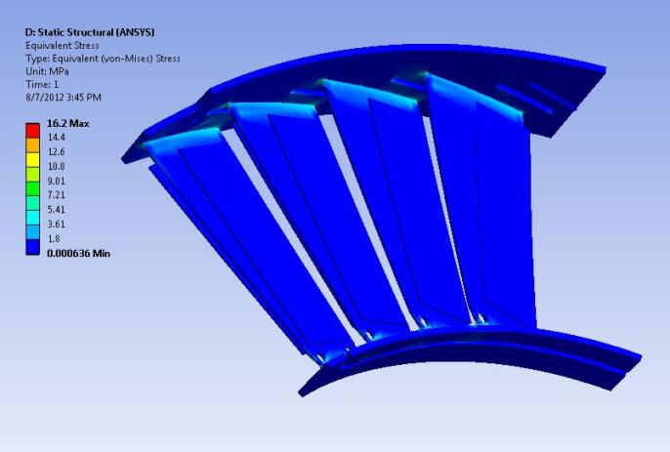
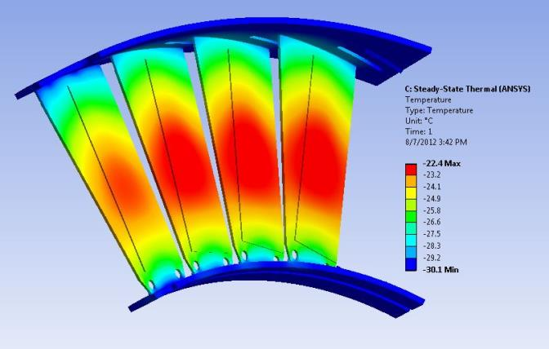
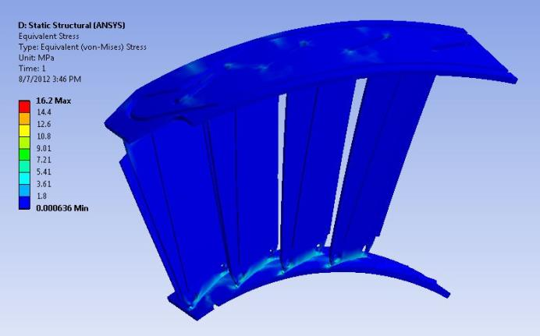
FPIX Mechanics – Half Disk Structural Analysis II
Boundary conditions same as previous slide, but with 3W power generated in each Si module
No change in overall stress with modules powered on or off
Most of the thermal stress results from the difference in CTE between C-C and TPG

Slide 25
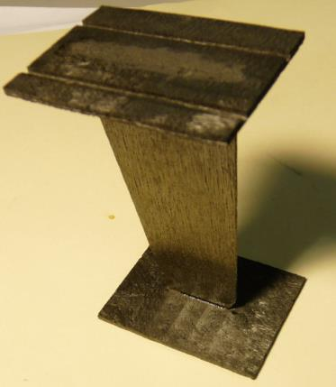
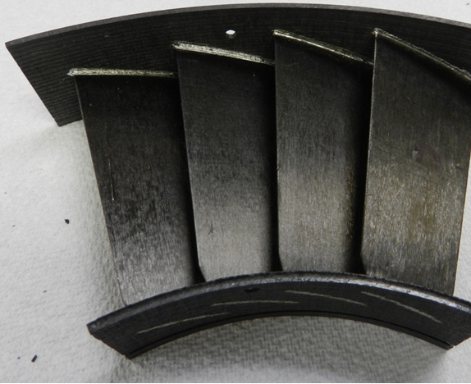
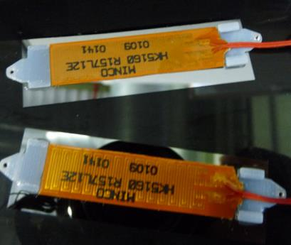
Blade/Ring thermal testing
4-blade soldered assembly from S Bond
1-blade Carbonized assembly from Allcomp
Dummy sensor modules with foil heaters
  Different thermal/mechanical coupling methods, using single blade and 4-blade assemblies with heated dummy sensor modules, are being performed

Slide 26
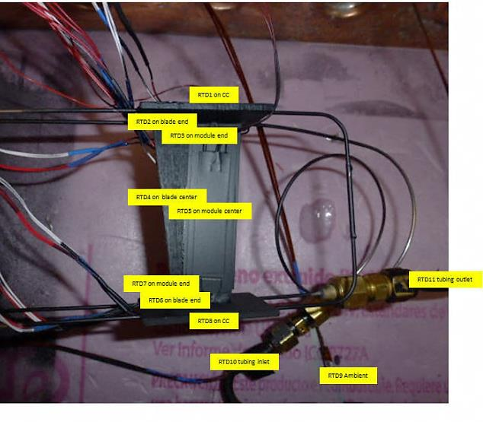
1-Blade Tests
Prepared samples with one TPG blade bonded at the ends to small CC material blocks with SS cooling tube embedded (like the Phase 1 FPIX design)
Blade joints made with 4 types of thermal interface material were tested using CO2 cooling and 3W heating power per module (all joints were reinforced with epoxy):
        Sn 97%/Ag 3% solder (assembled by S-Bond)
        Laird tpcm 583 4 W/m-K silicone phase-change film (assembled by Fermilab)
        Dow Corning TC-5022 4 W/m-K silicone grease (assembled by Fermilab)
        Carbon cement, then Carbonized (assembled by Allcomp)
All samples were thermal cycled for robustness (+/- 40C for 30 cycles) prior to thermal testing
RTDs and infrared camera were used for taking temperature measurements

Slide 27

Results of 1-Blade Tests
TPG bonded to CC slot with: | overall blade middle to CO2 | blade (middle to end) | blade end to ring joint | ring to CO2
S-bond 220 (93Sn4Ag alloy) solder | 5.1 | 1.8/1.6 | 2.0/2.2 | 1.4/1.3
S-bond 220 (93Sn4Ag alloy) solder | 4.9 | 2.1/2.3 | 1.1/1.6 | 1.7/0.9
Laird tpcm 583 silicone film 1-layer | 12.8 | 1.8/1.7 | 7.9/9.0 | 3.1/2.1
Laird tpcm 583 silicone film 2-layers | 7.7 | 1.5/1.7 | 4.6/4.4 | 1.6/1.5
Dow Corning TC-5022 silicone grease (1) | 8.2 | 1.1/2.2 | 4.0/4.0 | 3.1/2.0
Dow Corning TC-5022 silicone grease (2) | 6.5 | 2.1/0.9 | 2.1/4.1 | 2.3/1.4
Carbonized (1) | 7.2 | 1.7/1.4 | 2.4/4.0 | 2.8/1.5
Carbonized (2) | 10.6 | 1.2/2.5 | 6.1/5.3 | 2.6/2.2
Six assemblies meet the overall ∆T < 10ºC requirement.
Solder (highest thermal K) performed best, Thermal Grease (2) and Carbonized (1) next best.
Silicone layer under dummy silicon modules performed well with ∆T <1ºC.
Thermal grease between tubing and CC groove worked OK with ∆T of ~2ºC between “ring” and CO2.

Slide 28

FPIX Mechanics –
TC 5022 4-Blade Test Results
∆T from CO2 to silicon center =
6.9 6.7 6.4 7.6
A1 | silicon 1 ctr | -12.35
A2 | silicon 2 ctr | -12.61
A3 | silicon 3 ctr | -12.82
A4 | Blade 1 ctr | -12.49
A5 | Blade 2 ctr | -12.85
A6 | Blade 3 ctr | -13.40
A7 | silicon 1 i | -13.07
A8 | silicon 2 i | -13.39
A9 | silicon 3 i | -13.15
A10 | silicon 1 o | -13.34
A11 | silicon 2 o | -13.94
A12 | silicon 3 o | -13.67
A13 | Blade 1 i | -13.29
A14 | Blade 2 i | -13.70
A15 | Blade 3 i | -13.53
A16 | Blade 1 o | -14.42
A17 | Blade 2 o | -14.90
A18 | Blade 3 o | -14.68
B1 | Ring i 1 | -15.72
B2 | Ring i 2 | -15.16
B3 | Ring i 3 | -15.64
B4 | Ring o 1 | -16.35
B5 | Ring o 2 | -15.85
B6 | Ring o 3 | -16.39
B7 | silicon 4 ctr | -11.70
B8 | Blade 4 ctr | -12.00
B9 | silicon 4 i | -13.05
B10 | Blade 4i | -13.27
B11 | Ring i 4 | -15.22
B12 | silicon 4 o | -13.16
B13 | Blade 4o | -13.82
B14 | Ring o 4 | -16.29
B18 | tubing mid | -18.45
B19 | tubing in | -18.84
B20 | tubing out | -19.67
-16.3
∆T=2.5
-16.4
-13.8
∆T=1.7
-13.2
∆T=0.6
-14.7
∆T=1.0
-15.9
∆T=1.0
-13.7
Design goal: Delta T (sensors-to-coolant) of 10ºC or less
-14.9
∆T=1.0
-13.9
-16.4
∆T=2.0
-14.4
∆T=1.1
-13.4
-11.7
-12.0
-13.3
-12.9
-12.8
∆T=-0.3
-12.6
∆T=0.6
∆T=0.3
-12.4
-12.5
∆T=0.1
-13.1
∆T=0.2
-13.2
-13.3
∆T=1.9
-13.4
-13.5
∆T=0.3
-15.2
-13.7
∆T=0.3
-15.6
∆T=2.1
-13.1
∆T=0.2
∆T=1.5
-13.3
∆T=2.4
-15.2
-15.7
∆T from CO2 to outer ring = 2.9 3.4 2.9 3.0
∆T from CO2 to inner ring = 3.5 4.1 3.6 4.0

Slide 29

FPIX Mechanics – Thermal FEA Simulation agrees with Data
TC 5022 + epoxy attachment is qualified as baseline solution
Design goal: Delta T (sensors – coolant) of 10ºC or less

Slide 30

Blade-Ring Joint FEA Studies II
Better structural strength if carbon fiber facing continues into joint slot
FEA looks ok, increases ∆T by ~1⁰C

Slide 31


Alternative HD tube routing
As a Plan B, we’ve considered routing a continuous loop in a serpentine path across the blades (1 pass on each side of each blade, under each module)
Increases the material budget and complexity of assembly

Slide 32

FPIX CO₂ Cooling Loop Layout
Port Cards and POH
Pipes and Cables
3 Half Disks
End Flange
CO2 cooling tubes
and flex cables
DC-DC converters
Notes:
Add Kirk’s support cylinder drawing showing half disk & port cards & cables

Slide 33



FPIX Mechanics – Cooling Tube Coupling Prototypes
Parts have been designed and prototypes produced and tested up to 4000 psi (275 bar)
M3.5 female threads
M3.5 male threads
Welded with tubing
Replaceable gasket
Welded with tubing

Slide 34




FPIX Mechanics – CO2 Cooling Loop Configuration Studies
Full length stainless steel tubing assemblies with dummy (DC-DC converters, POHs and a single Half Disk) heat loads
Measure temperatures vs. flow & pressure drop
Studied
  variations in tube diameter
  inner/outer in series or in parallel
Main Loop
Concentric
Supply & Return
DC-DC & POH
FPix Detector
Transfer Lines
Tube Heat
Manifolds & Capillaries
Evaporator
Evaporator
Exchanger
Half-Disk
Supply Line
Return Line
Inner Assembly
Outer Assembly
Supply Line
Return Line
Notes:
Insert picture

Slide 35

FPIX Cooling: Combined Results
Design goals:
  Delta T sensors-to-coolant of <10ºC
  Pressure drop small enough to allow passive flow balancing with capillaries at a total ∆P of <20 bar
Two viable solutions for cooling of half-disks (via embedded tubes in CC rings) have been found:
  Outer and inner assemblies in parallel (1.4mm ID) or in series (1.6mm ID)

Slide 36

Cooling loop segmentation
4 hits
η = 1.6
3.5 hits
η = 2.1
1.5 hits
η = 2.5
Favored Segmentation:
2 cooling loops per Half Cylinder
(Total 4 cooling loops per end)
All Outers
2x8s
2x8s
2x8s
3 hits
η = 1.6
2.5 hits
η = 2.1
3.5 hits
η = 2.5
All Inners
2x8s
2x8s
2x8s
Notes:
Two cooling loops per HC (total 4 cooling loops per end) are required. Cooling loop "A" services all outer modules (shown on the upper half of slide). Cooling loop "B" services all inner modules (shown on the lower half of slide).
If cooling loop "B" fails, then all outer modules serviced by cooling loop "A" in the HC remain working, and vice versa. If one of the cooling loops fails, the average number of hits in the BPIX/FPIX system at one end would be (4 + 3.5 + 1.5 + 3 + 2.5 + 3.5 + (6 x 4 hits in the other HC))/12 = 3.50 hits.

Slide 37


FPIX Mechanics – Service Cylinders
FPIX Design of Half Cylinder
All carbon-fiber reinforced plastic design consists of 3 sections:
- front corrugated section with flex cable troughs (~1 mm thick)
- transition section where front and rear are glue joined
- rear section basically the same as existing HC
Design Goal:
Displacement of < 0.1 mm
Special Rib
rear section
transition section
Thicker Top & Bottom Ribs
front section

Slide 38




FPIX Mechanics – FEA of Half Cylinder
Preliminary FEA of Half Cylinder - revised
FEA as an aid for designing the front and transition regions (results for the stiff rear section suppressed)
Applied constraints on 4 support leg positions, with 2 top supports allowed downward displacement.
Half disk loads of 4.2 N each applied at 3 locations, no distributed load on the rear section.
3 beam “spokes” simulate half disks that help to retain a circular profile.
Max displacement at front ~ 0.1 mm.
Special Rib
Thicker Top & Bottom Ribs

Slide 39


FPIX Mechanics – Displacement vs. Material and Thicknesses
Sensitivity Check on Trough & Special Curved Rib Thicknesses
Trough T, mm | Sp Rib T, mm | Disp top, mm | Disp max, mm
0.72 | 0.54 | 0.083 | 0.146
0.97 | 0.72 | 0.079 | 0.141
0.36 | 0.9 | 0.078 | 0.138
0.5 | 0.54 | 0.063 | 0.102
0.96 | 0.72 | 0.059 | 0.099
0.8 | 0.9 | 0.058 | 0.096
Materials Moduli | GPa
Trough, Ex/Ey | 153/196
CF Facing, Ex=Ey | 193
Rib Typical, Ex=Ey | 18
Rib Special, Ex=Ey | 18
Rib & CF Facing, Ex=Ey | 120
Trough Rear, Ex=Ey | 193
Design Goal:
Displacement of < 0.1 mm
Rib Tubing Special
Inner face sheet
Outer face sheet
Trough face sheet

Slide 40


Mass distribution in existing and Phase 1 FPIX
Port Cards and AOH
Z = 1m
Within the eta coverage (up to Z = 1m from the IP) most of the material in the existing FPIX is in aluminum cooling channels, VHDI, connectors and cables
End Electronics
2 Disks
End Flange
Pipes and Cables Front
Coils of fibers
Z = 1m
Port Cards and
Pixel Optical Hybrids
Pipes and Cables Back
3 Disks
space for end electronics
CO2 cooling tubes
and flex cables
End Flange
DC-DC converters
space for
pipes and cables
Notes:
The goal of reducing the material by 50% is primarily accomplished by removing the VHDI and bulky adapter boards and connectors, using high performance carbon composites support structures, and CO2 cooling (for about a x10 reduction in the mass of cooling channels and coolant compared to the existing FPIX).

Slide 41
Service Cylinder Material Budget
(up to eta = 2.5)
Item | Current (Mass in g) | Current (% RL) | Upgraded (Mass in g) | Upgraded (% RL)
Single Half Disk | 650.8 | 4.93% | 471.8 | 2.09%
Q'ty of Half Disk | 2 | - | 3 | -
Total Half Disks | 1301.5 | 9.87% | 1415.4 | 6.27%
Flex Cable | 109.2 | 0.67% | 152.6 | 0.69%
Tubing & Coolants | 281.9 | 1.89% | 9.5 | 0.08%
Service Cylinder & Supports | 638.3 | 2.96% | 546.1 | 2.01%
Port Cards | 346.9 | 3.83% | - | -
Grounding Shields | 10.5 | 0.14% | - | -
Total | 2688.2 | 19.38% | 2123.6 | 9.05%
~20% reduction in mass and >2x reduction in % Effective Radiation Length in FPIX acceptance, even with 3 disks instead of the present 2!
Notes:
The goal of reducing the material significantly is primarily accomplished by removing the VHDI and bulky adapter boards, port cards, and connectors, and using high performance carbon composites support structures and CO2 cooling (for about a x30 reduction in the mass of cooling channels and coolant compared to the existing FPIX).

Slide 42

Material Budget Reduction
Notes:
Use of lightweight structures and moving services and connections out of tracking volume greatly improves material budget.
Phase 1 FPIX has ~20% less mass and 2x reduction in %RL in FPIX acceptance, even with 3 disks (instead of the present 2).

Slide 43

New Pixel Detectors – Less Material

Slide 44


Phase 1 FPIX integration with new beam pipe
Minimum clearance occurs as disks pass the support collar/wires ~7.5mm
The BP clearance issue for FPIX during insertion is around the BP support collar and vertical support wires/pulleys

Slide 45


Phase 1 FPIX integration with new BPIX
Working with BPIX to maximize clearance between the upgrade BPIX supply tube and FPIX service cylinder during installation.
5mm min. clearance goal.
New FPIX final installation position
Forward most Z = 290.4 mm
Top Clearance: 4.8 mm
Minimum Clearance: 4.2 mm

Slide 46
Phase 1 FPIX mechanics schedule
For the next 12 months
  Conclude 4-blade thermal tests to verify the ∆T from pixel modules to coolant (Summer 2013)
  Conduct a CO2 cooling test of a full loop mock-up (outer and inner in parallel with capillaries) to verify the ∆T and ∆P along the tube with simulated detector heat load (Summer 2013)
  Assemble mechanical and electrical grade module prototypes to evaluate adhesives, interconnects, and optimize module assembly tooling and procedures (ongoing)
  Build a dummy FPIX upgrade half-cylinder shell by end of 2013
  Module cabling mockup by Fall 2013
  Installation trials in PSI mock-up and CMS in 2014
  Final mechanics construction est. mid-2014 – mid-2015
  Ready to begin integration with electronics in early 2015
  Install New Pixel detector in CMS during 2016 YETS

Slide 47
FPIX Mechanics - Summary
Complete designs for the support cylinder, half disk and cooling system in hand
The designs meet specifications for mechanical & thermal performance according to Finite Element Analysis, while reducing the amount of material traversed by particles considerably
Baseline solutions for the pixel module and half-disk thermal interfaces and the cooling tube geometry have been qualified
Critical interfaces and parameters are being experimentally studied using prototypes and mockups

Slide 48
Backup slides

Slide 49
FPIX Mechanics – WBS summaries
WBS number | Title | Summary
401.03.03.03.01 | Half Disk Mechanics | The FPIX Upgrade will consist of 12 half disks, each with an outer assembly and an inner assembly. On the outer assembly, there will be 17 blades made of TPG, and on the inner assembly, 11 blades. The two assemblies are connected by supporting rods made of carbon material. The TPG blades will be attached to the carbon-carbon half disk support structure. The baseline attachment uses thermal grease encapsulated in epoxy, and the work will be done at Fermilab. The pixel sensor modules are attached onto the TPG blade by a module holder. We are still exploring other options of the blade attachment. These include using solder bonds (using Pb-free solder) and an all carbonized structure with the TPG and the CC ring carbonized using carbon cement and heated up to 1400 ºF. For the whole FPIX, we will need 336 TPG blades. Deliverables of this WBS element include the whole mechanical structure for the whole FPIX detector and up to 2 spare half-disks with blades attached, all the module holders (up to 1000 pieces), and all assembly fixtures.

Slide 50
FPIX Mechanics – WBS summaries
WBS number | Title | Summary
401.03.03.03.02 | Half Cylinder | The FPIX detector will have 4 half cylinders. The material used for construction is CFRP (carbon fiber reinforced plastic). We will build one prototype half cylinder which will be used for insertion tests as well as for various tests and checks (e.g. loading test).
401.03.03.03.03 | Cooling Tubes | The cooling tubes will be made out of thin walled (0.1mm) stainless steel. They will be bent and embedded into the C-C half rings. The bending will be different for the inner and outer assembly, using two different fixtures. There are up to three manifolds feeding each half cylinder. Outside the half disk, the cooling tubes will be of different diameters (2mm and 2.2mm). Hence we need to procure cooling tubes at least of three different diameters. The routing and connection scheme of the cooling tubes inside the half cylinder is still being studied. We are exploring two options: one design has the cooling tubes connected in series for the inner and the outer assemblies. The other has separate and parallel lines for the inner and outer assemblies.

Slide 51
FPIX Mechanics – WBS summaries
WBS number | Title | Summary
401.03.03.03.04 | Integration & Testing | The FPIX consists of four half cylinders each with three half disks. The half disks will have cooling tubes embedded in the half disk ring support. The half cylinder will have complete loops of cooling lines. After the placing of the cooling tubes in the half disks and to the half cylinder, tests will be performed to check the connections, manifold, and that the thermal performance is within the design specifications.
401.03.03.03.05 | Installation Fixture & Testing | The FPIX detector will be installed into CMS. There are existing rails and stops to be used. A new beam pipe and beam pipe support will be installed for the upgrade. The dimensions of the FPIX half cylinders and the BPIX service cylinder will be changed. We have to verify that these changes do not cause any problem or interference during installation. Insertion tests will be performed in-situ and perhaps on a beam pipe, BPIX, and rail system mock-up. We may need to modify the current installation fixture and half cylinder carrier platform depending on the outcome of these tests.

Slide 52

Flow Chart of Production Assembly
Module Production
Mechanical structure
Sensor wafer
probe testing
Probe testing
of ROC wafer
TPG blade fabrication
Half-ring support structure machining
Bump bonding (outside vendor)
HDI design
& testing
Attach TPG to half-ring
Cooling pipe bending
Mount TBM on HDI (glue, wire bonding, encapsulation) & burn-in
Final Detector Assembly
Embed cooling pipe to half-ring
Half cylinder fabrication
Assembly of pixel module
Placing of electronic circuits, cables, fibers, cooling lines into half cylinder & test
Test mechanical/cooling structure
Module qualification test
Half Disk assembly and testing
Half cylinder assembly and test
Half disk assembly & testing

Slide 53
System Parameters: Present & Upgrade
Parameter of Pixel System
# layers (tracking points)
beam pipe radius (outer)
innermost Disk (layer) radius
outermost Disk (layer) layer radius
pixel size (r-phi x z)
In-time pixel threshold
pixel resolution (r-phi x z)
cooling
material budget X/X₀ (η=0)
material budget X/X₀ (η=1.6)
pixel data readout speed
ROC pixel rate capability (loss)
control & ROC programming
Present
3
29.8 mm
6.0 (4.4) cm
14.0 (10.2) cm
100μ x 150μ
3400 e
13μ x 25μ
C₆F₁₄ (monophase)
6%
40%
40MHz (analog coded)
~3.8% @ 120 MHz/cm²
TTC & 40MHz I²C
Upgrade
4
22.5 mm (LS1)
4.5 (2.95) cm
16.1 (16.0) cm
100μ x 150μ
1800 e
13μ x 25μ (or better)
CO₂ (biphase)
5.5%
20%
400Mb/sec (digital)
~1.6% @ 150 MHz/cm²
TTC & 40MHz I²C
Layer 1: ~3% @ 580 MHz/cm²

Slide 54
System Parameters: Present & Upgrade
Parameter of Pixel System
# layers (tracking points)
beam pipe radius (outer)
innermost Disk (layer) radius
outermost Disk (layer) layer radius
pixel size (r-phi x z)
In-time pixel threshold
pixel resolution (r-phi x z)
cooling
material budget X/X₀ (η=0)
material budget X/X₀ (η=1.6)
pixel data readout speed
ROC pixel rate capability (loss)
control & ROC programming
Present
3
29.8 mm
6.0 (4.4) cm
14.0 (10.2) cm
100μ x 150μ
3400 e
13μ x 25μ
C₆F₁₄ (monophase)
6%
40%
40MHz (analog coded)
~3.8% @ 120 MHz/cm²
TTC & 40MHz I²C
Upgrade
4
22.5 mm (LS1)
4.5 (2.95) cm
16.1 (16.0) cm
100μ x 150μ
1800 e
13μ x 25μ (or better)
CO₂ (biphase)
5.5%
20%
400Mb/sec (digital)
~1.6% @ 150 MHz/cm²
TTC & 40MHz I²C
3 out of 4 is more robust for efficiency
Space point closer to IP, better resolution
Better P res, tracks spread out, can help strips
(Outer disk @ minimum z)
More radiation tolerant (less PH needed)
~1/2 Material savings
2 x Readout Bandwidth
Less loss at higher L, Trigger (Bx spacing)
Layer 1: ~3% @ 580 MHz/cm²
Take advantage of working system

Slide 55

FPIX Upgrade Summary

Slide 56
Background Material - Cylinders

Slide 57



FPIX Mechanics – Displacement vs. Trough Thickness
Sensitivity Check on Trough Layup
Trough Layup, Moduli, Thickness & Results | GPa | Trough T, mm | Rib Sp T, mm | Disp top , mm | Disp max, mm
Trough, Ex/Ey, (K13D2U 0º, M46J, +90º)X6, 12 plies | 238/157 | 0.91 | 0.72 | 0.0579 | 0.1030
Trough, Ex/Ey, (K13D2U 0º, M46J, +/-60º)X4, 12 plies | 155/107 |  |  | 0.0640 | 0.1060
Trough, Ex/Ey, (K13D2U 0º, M46J, +/-75º)X4, 12 plies | 153/171 |  |  | 0.0603 | 0.1000
Trough, Ex/Ey, (K13D2U 0º, M46J, +/-90º)X4, 12 plies | 153/196 | 0.97 |  | 0.0584 | 0.0990
Trough, Ex/Ey, (K13D2U 0º, M46J, +90º)X6, 1 extra K13D2U, 13 plies | 259/147 | 0.98 |  | 0.0541 | 0.0945
Trough, Ex/Ey, (K13D2U 0º, M46J, +90º)X6, 1 extra M46J, 13 plies | 217/166 | 1.00 |  | 0.0548 | 0.0924

Slide 58













Materials & Properties
6 Materials
Trough (ID7)
Rib and cf (ID9)
beam (ID10)
CF & trough rear(ID14)
Rib wall (ID37)
epoxy (ID48)
7 physical properties
beam (ID4)
Rib wall sp (ID5)
thickness
Rib wall (ID11)
thickness
cf (ID15)
thickness
Rib and cf (ID16)
Total thickness
Trough shell (ID21)
thickness
Trough solid (ID22)

Slide 59

Rib wall sp (ID5)
thickness
Rib wall (ID11)
thickness
cf (ID15)
thickness
Rib and cf (ID16)
Total thickness

Slide 60
Background Material - Disks

Slide 61

Module Building Blocks
ROC (Read Out Chip)
  4160 pixels (52 x 80 array)
  Digitize Pixel Charge
TBM (Token Bit Manager)
  Organizes info to/from ROCs
  Control and Trigger signals
HDI (High Density Interconnect)
  Flexible circuit to connect module parts electrically
TBM
HDI
Sensor
ROCs

Slide 62


FPIX Upgrade Pixel Module
Cross-section of a pixel module

Slide 63
FPIX Mechanics – Half Disk Alignment
Alignments are set during the gluing/bonding processes, non-adjustable after gluing.
Module holder gluing to module
  Module holder mounting holes to be aligned with sensor fiducials
Blade bonding to half rings
  Module mounting holes of blades to be aligned with the aid of CMM
HD mounting fittings to half cylinder
  HD (or its template) to be aligned with the aid of CMM.

Slide 64

Single Half-Disk Material Budget

Slide 65


Outer and Inner Assemblies Mount Designs
  spherical washer concept employed
  a proven design for minor angular misalignment
  reinforcement inserts are glued to C-C rings for stronger support
  assemblies can be removed separately
Outer Assembly Mounts x3
Inner Assembly Mounts x3
M2 screw
Washer with spherical surface
M2 screw
Insert with conical surface
Washer with spherical surface
Insert with conical surface
cf tubing
Insert with M2 threads
Insert with #3-48 threads
Rivet with #3-48 threads
Outer Ring Mount Assembly
Inner Ring Mount Assembly
SS Tube Coupling x3

Slide 66





Study of New FPix Geometries
Radial layouts of modules (using the Phase 1 PSI ROC) align the 150 micron dimension of each pixel in the radius direction and the 100 micron dimension in the phi direction.
150um global radius direction
100um global phi direction
New proposed FPix geometries were studied by Morris Swartz (JHU) using the detailed Pixelav simulation that is used to generate our reconstruction templates.
Four geometries were studied: the current design, the Rotated Vane, and 20° and 30° ‘Fresnel’ options pictured below…
2x8 module layout with 20° or 30° tilt to the Z-axis
modules aligned radially and castellated on conical 'disks'

Slide 67
Results of New FPix Geometries Study
The simulation assumes the operation of a new (undamaged) sensor at 100V bias and 263K temperature in a 3.8T magnetic field.
The Fresnel option was studied at the design angle of 20° with respect to the beam axis and also at 30° to assess how much the performance could be improved by increasing the angle and charge sharing.
The results for tracks near the center of the acceptance are given in local and global coordinates. The local, sensor frame, coordinates are defined so that x is radial (or approximately radial) and y is azimuthal (or approximately azimuthal). They are also given in true projected r-phi coordinates to account for the effects of the rotation angles.
FPix Geometry | RMS Res x | RMS Res y | RMS Res r | RMS Res phi
Current Geometry | 8.4 μm | 18.9 μm | 8.4 μm | 17.8 μm
Rotated Vane (20°) | 13.5 μm | 8.1 μm | 13.5 μm | 7.6 μm
Fresnel (20°) | 39.4 μm | 16.6 μm | 37.0 μm | 16.6 μm
Fresnel (30°) | 27.9 μm | 12.1 μm | 24.1 μm | 12.1 μm
The rotated vane works well. As in the current detector, the radial Lorentz-drift produced by the rotation angle can enhance the x-resolution (radial resolution) on both sides of the vanes and partly compensate the larger pixel size. The good azimuthal resolution is well matched to the good azimuthal resolution of the Si-strip tracker and the pixel barrel.
The Fresnel options does not work as well. The nominal 20° tilts the sensors so that most tracks are nearly normal in the x-direction (radial direction), significantly reducing the charge sharing in that direction. Increasing the angle to 30° increases the Lorentz-drift induced azimuthal charge sharing and the geometrical radial charge sharing. Unfortunately, there is also a second-order Lorentz term (drift along the B-field direction) that tends to cancel the geometrical effect, worsening the resolution.

Slide 68





0.06 cf + 0.68 TPG + 0.06 cf Blade
~150% heat load, 7.3W per blade;
sensor: 0.4 W/cm^3; ROC: 12.0 W/cm^3
Heat sink temperature at blade ends:
0C on outer & 1C on inner angled surfaces
Adhesive info:
(blade ends & btw ROC/TPG)
Thickness = 0.05 mm
Thermal K = 1 W/mK
∆T = 7.3C across model
∆T = 2.0C
adhesive btw ROC/TPG
∆T = 1.6C across sensors
∆T = 5.5C
adhesive across blade ends

Slide 69
Disk Structural Analysis - Engineering data used for this structural analysis
C-C rings:
Isotropic Instantaneous Coefficient of Thermal Expansion 4E-06 C^-1
Isotropic Elasticity Derive from Bulk Modulus and Young's Modulus
    Young's Modulus 95000 MPa
    Poisson's Ratio 0.318 Pa
    Bulk Modulus 87000 MPa
    Shear Modulus 36039 MPa
Isotropic Thermal Conductivity 200 W m^-1 C^-1
TPG blades:
Orthotropic Instantaneous Coefficient of Thermal Expansion
  Coefficient of Thermal Expansion X direction 5E-07 C^-1
  Coefficient of Thermal Expansion Y direction 5E-07 C^-1
  Coefficient of Thermal Expansion Z direction 6.5E-06 C^-1
Isotropic Elasticity Derive from Bulk Modulus and Young's Modulus
    Young's Modulus 20000 MPa
    Poisson's Ratio 0.467 Pa
    Bulk Modulus 100000 MPa
    Shear Modulus 6818 MPa
Orthotropic Thermal Conductivity
  Thermal Conductivity X direction 400 W m^-1 C^-1
  Thermal Conductivity Y direction 400 W m^-1 C^-1
  Thermal Conductivity Z direction 3.5 W m^-1 C^-1
Silicon modules:
Isotropic Instantaneous Coefficient of Thermal Expansion 2.49E-06 C^-1
Isotropic Elasticity Derive from Bulk Modulus and Shear Modulus
        Young's Modulus 114701 MPa
        Poisson's Ratio 0.306 Pa
        Bulk Modulus 98740 MPa
        Shear Modulus 43900 MPa
Isotropic Thermal Conductivity 124 W m^-1 C^-1

Slide 70

Indium Bonding
An interface material with high thermal conductivity and low melting point
Ease of operation
Only works for metal-to-metal surface; noble metal coating like gold, silver, nickel etc. is needed for bonding graphite
Another layer(s) of diffusion barrier to achieve a strong inter-metallic bonding may be needed.
Oxidization of metal surface interferes the wetting capability; Flux can be used to improve wetting
Several alloys available, will initially try strongest #1E alloy (52%In 48%Sn)

Slide 71



Indium Bonding R&D
3 joint samples consisting of cf encapsulated TPG & C-C were successfully made
  2 samples made on coatings of Ni + Ag
  1 sample made on coatings of Al + Ti + Ni + Ag
Reasonable joint strength observed
Thermal testing was conducted on first 2 samples
Weight of steel ruler & al block ~ 235 g

Slide 72




New Joint Samples Made and Inspection
Coating recipe: 5 micron Nickel + 1 micron Silver
- 1 sample between cf encapsulated TPG and CC
- 1 sample between ss tubing and CC
- all samples appear to have good joint strength
X-Ray for TPG sample through CC base
Cut-section Check

Slide 73



Assembling 4-blade test sample with indium joints

Slide 74


Disk Structural Analysis - In solder properties
The tensile strength of #1E In solder is 1720psi = 11.8 MPa
→ This is only 72% of the maximum stress in the blade/ring joints
Araldite 2011 epoxy cured properties
The tensile strength of Araldite 2011 is 4800psi = 33 MPa
→ This is 200% of the maximum stress in the blade/ring joints
S-Bond claims their “active” solder joints between carbon materials are “strong” (>5000psi), see http://www.s-bond.com/cms/files/file_ID53422.pdf

Slide 75

Details of the 1st Carbonized 1-Blade Test Assembly
CC surface
Diluted carbon cement (estimated thermal K ~ 5 W/m-K) was used to fill up the via holes within the bare TPG blade before cf encapsulation and heated at 1400F (760C) in N2.
cf prepreg was bonded on TPG at 1400F in N2 again, impregnated resin carbonized.
The carbonized blade was inserted to the CC pocket slots and bonded with carbon cement
Phenolic resin was added on the blade surface for some densification.
The assembly was heated at 1400F in N2 for the last time.
Carbonized joint
Blade surface
Notes:
- Limited densification was made. Doubling the thermal conductivity is possible if prepared with more heat treatments at higher temperature.
- The estimated yield strength of carbon cement is about 1000 ~ 2000 psi.
- Epoxy can be added for final structural reinforcement as the final step.

Slide 76


2nd Carbonized 1-Blade Test Assembly
Via holes on TPG blade were filled with diluted carbon cement and then carbonized to 760C in N2. (estimated thermal K of carbonized cement ~ 5 W/m-K)
CF prepreg was bonded on TPG and then carbonized to 760C in N2 again. It was further impregnated with phenolic resin.
The TPG-CF assembly was then inserted/bonded to the 3D CC ring segment slots using carbon cement. The Blade/segment assembly was then further carbonized to 760C in N2 and subsequently to 1600C in vacuum to increase the thermal K of the charred carbon bond. (5-10 W/m-K estimated)
The bond between blade to CC ring was further enhanced using carbon cement (note: the bond was good after 1600 C, most new adhesive was applied to build the fillet). The heat treated assembly was further impregnated with phenolic resin for one more densification / carbonization cycle to 760C in N2.
Micro cracks were found on the fillet joints and Allcomp believes they all occurred in the top layers which was cured at 760C only.
Notes:
- The estimated yield strength of carbon cement is about 1000 ~ 2000 psi.
- Epoxy can be added for final structural reinforcement as the final step.
- Allcomp believes that doubling the thermal conductivity is possible if the heat treatment of the bonded assembly is done at 2500 C instead of 1600 C.

Slide 77


FPIX Mechanics – Half Disk status
Engineering for baseline design is complete
Prototype disks have been 3D printed (shown here Outer Blade Assembly used to check fit of tubing with bends and cooling tube couplers)
Thermal & mechanical performance has been studied via Finite Element Analysis
Thermal performance for the baseline blade attachment method (TC 5022 + epoxy) has been qualified through measurements on a CO2 cooled 4-blade mockup using dummy sensor modules with heaters
Tests of S-Bond solder and Carbonized blade attachment methods is in progress
A prototype half disk support/cooling structure will be built to test the assembly procedure
3D Printed Prototypes for Mock-up Layout Study

Slide 78
Background Material - Cooling

Slide 79
Pixel CO₂ Cooling System

Slide 80

Delta P vs. Flow

Slide 81

FPIX Cooling: Combined Results

Slide 82

FPIX Cooling - 1.6mm ID Full Loop Test

Slide 83
FPIX Cooling: Calculations I
Outer loop, full heat load, lowest stable experimental mass flow (0.65 g/s) and 1.5 times l.s.e.m.f. (1.07 g/s)

Slide 84
FPIX Cooling: Calculations II

Slide 85
Loop Test Conclusions
Both parallel (with 1.4mm ID) and serial (with 1.6mm ID) geometry are viable
Decision on loop geometry & connection scheme will have to take into account complexity, material accounting and redundancy/failure tolerance considerations

Slide 86
Planned Cooling Tests on Production Parts
All ss tubing before bonding to the HD
  vacuum leak test and hydrostatic pressure hold-up test at 1800 psi will be conducted
HD with bare blades and bonded tubing
  a variety of thermal tests including thermal cycling test with dummy heaters can be conducted
HD with modules and bonded tubing
  A final thermal test with modules heating will be conducted; Will be accepted as deliverables when passed.

Slide 87
FPix upgrade service cylinder power estimate (2010)
Notes:
This table lists nominal power estimates for each component, then adds a 30% safety factor overall to estimate a maximum heat removal requirement.

Slide 88
FPIX Inner and Outer Blade Assemblies Temperatures
Erik Voirin (FNAL)

Slide 89
Thermal Conductance:
Axial and Radial Joint Thermal Conductance:
  25 kW/m²/K
CC to CF Ring Thermal Conductance:
  60 kW/m²/K
Tube to CF Conductance:
  25 kW/m²/K
Tube to CC Conductance:
  60 kW/m²/K

Slide 90
Boundary Conditions
Fluid Convection:
    15 kW/m²/K @ -20 deg C on all tubing
    (Fluid all at the same temperature is unrealistic but shows temperature differences due to geometry only)
  Heat Load:
    3W on each side of 11 Blades.
    66W Total

Slide 91

Inner Assembly Temperatures

Slide 92

Blade Temperatures

Slide 93

Carbon-Carbon Temperatures

Slide 94

Tube Heat Flux 43W to outer tube, 23W to inner

Slide 95

Outer Assembly Temperatures

Slide 96

Blade Temperature (excluding end blades)

Slide 97

Blade Temperature (excluding 2 end blades)

Slide 98

Carbon-Carbon Temperature

Slide 99

Tube Heat Flux

Slide 100


Slide 101

CMS Detector
Magnet
Muon
Detectors
Hadron
Calorimeter
Electromagnetic
Calorimeter
Si Strip
Tracker
Pixel
Detector

