Slide 1


Construction and Commissioning of the SuperNEMO Tracker Demonstrator
Forum on Tracking Detector Mechanics
Oxford, 19-21 June 2013
Stefano de Capua
on behalf of the SuperNEMO Tracker Group

Slide 2
Overview
Introduction to SuperNEMO.
The Demonstrator.
Tracker detector.
Construction of the Tracker detector:
  Cleaning
  Cell construction
  Testing
  Integration in the Tracker frame
Results from tests on the first cassette.
Next steps.

Slide 3
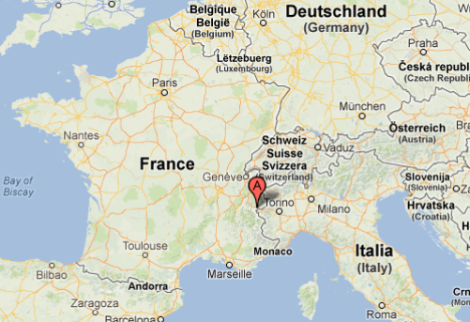
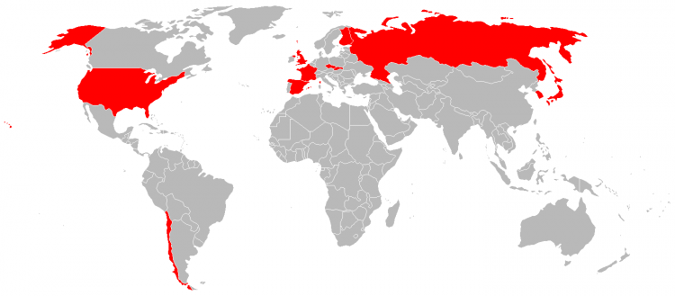
SuperNEMO
SuperNEMO is the successor of NEMO3, which ran in the LSM laboratory (Modane) in 2003-2011.
The installation will begin in 2014 and first data are expected in 2015.
International collaboration (10 countries, ~150 people).

Slide 4
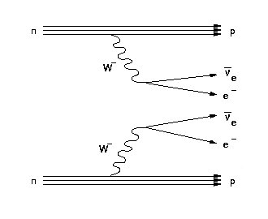
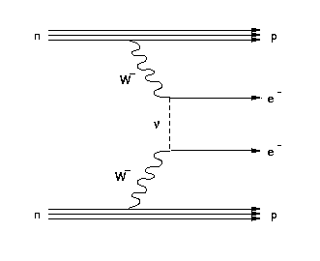
Physics goal
Study the mechanism of the ββ decay and search for neutrinoless ββ decay:
Experimentally:
2ν2β
0ν2β
k: constant
A: molecular weight
M: source mass
t: time of measurement
N_{bkg}: background events
r: energy resolution

Slide 5
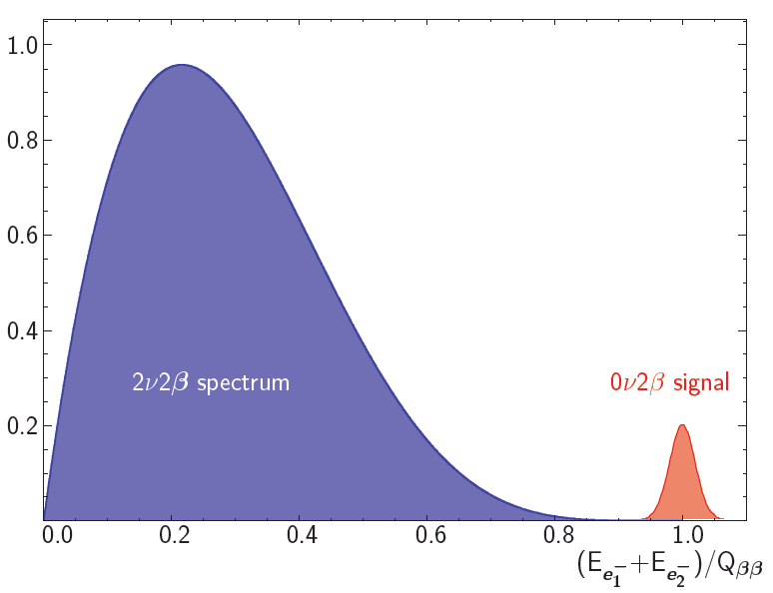
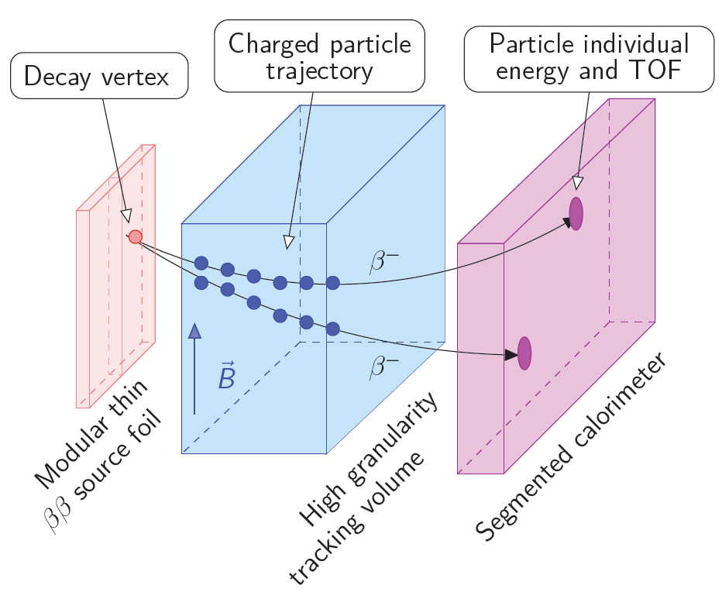
Measurement principle
We want to:
1. measure the energy of the two
electrons with good resolution.
2. identify the two electrons individually
(E_{e1}, E_{e2}, cosθ).
Choice of calorimeter+tracker technique.
Reconstruction of final state topology (vertex, E₁, E₂, cosθ, Δt).
Particle identification (α, β±, γ):
1. background rejection.
2. measurement of physics signal.
Source separated from detector: several isotopes.

Slide 6
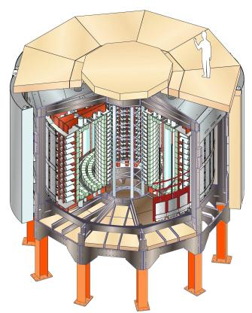
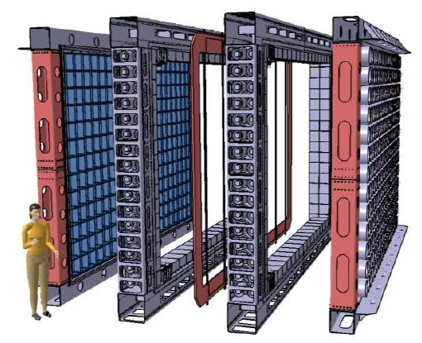
From NEMO3 to SuperNEMO
2003-2011
 | NEMO3 | SuperNEMO
isotope | ¹⁰⁰Mo (70%), ⁸²Se, ¹⁵⁰Nd, ¹³⁰Te, ¹¹⁶Cd, ⁹⁶Zr, ⁴⁸Ca | ⁸²Se (⁴⁸Ca or ¹⁵⁰Nd)
isotope mass | 7 Kg | ~100 Kg
efficiency | 18% | 30%
contamination in ββ foils | ²⁰⁸Tl ~ 100 μBq/Kg ²¹⁴Bi < 300 μBq/Kg | ²⁰⁸Tl ≤ 2 μBq/Kg ²¹⁴Bi ≤ 10 μBq/Kg
Rn in the tracker | 5 mBq/m³ | ≤ 0.15 mBq/m³
calorimeter resolution | 8% @ 3 MeV | 4% @ 3 MeV
sensitivity | T_{1/2}^{0ν} ≥ 10²⁴ yr m_{ββ} < 300-900 meV | T_{1/2}^{0ν} ≥ 10²⁶ yr m_{ββ} < 40-100 meV

Slide 7
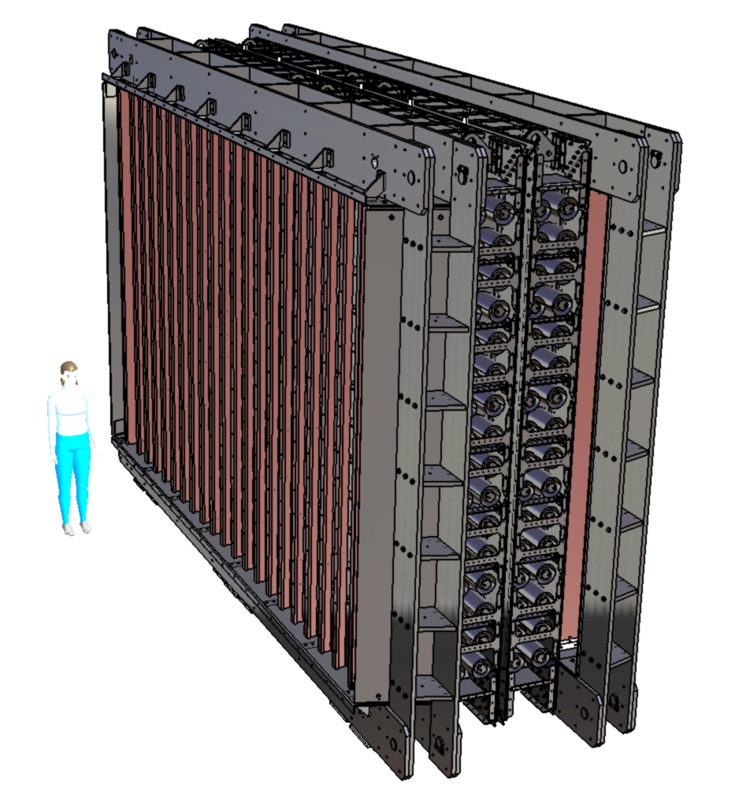
SuperNEMO detector
source foil
20 modules surrounded by passive shielding
(iron, water, plastic).
Source:
  2.7x4 m²
  5-7 Kg per module
  ⁸²Se (⁴⁸Ca and ¹⁵⁰Nd under consideration)
Tracker: drift wire chambers
in Geiger mode.
Calorimeter: ~600 plastic
scintillators coupled to low
radioactivity PMTs.
Challenge: large scale production under
ultralow background requirements.
Intermediate step to demonstrate the
feasibility -> the Demonstrator (one module
out of 20).
4 m
6 m
calorimeter
tracker

Slide 8
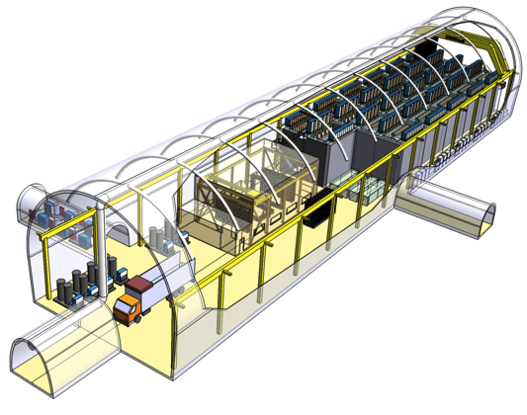
The Demonstrator
A zero background experiment!
Installation in the LSM.
Match radiopuririty requirements.
Prove BKG ~ 10⁻⁴ cts/keV/kg/yr.
Achieve NEMO3 sensitivity in 4.5 months!
Full production (2034 Geiger cells).
Demonstrator module construction and commissioning
Construction and deployment of
successive SuperNEMO modules
2013 | 2014 | 2015 | 2016 | 2017 | 2018 | 2019 | 2020 | 2021
Demonstrator module running

Slide 9
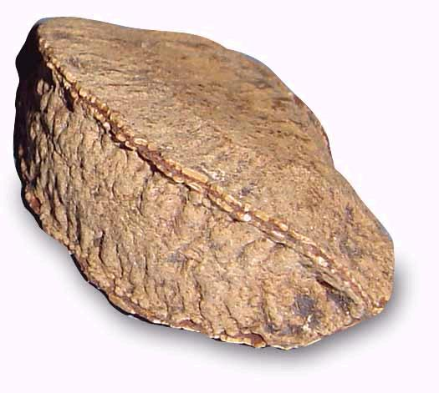
Radiopurity
Radiopurity requirement
is very demanding!
Choice of material very challenging.
  stainless steel.
  copper.
  Delrin.
Many bespoke solutions adopted.
  Delrin-clad internal cables.
  Feedthroughs.
Brazillian nut:
4 grams
~400 mBq
(Radium decays)
Demonstrator:
20 tons
<1.5 mBq
(Rn emanation into
tracker)

Slide 10
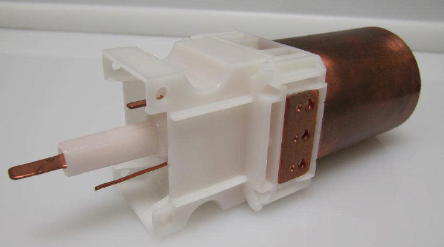
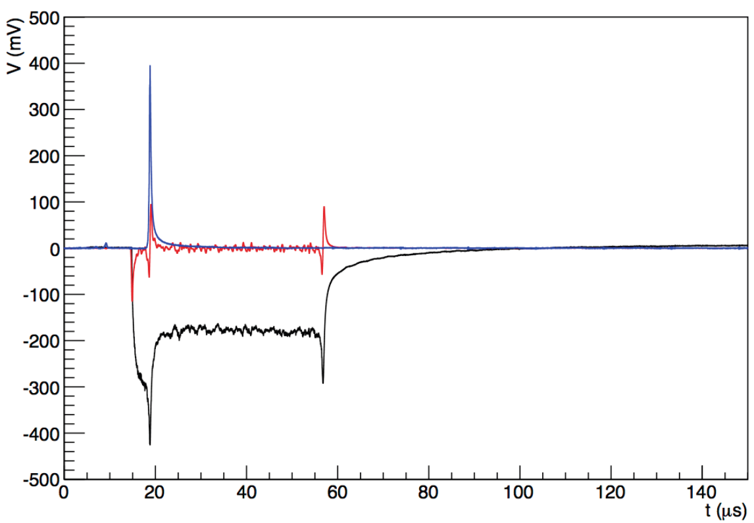
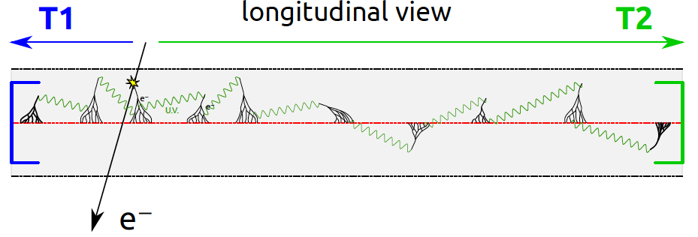
Tracker cell design
injected moulded Delrin block
UK (Manchester, UCL, MSSL) is responsible for the construction of the Tracker detector.
Decay vertex reconstruction, e± identification, e/γ separation.
The wires (stainless steel) of a cell are strung between
two endcaps.
Diameter of anode (cathode) wires is 40 (50) μm,
44 mm for the cell.
Gas mixture: 95% He, 1% Ar, 4% ethyl alcohol.
Operating voltage: ~1700 V
Measurement of radial and longitudinal coordinates.
cathode ring bar
HV bar
cathode
ring
cathode wires bar
cathode wires
anode signal
differential of
anode signal
cathode signal
T2
T1

Slide 11
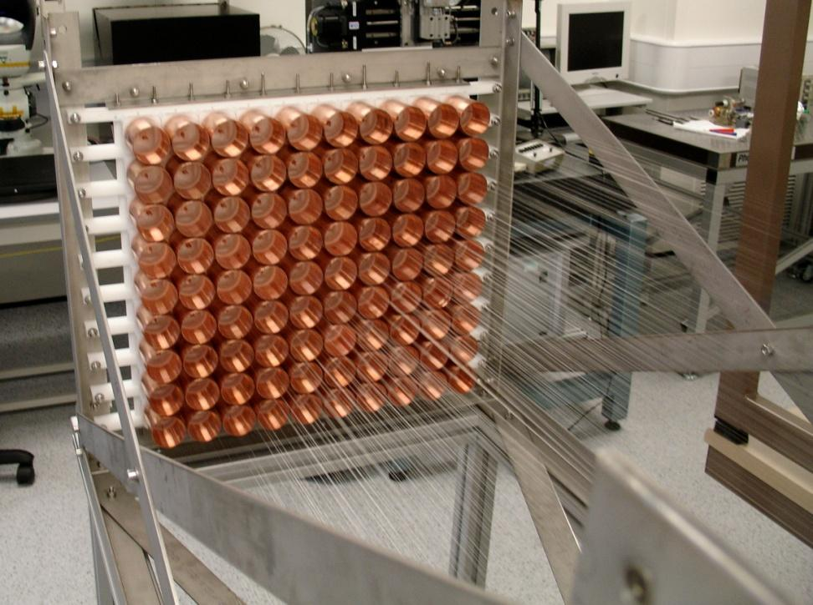
Tracker cell performance
Extensively studied with a 90-cell prototype.
Cosmic rays + plastic
scintillators trigger for
tracking studies.
Anode efficiency | 98%
Cathode efficiency | 91%
plasma propagation time | 52 μs
Transverse hit resolution | 0.7 mm
Longitudinal hit resolution | 1.3 cm

Slide 12
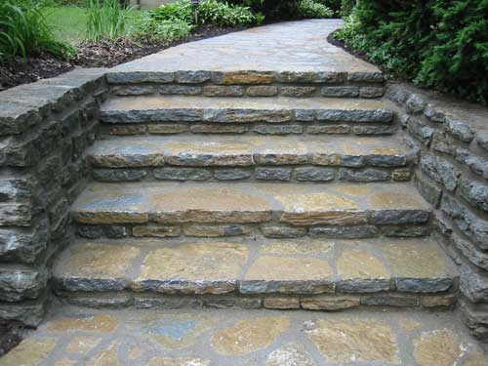
Tracker cell construction
Step 1: cleaning of all components.
Step 2: quality control of anode wires.
Step 3: construction of a cassette (18 cells).
Step 4: cassette quality control procedure.
Step 5: transport to MSSL and Tracker integration.

Slide 13
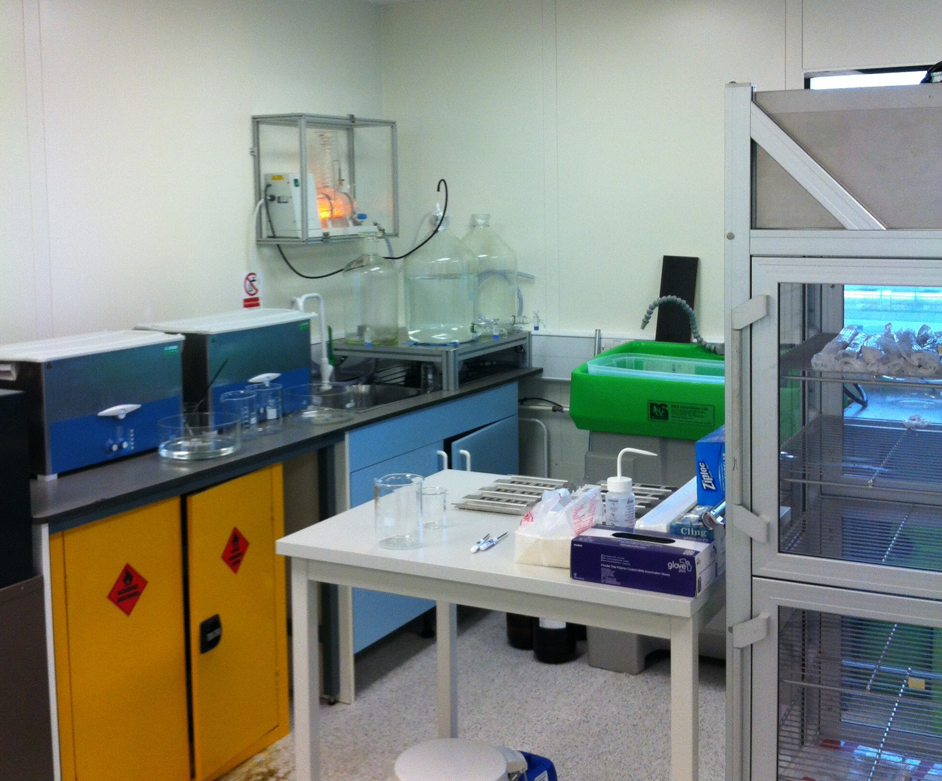
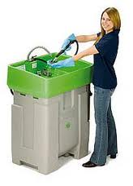
Step 1: cleaning
[class-1000 clean room]
  For stainless steel (frame material and wires):
    wipe clean with acetone
    rinse with tap water
    degrease in a biological bath
      Bio-Circle™ L at 41ºC
      Contamination (oils, salts) broken down by microorganisms
    Rinse with tap water then distilled water

Slide 14
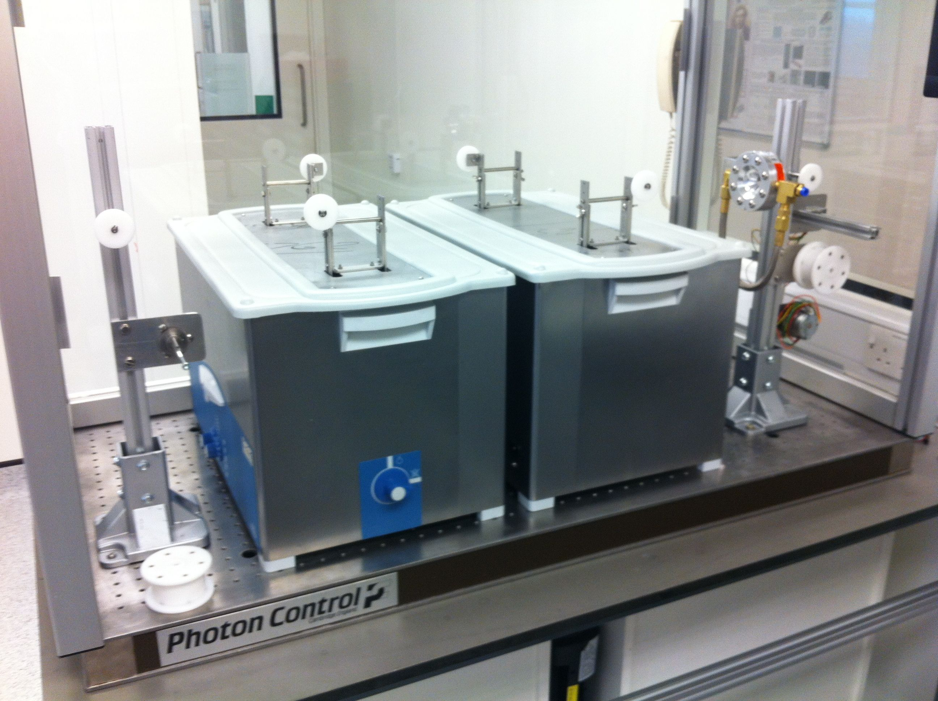
Step 1: cleaning
Ultrasonic bath in basic
solution at 80ºC.
5% base (Tickopur R33) in
distilled water.
Rinse with distilled water.
Ultrasonic bath in distilled water
(final rinse).
Drying at 60 ºC.
Samples stay in drying cabinet
until extraction and packaging.
Tested with HPGe after cleaning.
Pre-cleaned wire spool
Ultrasonic tanks
Venturi dryer,
motor drive
and take-up spool

Slide 15
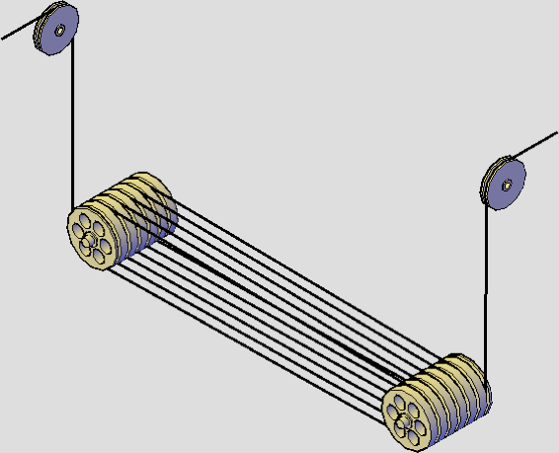
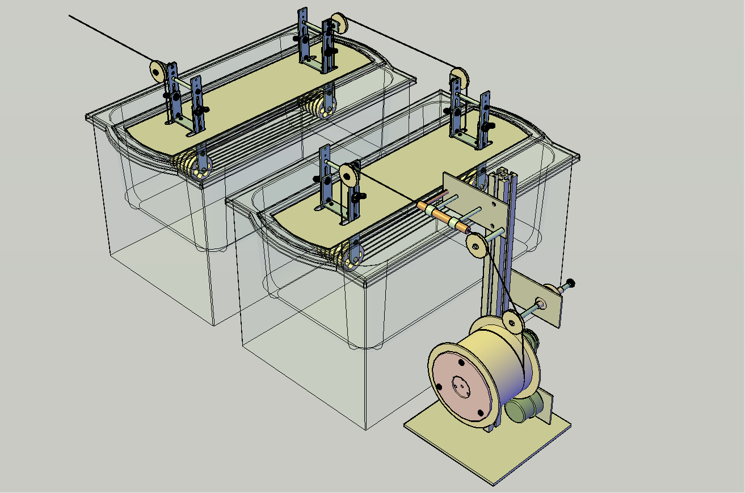
Step 1: cleaning
ultrasonic tank with looped wire
Forced-air (Venturi) dryer
Multiple loops of wire in ultrasonic tanks:
Tickopur R33 (base)
Distilled water rinse
Motor driven take-up spool

Slide 16
Step 1: cleaning
All chemicals used are safe for most materials including copper and plastics.
Delrin: same procedure
  Delrin offcut through procedure, examined under microscope before and after: no signs of damage (e.g. pitting, discoloration).
  Delrin-coated copper wire cleaned and tested recently to be OK.
Copper: propose same procedure and:
  final passivation step in citric acid bath (plus final rinse) to minimise oxidation.

Slide 17
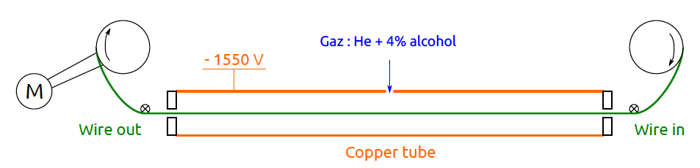
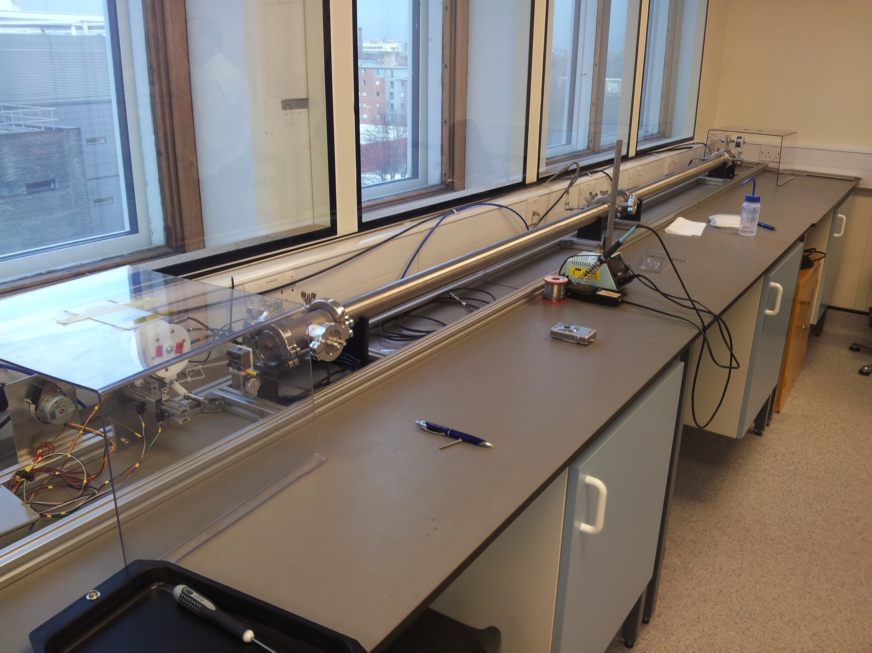
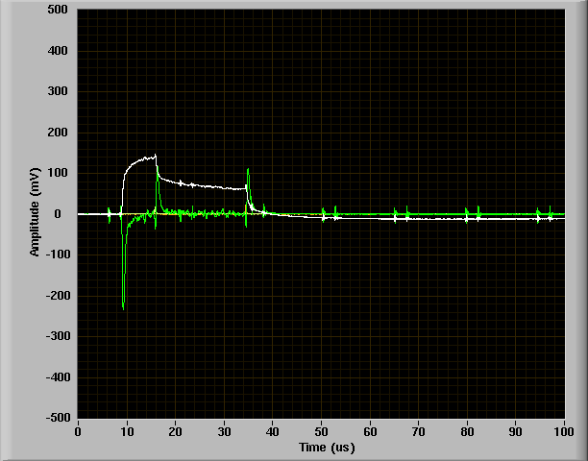
Step 2: anode wire quality check
Dedicated test bench for wire
quality control: 1.4 km/day can be tested.
We measure the signals due to cosmic
muons passing through the cell (trigger
rate, amplitude, plasma propagation
time,…).
Anode and cathode signals (both ends) are read out.
Gas: He + 4% alcohol
We can detect dust and self-triggering
points and measure their position.

Slide 18
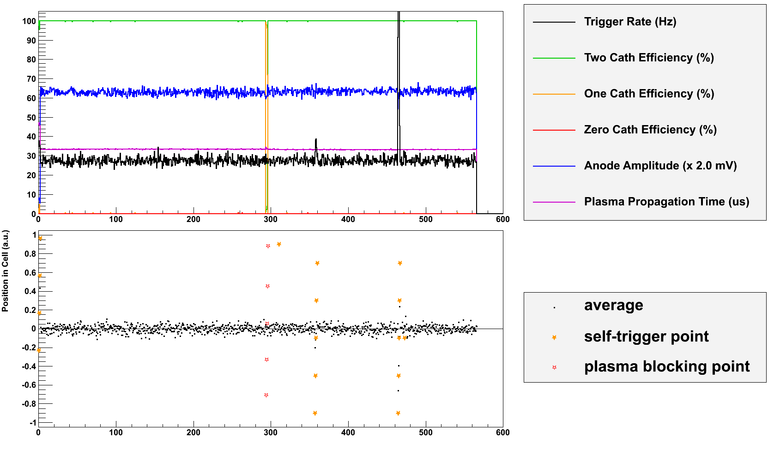
Step 2: anode wire quality check
m

Slide 19
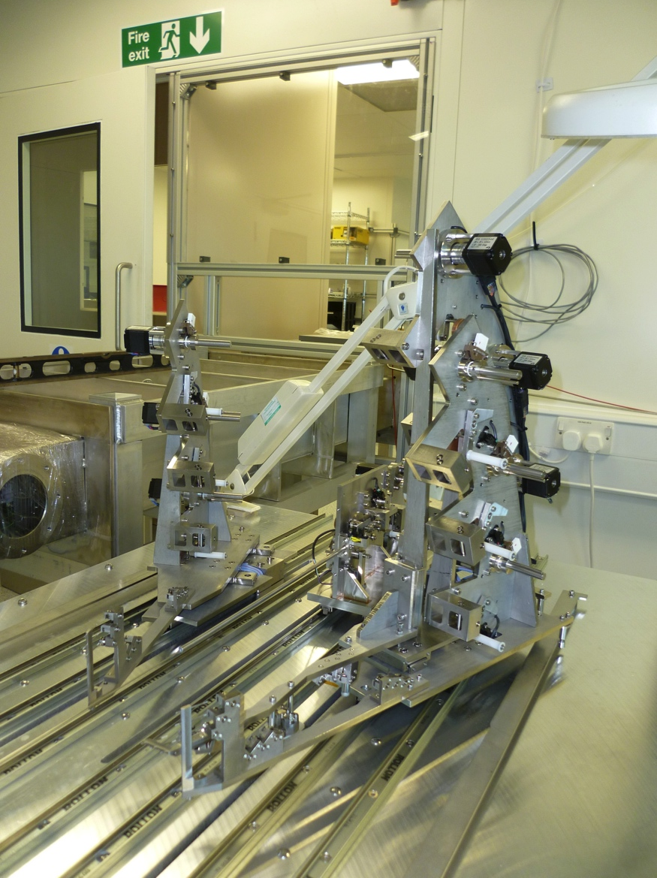
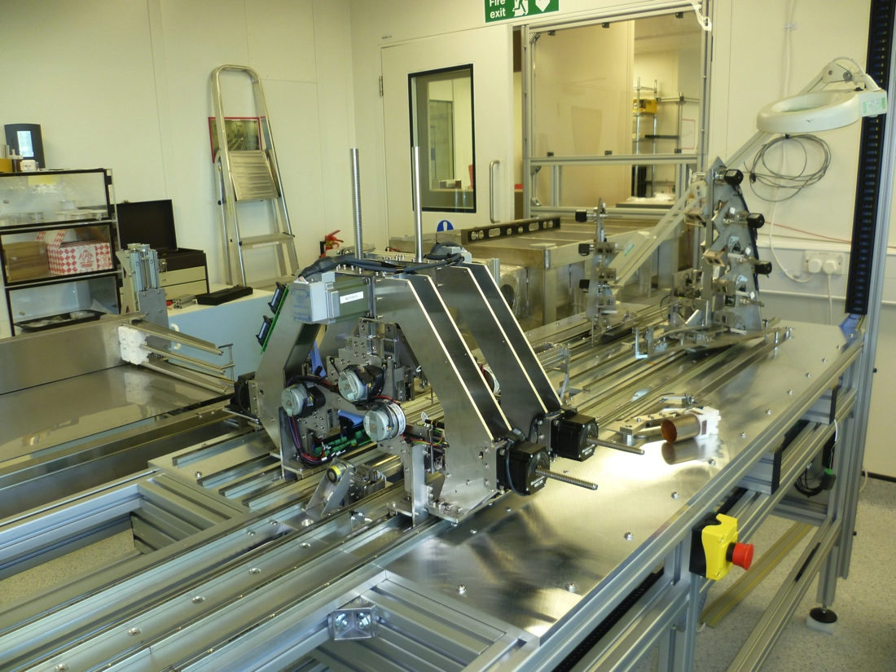
Step 3: cassette construction
5 cassettes/week (i.e. 90 cells per week) have to be constructed once
in production phase.
A wiring robot has been designed
in MSSL, built and optimised/finalised
with software in Manchester.

Slide 20
Step 3: cassette construction

Slide 21
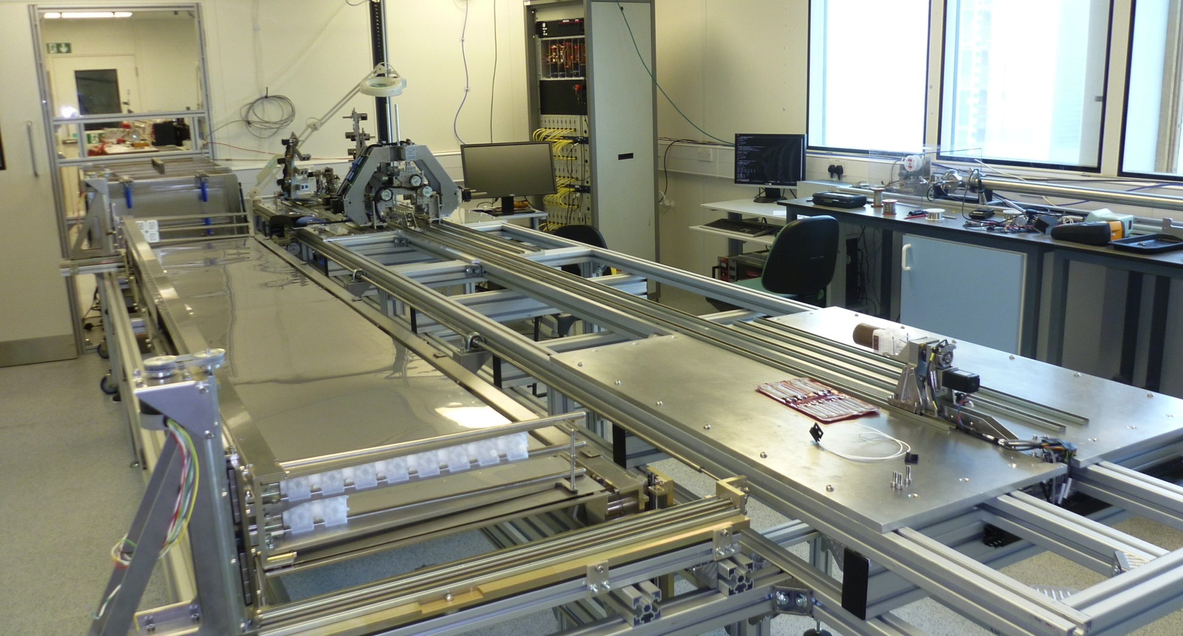
Step 3: cassette construction

Slide 22
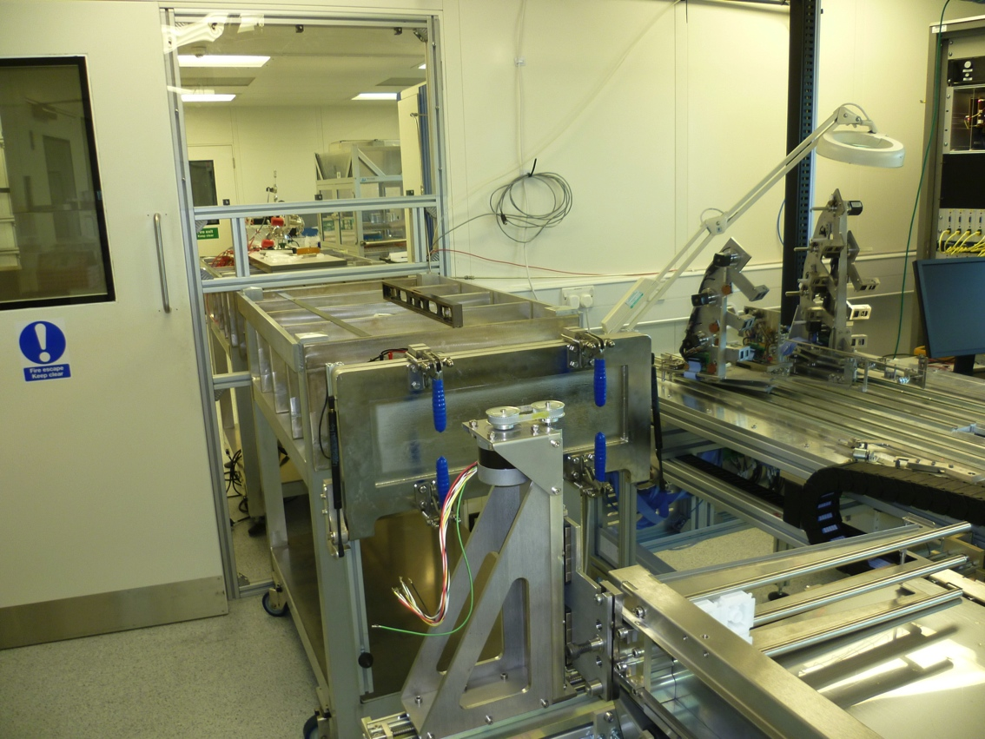
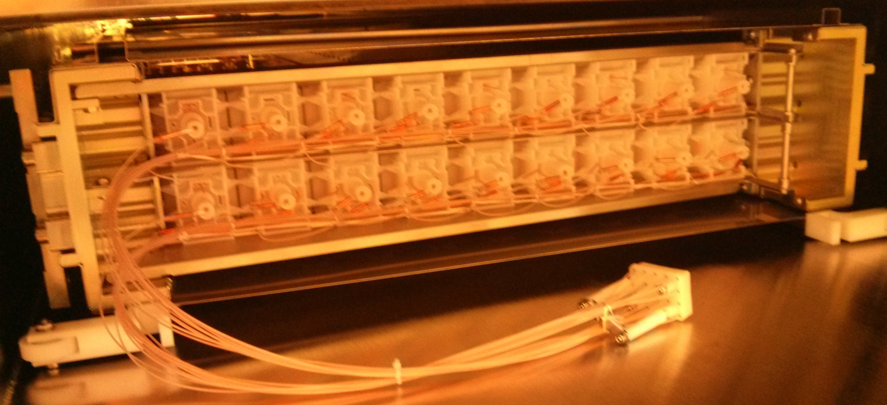
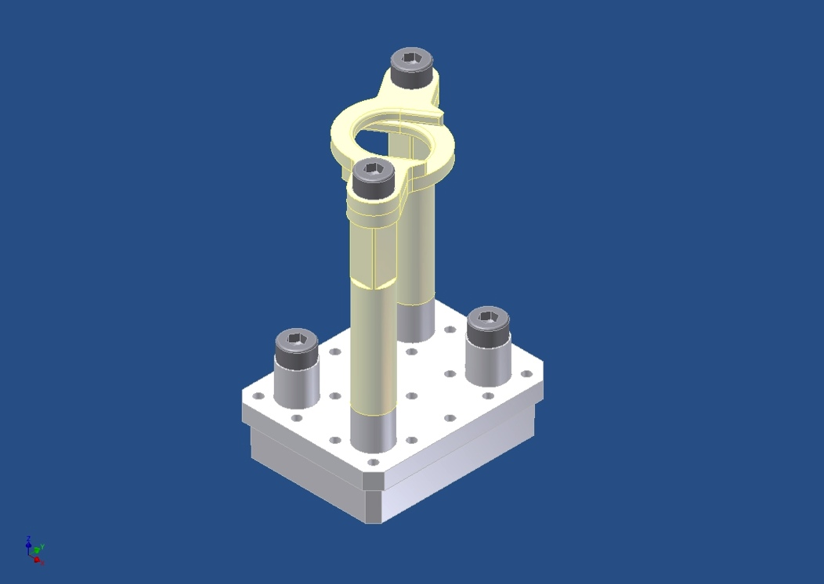
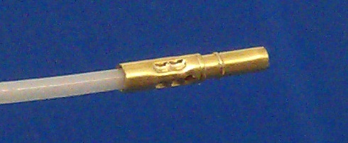
Step 3: cassette construction
Internal harness
Oxford U. is producing
feedthroughs and
associated connectors.
feedthroughs
connectors
Internal wire harnesses

Slide 23
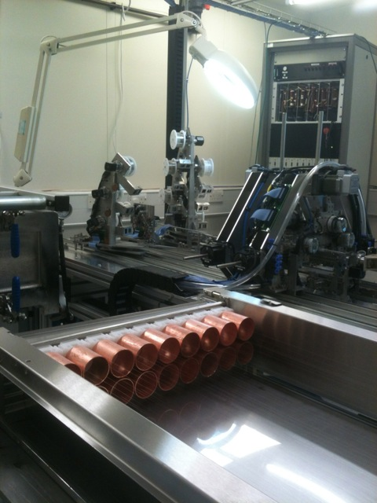
Step 3: cassette construction
First (dirty) cassette completed
at the end of April.
Ready for step 4!

Slide 24
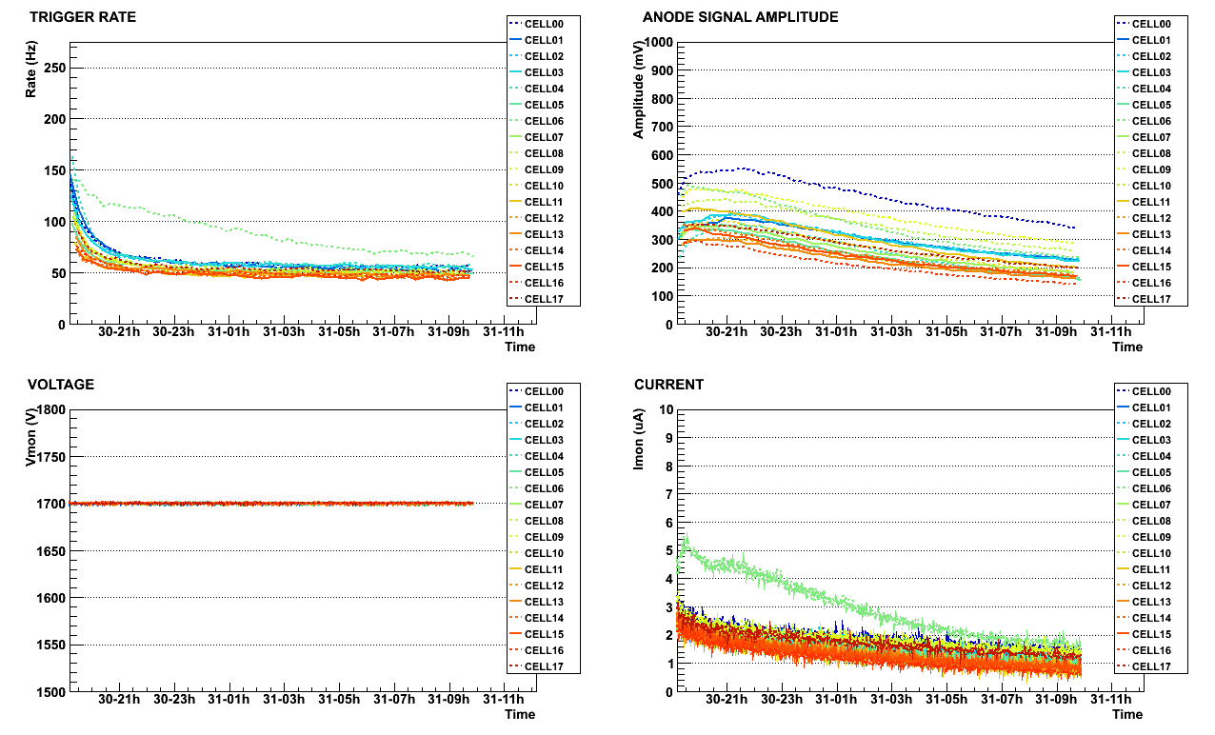
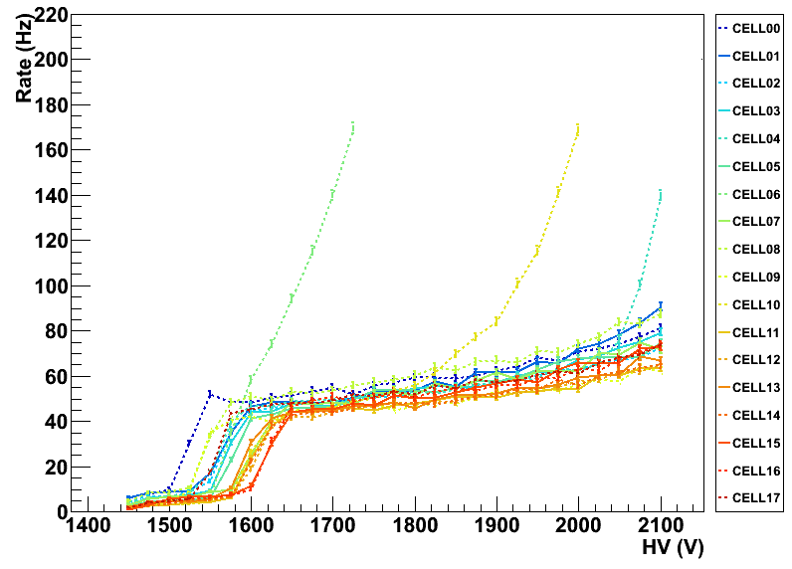
Step 4: cassette testing
Quality control criteria:
No self-triggering points.
No plasma-blocking points.
Monitoring of the 18 cells:
  Current
  Plateau width
  Operating voltage
  Cosmic rate
  Anode signal amplitude
  Cathode signal amplitude
  Cathode efficiency
  Plasma propagation time

Slide 25
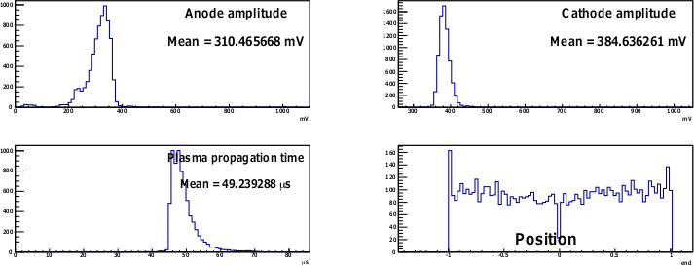
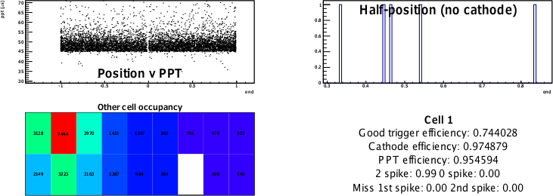
Step 4: cassette testing

Slide 26
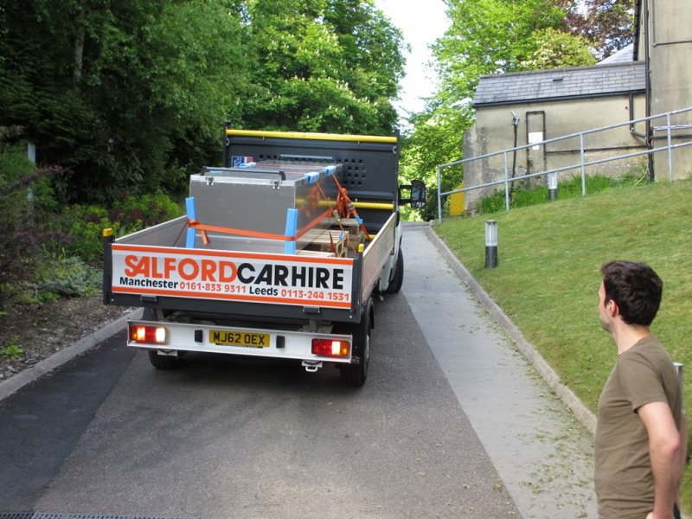
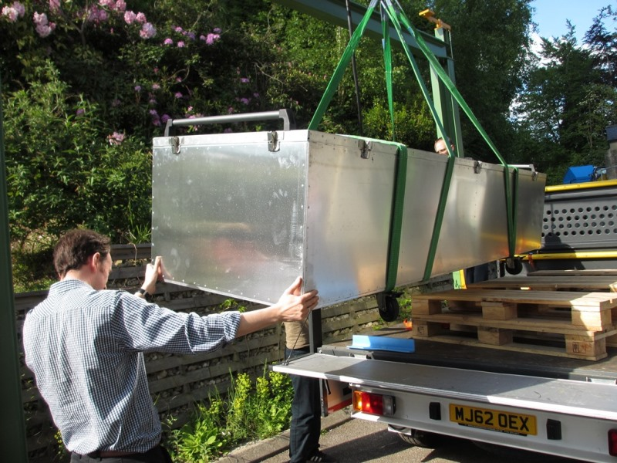
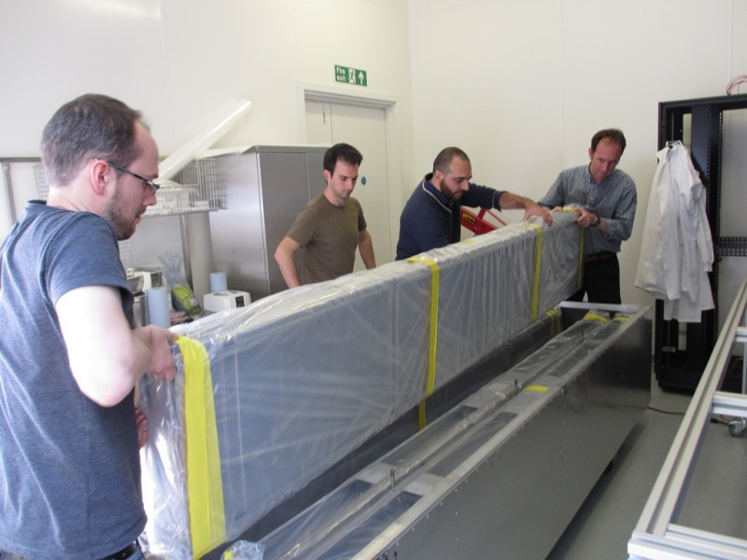
Step 5: transport to MSSL
first (dirty) cassette delivered to MSSL
for installation test onto the C-frame.
we aim for 5 cassettes/week:
C0 (1/4 of the Demonstrator) ready
in ~6 weeks.

Slide 27
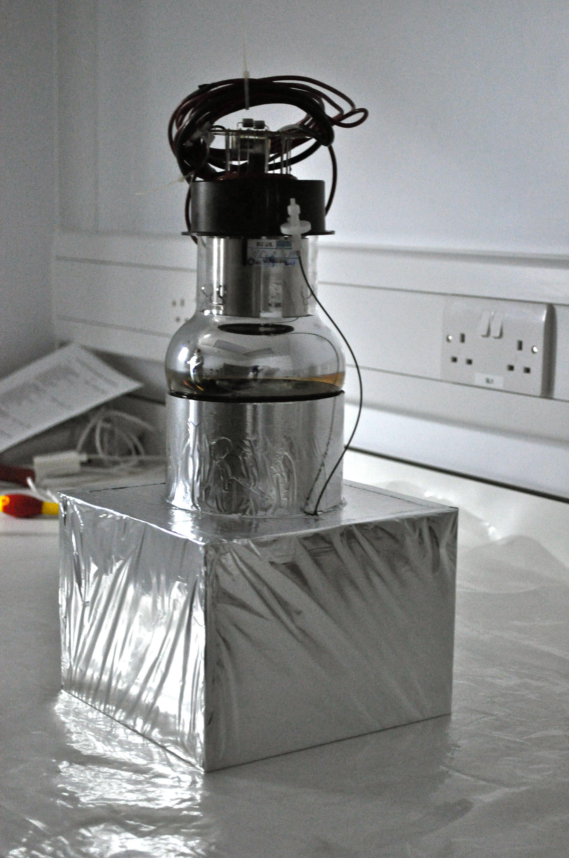

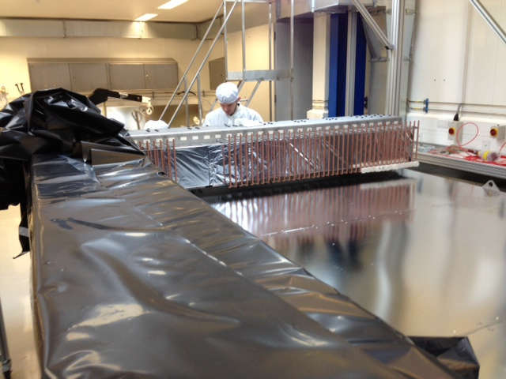
Step 5: Tracker integration
C0 (1st quarter of the Tracker frame)
has been completed.
All optical modules installed.
Being tested for radon emanation.
PMT
Light
guide
Plastic
scintillator

Slide 28
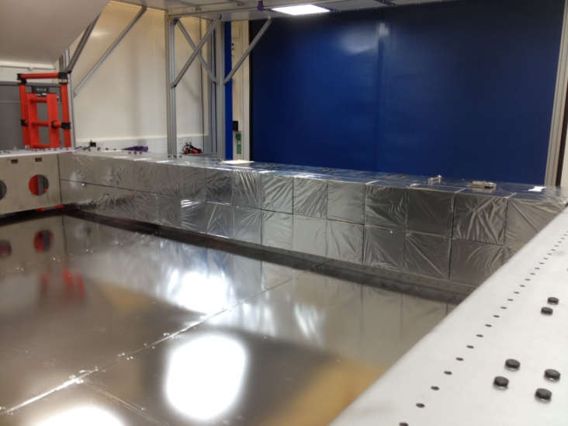
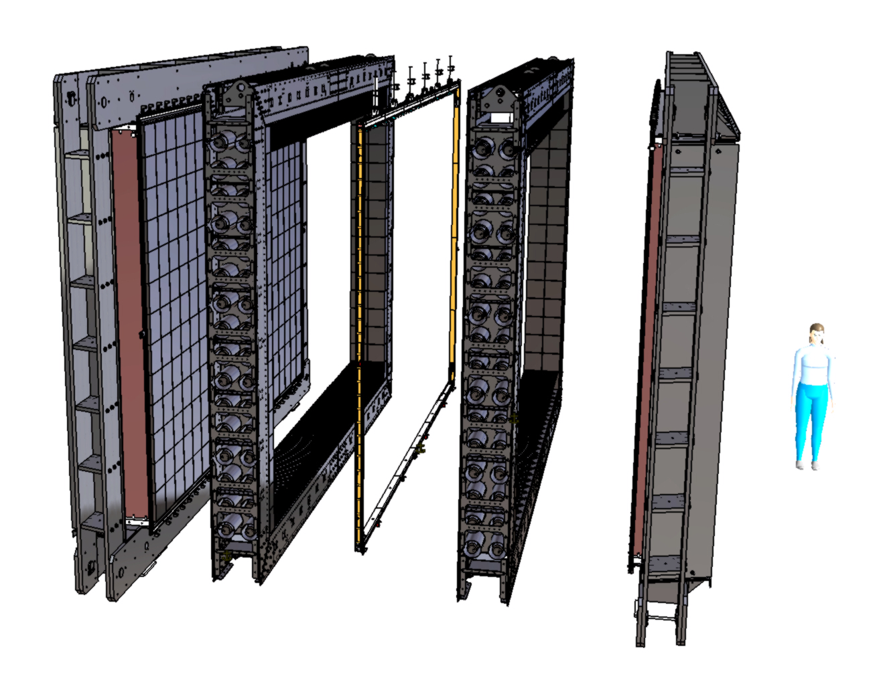
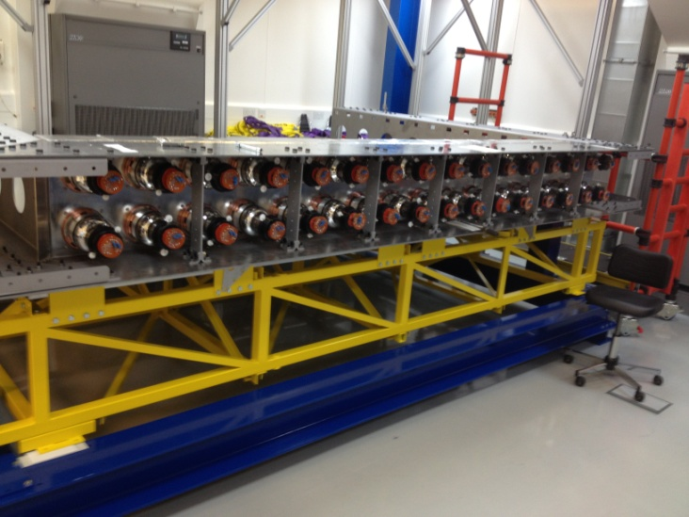
Step 5: Tracker integration
Ready to try installing a Tracker cassette.

Slide 29
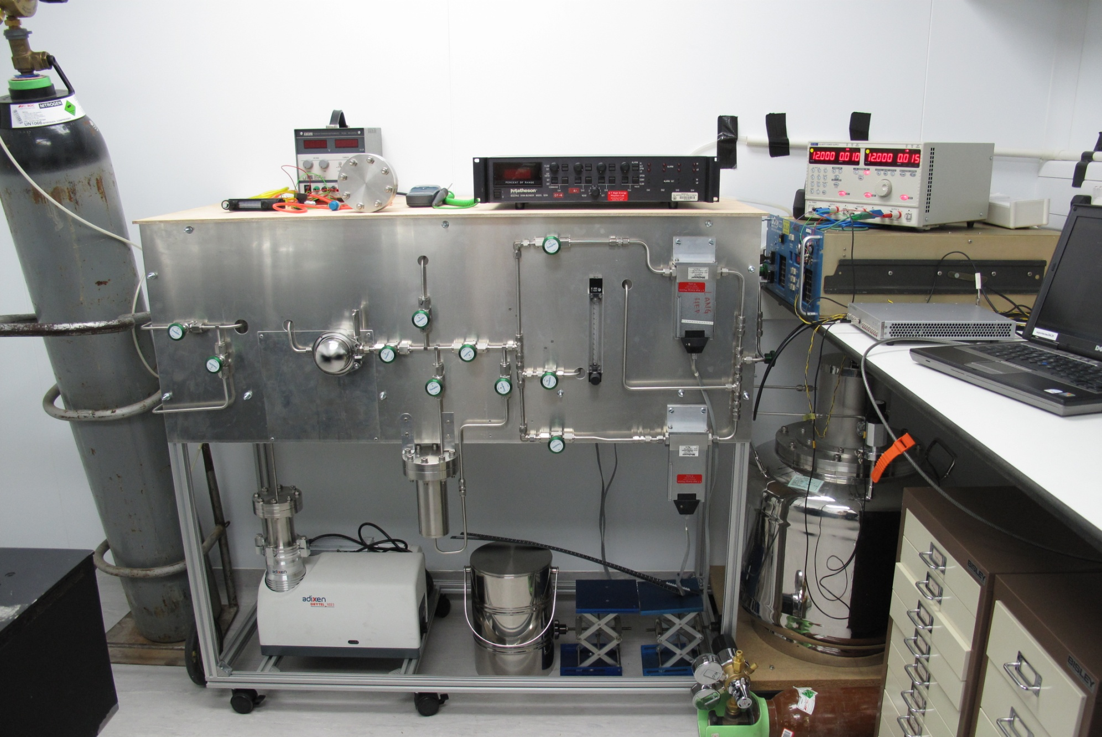
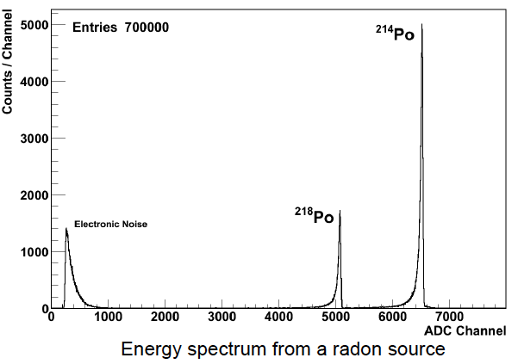
The Radon concentration line
Radon concentration in the Tracker is required to be < 0.15 mBq/m³.
Radon is able to diffuse through solids and may diffuse through gas seals and into the detector.
Monitoring during construction!
Gas from tracker pumped through a carbon trap and the radon in the gas is absorbed.
The trap is heated and radon pushed into detector via helium purge.
Radon progenies collected on a PIN diode and identified by energy deposit.
Sensitivity of ~0.05 mBq/m³ for a 3.8 m³ sub-module achievable.
Vacuum
pump
Carbon
trap
Radon
detector

Slide 30
Summary
SuperNEMO Tracker R&D phase is now concluded and all the objectives have been reached.
We are now entering the construction phase of the first SuperNEMO module (The Demonstrator).
UK is responsible for the construction of the Tracker detector.
Results from the first 18 cells built are very promising.
The Tracker frame has been completed and all optical modules installed.
Next:
Start mass production of cells in a proper clean environment.
Start assembling the Tracker and measuring the emanation of radon.

Slide 31
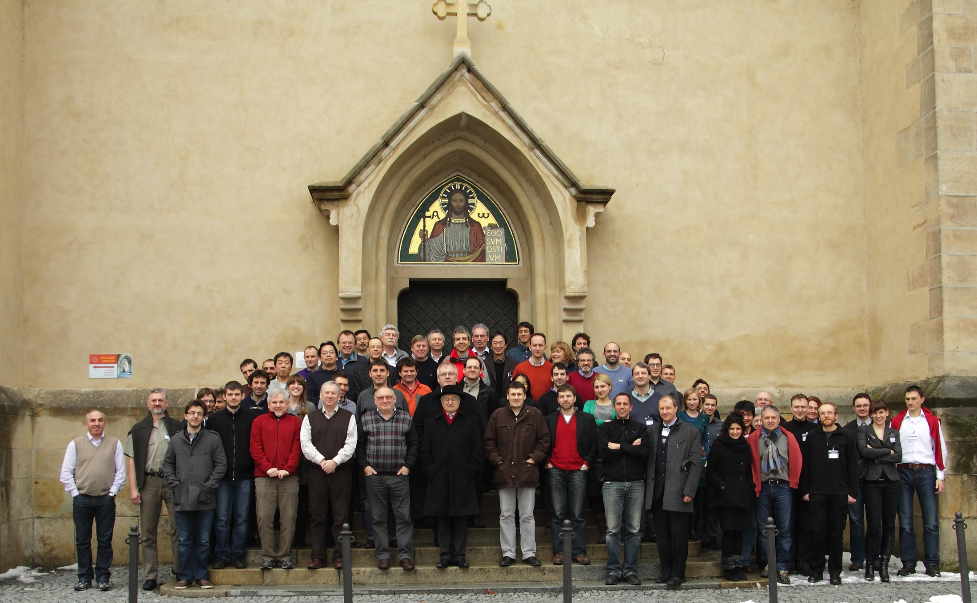
Thanks for listening!
Collaboration meeting in Prague,
03/2013

Slide 32
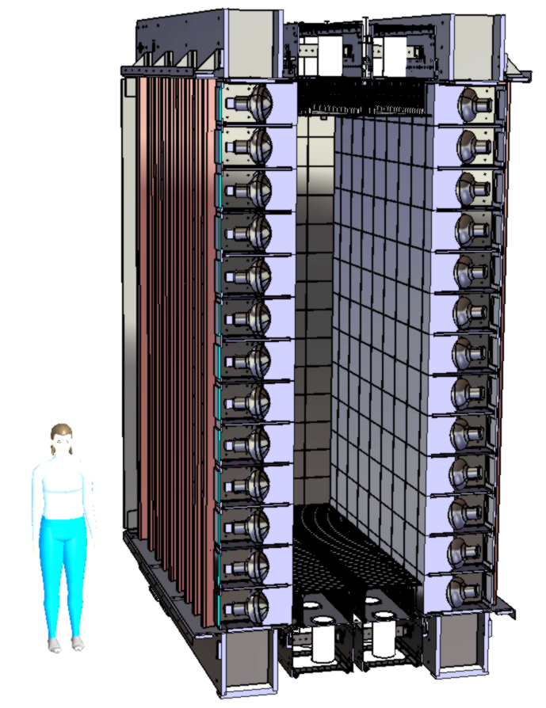
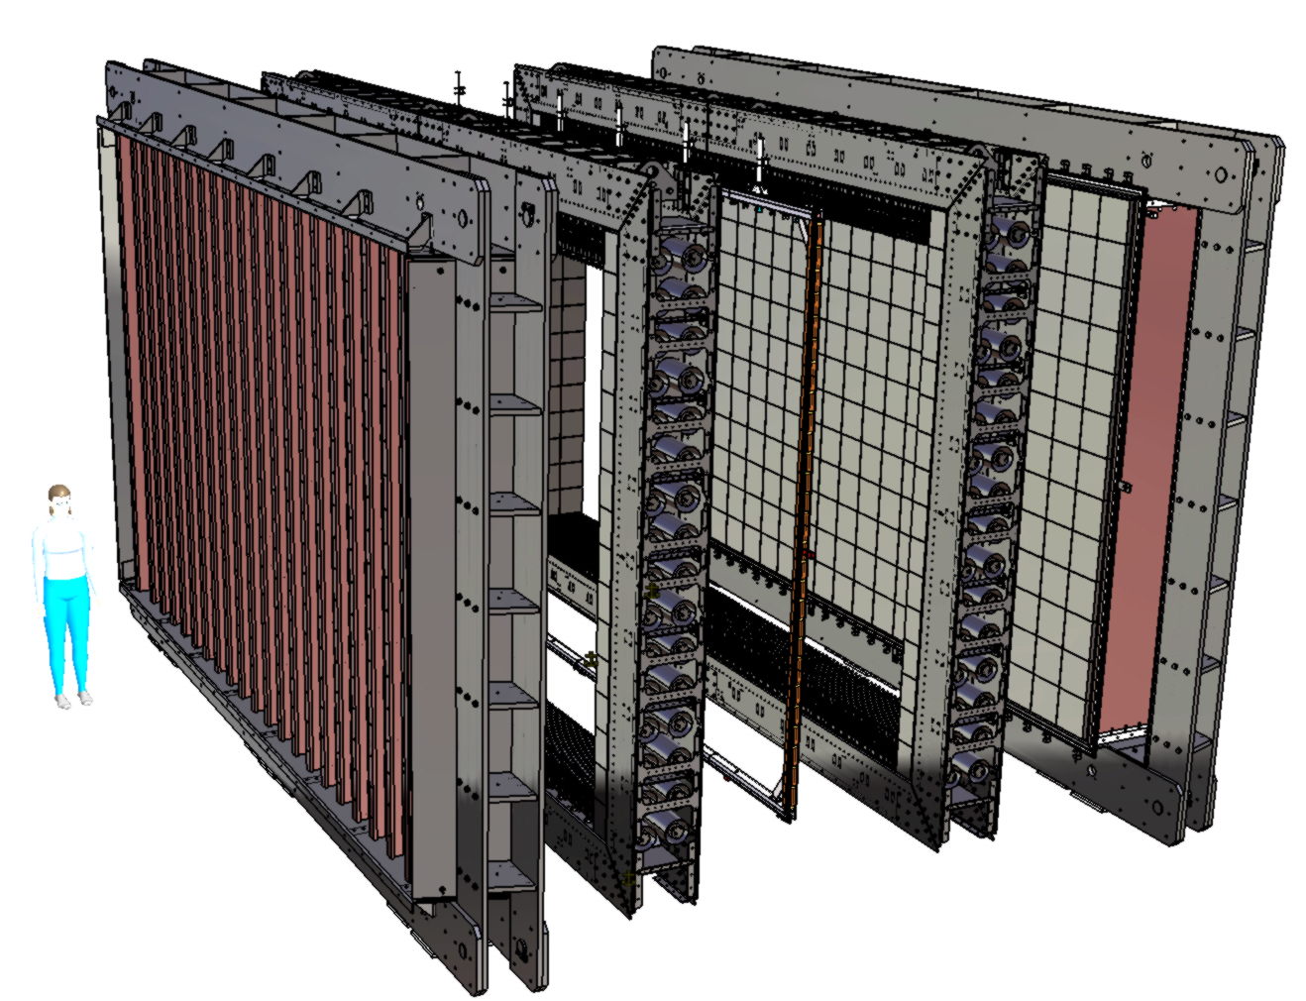
Spares

Slide 33



FEAST
Front-End Asics for Supernemo Tracker
technology 0.35 μm CMOS
time resolution 12.5 ns, 48 bits counter
54 channels (18 anodic, 27 cathodic, 9 generic)
test performed by Manu Chauveaux (MCR),
Sébastien Drouet and Laurent Leterrier (LPC)

Slide 34


Analog signal from FEAST
Analog signals from FEAST, using cell01 @ 1750 V
3 configurable thresholds : VLN, VHN and VHP
5 registers : 1 start (R0) + 4 stop (R1 to R4)
t(R1) ≈ t(R3) and t(R2) ≈ t(R4)
t(R1) + t(R2) ≈ t(R3) + t(R4) ≈ 50 μs

Slide 35




Results from FEAST test

Slide 36

Results from FEAST test
8175 events [delay time > 5 ms]
Category | Efficiency | (%)
t(R1) + t(R2) ≈ t(R3) + t(R4) ≈ 50 μs | 73.1
t(R1) + t(R2) ≈ 50 μs | 73.7 | 98.7
only t1 (center or endcap) | 25.0
t(R3) + t(R4) ≈ 50 μs | 93.4 | 99.0
only t3 (center or endcap) | 5.6
OR of all combinations |  | 99.6

Slide 37

Diffusion chamber
Radon source: 38 kBq/m³
film material under test
C₁
C₂
Possible radon seals:
RTV, silicone : C₁~C₂ → transparent!
Mylar/Tropac/PVA : C₁/C₂ ≥~10,000

Slide 38

Tracker cell operation

Slide 39



Background
external
internal

