Slide 1
Forum on Tracking Detector Mechanics
19th – 21st June 2013
Large Scale Metrology for
Tracking Detectors
Experience from LHC and Prospects
Antje BEHRENS, Jean-Christophe GAYDE, Dirk MERGELKUHL
(CERN BE-ABP-SU-EM)

Slide 2
Table of content
Mandate of survey team
Preparation and requirements
Toolbox
Equipment
  Photogrammetry
  Leica AT401
  Recent examples AT401
Scanning
Conclusion

Slide 3
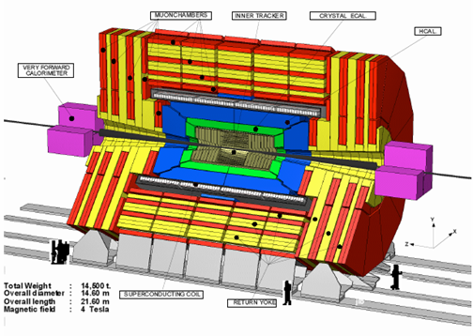


Large Scale Metrology Section
BE-ABP-SU Experiment metrology team
Mandate:
  The geometrical infrastructure for the detector installation
  Detector metrology for assembly and alignment on the beam lines
  The as-built measurements following with the installation phases
This includes:
  Prototypes, deformation tests, quality control, (pre-)assembly, alignment
What we see…
What we want to know…

Slide 4
Pre-Discussion
Discussion with physicist/engineer/designer for each tasks
  Define precisely the needs for geometrical control / alignment / survey
  Define all stages when survey will be needed
  Find reasonable solutions
  Include alignment to the design (references and space)
  Define local coordinate system
  We have to adapt to the experimental schedules
Typically provided measurement precision (1 sigma)
  Detector control at manufacturing before assembly
    0.03-0.3 mm (max. 0.5 mm)
  Deformation of detectors under special conditions
    ~ 0.1 mm
  Relative position of detectors wrt other detectors
    < 0.5 mm
  Absolute position of detectors wrt accelerator geometry
    < 1.0 mm

Slide 5
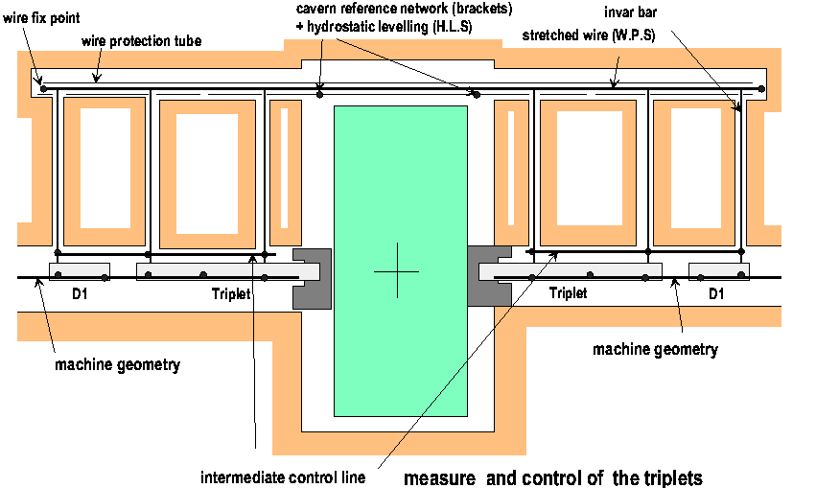
Link Machine – Experiment (ATLAS+CMS)
➔ NO survey galleries for ALICE and LHCb!

Slide 6
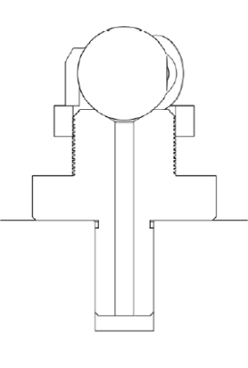
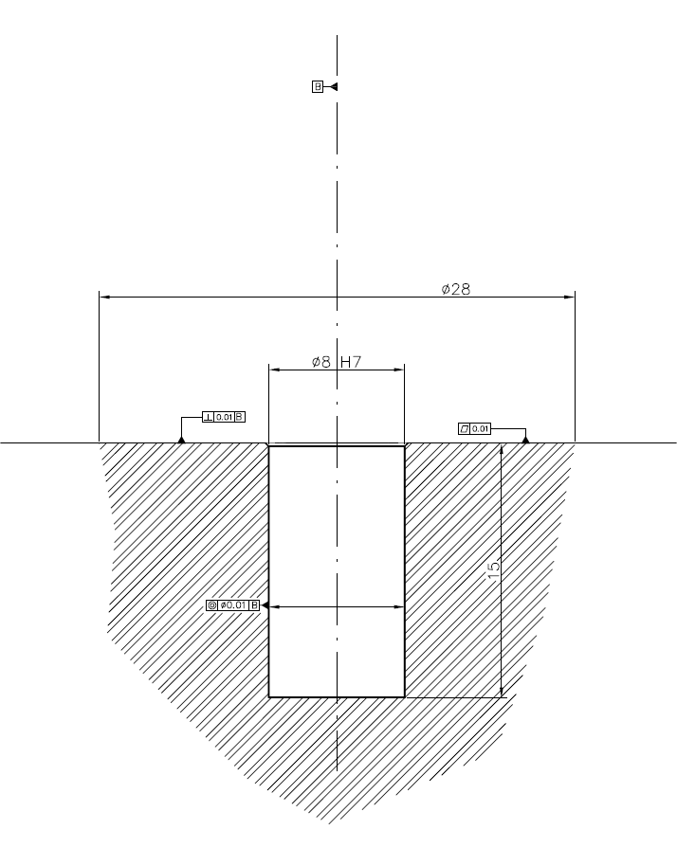
Preparation
Survey reference points
  Different survey targets have to be placed on object
  3D – survey reference hole
  ➔ best solution, highest flexibility
20.0 mm
Define survey reference holes on detector
  Already early in the design phase
  Reference hole accessible and visible during ALL phases
  Position on stable support
  On individual detector elements as later on assembled groups
  For theodolite, laser tracker or photogrammetry
  Coordinates are given for centre of survey target
  Sensitive elements are referred to reference holes by constructor
8H7 reference hole
28 mm contact surface
15 mm depth
WARNING: the values are given as indications
Every new values must be discussed and agreed!

Slide 7
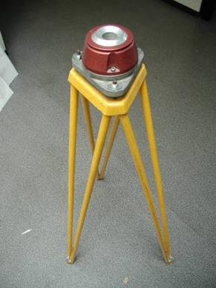
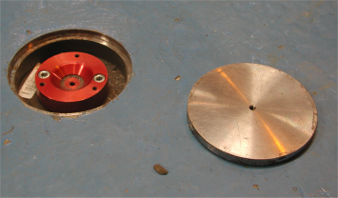
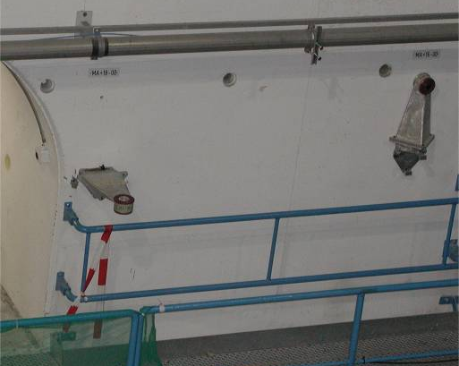
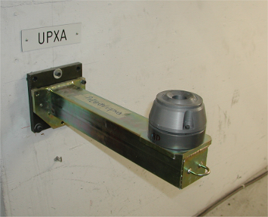
Additional survey requirements
Local network
  Tripods bolted to the floor or brackets on walls
  Support points permanently fixed on walls / stable pillars
  Temporary network points glued around detector
Stable floor for theodolite measurements (concrete foundation)
Access to detector for installation of survey target
Line of sight between instrument station and points
Constant temperature for significant results for dimension

Slide 8
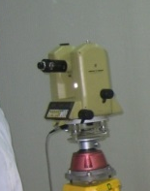
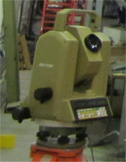
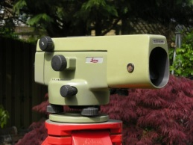


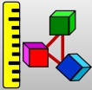

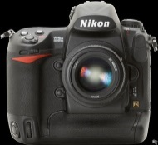
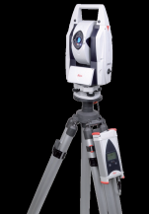
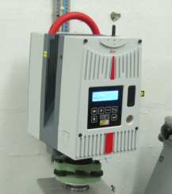


Survey Toolbox
T3000/TC2002
SU software
NA2
TOOLBOX
Experiment metrology
D3X
LTD500
Commercial software
HDS6200
AT401
➔ Line of sight between instrument and object required!

Slide 9
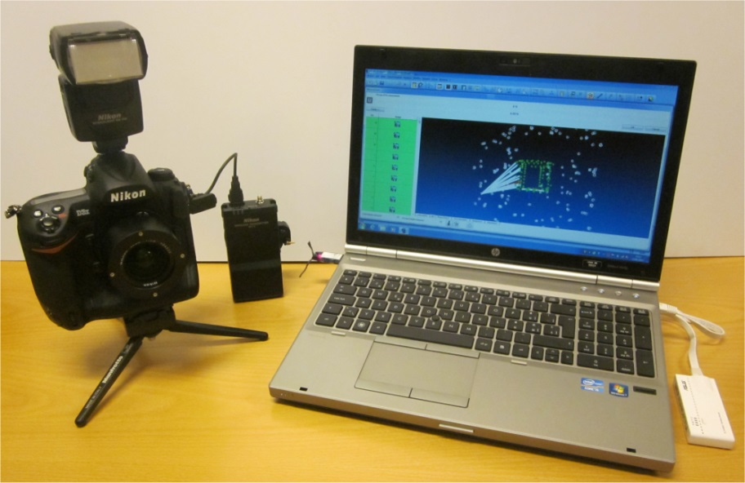
Photogrammetry
Image acquisition needs no stable station
  Photos taken on platform, scaffolding or cherry-picker
Mobile System with ‘high’ precision
  Off-site interventions in factory (Pisa, Aachen…)
  Clean rooms, assembly halls and experimental caverns
  Inner detector components < 1m (1 sigma < 50 microns)
Limited measurement time for large amount of points
  Short interruption for installation, production process
Camera system
  PC (windows XP, W7)
  Nikon D2X–12MP
  Nikon D3X–24MP (Full Frame)
  Wireless module
  Different lenses (17-28 mm)
  Top flash, ring flash
Software
  AICON 3D Studio V. 10.0 – DPA PRO

Slide 10
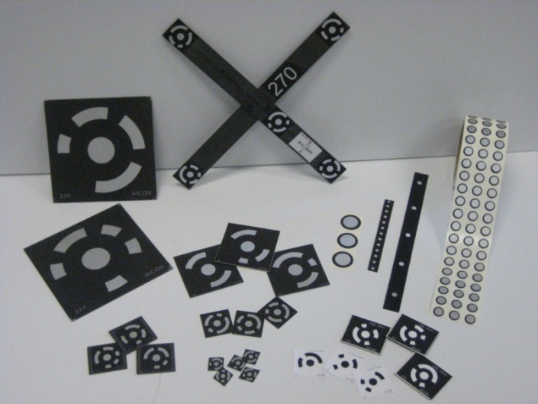
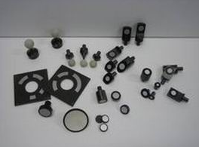
Photogrammetry
References
  Carbon fibre scale bars (max. 1.5 m)
    Calibration on CMM
  Geodetic measurements
    Laser tracker
    Total station
Targets
  Coded / non-coded
  Retroreflective / non-retroreflective
  Button targets Hubbs / GMS / Aicon
  System optimized for measurement of
  signalized points only = highest precision
  ➔ We have to touch the detector

Slide 11
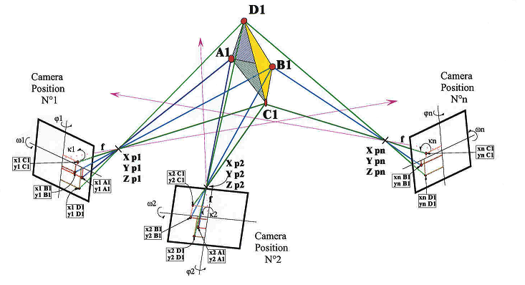
Photogrammetry principle
IST and VI 180
PST UX15
DST SR1

Slide 12
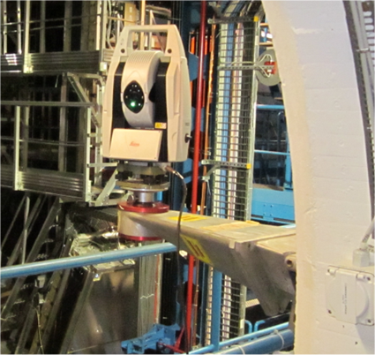
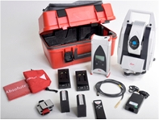
Leica AT401
Laser tracker in theodolite housing
As flexible and light as theodolite
For different volumes as
  experimental cavern network
  individual detectors
Instrument can be remote controlled
➔ automatisation possible (ALARA)
Instrument has same support as theodolite
➔ existing survey infrastructure can be used
Specifications for precision
  15µm + 6µm/m MPE
  7.5µm + 3µm/m typical
  ➔ Precision at 10m distance < 0.05mm typical (1 sigma)

Slide 13
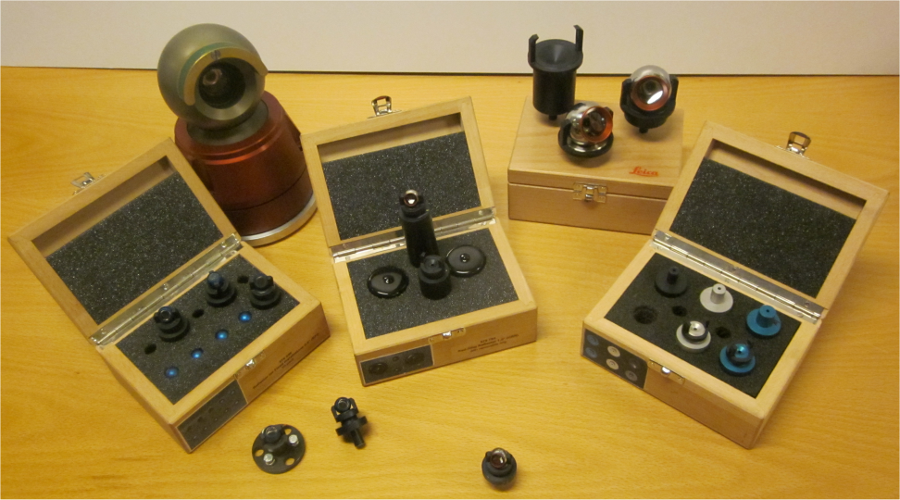
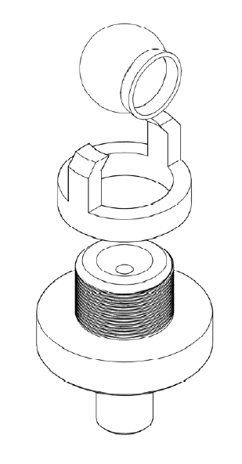
Leica AT401
AT401 is measuring with respect to previous equipment:
  5x better for distances
  2x better for angles
Prisms with 1.5” and 0.5” diameter and adapters
Interchangeable tooling to photogrammetric and total station targets available for survey reference holes
2x AT401 delivered September 2012 (LHC experiments contributed)
gain in precision, time and human resources!

Slide 14
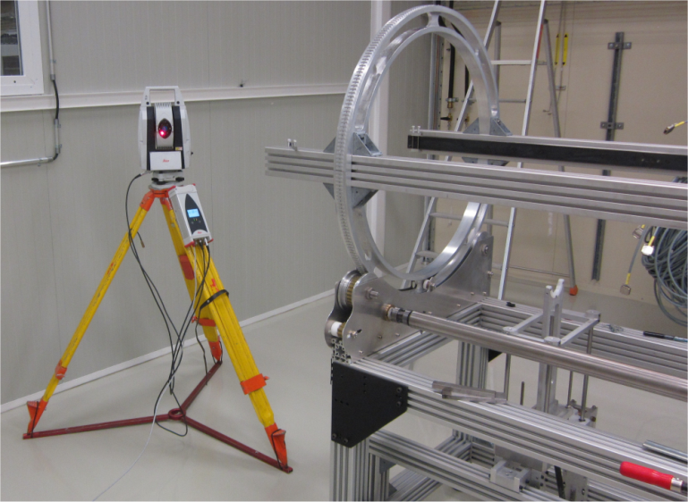
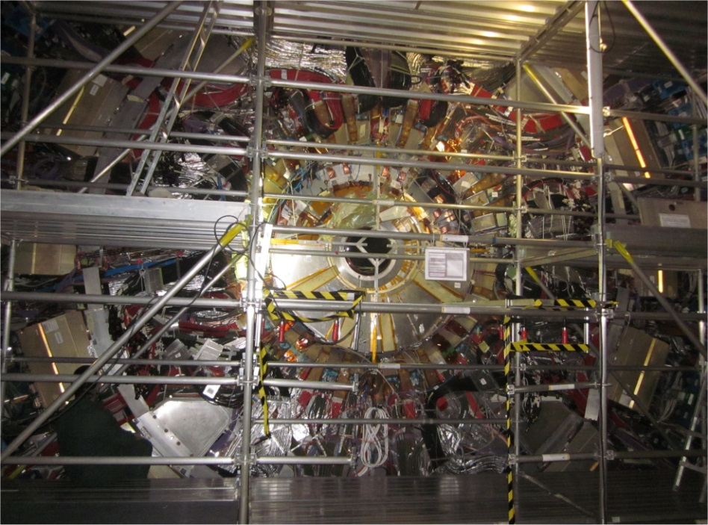
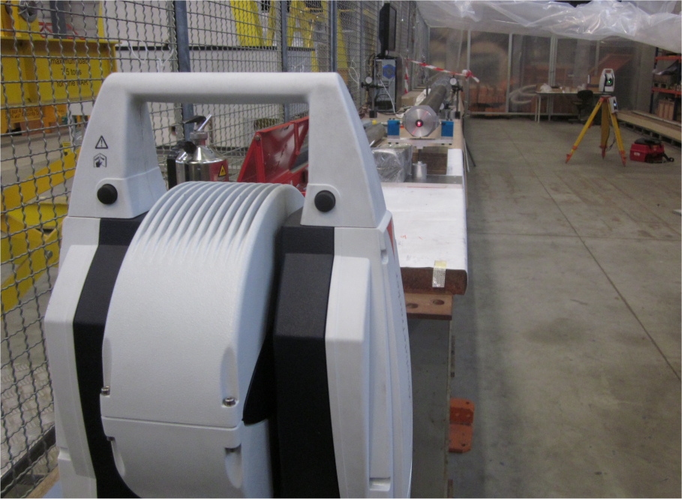
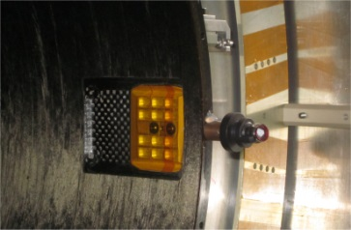
Recent examples AT401
Alignment of Pixel tooling in hall SR1
  False floor in SR1!
DST for Pixel extraction in UX15 and SR1
Measurement of PST ends in UX15
Deformation test for IST in hall 180
Relative precision < 0.1 mm

Slide 15
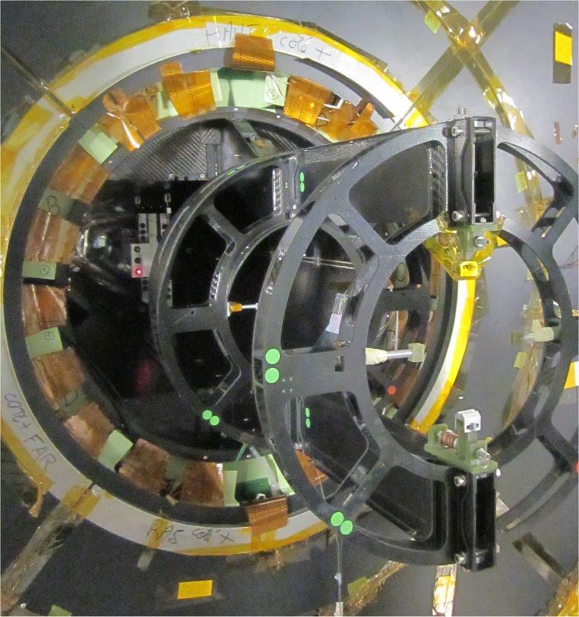
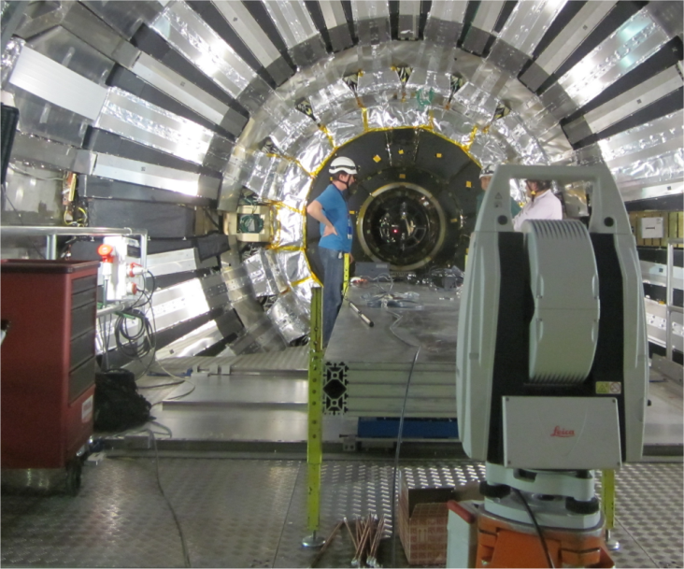
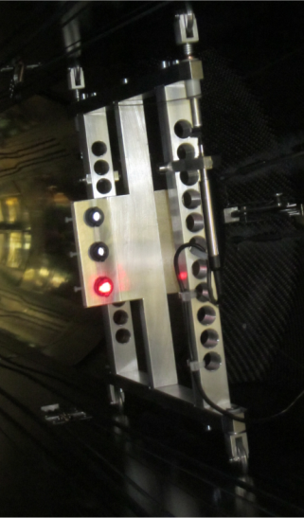
Recent examples AT401
Measurement of rails in Pixel support tube (CMS-UXC55)
Station on platform with very limited stability – no access during measurement
Special adapter for survey

Slide 16
Laser Scanning
Scan data can bring as-built dimensions into the 3D CAD model to have most accurate of CAD models for future upgrades etc.
Scanners exist for different precisions from μm to cm level
  Level for integration at 1-3 mm
Special properties for surfaces to get good quality:
  Not transparent (glass, resin)
  Not completely black or complementary colour of scanner laser
  Not too reflective (no mirrors, polished or shiny surfaces
  => Surface could be prepared with spray, adhesive tape, paint etc.
Geo-referencing necessary to link the scan to coordinate system of object or to global reference system
  by known targets distributed in object space
  link between scans by measurement arm, tracker, CMM
  transformation of point clouds (only relative)

Slide 17
Laser Scanner available on market
Laser Scanner
Long Range
Short Range
Handheld
Stable Station
Creaform Handyscan
Mantis Vision
F5
Stable Station
Leica
HDS6200
Noomeo
OptiNum
GOM
ATOS
Breuckmann
StereoSCAN, SmartSCAN
Measuring Arm
Romer
G-Scan
Steinbichler
COMET
Artec
Artec L
Faro
ScanArm
Faro
3D Imager AMP
Handheld with line of sight to stable station
Leica
T-Scan with LTD
NDI
ScanTRAK
Steinbichler
T-Scan with T-Track
Methods:
Time of Flight
Phase shift
Radar
Methods:
Triangulation
Structured Light
Already available in BE-ABP-SU
There are much more systems…and we see a fast development!

Slide 18
Treatment of scan data
Different steps for point cloud treatment:
  Data acquisition and transfer in the field
  Pre-treatment
    Removal of parasite measurements
    Assembly of scan stations
    Referencing to survey coordinate system
    Reduce point data to keep parts of interest
    Export point cloud (xyz files)
  Meshing has been performed (point cloud to triangular mesh)
  Mesh has been cleaned, small holes filled up
  (Creation of surfaces – reverse engineering)
  Export to CAD
You can find point clouds everywhere BUT very few final models!!! There is a reason why…

Slide 19
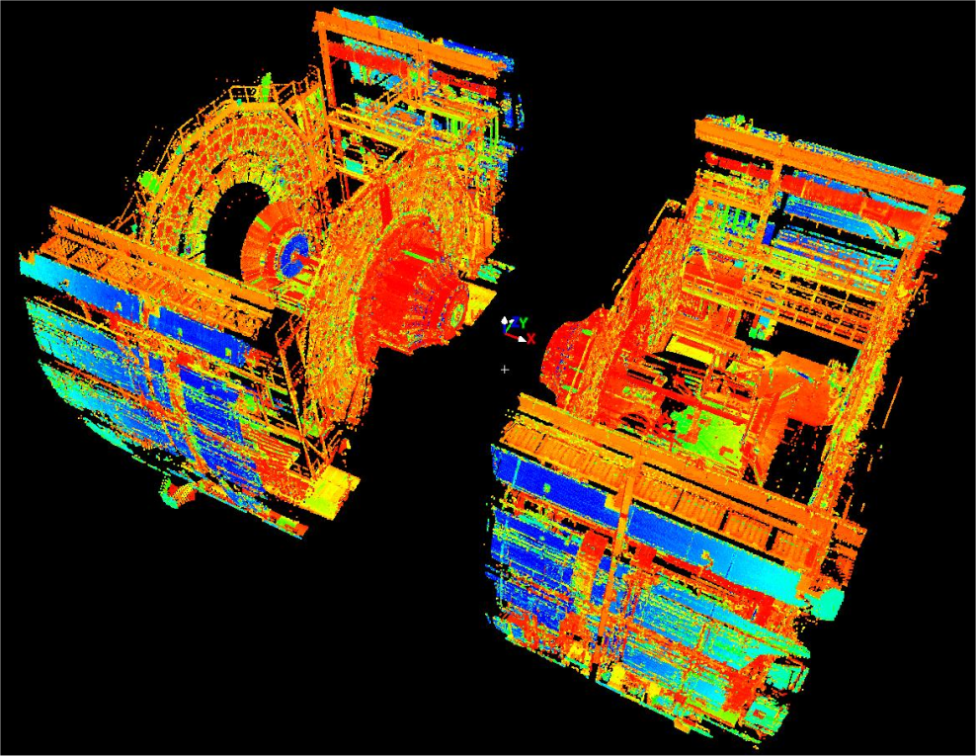
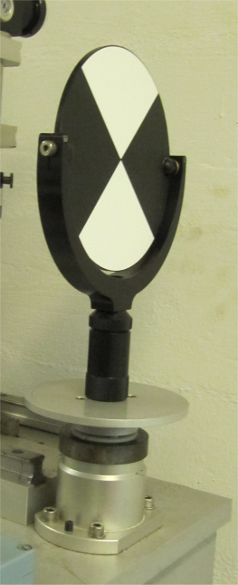
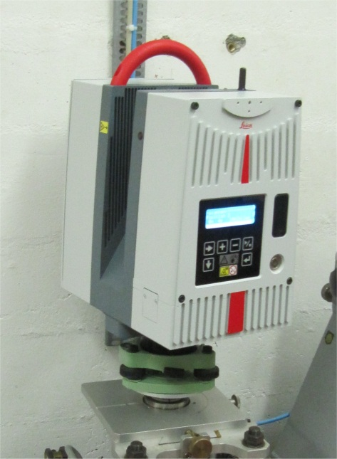
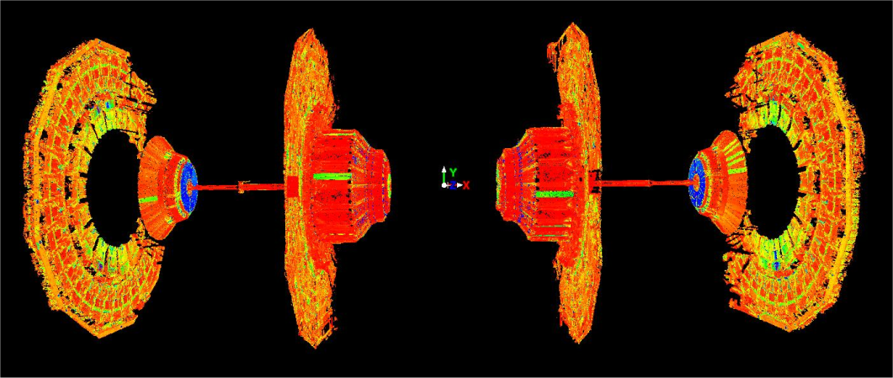
Leica HDS 6200 Laser Scanner
Up to 1 000 000 points/sec
Phase shift distance measurement
Point accuracy at 5m = +-3mm
Spot size = 5.0mm @ 10m
Field of view: 360° x 310°
Point cloud as result

Slide 20
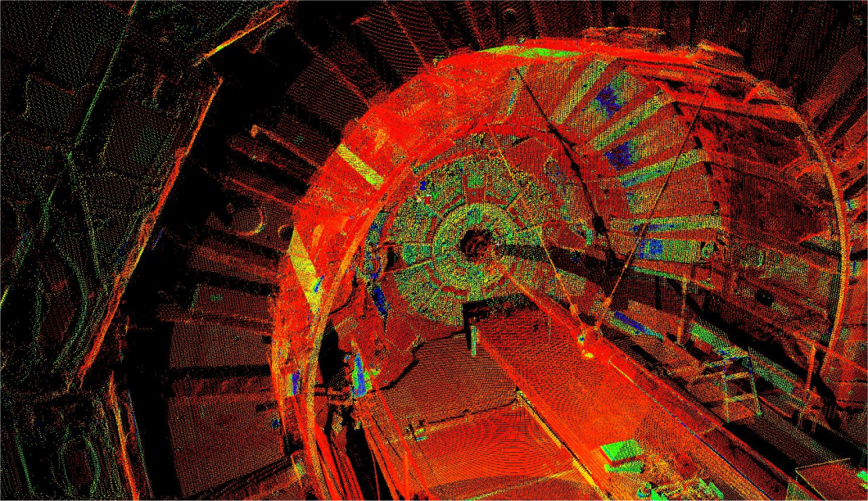
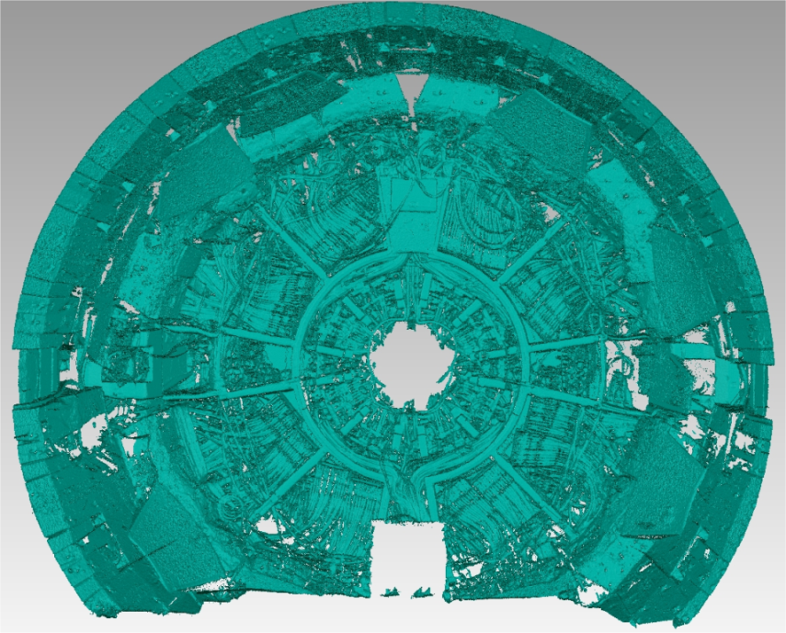
LEICA HDS 6200 Laser Scanner
CMS Bulkhead
Cone of Endcap
Scan of services for PLT installation
New as-built information for integration
1-2 days of in-field work

Slide 21
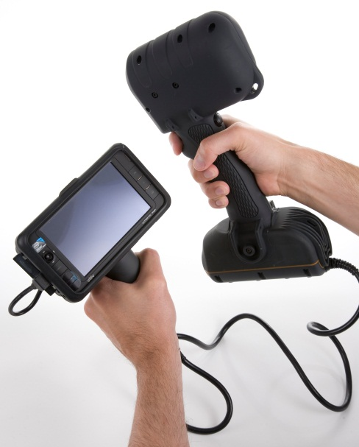
Mantis Vision F5 Handheld 3D Imager
Technical specifications F5 3D imager
3D resolution: up to 0.5mm
3D point accuracy: up to 0.05mm @ 0.5m distance
XY point density: 3mm in single frame @1m
Depth of field: 0.5 – 4.5m
Video frame rate: 10 frames per second
Data acquisition speed: 500 000 points per second
Weight: 1.7 kg
Technical specifications F5 short range 3D imager
3D resolution: up to 0.25mm
Depth of field: 0.3 – 0.8m
www.mantis-vision.com

Slide 22
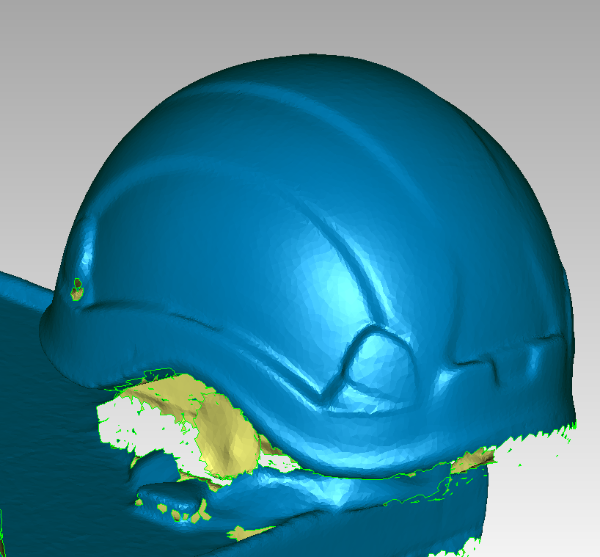
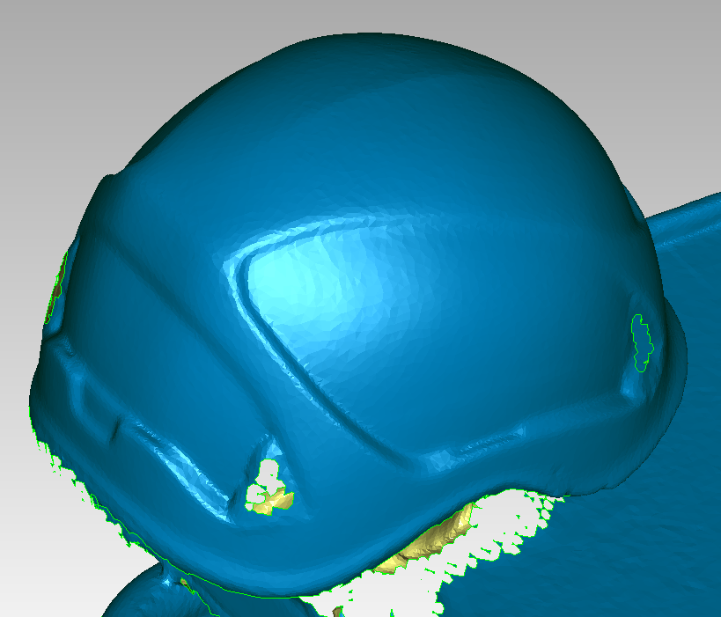
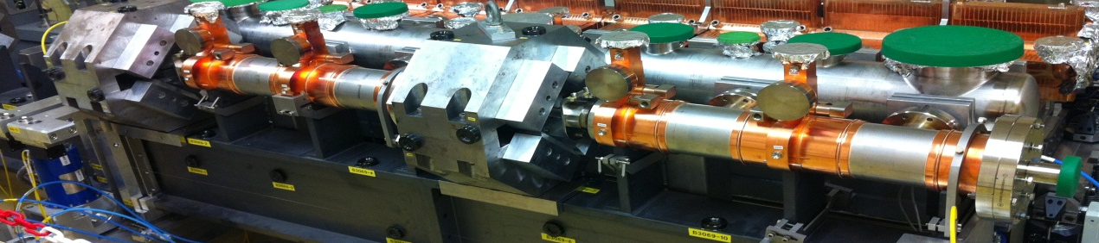
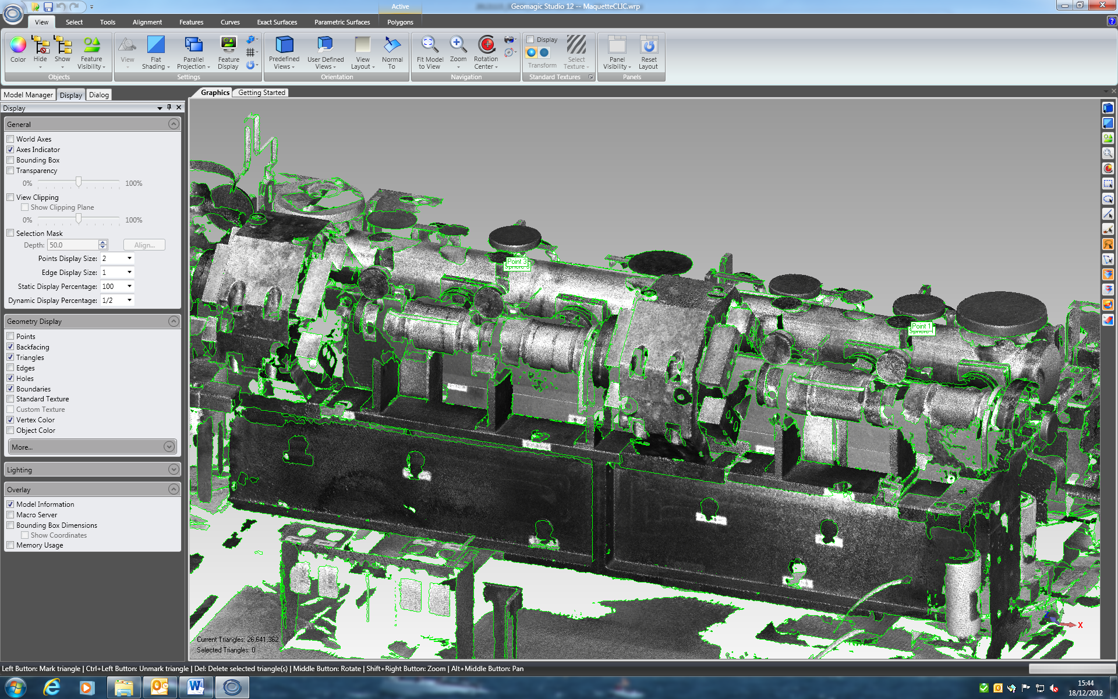
Mantis Vision F5 - Helmets
Demonstration of Mantis F5 at CERN
Stitching of different views
Data acquisition can be controlled on screen
Transfer of data to PC after work or in between
Precision on controlled distances up to 3 m < 1.0 mm
Problems on reflecting flanges, copper surfaces ok

Slide 23
Conclusion
All LHC experiments will have survey requests for tracking detectors for upgrades
  Construction
  Validation / test phase
  Installation
Mechanical adjustment systems need to be integrated
Tracking detectors have highest precision and need high precision survey
Photogrammetry and Laser Tracker are adapted tools
We are flexible in method and can adapt it to working conditions
Precision with respect to machine geometry has to cope with long term deformations at civil engineering level
Permanent contact between SU and detector responsible

Slide 24
… for future upgrades and projects
Define carefully the control and alignment needs
  What has to be measured?
  With respect to what?
  At what stage?
  Where?
  What is the required precision / error budget?
Definition of reference holes and special equipment (adapter…) needed by SU
First fiducialisation of sensitive elements at construction site
➔ references carry the detector geometry information
If there are NO references there is a risk that NO precise survey can be performed!
No detailed as-built model is available for LHC experiments (services etc.)
Measurement equipment has progressed since LHC construction
Detector installation will be more complex – ALARA procedure
➔ An early, individual discussion for each detector is necessary

Slide 25
20.0 mm
8H7 reference hole
28 mm contact surface
15 mm depth
Thanks for your attention!
Antje BEHRENS
Jean-Christophe GAYDE
Dirk MERGELKUHL
(CERN BE-ABP-SU-EM)

