Slide 1
MM mechanical prototypes
Full wedge option
At CERN

Slide 2
Purpose
Demonstrate feasibility
Setup of basic infrastructure
Gain experience with
  construction/assembly ideas/schemes
  Materials
  Procedures
  Precision (for me not the main objective)
Produce objects that can be measured
Establish an Assembly Manual

Slide 3
CERN mechanical prototype
Full-wedge small sector quadruplet
  Eta and stereo doublet
All panels of equal thickness: 11-12 mm
  Standard Al profiles of t=10 mm as frames
  Al honeycomb of t=10 mm
  Skins = 0.5 mm (FR4)
  Glue gaps ≈ few 100 µm
Drift gap spacers: 5 mm
Total thickness: 75–80 mm

Slide 4
Dimensions
70 – 80 mm
Dead area: 50 mm
Space for electronics: 50 mm
10+
10+
10+
10+
10+
Eta strips
20 mm
Stereo strips
5
5
5
5
Electronics boards
MM multiplet stack
(10+: 11 or 12 mm)
Space for electronics
(50 mm in phi)

Slide 5
Collaborative effort
CERN, Lecce, Saclay, … more collaborators are welcome
Drawings and calculations: Lecce and CERN
Infrastructure and tooling: CERN, Saclay
Technical work: CERN, Lecce, Saclay
Evaluation: all (two summer students for mechanical)

Slide 6
What could/should be included
Realistic materials and glues
Realistic thickness and segmentation of PCBs
Space for on-chamber electronics boards
Simplified cooling and cabling channels
  We foresee to insert heating wires into the cooling channels to simulate electronics/cooling
Gas channels and seals (to allow for gas pressure tests)
Mesh frame (but not necessarily the mesh)
T-sensors (a few) to allow for test measurements
Other ???

Slide 7
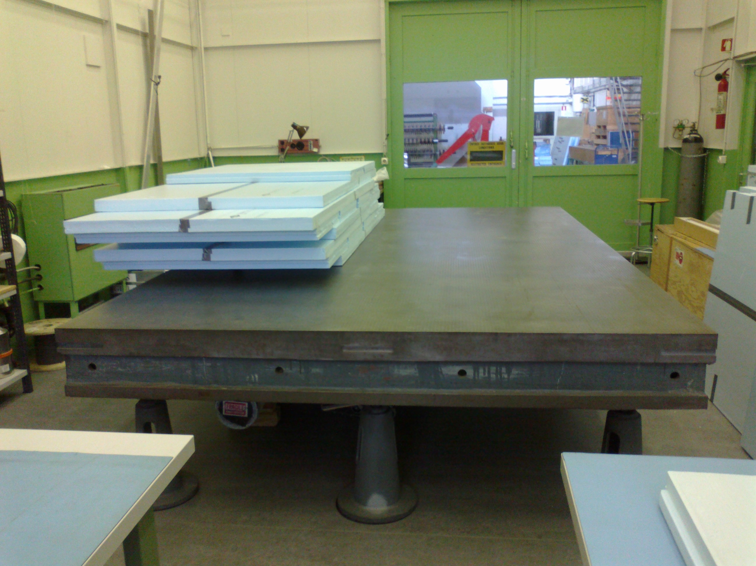
The table
Size: 4 x 2.5 m
Flatness: ≤ 20 µm
Location: B16
Available: mid May

Slide 8
Assembly scheme

Slide 9



Using Skin suction Tool
Clarinet gas
Vacuum
Vacuum
X 5
Vacuum
Vacuum
Rohacell honeycomb
Skin (G10)
Precision insert
Expansive glue
Precised shim

Slide 10
Stiffback
Simple stiffback structure with suction heads (following small test structure) used for 2 x 1 m² prototype
CERN-DT group is working on a more final system using a perforated honeycomb structure with a perforated lower skin
Work in progress
  Small 50 x 50 cm² system under construction
  Large system if prototype successful
60 mm

