Slide 1



VMM ASIC
―
Status Report - April 2013
Gianluigi De Geronimo
Microelectronics Team, Instrumentation Division Brookhaven National Laboratory
Notes:
Microelectronics, in general and then specific for science

Slide 2

Outline
VMM1 - tested
  architecture and results (brief)
  issues
VMM2 - in design
  architecture
  fixes (issues from VMM1)
  new features
  pinout and packaging (tentative)
  schedule (tentative)
Notes:
Consists of 23 slides, three parts

Slide 3
Architecture of VMM1
neighbor
TGC out (ToT, TtP) x 16
logic
or
ART (flag, parallel address)
CA
shaper
peak
mux
analog ampl
time
mux
analog time
addr.
mux
parallel addr
channel (64x)
logic
mux clock
dual polarity, adj. gain (0.5-9 mV/fC), adj. peaktime (25-200 ns), DDF shaper
discriminator with sub-hysteresis and neighboring (channel and chip)
address of first event in real time at dedicated output (ART)
16 direct timing outputs: time-over-threshold or time-to-peak
peak detector, time detector <1 ns
multiplexing with sparse readout and smart token passing (channel and chip)
threshold & pulse generator, analog monitor, mask, temperature sensor, 600mV BGR, 600mV LVDS
power 4.5 mW/ch, size 6 x 8.4 mm², process IBM CMOS 130nm 1.2V, test structures

Slide 4
Resolution Measurements
Charge
Timing
charge resolution ENC < 5,000 e⁻ at 25 ns, 200 pF
analog dynamic range Q_{max} / ENC > 12,000 → DDF
timing resolution < 1 ns
(at peak-detect)
  ENC τ_{P}
  λ_{P}
  ≈ 0.3-0.8
  σ_{t}
  ≈
  Q
  ρ_{P}

Slide 5
Architecture of VMM2
neighbor
TGC out (ToT, TtP) x 16
logic
or
ART (flag, parallel address)
CA
shaper
peak
mux
analog ampl
time
mux
analog time
addr.
mux
parallel addr
channel (64x)
issues in VMM1 → fixes in VMM2
logic
mux clock
Note: VMM2 will maintain all the functionalities of VMM1

Slide 6
Issues in VMM1 → Fixes in VMM2
power distribution
  voltage drop across power and ground wire-bonds
front-end
  stability at large capacitance (affects peaking time and gain)
  saturation at high rate
  leakage from ESD protection (disables positive charge operation)
  test pulse linearity, settling time, range (needs optimization)
  ESD protection (may need optimization)
discrimination
  digital pick-up in sub-hysteresis (affects low amplitudes)
  threshold dispersion and trimming (needs optimization)
signal processing
  peak detector stability (affects low amplitudes)
direct timing (TGC)
  digital pick-up on pulse tail
  delay and time walk (needs optimization)
  possible locking in TtP mode
test and readout
  internal reset optimization
  dedicated input for test-pulse strobe

Slide 7
Architecture of VMM2
neighbor
trigger
TGC out (ToT, TtP) x 16
TGC out (ToT, TtP, PtT, 6bADC) x 64
TGC clock (160 MHz)
logic
or
ART (flag, parallel address)
6b ADC
CA
shaper
peak
mux
analog ampl
time
mux
analog time
addr.
mux
parallel addr
channel (64x)
fixes
logic
mux clock
additional gain settings (TGC, MM)
external trigger
TGC: 64 outputs, 6-bit ADC 25ns serialized with dedicated clock
Note: VMM2 will maintain all the functionalities of VMM1

Slide 8
TGC ADC and Serializer
25ns
50ns
75ns
100ns
125ns
150ns
175ns
200ns
analog pulse
end of conversion
charge event
end of encoding
reset end (ready for next event)
peak-found
CK
OUT
timing edge
D5 - D0
160 MHz external clock
Conversion ends ~25ns after peak-found, programmable
Dead time from charge event <100ns
Amplitude data D5-D0 shifted at each clock edge

Slide 9
Architecture of VMM2
neighbor
trigger
TGC out (ToT, TtP, PtT, 6bADC) x 64
TGC clock (160 MHz)
logic
or
ART (flag, serial address)
ART (flag, parallel address)
6b ADC
ART clock (160 MHz)
CA
shaper
peak
mux
analog ampl
time
mux
analog time
addr.
mux
parallel addr
channel (64x)
fixes
logic
mux clock
additional gain settings
external trigger
TGC: 64 outputs, PtT, 6-bit ADC 25ns serial with dedicated clock
ART: flag and address serialized with dedicated clock
Note: VMM2 will maintain all the functionalities of VMM1

Slide 10
ART Serializer
25ns
50ns
75ns
100ns
125ns
150ns
175ns
200ns
analog pulse
reset
charge event
peak-found
CK
ART
FL D5 - D0
160 MHz external clock
Flag and address serialized
Address data D5-D0 shifted at each clock edge

Slide 11
Architecture of VMM2
neighbor
trigger
TGC out (ToT, TtP, PtT, 6bADC) x 64
TGC clock (160 MHz)
logic
or
ART (flag, serial address)
6b ADC
ART clock (160 MHz)
CA
shaper
peak
mux
analog ampl
spr
1-bit
10b ADC
thr
1-bit
time
10b ADC
mux
analog time
addr
6-bit
FIFO
DATA 48-bit
2-bit
ampl
10-bit
12b BC
time
10-bit
addr.
8b L1A
mux
parallel addr
BC
12-bit
channel (64x)
L1A
8-bit
fixes
mux clock
logic
DATA clock (80 MHz)
additional gain settings
Gray-code counters
DATA sync
logic
BC clock (40 MHz)
external trigger
L1A trigger
TGC: 64 outputs, PtT, 6-bit ADC 25ns serial with dedicated clock
ART: flag and address serialized with dedicated clock
10-bit ADCs 200ns for amplitude and timing, digital memories
Gray-code counters for BC-ID (12-bit) and L1A-ID (8-bit)
Note: VMM2 will maintain all the functionalities of VMM1
2-bit DATA output with dedicated sync and 80 MHz clock

Slide 12
New Features
front-end
  additional gain settings to match signal sfrom TGC and MicroMegas
  option to route monitors to PDO, TDO outputs for baseline acquisition
signal processing
  multi-phase current-output peak detector ¹
  ADC 10-bit 200ns on PDO and TDO ¹
  digital buffer, multiplexing, and logic for continuous acquisition ¹
  counters and latches for BC-ID (12-bit) and L1A-ID (8-bit) ¹
ART (address in real time)
  serialized flag and address
trigger
  external trigger for non-data-driven operation
direct timing (TGC)
  from 16 to 64 channels (initially packaging-limited to 32)
  pulse at peak (like ART)
  ADC 10-bit 25ns with serial output after flag ¹
  fixed ramp discharge (PtT) ²
layout and packaging
  pads count from 176 to 208
  dual-mode wire-bond (MM, TGC)
radiation tolerance
  off-ITAR switch circuit (CERN), optimization ²
¹ Major developments
² If time allows

Slide 13
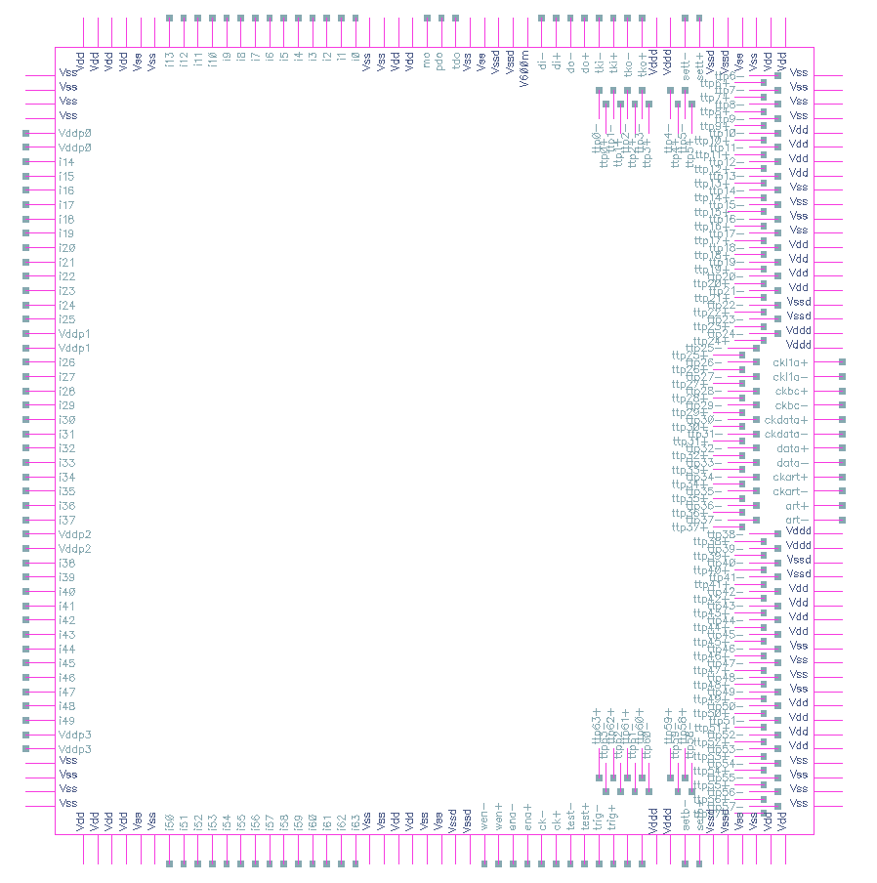
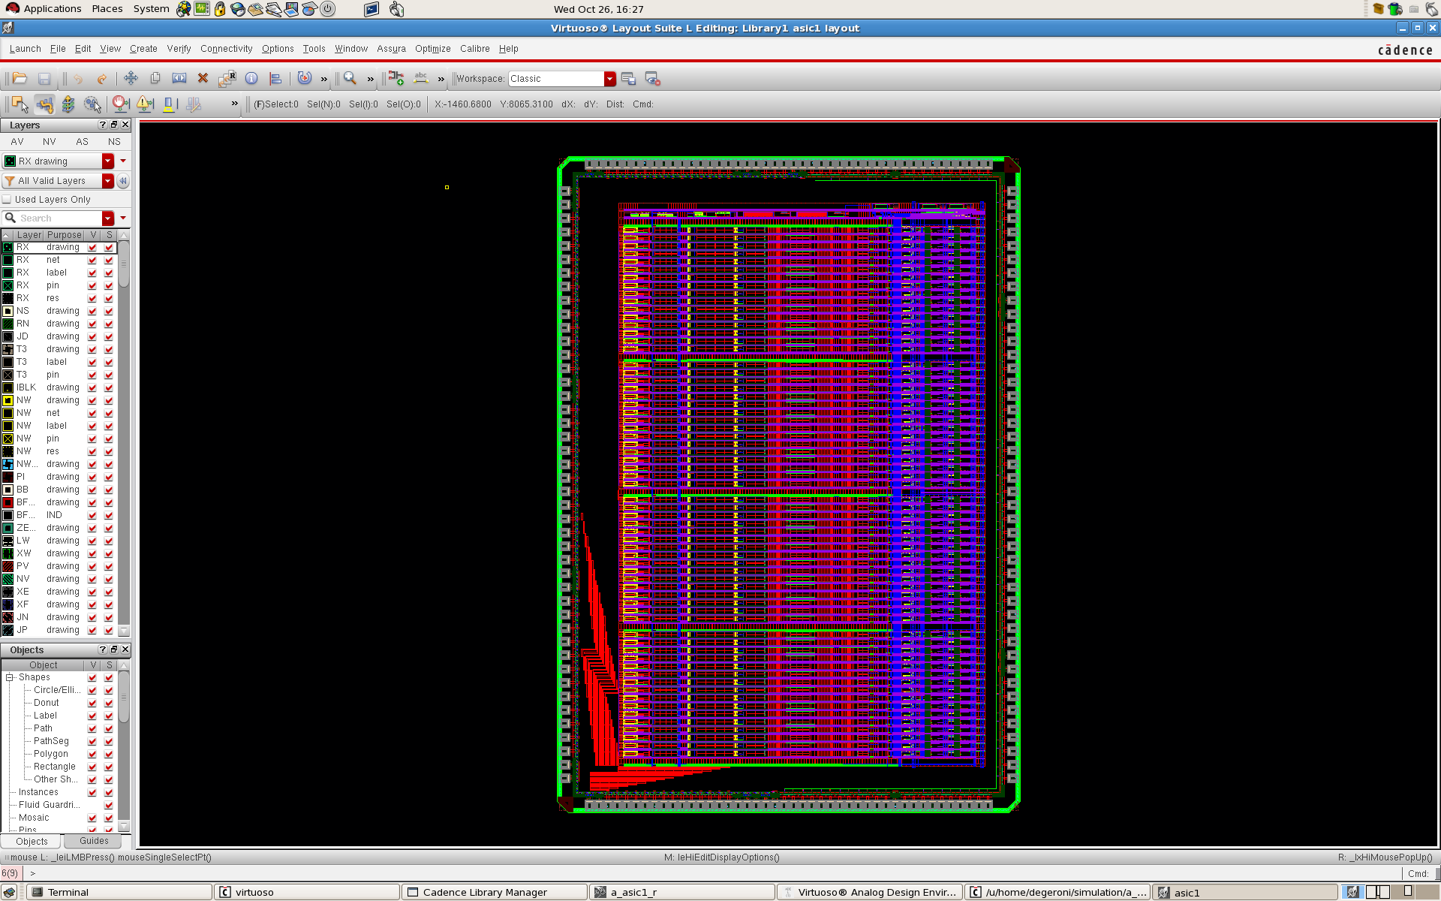
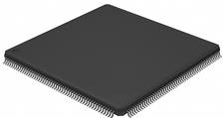
Pinout and Packaging
LQFP208
projected die size ~ 9mm x 9mm

Slide 14
Schedule and Status
task | status
fixes | in progress ~50%
external trigger | complete
ART serializer | in progress ~30%
current-output PD | complete
6-bit ADC and serializer | complete
10-bit ADC and digital buffer | in progress 70%
counters and latches | queued
analog gain | queued
physical layout | June-July 2013
fabrication | August 2013 (tentative)
Acknowledgment
Venetios Polychronakos (BNL)
Neena Nambiar, Emerson Vernon, Alessio D’Andragora, Jack Fried (BNL)
Jessica Metcalfe (BNL & CERN), Ken A. Johns, Sarah L. Jones (University of Arizona, USA)
Nachman Lupu, Lorne Levinson (Technion Haifa, Israel)
Georgie Iakovidis (BNL, USA and NTU Athens, Grece),
ATLAS Collaboration, CERN
14

