Slide 1
Remotely operated collimator exchange vehicle
Remote manipulations / diagnostics in radioactive areas and handling of radioactive material Workshop, Geneva, Switzerland 6th May 2013
JL.GRENARD (CERN)
Engineering Department / Transport Group
Notes:
Method:
individual interviews with group leaders based on the April schedule -> to gather bottom-up data,
EN retreat on 1st July -> the aim was to bring the MTP in line with the last schedule & saving requests from the Council in June
ENMB on 26th July -> validate with group leaders the top-down arbitration

Slide 2
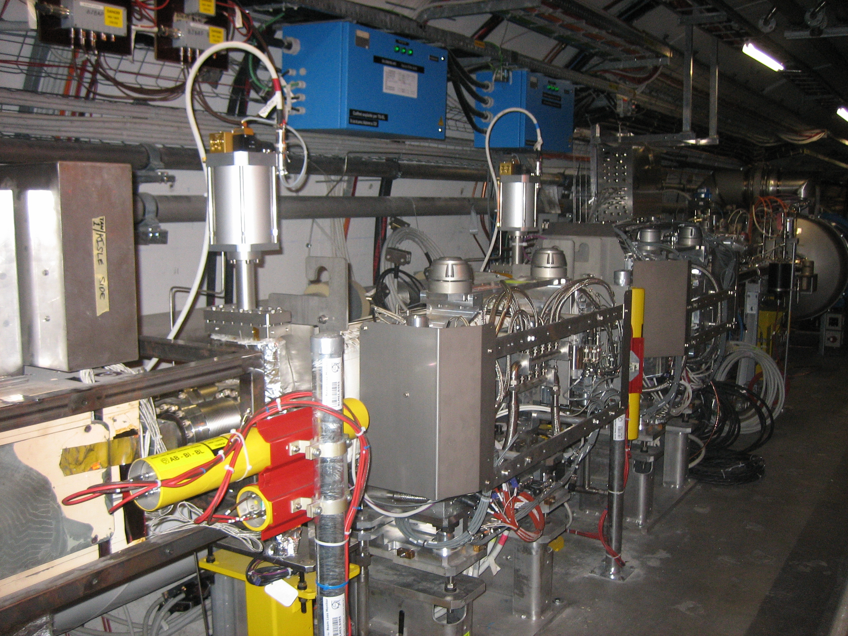
Reason of the vehicle
Collimators are one of the most radioactive element in the LHC tunnel
Around 100 collimators installed all around the LHC
But mainly at IR 3 and IR 7

Slide 3
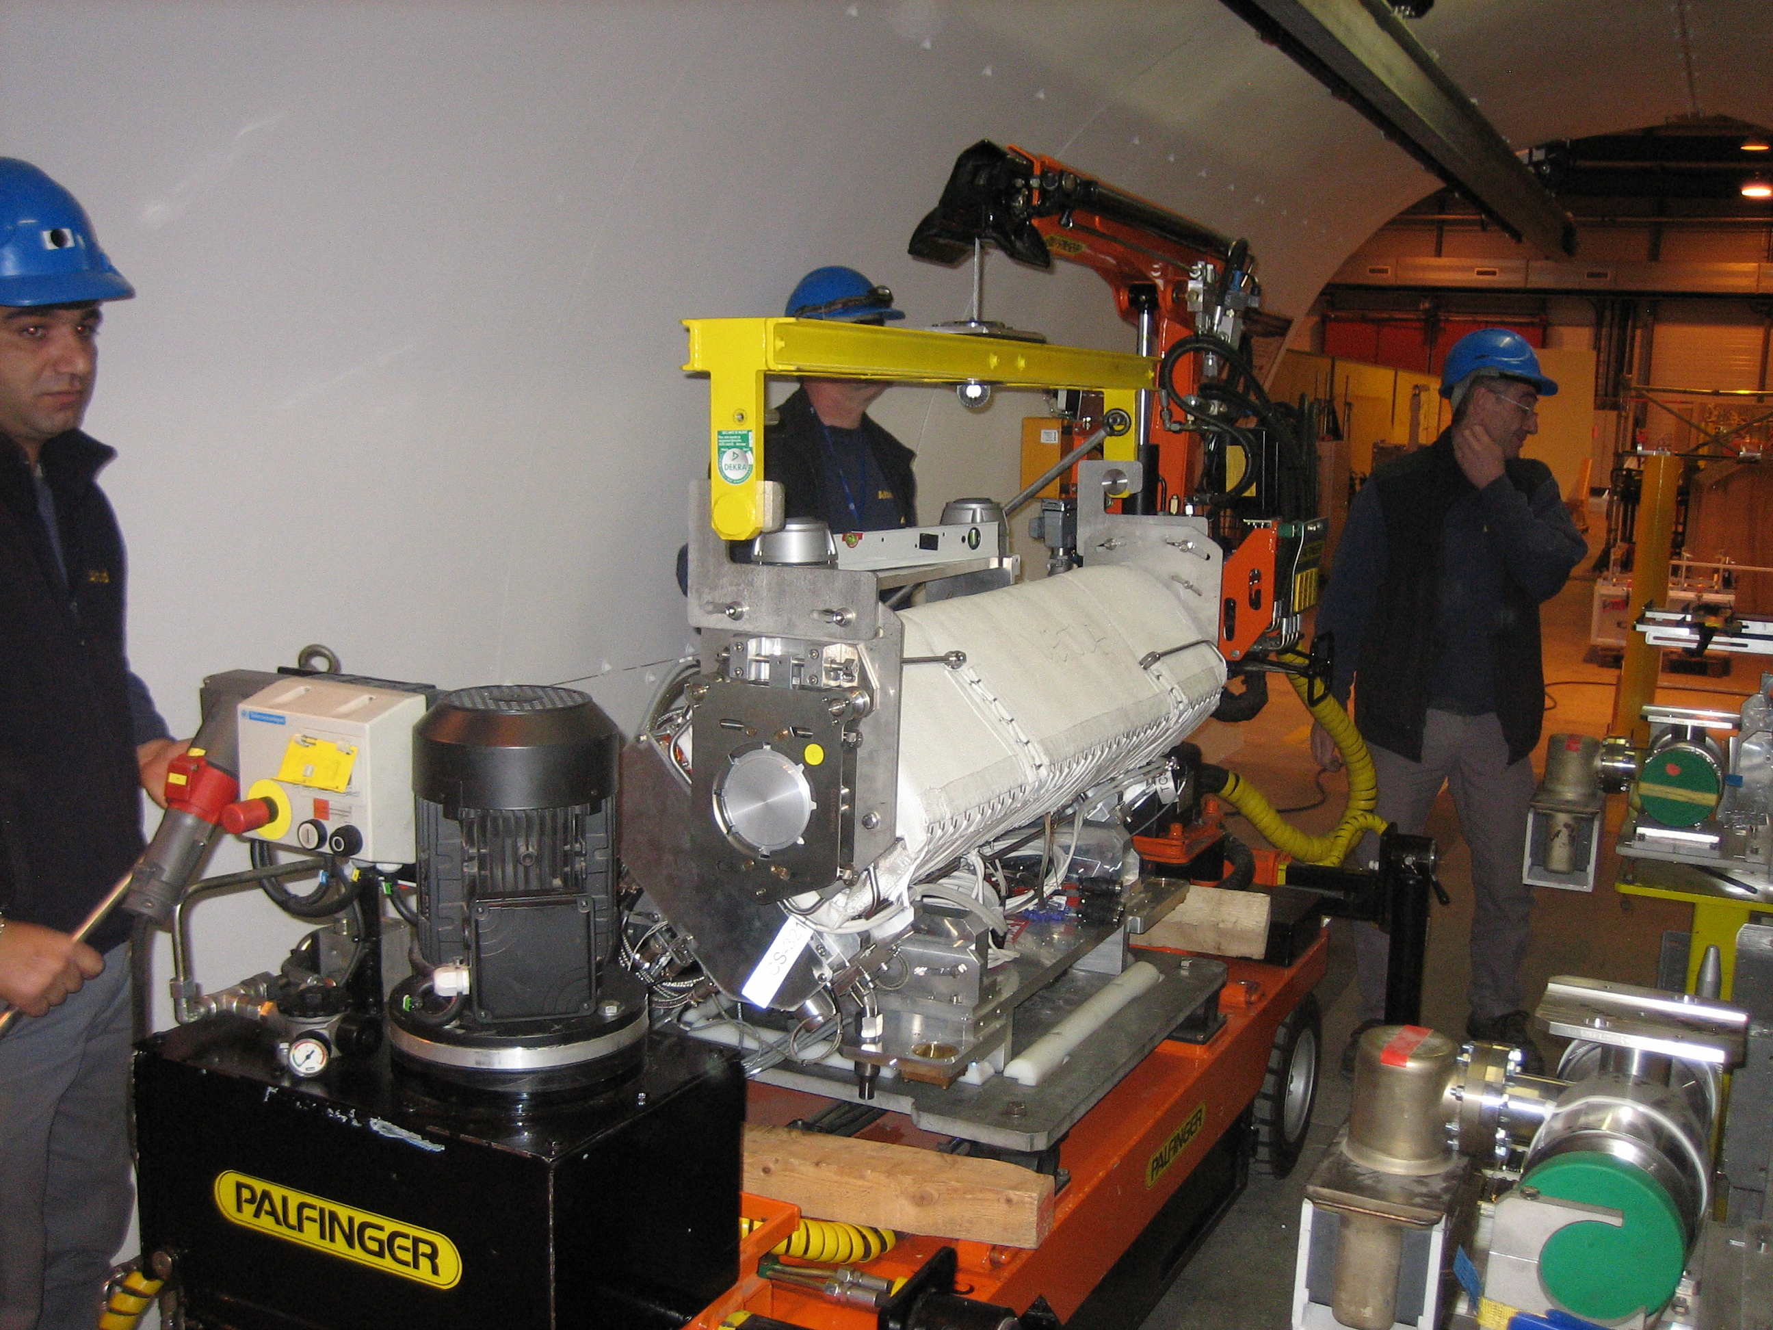
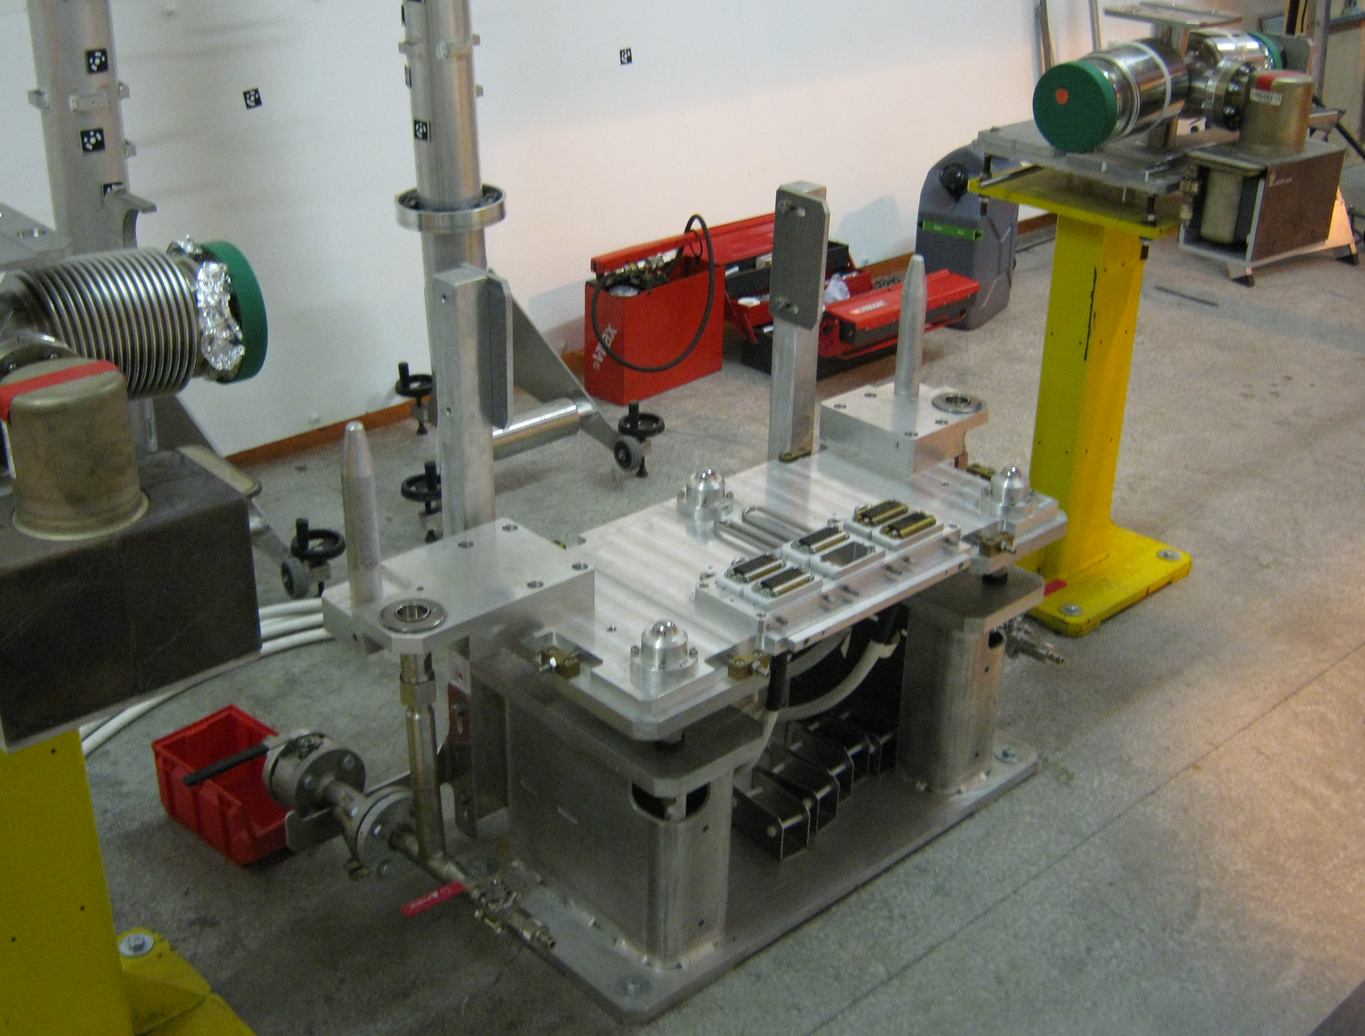
Present situation
Installation of the collimator with a trailer equipped with a crane
Most of the collimators are installed on a plug in system (mechanical, water, power, control)
Handling of the collimator at the gravity center (collimator balanced before installation)

Slide 4
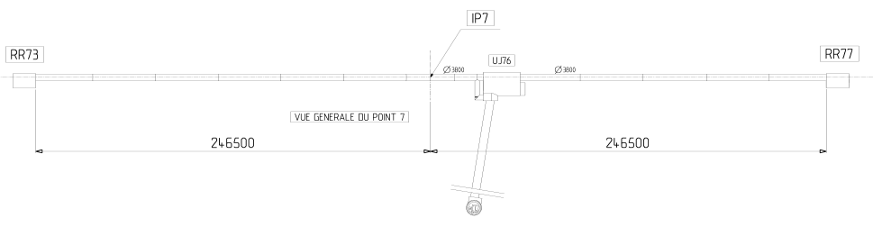
Handling at IR7
Remote trailer crane
Shielding
Shielding
Control station
Storage place for the vehicle
Access shaft for old and new collimator
Not showned but has to be taken in consideration : ventilation doors

Slide 5
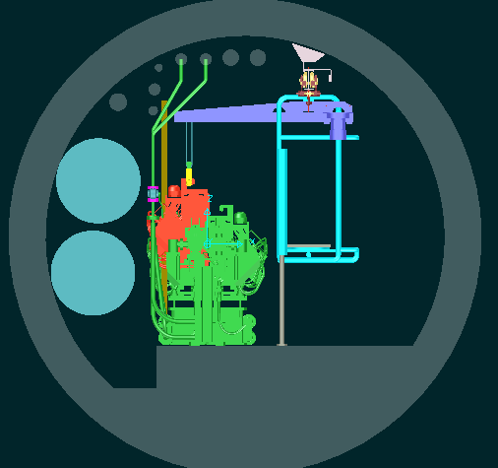
Different solutions
Dedicated handling device using the LHC monorail
No flexibility
Space constrain
Complexity of the machine
Stopped after the decision
Installation of a shielded wall at IR 7

Slide 6
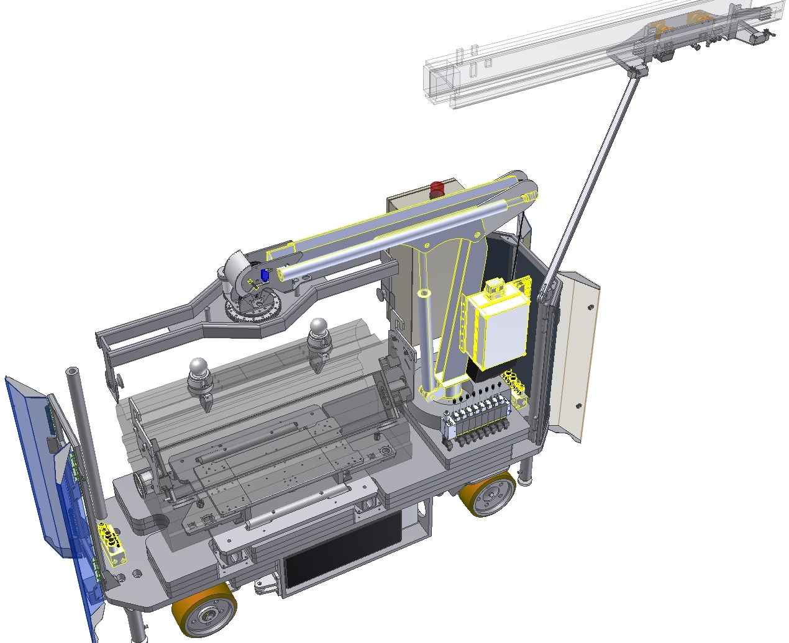
New remote controlled trailer crane
Boom collision detection
Power connected to the monorail
Motorized lifting spreader
Shielding at each extremity
Recovery manual hydraulic control
Side collision detection

Slide 7
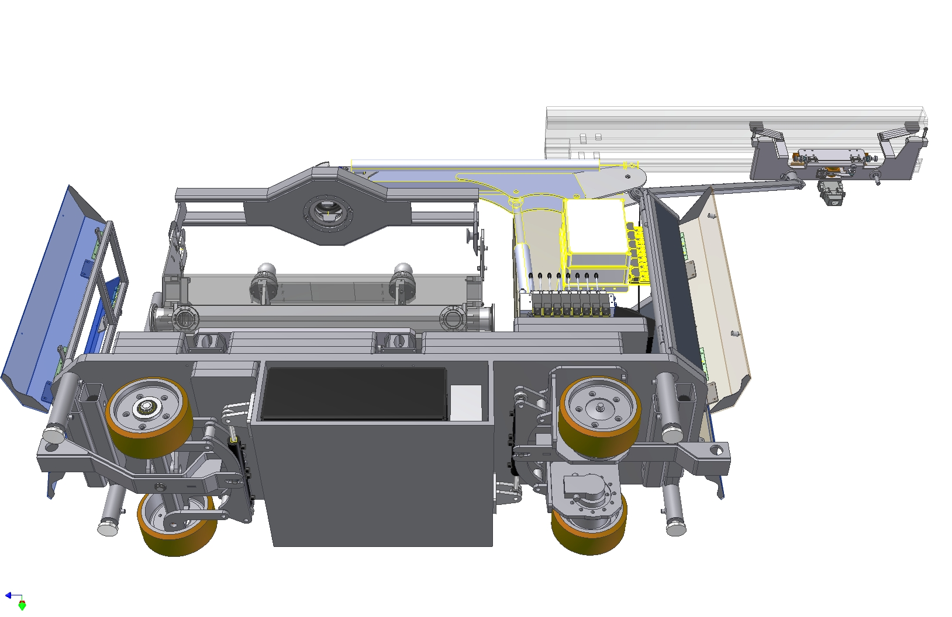
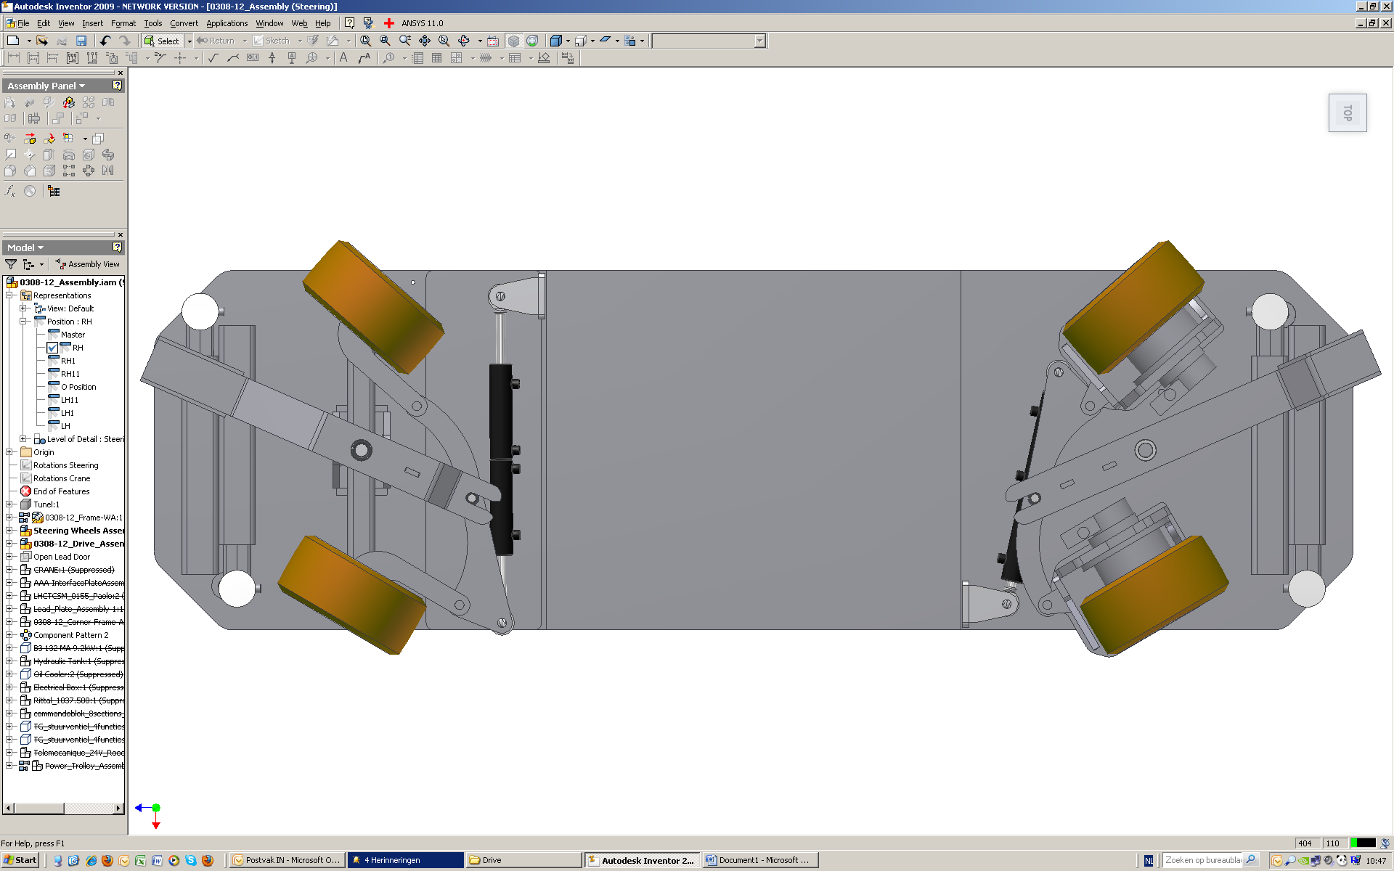
New remote control trailer crane
Key characteristics
lifting capacities: 1t
Max speed : 3km/h
Width: 780mm
Length: 2600mm
Height: 2010mm
Same concept of previous
Can pass key passage (UJ76)
CE marked

Slide 8
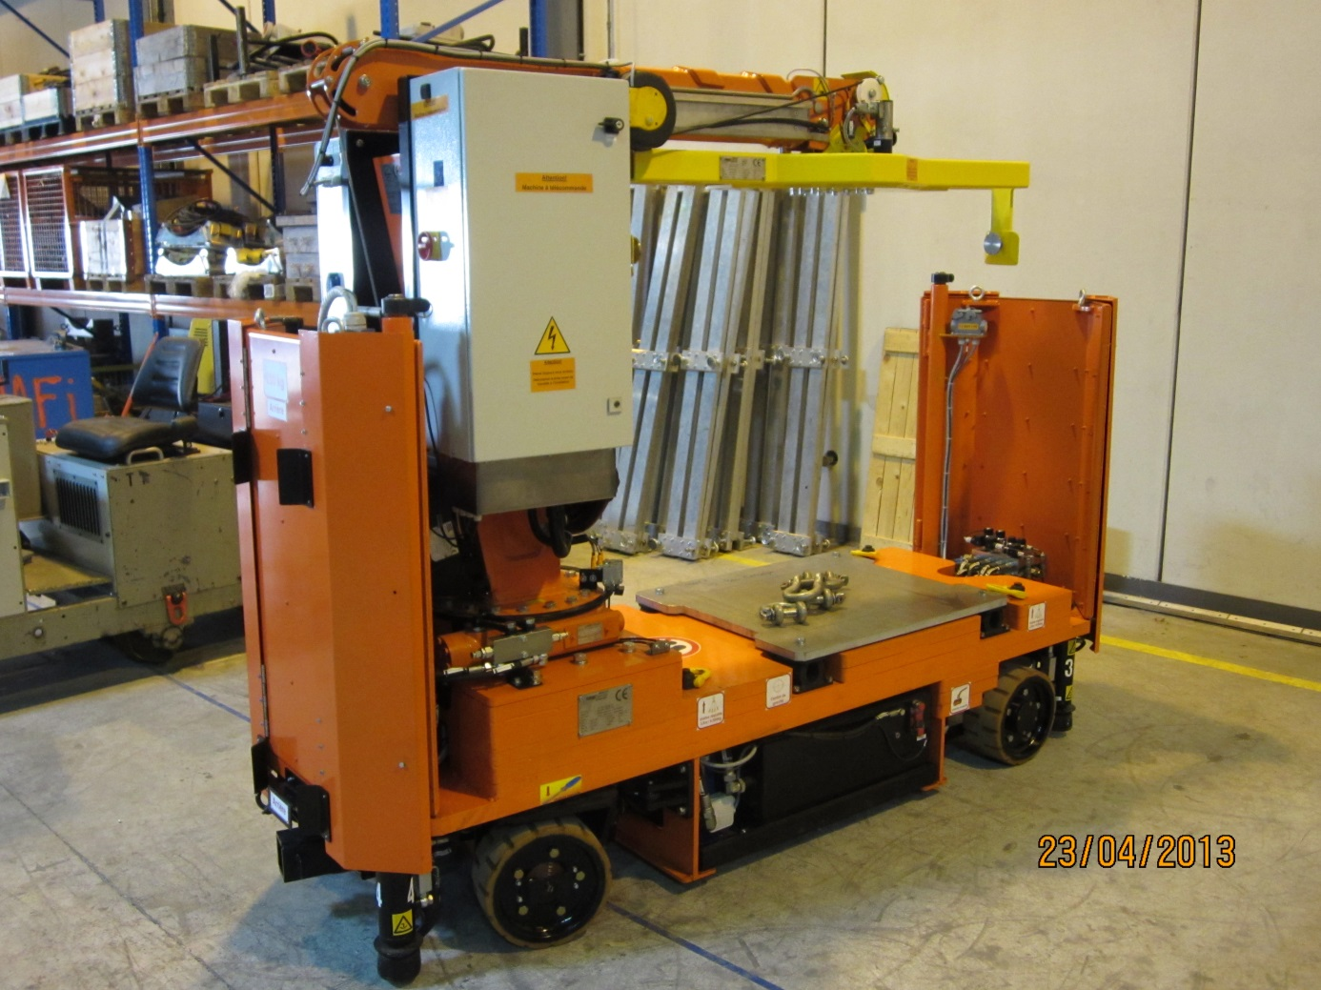
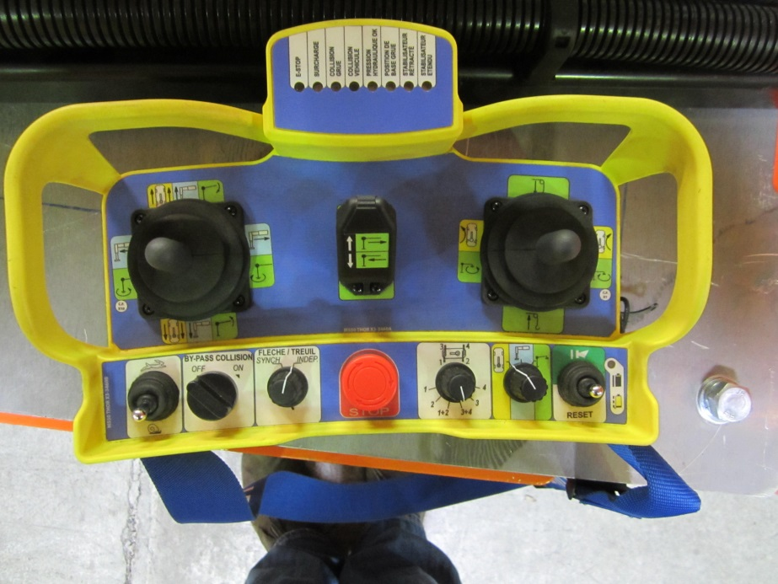
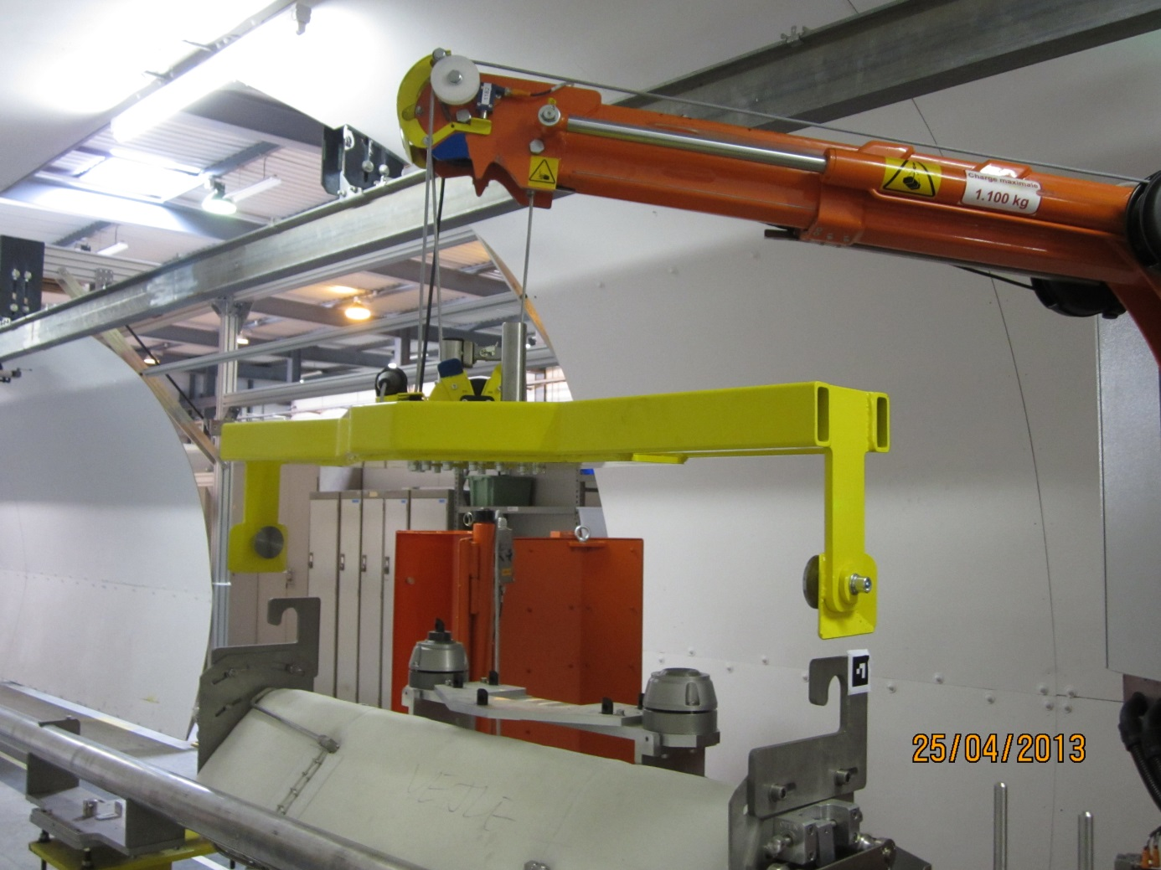
New remote control trailer crane

Slide 9
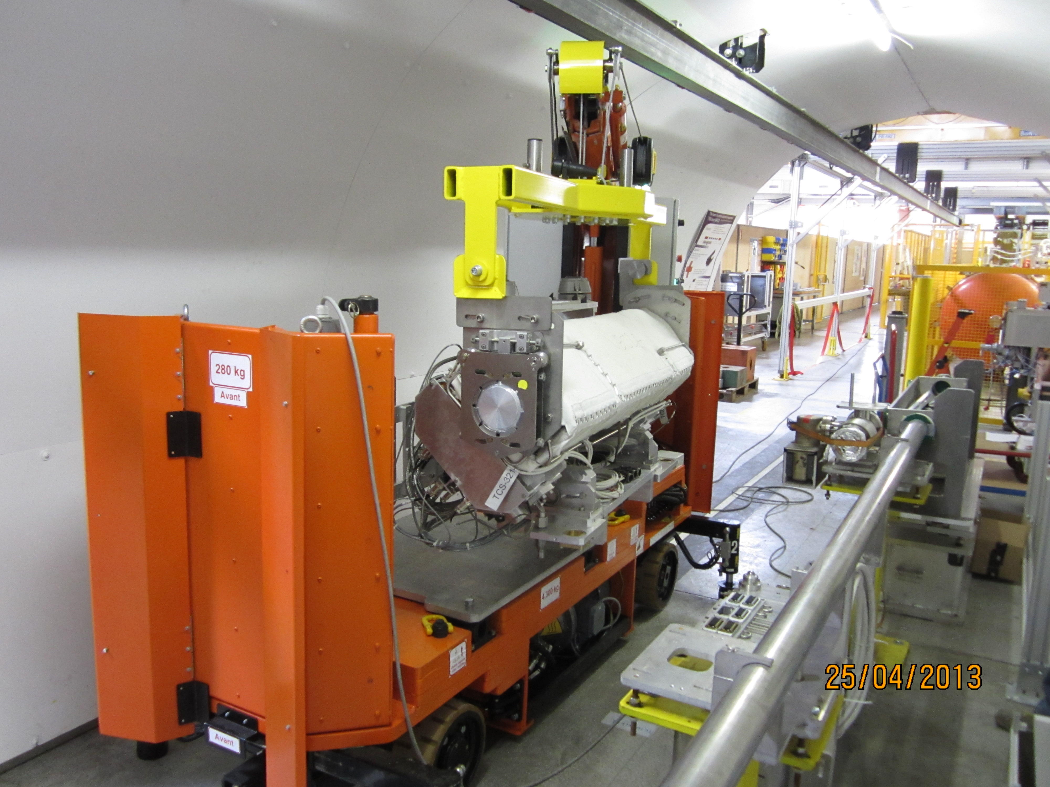
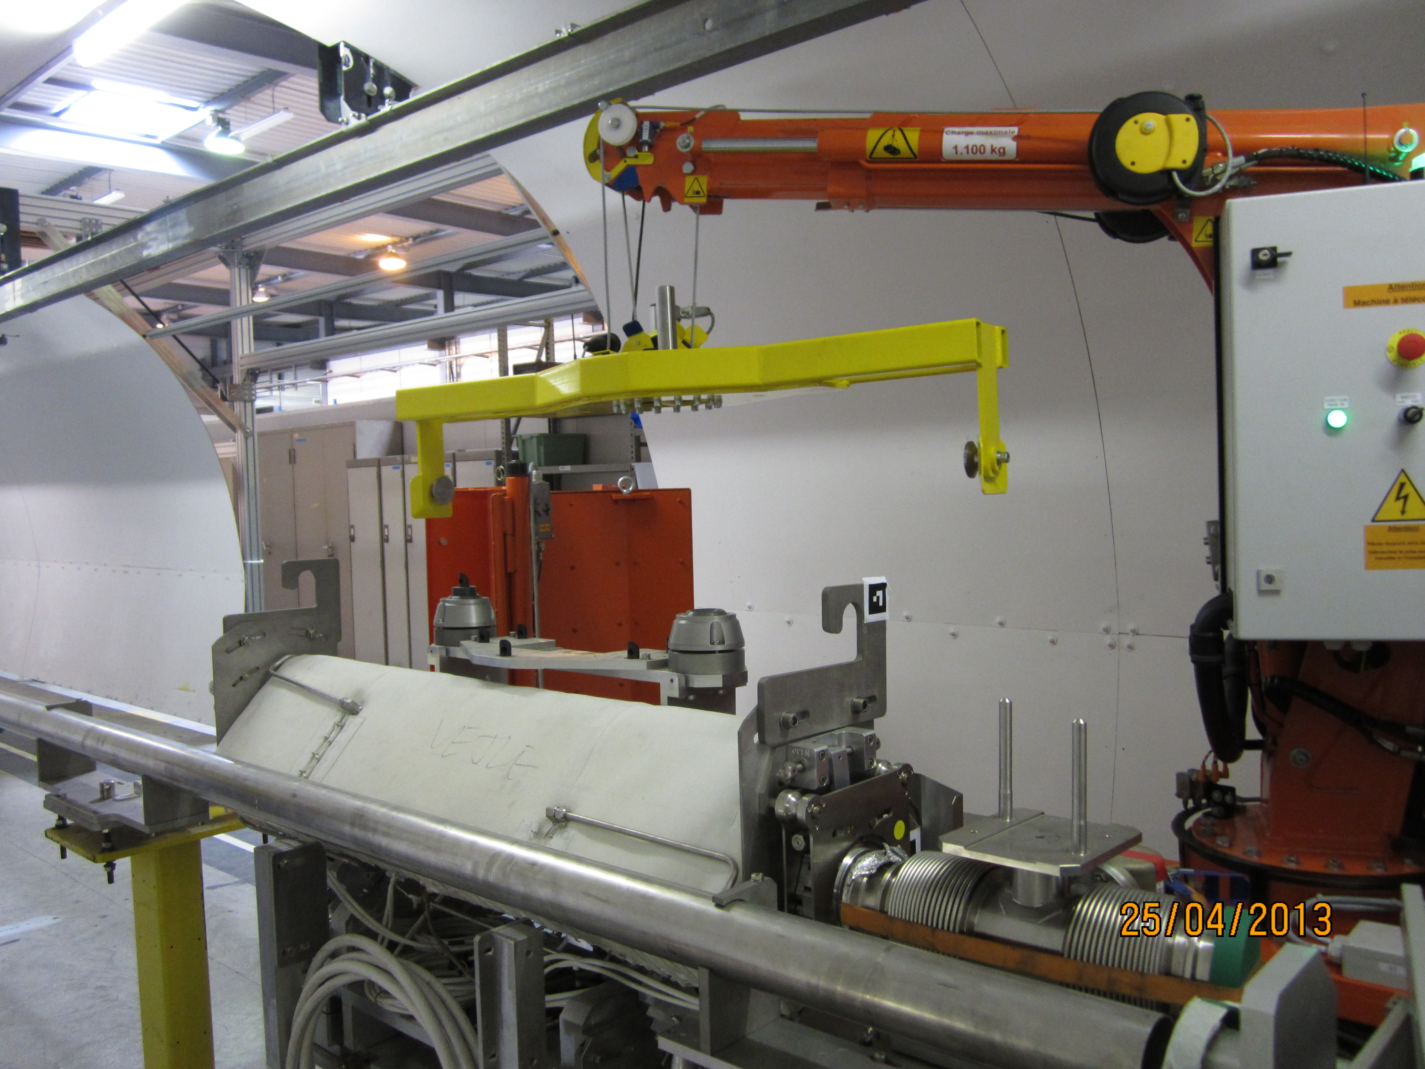
New remote control trailer crane
First testing @ CERN April 2013 : very promising
More tests would be organized in the next coming weeks in collaboration with EN-STI

Slide 10
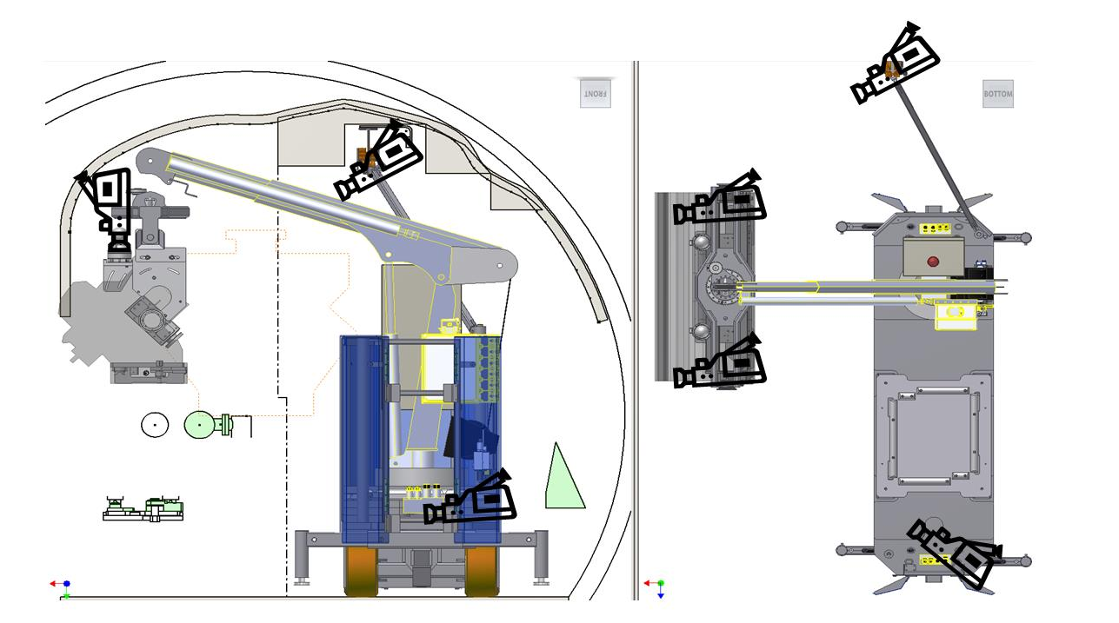
Vision system
The crane will be equipped with several cameras

Slide 11
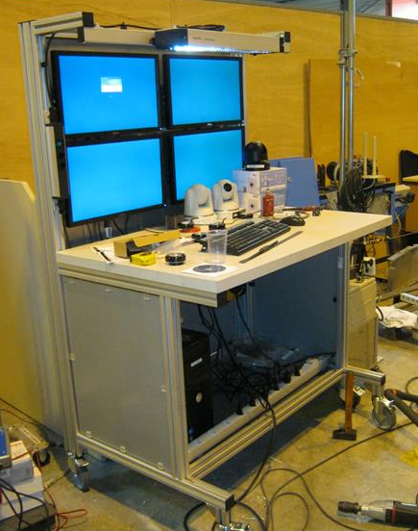
Vision system
Optical fiber transmission of the video signal
-> proven experience from other remote handling activities
(TAX repair, HiRadMat experiences handling)
Reason of the optical fiber : most reliable technology for real time visualization
Disadvantage-> the optical fiber as to managed

Slide 12
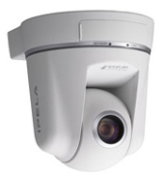
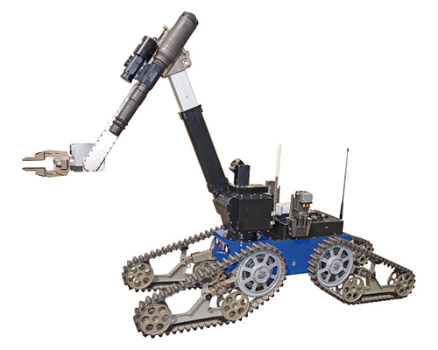
Vision system
Vision based on pan tilt zoom cameras
Possibility of recording
Some extra support vision for example with remote controlled vehicle TELEMAX

Slide 13
Recovery method
Included in the design
Loss of communication
Manual mode
Manual unloading mode without power

Slide 14
Operation point of view
Will be operated by a team of two
-> one operating the crane
-> one operating the video cameras
Access in the area will be forbidden during all those operations
Under supervision of DGS/RP
Under supervision of equipment owner EN/STI

Slide 15
Operation point of view
ALARA Committee
Equipment Owner EN/STI
Coordination / planification of work
Planification of Doses
Equipment
instructions
Handling Team Leader EN/HE
Radioprotection DGS/RP
Handling instructions
Radioprotection instructions
Operational team EN/HE

Slide 16
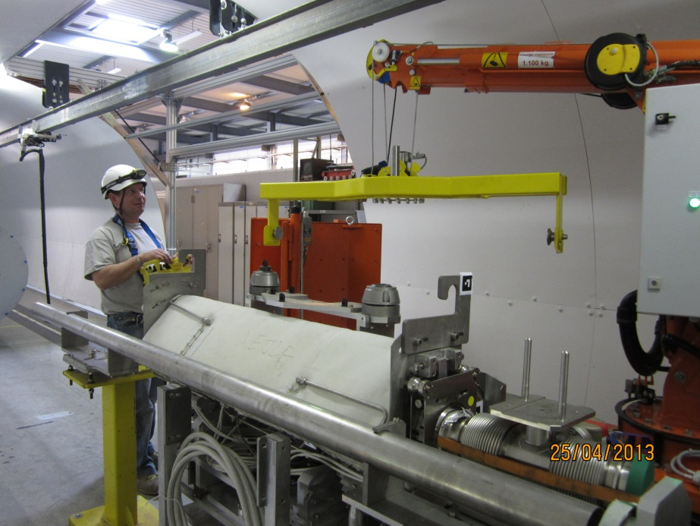
Training of operators
Already 5 peoples ready and trained for the use of the vehicle (remotely but with direct vision)
Use of the mock up of the LHC tunnel to training the operators
Specialist will be in charge of the organization of the intervention

Slide 17
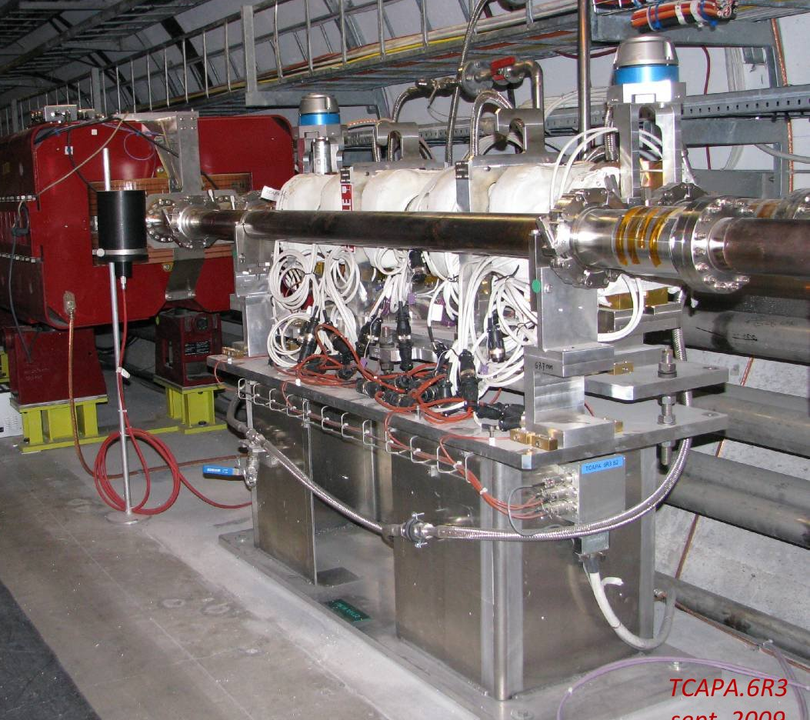
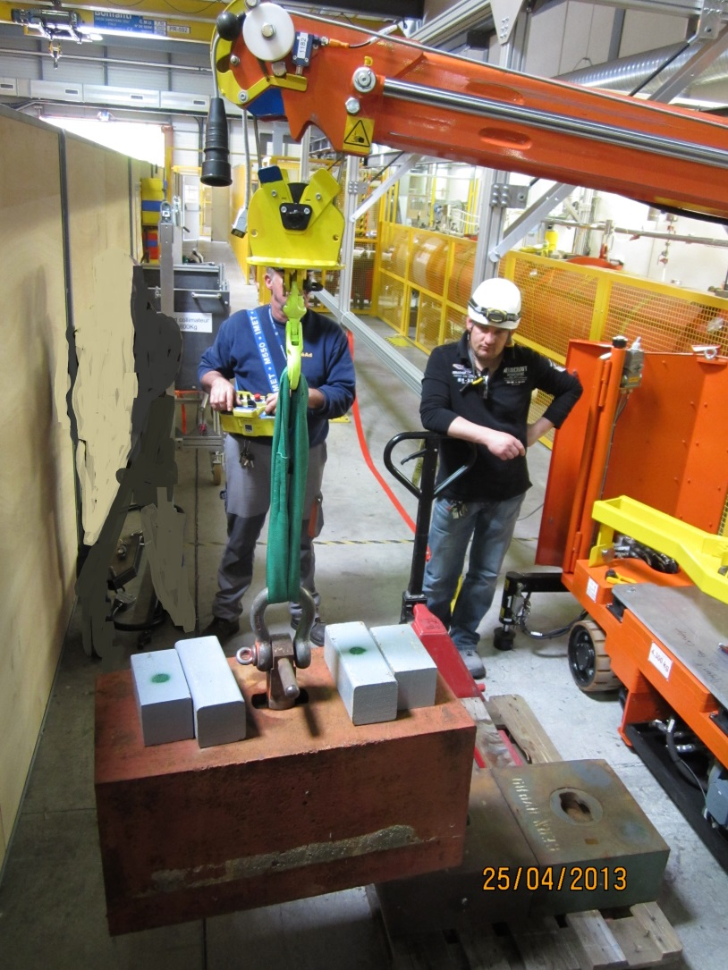
Other possible use
Handling of passive absorbers
Handling of shielding blocks (up to 1t)
Some additional tooling could be developed depending on need, the vehicle could be considered as a ‘’platform’’

Slide 18
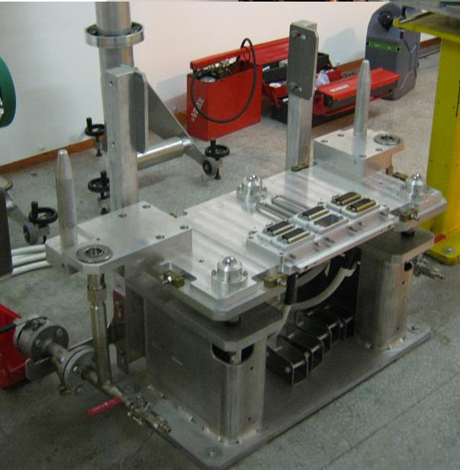
Points to note
Use of a cable to avoid lateral and longitudinal forces on the handled element
Careful ! The plug-ins can induce extra forces if not in the correct position
Water plugin not aligned with the gravity center

Slide 19
Conclusion
Will be use during LS1 to exchange collimators

