Slide 1
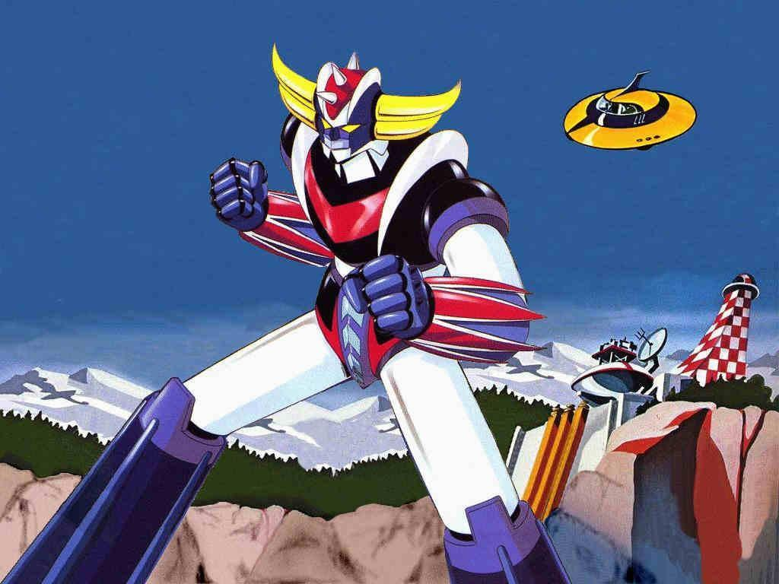
Robotic Interventions: the perspective of the user

Slide 2
Outline
Goal of this talk
EN/STI motivations
Main objectives of our investigations
Lessons learnt
Conclusions

Slide 3
Goal of this talk
EN/STI started exploring the possibility to use robots for interventions in radioactive areas back in 2009
Several different projects have been launched, some of them completed, some others still waiting for funding or for the right technology
The goal of this talk is to share the experience built in the last three years, and provide some seeds for further discussions.

Slide 4
EN/STI Motivations
We are in charge of some of the most radioactive objects at CERN
Most of them are obsolete, without proper documentation and drawings, any intervention may lead to surprises.
At ISOLDE, we also regularly cope with risk of contamination
Sometimes in the past, people in the group went close to or above 2 mSv in a year…

Slide 5
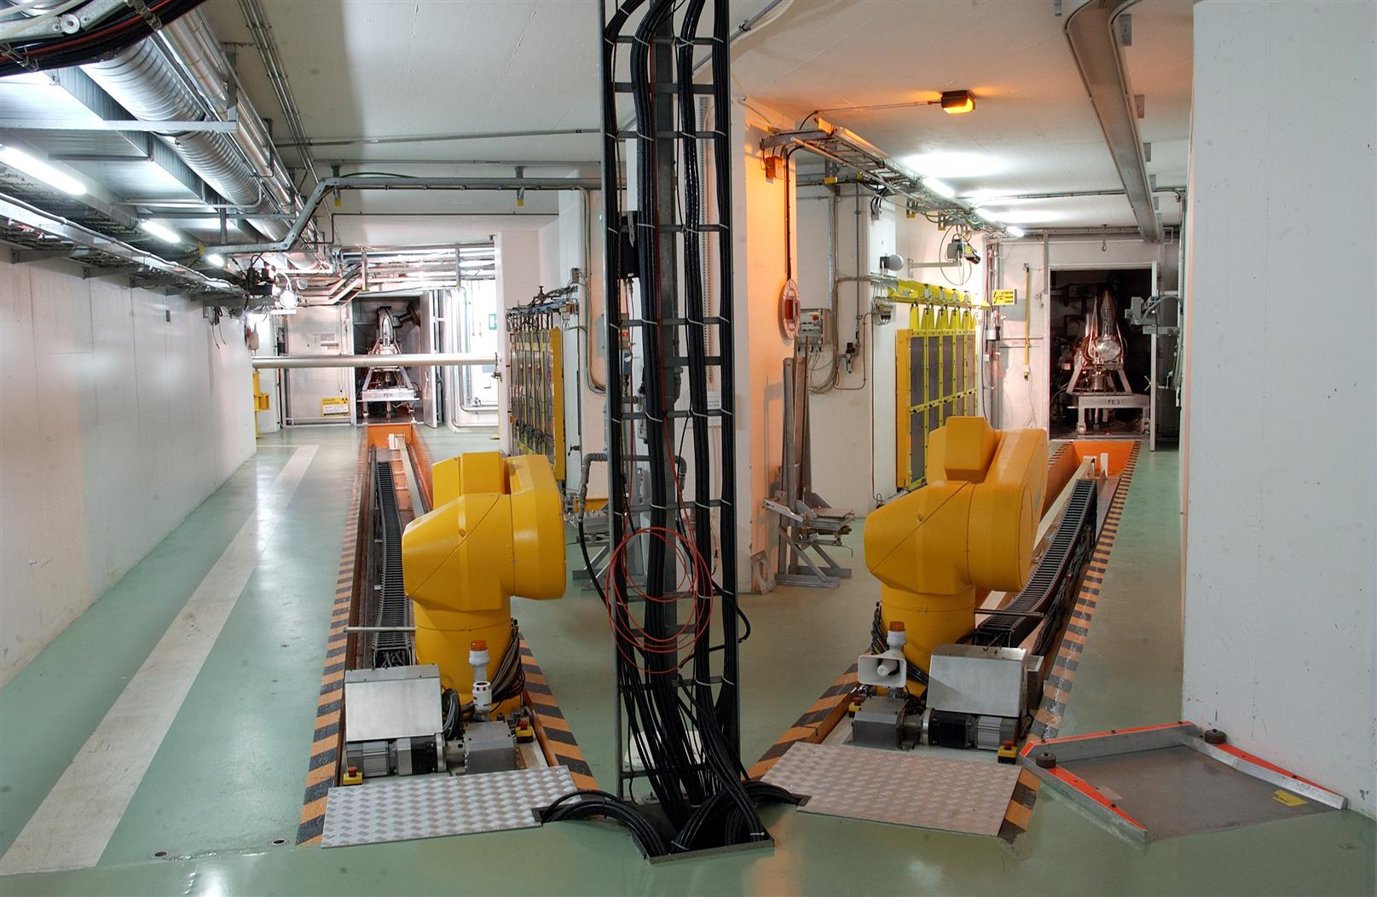
EN/STI Motivations
It all started with a series of failures of ISOLDE robots…

Slide 6
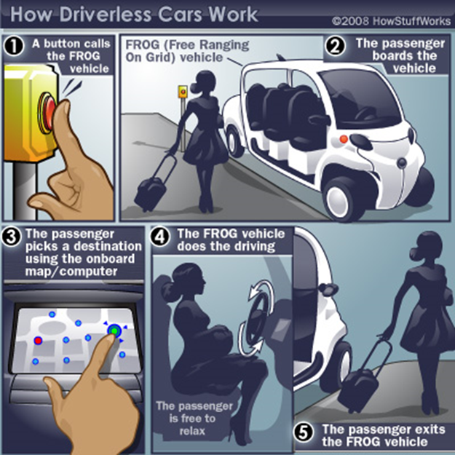
EN/STI Motivations
We investigated initially “exotic” solutions like Autonomous Guided Vehicles: very attractive, a lot of potential, and a lot of fun!

Slide 7
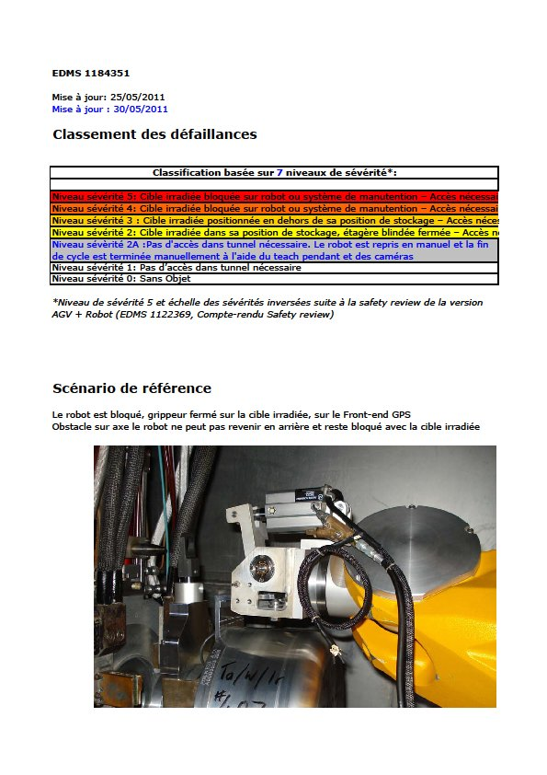
EN/STI De-motivations!
However, after a thorough risk analysis, we had to come back on earth, and recognise that increasing flexibility increases also the risks!
In fact we recognized that our most important spec was robustness
We ended up with a solution very similar (mutatis mutandis…)to the one chosen 20 years ago: a standard industrial robot, already sold in hundreds of exemplars, with just some small modifications for radiation tolerance.
Courtesy A-P Bernardes &C

Slide 8
Lessons learnt
Robots are quite fancy and lead to a lot of possibilities, but one should start from
a clear and sufficiently “down to earth” definition of needs
A clear understanding of the radiation field to which the robot will be exposed
A complete (as much as possible…) risk analysis, not to end up in having to intervene to rescue the robot!!!

Slide 9
EN/STI Motivations
From an analysis of ALARA interventions, about 50% of the dose to personnel originated from very simple actions, such as visual inspections
We decided therefore to address those dose-costly operations:
Inspection is a very simple action and can easily be performed by robots.
Robots can bring simple tools to perform simple actions (pictures, smearing test, sniffing helium etc…)

Slide 10
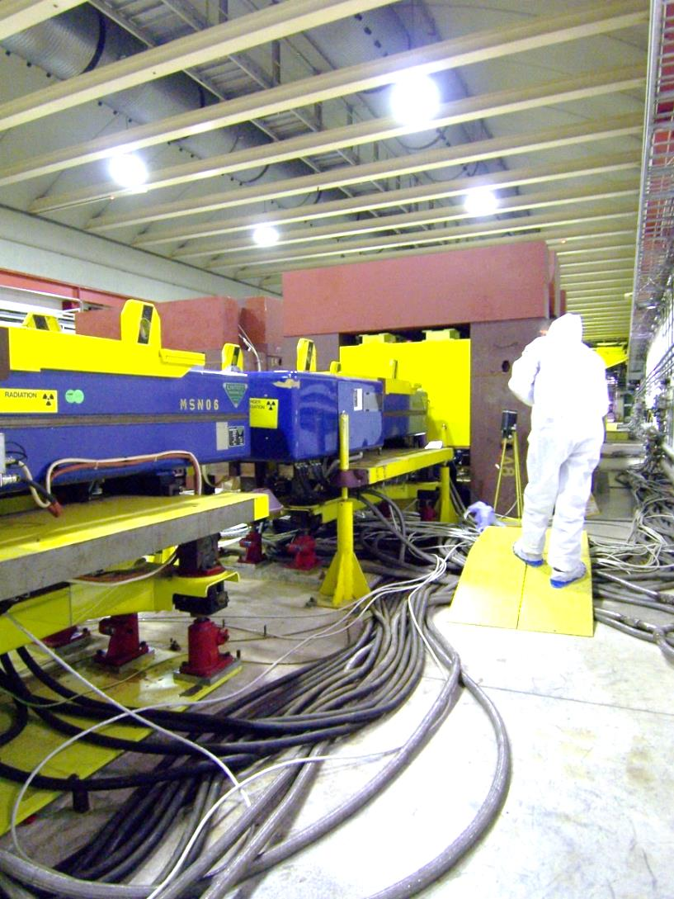
Lessons learnt
Our target and experimental areas are quite messy and tight. In particular lots of cables and pipes lie on the floor.
In general, robots are quite bulky and dangerous for the installation

Slide 11
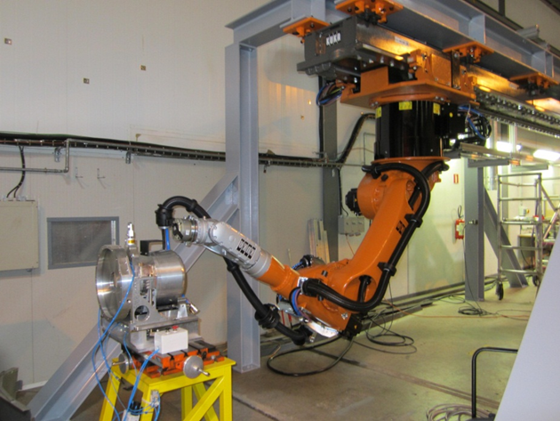
Lessons learnt
The ratio between the weight of a payload and the weight of the robot is enormous:
New Isolde robots weight about 1 Ton to be able to safely transport a target of 35 kg!!!

Slide 12
Intermediate Conclusions
Known scenarios
Unknown scenarios
Provide a full description of the operations to be performed
Perform a careful risk analysis (what can go wrong)
Analyse the maximum weight to be carried (and the speed).
Call Bruno Feral (EN/HE), but
Prepare yourself to invest manpower. You need to do your own part!
Can we prepare ourselves to unknown situations?
Yes, but
Don’t dream too much, especially without proper resources (M & P)
It will take years to build up the know-how.

Slide 13

Lessons Learnt
Robots need a crew to use them and maintain. Need (several) experts in house to be effective

Slide 14
CREW
An operator can drive a robot for one or two hours at most.
Need a “commander-in-chief” for the intervention
Need all the equipment experts
Need RP
Minimum: 1 robot, 3÷4 humans!

Slide 15
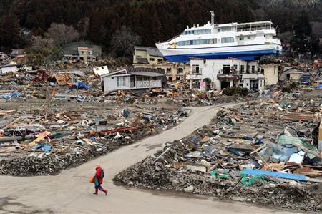
The unknown (unforeseen?) scenario

Slide 16
The unknown (unforeseen?) scenario
Fukushima is our most relevant study case (We have contacts with the teams intervening there…)
However the best example of organization (at least, the only one I know, I am sure every country has one…) is in France:
INTRA, a consortium AREVA/CEA/EDF is in charge of preparing robotic interventions in case of nuclear accidents

Slide 17
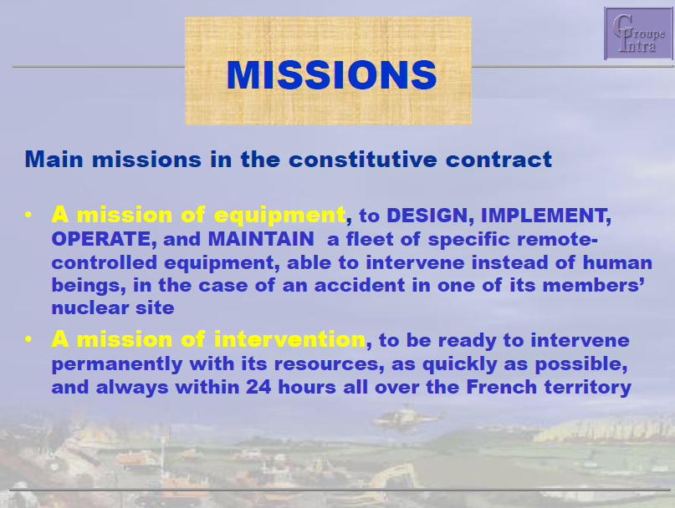

Groupe INTRA (court. M. Chevalier)

Slide 18
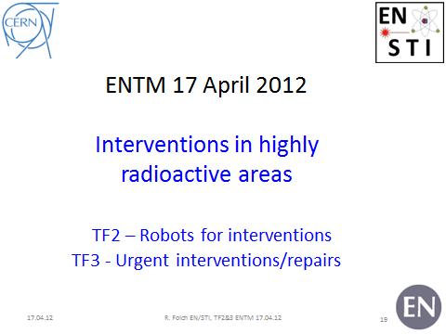
EN Dep. Initiative (HE, STI…)

Slide 19
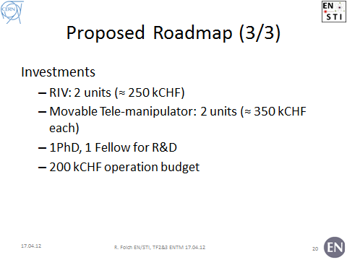
EN Dep. Initiative (HE, STI…)

Slide 20
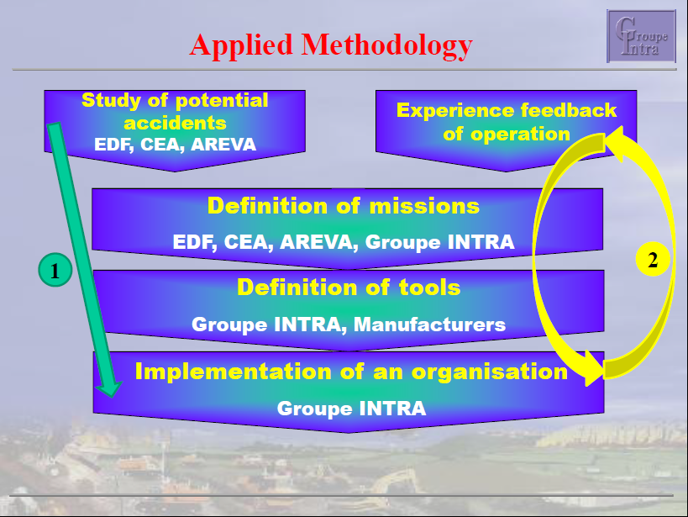
Groupe INTRA (court. M. Chevalier)

Slide 21
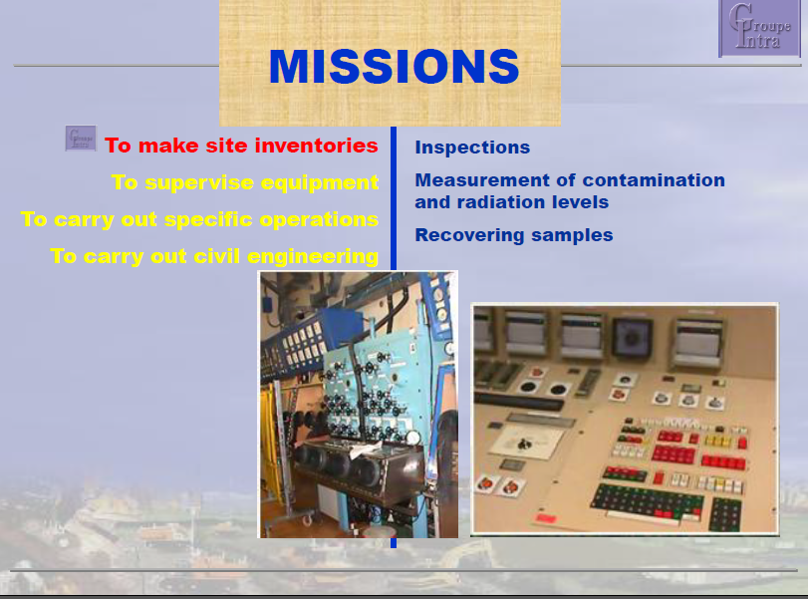
Groupe INTRA (court. M. Chevalier)

Slide 22
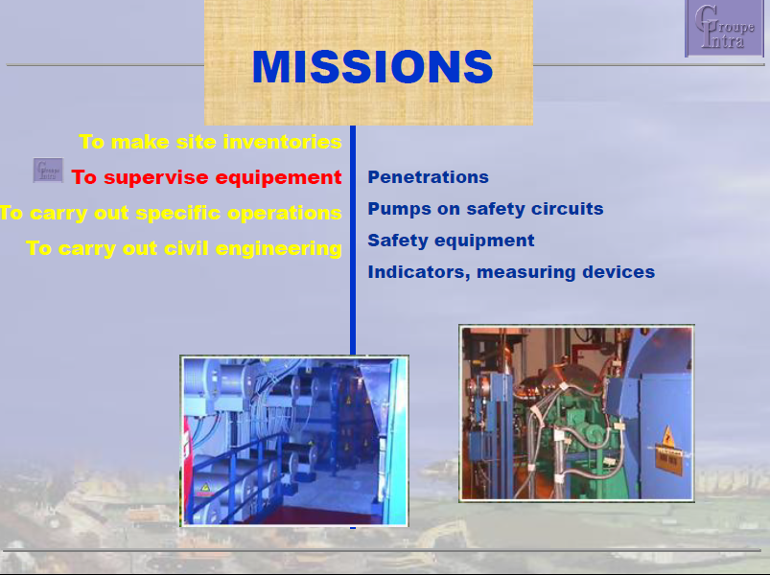
Groupe INTRA (court. M. Chevalier)

Slide 23
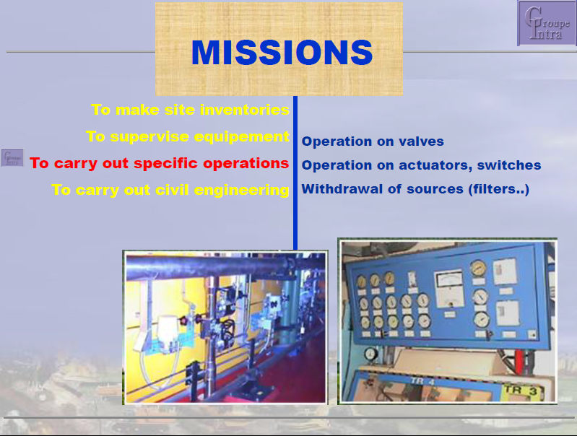
Groupe INTRA (court. M. Chevalier)

Slide 24
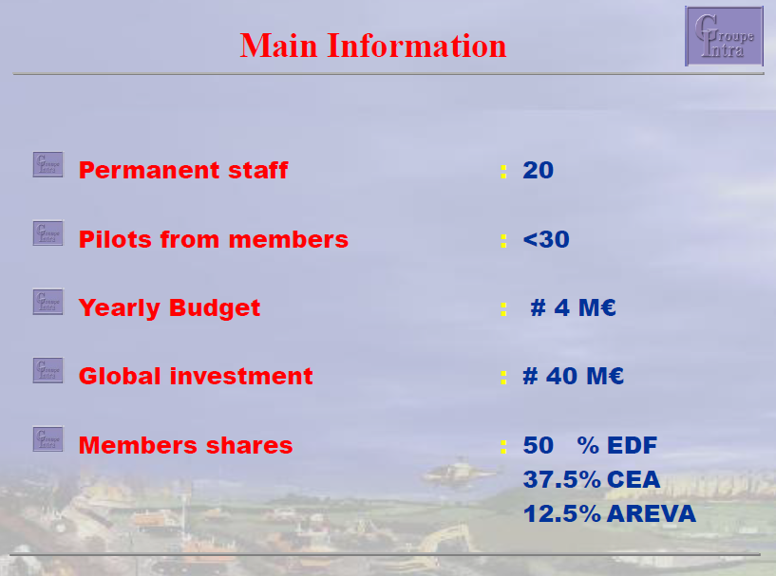
Groupe INTRA (court. M. Chevalier)

Slide 25
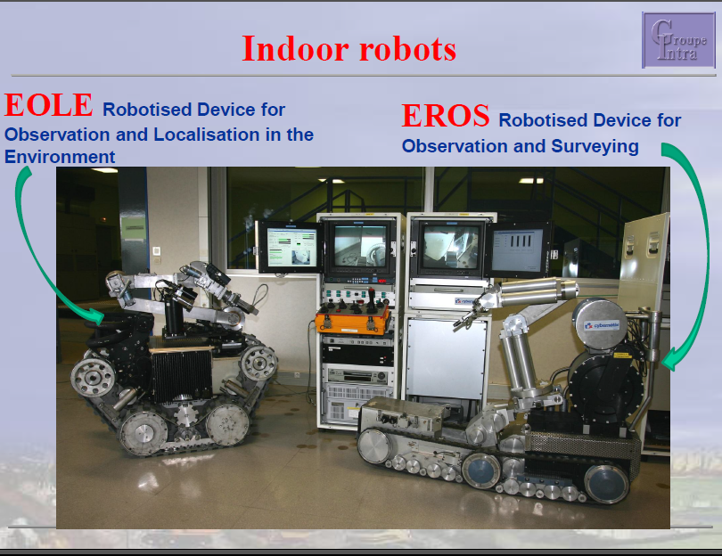
Groupe INTRA (court. M. Chevalier)

Slide 26
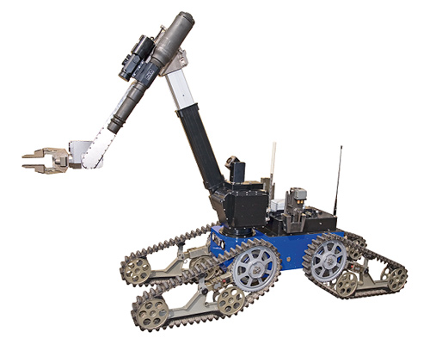
What should we aim for?
We (STI/HE) purchased a Telemax robot
We have now to make experience (e.g. in LSS1 and North area)
Then decide on further robots to purchase (bigger, smaller, on wheels, on chains, aerial, snakes etc…).
We can carry only 5 Kg!

Slide 27
Again Conclusions!
In presence of a well specified need, we (EN/HE, EN in general) have the capacity to define, purchase and operate robots.
There is a clear shortage of dedicated manpower. It is a limit to the quantity of project, not quality of solutions.
Groups interested should not dream of a “turn-key” service: they have to be ready to invest their own resources to define and solve the problem.

Slide 28
More Conclusions
A Robot for everything does not exist, we have to invest in robots of different sizes to address the largest number of cases
We can prepare ourselves to “unknown” scenarios, but we should limit to reasonable operations.
We can only be effective if we know the area, and we prepared it for robotic interventions (no cables on floor, enough room for passage, WIFI or VHF communication available, trained teams)

Slide 29
We have a solid basis
A team able to specify, procure, maintain robots (EN/HE).
Equipment groups (and HE) used to develop tools
But…
Components and Areas have to be designed for being handled/repaired and accessed with robots
Need a training area, and regular training on mock-ups for operators.
Remain reasonable, request simple operations or be ready to set up a sizeable amount of resources.

Slide 30
Thank you for your attention
Questions?

