Slide 1
VT Retractable Support motorization (Noguera/Vatansever)
Workshop on "Remote manipulations / diagnostics in radioactive areas and handling of radioactive material 06/05/2013

Slide 2
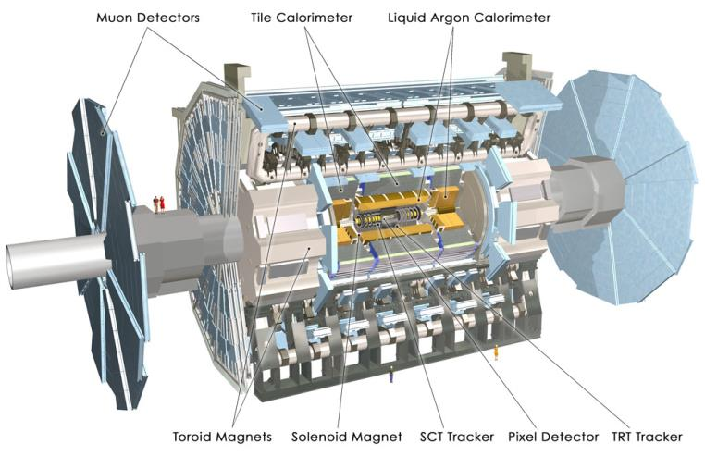

Slide 3
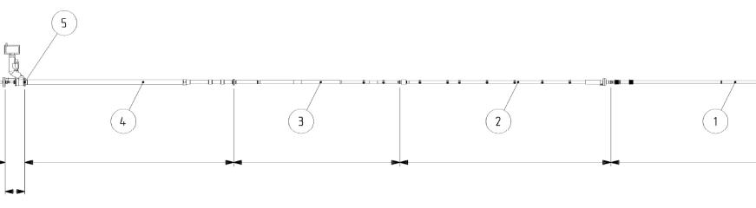
VJ
VT
VA
VI
7 beam-pipes of overall 38m length
VI (Vacuum inner detector)
VA (Vacuum argon end-cap)
VT (Vacuum toroid end-cap)
VJ (Vacuum forward shielding)
To minimize sag due to own weight and bellows supports are needed
Support system is conceived to allow ATLAS to rapidly move to a standard access

Slide 4
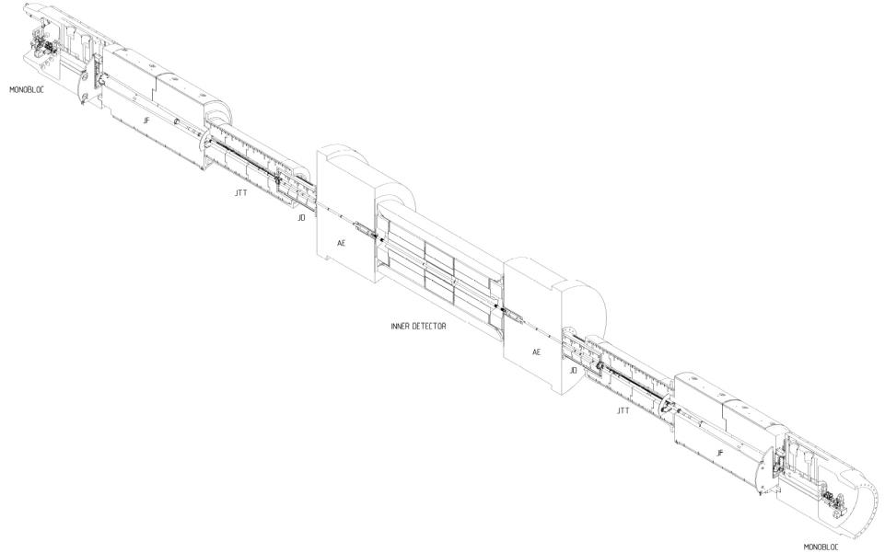

Slide 5
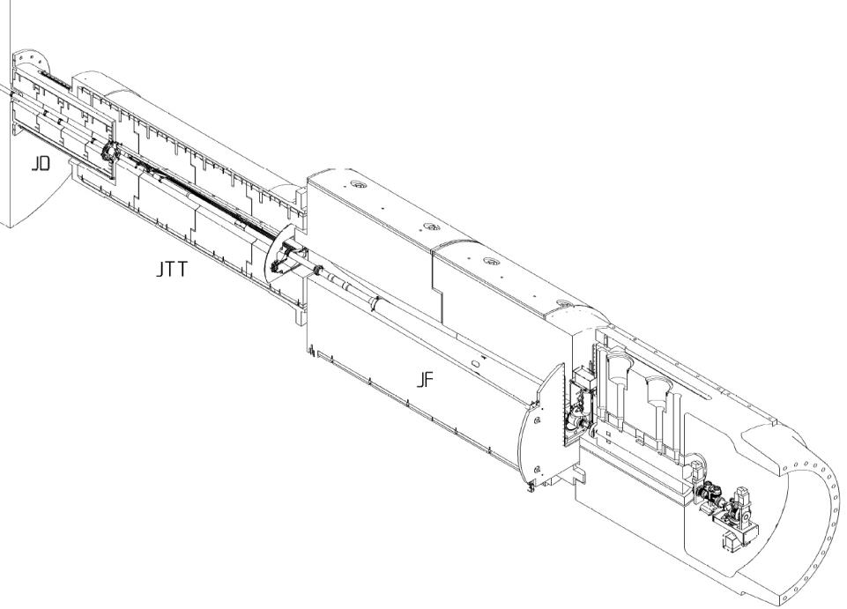
Multiple manual interventions needed in VJ/VT region
Removing supports, retracting supports, opening and closing bolted UHV flanges, positioning of beam pipe etc.

Slide 6
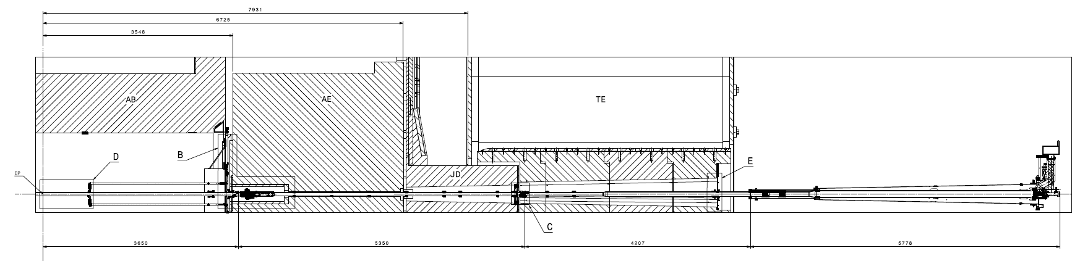
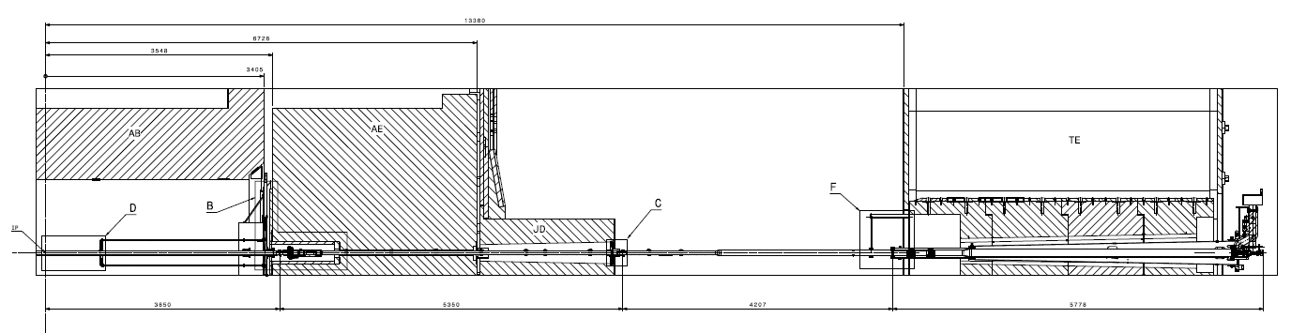
Opening procedures require manual interventions in order to move detector

Slide 7
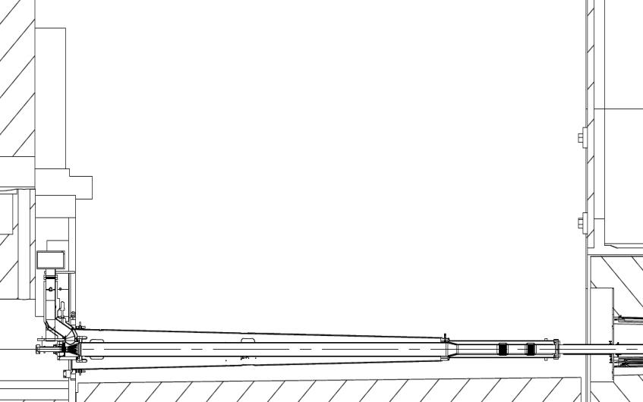
Measurements in μSv/h
RP - Conan Nadine; RPE – Spigo Giancarlo
ECT
12880 (ECT)
Contact
40cm
1.5 m
Contact
40cm
6.5
6.5
5.2
2
2
18600 (monobloc)
24
24
4.4
4.3
3.5
42
47
2.5 mSv/h
60
7.2
10
19
71
8
TAS
123
101
16
16
35
29
36
VJ
13207 (VT)

Slide 8
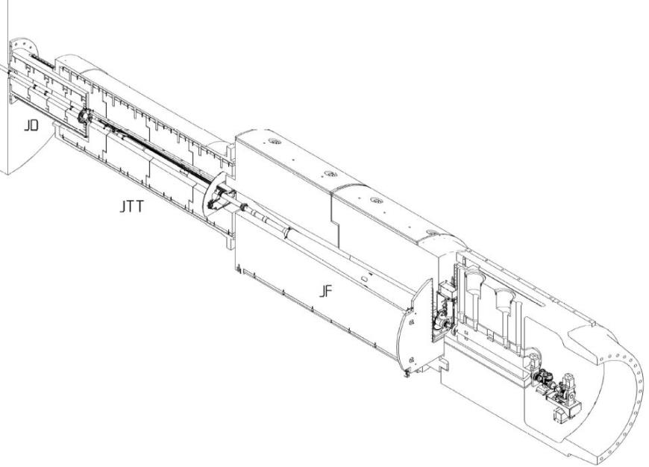
In order to minimize the radiation exposure of our team supports are being redesigned
low activation materials are used to reduce background
Already existing remote telemanipulator for the TAS
Highly limited by space constraints
Complicated accessibility (~13m height)
Activated material (no drilling into activated structures )

Slide 9
VT Retractable supports
Triangular support system which is manually retracted/elevated by turning a threaded bar
Overall 6 supports on each side
Used to position and support VT beam pipe

Slide 11
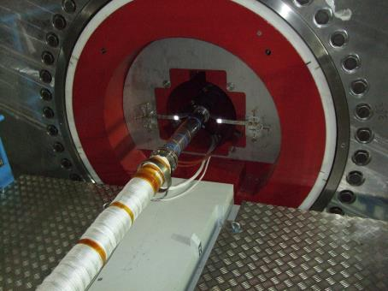
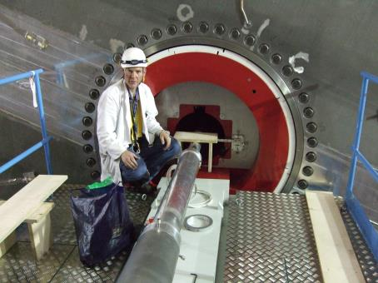

Slide 13
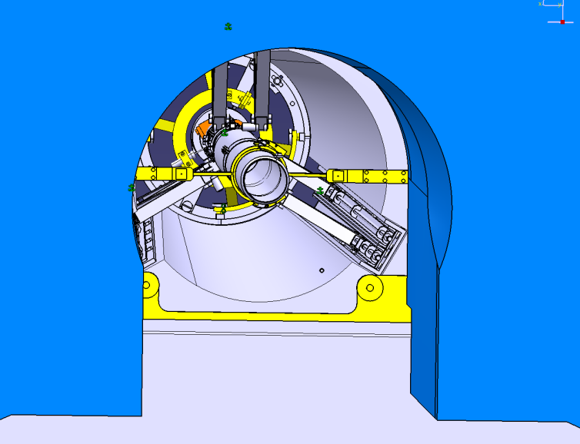

Slide 14
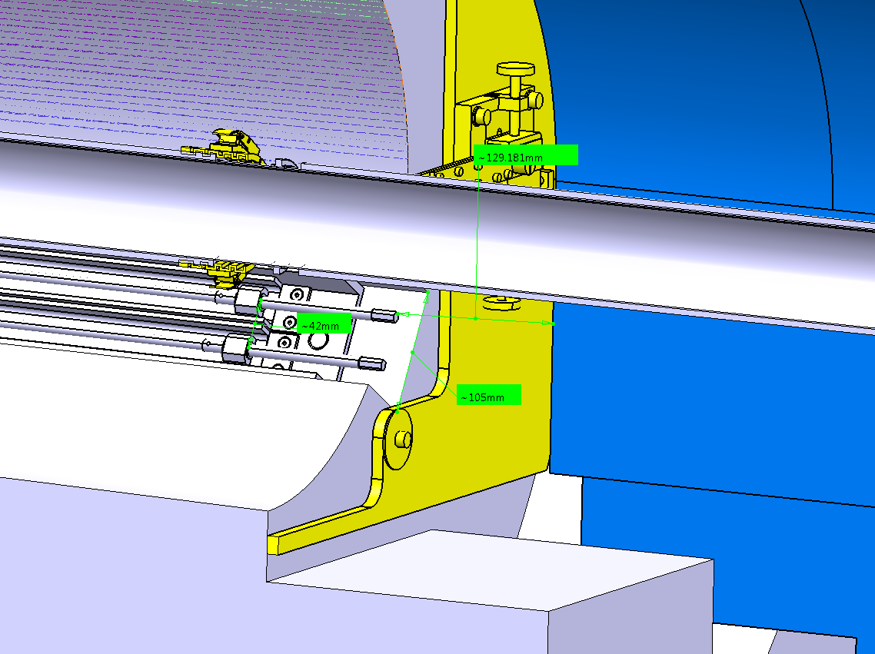

Slide 15
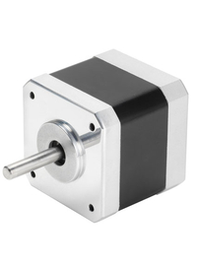
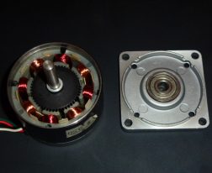
Possible solution found in the implementation of radiation hard stepper motors
CERN has already wide experience for the collimators (several hundred motors in use)
High torque and high accuracy with smallest possible dimensions
Design study has been performed by Pedro Noguera and Arkaitz Larman from AVS /Grenoble

Slide 16
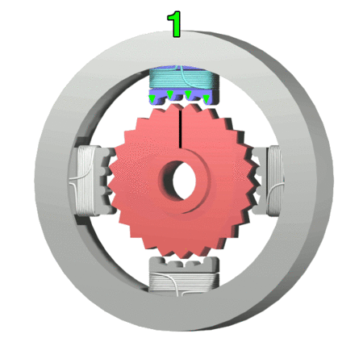
Windings placed on stator poles
Permanent magnet on rotor
Teeth on rotor provide a preferred path for the magnetic flux
Torque is produced due to interaction of the magnetic field produced by stator windings
200 steps per turn (1.8 degrees per step)
Allows a high positioning accuracy of the VT retractable support
Final position of VT supports achieved at approx. 160 turns
1 Step equals ~ 0.006 mm
No need for microstepping

Slide 17
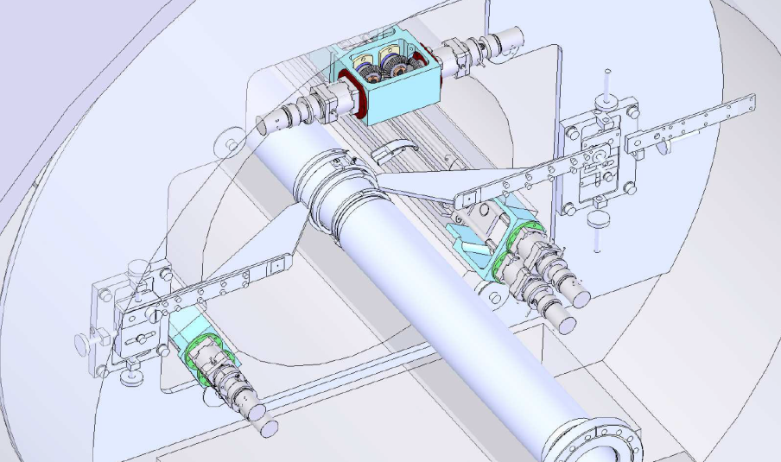

Slide 18
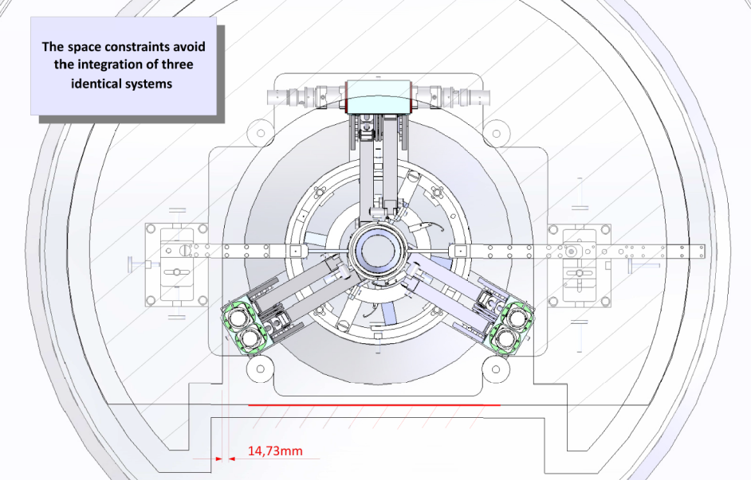

Slide 19
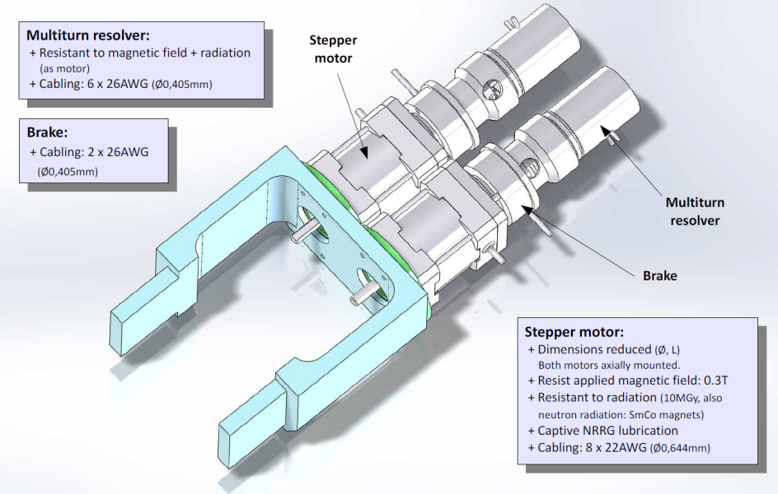

Slide 20
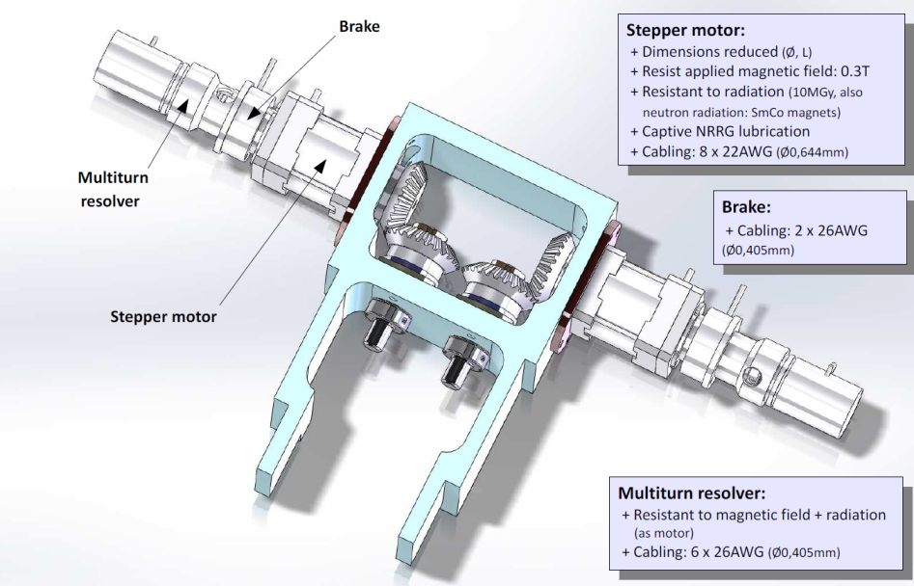

Slide 21
Summary
Tight space constraints in experiments reduce possibilities to redesign supports, flanges, adjustments etc.
Radiation hard stepper motors seem like a promising solution for retractable supports with high space constraints
Motors have shown their reliability in high radiation for the collimators
Magnetic field influence needs to be further examined (Mu-shielding?)
Possible manufacturers are chosen, prototype motors ordered, mock-up planed for the next months
Possibility to extend use to other adjustment systems in the experiments
Saves multiple hours in exposure of our personnel

