Slide 1
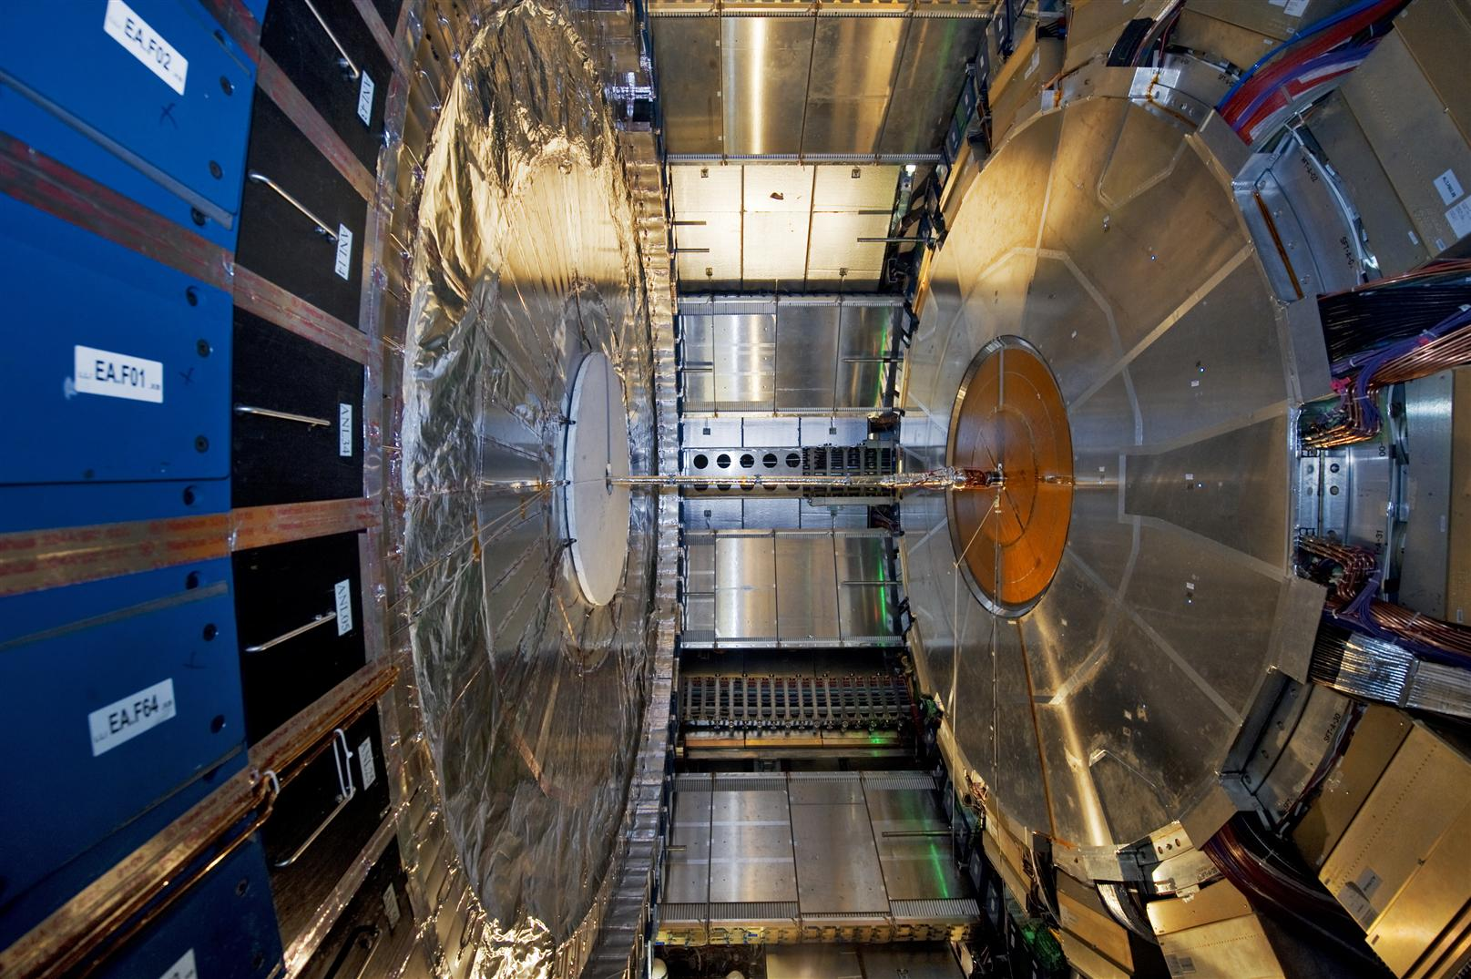
Augmented reality in ATLAS
Present and Prospective
O. Beltramello – 06.05.2013

Slide 2
An ATLAS Safety Upgrade Program
As a result of the intensive ATLAS Detector Upgrade Program and the increase of the performance of the LHC (luminosity) in the coming years:
➔ the radiations levels and generally the level of risks faced by our personnel in the coming years will increase by a lot.
The ATLAS safety upgrade program
is aiming to assist them and eventually
to replace them to perform these tasks
The ATLAS safety upgrade program is developed in several stages following the ATLAS Upgrade Program

Slide 3
1. Development of the ATLAS Wireless Personal Safety and Supervision system:
We are supervising them, their environment and their activities :
  audio / video connection
  monitoring of environment parameters: dose rates, gases, T, H
  monitoring of health data (heart rate, internal T, detection of fall, etc..)
We are providing to the worker information
  various infrastructure of display: IPAds, Head Mounted Display,...
  from various nature: working procedures, environmental data (dose maps,..)
  using virtual and augmented reality technologies
➔ improve safety of personnel in high radiation areas for planned interventions or in case emergency
➔ increase the safety levels, reduce human errors, decrease the time required for interventions and reduce the stress linked to these interventions

Slide 4
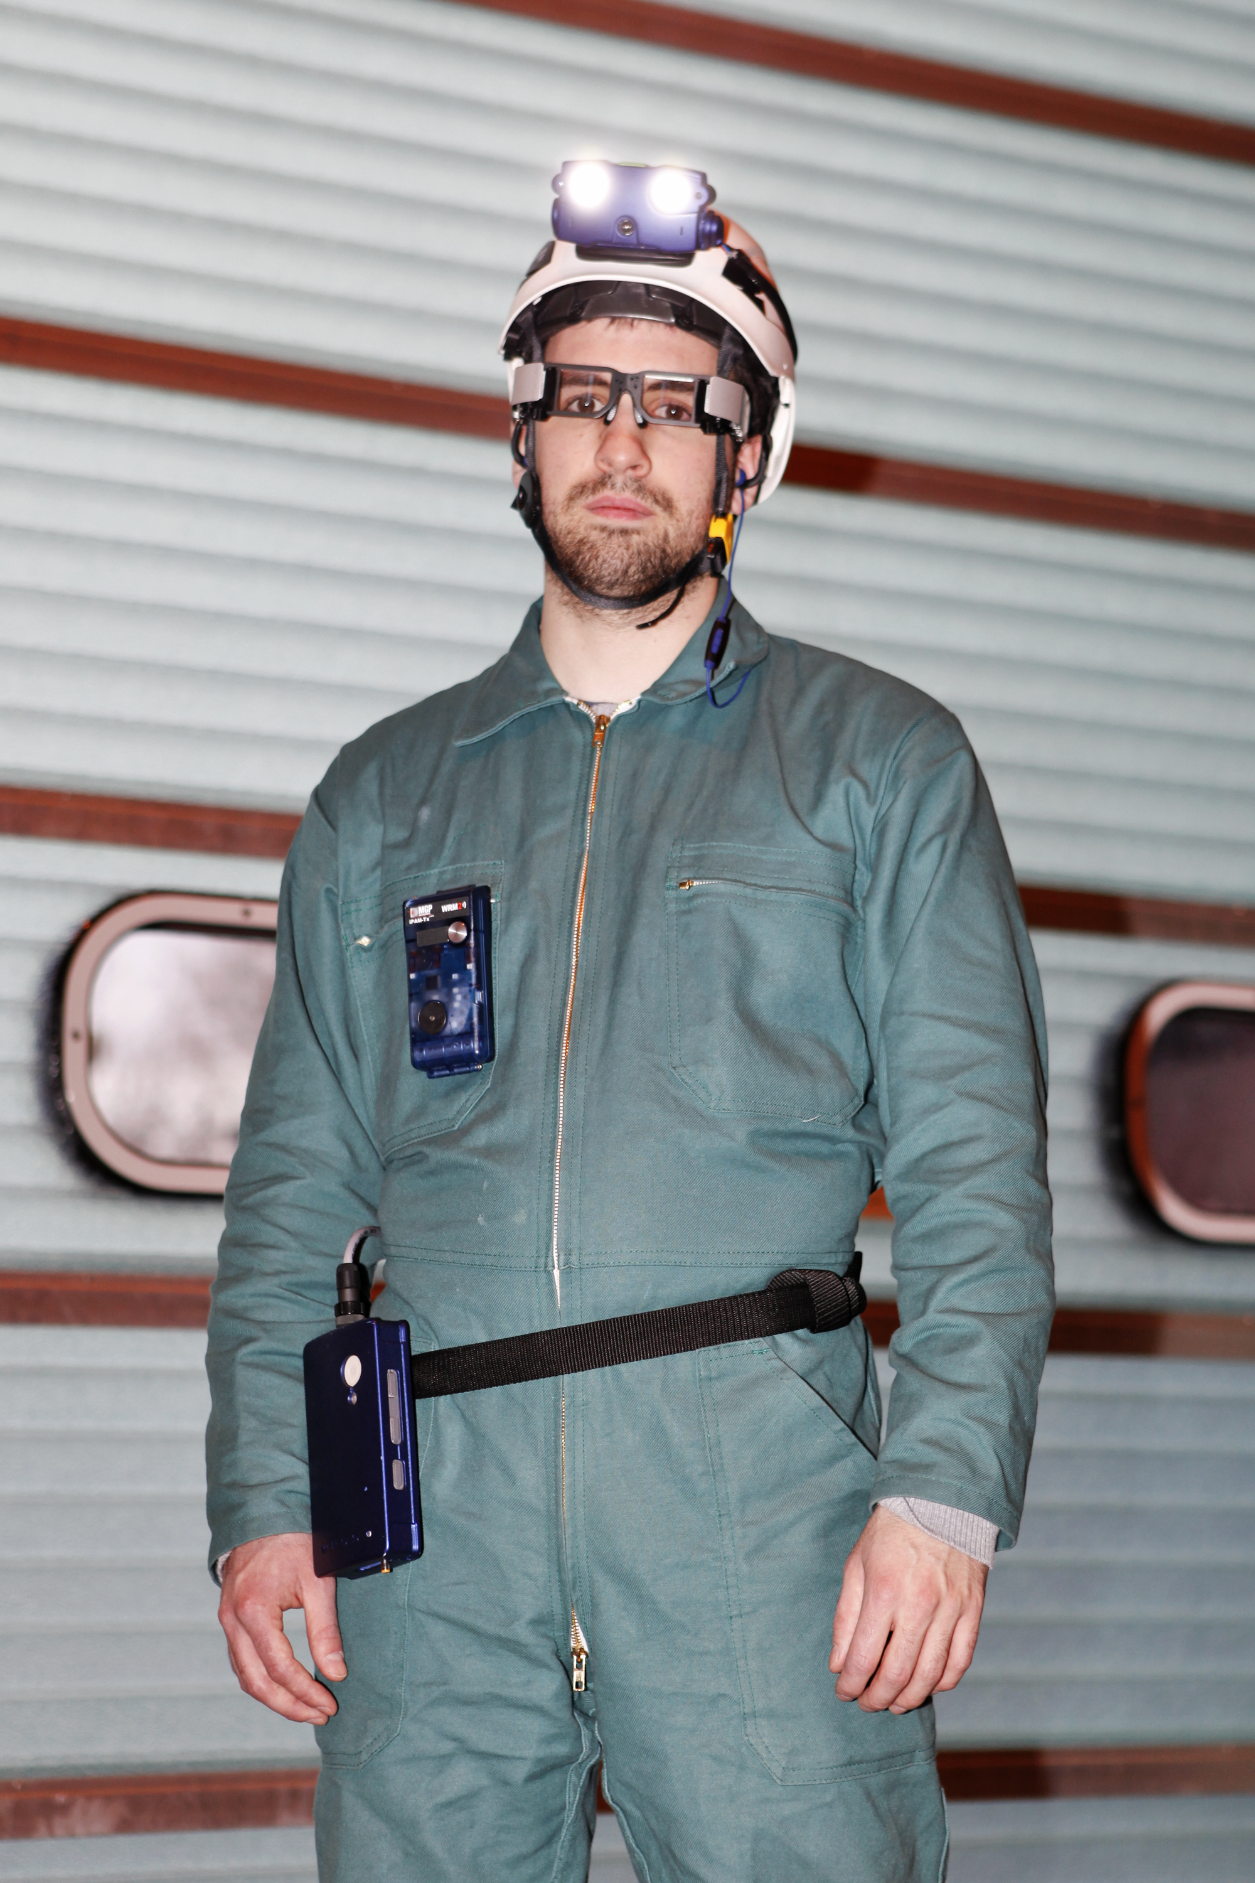
After 3 years of development, several system prototypes are operational
with:
  DMC operational dosimeter
  ODH, CO2 sensors
  Barometers, accelerometers, T
  Heart rate
In use for LS1 critical activities in ATLAS
undergrounds
We have already saved radiation doses

Slide 5
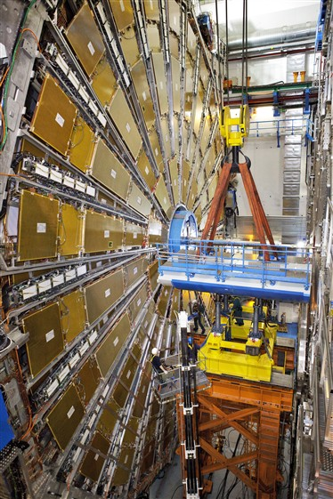
An example: the ATLAS VJ Forward Beam Pipe Removal
  ALARA optimization performed
  Dry run performed on surface
(*) average dose rate in the area of work
200 μSv /h
(*)
On JFC1 bridge, 15 meters high, restricted access
50 μSv /h
(*)
Estimated optimized dose rates: 50 μSv per person for the intervention

Slide 6
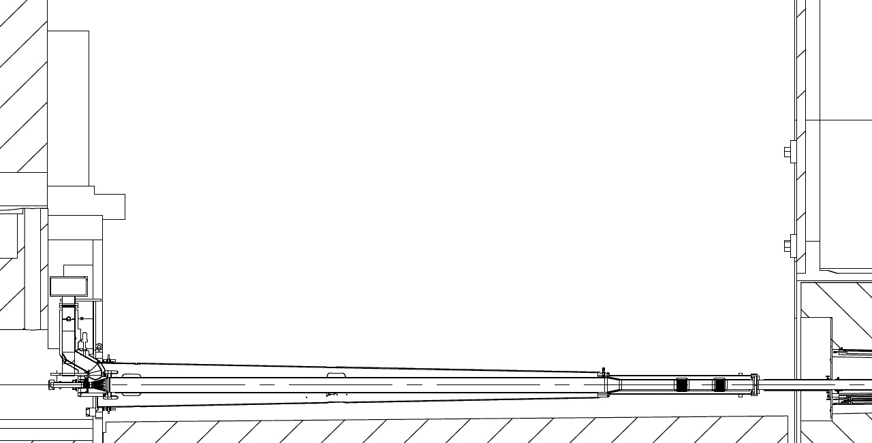
ECT - TAS side C, 21-Feb-2013
Distance from Beam Pipe: Contact, 20 cm, 40 cm, 1m, 2m
Drawing ATCO_0012
Measurements in μSv/h
RP - Conan Nadine; RPE – Spigo Giancarlo
12880 (ECT)
T
AS
Contact
ECT
40cm
1.5 m
Contact
40cm
6.5
6.5
5.2
2
2
18600 (monobloc)
24
24
4.4
4.3
3.5
42
47
60
7.2
10
19
71
8
123
101
16
16
35
29
36
VT
VJ
2.5 mSv/h
13207 (VT)

Slide 7
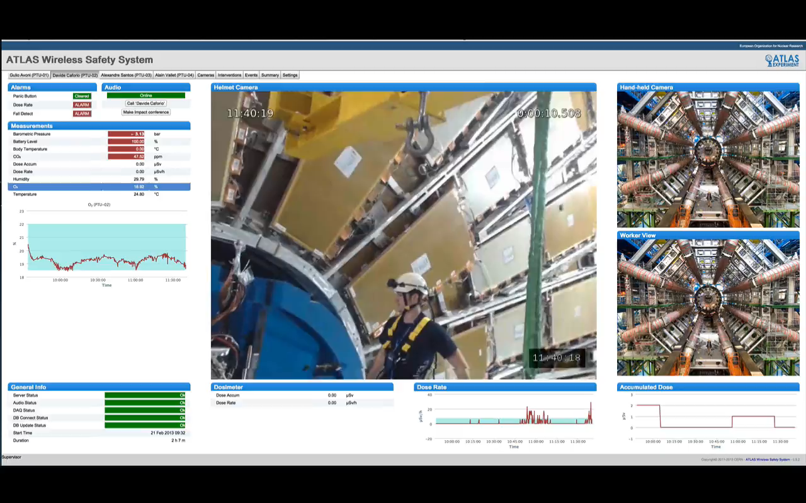
ATLAS VJ Forward Beam Pipe Removal - 21 February 2013

Slide 8
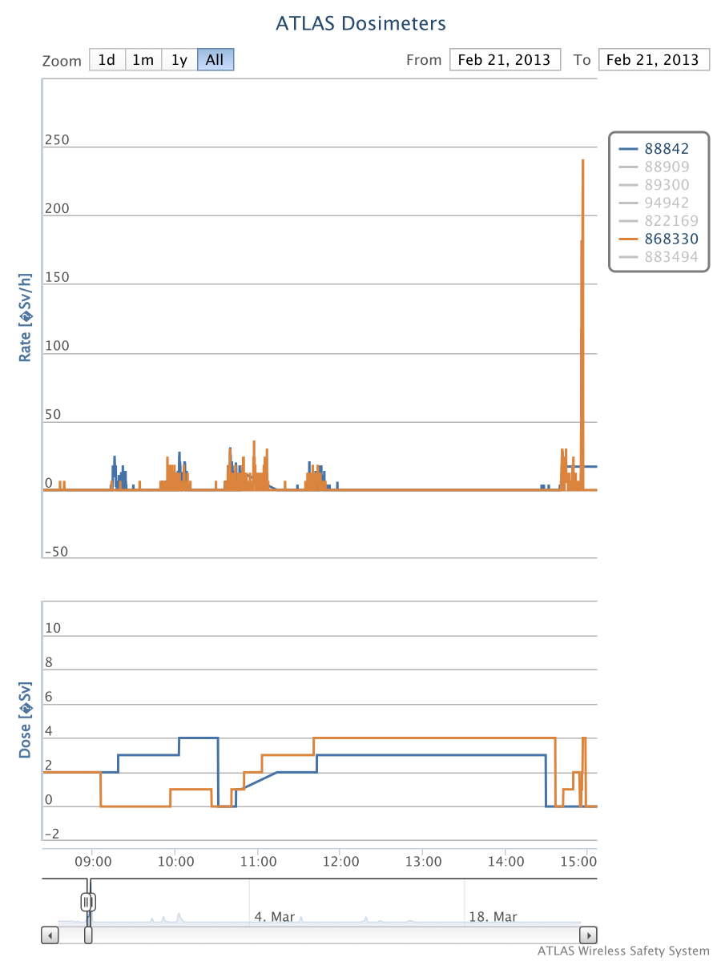
ATWPSS operational dosimeter – Real time and Collected doses
Standard VJ
removal operation
VJ bellow breaks during lifting
Brainstorming
and pause
Max. pers. dose (calc. / meas.) (μSv) | Max. interv. dose (calc/ meas) (μSv) | Time of intervention (calc / meas) (min)
34 / 10 | 58 / 20 | 89 / few hours
Removal of the VJ broken part inside TAS area

Slide 9
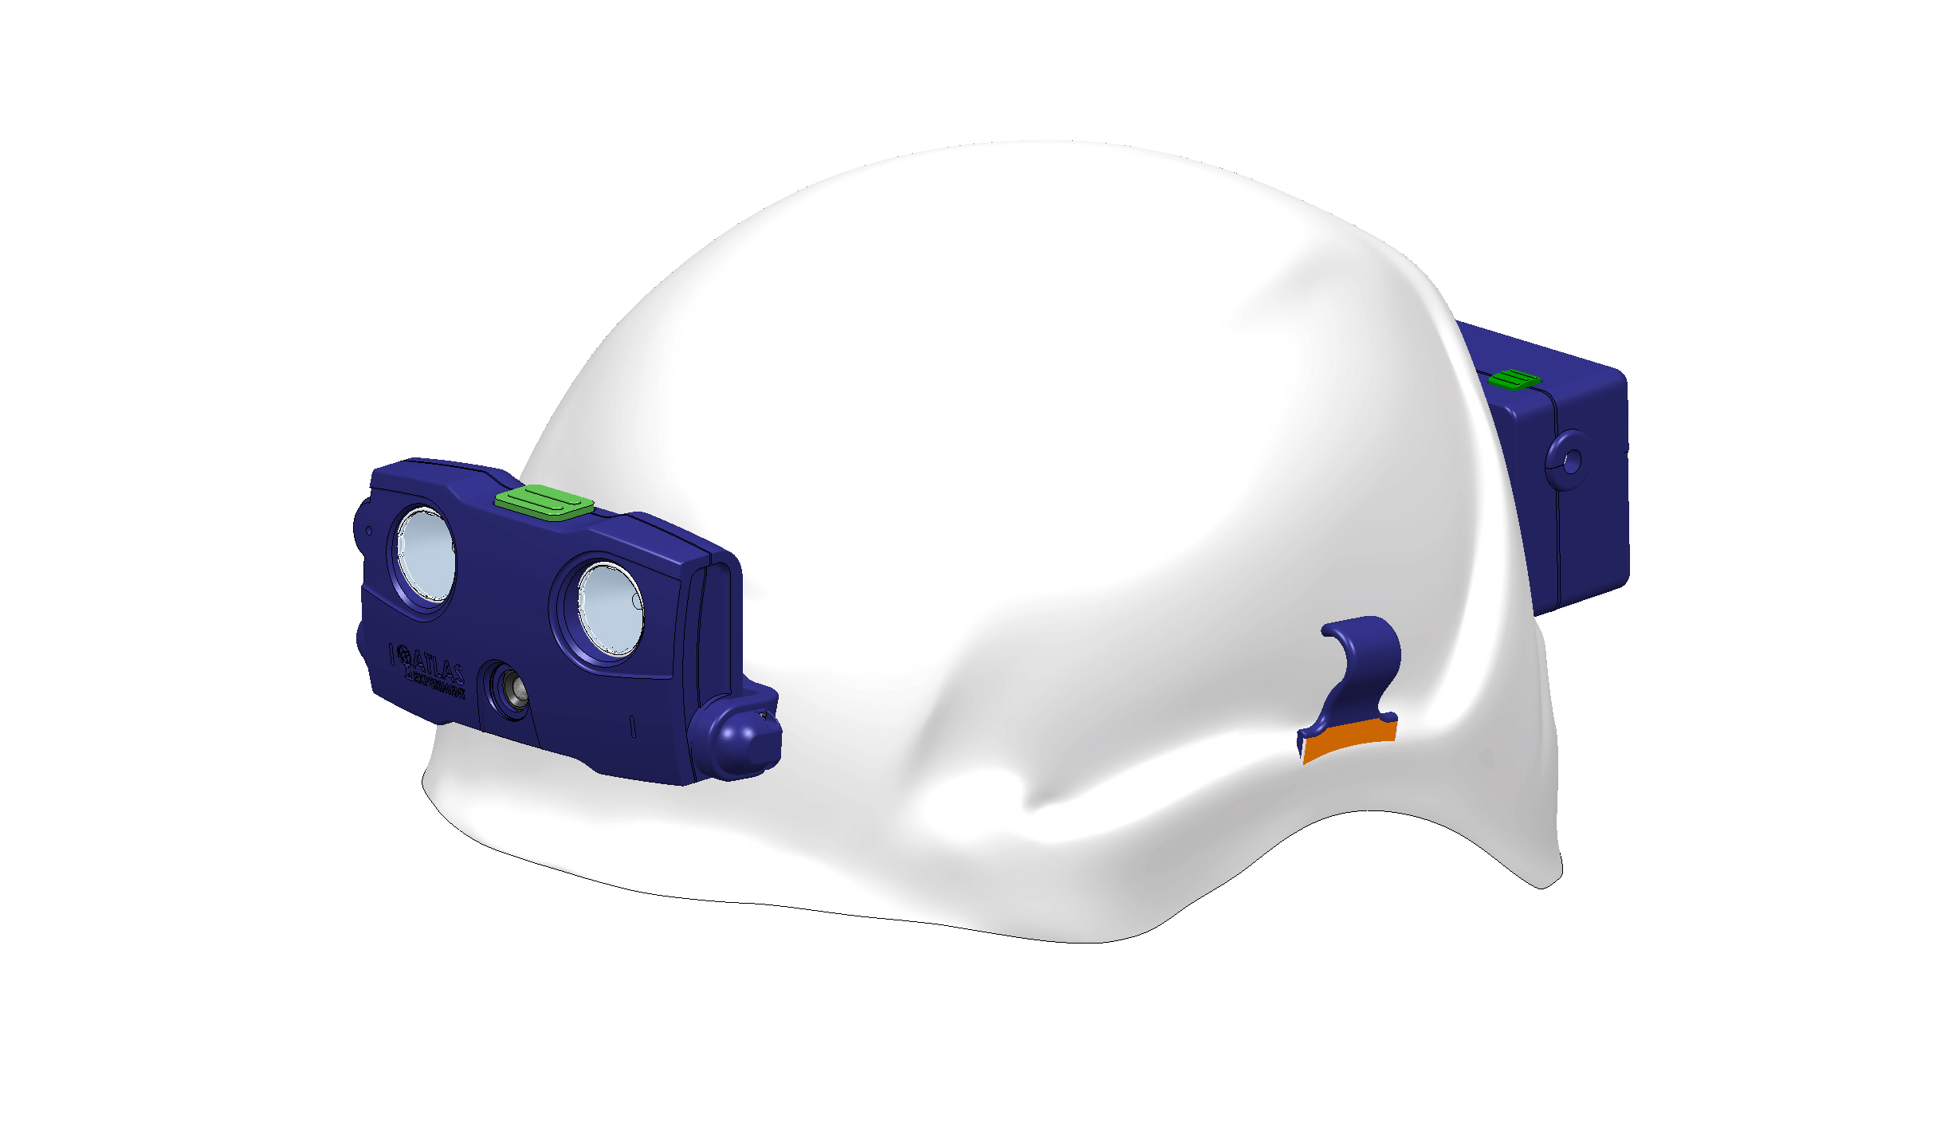
What are the next steps ?
  New development are ongoing to miniaturize the system and increase
  its robustness (HW and SW)
  The system is very flexible, we (ATLAS safety group) are driving the design and development: we can imagine plenty of configurations
  A version fully integrated
  on the helmet is under progress
  We are in discussion with CERN Fire Brigade and IT division for an
  adaptation of the system to the CERN FB needs.

Slide 10











2. Development and integration of the Virtual and Augmented Reality technologies in the system:
We want to extend our collaboration to partners external to the ATLAS Collaboration.
This is done within the EDUSAFE FP7 Marie Curie ITN Project
3.2 MEuros, 4 years program (started in Sept. 2012)
CERN / ATLAS is coordinator
10 PhD Fellows
2 Post Doc. Fellows
12 Partners :
Athens University of Economics and Business, Greece
Canberra, France
CERN / ATLAS
EPFL, Switzerland
Novocaptis, Greece
National Technical University Athens, Greece
Prisma Electronics, Greece
Technical University of Munich, Germany
Universita Degli Studi Di Roma Tor Vergata, Italy
Aristotle University of Thessaloniki, Greece
CAEN University, France
Democritus University of Thrace, Greece

Slide 11
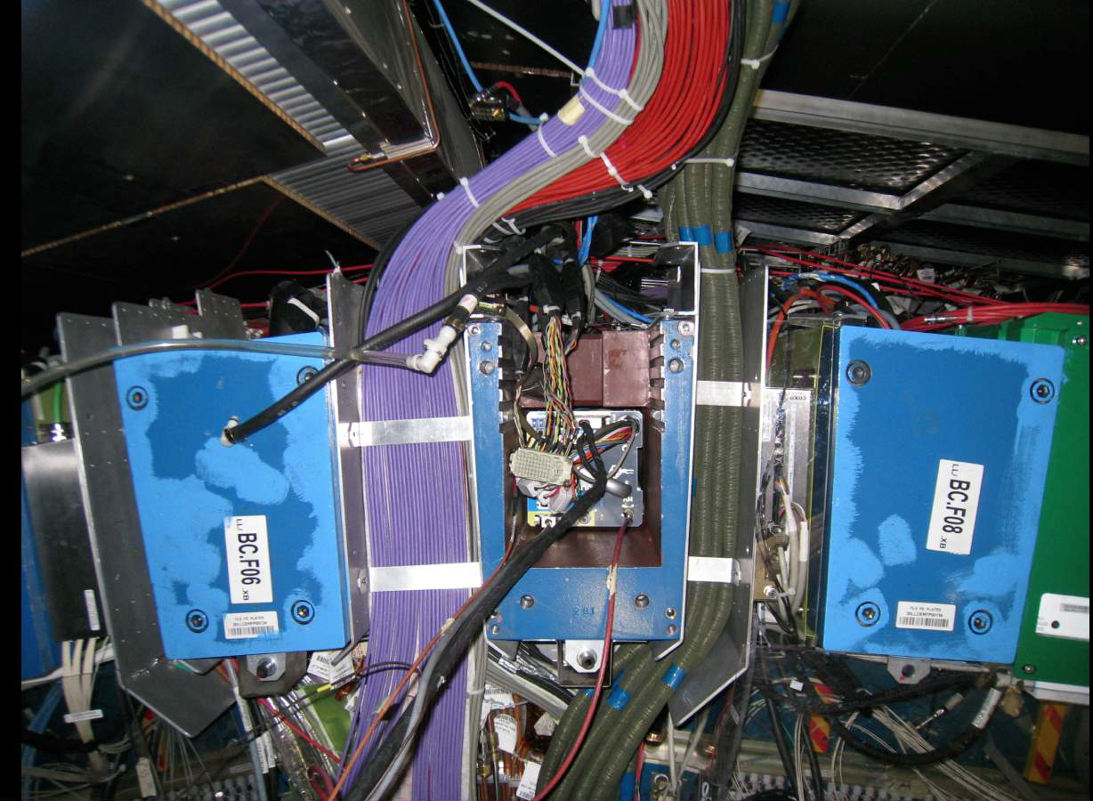
2. Development and integration of the Virtual and Augmented Reality technologies in the system:
We want to extend our collaboration to partners external to the ATLAS Collaboration.
This is done within the EDUSAFE FP7 Marie Curie ITN Project
3.2 MEuros , 4 years program (started in Sept. 2012)
CERN / ATLAS is coordinator
10 PhD Fellows
2 Post Doc. Fellows
12 Partners :
Athens University of Economics and Business, Greece
Canberra, France
CERN / ATLAS
EPFL, Switzerland
Novocaptis, Greece
National Technical University Athens, Greece
Prisma Electronics, Greece
Technical University of Munich, Germany
Universita Degli Studi Di Roma Tor Vergata, Italy
Aristotle University of Thessaloniki, Greece
CAEN University, France
Democritus University of Thrace, Greece

Slide 12
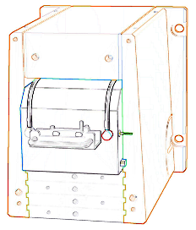
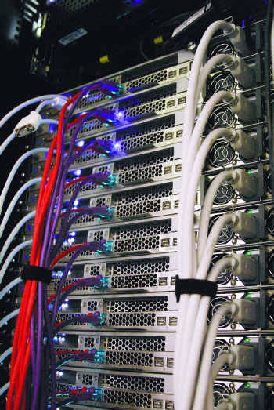
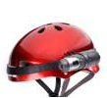
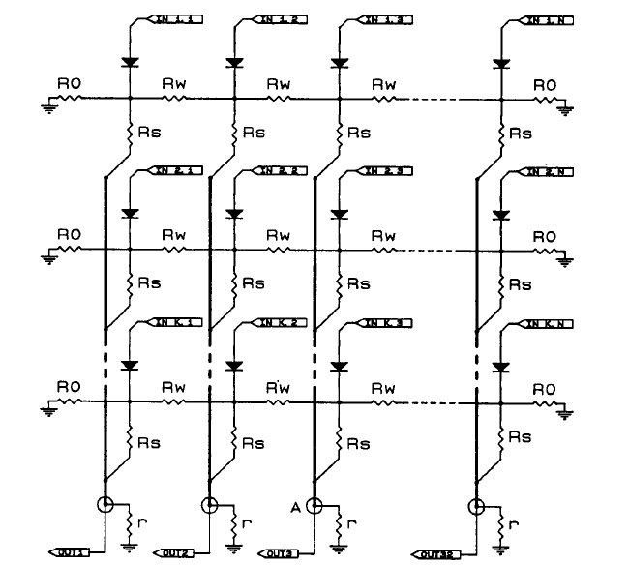
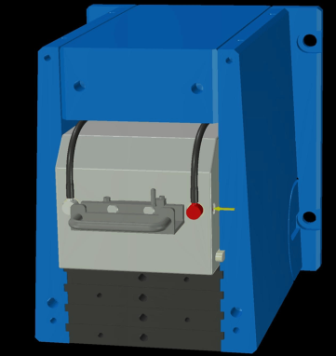
What are the main goals of EDUSAFE ?
  Development of Augmented Reality technology far beyond the current state of art
  Adaptation of a very innovative technology developed for the ATLAS Muon tracking (Roma Tor Vergata) to boost the AR visualization fastness. This is the WRM (Weighting Resistor Matrix): a very fast (nano seconds) ship to analogically detect images in noisy environment.
  A repetitive resistive matrix is used to test an input voltage pattern against a given hypothesis, providing analogical estimator of the likelihood.
HW edge detection (optionally software)
WRM 32x32 (minimum) components
X,Y,X’,Y’ image edge coordinates to the server. The scale factor is also calculated
The augmented content generated and superimposed at the right coordinates of the field of vision of the operator
The augmented content generated and superimposed at the right coordinates of the field of vision of the operator

Slide 13
What are the main goals of EDUSAFE ?
  Coupling this technology to today most advanced computer vision software and methods (EPFL).
  Development of advanced light and fast Gamma Radiation imaging camera (Canberra/ AREVA ) upgraded and adapted to CERN needs
  Development of real time wireless large data transfer
  Integration in an upgraded version of the existing system (CERN)

Slide 14
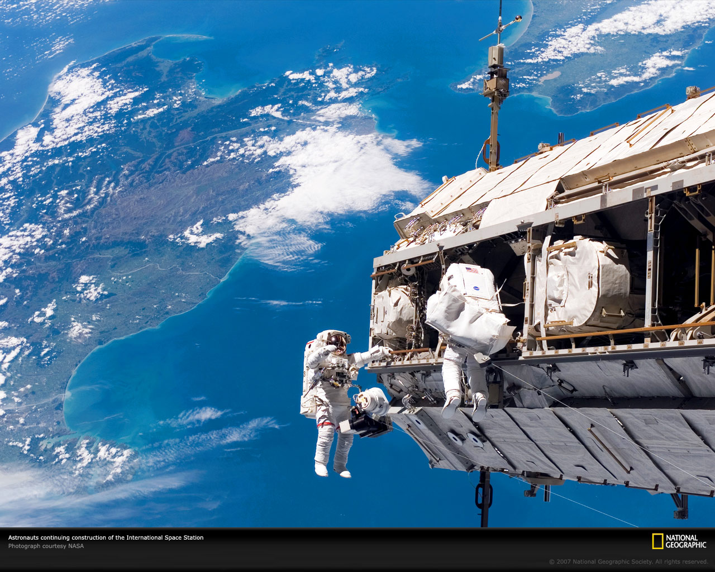
And adapt in future to potentially interested domains:
  Automotive and aerospace industries
  Extravehicular and intra-vehicular space applications
  Nuclear Power plants
  Public use
  Fire Brigade

Slide 15
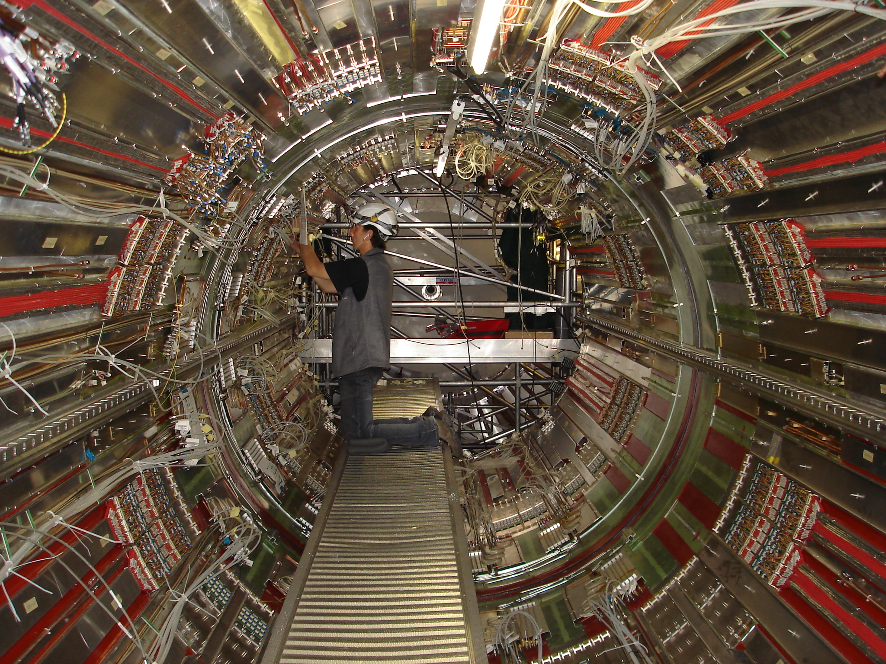
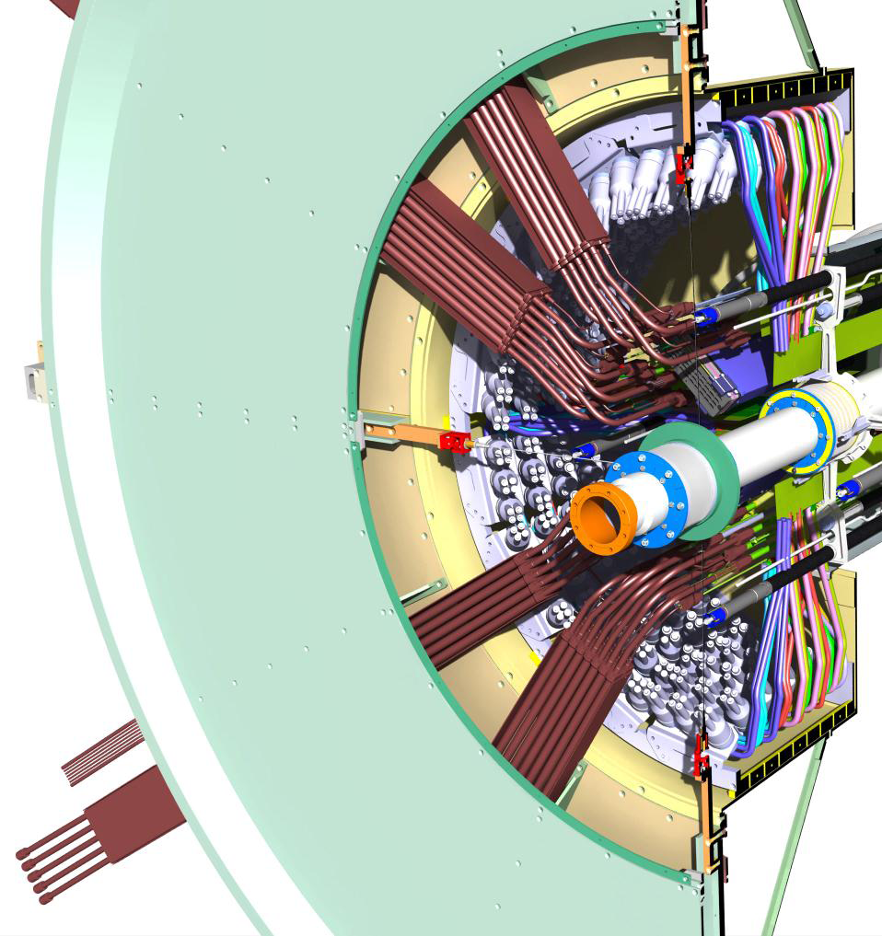
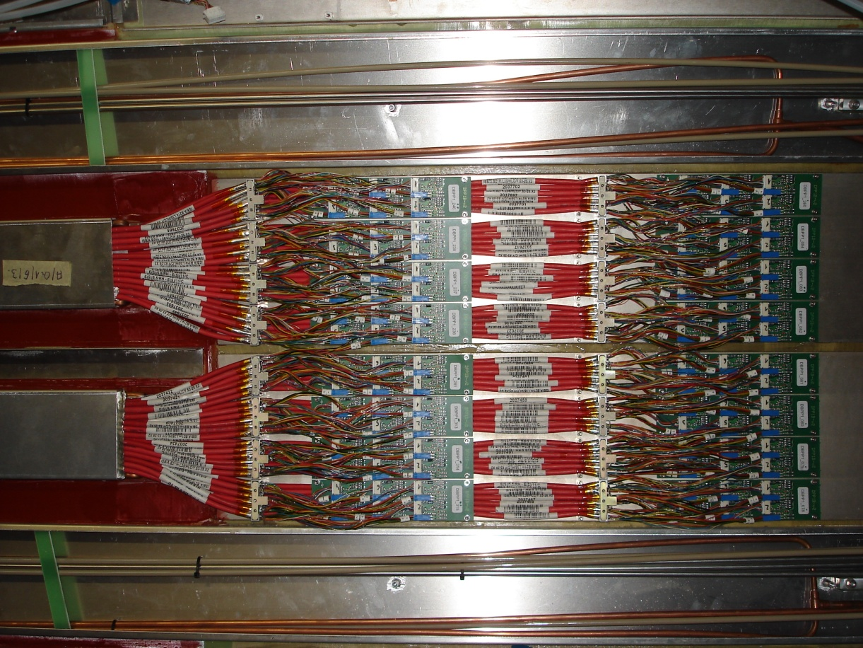
3. Development of remote handling and robotics technologies towards the ATLAS/CERN needs for the maintenance and upgrade activities with high radiation risks.
For places where the instantaneous dose rates and/or the collected doses are too high
Identified activities :
LS2 / LS3: Beam Pipes removal
LS3: Inner Detector Removal
LS3: ID services dismounting
After LS3: Annual Inner Detector
maintenance

Slide 16
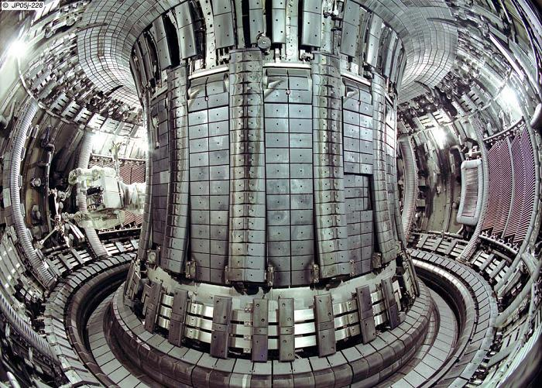
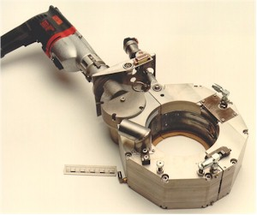
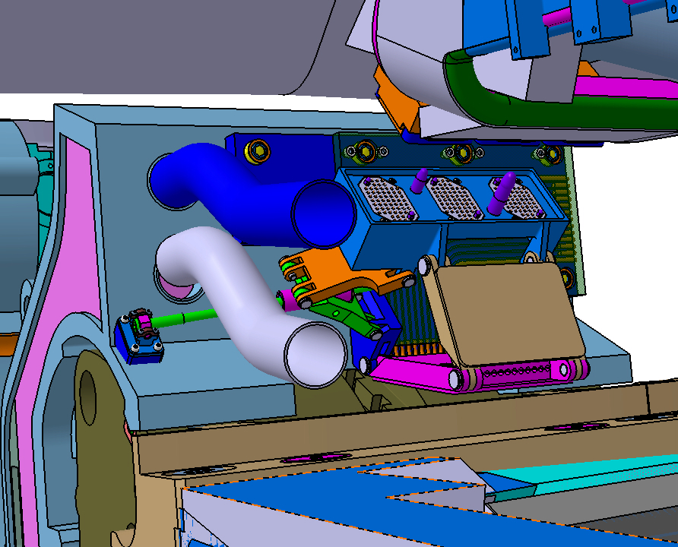
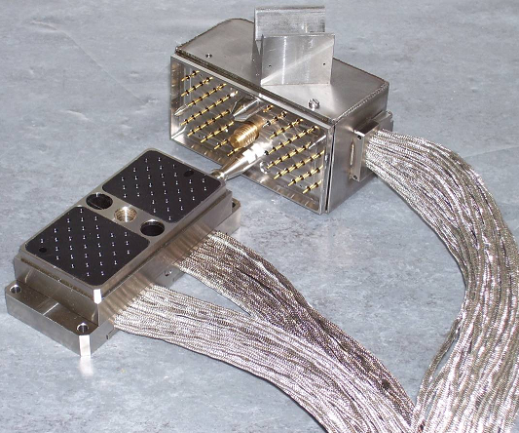
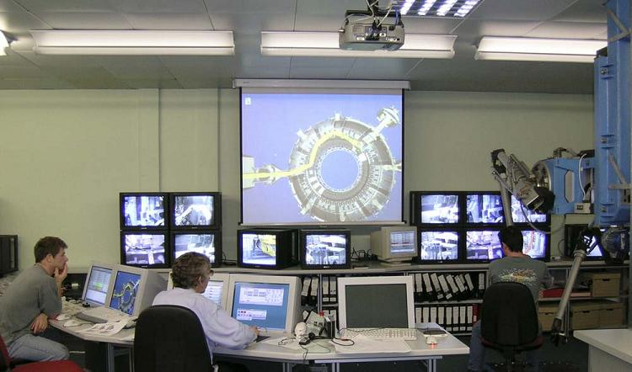
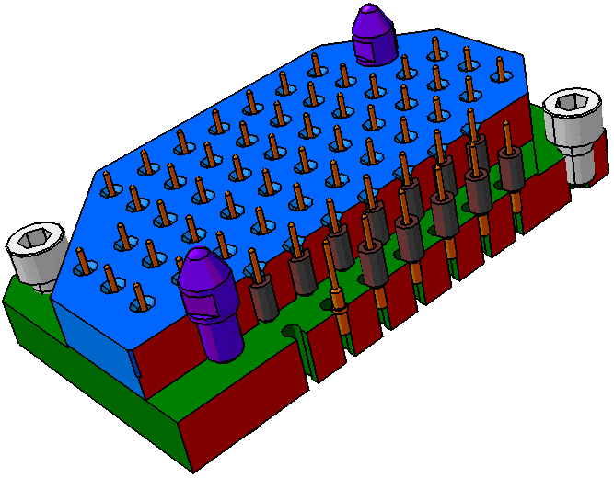
We are currently looking the best way to approach the problem
We have contacted some companies (Shadow, Oxford Technology, Space application,..)
In parallel, we are looking for some possible EU fundings (but we have to wait now for Horizon 2020) to develop / adapt technologies for the “CERN cases”

Slide 17
In conclusion :
  We need to develop methods and tools to assist and supervise our personnel in the future for highly radioactive areas
  We have developed the ATLAS Wireless Supervision and Safety system already in use for LS1
  We will upgrade this system in the coming years in particular in developing Augmented reality technologies via EDUSAFE ITN project
  In parallel, we know that we will face in future long shutdowns areas too radioactive for our workers:
  we need to address now the problem and look for flexible remote handling technologies adapted to the various CERN needs.
  ... With the ultimate goal to use the AR technologies to assist during the remote handling operations and their training.

