Slide 1
Remote Measurement and Alignment
Applications for Survey and Alignment
P. Bestmann for BE/ABP/SU
06.05.2013

Slide 2
Applications
Remote Monitoring and Alignment Systems
Inner Triplets
  Permanent monitoring of the position (5DOF)
  Remote adjustment
  Installation of remote maintenance systems during LS1
Remote Measurement and Diagnostic
Collimator Survey Train
  Remote measurements in defined areas
  Limited to IR7 today
  No remote alignment

Slide 3
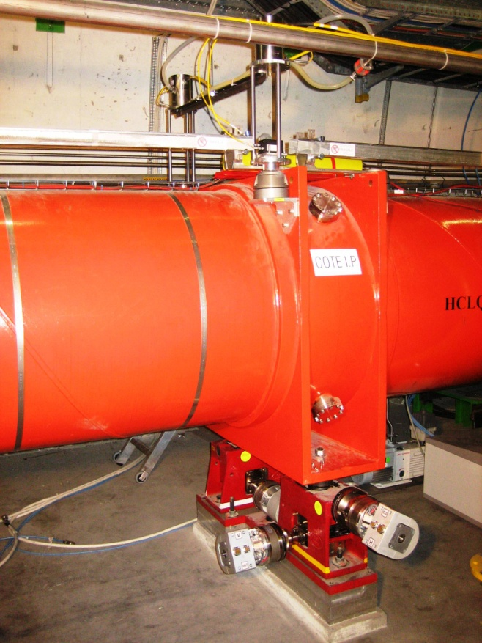
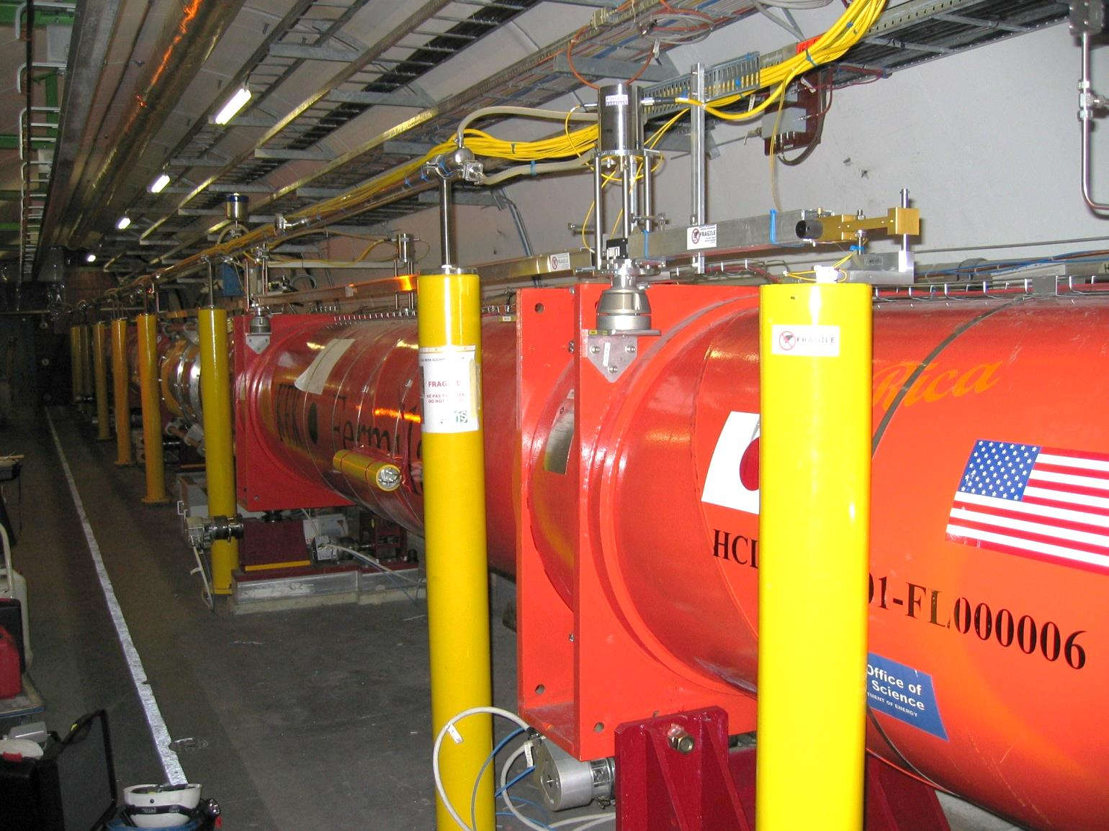
Inner Triplets
More than 60WPS and 100 HLS
Capacitive and load sensors
128 actuators
  Micrometric resolution of the monitoring sensors
  Resolution of adjustment below 10μm

Slide 4
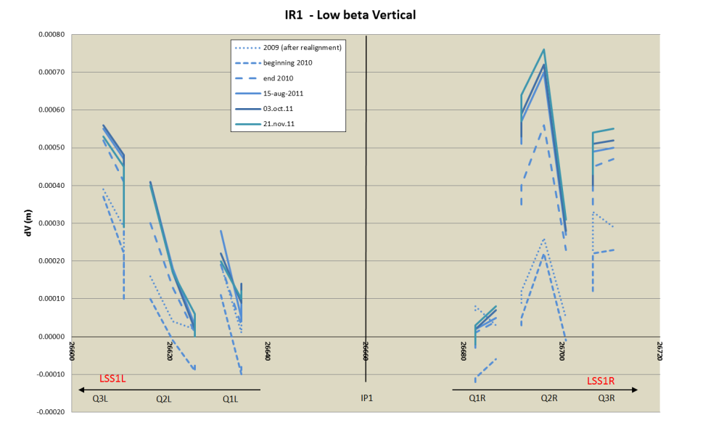
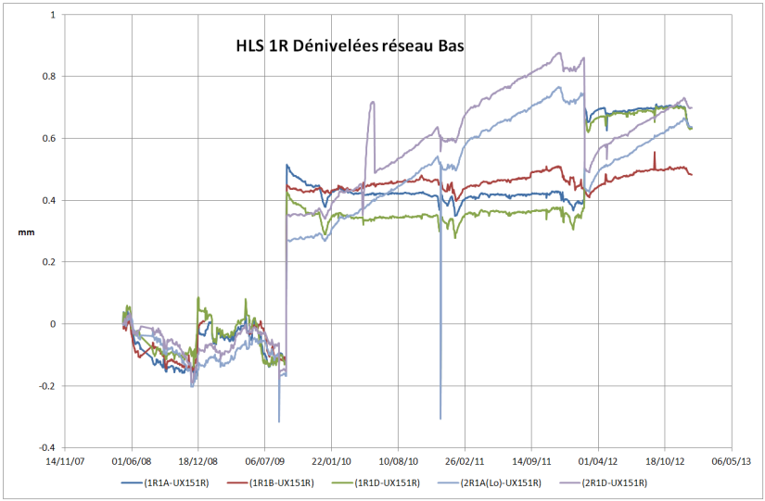
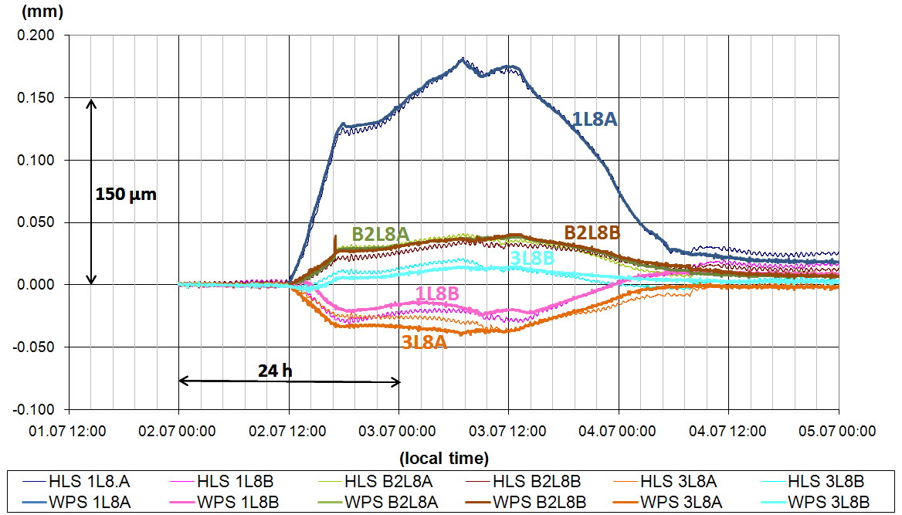
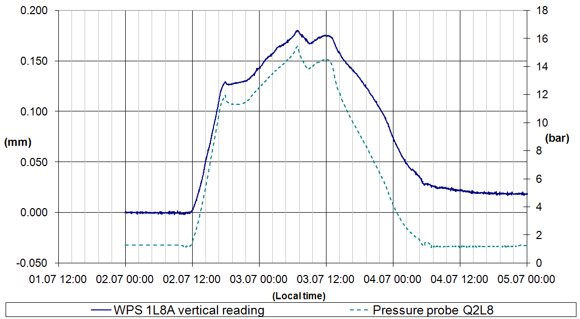
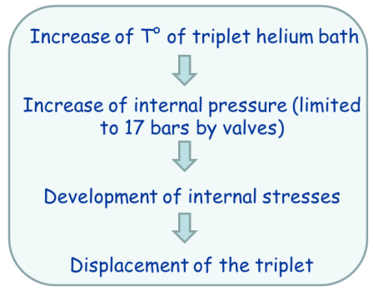
Operation

Slide 5
HiLumi LHC
Access to LSS will be more and more restricted, shielding added along the tunnel and components
  Monitoring of the position of the components from Q1 to Q5 in all 6 DOF
  Remote positioning by motorized jacks
  Remote maintenance systems

Slide 6
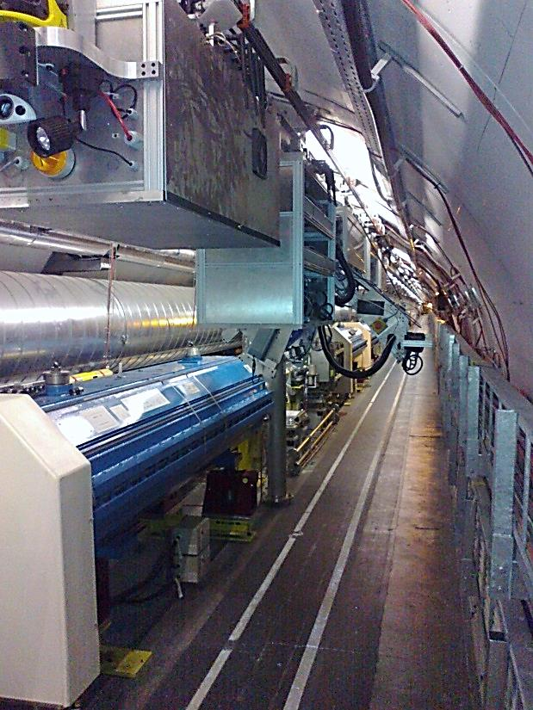
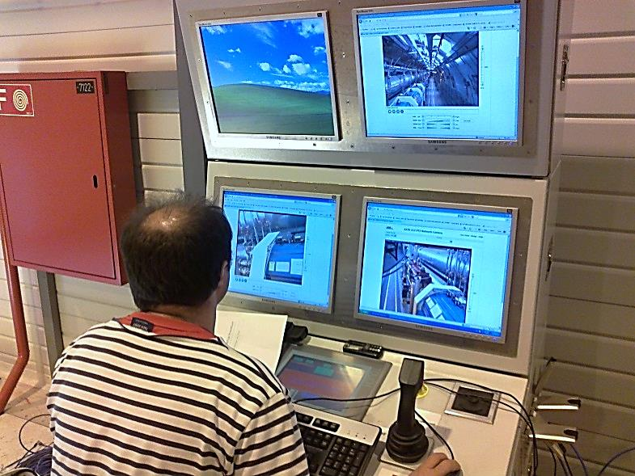
Collimator survey train
Development started in 2007 based on ALARA approach
Collaboration of EN/ICE (Software), EN/HE (Train / Mechanics /Infrastructure) and BE/ABP (Measurement equipment)

Slide 7
Concept
Digital close range photogrammetry
  Fast and non contact measurement of the activated collimators
Wire offset measurements to detect train position and link the different aquisition volumes.
  Reliable straight reference over long distances
Collimators
Quad
Quad

Slide 8
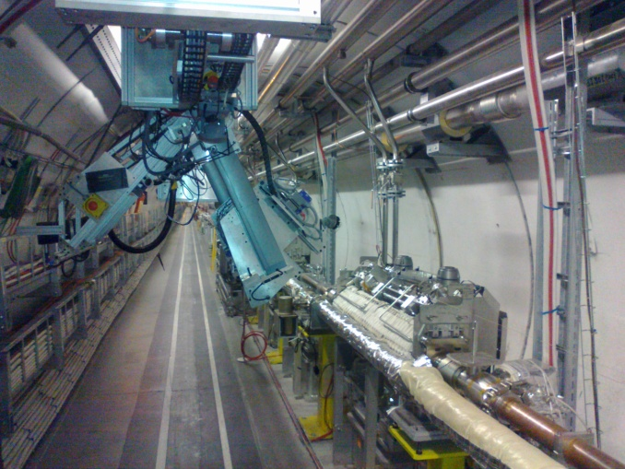
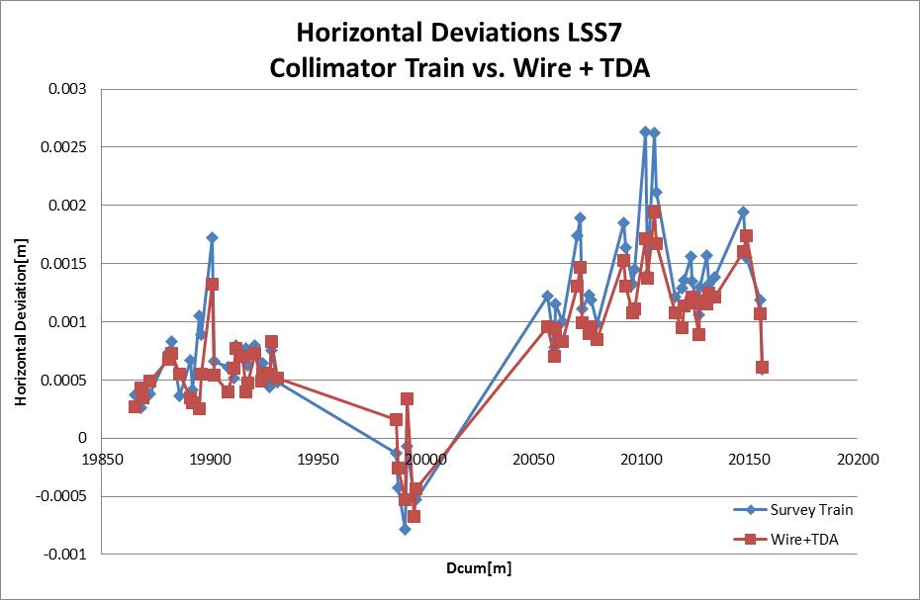
Results from 2012 Test
First measurements done with success in 2012
Precision as predicted around 0.2mm
Improvements and further development needed

Slide 9
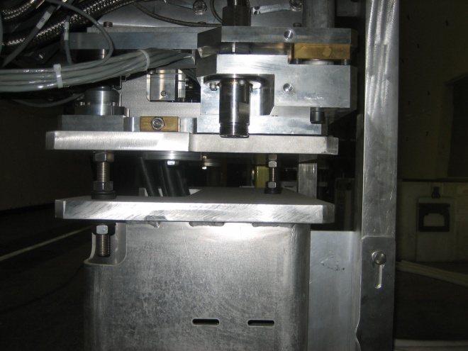
Issues
System is limited to specific zones which are prepared
No remote alignment
    Do we need remote alignment? ...for all Collimators? Magnets?
    Can we imagine to motorize some of the hot elements?
  Adjustment system is not designed for rapid intervenstions
  Remote interventions will be even harder
  Collimator replacement is under control using the plug-in

Slide 10
New train version
Universal for LHC arc sections not for LSS
Using a Hydrostatic Levelling System to gain precision and supress wire model
Wire only for straight reference and can be installed automatically by the train using a magnetic base
Can operate during tests without beam operation
  Supress the constraints on planning and co-activities
  Possibility to measure more frequently

Slide 11
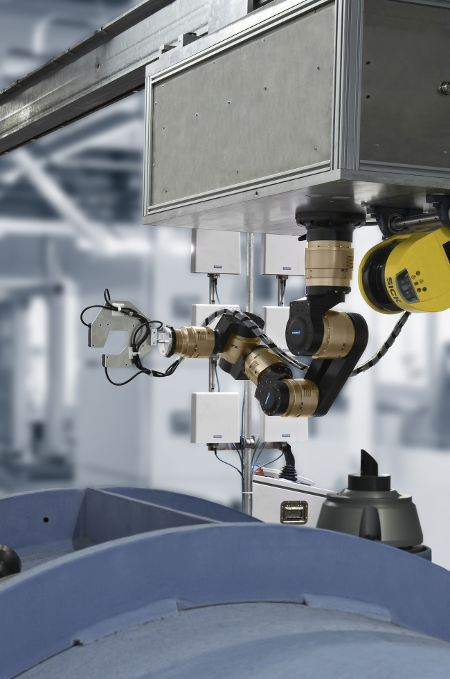
Studies on new Sensor Systems
6 DOF Robotic arm
New universal sensor head
Close range photogrammetry
Direct measurement of wire
Integration of an Hydrostatic Levelling System
Tests ongoing and very promising

Slide 12
New Sensor head
Installed on the 6DOF arm
  3 Photogrammetric cameras
  1 US HLS
  Bi-directional inclinometer
Installation of the wire is still a challenge
Cam
Clino
HLS
Magnet
Magnet

Slide 13
Future Train Project
We are developing towards new sensor systems
Could be used also for other tasks than alignment measurements (positioning of tools etc..)
But we do not have the ressources and competencies to develop the train hardware and control software
It would be great to centralize and concentrate the efforts and knowhow and to share the experience
Only simple remote operations / no contact

Slide 14
Future perspectives
Complete the collimator survey train project
Repair, installation and de-installation of sensor systems and infrastructure on inner triplets
Studies for a future LHC Train
  Realisation
We see an increasing need for remote operation / manipulation and we would need YOU!

