Slide 1

Status of the Experiment
RRB - TOTEM
16 April 2013
S.Giani - CERN
on behalf of the TOTEM Collaboration

Slide 2
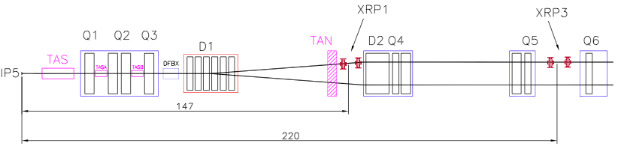
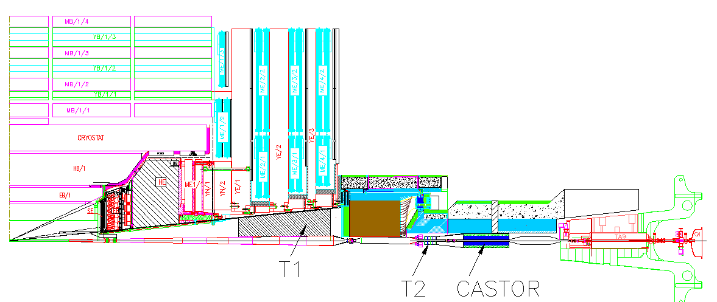
Experimental Setup @ IP5
Inelastic telescopes: charged particle
& vertex reconstruction in inelastic events
T1: 3.1 < η < 4.7
T2: 5.3 < η < 6.5
HF (CMS)
IP5
~ 10 m
T1
~ 14 m
CASTOR (CMS)
T2
Roman Pots: measure elastic & diffractive protons close to outgoing beam
IP5
(RP147)
RP220
Notes:
2
2

Slide 3
TOTEM Publications after RRB Oct’12
Measurement of proton-proton elastic scattering and total cross-section at √s = 7 TeV
[EPL, 101 (2013) 21002]
Measurement of proton-proton inelastic scattering cross-section at √s = 7 TeV
[EPL, 101 (2013) 21003]
Luminosity independent measurements of total, elastic, inelastic cross-sections at √s = 7 TeV
[EPL, 101 (2013) 21004]
Luminosity-independent measurement of the proton-proton total cross-section at √s = 8 TeV
[CERN-PH-EP-2012-354 ; accepted for publication by Physics Review Letters (LZ13703)]

Slide 4
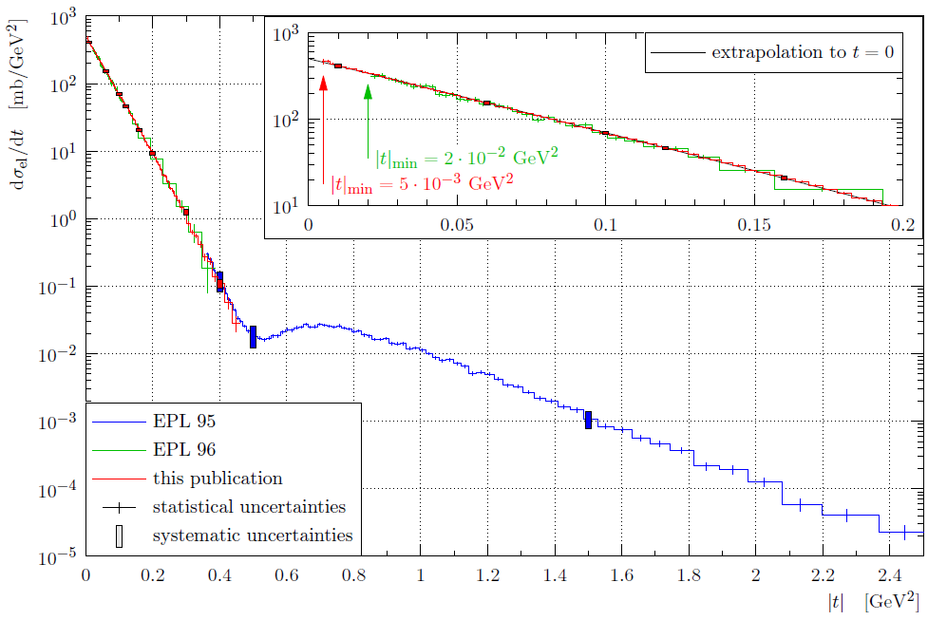
Elastic pp Scattering at 7 TeV: Differential Cross-Section
A = 506 ± 22.7^{syst} ± 1.0^{stat} mb/GeV²
A = 503 ± 26.7^{syst} ± 1.5^{stat} mb/GeV²
B = 19.9 ± 0.26^{syst} ± 0.04^{stat} GeV⁻²
|t|_{dip}= 0.53 GeV²
~ |t|^{−7.8}
Integrated elastic cross-section:
25.4 ± 1.0^{lumi} ± 0.3^{syst} ± 0.03^{stat} mb (90% measured)
24.8 ± 1.0^{lumi} ± 0.2^{syst} ± 0.2^{stat} mb (50% measured)

Slide 5
Luminosity-independent Elastic, Inelastic, Total Cross-Sections

Slide 6
Analysis Highlights from LHCC Mar’13
Charged multiplicities @ √s = 8 TeV
  Common data and analysis with CMS
  Combined plots to be blessed next Wed-Fri for DIS
  Laid ground for 1st joint CMS-TOTEM paper
Soft single diffraction @ √s = 7 TeV
  t-spectra integrated over x for different diffractive mass ranges
  Observed slope variation in accordance to theoretical predictions
Hadronic-Coulomb interference and r measurement
  Advanced analysis of data @ √s = 8 TeV ; reached |t| ~ 6 x 10⁻⁴ GeV²
  Theoretical impact of phase models ; r analysis

Slide 7
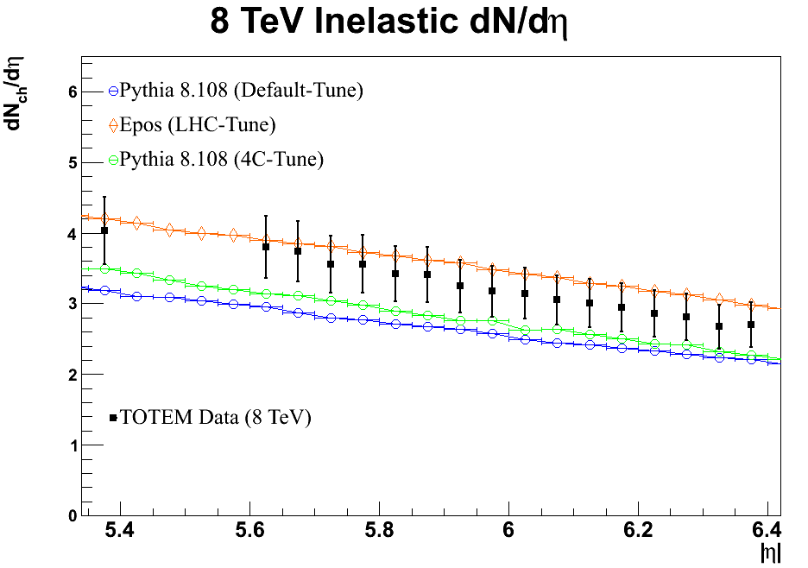
Inelastic @ √s=8 TeV : dN / dh
Common TOTEM-CMS data & analysis
PRELIMINARY
At least a charged particle in T2.
P_{T} > 40 MeV/c.

Slide 8
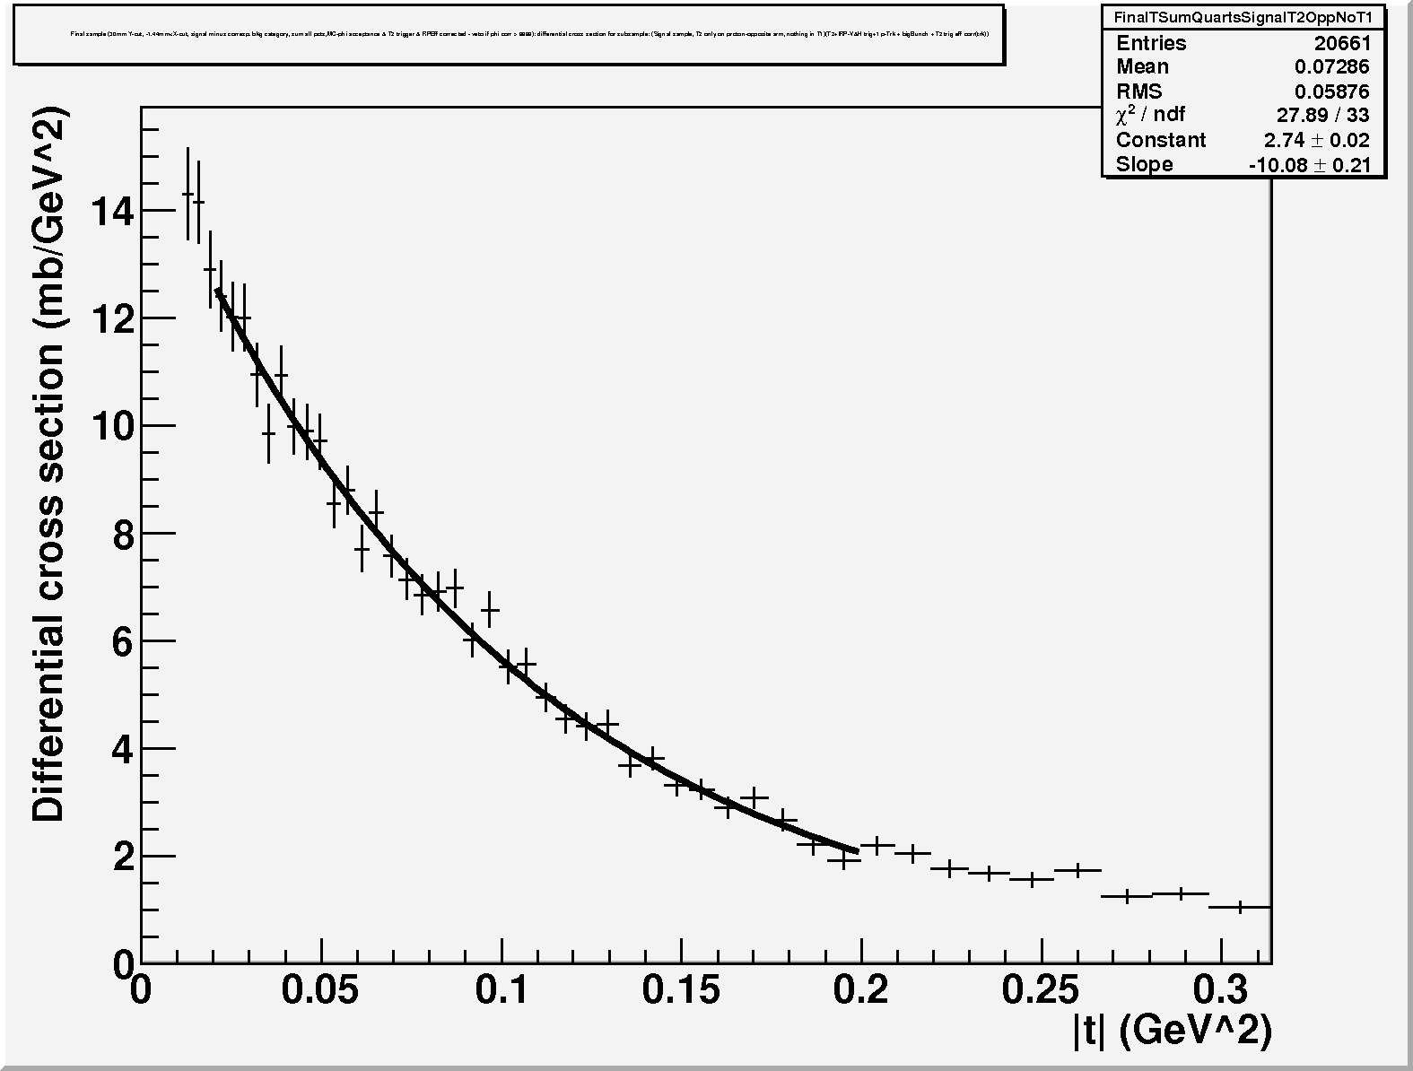
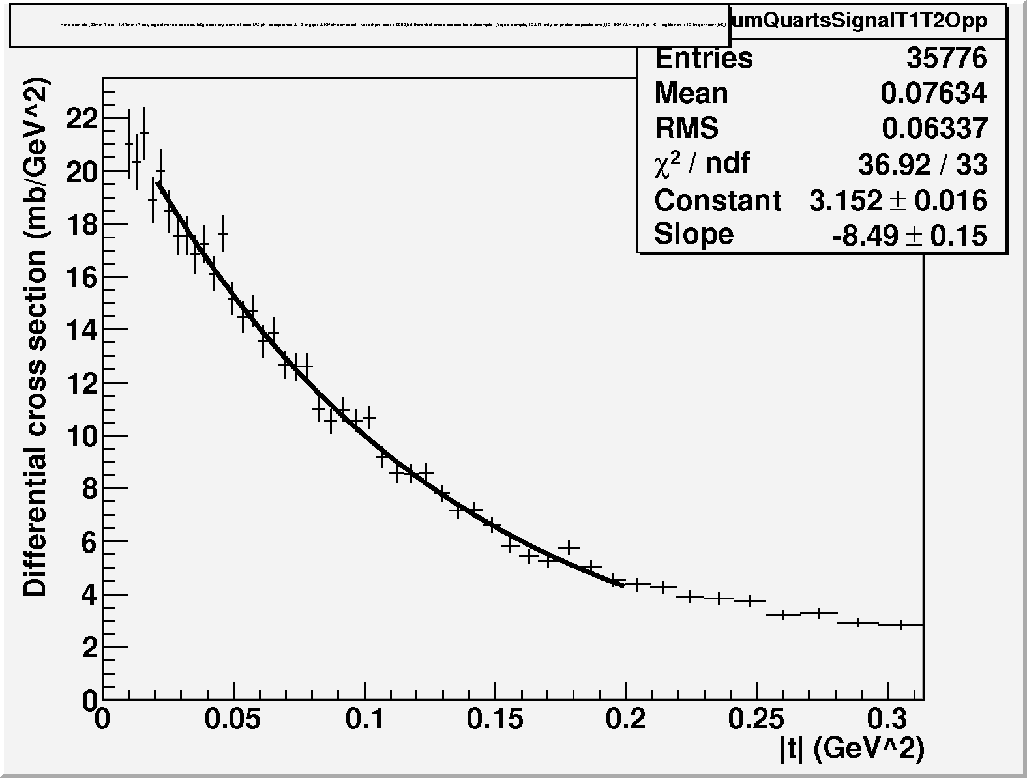
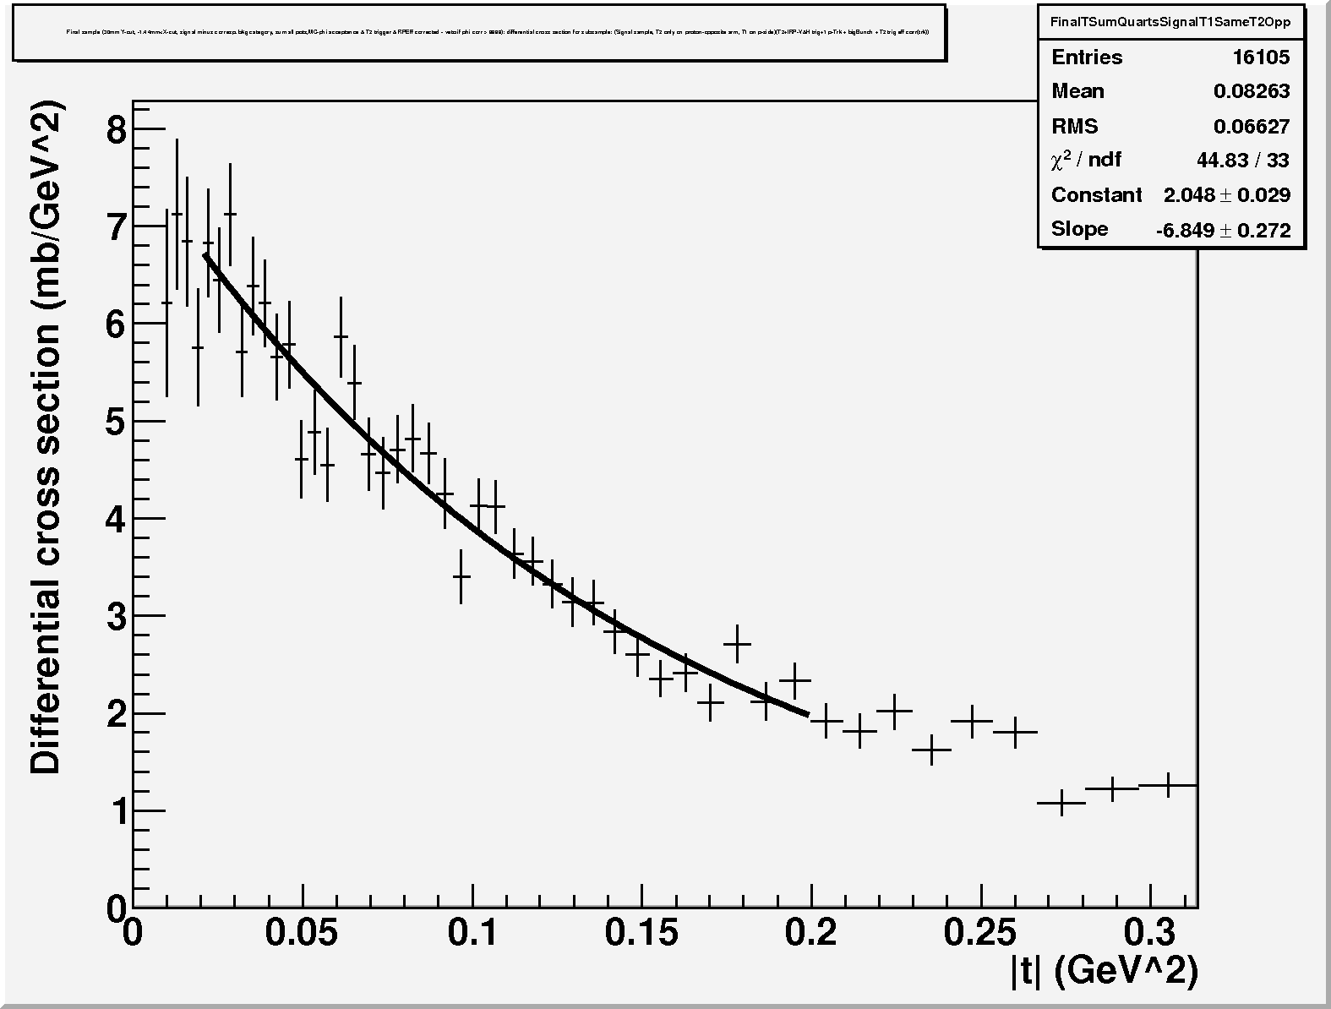
Soft single diffraction t-spectra at 7 TeV
Soft Single-Diffraction t-spectra @ 7 TeV
dσ/dt ∼ Ce^{−Bt}
dσ/dt ∼ Ce^{−Bt}
B = 10.1 GeV⁻²
B = 8.5 GeV⁻²
p +T2opposite M_{SD} ≈ 3.4 – 7 GeV
p + T1opposite M_{SD} ≈ 7 – 350 GeV
∼1.8 mb
∼3.3 mb
dσ/dt ∼ Ce^{−Bt}
Uncertainty estimated on slope
B ∼ 15 %
B = 6.8 GeV⁻²
p + T1same_arm M_{SD} ≈ 0.35 – 1.1 TeV
PRELIMINARY
∼1.4 mb

Slide 9
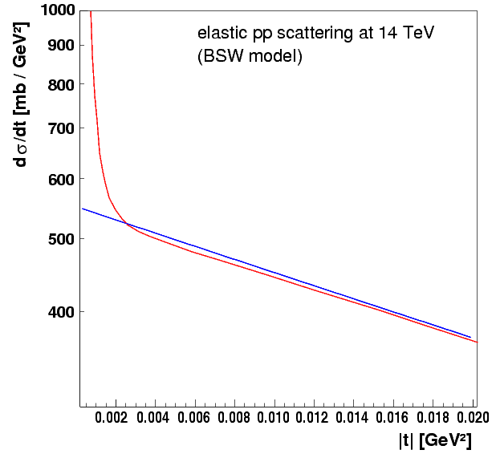
ρ Measurement: Elastic Scattering at Low |t|
Optical Theorem:
Total (Coulomb & nuclear)
Coulomb scattering dominant
Coulomb-Nuclear interference
Nuclear scattering
α = fine structure constant
= relative Coulomb-nuclear phase
G(t) = nucleon el.-mag. form factor = (1 + |t| / 0.71)⁻²
ρ = ℜ / ℑ [T_{elastic,nuclear}(t = 0)]
Measurement of ρ by studying the Coulomb – Nuclear interference region down to
|t| ~ 6 x 10⁻⁴ GeV²
Reachable with β* ~ 1000 m still in 2012 if RPs can approach beam center to ~ 4σ
Notes:
9

Slide 10
Study of Hadronic-Coulomb Interference Region at Low |t| (b*=1km)
PRELIMINARY
Started theoretical study of phase models and rho evaluation with different methods.

Slide 11
TOTEM Consolidation & Upgrade Plans
TOTEM consolidation plans for RPs @ 220m [ref. LHCC deliberations]
  Relocation of RP147 at 220m for enhanced tracking
  Infrastructure and services for eventual new stations at 220m
  TCL6 installation
TOTEM upgrade plans
  Proposal / LoI / TDR due for physics & performances [ref. LHCC deliberations]
  Radiation-hard silicon pixel detectors for tracking
  Timing detector for high-luminosity & reduced pile-up scenarios
Running scenarios
  Special runs β* 90m with 1000 bunches (x-angle) give sensitivity to ~1pb
  Collaboration with CMS under discussion evaluating joint effort for high luminosity

Slide 12
An Example on Consolidation

Slide 13
An Example on Upgrade
Relocated stations from 147 m
Existing TOTEM RP-220 m (near-far)
New RP stations
New
Si pixel tracking detectors
in horizontal RPs
New
LHC component
New
timing detectors
New
New
LHC component
2 vertical RP
1 horizontal RP
TRACKING
Detector
2 vertical RP
1 horizontal RP
TRACKING
Detector
Near
2 vertical RP
top/bottom
1 horizontal RP
1 horizontal RP
TIMING Detector
1 horizontal RP
TIMING
Detector
Far
2 vertical RP
top/bottom
1 horizontal RP
outgoing
beam
TCL-4
shielding
TCL-6
Q6
~ 5-10 m
~ 5 m
12 RPs can be operated simultaneously !
CMS ip5
~ 220 m

Slide 14
Remarks & Conclusions
Physics analyses advanced towards joint publication with CMS on dN_{ch}/dh @ √s = 8 TeV and towards publication of paper on study of Coulomb-hadronic interference region in low-t elastic scattering at √s = 8 TeV .
LS1 TOTEM consolidation plans presented to the LHCC. Initiated discussion and work for preparing TOTEM Upgrade Proposal to the LHCC including physics cases, detector performances, running scenarios, physics performances, timeline.
New institute applied to join TOTEM: University of West Bohemia. Decision and formalization in June.

