Slide 1
Renovation of the Accelerators Controls Infrastructure and its Assets Management
Asset and Maintenance Management Workshop
November 14th, 2013
Cl.Dehavay
On behalf of S. Catin, M. Gourber-Pace, M.Vanden Eynden, Z. Zaharieva
CERN-BE-CO

Slide 2
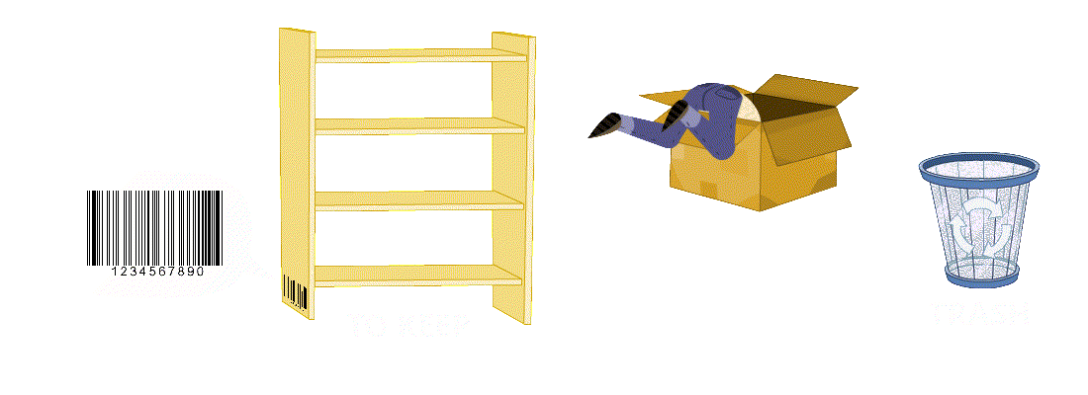
Outline
Controls Asset
ACCOR Renovation Project
Steps towards an AMM solution for Controls
Short & mid term objectives
Conclusion
AccoR
copyright juliendehavay.com

Slide 3
Outline
Controls Asset
ACCOR Renovation Project
Steps towards an AMM solution for Controls
Short & mid term objectives
Conclusion

Slide 4
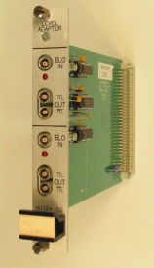
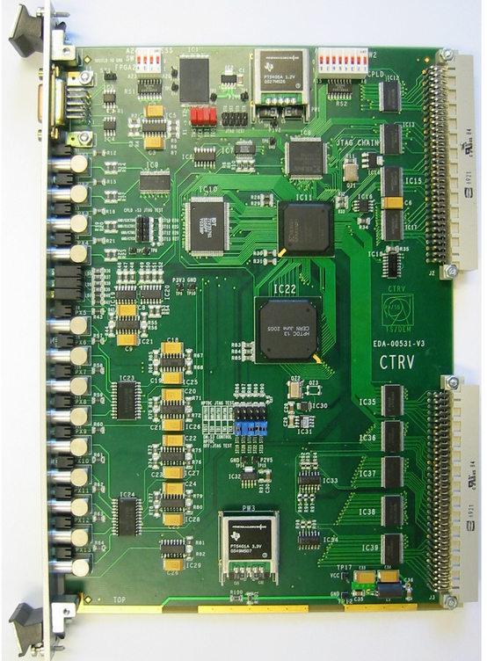
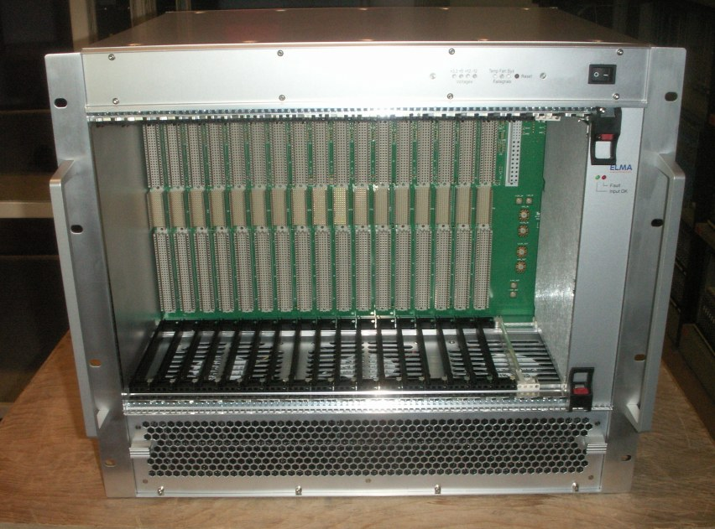
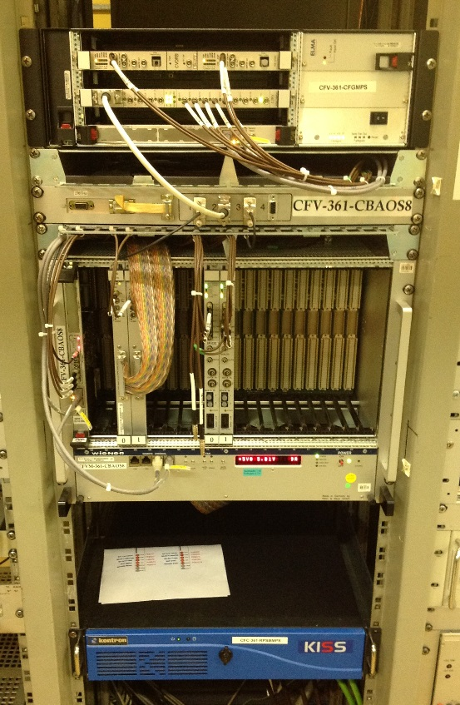

Controls Asset (examples)
Chassis ~ 2,000
Electronics Cards ~ 20,000
Accessories ~ 10,000
Notes:
All components used to interface the accelerator equipments like Power converters RF cavities, Instrumentation,

Slide 5
Controls Asset environment
About data:
Front End Computers
Hardware
Software
Network
Doc
Cabling
Location
Updated or Not.
No consistency check.
IT/CS
BE/CO
BE/CO
BE/CO
EN/EL
BE/CO
GS/ASE
BE/CO
CO specific fields
Notes:
Multiple databases. No coherence for the same data.

Slide 6
Outline
Controls Asset
ACCOR Renovation Project
Steps towards an AMM solution for Controls
Short & mid term objectives
Conclusion
AccoR

Slide 7
ACCOR Renovation project (2009)
AccoR
To replace obsolete HW & SW modules running since 2 decades or more
=> Opportunity to implement CERN AMM solution
Naming: Equipment Code
Design: Renovation specs
Manufacturing: Assembly
Installation: Steps, Docs
Maintenance
Dismantling
Design
Manufacturing
Installation
Maintenance
Dismantling
Commissioning
EDMS, MTF, InforEAM
Notes:
Huge amount of HW & SW to renovate => Massive deployment of the AMMS
Decision d’utiliser cette infrastructure

Slide 8
Provisional Schedule (2010)
Hard-Catalog Migration to MTF
Integration in
InforEAM
Information & training
Integration of:
- Preventive maintenance
- FE installation
- Documentation
with MMP
With Data Management
Team in CO
CERN EDMS
Training Program
with GS/ASE
(providers of CERN’s CMMS)
Dec.2010
Q1-2011
Q2-2011
2012
LS1
Notes:
Very optimistic provisional schedule

Slide 9
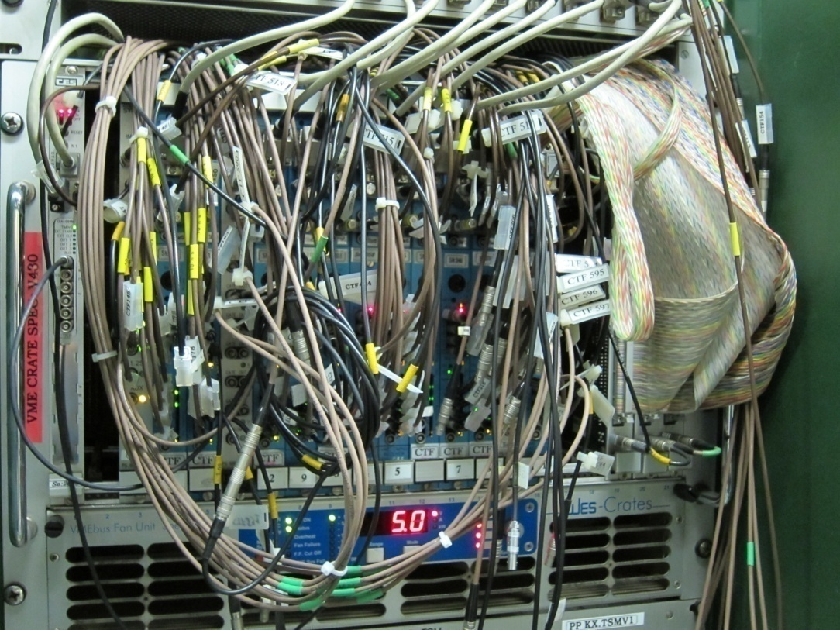
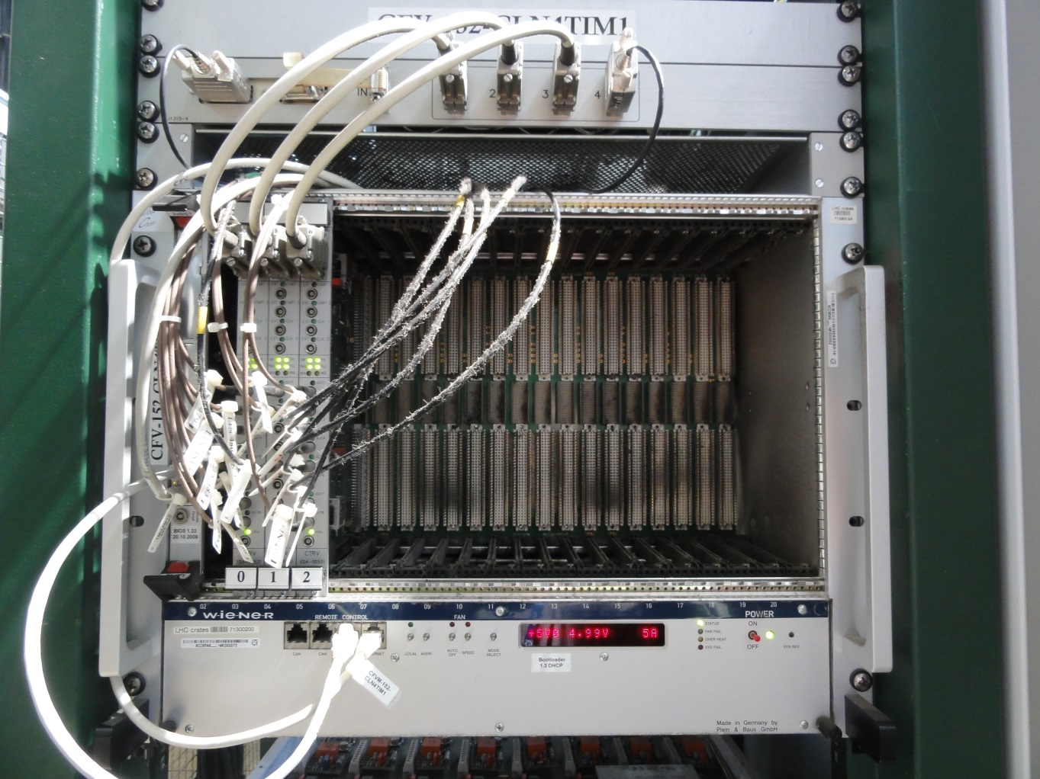
Nasty installation examples
Guessing similar situation on the SW side !
Notes:
Parts, Schematics, Cables, Docs

Slide 10
Outline
Controls Asset
ACCOR Renovation Project
Steps towards a central Maintenance Management solution for Controls
Short & mid terms objectives
Conclusion
Cleaning DB & Storage (2009-2010)
Naming, Identification (2010-2011)
Migration from HW Catalog to MTF (2011-2012)
Front End (FE) Assemblies in MTF (2012 - …)
EDMS & Documentation (2012 - …)

Slide 11
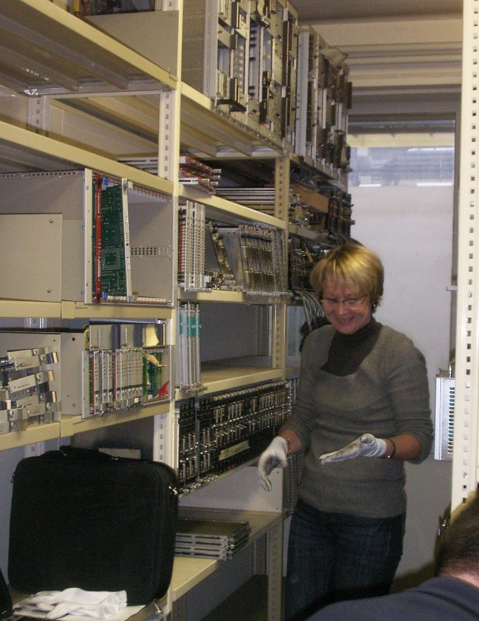
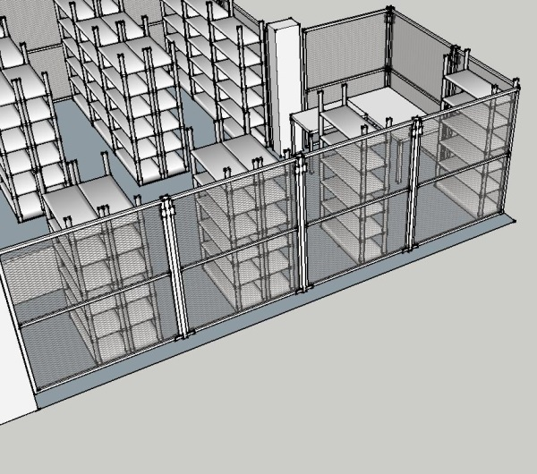
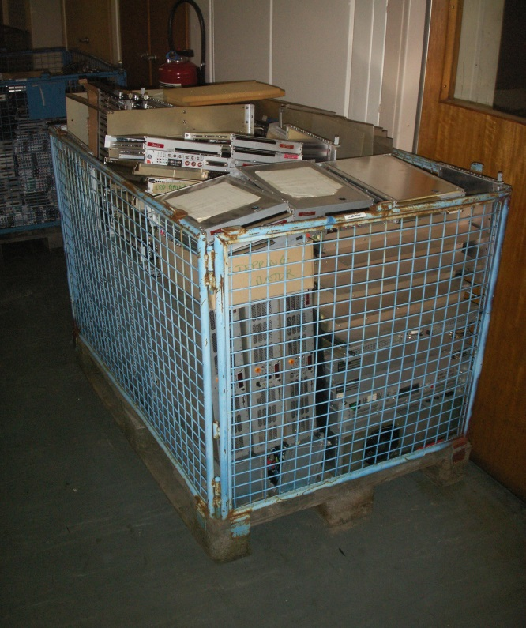
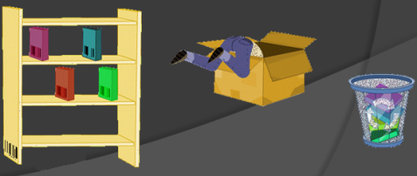
Step : Cleaning DB & Storage
Ch.Gayraud
Retired Q2-2012
X 10
Notes:
To explain:
Tools added, process, methods, roles, etc

Slide 12
Step : Cleaning DB & Storage
35 years of storage
Difficulty
To decide what to keep or to throw away
Status: 100% Done
With still some collectors !
Notes:
To explain:
Tools added, process, methods, roles, etc

Slide 13


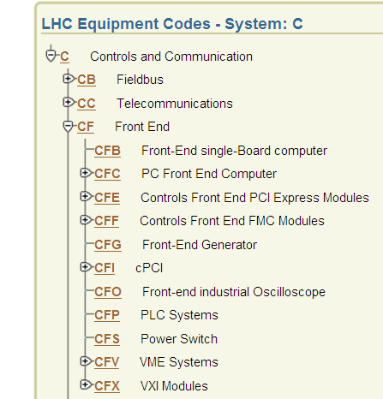
Step : Naming & Identification
Collaboration with Naming Service
Attribution of Equipment codes for equipment types, assets, … (423 equipment types identified)
Labels for assets
Difficulty
Organisational:
  External service with low priority
  New process, new method, new vocabulary
  Labels production => Internal
Status: 100% Done (except labels for on site modules).
Notes:
To explain:
Tools added, process, methods, roles, etc

Slide 14
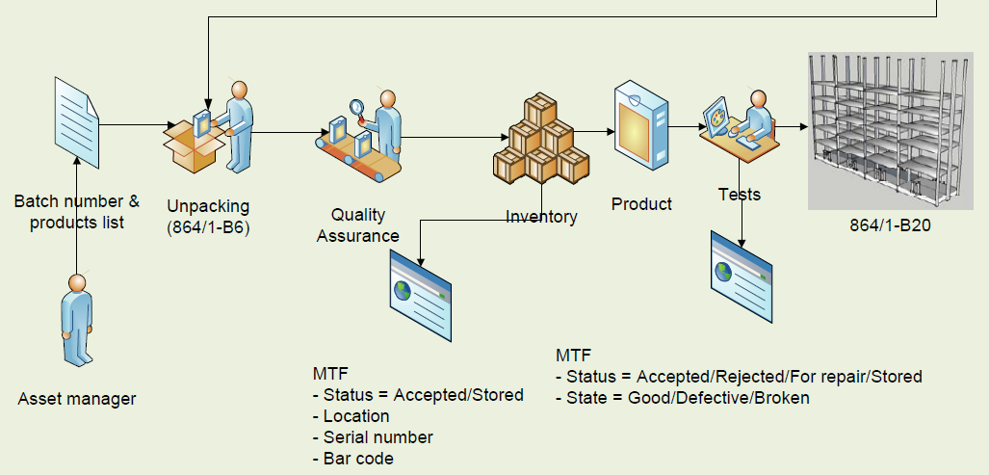
Enhancing methods & processes
Cabling
Production process

Slide 15

Step : Migrating HW Catalog to MTF
Automatic for 90%, then case by case
Archives used during 12 months
Difficulty
Precise data format or syntax
Equivalent to new language:
New data or user specific fields, new reports, new GUI interface
Status: 100 % Done.
MTF
HW CAT
WIENER FAN =?= CVFWA

Slide 16
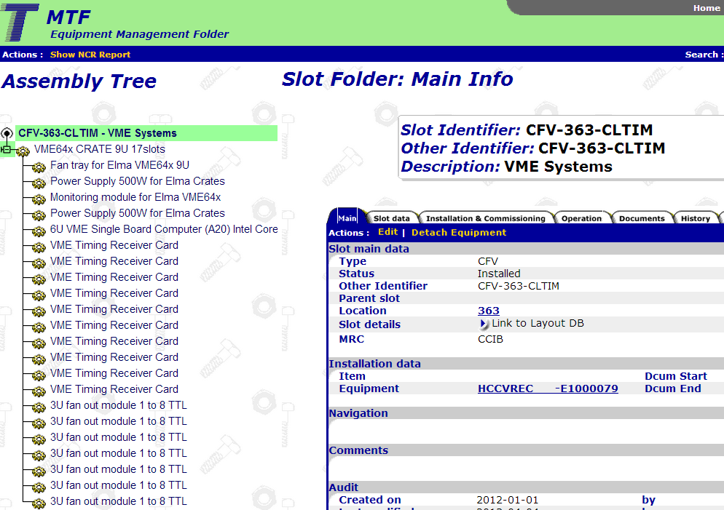
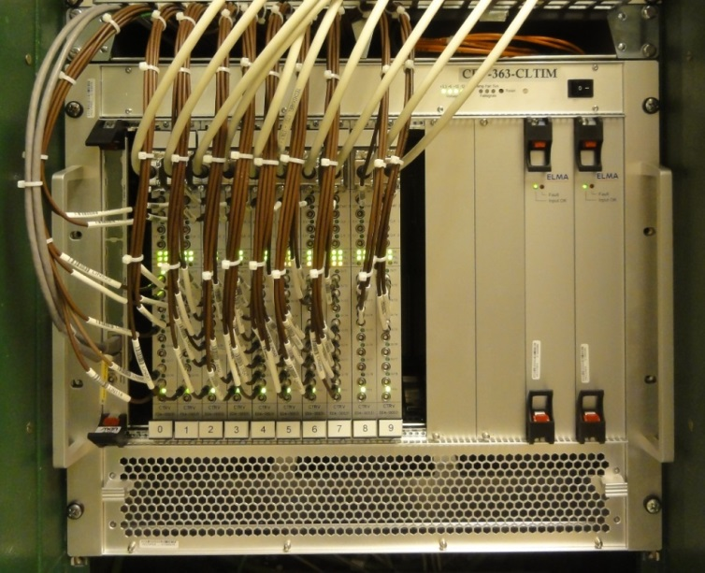

Step : FE assembly in MTF
Introducing FE assembly as a Functional Position (Slot)
New concept for BE-CO & MTF/LAYOUT
Useful for Doc, manufacturing, life cycle
Relation & Coherence between Controls Configuration & MTF

Slide 17

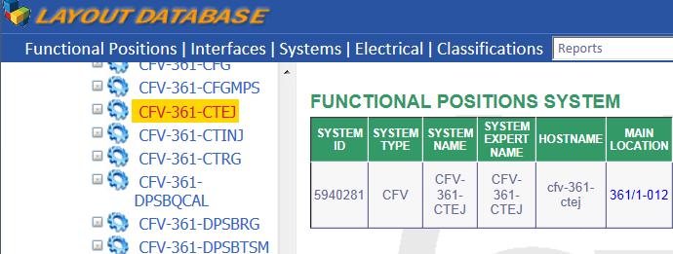



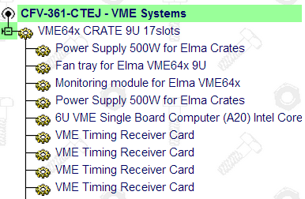
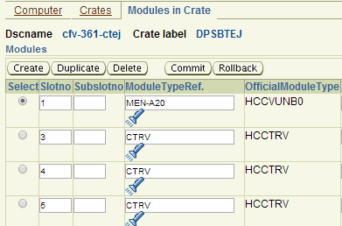
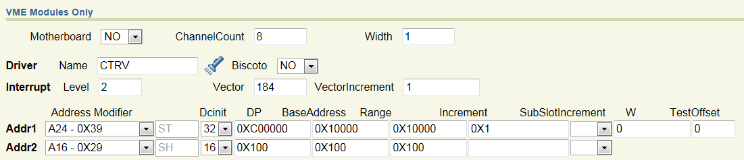
Creating a FE assembly
Design & Configuration
CFV-361-CTEJ
Consistency check !

Slide 18
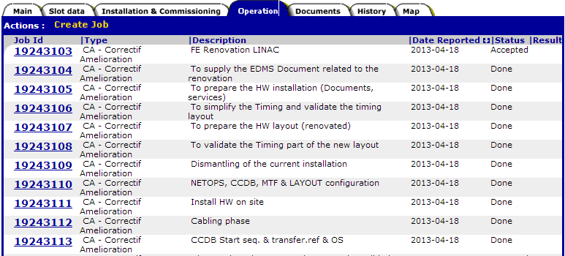
Installation process follow up
JOBS
Configuration HW & SW
Assembly
Installation
Cabling
Commissioning
Inadequate tool !
Notes:
Feature Workflow : present in MTF (Steps) but not easy to implement in Infor
Feature Notification: Present in Infor but not in MTF
Maintaining the data up to date : Cross check consistency between Configuration & Actual Installation & Declared assembly in MTF

Slide 19
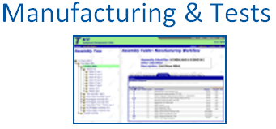
Step : FE assembly in MTF
Difficulty
Low priority within BE-CO & Central supports
New mechanism => Discovering missing features during implementation. Ex: Deleting a FE
Operation : Not easy to use for Commissioning process as all FEs are different; Heavy procedure.
Status: Done for renovated FEs during LS1

Slide 20

Step : EDMS Documentation
ACCOR: EDMS approval mechanism.
FE related documentation
Difficulty
New environment => Training (internal)
Massive transfer of files from DFS: Need to reorganise our files.
DFS repository for FE installation
15831 files in 2348 folders ☹

Slide 21
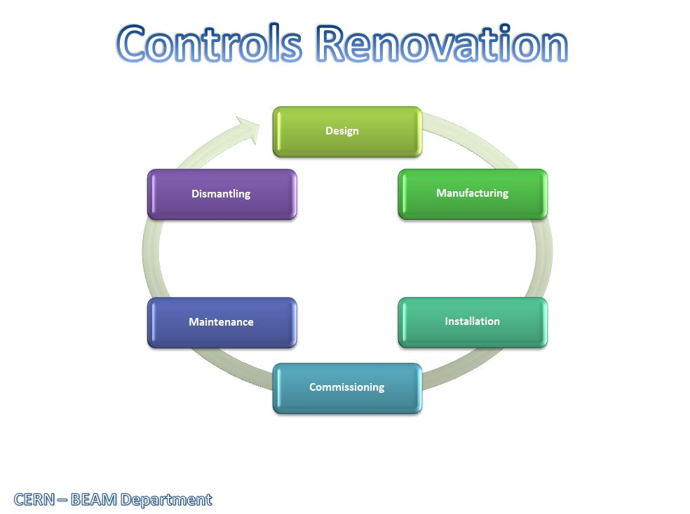
Demonstration – Video (2’30’’)

Slide 22
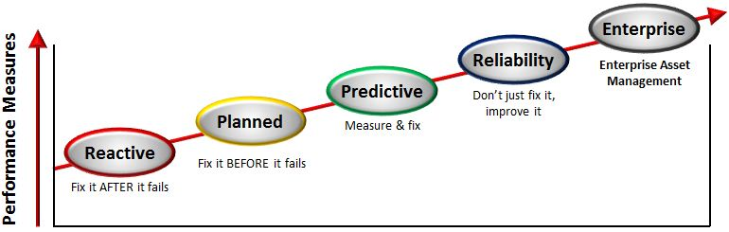
Outline
Controls Asset & previous MM Tools
Renovation Project: ACCOR
Steps towards an AMMS
Short & mid terms objectives
Conclusion
Inventory (2013-2014)
Corrective maintenance – ODM (2014)
Preventive maintenance - Work Order (2015)

Slide 23
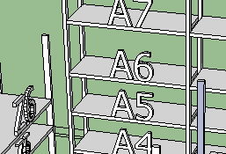
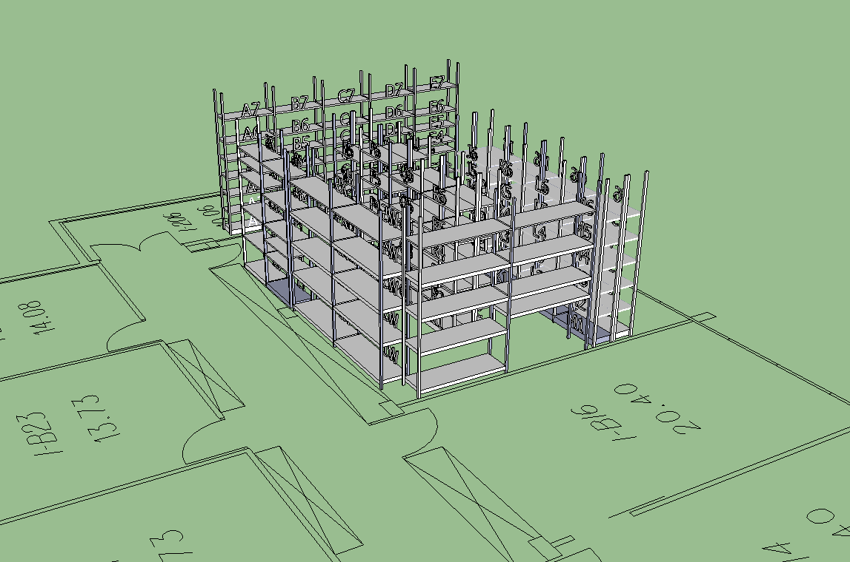
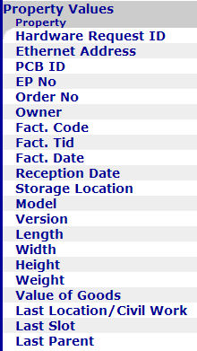
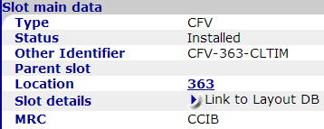

Short & Mid term objectives
Inventory
  For reliable data!
  Reports
  Production.
Notes:
Inventory: warning limit for spare parts.
Reliable data (1 full day to get a report – Excel file)

Slide 24
Short & Mid term objectives
  Inventory
Corrective maintenance (2014)
  Repairing procedures & Follow up
  Usage of Notification
  To elaborate Statistics
Notes:
Modest objectives after LS1

Slide 25
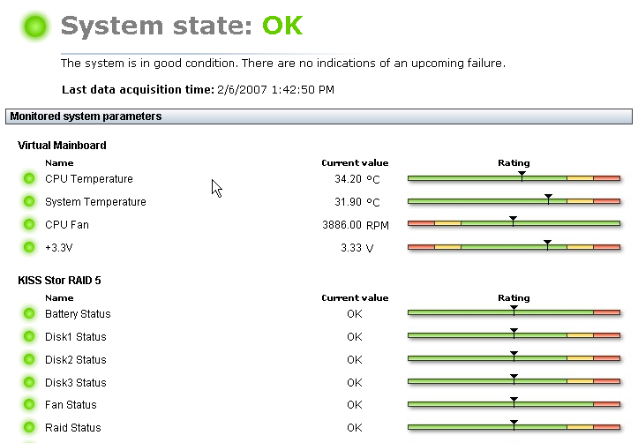
Short & Mid term objectives
Inventory, reports (2013-2014)
Corrective maintenance – ODM (2014)
Preventive maintenance (2015)
  Link to Controls Diagnostic & Monitoring tool
  To use Statistics
  Critical parts:
    Low MTBF
    Long delay for new production
    Critical system/function
Notes:
Modest objectives after LS1

Slide 26
Outline
Controls Asset & previous MM Tools
Renovation Project: ACCOR
Steps towards an AMMS
Future implementation
Conclusion
Maintenance Management Workshop 25th November 2011
Quite often the central tools are perceived as difficult and heavy to use in their present state => Still the case !
Notes:
Maintenance Management Workshop 25th November 2011
Quite often the central tools are perceived as difficult and heavy to use in their
present state => still the case!

Slide 27
Provisional Schedule (2010)
Hard-Catalog Migration to MTF
Integration in
InforEAM
Information & training
Integration of:
- Preventive maintenance
- FE installation
- Documentation
with MMP
With Data Management
Team in CO
CERN EDMS
Training Program
with GS/ASE
Q1-2012
Q4-2013 ?
2013
LS2
Dec.2010
Q1-2011
Q2-2011
2012
LS1
Notes:
Very optimistic provisional schedule

Slide 28
Conclusion
  Triggers: ACCOR & LS1
  Migration = Long process , low priority
Prototype within a big system/environment:
  Not optimised, missing features
  Central support
Modern procedures & tools
We keep the track. Stay tune !
Notes:
We still hope to get many useful features!

