Slide 1
The Layout Service
Eve Fortescue-Beck (BE-CO-DA)
on behalf of the Layout Service

Slide 2
Agenda
What is the Layout Service?
Case Study: Cryogenic Instrumentation and Controls
5 ways that the Layout Service helps Maintenance and Asset Management
Conclusions

Slide 3
What is the Layout Service?
A CERN-wide Oracle database
A set of tools, including:
  A public web-interface with navigation and search capabilities
  Applications for data entry
  Views and APIs for external clients
Support from a dedicated team of people with expertise and experience
  Assist the equipment groups to structure their layout data
Centralises the management of integrated functional position data across CERN
  Layout data from different domains are fully inter-related
Notes:
Detail explanation of centralised and integrated

Slide 4
History of the Layout Service
Layout Database and Web Interface developed in 2003
  Plan for the installation of components in the LHC
  A model of the beam components architecture (The optics)
    Magnets
    Beam instrumentation
    RF cavities
    …
Gradual Increase of scope since 2007
  Geographical: Covers all CERN accelerators and surface buildings
  Domain: All component types (vacuum pipes, control electronics, instrumentation…)
Notes:
Database was originally designed to make sure that the LHC actually fits in the tunnel

Slide 5
Modeling CERN Infrastructures (Layouts)
Classifying the components of the infrastructure
  Within a hierarchy of Classes
Defining the components as Functional Positions
  Nature/function of the components
  Localisation/position of the components
Defining relationships between these components:
  Optical sequences
  Mechanical assemblies (ABS)
  Powering and control connections and circuits
  Logical connections between otherwise unrelated components

Slide 6
Functional Position Characteristics
A Type
  Identified by a 2-5 letter functional code
    Adhering to CERN naming conventions
A Location
  Machine half-cell, period, alcove, building, room, etc
Metric Positions
  within the location with respect to given reference points
Dimensions
  Very large (several metres)
  Very small (a few millimetres)
Unique Name(s)
  Official name defined by the QA plan of each machine
  Additional expert names specified by equipment owners

Slide 7
Example: Magnet Functional Positions
    All codes, used for functional positions, are defined in the
    Accelerators Entities and Signals Naming DB: https://cern.ch/service-acc-naming
5-letter
Functional Code
Location
Dimensions
15.0m
LQATH.14L8
LBBRA.14L8
LBARA.14L8
LBBRD.14L8
DCUM: Cumulative
Distance from IP1 [m]
22726.32
22732.79
22748.45
22764.11
Official Name
Position within
the accelerator

Slide 8
Layout Service collaborations with other CERN systems
Layout Service shares data with ~40 CERN database accounts.
Layout Service website integrates navigation to other external web interfaces:
  CERN Phone Book
  MTF (Assets Maintenance Management)
  EDMS (Documentation Management)
  GIS Portals (CERN Geographical Information Systems)
  IT Network Service
  Control Configuration Service (Configuration of the Accelerator Controls System)
  ALIM DB(Power converters database)
  Norma DB (Normal Conducting magnets database)
2.5million .NET page accesses in the last 6 years
  ~1000 individual users
  ~500 pages-loads per day in the last year

Slide 9
Case Study: Modeling the LHC Cryogenic Instrumentation and Controls
Cryogenics Instrumentation and Controls is one of the largest domains to use the Layout Service
  Most complex system in Layout DB
  Most demanding domain in term of layout features
Instrumentation team use the Layout Service to fully document their systems
Data is used in many aspects of their work:
  Installation, configuration and maintenance of their components
  Identify components which make up an instrumentation channel in order to help diagnose faults
  Generate the control system software

Slide 10
Step 1: Define Instruments
LQATH.14L8
LBBRA.14L8
LBARA.14L8
LBBRD.14L8
DCUM:
Cumulative Distance
from IP1 [m]
22726.32
22732.79
22748.45
22764.11

Slide 11
Step 1: Define Instruments
LQATH.14L8

Slide 12
Step 1: Define Instruments
Functional Positions are defined in hierarchies
An instrument FP is the child of a magnet FP
Thermometers
Heater
QJQAA.
A14L8
Flange
Start position of
Thermometer FP
LQATH.14L8
QITEL.B14L8
LQATH.14L8
QIHEW.14L8
Heater
QITEL.A14L8
Start position
of Magnet FP
Y offset
QIHEC.
14L8
X offset
22726.32
Cumulative Distance (m)
22732.79
Position of instruments defined as an offset with respect to the start position of the magnet
Instruments inherit the location
Their exact positions are calculated
If the position of the magnet changes, the position of the instrument is recalculated automatically

Slide 13
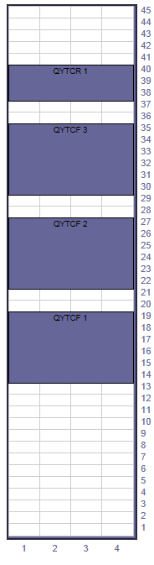
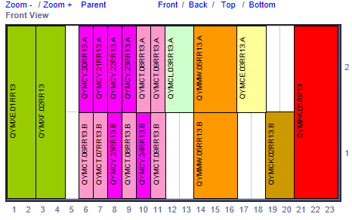
Step 2: Define Electronics
Rack: QYC.02RR13
Controls component Functional Positions also defined in hierarchies
Hierarchy easy to navigate using Layout web interface: http://cern.ch/layout
Crate: QYTCF.RR13.21.B
Chassis
Electronics Cards
Chassis positioned within racks
Electronic cards/modules positioned within chassis

Slide 14
Step 3: Define Connections
Connections are logical relationships between two functional positions
Once all Instrumentation and electronics FPs are declared they are connected together to describe an instrumentation channel
The DB model is able to handle any level of granularity defined by the users
Physical Approach (Cabling): High level of detail, approaching physical installation
Sensor
Flange
Connector
Enclosure
Connector
Conditioner
Card
FIP Card
Fibre /
Network
PLC /
Gateway
  Conceptual Approach: Lower level of detail, more conceptual, defining only the minimum connections required to describe the system.
Each equipment group decides on the level of detail they require, based on the foreseen use of the information. The granularity can be refined over time
Notes:
Each equipment owner must decide the level of detail that is required, based on the foreseen use of the information.
FP and connections can have their custom properties

Slide 15
Step 4: Integration with InforEAM
Functional Positions
Theoretical position of a component of a given type
Stored in Layout Database
Identified by
Functional Position Name
A plan of how components are arranged and connected in accelerator complex
Assets
Physical piece of equipment with specific characteristics
Stored in InforEAM (MTF)
Identified by
CERN Unique Identifier
Assets installed in different positions over their lifetime.
  Traceable history

Slide 16
Step 4: Integration with InforEAM
Assets assigned to Functional Positions
INFOR EAM (MTF)
Instrument Asset
Fan-In Card Asset
Conditioner
Card Asset
FIP Card Asset
HCQITELCXT-CR031310
HCQYMXA001-JT000050
HCQYMCT001-JT000260
HCQYMMW001-JT000070
Instrument FP
Fan-In Card FP
Conditioner
Card FP
FIP Card FP
FIP Card FP
QITEL.17L8.TT822
LBARB_17L8_TT822
QYMXA.A17L8
QYMCT.A17L8.A
QYMMW.A17L8.A
Functional Positions published to InforEAM
Traverse the Functional Position structure to identify the assets in the Instrumentation Channel
LAYOUT Database

Slide 17
5 ways the Layout Service helps with Maintenance and Asset Management
Throughout their lifecycle, assets may be installed in different positions
  Successive assignments between Funtional Positions and assets are recorded
  Provides a valuable history and traceability
  The position of the assets may be correlated with the failure rate of the asset over time.
History is recorded when an asset moves.
Can track where it has been installed
INFOR EAM (MTF)
Card Asset 1
Card Asset 2
Card Asset 3
HCQYMCT001-JT000456
HCQYMCT001-JT000123
HCQYMCT001-JT000789
Multiple failures of assets installed in the same place could indicate a problem related to the position
Card FP 1
Card FP 2
Card FP 3
QYMCT.A17L8.A
QYMCT.A18L8.A
QYMCT.A19L8.A
LAYOUT Database
Notes:
Need proper used cases from real users.

Slide 18
5 ways the Layout Service helps with Maintenance and Asset Management
Possibility to identify unused functional positions and empty space
  Find Functional Positions that do not have assets installed
  Visualise free space in a crate, rack etc…
There is space for 5 extra cards in this crate

Slide 19
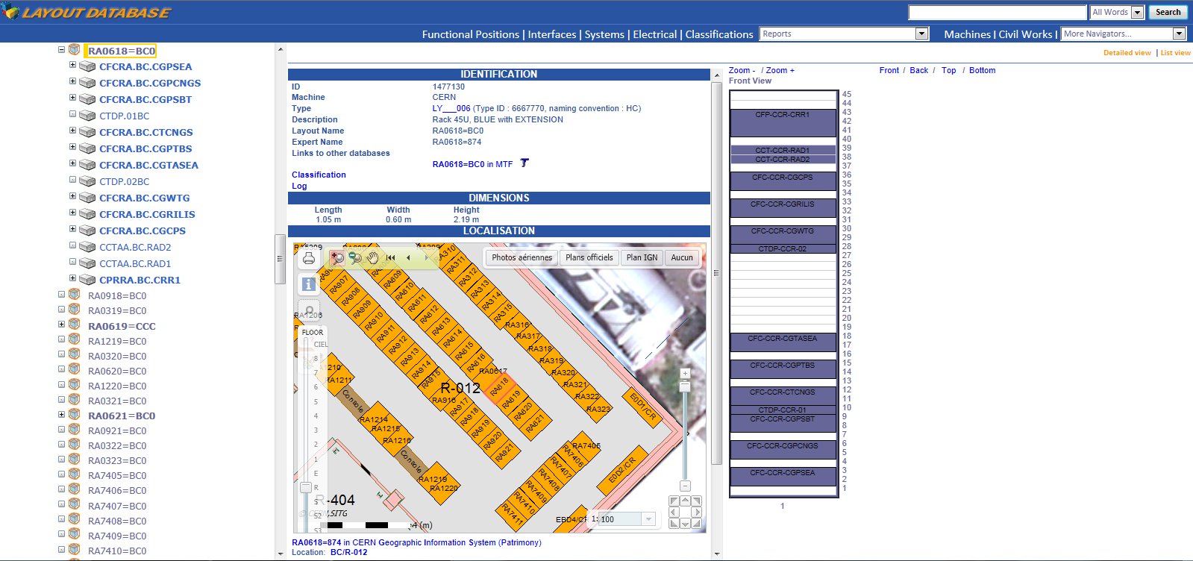
5 ways the Layout Service helps with Maintenance and Asset Management
Once an asset is assigned to a Functional Position, one can build combined complex reports
  Integration between layout and GIS helps to quickly localise components on site when intervening for urgent maintenance.
Rack RA0618=BC0 in CCR
Front-end computer crates positioned in rack
Localisation in GIS

Slide 20
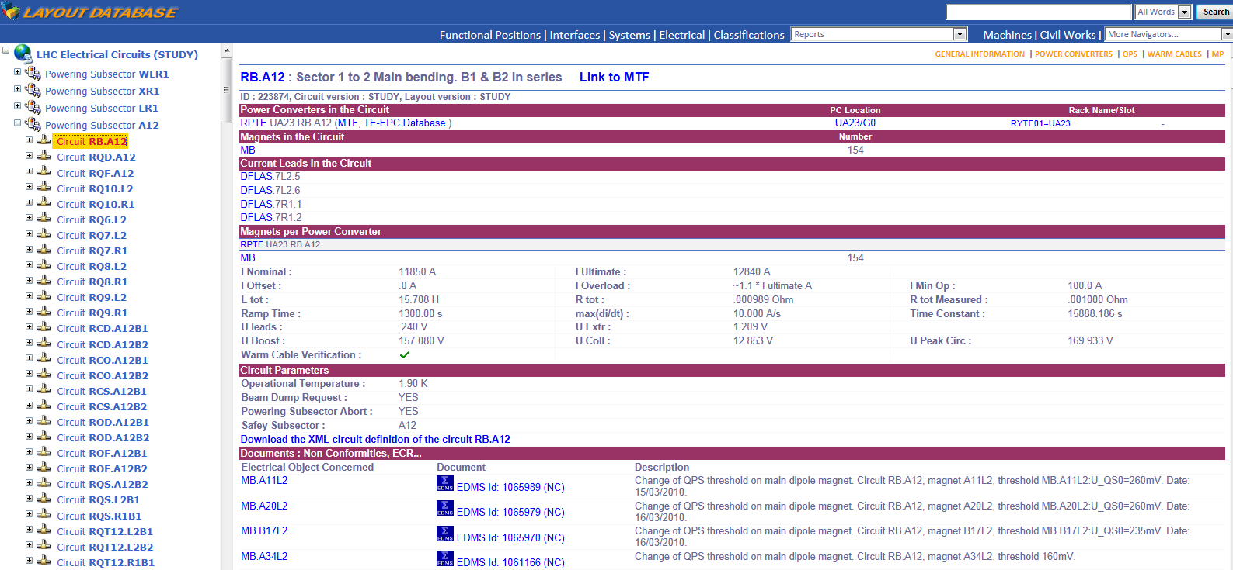
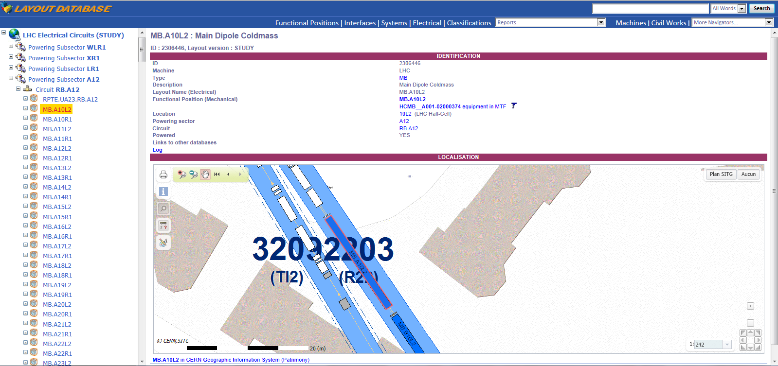
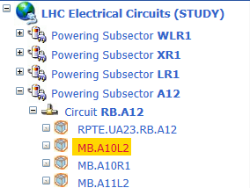
5 ways the Layout Service helps with Maintenance and Asset Management
Identification of power sources of components
  The descriptions of the connections and circuits (from magnets, to cold cables , current leads, warm cables, power converters) can help ensure the electrical lockout.
Circuit
Current Leads
Power Supply
Circuit Parameters
Search of an LHC dipole magnet in the Electrical Circuit Navigator
Dipole Magnet
Links to EDMS Documentation

Slide 21
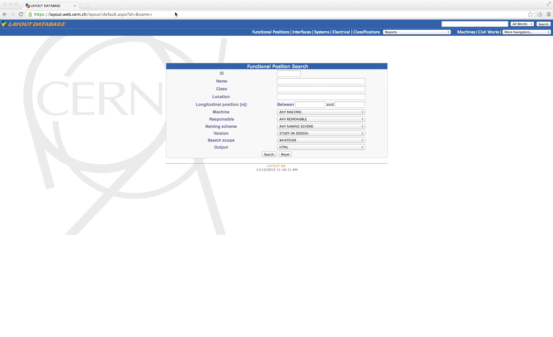
5 ways the Layout Service helps with Maintenance and Asset Management
Ability to navigate through the connections (circuits) between functional positions
  Quickly diagnose failures in acquisition chains
    Identify faulty asset in the chain and create a work order on that Asset
Data from different equipment groups is fully integrated, which facilitates cross-domain maintenance
3. The thermometer is wired to an 8-pin connector on the magnet
8. By traversing the Worldfip network we reach the gateways located in a controls rack
6. From the conditioner card you can navigate to see the configuration of the electronics crate
5. The 15-pin connector is connected (via the crate backplane) to a
conditioner card which reads the signal coming from the thermometer
7. The crate contains communication cards which connect the crate to the WorldFip network
4. The 8-pin connector on the magnet is cabled to a 15-pin connector in a control crate by a cable with number 1703890
1. Search for thermometer: QITEL.29R7.TT822
2. The thermometer is attached to the dipole magnet LBBRA.29R7

Slide 22
Conclusion
The Layout Database provides the infrastructure models, required by Asset management
  Integrated Data, permits navigation across domains and web interfaces
  Available to everyone at CERN
  Flexible enough to handle the needs of many diverse user groups
  It will also evolve to cope with future Asset Management requirements, if needed
Several equipment groups at CERN have included the management of their Functional Positions as a standard part of their QA plan
  Layout-type data is already managed internally within equipment groups
    Why not centralise this information using common tools?
    Profit from cross-domain integration
    Effort to structure this data in Layout DB is different, but not necessarily increased

