Slide 1
Organization of LS1
Consolidation, upgrade and maintenance
K. Foraz, CERN
AMMW 2013

Slide 2
Contents
Introduction
LS1
  Main activities and schedules
  Preparation
  Organisation
  Status
Conclusions

Slide 3


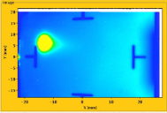
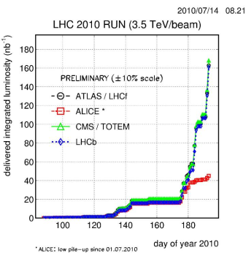
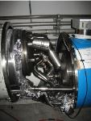

Introduction - LHC
August 2008
1st injection test
Nov. 2009
Beam back
Aug. 2011
2.3e33, 2.6 fb⁻¹
1380 bunches
4 July, 2012
Higgs discovery
September 10, 2008
First beams around
Oct. 2010
1e32
248 bunches
Dec. 2012
23 fb⁻¹
2008
2009
2010
2011
2012
September 19, 2008
Disaster
Accidental release of 600 MJ stored in one sector of LHC dipole magnets
Jun. 2011
1380 bunches
18 June, 2012
6.6 fb⁻¹
to ATLAS & CMS
Nov. 2010
Ions

Slide 4
Introduction
Code name LS1 (Long Shutdown 1)
Priorities:
  Implement the necessary safety mitigation measures
  Perform the necessary consolidation and upgrade activities
  Perform the full maintenance of equipment
in order to ensure the operation of the LHC above 13TeV collision center mass of Energy, and a reliable operation of the accelerator complex.

Slide 5
Contents
Introduction
LS1
  Main activities and schedules
  Preparation
  Organisation
  Status
Conclusions

Slide 6
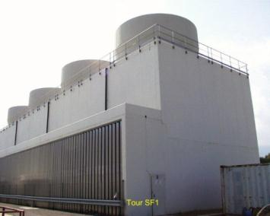
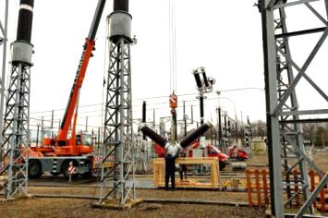
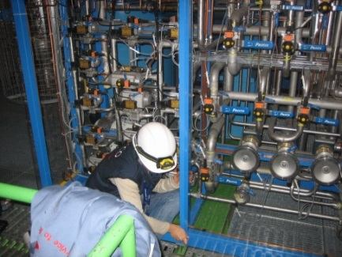
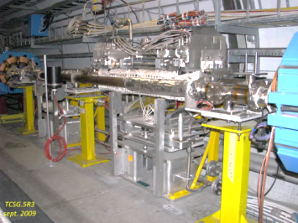
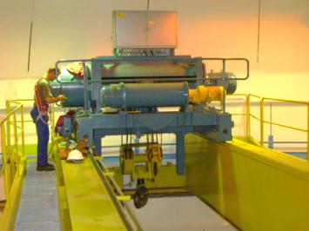
LS1 – Maintenance
Perform the full maintenance of all equipment
  Cryogenics  N. Bonneti - Thursday
  Cooling and ventilation  G. Peon - Thursday
  Main electrical sub-station J.-M. Foray - Thursday
  Safety systems: fire, ODH detections, alarms…
  Access system
  Magnets
  Quench protection systems
  Power converters
  Cranes lifts
  Collimators
  …..

Slide 7
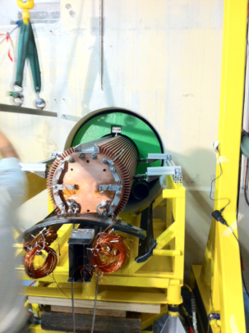
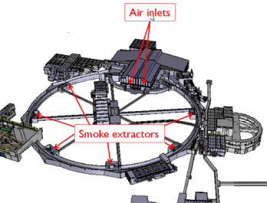
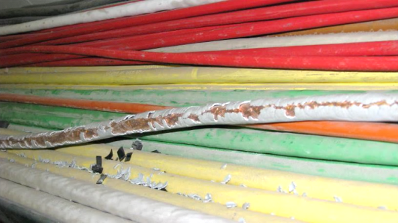
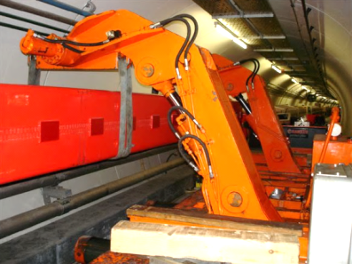
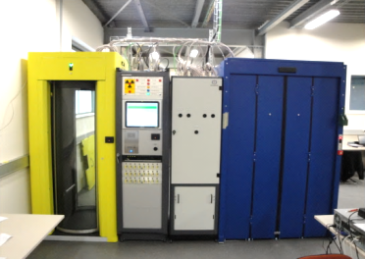
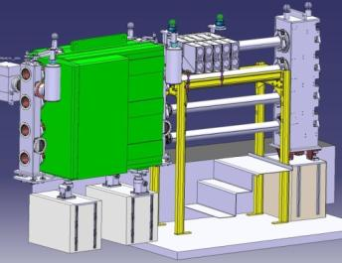
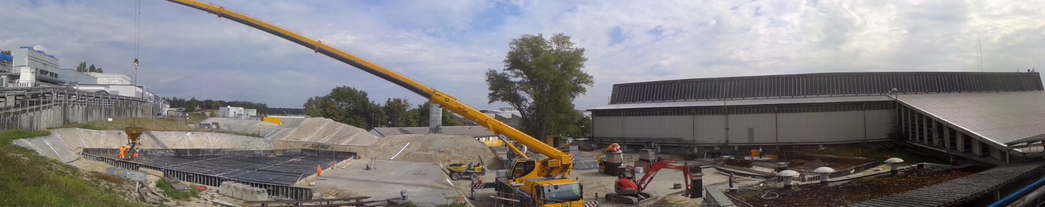
Main consolidation & upgrade works in injectors
PS ventilation system
SPS – replacement of irradiated cables
Improvement of the radiation shielding
over the PS and Septum 16
Magnets
New access system
Demineralized water prod. Station
SPS valves exchange
Interlocks
PS & PSB Upgrade of the RF systems
18kV transformers

Slide 8
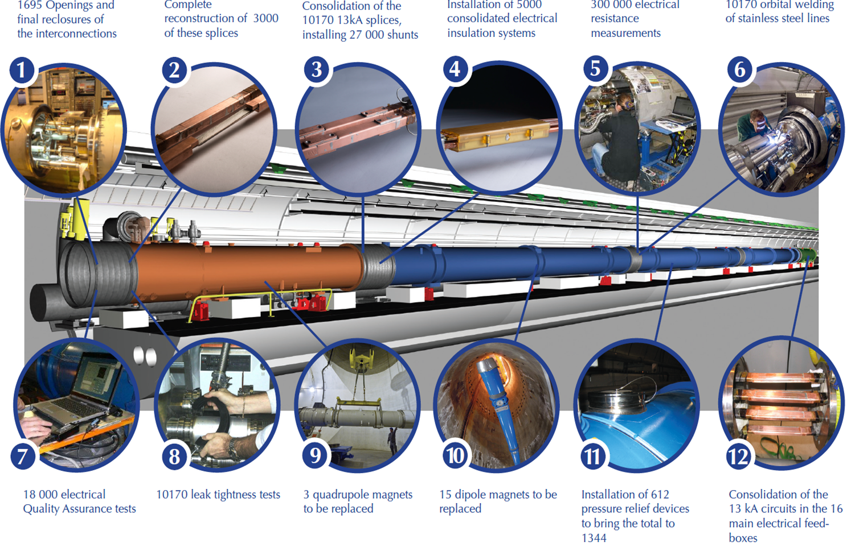
Main consolidation activities in LHC -1
SMACC-Superconducting Magnets And Circuits Consolidation

Slide 9
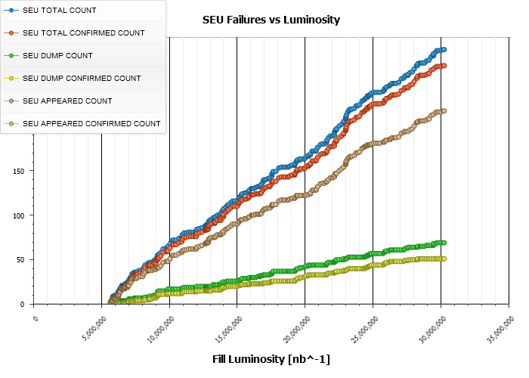
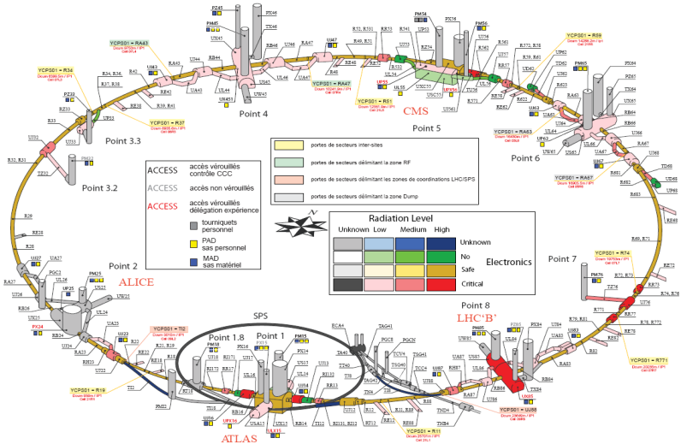
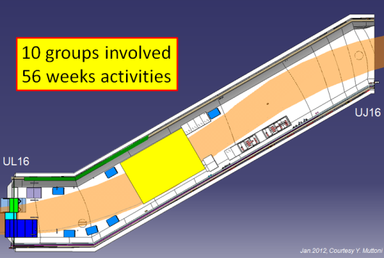
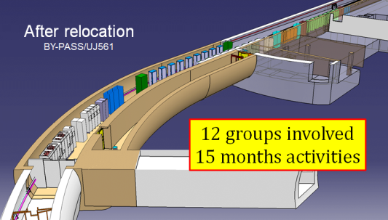
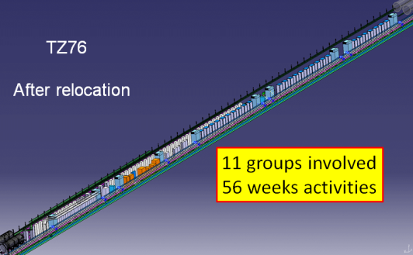
Main consolidation activities in LHC -2
R2E – Radiation to Electronics
2011
P5
~12 dumps per fb⁻¹
P7
2012
~3 dumps per fb⁻¹
< 0.5 dump per fb⁻¹
P8
P1
Point 1 – ULs, Ujs, RRs
Point 5 – UJ56, UL55, RRs
Point 7 – UJ, TZ

Slide 10
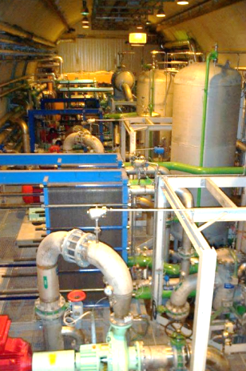
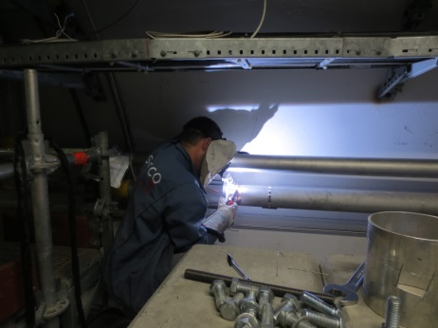
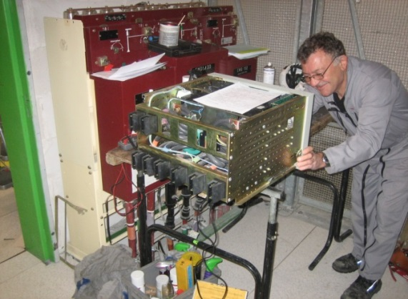
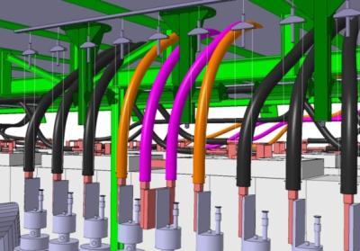
Main consolidation and upgrade activities in LHC -3
But also
  LHC pumping stations
  Replacement of water cooled cable hoses
  Replacement of UPS
  New collimators
  Vacuum
  Current leads
  Helium ring line
  Beam instrumentation

Slide 11
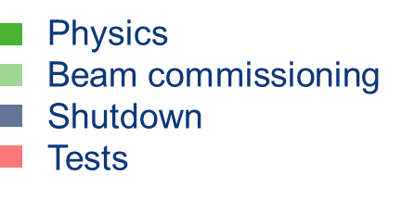
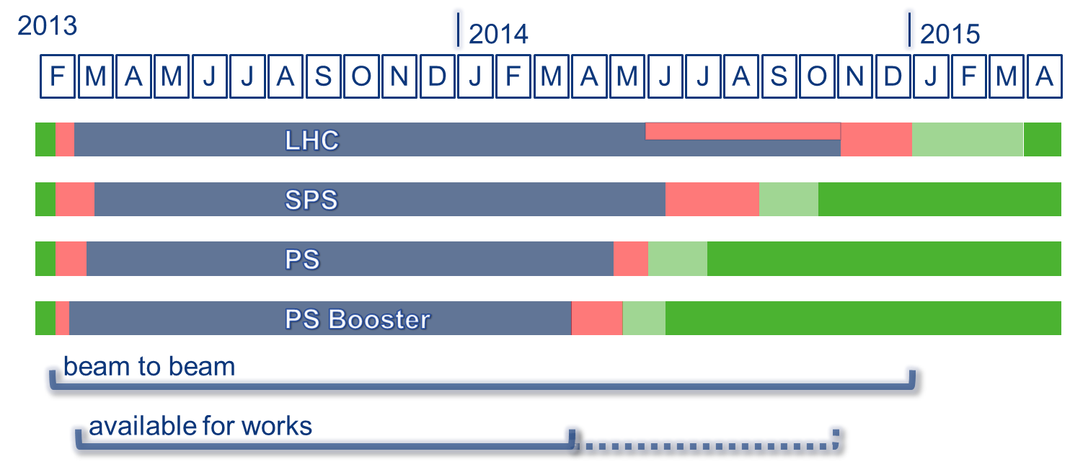
Schedules -1

Slide 12
Contents
Introduction
LS1
  Main activities and schedules
  Preparation
  Organisation
  Status
Conclusions

Slide 13
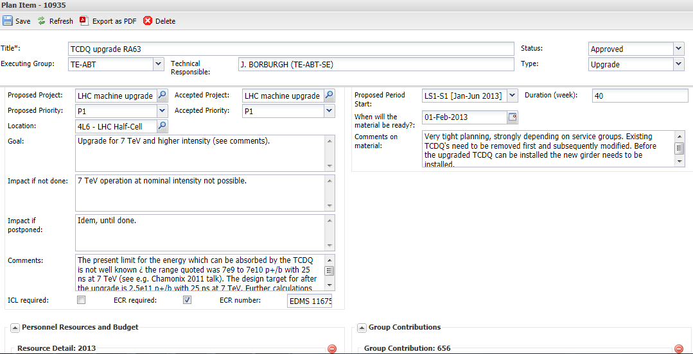
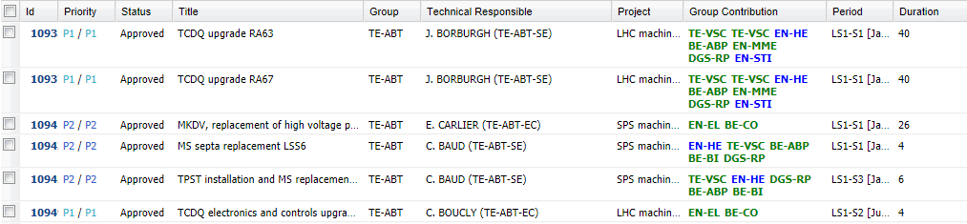
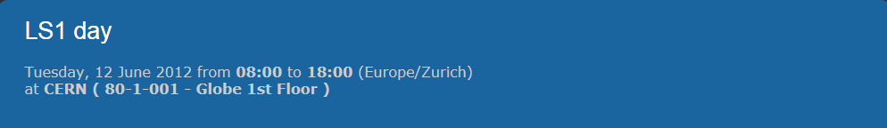
Preparation is fundamental -1
Define
  Arbitration between requests  plan.cern.ch
  w.r.t resources & priorities
  Understand and evaluate the # requests  coordination meetings, reviews

Slide 14
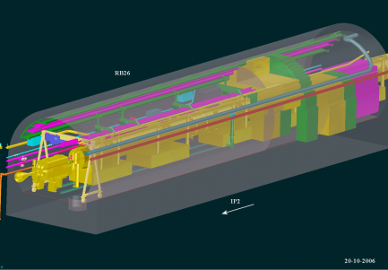
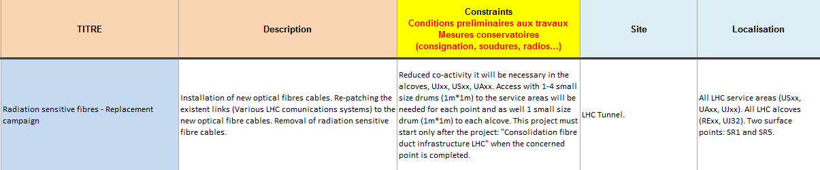
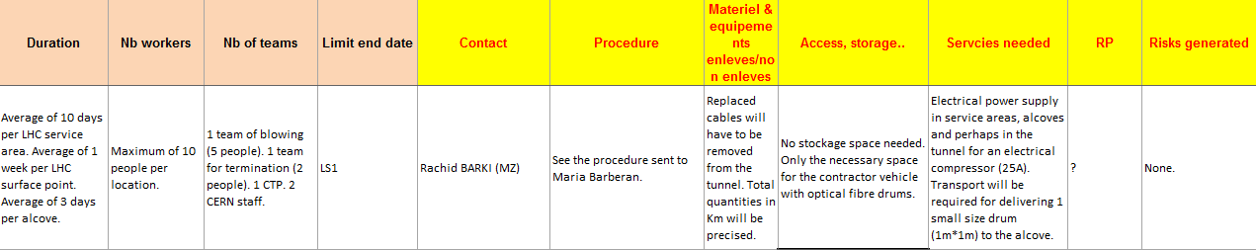
Preparation is fundamental -2
Prepare
  3D integration and plans  design offices & ICL
  Prepare, award & set up contracts, Follow material production
  Find and organize resources
  Document changes  ECRs  T. Birtwistle- Thursday
  Schedule activities  detailed and global schedules
  Mitigate risks  Task forms, VIC, DIMR
  Prepare and prepare  Work Package analysis, reviews

Slide 15
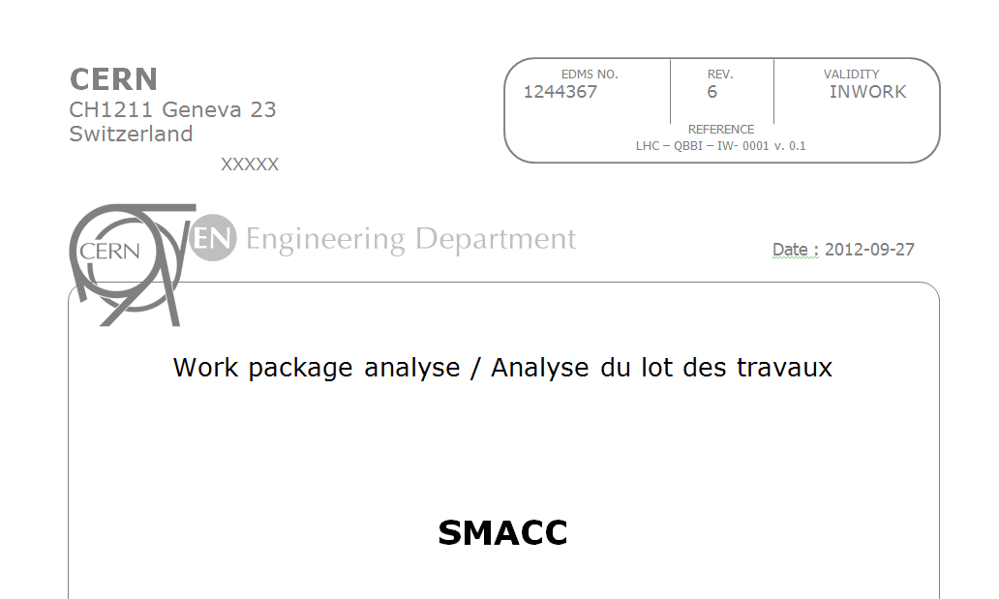

Risks
Incidents
  Anticipate and prepare
Work Packages Analysis
Evacuation simulation
Vent.
Vent.
Vent.
AMMW - K. Foraz
LSS
P_{even}
LSS
Tunnel sector
LSS
P_{odd}
LSS
Cryogenics
Electrical systems
Safety systems
Courtesy: S. La Mendola

Slide 16

Risks
Incidents
  Anticipate and prepare
  Safety is a shared concern
Delays due to
  Material unavailability
  Contracts &/ resources problems
  Unexpected additional activities
Work Packages Analysis
Evacuation simulation
  It’s better to lose one minute in life… than to lose life in a minute.
Follow-up & communication of drifts
AMMW - K. Foraz
Special Intervention Teams
Priorities for work coordination
Safety
Quality
Schedule and Cost

Slide 17
Contents
Introduction
LS1
  Main activities and schedules
  Preparation
  Organisation
  Status
Conclusions

Slide 18
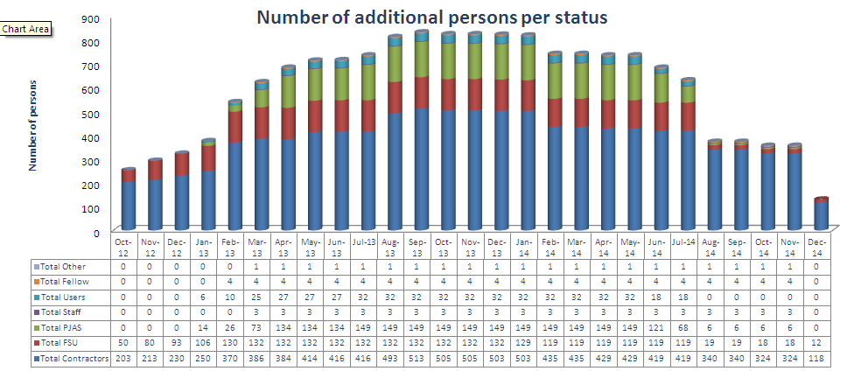
LS1 additional persons

Slide 19
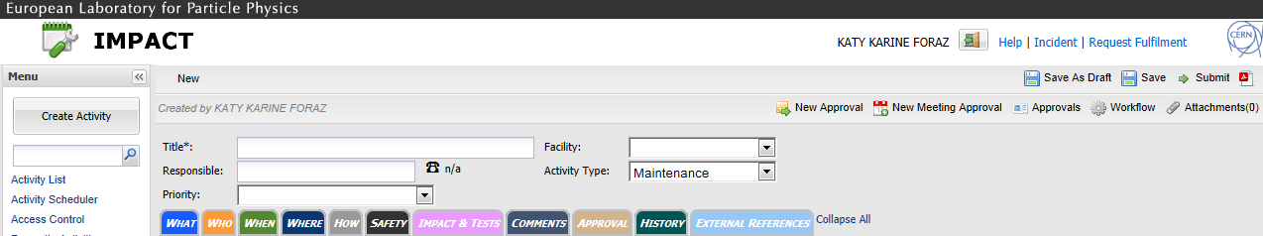
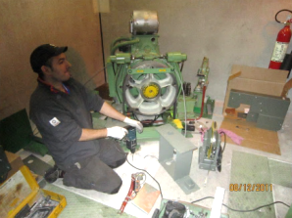
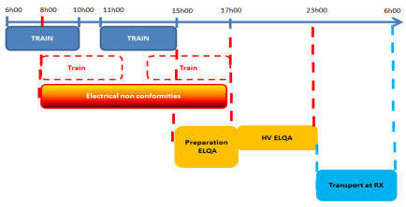
Access
  All activities are declared and accepted via in IMPACT D. Lafarge Friday
  No Impact approved = No access
Access in the LHC is a crucial point !!
  Up to 250 persons in two adjacent sectors
  ☞ ~ 200 bikes (logistics)
  Start hours spread over 2h30’
  Lift: sensible equipment
    Reinforced “piquet”
    Maintenance - Frequency doubled
AMMW - K. Foraz

Slide 20

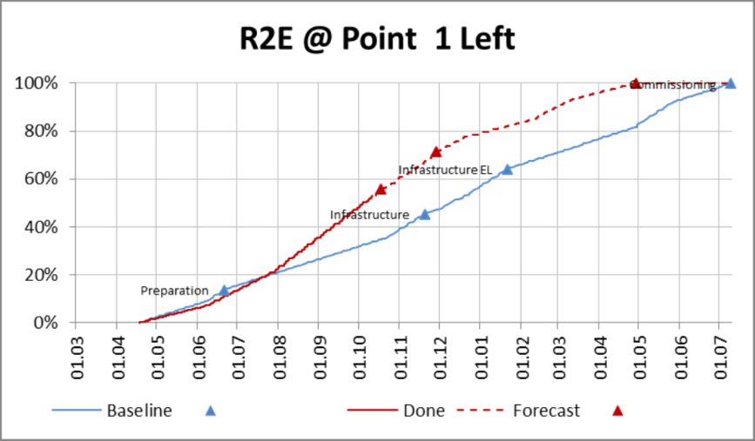
Follow-up
Bi-monthly plenary meetings to follow the activities in each machine
A lots of had-occ meetings
  On site
  Preparation
  Treat new issues
Bi-monthly report to Long Shutdown Committee
Issues management
  New activities
  Material delays – not that much !!
  Delays – not that much, neither !!
Dashboards
  Curves
  Broken line

Slide 21
Contents
Introduction
LS1
  Main activities and schedules
  Preparation
  Organisation
  Status
Conclusions

Slide 22
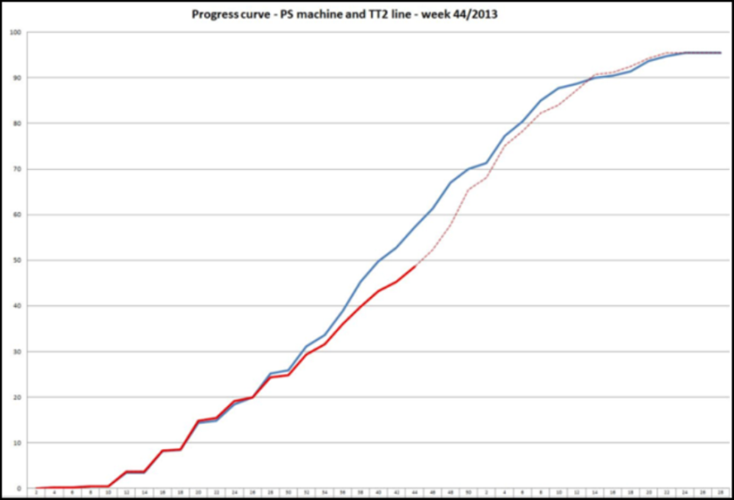
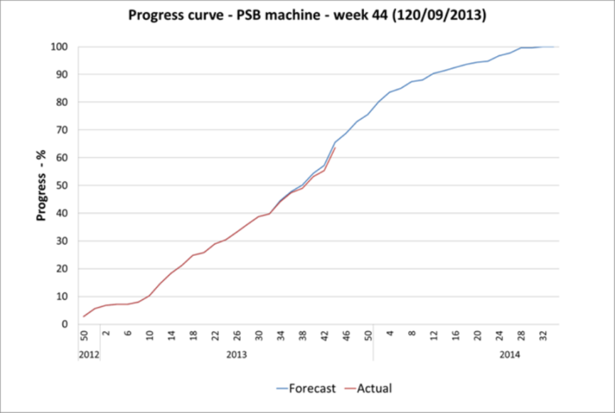
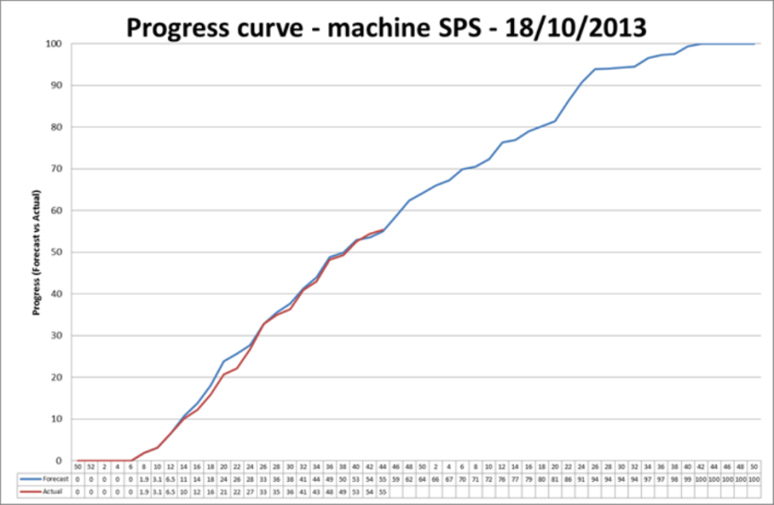
Injectors status
Very good progress ☺

Slide 23
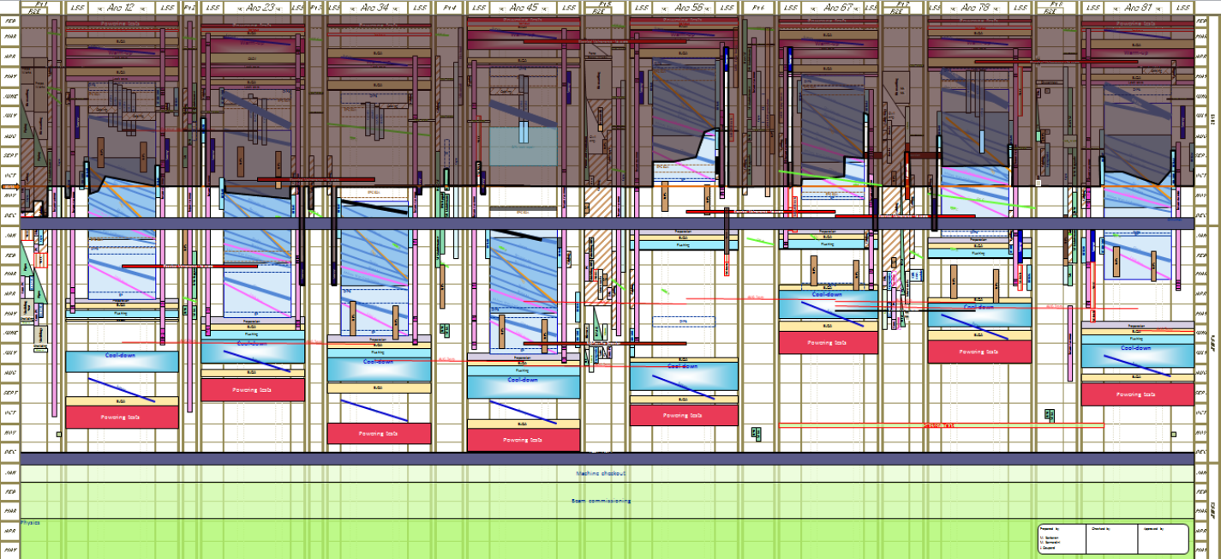
LHC status
R2E
  P1 ~ 2months ahead of schedule
  P5, P7 on schedule
SMACC
  ~3 weeks delay
  But 1st wagons will help the followings
Maintenance on schedule

Slide 24
Contents
Introduction
LS1
  Main activities and schedules
  Preparation
  Organisation
  Status
Conclusions

Slide 25
Conclusions
The main drivers
  The Consolidation of the Superconducting Magnets and Circuits (SMACC )
  Radiation to Electronics (R2E)
  Massive maintenance after more than 3 years of operation
An exceptional number of activities & co-activities
An exceptional number of additional personnel from contractors, Project Associates, FSU, etc.
Preparation is essential
Strong commitment of all stakeholders
Few bad surprise so far
So far..so good

