Slide 1
Machine operation and daily maintenance management in SOLEIL

Slide 2
Summary
Objectives
Failure duration
Interventions
State of our organization

Slide 3
Objectives

Slide 4
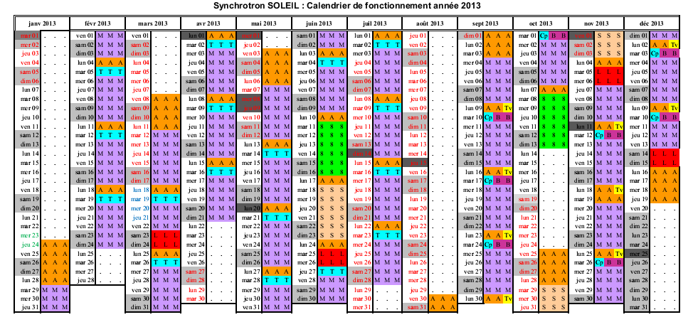
Objectives:
5500 hours of operation per year (5000 hours for 2013)
2013: Operation schedule

Slide 5
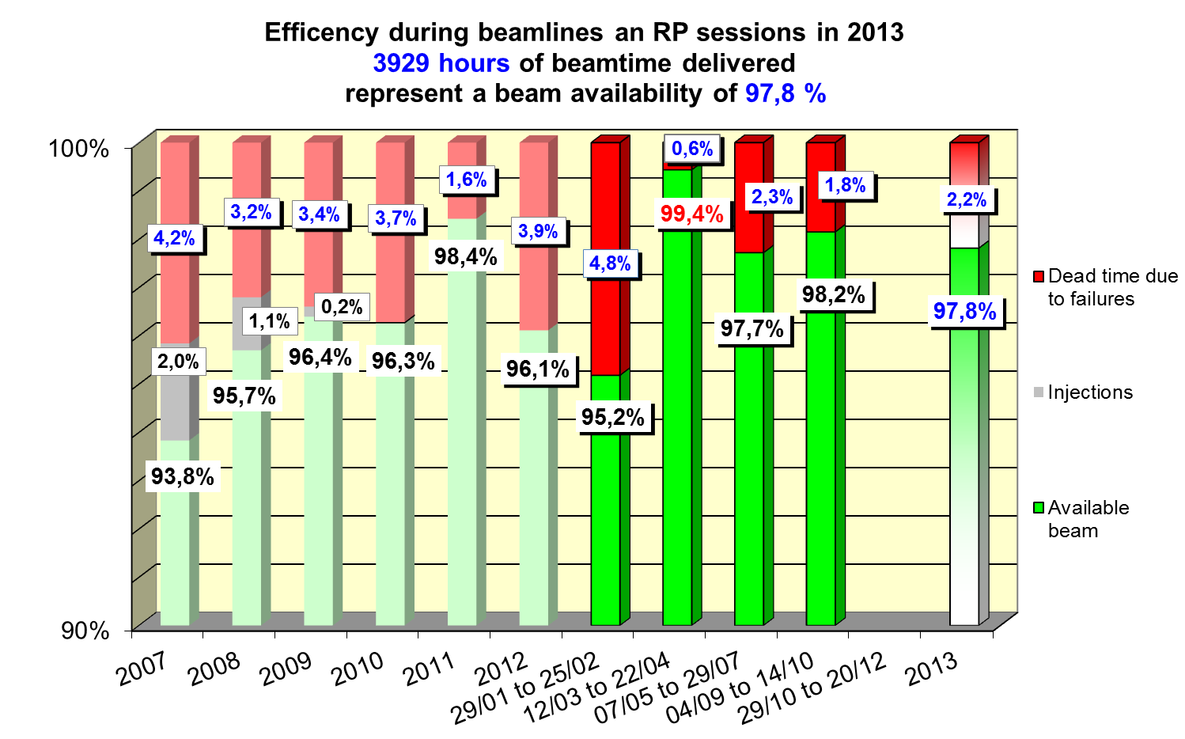
Objectives:
99 % of photon beam availability

Slide 6
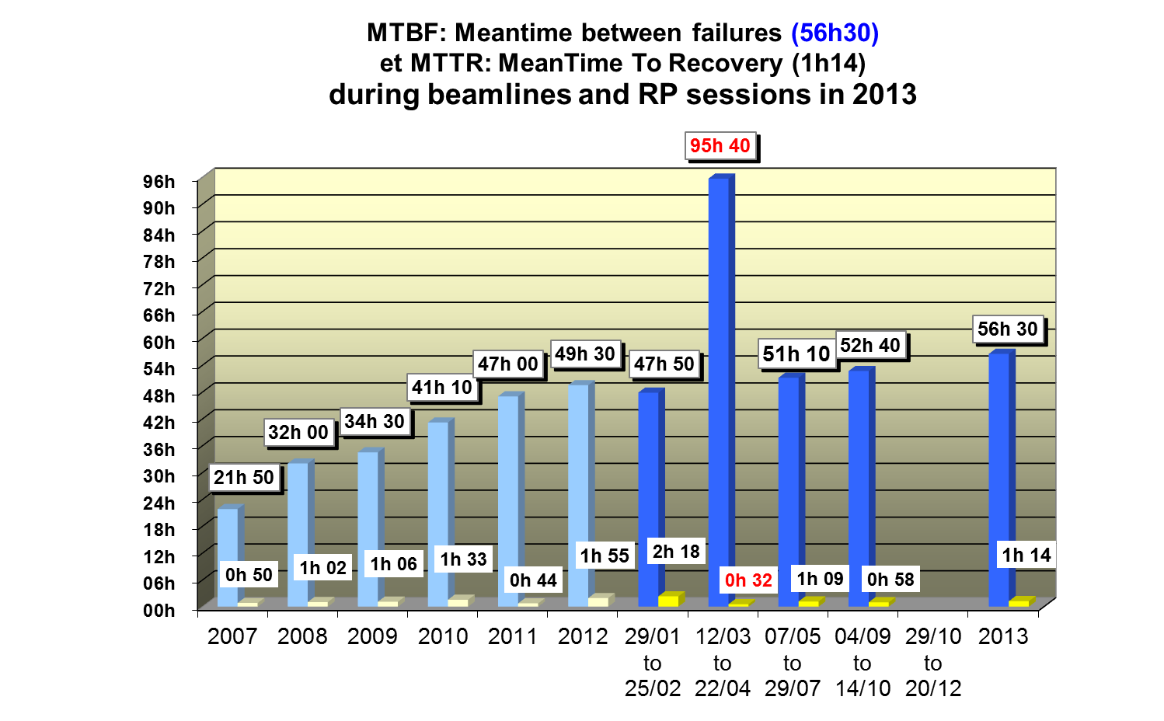
Objectives:
A meantime between failure of 100 hours

Slide 7
Objectives
To continue the installation of new equipment
To ensure high reliability (Operation / Maintenance)

Slide 8
Failure duration

Slide 9
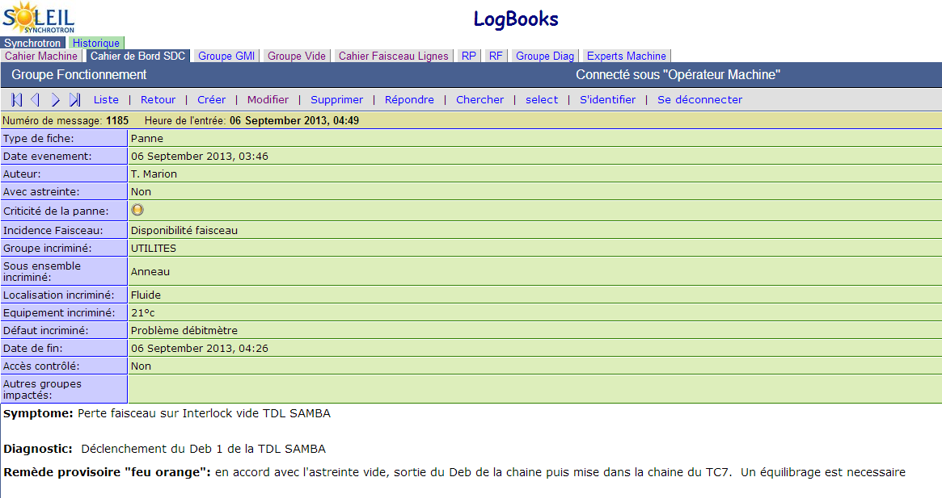
ELOG
The record of the failure by the operator automatically sends an email to the concerned group

Slide 10
Discussion and preparation:
Five main meetings
1) OASIS meetings (every Week)
To discuss and analyze equipment problems and events on the beam
2) Command-control meetings (at the beginning and the end of the run)
To discuss and analyze the computing problems and developments
3) Retour d’EXpérience (feedback) meetings
To discuss and analyze the items that could bring improvements to the accelerators and photon beam performances. Proposals for the improvements on work organization, communication, procedures in order to increase our vigilance and minimize human errors.
4) « CONtrôle Technique des Equipements
et Maintient des Performances » CONTEMP Meetings
These meetings, according to the difficulties met, aimed at analyzing the recurrent failures and defining the actions to be implemented at short, medium and long term.
5) OASIS schedule for shutdown
Several meetings focused on the implementation of the schedule of the next shutdown

Slide 11
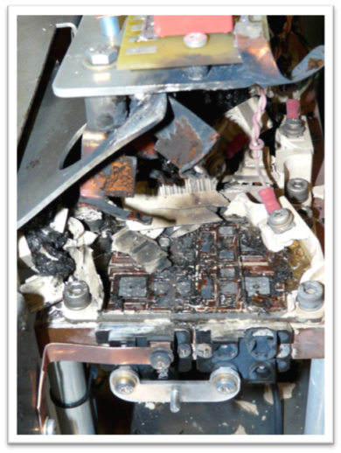
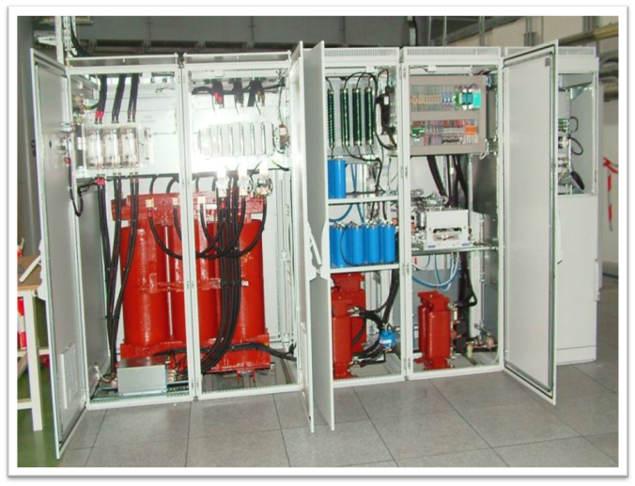
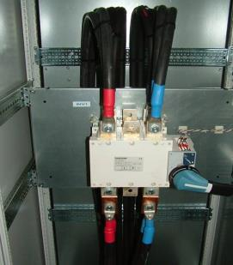
Power Supplies: first cause of failures in 2007 and 2008
3Hz Booster dipole power supplies : upgrade IGBT class (400A to 600A) but was not sufficient. The number of operating cycles is larger than expected. A redesign of these units is progressing.
A new dipole storage ring power-supply (580A / 610V +/- 10ppm), has been in-house developed. Switching between power supplies takes less than 5 minutes
After suffering from quite a few IGBT explosions on 3Hz Booster dipole power supplies, a campaign to upgrade IGBT class (400A to 600A) as the first step. But was not sufficient, the number of operating cycles is larger than expected. A redesign of these units is progressing, especially by oversizing the IGBT modules and by improving the cooling system.

Slide 12
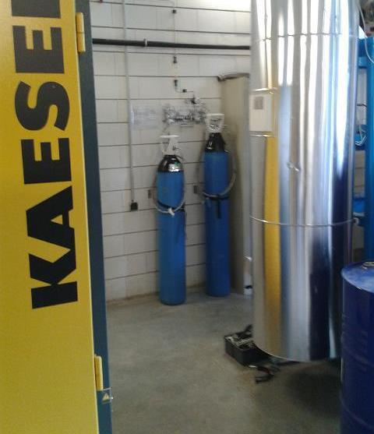
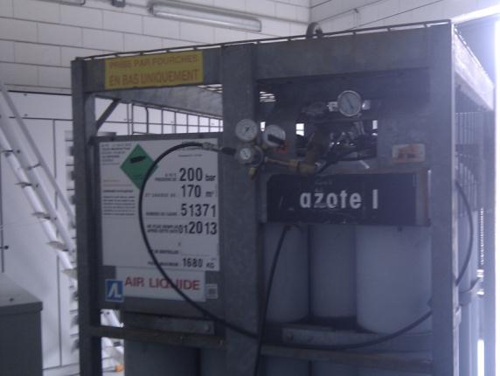
Compressed Air
An interruption, for few minutes, of the superconducting RF cavities liquefactor generates their unavailability during several hours
July 2012 : compressed air failed but no Beam loss!!!
Thanks to new cylinders installed at the compressor and CRYO
=> Several beam losses of at least 6 hours have been avoided !!!
Technical shutdown of August: Installation of 18 cylinders on the main circuit allows us a 2-hours autonomy

Slide 13
Failure duration
A failure
Solved, temporarily or finally by operators or by oncall person
automatically sends an email to the concerned group
Discussion, at the beginning and the end of a run, in command-control meetings dealing with computing problems and developments
ELOG ENTRY
Discussion at the weekly meeting every Thursday called OASIS
Recurrent problem or needing a focus at medium or long term
Establishment of temporary instructions
Discussions, in small groups, in two specific meetings called REX and/or CONTEMP
resolution of the problem during the dedicated physical time sessions or during shutdown
Implementation of procedures and / or changes during shutdown
development of the schedule for shutdown in several meetings

Slide 14
Interventions

Slide 15
Interventions
Depend of the priority, resolution of the problem :
A) either while Machine dedicated time
B) Or during shutdown period

Slide 16
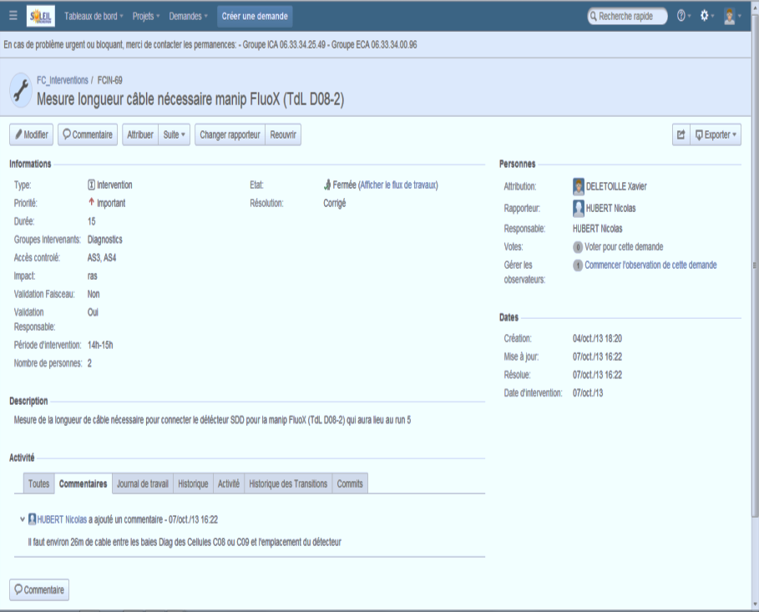
Interventions during Machine dedicated time
Using Jira Software since 2 months
Every Intervention is validated in OASIS meeting or by 3 persons (part of Accelerator coordinator and Operation Group )

Slide 17
Interventions during Machine dedicated time
1 chart summarizing all the interventions of the next Monday is automatically sent every Friday to all the participants

Slide 18
Interventions during shutdown
To fix the problems that occurred during the last RUN
To do the preventive maintenance of the equipment already installed, using CMMS software
To continue the installation of new equipment

Slide 19
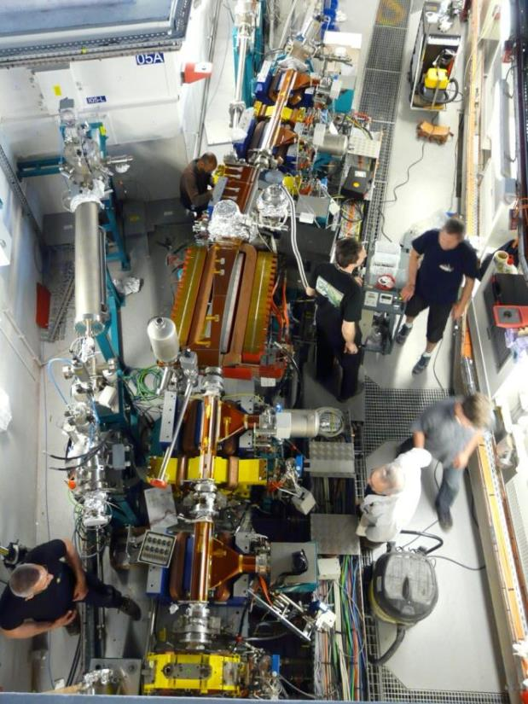
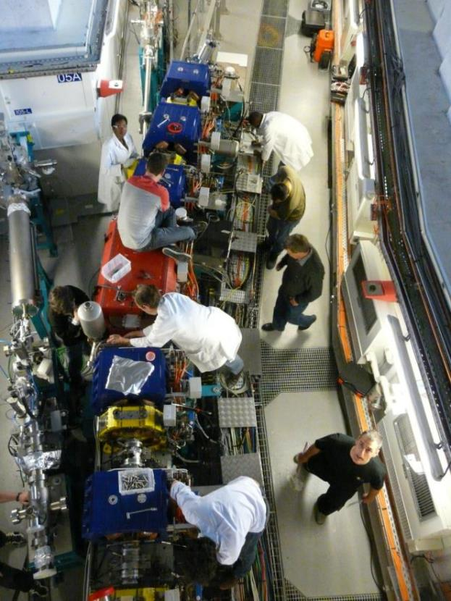
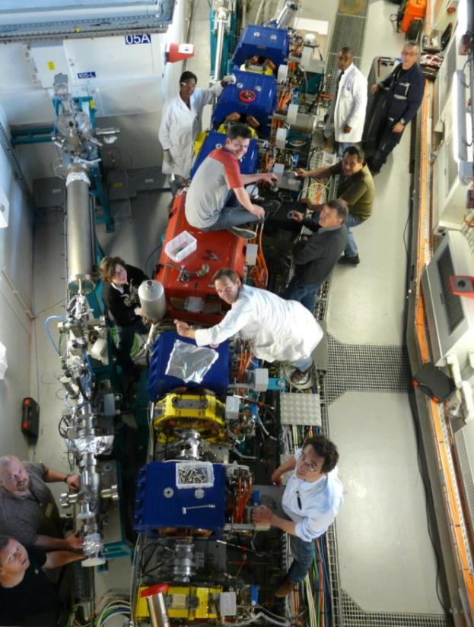
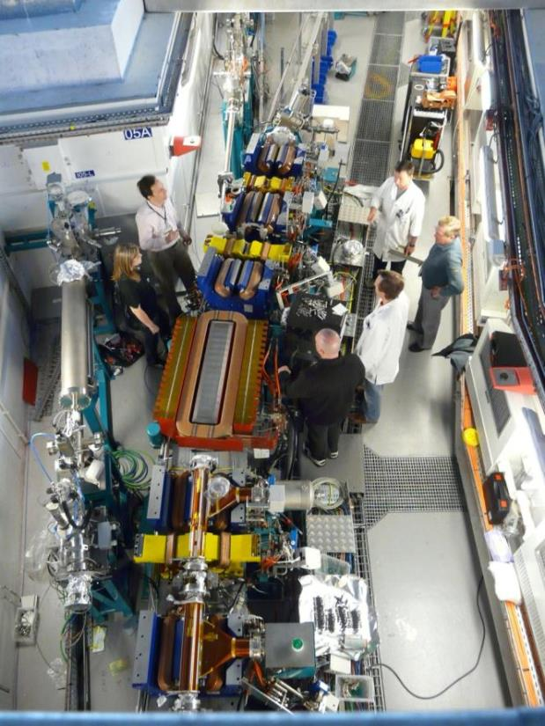
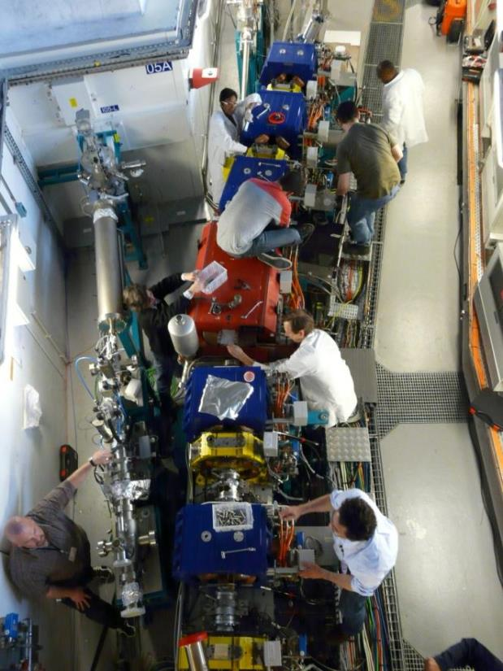
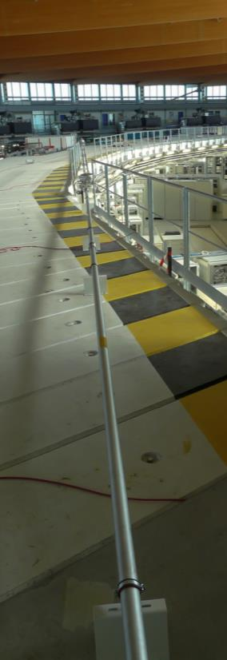
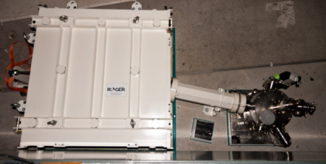
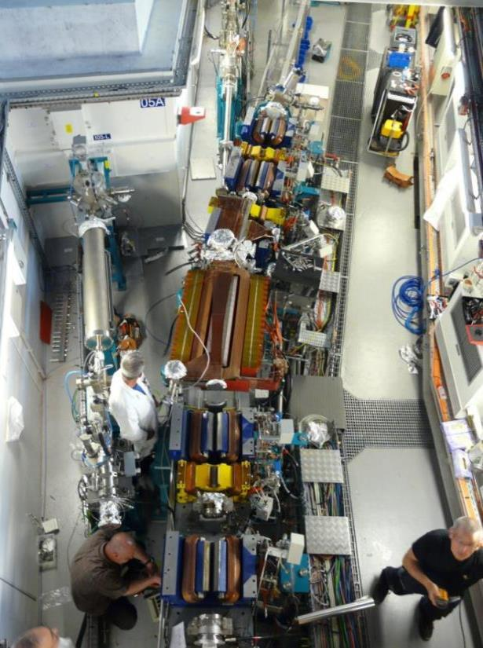
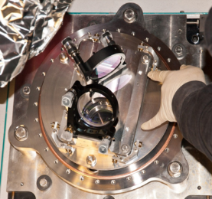
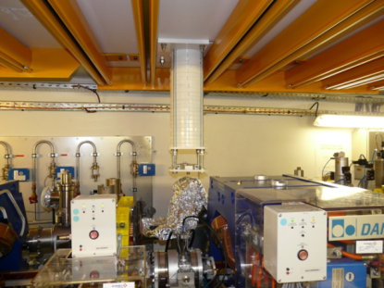
Installation during shutdown => Example of installation for the Femto-Slicing
Laser hutch
January 2103
August 2013
May 2012

Slide 20
Installation during shutdown => Example of installation for the Femto-Slicing in May 2012
70 identified tasks that keep coming
11 groups involved:
- Alignment, Electric, Fluids, Mechanics, Craneman, Vacuum
- Power supply, Diagnostics, Magnetism , Operators
- Radioprotection
Optimized planning according to various constraints (Worktime, cohabitation): Work shift, holiday and weekend
Each skill is important, all the tasks have to be done in a defined order

Slide 21
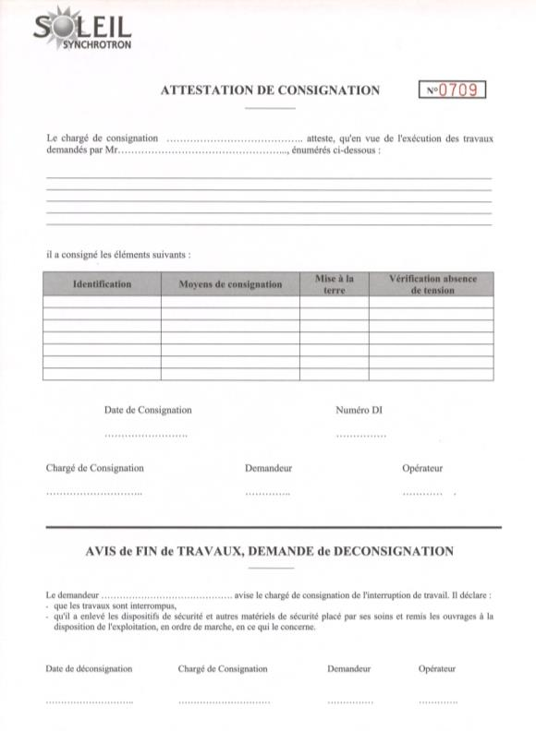
The interventions: The consignment certificate
All the consignment certificate
must be filled ​​before the allowing staff
goes working in the rings

Slide 22
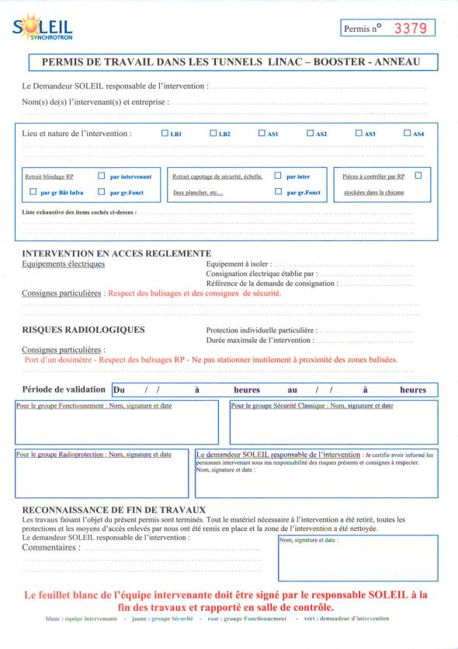
The interventions: The work permit
All the interventions into the ring have to be indicated in a work permit
Security and radioprotection groups mention all the safety rule instructions for the intervention
Validation by the Operation group and the workers before starting the intervention

Slide 23
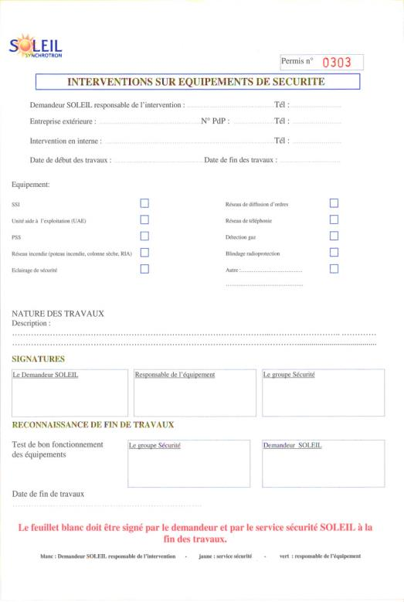
The interventions: Intervention on Safety System
Must be filled if the safety system is impacted by the intervention
Validated by Safety group at the beginning and at the end of the shutdown

Slide 24
State of our organization
Our current organization allows us to have a significant gain on the reliability, the use of equipment and the improving of our responsiveness. However, to make it more efficient, we have to optimize the meetings to avoid the “lost time”
All interventions must be tracked and consultable at any time
=> using CMMS Software
A study is in progress to simplify all the paperwork during shutdown (with Jira)
Having a single software portal (will be introduced in Pascale BETINELLI’s presentation)

Slide 25
Machine operation and daily maintenance management in SOLEIL
Thank you for your attention
Any question ?

