Slide 1


  Accelerating Science and Innovation
Notes:
1

Slide 2
CERN was founded in 1954 as a Science for Peace Initiative by 12 European States
Member States: Austria, Belgium, Bulgaria, the Czech Republic, Denmark, Finland, France, Germany, Greece, Hungary, Italy, the Netherlands, Norway, Poland, Portugal, Slovakia, Spain, Sweden, Switzerland and the United Kingdom
Candidate for Accession: Romania
Associate Members in Pre-Stage to Membership: Israel, Serbia
Applicant States for Membership or Associate Membership: Brazil, Cyprus (awaiting ratification), Pakistan, Russia, Slovenia, Turkey, Ukraine
Observers to Council: India, Japan, Russia, Turkey, United States of America; European Commission and UNESCO
2300 staff: physicists, engineers, technicians, administrative personnel
1000 personnel on contract
11000 users who represent more than half of the living particle physicists originating from 500 universities and institutes and of more than 80 nationalities
Annual budget 1 BCHF

Slide 3
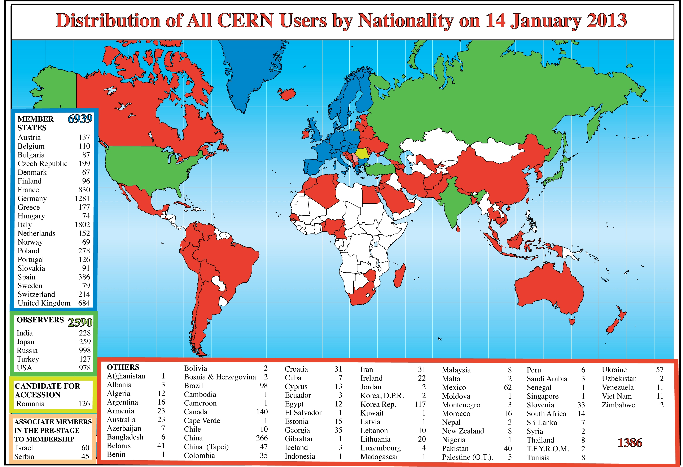
CERN is a Global Lab

Slide 4
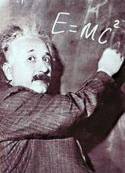
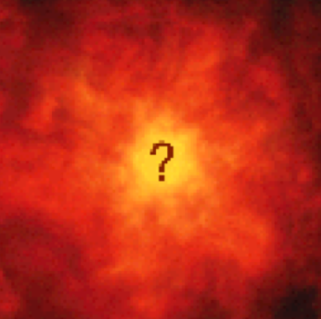


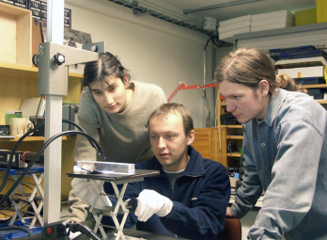
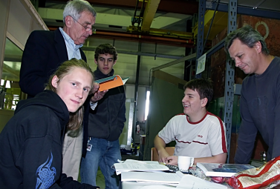
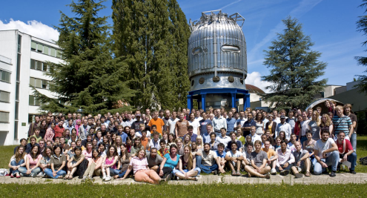
The Mission of CERN
Push forward the frontiers of knowledge
e.g. the secrets of the Big Bang …what was the matter like within the first moments of the Universe’s existence?
Develop new technologies for accelerators and detectors
Information technology - the Web and the GRID
Medicine - diagnosis and therapy
Train the scientists and the engineers of tomorrow
Unite people from different countries and cultures

Slide 5
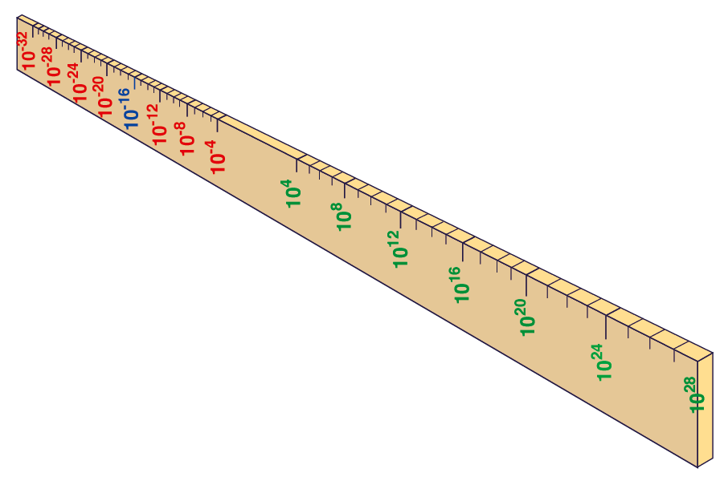

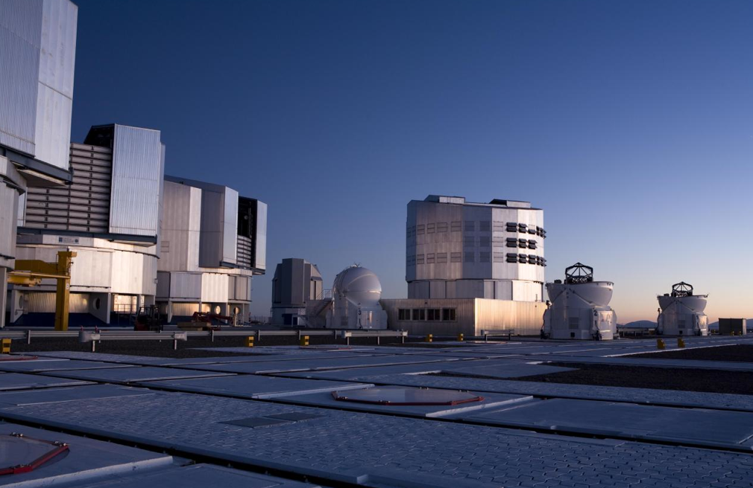
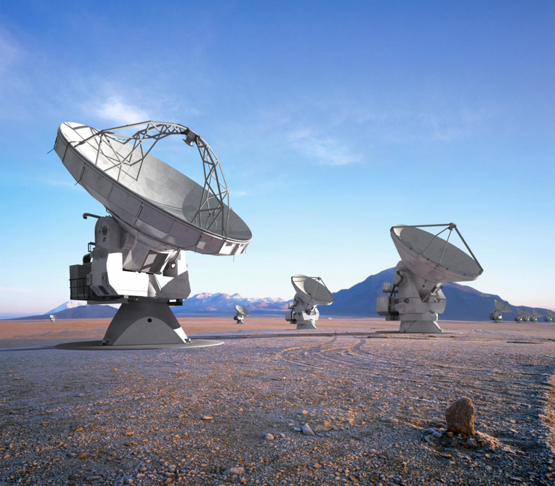
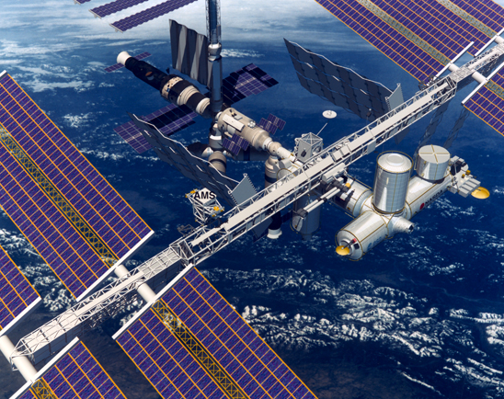
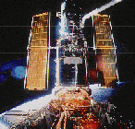
Big Bang
Proton
Atom
Radius of Earth
Earth to Sun
Radius of Galaxies
Universe
cm
LHC
ALMA
VLT
AMS
Hubble

Slide 6
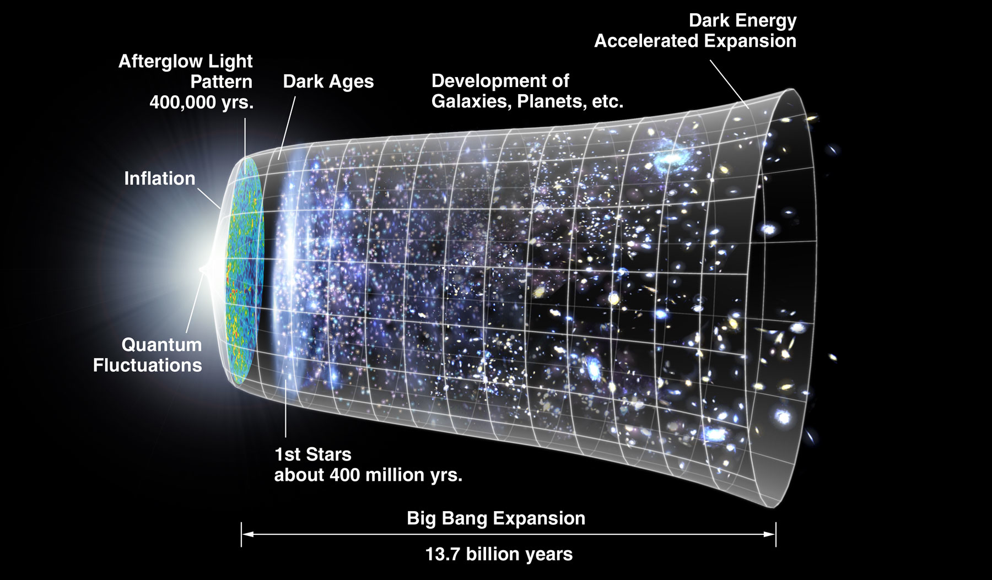
The next scientific challenge is to understand the very first moments of our Universe after the Big Bang
LHC
10⁻¹⁰s

Slide 7
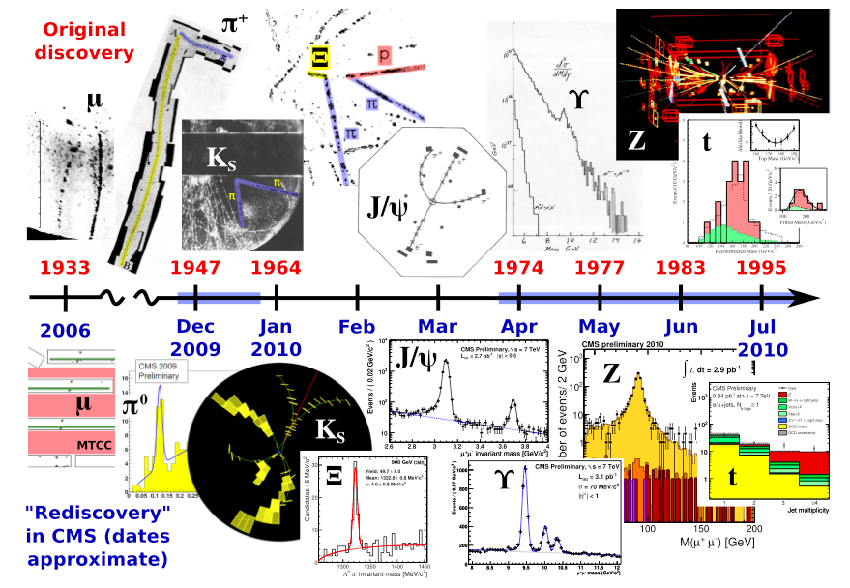
The history of particle physics
rediscovered in less than one year !

Slide 8
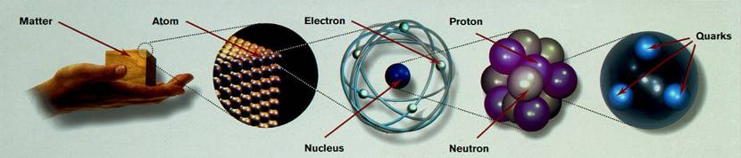
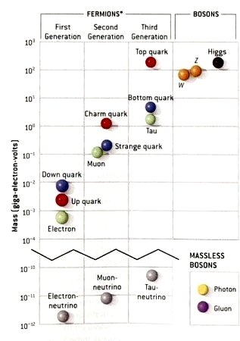
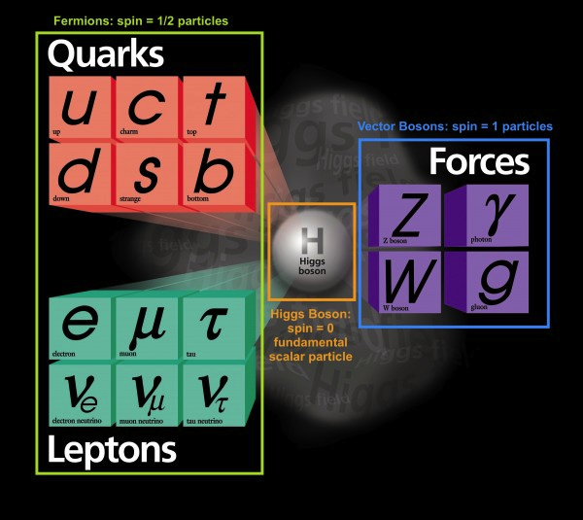
The Standard Model

Slide 9
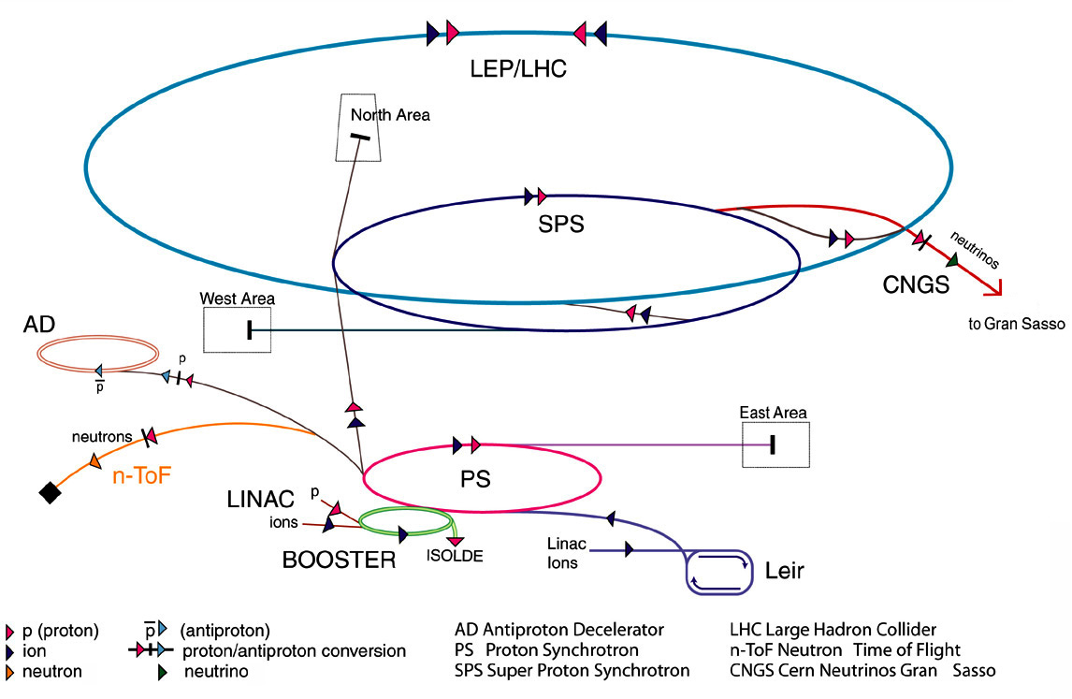
The CERN Accelerator Complex

Slide 10
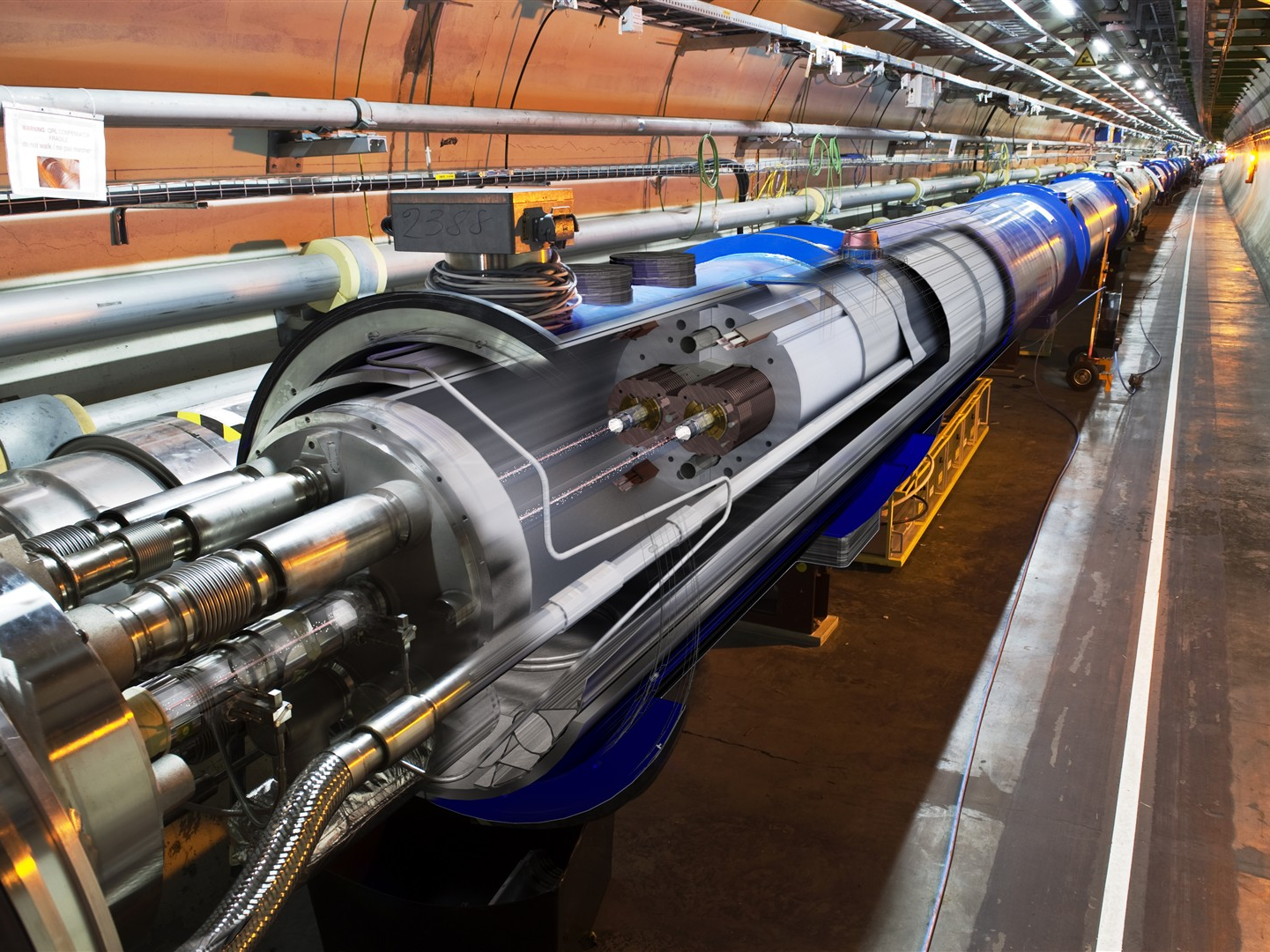

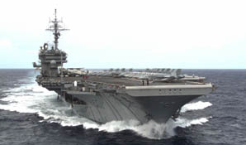
The LHC
A collider situated in a 100m underground 27 km (almost) circular tunnel which accelerates two proton beams to 7 TeV
1982 : First studies
1994 : Project Approved by the CERN Council
1996 : Final Decision and start of the construction
2004 : Installation Starts
2006 : Hardware Commissioning Starts
2008 : End of Hardware Commissioning
2009-2030: Physics
>25 years
10 GJ = 55 km/h

Slide 11
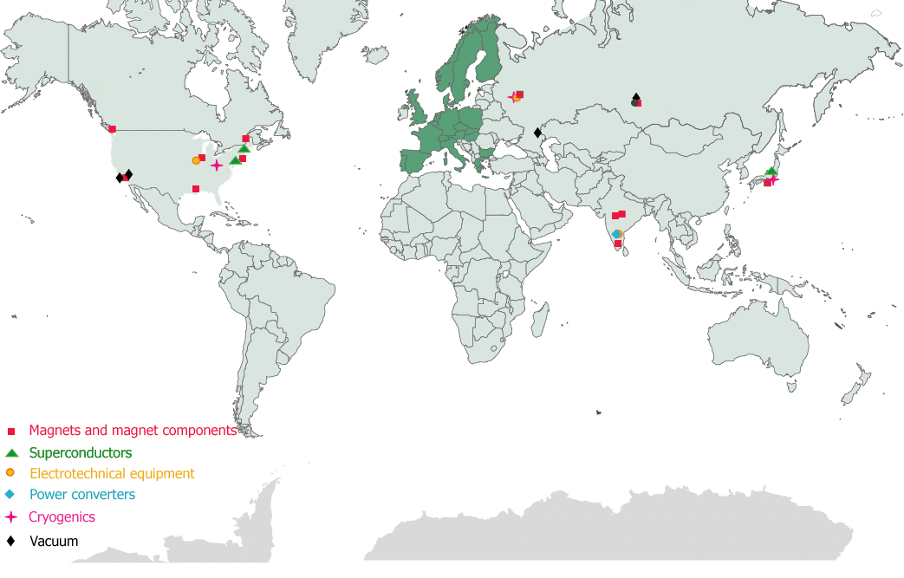
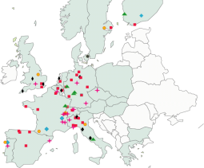

The Major Projects

Slide 12
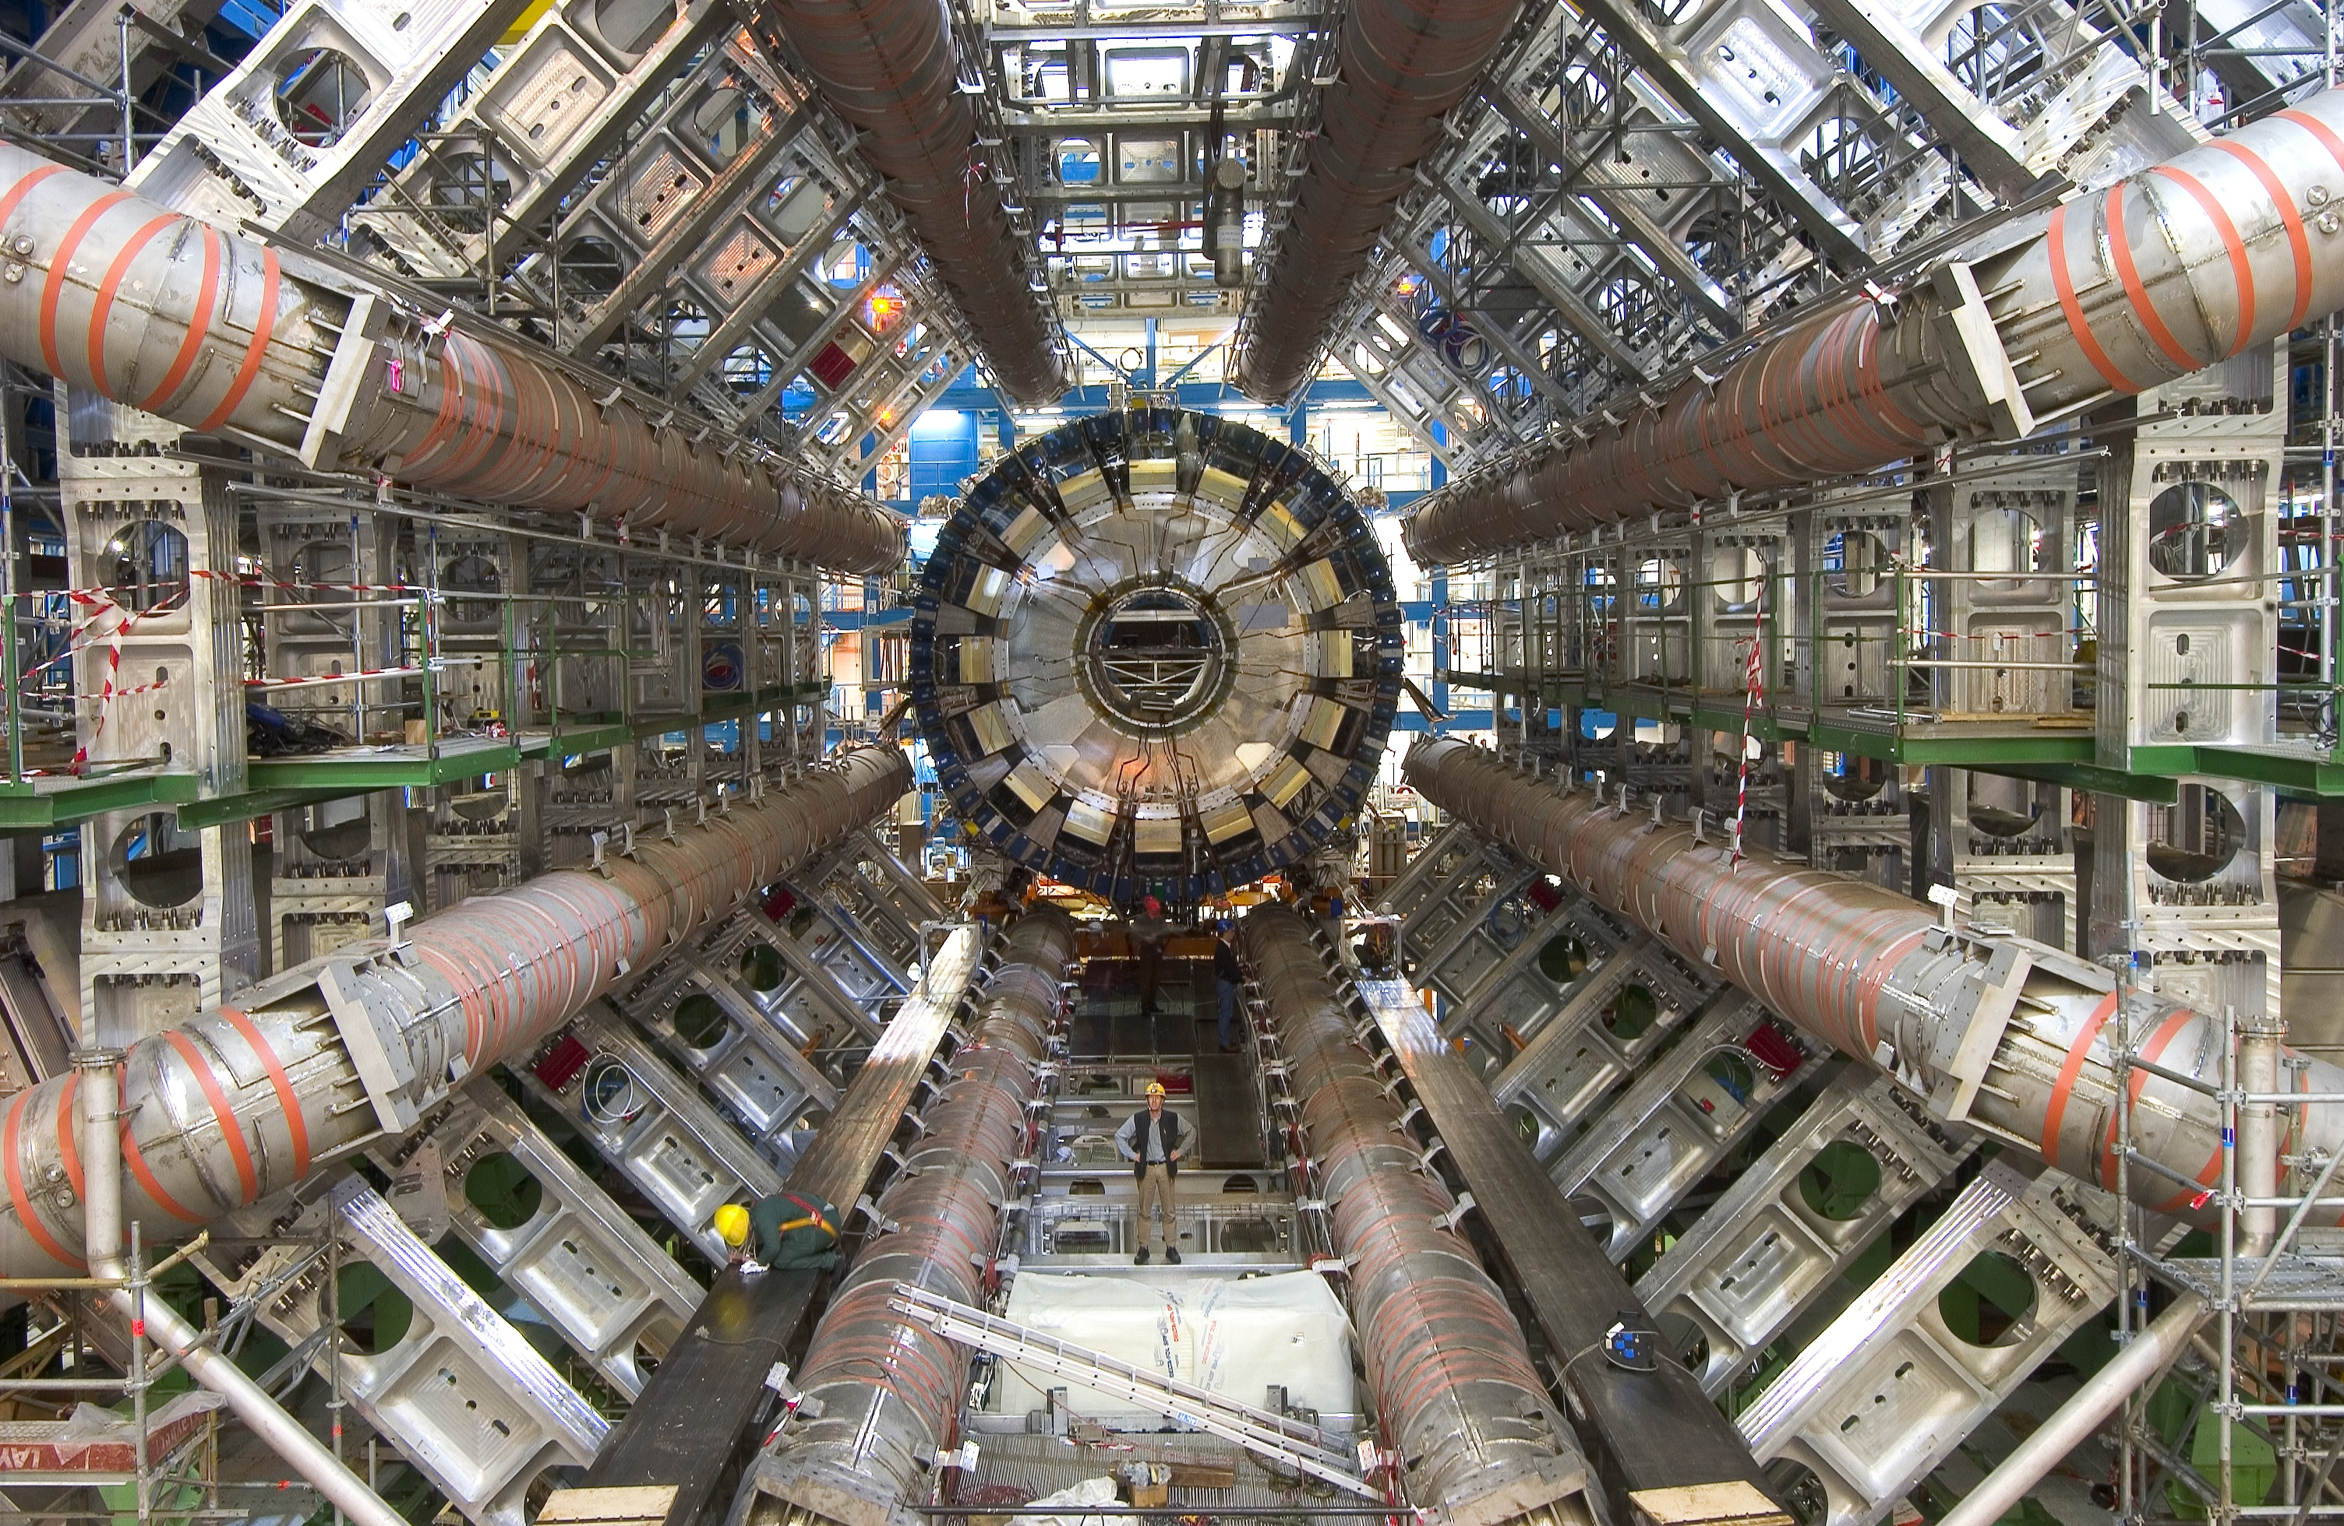
The ATLAS Experiment

Slide 13
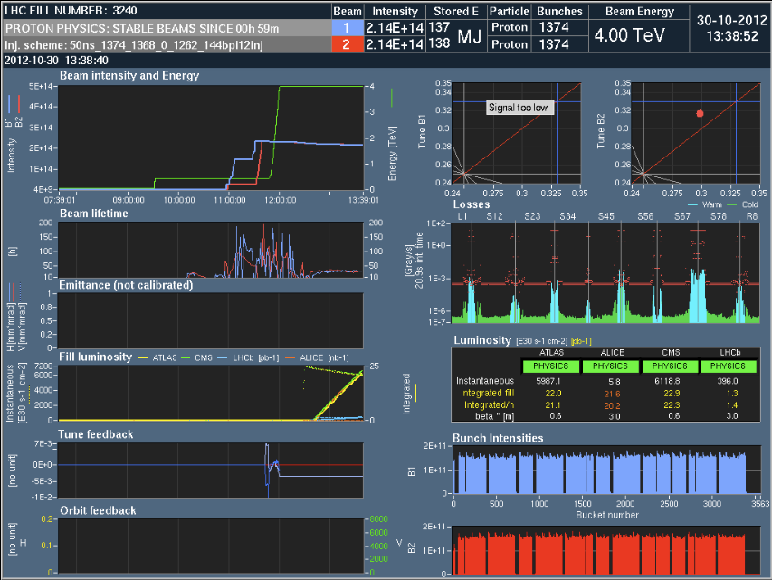

Slide 14

H ➔ γ γ

Slide 15
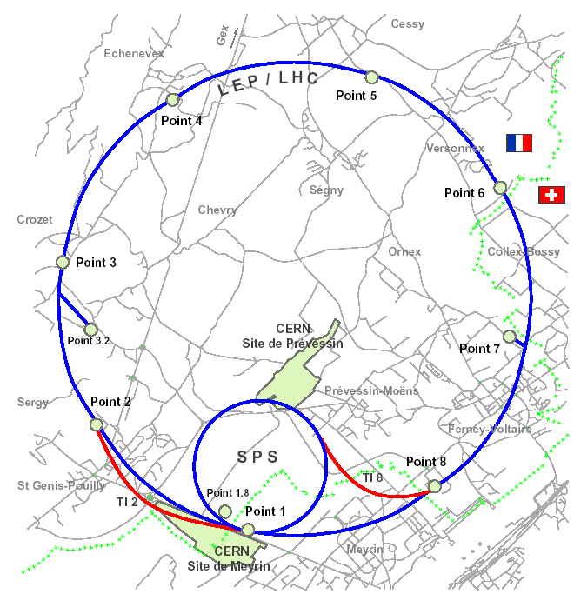
The Cryogenics
50% of the world’s helium liquefaction capacity
><11m<>
8 x 18kW @ 4.5 K
1’800 superconducting magnets
24 km & 20 kW @ 1.8 K
125 t @ 1.9K
150 t He inventory
Courtesy Serge Claudet

Slide 16
The Cryogenics
It takes one month to cool down an LHC sector from 300 K to 1.9 K.
This is followed by two weeks of tuning of the control loops.

Slide 17
Specificity and complexity of the LHC
Superconducting magnet system
Superconducting RF
Eight independent sectors
Large or very large
  distances
  number of electrical circuits
  energy stored in the magnetic system
  high-tech superfluid helium production plants
  unprecedented resolution power converters
  number of infrastructure systems
Coupling between systems
Systematic tests which ensure completeness, repeatability, traceability.

Slide 18
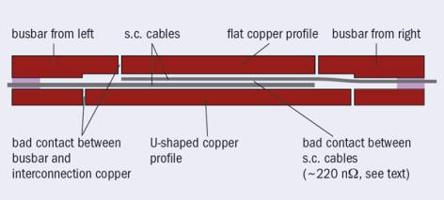
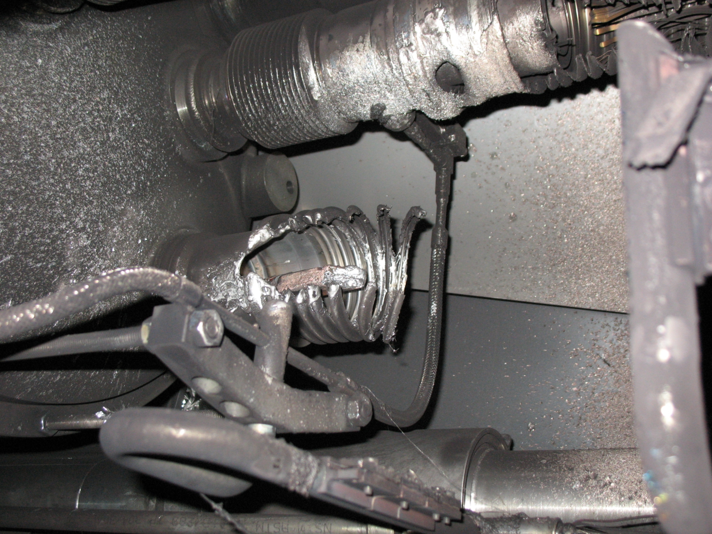


The magnet interconnects
An assembly defect in a splice

Slide 19
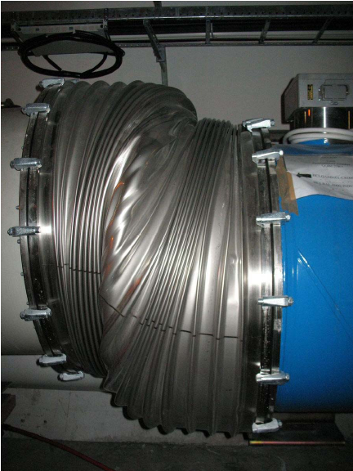
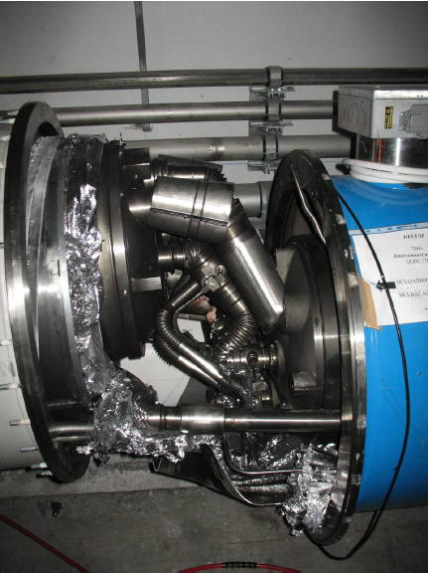
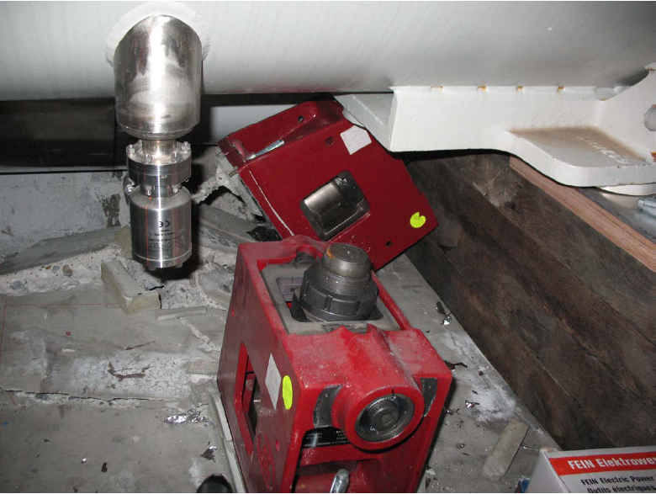
The collateral damage
Insulation vacuum subsector

Slide 20
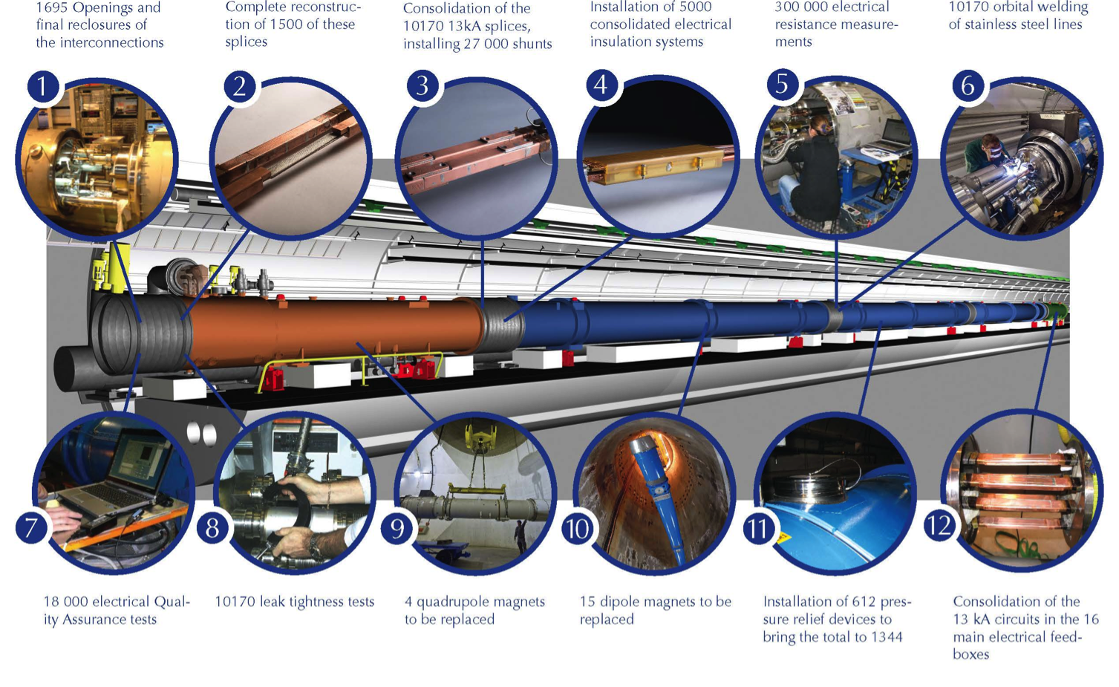
The Long Shutdown 1

Slide 21
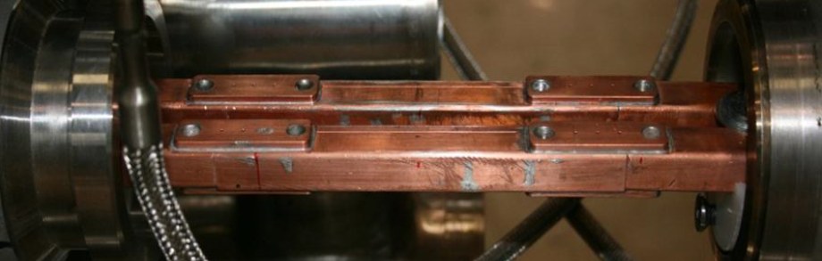
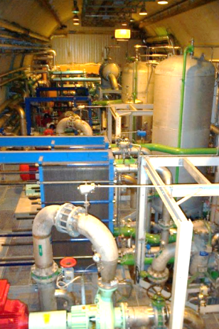
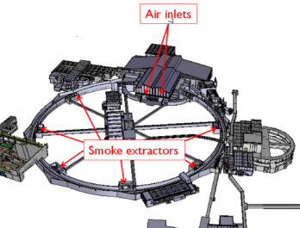
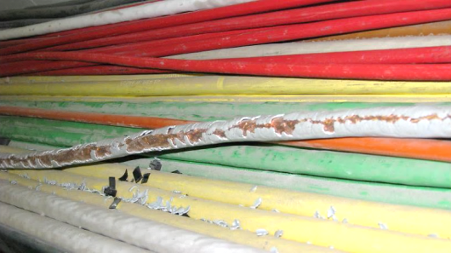
The Long Shutdown 1
LS1 starts as the shutdown to repair the magnet interconnects to allow nominal current in the dipole and lattice quadrupole circuits of the LHC.
It has now become a major shutdown which, in addition, includes other repairs, maintenance, consolidation, upgrades and cabling across the whole accelerator complex and the associated experimental facilities.

Slide 22
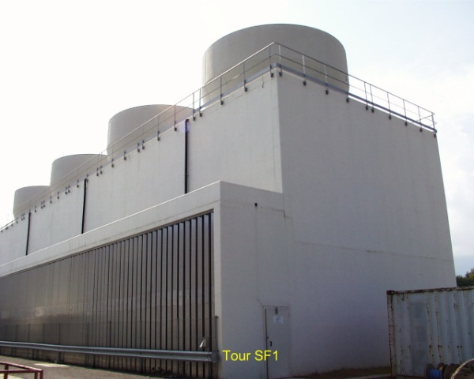
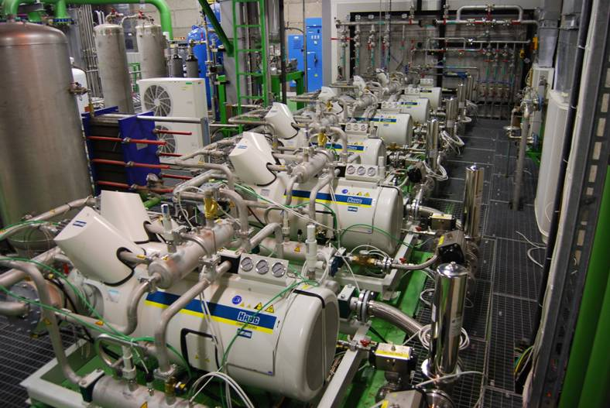
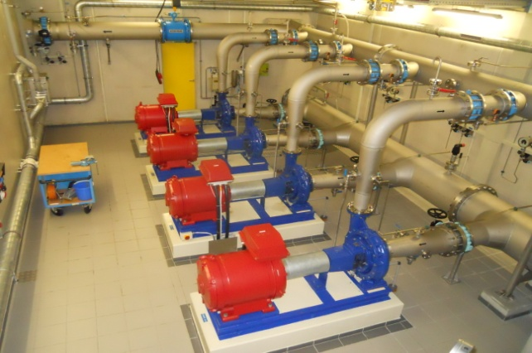
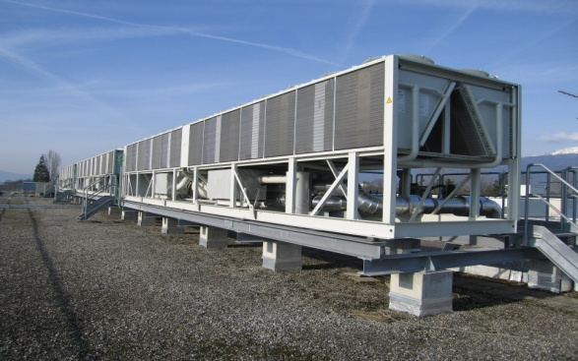
Hi-tech but also conventional industrial installations
Cooling plants (raw, demineralised water, C₃F₈, C₆F₁₄) | 150
Pipelines | 800 km
Hydrants | 800 points
Cooling towers (450 MW) | 22
Chilled water plants 6-12 °C (73 MW) | 35
Water network with three pumping stations | 5’400 m³/h
Equivalent to a small town of 45’000 inhabitants
10% of the water needs of Geneva

Slide 23
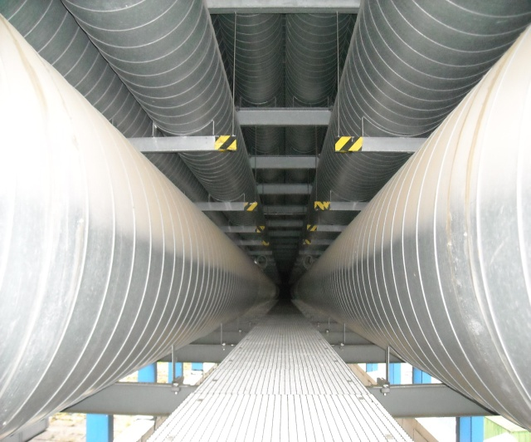
Hi-tech but also conventional industrial installations
Heating, ventilation and air conditioning | 1’500 units from 2’000 to 120’000 m³/h each
Compressed air | 14 stations 200 km network
 | km | m³/h
Eurotunnel | 50 | 540’000
LHC | 27 | 290’000

Slide 24
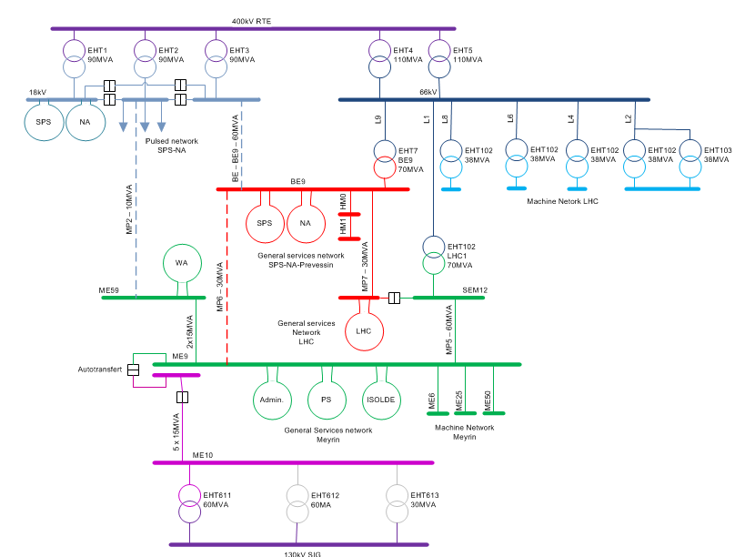
Hi-tech but also conventional industrial installations
Normal source EDF > 300 MW
    Annual Consumtion 1.26 TWh
    ⅙ of Geneva
Instantaneous Power 180 MW
½ - ⅓ of Geneva
Emergency source SIG/ALPIQ ≤ 60 MW

Slide 25
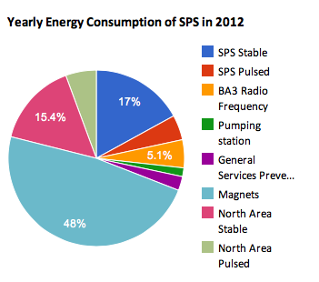
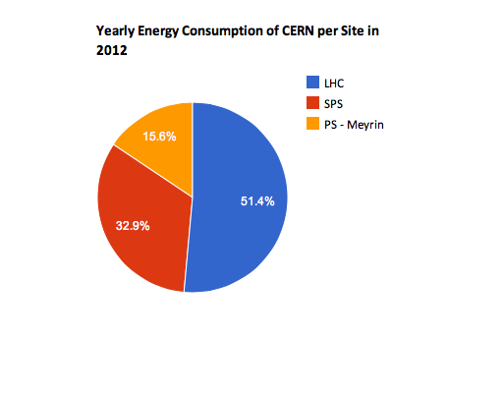
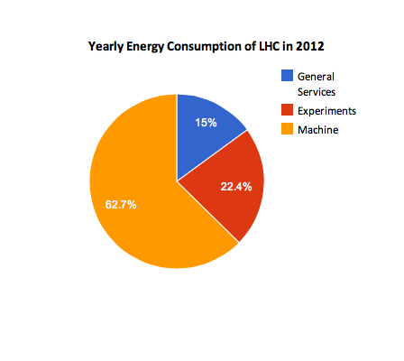
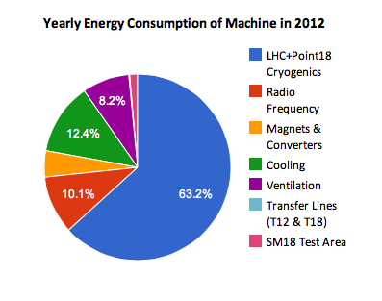
Energy Consumption
Total: 1,261,626 MWh

Slide 26
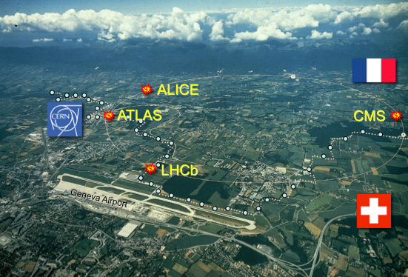

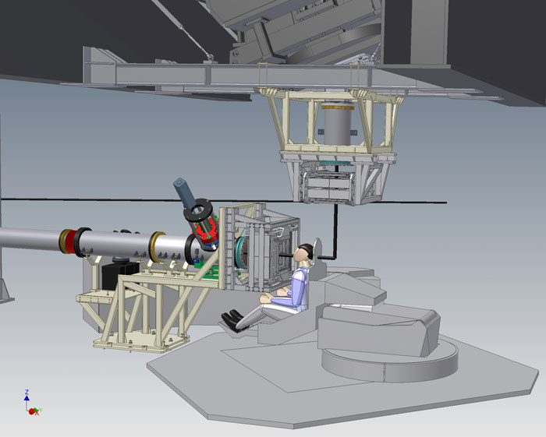
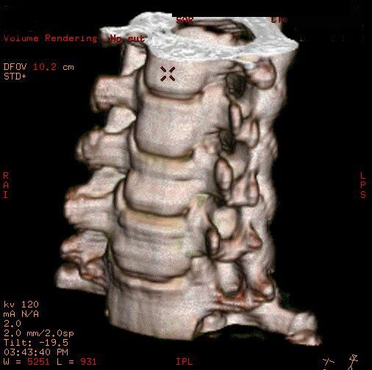
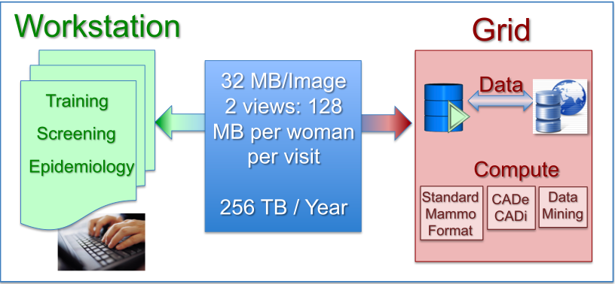
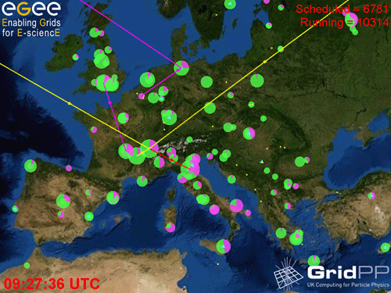
The technologies generate innovation
Accelerators
Detectors
CAT
Hadron therapy
The Computing Grid

Slide 27
In summary …
Standard technologies and much beyond …
  Superconducting Magnets
  Gigantic Cryogenic Installations
  Very High-Precision Power Converters
  Huge and Composite Detectors
  Interdependency of systems which create complexity for diagnostics

Slide 28
“The Large Hadron Collider at CERN is the largest most complex machine in the world, possibly the universe. By smashing particles together at enormous energies, it recreates the conditions of the Big Bang. The recent discovery of what looks like the Higgs Particle is a triumph of human endeavor and international collaboration. It will change our perception of the world and has the potential to offer insights into a complete theory of everything.”
Stephen Hawking at the Opening of the Paralympic Games Ceremony, August 2012

Slide 29
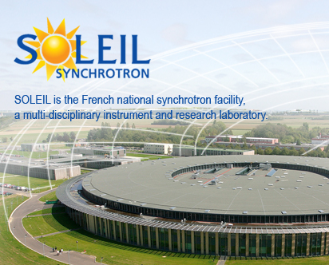

















AMMW 2013 - Participating Laboratories

