Slide 1
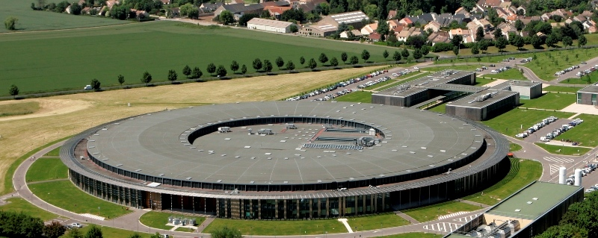
SOLEIL
Asset and Maintenance Management Workshop
CERN_ 13-15 November 2013

Slide 2
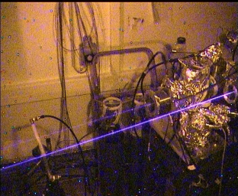
SOLEIL Presentation
24 beamlines open to users
5 beamlines under construction
1 transversal project : Femto Slicing
New accelerator concepts

Slide 3
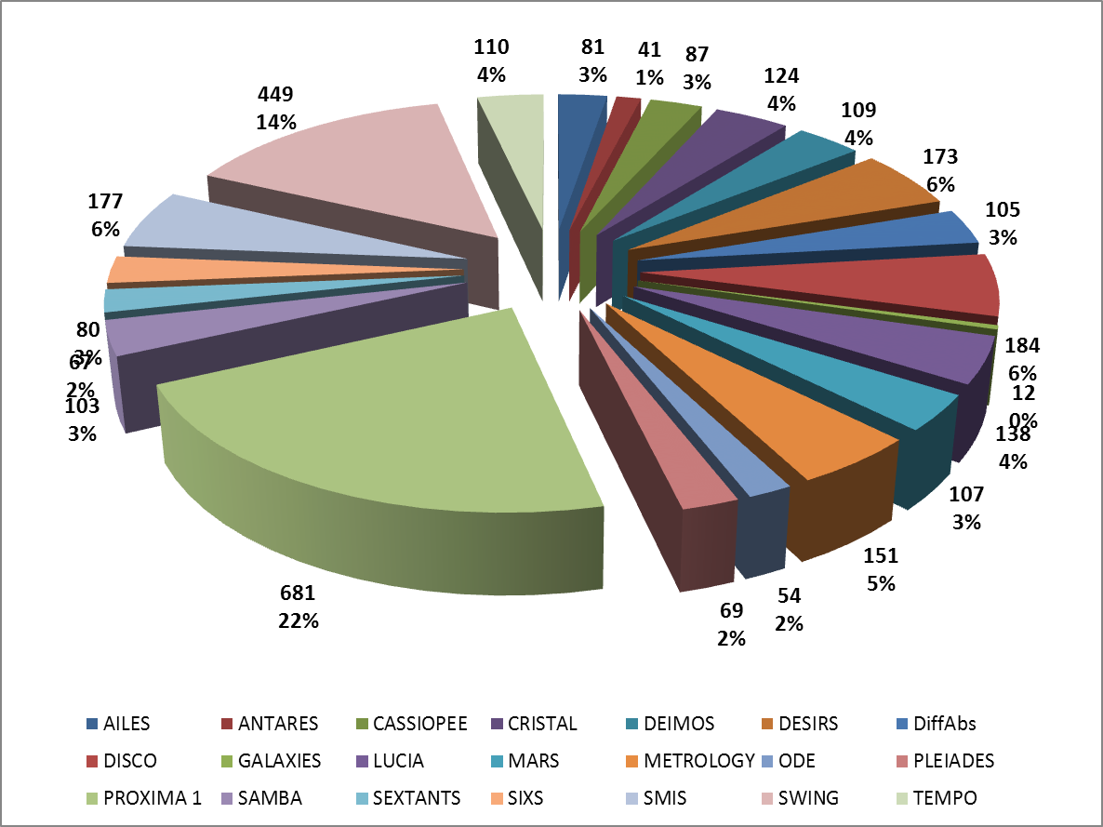
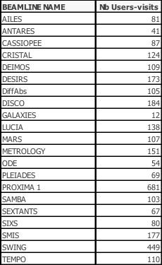
SOLEIL Presentation
Users at SOLEIL on beamlines in 2012

Slide 4
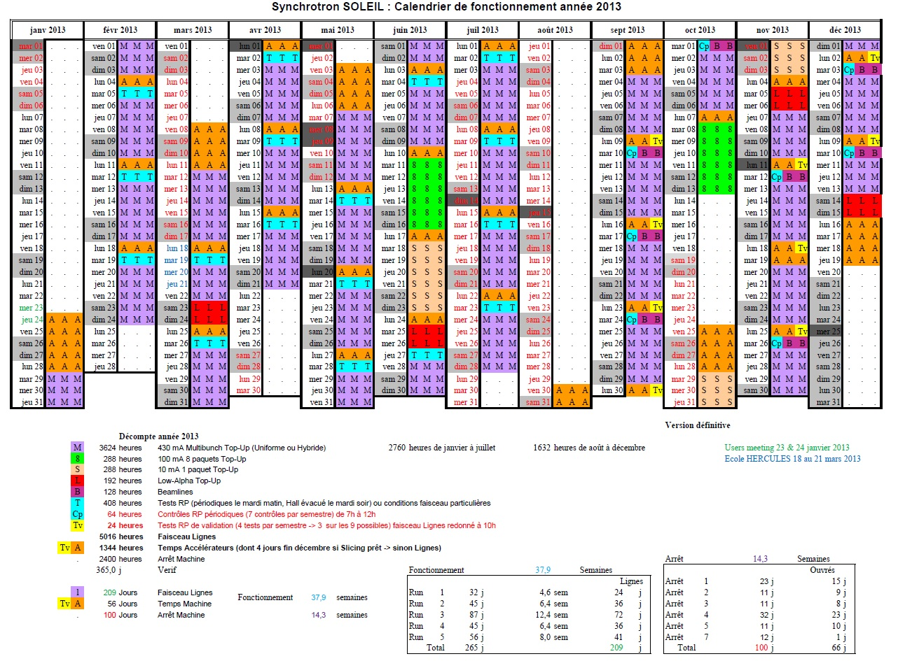
SOLEIL Presentation
2013 Operation Schedule

Slide 5
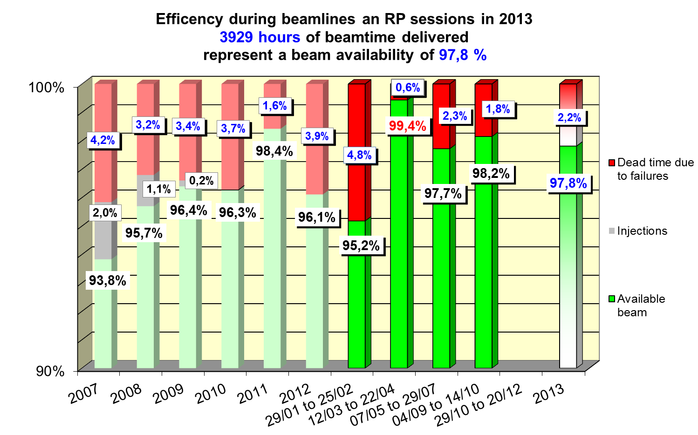
SOLEIL Presentation
Machine availability from 2007 to 2013

Slide 6
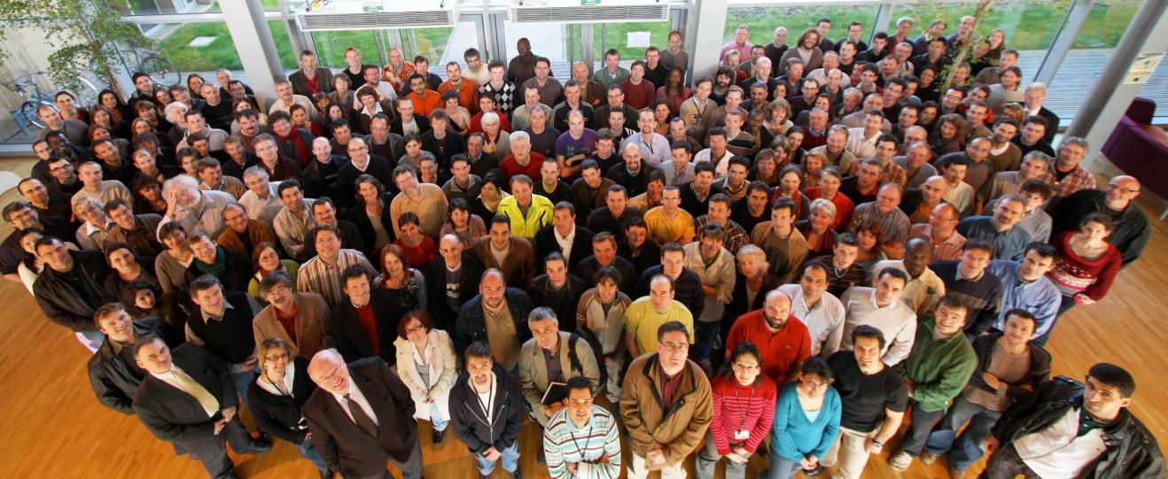
SOLEIL Presentation
Staff
344 permanent staff (end 2012)
⇨ 358 people
Direction (17)
Experiences Division (136)
Machine Division (58)
Technical supports & valorization Division (62)
Computing Division (41)
Administrative Division (27)
21 % seconded from CNRS
6 % UR1 CNRS
6 % seconded from CEA
67 % SOLEIL permanent

Slide 7
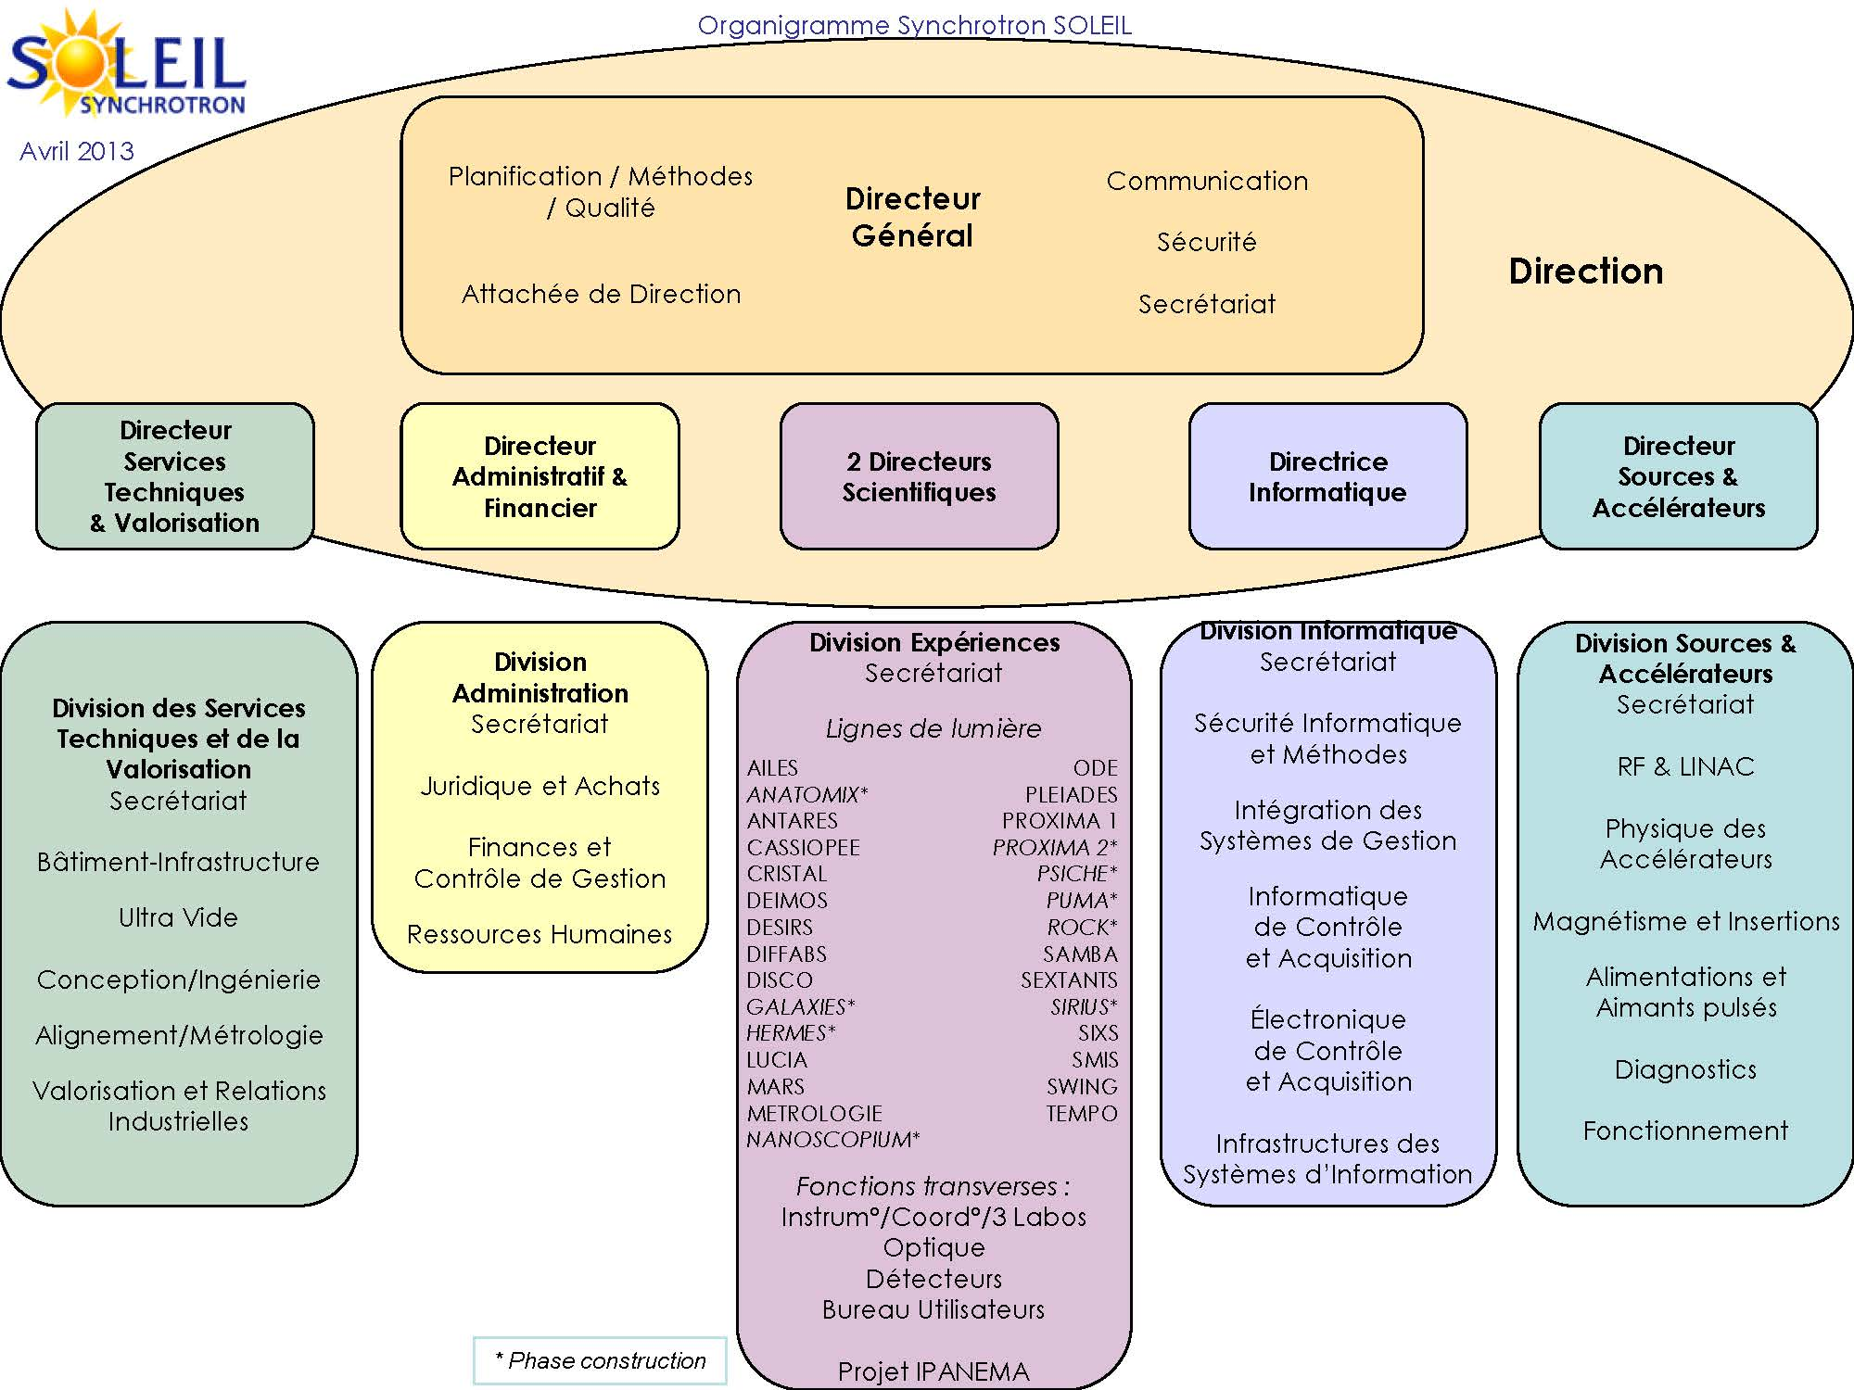
SOLEIL Presentation: organization chart
Matrix type of organization

