Slide 1
Safety Organization of the ATLAS Experiment
Asset and Maintenance Management Workshop
CERN, Geneva, Switzerland
13-15 November 2013

Slide 2
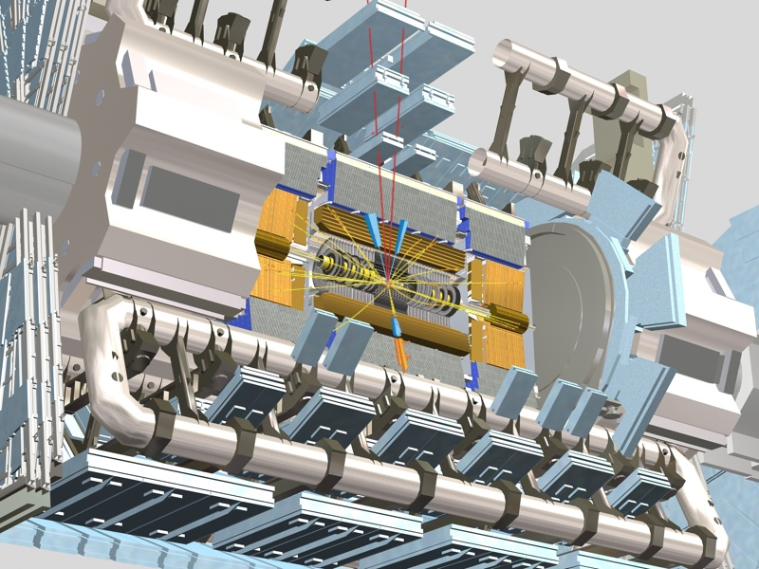
What were the risks linked to the installation
of the ATLAS detector?
11/15/2007
Notes:
2

Slide 3
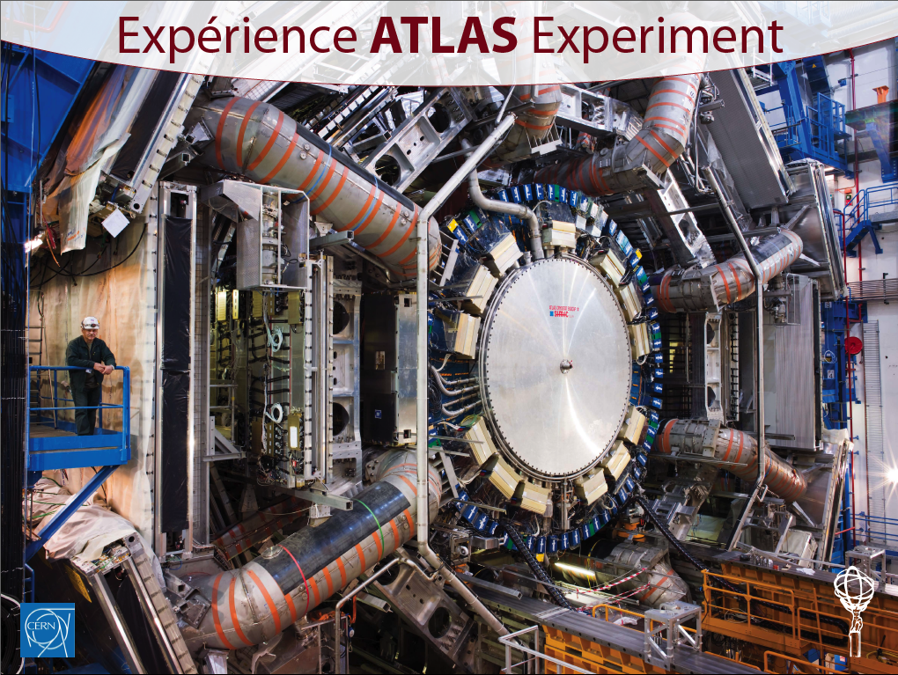

Slide 4
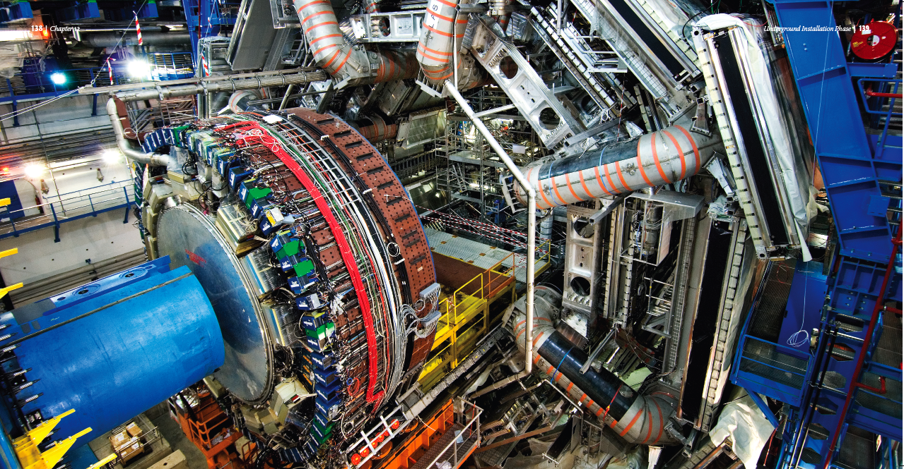

Slide 5
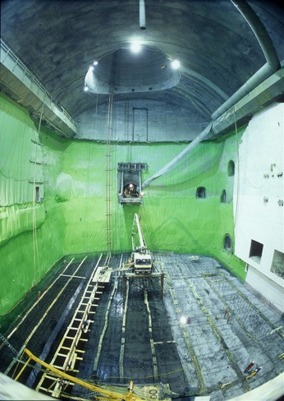
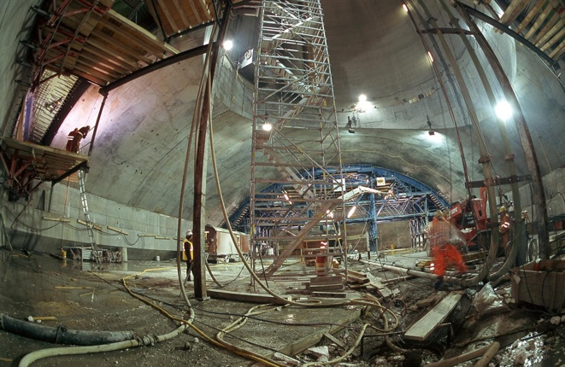
Civil Engineering and cavern excavation
A cavern excavated 92 m below ground!
53m long, 35m high, 30m wide
300’000 tones of excavated rocks
50’000 tones of concrete
The cavern vault: 10’000 tones of concrete
After 4 years of work the was cavern ready for the detector installation at the end of 2003

Slide 6
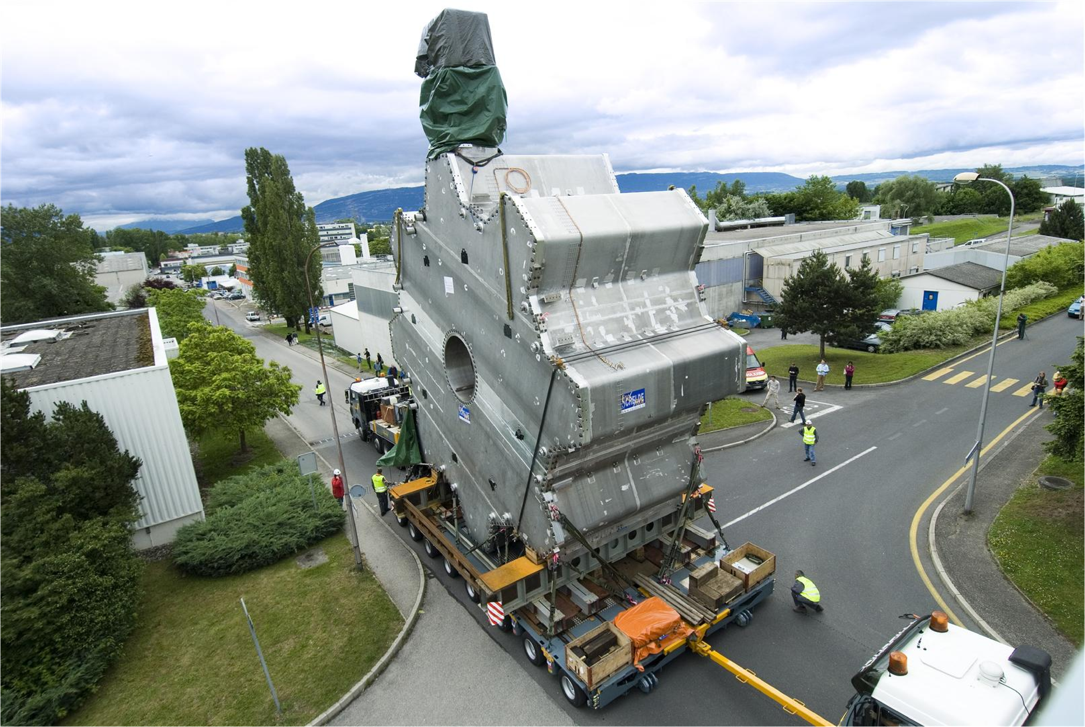
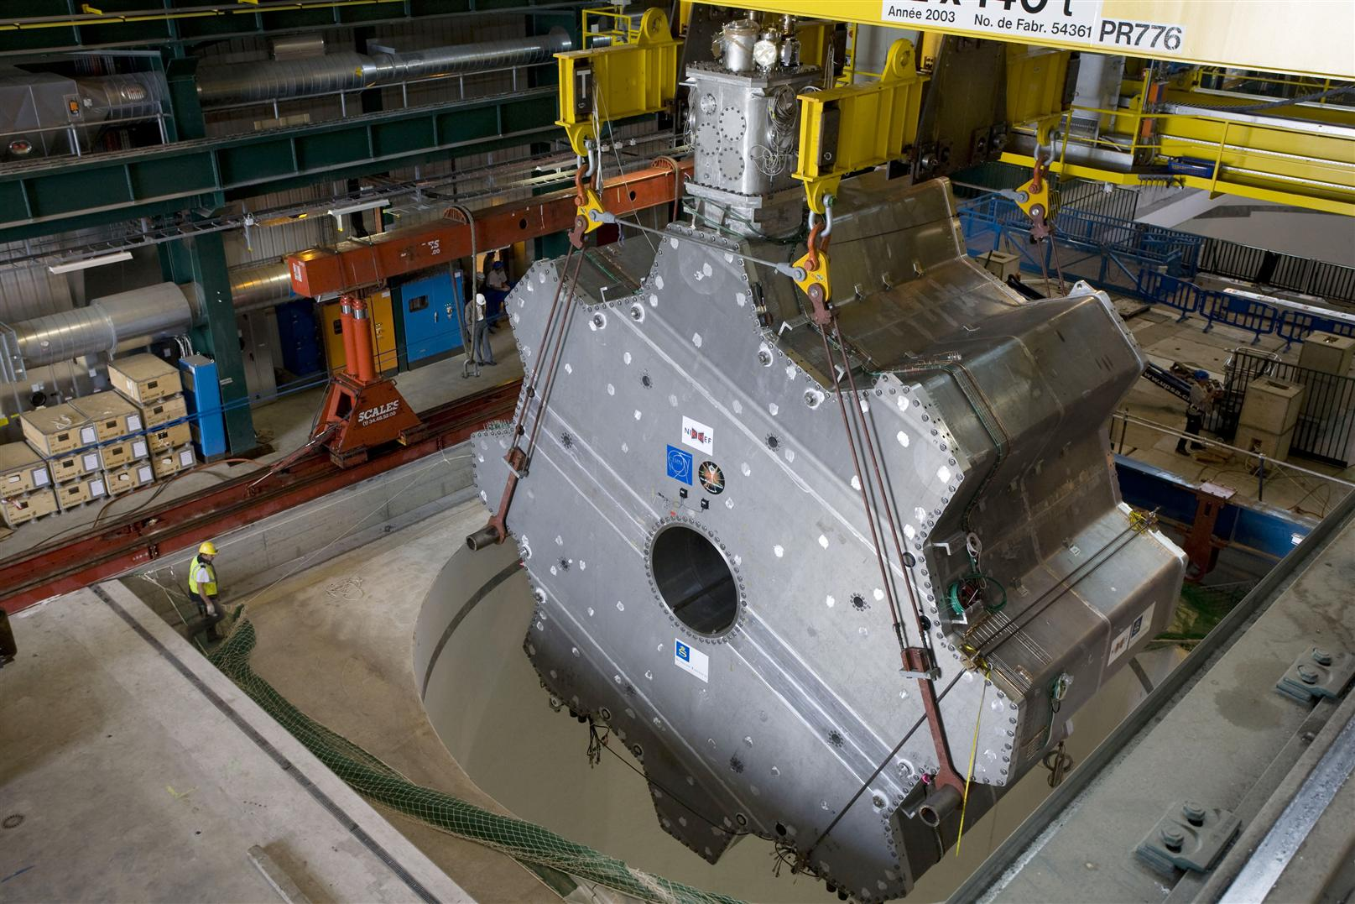
Risks linked to the transport of detectors,
from surface, to their final place in the underground cavern
Very huge components but very delicate and very costly!
Transport of the ECT Forward Magnet
240 tones
Conception and certification of the lifting tools
Detailed analysis of the working and lifting procedures - (PPSPS)
ECT Forward Magnet suspended from the surface crane 2x140 tones
Safety team on the field integrated in the working team

Slide 7
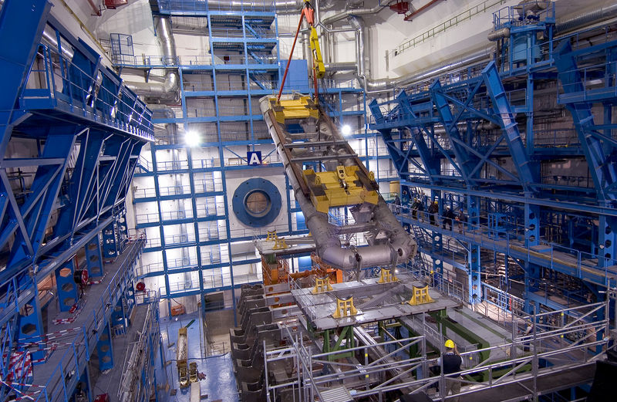
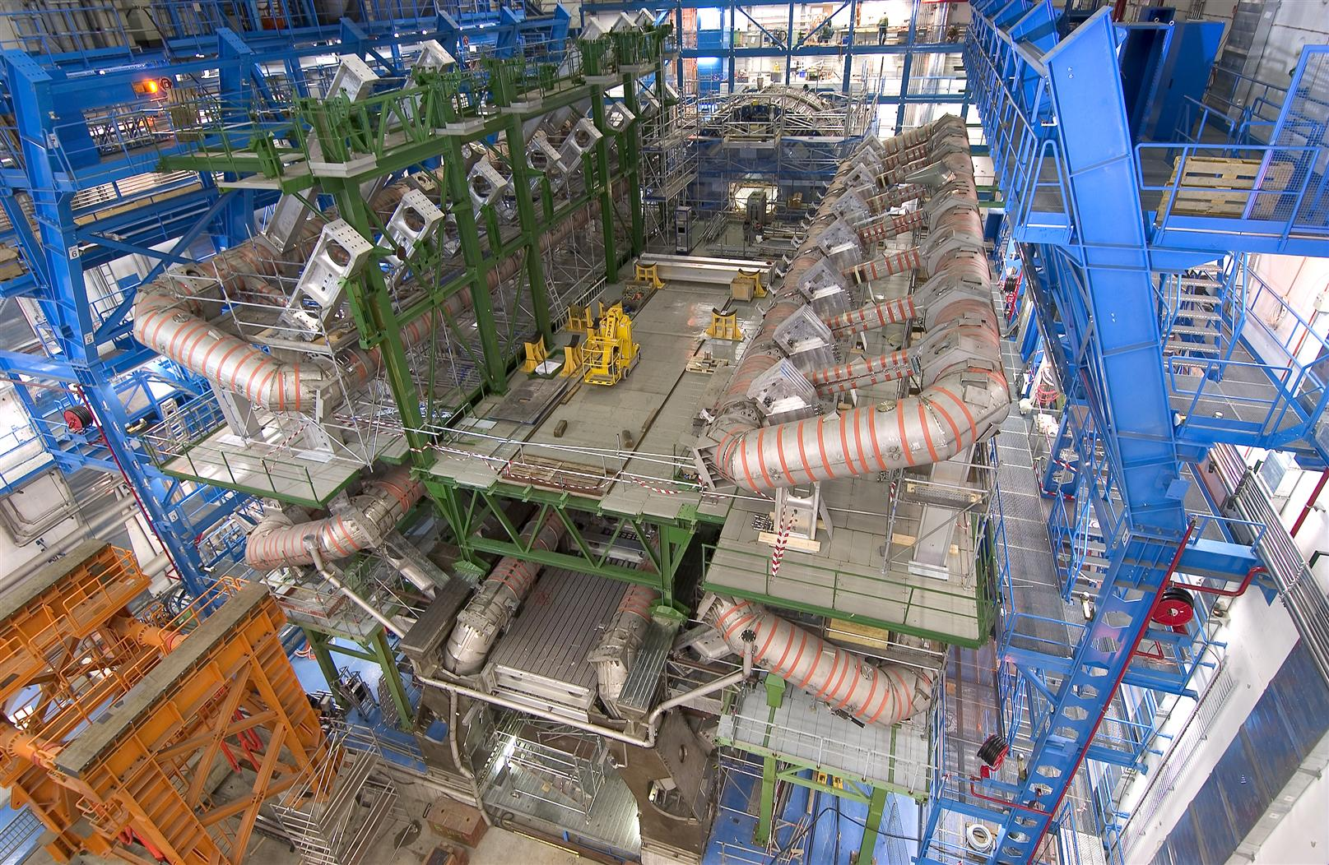
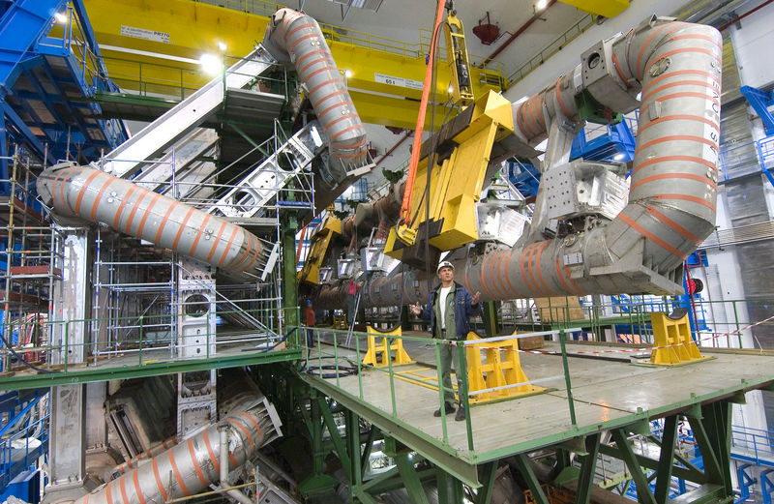
An example of a difficult installation activity: the central toroid magnet
11 months of an intensive and
highly precise engineering work:
Working at height
Heavy loads transport
Risks of falling objects
Control of coactivities
No Accidents !
30 mm calculated
~27 mm measured
Notes:
7

Slide 8
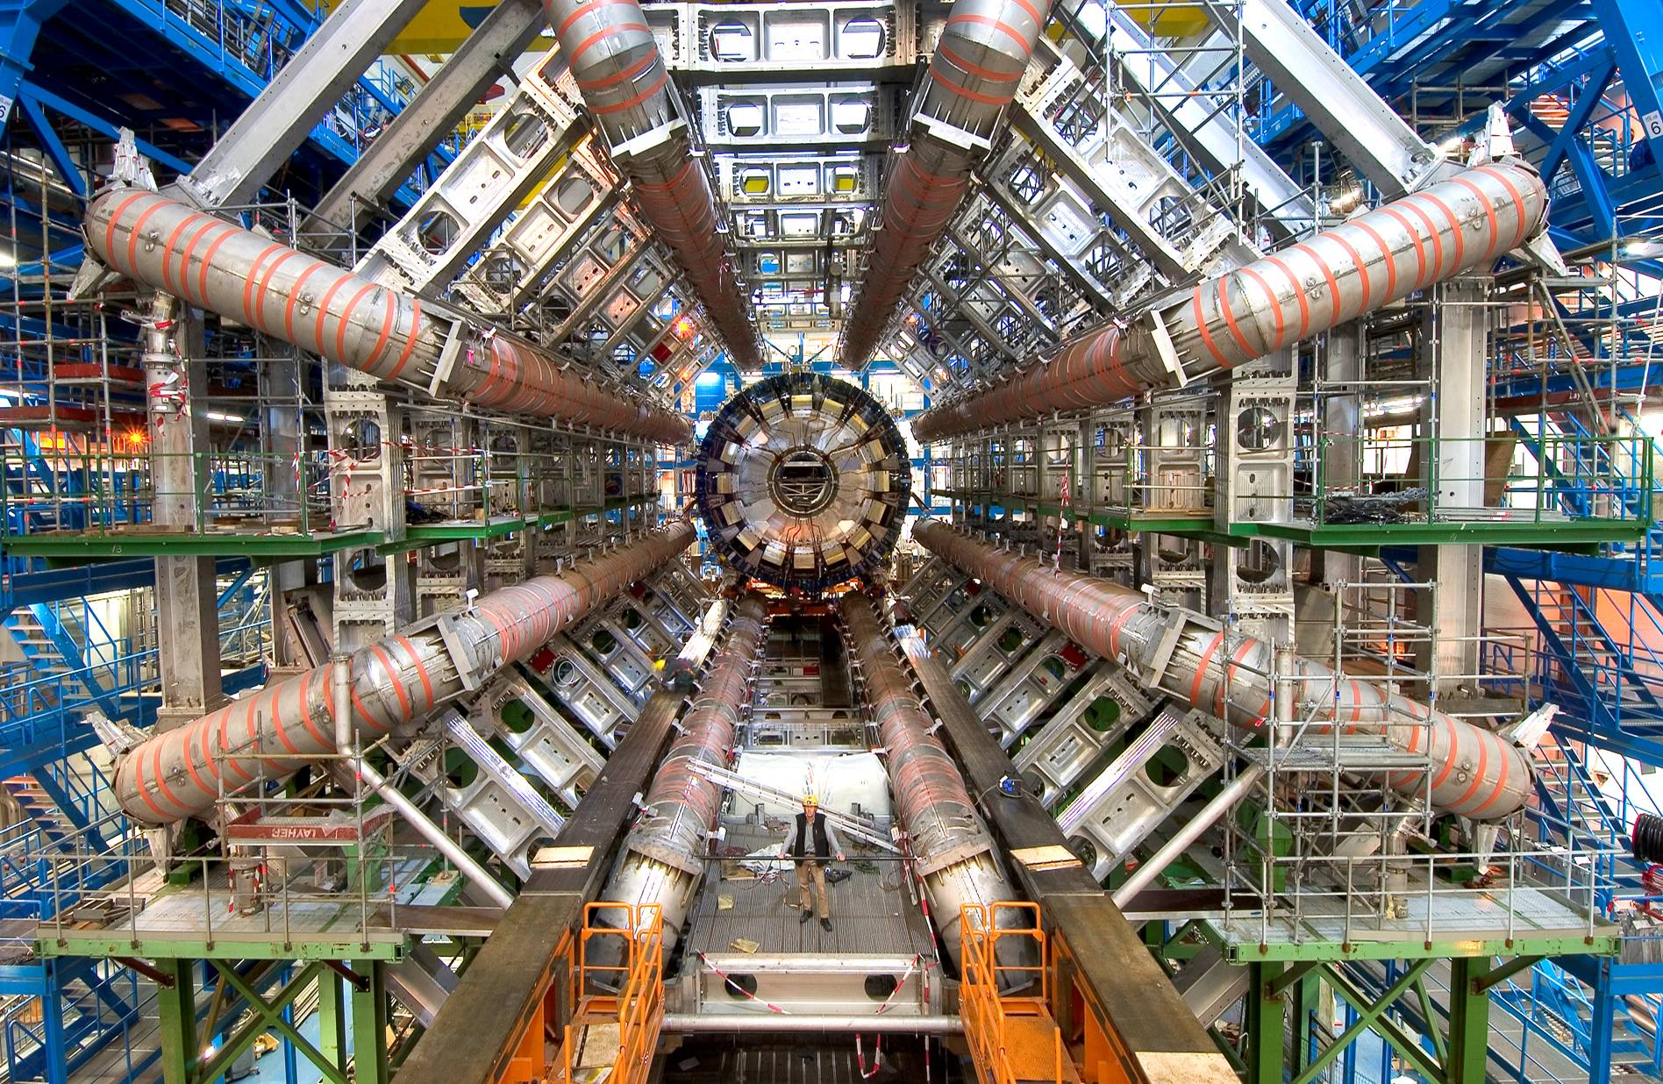

Slide 9
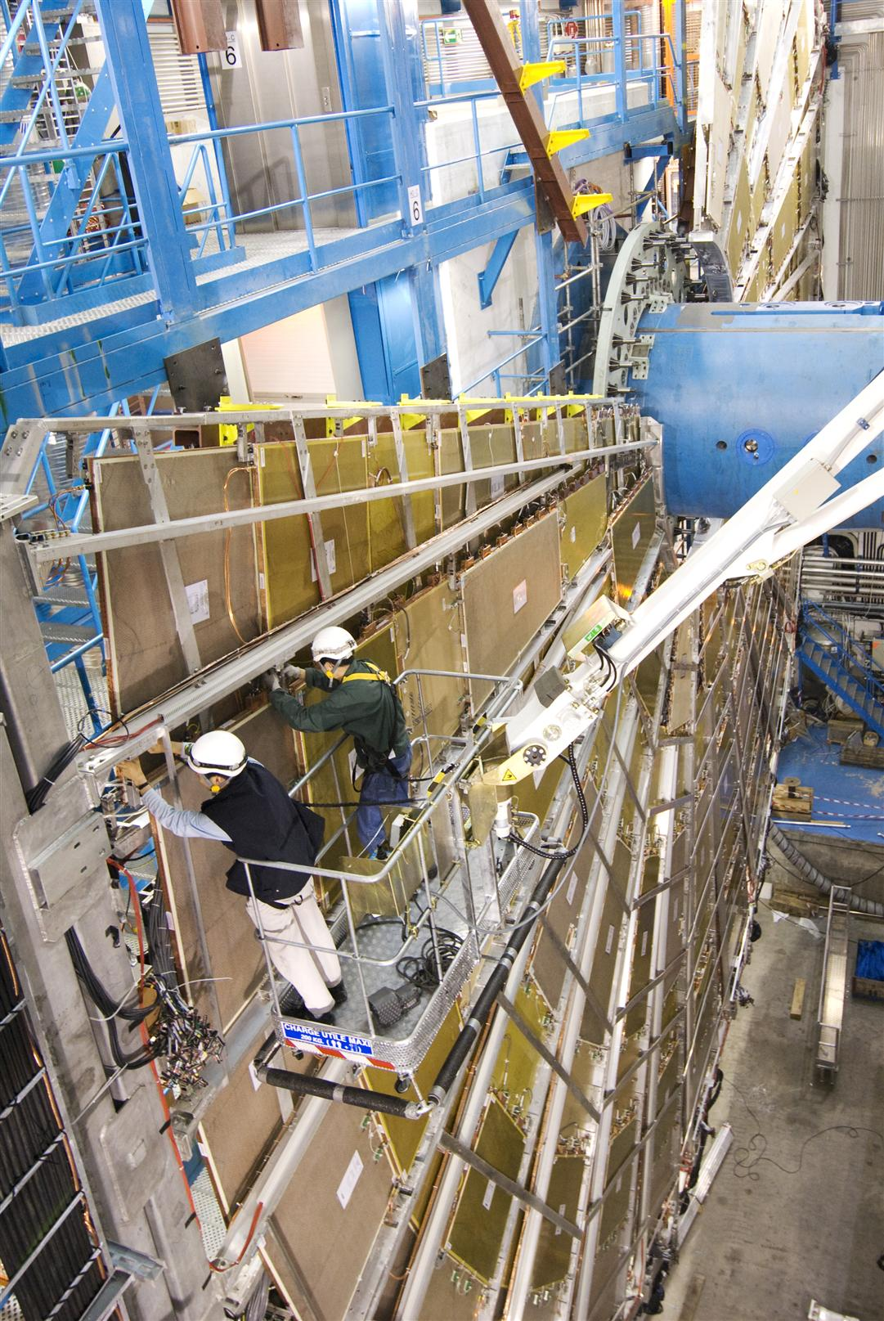
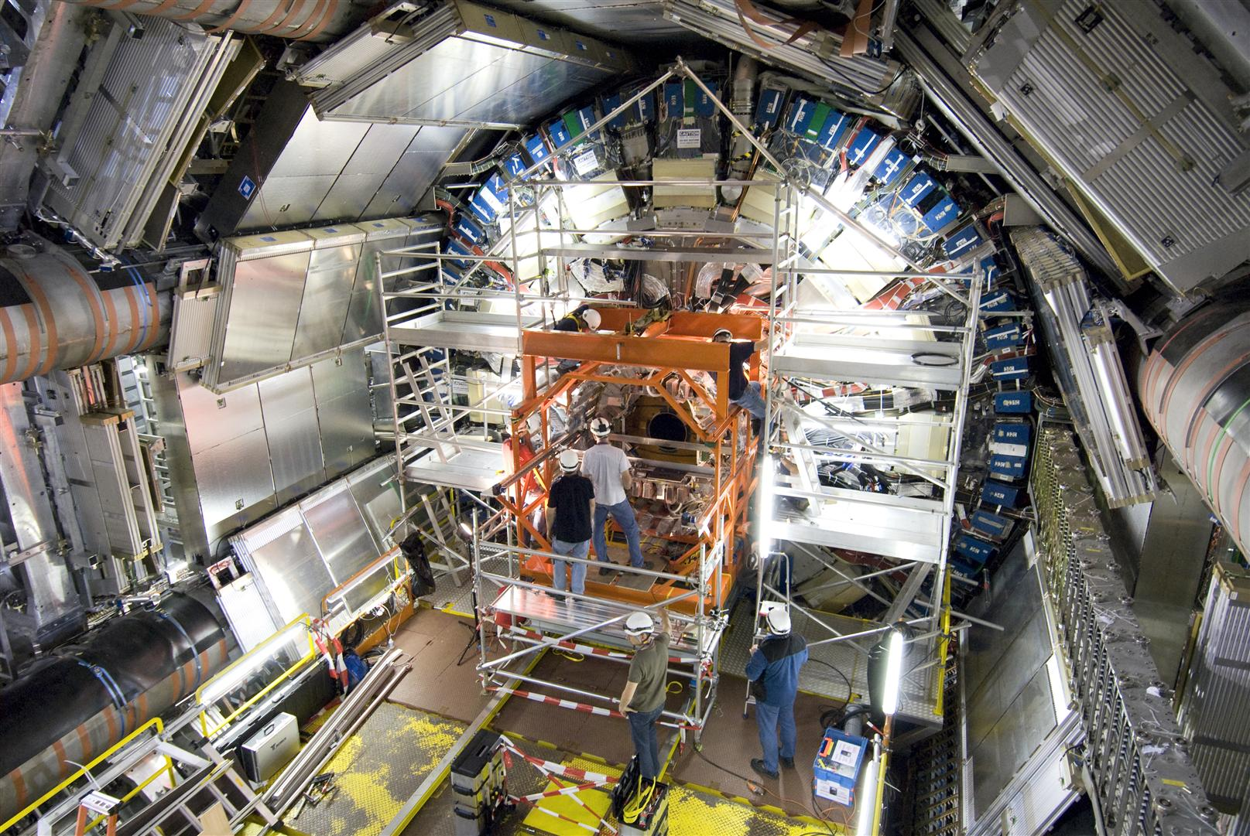
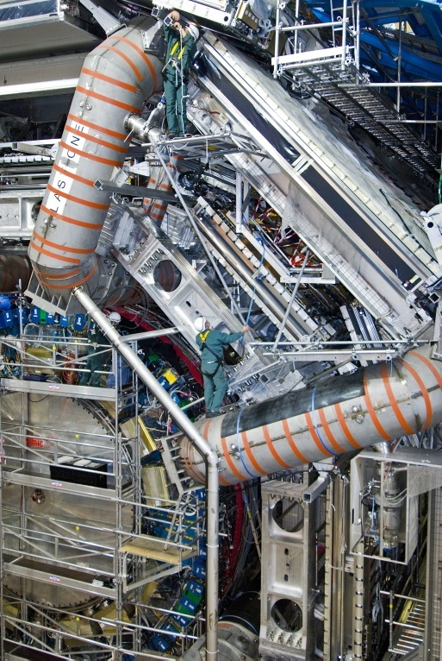
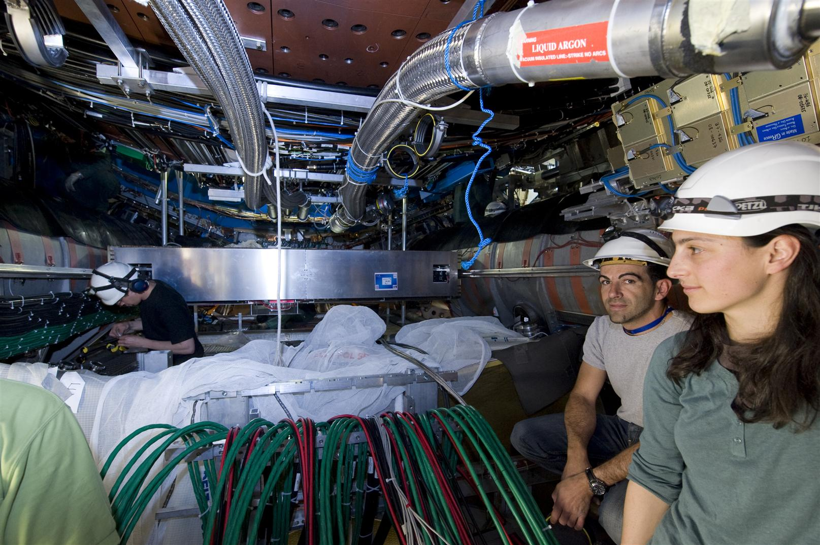
An installation work inside the cavern more and more difficult
while the space reduces
The safety team was always on the field to assist the workers
and control in real time the possible changes in the
working environment
  Control of the scaffoldings
  Working at height (signalization, safety lines, etc.)
  Management of co-activity
  Protection against falling objects
  Safety signalization, etc.
Workers safety training
ATLAS specific safety training
evacuation, cryogenic, installation risk,..
working at height
scissor lift training
nacelle training
biocells training
magnetic field

Slide 10
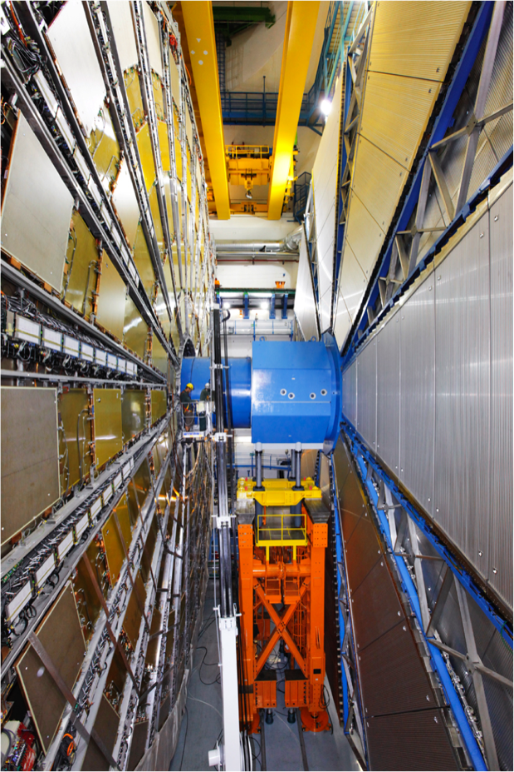
In august 2008, the detector was ready for operation
7’000 tones of detectors
> 15 million of components
> 50 000 cables
6 years of work
> 1’000 technicians
And - no major accidents!!!

Slide 11
ATLAS
What are the risks linked to
the ATLAS Detector Operation?
11/15/2007
Notes:
11

Slide 12
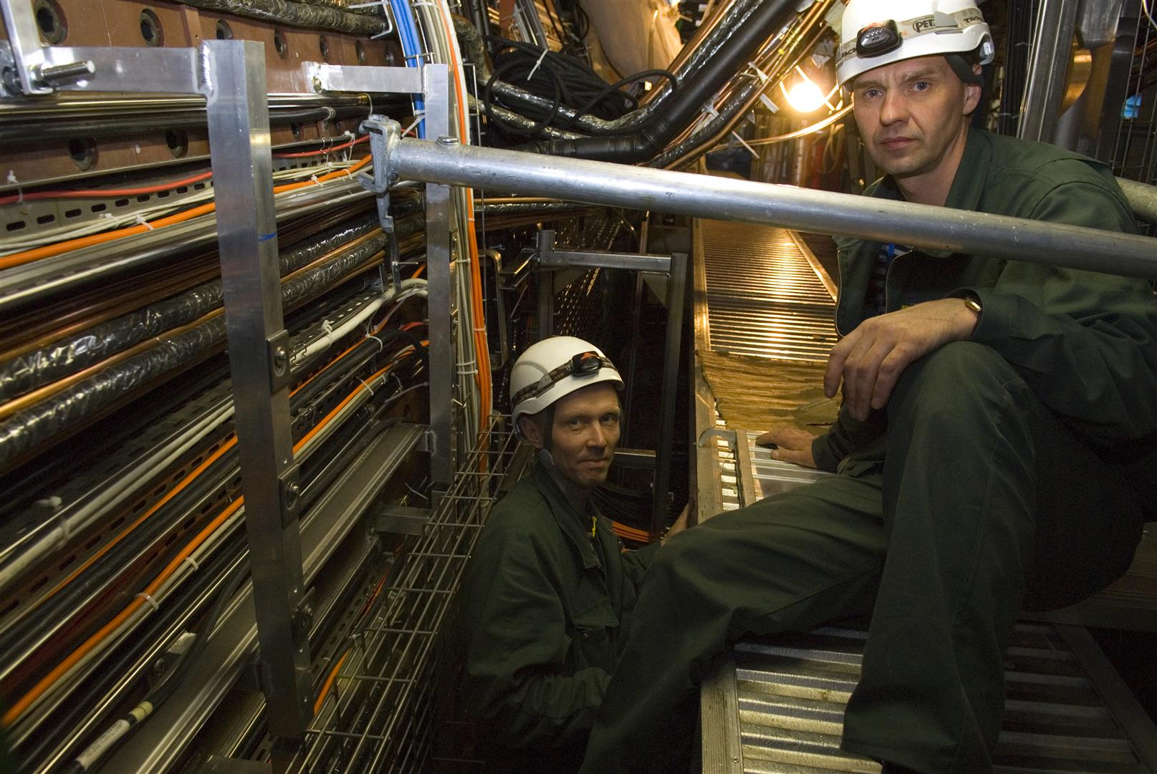
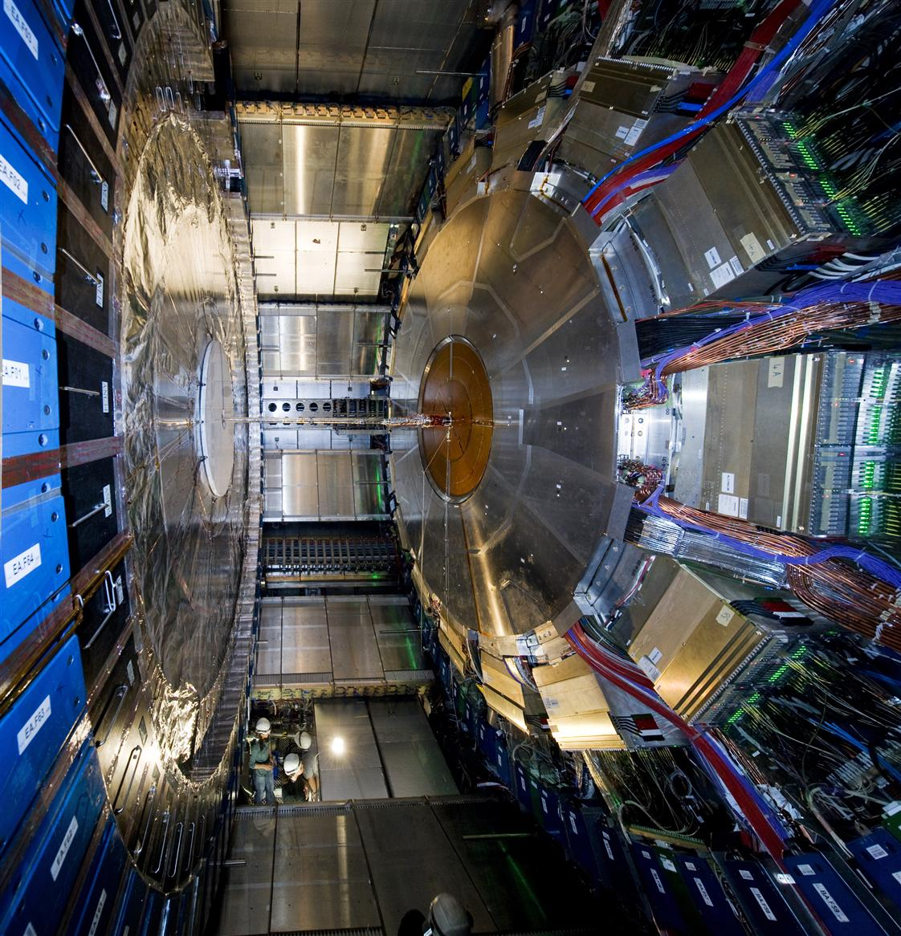
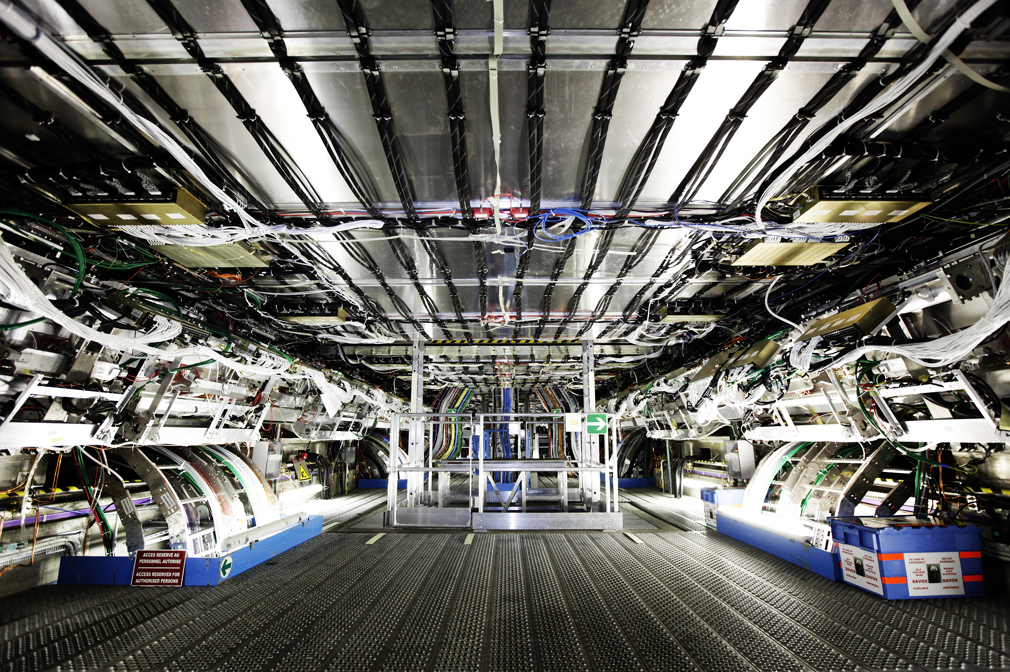
Fire risk
3’000 Km of cables installed in the undergrounds
~ 300 connection racks
10 MW of electrical distribution

Slide 13
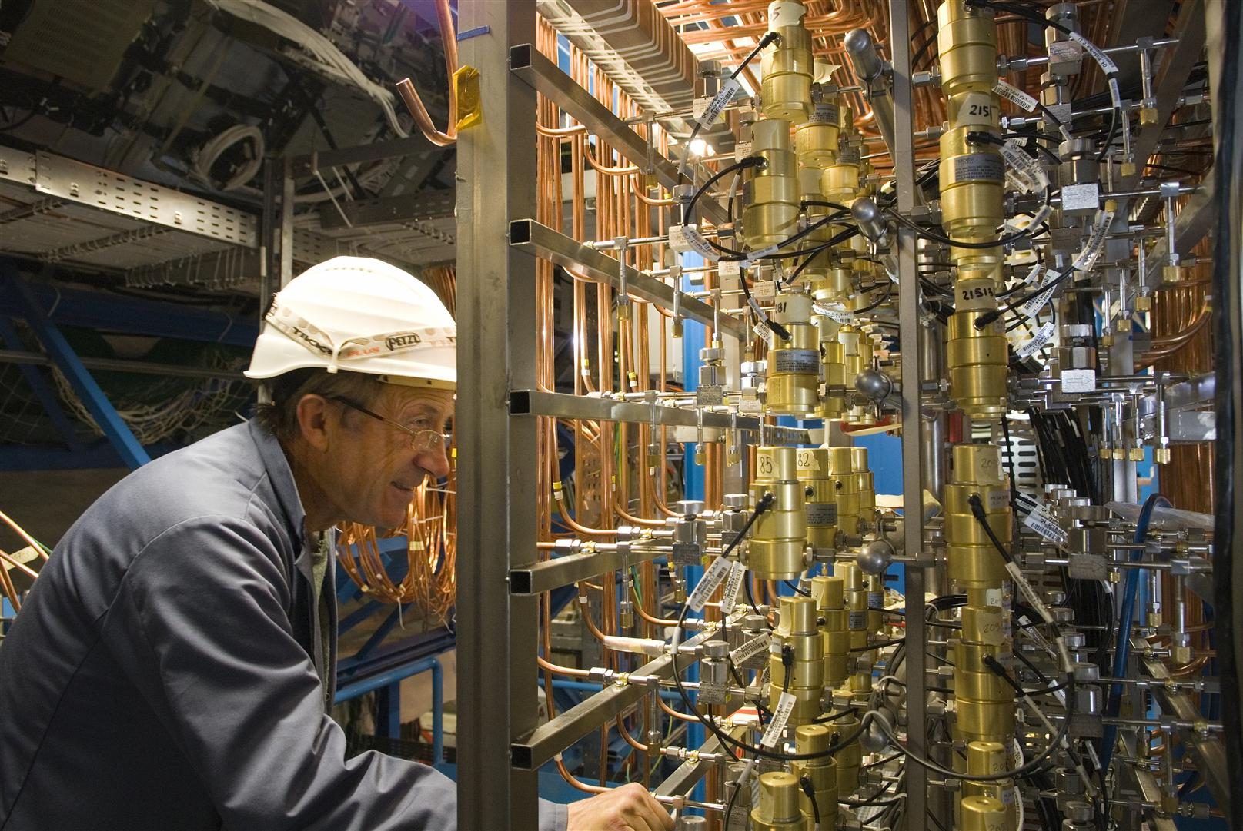
Flammable and inert gases
17 m³ of flammable gases (n-penten 45 %)
inside the ATLAS big wheels
850 m³ of non flammable gas
inside the central Muon Chambers, the Big wheels and inside the Inner Detector

Slide 14
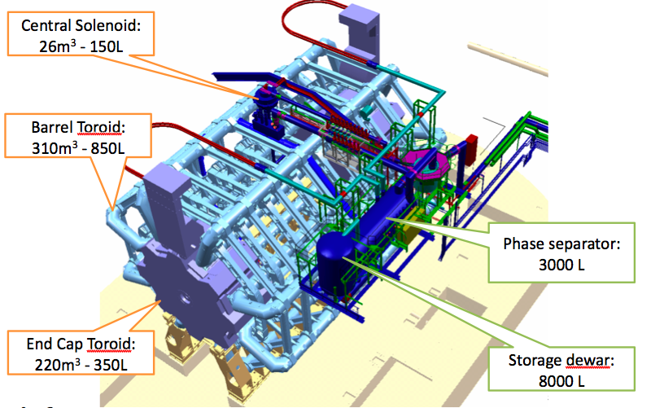
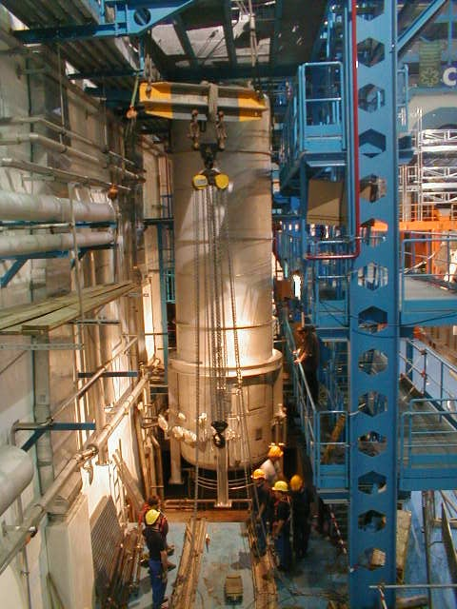
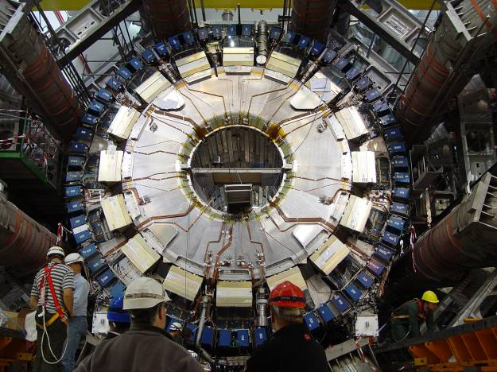
Cryogenic fluids in the experimental cavern,
A risk of lack of oxygen and of cold burns
    Liquid Argon: 90 m³ at -183°C inside the LAr Calorimeter
    Liquid Helium:
    11000 litters, -268°C
    15 m³ of Liquid Nitrogen

Slide 15
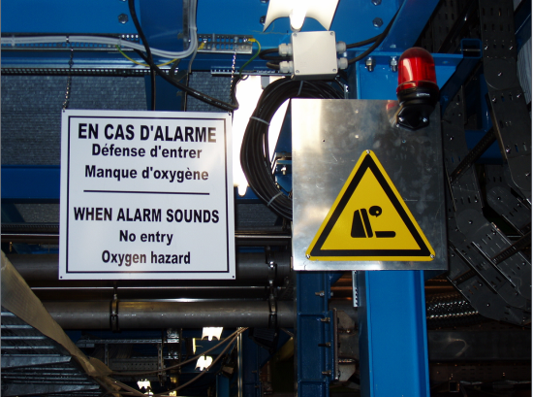
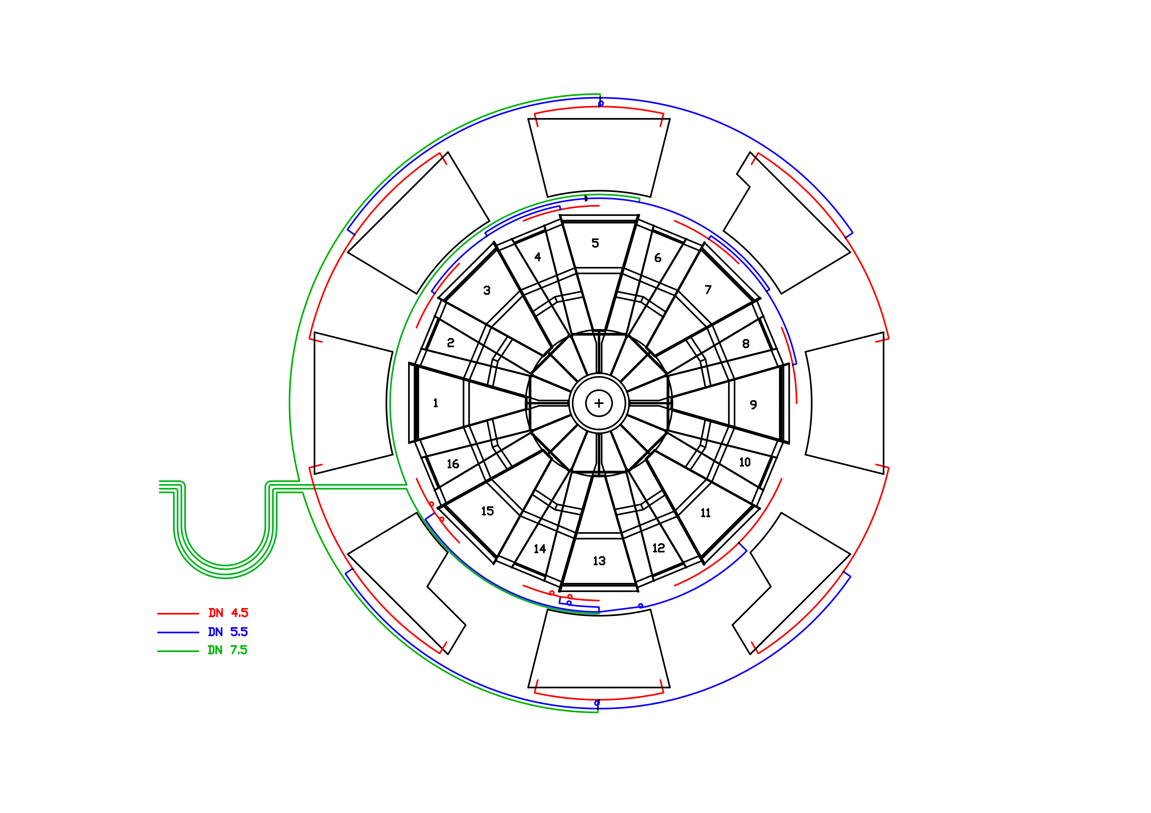
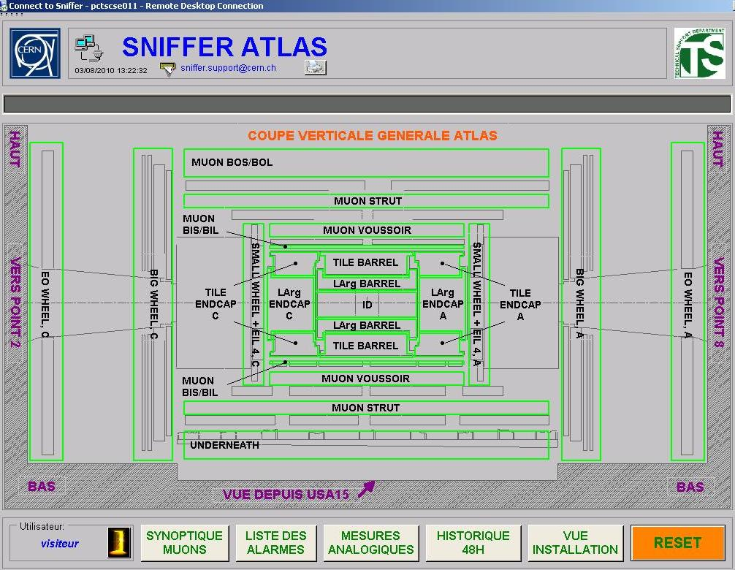
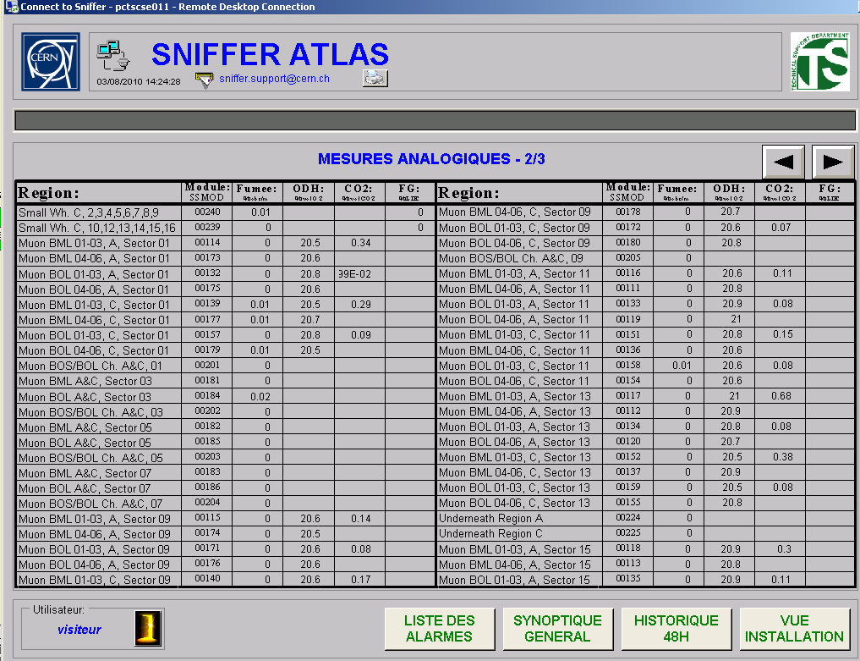
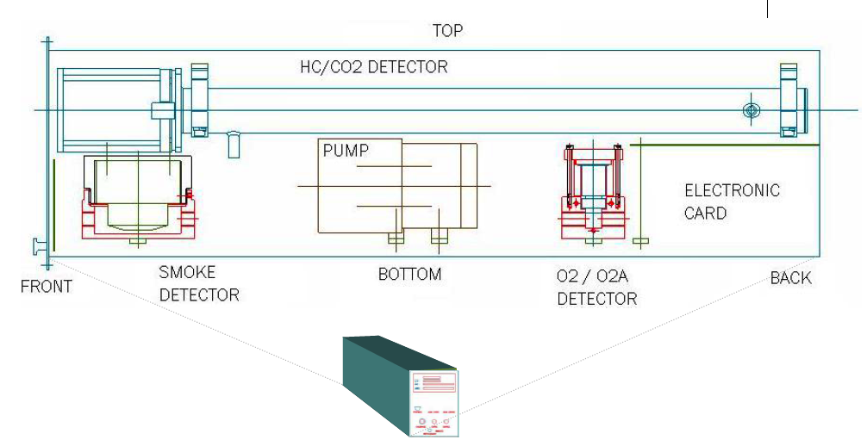
To control these risks
A very strict control of the material in the undergrounds
A very dense network of fire detection system
But also oxygen deficiency, CO₂ and flammable gases detection
systems
Inside the detector an « home made » SNIFFER system
composed of pipes sniffing and analysing the air composition continuously in the heart of our detectors
Sniffer air sampling system – 137 main lines of detection, 572 detection points
They are detecting the presence of smoke, CO₂, flammable
gases or lack of oxygen in real time
Maximum detection time: 60 seconds

Slide 16
Associated to these detection systems
An immediate transmission of all alarms to the CERN Fire Brigade, the CERN Control Room and ATLAS Control Room via – CSAM (CERN Safety Alarm Monitoring System, a Level 3 safety system)
and automatic actions:
  defined in the safety matrix in collaboration between the sub detectors responsible and the safety commission at CERN
  implemented directly
  or triggered by the DSS (Detector Safety system)
  A safety system for equipment and personnel safety which acts already at Level 2
Caverns evacuation
Flammable gases cut-off
Modification to the caverns ventilation mode
Cut off the electrical power
Etc.

Slide 17
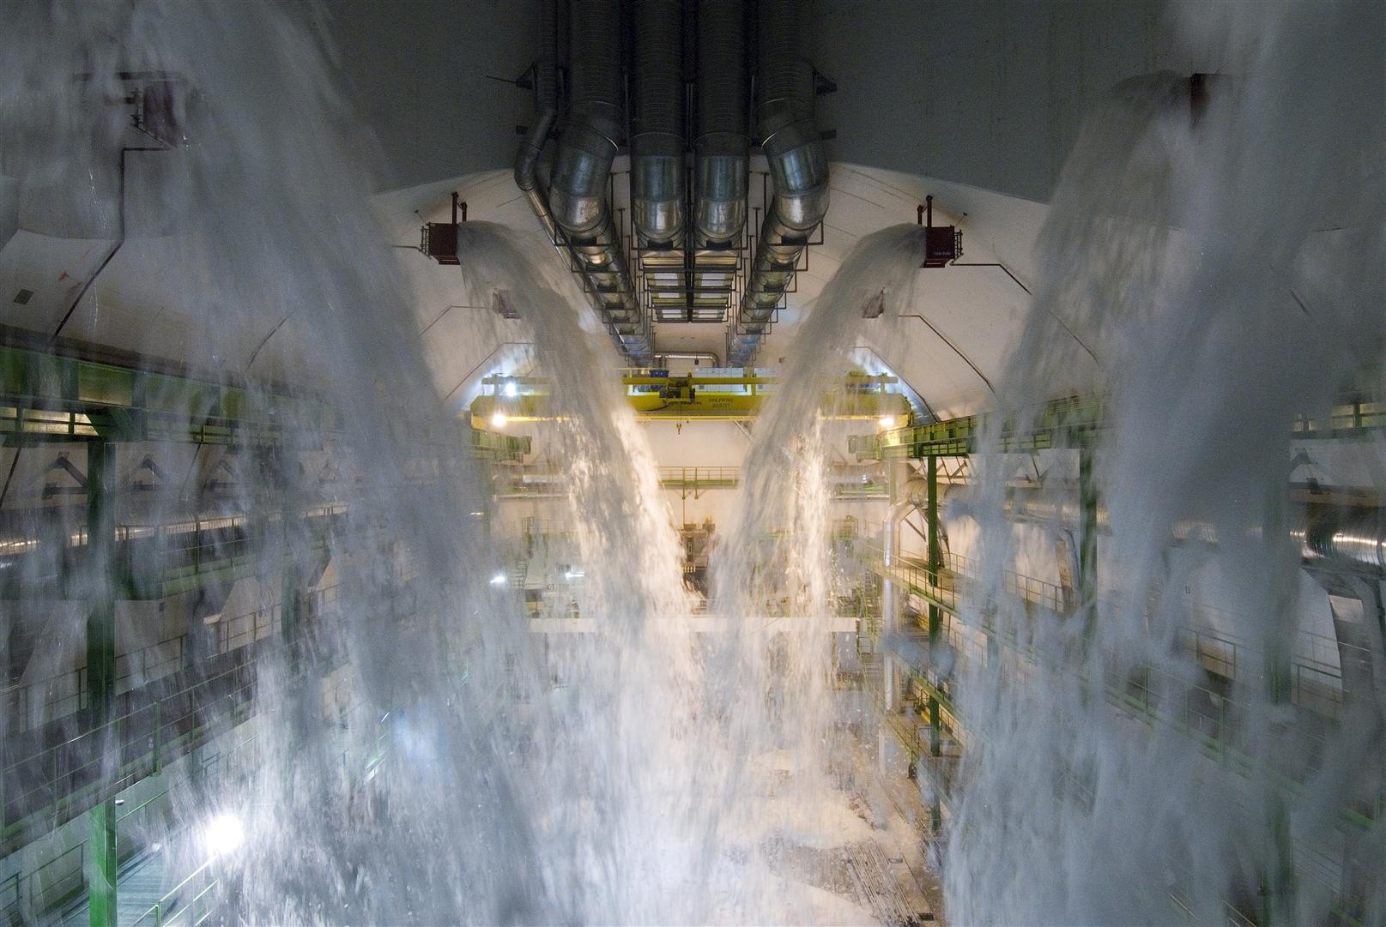
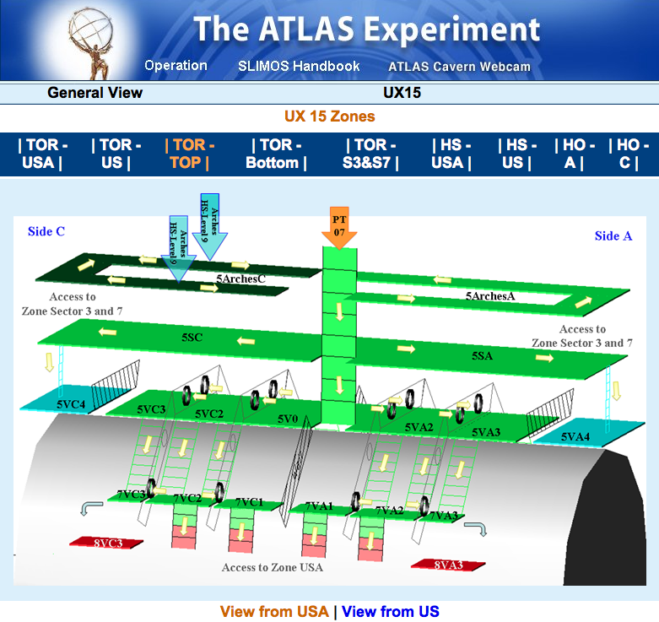
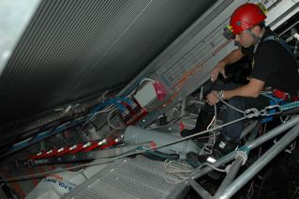
Collaboration program with the CERN Fire Brigade
Due to the complexity of the experimental area, we have developed a training of half day which we deliver to each Fire Brigade intervention team member and all new comers which includes:
  A presentation of the main risks and the corresponding emergency procedures , site topology and how to orientate inside ATLAS
  A presentation of the SLIMOS desk and the protocol of interaction between the Fire Brigade and the SLIMOS
  A “tour” in selected difficult areas of ATLAS
  A practical test of orientation inside the detector
The Foam System
How to access quickly the intervention zone?
What are the risks and the difficulties ?

Slide 18
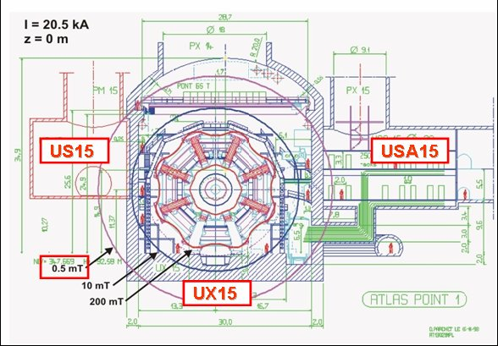
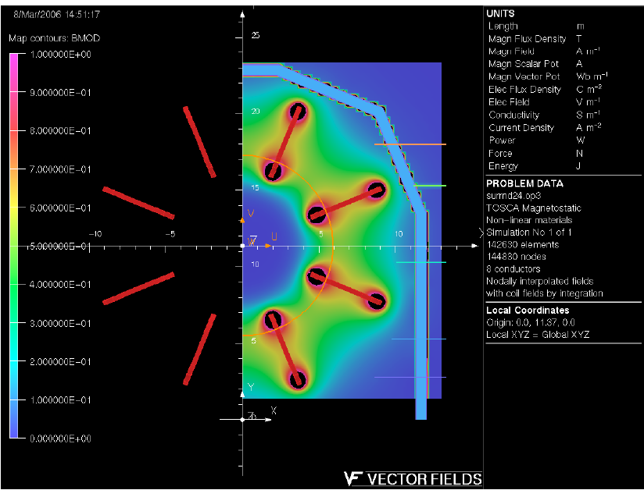
The Magnetic Field
Up to 1 Tesla in the accessible areas of the detector
A very strict control of the magnetic material inside the experimental cavern
Access in the field in the heart of the detector authorised only in exceptional cases, only for expert personnel, under an appropriate medical overlooked and who have followed a specific training
The ALARA (As Low As Reasonably Achievable) philosophy applied to non ionising radiations exposure (magnetic field higher than 200 mT)

Slide 19
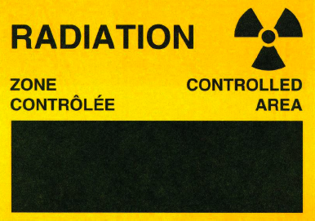
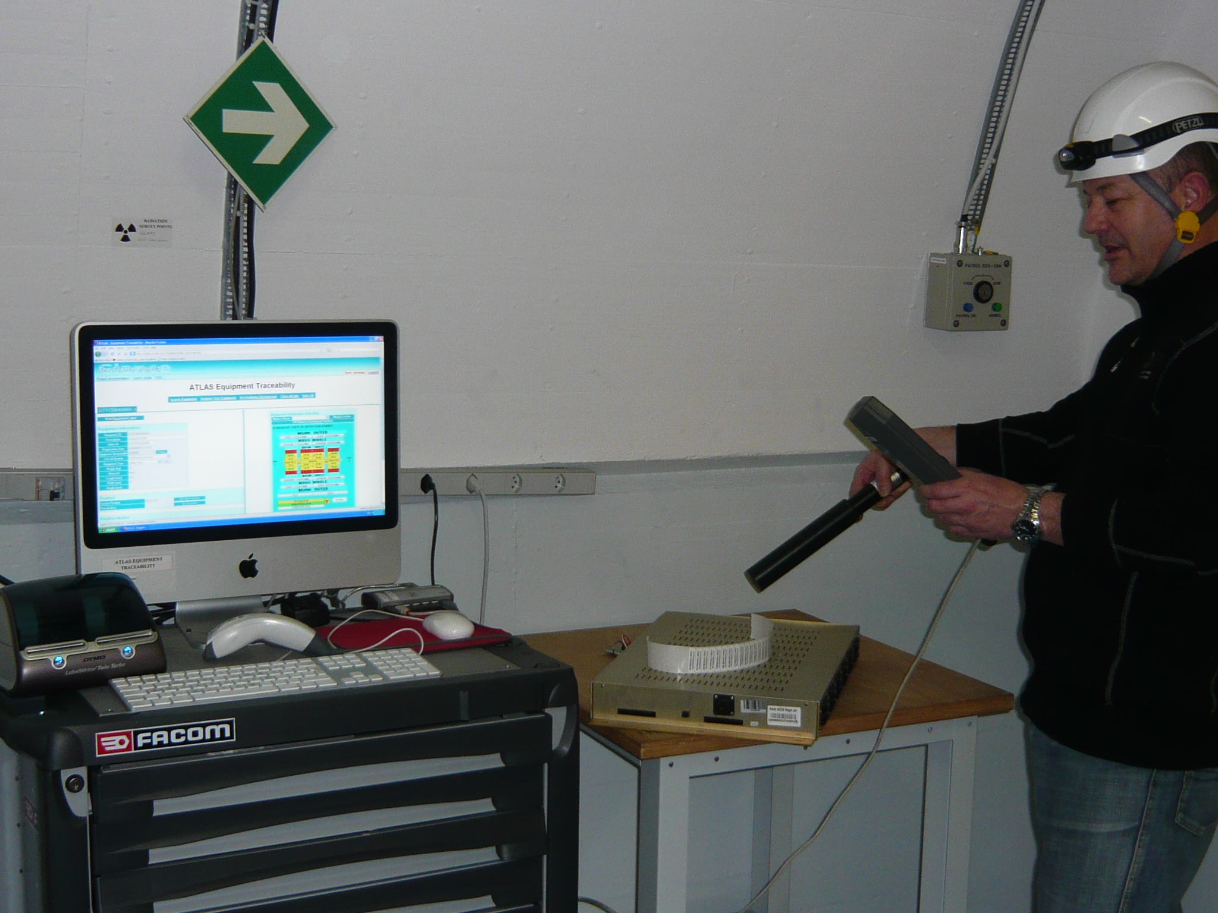
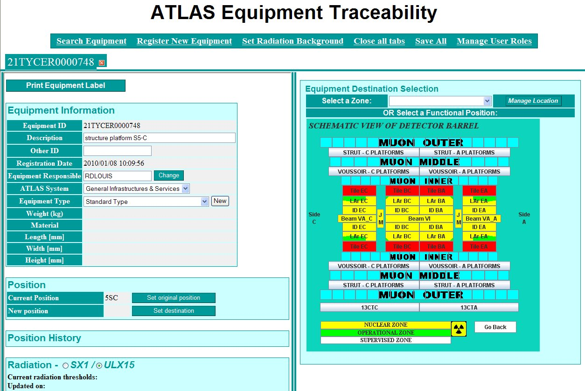
Radiological Risks
The experimental cavern is radiology classified
The personnel is trained for the risks
Under medical surveillance
With passive dosimeters
A special zone, at the canter of the detector is classified and declared by the Swiss and French nuclear authorities as “radioactive waste” area
A systematic control for possible activation of all material leaving the experimental area including a traceability
RPE - Radioprotection Experts, trained by the national authorities (IRA – Lausanne) are on standby service 24/7

Slide 20
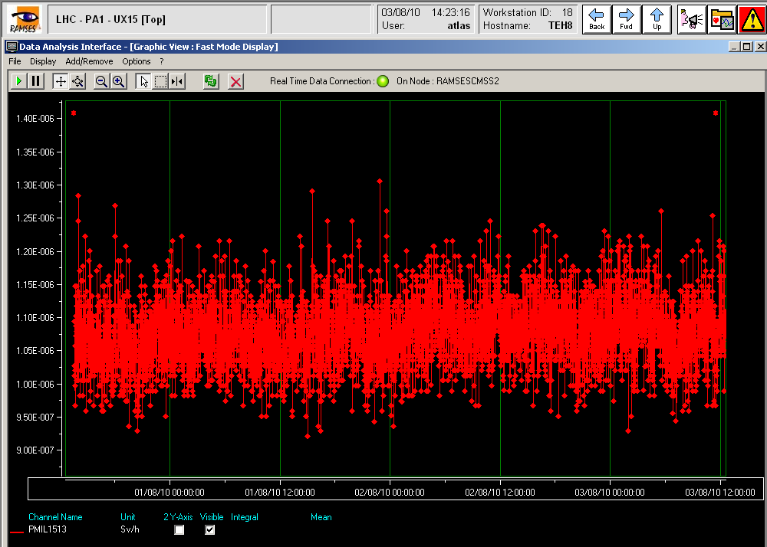
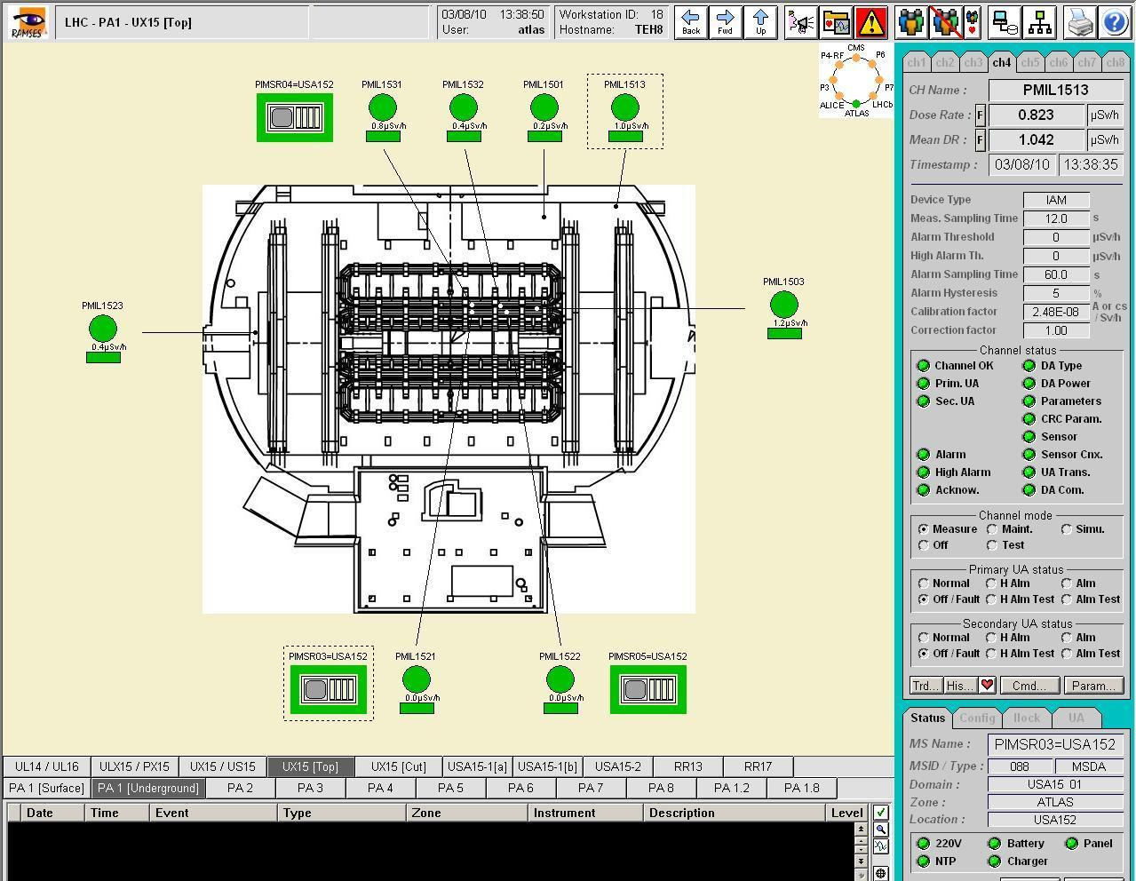
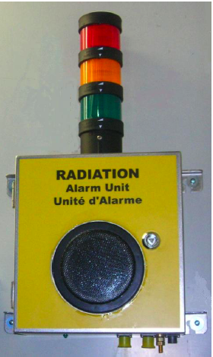
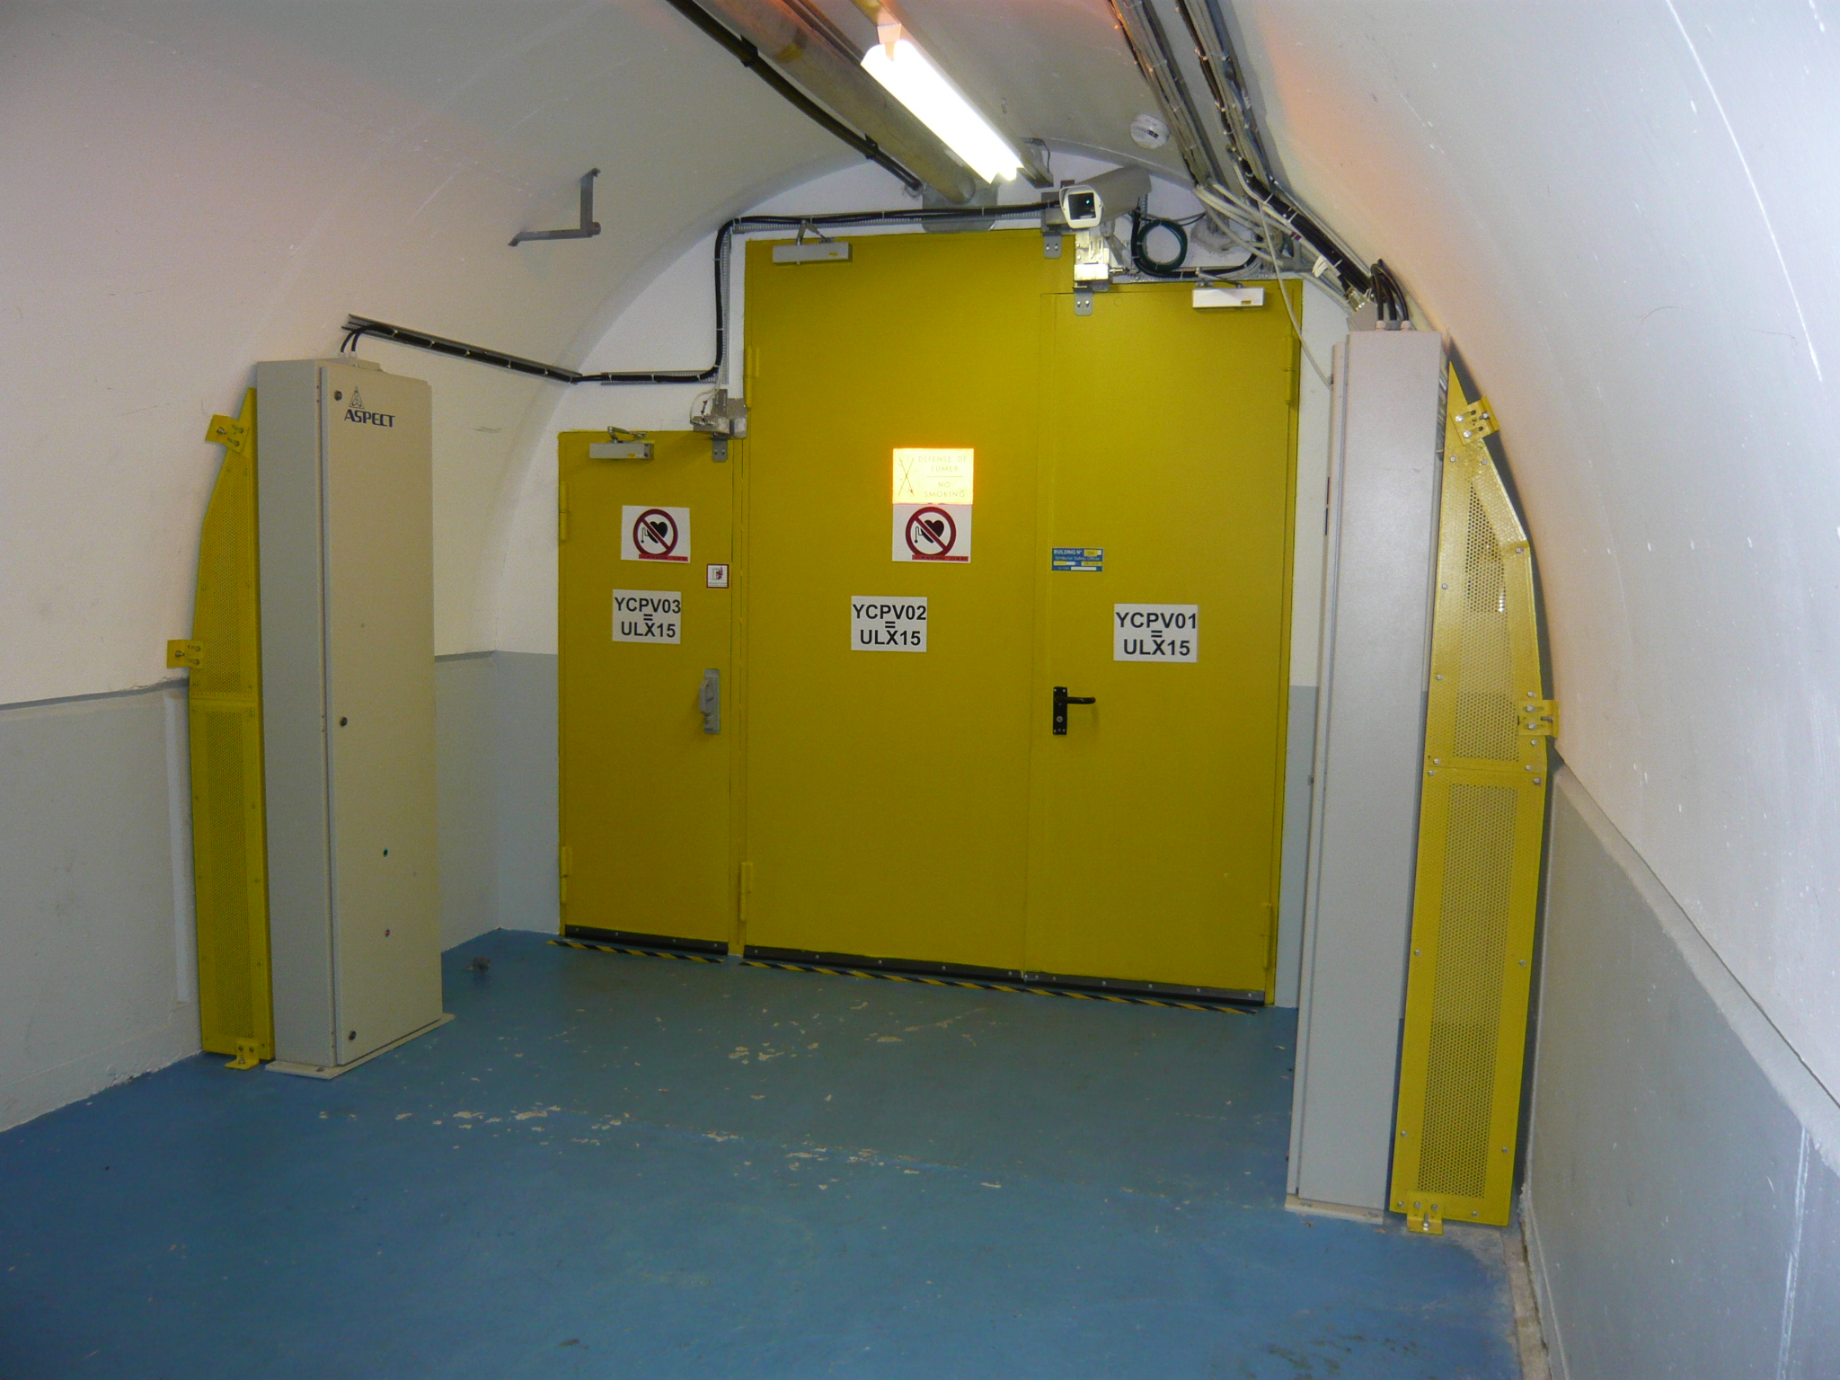
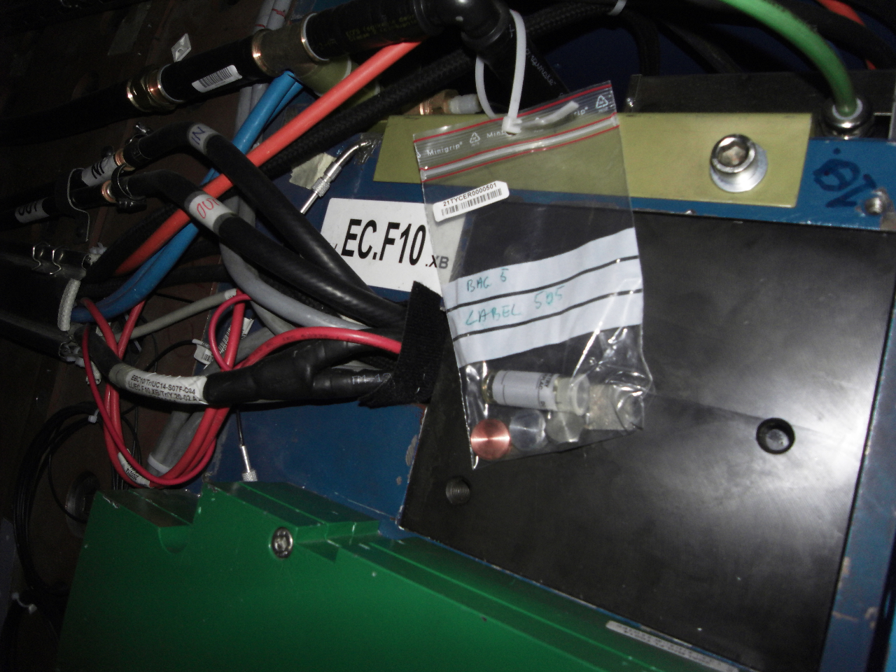
The level of radiation is under constant surveillance of RAMSES
Alarms when the thresholds are exceeded
« Gate Monitors » are installed at the experimental cavern exits, with constant link to ACR, to monitor the level of radiation of the equipment leaving the cavern
Regular campaigns to measure the radiation level:
  Environmental dose levels
  Spectroscopy of around 95 material samples
  contamination
To authorise or not access to zones
To correlate the radiation calculations

Slide 21
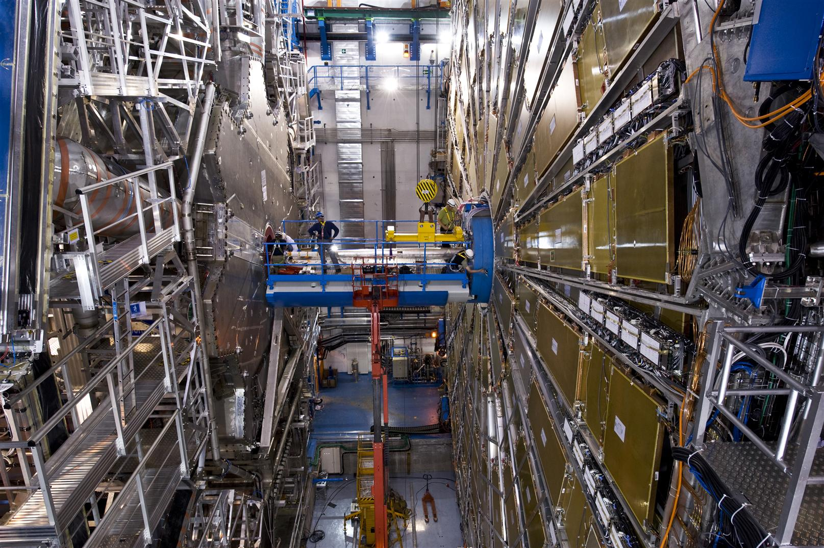
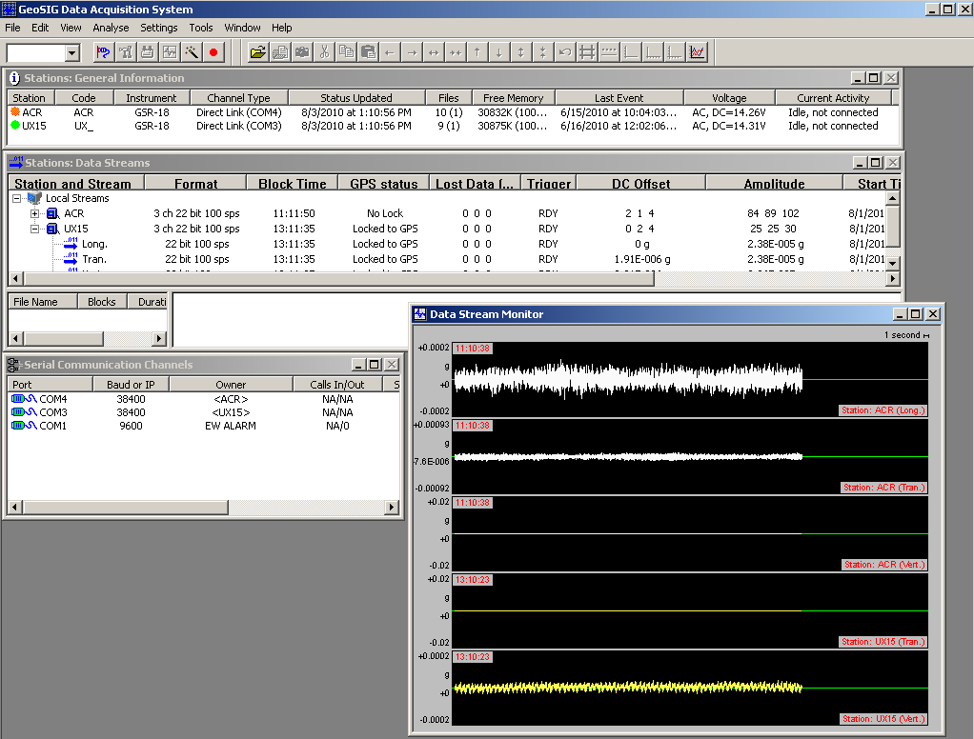
But also
Electrical risks
A beam pipe in Beryllium
Lasers (>100)
Mechanical and Seismic risks (Eurocode 3 et 8)
In collaboration with the Geneva University
4 seismographs
3 on surface et 1 in cavern (at -92 m)

Slide 22
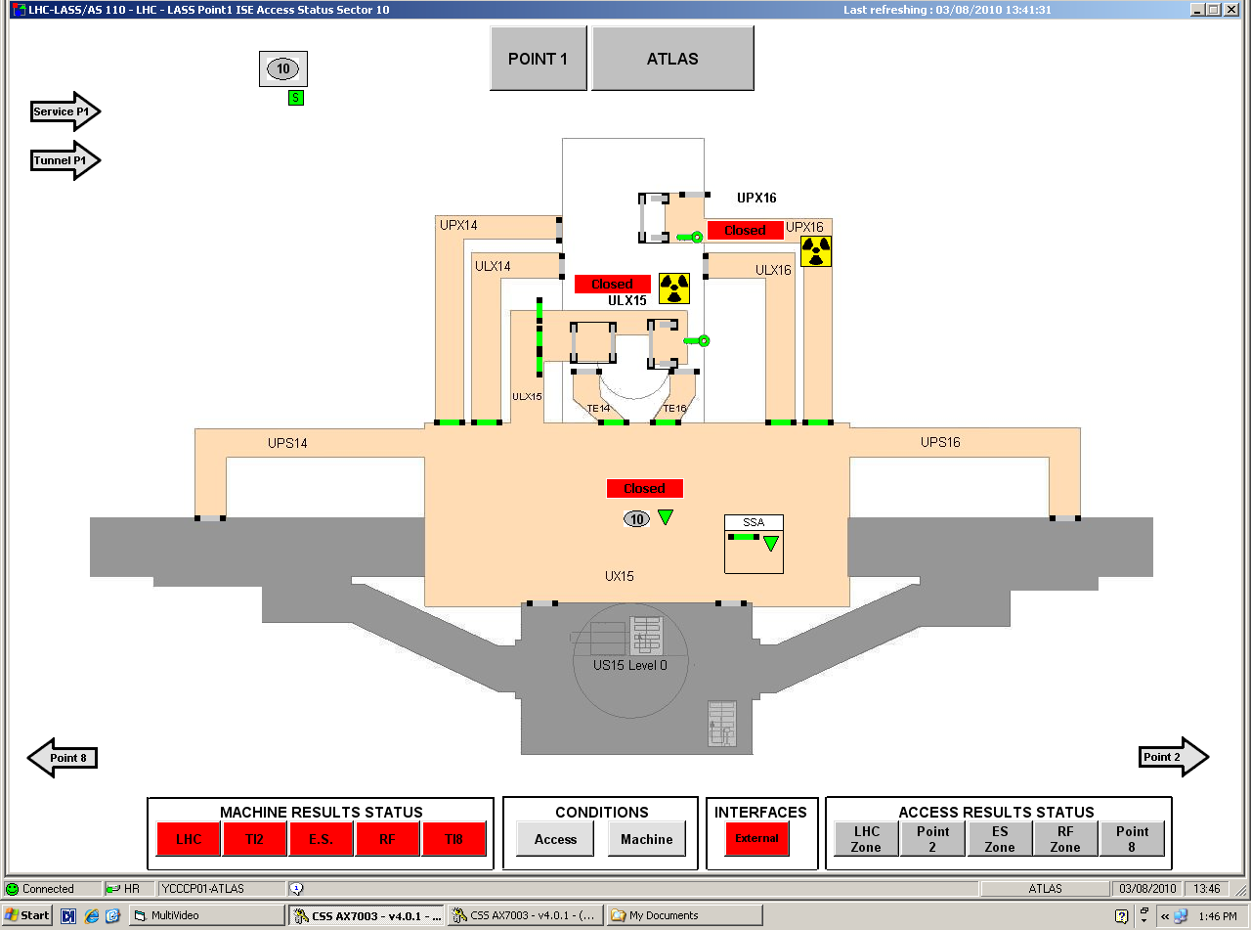
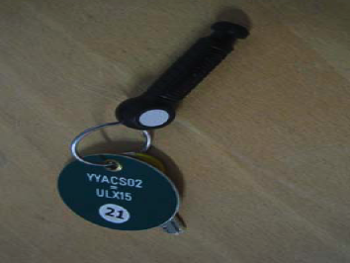
And a very complex safety access system:
LASS, “LHC Access Safety System”
A safety system that guaranties that there is nobody inside the experimental and accelerator areas while the beam is present.
During beam operation:
Immediate stop of the beam in case of intrusion inside the « beam » areas
During access periods:
The safety tokens taken from the LASS bays at the entrance of the
area guaranty the safety of the personnel entering the experimental
caverns.
If the tokens are not back in the bay, the beam can not be injected.
At all time the PATROL must be maintained too!

Slide 23
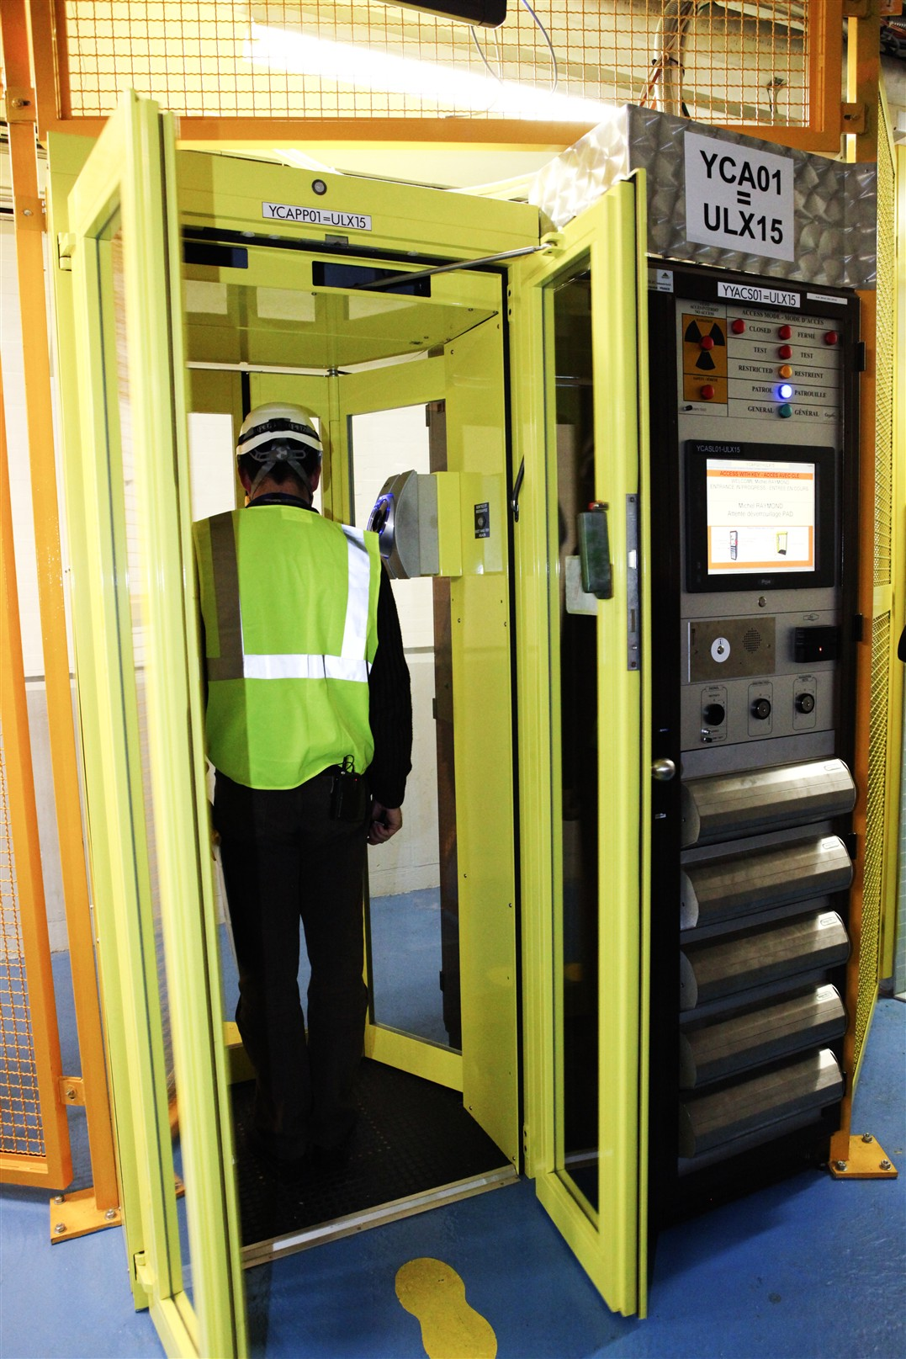
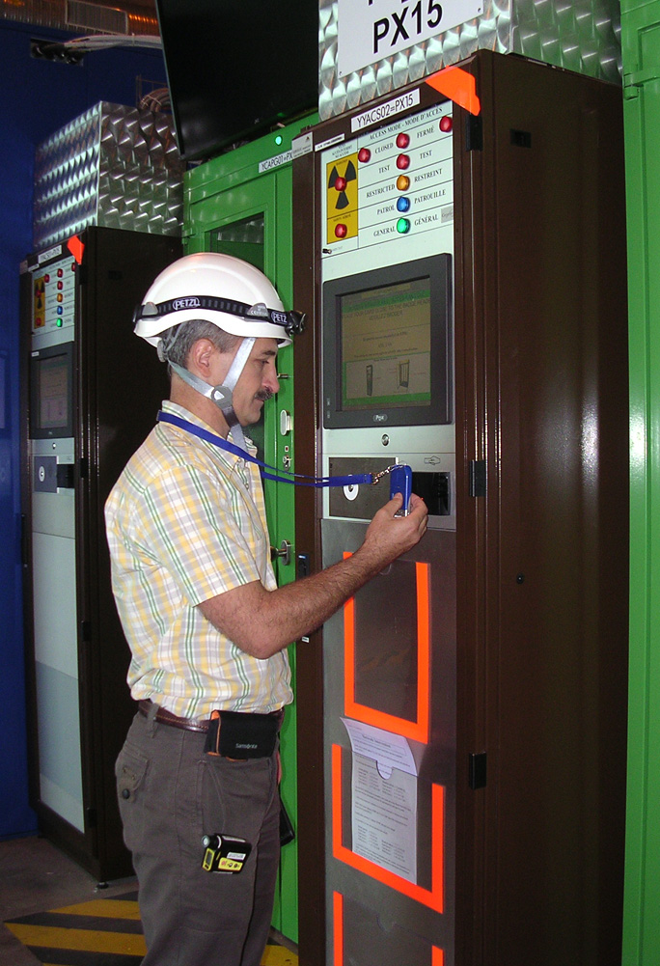
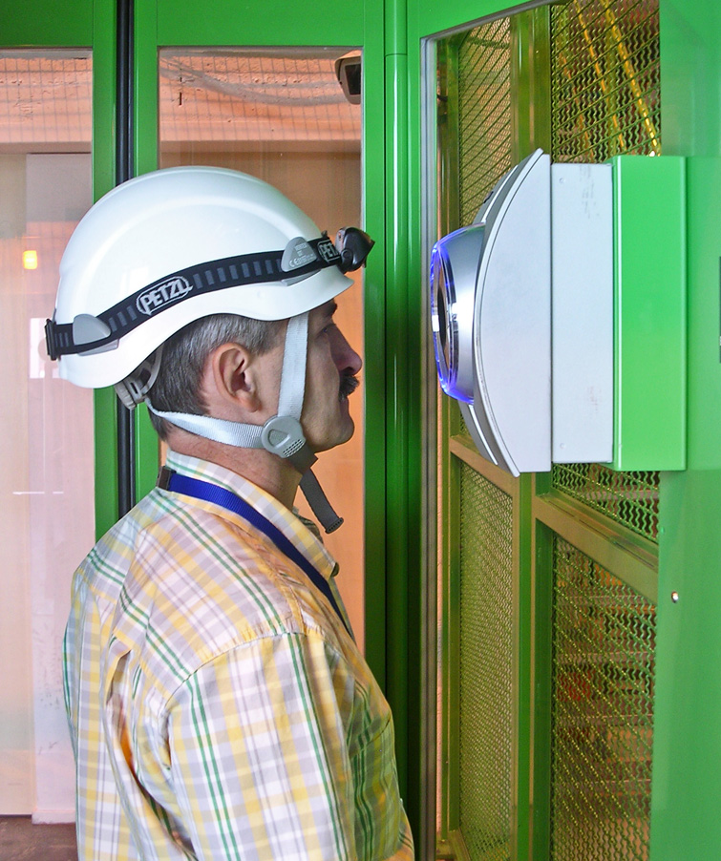
Associated to the LASS, the LACS, “LHC Access Control System ”
The LACS system controls:
the validity of access rights and safety course associated to the area
the biometry via the eye scan
IMPACT – additional access authorisation signed by safety and facility coordinators
The final access authorisation and the safety tokens delivery is done by the SLIMOS from the ATLAS control room.

Slide 24
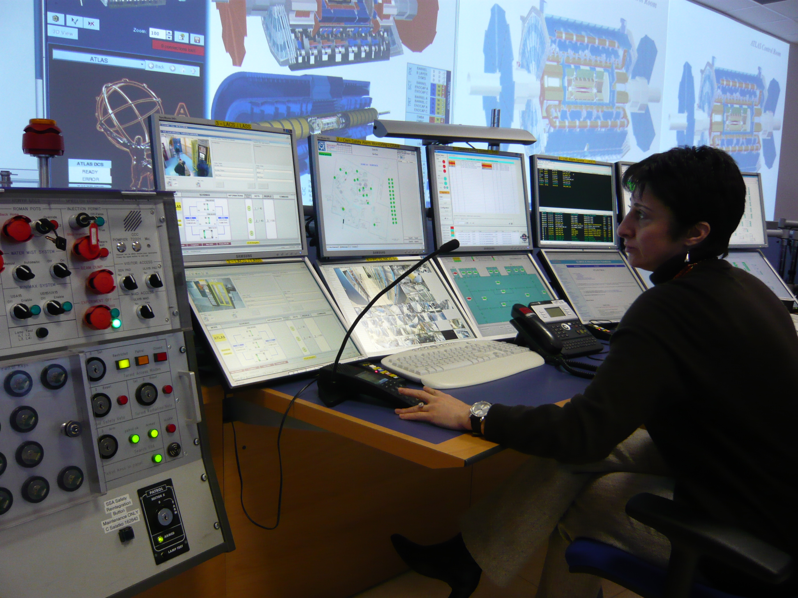
SLIMOS - Shift Leader in Matter of Safety
A key role in the organisation of the experiment
All the safety information, the access, and the infrastructure related information are converging to a central location: the SLIMOS desk at the ATLAS Control Room
The information is processed by SLIMOS to whom the GLIMOS has delegated a part of his functions of operational safety.
The SLIMOS are qualified persons
(engineers or physicists) which has followed
an extensive training on safety procedures.
The presence of the SLIMOS in the
ATLAS Control Room is maintained 24/7.

Slide 25
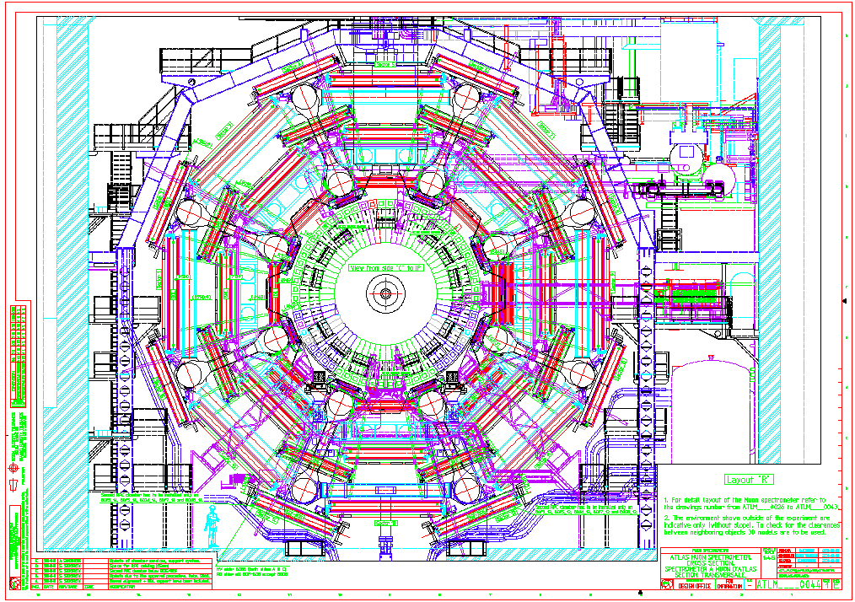

Finally, to follow movement of personnel in the heart of the detector: FPIAA – Finding People Inside ATLAS Areas
system developed by ATLAS
hundreds of infrared detectors covering the ATLAS experimental cavern
ability to check the presence of personnel underground from the ATLAS control room

Slide 26
ATLAS Safety Structure
Collaboration Institutes
Safety commission
CERN departments
All CERN Safety Committees, Fire Brigade, DSOs, etc.
GLIMOS
Group Leader in Matter of Safety
CSO
Cryogenic Safety Officer
ESO
Electrical Safety Officer
LSO
Laser Safety Officer
FGSO
Flammable Gas Safety Officer
Safety Engineering
and DB Team
7 Engineers
RSO (Radioprotection Safety Officer)
ALARA Coordinator
RPE / RPA (radioprotection experts
and assistant)
16 Technicians , Engineers or Physicists
SLIMOS
(Shift Leader in Matter of Safety)
Around 70 engineers or physicists
TSO
Territorial Safety Officers
17 Technicians or Engineers
Work Package analysis Structure
Safety training office
ATLAS Patrol Team
Around 20 persons
Safety Coordinator
For access periods

Slide 27
A systematic analysis of all activities happening in the ATLAS experimental areas:
The “Work Packages” Analysis
The activity responsible provides work declaration to the ATLAS technical coordination to request a working authorization and access to the caverns
He provides all data linked to the activity and the PPSPS - “Plan Particulier de Sécurité et de Protection pour la Santé”:
  Detailed working procedures, location, planning
  Risks linked to the activity (electrical, magnetic field, coactivities, hot works, transport of equipment, working at height, etc.)
  Criticality of the access request and work nature (maintenance, emergency access)
  List of intervening personnel and of their safety courses
  Equipment certification
  Requirements for scissor lifts or cranes
  List of all material entering and exiting the experimental cavern
All the risks are analysed and specific safety measures are proposed.
The work declaration are analysed and authorised day by day
And before start of the work -> a joint safety inspection in situ

Slide 28
ATLAS Safety organization for LS1
All ATLAS activities covered by:
- PPSPS and Work package analysis, 70 since the start of LS1
- IMPACT declarations signed by safety and facility coordinator on daily basis, 6’200 since start of LS1
Safety is ensured by:
- SLIMOS in two shifts covering normal working hours
- OPM for the outside normal working hours
- Safety shifters inside the caverns assisting the working team and patrolling during normal working hours.
- EOD (Engineer on Duty): (weekly shifts) responsible to control schedule, activities, priorities the co-activities, crane usage, safety issues (with safety shifter)
- RSO, RPE and RPA, for gamma radiation measurements, access areas opening, checks of material activation, database filling, radioactive material transport assistance, contamination tests, etc.
- ALARA team - for follow up and assistance for the ALARA level 2 activities
... and of course under supervision of TC and GLIMOS ...

Slide 29




We use our WPSS system to assist the personnel in the “hottest” activities
We use WPSS for the Beam Pipe interventions at the start of LS1

Slide 30


We are investigating possible solutions to mitigate radiation issues for the coming shutdowns
Shielding
Tooling
Remote handling
  We are evaluating remote handling solutions using an old CERN Mantis manipulator.
  In spite of its obsolescence it gives us some very interesting experience and knowledge about remote handling technologies.
We plan to build mock-ups
to be manipulated and gain
the necessary information to
explore the modern solutions
with the correct level of understanding.

Slide 31
Thank you!
And questions?
Asset and Maintenance Management Workshop
CERN, Geneva, Switzerland, 13-15 November 2013

