Slide 1
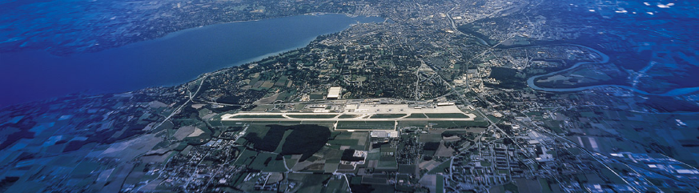
Global Presentation
2013

Slide 2
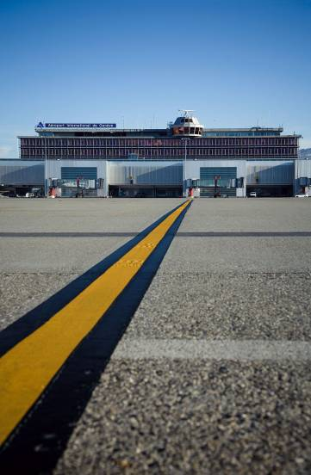
Generalities
Site area : 340 hectares
Runway of 3900 meters long
200 enterprises – 9500 employees on site
Geneva Airport : 920 employees
Notes:
Je vous expliquerai dans quelques instants le rôle de l’autorité aéroportuaire

Slide 3
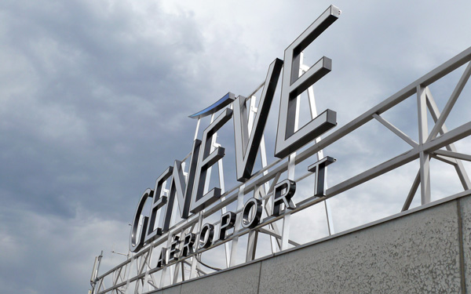
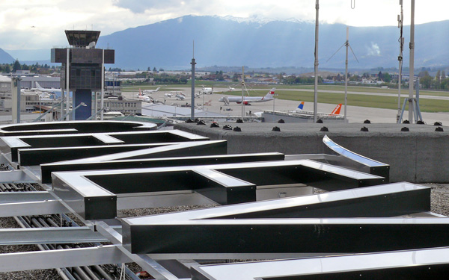
Organisation, Strategy
Investments : more than 100 millions francs a year
Maintenances : over 50 millions francs a year
Maintenance management in accordance to British Standard Institute (BSI) Pas 55
Availability percentage for main assets (plane bridges, lifts, runway lighting…)
User feedback system under development
CAM (Computer Aided Maintenance) is made under Carl Source for asset and maintenance
Notes:
BSI : British Standard Ins

Slide 4

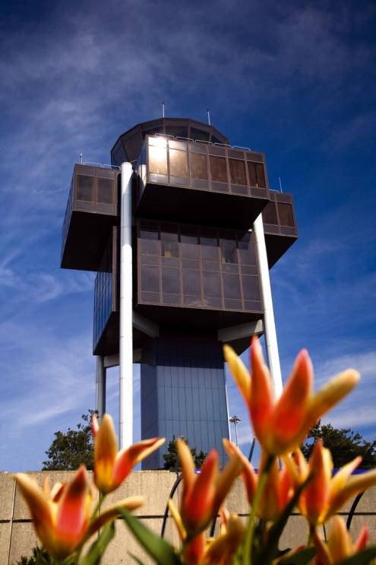
Thank you for your attention!

