Slide 1
CERN Accelerators Topology Configuration and Change Management
Engineering Department
Thomas Birtwistle, Samy Chemli – EN/MEF/DC

Slide 2
Contents
Configuration Management of Accelerators Topology
Accelerators Hardware Baselines
Handling Changes in the Baselines and Layouts
Usage of the Accelerators Naming Service in the Baselines and Layouts
Managing Accelerator Layouts using the ‘Layout Database’
Current Status
Summary

Slide 3
Configuration Management of Accelerator Layouts
Provides a clear and coherent picture of the status of a project or machine at a given point in time.
In order to achieve this, we use three important tools
  Changes to the machines and transfer lines are documented, circulated and approved in the Hardware Baseline (also known as a Product Breakdown Structure) using EDMS
  We register the layouts of the accelerators and all changes to them within the Layout Database that has to remain up-to-date.
    Sequence of functional positions = space management
    Integration and Installation Drawings match the recorded layout to ensure that envelopes of reserved space still match the physical equipment dimensions
  Naming is critical throughout the lifecycle of the machines/projects. To store and manage naming, we use the Naming Portal
Keyword is coherence between the tools.
2013-11-14
EDMS: 1324768

Slide 4
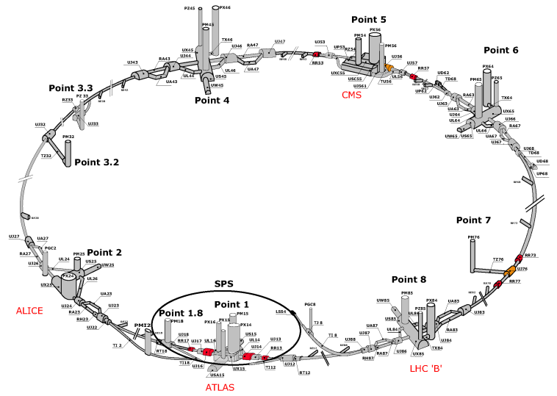

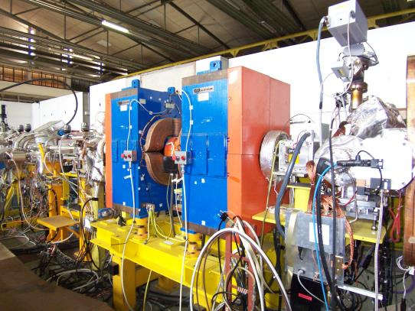
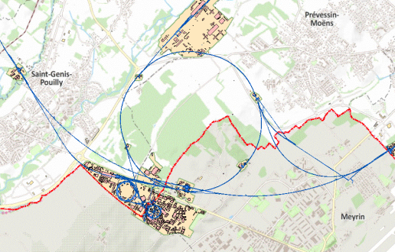
Configuration Management of Accelerator Layouts
2013-11-14
EDMS: 1324768

Slide 5
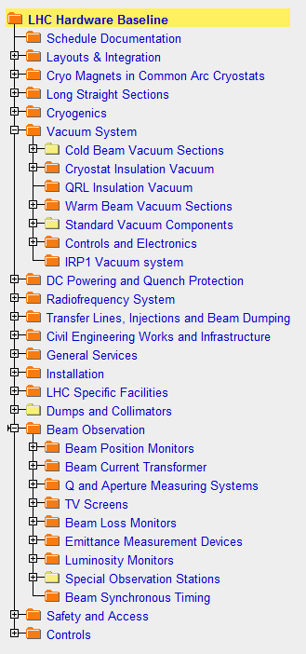
Hardware Baseline…
…is an EDMS (Electronic Document Management System) based tool.
The hardware baseline contains all the information needed to re-build the machine, including:
  Engineering Specifications, Drawing Folders, ECR, Procurement Documents (IT, DO, MS…)
  LHC Baseline was the first to be issued
  SPS and PS Complex Hardware Baselines are in progress
Logical structure of nodes, based on hardware types and functions
Documentation can be linked to multiple locations
2013-11-14
EDMS: 1324768

Slide 6
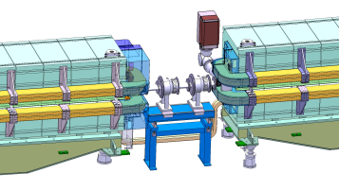
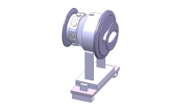
Handling Changes
Need for a change is identified
How: using Engineering Change Requests (ECRs)
  Determine an associated name for the change (equipment, function, layout, service…)
What for:
  Inform other stakeholders and get their approval/refusal
  Impact analysis.
  Allow all persons concerned the opportunity to comment about the impact of changes on surrounding equipment or general planning.
2013-11-14
EDMS: 1324768

Slide 7
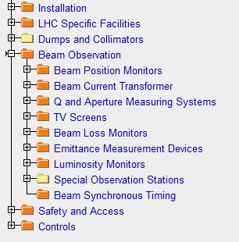
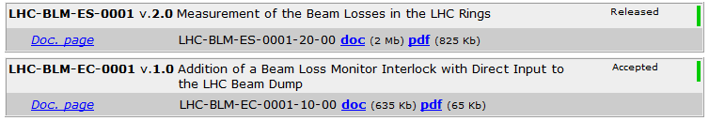
Handling Changes
Where: in the HW baseline for long-term traceability
  Identify the adequate node in the structure
  All changes concerning given equipment recorded in the same place in the HW Baseline
When: prior to the change taking place
Resulting action: update the HW Baseline (Engineering Specifications, Drawings…) and the Layout Database.
Machine/Project
Equipment code/category
Document type. For example: ES = Engineering Specification, EC = Engineering Change request, TP = Test Procedure etc.
2013-11-14
EDMS: 1324768

Slide 8
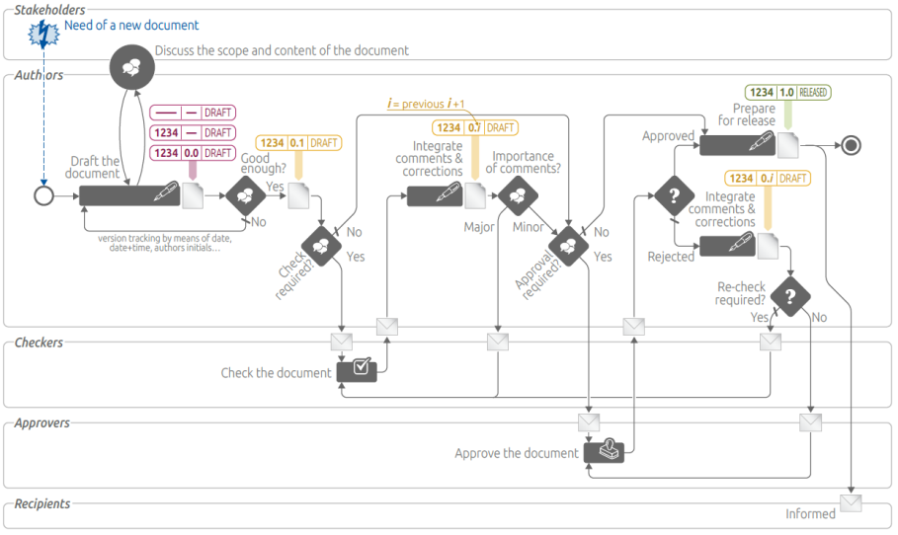
Handling Changes
2013-11-14
EDMS: 1324768

Slide 9
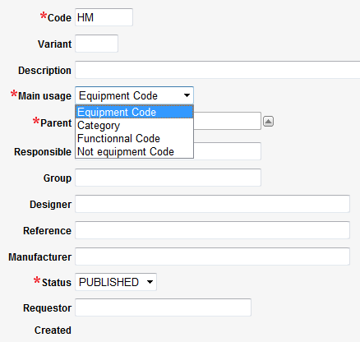
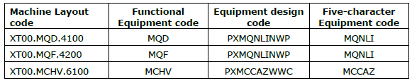
Usage of the Naming Service
The naming portal is the source for all codes in EDMS, CDD and Layout.
  Equipment codes (types) - description of the equipment
    Includes CDD (CERN Drawing Directory) naming for design office
  Functional positions for mechanical and electrical layouts – functional naming in the layout database
    It takes into account optics naming (ABP and OP)
According to Naming Conventions
  LHC, SPS, PS Complex
  QA documents linked within the naming portal
Machine region / zone
Functional description
‘D’ = Defocusing,
‘F’ = Focusing
‘Convention’ reference:
PX = PS Complex, SP = SPS, HC = LHC
Variants on equipment type
2013-11-14
EDMS: 1324768

Slide 10
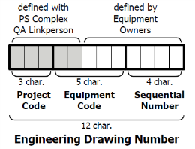
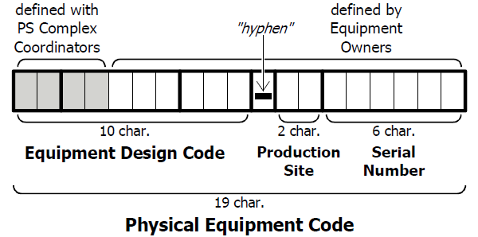
Usage of the Naming Service
Design office use the equipment code for registering drawings
Manufacturing stage - asset naming
  Reference for a specific piece of equipment
Only equipment code (excludes the variant)
Accelerator / Project Code - LHC, SPS, PS_, PSB, ISL…
2013-11-14
EDMS: 1324768

Slide 11
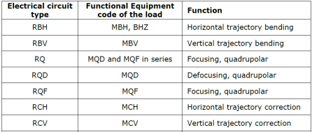
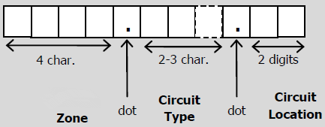
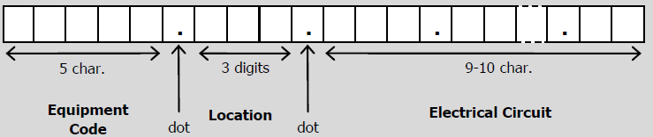
Naming – Electrical Functional Positions
Electrical circuit naming:
Electrical power converter naming:
All names registered in the naming database, and functional positions with additional attributes declared in the layout database:
2013-11-14
EDMS: 1324768

Slide 12
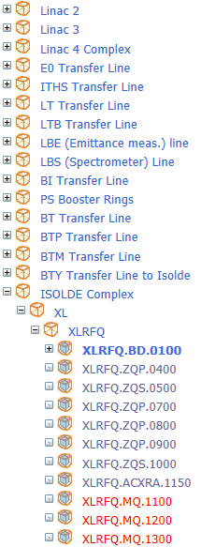
Managing Layouts - Usage of the Layout Database
https://layout.web.cern.ch/layout/
Stores the sequence (layout) of accelerator and transfer line components.
  Equipment types and details
  Functional positions for mechanical and electrical layouts
  Asset names – functional position is exported to MTF database and associated to an asset. Layout just shows the result.
  Expert name – optional, alternative functional name
Updated as a result of ECRs - all past layout information is kept for traceability purposes (database is versioned – see following slide)
  Functional positions become ‘expired’, not deleted
Accessible to all CERN users (CERN IP address)
2013-11-14
EDMS: 1324768

Slide 13
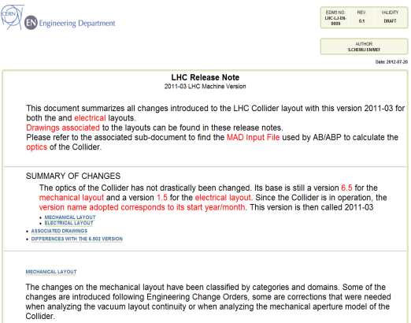
Machine Layout Versioning – Release Notes
Modifications to the layout of the machines (using ECRs) are buffered and grouped into versions in the Layout Database
Release notes summarise the modifications between versions done to the layout/optics inside the database
Triggered by:
  Technical stops (few days)
  Extended technical stops (2-3 months)
  Long shutdowns (e.g. LS1)
2013-11-14
EDMS: 1324768

Slide 14
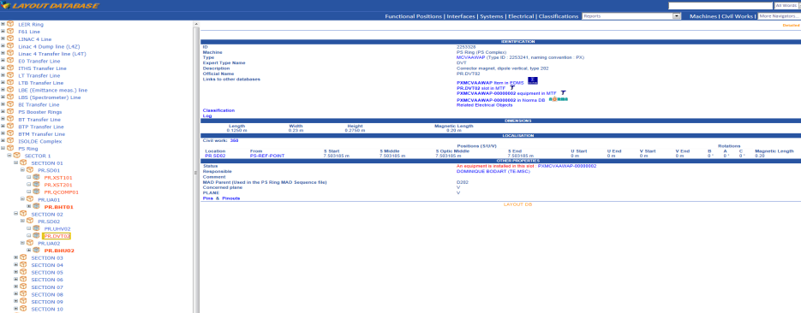
Layout Database
Equipment type & description from naming service
Navigator with functional position names – logically ordered
Position relative to a defined origin
Dimensions
Links to other information
(EDMS, MTF, NORMA…)
2013-11-14
EDMS: 1324768

Slide 15
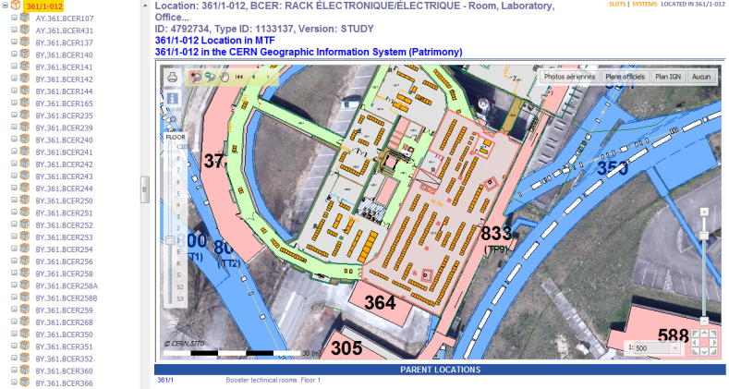
Layout Database
Layout database linked to GIS portal to show the precise location of functional positions (example: PS-Booster racks)
2013-11-14
EDMS: 1324768

Slide 16
Current Status
Defined in Layout database:
  Accelerators: LHC, SPS, PS-Ring, PS-Booster, LEIR.
  Linacs: L4
  Isolde Complex: HIE-Isolde
  Transfer Lines : TI2, TI8, TD62, TD68, TT2, LT, BI, BTP, BTM, TT10, TT60…
Defined with a Hardware Baseline:
  Linac 4, LHC, HIE-Isolde
  In progress: SPS, PS-Ring, PS-Booster, AD, LEIR, ELENA
The scope is growing to include new projects and catch up with existing facilities (reverse engineering)
2013-11-14
EDMS: 1324768

Slide 17
Summary
The purpose of Configuration and Change Management of the Accelerators Layout is to provide a clear picture of a project/machine at a given point in time.
It is achieved through the use of:
  Hardware Baselines:
    Store for all information on the hardware installed in a given machine.
    Only concerns ‘hardware’ (products), not activities.
  Handling of Changes:
    Engineering Change Requests
    Stored in Hardware Baseline
    Proper versioning of documents is important
  Naming:
    Important at all stages of the project/machine lifecycle
    Documentation in HWBaseline, Equipment types, Functional positions, Mechanical design, Manufacturing
  Layout Database:
    Stores the sequence (layout) of components, including electrical components and circuits.
    Naming is stored
    Links to other information sources – GIS portal to visually display functional position locations
2013-11-14
EDMS: 1324768

Slide 18
Summary
Further information:
  Naming Service: accelerators-naming.service@cern.ch supported by BE-CO-DA and EN-MEF-DC
  Naming Portal: https://cern.ch/service-acc-naming supported by BE-CO-DA
  Layout Service: layout-service@cern.ch supported by BE-CO-DA and EN-MEF-DC
  Layout Web Interface: https://layout.web.cern.ch/layout/ supported by BE-CO-DA
  EDMS: https://edms.cern.ch supported by GS-ASE
  Configuration and Change Management of the Accelerators Baselines: ecr-configuration@cern.ch supported by EN-MEF-DC
2013-11-14
EDMS: 1324768

