Slide 1

Maintenance Specificities in the CERN Cooling and Ventilation Group
I. El Hardouz, U. Epting, S. Poulsen, G. Peon (CERN EN/CV)
Asset and Maintenance Management Workshop CERN, 13-15 November 2013

Slide 2
Summary
Definitions and Acronyms
Introduction to EN/CV
Overview of EN/CV Maintenance
CMMS in EN/CV
Key Performance Indicators
Meter Readings
Conditional Maintenance
Summary
Conclusions

Slide 3
Definitions and Acronyms
Position
Hierarchical structure
  Parent
  Child
MP: Maintenance Plan
PM: Preventive Maintenance
CM: Corrective Maintenance
WO: Work Order
Notes:
Position: place of the installation in which a certain type of equipment has to be hosted
Parent: groups positions of an installation that have a common role

Slide 4
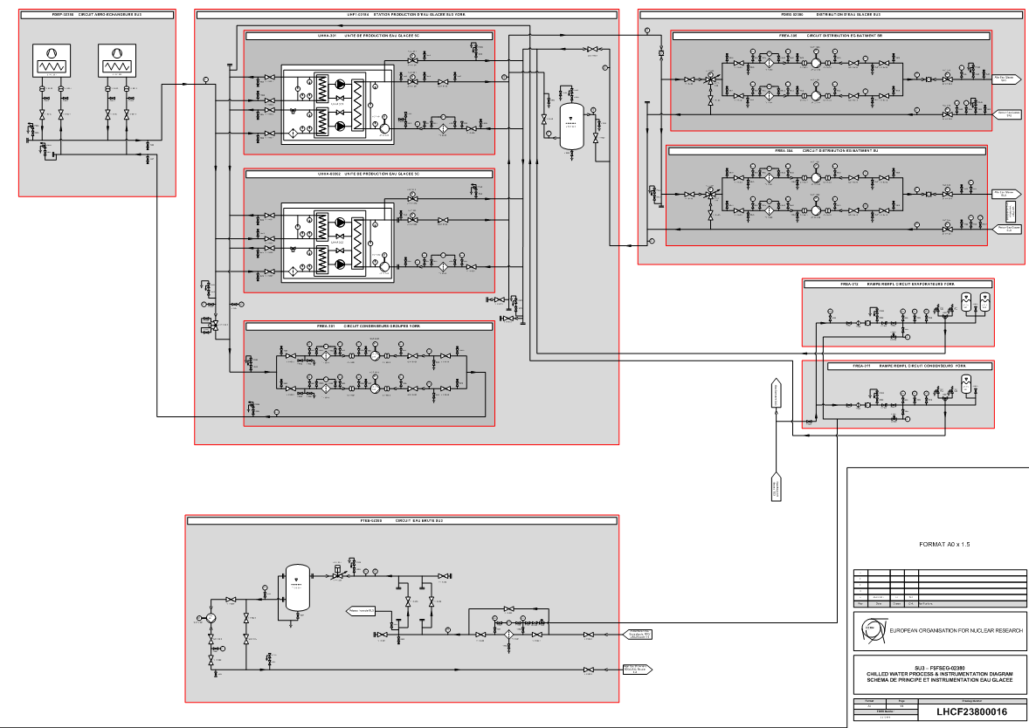
Equipment Structure
Notes:
Reflects the structure of the CMMS

Slide 5
Introduction to EN/CV
The CV group is responsible for the CERN
Cooling and Ventilation
installations:
ACCELERATORS
DETECTORS
EXPERIMENTAL AREAS
COMPUTER CENTER
DESIGN
WORKS
OPERATION
MAINTENANCE

Slide 6
Introduction to EN/CV
HVAC:
  Tunnel
  Experimental caverns
  Service caverns
  Pressurized safe areas
  Surface “machine” buildings
  Smoke and Gas Extraction Systems
Compressed air systems
Electricity
Control and supervision systems
Water Systems:
  Primary water
  Demineralised water
  Chilled water
  Mixed water
  Reject water
  Sanitary water
  Fire fighting water
A total of
76000
pieces of equipment

Slide 7
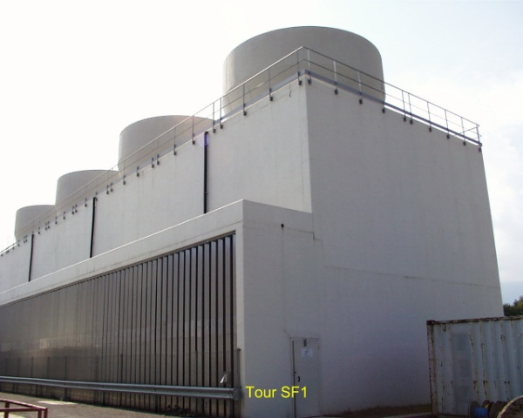
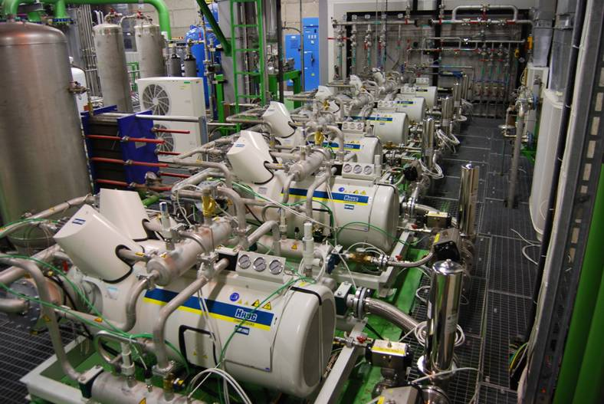
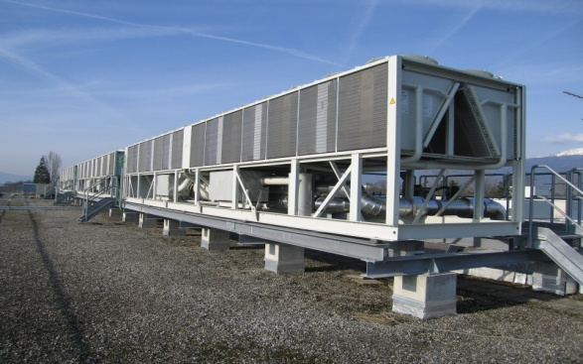
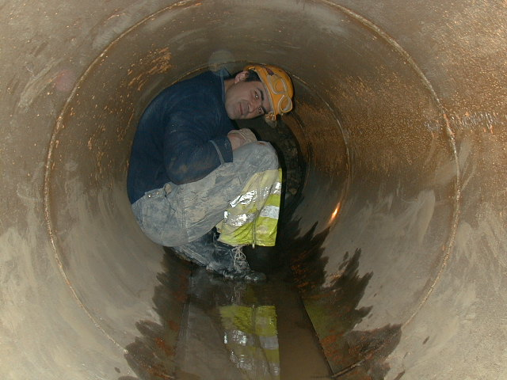
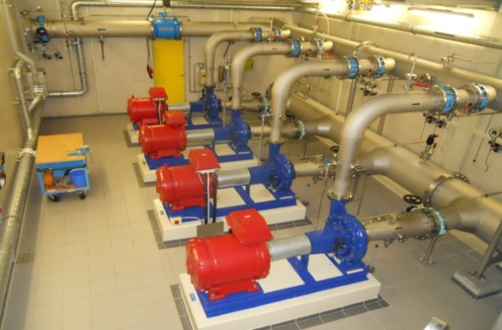
Cooling and distribution
Cooling towers (450 MW) 22
Chilled water production : 6-12ºC (73 MW) 35
Cooling plants (raw water, demineralized water, C₃F₈, C₆F₁₄) 150
Distribution Pipework 800 km
Total water consumption 5'400 m³/h
Equivalent to 10% consumption Geneva Canton

Slide 8
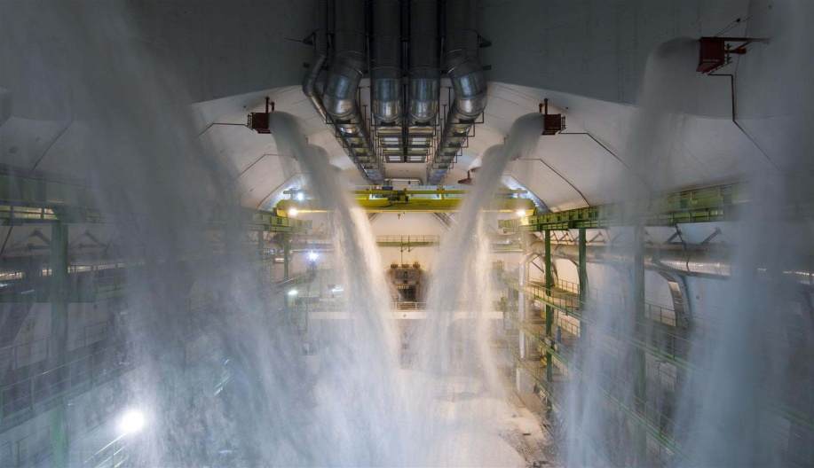
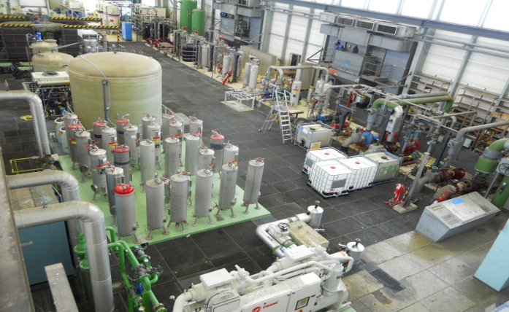
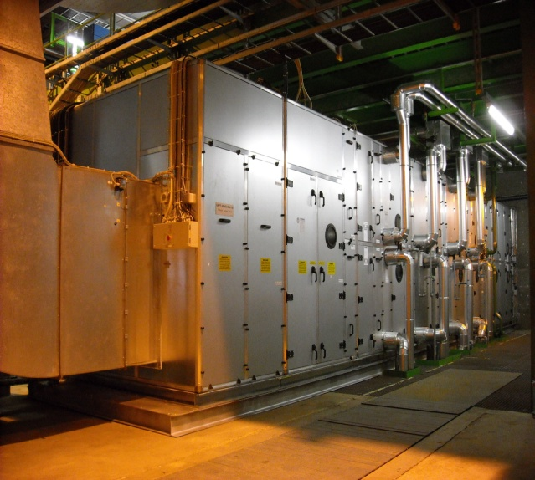
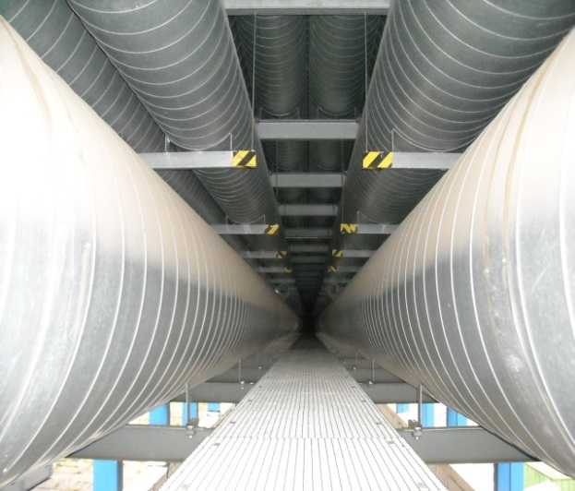
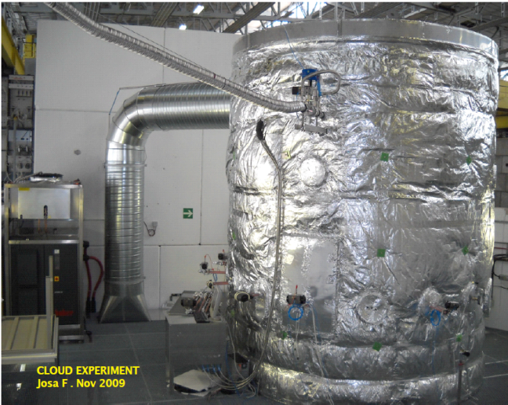
Ventilation, Fluid Systems
HVAC 1’500 units
from 2’000 to 120’000 m3/h per unit
Fire fighting systems 800 points
Compressed air 14 installations
distribution network 200 km
Demineralised water production 20 m3/h - 0.1 μS/cm

Slide 9
Overview of EN/CV Maintenance
The general activities are covered by just two contractors
Other particular activities are assigned to specialised contractors, i.e. water treatment
Their work is divided in geographical areas
  PS complex plus 50% of the LHC installations
  SPS complex plus 50% of the LHC installations
Stand by interventions:
  PS, SPS: Contractors
  LHC, CERN Computing Centre: CERN
Maintenance Budget of 6MCHF/yr
Asset Value of 600MCHF

Slide 10
Organisation of the Preventive Maintenance

Slide 11
Preventive Maintenance
Maintenance Plans
MPs generates WOs at the level of the Parent
The WOs point to Maintenance Procedures according to the equipment installed within the Parent
The MPs automate provisional WO start and end dates

Slide 12
Organisation of the Corrective Maintenance
Notes:
If spare parts missing, contractor communicates in WO
If intervention due to access, safety, length of time is forbidden, contractor communicates in WO

Slide 13
CMMS in EN/CV
CV utilizes mainly the following modules in INFOR EAM
  Equipment
    Assets
    Positions
    Parts
    Structure
  Stores
    Spare Parts
    Pick Tickets
    Reservation
    Requisition
    Purchase orders
    Parts labelling
    Minimum stocks
  Works
    Work requests Work orders (WO)
    Maintenance plans
    Inspections
    Meter readings

Slide 14
Information in the WOs
Other Information:
  Filled by CV personnel
    Information to assess the work
    Contact person
    Particular safety issues
  Filled by contractors’ personnel
    «Assigned to»
    Booked hours for a particular employee and day
    Description of the work done
    Spare parts used
    Tests carried out
    …
Dates in WOs
  Filled by the system
    Event date: date of WO creation
  Filled by CV personnel
    Requested start date
    Requested end date
  Filled by contractors’ personnel
    Schedule start date
    Schedule end date
    Actual start and end dates
    Request and delivery of spares

Slide 15
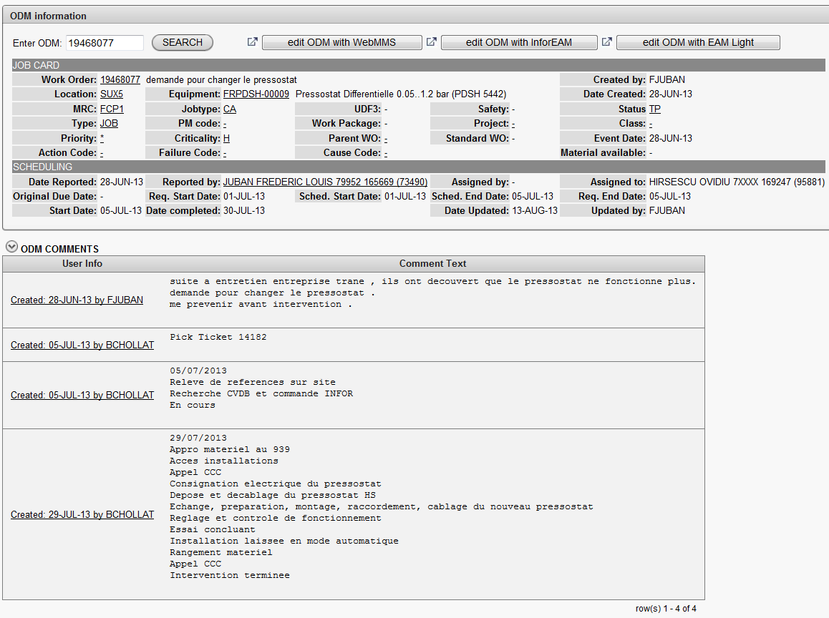

Slide 16
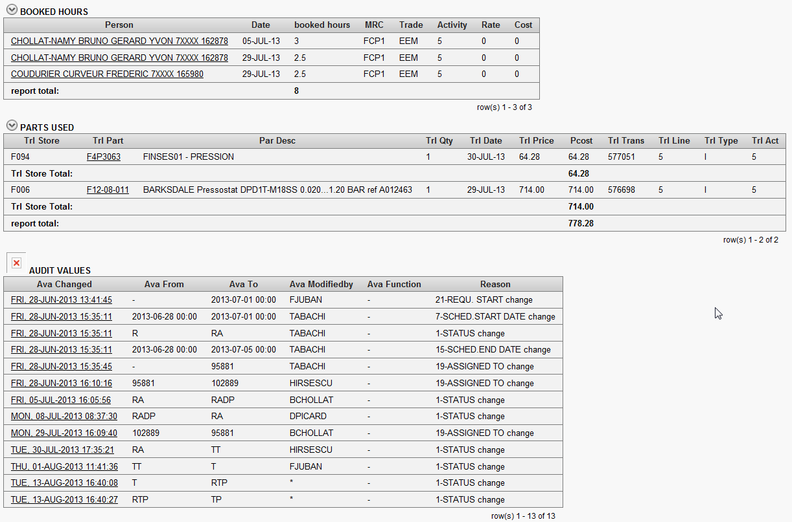

Slide 17


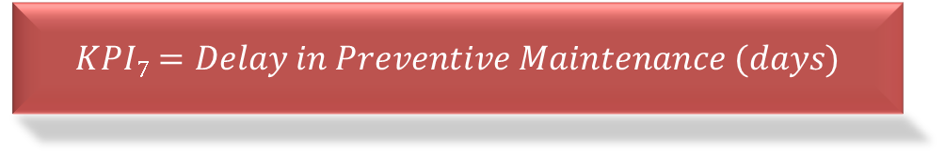

Main KPI: Contractor Performance
$$KPI3=\frac{Completed PM WOs}{Total no. of Requested PM WOs}$$
$$KPI5=\frac{Completed PM WOs}{Total no. of Planned by Contractor PM WOs}$$
$$KPI7=Delay in Preventive Maintenance (days)$$
$$KPI10=No. of non_approved WO$$

Slide 18


Main KPIs: Equipment Condition
$$KPI13=Top 10 positions creating CM$$
$$KPI=No. of WOs per Cause Code$$

Slide 19



Main KPIs : Reactivity
$$KPI15=Delay in WOs verification$$
$$KPI17=MTTR$$
$$KPI18=MTTC$$

Slide 20




Main KPIs : Overall performance
$$KPI1=\frac{Completed CM WOs}{Total no. of Completed WOs}$$
$$KPI5=\frac{Delay in PM (days)}{Total no. of days between two PM}$$
$$KPI7=No. WOs waiting for access$$
$$KPI11=No. WOs waiting for spare parts$$

Slide 21
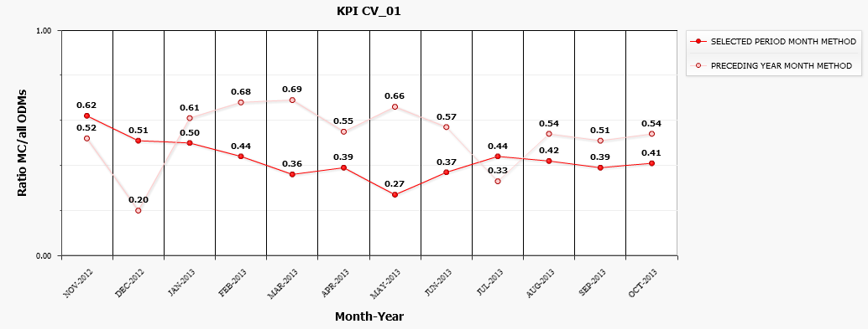
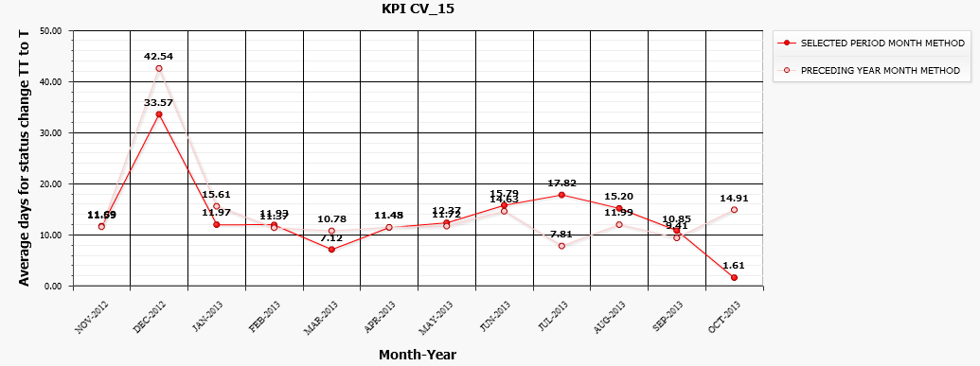
Examples of two KPIs over time

Slide 22

Meter Readings in the CV group
Meter readings for different equipment
  Air Compressors
  Trane Chillers
Frequency
  Different intervals: e.g. weekly, twice per year
  Configured via Infor EAM PM Schedules
Visualization
  Infor EAM Custom Tab: “Inspections & Readings”
Tools for data entry
  GS-ASE Infor EAM Mobile (Psion handheld)
  EN-CV smartphone application

Slide 23
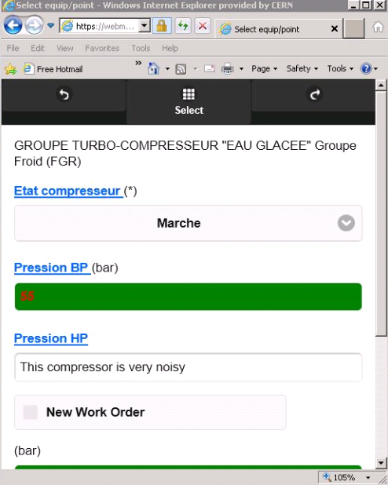
Meter Readings: CV Smartphone
Application
Webpage application optimised for smartphones
It organizes the data collection by PM Schedule (can comprise equipment of different Classes)
No investment required for proprietary equipment and can be on operators personal device (Bring-Your-Own-Device)
It can also be used from any platform with a Web browser (including Psion Ikon)
It works off-line in areas without GSM/WiFi
It is very responsive

Slide 24
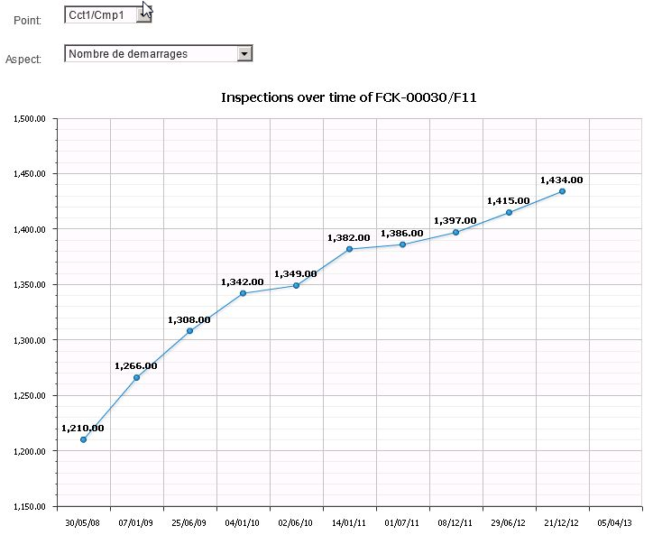
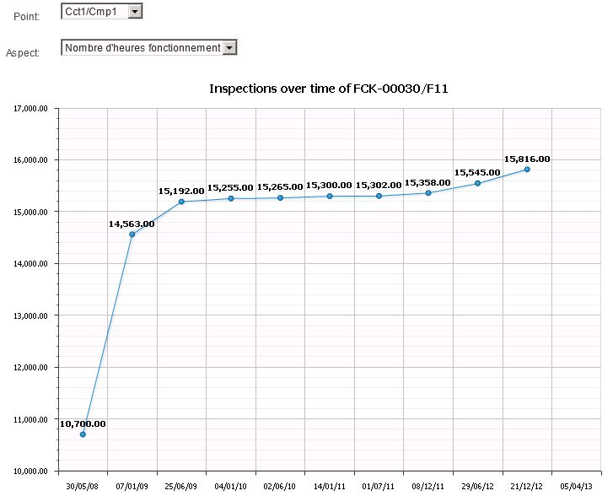
Meter readings: Ex. Historical data of chiller FCK-00030

Slide 25
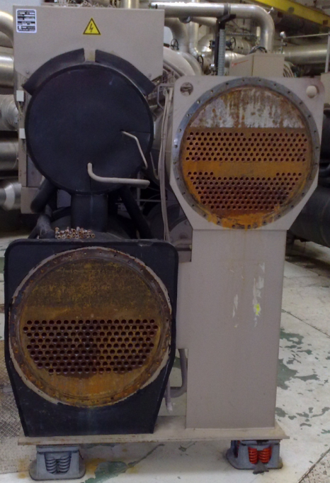
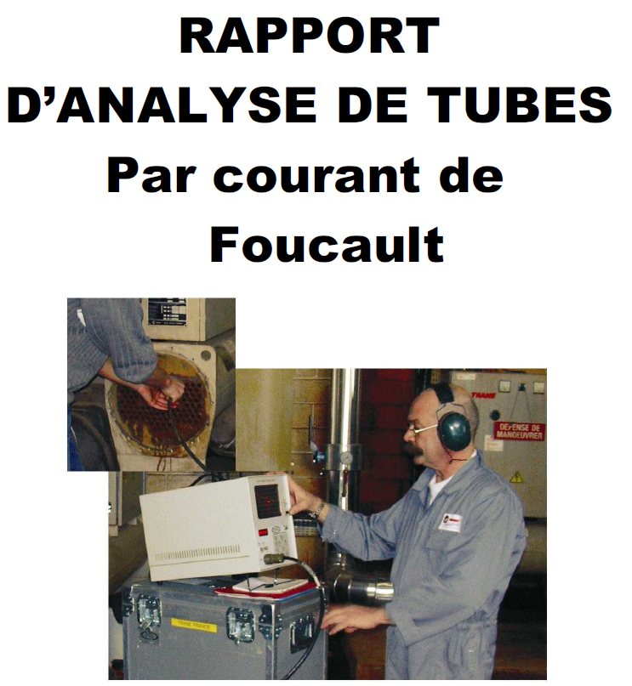
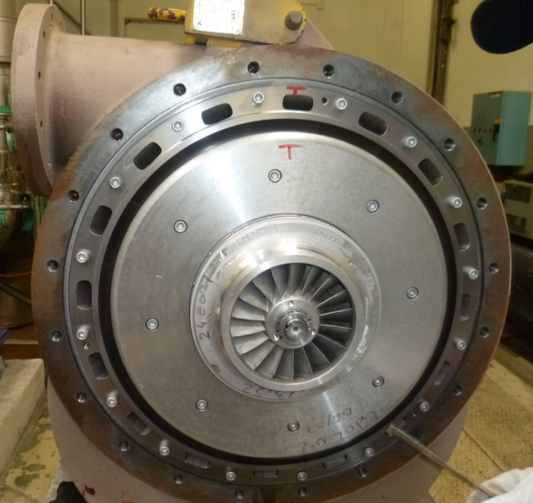
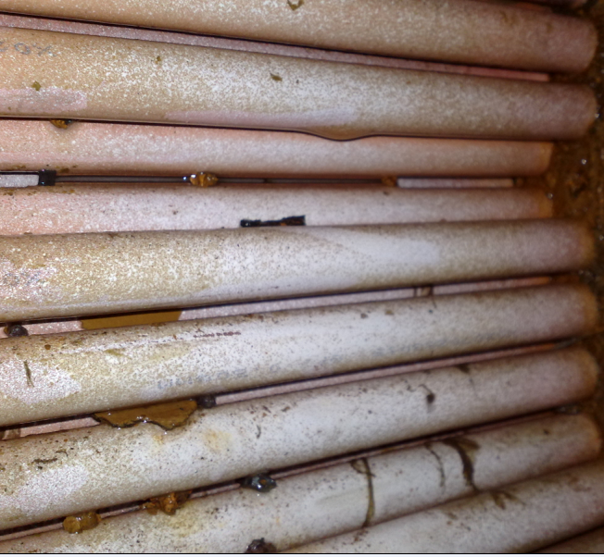

Mechanical revision 40000h and cleaning of a chiller in bldg. 355, 378
… before and after cleaning
bldg. 378

Slide 26
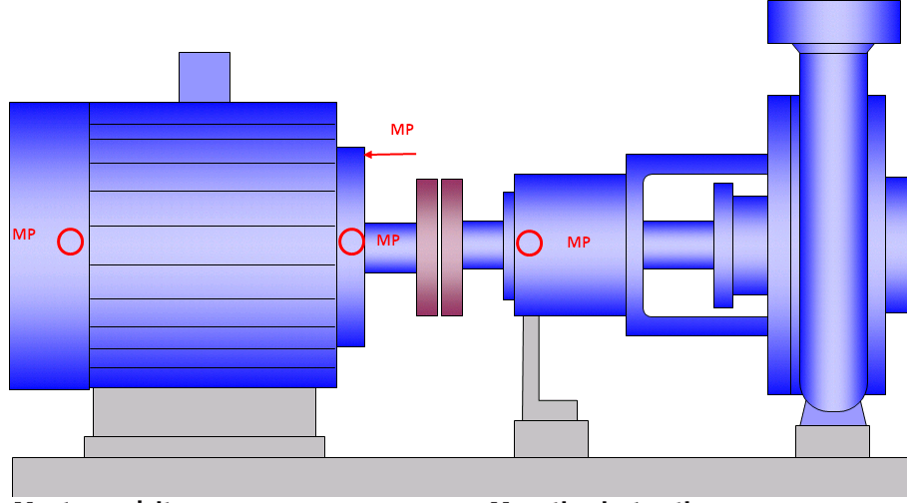
Conditional Maintenance:
Vibration analyses

Slide 27
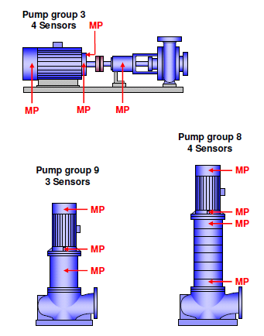
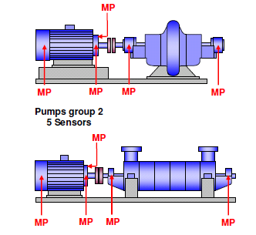
Conditional Maintenance:
Vibration analyses

Slide 28
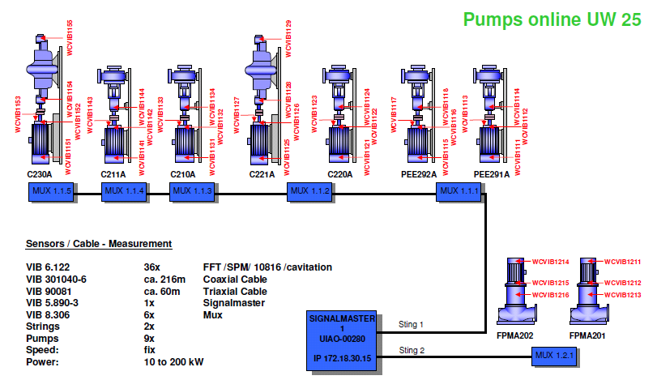
Conditional Maintenance:
Vibration analyses

Slide 29
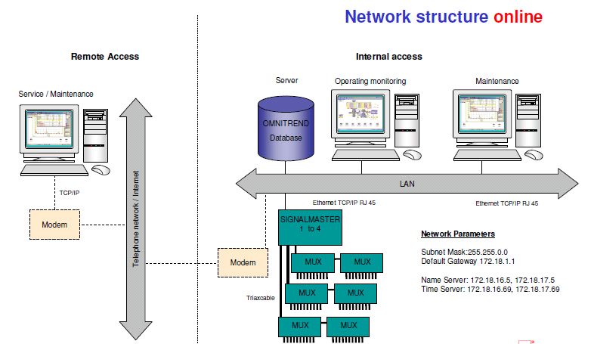
Conditional Maintenance:
Vibration analyses

Slide 30
Summary
EN/CV utilises the main modules of INFOR EAM
Information entered by the System, CV staff and Maintenance contractors is crucial to assess the different actors in maintenance
CV makes use of tailored made KPI to pinpoint weak and strong points in the Maintenance activities
Particular Meter Readings are valuable information to trigger conditional maintenance in some equipment such chillers and compressors
A specific project has been made for Conditional Maintenance based on Vibration measurements

Slide 31
Conclusions
Structure of equipment it reduces the intervention time for all the maintenance participants
KPIs, utilised to better monitor the Maintenance Activity and plants condition to:
      Support the decisions by the CERN management
      Take actions by Stores and Operations
      Manage of Contractors
      Repair and improve the installations
Meter readings
  Faster data entry and interpretation of results
  Clearer vision of the equipment utilization over time
Vibration analysis
  Detect risk and allow for intervention before breakdown

Slide 32
Thank you for your attention!!

