Slide 1
A new high resolution general purpose TDC
Jorgen Christiansen
CERN/PH-ESE

Slide 2
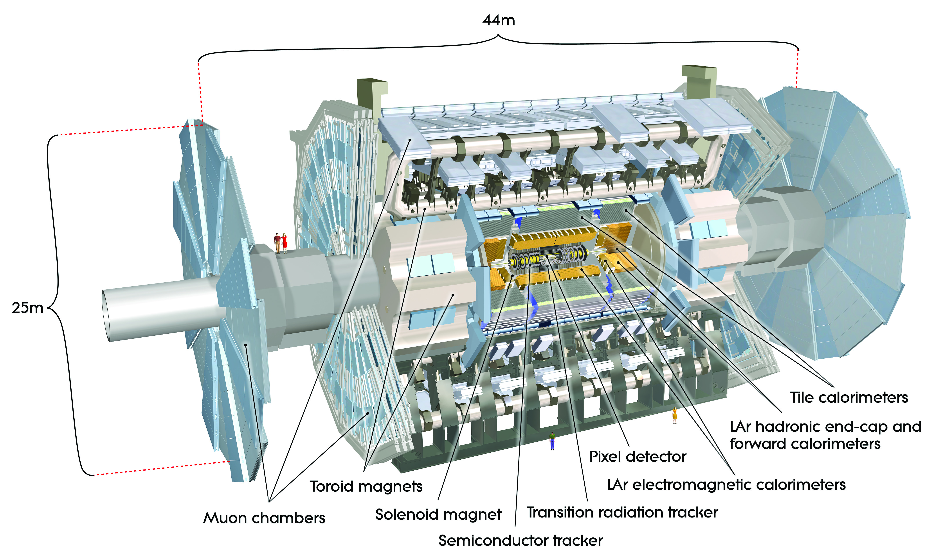
Time to Digital Converters in HEP
Large HEP systems with many (100k or more) channels
Time resolution, precision and stability required across whole system.
Time correlations to be made across “all” channels
Use and distribution of common time reference to all channels
Large dynamic range
Single shot measurements (with some exceptions, e.g. RICH)
Short dead time
No reason to aim at much better TDC time resolution than detector and system can effectively use (TDC contribution to total system time resolution should though not be significant )
Detector (e.g. MCP, SIPM, MGRP, etc. for high resolution applications) and analog interface critical

Slide 3
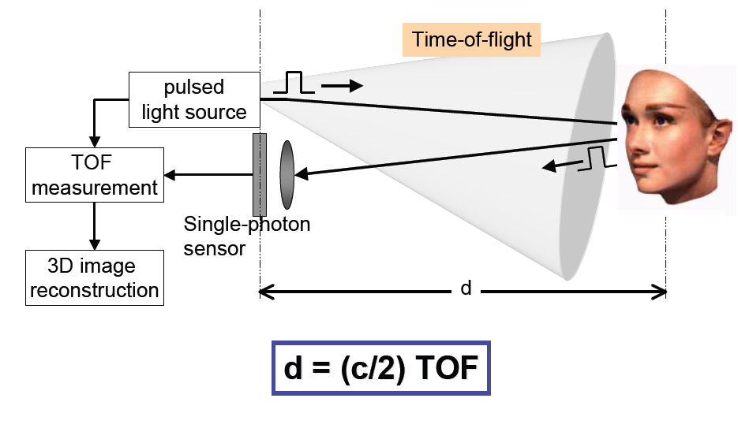
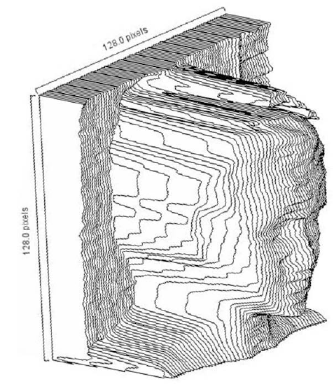
Other TDC applications
Laser ranging,
PLL’s,
3D imaging
TOF-PET
Etc.
General differences to HEP systems
Small local systems
Few channels
Limited dynamic range
Averaging can often be used to improve effective RMS resolution
E. Charbon, DELFT

Slide 4
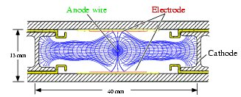
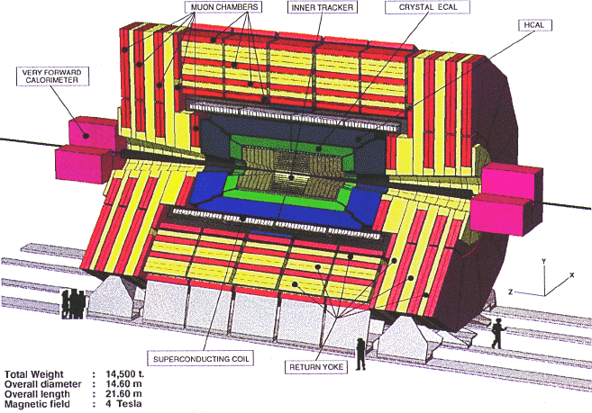
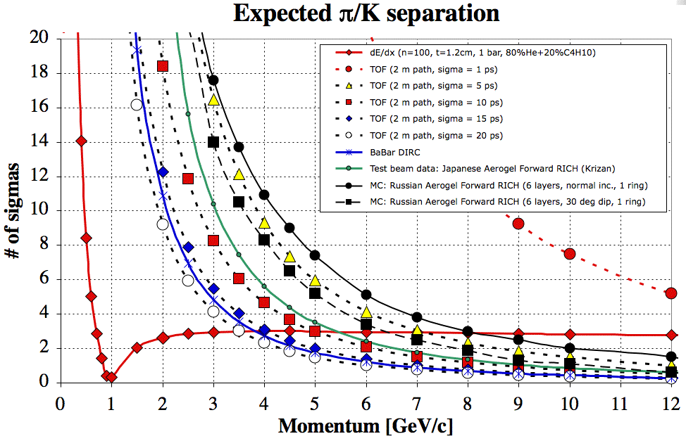
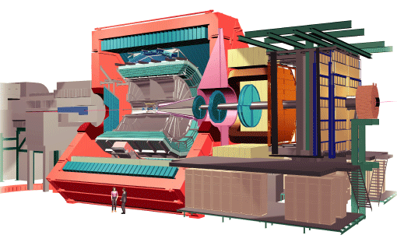
TDC applications in HEP
Drift time in gas based tracking detectors
Low resolution: ~1ns
Examples: CMS and ATLAS muon detectors
TOF, RICH TOP
High resolution: 10ps – 100ps
Example: ALICE TOF
Background reduction
Signal amplitude measurement: TOT
Va’vra RICH2007

Slide 5
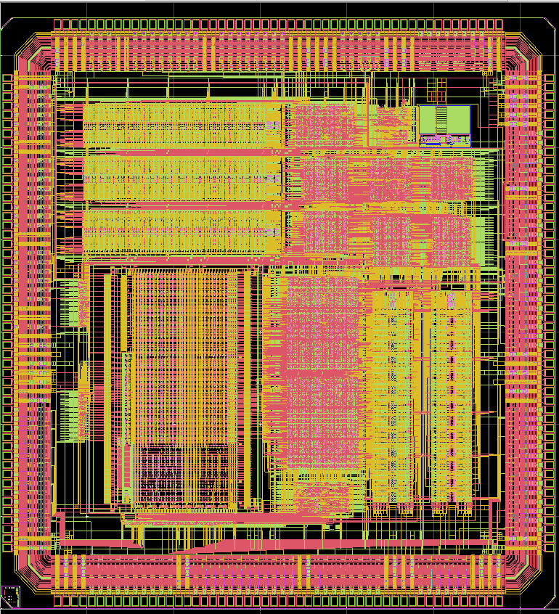
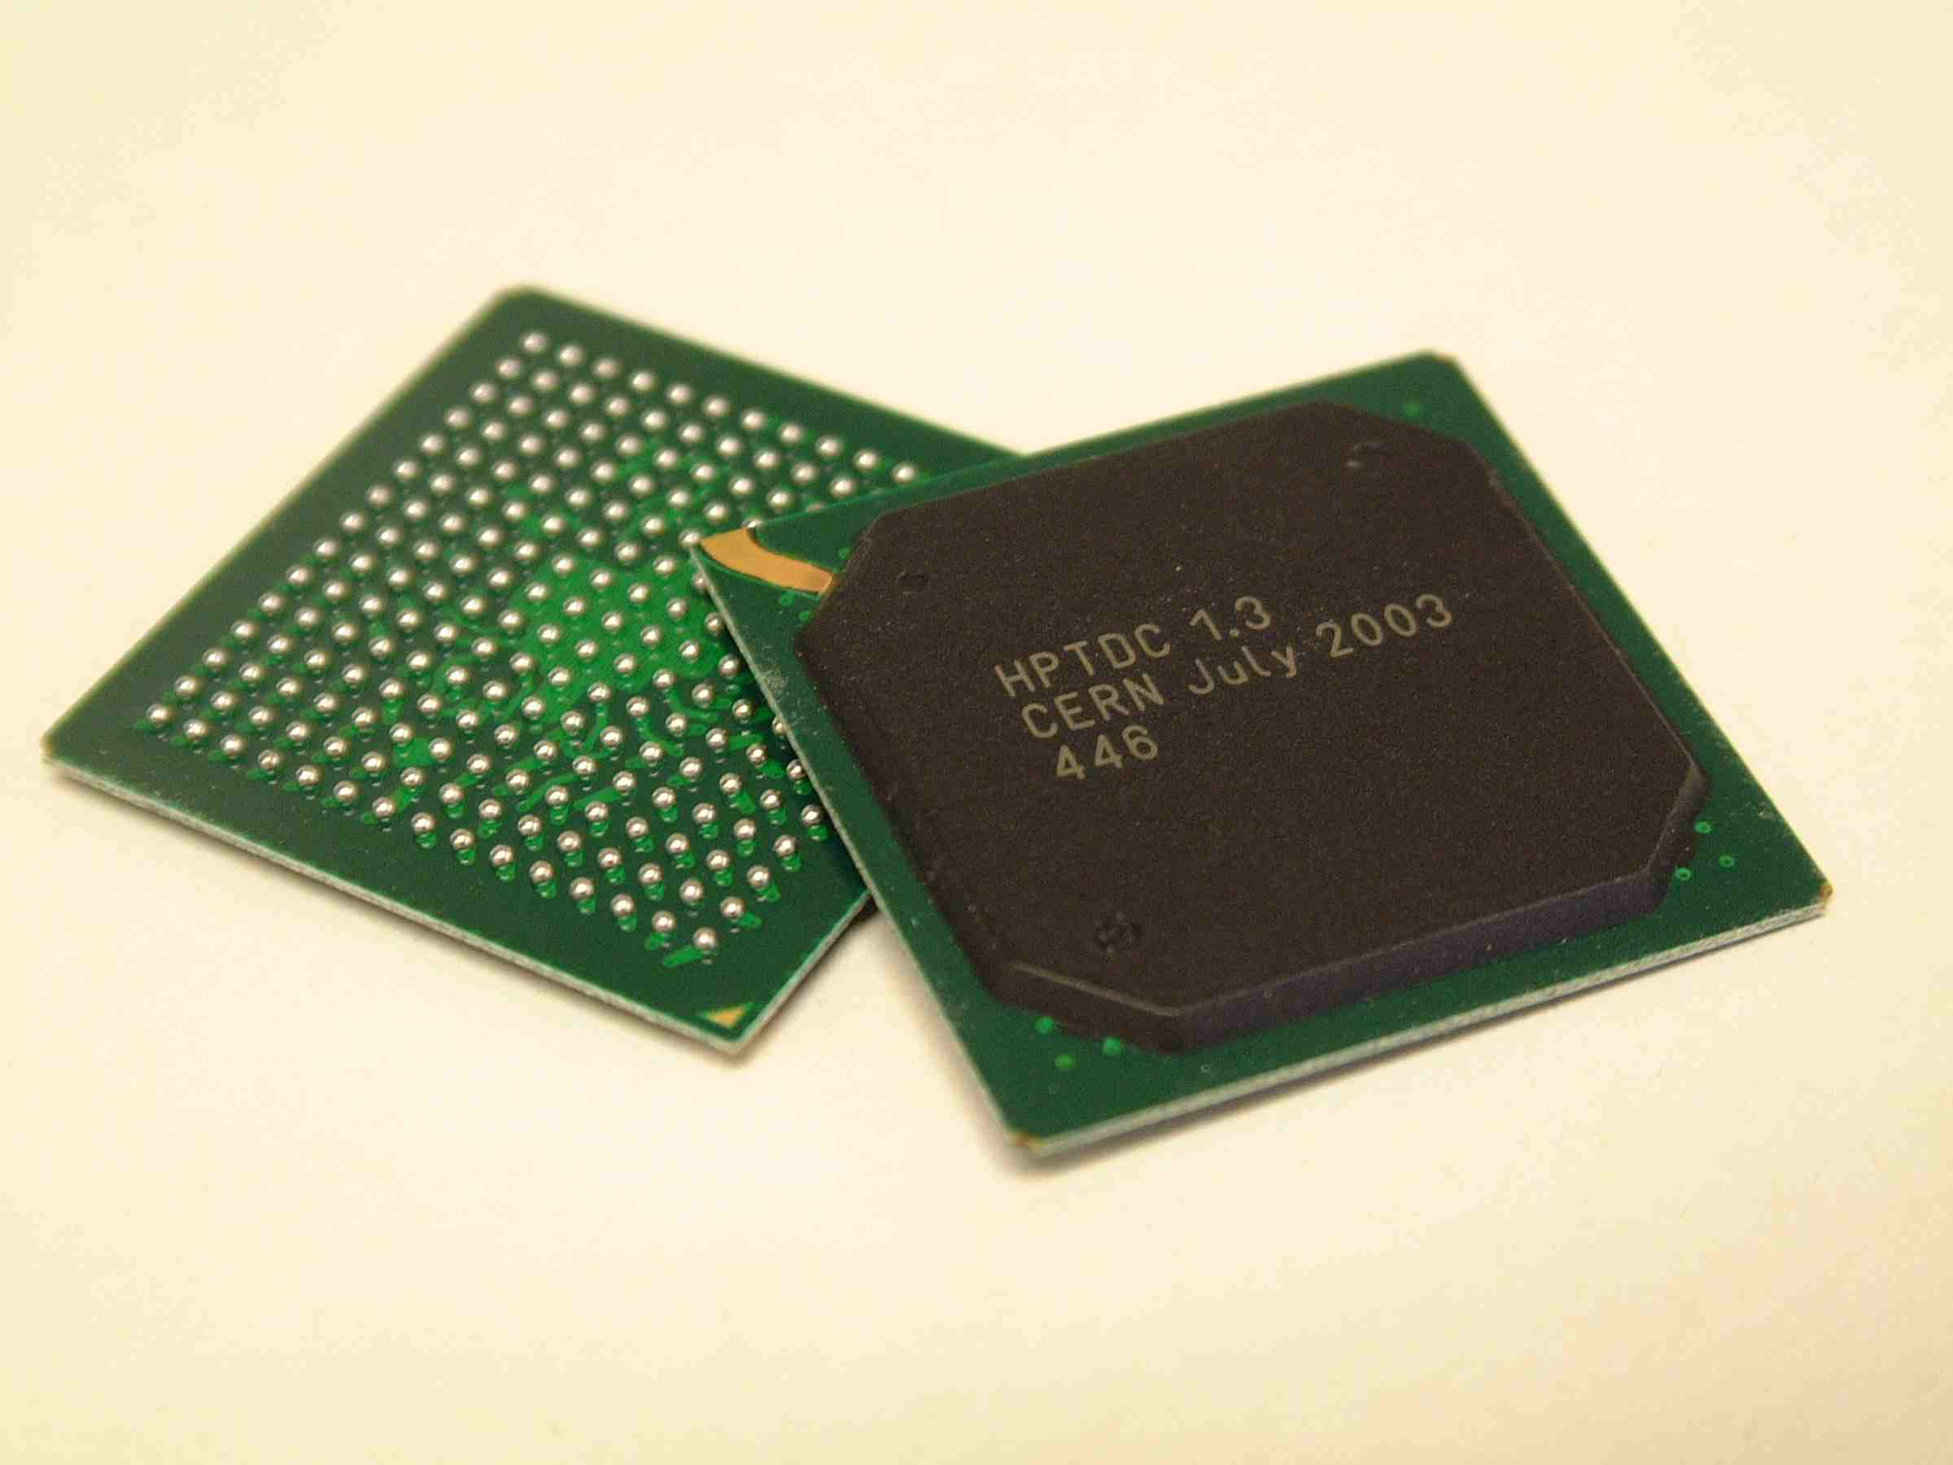
HPTDC
HPTDC used in large number (>20) of HEP applications:
ALICE TOF, CMS muon, STAR, BES, KABES, , ,
Commercial modules: CAEN, Cronologic, Bluesky
~50k chips produced
250nm technology (in principle still available)
New production masks required.
Packaging problems (original company does not anymore support this package)
Production test based on old obsolete IC tester
Process trimming to get internal memories to work reliable
Few thousand chips still on stock.
Design and production effort:
~ 6-8 man years

Slide 6
HPTDC features
32 channels(100ps binning) or 8 channels (25ps binning)
LVDS (differential) or LVTTL (single ended) inputs
40MHz time reference (LHC clock)
Leading, trailing edge and time over threshold (for leading edge time corrections)
Non triggered or Triggered
Programmable latency, window and overlapping triggers
Buffering: 4 per channel, 256 per group of 8 channels, 256 readout fifo
Token based readout with parallel, byte-wise or serial interface
JTAG control, monitoring and test interface
SEU error detection.
Power consumption: 0.5W – 1.5W depending on operating mode.
Problems:
INL correction required to benefit from 25ps binning (substrate coupling from logic part of chip) 40ps RMS without INL correction 17ps RMS with INL correction
Reliability problem in on-chip memory resolved by process trimming

Slide 7
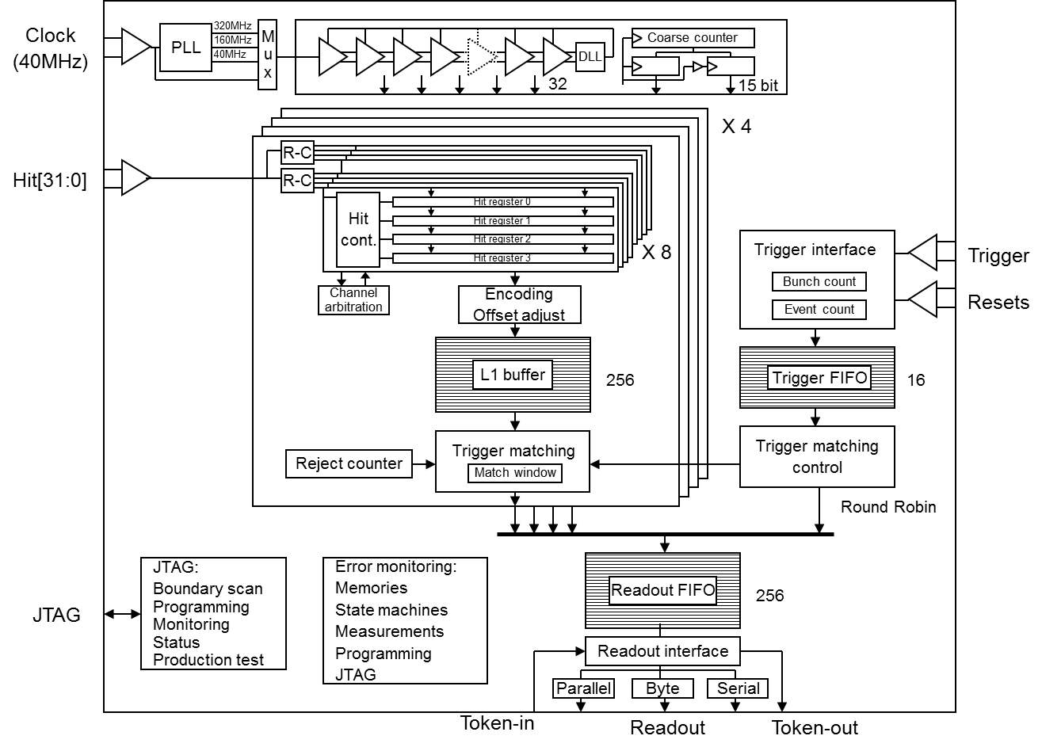
Good old HPTDC

Slide 8
New TDC
Needs for different projects ?.
HEP, (Especially at CERN as good justification for us)
Other ?
Requirements:
Time resolution
High resolution (1-10ps) : TOF type applications
Mid resolution (~100ps): ?
Low resolution (~1ns): Drift time measurements (can be done with FPGA’s but rad tol an issue)
Channels,
Triggering,
Buffering,
Readout,
Radiation tolerance
?
When and how many
Analog front-end application specific (e.g. NINO)
We are not (yet) proposing to make new analog front-end - discriminator
Collaboration to assemble sufficient resources
Other ongoing TDC developments ?

Slide 9
Possible spec of new “super” HPTDC
32, 64 or 128 channels
Depends on system configuration and chip packaging what is best.
6.1ps binning (with 40MHz reference),
RMS resolution = ~ 2-3 ps (possibly a bit worse if going for lower power)
Low power modes: 12.5ps, 25ps, 50ps, 100ps
Disable resistive interpolation (factor 4 in resolution and power)
Run DLL at lower (1/2 – 1/4) frequency (factor 2-4 in resolution and power)
SLVS (low voltage differential) inputs with on-chip termination.
LVDS compatible ? (higher chip cost as double gate transistors required)
Resistor network to “convert” to SLVS
40MHz time reference (low jitter PLL to be integrated)
Other reference frequencies required ?
Leading, Trailing, and TOT measurements (leading +width).
Dynamic range: Counter size limited: 16bit - 32bit Readout bandwidth -> Two modes: Large, Small ?
Non triggered
Triggered with programmable latency, window and overlapping triggers.
Buffering: ~256 hits per channel, ~1024 hits readout FIFO.
Readout: SLVS (LVDS , Single ended needed ?)
E-link (serial: 40, 80, 160, 320 Mbits/s) of the GBT optical link chip.
Parallel (byte/word) readout.
Other ?
Control/monitoring via “I2C” (1.2v CMOS levels) . Or E-link, JTAG ?.
Radiation tolerance
TID: should be OK to several Mrad (if not using double gate transistors)
SEU detection ( protection on control path ?).
Not rad hard as then strict export/use restrictions
Power consumption: Max 1 – 2 W
Significantly lower for lower resolution modes ~1/4
Technology: 130nm CMOS

Slide 10
Way ahead
Political justification to start project
Your help appreciated/vital
Timing core designed, tested and characterized (Lukas)
Extend to required number of channels
Power optimization
Timing capture: clock sampling or hit sampling
Course counter
Low jitter PLL: Few ps jitter PLL not trivial
Based on PLL from GBT if it can be modified with limited efforts ( 3-6 months)
Buy PLL IP block if one with sufficently low jitter can be found ( ~50k)
HPTDC Verilog model to be modified/simplified and re-verified
Individual buffers per channel simplifies Verilog model as hits in chronological order.
~3 years for final design
Year 1: Specs, Verilog model, PLL
Year 2: Synthesis, P&R, Verification, Prototype
Year 3: Testing, Production version, Packaging, Prod test.
Manpower:
¼ senior/rusty designer,
3 years fellow, Support from experiments/users vital
2 x technical student (6-12Months) for test/prod.
Funding:
(PLL: 50k, 2014, if GBT PLL not appropriate)
(P&R 50k, 2015, if short on manpower)
MPW Prototype: 100k, 2015
Final production masks: 450k, 2016 (1/2 or less if shared with other project)
Packaging: 50k (depending on package type)
Contributions/collaboration from others ?.
Design: PLL, HDL, Hit receiver, P&R
Test and qualification
Financial

Slide 11
Architecture outline
Delay cell
DLL
PLL
Clk
Resistive
interpolation
R
R
R
R
R
R
R
R
R
R
R
R
Hits
(32 - 64)
Capture Register
Config and monitoring
Encoding
Channel
buffer
I2C
(Trigger)
Trigger matching
Readout
FIFO

Slide 12
TDC ASIC’s for physics
Only very few flexible TDC ASIC’s are available for HEP (e.g. HPTDC).
Resolution
Number of channels
Data buffering, triggering and readout
Radiation tolerance
Flexibility can be obtained by FPGA based TDC’s but
Limited resolution
many experimental circuits being tried: Gate delays, fast carry chains, Vernier principle using different loading, Wave union,
Channel count
Radiation tolerance
Cost, power and integration for large scale system

Slide 13
Difficulties in the ps range
Calibration is a must, but at what rate
We therefore tend to prefer auto calibrating architectures based on DLL’s (basic offset calibration still required)
Slew rate of signals much slower than resolution aimed at (digital signals do not exist in the ps domain)
Matching gets critical and mis-match compensation becomes a must if aiming at ~ps resolution.
Automated on chip (for commercial applications)
With help from “outside” (OK in HEP). We can even work with imperefct TDC’s if it can be appropriately corrected in software.
Distribution of timing signals gets critical (R-C delays in Al, Cu wires, via’s, contacts, etc.)
Metastability in timing capturing circuit gets significant/critical.
Interpolation to high ratios gets increasingly sensitive to power supply noise (even for the digital approaches), substrate coupled noise, etc.
Routing delays are significant and difficult to balance (especially for loop feedbacks and parallel load of many registers)
Phase error across DLL (phase error in PD and end-begin effect)
Testing a TDC with ps resolution is far from trivial
Stochastic testing for linearity (Code Density Test).
Fixed delays for jitter and stability.
Time sweep if you can find the appropriate instrument (resolution and jitter) and can afford it
System level performance is what counts in HEP !
Detector, analog front-end, discriminator, time walk compensation, board design, power decoupling, connectors, cables, stability (jitter) across full system, timing distribution across full system, calibration, , ,

Slide 14
Warnings when it comes to compare TDC performance
If only obtained on simple test circuit
No additional circuitry introducing noise (substrate, ground, Vdd, crosstalk)
If only demonstrated over small dynamic range
If not clearly demonstrating correct alignment between coarse and fine interpolation(s).
If results shown with averaging over many hits.
If only showing jitter/effective resolution at some fixed measured intervals
Temperature, voltage, process variations
Mismatch not analyzed and only show measurements from one single chip/channel.
Why make a 1ps “resolution” TDC if effective RMS resolution is much worse than this ?.
Reminder for perfect TDC: RMS = bin/v12 = bin/3.5
Global aim: RMS <= Bin size.
(Exception if averaging of multiple measurements can be made)
How to use efficiently in a large system ?

Slide 15
clients/users
LHCb Torch
Totem
HPS (CMS), FP420 (ATLAS)
Panda
CBM
CAEN
Crispin Williams
Other ?

Slide 16
Back up slides

Slide 17
Start – stop measurement
Measurement of time interval between two local events: Start signal – Stop signal
Used to measure relatively short time intervals with high precision
For small systems (1 channel)
Like a stop watch for a local event
Time tagging
Measure time of occurrence of events in relation to a given time reference Time reference (Clock) Events to be measured (Hit)
Used to measure relative occurrence of many events on many channels on a defined time scale
Such a time scale will have limited range but can be circular (e.g. LHC machine orbit time)
For large scale HEP systems
Like a normal watch with a common 24h scale
Start
Stop
Time scale (clock)
Ch1
Ch2
ChN

Slide 18
Interface to front-end and time walk compensation schemes
Basic discriminator
Significant time walk (depending on signal slew rate)
Double threshold
Interpolate to “0” volt amplitude
Needs two discriminators and two TDC channels, Limited efficiency reported in practice.
TDC plus pulse amplitude (peak or charge) measurement with ADC
ADC measurement expensive and slow (may be needed anyway)
Time walk
Thr
Thr2
Thr1
Amp1
Time walk
Amp2
Thr

Slide 19
Enable (thresholded)
Constant Fraction Discriminator: CFD
Compensate directly in discriminator
Works very well for fixed pulse shape with varying amplitude.
Needs delay: Made as distributed RC within ASIC’s(but also works as filter)
If signal shape not constant then ?.
Leading edge + Time Over Threshold (poor mans ADC)
Minimal extra hardware (also measure falling edge time)
Has been seen to work quite well in several applications.
If signal shape not constant then ?.
TOT now very often seen in HEP for indirect amplitude measurement with moderate resolution
Delayed
Thr
Original
Fraction of
original
Crossing point
independent
of amplitude
Time walk
Thr
TOT

Slide 20
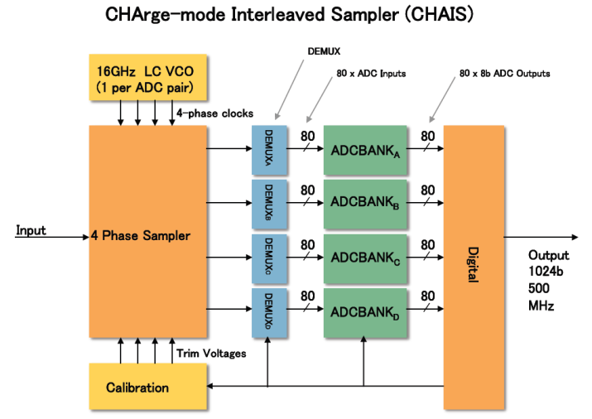
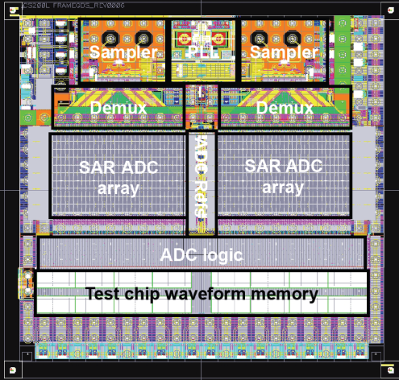
Alternative: Very fast analog sampling
Pulse matching – highest possible flexibility and performance
High power – low channel density
64GHz 8b ADC’s now feasible, 2W
100GbE optical
Large amount of data to read out and process (unless done on chip).
Multiple sampling capacitor array chips made in HEP community
Sampling rate: 1 – 5Gs/s
Analog bandwidth: Few hundred MHz - GHz
Resolution: 8 – 12 bits
Memory size
Channel count
Triggering - Buffering
ADC
Readout

Slide 21
Time measurement
Clock
Counter
Coarse count: ~1ns
Multi GHz counters can be made in modern ASIC’s.
Gray code
Only one bit changing
Dynamic range: Large
1st. Level fine interpolation:
Extract timing difference between signal and reference (clock)
Dynamic range: 1 (2) clock cycle
A: Use same interpolation reference as counter (Clock).
B: Use Different “reference”
Alignment between coarse and fine needs special care.
Must be done with precision of full resolution
If badly done then large error (coarse count) in small time window around coarse time change.
Example: Use of two phase shifted binary counters and selecting one based on fine interpolation.
Hit
Register
Clock
Cnt
N
N+1
N+2
N+3
N+4
N+5
Hit
Coarse
N
N+1
N+2
Fine
0 – 1 clock
Fine
1 – 2 clocks
Start
Stop

Slide 22
Time to amplitude
Time to Amplitude Conversion: TAC
Classical type high resolution TDC implemented with discrete components
Delicate analog design
Requires ADC
Slow conversion time –> dead time
Not using same reference as coarse time
Dual slope Wilkinson ADC/TDC
Time stretcher
Measure stretched time with counter
Slow: Analog de-randomizer
Example: NA62 GTK in-pixel design
I
V
T*I\C
Start
Stop
ADC
Start
Stop
I
Start/stop
Stop/start
C
I/k
V
I
I/k
Start
Stop
T= (1+k)(Stop- Start)

Slide 23
Delay line based
Basic principle
Use “gate” (inverter) delays
Normally two inverters
Gate delays have large process, voltage and temperature dependency
Using inverting cell
Rise and fall time ( N and P transistors) does not match well over process, voltage and temperature.
Different tricks can be used to make inverting and non inverting buffer have “same” delay but remains problematic.
Fully “digital”
Capture:
Use hit as clock to capture state of delay chain
Use delay signals to capture state of hit signal (high speed sampler)
Delay Locked Loop
Control delay chain to cover exactly one clock cycle.
Compensates for Process, Voltage and Temperature effects (but not miss-match)
Uses same timing reference as course count and self calibrates to this.
Begin-end effects, Phase error, Jitter, Delay cell matching
Such a delay locked loop is a very quite circuit as all transitions are perfectly distributed over clock period (not the case for the Hit signal)
Half digital / half analog
Start
Stop
Register
Start
PD
Charge
pump
Clock
Hit
Register
23

Slide 24
Delay elements
Current starved inverters/buffers
N-side, P-side, Both
Only one of the two current starved
Regulate delay chain power supply with local LDO
Careful interfacing to other circuits
Differential delay cell
Consumes DC power -> More power
Only needs one cell per delay (better resolution)
(Less sensitive to power supply noise)
(Generates less noise)
Different types of loads can be used
Inductive peaking can gain ~20%
~25ps possible in 130nm, worst case
Pseudo differential and many more
VDD
CP
LDO
Bias
In
Bias
24
In
Bias

Slide 25
Sub-gate delay. 2nd. interpolation
Vernier principle
Difference in delays can be made much smaller than delay in cell R=T2-T1
Basic Vernier chain gets impractical long
Performance gets miss-match dominated
Delay difference can be implemented in many ways:
Capacitance loading
Transistor sizing
Different current starving
etc,.
How to lock to reference ?
DLL’s locked to different references
DLL’s with different number of delay cells locked to same reference.
T1
Start
Stop
T2

Slide 26
DLL arrays
An array of DLL’s can use the Vernier principle
DLL’s auto lock to common timing reference
Example: Improve binning from 25ps to 6.25ps
4 equal DLL’s driven by fifth DLL with slightly larger delay
Potentially very miss-match sensitive
1 DLL driving many small DLL’s
Less miss-match sensitive (miss-match correction still advantageous)
Non trivial layout to assure matching routing capacitances and R-C delays
T1
T2=5/4T1
5
4

Slide 27
Passive delays
In modern IC technologies wiring delays already the dominating source of delays.
No easy way to “lock” to global reference
Some kind of adjustment required
R-C delay
The adjustment of any tap affects all the other taps
Used in HPTDC. In practice a bit of a pain (but works)
Transmission line
Short delays can be made with on-chip transmission lines
Predefined and characterized transmission lines exists in may chip design kits.
Lossy so signal shape changes down the line.
Can be used on hit signals instead of on DLL signals
Flexibility on channel count versus resolution (used in HPTDC)
This scheme can be used with many approaches

Slide 28
Looped Vernier (beating oscillators)
Two delay chains/loops propagates timing signals with slightly different delay.
Start – Stop type
Start oscillators with start and stop signals
Latch loop1 count (start) when stop occurs
Latch loop2 count (stop) when edge in loop2 catches up with edge in loop1.
Store in which vernier cell the two edges meet.
Appears elegant but hard to implement:
Loop feedback time and re-coupling must be “zero” delay
Circular layouts tried (but not so good for matching)
All this per channel
No direct lock to a reference
Long conversion time -> Dead-time
Some errors accumulate during recirculation
T1
Start
Cnt1
Ver
Stop
Cnt2
T2
Vernier point where loop2 edge ”meets” with Loop 1 edge
Start
Stop
Cnt1
Coarse
Cnt2
Fine time interpolation expanded to be sum of Cnt2 plus Vernier

Slide 29
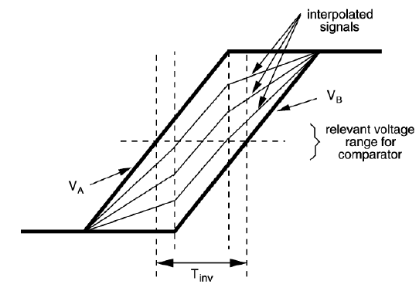
Analog interpolation between delay cells
Resistive voltage division across neighbor delay cells.
Rise times in delay chain longer than delay of cell.
Purely resistive division “autoscales” with delay of delay cell
Only carries current during transitions.
Parasitic capacitance makes this resistive division a mixture of resistive division and R-C delays
Relatively low resistor values required to prevent being R-C dominated.
With equal resistances the bins are not evenly spaced -> re-optimize individual resistors
Does not any more fully “autoscale” to delay of delay cell.
Can be done on single ended and differential delay cells
Delay cell
R
R
R
R
R
R
R
R

Slide 30
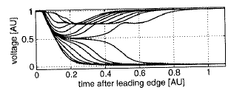
Time amplifier in “metastable window” of latch (with internal feedback).
Any type of latch have a small time window where it enters a metastable region and it takes some time to resolve this
A small change of timing on the input gives a “large” change of timing on the output: Time Amplifier
For very high time resolution cases.
Only small window where time amplification occurs
Non linear, Very sensitive to power supply, etc.
Hard to use in practice
For 3rd level interpolation
Plus other “exotic” schemes.
(implementation nightmare)
1ns
0
1
10ps
10ps

Slide 31
Central timing block
Reference
(Clock)
Centralized timing block locked to global reference (e.g. DLL array)
For multi channel TDC’s it is attractive to have a central timing block used to drive array of individual channels
Minimal complexity per channel.
Only one block to calibrate.
Power consumed in timing block less critical (but timing distribution to channels gets significant)
For very high resolution TDC’s this gets increasing difficult as required signal propagation delays larger than required resolution (miss-match !).
Buffer delays large than resolution: miss-match sensitive
For highly distributed TDC functions on large chips (e.g. pixel chips) it gets routing and power prohibitive even for low time resolution.
Alternative: Centralized DLL locked to reference generates control voltage to distributed delay loops (miss-match !)
Ch0
Register
Ch1
Register
ChN
Register

Slide 32
Time capture registers
The latches/registers used to capture the timing event gets critical in the ps range
Fast capture/regeneration registers required
Timing signals have large rise/fall times compared to required resolution.
Small and well defined metastability window with good resolving capability.
Single ended (e.g. classical master slave FF) or differential (sense amplifier for fast SRAM’s)
Mismatch between registers
Assuming multiple registers must latch at same instance
Routing of hit signal to registers must be done with care

Slide 33
Example HPTDC
Features
32 channels(100ps binning), 8 channels (25ps binning)
LVDS (differential) or LVTTL (single ended) inputs
40MHz time reference (LHC clock)
Leading, trailing edge and time over threshold (for leading edge time corrections)
Non triggered
Triggered with programmable latency, window and overlapping triggers
Buffering: 4 per channel, 256 per group of 8 channels, 256 readout fifo
Token based readout with parallel, byte-wise or serial interface
JTAG control, monitoring and test interface
SEU error detection.
Power consumption: 0.5W – 1.5W depending on operating mode.
Used in large number (>20) of HEP applications:
ALICE TOF, CMS muon, STAR, BES, KABES, , ,
Commercial modules from 3 companies
~50k chips produced
250nm technology (designed ~10 years ago for LHC experiments)
On-chip clock
crosstalk corrected
Offline:
40ps –> 17ps RMS

Slide 34
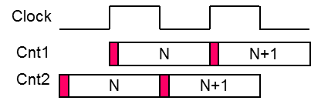
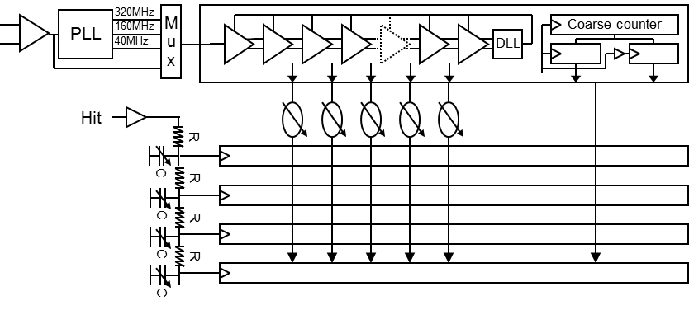
HPTDC Time measurement
Combination of
Counter with PLL for clock multiplication (x1, x4, x8)
Double phase shifted counters to resolve possible metastability in coarse count measurement.
DLL with 32 taps for clock interpolation
Use of differential delay cell for power supply noise immunity
R-C delay line on hit signals for very high resolution
Channel reduction by factor 4 (8 channels per chip)
Low resolution: 781 ps
Medium resolution: 195 ps
High resolution: 98ps
Very high resolution: 24ps (8 channels)
Ch0
Ch1
Ch2
Ch3
Very high resolution
R-C delay line dependent on IC processing (Only small difference between chips seen) R-C delay line independent of temperature in range of 20 deg Infrequent calibration required Calibration can be obtained with code density test with physics hits Option of correcting integral errors from DLL 8 channels per chip Not possible to pair leading and trailing edges

Slide 35
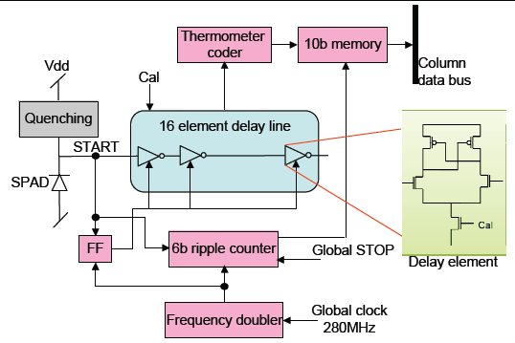
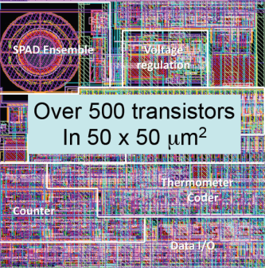
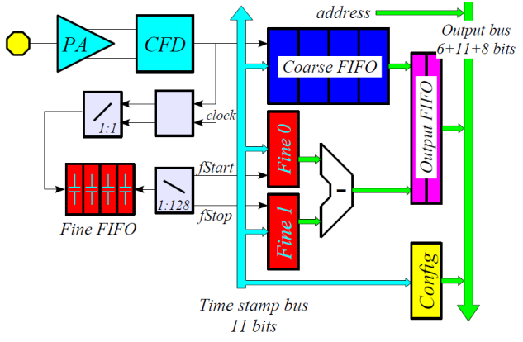
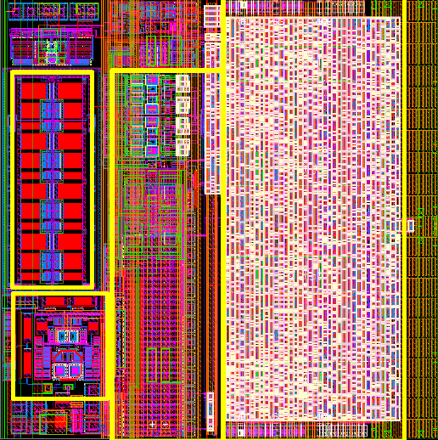
TDC’s for pixel applications
For large pixel array chips with TDC function the routing and power to distribute required TDC signals to whole array may get power/routing prohibitive
Local TDC in each pixel or shared among neighbor pixels (super-pixel)
Local TAC with dual slope Wilkinson ADC
Local delay loop (oscillator) only running when hit has been seen.
Controlled from central DLL locked to timing reference
Route hit signals (e.g. or’ing of pixels if rate allows) to centralized TDC block
SPAD with TDC: ~100ps binning
NA62 GTK: 100ps binning
A: TAC per pixel with CFD and analog de-randomizer
B: DLL for leading and TOT per column
Timepix3: ~1ns binning
Local oscillator only running when hit occurs. Controlled from central DLL
SPAD array, E. Charbon, Delft
GTK in-pixel, G. Mazza, Turin
GTK EOC, A. Kluge, CERN

Slide 36
Conclusions
Many different schemes and variants to get ~ps resolution in ASIC’s.
Combination of several to get dynamic range and resolution
Fast (Gray) counters +
DLL’s +
Vernier - delay difference +
R-interpolation +
Time amplifier
Etc.
Stability, jitter and miss-match critical at this level of timing resolution.
Global system timing resolution is what counts in HEP

Slide 37
NEW HEP Versatile TDC ?
64 or 128 channels
5 – 10 ps bin, RMS: 2 – 5 ps, Delay Locked Loop based
Option A: R(-C) interpolation
Option B: Array of delay locked loops on same reference
Option C: Single DLL on clock + DLL on hits
Adjustment features to allow compensation of miss-match effects.
RMS to be better that bin size (resolution)
Global time reference compatible with major experiments (e.g. 40MHz for LHC)
Internal PLL for clock multiplication (jitter critical)
Flexible data buffering, triggering and readout
Use general scheme as used in HPTDC
Max 10mW per channel
Timing part of such TDC currently under study
130nm CMOS
Finalization depending on actual needs (and funding and manpower)
Versatile front-end/discriminator more delicate

Slide 38
25ps
PLL
1.25GHz
DLL
Coarse counter
21 bit
25ps ⁺ 6.26 ps
2 x 21 bit
DLL
DLL
DLL
4 x 32 time taps

Slide 40
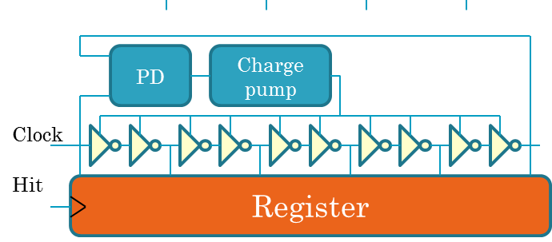
Time capture
Hit sampling interpolator signals
Hit based intrinsic zero-suppression
Need of course counter
Double pulse resolution determined by time to empty sampling register
Small hit buffer per channel
Efficient to share buffer resources
Needs to sync to logic clock
HPTDC
Interpolator signals sampling hit
Continuous sampling
Can digitize input signal without any double pulse constraints
Requires high speed pipelined logic afterwards to reduce data
Buffer sharing difficult.
New Super-HPTDC ?

