Slide 1
Astrophysical Constraints on Secret Neutrino Interactions
Shun Zhou (周顺)
KTH Royal Institute of Technology, Stockholm
Shanghai Particle Physics and Cosmology Symposium
June 3-5, Shanghai

Slide 2
Outline
Motivation and General Arguments
SN Bound on a neutrinophilic 2HDM
BBN Bound on a Dark Matter Model

Slide 3


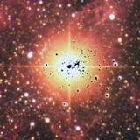
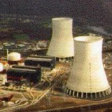

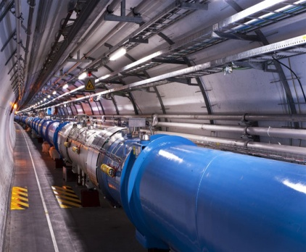


Neutrino Sources in Nature
Earth Crust
(Natural
Radioactivity)
Sun
✓
✓
Supernovae
✓
Nuclear
Reactors
SN 1987A
✓
Particle
Accelerators
✓
Earth Atmosphere
(Cosmic Rays)
✓
Cosmic Big Bang
(Today 330 ν/cm³)
Indirect Evidence
Astrophysical
Accelerators
Already?

Slide 4
Where to Test Neutrino-Matter Interactions
Discovery of neutrino oscillations
New physics beyond the std. model
Exotic interactions with matter
To Derive Experimental Constraints:
Based on the SM of elementary particle physics and cosmology
Assume non-standard neutrino interactions
Compare with the precise measurements and cosmological observations

Slide 5
Where to Test Neutrino-Neutrino Interactions
Secret Neutrino Interactions
High neutrino number densities
Neutrinos play an important role
Agreement with standard theories
Neutrinos in
Supernovae
SN 1987A
Neutrino signal from SN 1987A
Average energy and sig. duration
Consistent with delayed-explosion
Neutrinos in the
Early Universe
Primordial abundance of light elements
Cosmic microwave background
Consistent with the std. cosmology

Slide 6
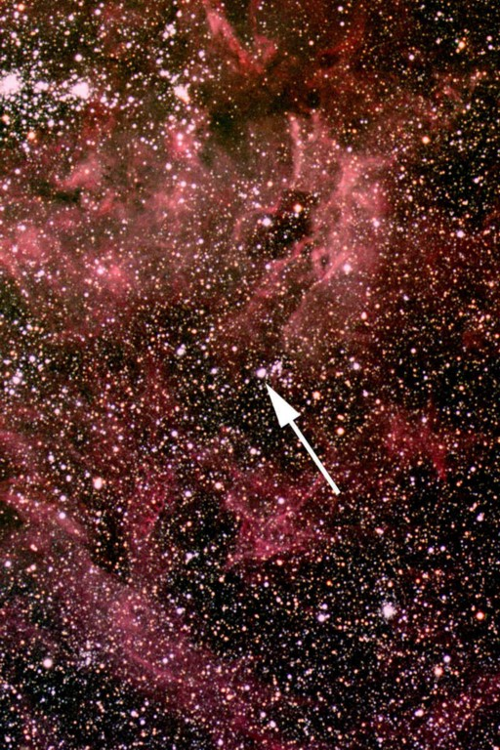
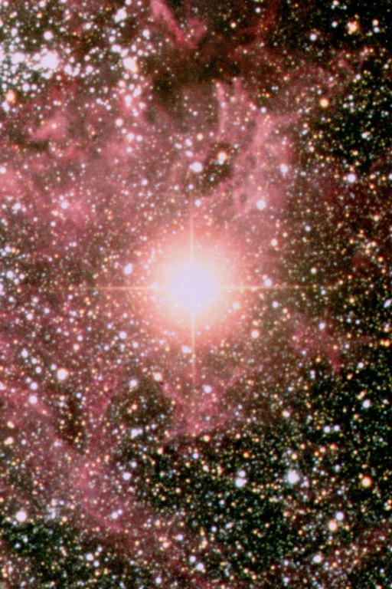
Sanduleak −69 202
Supernova 1987A
23 February 1987

Slide 7
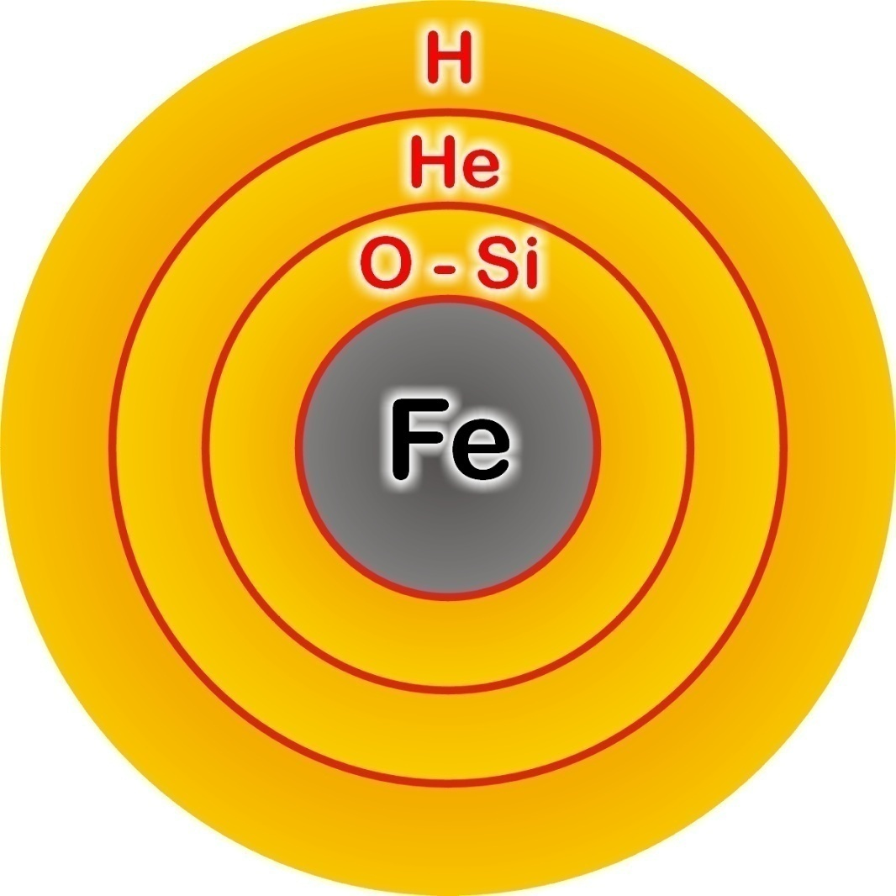
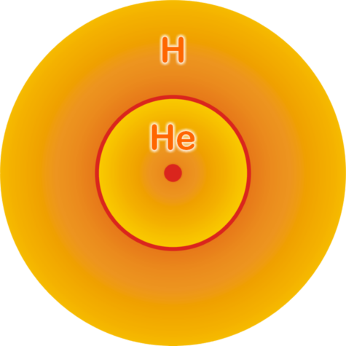


Supernova Explosions
©Raffelt
©Raffelt
Main-sequence star
Onion structure
Helium-burning star
Collapse (implosion)
Degenerate iron core:
ρ ≈ 10⁹ g cm⁻³
T ≈ 10¹⁰ K
M_{Fe} ≈ 1.5 M_{sun}
R_{Fe} ≈ 8000 km
Hydrogen Burning
Helium
Burning
Hydrogen
Burning

Slide 8



Supernova Explosions
©Raffelt
©Raffelt
Newborn Neutron Star
Collapse (implosion)
Explosion
~ 50 km
Neutrino
Cooling
Proto-Neutron Star
ρ ≈ ρ_{nuc} = 3 × 10¹⁴ g cm⁻³
T ≈ 30 MeV

Slide 9
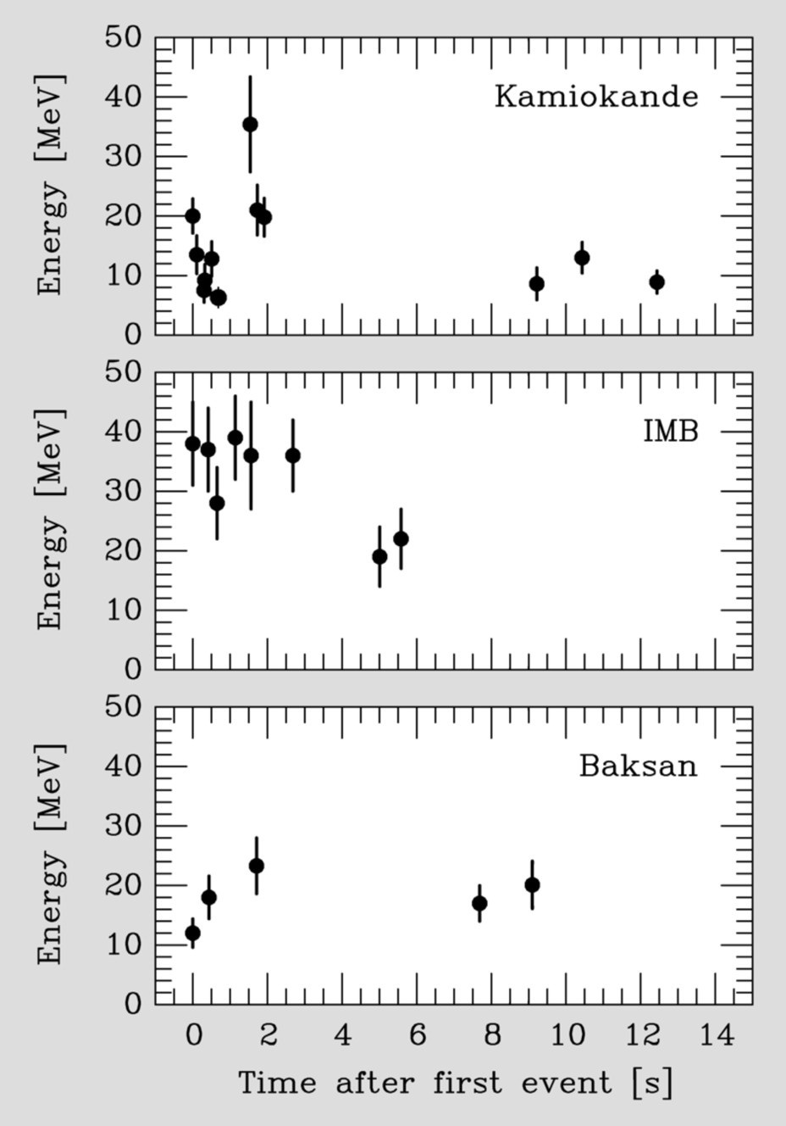
Neutrino Observation of SN 1987A
Neutrino Signals from SN 1987A
Kamiokande (Japan) and IMB (US):
Water Cerenkov Detector
Intended for Proton Decays
Baksan (Soviet Union):
Scintillator Telescope
Clock Uncertainty: + 2/-54 s
Information from observations
Standard Picture of Core-collapse SNe
Neutrino Diffusion Time from the NS
Neutrino Luminosity Lν = 10⁵³ erg s⁻¹

Slide 10
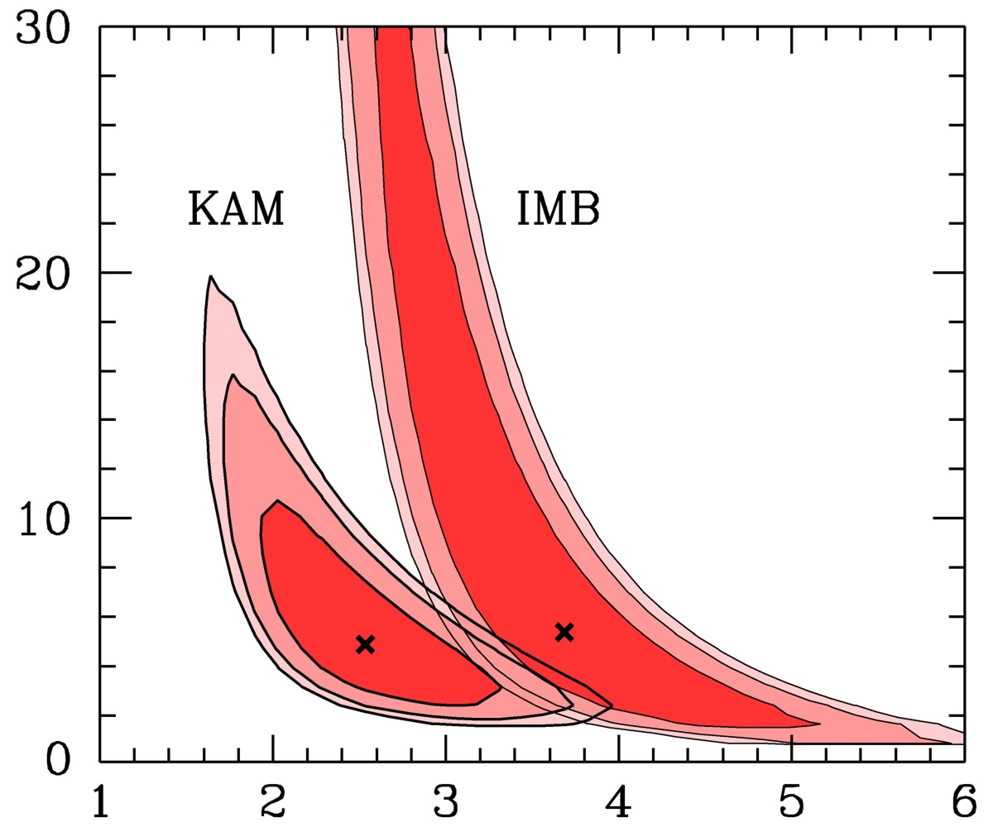

Neutrino Observation of SN 1987A
Contours at CL
68.3%, 90% and 95.4%
Assumptions:
1. Thermal Spectra
2. Energy Equilibration
Recent long-term
simulations
(Basel, Garching)
E_{b} [10⁵³ ergs]
Jegerlehner,
Neubig & Raffelt,
PRD 54 (1996) 1194
Spectral anti-ν_{e} Temperature [MeV]

Slide 11
Supernova Explosions
Gravitational Binding Energy
outshine the host galaxy

Slide 12
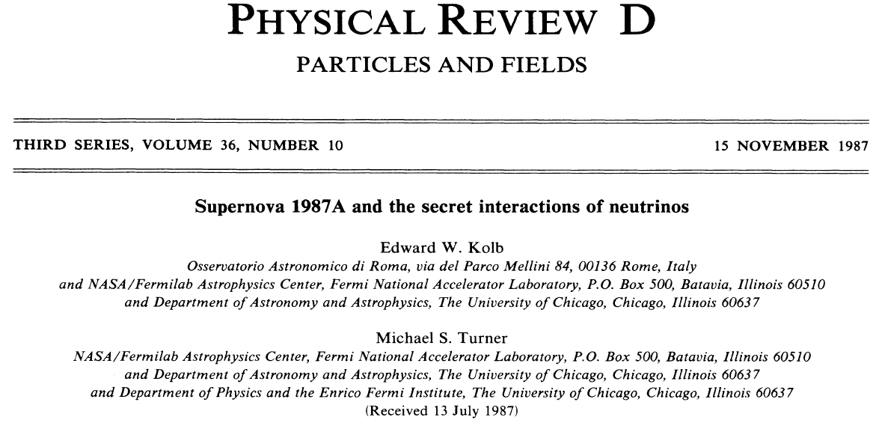
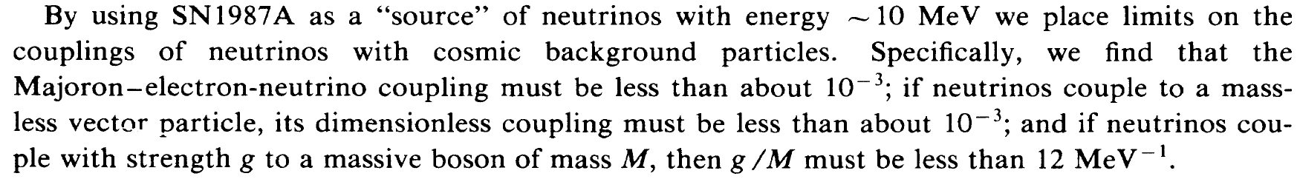
Supernova Bound on secret neutrino interactions

Slide 13
Energy-loss Argument
Neutrino Cooling
If new weakly interacting particles can be produced in the supernova core, they will steal energies from neutrino bursts, which reduces the duration of neutrino signals.
Volume Emission of New Particles
Proto-Neutron Star
ρ ≈ ρ_{nuc} = 3 × 10¹⁴ g cm⁻³
T ≈ 30 MeV
Axions, Majorons, Sterile Neutrinos, …

Slide 14
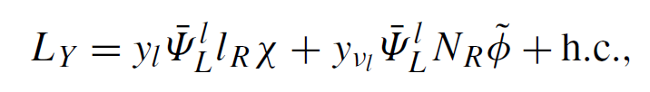
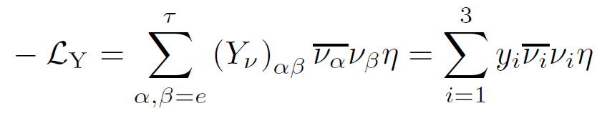
Supernova Bound on a neutrinophilic 2HDM
Excluding a ν2HDM
Wang et al., EPL 76 (2006) 388;
Gabriel & Nandi, PLB 655 (2007) 141;
Sher & Triola, PRD 83 (2011) 117702
Tiny Dirac neutrino masses from small vev and large Yukawa coupling
But …… a light scalar boson, interacting only with neutrinos----Safe?
Constraints from the neutrino observation of SN 1987A

Slide 15
Supernova Bound on a neutrinophilic 2HDM
S.Z., PRD 84 (2011) 038701
Kolb-Turner Criterion
D λ⁻¹ <1
Neutrino-sphere
y_{i} <1.5 x 10⁻³
D = 51.4 kpc

Slide 16
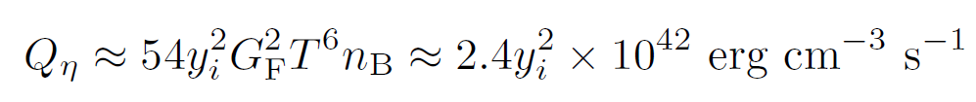
Supernova Bound on a neutrinophilic 2HDM
S.Z., PRD 84 (2011) 038701
Energy-loss Argument
produced in the SN core, but decay back to neutrinos
y_{i} ~ 10⁻⁴
τ = (3y²m/16π²) ⁻¹ ~ 10⁻⁹ s
m = 1 keV
But …… T = 30 MeV, E = 3 T , leading to a Lorentz factor of 10⁵
y_{i} <3.5 x 10⁻⁵

Slide 17
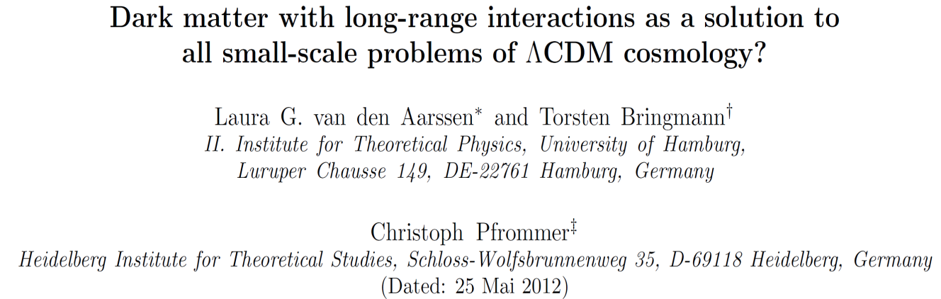
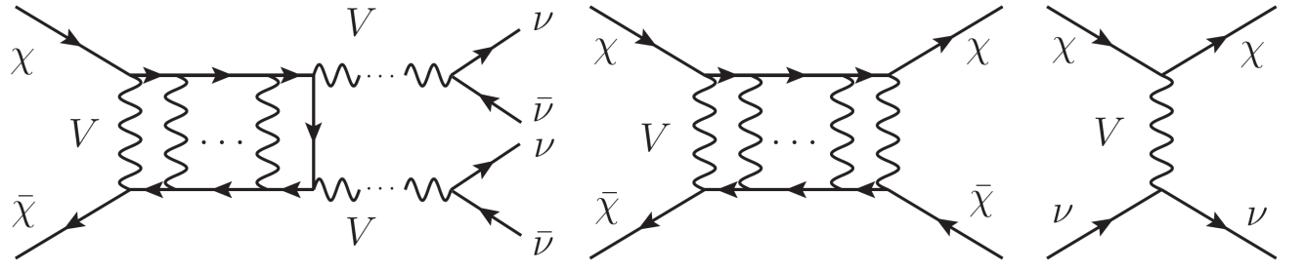
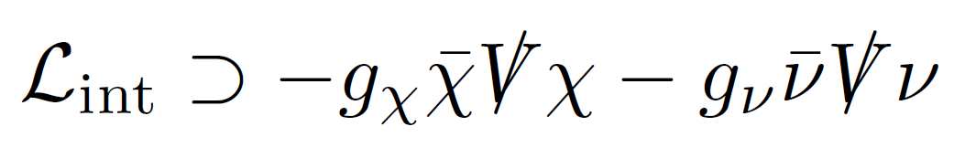
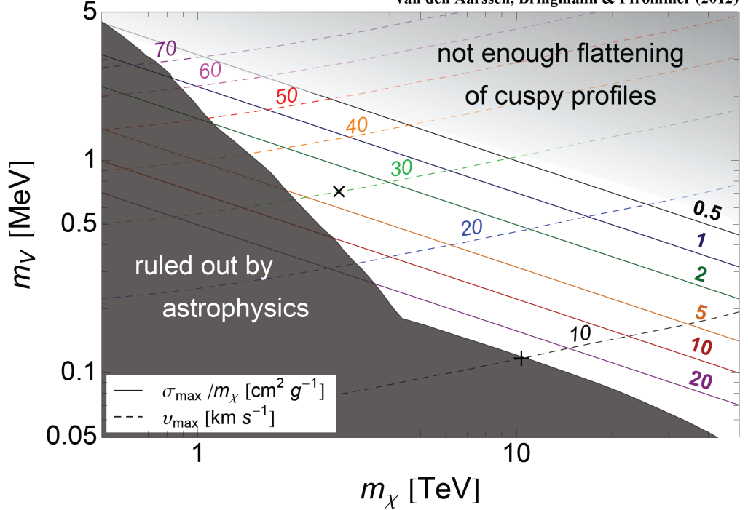
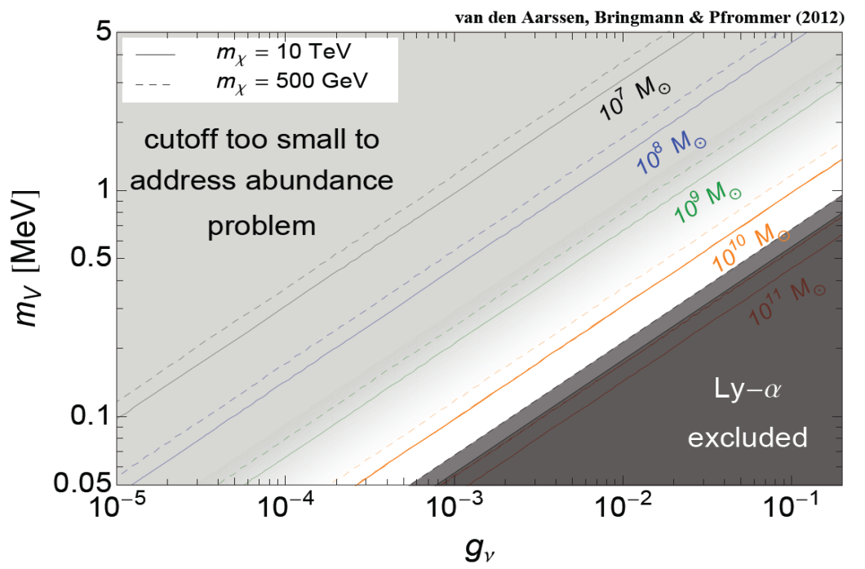
A CDM scenario without small-scale problems
arXiv: 1205.5809

Slide 18
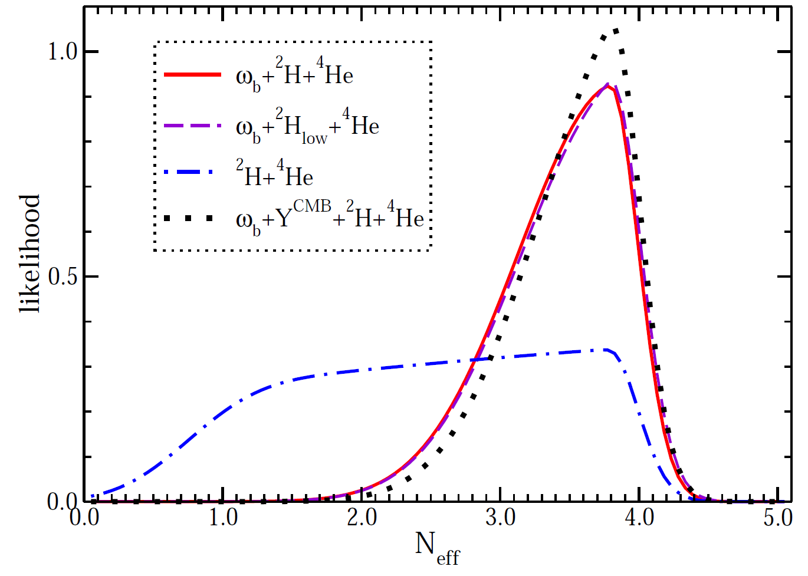
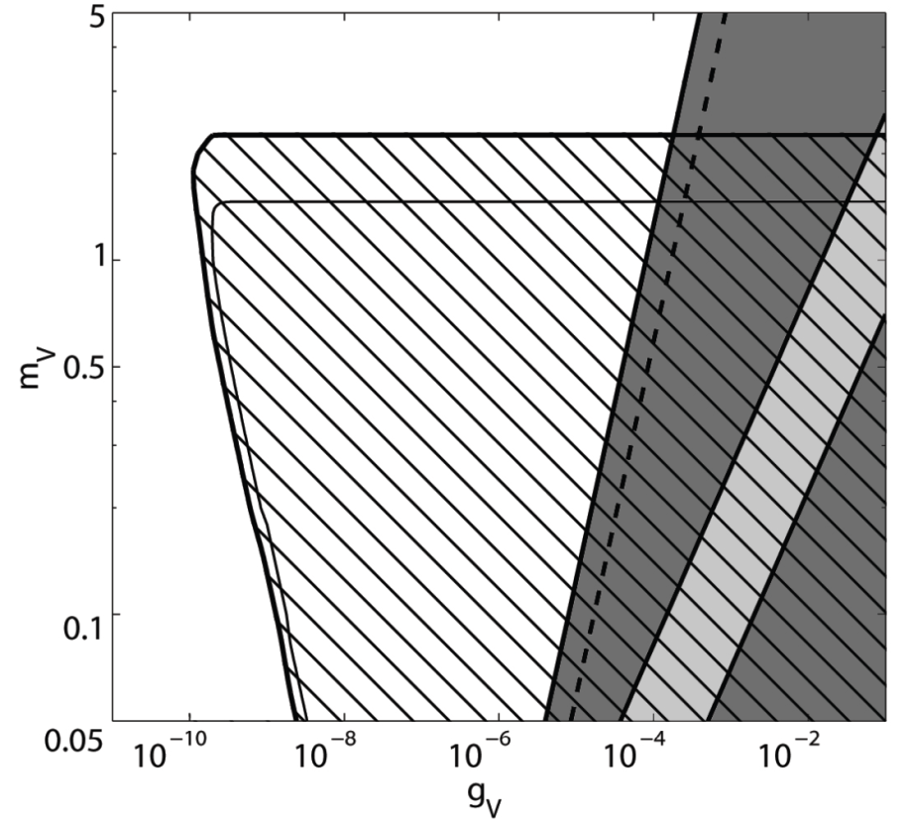
Constraints from BBN
Neutrinos interact with an MeV-mass vector boson
In thermal equilibrium:
Inverse decays
Pair production
Constraints from K and W decays
Enhanced total width
Two vs. three-body decays
BBN bound: ΔN_{eff} ≤ 1 @ 95% C.L.
Laha, Dasgupta & Beacom
1304.3406
ΔN_{eff} =1
K decay
W decay
ΔN_{eff} =1.3
Mangano & Serpico
1103.1261
Ahlgren, Ohlsson & S.Z.
in preparation

Slide 19
Summary
Neutrino signals from SNe can be used to place stringent limits on exotic neutrino interactions, as well as other weakly interacting particles.
We show a neutrinophilic 2HDM has been excluded, based on the simple energy-loss argument. Using the BBN bound on extra neutrino species, we have derived very restrictive constraints on a CDM model.

