Slide 1


SoLID at Jefferson Lab
Zhiwen Zhao (赵志文）
University of Virginia
for SoLID Collaboration
SPCS 2013
2013/06/03-05

Slide 2
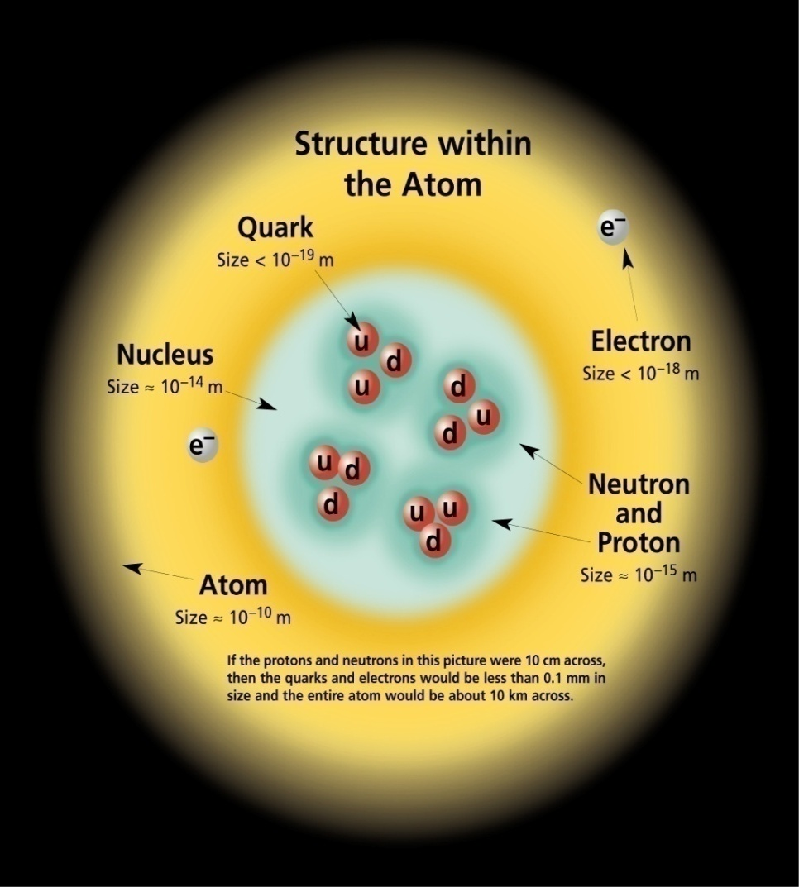
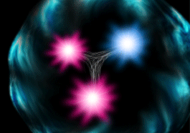
What Is the Visible World Made of?
Visible Matter → Atom → Electrons + Nucleus
Nucleus → Nucleons → Quarks + Gluons
Nucleon has far more than just valence quark structure like proton (uud) and neutron (udd)

Slide 3
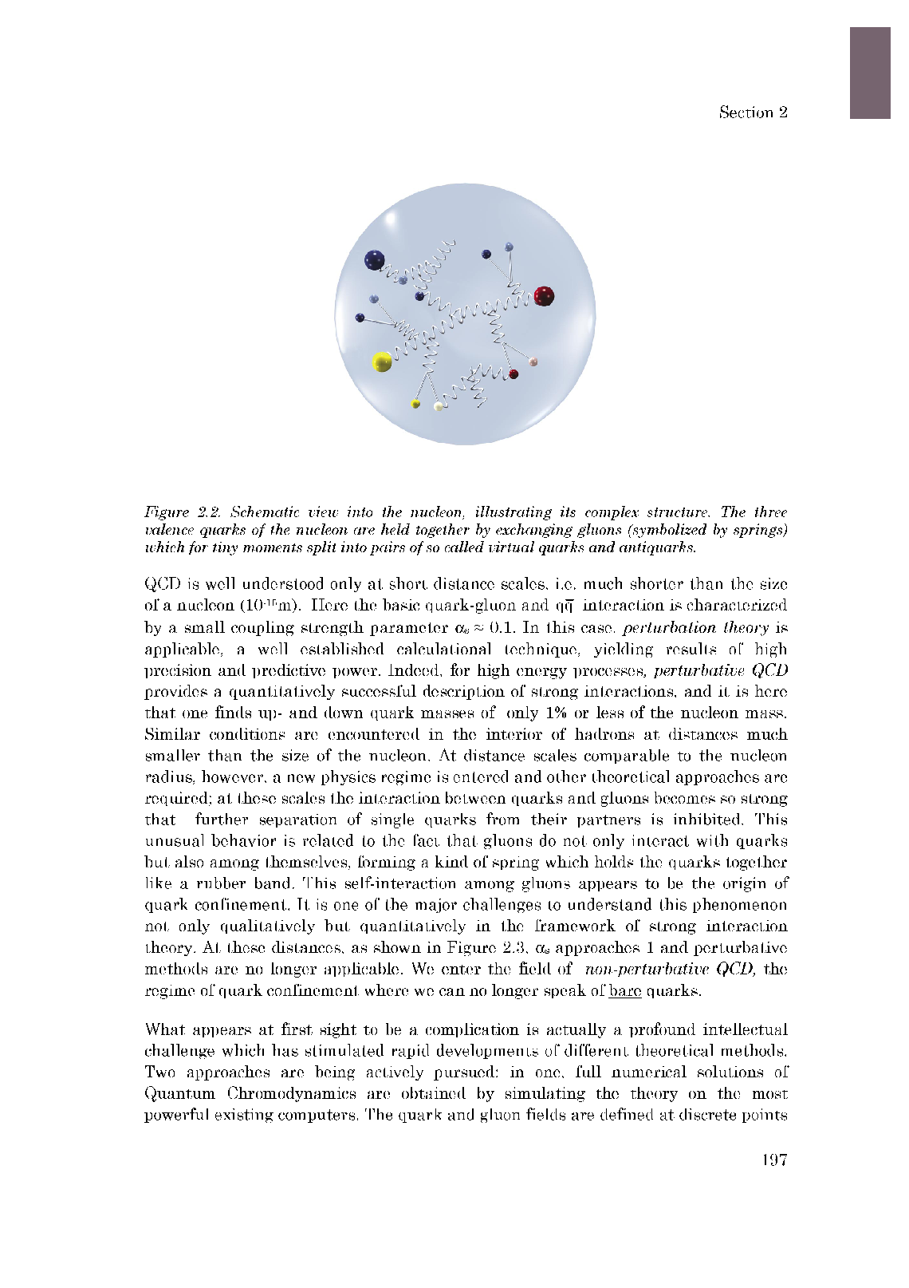
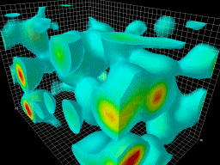
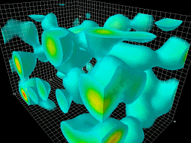
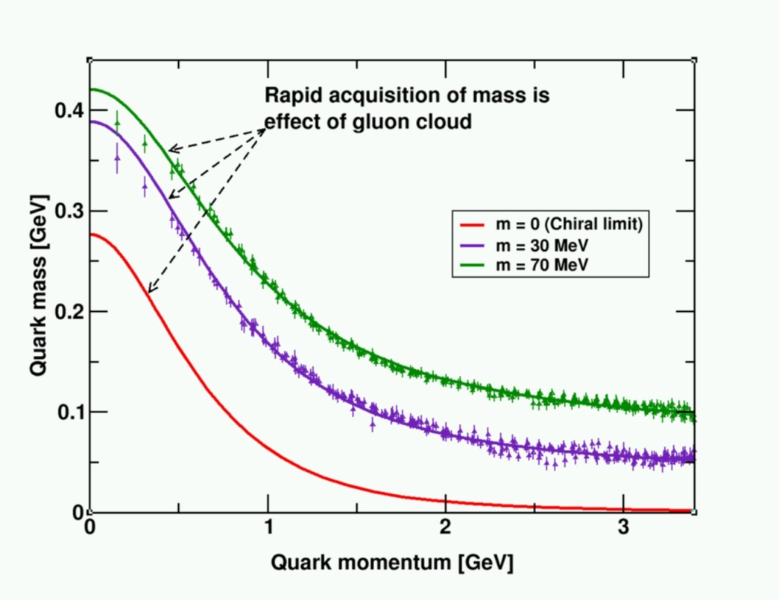
QCD and the Origin of Mass
99% of the proton’s mass/energy is due to the self-generating gluon field
  Higgs mechanism has almost no role here.
The similarity of mass between the proton and neutron arises from the fact that the gluon dynamics are the same
  Quarks contribute almost nothing.
M(up) + M(up) + M(down) ~ 10 MeV << M(proton)

Slide 4
What Are the Challenges?
Success of the Standard Model
Recent discovery of “Higgs-like” particle
Electro-Weak theory tested to very good level of precision
Strong interaction theory (QCD) tested in the high energy (short distance) region
Major challenges:
Understand QCD in the strong region (distance of the nucleon size)
Understand quark-gluon structure of the nucleon
Confinement
Beyond Standard Model
Energy frontier: LHC search: confirm Higgs? Supersymmetry? …
Dark matter? Dark energy? …
Intensity frontier: Precision tests of Standard Model at low energy

Slide 5
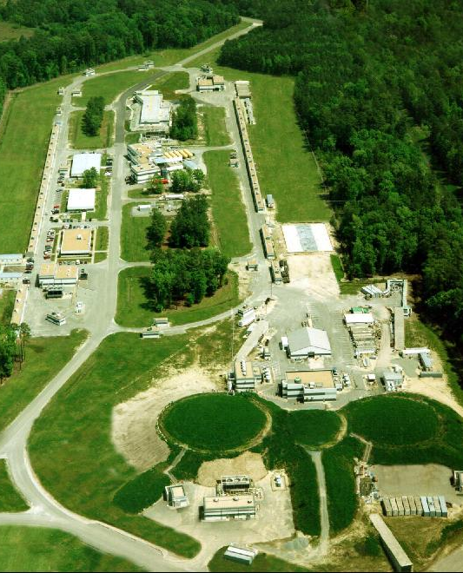
Jefferson Lab
Newport News, Virginia, USA
SRF powered linear accelerator provides continuous polarized electron beam
  E_{beam} = 6 GeV -> 12GeV upgrade
  P_{beam} = 85%
Various fixed targets, both unpolarized and polarized
15 years of 6 GeV programs finished, upgrading to 12GeV, beam on again in 2014
Upgrading 3 existing Hall A, B, C
Building new Hall D - GlueX
A
B
C

Slide 6
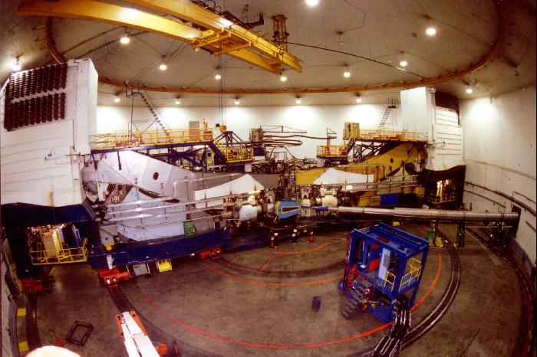
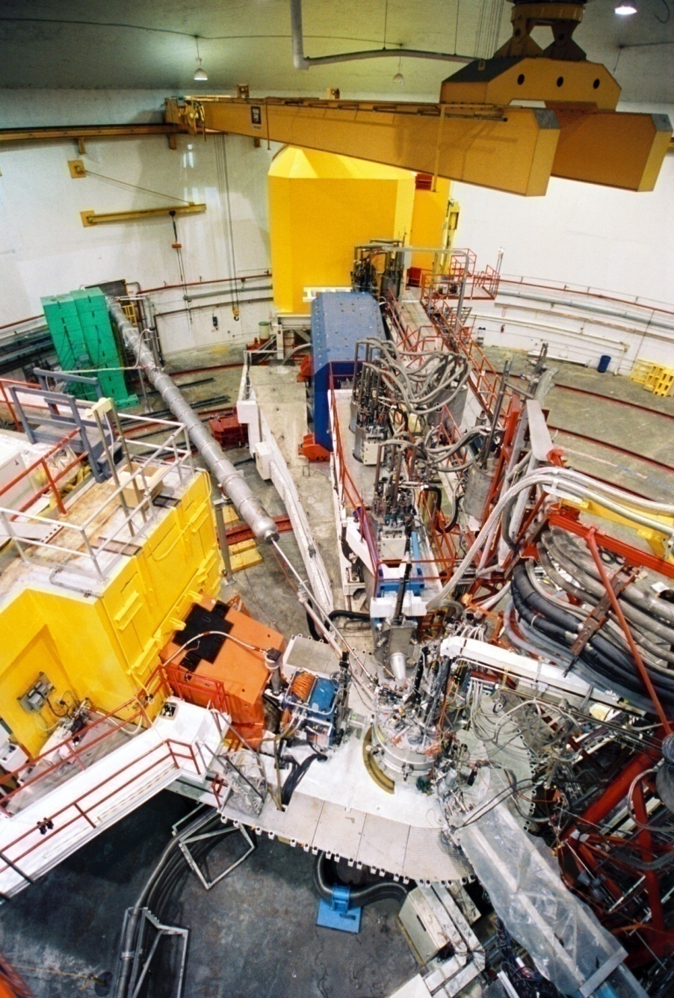
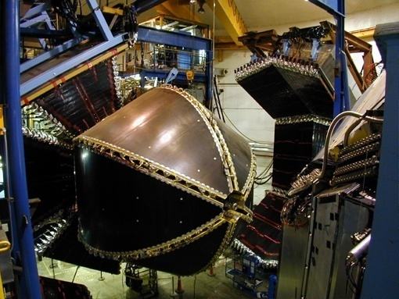
Halls A/B/C 6GeV
Hall A (2 HRS)
Hall C (SOS/HMS)
Hall B (CLAS)

Slide 7
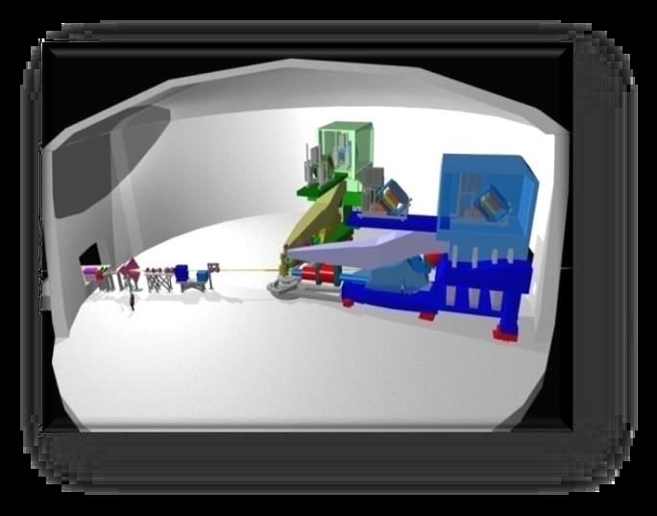
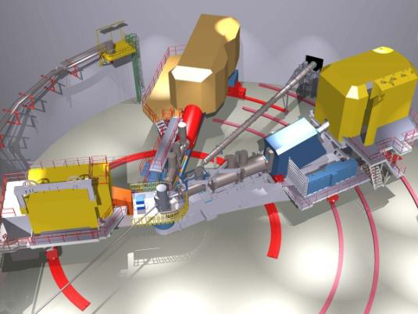
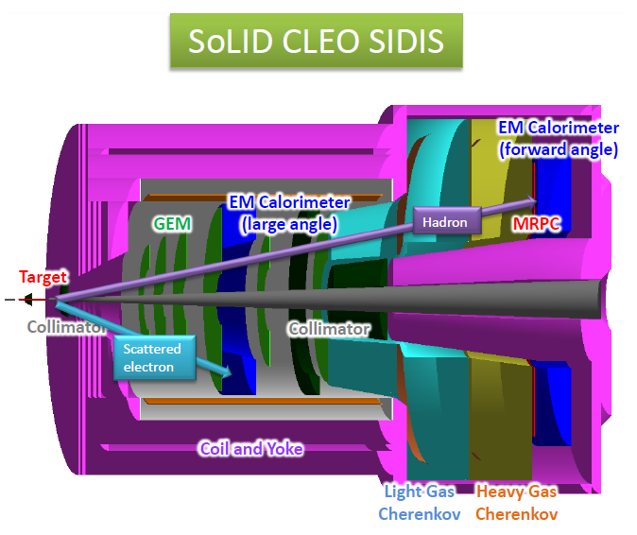
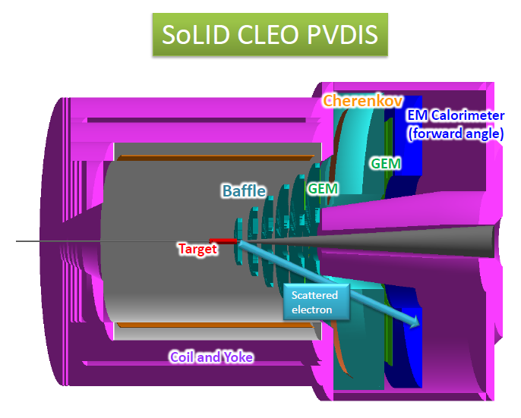
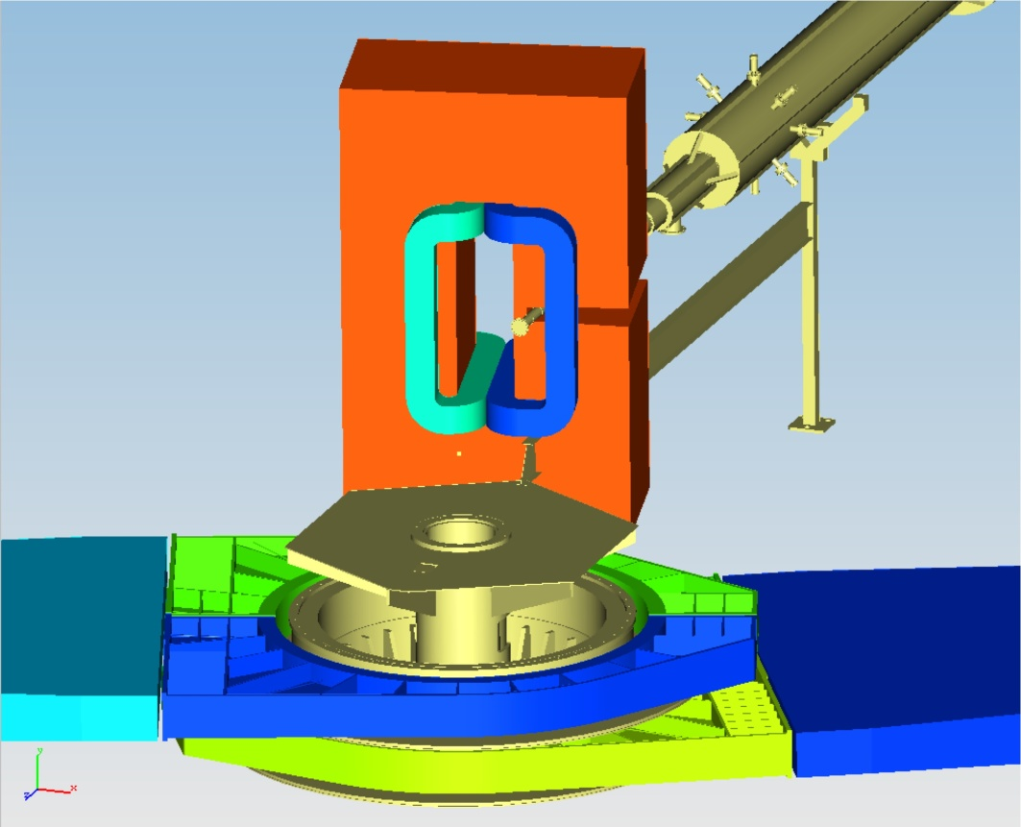
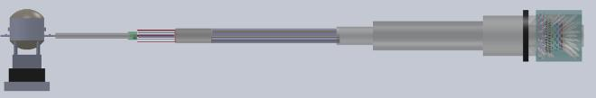
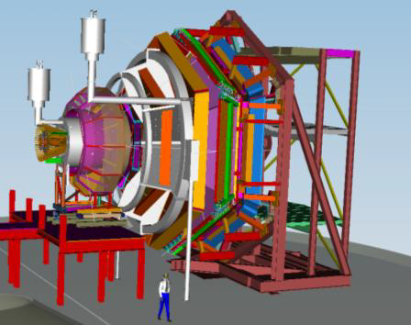
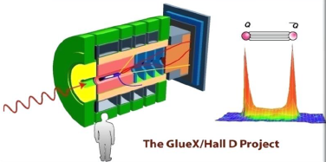
Halls A/B/C and D 12GeV
Hall A (2 HRS)
Hall C (SHMS)
HallA(SBS)
HallA(Moller)
Hall D (GlueX)
Hall B (CLAS12)

Slide 8
SoLID (Solenoidal Large Intensity Device)
General purpose device, large acceptance, high luminosity
Lumi 1e³⁷/cm²/s (open geometry)
3D hadron structure
  TMD (SIDIS on both neutron and proton)
  GPD (Timelike Compton Scattering)
Gluon study
  J/ψ production at threshold
Lumi 1e³⁹/cm²/s (baffled geometry)
Standard Model test and hadron structure
  PVDIS on both deuterium and hydrogen
High rate
High dose
High field

Slide 9
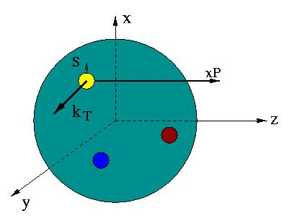
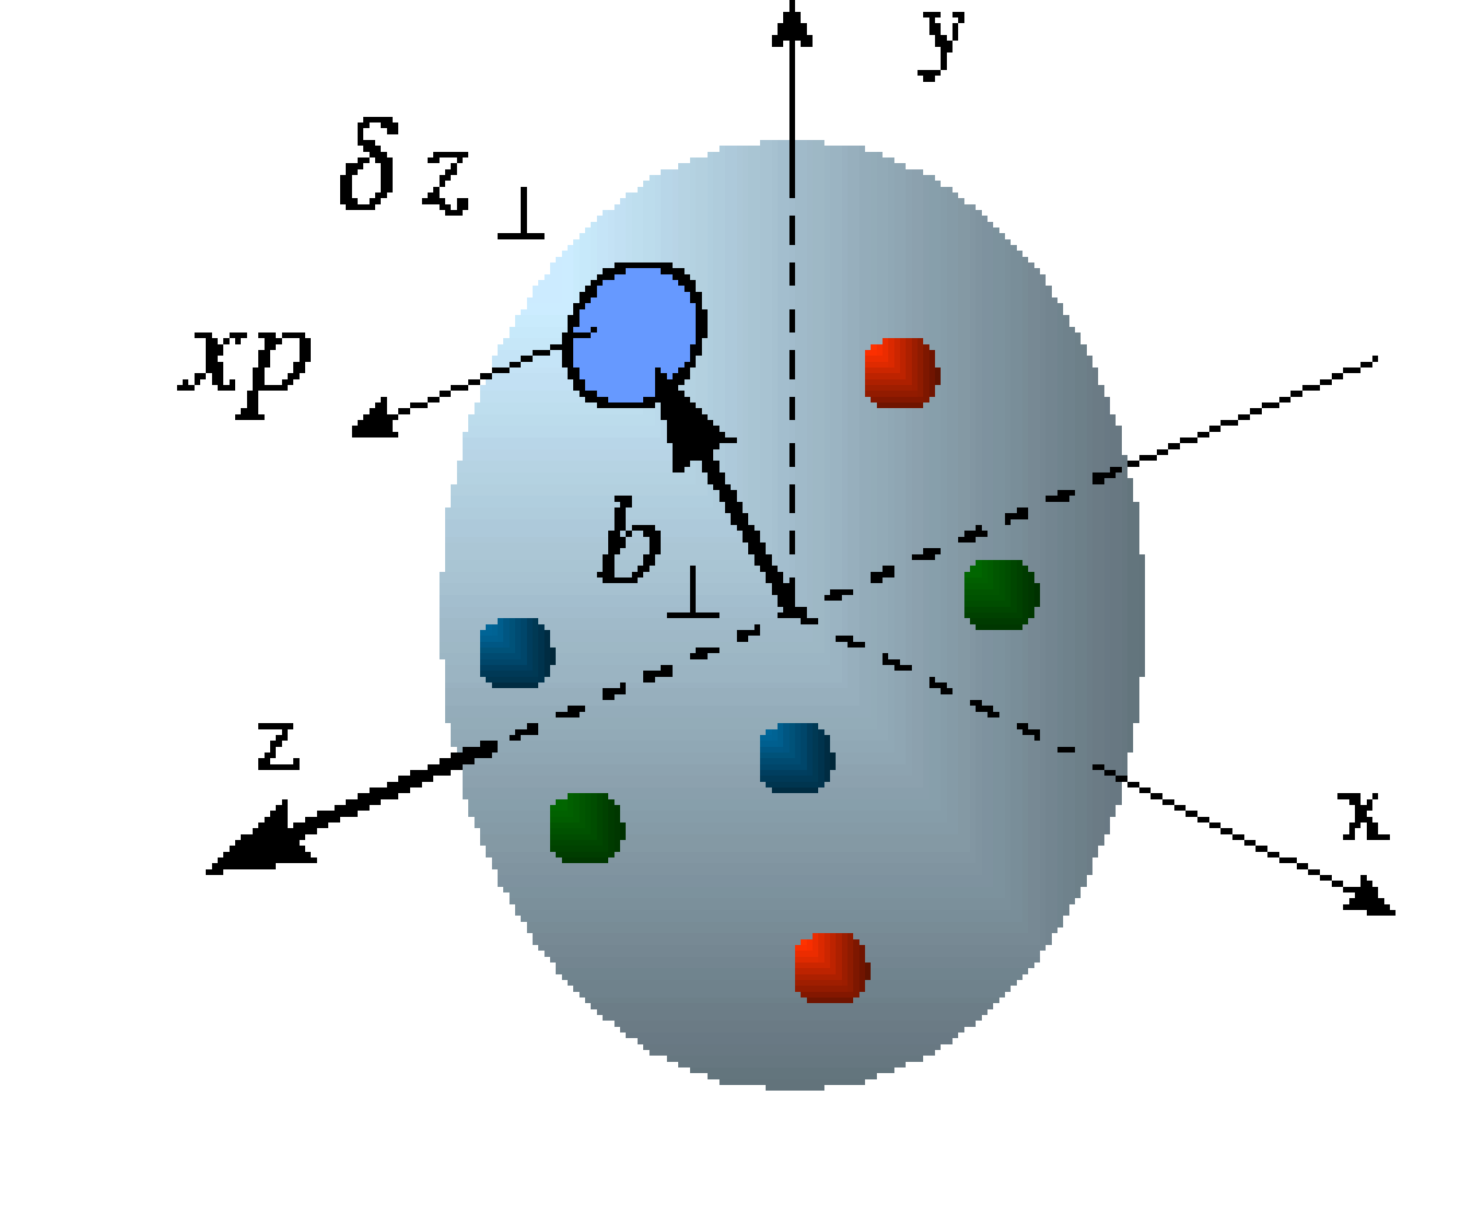
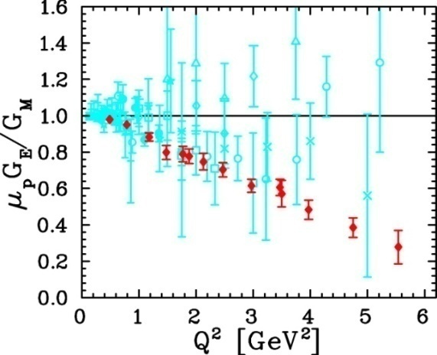
Unified View of Nucleon Structure
W_{p}^{u}(x,k_{T},r ) Wigner distributions
6D Dist.
d³r
d²k_{T} dr_{z}
TMD PDFs f₁^{u}(x,k_{T}), .. h₁^{u}(x,k_{T})‏
GPDs/IPDs
3D imaging
dx &
Fourier Transformation
d²k_{T}
d²r_{T}
Form Factors
G_{E}(Q²),
G_{M}(Q²)‏
PDFs
f₁^{u}(x), .. h₁^{u}(x)‏
1D

Slide 10
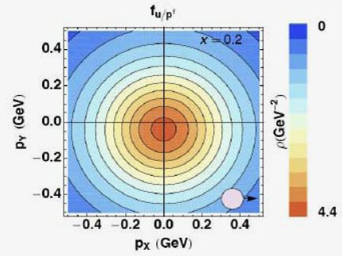
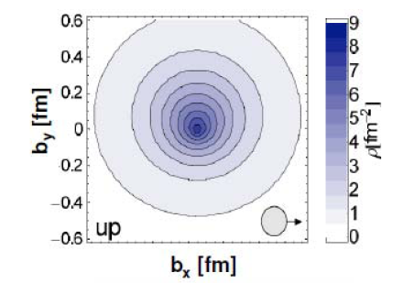
Imaging - Two Approaches
TMDs
GPDs
2+1 D picture in momentum space
2+1 D picture in impact-parameter space
Bacchetta, Conti, Radici
QCDSF collaboration
intrinsic transverse motion
spin-orbit correlations- relate to OAM
non-trivial factorization
accessible in SIDIS (and Drell-Yan)
collinear but long. momentum transfer
indicator of OAM; access to Ji’s total J_{q,g}
existing factorization proofs
DVCS, exclusive vector-meson production

Slide 11
The Spin Structure of the Proton
Proton helicity sum rule:
½ = ½ ΔΣ + ΔG + L_{q} + L_{g}
~ 0.3
Small?
? Large ?
The Impact of Quark and Gluon Motion on the Nucleon Spin
“TMDs and GPDs”

Slide 12




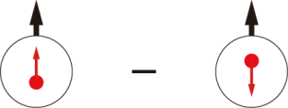
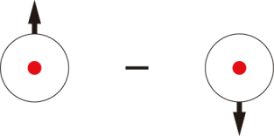
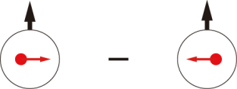
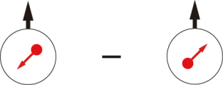
Leading-Twist TMD PDFs
 |  | Quark polarization
 |  | Unpolarized (U) | Longitudinally Polarized (L) | Transversely Polarized (T)
Nucleon Polarization | U
 | L
 | T
f₁ =
h₁⊥ =
Boer-Mulders
h_{1L}⊥ =
g₁ =
Helicity
Worm Gear
h₁ =
f _{1T}⊥ =
Collins/Transversity
g_{1T} =
Sivers
h_{1T}⊥ =
Worm Gear
Pretzelosity
Nucleon Spin
Quark Spin
Notes:
! relate g1, f1 -> collinear w/ pT dep.
Say: Noval new information on structure of nucleon, spin-orbital cor and multi-parton cor.

Slide 13
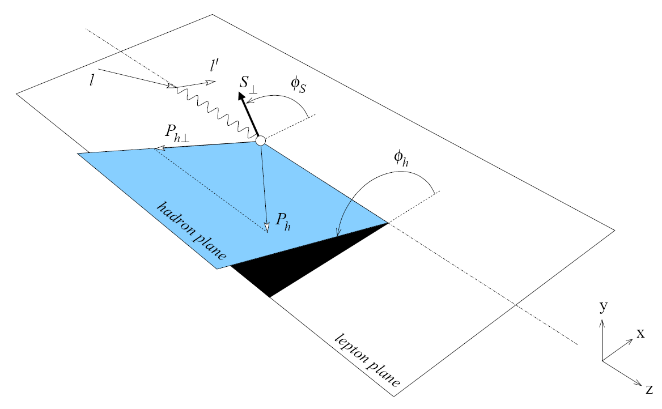
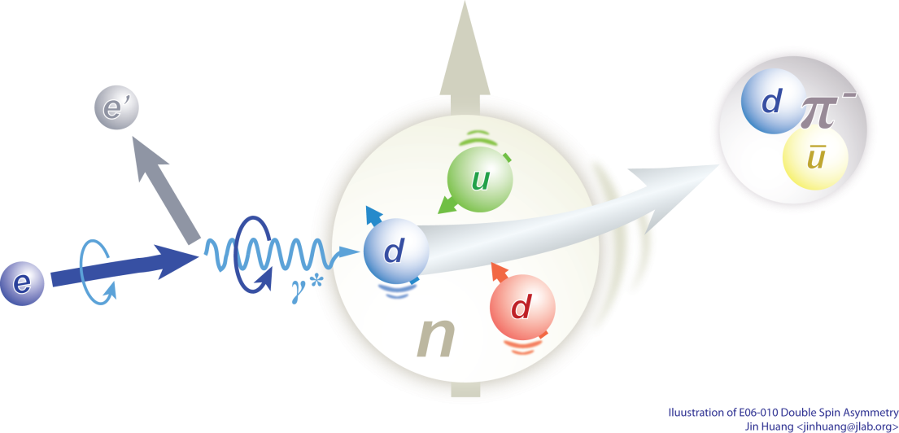
Semi-Inclusive DIS (SIDIS)
TMD
Nucleon Spin
QCD Dynamics
Quark OAM / Spin
QCD Factorization
3-D Tomography
Lattice QCD
Models
Precision mapping of transverse momentum dependent parton distributions (TMD)
TMD links:
Nucleon spin
Parton spin
Parton intrinsic motion

Slide 14
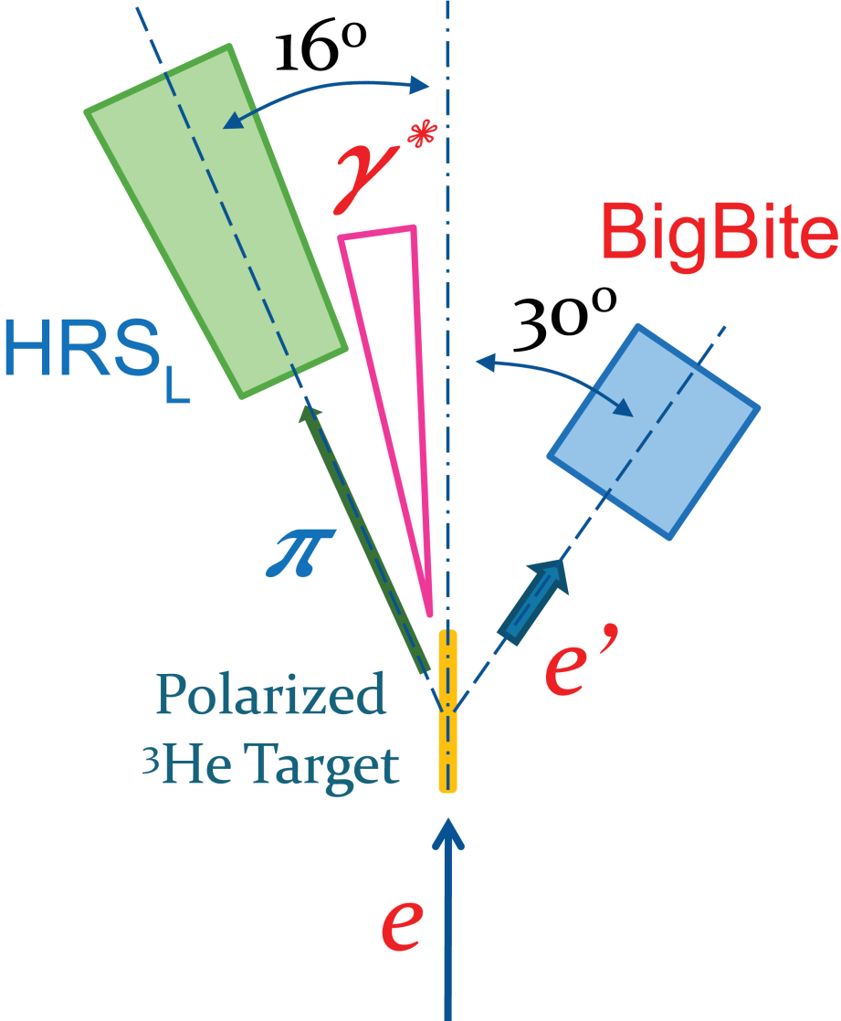
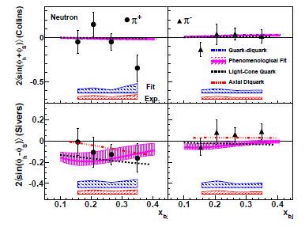
6GeV Neutron Results with Polarized ³He from JLab
Collins asymmetries (top) for π⁺ are not large, except at x=0.34
Sivers asymmetries (bottom) for π⁺ are negative
Blue band: model (fitting) uncertainties
Red band: other systematic uncertainties

Slide 15
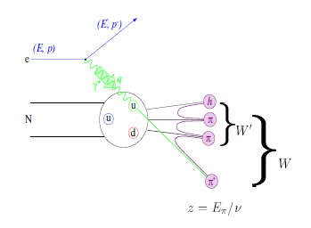
SoLID: Precision Study of TMDs
From exploration to precision study with 12 GeV JLab
Transversity: fundamental PDFs, tensor charge
TMDs: 3-d momentum structure of the nucleon
→ Quark orbital angular momentum
Multi-dimensional mapping of TMDs
  4-d (x,z,P┴,Q²)
  Multi-facilities, global effort
Precision → high statistics
  high luminosity
  large acceptance

Slide 16
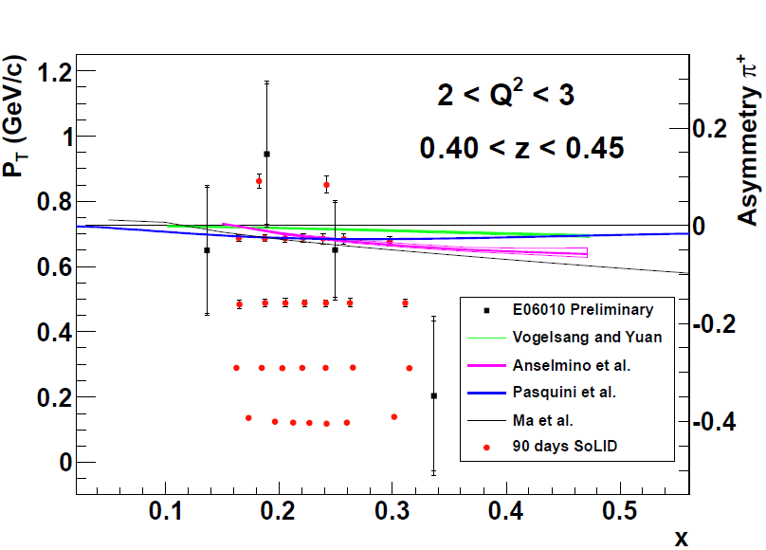
Mapping of TMD Asymmetries with SoLID
Both π+ and π-
Precision Map in region
x(0.05-0.65) z(0.3-0.7)
Q²(1-8)
P_{T}(0-1.6)
Input for determining quark tensor charge (integral over x)
Collins Asymmetry

Slide 17
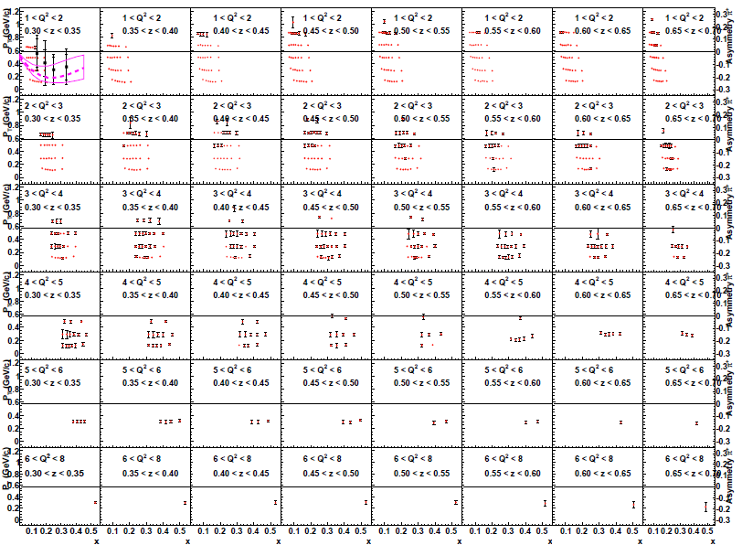
Map TMD asymmetries in 4-D (x, z, Q², P_{T})

Slide 18
Summary of SoLID TMD Program
Unprecedented precision 4-d mapping of SSA
  Collins, Sivers, Pretzelosity and Worm-Gear
Both polarized ³He (n) and polarized proton with SoLID
Study factorization with x and z-dependences
Study P_{T} dependence
Combining with the world data
  extract transversity and fragmentation functions for both u and d quarks
  determine tensor charge
  study TMDs for both valence and sea quarks
  learn quark orbital motion and quark orbital angular momentum
  study Q² evolution
Global efforts (experimentalists and theorists), global analysis
  much better understanding of multi-d nucleon structure and QCD
Long-term future: EIC to map sea and gluon SSAs

Slide 19
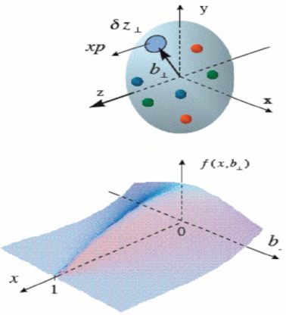
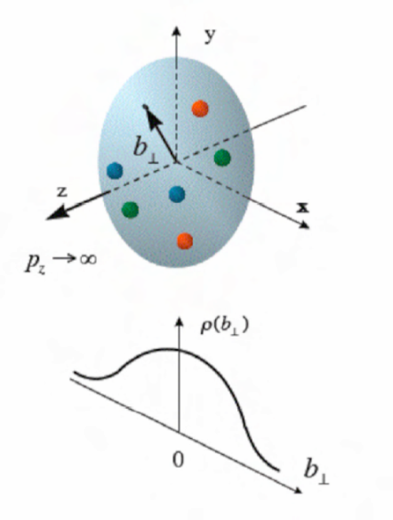
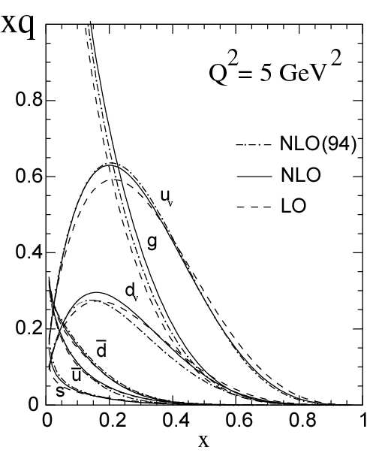
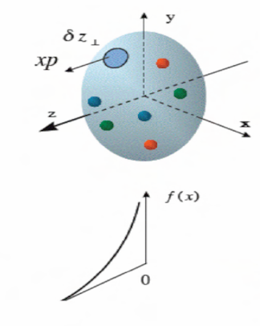
Generalized Parton Distribution (GPD)
A unified descriptions of partons (quarks and gluons) in the momentum and impact parameter space
Elastic form factors Transverse spatial distributions
Parton Distribution Functions Longitudinal momentum distributions

Slide 20
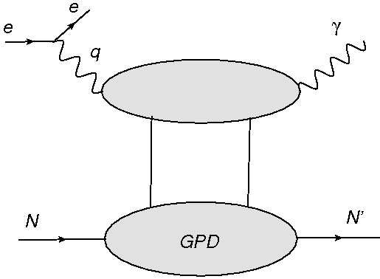
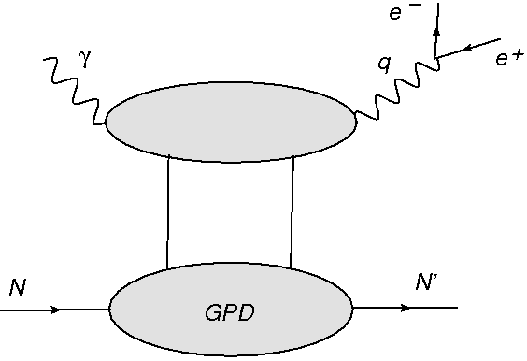
DVCS and TCS: access the same GPDs
Spacelike Deeply Virtual Compton Scattering
Timelike Compton Scattering
γ*p → γ p′
γ p → γ*(e⁻ e⁺) p′
“The amplitudes of these two reactions are related at Born order by a simple complex conjugation but they significantly differ at next to leading order (NLO)”
“ The Born amplitudes get sizeable O(α_{s}) corrections and, even at moderate energies, the gluonic contributions are by no means negligible. We stress that the timelike and spacelike cases are complementary and that their difference deserves much special attention.”
H. Moutarde et al. arXiv:1301.3819, 2013

Slide 21
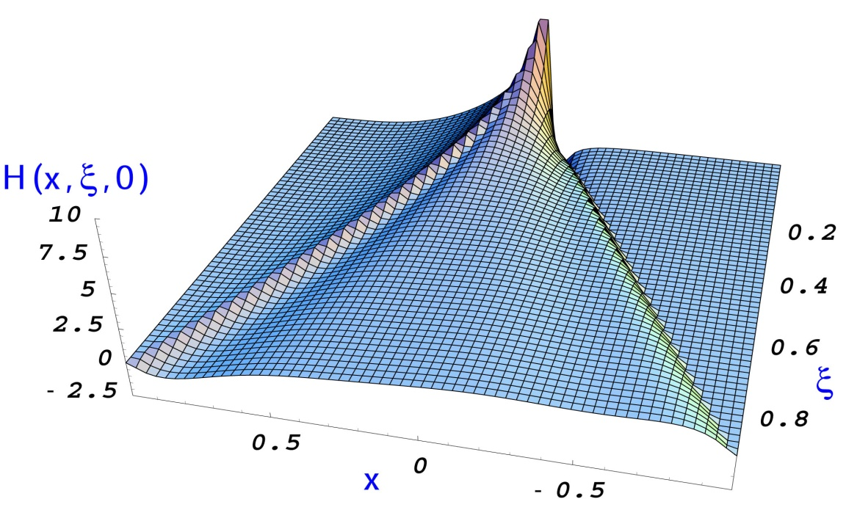
General Compton Process: access the same GPDs
(Im, x=ξ)
DVCS: spin asymmetries
(TCS with polarized beam)
(Re)
TCS: azimuthal asymmetry
DVCS: charge asymmetry
(Im, x ≠ ξ, x < |ξ| )
Double DVCS
(|Im|²+|Re|²)
DVCS: cross section

Slide 22
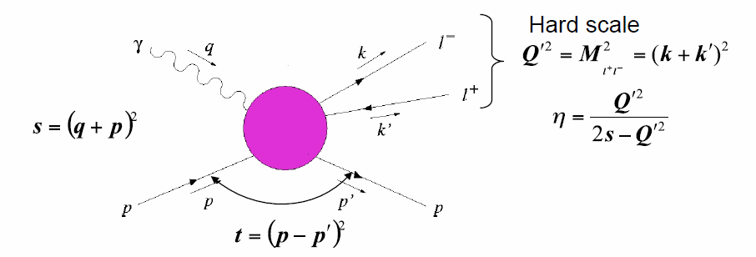




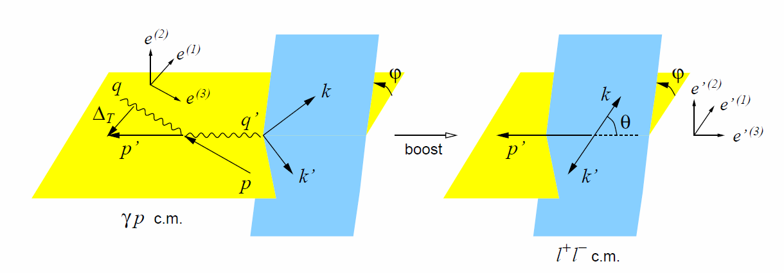
TCS
Information on the real (imaginary) part of the Compton amplitude can be obtained from photoproduction of lepton pairs using unpolarized (circularly polarized) photons
TCS
DVCS

Slide 23
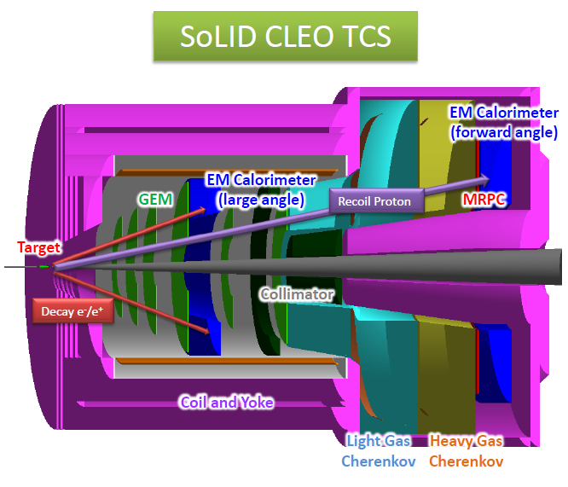
SoLID CLEO TCS
Exclusive channel
Detect decay e⁻ e⁺ pair and recoil proton

Slide 24
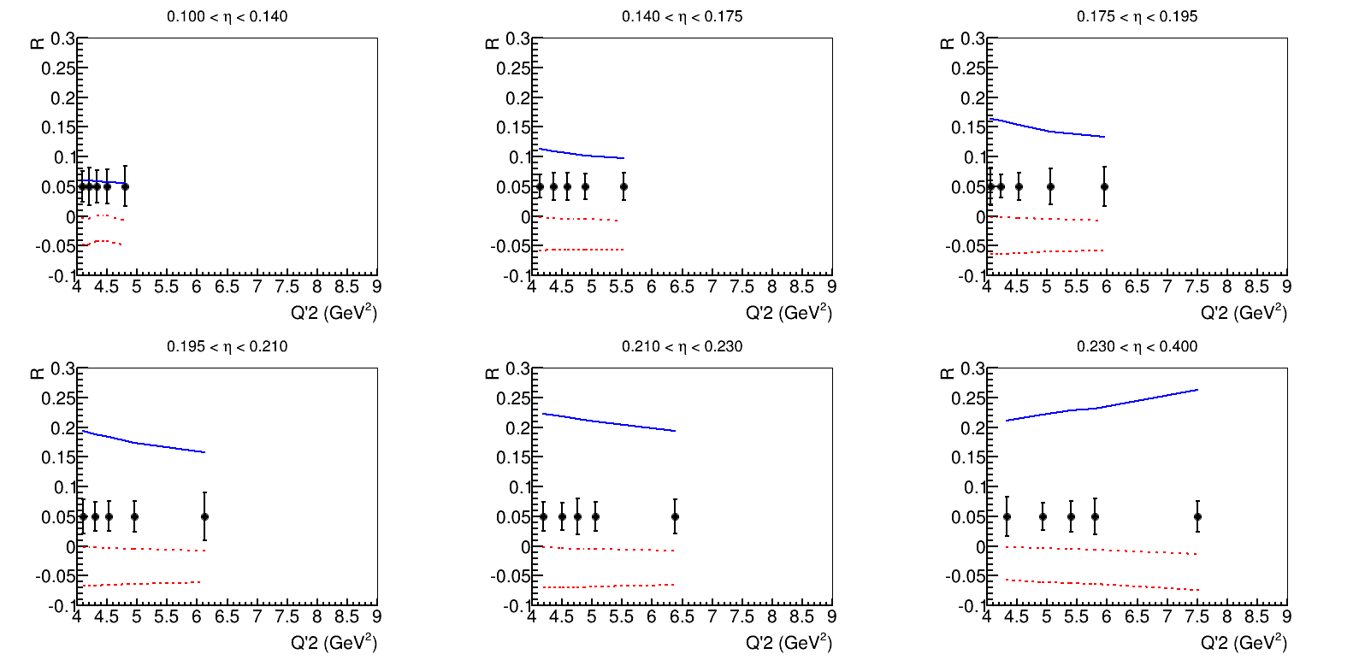
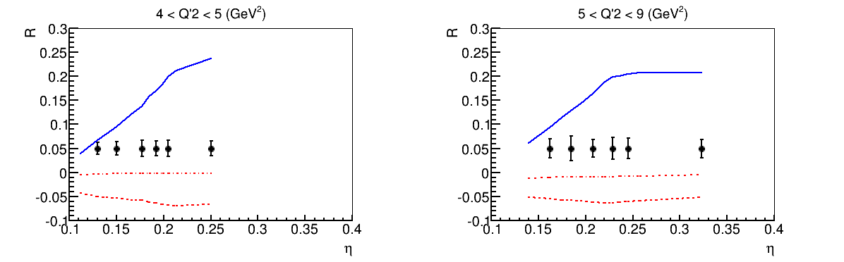
SoLID TCS Projection
Blue solid line, dual parameterization model
Red dash-dot line, double distribution with D-term model
Red dash line, double distribution without D-term model

Slide 25
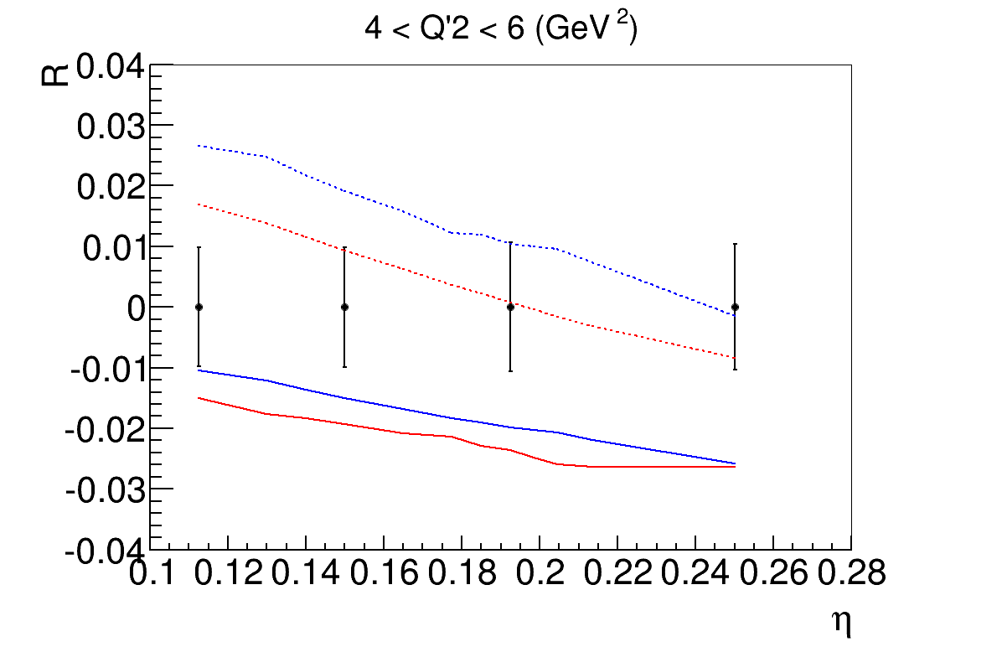
SoLID TCS Projection
Solid line: two models, LO
dotted line: two models, NLO

Slide 26
Summary of SoLID GPD Program
First measurement on TCS within the resonance free region
Open a new way to GPD study besides DVCS
Coherent program with other GPD programs at Jlab 12 GeV
Other GPD programs may follow

Slide 27
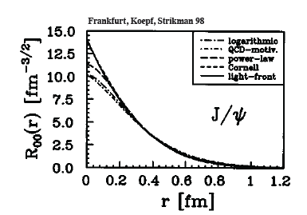
Gluon Study Using J/ψ
J/ψ is a charm-anti-charm system
  Little (if not zero) common valence quark between J/ψ and nucleon
  Quark exchange interactions are strongly suppressed
  Pure gluonic interactions are dominant
Charm quark is heavy
  Typical size of J/ψ is 0.2-0.3 fm
J/ψ as probe of the strong color
field in the nucleon

Slide 28
Interaction between J/ψ-N
New scale provided by the charm quark mass and size of the J/ψ
  OPE, Phenomenology, Lattice QCD …
High Energy region: Pomeron picture …
Medium/Low Energy: 2-gluon exchange
Very low energy: QCD color Van der Waals force
  Prediction of J/ψ-Nuclei bound state
    Brodsky et al. ….
Experimentally no free J/ψ are available
  Challenging to produce close to threshold!
  Photo/electro-production of J/ψ at JLab is an opportunity

Slide 29

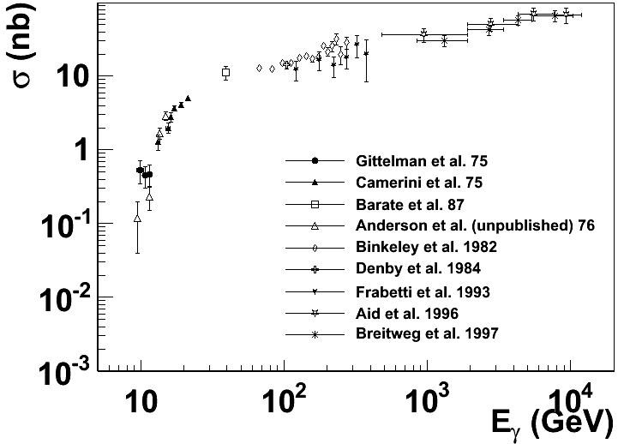
Experimental status
More data exist with inelastic scattering on nuclei, such as A-dependence.
Not included are the most recent results from HERA
H1/ZEUS at large momentum transfers and diffractive production with electro-production
SLAC, Cornell, Fermilab, HERA …
The physics focus is this threshold region

Slide 30
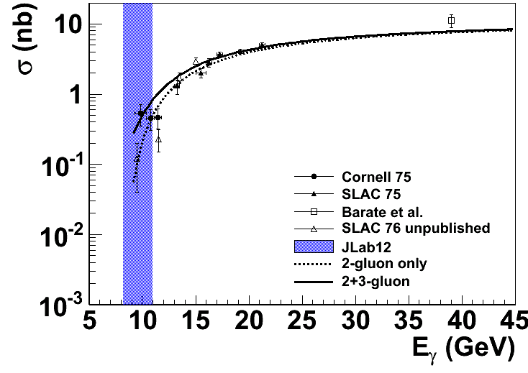

Reaction Mechanism
Models (I): Hard scattering
(Brodsky, Chudakov, Hoyer, Laget 2001)
Add in 3-gluon scattering
?

Slide 31

SoLID J/ψ
Exclusive channel
Detect decay e⁻ e⁺ pair and scattering e⁻

Slide 32

SoLID J/ψ Projection
  With < 0.01 GeV energy resolution and small binning to
  study the threshold behavior of cross section

Slide 33
Summery of SoLID J/ψ Program
It was not accessible at CLAS 6GeV, perfect for 12GeV
Familiar resonance with a new perspective
A unique approach to gluon study
More studies on decay angle distribution and nuclei target may follow

Slide 34





Parity Violation DIS (PVDIS)
Weak PV
Electromagnetic
Kinematic factor
A
V
The couplings g depend on electroweak physics as well as on the weak vector and axial-vector hadronic current.
Both new physics at high energy scales as well as interesting features of hadronic structure come into play.
A program with many targets and a broad kinematic range can reveal the physics.
V
A
Is the glass half full or half empty?

Slide 35


SoLID PVDIS
Approved beam time: 169 days, at 10³⁹cm⁻²s⁻¹ luminosity
Standard Model
Precision test of Standard Model by measuring parity violation DIS electron asymmetry (δA ~ 0.5ppm)
Error bar σ_{A}/A(%) shown at center of bins in Q², x
4 months at 11 GeV
2 months at 6.6 GeV
Notes:
a precision measurement of the electroweak mixing angle at the same Q2 as the NuTeV experiment
a determination of the u/d ratio in the proton
a measurement of charge symmetry violation at high x that could be relevant to addressing the NuTeV anomaly
a investigation of the presence of nucleon higher twist effects in polarized electron scattering

Slide 36

SoLID PVDIS Projection
Jlab SM test by Parity Violation electron scattering:
Moller, ee scattering, no hadron involved, will run at 12GeV era
Qweak, ep elastic scattering, sensitive to C1, data is being analyzed
PVDIS, ep DIS, sensitive to C2, will run at 12GeV era

Slide 37


Charge Symmetry Violation
We already know CSV exists:
u-d mass difference δm = m_{d}-m_{u} ≈ 4 MeV
δM = M_{n}-M_{p} ≈ 1.3 MeV
electromagnetic effects
Direct observation of CSV—very exciting!
Important implications for PDF’s
Could be a partial explanation of the NuTeV anomaly
For A_{PV} in electron-²H DIS:
MRST PDF global with fit of CSV
Martin, Roberts, Stirling, Thorne Eur Phys J C35, 325 (04)
Broad χ² minimum
(90% CL)
MRST (2004)

Slide 38
Summery of SoLID PVDIS Program
Powerful and unique tool for SM test.
Large kinematic coverage with good precision
Shed light on hadron structure also

Slide 39
Summary of SoLID Program
Jlab 12GeV upgrade and SoLID spectrometer will open doors to exciting physics, including precision study of nucleon structure, new study strong interaction, and test of standard model
Lumi 1e³⁷/cm²/s (open geometry)
3D hadron structure
  TMD (SIDIS on both neutron and proton)
  GPD (Timelike Compton Scattering)
Gluon study
  J/ψ production at threshold
Lumi 1e³⁹/cm²/s (baffled geometry)
Standard Model test and hadron structure
  PVDIS on both deuterium and hydrogen
More experiments will be proposed to take advantage of the feature of large acceptance and high luminosity of SoLID

Slide 40





Jlab and Chinese Collaboration
China Institute of Atomic Energy (CIAE)
Institute of Modern physics
Lanzhou University
Tsinghua University
University of Science and Technology of China (USTC)
Besides Physics,
GEM ($5M) and MRPC ($2M) for production and funding in China,
pol He3 target for collaboration
The fifth workshop on hadron physics in China and Opportunities in US
July 2-6, 2013
USTC and Huangshan Univ.
Huangshan, Anhui, China

