Slide 1
PandaX: Direct Dark Matter Search Experiment in China Jinping Underground Lab
Xiangdong Ji (季向东）
Shanghai Jiao Tong University (上海交通大学）
University of Maryland
SJTU, 2013, 6, 5

Slide 2
Outline
WHY DARK MATTER?
DARKMATTER RUSH
    FERMI & AMS-2
    LHC
    Direct Detection (DAMA, CoGeNT, CRESST, XENON100, CDMS)
PandaX
Summary

Slide 3
Why Dark Matter?
There are plenty of astrophysical and cosmological evidence for DM,
    All gravitational effects
    Galaxy rotation curve, hot X-ray, gravitational lensing, bullet cluster….
    Large scale structure, CMB fluctuation….
There are plenty of DM candidates in theories
    Color and electric neutral, long-lived
    Might have weak-scale interactions (WIMPs)
    SUSY, extra dimension, …

Slide 4
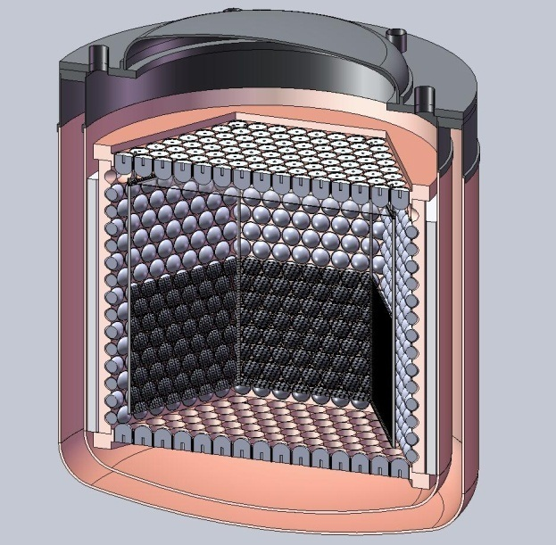
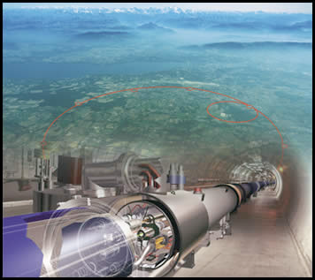
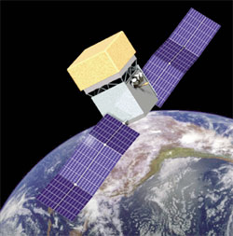
WIMPs Detection
Direct Detection
Accelerator
Indirect Detection

Slide 5
Dark matter rush…

Slide 6
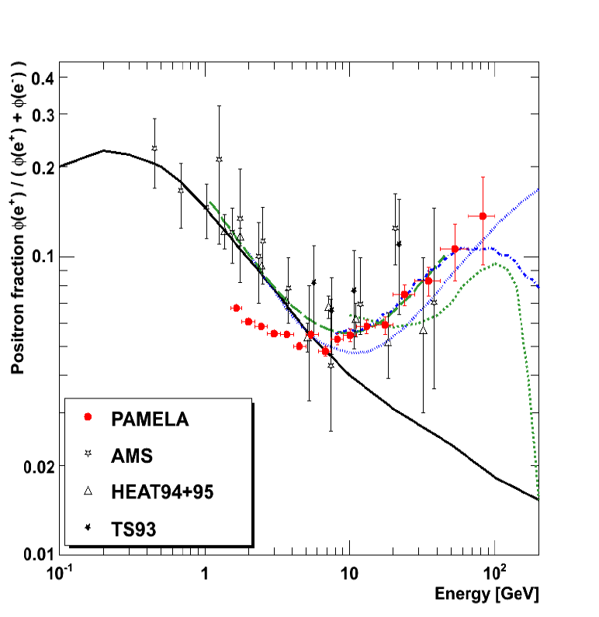
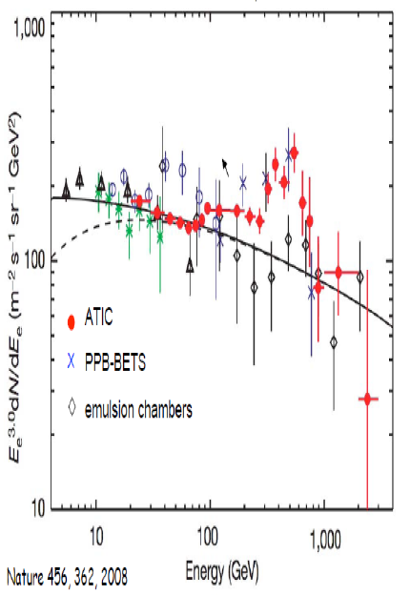
Indirect signals
Sources of standard model particles from dark matter annihilations in our galaxy
  Gamma ray
  Electrons and positions, neutrinos…
Positrons and electrons

Slide 7
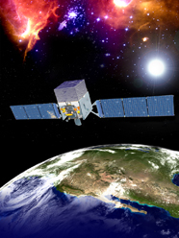
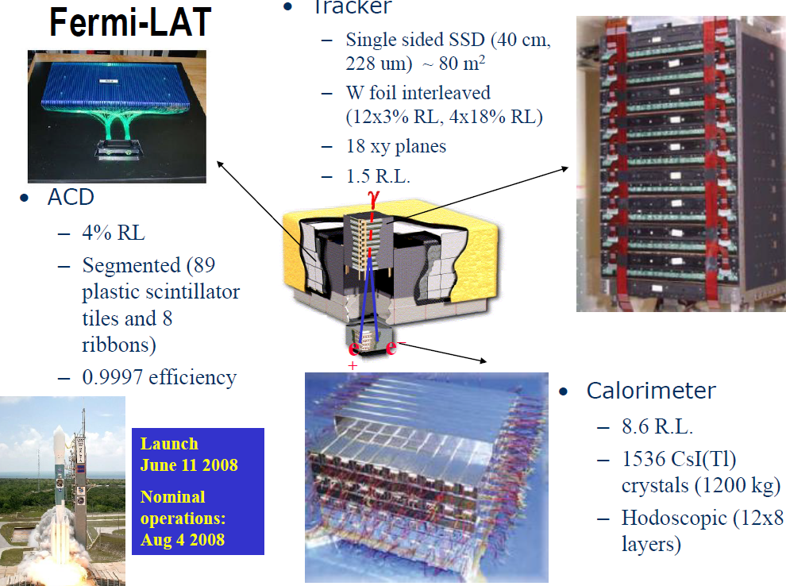
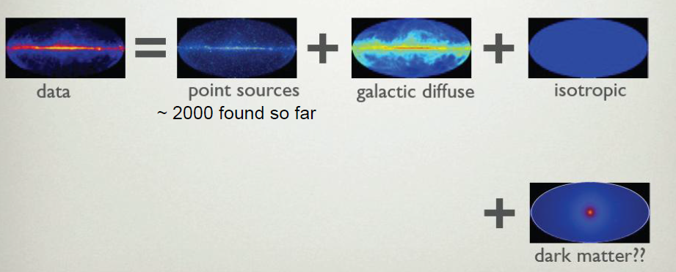
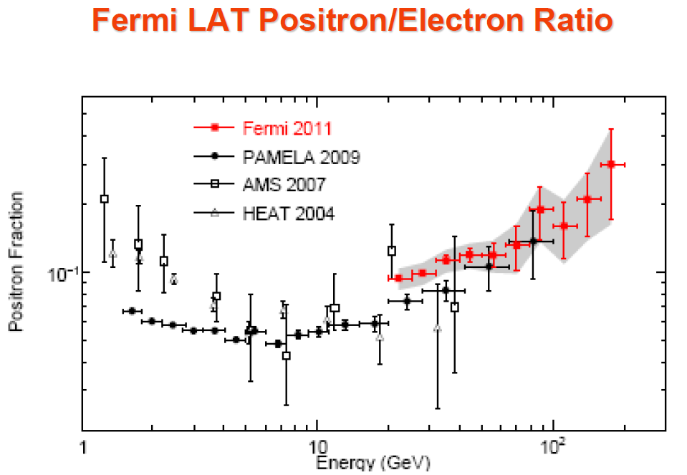
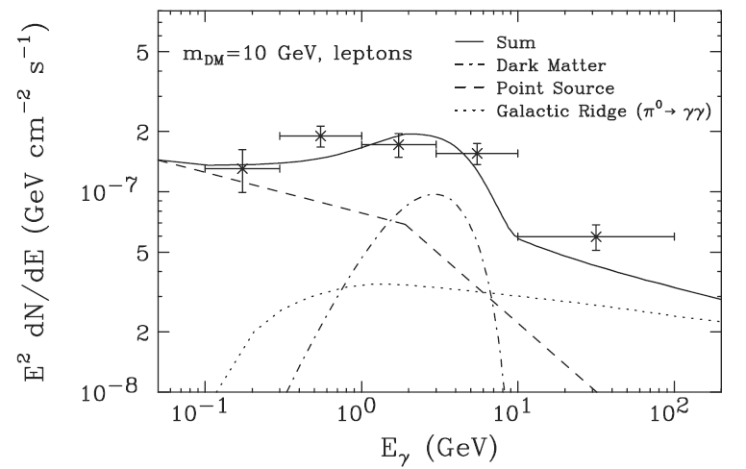
Fermi Satellite
Lunched June 11, 2008
Gamma Ray detector

Slide 8
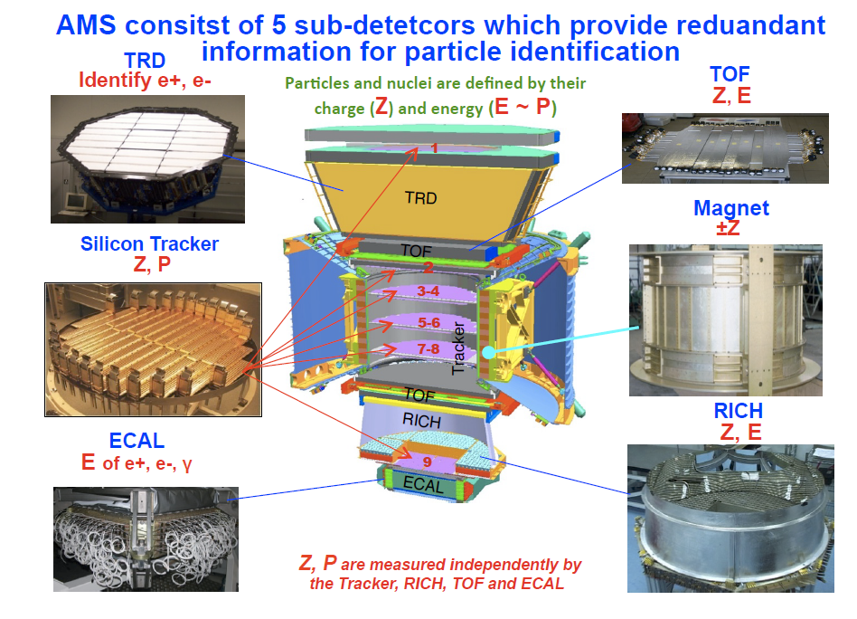
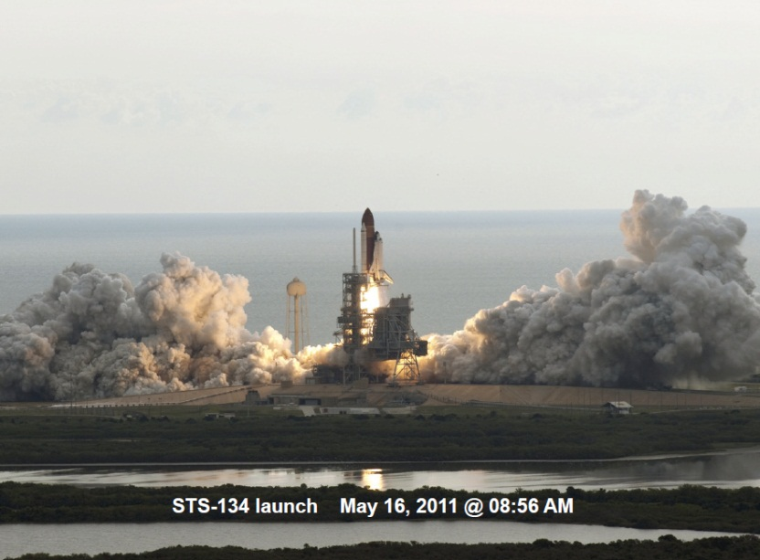
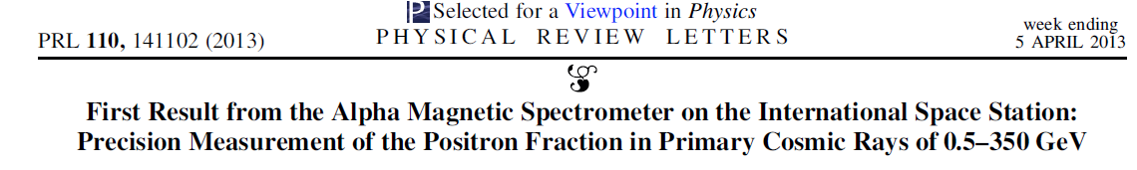
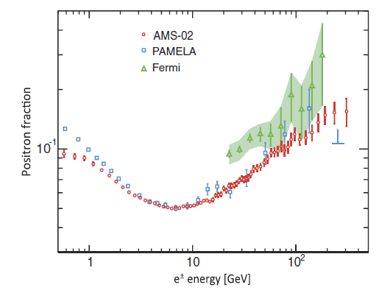
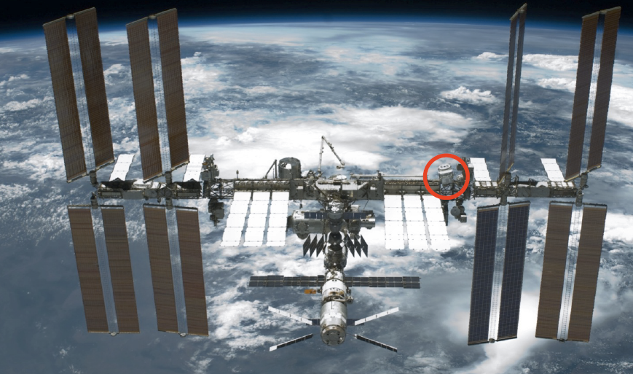
AMS-2
Lunched May 16, 2011

Slide 9
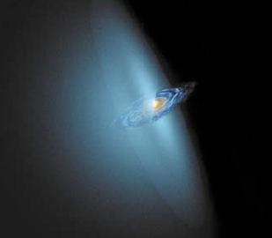
Direct searches
Dark matter forms a giant sea, enclosing the milky way. The earth and solar system like a small fish, swimming in it.
Dark Matter particle has a small probability hitting the atomic nuclei (<1 time/ 100kg day)，producing nuclei recoil
Direct detection is to detect the atomic excitations due to nuclear recoil

Slide 10
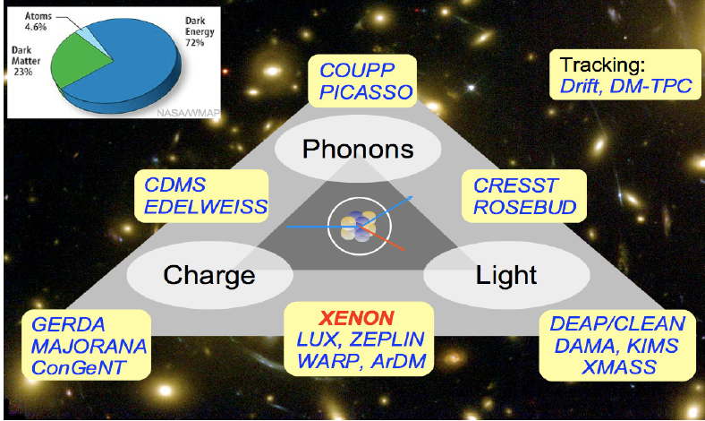
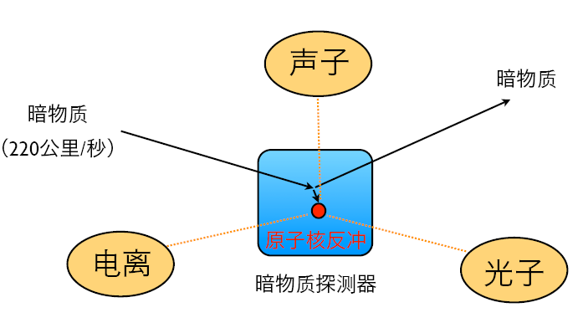
Three types of signals

Slide 11
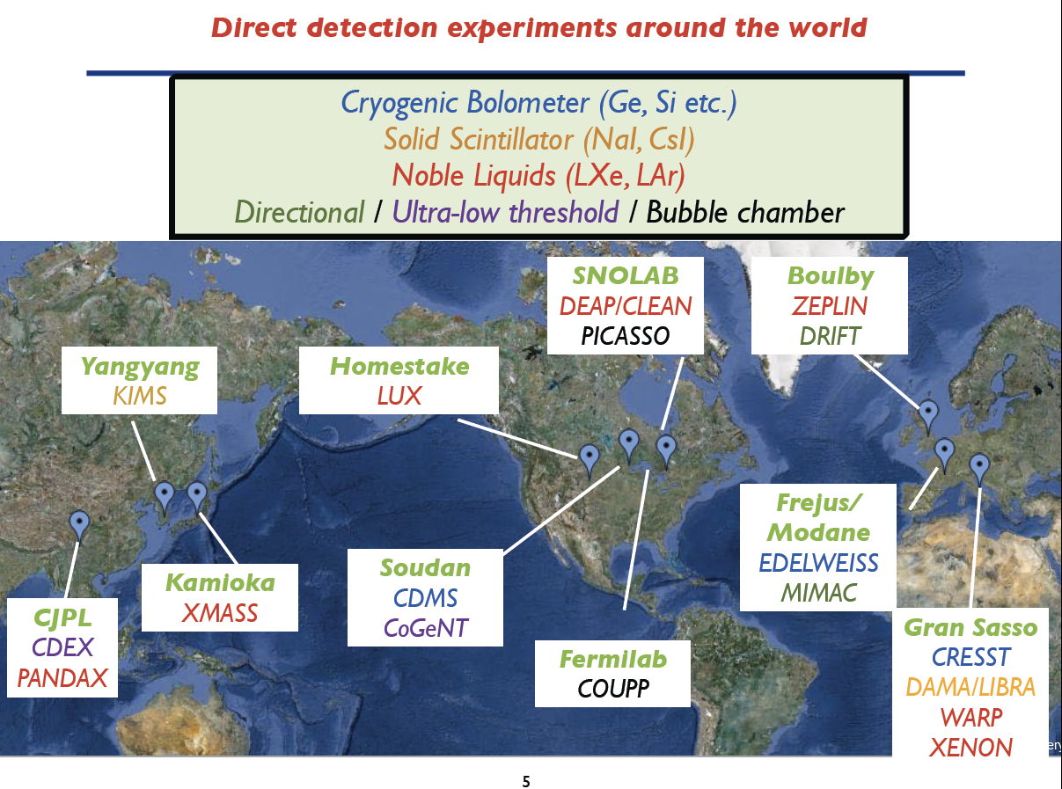

Slide 12
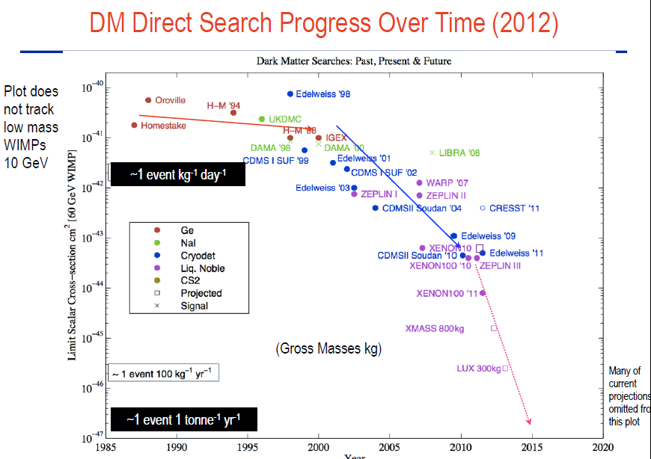

Slide 13
Some high-lights
DAMA/LIBRA (NaI crystal)
CoGeNT (Ge)
CRESST (crystal)
XENON100 (Xe)
CDMS
…..

Slide 14
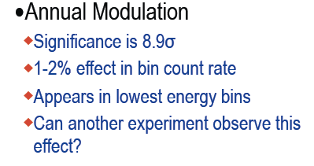
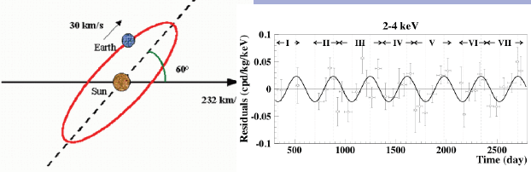
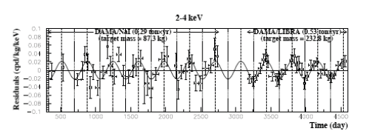
DAMA/LIBRA

Slide 15
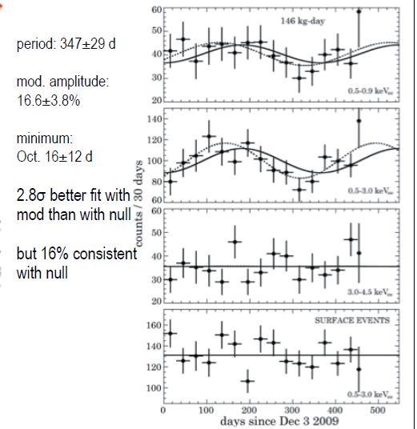
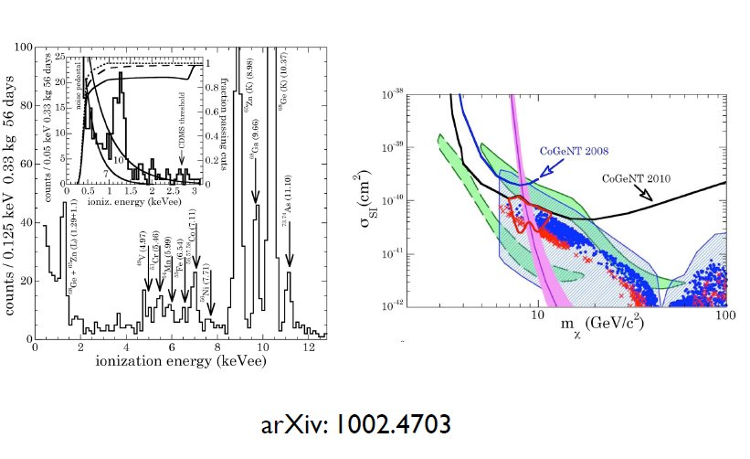
Direct detection status: CoGeNT

Slide 16
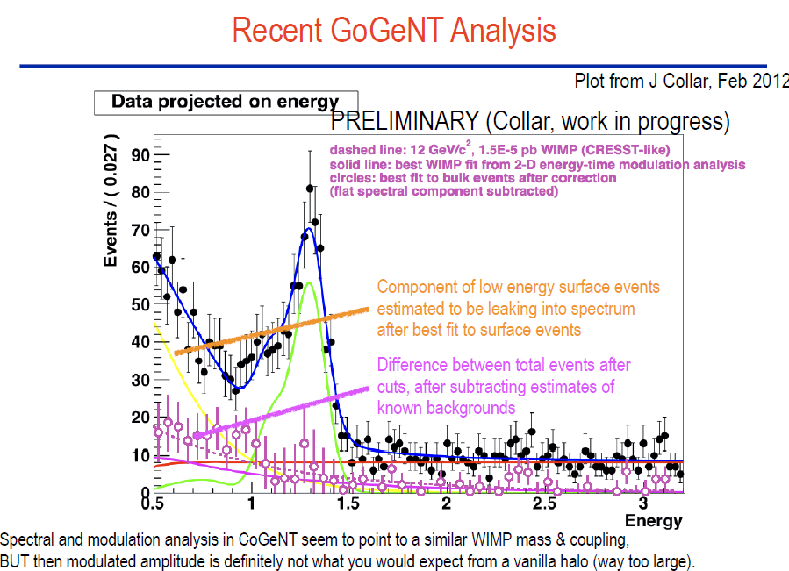

Slide 17
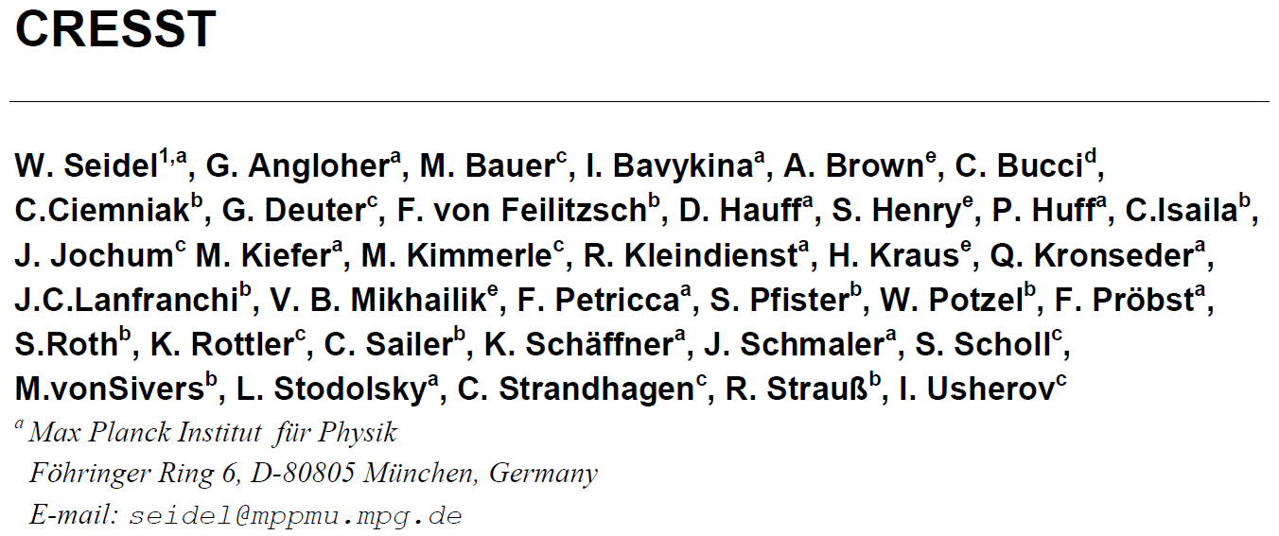
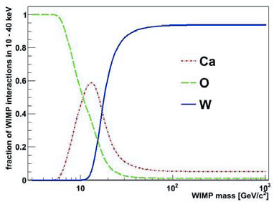
CRESST
An experiment in Gran Sasso
Using 10x300g CaWO₄ crystals
Measure both light and heat (phonon)
Different element has different sensitivity on the different WIMP mass

Slide 18
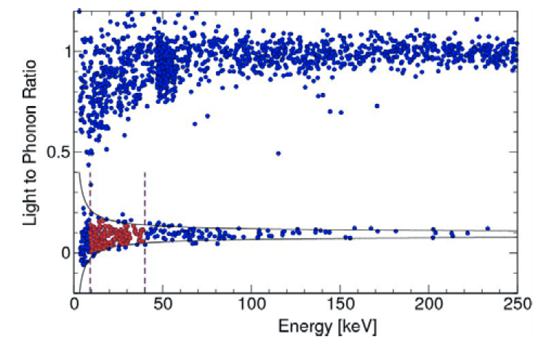
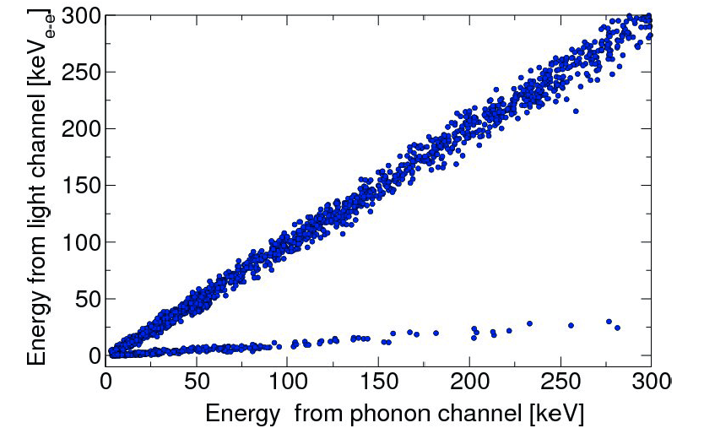
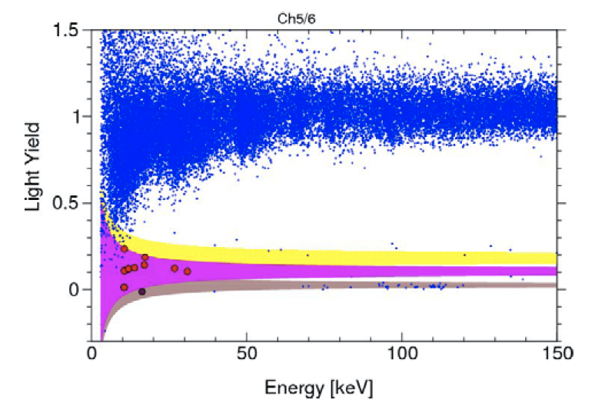
Recent results
Nuclear recoil vs.
Electron recoil

Slide 19
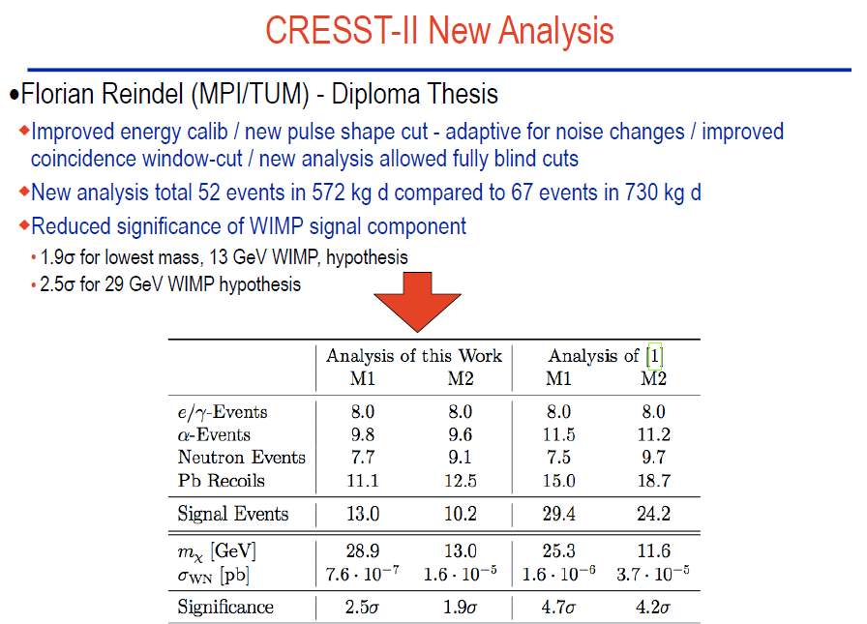

Slide 20
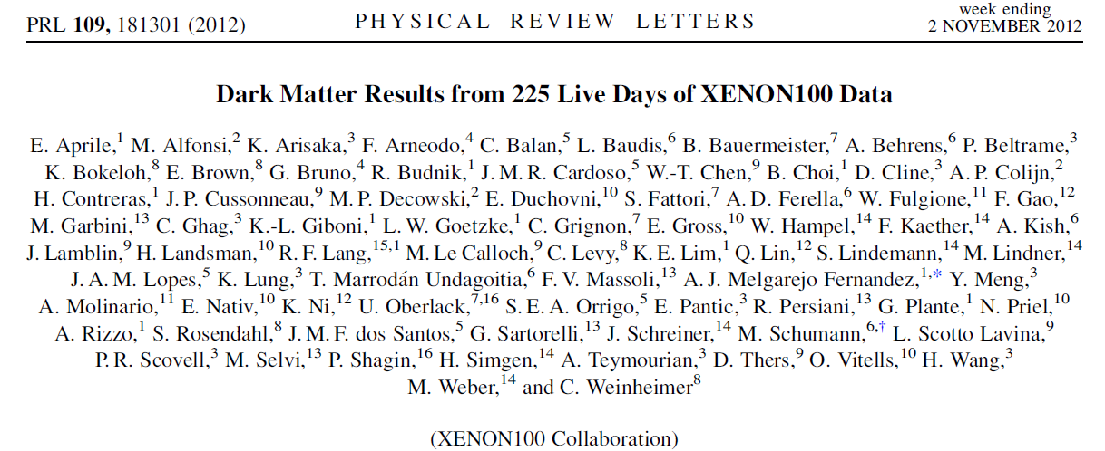
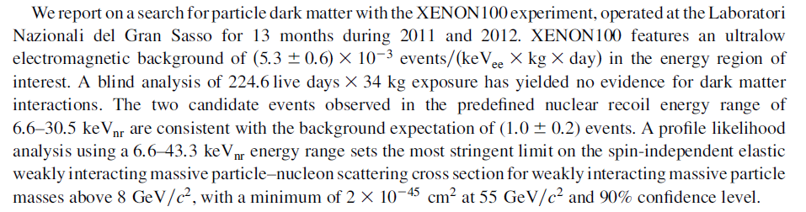
XE100 latest

Slide 21
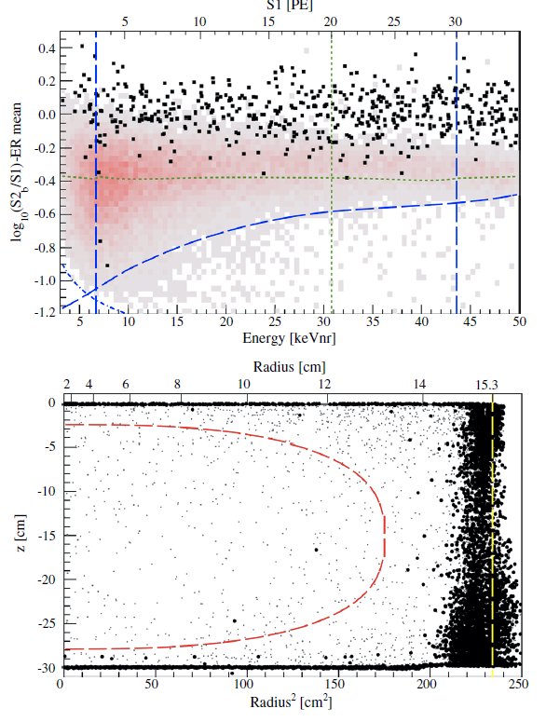
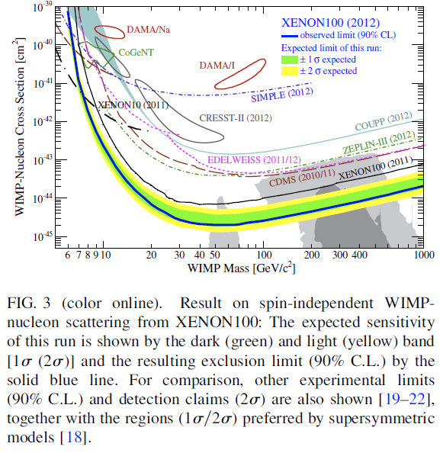
XENON100 bound

Slide 22
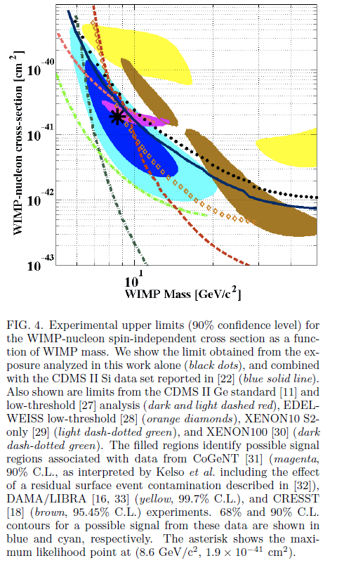
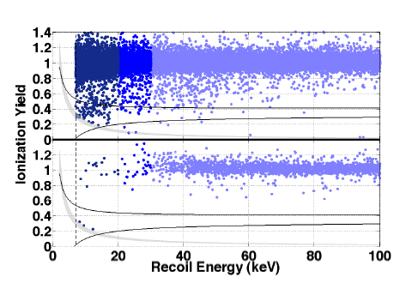
CDMSII Silicon
Total exposure 140 kg.day
3 events with background < 0.2
Fit: WIMP mass 8.6 GeV
cross section 1.9 x 10⁻⁴⁴ cm
arXiv:1304.4279, April 15 2013

Slide 23
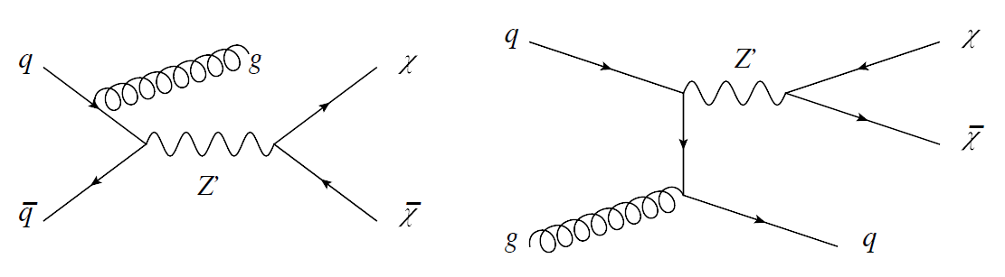
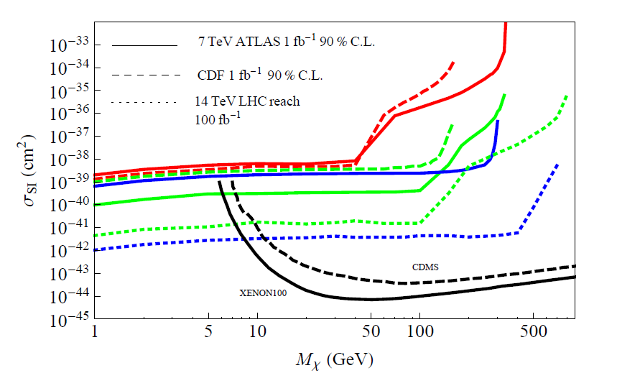
Collider search
Associated production
An, Ji, and Wang,
arXiv:1202.2894 [hep-ph]

Slide 24
PandaX

Slide 25
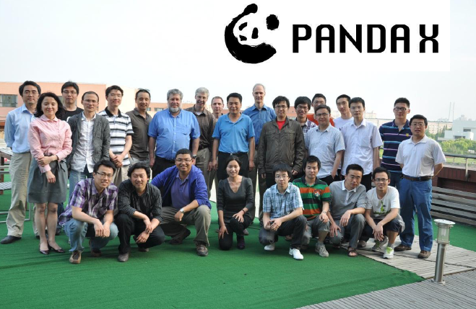
PandaX collaboration
Started in 2009 and evolving…
  上海交通大学 (Shanghai Jiao Tong University)
  中科院上海应用物理研究所 (Shanghai Inst. of Applied Physics)
  山东大学 (Shangdong University)
  北京大学 (Peking University)
  二滩水电公司
  University of Michigan
  University of Maryland

Slide 26

PandaX goal
PandaX: Particle AND Astrophysical
Xenon TPC
Build a state-of-art large-size xenon dual-phase TPC detector working at the lowest background possible
    Used for both dark matter search and
    136Xe double beta decay search
Two important features:
Emphasize light collection efficiency so as to enhance the sensitivity to low-mass WIMPs (stage 1)
Accommodate a ton-scale experiment (stage 2)

Slide 27
Why Xe?
Liquid Xe is an excellent liquid scintillator (S1)
Free charges In LXe drift under an electric field and can be collected/detected through a proportional chamber (gas phase) (S2).
With S1 and S2 signals, one can construct the location of events and veto gamma rays.
Xenon does not have long-lived radioactive isotopes, can be purified relatively easily.
Xenon is not terribly expensive and the cost for ton scale experiment is manageable.

Slide 28
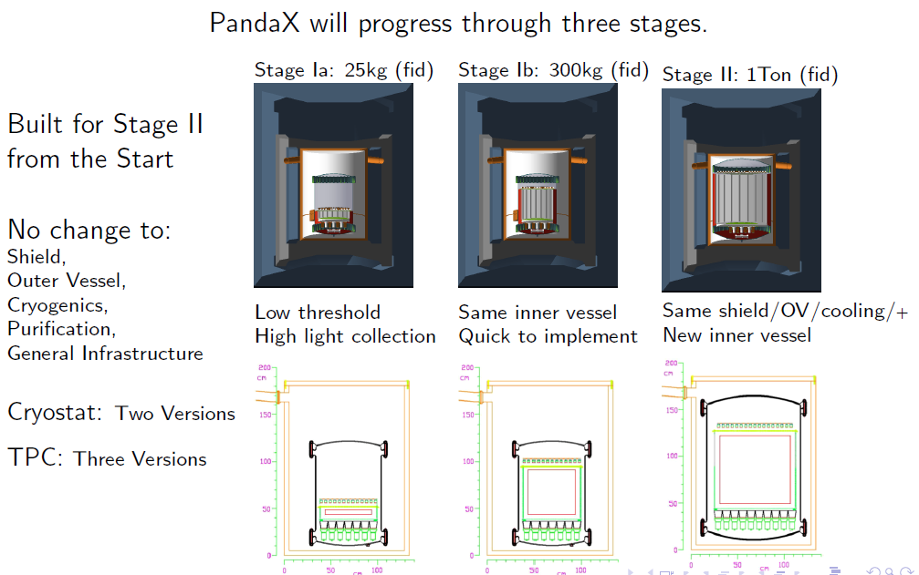
PandaX Design Concept
All aspects of the exp are designed for 1 ton LXe fiducial target.
Except for the central TPC, which depends on the funding stages…
  Stage 1a: 100kg target (25kg fiducial)
  Stage 1b: 500kg target (200kg fiducial)
  Stage 2: 1.5 ton target (~ 1ton fiducial)

Slide 29
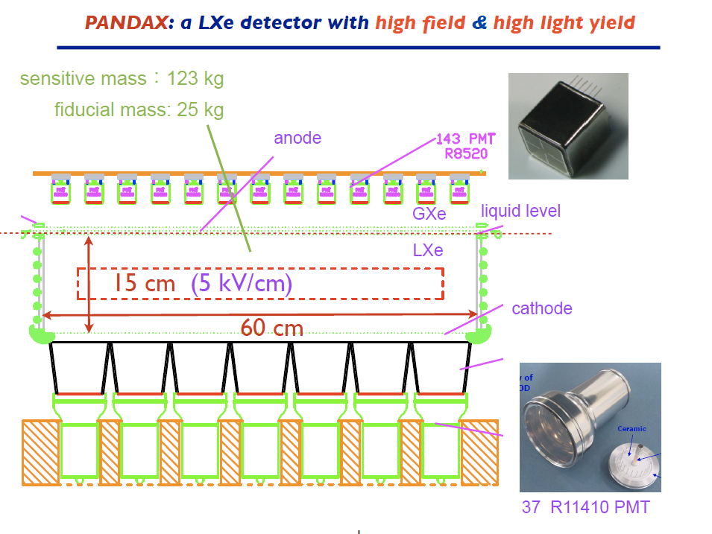
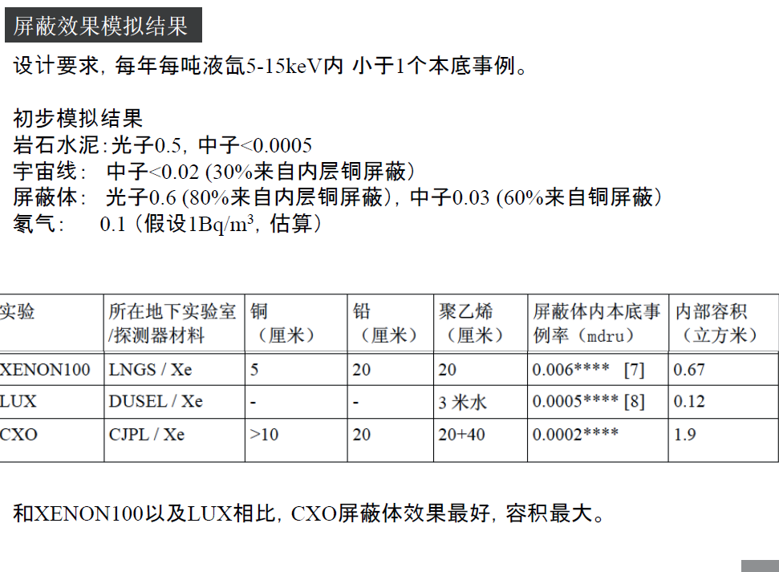

Slide 30
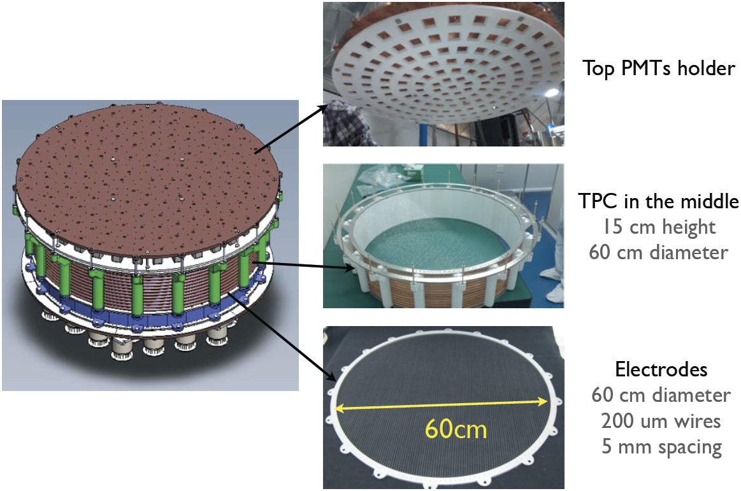
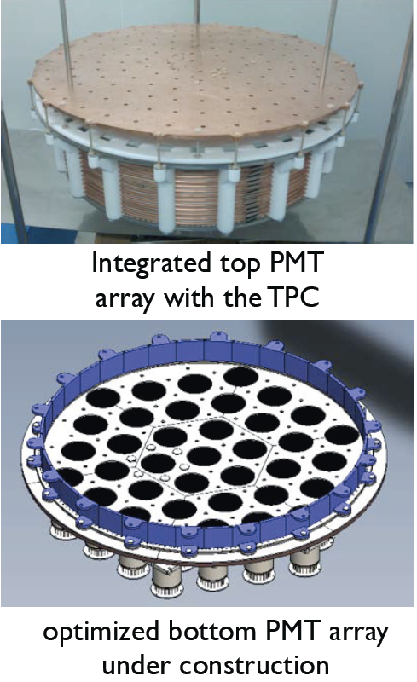
TPC construction

Slide 31
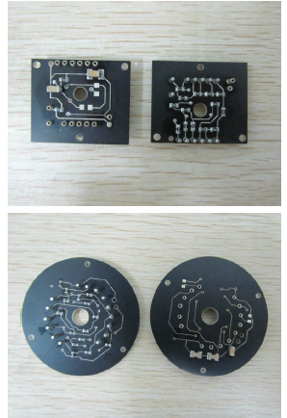
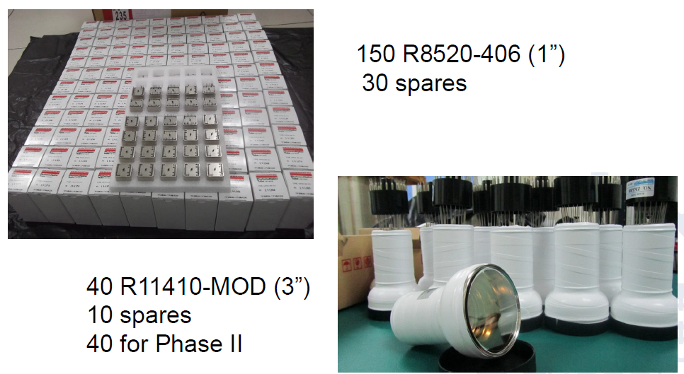
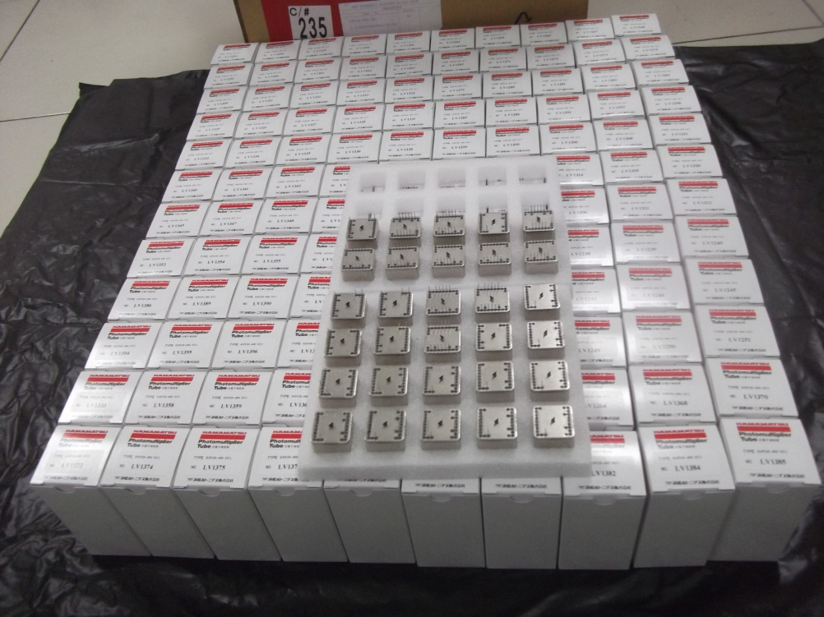
PMTs
150 1-in R8520-406 PMT, bases and decoupler designed and constructed. PMT’s tested . A data base has been established.
50 3-in PMT for the bottom TPC.

Slide 32
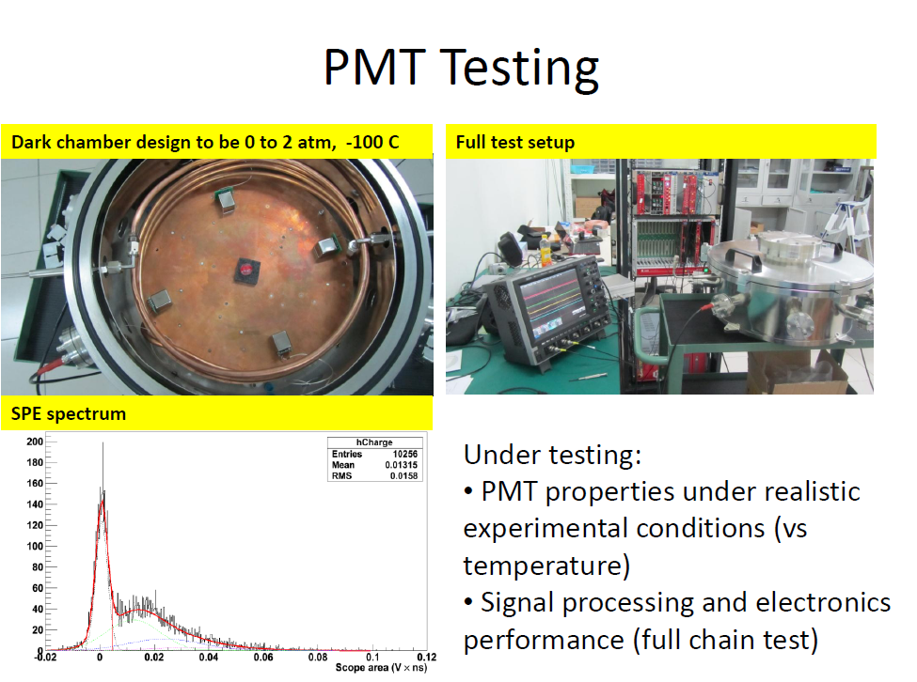

Slide 33


InnerVessel
Two stages:
First stage: a steel vessel to make sure it works
Second stage: a pure Ti vessel

Slide 34


Cryogenic system
Outer Vessel (vacuum) part of shield 5 cm OFHC copper
All auxillary structures removed to outside of shield
‘Weir’ structure instead of ‘Bell’
Minimize PTFE use. Neutron production on Fluorine
Reduced cabling in xenon. Less outgassing

Slide 35

Testing Vessel and gas handling

Slide 36

Cooling bus
with Heat Exchanger ,
with speed up to 100 SLPM.

Slide 37




Jinping lab in Sichuan, China

Slide 38


Slide 39


Slide 40


Slide 41

Layout of the exp in Jinping lab
Shield
Xe Storage

Slide 42



Before moving in

Slide 43




Slide 44


Slide 45

TPC & PMT at Jinping

Slide 46


Cabling, decouplers, DAQ at jinping

Slide 47



First LXe Test Run (450kg Xe)
⁶⁰Co
Light signals only (bottom PMT array only): functional cryogenic liquid scintillator

Slide 48


PandaX sensitivity

Slide 49
Summary
There are multiple evidences indicating that the dark matter might be found just around the corner.
PandaX is a first large scale experiment in China aiming to: 1) detect low-mass WIMPs with unprecedented sensitivity 2) enhance the detection threshold for WIMPs by a ton-scale target.
PandaX is on its way to prepare a first stage running.

