Slide 1
Accelerator Needs from Medical and Industrial Applications for the next 50 years
Ken Peach
Particle Therapy Cancer Research Institute
(Oxford Martin School)
&
John Adams Institute for Accelerator Science
University of Oxford
final EuCARD meeting & EuCARD2 kickoff meeting
11th June 2013

Slide 2
Outline
What is problem? Where is the Challenge?
Medical Applications
Industrial Applications
Neutron Radiography
Energy
Security Applications
Are lasers the answer?
Summary

Slide 3
Predicting the future
“In the long run we are all dead”
      John Maynard Keynes A Tract on Monetary Reform (1923)

Slide 4
What is the Problem?
What is the Challenge?

Slide 5
Today’s accelerators are …
Large
  Limited by either Magnetic Field
    R ~ P/(0.3B) [R in m, P in GeV/c, B in T]
      e.g. P=0.8 GeV/c , B=1 T, R=2.7 m
  or Gradient
    L=E/V [L in m, E in MeV, V in MV/m]
      e.g. E=300 MeV, V=10 MV/m, L= 30 m
        Examples are for a Proton Therapy Machine with proton radiography as an option

Slide 6
… and today’s accelerators are …
Expensive
  Large high-field magnets
  High power RF
    … and …
Difficult to move

Slide 7
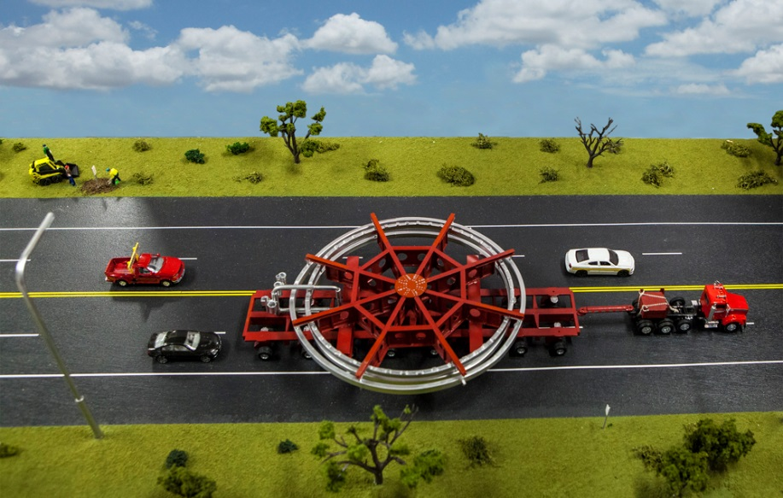
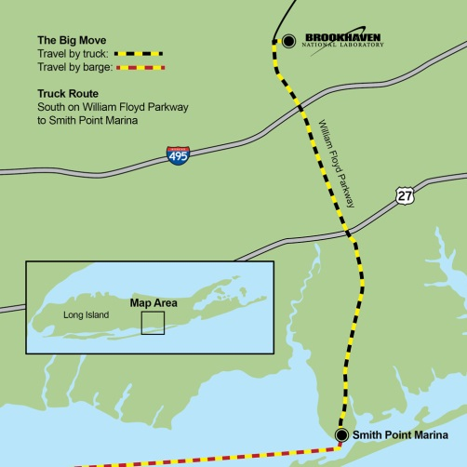

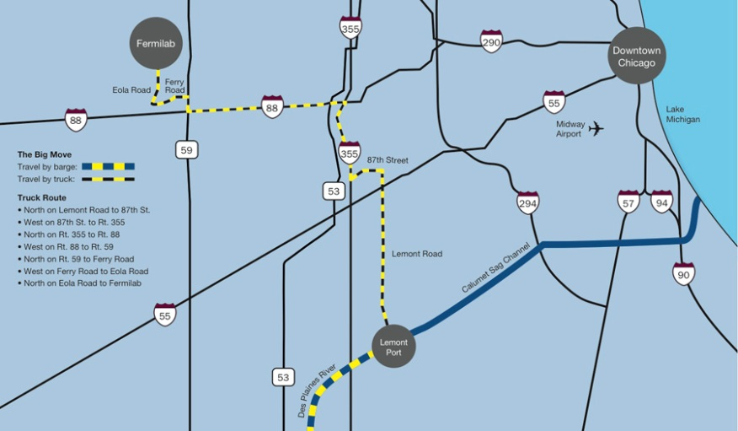
Moving an Accelerator …
Artist’s Impression
A version of the salesman problem

Slide 8
Medical Applications

Slide 9
Radionuclide Production

Slide 10
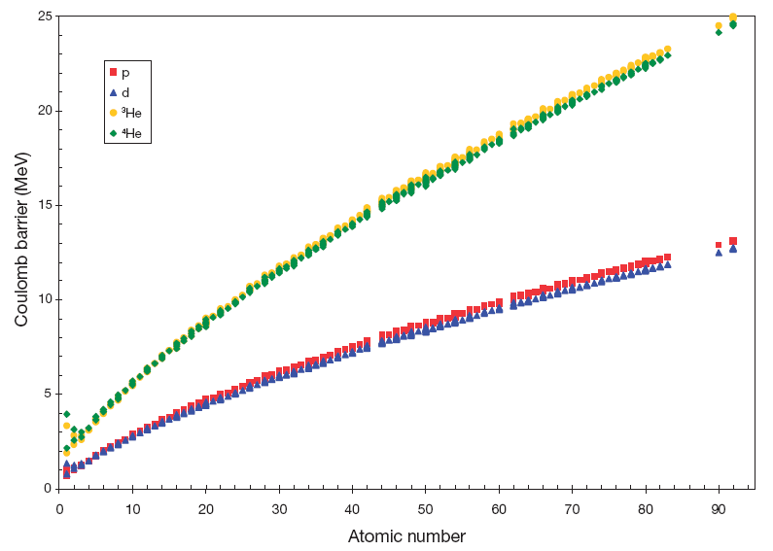
Coulomb Barrier for p, d, ³He, ⁴He
From IAEA Technical report 468 (2009)

Slide 11
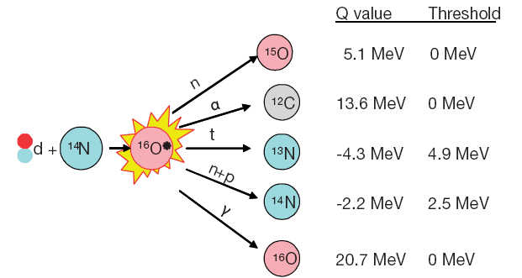
An example
From IAEA Technical report 468 (2009)

Slide 12
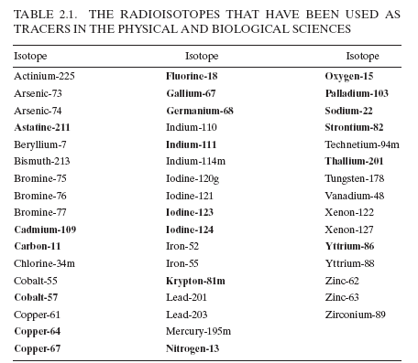
A list of 49 “useful” radionuclides
From IAEA Technical report 468 (2009)

Slide 13
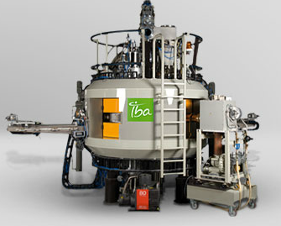
IBA Cyclone 30 – industrial production

Slide 14
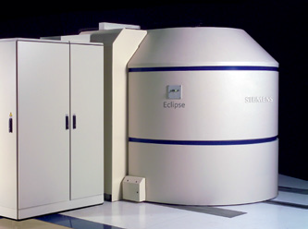
Siemens 11 MeV Eclipse cyclotron

Slide 15
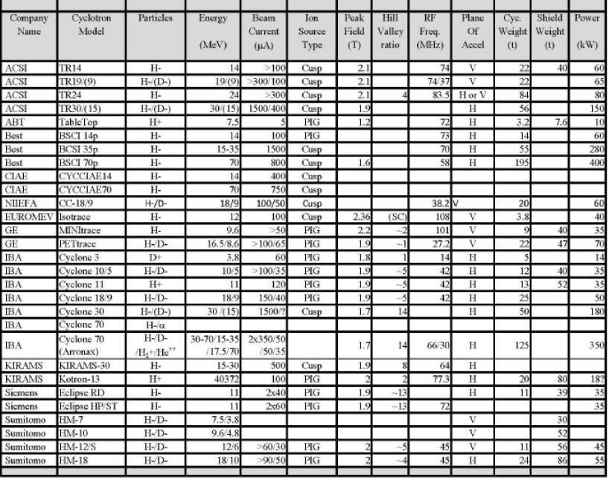
Current commercial radiopharmaceutical cyclotrons
JM Le Goff/CERN

Slide 16
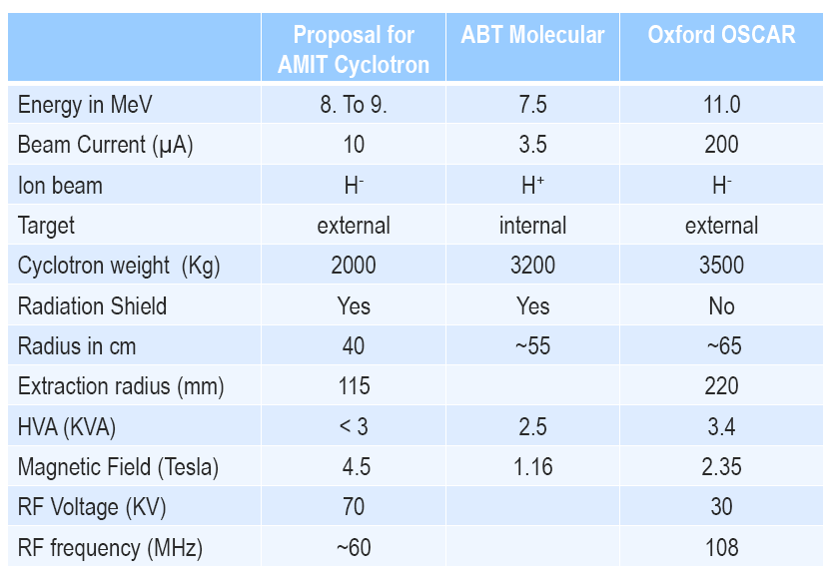
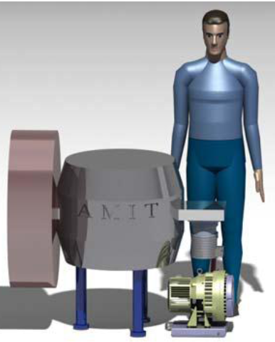
AMIT Technical Specification
Courtesy of P. Arce/CIEMAT, D. M. Lewis/CERN: Development and design of low energy, small cyclotrons;
The Accelerator-Driven Production of Medical Isotopes Workshop held at the Cockcroft Institute 8/9 -12-2011

Slide 17
The challenge
Custom radiopharmaceuticals
  Created close to the patient
    Small enough to be moved …
      Shielding!!!!!!!!!!!!!!!!!!
    Cheap enough for every doctor’s surgery
      Tens of thousands of something, not millions …
  Not just the radiopharmaceutical
    But also the agent
      e.g. targeted radiotherapy
        cancer-specific molecules as delivery agents

Slide 18
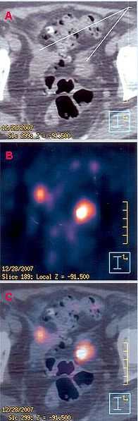
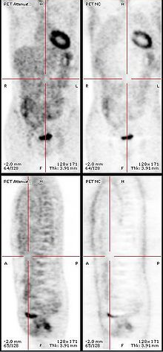
Using radiopharmaceuticals
Positron Emission Tomography
Also for therapy?
Excerpt of PET-CT clinical images from a 69-yrs old female with metastases in the pelvic area, evidenced by hypermetabolic spots, one near the sigmoid colon (at right), another in a lymphatic node (at left).

Slide 19
Charged Particle Therapy
(protons … carbon ions…)

Slide 20
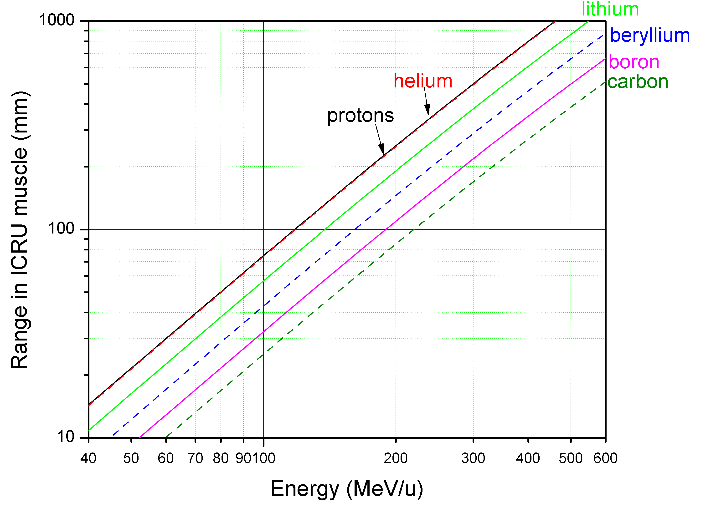
Parameters

Slide 21
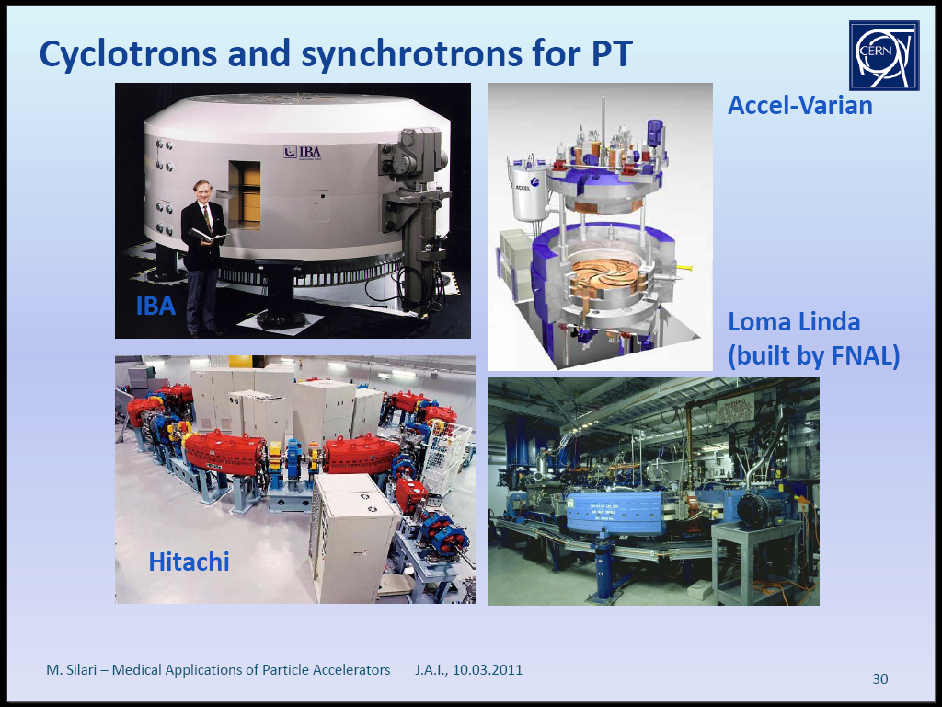
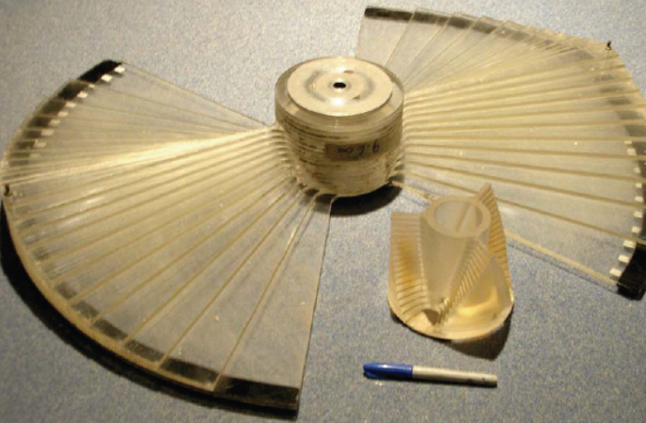
IBA & Varian cyclotrons
Cyclotrons are essentially fixed energy extraction

Slide 22
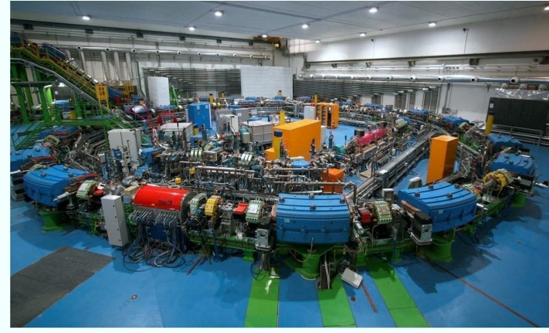
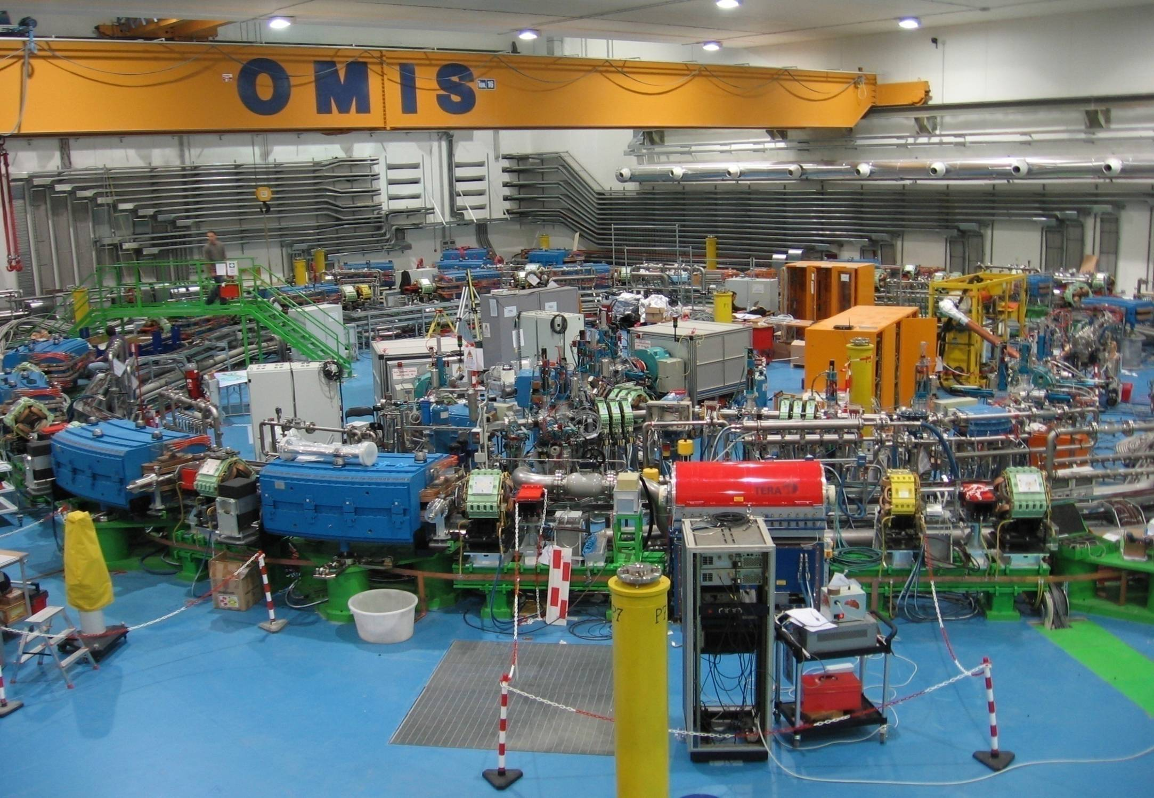
PIMMS (CERN/TERA) Synchrotron Hall @ CNAO
2012
Courtesy Amaldi
Ugo Amaldi/TERA

Slide 23
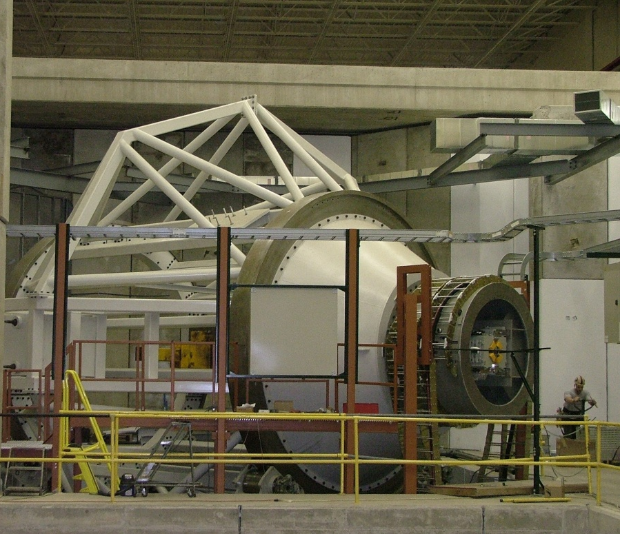
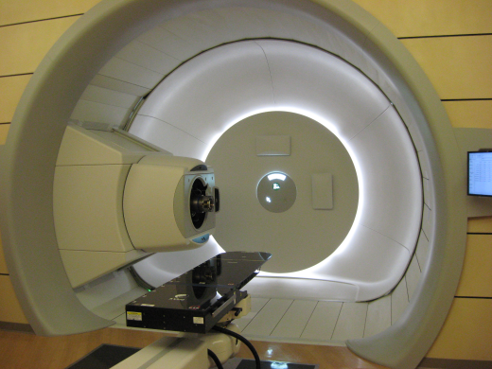
The gantry

Slide 24
The challenges
> 2Gy/minute rate for volumes ~1L
Dose uncertainty <2%
Dose conformity <2% (to plan)
Lateral position precision <1mm
(Kinetic) Energy uncertainty <3 MeV
Cost
  10M (Accelerator) + 10M (Infrastructure) + 10M/Treatment Room
Size

Slide 25
Other Medical Accelerators

Slide 26
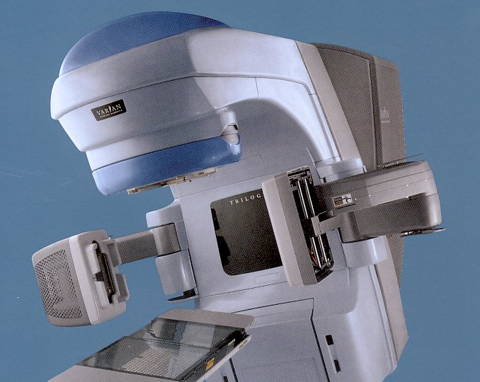
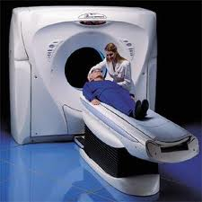
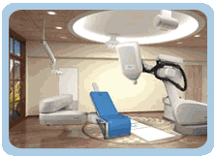
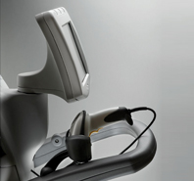
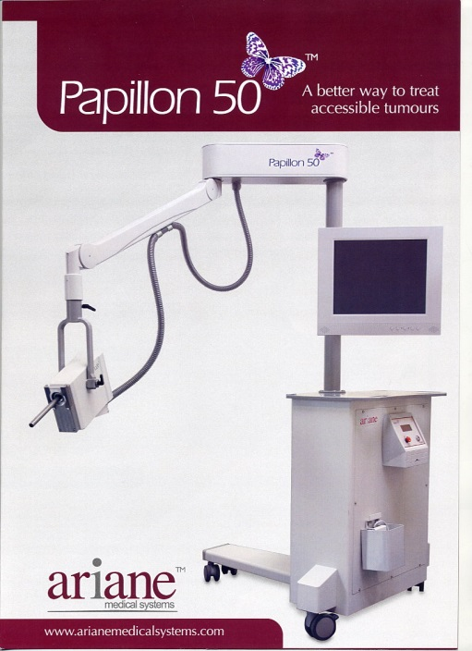
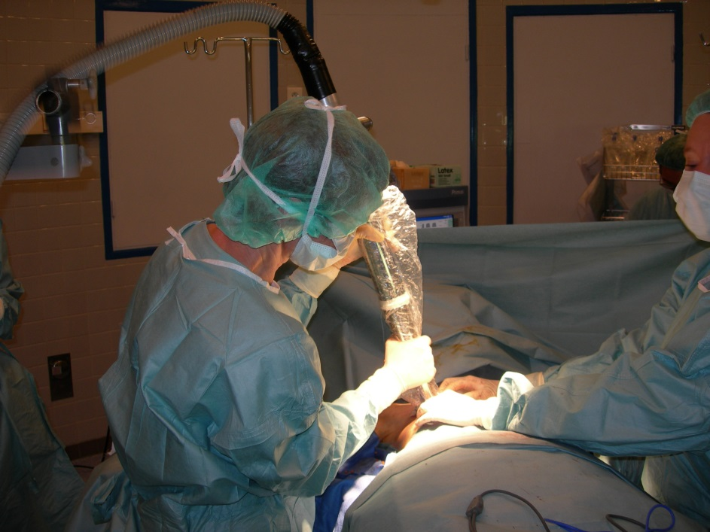
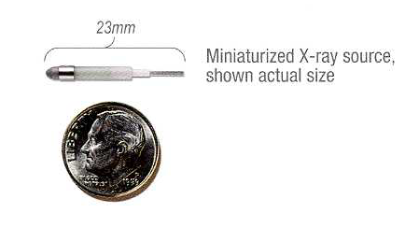
X-rays
cyberknife
Radiotherapy CT scanner
Axxent Xoft
“brachytherapy”
Images: -P Gerard

Slide 27
Industrial Applications

Slide 28
Industrial Accelerators
Direct Voltage
  Van de Graaf, Cockcroft Walton …
    Protons, ions to a few MeV (~5)
Linacs
  Electron beam
    Up to 16 MeV
  Ion beam
    Up to ~70 MeV
Rings
  Cyclotrons
    Ions up to ~70+ MeV
  Betatrons
    Electrons up to a few 10s of MeV
  Synchrotrons
    Up to several GeV

Slide 29
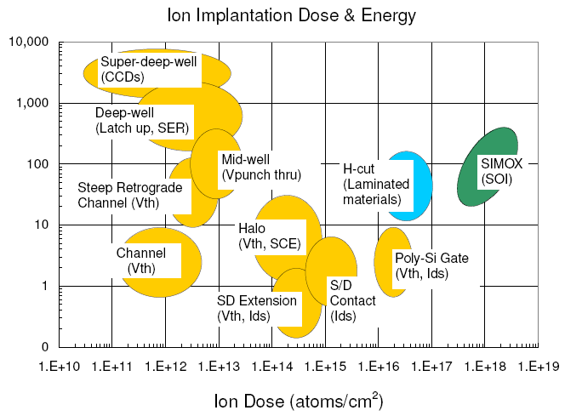
Ion Implantation
Semiconductors
  Precision composition
Metals
  hardening
Glass
  Hardening
  Modified optics
    Note: All digital electronics depends upon ion implantation

Slide 30
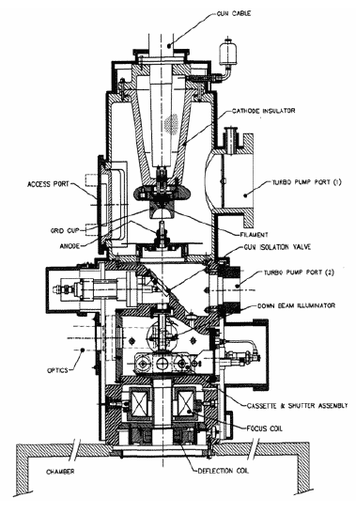
Electron Beam Materials Processing
Usually low energy
  Few hundred keV
  Used for precision
  engineering
  (cutting, welding)

Slide 31
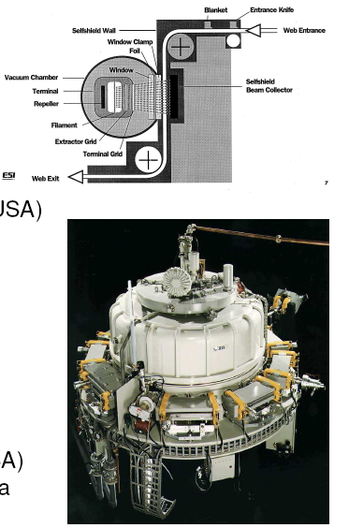
Electron Beam Irradiators
Low energy (<300 keV)
    Curing, laminating
  up to 1 MeV
    Also polymerisation
Medium energy (<5 MeV)
  Polimerisation
  Sterilisation (medical)
High Energy (~10 MeV)
  Food irradiation
  Waste water treatment
  Gemstone colour enhancement

Slide 32
From Ion Implantation to Meta-materials
Can we move from embedding ions in substrates to building complex (meta)-materials?
  3-d printing at the milli-scale
    e.g. customised “factory-on-a-chip”

Slide 33
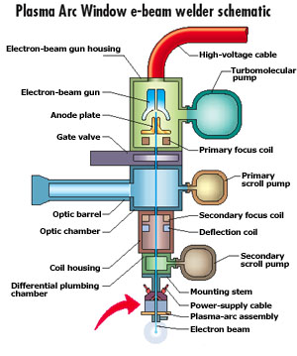
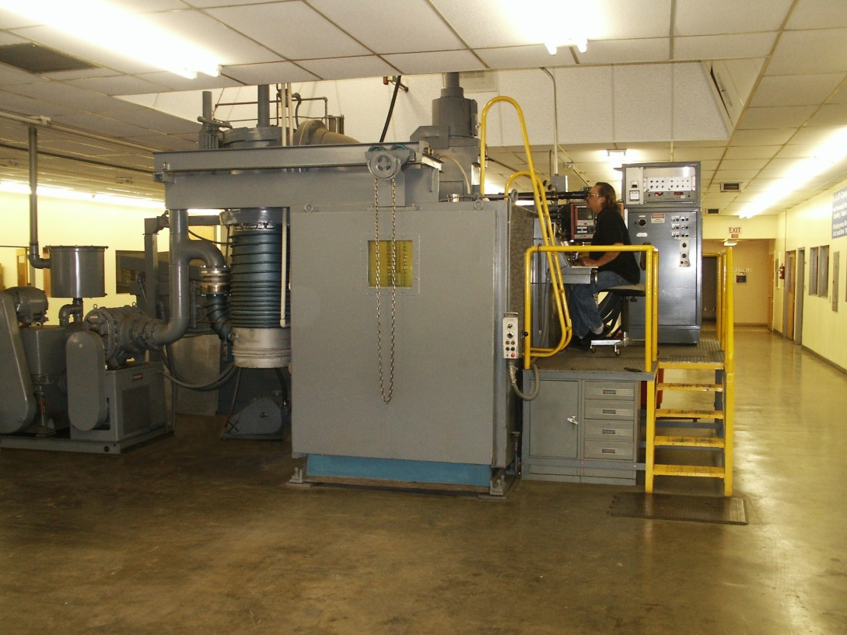
Electron Beam Welding

Slide 34
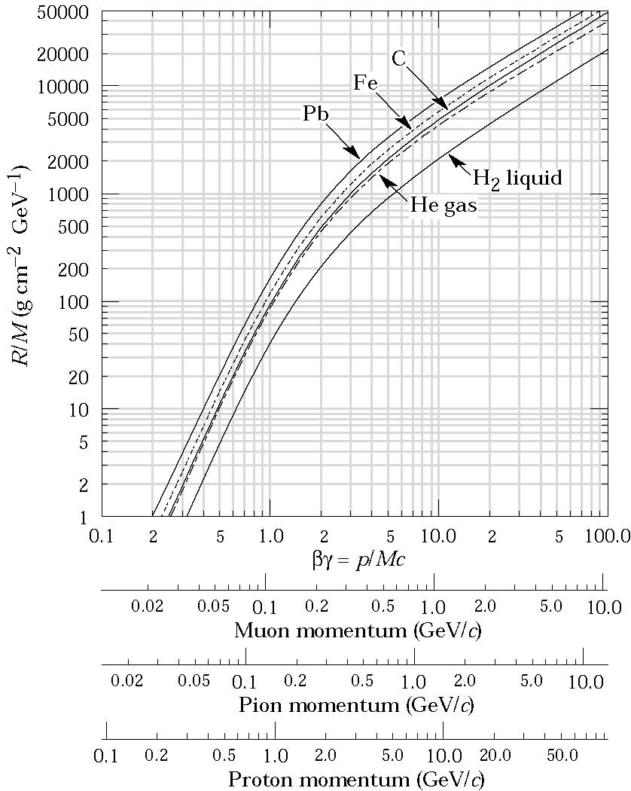
Why not proton beam welding?
Requirements
  10-100 MeV
  10³ - 10⁸ W/mm³
  2 - 50 mm/s
  (~10¹²-10¹⁴ p/s)
So why not
  Size
  Cost
  Shielding!!!

Slide 35
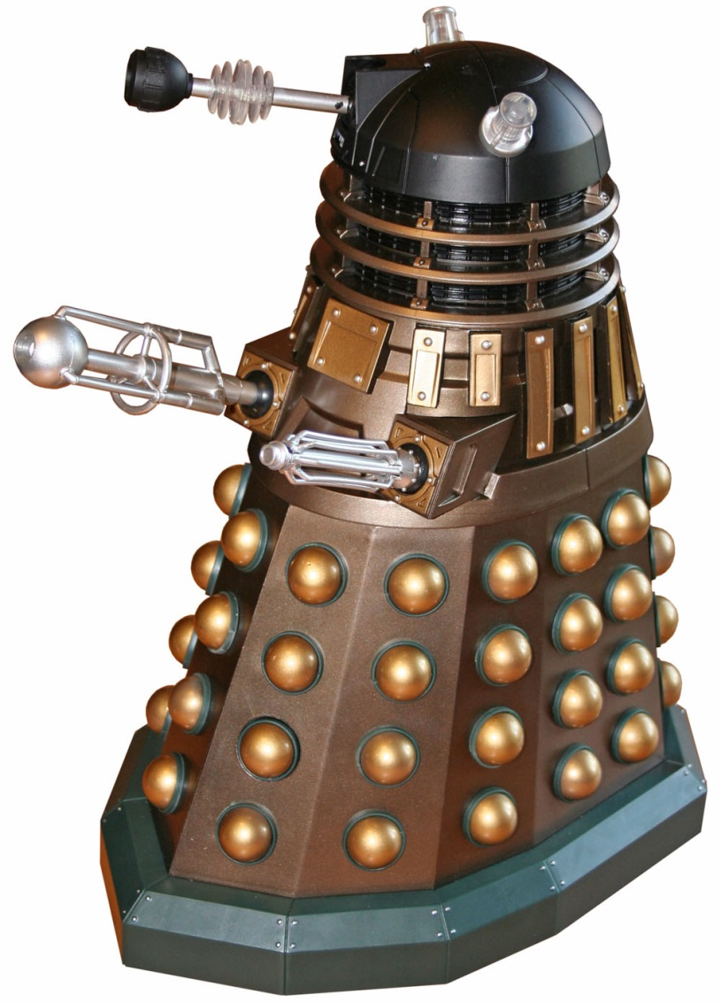
A possible mobile EPM device

Slide 36
Neutron RADIOLOGY

Slide 37
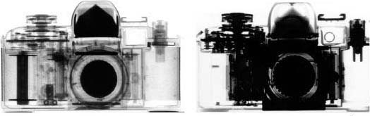
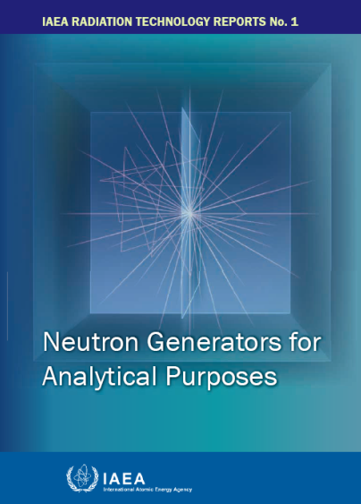
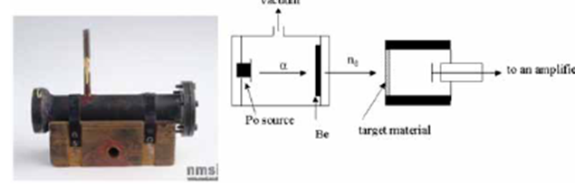
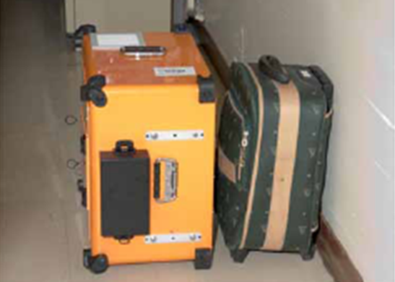
Neutron Radiology
neutron
X-ray
From this
IAEAL 12-00724
162 pages!
Chadwick
to this
Images from IAEAL 12-00724

Slide 38
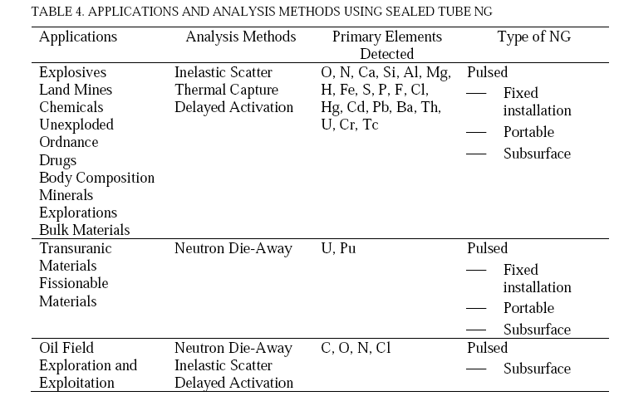
Applications
From IAEAL 12-00724

Slide 39
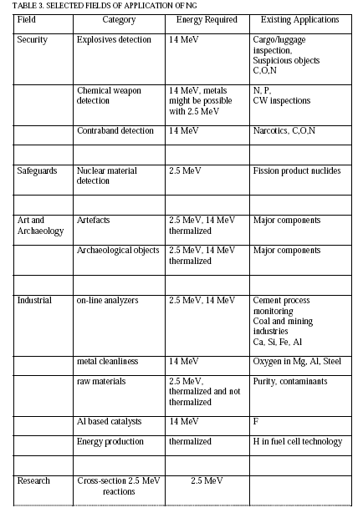
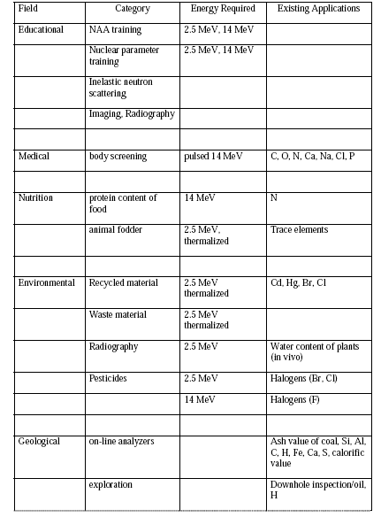
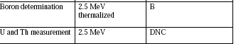
Applications
From IAEAL 12-00724

Slide 40
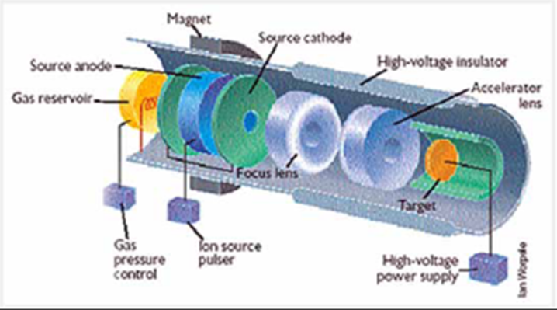
A typical Neutron Generator

Slide 41
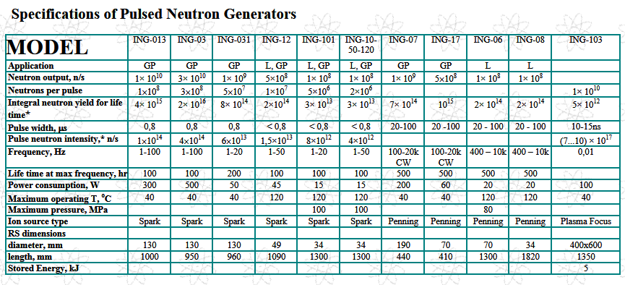
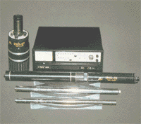
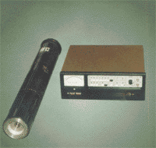
A practical implementation
http://www.sciner.com/Neutron/

Slide 42
Energy

Slide 43
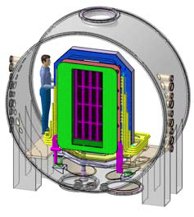
Neutral Beam Accelerator for ITER
Vacuum Vessel
Beam Source
Accelerator/Extractor Grid
Beam Direction
33 MW of beam power required
(2 Neutra;l Beam Injectors planned)

Slide 44
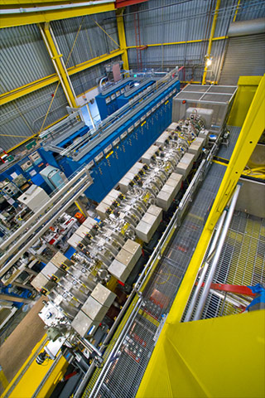
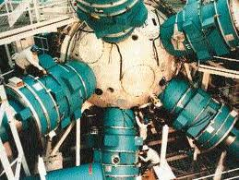
Accelerator-Driven Inertial Confinement
NDCX-II @ LNBL
Induction Linac
Li ions, 1.25 MeV, 50nC, 38A, 8.6J/cm²

Slide 45
Accelerators for Energy
Fusion is a Big Business
  Billions of somethings ($, €, £…)
  Mega (amps, watts, joules…)
  Heavy Engineering
    99% uptime is poor!
      15 minutes downtime per day
    Maintenance
      Radiation …
    Safety

Slide 46
Security Applications

Slide 47
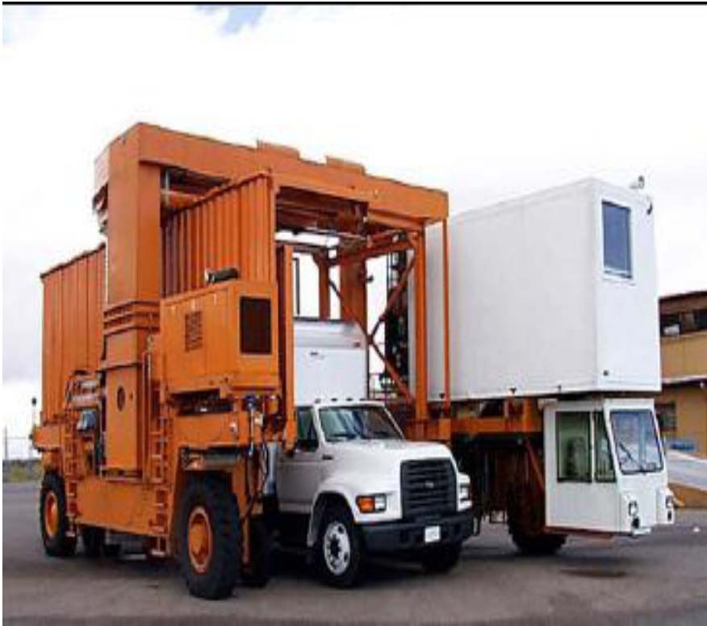



Cargo Scanners

Slide 48



Siemens SILAC 6-9 MeV scanner

Slide 49

SILAC parameters

Slide 50
Are Lasers the Answer?

Slide 51
Classical Accelerator Types
Type | Magnetic Field | RF | Radius
Electrostatic | × | × | ∞
Betatron | Variable | × | Fixed
Linear accelerators (Linacs) | × | ✓ | ∞
Cyclotron | Fixed | ✓ | Variable
Synchrotron | Variable | ✓ | Fixed
FFAG (Fixed Field Alternating Gradient) | Fixed | ✓ | ~Fixed

Slide 52




Maxwell’s Equations
Gauss's law
Gauss's law for magnetism
Maxwell–Faraday law
Maxwell-Ampère law
Mix electric &
magnetic fields
$R_{μν}−\frac{1}{2}$ ${R g}_{μν}$ = ${\frac{8πG_{N}}{c^{4}}T}_{μν}$
Einstein Gravitational Equation

Slide 53

Riding the electromagnetic wave
It is difficult to control, but not impossible
Thanks to Dan Warren for help with the video
http://www.youtube.com/watch?feature=player_detailpage&v=wHN0eldgXqQ#t=22s

Slide 54



Laser-plasma accelerators
Electron
Proton/ion
Z⁺
e-
Simulation Jimmy Holloway, UCL

Slide 55



But not SO compact …
Vulcan@RAL
NIG @ LLNL

Slide 56


TARANIS Laser at Queen’s University Belfast
Type: Ti:Sapphire-Nd:glass
Wavelength: 1053nm
Pulse duration of ~500fs
Beam energy up to 30J
Beam profile Flat top relay imaged
Repetition rate One shot every 12 minutes
T. Dzelzainis et al, LPB, 28, 451 (2010)
Courtesy Dave Neely (RAL)

Slide 57



A compact high-power fibre laser
Courtesy Laurie Nevay/Oxford
Laser-Plasma Proton Therapy

Slide 58



Which accelerators are useful?
Low energy (< or << 1 GeV)
Low Power (<<< MW) [often <W)
Modest emittance

Slide 59
Accelerator-on-a-chip?
Electron/proton/ion beams
  Few MeV ; nA→μA ; small spot (μm not mm)
  Low emittance (μm·mrad)
would have many uses
  Micro-surgery
  Welding/edtching/engraving
  Micro-lithography
  Meta-materials
    3-d micro-printing
  …
Can this be packaged on a chip?

Slide 60


An idea
0.76 cm
2.54 cm
Staude et al, Optics Express 20 5607 (2102)
Assume 1 cm length for acceleration
  100 MV/m per MeV
Could suitable materials be engineered?
  Not today …
    … but in 50 years?

Slide 61
Summary

Slide 62
Summary
Medical, Industrial and Security need
  keV to a few MeV
  nA to mA
  Stringent control on both
  Usually small emittance
Challenges: accelerators are
  Large
  Expensive
  Often no mobile (or not very mobile)
In 50 years they may be
  Small, Cheap and mobile …
    Shielding????
    Do small precise accelerators need shielding?

