Slide 1
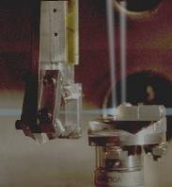
bending and focusing with plasmas and crystals - potential and challenges
Frank Zimmermann
EuCARD2013, 11 June 2013
photo
SLAC

Slide 2
outline
plasmas
  plasma lenses
  plasma wiggler
  plasma dipole
crystals
  crystal channeling & reflection
  leptons in crystals
  crystal accelerators
  crystalline beams

Slide 3
plasma focusing: plasma lens
proposed as final focusing element for future high energy electron-positron colliders
– P. Chen, 1987
early experiments with e⁻ at low energy (50 MeV)
  J. Rosenzweig, H, Nakanishi etc, 1990, 1991
SLAC FFTB experiment (2001): focusing of 28.5 GeV e⁺ beam using plasma formed by ionizing a 3-mm N₂ gas jet; simultaneous focusing in both transverse dimensions
effective focusing strength: 10⁶ T/m
plasma density
n≈5x10¹⁷ cm⁻³

Slide 4
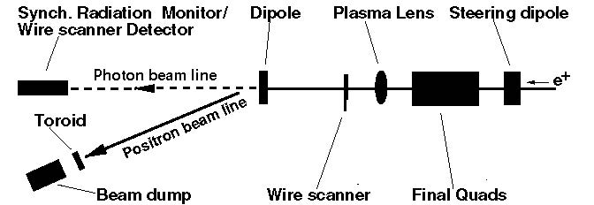
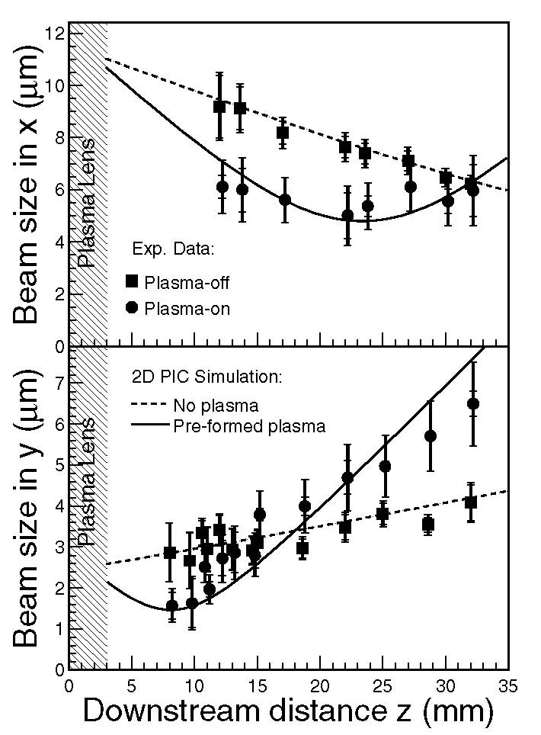
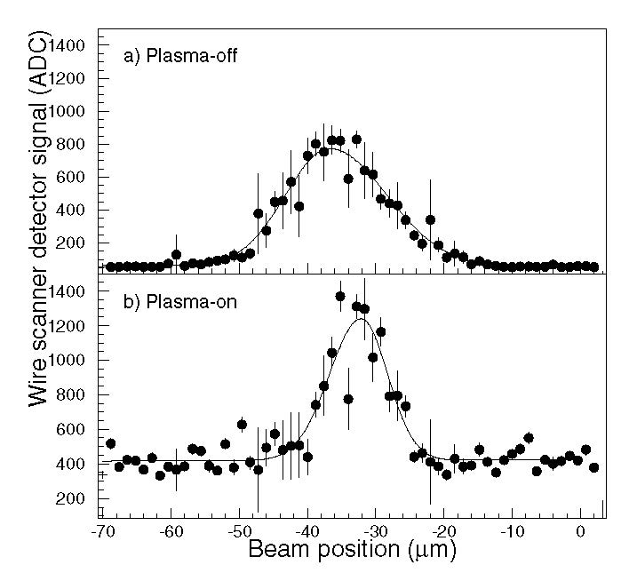
plasma lens @ FFTB (2001)
J. S. T. Ng et al,
Phys. Rev. Letters
87, 24 (2001)
minimum area of beam spot reduced by factor ~2

Slide 5
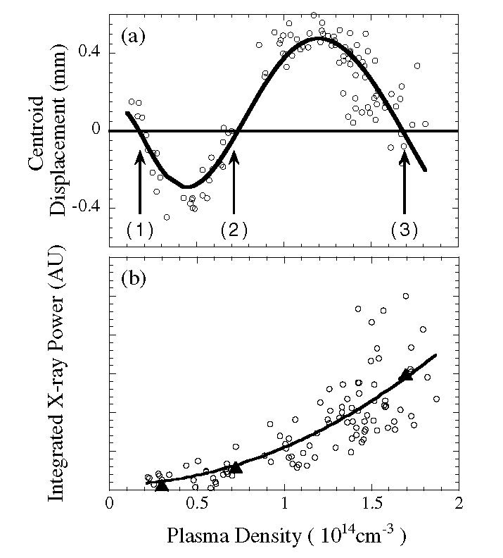
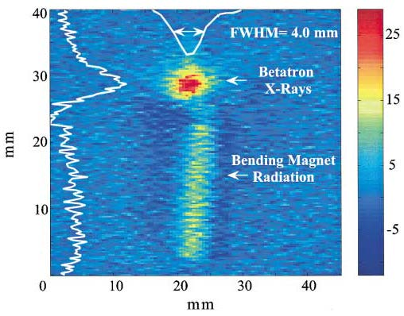
n=1.7x10¹⁴ cm⁻³: focusing force ~5x10⁶ T/m, shrinking beam size from 40 μm to <5 μm
plasma betatron wiggler: FFTB (2001)
S. Wang et al, Phys. Rev. Letters, 88, 13 (2002);
also see M. Litos, S. Corde, SLAC-PUB-15215 (2012)

Slide 6
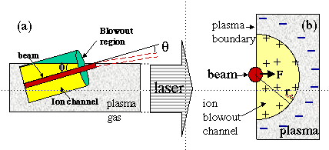
plasma bending: FFTB (2000)
Collective Refraction of a Beam of Electrons at a Plasma-Gas Interface
collective response of the plasma produces a deflection of the electron beam of the order of one millirad
Nature 411, 43 (3 May 2001)
P. Muggli,
T. Katsouleas,
et al
1.9x10¹⁰ electrons at 28.5 GeV in a Gaussian bunch of length σ_{z}=0.7mm and spot size σ_{x}~ σ_{y}~40 μm

Slide 7
plasma bending at FFTB
Cerenkov images of e⁻ beam showing refraction of a portion of the beam with the plasma (i.e., laser on) & PIC simulation
P. Muggli,
T. Katsouleas,
et al

Slide 8
plasma bending at FFTB
Measured e- beam deflection θ versus angle φ between laser and e-beam/ Solid curve is an analytical model prediction. The bunch length & plasma density were 0.7 mm and 1x10¹⁴ cm⁻³ (λ_{p}~3 mm, r_{c}~0.2 mm?)
length of interaction
2rc/sinφ
equivalent field
~5 T – 100 T?
P. Muggli,
T. Katsouleas,
et al

Slide 9
from plasmas to crystals !?
maximum field in a plasma
G≈ 100 GV/m (n₀ [10¹⁸ cm⁻³])^{1/2} ;
n₀ ≈10¹⁷-10¹⁸ cm⁻³
maximum field in a crystal
G≈ 10 TV/m (n₀ [10²² cm⁻³])^{1/2} ;
n₀ ≈10²²-10²³ cm⁻³
crystals are also more regular and could be cooled → less beam interaction with nuclei, etc.

Slide 10
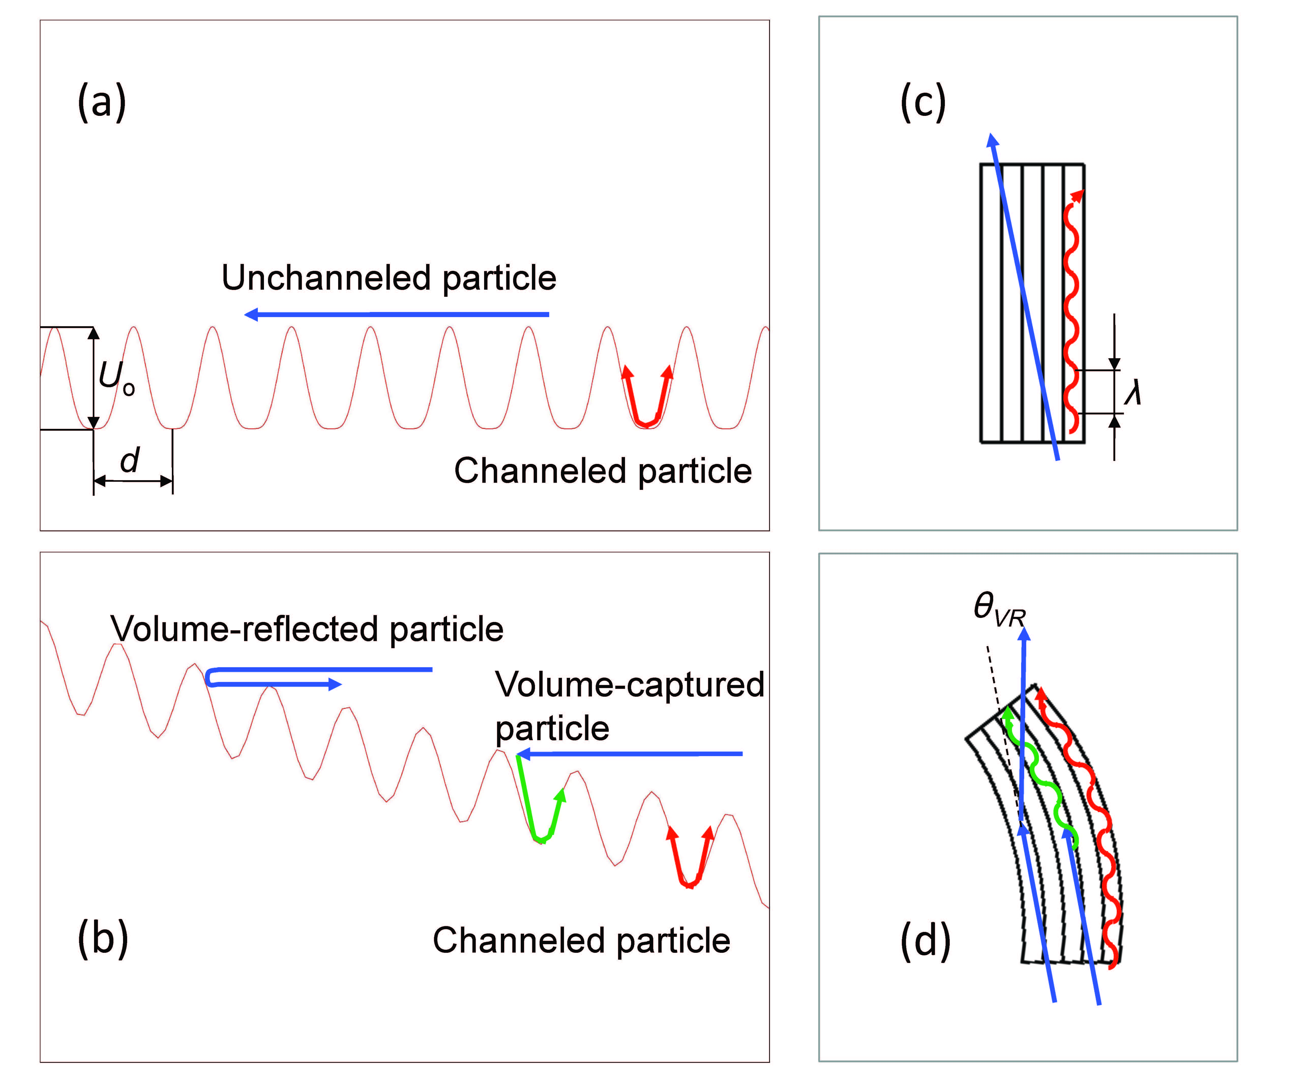
crystals - world’s strongest “magnets
straight crystal
crystal focusing strength
φ~20-60 eV/Å²
B_{max}≈2000 T !
λ=2πβ=2π (E/φ)^{1/2}
bent crystal
W. Scandale, MPL A (2012)
S.A. Bogacz, D. Cline, 1997

Slide 11
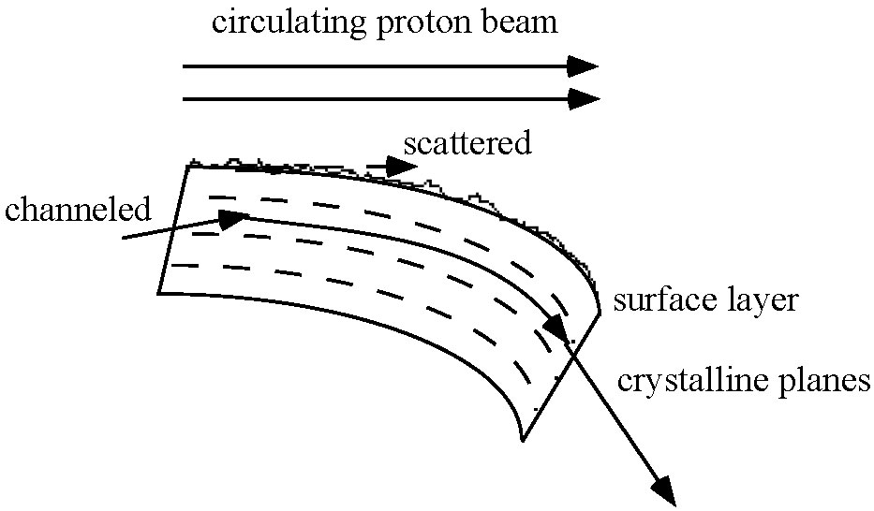
crystal extraction from stored proton/ion beam
Dubna, Protvino,
CERN SPS,
Tevatron
since 1978 crystals are used for extracting high-energy protons or ions from storage rings; can they also be used for a circular collider?!

Slide 12
channeling condition: angle of incidence < Lindhard critical angle ~5 μrad (Z/p [TeV/c])^{1/2}
thermal vibrations, discreteness of lattice, electrons
→ dechanneling (exponential decrease of channeled
protons)
dechanneling length L₀~0.9 m p[TeV/c]
cooling of crystal increases L₀
minimum bending radius for channeling
R_{c}~0.4 p [TeV/c] meter

Slide 13
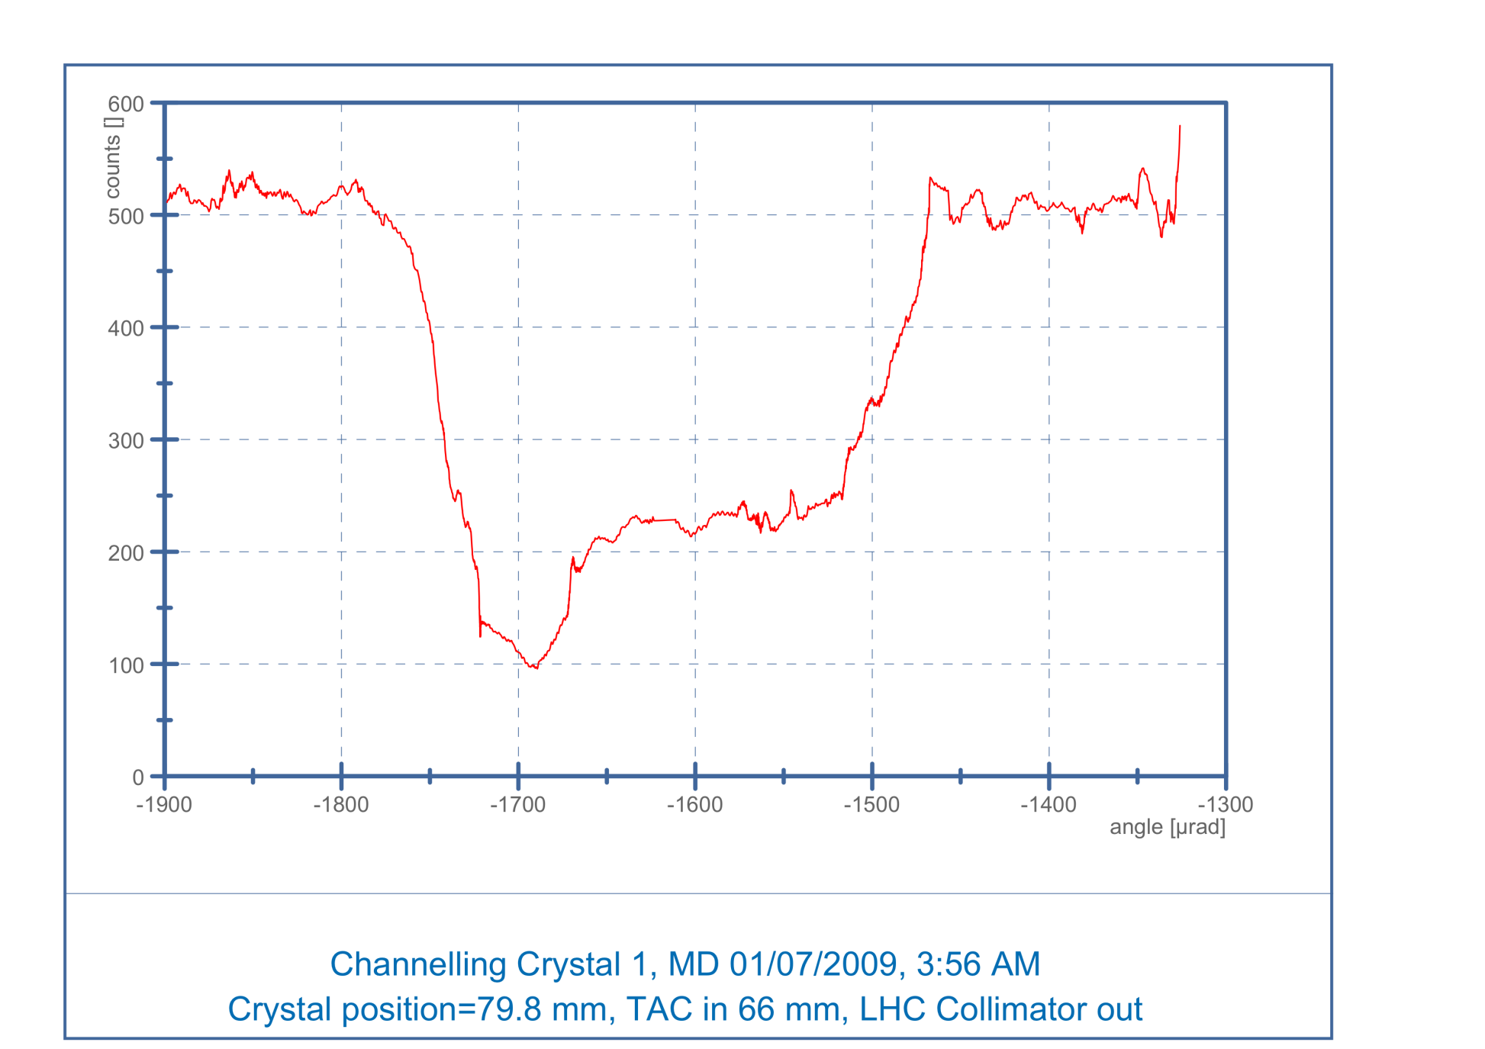
crystal extraction experiment UA9 at SPS (2009)
500
Amorphous orientation
Amorphous orientation
× 5 reduction rate
counts
Nuclear loss rate seen by a scintillator telescope downstream of the crystal
Reflection range
100
⬆
Channeling peak
-1800
-1700
-1600
-1500
Angle [μrad]
Nuclear loss rate (including diffractive) strongly depressed
W. Scandale

Slide 14
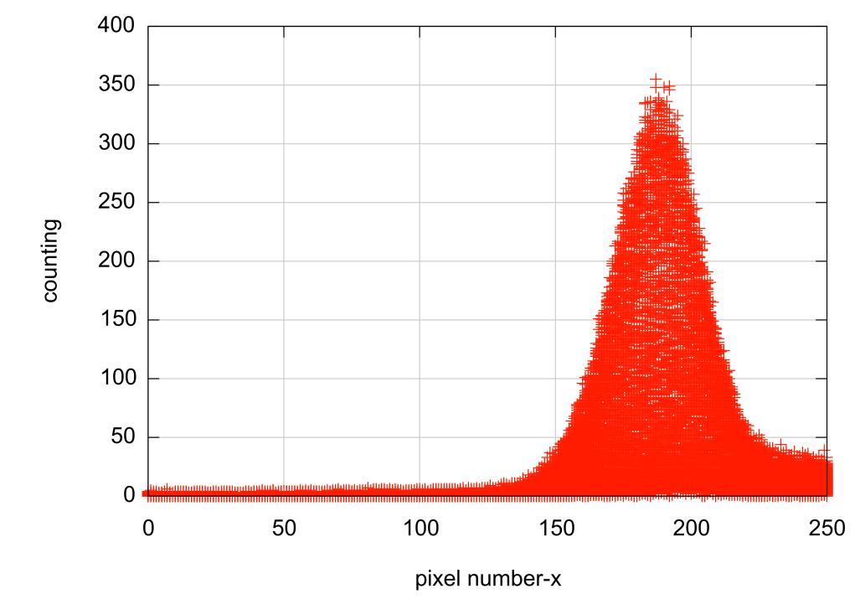
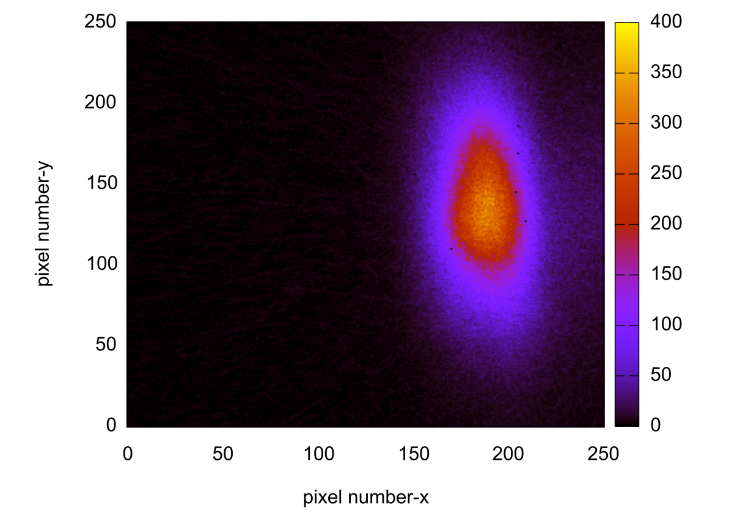
profile of “beam” deflected by crystal
256×256 square pixels
1 pixel size = 55 μm
1 frame integration time 1 s
W. Scandale

Slide 15
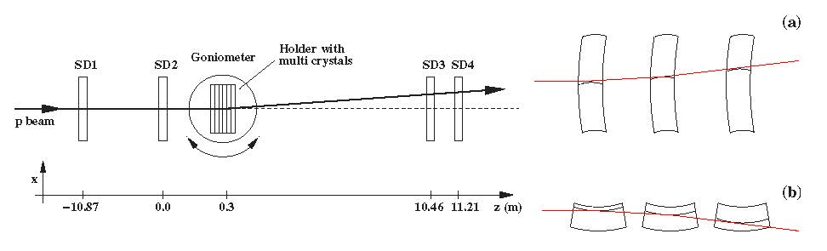
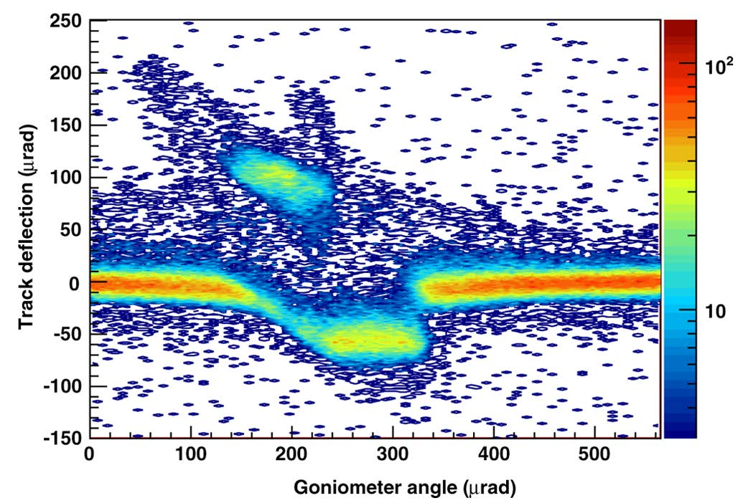
staging of crystal deflectors
schematic layout
of the experimental setup used to
study multiple volume reflection at the H8 beam line of the CERN SPS
quasimosaic
strip
crystals
6 strip crystals in series
(each 2 mm long):
400 GeV/c protons
reflected by 40±2 μrad
[effective field 16 T]
with efficiency 0.93±0.04
proof of principle demonstration!
W. Scandale et al, Observation of Multiple Volume Reflection of Ultrarelativistic Protons by a Sequence of Several Bent Silicon Crystals, Phys.Rev.Lett. 102 (2009) 084801

Slide 16
crystal channeling efficiency
for single crystal traversal: present deflection efficiency >0.8-0.9 t.b.c.w. 1990’s : 0.1-0.2
gain in deflection probability over last decades:
now short crystals bent with constant curvature (anticlastic bending); crystal length in the 1990’s was 5 cm or more and now it is 5 mm or less
multi-reflection / multi-strip crystal - drawbacks:
1. difficult to produce a multi-crystal with coherent reflections (alignment imperfections )
2. for high energy the multi-crystal length should be large
  large production of diffractive protons !
  3. larger radiation damage of the crystal (larger ionization energy deposition again because of longer paths)
W. Scandale

Slide 17
radiation damping in ideal crystal
transverse radiation damping
- independent of particle energy!
no quantum excitation
decay to transverse ground state
minimum beam emittance: γε_{min} = ħ/2mc
limited only by the uncertainty principle
particle can be accelerated along focusing channel in its ground state without any energy loss
Z.Huang, P.Chen, R.D.Ruth, Radiation reaction in a continuous focusing channel, Phys.Rev.Lett. 74 (1995) 1759-1762

Slide 18
crystal accelerators
acceleration in crystal channels
G≈ 10 TV/m (n₀ [10²² cm⁻³])^{1/2} ; n₀ ≈10²²-10²³ cm⁻³
driven by x-ray laser
max. energy set by radiation emission due to betatron oscillations between crystal planes, excited by multiple scattering off channel e⁻
E_{max} ≈300 GeV for e⁺, 10⁴ TeV μ, 10⁶ TeV for p ?!
Chen & Noble 1997; Dodin & Fisch 2008; Shiltsev ‘12 10 TV/m – disposable crystal accelerator
or 0.1 TV/m – reusable crystal accelerator
side injection of x-ray pulses using long fibers
now/soon available!
LCLS, Spring-8, XFEL, SwissFEL …

Slide 19
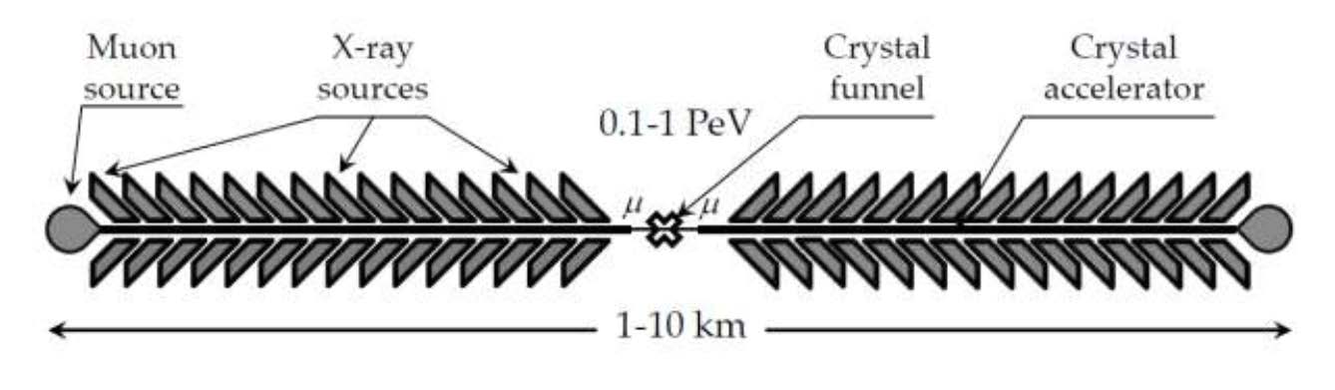
e± may soon run out of steam in the
high-gradient world!
→ need to change particle type
linear X-ray crystal μ collider
issues:
μ production rate
neutrino radiation
ν beam
Vladimir Shiltsev, 2012
ν beam
μ linac 1
μ linac 2
earth

Slide 20
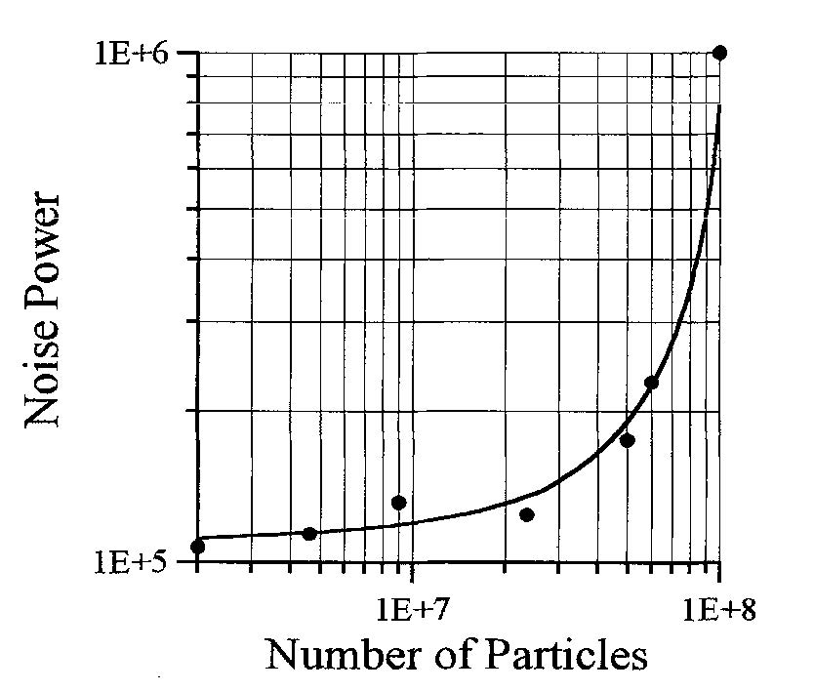
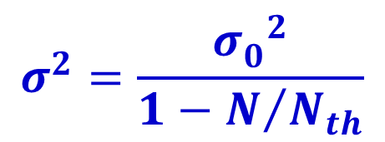
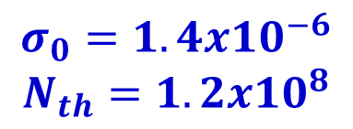
crystalline beams
e-cooled p beam at BINP NAP-M, 1980
$$σ^{2}=\frac{{σ_{0}^{}}^{2}}{1−N/{N_{th}}}$$
explanation:
formation of
crystalline beam
$$σ_{0}=1.4x{10}^{−6}$$
$$N_{th}=1.2x{10}^{8}$$
E.N. Dementiev et al., Sov. J. Tech. Phys. 50 (1980) 1717.
V.V. Parkhomchuk and D.V. Pestrikov, Sov. J. Tech. Phys. 50 (1980) 1411.
D. Pestrikov, NIM A 379, 1996
Schottky noise power vs number
of particles in the beam (N)

Slide 21
theoretical studies:
constant gradient rings, alternating focusing, effect of bending-magnets shear… :
A. Rahman and J.P. Schiffer, Phys. Rev. Letts. 57, 1133 (1986);
R.W. Hasse and J.P. Schiffer Annals, of Physics 203, 419 (1990).
J. Wei, T.P. Li, and A. Sessler, Phys. Rev. Letts. 73, 3089 (1994).
increasing beam density:
1-D crystal → 2-D crystal → 3-D crystal

Slide 22
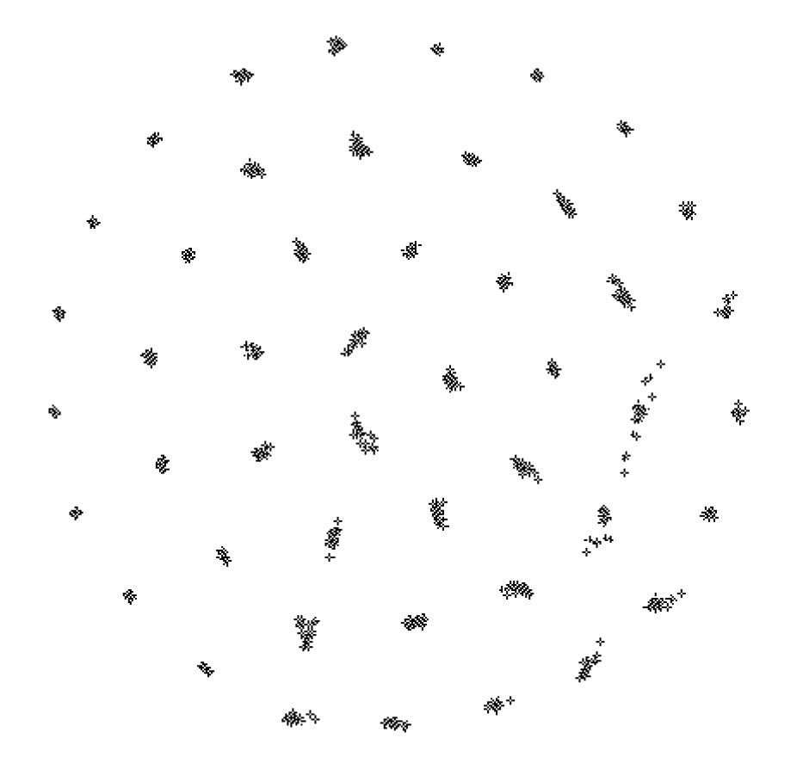
molecular dynamics simulations
J.P. Schiffer
IEEE 1996
projection onto x-y plane with strong continuous cooling

Slide 23
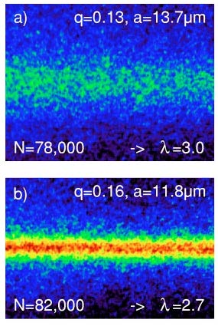
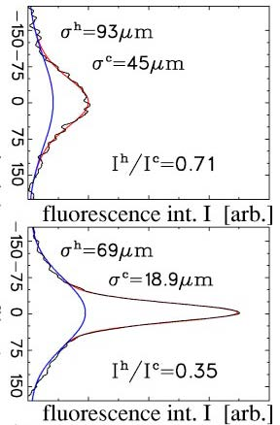
experiments on crystalline beams
BINP NAP-M, e-cooling
TSR Heidelberg, laser cooling, < 1 K
ASTRID Arhus, laser cooling Laser , ~mK
PALLAS, LMU Munich
J. S. Hangst et al., Phys. Rev. Letts. 67, 1238 (1991).
U. Schramm et al,
PRE 66 (2002)
non-crystalline
higher line density
lower line density
crystalline, helix

Slide 24
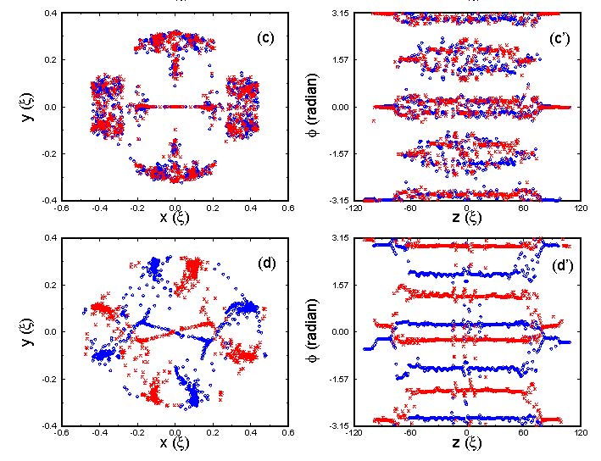
colliding crystalline beams
ΔQ_{bb}=0.27
MD simulations
showing
formation of
crystalline
ground states with
1000 macro-particles /
beam
100 times higher luminosity than in normal colliders!
ΔQ_{bb}=2.7
can we use crystals to bend and focus crystalline beams?
J. Wei, A. Sessler, Colliding Crystalline Beams, BNL-65137, 1998

Slide 25
possible long-term strategy
(CERN implementation)
TLEP (80-100 km,
e⁺e⁻, up to
~350 GeV c.m.)
PSB
PS (0.6 km)
LHC (26.7 km)
SPS (6.9 km)
VHE-LHC
(pp, up to
100 TeV c.m.)
& e± (120 GeV) – p (7, 16 & 50 TeV) collisions ([(V)HE-]TLHeC)
≥50 years of e⁺e⁻, pp, ep/A physics at highest energies
100 TeV pp collider may not be enough ?!? (D. Schulte)

Slide 26
possible longer-term strategy
(CERN implementation)
TLEP (80-100 km,
e⁺e⁻, up to
~350 GeV c.m.)
PSB
PS (0.6 km)
LHC (26.7 km)
SPS (6.9 km)
VHE-LHC
(pp, up to
100 TeV c.m.)
CCC, > 1 PeV
& e± (120 GeV) – p (7, 16 & 50 TeV) collisions ([(V)HE-]TLHeC)
≥50 years of e⁺e⁻, pp, ep/A physics at highest energies
followed by >1 PeV circular crystal collider (CCC)?!?

Slide 27
circular crystal collider?
cryogenic?
crystal
bending
stage
cryogenic?
crystal
bending
stage
tunnel mostly empty
a dream or our future ?
proton beam
energy ramp using induction acceleration?

Slide 28
conclusions
plasmas & crystals demonstrate large focusing forces, 10³-10⁴x stronger than SC quadrupoles
they could also provide large dipole field; so far bending fields of 5-100 T demonstrated
beam-matter interaction & efficiency are the critical issues for circular ring applications
straightforward use in single-pass systems
incentive to strengthen crystal R&D!

Slide 29
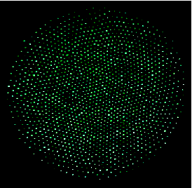
… and how about plasma crystals?
many thanks for your attention!
Sandia Labs

