Slide 1
LOW-ε-RING network:
Common challenges and common solutions
R. Bartolini (Oxford Un.), S. Guiducci (INFN-LNF) and
Y. Papaphilippou (CERN)

Slide 2
WP6 - Low Emittance Rings: scope and background
Bring together scientific communities of synchrotron light sources’ storage rings, damping rings and e+/e- ring colliders in order to communicate, identify and promote common work on topics affecting the design of low emittance electron and positron rings
Initiated by the CLIC-ILC collaboration working group on damping rings, chaired by YP and Mark Palmer (now at FNAL)
State of the art in design of accelerator systems especially in X-ray storage rings approaches the goals of damping rings for linear colliders and future e+/e- ring collider projects

Slide 3
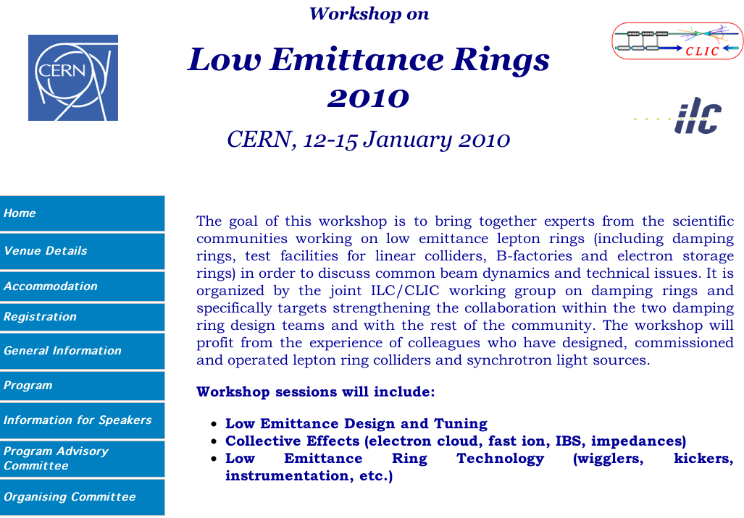
First Low Emittance Rings’ workshop
Organization of the 1st Low Emittance Rings’ workshop in January 2010, at CERN (~70 participants)
Common tasks identified including beam dynamics but also technology

Slide 4
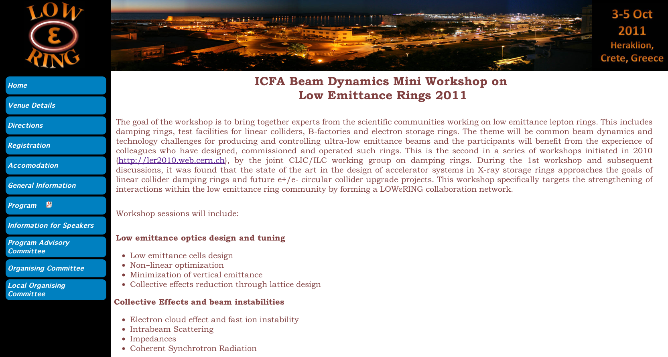

Second Low Emittance Rings’ workshop
Second workshop on October 2011 in Creta acted as a catalyzer
Proposal of a collaboration network enabling scientific interaction and coordination for common design work including measurements and tests in existing facilities for achieving ultra-low emittance, high intensity beams with remarkable stability

Slide 5
WP6: Objectives
Task 6.1: Coordination and Communication
Task 6.2: Low Emittance Ring Design (LERD)
Task 6.3: Instabilities, Impedances and Collective Effects (IICE)
Task 6.4: Low Emittance Rings Technology (LERT)

Slide 6
Task 6.1: Coordination and Communication
Coordinators:
  R. Bartolini (UOXF)
  S. Guiducci (INFN-LNF)
  Y. Papaphilippou (CERN)
Form a coordination board, representing the Low Emittance Rings community (including non-EU members)
  B. Hettel (SLAC)
  Q. Qin (IHEP)
  D. Rubin (Cornell)
  J. Urakawa (KEK)
  Task coordinators: M. Böge (PSI), R. Nagaoka (Soleil), H. Schmickler (CERN)
Organize Low Emittance Rings’ general and topical workshops
Each one representing community of X-ray storage rings of e+/e- colliders and damping rings
Representing “Ultimate-storage ring” community and damping ring test facilities

Slide 7
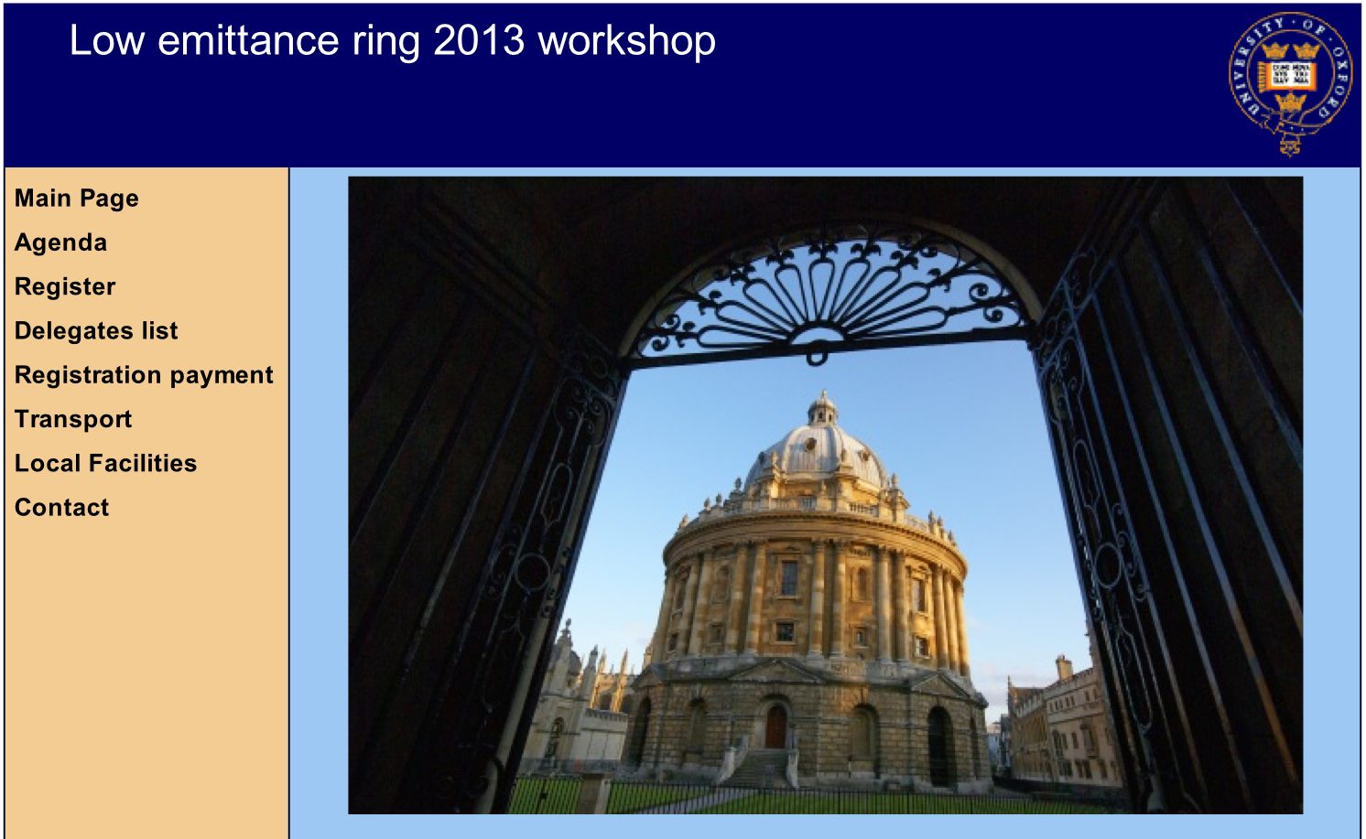

Third Low Emittance Rings’ workshop
Third workshop to be held on July 2013 in Oxford
http://www.physics.ox.ac.uk/lowemittance13/index.asp
Already ~70 registered delegates
Agenda to be finalized by the end of this week

Slide 8
Task 6.2: Low Emittance Ring Design
Coordinator: M. Böge (PSI)
Sub-Task 6.2.1. Optics Design of Low Emittance Rings
  Optics design of multi-bend achromats in conjunction with damping wigglers
  Potential benefit of dipole magnets with longitudinally variable bending field or Robinson wigglers
  Numerical tools (GLASS, multi-objective algorithms) for linear and non-linear dynamics optimization
  Reduction of collective effects through optics design
  Design of low momentum compaction factor optics for bunch length reduction and production of coherent synchrotron radiation
  Experimental tests for understanding limitations of existing theories and benchmarking of numerical codes
Sub-Task 6.2.2. Minimization of Vertical Emittance
  Methods for obtaining sub-picometer vertical emittance in high intensity beam conditions (betatron coupling and vertical dispersion)
  Evaluation of magnetic error tolerances and control of geometric alignment (see task 6.4.1)
  Diagnostics’ requirements for precise beam size, position and emittance measurement as well as on-line correction techniques (see task 6.4.2)

Slide 9
Task 6.3: Instabilities, Impedances and Collective Effects
Coordinator: R. Nagaoka (Soleil)
Sub-Task 6.3.1: Impedances and Instabilities
  Single and multi-bunch instability evaluation for ultra-high brightness, short bunches
  Estimation and optimization of accelerator components’ impedance in the presence of coating
  Experience in existing machines on impedance reduction campaigns and impedance degradation due to new equipment installation
Sub-Task 6.3.2: Two-Stream Instabilities
  Numerical and experimental methods to estimate impact of two-stream instabilities, including code-benchmarking
  Choice of most appropriate cures, including vacuum (coating for low pressure and/or secondary electron yield) and feedback systems and their impact to impedance budget
  Vacuum methods including laboratory tests and impedance degradation leading to heating, pressure rise and ion instabilities
Sub-Task 6.3.3: Particle Scattering
  Scattering theory extension for non-Gaussian beams and benchmarking with simulations and experiments
Sub-Task 6.3.4: Coherent Synchrotron Radiation Instabilities
  Theory and simulation comparison of micro-bunching instability thresholds with experiments

Slide 10
Task 6.4: Low Emittance Ring Technology
Coordinator: H. Schmickler (CERN)
Sub-Task 6.4.1: Insertion Device, Magnet Design and Alignment
  Manufacturing and operation of insertion devices with new super-conducting materials
  Cryogenic and vacuum technology in the presence of synchrotron radiation heat loads
  Novel measurement techniques for estimating magnetic errors
  Beam based alignment techniques and real time alignment technologies for very low emittance and long-term stability
Sub-Task 6.4.2: Instrumentation for Low Emittance
  BPM systems for submicron orbit feedback and vertical dispersion control of a few mm, including turn-by-turn capabilities with micrometer resolution
  Synchrotron radiation monitors for measuring ultra-low beam sizes and bunch lengths
  Wideband feedback systems in the range of GHz able to measure, control and damp multi-bunch instabilities with fast rise times
Sub-Task 6.4.3: Design of Fast Kicker Systems
  Low impedance fast strip-line kickers with tight field tolerances
  Fast rise- and fall-time high voltage pulsers with good amplitude stability and high reliability.
  Experimental methods for minimizing kicker-induced orbit errors
Sub-Task 6.4.4: RF Design
  RF powering, super-conducting RF technology, and low level RF system design
  RF systems contribution in total machine impedance and parameter optimization to reduce it

Slide 11
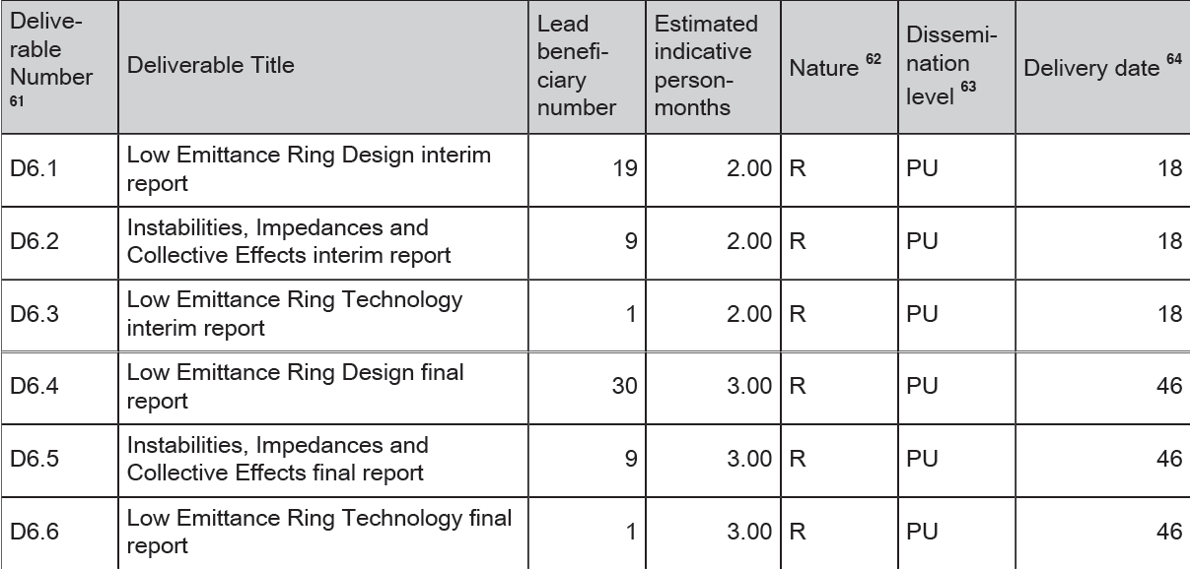
Deliverables
One interim and one final report per task
Help provided by sub-task coordinators (already identified)

Slide 12
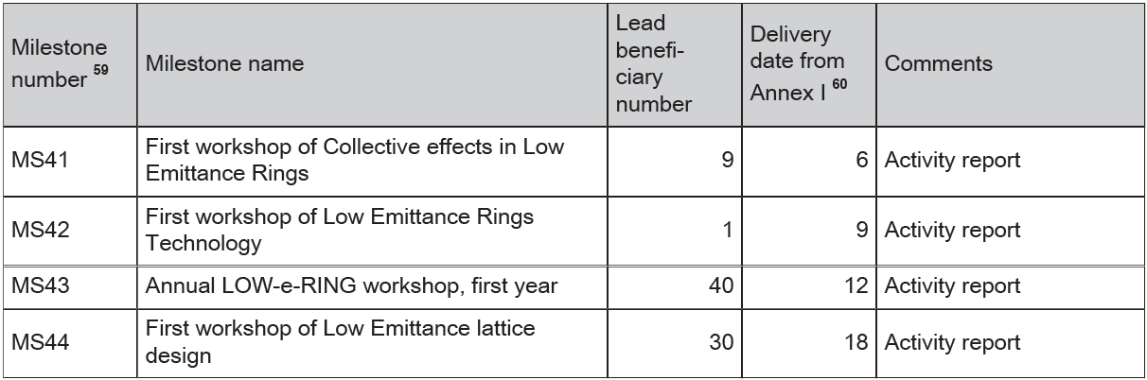
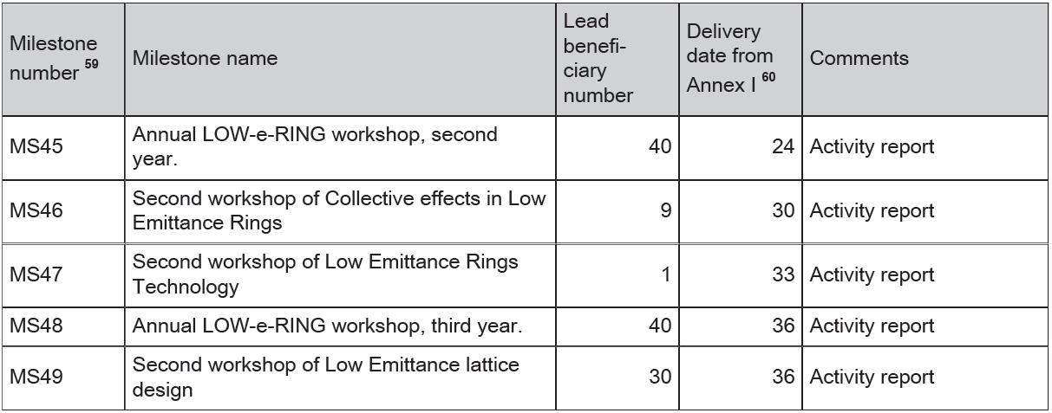
Milestones
3 topical and 3 general workshops (dates may be slightly adapted)
Organize common events with other WPs (X-BEAM, Future magnets, Innovative RF technologies)

Slide 13
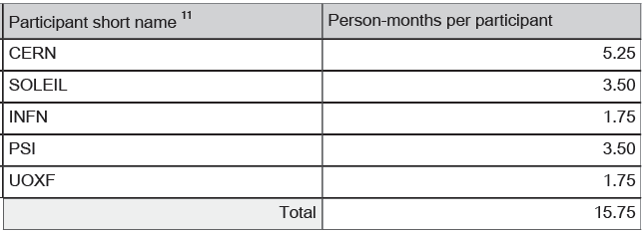
Resources
Total of 15.75 person months and 330KEuros

Slide 14
Next steps
1st coordination meeting, room 304-1-007, Friday 14 June, 9:00-12:00
Draft Agenda:
  Organisation of general workshop (program finalisation)
  Future topical workshops: time, place and budget allocation
  Collaboration board: membership and next meetings
  Synergy with other EUCARD2 WPs
  Low Emittance Ring’s student prize

Slide 15
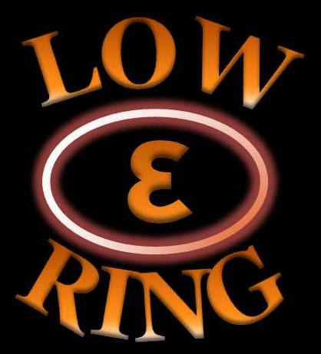
THANK YOU!!!

