Slide 1
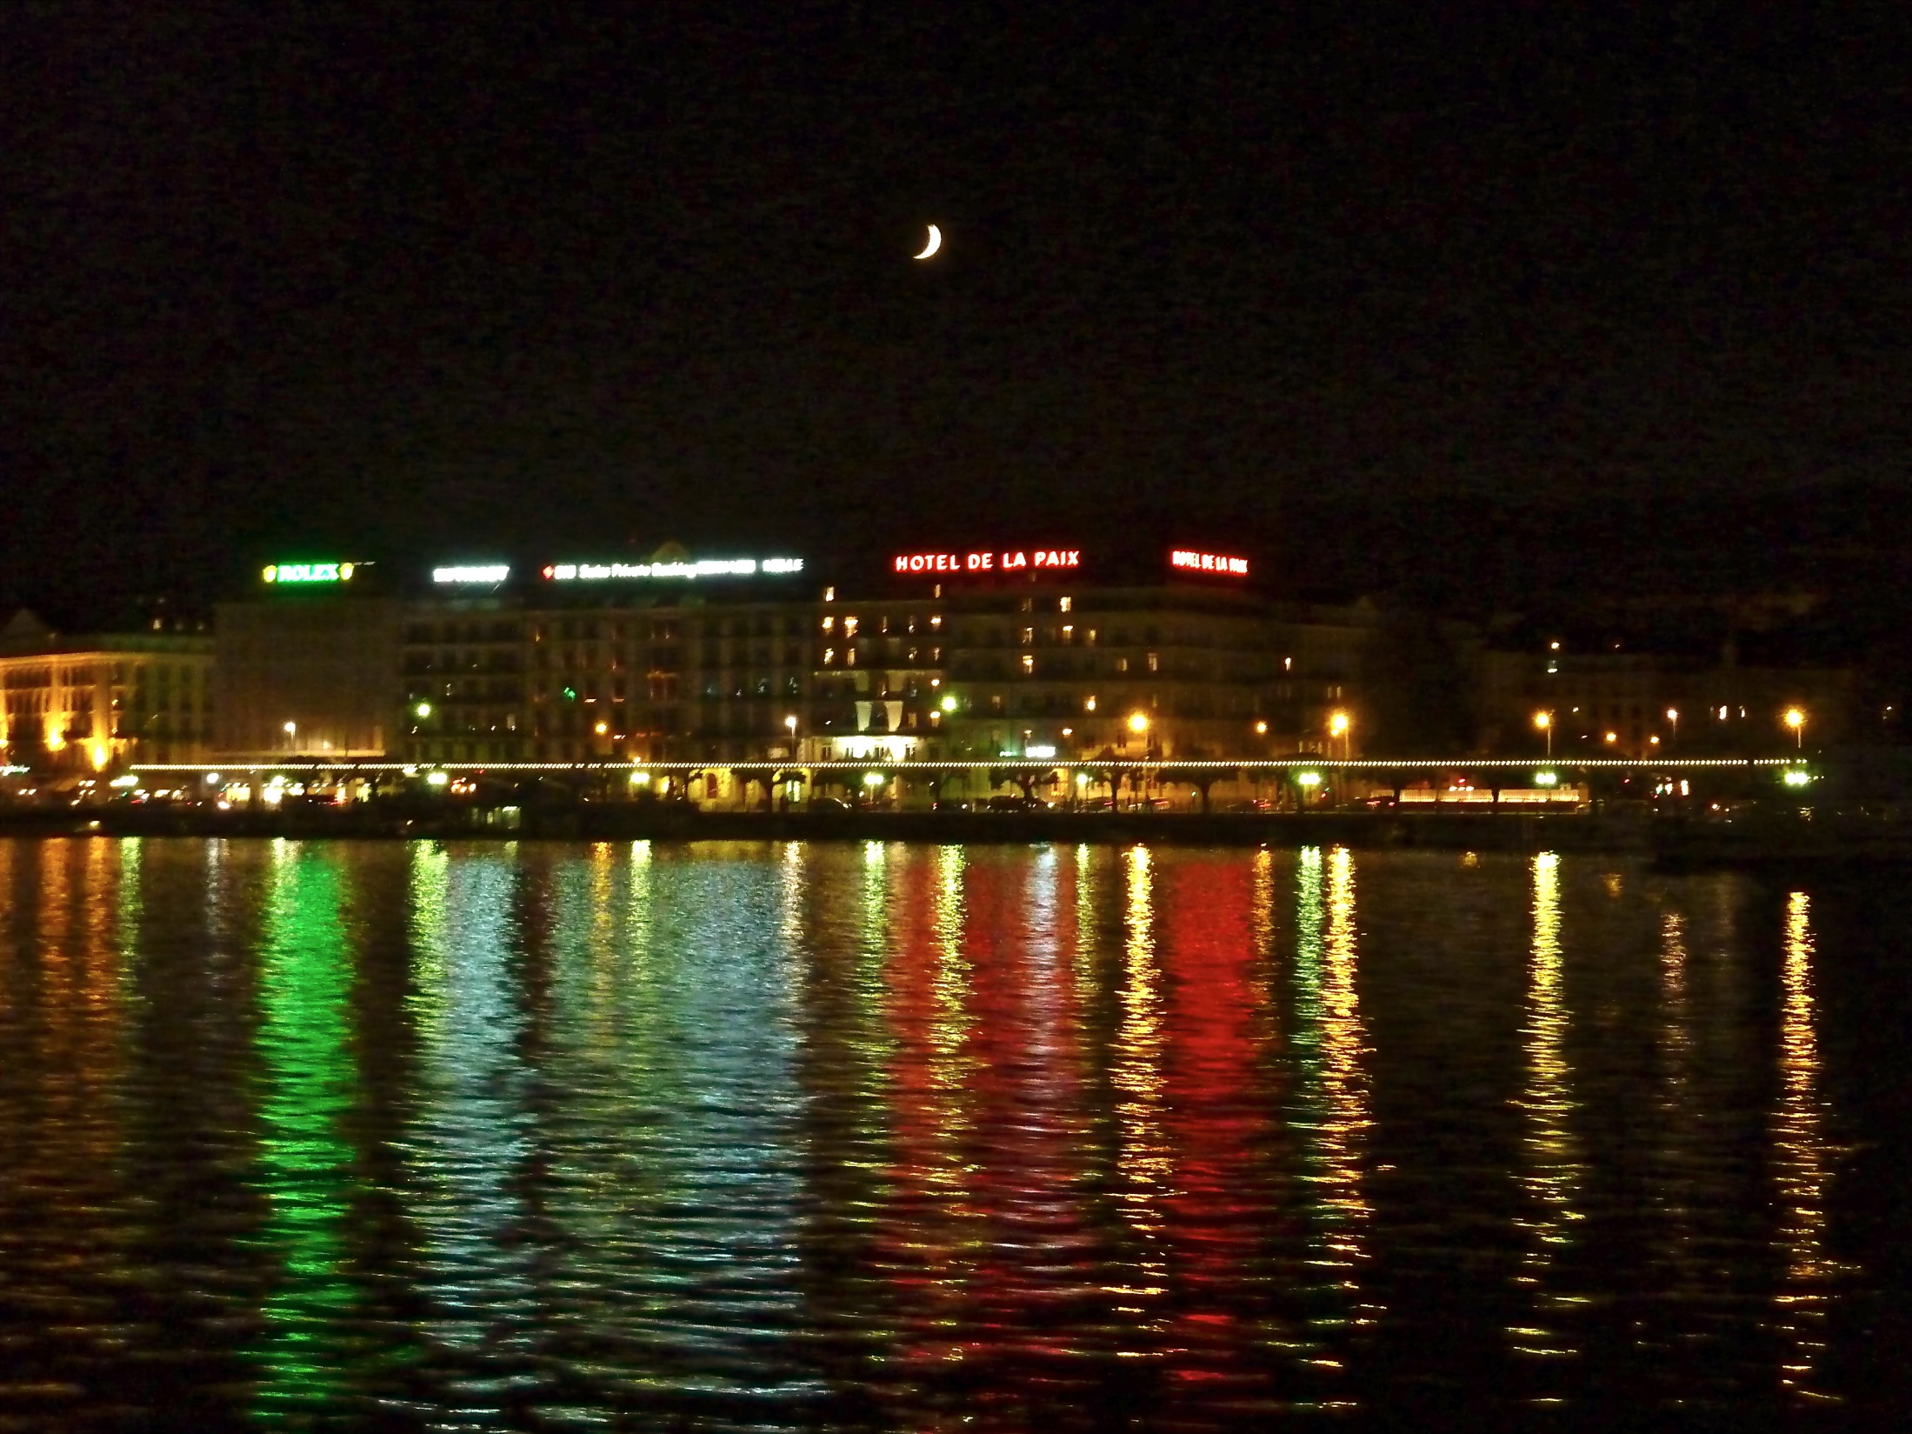


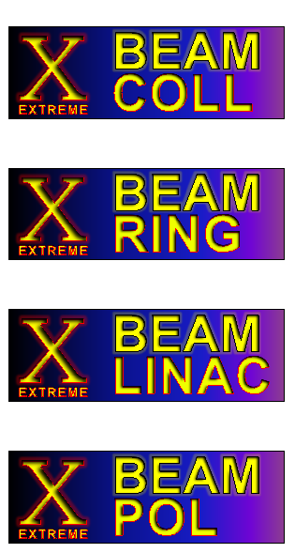
eXtreme BEAMs (XBEAM):
Exploring the Accelerator Frontiers – WP5
Frank Zimmermann
EuCARD-2 Kick-Off Meeting
CERN13 June 2013
many thanks to Giuliano Franchetti,
Mohammad Eshraqi & Marica Biagini

Slide 2
XBEAM network
platform for information exchange and collaboration between communities
e.g. proton, electron, nuclear physics, particle physics accelerator researchers; magnet designers; SRF experts; European industry, European universities and laboratories; pan European organizations (such as ESA)
to study and overcome critical accelerator limitations,
to boost performance of present and future accelerators or colliders beyond the state of the art
help present projects (e.g. HL-LHC, FAIR, ESS, SuperKEKB,…) to reach their goals
lay the groundwork for next generation of extreme-performance accelerators in Europe (e.g. HE-LHC/VHE-LHC, LHeC, MESA, TLEP,…)

Slide 3
XBEAM network
XBEAM will push all accelerator frontiers: luminosity, energy, beam power, beam intensity, and polarization
luminosity: x10-100 (1000) higher than present state of the art
beam power: x10 higher
beam intensity: x10 higher
polarization: ≥60% (p), ≥30% (e⁺), ≥80-90% (e⁻)

Slide 4
XBEAM structure
Task 5.1. Coordination and Communication
coordinated by F. Zimmermann (CERN)
Task 5.2. Extreme colliders (XCOLL)
coord: F. Zimmermann (CERN), M. Biagini (INFN-LNF)
Task 5.3. Extreme performance rings (XRING)
coord: G. Franchetti (GSI), J. Struckmeier (GSI)
Task 5.4. Extreme SC linacs (XLINAC)
coordinated by M. Eshraqi (ESS)
Task 5.5. Extreme polarization (XPOL)
coordinated by K. Aulenbacher (JGU Mainz)

Slide 5

Coordination & Communication– 5.1
objectives & work:
coordinate and schedule WP tasks, adjusting activities according to priorities and budget
monitor the work and use of resources, informing project management and WP participants
ensure compliance with contract obligations and disseminate achievements
organization of XBEAM internal steering meetings
organization of and/or support to activity workshops or specialized working sessions, implying the attendance of invited participants from inside and outside the consortium

Slide 6



Common Elements & Objectives
annual workshops with publication of proceedings as well as topical mini-workshops
  - similar to past CARE-HHH and EuCARD-AccNet events
support visitors and visits between partner institutes
summer students; supporting travel of technical students, PhD students and postdocs/fellows
disseminating network results by journal publications and by seminars at partner institutes, conferences, European universities, and via web documentation
integrate efforts of large laboratories, smaller institutes and universities; form and maintain community capable of advancing technical realization & scientific exploitation of European accelerator infrastructure
create synergies across communities, countries & continents

Slide 7
work plan for each task:
identify issues for each project
tentative workshop schedule, dates & location
web site(s)
….

Slide 8


Slide 9
Extreme colliders (XCOLL) – 5.2
objectives & work:
realize full potential of the LHC, by means of LHC luminosity and energy upgrades, and/or extension to LHeC, HE-LHC, VHE-LHC
maximize performance of future Super B, Higgs and τ-c factories (SuperB, SuperKEKB, TLEP, SAPPHiRE), and hadron-lepton colliders (LHeC, eRHIC, MEIC) and IRIDE
explore key items for a (Very) High-Energy LHC (injector, synchrotron radiation, beam dynamics, magnets)
provide guidance for the LHC injector upgrade
become THE European forum for discussing key aspects of extreme performance colliders
ultimate limitations, optimum solutions, beam experiments
bring together experts in collider beam dynamics with specialists of magnets & collimation to find optimum solutions

Slide 10








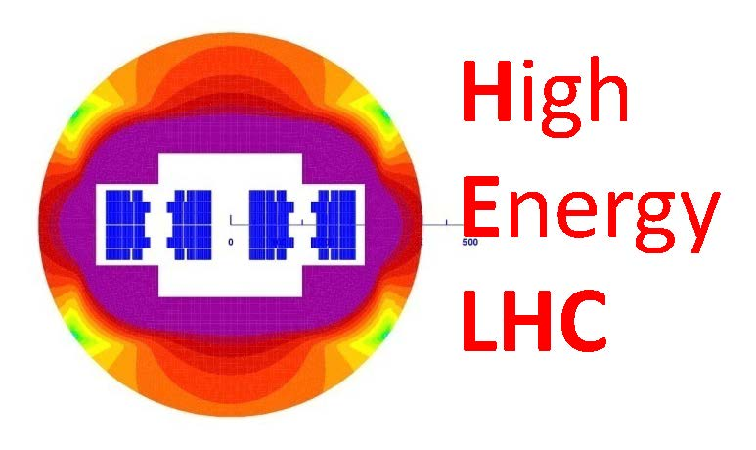
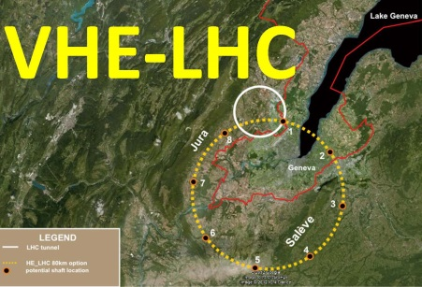

Extreme colliders (XCOLL) – 5.2
projects:

Slide 11
Extreme colliders (XCOLL) – 5.2
example issues:
inter-WP issues:
vertical emittance tuning (WP6)
RF & energy efficiency (WP3, 5.3)
top-up injection (e±)
off momentum aperture
beam-beam effects incl. beamstrahlung
cooling of hadron beams, e.g. CeC
e⁺ sources & polarization
draft near-term schedule (preliminary):
first workshop 16-18 October (TLEP & LEP3) with WP5.5
WS on SuperKEKB commissioning, November 2013
joint workshop TLEP & VHE-LHC, February 2014
joint mini-workshop with ICAN on γγ colliders & Higgs factories

Slide 12
Extreme colliders (XCOLL) – 5.2
continuing/new collaborations:
CONACyT/CINVESTAV Mexico
  - 2-3 new students
ESA
ICAN new!

Slide 14
Extreme rings (XRING) – 5.3
objectives & work:
help optimize performance of FAIR, ISIS and PSI-HIPA, and guide the upgrade strategy for the LHC injector complex
studies on critical beam diagnostics (e.g. continuous emittance & beam-loss measurements)
ultimate limitations, optimum solutions, beam experiments
studies on advanced FFAGs designs, including machine experiments at EMMA
become THE European forum for discussing performance limitations of high-intensity high-brightness hadron rings
bring together experts in beam dynamics with specialists of magnets and collimation to arrive at optimum upgrade solutions with risk mitigation

Slide 15




Extreme rings (XRING) – 5.3
projects:
The high-intensity proton accelerator (HIPA)
G. Franchetti

Slide 16



Extreme rings (XRING) – 5.3
high intensity issues:
Long term effect of
space charge
Lattice modeling
Diagnostics for
high intensity
Benchmarking
experiments
G. Franchetti

Slide 17

Extreme rings (XRING) – 5.3
synergies:
overlapping topics: high intensity
beam dynamics, lattice modeling,
benchmarking experiments
G. Franchetti

Slide 18
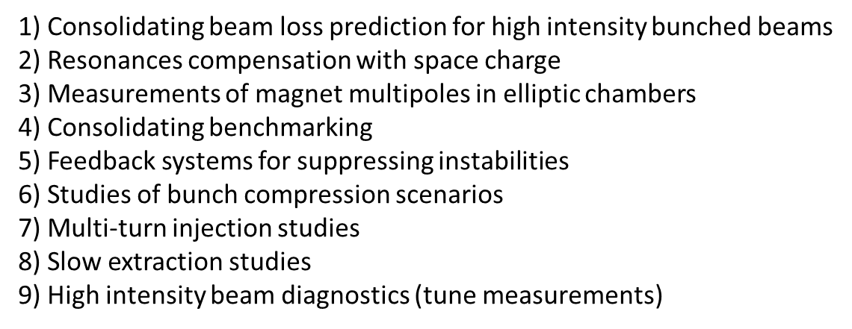
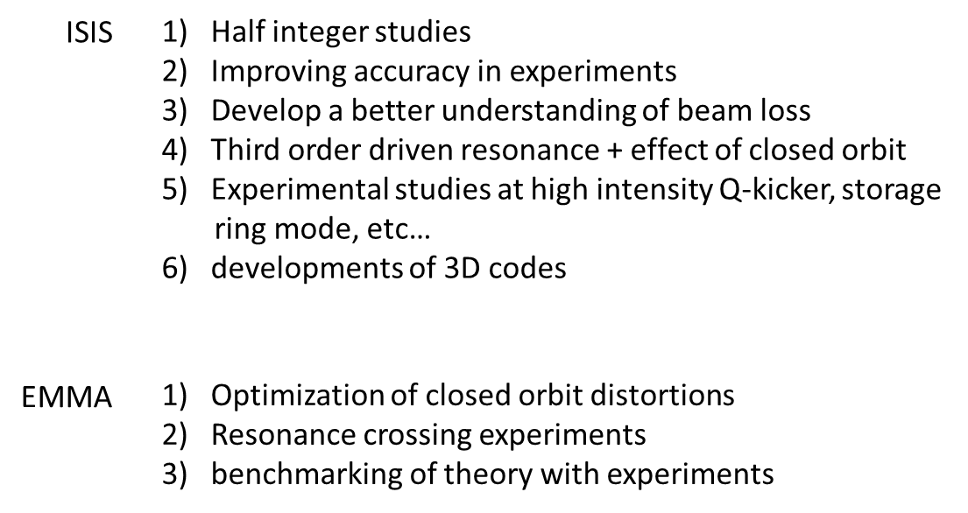
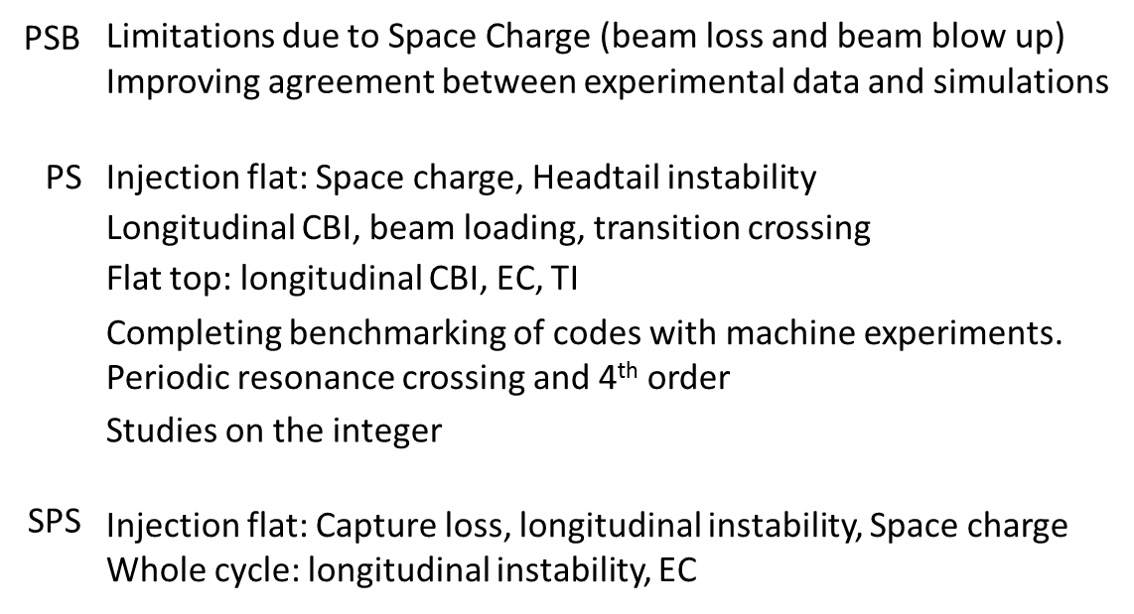
Extreme rings (XRING) – 5.3
example issues (preliminary):
FAIR
ISIS/EMMA
LIU
G. Franchetti

Slide 19
Extreme rings (XRING) – 5.3
example schedule (preliminary):
1st workshop (M12)
magnets and nonlinear beam dynamics. Measurements of
multipoles for non-circular chambers. …..
Space charge in diagnostics (IPM, tunes, etc.)…
2nd workshop (M24), SpaceCharge2014
simulations and experiments with high intensity beams
3rd workshop (M36)
topical
4th workshop (M48), SpaceCharge2016
simulations and experiments with high intensity beams
G. Franchetti

Slide 20


Slide 21
Extreme linacs (XLINAC) – 5.4
objectives & work:
help optimize performance of high-power SC linacs such as ESS, FRIB, HP-SPL, MYRRHA, MESA, eRHIC, or Project-X
study beam dynamics issues, e.g. space charge, beam break up, ion effects, halo generation, beam losses, recirculation aspects, and energy recovery
ultimate limitations, optimum solutions, beam experiments
advance crucial beam diagnostics like measurements of beam profile and emittance
become THE European forum for discussing performance limitations of high-intensity high-power SC linacs, and optimizing designs of European SC linac facilities.
bring together experts in beam dynamics with specialists of SRF and cryogenics to arrive at optimum upgrade solutions

Slide 22

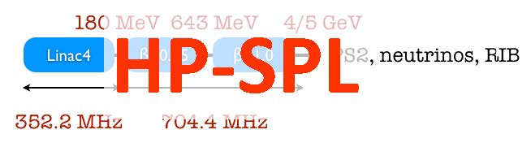





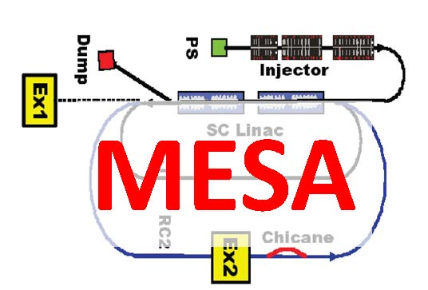
Extreme linacs (XLINAC) – 5.4
projects:

Slide 23
Extreme linacs (XLINAC) – 5.4
example issues:
inter-WP issues:
HOMs and SOMs (WP12.4)
Reliability and availability (WP4)
IOTs, other RF sources (WP3.3)
ions sources
high power couplers
modulators
cavity failure due to beam loss (SNS)
increased Field/Yield of SC cavities, XFEL,..
example schedule (preliminary):
first workshop at ESS some time in November
other workshops in different labs
two workshops per year
at least two workshops per subject (see above)

Slide 24
Extreme linacs (XLINAC) – 5.4
a special message from the XLINAC coordinator:
5 doctoral positions are being opened at ESS [Application deadline 04 September 2013]
The subjects are related to accelerator science, XLINAC, and especially to SRF.
Norway guarantees the financial support and ESS chooses the candidates.
Candidates shall apply through the Norwegian web site shown in:
http://esss.se/vacancies.
In case of questions please contact Mohammad Eshraqi.

Slide 26

Extreme polarization (XPOL) – 5.5
objectives & work:
help reach the lepton and hadron beams of highest possible polarization, for future projects such as SuperB, LHeC, MESA, TLEP, SAPPHiRE and RHIC-II/e-RHIC
study polarized sources, preservation of polarization during acceleration, spin manipulation, depolarization mechanisms, and high-accuracy polarimetry
ultimate limitations, optimum solutions, beam experiments
become THE European forum for discussing performance limitations of polarized particle beams
bring together experts in beam dynamics with specialists on sources, magnets and beam instrumentation as well as particle physicists and laser experts to arrive at optimum solutions

Slide 27





Extreme polarization (XPOL) – 5.5
projects:

Slide 28
Extreme polarization (XPOL) – 5.5
example issues:
inter-task issues:
depolarization e.g. due to beam-beam (with WP 5.2)
polarimetry
Siberian snake schemes
polarization for hadron beams
polarization for LHeC
polarization in SuperKEKB & TLEP
polarized sources (with WP 5.2)
draft near-term schedule (preliminary):
first workshop 16-18 October (TLEP & LEP3) – with WP5.2
topical workshop on polarimetry in 2014

Slide 29
deliverables :
Preliminary strategies, optimization, limitations, paths & parameters for
  future hadron & lepton colliders;
  future high-performance hadron rings;
  future high-power high-current SC linacs; and
  future polarized beams
  [month 36]
Strategy for
  future extreme beam facilities;
  [month 48]

Slide 30

milestones :
Milestone name | Work package(s) involved | Expected date | Means of verification
XCOLL topical workshop | 5 (Task 5.2) | M12 | XCOLL web pages
XRING topical workshop | 5 (Task 5.3) | M12 | XRING web pages
XLINAC topical workshop | 5 (Task 5.4) | M12 | XLINAC web pages
XPOL topical workshop | 5 (Task 5.5) | M12 | XPOL web pages
XCOLL topical workshop | 5 (Task 5.2) | M24 | XCOLL web pages
XRING topical workshop | 5 (Task 5.3) | M24 | XRING web pages
XLINAC topical workshop | 5 (Task 5.4) | M24 | XLINAC web pages
XPOL topical workshop | 5 (Task 5.5) | M24 | XPOL web pages
XCOLL topical workshop | 5 (Task 5.2) | M36 | XCOLL web pages
XRING topical workshop | 5 (Task 5.3) | M36 | XRING web pages
XLINAC topical workshop | 5 (Task 5.4) | M36 | XLINAC web pages
XPOL topical workshop | 5 (Task 5.5) | M36 | XPOL web pages
XCOLL topical workshop | 5 (Task 5.2) | M48 | XCOLL web pages
XRING topical workshop | 5 (Task 5.3) | M48 | XRING web pages
XLINAC topical workshop | 5 (Task 5.4) | M48 | XLINAC web pages
XPOL topical workshop | 5 (Task 5.5) | M48 | XPOL web pages

Slide 31



XBEAM time line & other community meetings
XBEAM takes over / sponsors European meetings
≥6 workshops
≥6 workshops
≥ 5 topical
meetings
Tentative schedule
≥5 topical
meetings
SC-2013
(CERN)
EuCARD-2
Kick-Off
1st W
2nd W
3rd W
4th W
EuCARD
1
2
3
4
time-line
2012
2013
2014
2015
2016
2017
Other
Meetings or
Conference
IPAC’14 (Germany)
HB2014 (USA)
IPAC’13 (China)
IPAC’15 (USA)
IPAC’16 (Korea)
HB2012
HB2016
G. Franchetti

Slide 32

next step:
1st XBEAM meeting, room B,
tomorrow, Friday 14 June 9:00-12:00
photo courtesy Marica Biagini

