Slide 1

Introducing EuCARD-2
M. Vretenar, CERN

Slide 2

Good bye EuCARD, welcome EuCARD-2 !
The adventure continues…
but themes and priorites change.
The approval of the EuCARD-2 project shows that R&D for particle accelerators remains a global priority for improving the European Research Infrastructure.
The transition from EuCARD to EuCARD-2 allows to redefine our strategy, in accordance with the guidelines from the particle accelerator community and from the European Commission.
And we warmly welcome the new EuCARD-2 participants !

Slide 3
EU and accelerators- 10 years of success
Capacity – research infrastructures
ESGARD
Integrating Activities
Design Studies,
Preparatory Phases
CARE
Coordinated Accelerator Research in Europe for Particle Physics
01/2004 – 12/2008 (5 years) 15.2 M€ EU contribution
FP6
EuroNu DS, 2008/12, 4M€
EuCARD
European Coordination for Accelerator Research and Development
04/2009 – 03/2013 (4 years) 10.0 M€ EU contribution
SLHC-PP, 2008/11, 5.2M€
ILC-HiGrade, 2008/12, 5M€
FP7
EuCARD-2
Enhanced Eur. Coordination for Accelerator Research and Development
05/2013 – 04/2017 (4 years) 8.0 M€ EU contribution
TIARA-PP, 2011/13, 3.9M€
HiLumi LHC, 2011/15, 4.9M€
Long series of projects co-funded by the European Commission since 2004:
68 M€ from the EU for the accelerator community in 2004/2017,
with a peak of ~7 M€/year in 2011 (~5 M€/year in 2013).
Notes:
Reduced budget for general R&D, increasing competition

Slide 4
The EuCARD-2 Timeline
January/September 2011 Project definition (on priorities set by ESGARD)
September/November 2011 Nomination of coordinator, Project finalization
24.11.2011 Proposal submitted (10 M€ requested EU contribution)
08.03.2012 Evaluation Summary Report received: 14/15
30.03.2012 Favourable evaluation for funding, in stand-by for 2013 EC budget
16.07.2012 Invitation to negotiations received (8 M€ contribution)
27.08.2012 Negotiation meeting with EU officer
07.09.2012 Draft Annex1(reference document) submitted
19.10.2012 New version of Annex1 incorporating EC comments submitted
24.10.2012 Final Annex1 accepted by EC – end of negotiation phase
14.12.2012 All signed documents (Grant Preparation Forms) sent to Brussels
01.03.2013 Grant Agreement received from EU (after clearing technical details)
12.03.2013 Signed Grant Agreement sent to EU
22.04.2013 Signed Grant Agreement received from EU + autorisation 1st payment
01.05.2013 Start of the project

Slide 5
EuCARD-2 in numbers
48 months duration (01.05.2013 - 30.04.2017)
13 Workpackages (6 Networks, 2 Transnational Access, 4 JRAs)
40 beneficiaries (3 with 0 EU contribution)
14 countries (+ CERN)
23.5 M€ total cost (13.4 M€ direct costs, 10.1 M€ indirect+access cost)
8 M€ EC contribution (34% of total cost, 59.7% of direct cost)
1288 persons.month (average 8 pm/participant.year)
62 deliverables
86 milestones

Slide 6
EuCARD-2 objectives
Scientific objectives:
Contributions to few R&D topics of excellence (high risk, high pay-off) on accelerators for research (HEP, nuclear physics, synchrotron lights, etc.).
Include new dimension of innovation, applications, relations with industry (healthcare, energy, environment, etc.).
Political objectives:
For EU: strenghten collaboration and foster synergies, create a network of complementary scientific infrastructures, enhance EU competitiveness.
For large laboratories: attract partners into (long-term) projects, connect with high-level R&D, create a network of competences around the large laboratories.
For small Institutes: get access to big labs and to large scientific programmes, get the recognition (and the internal matching funds) related to EU projects.

Slide 7

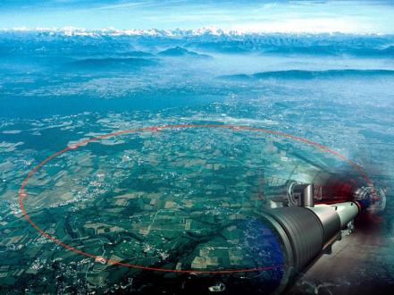
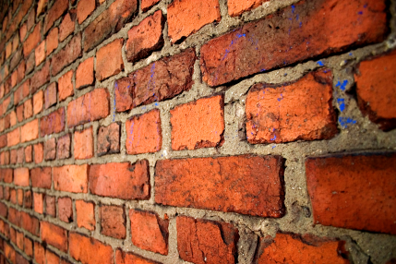
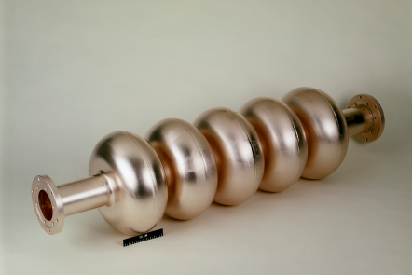
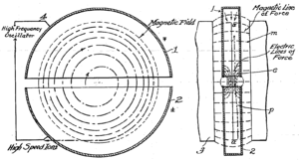
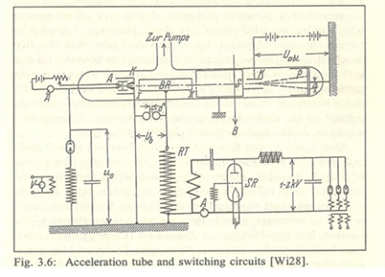
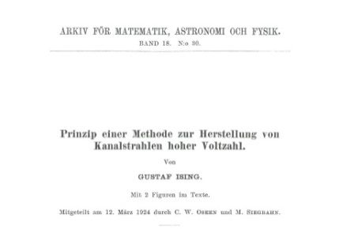
EuCARD-2 as a global actor for accelerators’ future
2013 …
Break the wall:
Push B, E
reduce P
89 years of progress… what’s next?
Size, Cost, Power, Physics motivations
2
1970’s
Superconductivity
Climb the wall: optimize the frontier accelerators
Go round the wall:
beyond cyclic RF acceleration, lasers and plasmas
89 years of cyclic RF particle accelerators
1931
Lawrence
1
Enhance the transfer process
3
1928
Wideroe
4
Applied science
The four EuCARD-2 themes for the future of particle accelerators
Medicine
1924
Ising
Industry

Slide 8
EuCARD-2: motivations
We are at a turning point for particle accelerators:
1. Accelerator technology is rapidly moving from basic science to applied science, medicine, industry.
2. Size and complexity of large machines start rising questions of sustainability and societal acceptance.
The ambition of EuCARD-2 is to play a role in this process, fostering a global and cooperative approach to address the main open issues, acting at 4 levels:
Explore limitations and frontier performance of present machines (WP5).
Address the technological limits: bending field (WP10), RF and accelerating gradient (WP11), power consumption (WP3), collimation (WP11).
Strengthen and focus the research on alternative approaches (WP6) and support their R&D effort (WP13)
Support the transfer of technology from research to industrial accelerators (WP2, WP4).
Notes:
Global, increase the focus, where to do the job?

Slide 9
EuCARD-2: the context
In this critical moment, accelerator R&D tends to be second priority for large laboratories that are focused on their short-term programmes and is often left to small institutes and universities that do not have the critical mass for breakthrough achievements.
EuCARD-2 follows in the line of EuCARD and aims at joining the experience and infrastructure of the major labs with the intellectual potential and creativity of smaller universities and institutions on few research topics of excellence to prepare the future evolution of the European particle accelerator infrastructure.
Notes:
Global, increase the focus, where to do the job?

Slide 10
EuCARD-2: new dimensions
With respect to the previous programmes, EuCARD-2:
Increases the share of Networking Activities;
Puts priority to innovation and outreach to industry → new Networks (innovative technologies, applications and technology transfer).
Improved Transnational Access to our Test Facilities.
Improved coordination with other EU accelerator projects.
Give preference to high-risk, high pay-off activities.

Slide 11
EuCARD-2 WBS
Notes:
CERN 8/20, female 4/20

Slide 12
The EuCARD-2 partners
40 partners from 15 European countries, including Russia

Slide 13
Management structure
Governing Board
One representative from each beneficiary
Project Coordinator (ex-officio)
Deputy Project Coordinator (ex-officio)
Advisory Board
Steering Committee
Management Team
Project Coordinator
Deputy Project Coordinator
Administrative Manager
WP2-NA Leader
WP3-NA Leader
WP8-TA Leader
WP10-JRA Leader
WP11-JRA Leader
WP4-NA Leader
WP5-NA Leader
WP9-TA Leader
WP12-JRA Leader
WP13-JRA Leader
WP6-NA Leader
WP7-NA Leader

Slide 14
6 Networks
Extreme Beams (XBEAM) – coord.: F. Zimmermann (CERN) – 330 k€ EU contribution
Frontier performance of colliders and other accelerators (including SC linacs, polarisation,…). Interest for HL-LHC, ESS, FAIR, HE-LHC, LHeC, VHE-LHC, etc.).
Low emittance rings – coord.: Y.Papaphilippou (CERN), S.Guiducci (INFN), R.Bartolini (UOXF) – 330k€
New synergy between synchrotron light sources, storage rings, damping rings and lepton colliders facilities (activity started under ICFA, now integrated into EuCARD-2).
Novel Accelerators (EuroNNAC) – coord.: R. Assmann (DESY) – 330k€
Federating the European effort in plasma-based accelerators, prepare a roadmap for an efficient use in full-scale accelerators (from acceleration to accelerators...).
Energy Efficiency – coord.: M. Seidel (PSI) – 350 k€
Optimized energy management for a sustainable accelerator science. Energy recovery from cooling, efficient klystrons, energy storage, virtual power plant, low-power transport channels.
Accelerator Applications – coord.: R. Edgecock (HUD) – 350k€
Reviewing and analyzing present applications, propose how to adapt existing accelerator technology to industry, health care, energy, security.
Catalysing Innovation – coord.: G. Anelli (CERN), P. Woodman (STFC) – 126k€
Technology transfer Network based on the existing CERN and STFC structures.

Slide 15
2 Transnational Access
Ion Cooling Test Facility (ICTF) at STFC – coord.: R. Preece (STFC) – 200 k€
Tests with high-quality low-energy beams (MICE and others)
HighRadMat and MagNet at CERN – coord.: A. Fabich and M. Bajko (CERN) – 500 k€
Measure performance of materials bombarded with intense proton beams; Open SM18 (superconducting cable and magnet test station) at CERN to external users.

Slide 16
4 Joint Research Activities
Future Magnets – coord.: L. Rossi (CERN) – 1.31 M€ - CERN, CEA, INFN, INP, BHTS &others
R&D towards a 20 T dipole magnet for the HE-LHC (2 x 16.5 TeV) based on High-Temperature Superconductors (10 kA). Magnet design, choice of HTS material, manufacturing and characterization at low field of an HTS coil as full-bore high-field insert of a 20 T dipole.
Collimator Materials for fast high dens. en. dep. – coord.: A. Rossi (CERN), J. Stadlmann (GSI) – 0.4 M€
Material studies and collimator tests. Building of samples made of new (and old) materials and test them under high energy beam impact. Material mechanical modelling; specification of materials using collimation simulation codes. CERN, GSI, KUG, POLITO, UM &others
Innovative RF Technologies – coord.: P. Macintosh (STFC) – 2.18 M€ - CEA, UNIMAN, ULANC, PSI, etc.
Multi-disciplinary (NC and SC) grouping a number of promising RF R&D activities: 1) thin film deposition technologies for SC cavities (CEA et al.); 2) advances in X-band technology: high-gradient, low-wakefield structures, novel power sources (CERN et al.); 3) HOM-based analysis for XFEL-type cavities (DESY et al.); 4) new RF photocathodes (NCBJ et al.).
Novel Acceleration Techniques – coord.: V. Malka (CNRS) – 0.927 M€
Selected R&D topics on laser plasma acceleration, ultra-fast accelerator science and long plasmas. Develop laser-driven and proton-driven plasma-wakefield acceleration, including femtosecond arrival time control. CNRS, INFN, UDUS, UCL, DESY, etc.

Slide 17
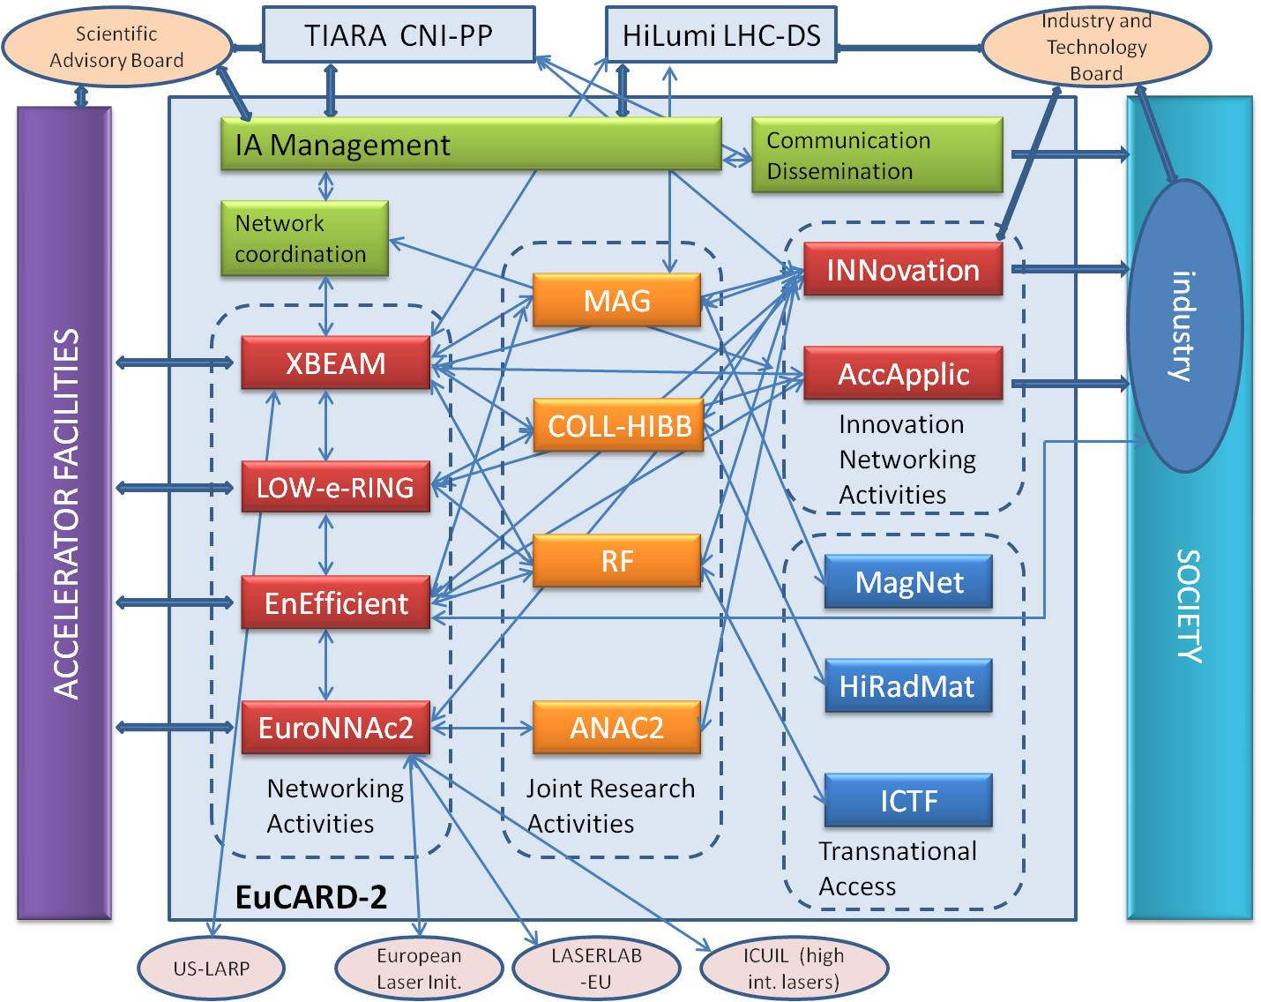
Internal and external links

Slide 18
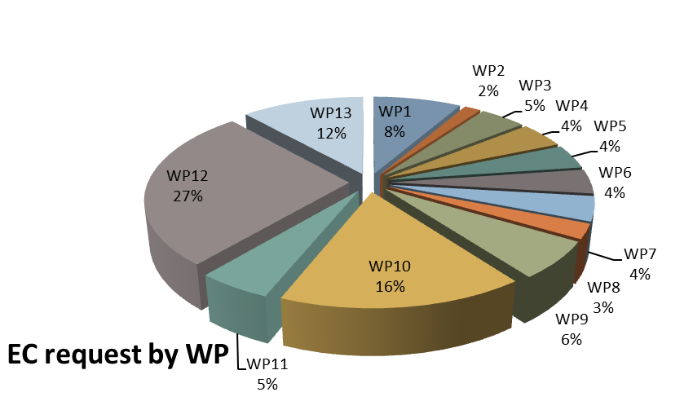
The Eucard-2 budget

Slide 19
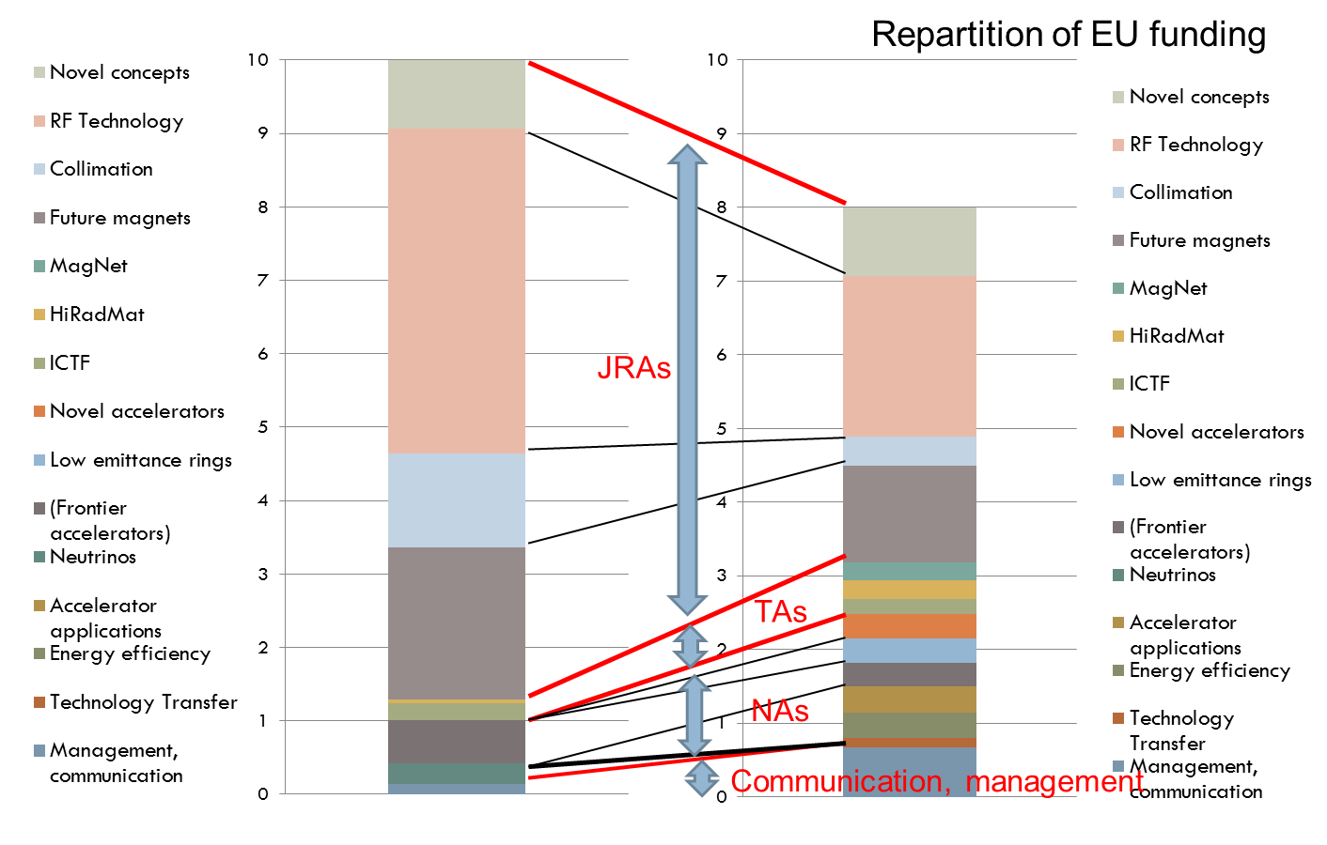
From EuCARD to EuCARD-2

Slide 20
EuCARD-2 reporting strategy
Goal: simplification, respect the engagements with the EC while mininising the administrative overheads.
One report/year, with arrangements to match the EC reporting periodicity (IAR becomes P1R).
Deadlines (for each report):
Input from Task Leaders to WP Coordinators Y+10 10 May
Input from WP Coordinators to Project Coord. Y+20 20 May
Draft submitted to Steering Committee Y+30 30 May
Draft approved by GB at Annual Meeting ~10 June
Report submitted to EC (when required) Y+60 30 June
Size:
Inputs from Task Leaders: maximum 2 pages, including 1 or 2 pictures, graphs, tables.
Inputs from WP coordinators: input from Tasks (between 8 and 12 pages) plus an executive summary.
Notes:
Go down from 1’000 pages/year to 100 pages/year

Slide 21
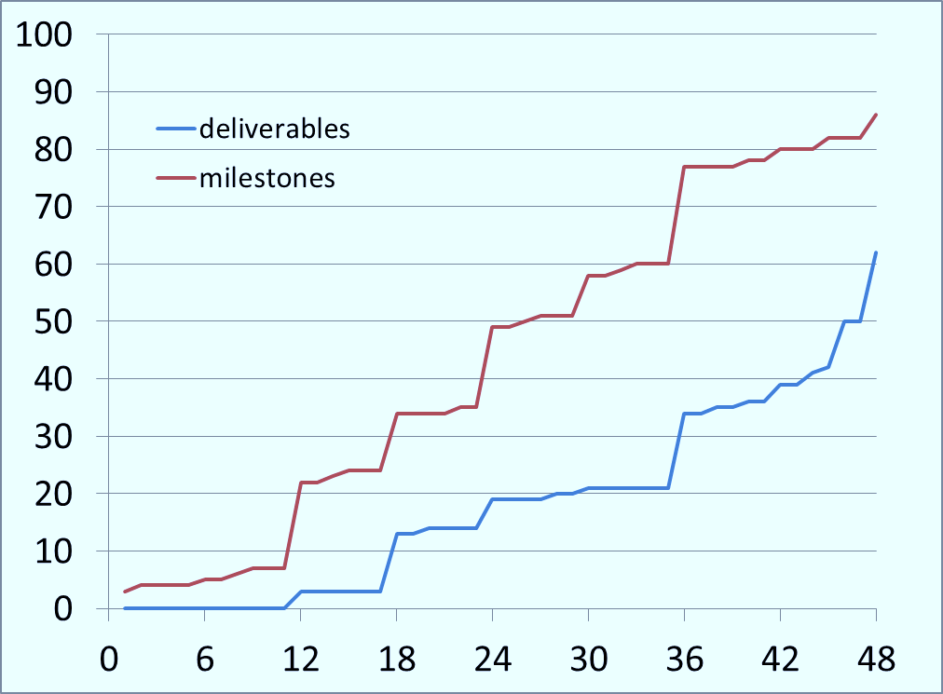
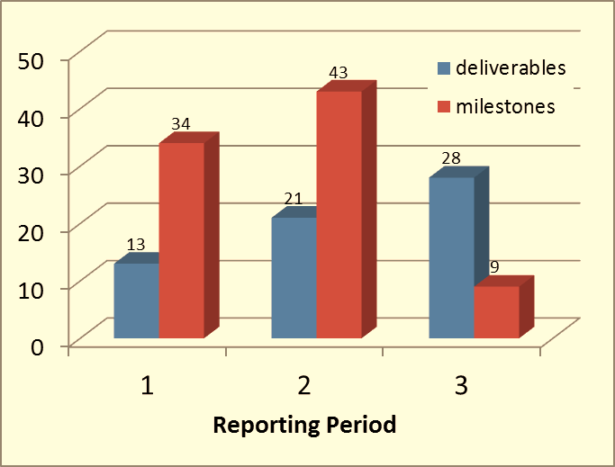
The EuCARD-2 deliverables
Our first objective is to produce (in time) all our 62 deliverables.
The deliverable reports can be short – its main goal is to demonstrate that the result has been achieved, and it can make reference to more detailed reports and papers.

Slide 22
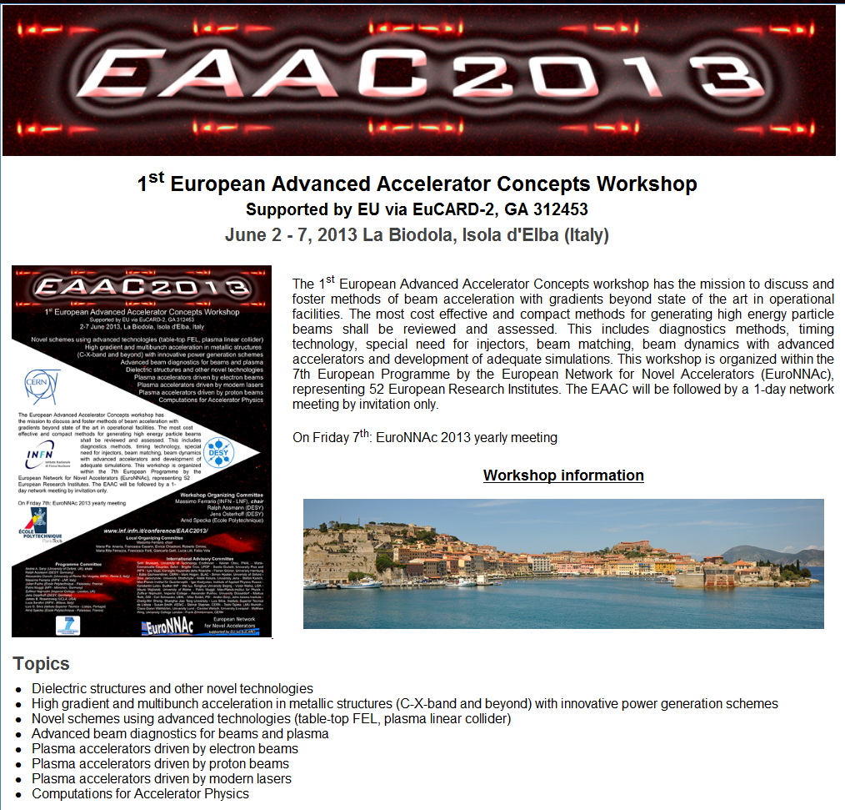
A 1st Workshop in the frame of EuCARD-2
1st European Advanced Accelerator Workshop
June 2-7, 2013
Co-organized by the EuroNNAC Network (WP7) of EuCARD-2.
Idea to foster European research on innovative acceleration techniques (plasmas, dielectrics, high-gradient) launching a series of European workshops in alternance with the US series (running since several years…).
Large participation (150) and interest, lot of young people, impressive amount of presentations.
See R. Assmann’s presentation for details.

Slide 23
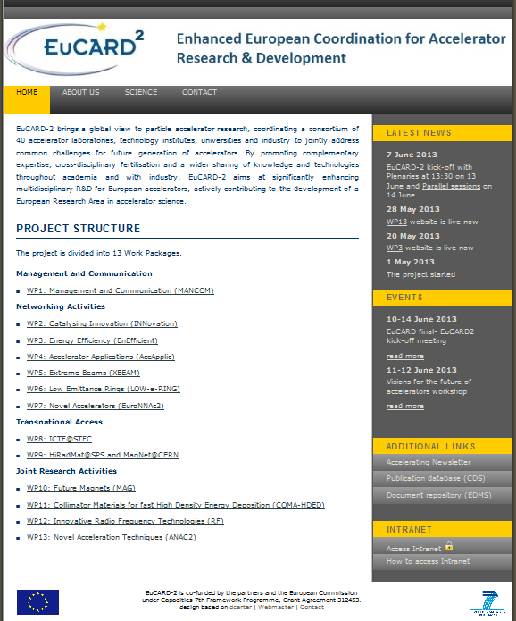
The Website is up and running !
Thanks to Agnes Szeberenyi, our Communication Manager, the web site is open since March:
http://eucard2.web.cern.ch
Two WP websites are already available and accessible from the main site:
WP3 (Energy efficiency)
WP13 (Novel Acc. Techniques)

Slide 24
EuCARD-2 next steps
All Forms A (Grant Accession Forms) have been signed and received by the EC on May 30th.
Prefinancing received by CERN on May 2nd, being now distributed to all partners (proportionally to their share of the overall budget).
Consortium agreement: all comments to the 2nd draft have been received, the CERN legal service has finalised the document. One week more for additional comments, will be then distributed for signature.
Setting up the governance: first meeting of the Governing Board today at 17:00; approval of the Steering Committee (WP Coordinators and Deputies).
A great thank to the administrative services and to the technical contacts of all partners for their kind and fruitful collaboration and to the CERN EU office (the great trio!) for successfully going through all the administrative procedures.
…and now we have no excuses not to do the work!

Slide 25
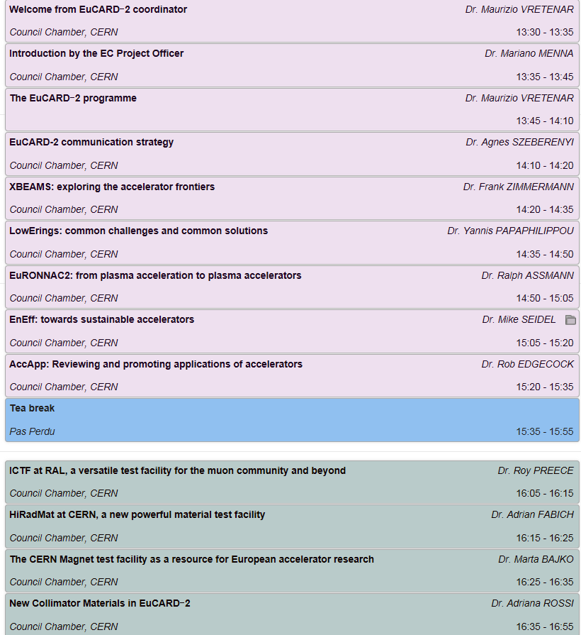
Today, June 13th: EuCARD-2 kick-off
Presenting all WPs that were not already introduced during the common workshop of Tue/Wed
17:00-19:00
Joint Governing Board and Steering Committee Meeting
19:30
EuCARD-2 Cocktail (Glass Box)

Slide 26
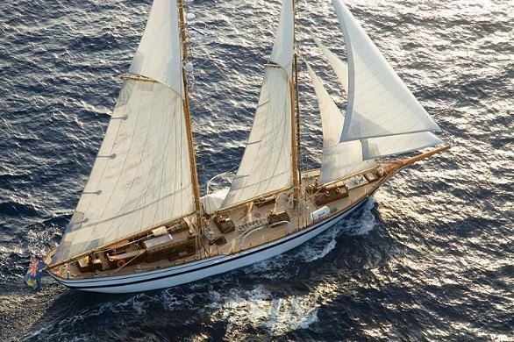

And now it’s time to set sail for a new adventure !
Thank you for your attention

