Slide 1





Jochen Teichert
for the Rossendorf SRF gun collaboration
Arnold, P. Lu, P. Murcek, H. Vennekate, R. Xiang (HZDR)
T. Kamps, J. Rudolph (HZB)
P. Kneisel (Jlab), I.Will (MBI)
Polarized Photocathode
SRF Guns
EuCARD´13
June 10-14, 2013, CERN, Geneva, Switzerland

Slide 2
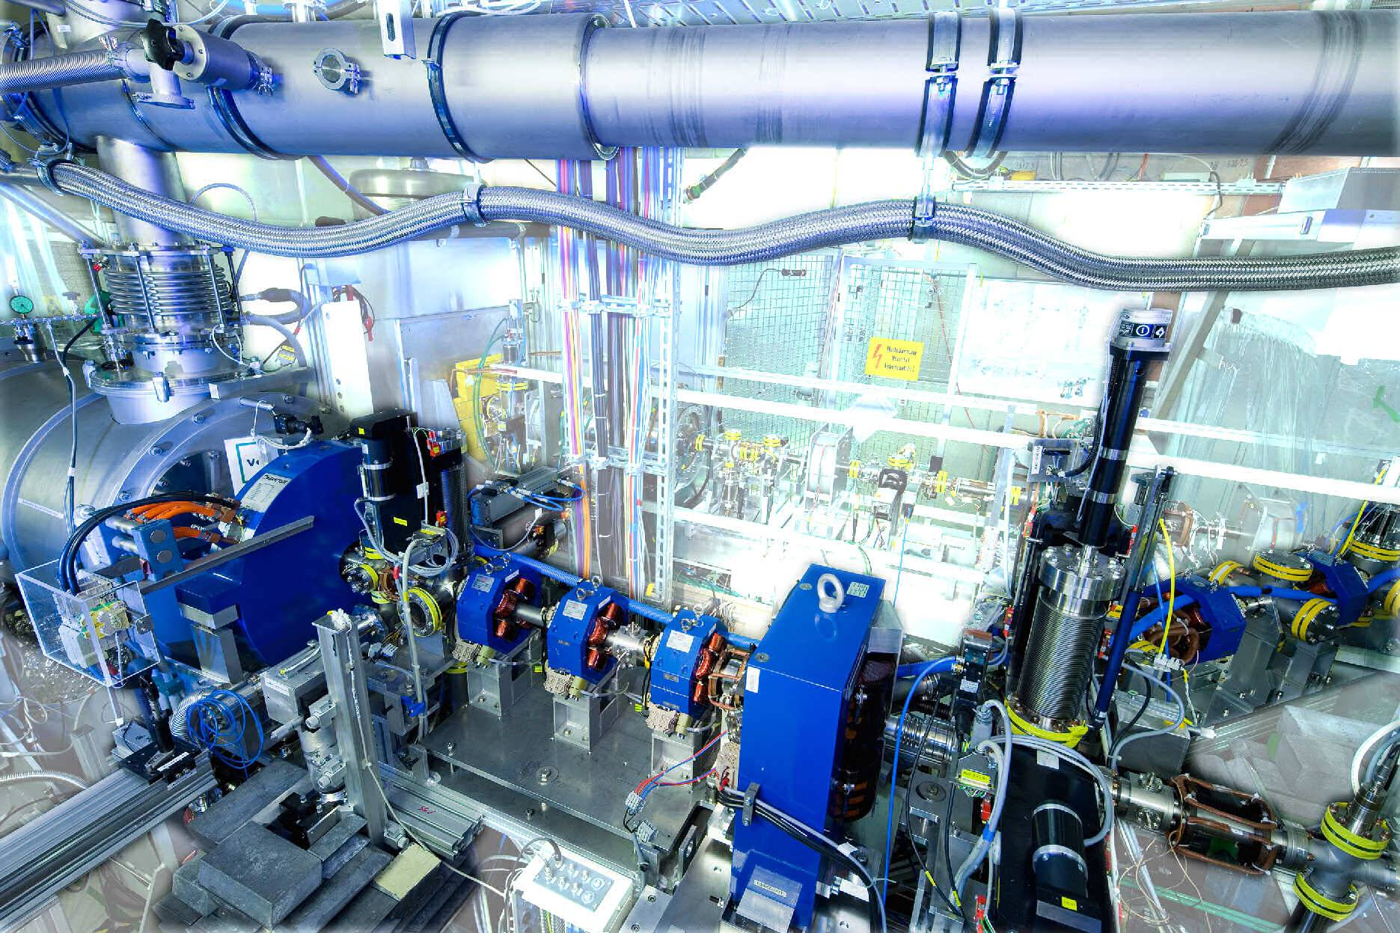
OUTLINE
1. Introduction
2. Previous GaAs PC activities for RT and SC RF photo guns
- RT RF photo gun test at Novosibirsk
- BNL activities
- HZDR
3. Status and Future of the HZDR SRF gun
- Operation status and Cs2Te PC
- Gun upgrade with improved cavity
4. GaAs PC preparation with new concept and hardware
5. Summary

Slide 3
Introduction
Why GaAs Photocathodes ?
cesiated GaAs
is a NEA
(negative electron affinity)
material
with high quantum efficiency
>15 % @ green light
for high currents
One candidate for ERL guns
JLab FEL: 10 mA
Cornell Univ.: 50 mA
Other high-current cathodes:
CsK₂Sb
Diamond Amplifier
cesiated GaAs
is the only material
for
polarized electrons
with
GaAs/GaAsP
superlattice crystals
95 % polarization
Used at
CEBAF (Jlab),
MAMI Mainz,
ELSA Bonn, etc.
in DC photoguns

Slide 4
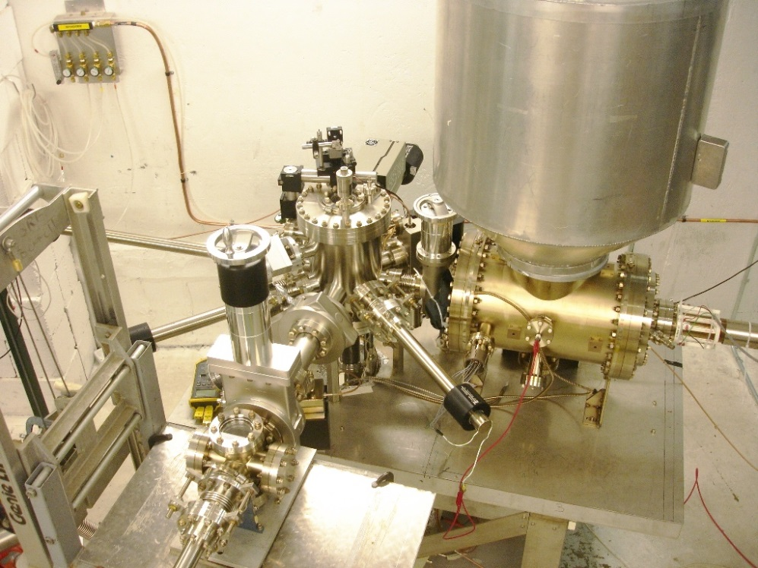
Introduction
example: CEBAF load-locked gun (100 kV)
Up to now all the guns of
polarized electrons
are DC guns
since GaAs PCs need
excellent ultra-high vacuum
p < 10⁻¹¹ mbar
Preparation/activation chamber
Loading chamber
HV chamber
“suitcase”
M. Poelker, ERL´07, Daresbury
ADVANTAGES OF SRF GUNS
superconducting: low RF losses -> high rep. rates in CW
laser and RF field: short pulses & high gradient -> high brightness
very good vacuum: GaAs -> polarized electrons?

Slide 5
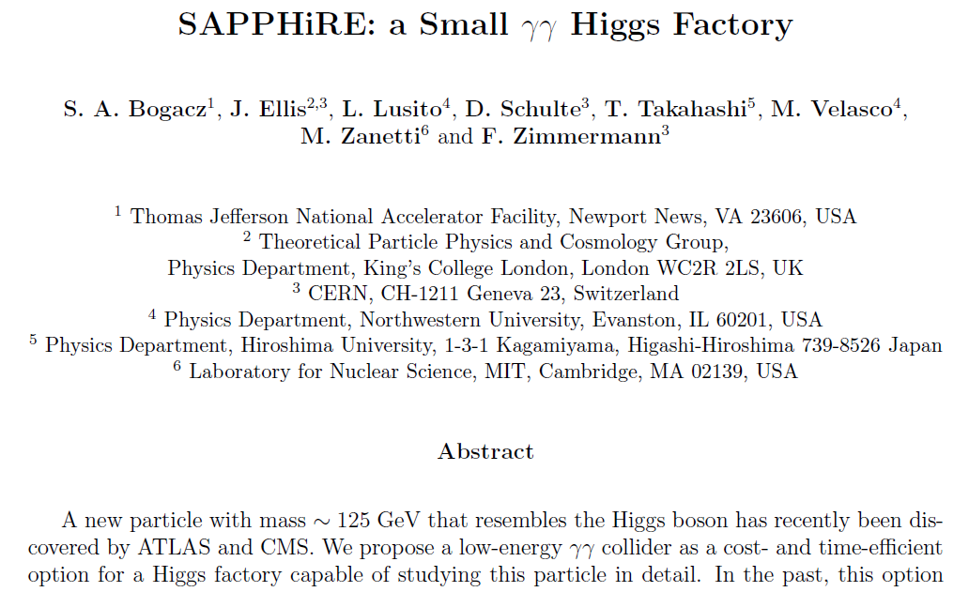
Introduction
MOTIVATION up to now: for Future Light Source (ERLs):
Cs₂Te (UV) -> GaAs (green) in SRF guns:
allows higher currents and simplifies the drive laser
SRF gun of
high-brightness,
high bunch charge,
polarized electron beams
for
particle physics
ILC, eRHIC, …

Slide 6
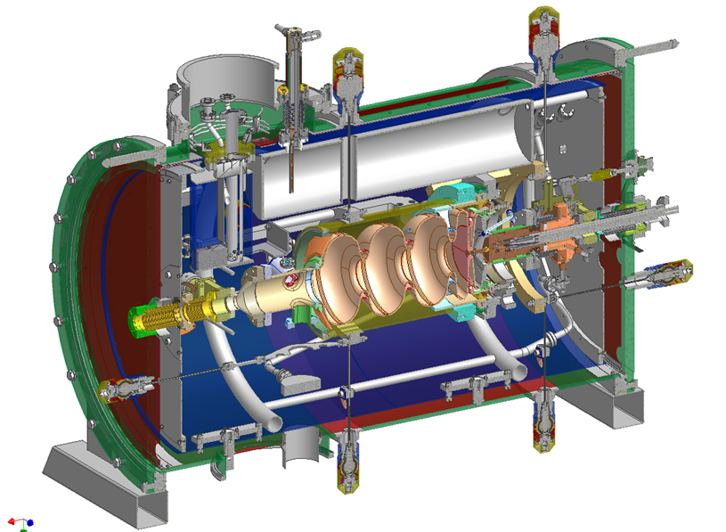
Introduction
Application of the ELBE SRF Gun
high peak current operation for CW-IR-FELs with 13 MHz, 80 pC
high bunch charge (1 nC), low rep-rate (<1 MHz) for pulsed neutron and positron beam production (ToF experiments)
low emittance, medium to high charge with short pulses for THz-radiation and x-rays by inverse Compton backscattering
SAPPHiRE
GaAs
1.6 nC
200 kHz
1.5 µm
Parameter | ELBE |  | High Charge
final electron energy | ≤ 9.5 MeV
RF frequency | 1.3 GHz
operation mode | CW
Photo cathode | Cs₂Te
bunch charge | 77 pC | 1 nC
repetition rate | 13 MHz | 500 kHz
laser pulse (FWHM) | 4 ps | 15 ps
transverse rms emittance | 1 mm mrad | 2.5 mm mrad
average current | 1 mA | 0.5 mA

Slide 7
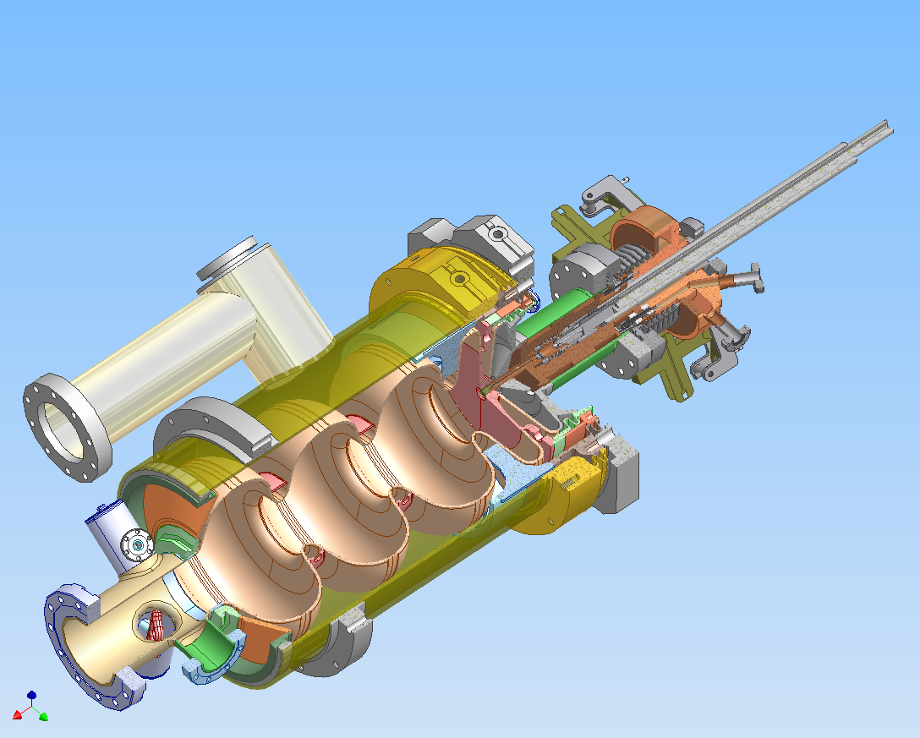
Introduction
cathode transfer rod
Normal-conducting
photocathode in
superconducting cavity
Photo cathodes must be
exchangeable without
- breaking the vacuum
warming-up the gun
no particle generation
During exchange
Separate support and
cooling with liquid N₂
- Vacuum gap, electrically and thermally isolated
LN₂ reservoir
cathode cooler
cathode
choke filter
gun half-cell

Slide 8
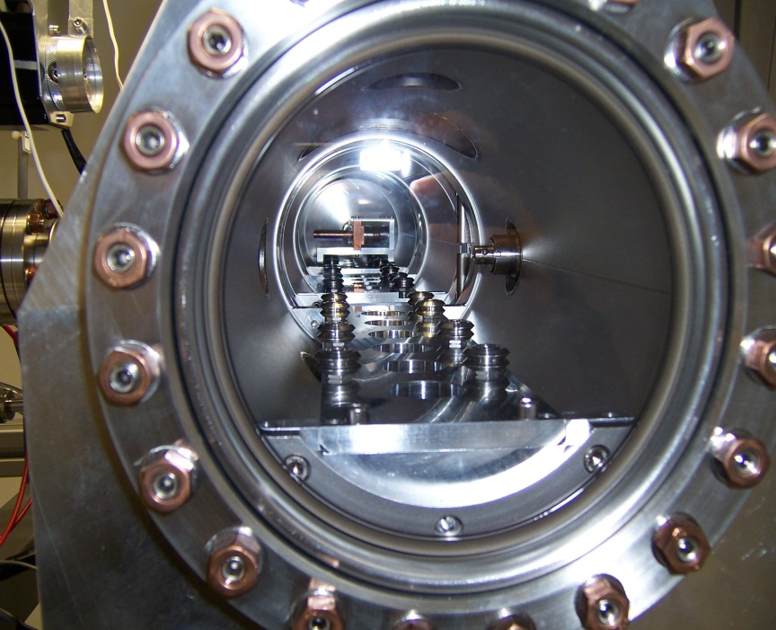
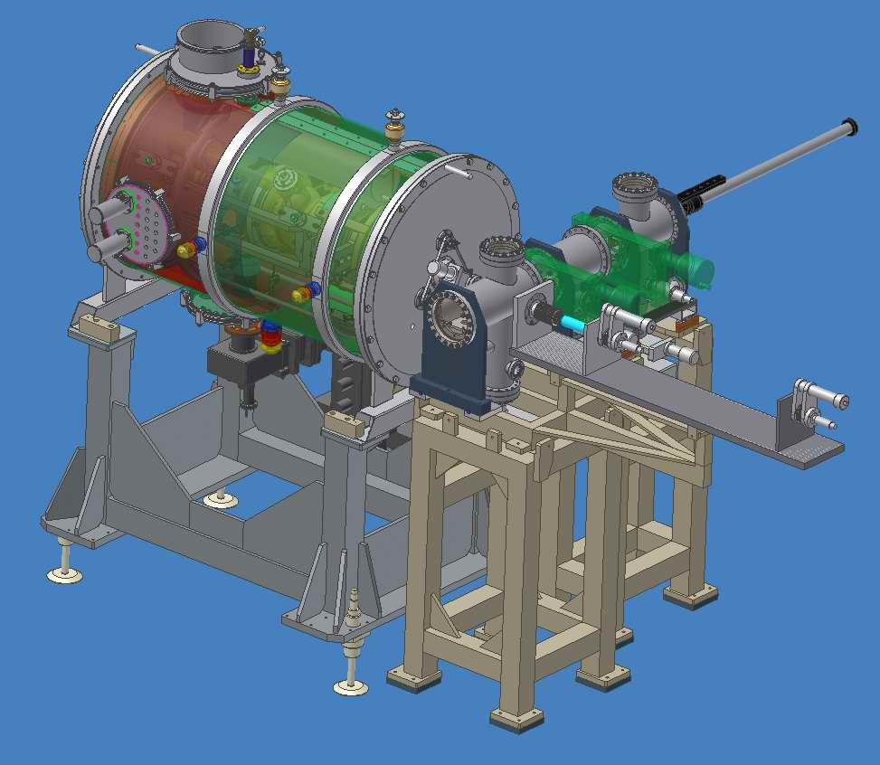
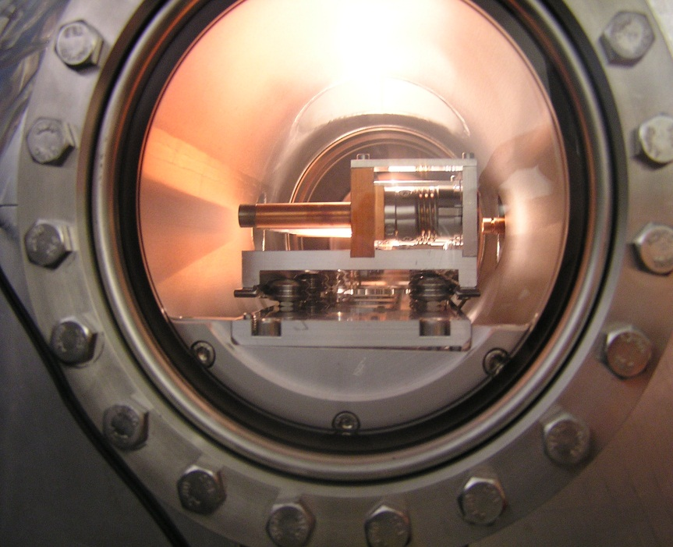
Introduction
Lock
Places for
6 cathodes
Transport
chamber
Transfer
chamber
Cathode transfer rod
linear & rotation
Use of semiconductor photo cathodes like
Cs₂Te requires a UHV (<10⁹ mbar) exchange
system

Slide 9
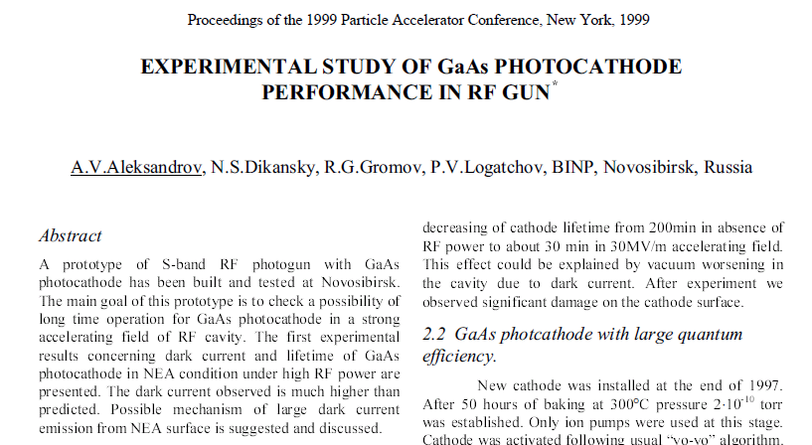
Previous GaAs PC activities at RT and SC RF photo guns
BINP activity with a copper (RT) RF photo gun
Problems with GaAs Photocathodes:
experiment failed due to
- worse vacuum of > 10⁻⁹ mbar,
high dark current,
electron backbombardment

Slide 10
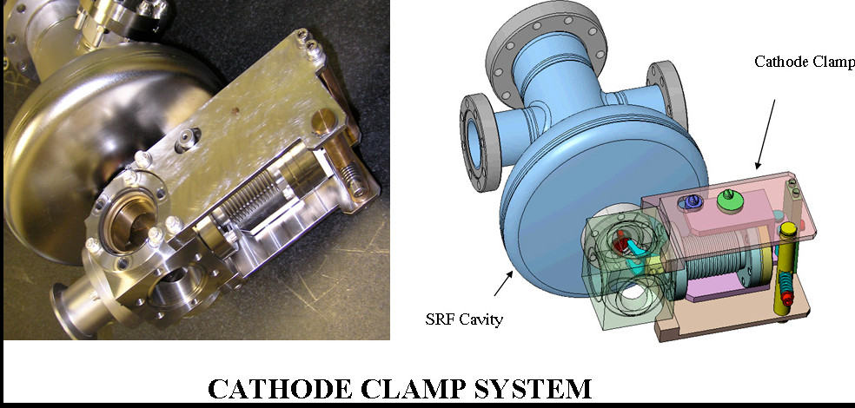
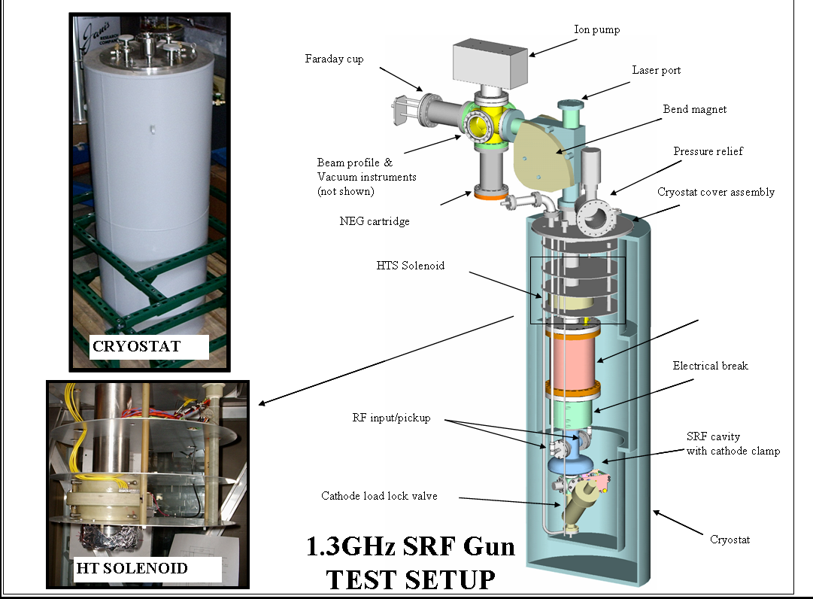
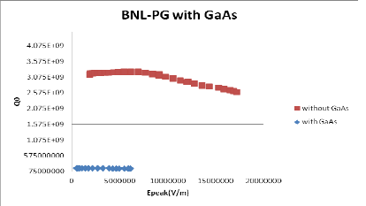
Previous GaAs PC activities at RT and SC RF photo guns
GunBNL Polarized SRF Photocathode
Test set-up with ½-cavity installed,
GaAs (Cs,O) preparation system exists,
NEA GaAs PC prepared, QE=10%,
First tests with cavity,
Experiments ongoing
Problems:
- transport of PC from preparation chamber
to gun: vacuum only ~10⁻⁹ mbar
- RF heat load in the GaAs crystal
- Solution to prevent e⁻ back bombardment
J. Park, et al., PAC´11, New York, p.385
E. Wang, et. al., PAC´11, New York, p. 388

Slide 11
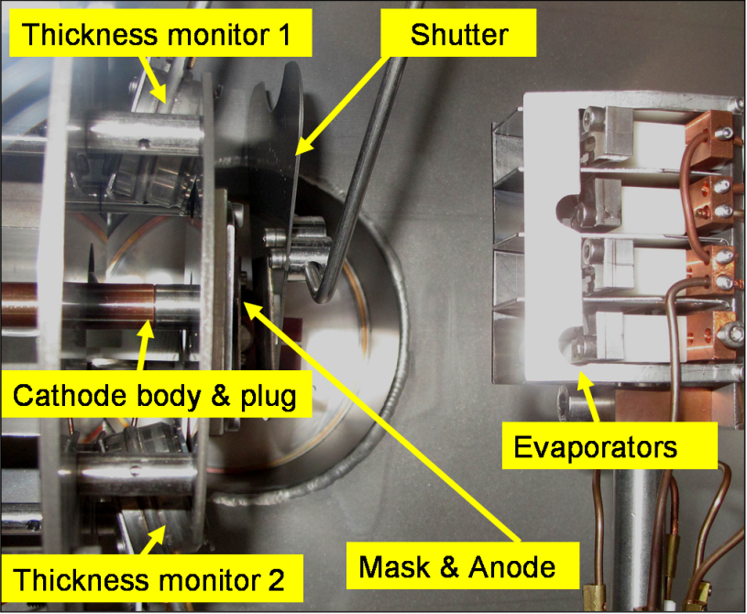
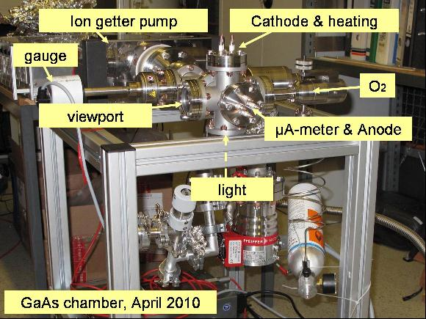
Previous GaAs PC activities at RT and SC RF photo guns
HZDR GaAs PC preparation system for ELBE SRF Gun
Inside view of the Cs2Te
preparation system
Compact GaAs
preparation system (developed within EuCARD)
R. Xiang, et al., FEL´10, Malmö, p. 449
R.Xiang, et al., IPAC´12, New Orleans, p. 1524
should be later integrated in the existing
Cs2Te chamber
Problems:
Preparation of GaAs failed
- To many compromises in design
- Low QE, very short storage time

Slide 12
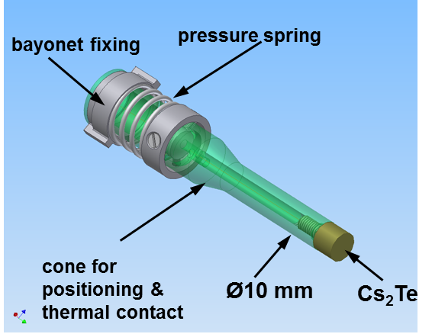
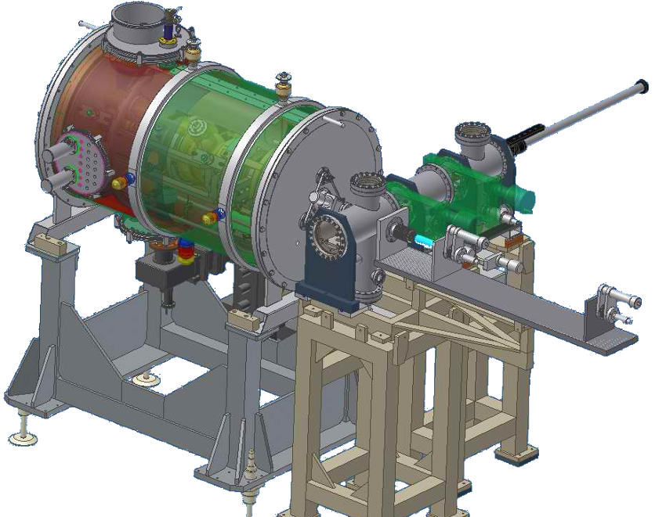
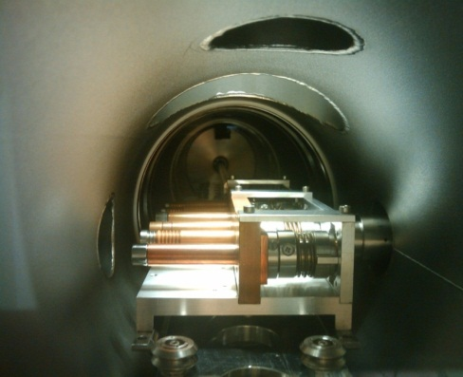
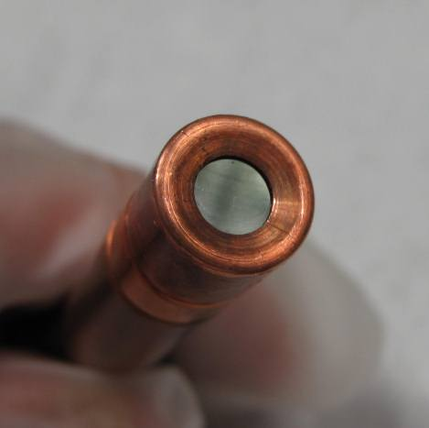
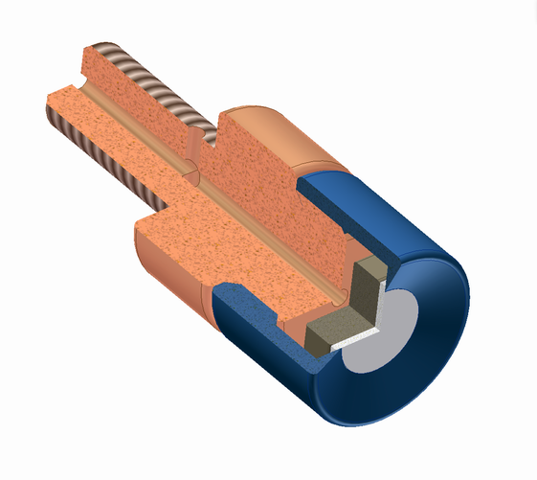
Previous GaAs PC activities at RT and SC RF photo guns
Test of non-activated GaAs PC
SRF Gun
Transport
chamber
Load-lock
Mo
Mo
Modified PC design for GaAs
Pb/Nb
GaAs
Cs₂Te
Cs₂Te
With Pierce cone
Inside ɸ 4.75 mm
Outside ɸ 10 mm
GaAs
R. Xiang, Phys. Rev. Special Topics AB 13 043501 (2010)

Slide 13
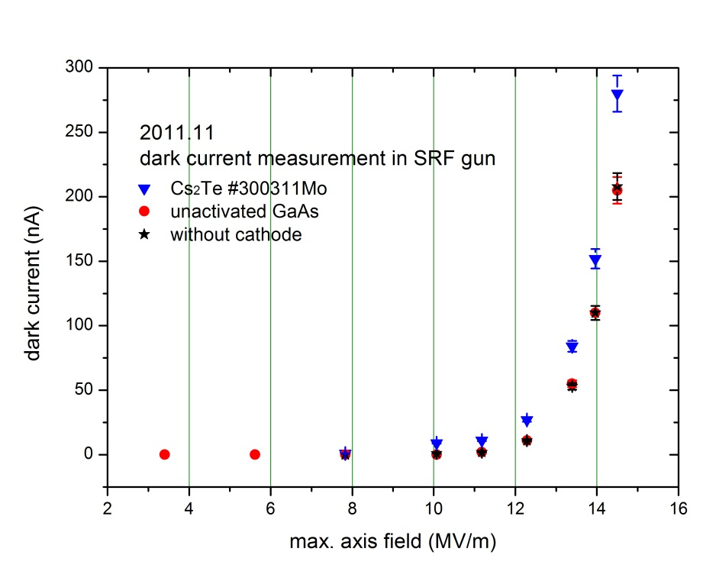
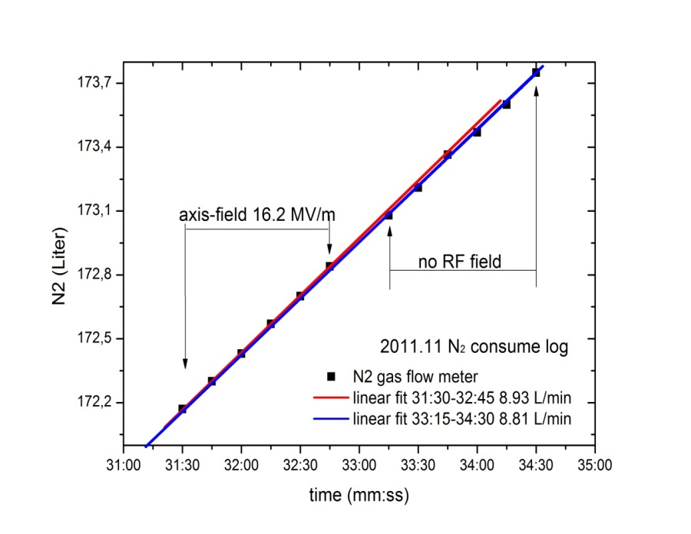
Previous GaAs PC activities at RT and SC RF photo guns
HZDR design:
Higher RF field than at BNL, but no dark current or heat load problems
time (hh:mm)
No detectable dark current from GaAs-crystal.
Gun with GaAs crystal (0.35mm) and holder
Without RF, P_{N2}=34.52W
With RF_{max}=5.5MV/m on surface , P_{N2}=35 W
R. Xiang, Task 10.7, EuCARD-SRF Annual Review 2012

Slide 14
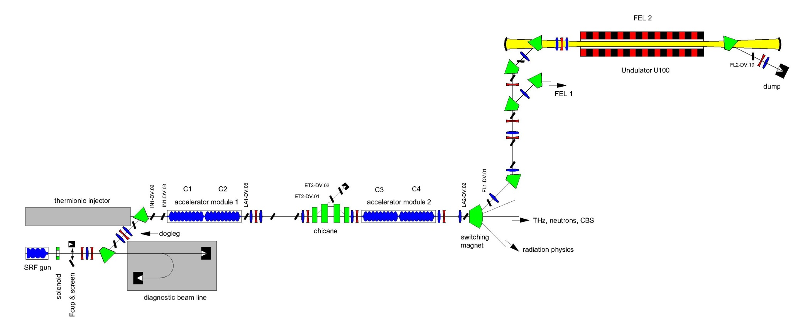
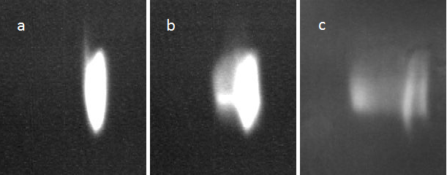
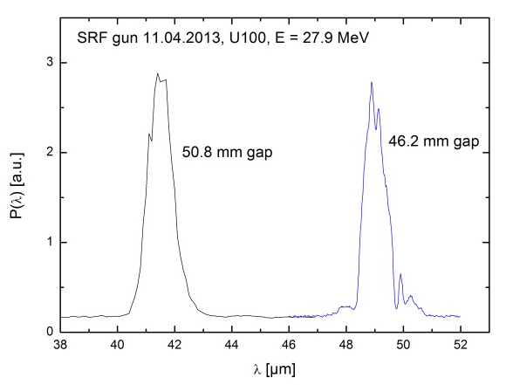
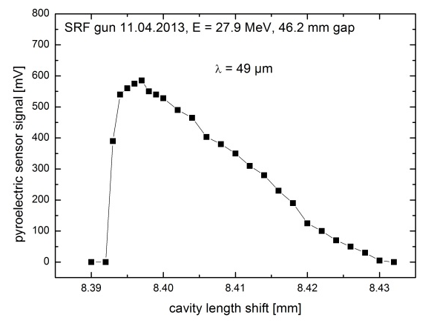
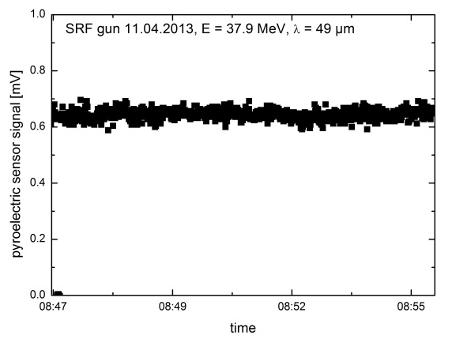
Status and future of the HZDR SRF gun
First lasing with the SRF Gun at ELBE – Successful proof of the basic design
E_{kin} at gun exit | 3.3 MeV
Micro pulse repetition rate | 13 MHz
Macro pulse repetition rate / length | 1.25 Hz / 2 ms
Beam energy at FEL | 27.9 MeV
Bunch charge / beam current | 20 pC / 260 µA
Photo cathode | Cs₂Te
RMS bunch length | 1.6 ps
Normal. RMS emittance | 1 mm mrad
ELBE infrared FEL (20 – 250 µm)
before
first lasing
optimized
April 11, 2013
stabilty
FEL spectra
FEL detuning curve

Slide 15

Status and future of the HZDR SRF gun
Excellent lifetime of Cs2Te PC in SRF gun
Requirements for Transfer:
Load lock system with < 10⁻⁹ mbar to preserve QE ≥ 1 %
Exchange w/o warm-up & in short time and low particle generation
Cathode | Operation days | Extracted charge | Q.E. in gun
#090508Mo | 30 | < 1 C | 0.05%
#070708Mo | 60 | < 1 C | 0.1%
#310309Mo | 109 | < 1 C | 1.1%
#040809Mo | 182 | < 1 C | 0.6%
#230709Mo | 56 | < 1 C | 0.03%
#250310Mo | 427 | 35 C | 1.0%
#090611Mo | 65 | < 1 C | 1.2%
#300311Mo | 76 | 2 C | 1.0 %
#170412Mo | From 12.05.2012 | 236 C | ~ 0.6 %
fresh QE 8.5%, in gun 0.6%
total beam time 575 h
extracted charge 236 C
05.06.2013
problems: multipacting, QE drop-down during storage
Notes:
After preparation the cathodes needs to be stored and later moved into the gun, this is done by a transfer system with the requirements shown above.
What we see at every cathode is an early q-drop right after preparation were we do not know were it comes from
But this is stabilized at about 1% which is enough and can be preserved in the gun
The table shows the operation days and the QE in the gun of the cathode being used in the gun
The best one was in operation for more than 400 days, with an QE of at least 1%
The total beam time was 1013h and the total extracted charge was 35C
Unfortunately the cathode died during a vacuum problem

Slide 16
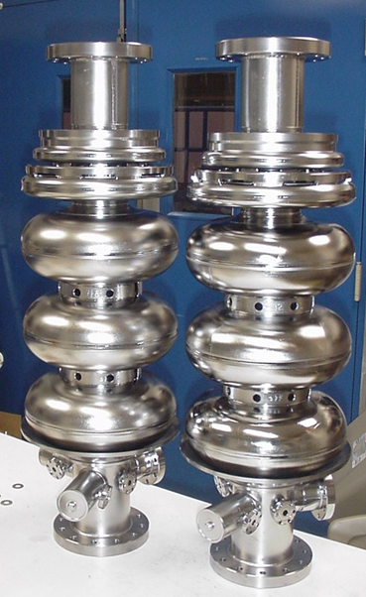
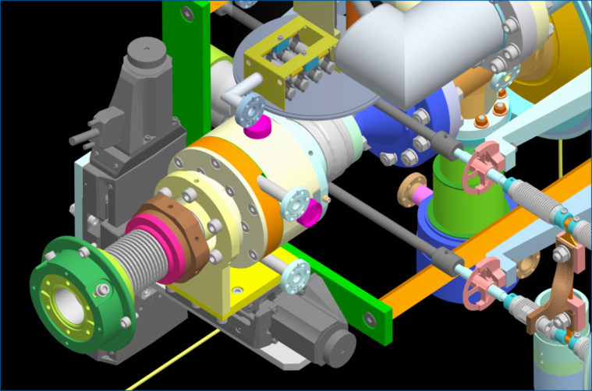
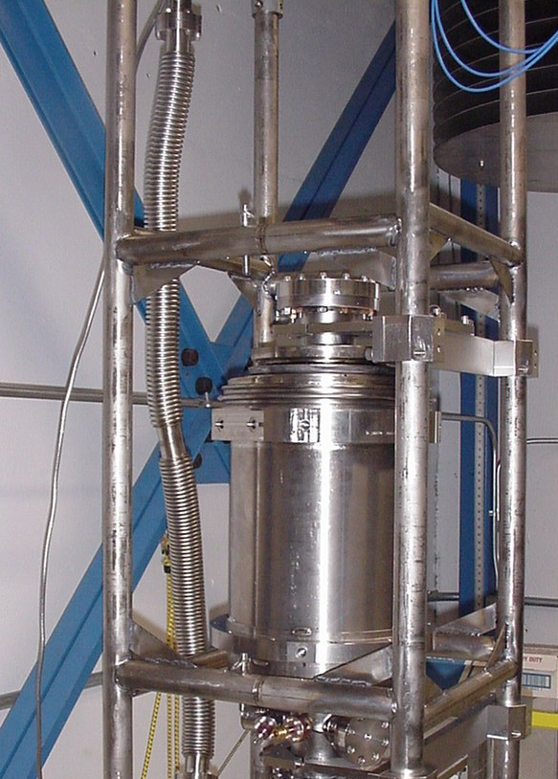
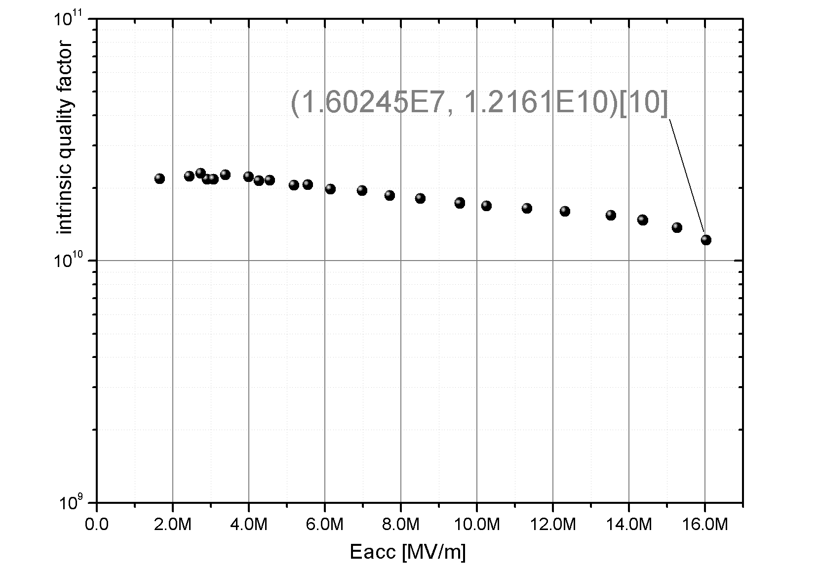
Status and future of the HZDR SRF gun
Version II gun with high-performance cavity & SC solenoid
Fabrication of two new cavities in collaboration with Jlab
(fabrication, treatment and tests)
New cryomodule with
SC solenoid (2 K)
Niowave Inc. (NPS, HZB)
remote controlled xy-table for alignment (77 K)
fine grain
RRR 300
Nb cavity
large grain
Nb cavity
43 MV/m peak field
in vertical test @ JLab
after He tank welding
JLAB_fine grain-cavity

Slide 17
GaAs PC preparation with new conception and hardware
- Preparation has to be performed near the gun
movable system, commissioning and tests in preparation lab
connected to gun during GaAs PC beam time
design of the system based on existing successful systems
(BNL, Daresbury Lab, Univ. Mainz)
- in the prep. system only small plug is handled
(new unified cathode/plug design of HZB, HZDR, Uni Mainz)
financial support of GaAs project:
(not by EuCARD2)
German Helmholtz Society / ARD program:
> 100 k€ investment/year since 2012
new photo cathode labaratory (class 100 clean room)
BMBF collaboration project “photocathodes”
HZB, HZDR, Uni. Mainz, MSU Moscow, SPSPU St. Petersburg
GaAs supper lattice supplier

Slide 18
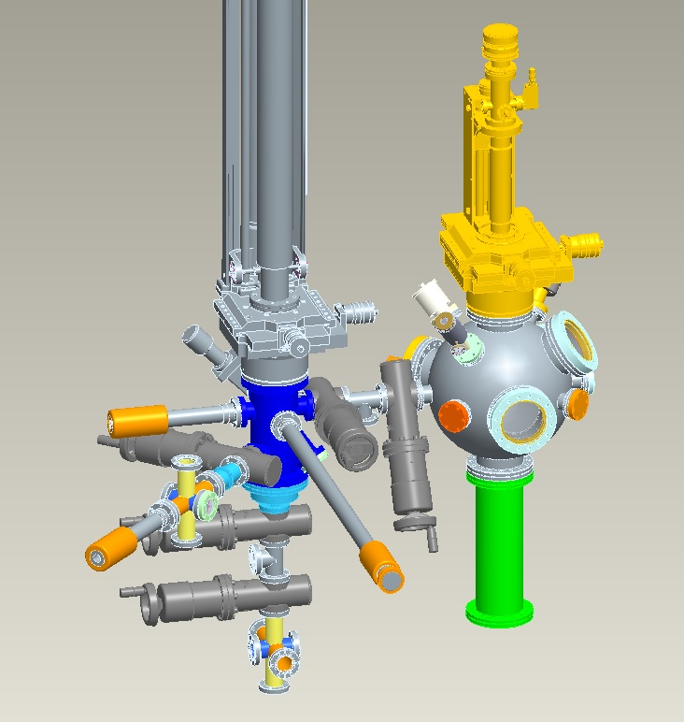
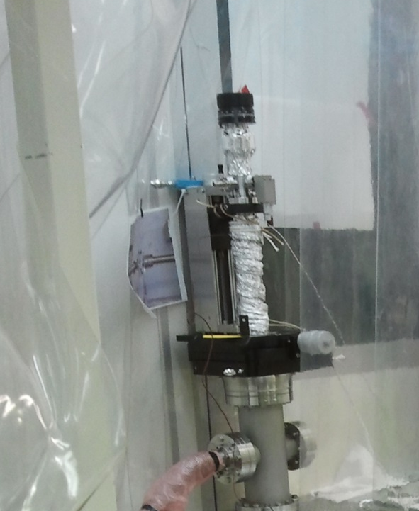
Status and future of the HZDR SRF gun
preparation and transfer system for GaAs (Cs,O)
Close to SRF gun
XHV chamber 10⁻¹¹ mbar
Green light
Commissioning planned in 2013
Interesting points:
QE / lifetime
dielectric loss on crystal
temporal response
thermal emittance
potential field emission
dark current
3. Connect to gun
1. GaAs Prep-
system
2. Storage and transport

Slide 19
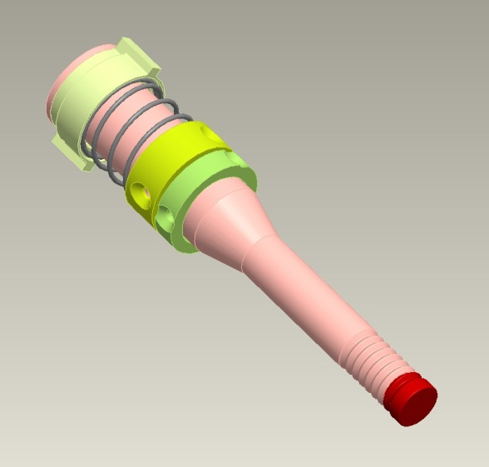
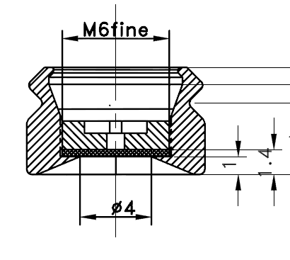
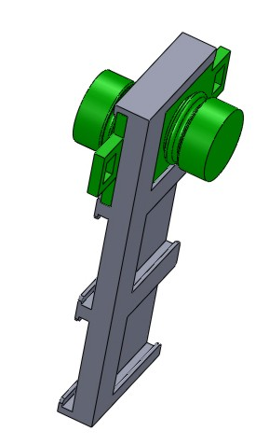
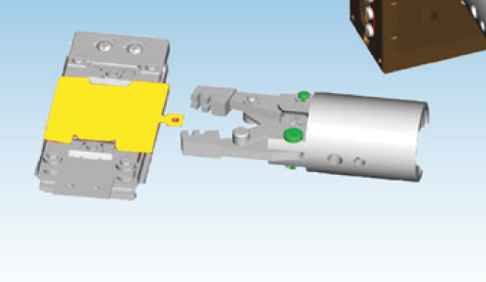
Status and future of the HZDR SRF gun
Transport only small plugs (up to 6 plugs)
fixed on VG Scienta
holders for storage
and transport
GaAs
Cathode 106 mm long
plug ɸ10mm x 6mm (HZB, HZDR, Mainz standard)
Easier for transport
Easier for heat-cleaning
VG Scienta sample handling

Slide 20
Summary
topic | discussion | risk
GaAs cathode preparation | successfully demonstrated at many places | low
e-polarision | using GaAs super lattices | low
SRF gun concept | demonstrated at HZDR/ELBE | low
PC lifetime in gun | vacuum ok; ion back bombardment low new unexpected problems? | medium
PC compatible with SC RF field | dark current, RF losses etc. degradation of cavity performance | medium
Beam brightness, emittance | high performance cavity Laser shaping, advanced emittance compensation | medium
QE, thermal emitt. time response, etc. | Experiences and solutions from DC guns | low

Slide 21
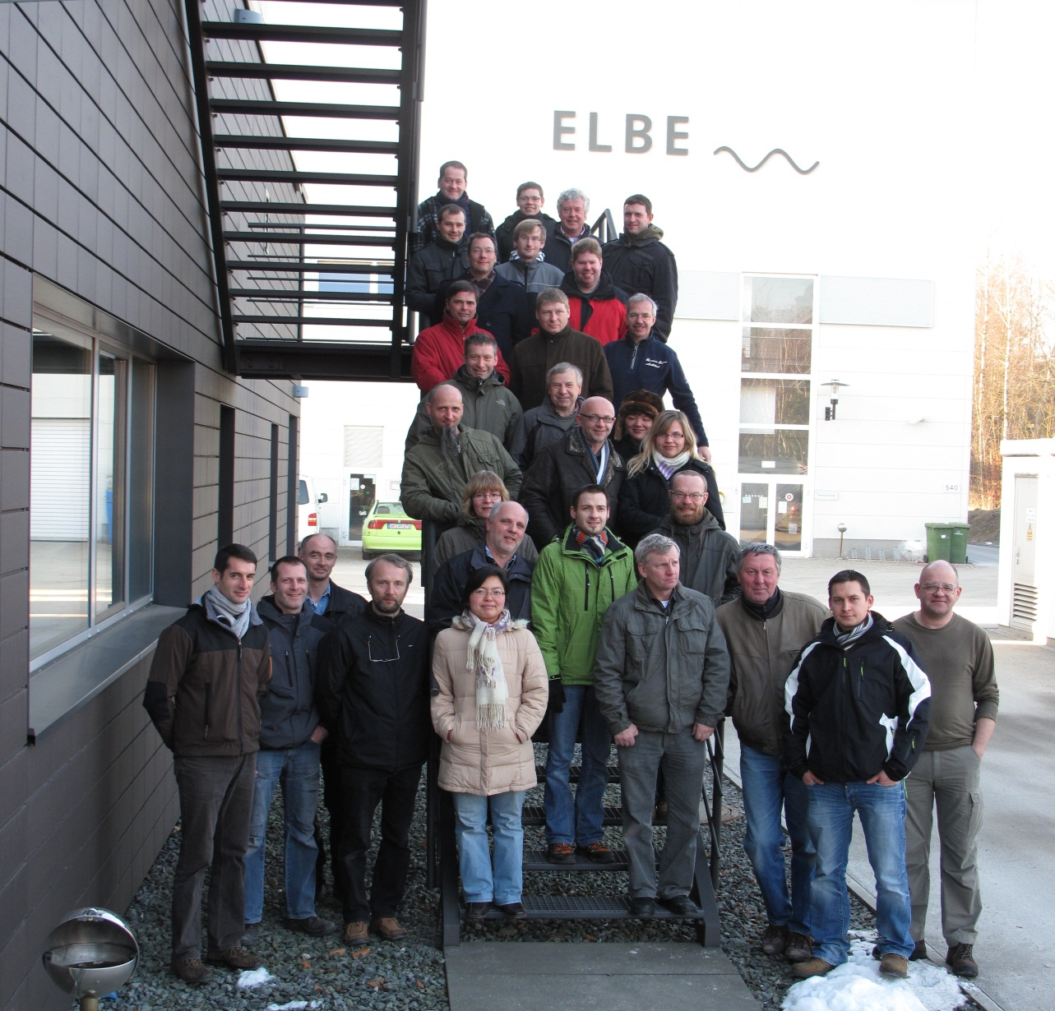
THANK YOU FOR ATTENTION
Acknowledgement
We acknowledge the support of the European Community-Research Infrastructure Activity under the FP7 programme since 2009 (EuCARD, contract number 227579) as well as the support of the German Federal Ministry of Education and Research grant 05 ES4BR1/8.

