Slide 1



Eucard2 – WP10
Future Magnets
Philippe Fazilleau & Lucio Rossi
WP10 kick off meeting
CERN, 14 June 2013

Slide 2
Budget
(total and EU funding)
The Eucard2 Collaboration, through the steering committee, has the right to modify the assignation of EU funding (the last 45%) according to change of scope or to lack of engagement of a partner.

Slide 3
Task 10.1 Coord
CERN: Lucio Rossi, WP and task 10.1 Coordinator; G. de Rjik: General mgmt and coordination between WPs; Budget follow up; Secretariat & Archiving; keep list of Publications; Webpage and Indico support; Organization of General Meetings; organize relation with USA and JP collaborators; put in place roadmap to select between YBCO and Bi-2212; Organize the test as insert in a HF facility.
CEA (Philippe Fazilleau, WP and task 10.1 deputy Coordinator): Reporting both internal and for EU; Control of MS and Deliverables (with their reports). Webpage (content) with task leaders; Relation with TIARA and other relevant EU projects; Organization of the Steering Committees of the WP (10 per year, also via video) and reviews (to be decided).

Slide 4
Task 10.2 Conductor
CERN (Luca Bottura, task 10.2 leader, Amalia Ballarino):
Tech specs of HTS; Planning and Procurement of material: Powder (Nexans) and then Bi-2212 wire , through USA collaboration; YBCO : additional order to Bruker (about 5 km of final specs). Provide a parameters for downselection among Bi-2212 and Ybco Measurements on strands/tapes: Ic, M vs T,B; metallurgy measurements (synchrotron X-ray)
Tech Specs of cables; cabling test for Rutherford Bi-2212 and cable production; Cabling test of Roeble YBCO and cable production; Measurements on cables Ic vs. B, T, ε_{t} ;

Slide 5
Task 10-2 cont.
UniGE (Carmine Senatore, Task 10.2 deputy leader): Measurements of: Ic, RRR, heat capacity, strain sensitivity, T_{c} distribution, percolation threshold, magnetic relaxation and pinning properties till 21 T. Measurements on basic material and on final conductor.
INPG (Pascal Tixador): Cable design; cable characterization (which ???) and protection; e.m. of the various cables. Also strand/tape?

Slide 6
Task 10.2 – cont.
KIT (Wilfried Goldacker, Anna Kario): development of Roebel Coated Conductor Cable prototypes (short and medium samples (5m); Material Processing of YBCO tapes with striation (short samples); Characterization of mechanical and electrical properties of strands/tapes and cables with respect mechanical deformation (bending (77 K), torsion and tensile (4.2 K)) and ability for winding process.
Univ. of Twente, UT (Marc Dhallé,…): Wire and cable mechanical characterization: Ic vs ε_{l}, ε_{t} (Pacman, Tarsis probe) Jc until 20 T, M (DC and Ac), and interstrand resistance (both measurements ans modelling).

Slide 7
Task 10.2 – Cont.
Univ. of South Hampton SOTON (Yifeng Yang,…): Measurement of M and AC losses on wire/tapes and cables vs temperature (4-80 K).
INFN-LASA (Giovanni Volpini): Ic measurement on wires/tapes and cable till 15 T, vs temperature.
Bruker HTS (Alexander Usoskin): Development of process of YBCO tapes and production of tapes for the collaboration (about 5 km of 4mm mm wide tape equivalent) for RF&D, studies and tests.
CEA (Philippe Fazilleau): observer, connection to task.10.3

Slide 8
Task 10.3 - Magnet
CEA ( Maria Durante, Task 1.3 Leader) : Design (in broad sense, FQ included) and construction of Ybco made coil, developing all necessary technology (insulation, stress restrain, joints, etc.), etc.. Partecipation to design of Bi-2212 coil. Goal are 5 T with large margin in stand alone and design of system for stress restrain in the background field of 12-15 T (to approach 16-20 T total)
CERN ( Glyn Kirby, deputy Task 10.3 Leader) : Design (especially for FQ) and support to construction of the YBCO; Design and construction of Bi-2212 coil in the collaboration with USA, with development of proper technologies (Insulation, joints, stress retain, etc.). System for magnetic measurement evaluation.

Slide 9
Task 10.3 cont.
Grenoble-INP (Pascal Tixador): Design of HTS coils, analysis of e.m. behaviour, development of technology (small coils for investigation, tests under high fields)
Tampere University of Technology, TUT (Antti Stenvall) : Modelling of HTS coil both YBCO and Bi-2212, Quench analysis and protection evaluation
Danish Technological Institute, DTI (Nikolaj Zangenberg): development of insulation technology for coated conductor, both gel and epoxy; fabrication and test of sample and then of all tapes/cable; study of extension to Bi-2212.
INFN (Massimo Sorbi) : Quench computation and link to testing boundary conditions.

Slide 10
Task 10.4 standalone test
INFN (Giovanni Volpini Task 10.4 Leader) : Preparation of test station at 4.2 K, with adaptation and upgrade of existing facility at LASA; Data acquisition and first analysis of results.
CERN (Marta Bajko Task 10.4 deputy leader) : Participation to test, providing some equipment (possibly quench antenna, magnetic measurements, fiberglass for temperature and stress monitoring)
CEA (Maria Durante): participation to test and analysis
Tampere University of Technology, TUT (Antti Stenvall) : participation to test and analysis
Danish Technological Institute, DTI (Nikolaj Zangenberg): participation to test and analysis

Slide 11
Job to do next weeks (10 July 2013)
Put in order listings and have it on web in a usable form…
Make nice format for presentation and documents with logos of all WP10 Institutes…
Launch formal agreement with FSU (D. Larbalestier) in form of simple MoU to signed by CERN in name of Eucard2 for the Bi-2212 collaboration (with clause to make easy to exchange material, and personnel).
I remind you the politics for publication. Of course each one is owner of its own work but this is a collaborative effort: in doubt better to co-author than to exclude.
IP: respect the rules of the CA.

Slide 12
Schedule of WP10
Cable
concepts
Tests
Magnet
designs
Cable
production
Reports
From the « DOW Eucard² » dated: 2013-02-13

Slide 13
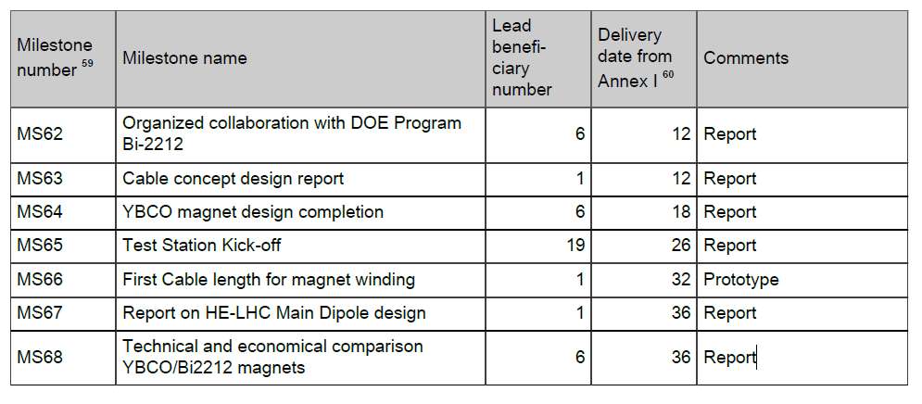
Milestones
cea
(cern)
cern
cea
infn
cern
cern
cea
Concerns only the « official » milestones with EU,
Reports should be 1 to 2 pages,
milestones « alarm » in charge of coordination, 2 months before,
MS62 driven by cern, but cea is mentionned
« sub » milestones : presented in the tasks description

Slide 14
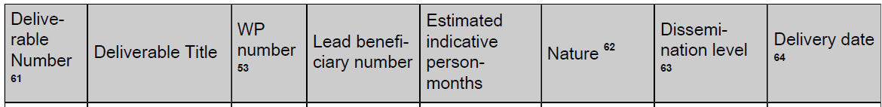
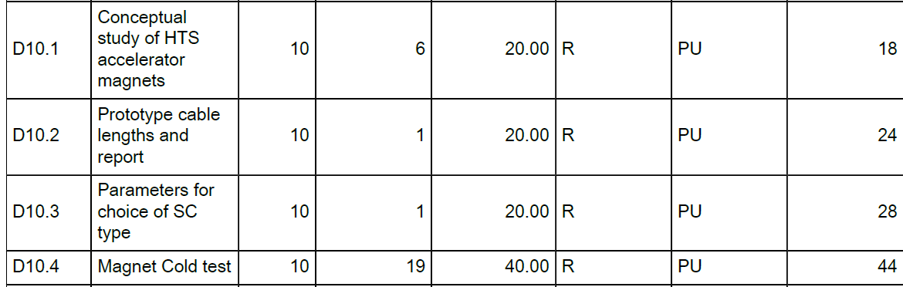
Deliverables
cea
Report
cern
Report
cern
Report
infn
Report

Slide 15
Deliverables
D10.1) Conceptual study of HTS accelerator magnets: The report will contain all key elements of the novel magnet design, considering electromagnetics, mechanical, thermal, stability and protection aspects. (Task 10.3) [month 18]
D10.2) Prototype cable lengths and report: This is the first unit length of 10 kA class HTS cable, usable for characterization and short winding tests. (Task 10.2) [month 24]
D10.3) Parameters for choice of SC type: The outcome of a mid-term meeting is a set of parameters deemed important for the decision between the two SC materials (Bi-2219 and YBCO) and the criteria on which to make a successful choice. (Task 10.1) [month 28]
D10.4) Magnet Cold test: The test will include: warm measurements, cold down, electrical quality assurance at cold, power test, training curve, magnetic measurements and finally re-training for memory effects (Task 10.4)
[month 44]
Reports should be 6 to 10 pages, main goal is to demonstrate the work is achieved (references to detailed reports or papers)
Very limited number of deliverables, importance of being on time,
deliverables « alarm » in charge of coordination, 3 months before,

Slide 16
Technical program - 1
Developement of YBCO cable (real cable) will take time. Task 10.2 needs ceetainly morfe time to get usable cable.
While YBCO is our PRIMARY choice (following Eucard and the fact that EU Industry is on YBCO), I would suggest to start with Bi-2212 cable. We are providing advanced powder form Nexans to ASC-FSU.
  Design cable, magnet and tooling for a Bi-model in cosϑ (alternative ideas to be considered but we need to get early a real model magnet)
  Rutherford Cable «easy»; stresses for first coil (5 T minimum field) can be not excessive
  Ask USA a design in // to ours for a similar size CCT mageet
  We can share all magnet technology with USA (+ advanced)
  Test and comparison (wed can test also at varaibel temperature!!! And measure losses.

Slide 17
Technical program - 2
YBCO: concentrate on material development (↑Jc with B//c) and on cable configuration
  Cable development is going to be long
  But we need to start now!!!
    Vigorous program with Roebel
  Conceptual study for layout best suited to Roebel:
  cos ϑ, CCT? Block flat coils? Blocks with flare ends? A mix of them?
  Who volunteer to study alternative solution?
    Tape around channel…
    «Desperate» Rutherford Cable made out with tape?
Any other crazy ideas?

