Slide 1
View of DESY
(Accelerator-Related EU Projects)
Ralph W. Aßmann
Leading Scientist, DESY
Visions for the Future of Particle Accelerators, Workshop at CERN
11.-12.6.2013

Slide 2
National – International – European
DESY is a national lab, as far as its core funding is concerned.
DESY conducts research in an international context, from accelerator research over photon science to particle physics. World-wide competitiveness is an important factor in our program.
DESY has a long tradition of international collaboration, as shown by the European XFEL project under construction in Hamburg: European XFEL is a consortium supported by 12 countries.
Naturally, many of our friends and neighbors are in Europe: Europe is our most important reference frame.
Participation in EU projects has therefore a high priority and has a strong and long tradition at DESY and the Helmholtz association:
  EU project office in DESY.
  Helmholtz office in Brussels.

Slide 3
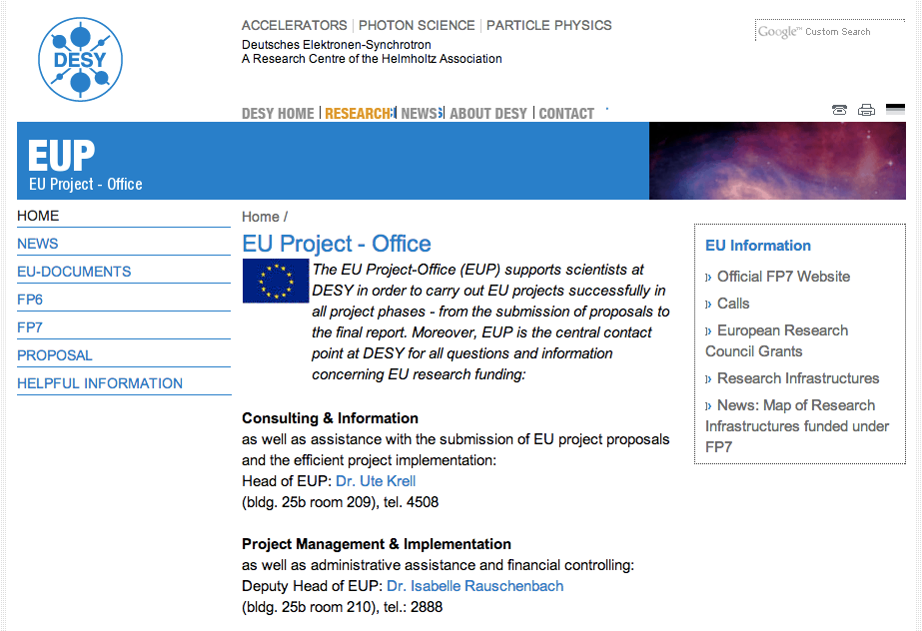
DESY EU Project Office – Hamburg

Slide 4
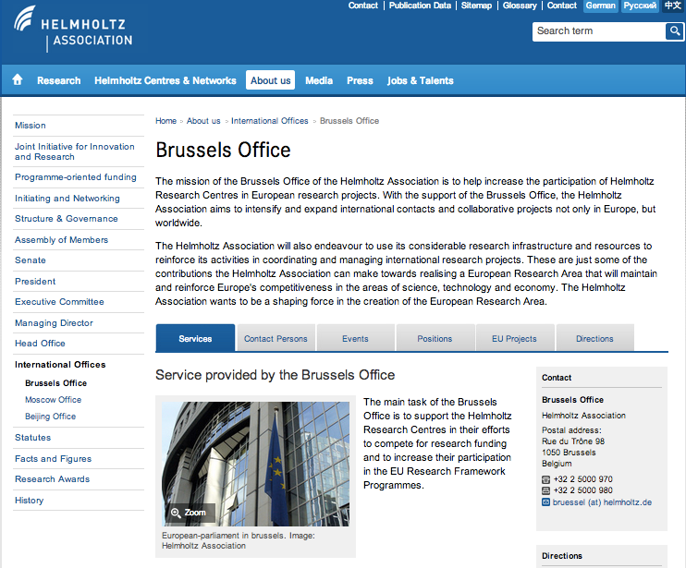
Helmholtz Association – Brussels Office

Slide 5
Present Programs Connected to Accelerator R&D
Programs with DESY accelerator involvement | Ongoing EU Projects
EUCARD Jacek.Sekutowicz | 01.04.2009 – 31.03.2013 | 32.3 M€ (EU: 10 M€) | 0.6 M€
EUCARD2 Ralph Assmann | 01.05.2013 – 30.04.2017 | 23.5 M€ (EU: 8 M€) | 0.7 M€
TIARA Reinhard Brinkmann | 01.01.2011 - 31.12.2013 | 9.1 M€ (EU: 3.9 M€) | 0.14 M€
CRISP Hans Weise | 01.10.2011 – 30.09.2014 | 15.9 M€ (EU: 12 M€) | 1.7 M€ (Acc. 1.15 M€)
HiLumi-LHC Rainer Wanzenberg | 01.11.2011 – 31.10.2015 | 21 M€ (EU: 4.9 M€) | <0.1 M€
Courtesy H. Weise

Slide 6

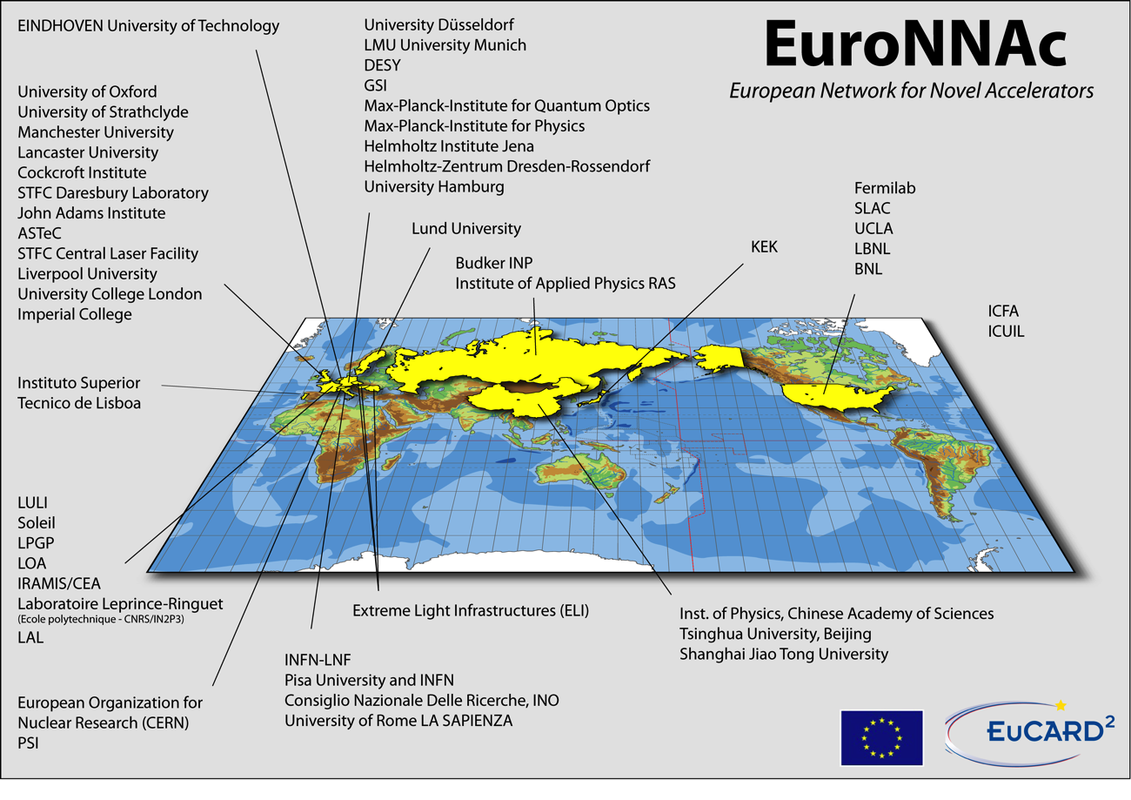
European Networking – Example

Slide 7
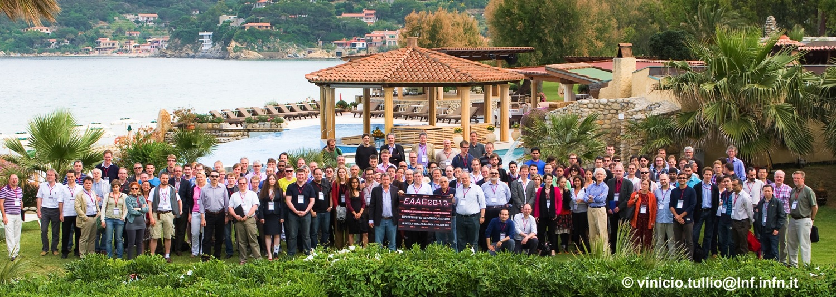
First European Advanced Accelerator Concepts Workshop
A network with DESY coordination (teamed up with CERN and ecole polytechnique) and central network fund at DESY.
145 participants, 128 from EU, 15 countries, 69 institutes.
EU funding allows building this network and inventing together novel accelerators for science (particles and photons) and society (medicine).
Would not have happened without EU projects!

Slide 8
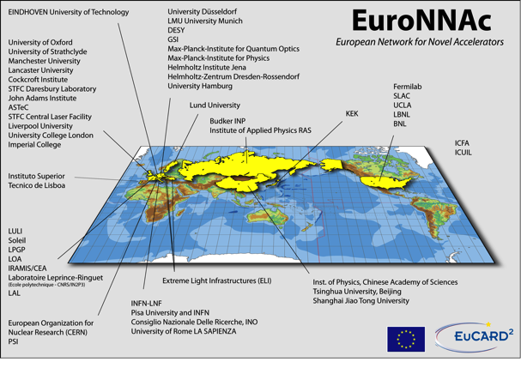
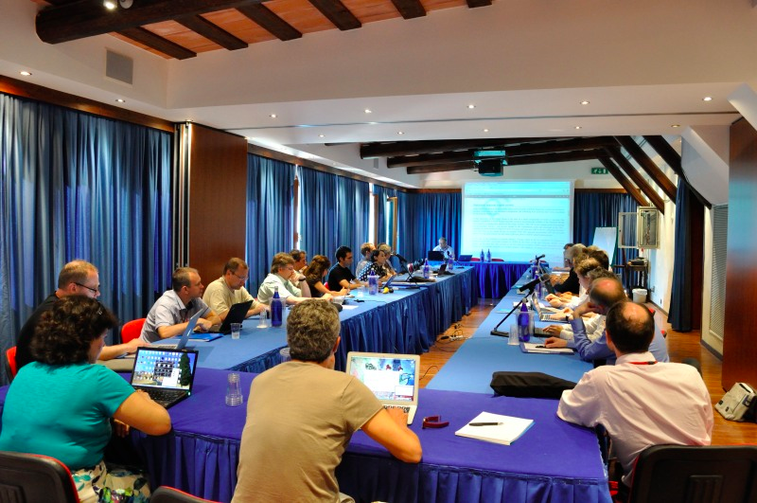
EU Projects for World-Class Science…
Europe is small on this map, if compared for example to Asia…
Germany is even much smaller on this map!
World-class science is one of our big European assets. We have a tradition here! See also success of CERN!
EU projects bring national labs, universities, institutes, international endeavors (ELI), … in accelerator R&D together.
Together we can keep up world-class competition with our friends in Asia and the US!
EuroNNAc member’s board, June 2013

Slide 9
DESY Experience and Comments I (Acc. Research)
DESY is a strong, happy supporter of EU projects in accelerator research and other fields!
Financial motivation for participating into EU projects is limited due to relatively low funding for accelerator R&D (accelerators are expensive).
Participation makes a lot of sense due to networking and teaming up with other European actors (medium-term benefit). Efforts to improve acceptance in technical teams are ongoing.
Resources for EU projects are limited and should be available for turning EU projects into big successes and not for reporting, if avoidable!
Minimization of bureaucracy is very important and should be further pursued. A happy researcher is a good researcher!
The same is true for administrative procedures. E.g. simplified reporting on lab resources inside EU projects.
Support from a dedicated EU project office is essential for success, like existing at DESY (DESY-EUP, U. Krell et al).

Slide 10
DESY Experience and Comments II (Acc. Research)
Not easy to keep up to date on new opportunities in EU calls and to find our way.
Example: We are discussing plans for a Next Generation European Distributed Test Facility for Novel Accelerators.
  We could imagine building only one next generation infrastructure in Europe. Would bundle efforts and maximize competitiveness.
  Work and budget could be distributed in Europe. Similar to HEP big experiments → one experiment that is constructed by many partners. Similar to ELI approach…
  Location could be determined in European bidding. Host state puts extra resources. Research time is distributed and R&D outcome available to all partners.
  How would we fund it? European funding or national funding? National funding has a tendency to favor installation in its country. European funding, as available now, is insufficient for our goals.
Increased funding for accelerator R&D would be beneficial. Would open new possibilities of collaboration and R&D.

