Slide 1
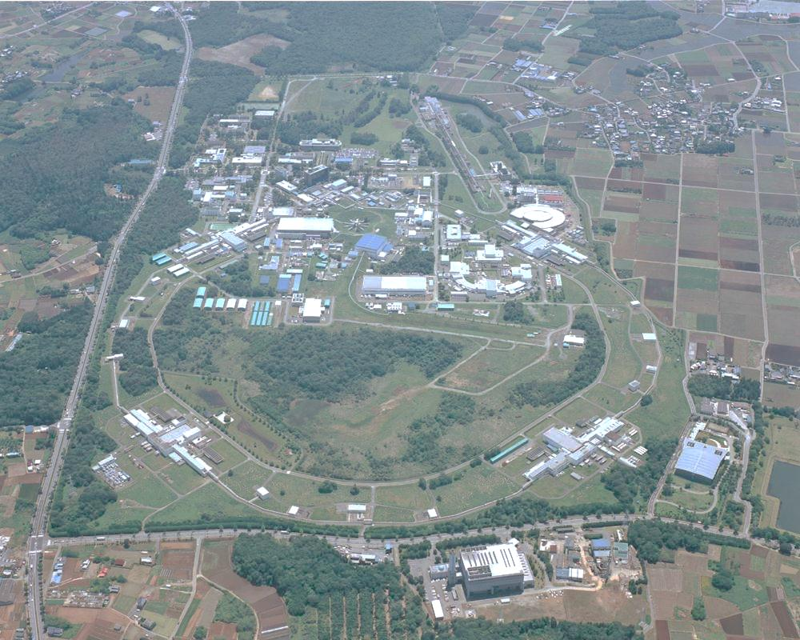

KEK, High Energy Accelerator
Research Organization
- EU-projects-
View of non-EU partner :KEK
June 11, 2013
Katsuo Tokushuku
IPNS, KEK, Japan

Slide 2
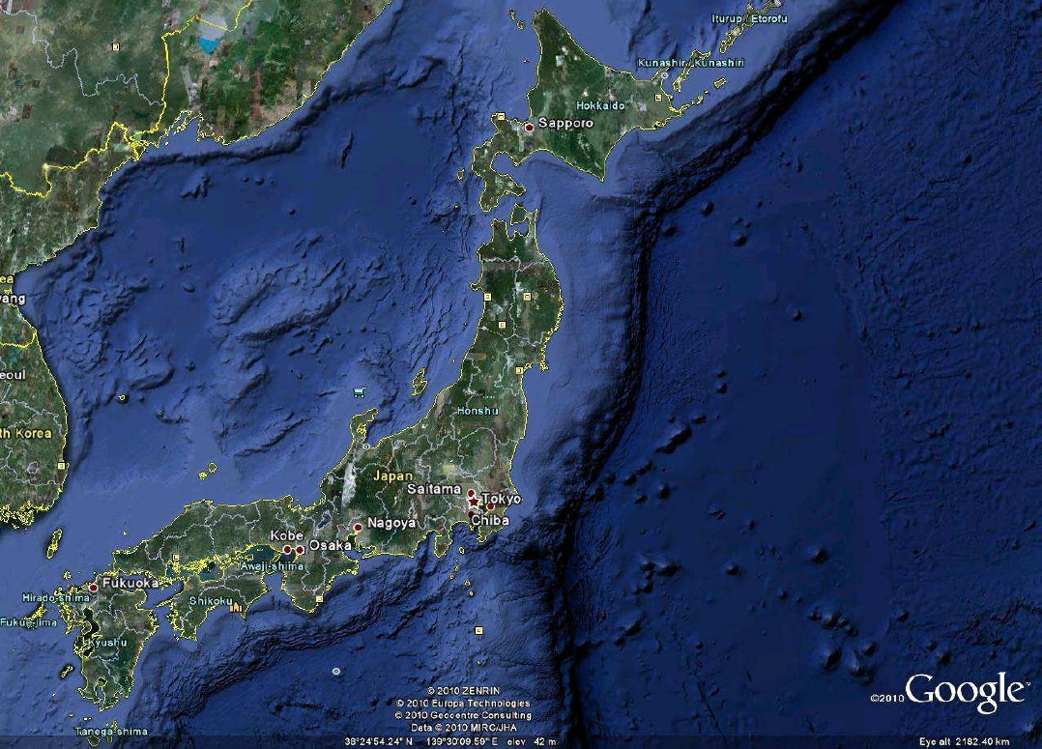
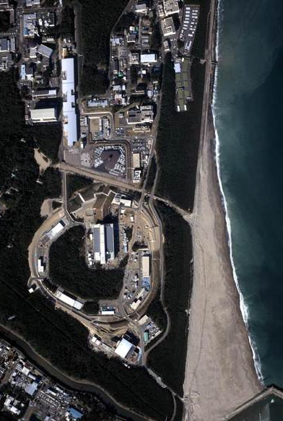
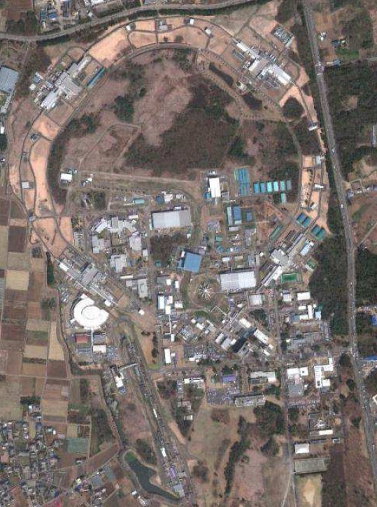
Electron machines in Tsukuba
and proton machines in Tokai
J-PARC
Tokai
KEKB
Tsukuba
ATF
Synch. light
facilities

Slide 3
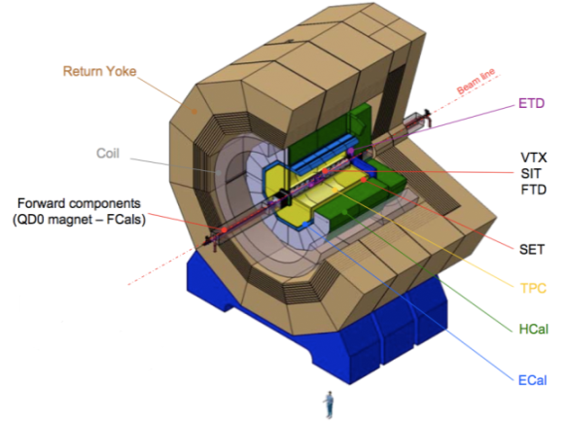
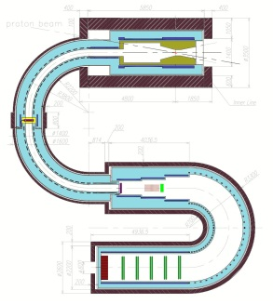
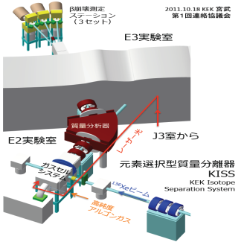
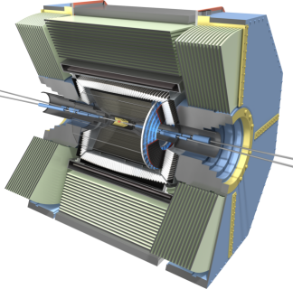
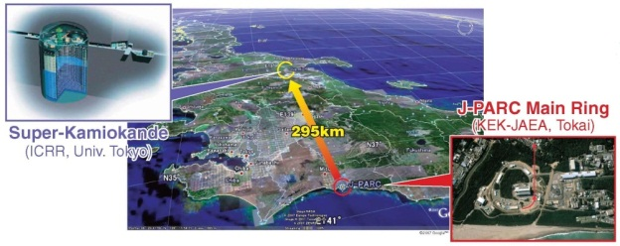
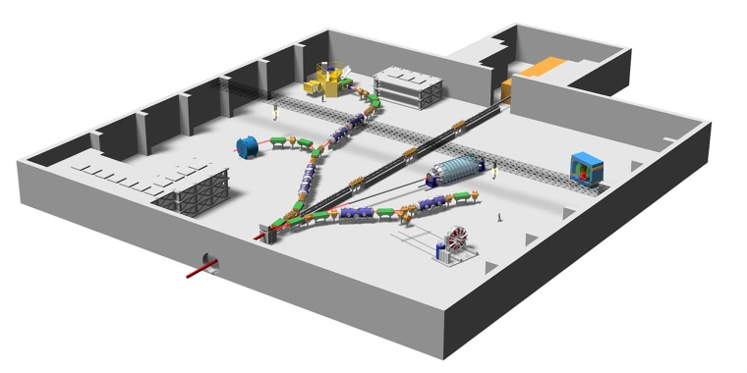
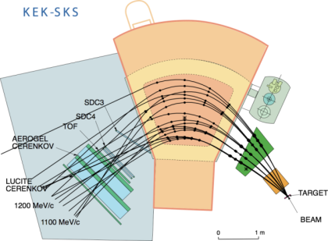
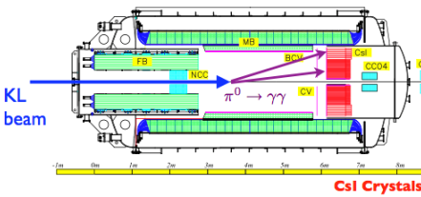
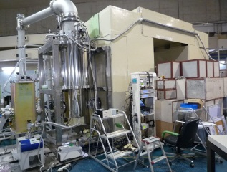
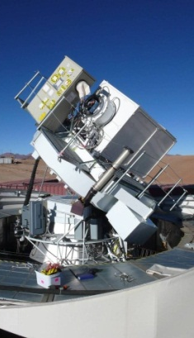
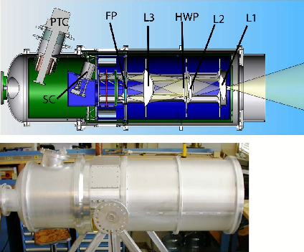
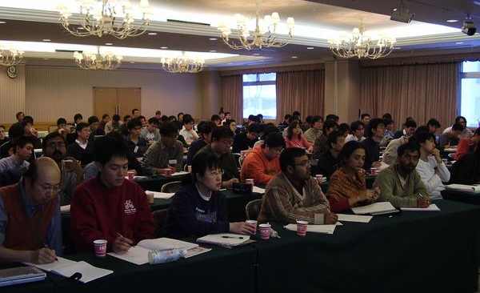
ATLAS
(CERN)
ILC
Energy Frontier
COMET
(J-PARC)
KISS
(RIKEN)
Belle-II
(KEKB)
Flavor Physics
Hadron and NuclearPhysics
T2K
(J-PARC)
Physics
at KEK
Hadron hall
(J-PARC)
KOTO
(J-PARC)
Astro- particle Physics
Theory
SKS
(J-PARC)
Theory
String theory
Particle physics
Hadron physics
Cosmo-physics
Lattice simulation
UCN
(RCNP)
QUIET
(Atacama)
PolarBeaR
(Atacama)

Slide 4
ATLAS
(CERN)
ILC
Energy Frontier
COMET
(J-PARC)
KISS
(RIKEN)
Belle-II
(KEKB)
Flavor Physics
Hadron and NuclearPhysics
T2K
(J-PARC)
Physics
at KEK
Hadron hall
(J-PARC)
Rich In-house programs on flavor physics (superKEKB and J-PARC), and on Nuclear Physics.
International Collaborations on Energy frontier physics (LHC) with the KEK’s expertise.
KEK roadmap:
http://kds.kek.jp/conferenceDisplay.py?confId=11728
KOTO
(J-PARC)
Astro- particle Physics
Theory
SKS
(J-PARC)
Theory
String theory
Particle physics
Hadron physics
Cosmo-physics
Lattice simulation
UCN
(RCNP)
QUIET
(Atacama)
PolarBeaR
(Atacama)

Slide 5
Energy Frontier
Flavor Physics
Hadron and NuclearPhysics
Physics
at IPNS
Astro- particle Physics
Theory

Slide 6
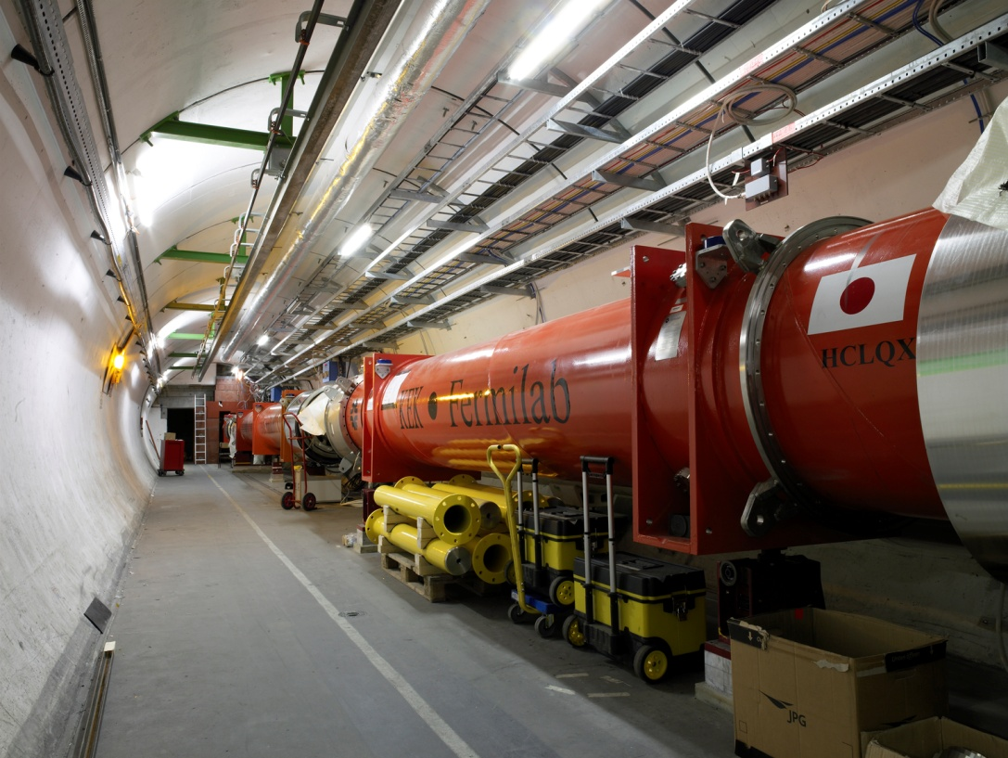
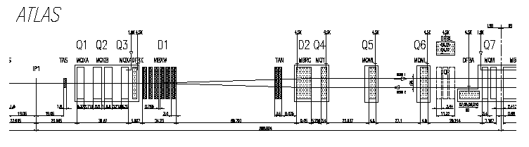
Long Collaboration with CERN on LHC
Inner Triplet Quadrupoles
Near the interaction points, triplet quadrupole magnets focus the beam. Two types of superconducting magnets are separately developed and manufactured at KEK and Fermilab. Both magnets were assembled with common cryostat at Fermilab and then shipped to CERN.
KEK
Fermilab
Collision point

Slide 7

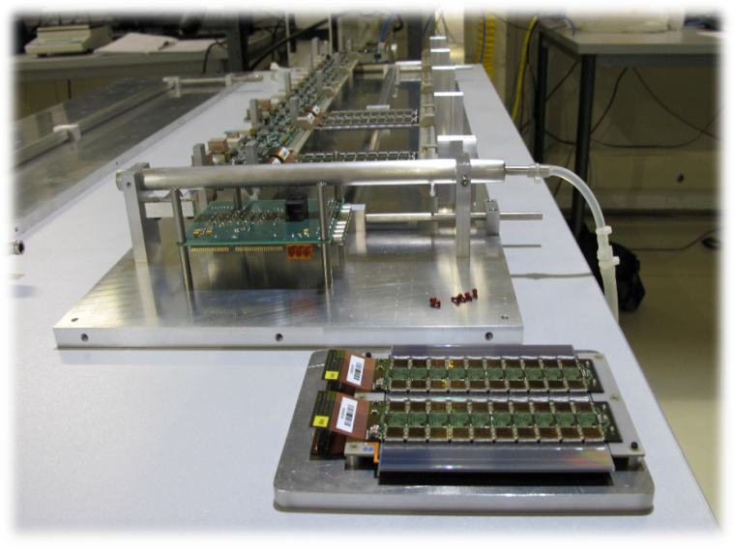
ATLAS: KEK contribution to the ATLAS initial detector
and its upgrade
Prototype of new strip detectors
Superconducting Central Solenoid (Japanese contribution:100%)
Time-to-digital conversion chips for muon drift tubes (100%)
End-cap muon triggering system (TGC) (~50%)
-> New trigger logic system for LVL1
Silicon microstrip tracking system (SCT) (~20%)
-> New inner tracker with pixel and strip detectors
Tracking (|η|<2.5, B(solenoid)=2T) :
-- Si pixels and strips
-- Transition Radiation Detector (e/π separation)
Calorimetry (|η|<5) :
-- EM : Pb-LAr
-- HAD: Fe/scintillator (central), Cu/W-LAr (fwd)
Muon Spectrometer (|η|<2.7) :
air-core toroids with muon chambers
Length : ~ 46 m
Radius : ~ 12 m
Weight : ~ 7000 tons
~ 10⁸ electronic channels
~ 3000 km of cables

Slide 8
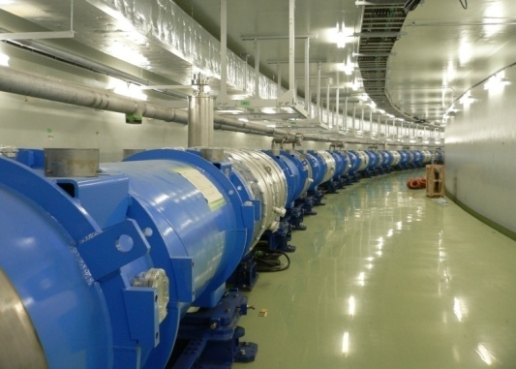
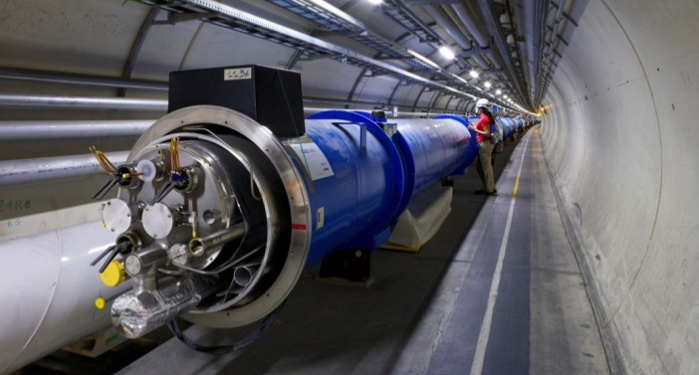
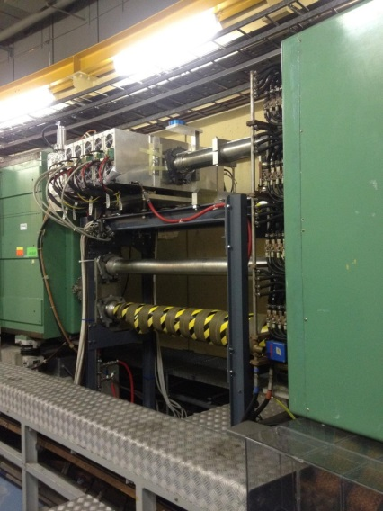
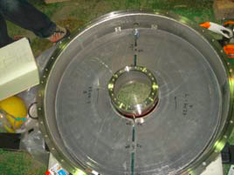
Very fruitful collaboration with CERN
LHC magnets
J-PARC neutrino beamline
PSB: cavities
J-PARC RF cavities

Slide 9
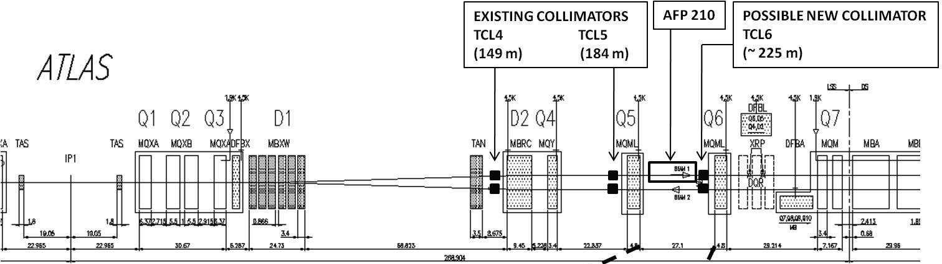
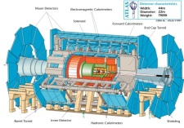
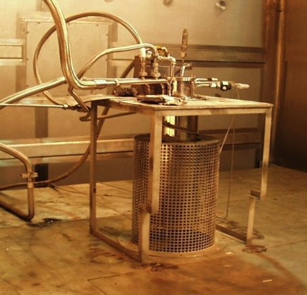
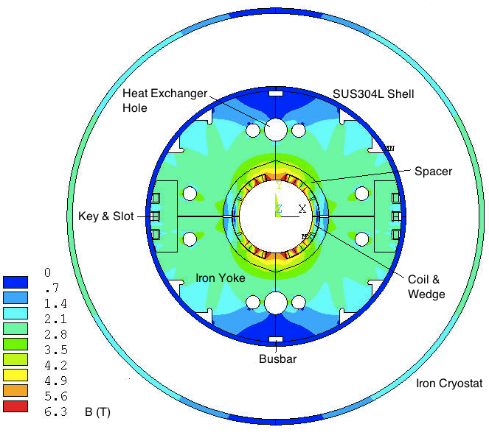
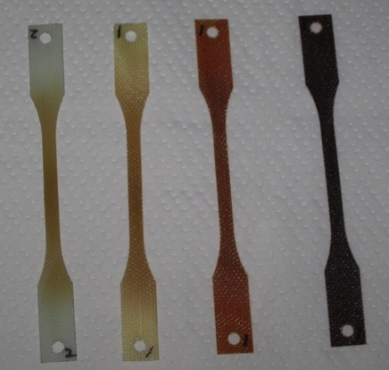
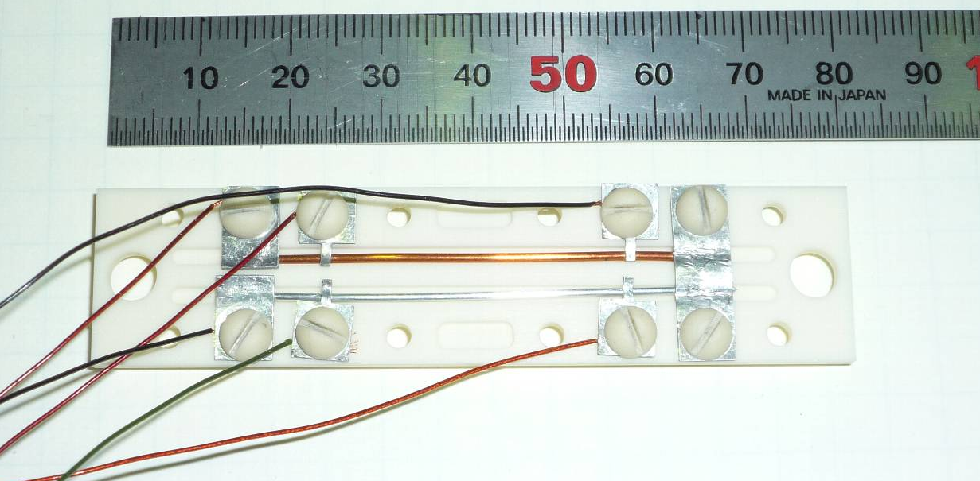
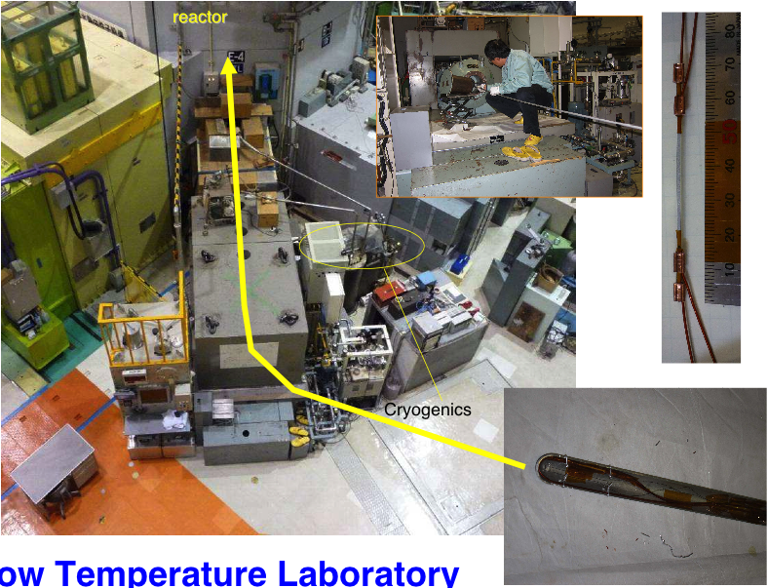
International collaboration has started for the design work of the magnet system under HiLumi (FP7)
～３００m
D1: KEK
Q1-3:
US-LARP(Nb3Sn) or
CERN(NbTi)
D2: BNL
Q4-6:
CEA/Saclay
JAEA Takasaki
Cryogenic γ-ray
irradiation Facility
Epoxy
(G10)
CE
BT
BMI
Radiation test at J-PARC
Challenges:
Large aperture (φ130~150mm) 6 Tesla magnet: saturation, flux leakage
High radiation dose: selections of rad-hard materials
There is a CERN-KEK collaboration on high-field magnet Nb₃Sn, Nb₃Al
9

Slide 10
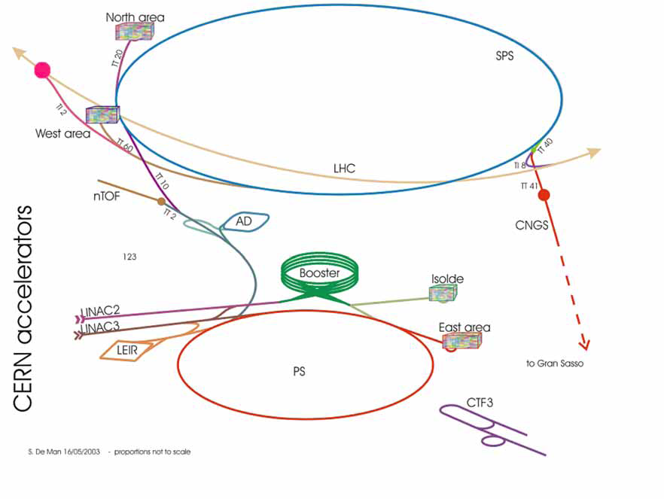

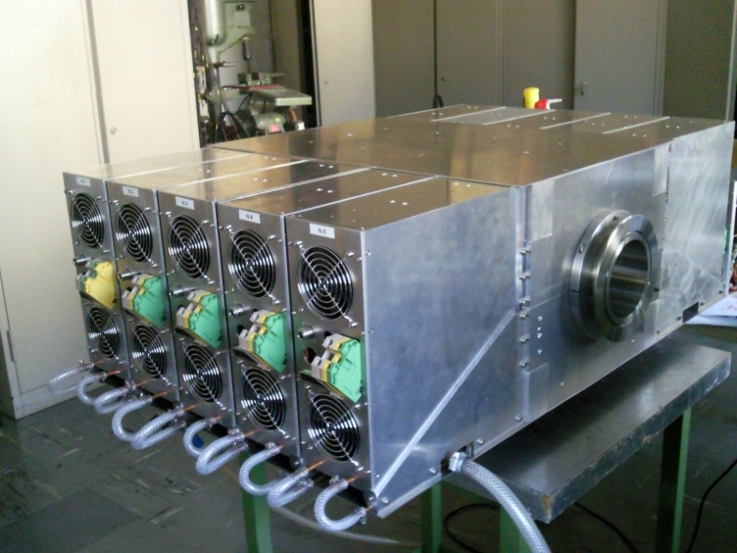
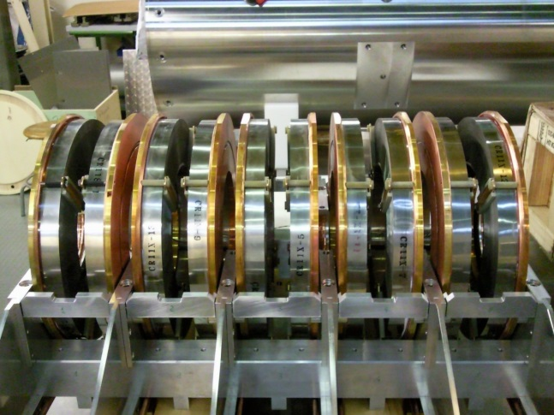
LHC Injector
LHC
ATLAS
SPS
PS booster
PS
LINAC4 （2018）
RF Amplifiers:
Possible KEK contributions
Magnetic alloys in the RF cavity. (developed at J-PARC)

Slide 11
EU-project and KEK
Questions from Frank Zimmerman:
- what does KEK think about these EU co-funded projects?
- what are the perceived advantages or drawbacks?
- are there legal issues?
- is the KEK participation in HiLumi an “accident” or could/will it repeat in future projects?
- outlook or wishes from KEK for future EU programmes?

Slide 12
EU-project and KEK
Questions from Frank Zimmerman:
Are there legal issues?
  No serious issues. If the project is still at the R&D stage and if the extra resource is not needed, KEK is very flexible.
  If a large resource is needed in the project, KEK needs to submit the request to our FA (MEXT) and it takes time.
  For example, we signed for HiLumi, LAGUNA-LBNO with the initiatives of the contacted researchers. But this does not mean that KEK is ready to contribute to the full project of HL-LHC (or LBN in Europe).

Slide 13
EU-project and KEK
Questions from Frank Zimmerman:
Is the KEK participation in HiLumi an “accident” or could/will it repeat in future projects?
It was easy to participate to HiLumi because we have been long working collaboration between CERN and KEK on the LHC.
If there is other good projects which attracts KEK people, it can happen.
But there is no direct connection to the funding in Japan to the EU-projects so either we need to collaborate with the existing resources or with a new funding request to the mext (which is not easy).

Slide 14
EU-project and KEK
Questions from Frank Zimmerman:
What does KEK think about these EU co-funded projects?
What are the perceived advantages or drawbacks?
  At this stage, there is no coherent strategy to react on the EU-projects. It heavily depends on individual researchers. There is no clear preference between KEK-EU collaboration and bi- or multi-lateral KEK-EU lab(s) collaboration.
  Situation may change if there is a Japanese fund linked to EU-programs. There is a EU-Japan science and technology agreement (started March 2011). Some discussions are going on.

Slide 15
EU-project and KEK
Questions from Frank Zimmerman:
Outlook or wishes from KEK for future EU programmes
  In general, the closer collaborations between world wide accelerator laboratories are more and more important for on-going and future accelerator R&Ds. KEK is willing to participate to the network.

Slide 16
Extra Slides
related to KEK activities

Slide 17
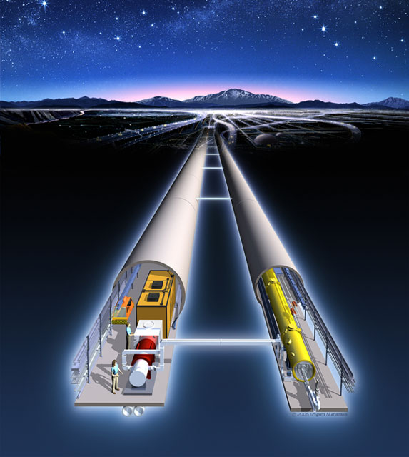
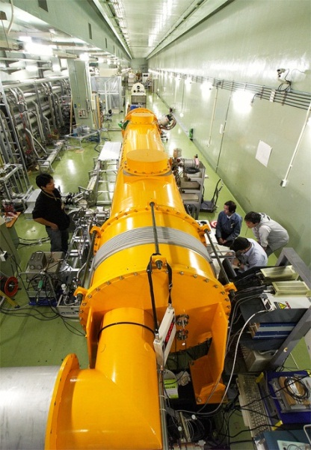
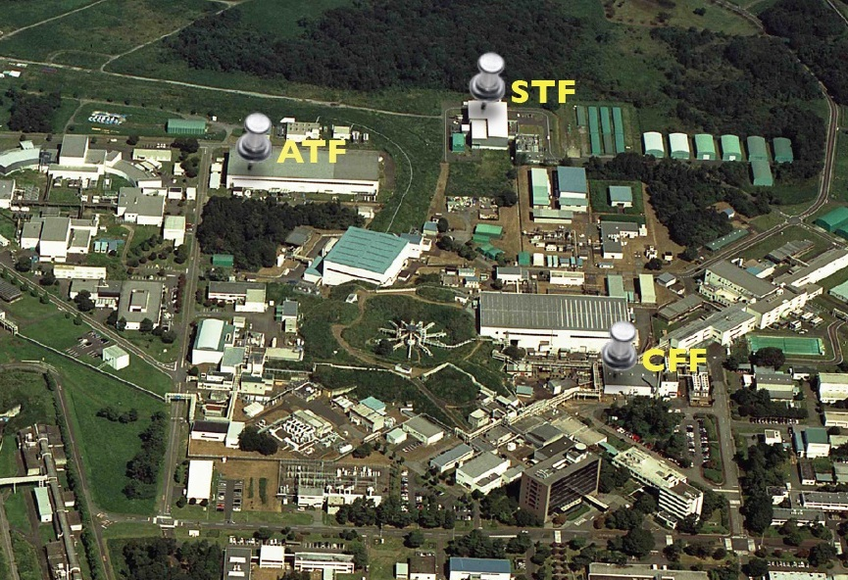
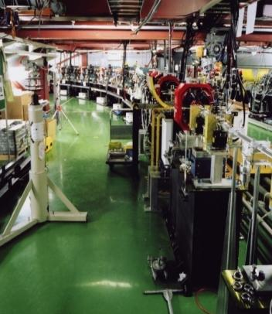
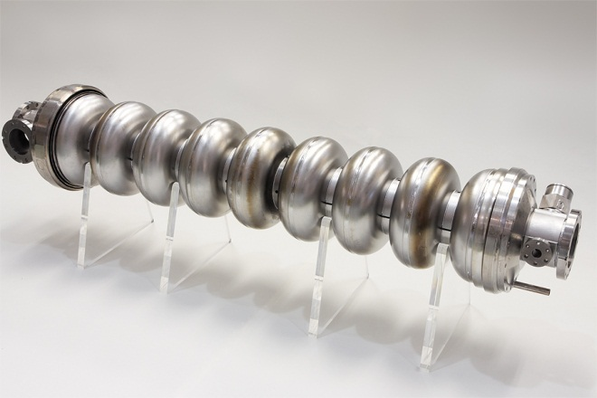
More on KEK activities.
ILC
Accelerator R&D:
Superconducting
linacTest Facility
Accelerator
Test Facility
Cryomodule
Fabrication
Facility

Slide 18
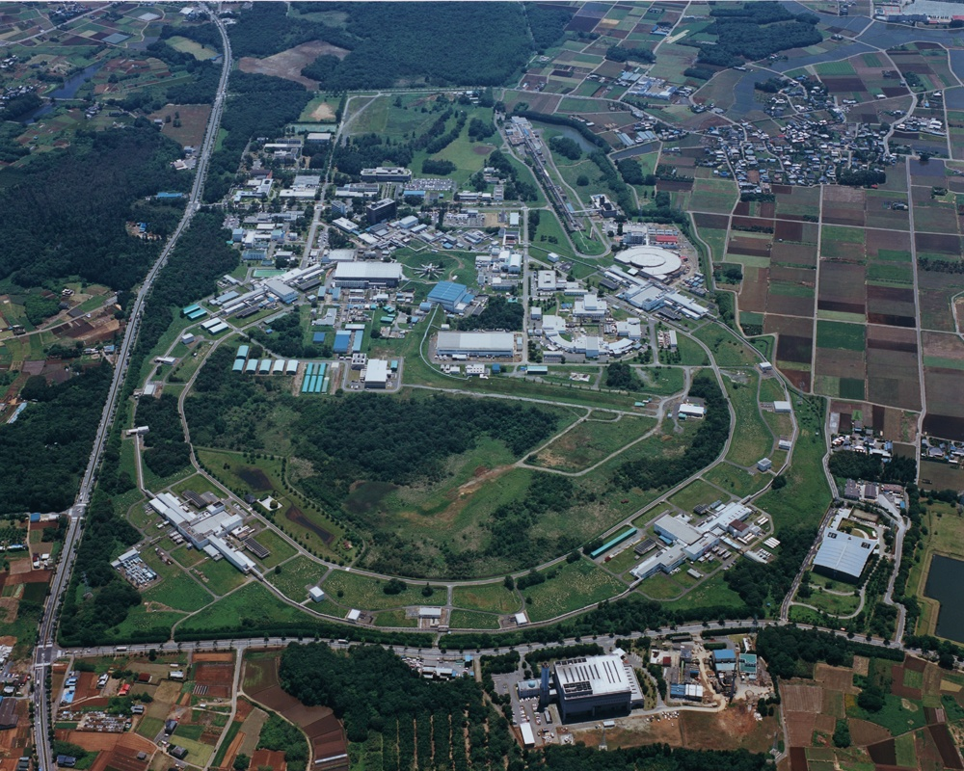
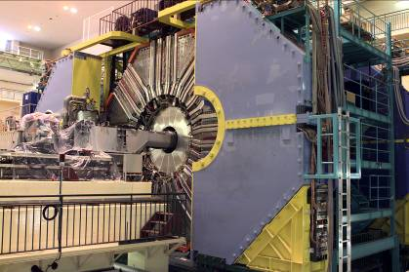
KEKB and Belle
SuperKEKB and Belle II

Slide 19
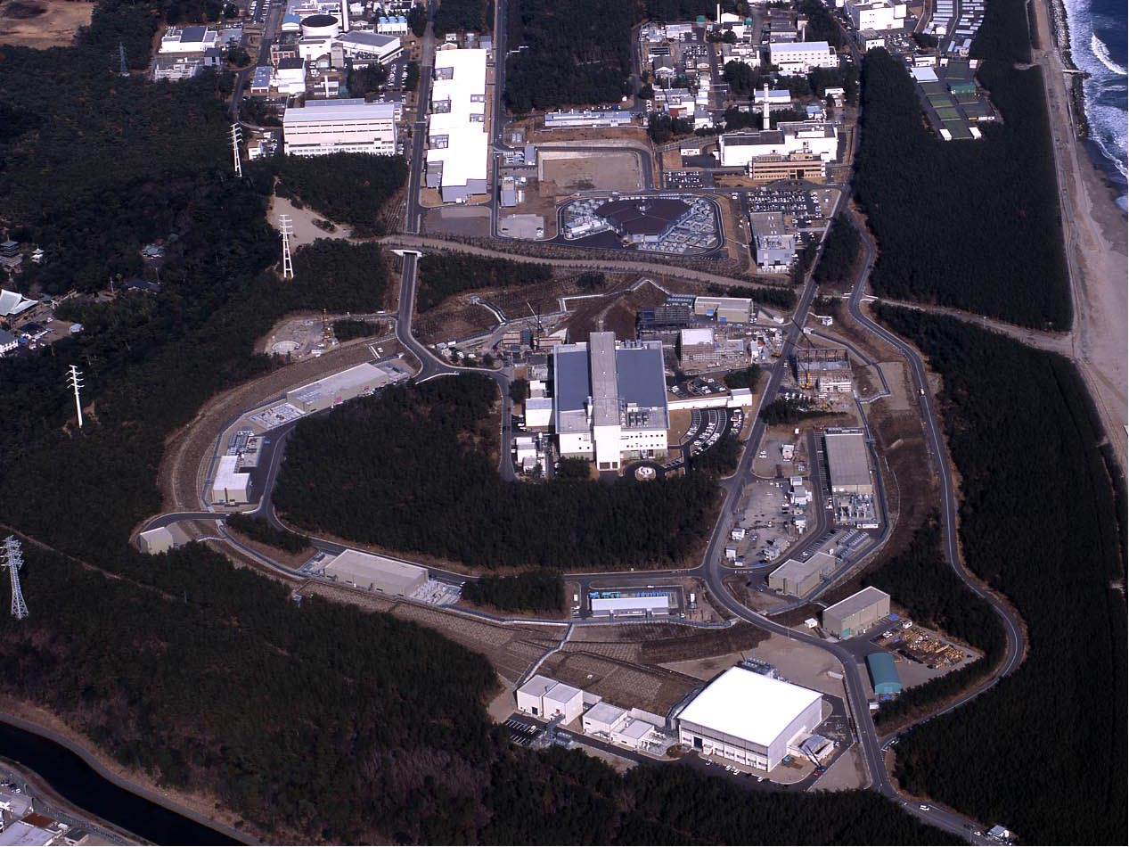
J-PARC
Joint project between KEK and JAEA
Linac
3 GeV Booster
Neutrino beam (to Kamioka)
30 GeV MR
Hadron exp. facility
Bird’s eye photo in January 2008
Notes:
The J-PARC consists of three accelerators and three experimental facilities.
●In calendar year of 2007 the linac and 3 GeV synchrotron were completed. ● Then, in fiscal year of 2008 the 50 GeV synchrotron and two experimental facilities, the materials and life experimental facility with neutron and muon beams, and the hadron experimental facility with primarily kaon beams were completed. ● Finally, in fiscal year of 2009, which is the last year, the neutrino facility to send the neutrino beams to Superkamiokande was completed.

Slide 20
J-PARC
Joint project between KEK and JAEA
On May 23, 2013, an accident took place in the Main Ring at the Japan Proton Accelerator Complex (J-PARC). What follows is our current understanding of the accident. A bunch of proton beam (2x10¹³ protons) hit the primary gold target in an anomalously short extraction (5ms instead of standard 2s). As a result, radioactivity escaped from the beam-line into the Hadron Experimental Facility (HEF) hall, and the persons working there were subjected to internal radiation exposure (0.1~1.7 mSv for 34 persons). In addition, due to the usage of ventilators, the radioactive particles in the air were brought out of the HEF hall, and caused a momentary increase of the environmental radiation level.
For the details on the accident ,
see http://j-parc.jp/en/topics/summary20130531.pdf
and http://j-parc.jp/en/topics/HDAccident20130531.pdf
Linac
3 GeV Booster
Neutrino beam (to Kamioka)
30 GeV MR
Hadron exp. facility
Bird’s eye photo in January 2008
Notes:
The J-PARC consists of three accelerators and three experimental facilities.
●In calendar year of 2007 the linac and 3 GeV synchrotron were completed. ● Then, in fiscal year of 2008 the 50 GeV synchrotron and two experimental facilities, the materials and life experimental facility with neutron and muon beams, and the hadron experimental facility with primarily kaon beams were completed. ● Finally, in fiscal year of 2009, which is the last year, the neutrino facility to send the neutrino beams to Superkamiokande was completed.

Slide 21
J-PARC
Joint project between KEK and JAEA
Linac
KEK is the institution that is primarily responsible for design, construction, operation and management of the HEF. We at KEK extend our sincere apologies to those who are concerned and affected in local, national and international communities. KEK will be making its all possible efforts in investigating the accident and in improving the safety-protection measures and practices, thereby restoring the confidence of all who have been supporting our scientific effort at our research facility in the past and in the future.
For the details on the accident ,
1see http://j-parc.jp/en/topics/summary20130531.pdf
and http://j-parc.jp/en/topics/HDAccident20130531.pdf
3 GeV Booster
Neutrino beam (to Kamioka)
30 GeV MR
Hadron exp. facility
Bird’s eye photo in January 2008
Notes:
The J-PARC consists of three accelerators and three experimental facilities.
●In calendar year of 2007 the linac and 3 GeV synchrotron were completed. ● Then, in fiscal year of 2008 the 50 GeV synchrotron and two experimental facilities, the materials and life experimental facility with neutron and muon beams, and the hadron experimental facility with primarily kaon beams were completed. ● Finally, in fiscal year of 2009, which is the last year, the neutrino facility to send the neutrino beams to Superkamiokande was completed.

