Slide 1




Ionisation Cooling Test Facility @ RAL
(ICTF@RAL)
Roy Preece
Particle Physics Department, STFC
EuCARD2 Kick off meeting, CERN, June 10th-14th, 2013

Slide 2
MICE and the ICTF
MICE = Muon Ionisation Cooling Experiment
Key step for feasibility of neutrino factory and µ-collider.
MICE is installed at the Ionisation Cooling Test Facility (ICTF) at STFC’s Rutherford Appleton Laboratory.
The ICTF comprises a specially developed target and beam-line at the ISIS proton synchrotron (800 MeV), and installations to supply radio-frequency (RF) and liquid hydrogen (LH2).
The beam-line provides µ, p, π, e at 100 MeV/c to 400 MeV/c. It has been operational for several years, though intensity continues to increase.
WP8 under EuCARD-2 supports access to the ICTF.

Slide 3
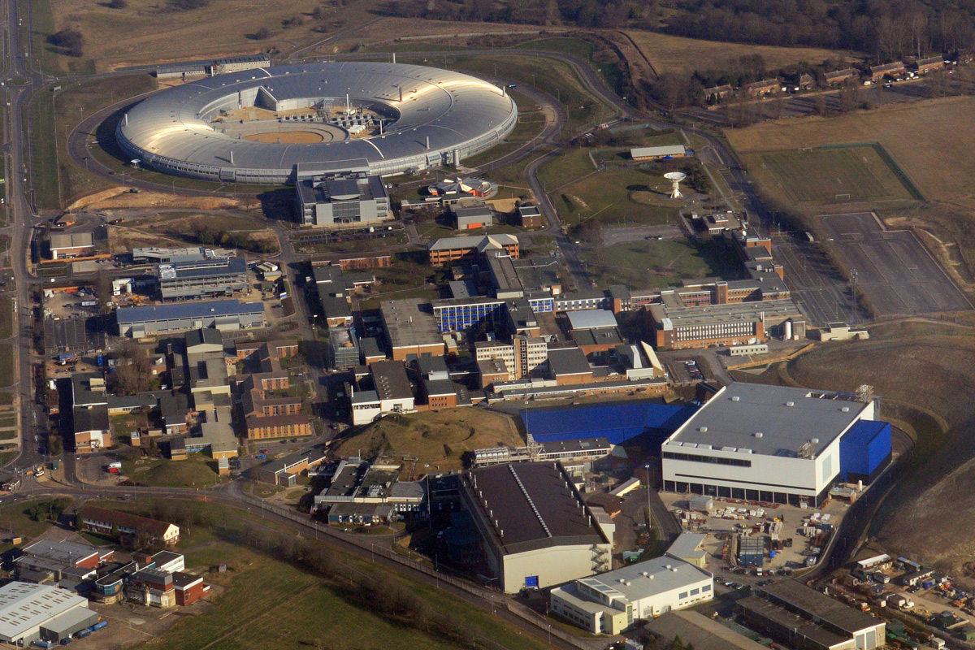
ISIS
MICE Hall
R5.2

Slide 4
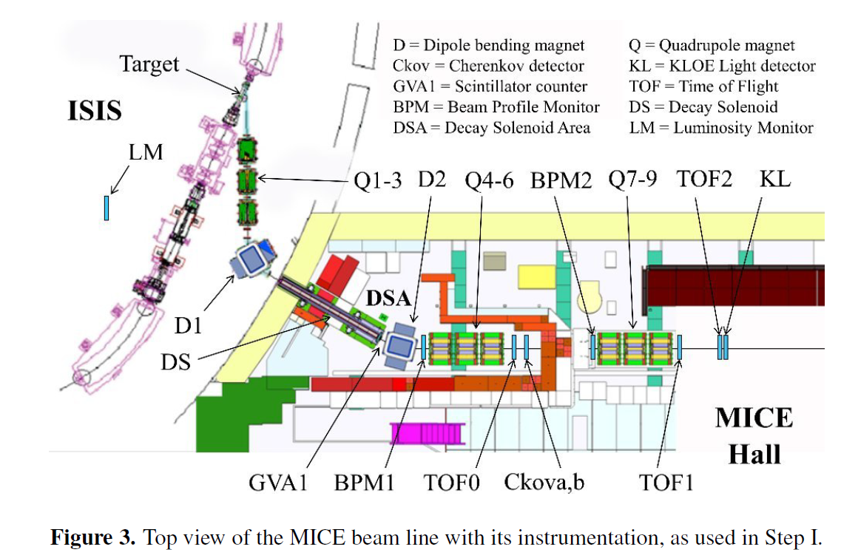
ICTF : Ionisation Cooling Test Facility Beamline

Slide 5



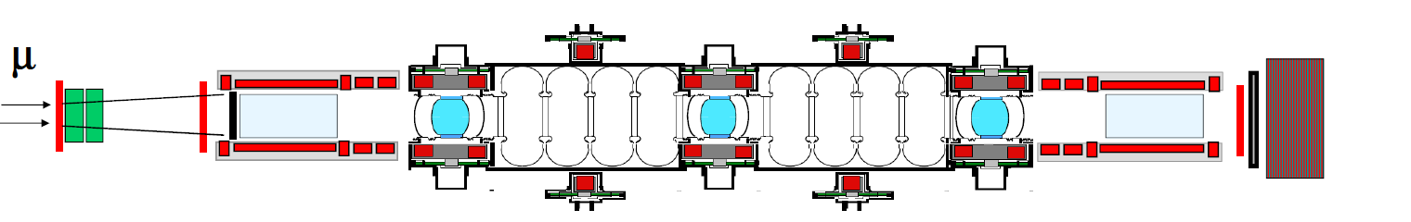







MICE Collaboration across the planet
Spectrometer Solenoid 1
Spectrometer Solenoid 2
Variable Diffuser
Focus coils
Coupling Coils 1&2
RF cavities
RF power
Beam PID, TOF 0, TOF 1
Cherenkovs
Downstream particle ID: TOF 2, KL, EMR
Liquid Hydrogen absorbers 1,2,3
Incoming muon beam
Trackers 1 & 2

Slide 6


MICE SCHEDULE update: May 2013
μ
STEP I
Planned EMR run October 2013
STEP IV
(Q2 2014,
no field)
Q1 2015
to Q1 2016
Under construction:
STEP VI
Possible Step V run Q4 2017
Step VI 2019

Slide 7
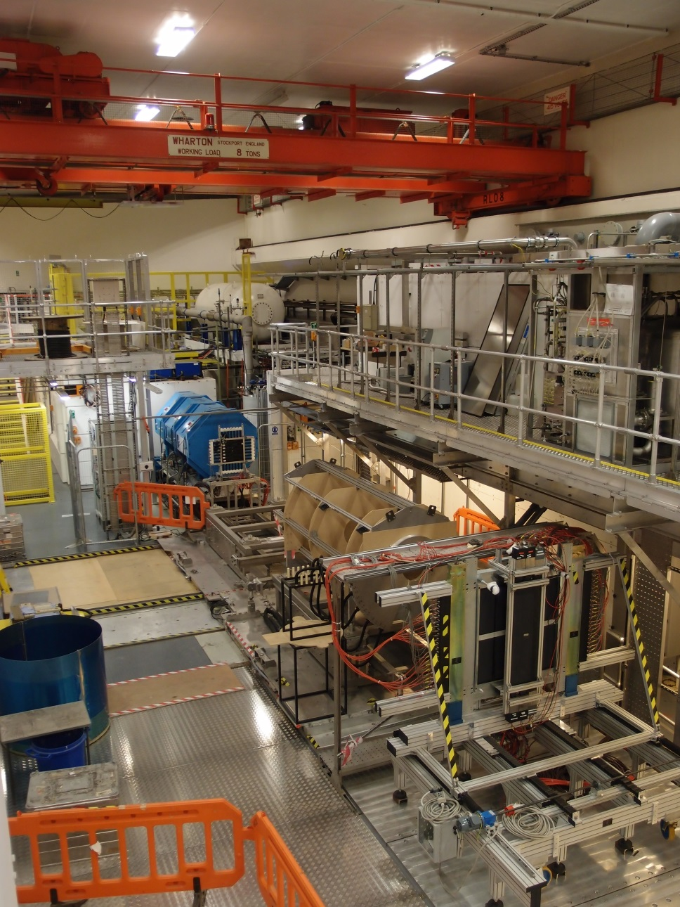
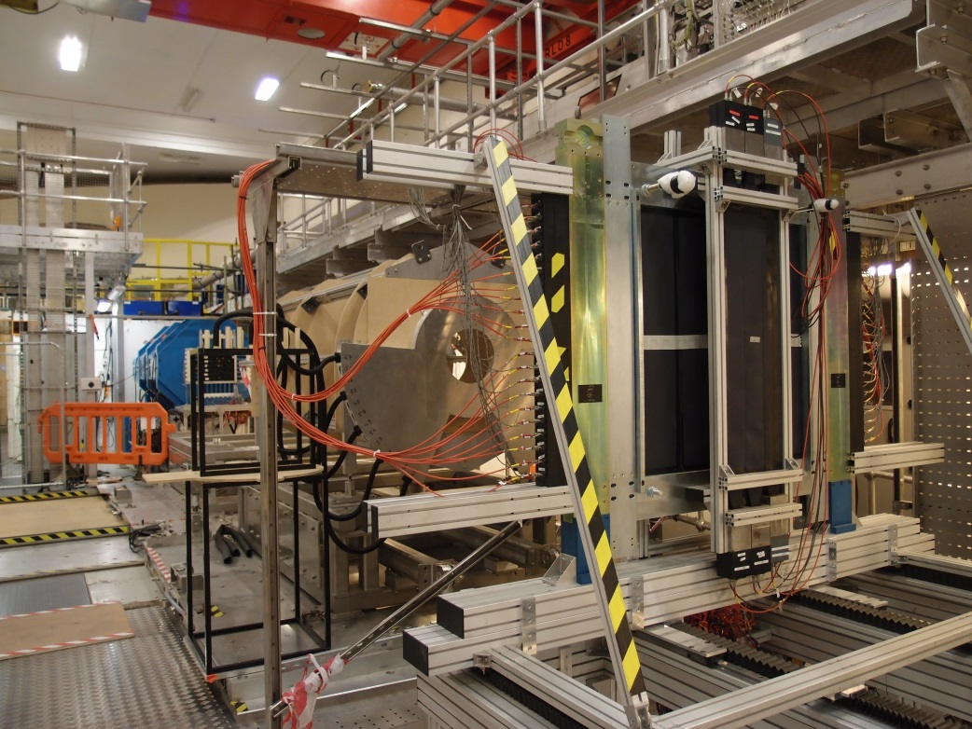
MICE Hall - June 2013

Slide 8
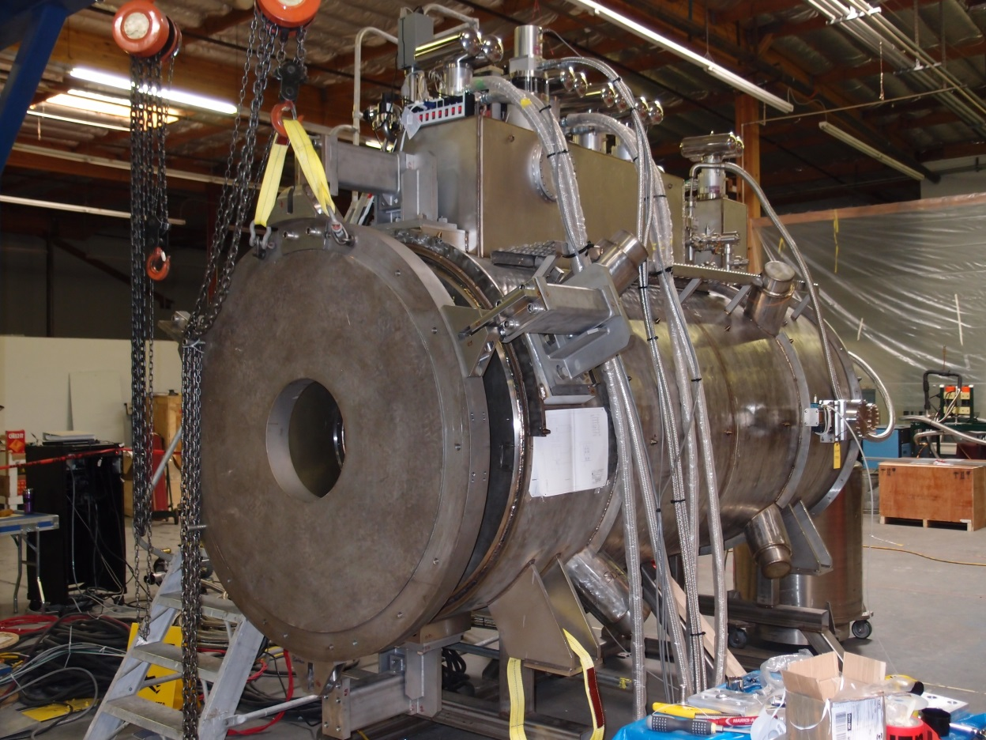
Magnets – Spectrometer Solenoids
First Magnet fully trained
Magnetic mapping team from CERN setting up the mapping equipment
Delivery to RAL end July 13
Second in final stages of build.
Delivery to RAL end of September 13

Slide 9
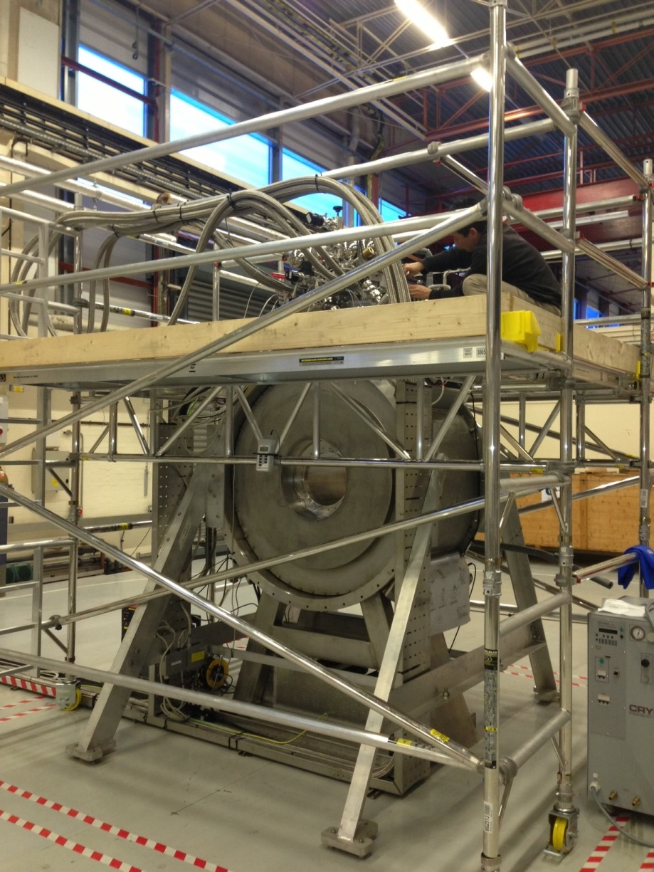
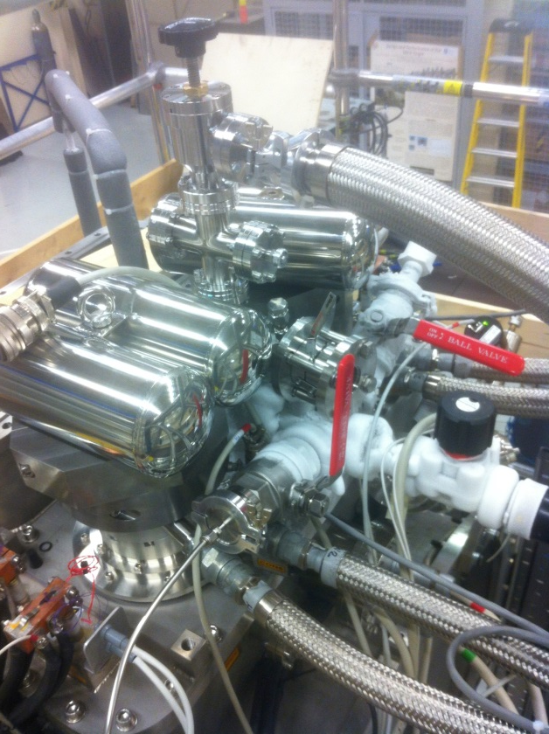
Magnets – Focus Coil
First Magnet at RAL and being trained
Second magnet scheduled for delivery early August

Slide 10
TA (WP8)
Transnational Access (TA) to the ICTF is a good fit to the EuCARD-2 aim of supporting the development of a European Research Area in accelerator science and strengthening collaboration among European partners.
TA provides financial support for travel and subsistence for “eligible researchers” (= at non-UK European institution)
The TA award to STFC is 199k€ (Euro), of which 154k€ is to be used for funding TA directly and the rest is a contribution to the management and associated costs of the scheme.
Scheme runs for 4 years starting 1 May 2013 ending March 2017.
TA funding is to be used and will support:
  “The presence at RAL of external users for equipment delivery, data taking, analysis, in support of Muon cooling experiments, including the MICE experiment.”
  “The presence at RAL of external users of the beam for tests of particle physics detectors in a low-energy beam.”
  “The presence at RAL of proponents of new cooling experiments to undertake studies, installations and eventually data taking.”

Slide 11
TA (WP8): application process
Applications are assessed by TA Panel: Ken Peach (Oxford, Chair), panel members Francesco Terranova (INFN) and Steve Geer (Fermilab), plus technical (MICE) and administrative (FP7) input as needed.
Panel works on cycle of two calls per year, advertised on the web pages of:
  EuCARD-2 (http://cern.ch/eucard2) – To be updated
  STFC (To be announced)
  MICE (http://mice.iit.edu) – To be updated
and email to Neutrino community.
EU has urged widest possible advertising of TA. So, for the “August” 2013 call, the Research Directors (or equivalent) at KEK, PSI and TRIUMF will emailed, and asked to advertise TA access to their user communities.
11

Slide 12
TA (WP8) in EuCARD-2
The TA programme has been, and will continue to be, extremely beneficial in supporting access to the ICTF at RAL, furthering excellent pan-European collaboration.
Without this TA support the access to ICTF would have been much more constrained, or, in some cases, not even possible.
During the next phase of the EuCARD the ICTF will be providing beam to a major MICE experimental milestone.
Exciting times with the first results of emittance reduction during the EuCARD-2 operational period.
12

