Slide 1

New Collimator Materials in EuCARD²
Adriana Rossi for the
ColMat-HDED collaboration

Slide 2
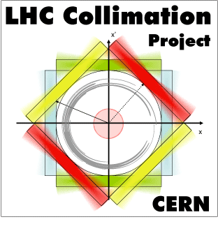
ColMat-HDED
(Collimator Materials for fast High Density Energy Deposition)
The collimators determine the LHC impedance
  Tight collimator settings (2012-13) necessary to improve cleaning performance limited beam lifetime.
The β* reach is determined by collimation constraints
  Retraction between beam dump and horizontal TCTs (BPM collimators) and TCT robustness.
  LHC challenges: 360MJ design ➔ 500MJ HiLumi and 1E16 p/y doses in IR7 (betatron cleaning)
Improve impedance and robustness
  State-of-the-art material and new design for secondary collimator jaws
  Improved robustness at critical locations (like tertiary collimators - close to experimental IRs)
Accelerator performance with ever increasing beam brightness and stored energies pushes material requirements for collimators into more challenging grounds.
Accidental energy deposition can be very fast (over a few nanoseconds) and with high density: peak energy densities of 15 GJ/mm² are now imaginable in the LHC beam, so even a small fraction of it would cause discontinuous change in the medium pressure, temperature and density.
Requirements on impedance are even more strict.
Notes:
Accelerators as for the CERN projects of LIU and HL-LHC, and other projects such as FAIR or future neutrino facilities.
Contesto
L’hc: challenges 500MJ + 10e16p/y in ir7 irradiation
In 2012-13 tight collimator setting (cleaning ineff 1E-5 in most cold apertures of LHC) required to reach smaller beta* caused shorter beam lifetime

Slide 3

ColMat-HDED
(Collimator Materials for fast High Density Energy Deposition)
Building upon the results of EuCARD and pushing them into a new and even more innovative regime, the collimation WP in EuCARD² will support progress with material developments for collimators and targets.
The new availability of irradiation facility such as HiRadMat (in 2012 at CERN) and M-branch (2011 in GSI), together with well-established irradiation facilities (Kurchatov), will allow to fully characterising promising candidate materials like metal-diamond and metal-graphite composites and new types of silicon carbide.
These studied have also a wide range of possible applications starting from thermal management for electronics, to nuclear industry, fusion research, and high temperature space applications.
Note complementarity with irradiation tests at BLN, different energies and additional materials tested (see A.Bertarelli presentation) within the USLARP program
Notes:
Accelerators as for the CERN projects of LIU and HL-LHC, and other projects such as FAIR or future neutrino facilities.

Slide 4

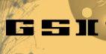









ColMat-HDED collaboration
(Collimator Materials for fast High Density Energy Deposition)
Main founding to Kurchatov lab. From CERN Collimation
Project

Slide 5
WP11 Objectives
Task 11.1. Coordination and Communication
(A. Rossi and J. Stadlmann)
  Define the global system taking inputs from different work-package (WP) tasks
  Coordinate and schedule WP tasks, to monitor work progress and inform the project management and WP participants
  Follow up the WP budget and use of resources
  Prepare internal and deliverable reports

Slide 6

WP11 Objectives
Task 11.2. Material testing for fast energy density deposition and high irradiation doses (A. Bertarelli)
The collimator robustness and integrity after impact is of great importance in a collimation system. Aim of this task is to review the best modern materials and to perform experimental tests on material robustness and mechanical behaviour.
  R&D focuses on Metal Matrix Composites (MMC) with Diamond or Graphite reinforcements as they have the potential to combine the properties of Diamond or Graphite (high k, low ρ and low CTE) with those of Metals (strength, γ , …).
  Perform experimental tests on material robustness and mechanical behaviour after highly energetic beam impact and high thermal stresses measuring heating and shock waves.
  Perform irradiation and characterisation of property changes of collimator materials.
Notes:
Make a distinction of what does who, why it is complementary to have different sources.

Slide 7


Material sintering, some examples
Cu-CD composite
Mo-CD composite
Mo-Gr/Mo sandwich
Mo-Gr composite
Courtesy of A. Bertarelli
Notes:
Mo-Gr with c oating C (per ridurre impedenza)

Slide 8
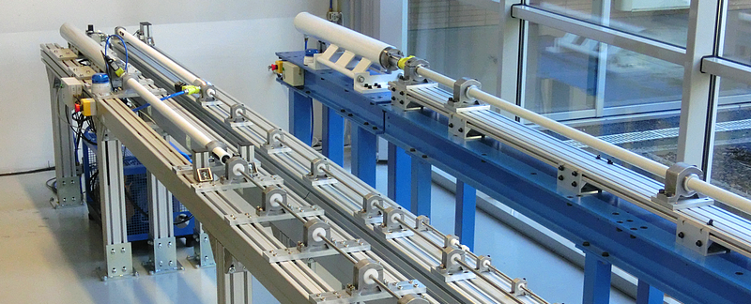
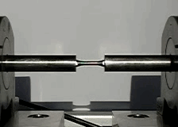
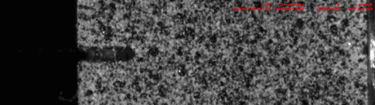
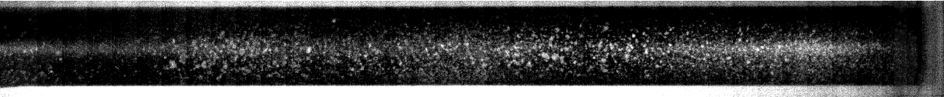
Material testing, some examples
Tension
GasGun (taylor test, flyer plate)
Compression/
bending
Ultra high speed
Dynamic tensile test
Dynamic fracture test
High speed spalling test (for brittle material)
Courtesy of M. Scapin and L. Peroni

Slide 9
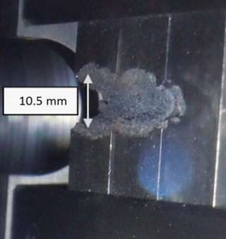
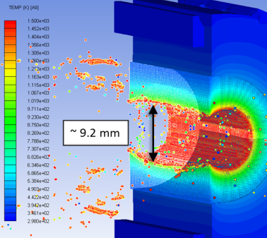
Material testing, some examples
HiRadMat tests show that an acoustic monitoring of collimator sections in the LHC is a promising tool for post-mortem analysis of beam induced
damage in solid
materials.
Post-mortem observation of Inermet® 180 samples and simulated after irradiation in HiRadMat at 440GeV (A. Bertarelli IPAC’13)
Notes:
HiRadMat tests show that an acoustic monitoring of collimator sections in the LHC is a promising tool for post-mortem analysis of beam induced damage in solid materials.

Slide 10
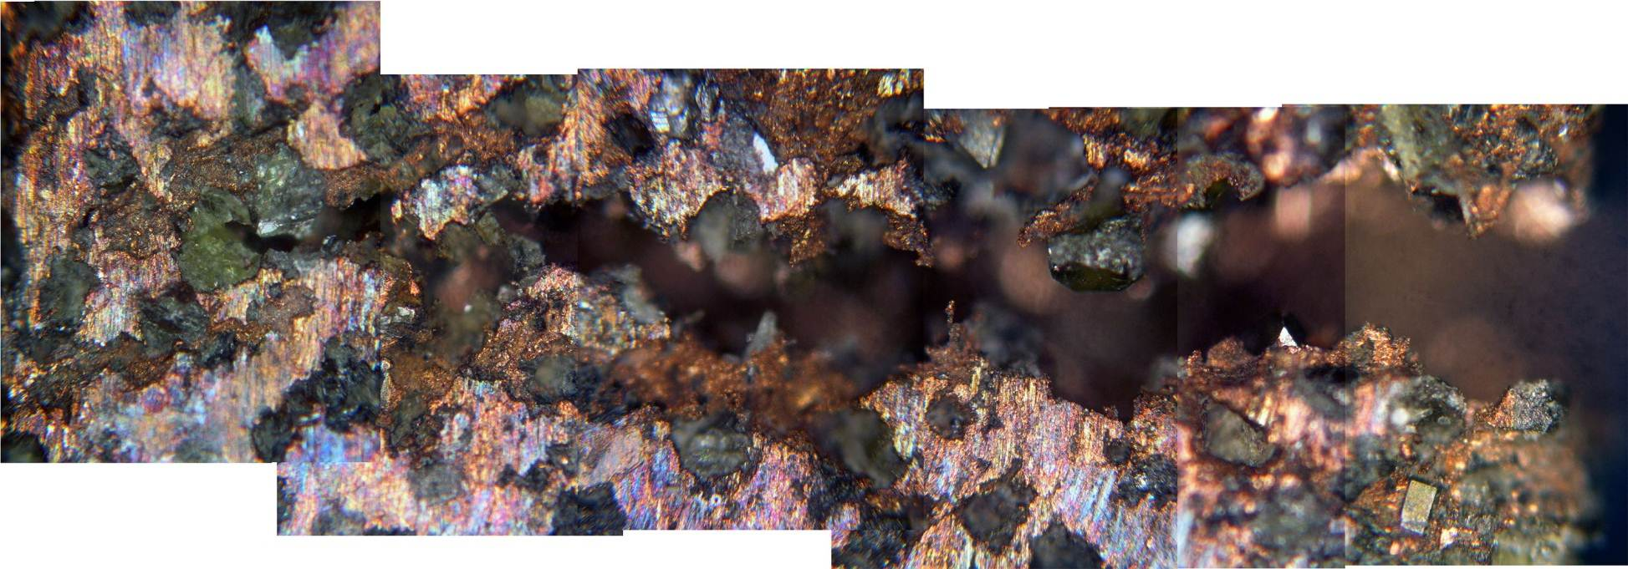
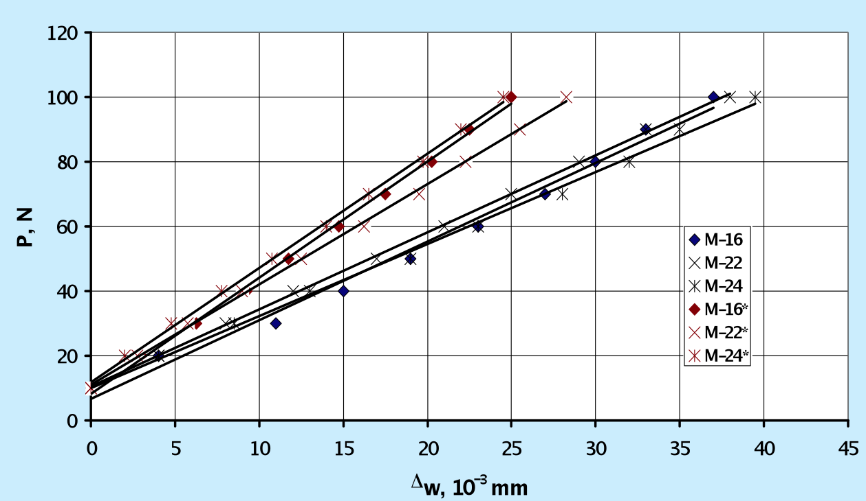
Material testing, some examples
After
irradiation
Before
irradiation
Cracks in Cu-D material after 30 MeV proton beam irradiation
Deformation curves for unirradiated and 30 MeV proton irradiated Cu-D , fluence Ф =10¹⁷p/cm²
Courtesy of A. Ryazanov
Notes:
HiRadMat tests show that an acoustic monitoring of collimator sections in the LHC is a promising tool for post-mortem analysis of beam induced damage in solid materials.

Slide 11
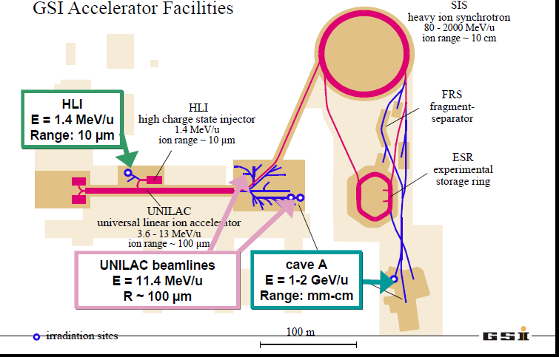
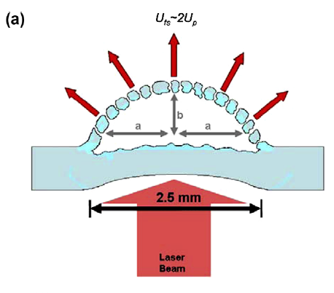
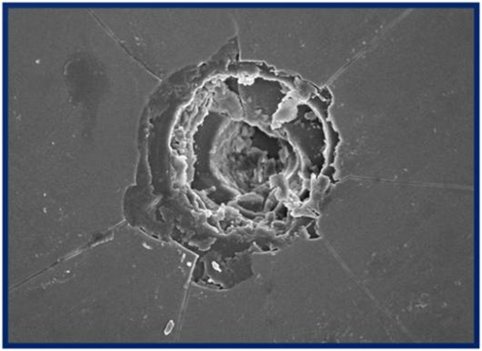
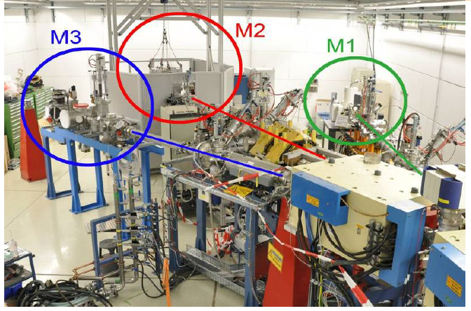
Material testing,
some examples
Material irradiation at M-branch – UNILAC GSI
  Energies close to Bragg peak to maximize energy deposition and damage and to avoid activation
  Online and in-situ monitoring available: video camera, fast IR camera, SEM, XRD, IR spectroscopy
  Characterisation of mechanical properties degradation as a function of dose using nano-indentation: hardness, Young modulus, impact resistance, fatigue behaviour, creep- material response to fast extracted ion beam
  Spall strength studies of different materials in ultrafast experiment using the the Petawatt laser at GSI
Jarmakani H et al. , Acta Mater (2010)
Courtesy of M. Tomut

Slide 12
WP11 Objectives
Task 11.3. Material mechanical modelling (A. Bertarelli)
Theoretical modelling of new materials and composites, the calculation of energy deposition following accidents and the modelling of shock-induced and radiation damage.
  Model and theoretically characterize new materials and composites for collimation, and provide parameters for stress analysis.
  Model energy deposition and shock-induced damage following abnormal beam loss events.
  Model radiation damage.
  Compare results with experimental data.
Notes:
CERN, GSI, POLITO, RHP, RRC KI, UM

Slide 13
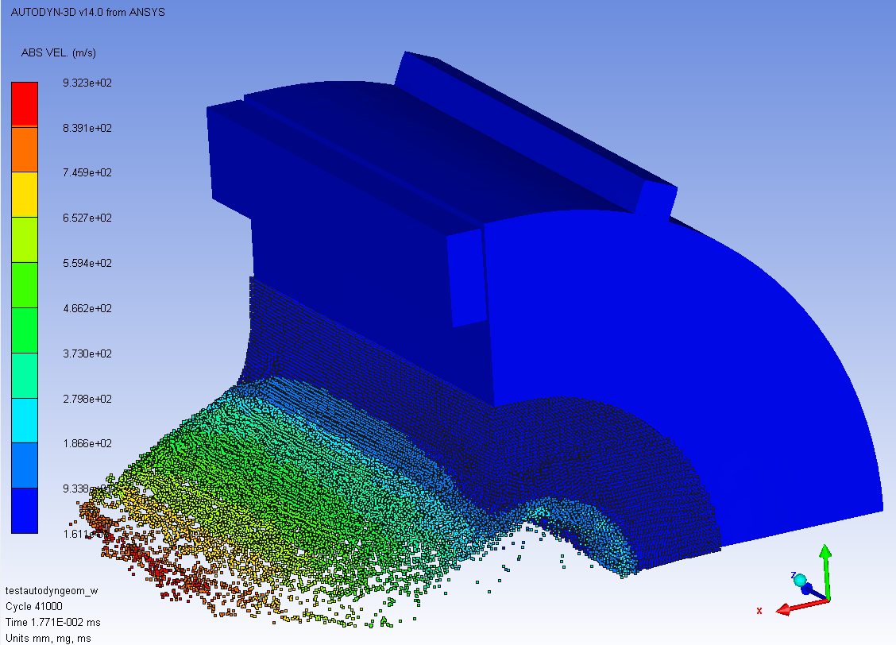
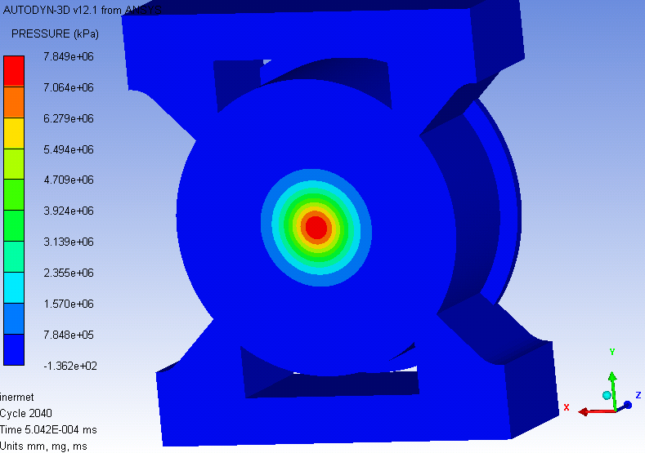
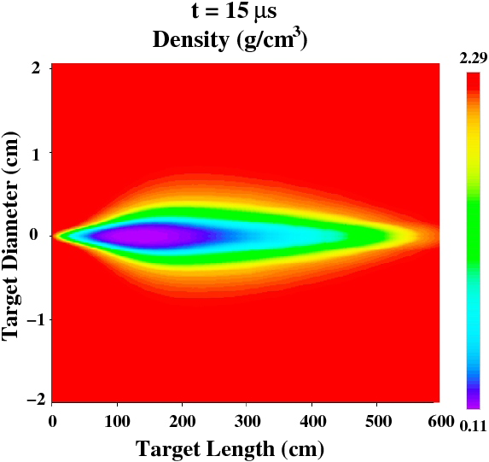
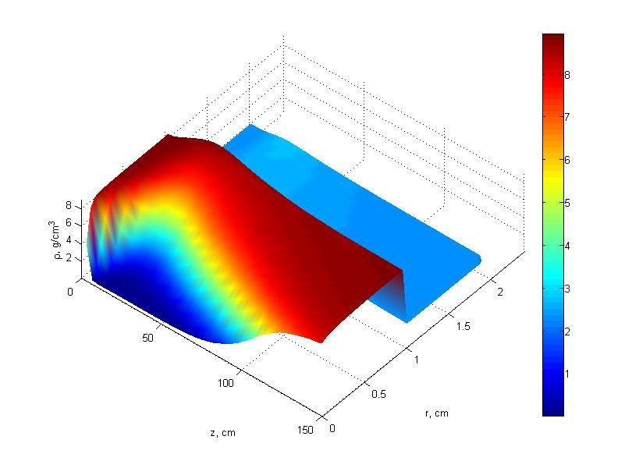
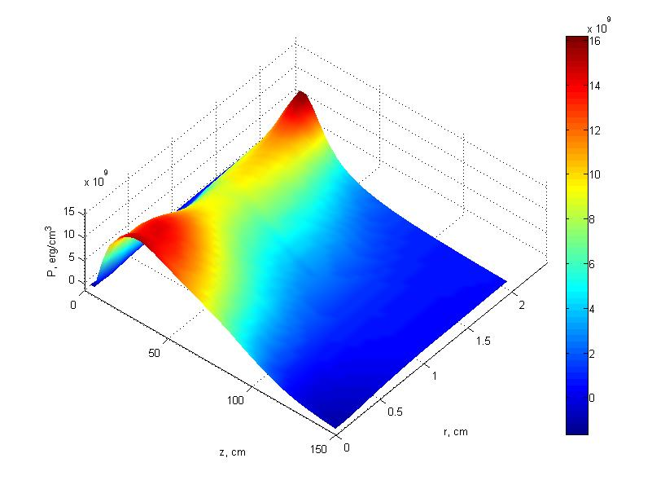
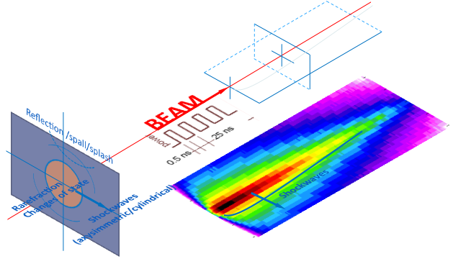
Examples of mechanical modelling
Extensive Complex Calculations of Beam-induced Shockwaves with advanced non-linear tools (Hydrocodes – Autodyn)
SPH (Smooth Particle
Hydrodynamics) material fragmentation and particle projection, material density changes
Modelling of shock wave formation in assembled Cu - D materials (“sandwich structures”) at 450 GeV proton beam 600 bunches (15 000ns)); wave reflection (boundary conditions)
Energy loss code FLUKA and 2D hydro
code Big2 are run iteratively using a step
of 2.5 s to include hydrodynamic tunneling.
N.A. Tahir et al., PRSTAB 15 (2012) 051003
density
stress
Courtesy of A. Bertarelli
and L. Peroni
600 bunches
boundary conditions
600 bunches
boundary conditions
C
C
Cu
Cu
Couple FLUKA and Hydrocodes (LS-Dyna) to study effects of changing density during beam impact (tunnelling effect)
Notes:
CERN, GSI, POLITO, RHP, RRC KI, UM

Slide 14
WP11 Objectives
Task 11.4. Material specification (A. Rossi)
The increasing beam intensity in accelerators requires ever better cleaning efficiency, and lower collimator impedance. Aim of this task is to evaluate the potential, advantages and disadvantages of materials and report on comparative assessment of beam simulation codes
  Simulate the potential of new collimator materials like silicon carbide and metal-diamond compounds for collimation of hadron beams and iterate on material specifications to address the needs of future accelerator developments.
Notes:
Scattering routine FLUKA- Merlin-SixTrack presente e futuri materiali
Absorber after crystals

Slide 15
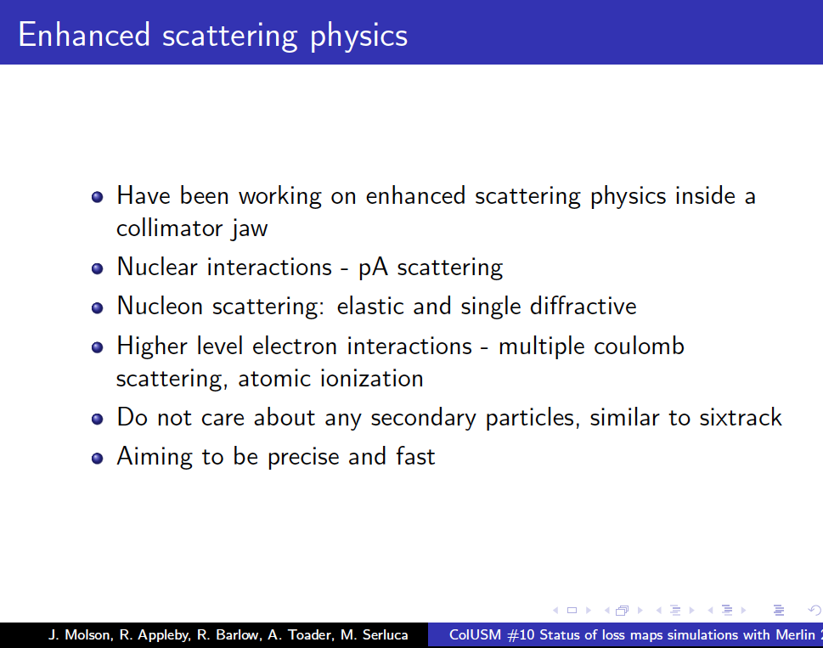
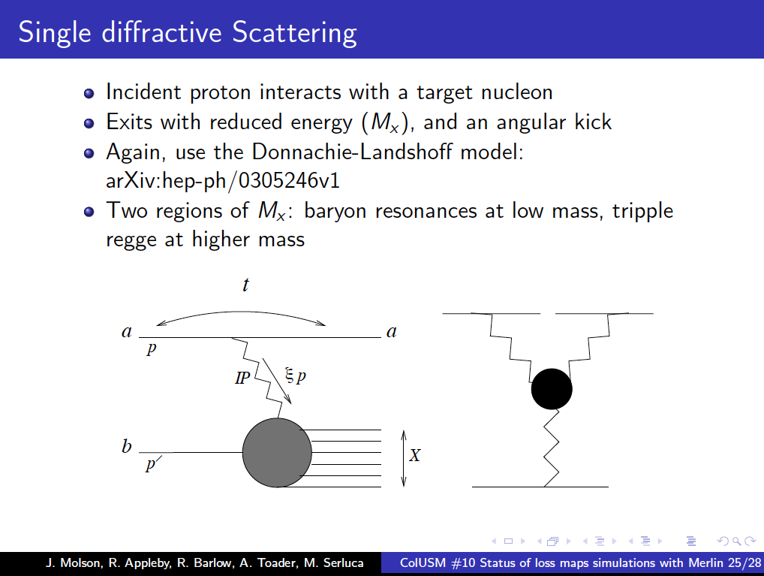
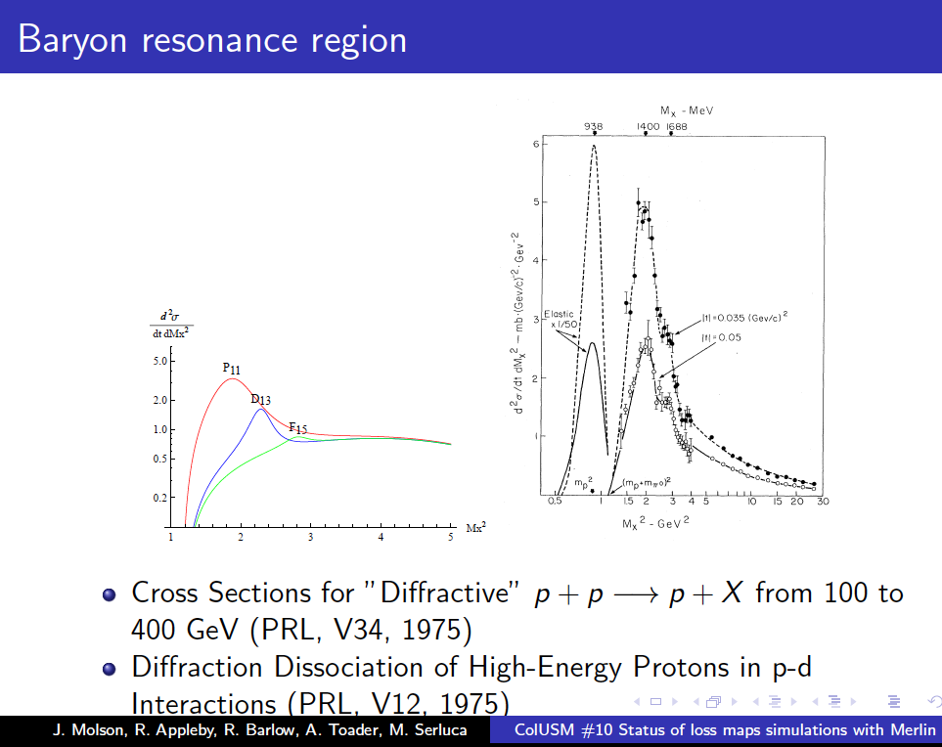
Examples of material spec
SixTrack used for collimations studies have proton scattering in various collimator materials:
  Multiple Coulomb scattering,
  Ionization of the collimator material,
  Elastic proton-proton (pp) scattering,
  Inelastic diffractive pp scattering (single diffractive scattering),
  Inelastic proton-nucleon scattering,
  Elastic and inelastic proton-nucleus scattering,
  Rutherford scattering.
MERLIN
Notes:
Scattering routine FLUKA- Merlin-SixTrack presente e futuri materiali
Absorber after crystals

Slide 16
Examples of material spec
SixTrack – Merlin – FLUKA are being compared
New material cross sections have to be implemented: not easy for composite
Simulations to design absorbers behind crystals
Notes:
Scattering routine FLUKA- Merlin-SixTrack presente e futuri materiali
Absorber after crystals

Slide 17
WP11 Deliverables
ColMat-HDED web pages published: Online resources for ColMat-HDED will be continuously updated to provide the collimator community with information such as relevant events and publications (Task 11.1) [month 6]
Results on simulations of new materials and composites: Calculation of energy deposition and modelling of shock-induced and radiation damage following beam losses in new materials
(Task 11.3) [month 40]
Report on comparative assessment of beam simulation codes
(Task 11.4) [month 40]
Irradiation test results: Beam impact on new material and composite (Task 11.2) [month 48]
Results on characterisation of new materials and composites: Produce new materials and measurements mechanical characteristics (Task 11.3) [month 48]

Slide 18
THANK YOU FOR YOUR ATTENTION

