Slide 1
EucARD Annual Meeting
11 June 2013, CERN
WP10 - SRF
“SC RF technology for higher intensity proton accelerators & higher energy electron linacs”

Slide 2
WP10-SRF Task ‘Patchwork’

Slide 3

















WP10-SRF Fifteen Institutes
IN2P3
Les deux infinis
Krakow
Swierk

Slide 4
Pushing Accelerator Performance Barriers
R&D is needed to advance the Superconducting RF Technology for Accelerator applications
High Gradient barrier (ILC, SPL, ESS, etc…) → Task 10.2, 10.4
High Q0 barrier (efficiency, duty cycle) → Task 10.4
High RF Power barrier (HPPAs) → Task 10.2, 10.8
High Stability and Reliability barriers (ILC, XFEL, ADS) → Task 10.5, 10.6
Low Beta barrier (e.g. Spiral2 β=0.07) → Task 10.4
Industrialization and cost barrier (ILC) → Task 10.8
New Applications barrier:
  Crab cavities (LHC, ILC) → Task 10.3
  SC-RF Gun (electrons) → Task 10.4, 10.7
  Energy Recovery Linac (ALICE, BERLinPro) → Task 10.5, 10.7

Slide 5
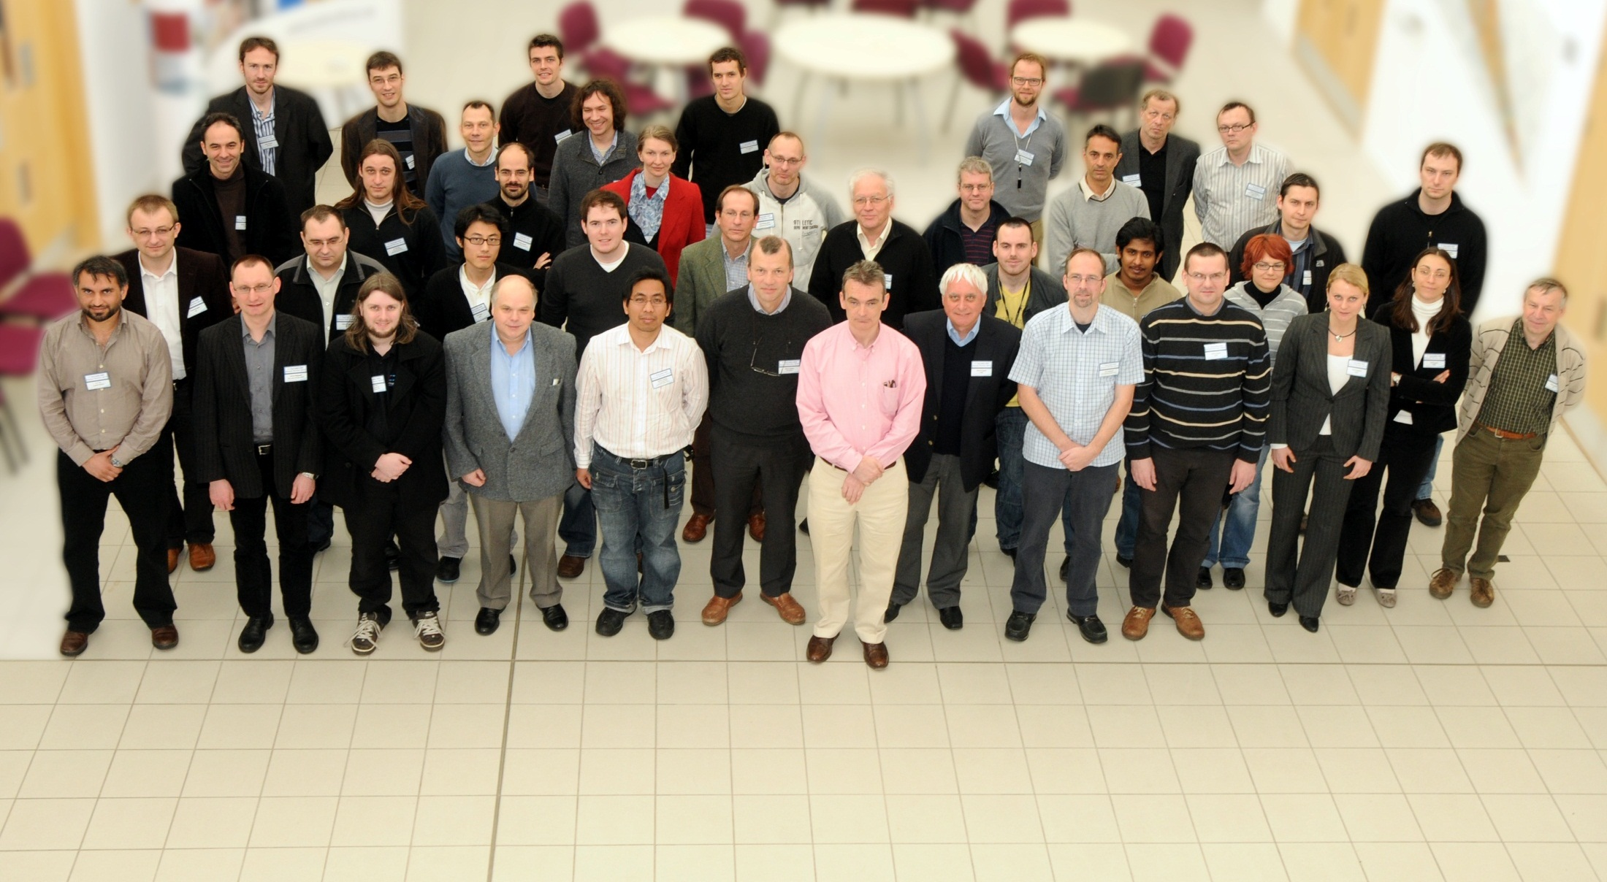
WP10-SRF 1st Annual Review
7-9 April 2010, Cockcroft Institute, Daresbury
45 Participants = 47 Registrants – 2 Visa Problems (@ LAL and FZD)
14/15 Partner Institutes represented
https://espace.cern.ch/EuCARD/AnnualMeeting2010/default.aspx

Slide 6
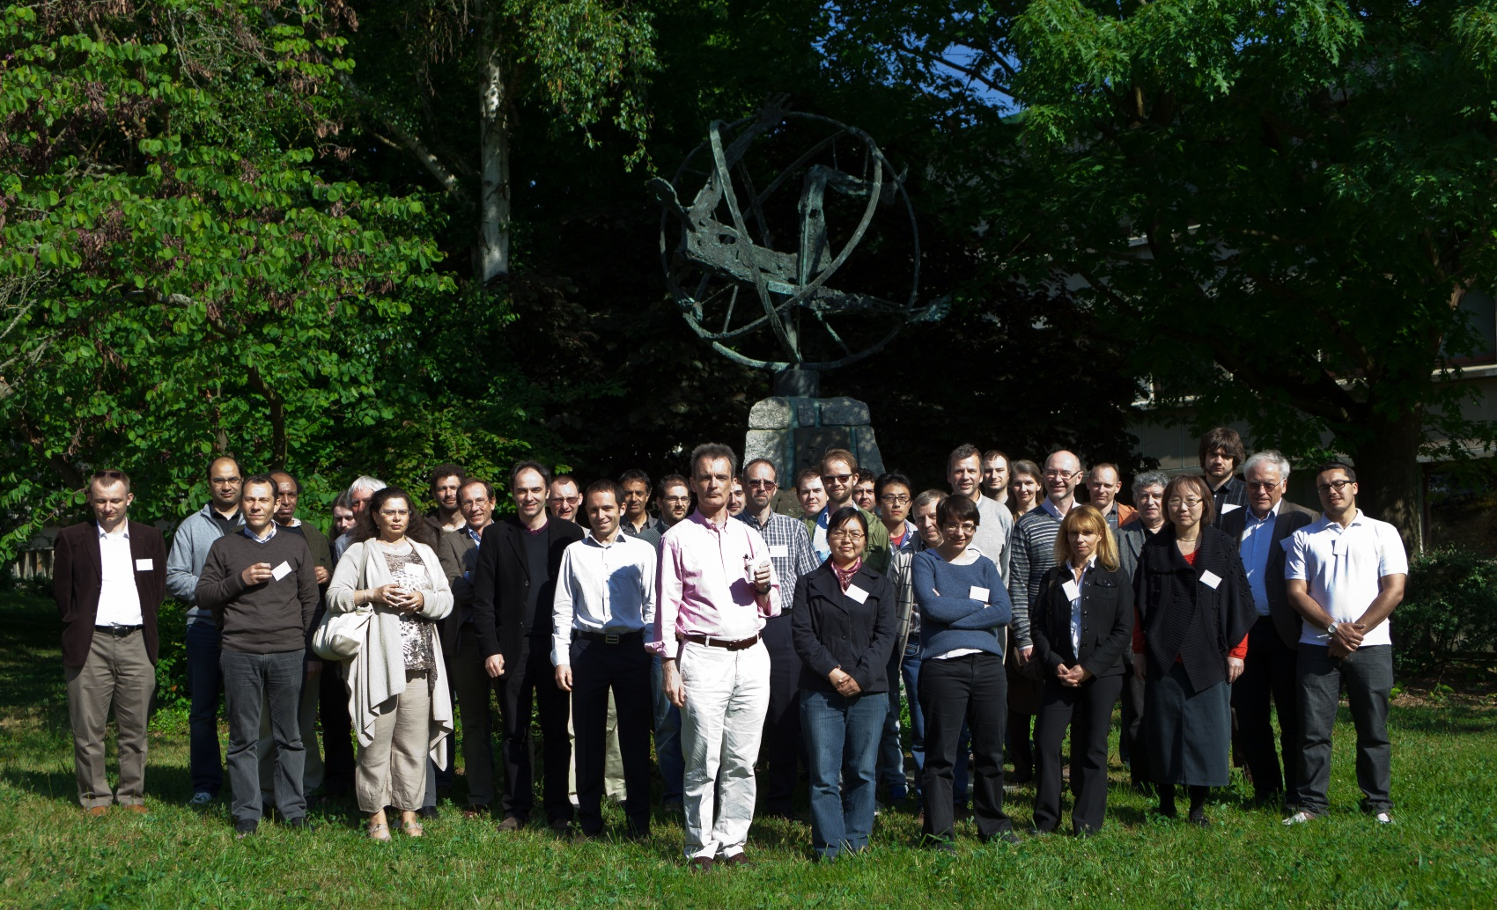
WP10-SRF 2nd Annual Review
4-5 May 2011, IN2P3 – Inst. Phys. Nucl. Orsay
42 Participants, including the 2 Coordinators + 7 Task Leaders
14/15 Partner Institutes represented
http://indico.cern.ch/internalPage.py?pageId=7&confId=115634

Slide 7
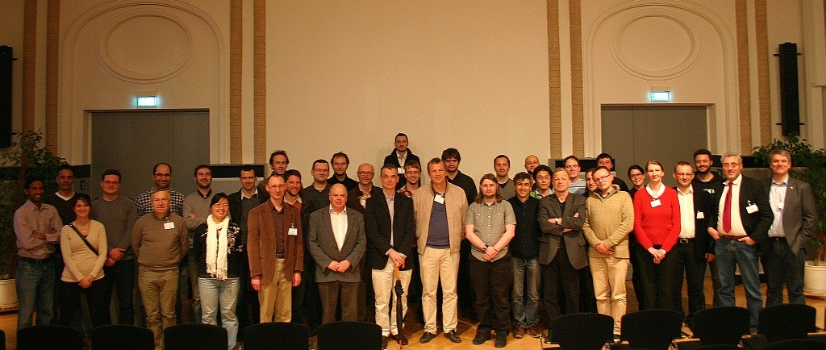

WP10-SRF 3rd Annual Review
29-30 March 2012, HZB, Berlin
45 Participants, including the 2 Coordinators + 6 Task Leaders (1 excused)
13/15 Partner Institutes represented
http://www.bessy.de/indico/conferenceDisplay.py?confId=380

Slide 8
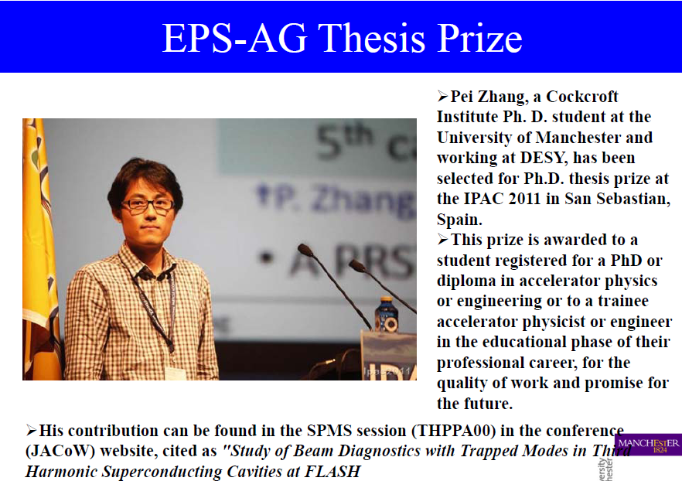
WP10-SRF PhD Students
Ben Hall, Lancaster University T10.3
Ben Woolley, Lancaster University T10.3
Pei Zhang, Manchester University, working at DESY T10.5
Thomas Fligsen, Rostock University T10.5
Nawin Juntong, Manchester University T10.5
Chris Glasman, Manchester University T10.5
Jeniffa Rudolph, HZ Berlin, working partly at Rossendorf T10.7
André Arnold, HZD Rossendorf T10.7

Slide 9
WP10.1: Coordination and Communication
Deliverable:
Proposal to link to TTC Infrastructure database under construction
+ Database on SRF Accelerators in Europe, linked to the TTC server.

Slide 10
Name | Particles | # cavities |  | Type | Material | Gradient | Mode | T | Status | Location
HERA | electrons, positrons | 16 | 500 MHz | β=1 elliptical 4-cell | Nb | 4.0 MV/m | CW | 4.2 K | de-commissioned | DESY
LEP200 | electrons, positrons | 16 272 | 352 MHz | β=1 elliptical 4-cell | Nb Nb/Cu | 5 MV/m 7 MV/m | CW | 4.5 K | de-commissioned | CERN
LISA | electrons | 4 | 500 MHz | β=1 elliptical 4-cell | Nb | 6 MV/m | pulsed | 4.2 K | de-commissioned | LN Frascati
MACSE | electrons | 5 | 1.5 GHz | β=1 elliptical 5-cell | Nb | 10 MV/m | CW | 1.8 K | de-commissioned | CEA-Saclay
Tandem PA | ions | 16 34 | 81 MHz 135 MHz | β=0.085 helix λ/2 β=0.085 helix λ | Nb | 2.2 MV/m | CW | 4.2 K | de-commissioned | CEA-Saclay
Tandem PA | ions |  |  |  |  |  |  |  | de-commissioned | Daresbury
ALICE | electrons | 2 2 | 1.3 GHz | β=1 elliptical 9-cell β=1 elliptical 9-cell | Nb | 3-5 MV/m 13.5 MV/m | pulsed | 2 K | operation | Daresbury
ALPI | ions | 2 12 50 58 | 80 MHz 80 MHz 160 MHz 160 MHz | β=0.0255 RFQ β=0.055 QW β=0.13 QW β=0.13 QW | Nb Nb Pb/Cu Nb/Cu | 2-3 MV/m 4 MV/m 2.7 MV/m 4.8 MV/m | CW | 4.5 K | operation de-commissioned | LN Legnaro
DIAMOND | electrons | 2 | 500 MHz | β=1 elliptical 1-cell | Nb | 6.5 MV/m | CW | 4.5 K | operation | Oxford
ELBE | electrons | 1 4 | 1.3 GHz | β=1 elliptical 3½-cell β=1 elliptical 9-cell | Nb | 8 MV/m 9 MV/m | CW | 2 K | operation | HZDR
ELETTRA | electrons | 1 | 1.5 GHz | β=1 elliptical 2-cell | Nb | 5 MV/m | CW | 4.5 K | operation | Trieste
FLASH | electrons | 56 4 | 1.3 GHz 3.9 GHz | β=1 elliptical 9-cell | Nb | 20-30 MV/m 14.5 MV/m | pulsed | 2 K | operation | DESY
ISOLDE | ions | 12 20 | 101 MHz | β=0.063 QW β=0.103 QW | Nb/Cu | 6 MV/m | CW | 4.5 K | operation | CERN
LHC | protons, ions | 16 | 400 MHz | β=1 elliptical 1-cell | Nb/Cu | 6 MV/m | CW | 4.5 K | operation | CERN
S-DALINAC | electrons | 1 1 10 | 3 GHz | β=0.85 elliptical 2-cell β=1 elliptical 5-cell β=1 elliptical 20-cell | Nb | 5 MV/m 5 MV/m 5 MV/m | CW | 2 K | operation | Darmstadt
SLS | electrons | 1 | 1.5 GHz | β=1 elliptical 2-cell | Nb | 5 MV/m | CW | 4.5 K | operation | PSI
SOLEIL | electrons | 4 | 352 MHz | β=1 elliptical 1-cell | Nb/Cu | 6 MV/m | CW | 4.2 K | operation | SOLEIL
BERLinPro | electrons | 1 3 3 | 1.3 GHz | β=1 elliptical 1½-cell β=1 elliptical 2-cell β=1 elliptical 7-cell | Nb | 20 MV/m 18 MV/m | CW | 2 K | construction | HZB
E-XFEL | electrons | 808 8 | 1.3 GHz 3.9 GHz | β=1 elliptical 9-cell | Nb | 24 MV/m 15 MV/m | pulsed | 2 K | construction | Hamburg
IFMIF-EVEDA | D+ | 8 | 175 MHz | β=0.094 HW | Nb | 4.5 MV/m | CW | 4.5 K | construction | Rokkasho
SPIRAL2 | D+, ions A/Q = 3 | 12 14 | 88 MHz | β=0.07 QW β=0.12 QW | Nb | 6.5 MV/m 6.5 MV/m | CW | 4.2 K | construction | GANIL
ESS | protons | 28 64 112 | 352 MHz 704 MHz 704 MHz | β=0.5 double spoke β=0.7 elliptical 5-cell β=0.9 elliptical 5-cell | Nb | 8 MV/m 15.5 MV/m 18.2 MV/m | pulsed | 4.5 K | design | Lund
EURISOL Driver | protons, deutons, H-, 3He2+ | 16 56 36 45 40 24 | 176 MHz 176 MHz 352 MHz 704 MHz 704 MHz 704 MHz | β=0.09 HW β=0.15 HW β=0.3 triple spoke β=0.47 elliptical 5-cell β=0.65 elliptical 5-cell β=0.76 elliptical 5-cell | Nb | 4.7 MV/m 5.2 MV/m 5.8 MV/m 12 MV/m 15 MV/m 18 MV/m | CW | 2 K | design | -
EURISOL PA | ions, A/Q from 2 to 8 | 15 27 80 154 | 88 MHz 88 MHz 176 MHz 264 MHz | β=0.065 QWR β=0.14 QWR β=0.27 HWR β=0.39 single-spoke | Nb | ? | CW | 4 K | design | -
ILC 500 | electrons, positrons | 16 900 | 1.3 GHz | β=1 elliptical 9-cell | Nb | 35 MV/m | pulsed | 2 K | design | -
LUNEX5 | electrons | 16 | 1.3 GHz | β=1 elliptical 9-cell | Nb | 25 MV/m | pulsed | 2 K | design | SOLEIL
LHeC ERL | electrons | 944 | 721 MHz | β=1 elliptical 5-cell | Nb | 20 MV/m | CW | 2 K | design | CERN
MYRRHA | protons | 8 48 34 60 | 176MHz 352 MHz 704 MHz 704 MHz | CH DTL β=0.35 single spoke β=0.47 elliptical 5-cell β=0.65 elliptical 5-cell | Nb | 4 MV/m 6 MV/m 8 MV/m 11 MV/m | CW | 2 K | design | SCK Mol
POLFEL | electrons | ? | 1.3 GHz | β=1 elliptical 9-cell | Nb | 25 MV/m | pulsed | 1.8 K | design | -
SPL | protons, H- | 60 192 | 704 MHz | β=0.65 elliptical 5-cell β=1 elliptical 5-cell | Nb | 19 MV/m 25 MV/m | pulsed | ? | design | CERN
TRASCO | protons |  | 704 MHz |  | Nb |  | pulsed |  | design | -
SRF Accelerators
in Europe
or involving EU labs:
6 de-commissioned,
11 in operation,
4 in construction,
10 under design.
The TTC started this
work for
SRF Accelerators
in America and Asia

Slide 11
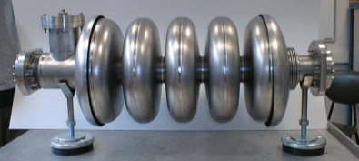
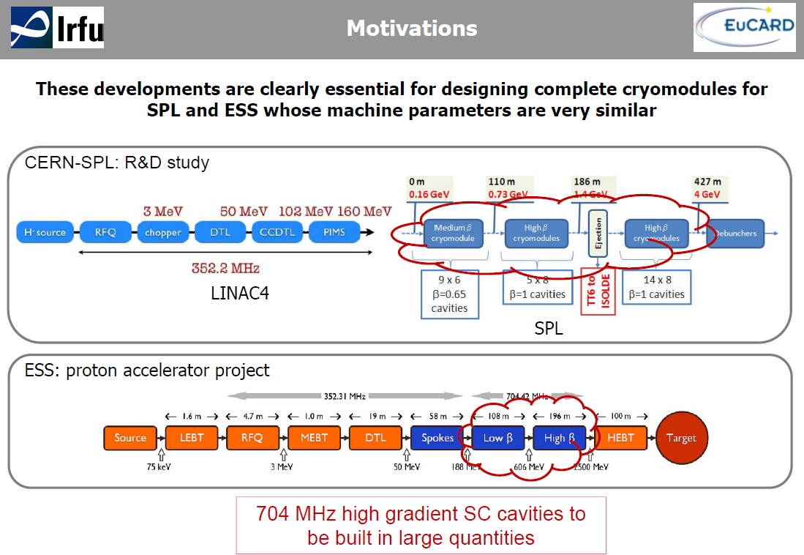
WP10.2: SC Cavities for Proton Linac

Slide 12
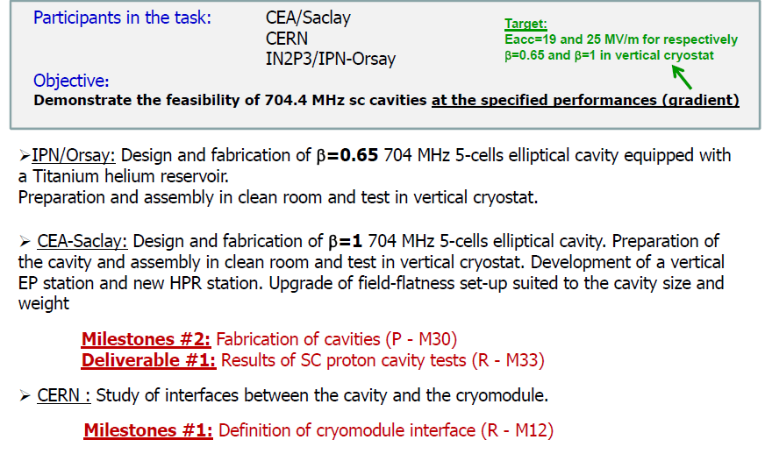
WP10.2: SC Cavities for Proton Linac

Slide 13
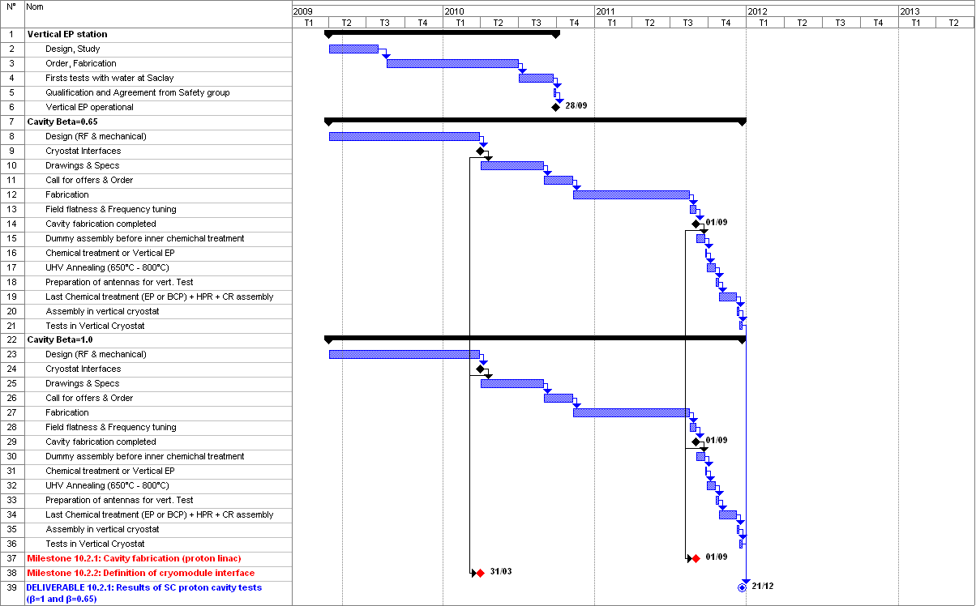
WP10.2: SC Cavities for Proton Linac

Slide 14
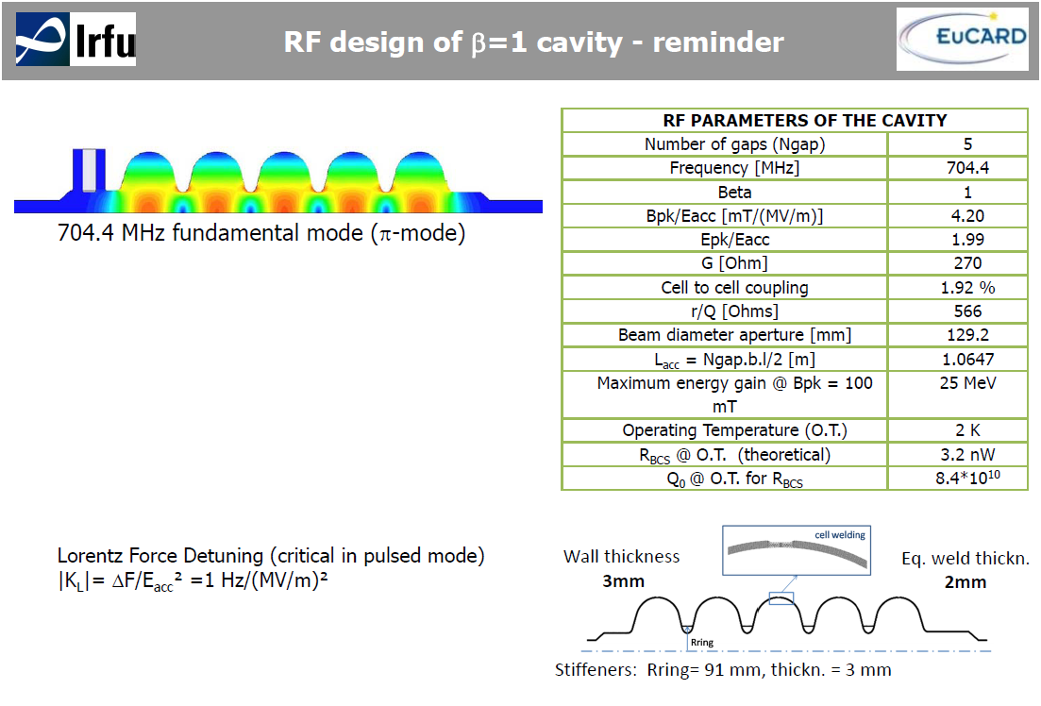
WP10.2: SC Cavities for Proton Linac

Slide 15
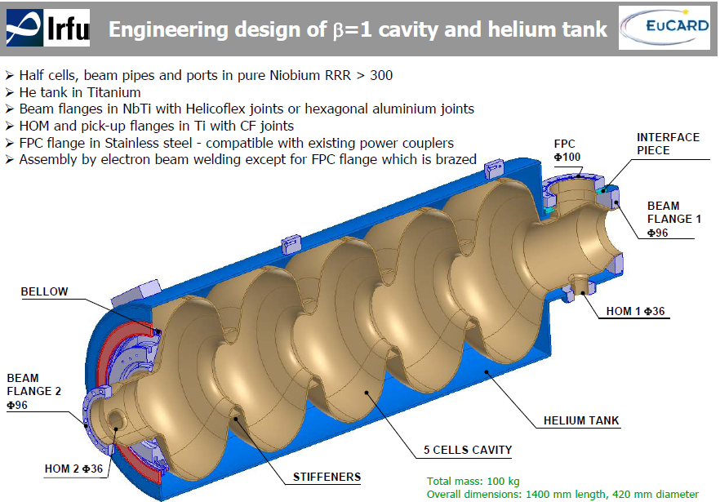
WP10.2: SC Cavities for Proton Linac

Slide 16
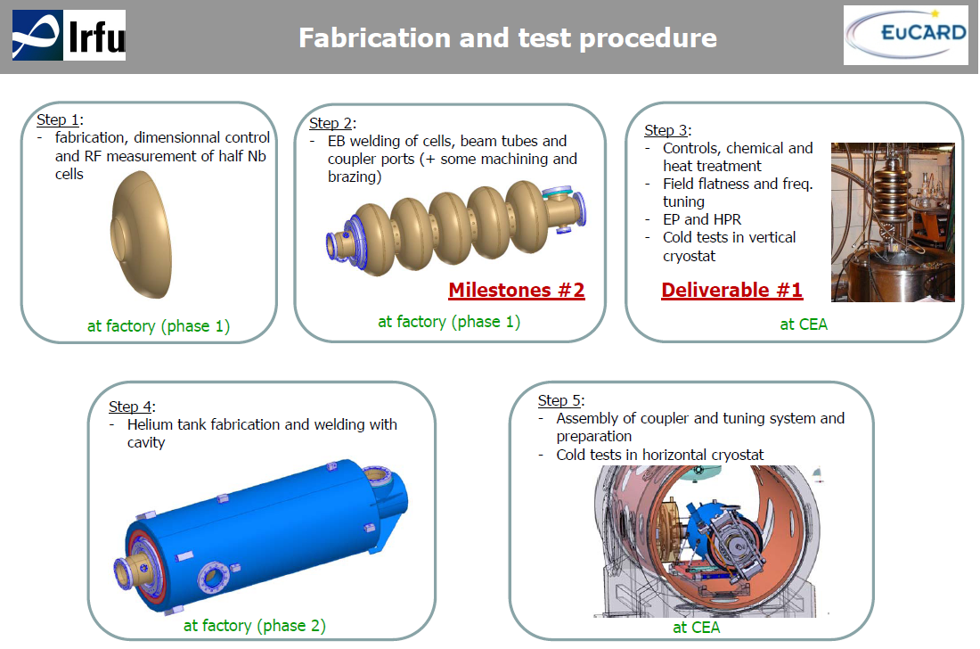
WP10.2: SC Cavities for Proton Linac

Slide 17
WP10.2: SC Cavities for Proton Linac
FABRICATION SCHEDULES
Cavity β = 0.65 (IPN) :
  Week 13 : reception of the cavity without He tank
  Week 14-15: resonant frequency measurements, vacuum tests, chemical etching and field flatness tuning at IPN
  Week 16: cavity shipped back to RI for He tank welding
  Week 23-26: reception of the cavity with He tank
  September 2013: Test in vertical cryostat
Cavity β = 1 (CEA) :
  Week 12 : resonant frequency measurements of dumbbells at ZANON before final welding
  Week 22: reception of the cavity without He tank
  Week 23 to 29: controls, resonant frequency measurements, vacuum tests, electropolishing, and field flatness tuning at CEA
  Week 30-31: Clean room assembly, HPR
  End of August 2013: Test in vertical cryostat
  September 2013: cavity shipped back to ZANON for He tank welding

Slide 18
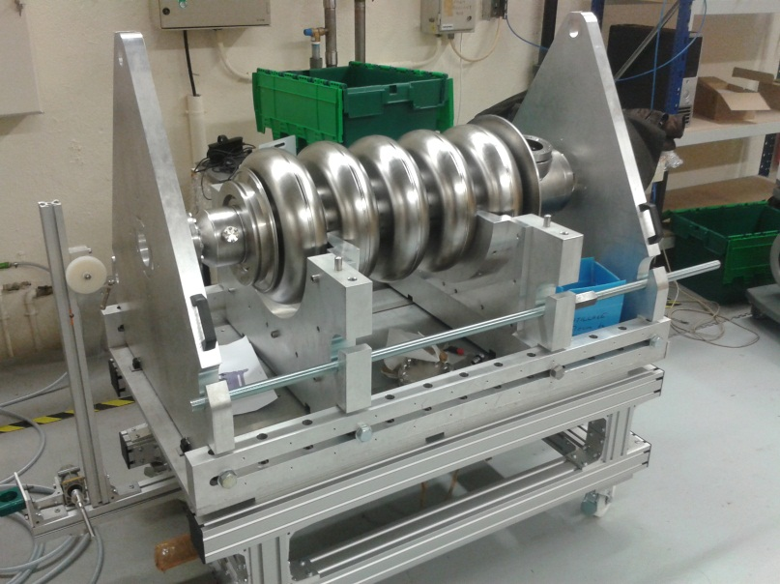
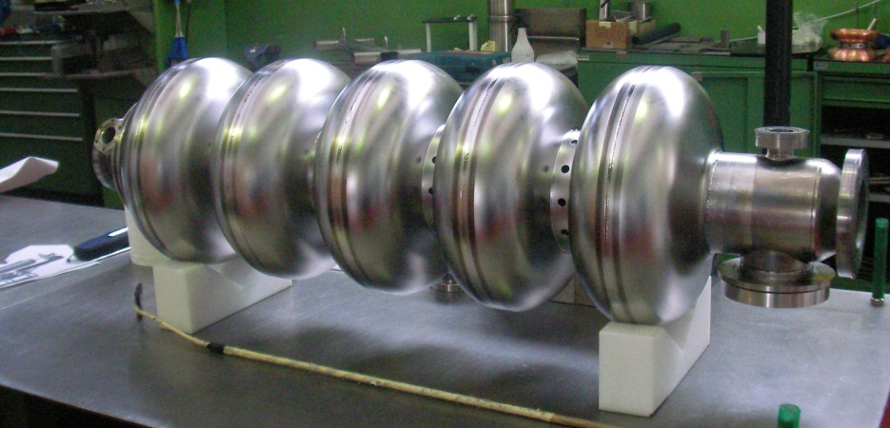
WP10.2: SC Cavities for Proton Linac
β=0.65 cavity ready for field flatness tuning at IPN Orsay
β=1 cavity after final welding at equators @ EZ in May 2013

Slide 19
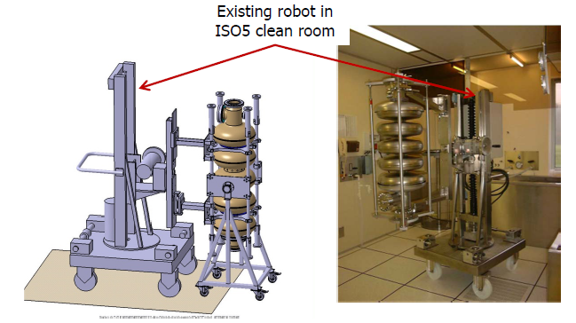
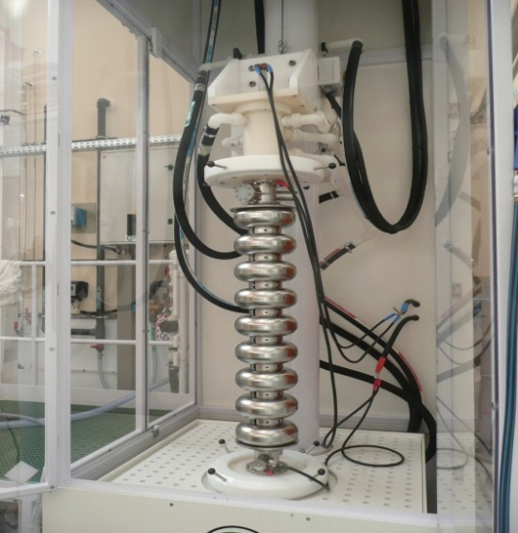
WP10.2: SC Cavities for Proton Linac
Clean room preparation
(with CARE β = 0.5 cavity)
Vertical EP cabinet
with ILC cavity from FNAL (courtesy C. Ginsburg))

Slide 20
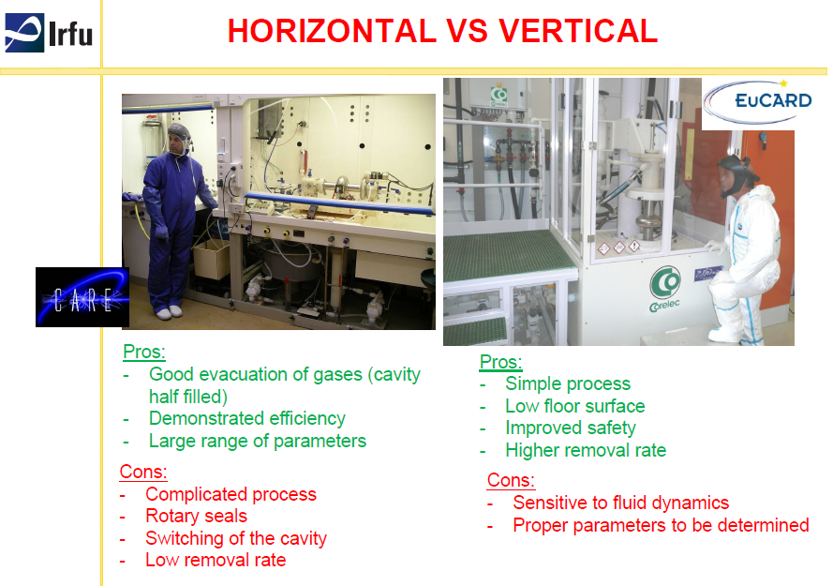
WP10.2: SC Cavities for Proton Linac
ELECTROPOLISHING

Slide 21
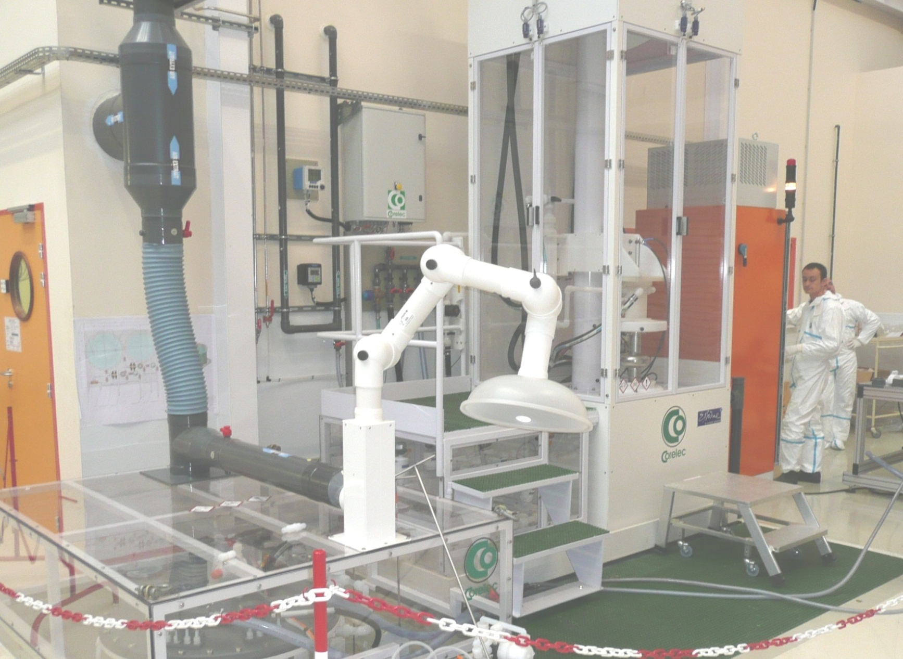
WP10.2: SC Cavities for Proton Linac
Ventilated cavity cabinet
H2 detection
Automated process
N2 blowing in cavity
Ventilated acid cabinet
Ventilated acid transfer area
H2 detection
N2 blowing in tank

Slide 22
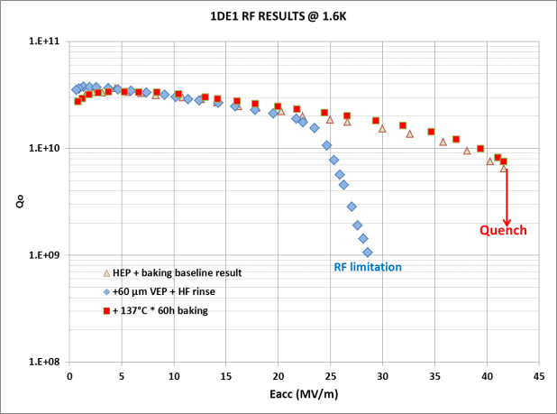
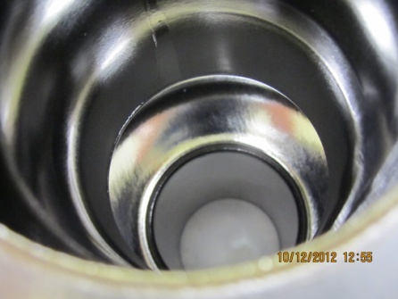
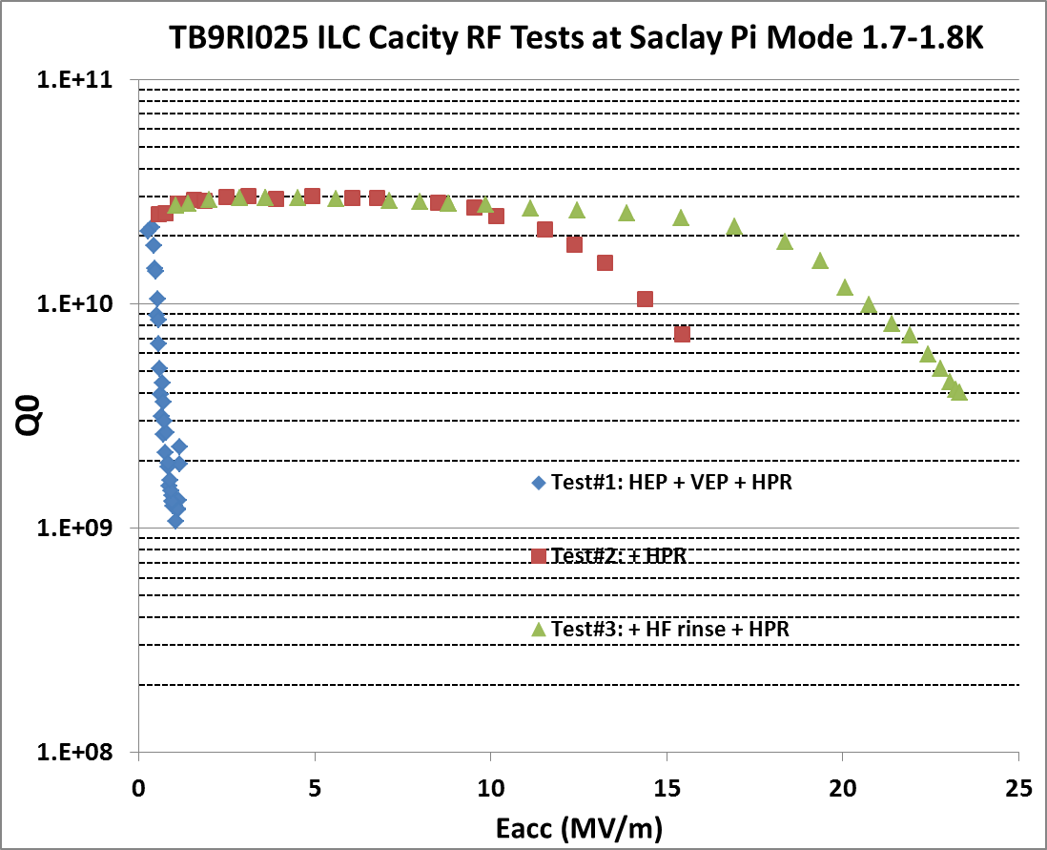
WP10.2: SC Cavities for Proton Linac
Top: RF vertical test on a single cell cavity
→ Eacc = 42 MV/m limited by quench
Bottom: RF vertical test on a 9-cell cavity
Eacc = 23 MV/m limited by field emission
new EP and RF test will be done.

Slide 23
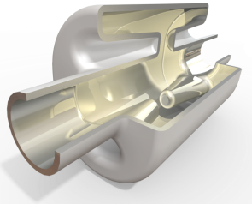
WP10.3: LHC and CLIC Crab Cavities
Goals:
Design, build and test a single LHC and CLIC crab cavity structure, including input coupler, mode couplers and tuners.
Design, build and test a LLRF and synchronization system that meets the crab cavity phase and amplitude control specifications for LHC and CLIC.
Deliverables:
All deliverables are completed.

Slide 24
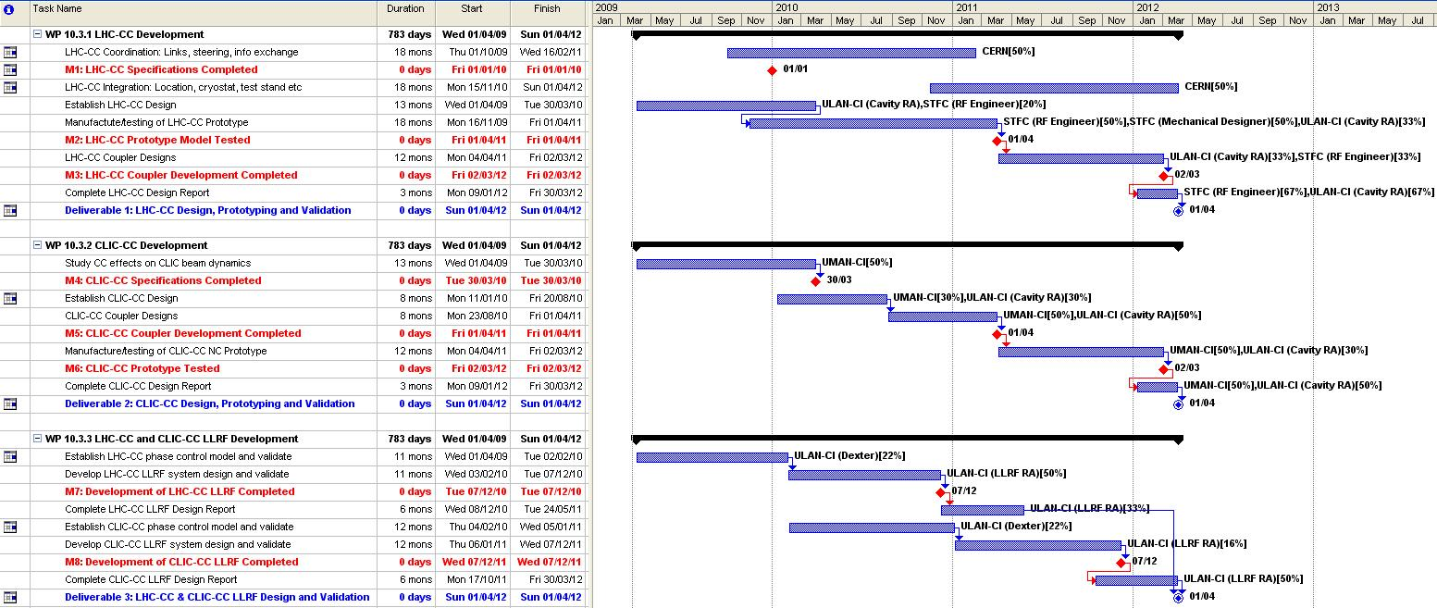
WP10.3: LHC and CLIC Crab Cavities

Slide 25
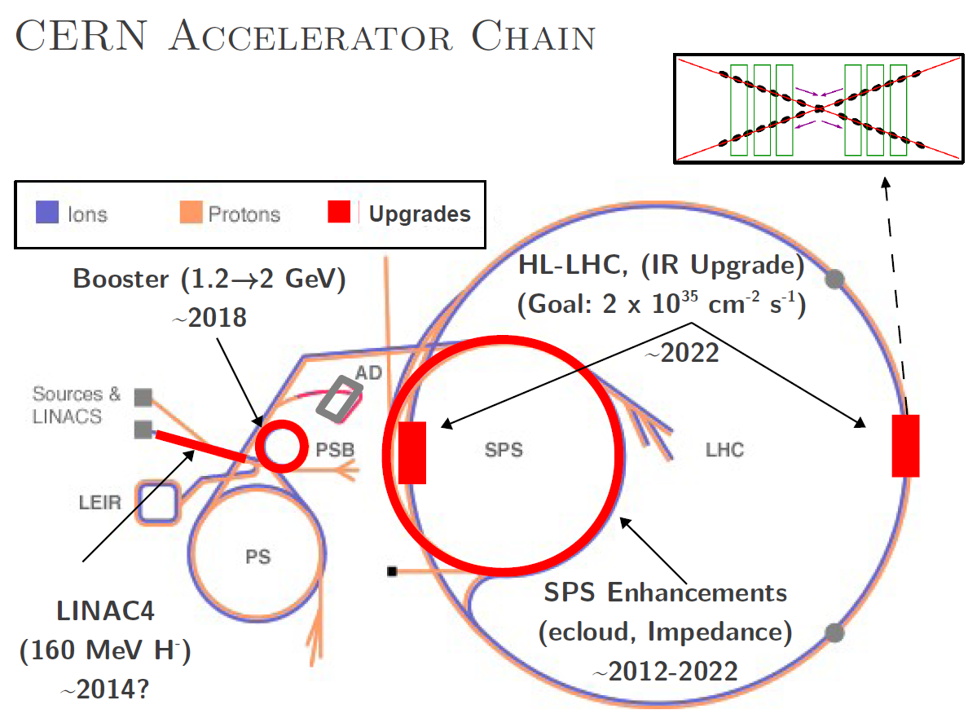
WP10.3: LHC and CLIC Crab Cavities
Motivation for crab-crossing ccheme at HL-LHC

Slide 26
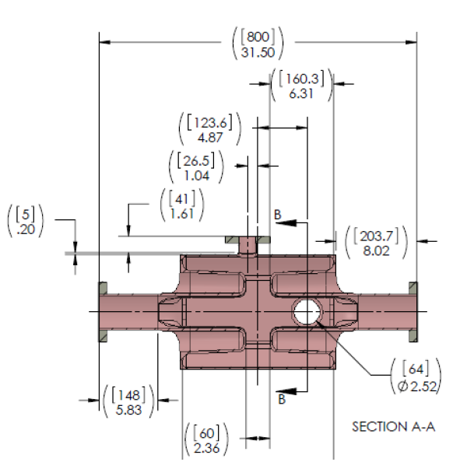
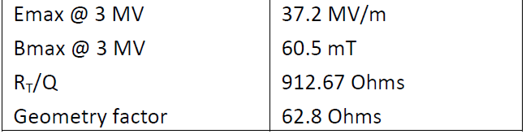
WP10.3: LHC and CLIC Crab Cavities
The LHC cavity is a four rod structure which makes it ultra-compact and appropriately applicable for local crab crossing on LHC, which has been optimised for low surface fields and a very high shunt impedance. The rod shape has been specially configured to minimise the sextupole component of the deflecting voltage to provide a uniform deflecting field as a function of transverse beam offset.
Four-Rod Crab Cavity (4RCC) geometric and RF parameters

Slide 27
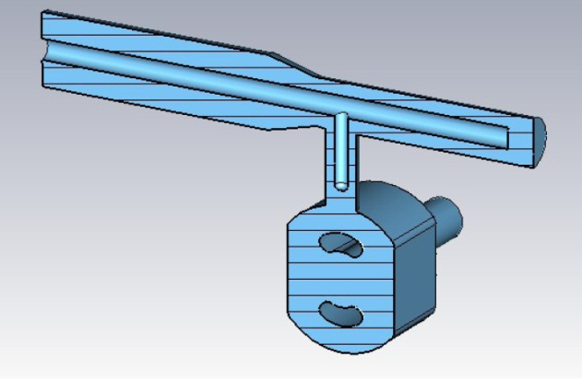
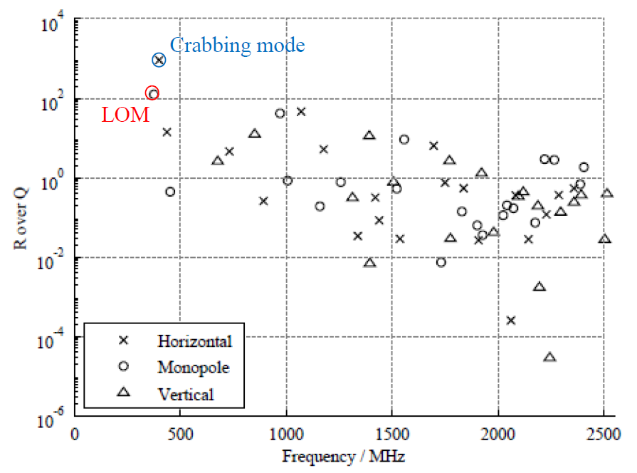
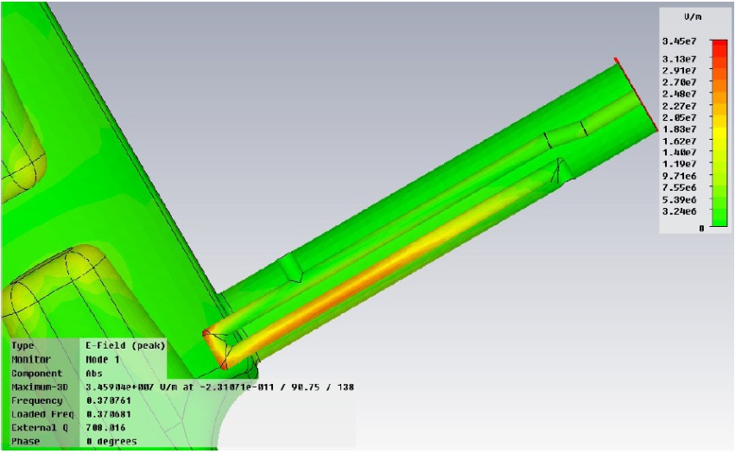
WP10.3: LHC and CLIC Crab Cavities
The input power coupler is a coaxial type coupler with a T-section which interfaces to a cavity coupler design which is identical to that of the existing LHC accelerating mode 400 MHz SRF cavities.
A special loop type coupler has been developed for damping the LOM and HOM impedances, with optimisation still being performed for the HOM coupler solutions.
Input coupler
R/Q spectrum of LHC-4RCC
LOM coupler

Slide 28
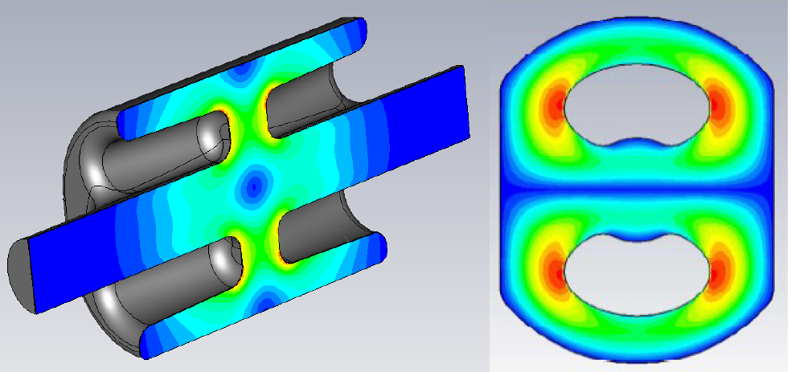
WP10.3: LHC and CLIC Crab Cavities
Geometry of the LHC 4RCC and magnitude of the electric field

Slide 29
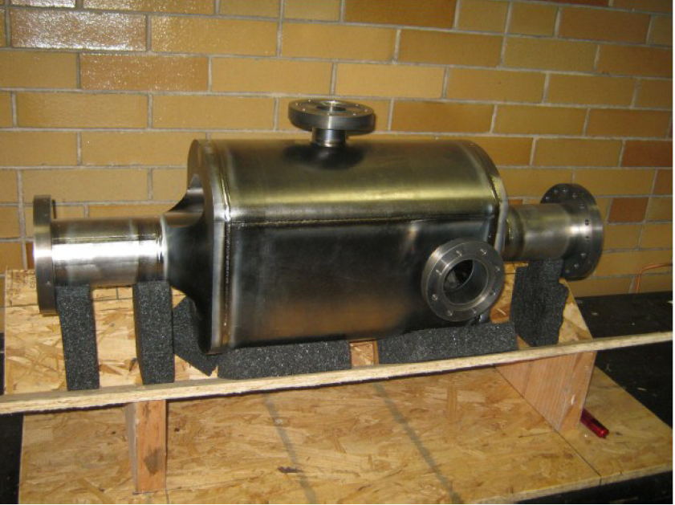
WP10.3: LHC and CLIC Crab Cavities
Assembled prototype Niobium cavity, fabricated at Niowave Inc.

Slide 30
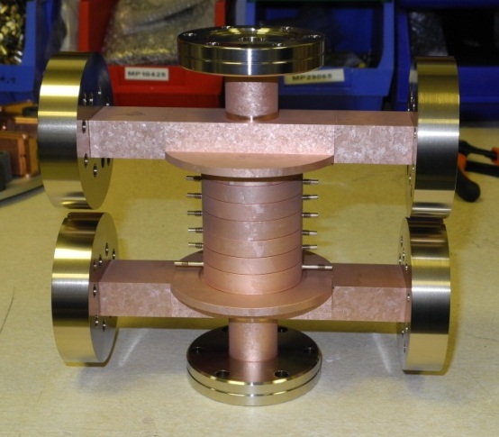
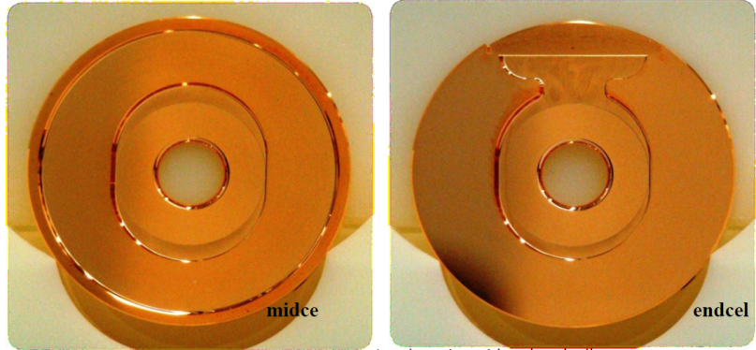
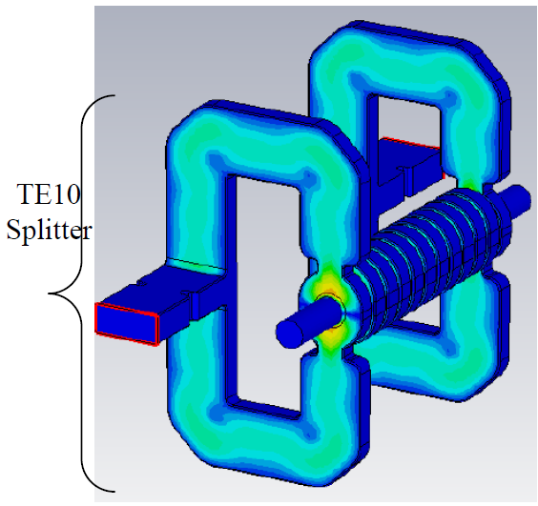
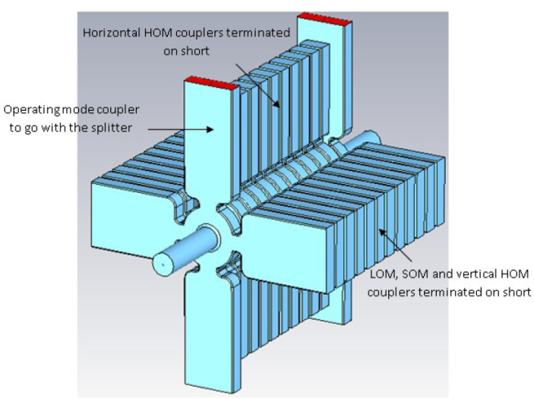
WP10.3: LHC and CLIC Crab Cavities
A prototype cavity has been manufactured in UK, which achieved machining tolerances of 1-2 µm. This is the first demonstrated X-band structure in the UK.
A 2nd structure is manu-factured by CERN for breakdown testing using the same manufacturing process as for the main linac.
CERN end and mid cells
UK built CLIC crab cavity
Dual feed coupler design
Horizontal and vertical waveguide damped cell with integrated SiC dielectric loads

Slide 31
WP10.3: LHC and CLIC Crab Cavities
Crab cavity to cavity synchronisation requirement ~5 fs.
Crab cavity to beam synchronisation requirement ~ 100 fs.
Detector
quadrupoles
quadrupoles
20 mrad crossing
travelling wave crab cavity
Target luminosity loss fraction | f (GHz) | σ_{x} (nm) | θ_{c} (rad) | φ_{rms} (deg) | Δt (fs) | Pulse Length (μs)
0.98 | 12.0 | 45 | 0.020 | 0.0188 | 4.4 | 0.156
RF path lengths need to be equal to better than cΔt = 1.3 µm

Slide 32
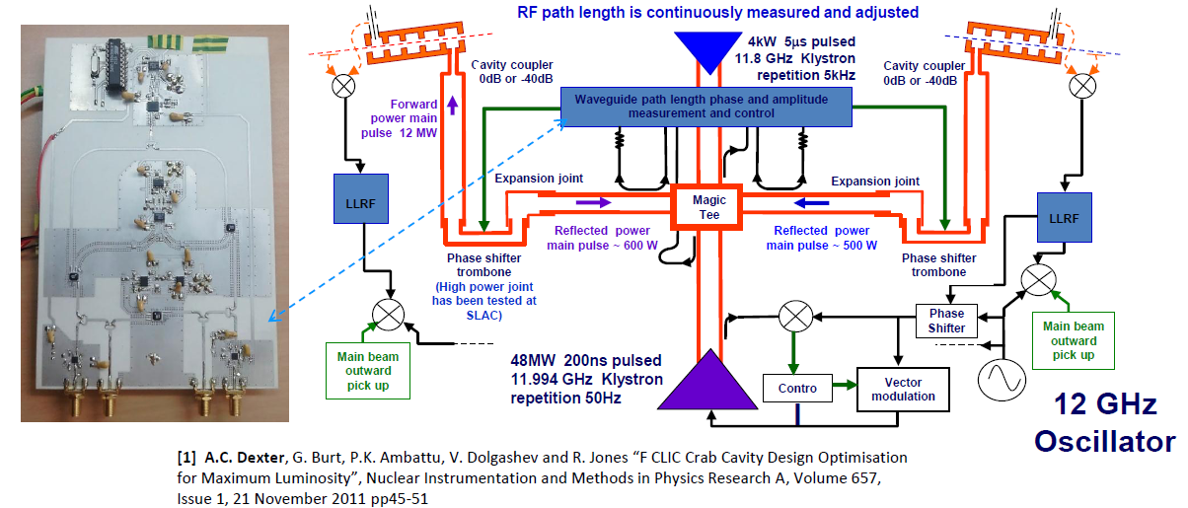
WP10.3: LHC and CLIC Crab Cavities

Slide 33
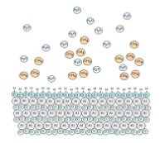
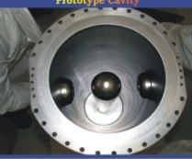
WP10.4: Thin Films
Goals:
Development of magnetron sputtering for the HIE-ISOLDE QW cavities
Build and test Pb coated phtocathodes on 1 ½ cell SRF gun
Facilitate communication about new thin film tehcniques
Deliverables:

Slide 34
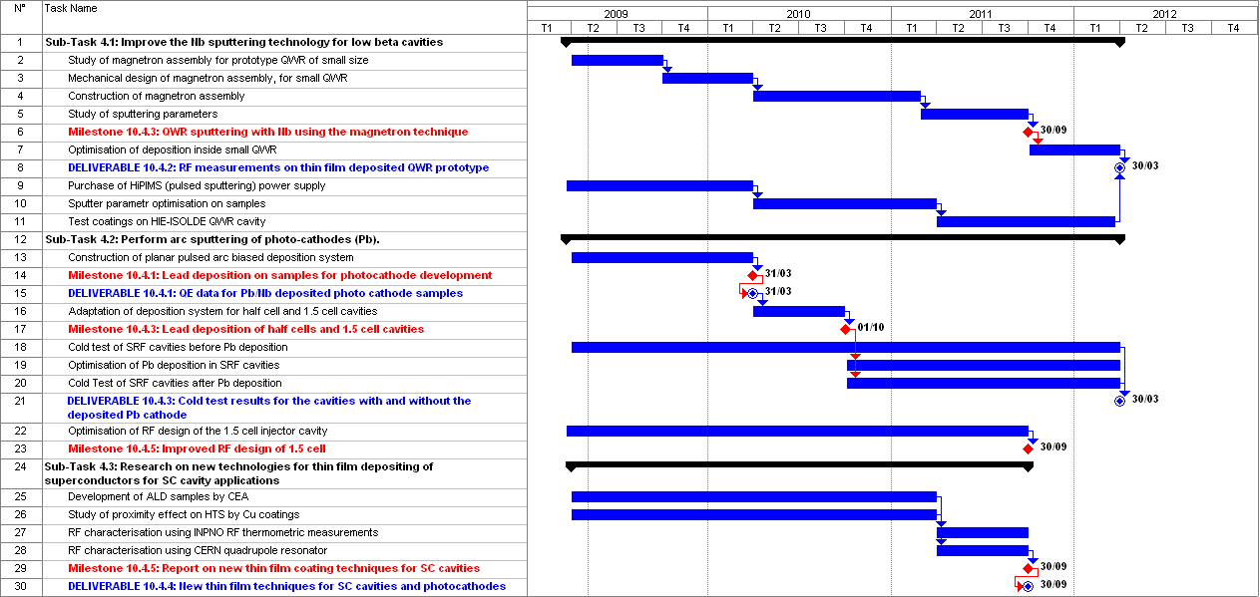
WP10.4: Thin Films

Slide 35
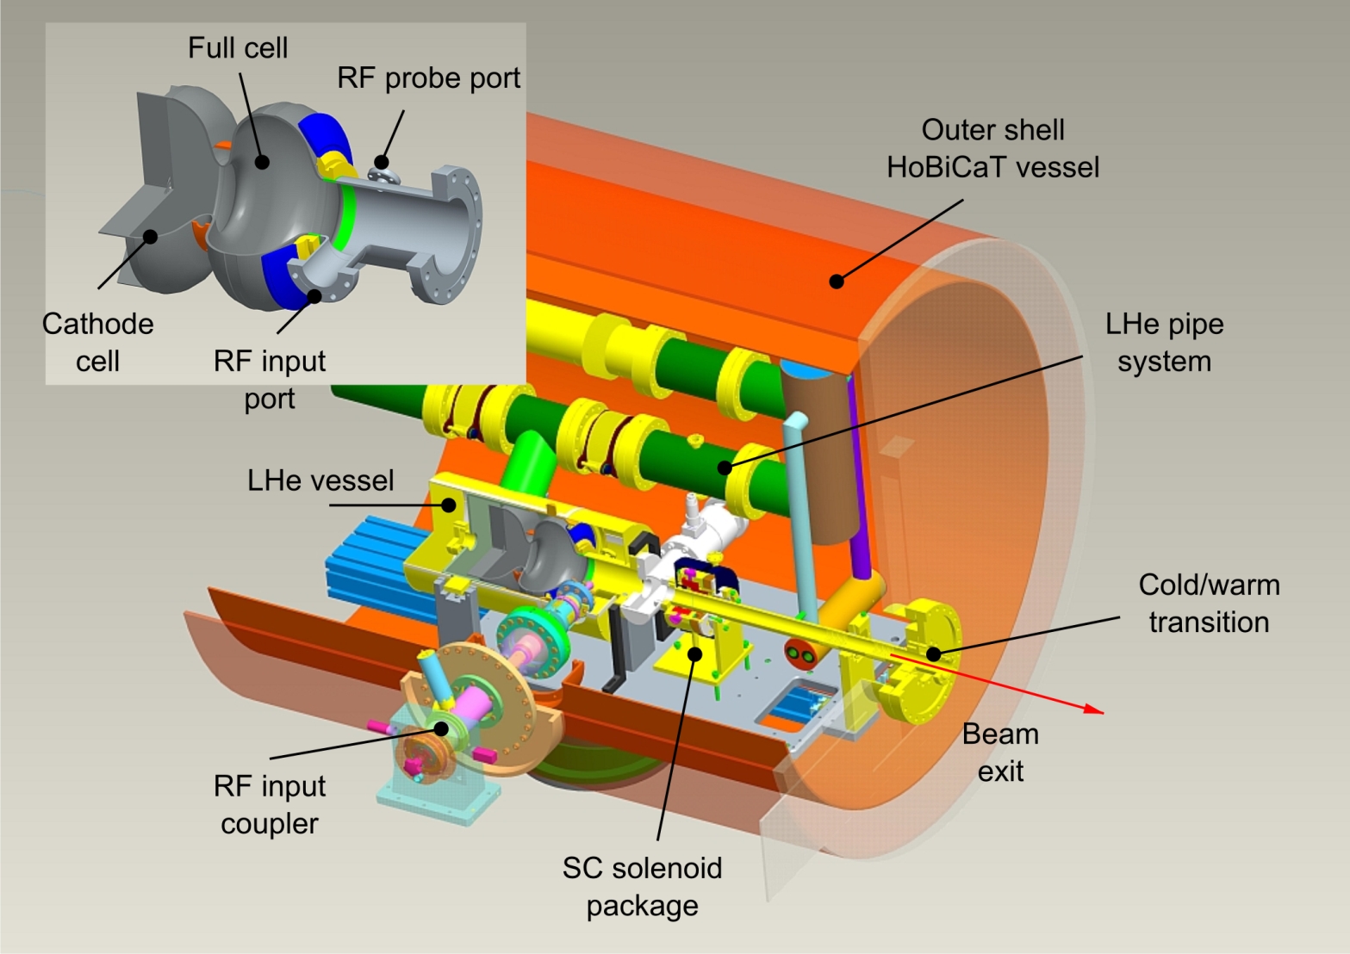
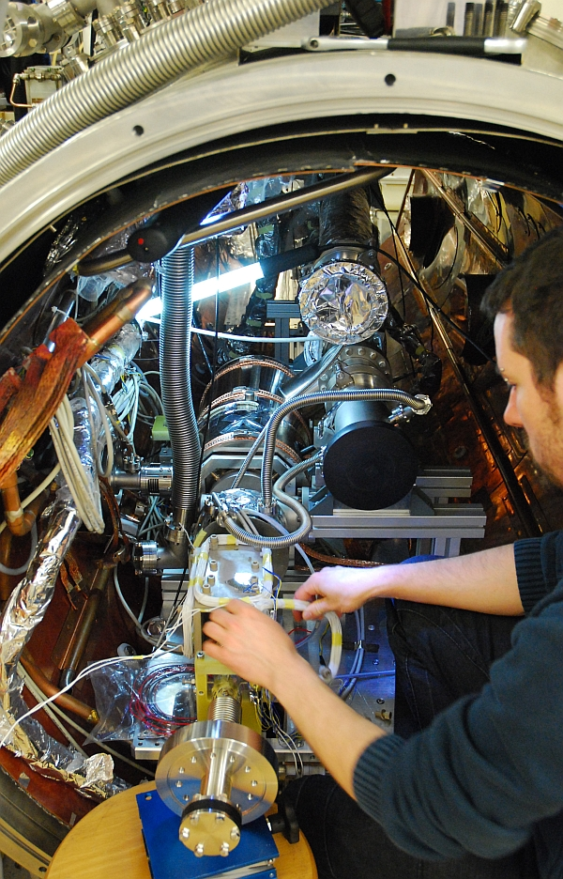
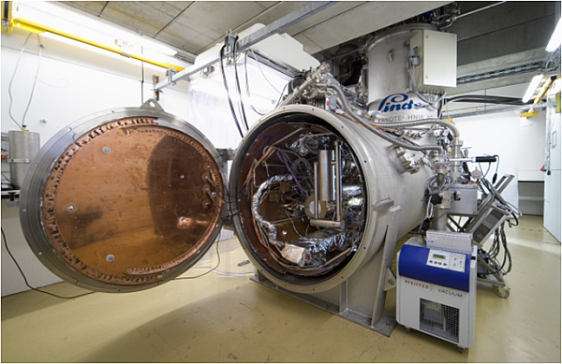
Completed cold mass inside cryomodule of HoBiCaT HZB).
WP10.4: Thin Films

Slide 36
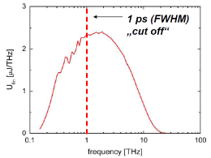
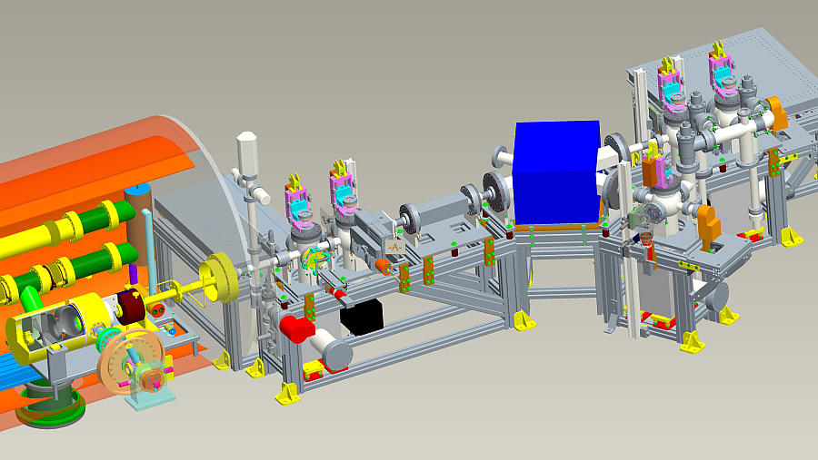
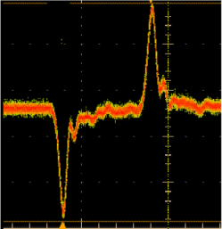
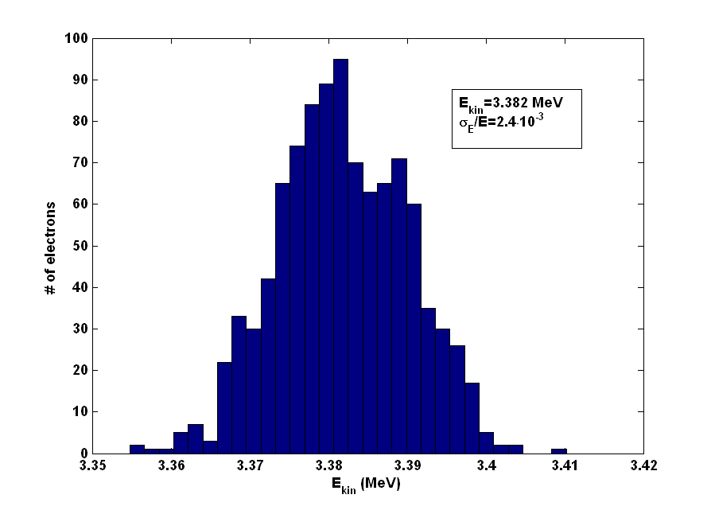
Beam test: drive laser and electron beam diagnostics
WP10.4: Thin Films
THz diagnostics
Stripline BPM,
ICT
Dipole magnet
Viewscreens
0.26 µm, 30 kHz, 2…3 ps, 0.15 µJ pulses from Yb:YAG oscillator + regen. amp. + 4th harm conv.

Slide 37
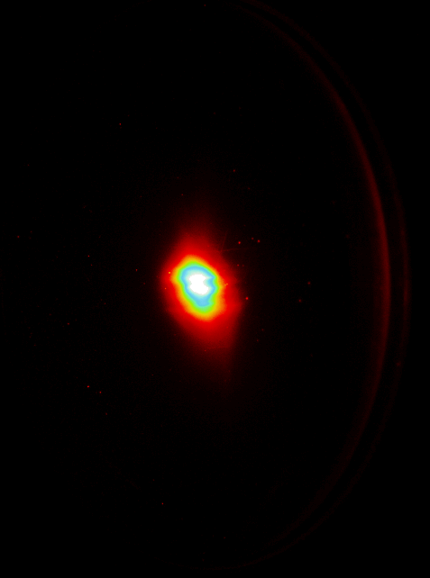
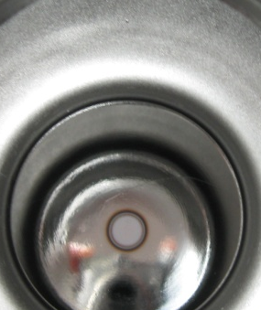
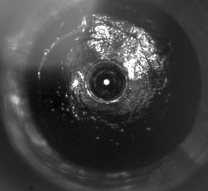
T10.4 + T10.7 : Pb/Nb SC-RF Gun Operation
WP10.4: Thin Films
First beam of photoelectrons from Pb cathode generated and accelerated at 21st April 2011, < 2 years after project approval
Lead coated photocathodes in 1 ½ SRF gun
achieving QE of 3.3x10⁻³
(NCBJ, DESY, Jlab)

Slide 38
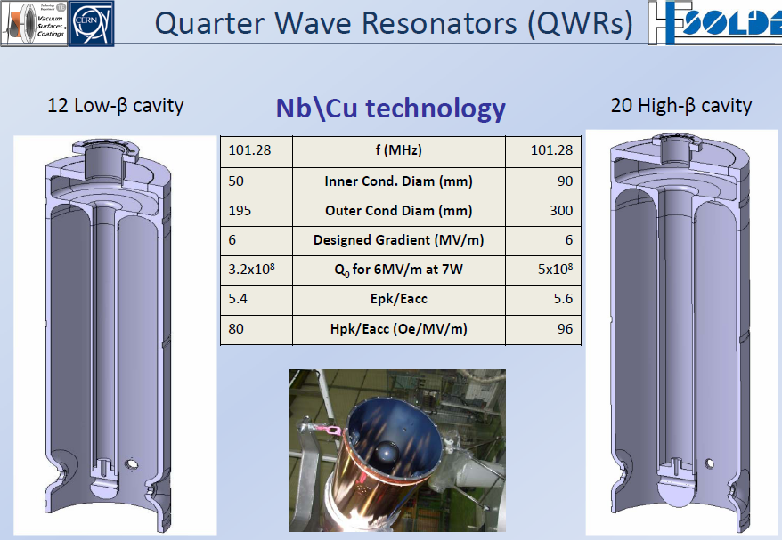
WP10.4: QWR for HIE Isolde

Slide 39
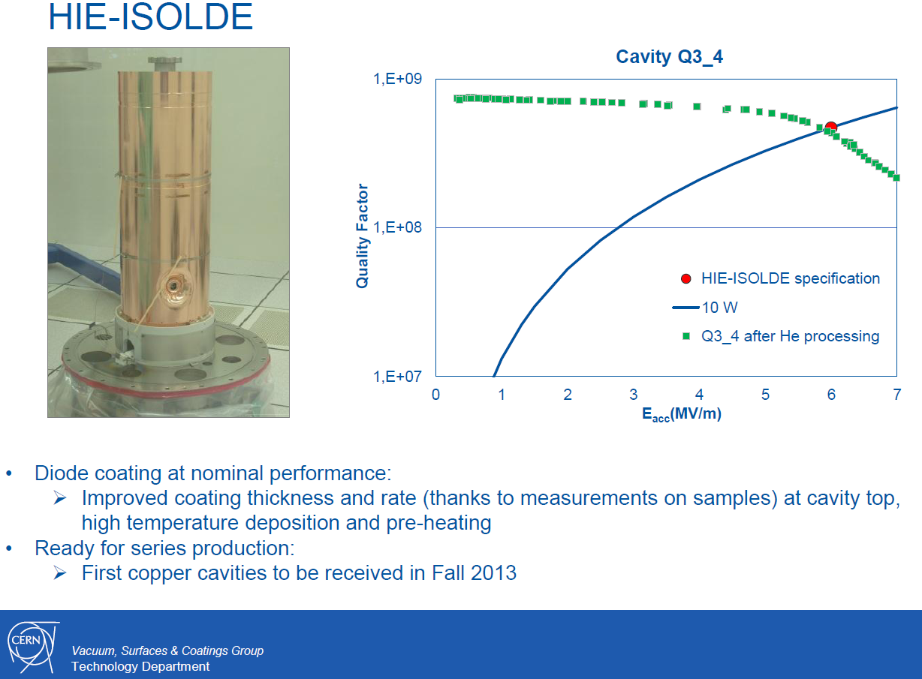
WP10.4: Thin Films

Slide 40

WP10.4: Thin Films

Slide 41

WP10.4: Thin Films
Magnetron sputtering facility
at INFN/Legnaro
The RRR of our Nb sputtered samples was increasing when increasing the power of sputtering.
We got progressive improvements. The film is uniform all over within the cavity. We can sputter over 1 micron in about 15 minutes.
Today we got RRR values of 22, that means we are ready for sputtering the cavity.
In this situation, we could try the miracle to sputter and test it for the beginning of June, but we need the cavity, and the ancillary equipment (coupler, pickup, bottom plate and closing system).
Communication from E. Palmieri (15/05/2013)

Slide 42

WP10.4: Thin Films
Monograph touching upon
New Thin Film Techniques
by C. Antoine
(cf. EuCARD2 KoM)

Slide 43


WP10.5: HOM Distribution

Slide 44

WP10.5: HOM Distribution
Deliverables:

Slide 45

WP10.5: HOM Distribution

Slide 46

WP10.5: HOM Distribution

Slide 47

WP10.5: HOM Distribution

Slide 48

WP10.5: HOM Distribution

Slide 49

WP10.5: HOM Distribution

Slide 50

WP10.5: HOM Distribution

Slide 51

WP10.5: HOM Distribution

Slide 52

WP10.5: HOM Distribution

Slide 53

WP10.5: HOM Distribution

Slide 54

WP10.5: HOM Distribution

Slide 55

WP10.5: HOM Distribution

Slide 56

WP10.5: HOM Distribution

Slide 57

WP10.5: HOM Distribution

Slide 58


WP10.6: LLRF at FLASH
Goals:
Develop components of LLRF system using µTCA technology.
Improve the reliability and functionality of the LLRF at FLASH
Improve the energy stability of the beam in FLASH
Deliverables:

Slide 59

WP10.6: LLRF at FLASH

Slide 60
WP10.6: LLRF at FLASH

Slide 61


WP10.6: LLRF at FLASH
Downconverter optimization
Vector modulator improvements
Downconverter
Vector modulator
It has been optimized for an input frequency of 1.3 GHz, a heterodyne of 1.354 GHz and an intermediate frequency of 54 MHz.
After extensive tests and requests for new features a second revision of the board with two output channels has been developed. The second channel will be used in the future to perform system calibration.

Slide 62

WP10.6: LLRF at FLASH
Synthesis and distribution of clock and reference signals in xTCA system (RF Backplane)
RF backplane for the MTCA crate increases reliability and maintainability and reduces the limitations external RF cabling. It generates and distributes high-quality synchronization and reference signals as well as low-jitter clock signals.
There is a patent application for RF Backplane requested and beeing processed.
The patent requiest for RF Backplane was filled in (June 2012).

Slide 63



WP10.6: LLRF at FLASH
Development of an AMC module with fast radiation sensors
FMC board with RadMon mezzanine
The neutron radiation sensors developed with support of CARE project has been patented (EP 1 729 149 B1, Solid State Neutron Detection System, 09.01.2013) – this work was a base for current developments.

Slide 64
WP10.6: LLRF at FLASH
Extracted calibration factors
Calibration of the radiation sensors in FLASH

Slide 65


WP10.6: LLRF at FLASH
The developed LLRF system has been installed in the FLASH accelerator and commissioned during maintenance periods. The system was tested with and without beam.
RF field stability (with beam) is of order of 10⁻⁴

Slide 66


WP10.7: SC RF Gun at ELBE
Goals:
Slice emittance measurements on the SRF gun of ELBE
Development of GaAs photocathodes in SRF gun
Evaluation of critical Issues of SRF guns
Deliverables:

Slide 67

WP10.7: SC RF Gun at ELBE

Slide 68

WP10.7: SC RF Gun at ELBE
Zero Phasing Measurement Principle (PhD Thesis J. Rudolph)

Slide 69

WP10.7: SC RF Gun at ELBE
Browne-Büchner Spectrometer realizes point to point imaging

Slide 70


WP10.7: SC RF Gun at ELBE
Quad scan method applied to slice profiles

Slide 71
WP10.7: SC RF Gun at ELBE
Report of the GaAs activity will be presented by J. Teichert this week.
The conclusion of the project results is to develop a more advanced system which includes the experience of the previous work and state-of-the-art technique in this field:
• split of the cathode body and the new plug,
• only the plugs are treated in the preparation system,
• design of preparation system which can installed near the electron gun,
• using different chambers for cleaning, transfer and preparation.
Furthermore a standard design of the photocathodes, plugs and storage chambers was fixed between the German institutes HZB, HZDR and University of Mainz. This required a further redesign but will allow the exchange of photocathodes for tests and characterization between these institues in the future.
HZDR gives additional funds for investment for this project in 2012 and 2013.

Slide 72


WP10.7: SC RF Gun at ELBE
New design of the exchangeable cathode plug for GaAs (left) and the new preparation chamber with the interface to the gun and the transport chamber

Slide 73

WP10.8: RF Coupler Cleaning at LAL
Goals:
Demonstrate new coupler cleaning procedures suitable for
mass production of 1.3 GHz couplers
short RF conditioning time.
Three methods have been investigated:
1. High Pressure Water rinsing
2. Argon plasma discharge
3. Automatic cleaning
Deliverables:

Slide 74

WP10.8: RF Coupler Cleaning at LAL

Slide 75

WP10.8: RF Coupler Cleaning at LAL
The man-made preparation procedure: E-XFEL case for 800 couplers

Slide 76


WP10.8: RF Coupler Cleaning at LAL
The EuCARD automated reparation procedure

Slide 77

WP10.8: RF Coupler Cleaning at LAL
(Automate de Lavage Intégré pour Coupleur Electromagnétique)

Slide 78

WP10.8: RF Coupler Cleaning at LAL
Evolution of the concept of automatic coupler washer, over the 4 past years

Slide 79

WP10.8: RF Coupler Cleaning at LAL
The studies of ALICE are complete enough to give us a complete overview and estimation of the feasibility, the process and the costs: the efficiency of the process, as far as the large mass production is concerned, is undisputed.
The cost of a such machine as ALICE is estimated at 150 k€.
All the technical functions can be respected to clean couplers automatically and correctly without any damage for them.
ALICE design v2

Slide 80
WP10-SRF: The fifteen deliverables

Slide 81


Thank You for Your Attention
Many thanks to:
Olivier Brunner
Stéphane Chel
Frank Peauger
Peter McIntosh
Sergio Calatroni
Roger Jones
Nicoleta Baboi
Mariusz Grecki
Jochen Teichert
Walid Kaabi

