Slide 1
EUCARD 12 Kick-off meeting
Introduction to Task 12.3
W. Wuensch
CERN
13-6-2013

Slide 2
Task 12.3: Normal Conducting High Gradient Cavities
This task is led by CERN and includes work from CERN, CEA, PSI, STFC, ULANC and UNIMAN. X-band technology for compact high-gradient normal-conducting linacs is being considered for an increasing wide range of applications which includes linear colliders, compact free-electron lasers, Compton-scattering light sources and medical accelerators. The applicability of X-band technology to these applications is driven to a significant extent by progress made by the CLIC collaboration. This proposal seeks to further the development of high-gradient, X-band rf structures directly for the CLIC study, enhancing the collaboration, but also benefitting many other applications. There are two main high-gradient rf structures for CLIC which are part of this proposal: main linac accelerating structures and final-focus system crab cavities. The structures perform distinct functions but share many crucial performance issues such as: high-gradient performance, wake-field suppression and tight phase stability requirements. Additionally a wide range of international collaborators are working on these structures. Existing collaborations with SLAC and KEK will also be built upon and included in this project.

Slide 3
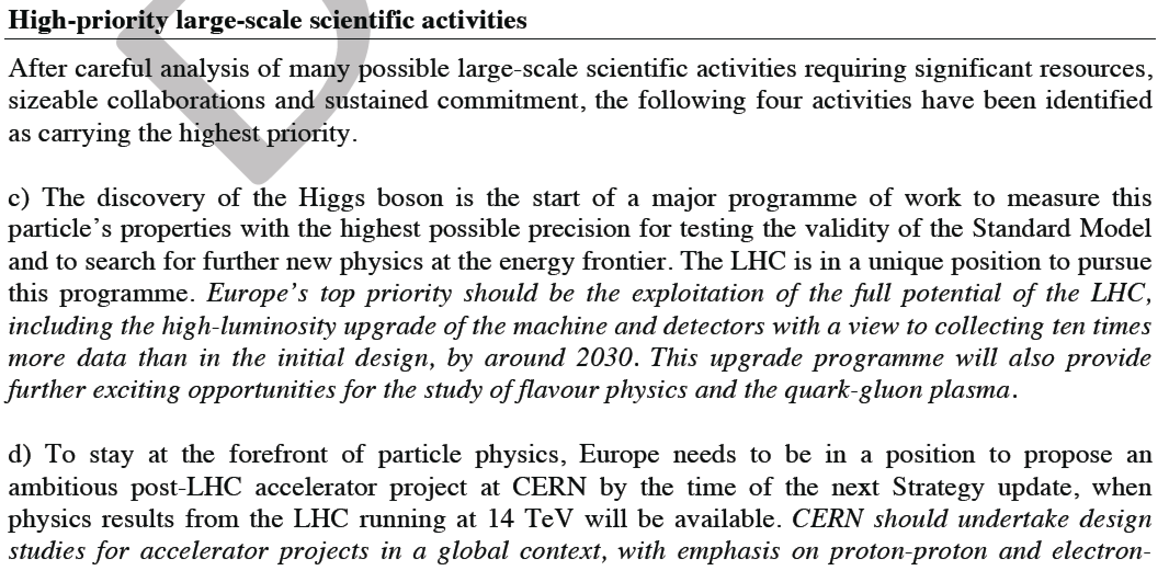
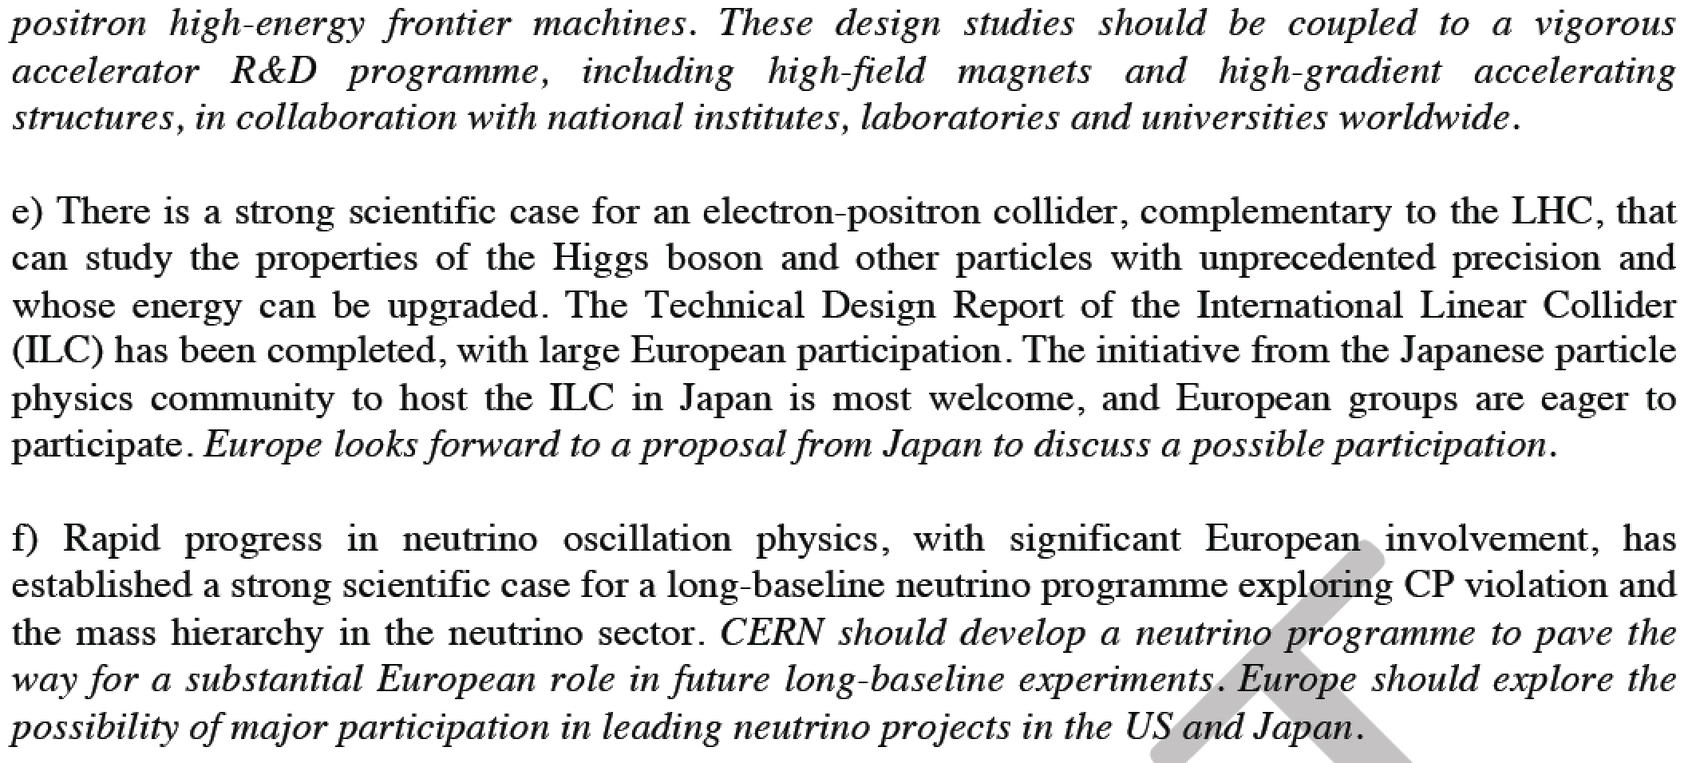

Slide 4
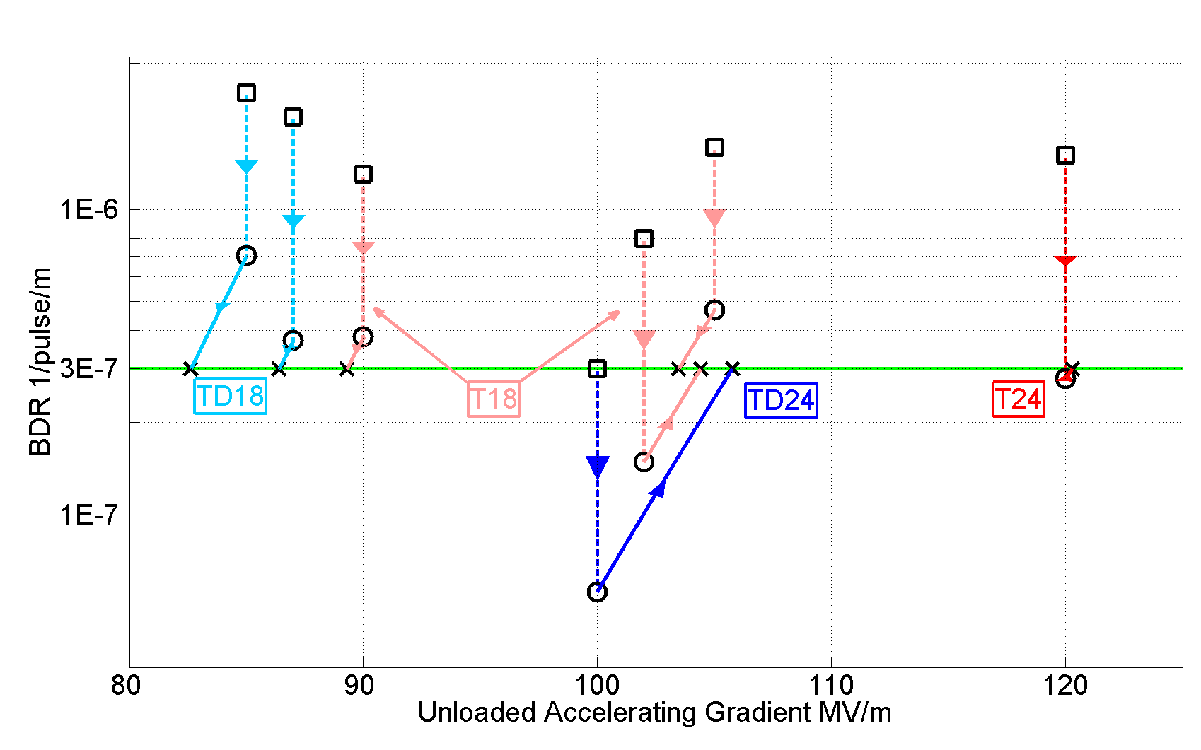
Accelerating gradients achieved in tests.
Status: 4-9-2012
HOM damped

Slide 5
On 30 May we had a phone kick-off meeting for Task 12.3 http://indico.cern.ch/conferenceDisplay.py?confId=251925. The objective of the meeting was to:
Meet all together (even if mostly by phone) for the first time since our task has been put together and approved.
Hear a quick summary from each of you to remind ourselves of our scientific objectives and plans – including updates since almost two years have gone by since we started planning.
Present the slides for Peter McIntosh, our work package leader.
What we will need to cover in the coming months
Resource and financial planning for each of the sub-tasks (hiring and spending profiles)
Begin the progress reporting.

Slide 6
Normal Conducting High Gradient Cavities
Objective: Advance high-gradient technology and its application.
Members: CERN, CEA, PSI, STFC, University of Lancaster, University of Manchester and Uppsala University.
Four Sub-tasks:
12.3.1 Wakefield suppression in high-gradient applications – University of Manchester
12.3.2 X-band high-power test facility development – CEA and Uppsala
12.3.3 Wakefield measurement electronics – PSI
12.3.4 Crab cavity and high-power phase stabilization development – University of Lancaster.
Three deliverables:
Initial progress report due by M18, November 2015.
Intermediate progress report due by M36, November 2016.
Final progress report due by M48, May 2017.

Slide 7
How it all fits together
X-band power source development - SACLAY
Test stand integration - Uppsala
RF front-end - PSI
RF design, damping and standing wave - Manchester
Crab cavity and phase stability – Lancaster and STFC

Slide 8
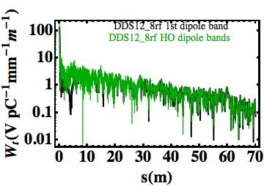
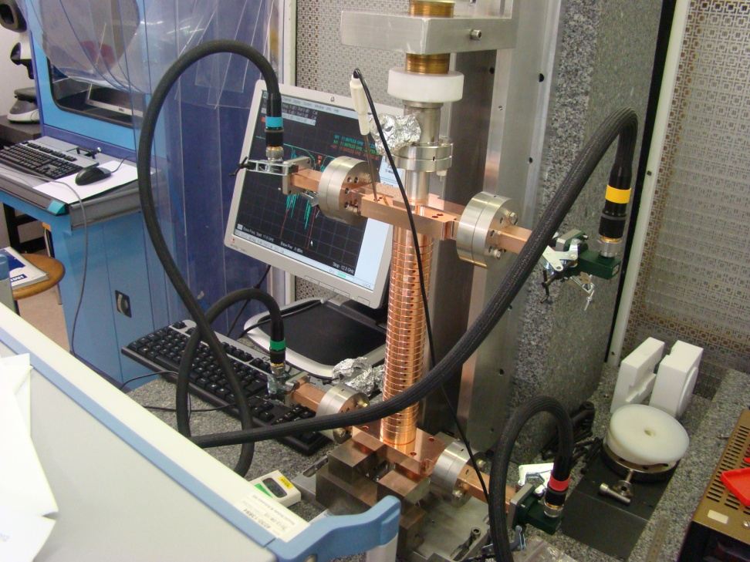
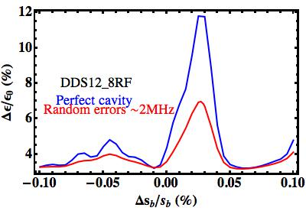
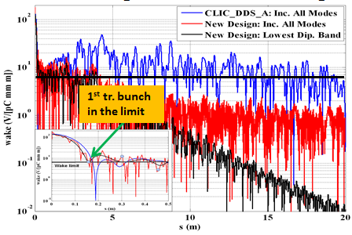
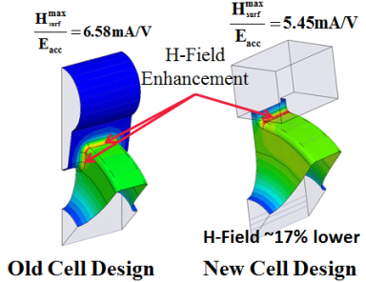
Wakefield Suppression In High-Gradient Applications
The use of Detuned Damped Structures (DDS) has been efficiently applied in the NLC experience
The wakefield suppression is provided by a strong detuning and moderate damping (Q~700) by 4 manifolds which are slot-coupled to each cell;
Interleaving neighboring structure frequencies helps to enhance wakefield suppression;
In this damping scheme it is the total wake distribution produced by the whole bunch train which has an impact on the projected emittance.
CLIC_DDS_A 12-Fold Interleaving
Emittance dilution
CLIC_DDS_A
Task within EuCARD2: Finalization of DDS studies, power test of CLIC_DDS_A and study of alternative schemes to the present CLIC Main Linac baseline
CLIC_DDS_A disks have been successfully bonded and almost ready to be tested (needed a test slot at CERN)
Finalization of the studies on the wakefield damping including all the possible perturbation sources (frequency errors, misalignment…) by means of combined RF (GdfidL) and beam dynamics (PLACET) simulations
Study of further possible alternative to the present baseline such as Standing Wave Linac
Recently an expert in power sources joined Manchester Group: we will profit of her experience to open a ‘sub-sub-Task’ on this subject.

Slide 9
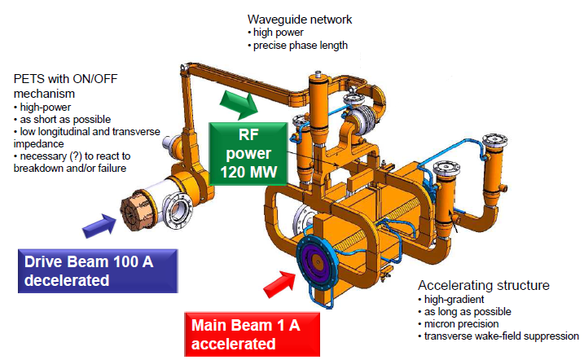
    Sub-task 12.3.2
« In this sub-task, CEA will develop and search for innovative concepts of X band RF power sources and components. The objective is to propose affordable and reliable solutions for future testing capabilities for the CLIC accelerating structures. The task includes the design and the fabrication of prototype RF devices to demonstrate the feasibility of the new concepts proposed. »
Scheme with pulse compressor (Igor Syratchev) and klystrons ordered by CERN
Pulse compressor
20 MW – 200 ns
RF Source
~ 6 MW
some μs
400 Hz
12 GHz
40 MW
200 ns
RF Source
~ 6 MW
some μs
400 Hz
Pulse compressor
To the structure
20 MW – 200 ns
Our objective is to design a technical solution : 12 GHz klystron able to deliver both a peak power of 10 MW with a pulse duration of some μs and repetition rate of 1 kHz
This is an occasion to acquire knowledge and experience on RF sources “in-lab fabrication”

Slide 10
We will study several solutions for the different parts of the microwave tube
Mono or multi beam ?
Sheet beam ?
Electron gun
Coupling cavities
The klystron
Focalization system
Coil ?
Permanent magnets ?
Superconducting magnets ?
First steps will go through calculations
Electrostatics
Magnetostatics
RF
Mechanicals
Thermal
…
Collector
Window
No PhD student for September 2013 – maybe next year ?
An Indian PhD student will maybe come from January to June 2013 (candidature to the Raman-Charpak fellowship applied)

Slide 11
Study modulator and klystron technology available in industry and make a design for a modulator-klystron unit for the full power CLIC X band test facility as part of Task 12.3.2.
Uppsala University
Tord Ekelöf
2013-05-30

Slide 12
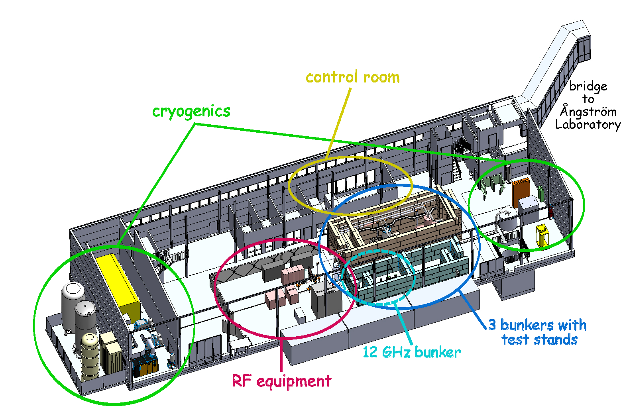

Slide 13
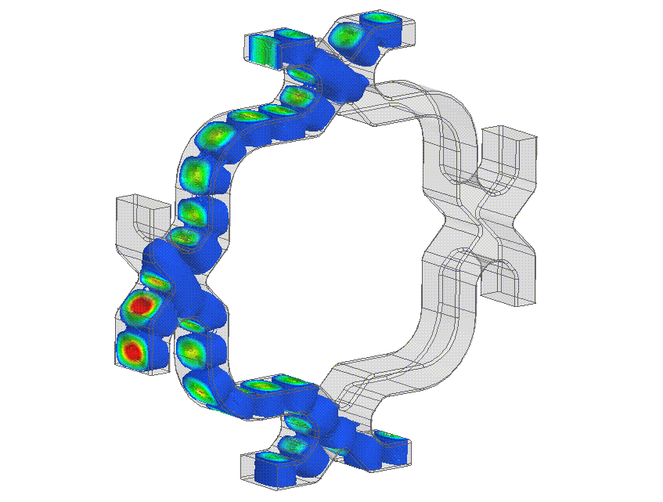
Some starting points (from Igor Syratchev)
1. 50 MW klystron (XL-5, CPI) test stand will be able to deliver to the testing area up to 130 MW x 250 ns pulses at 50 Hz (potentially 100 Hz)repetition rate. The overall power consumption is 43 kW.
2. 6 MW klystron’s cluster test stand will be able to deliver to the x 4 testing areas up to 70 MW x 250 ns pulses at 100 Hz repetition rate in parallel. The overall power consumption is 88 kW.
3. By RF phase manipulation of klystrons pairs (0- ), we can established 4 testing slots running at 100 Hz each. In the case of a single/few structure/s breakdown/s, the missing pulse can be send to any other testing channel, thus maintaining the overall repetition rate available for the tests
Contribution from Uppsala: 5 person-months. The investigation will be done by Rolf Wedberg, power supply and modulator specialist. Rolf is presently responsible for the power supplies for the ESS tetrode based RF power stations and involved in the modulators for the ESS klystron based RF power stations. He has worked with Scandinova type modulators.

Slide 14
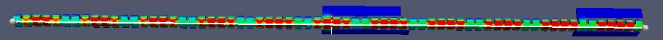
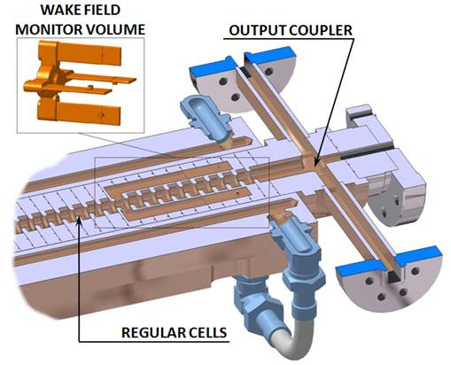
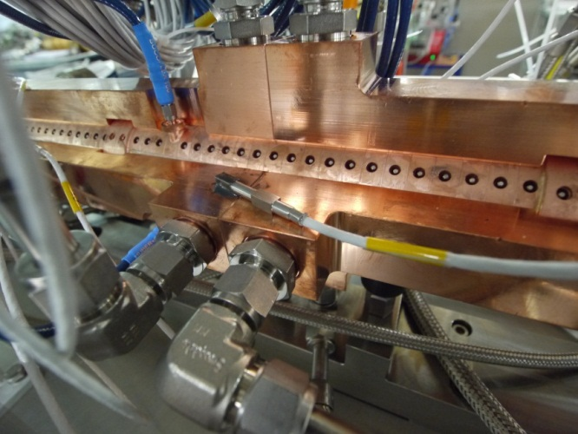
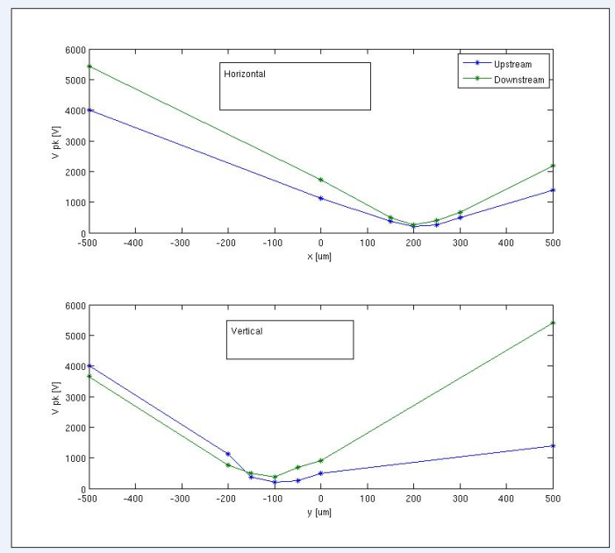
Wake field monitor (PSI)
X Band structure with integrated wake field monitors showing accelerating mode
Wake field monitors as integrated devices are excellent tools
Ensuring optimum structure alignment as opposed to indirect methods as e.g. measuring the beam emittance
Showing not only offsets but also errors in roll and pitch of the structure
Giving information about internal alignment errors due to random offsets or bends
Prototype stack
Task within EuCARD2: develop front end for existing monitors
Wide band signals – 2 GHz band width
Optimize signal/noise to reach theoretical micron scale resolution
Allow for spectral analysis to extract information about higher order misalignments (pitch, roll, bend), while also giving simple ‘operator’ signal
Evaluating classical RF style option versus Electro-Optical approach with promising properties with respect to radiation damage, electromagnetic interference and bandwidth.
WFM signal level vs. structure offset as measured using the PSI/ST/CERN X Band structure
Notes:
¹⁴

Slide 15
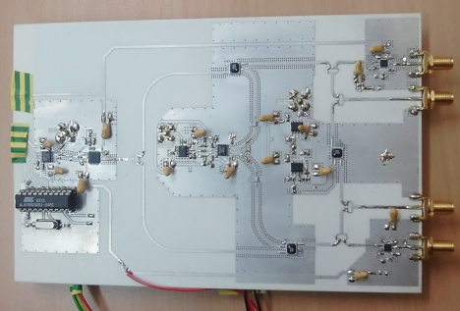
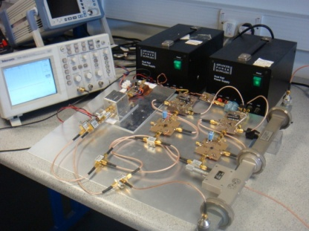
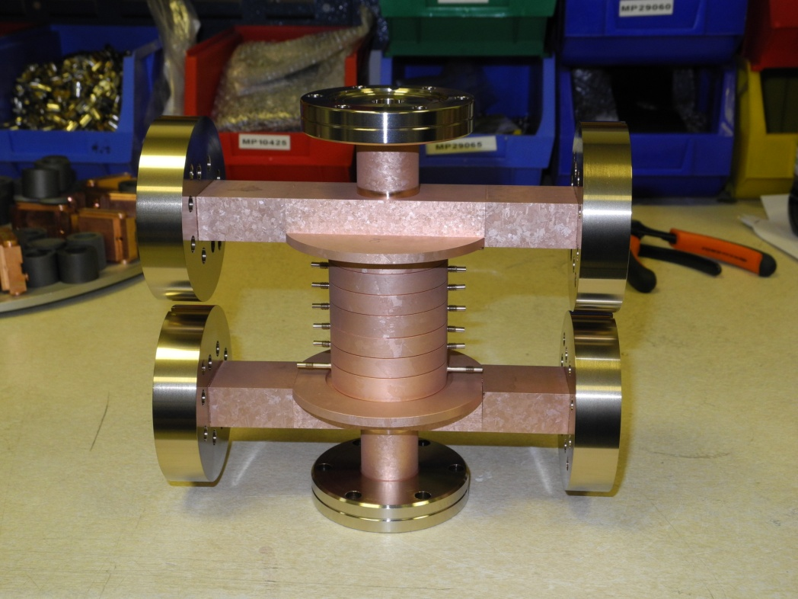
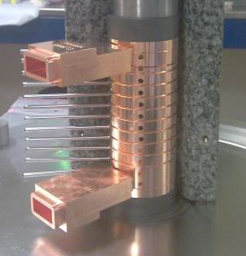
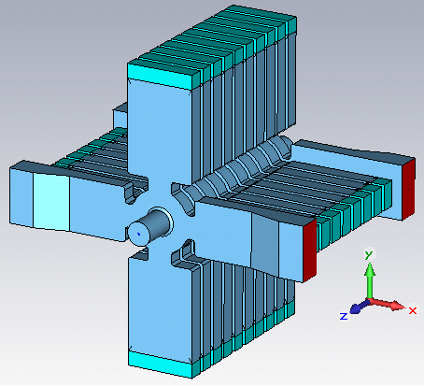
Sub-task 5: CLIC crab cavity and stabilisation development.
This sub-task has two main goals
  To understand and measure long-term phase stability in high power pulsed RF distribution and amplification, and use this to develop a distribution scheme for CLIC crab cavity
  To design, evaluate and high gradient test a CLIC crab cavity design. This will involve the testing of cavities developed pre-EUCARD2 and the development of a new cavity.

Slide 16
CLIC Crab High Power Distribution
Need to understand long term phase stability of the distribution scheme (thermal and mechanical effects)
Requires an experiment to measure phase transients and assess viability. Can be done parasitically at CERN
  Measure klystron transients
  Measure waveguide transients
Use this to develop a realistic distribution scheme
Laser interferometer
travelling wave cavity
Dual Output or Magic Tee
Control
Main beam outward pick up
Waveguide with micron-level adjustment
Waveguide with micron-level adjustment
LLRF
LLRF
Phase Shifter
From oscillator
12 GHz Pulsed Klystron
( ~ 20 MW )
Pulsed Modulator
12 GHz Oscillator
Control
Vector modulation
main beam outward pick up

Slide 17
CLIC Crab High Gradient Testing
Cavities Built but not tested
Cavity 1: UK manufactured, waveguide coupler, test of mid cells
Cavity 2: Elliptical cells and on cell couplers. CERN manufactured.
Cavities designed but not built
Cavity 3: Final cavity design with damping waveguides (without loads)
Cavities not designed
Cavity 4: Final prototype with HOM loads.
At the end of EUCARD 2 we plan to have designed all 4 cavities and build the first 3.
Also will evaluate wakefields of final design

Slide 18
Sub-task 5: CLIC crab cavity and stabilisation development.
This sub-task focuses on the RF design of the CLIC crab system. The CLIC crab cavities require extremely tight phase stabilization between the two cavities during the beam pulses. In order to ensure both cavities have the same phase it is necessary to drive both cavities from a single klystron. The phase stabilization at the end of two 25 meter long lengths of waveguide will be investigated. An experimental system test will be planned, designed and constructed to fully understand how such a system will operate at CLIC. This task will investigate the phase stability of long lengths of waveguide as well as individual components such as bends and splitters, and will study the transient behavior of high power klystrons. These measurements will be performed parasitically on existing high power tests at CTF3 and on the high power klystrons at CERN. The sub-task will also develop a full structure design, including input couplers, unwanted mode dampers, HOM/SOM loads, and evaluation of this design. During EUCARD an initial design of the cavity has been developed with a basic study of various unwanted mode dampers. A bare cavity prototype without damping was also produced. In this task a complete RF design will be developed considering electromagnetic and mechanical issues. Full 3D electromagnetic simulations of the crabbing mode and higher order modes in the structure will be performed with and without beam to verify the design meets the required tolerances including wakefields. A prototype cavity will be constructed external to this project and high gradient testing of this prototype cavity will be undertaken at CERN utilizing a high power klystron.
10.2.5 | Phase stabilisation experiment design | M | M24
10.2.5 | Crab cavity electromagnetic design | O | M30
10.2.5 | RF distribution design and analysis | R | M36
10.2.5 | Crab cavity structure testing | R | M42

