Slide 1
ISTITUTO NAZIONALE DI FISICA NUCLEARE
SEZIONE DI MILANO
LABORATORIO ACCELERATORI E SUPERCONDUTTIVITA’ APPLICATA
Task 10.4
Test in single mode:
Objectives, plan, subdivision of work
Giovanni Volpini, EuCARD2-WP10 meeting CERN June 14 2013

Slide 2
Objectives
From the DOW
Task 10.3 5 T HTS Dipole Magnet Design and Construction
Design and manufacture a prototype magnet using Bi2212 cable. This prototype will be intended to determine the highest stress allowable […] and manage the wind and react manufacturing operation
Design and manufacture an accelerator like prototype magnet using YBCO tape based conductor and having an operating current of at least 5 kA.
Task 10.4. HTS Magnet Stand Alone Test
D10.4) Magnet Cold test: The test will include:
warm measurements;
cool down & electrical quality assurance at cold;
power test, training curve;
magnetic measurements
re-training
1 o 2 ?
Giovanni Volpini, EuCARD2-WP10 meeting CERN June 14 2013

Slide 3
Objectives
From the DOW
Task 10.4. HTS Magnet Stand Alone Test
Subtask 10.4.1 Test station modification
The test station must be adapted to suit the specific features of the magnet.
The adaptation includes:
(i) Cryogenic verification of the cryostat, with respect to the specific level of stored energy;
(ii) Mechanical verification, including magnet weight and forces between
stray magnetic field and ferromagnetic structures;
(iii) Assembly station modification;
(iv) Magnet mechanical suspension;
(v) Electrical power.
Subtask 10.4.2 Magnet cool-down and energization.
...
Subtask 10.4.3 Magnetic measurements
Measure the harmonic content of the magnet at different excitation currents in liquid helium. Measure AC losses during current cycles. The tests will be carefully analysed and will give feed back to design.
Giovanni Volpini, EuCARD2-WP10 meeting CERN June 14 2013

Slide 4
Schedule
From the DOW
Test station kick-off (MS 65, Report) M26 or 30 June 2015
Magnet Cold test (D10.4) M44 or 31 December 2016
First cable length for magnet winding (MS66) M32 or 31 December 2015
The magnet manufacture completion itself is not a Deliverable…
so we have 1 year
-to complete the manufacture of all the cable
-to assemble the magnet
-to test it (w/ two cool down’s)…
Today: I will present the capabilities of the LASA test station
Giovanni Volpini, EuCARD2-WP10 meeting CERN June 14 2013

Slide 5
Introduction
The Magnet Test Station @ LASA has been developed to test the
fast-ramped superconducting dipole model for the SIS-300 synchrotron at FAIR (Darmstadt, Germany), built under the scope of a INFN-GSI collaboration. On the Italian side the project was known as DISCORAP, an acronym for Dipoli SuperConduttori Rapidamente Pulsati or Fast Pulsed Superconducting Dipoles.
The magnet was tested between June and September 2012, with excellent results.
Although less challenging from a technical point, also the successful operation of the test station was an important achievement.
Giovanni Volpini, EuCARD2-WP10 meeting CERN June 14 2013

Slide 6
Test Station Main Features - I
Vertical cryostat
inner diameter 700 mm
useful length (maximum LHe level) 6,000 mm
DUT maximum load 10,000 kg
suspension system design load 6,000 kg
design pressure 4.5 bar
Power supply
three switching power converters, each 10 kA x 6 V, can be operated in series (present configuration) or in parallel.
may operate in discharge mode for pulsed operation with max ΔV ~ –20 V.
External current bus-bars
air-cooled, 10 kA rated
Current leads
gas-cooled, CuP based, designed by LASA. Maximum operating current probably around 15 kA.
Giovanni Volpini, EuCARD2-WP10 meeting CERN June 14 2013

Slide 7
Test Station Main Features - II
Protection
Dump resistor w/ reverse current diode 45 mΩ
Design dissipated energy 500 kJ
Mechanical Switch double pole, 24 kA
(gentleman’s loan from ATLAS)
QDS loan from CERN
Cryogenics
LHe liquifier, 40 liter/hour
LHe storage dewar 3,300 liter
Measurement & Control
Quench study (64 channels, optoinsulated, 1 kHz sampling rate)
Voltamperometric loss measurement
Magnet/station control & monitoring (64 channels, 1 Hz sampling)
no apparatus for magnetic field measurement is present, nor it is foreseen
Giovanni Volpini, EuCARD2-WP10 meeting CERN June 14 2013

Slide 8
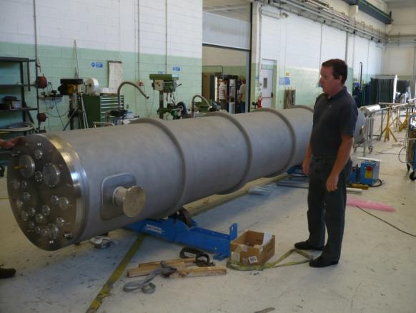
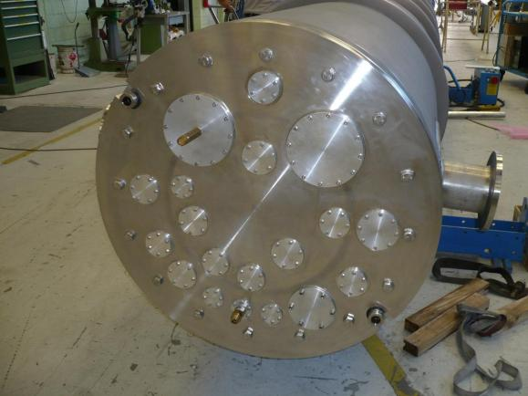
Cryostat with magnet under test
ground floor
magnet connection system
cold mass
vertical cryostat
Giovanni Volpini, EuCARD2-WP10 meeting CERN June 14 2013

Slide 9
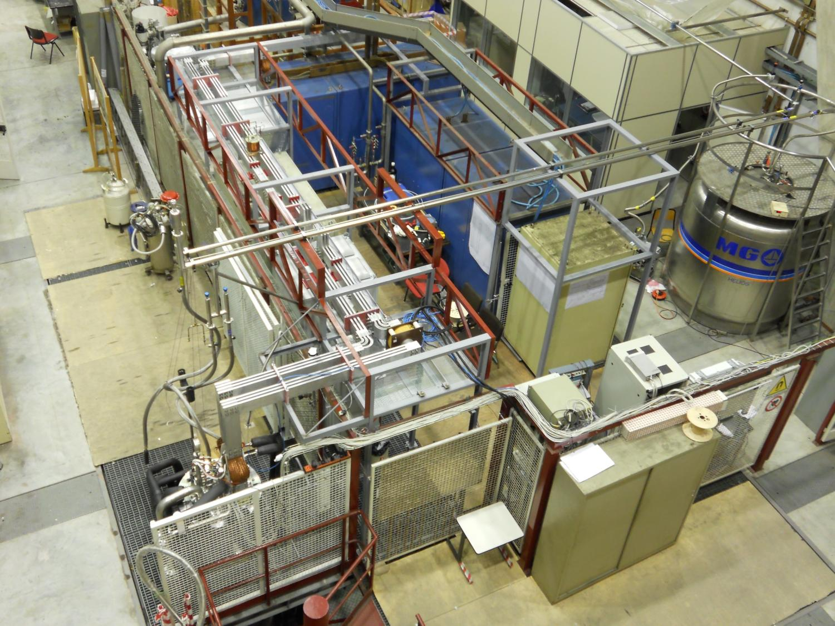
Experimental area

Slide 10
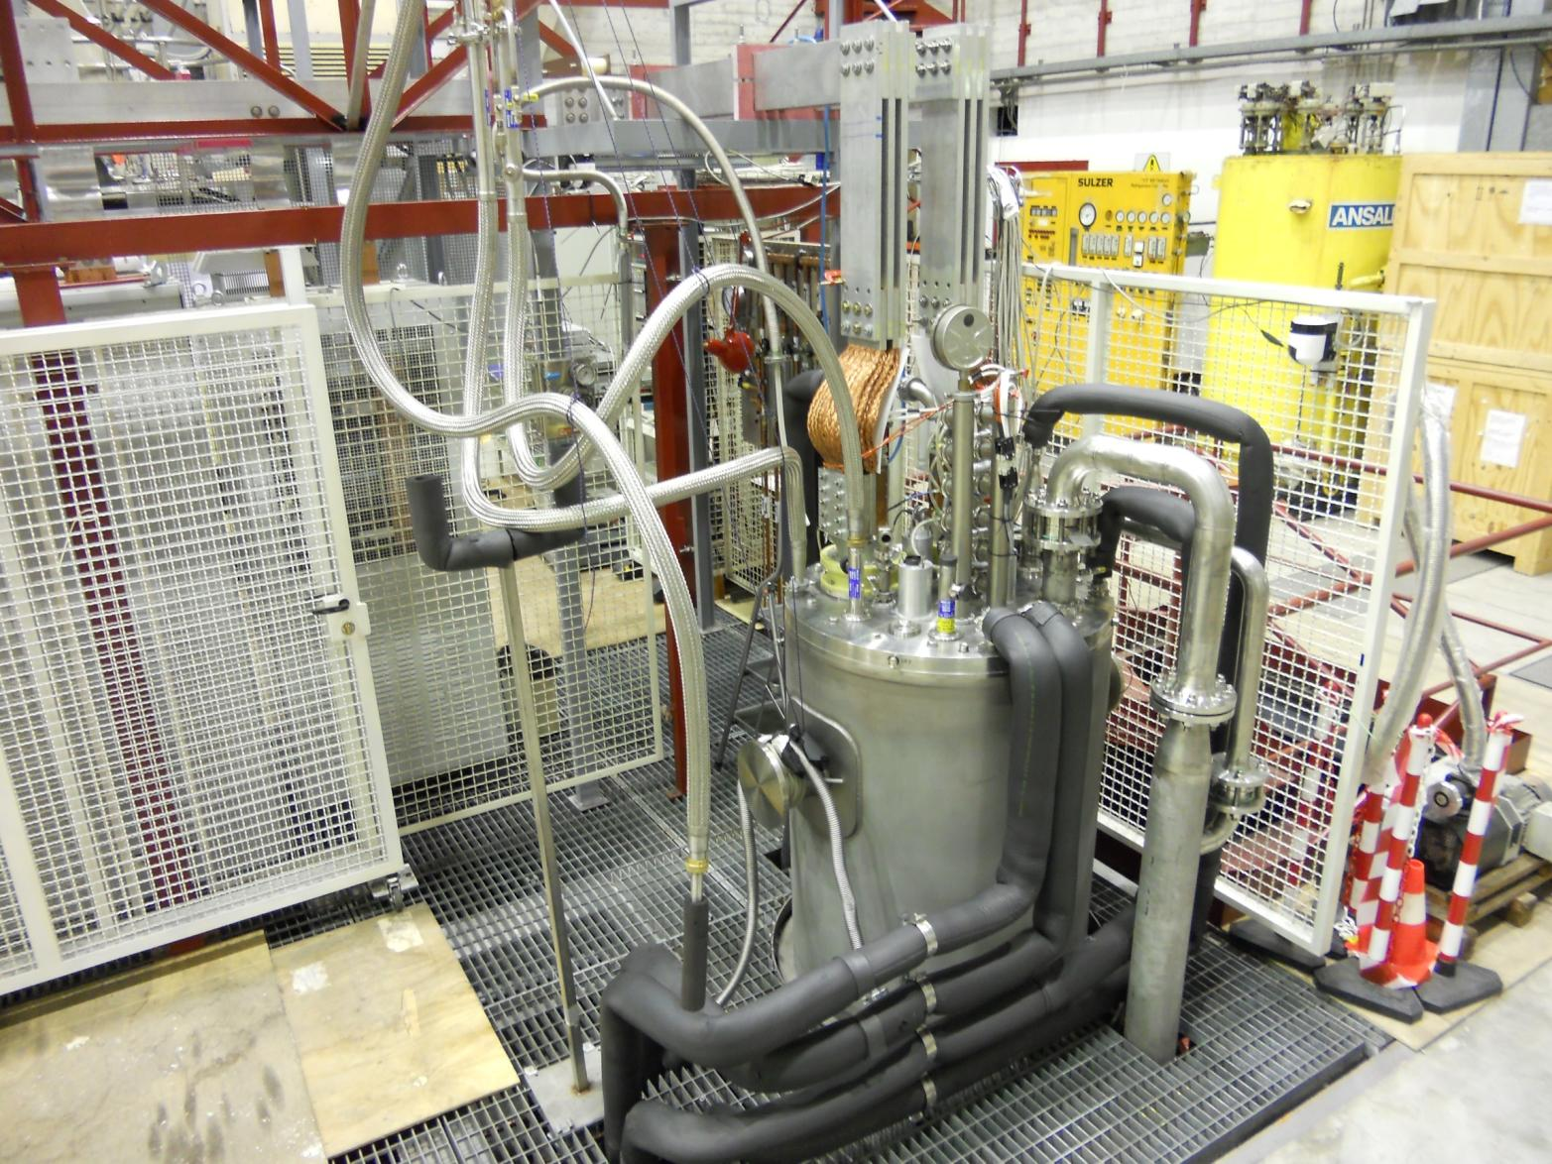
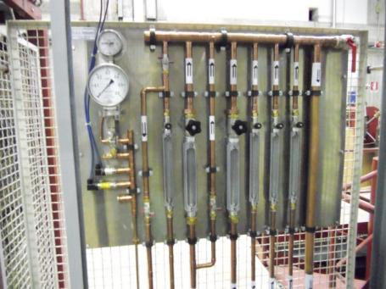
Vertical cryostat

Slide 11
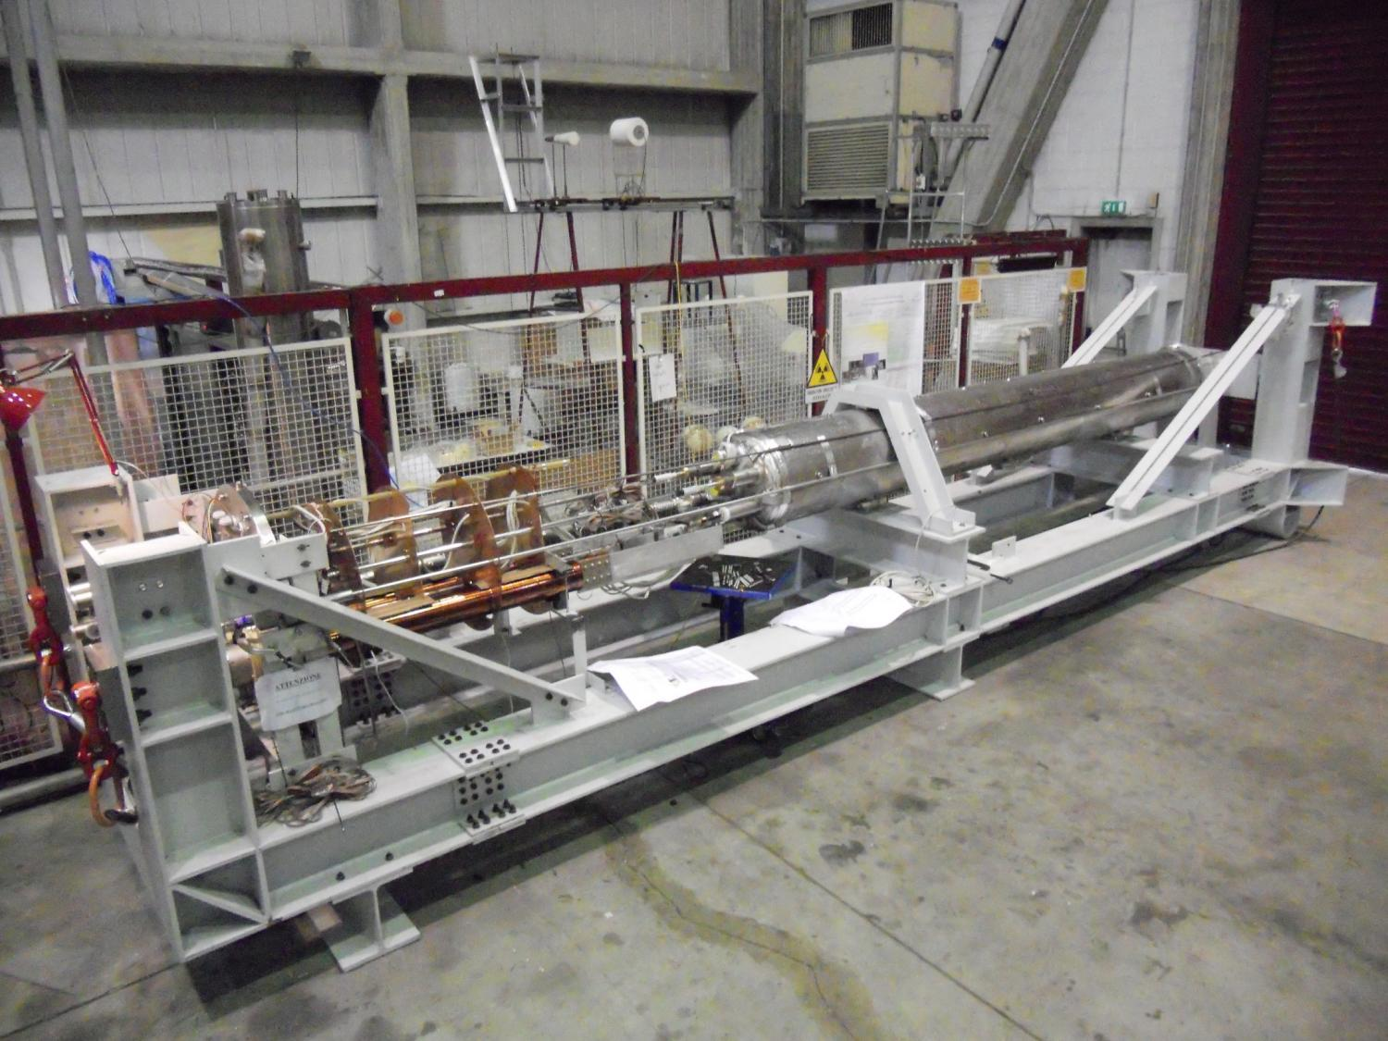
Cold mass on the assembly station

Slide 12
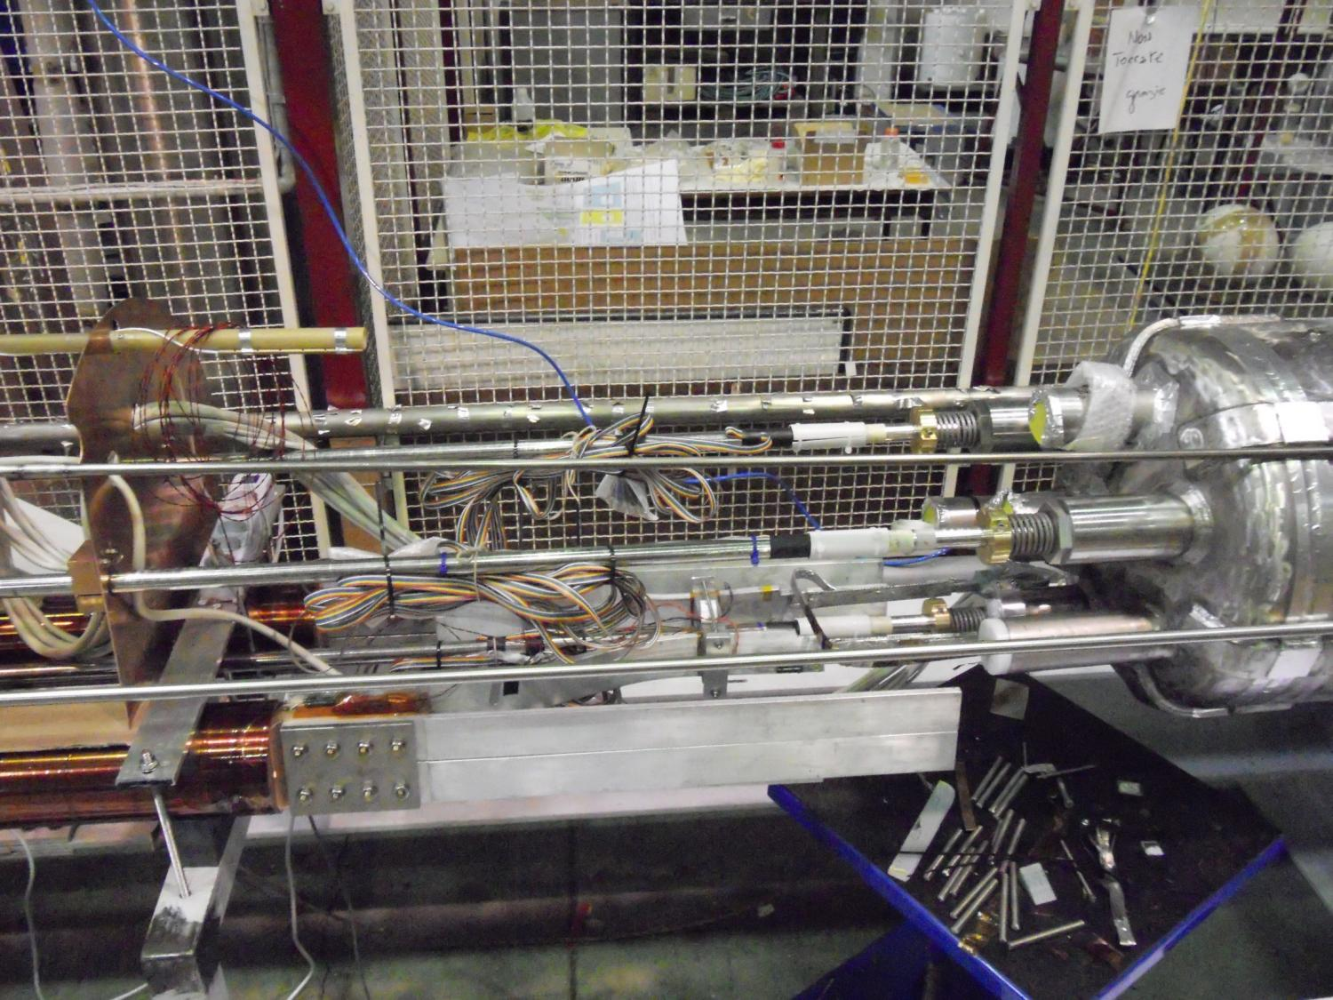
From CL’s to the cold mass

Slide 13
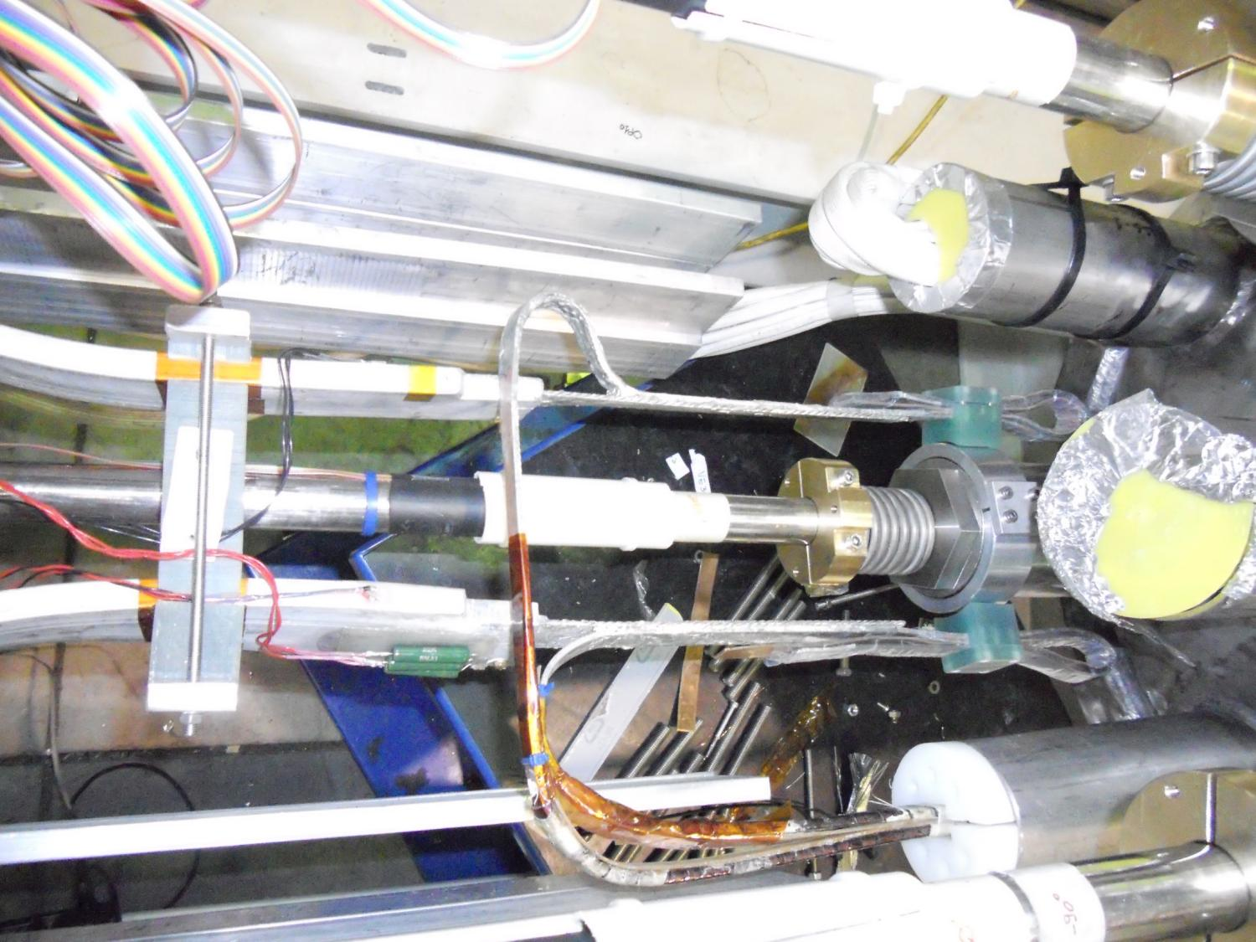
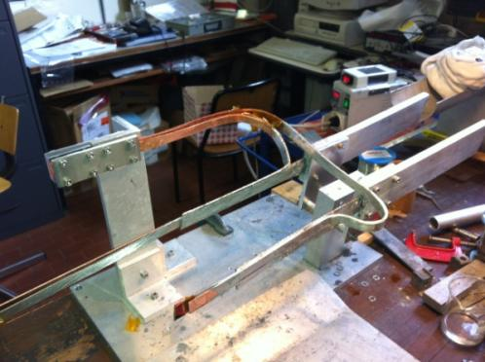
Electrical connection between bus-bar & magnet

Slide 14
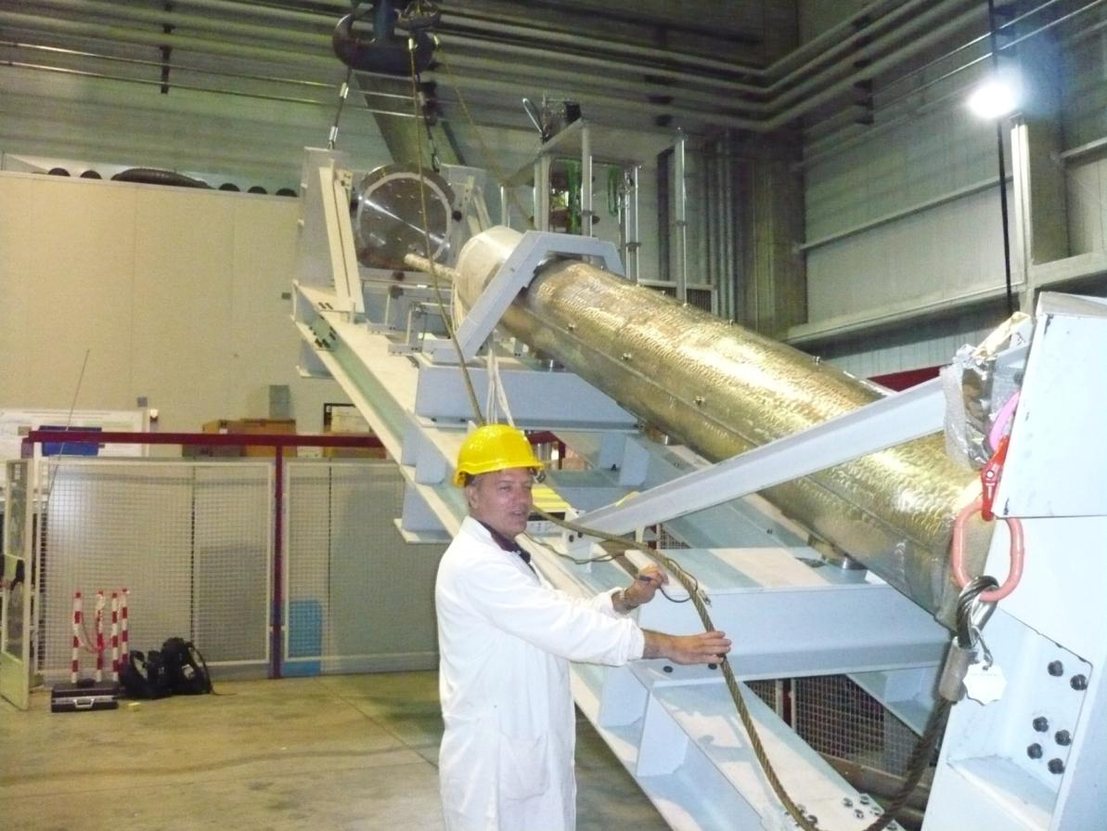
cold mass raising

Slide 15
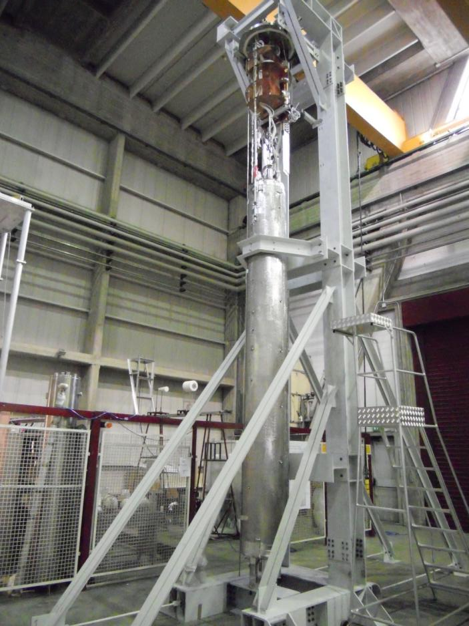
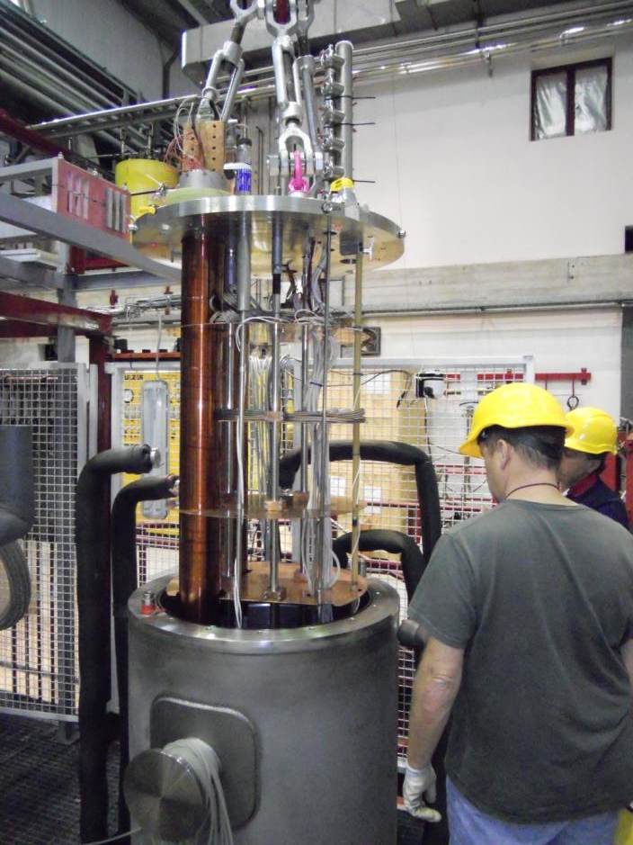
Into the cryostat...

Slide 16
magnet powering scheme - I
The discharge of an inductance requires a power supply which can provide a negative tension while feeding a positive current: i.e. it must be able to both source and sink energy.
The price tag of a 10 kA ± 40 V is probably around 180 k€. For budget reasons we have opted for a system based on:
the three 10 kA x 6 V power supplies available at LASA;
a discharge system based on a diode bank which sinks the power, in parallel with Mosfet’s which short-circuit the diode bank during the current ramp-up.
The maximum power at the magnet’s extremities probably does not exceed 15 V, so that the highest ramp rate is around 0.6 T/s, instead of 1 T/s.
Giovanni Volpini, EuCARD2-WP10 meeting CERN June 14 2013

Slide 17
magnet powering scheme II
discharge
charge
fast dump
Giovanni Volpini, EuCARD2-WP10 meeting CERN June 14 2013

Slide 18
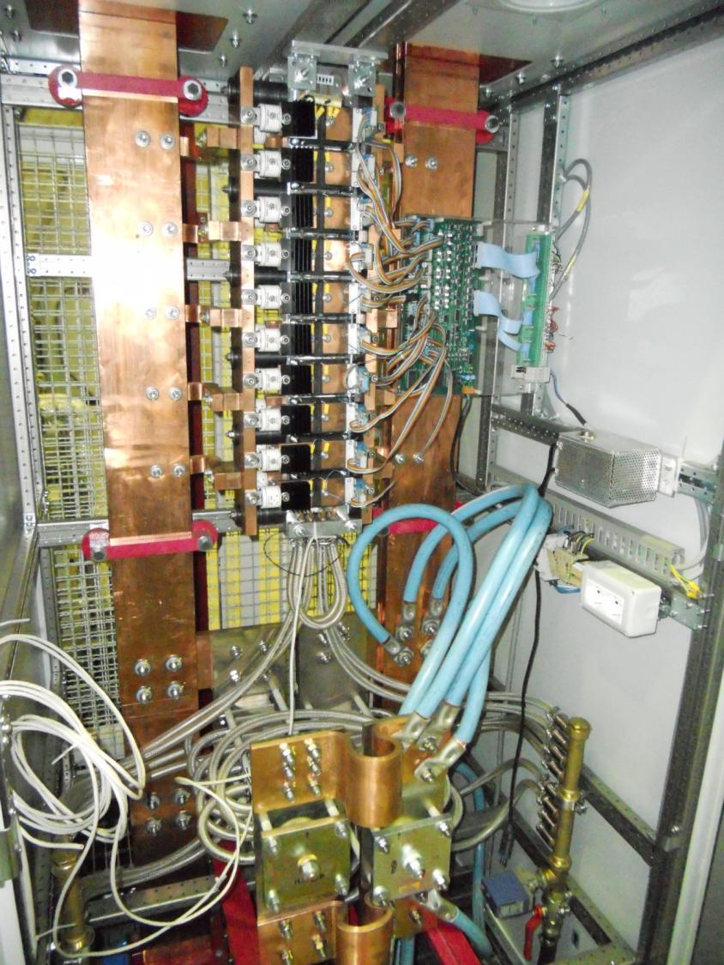
I_{in}
I_{out}
mosfet’s
Current control
diode bank

Slide 19
cooldown
The DISCORAP model magnet (6 tons) cool down was performed:
With temperature controlled GN, keeping a DT of less than 40 K across the cold mass; the DT is increased to 50 K, when the hot spot temperature drops below 200 K;
with LN, when the cold mass hot spot drops below 127 K;
with LHe, after thermalizing the cold mass in LN.
Time Table
14 days from room temperature to 127 K approx
2 days from 127 K to 77 K
2 days thermalization in LN bath
1 day LN removal
2 days cool down to 4 K
1 day LHe fill up and start
Giovanni Volpini, EuCARD2-WP10 meeting CERN June 14 2013

Slide 20
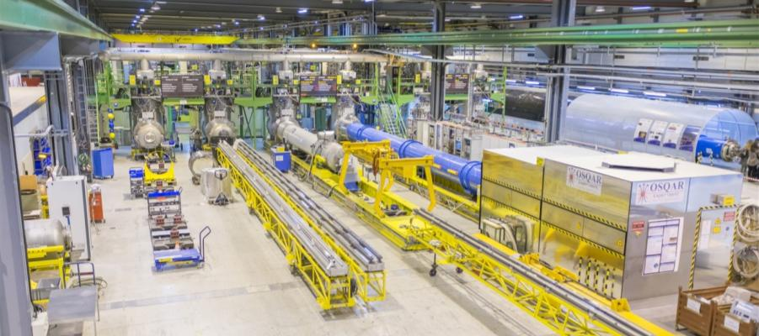
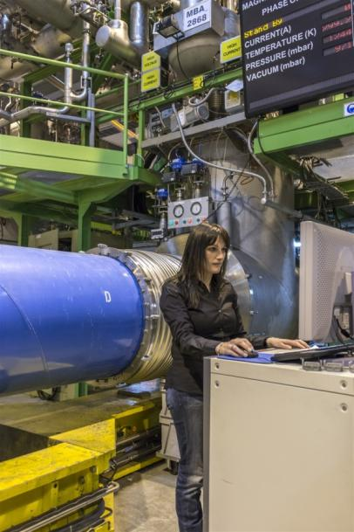
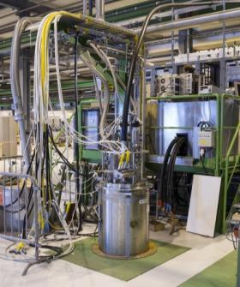
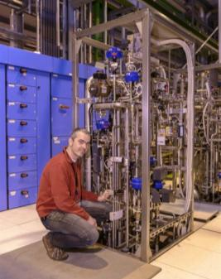
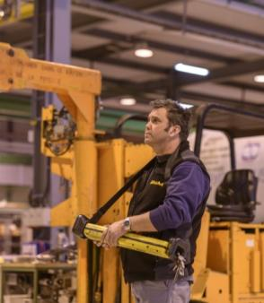
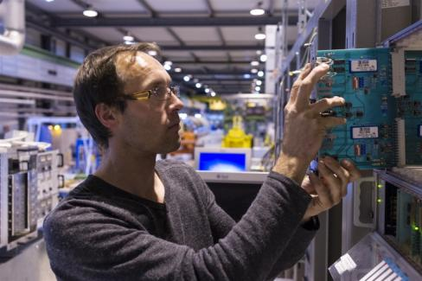
SM18 test station @ CERN
Adapted from Marta Bajko’s presentation on Task 9.2 - MagNet@CERN (TA)
EuCARD2 meeting, Thursday June 13, 2013
Giovanni Volpini, EuCARD2-WP10 meeting CERN June 14 2013

Slide 21
Test organization
From the DOW
Task 10.4 (standalone test) will be led by INFN, with the participation of CERN, CEA, TUT, DTI and Grenoble INP
CERN will play a fundamental role in the test with its expertise and equipment, including
Magnetic field mapping equipment
Quench antennas
Optical fibers for stress/temperature measurement
…
A number of other partners, including CEA, TUT, DTI, have expressed their interest to participate to the test. Others are welcomed: there is a plenty of work to do for everybody!
Giovanni Volpini, EuCARD2-WP10 meeting CERN June 14 2013

Slide 22
thank you for your attention!
Giovanni Volpini, EuCARD2-WP10 meeting CERN June 14 2013

