Slide 1
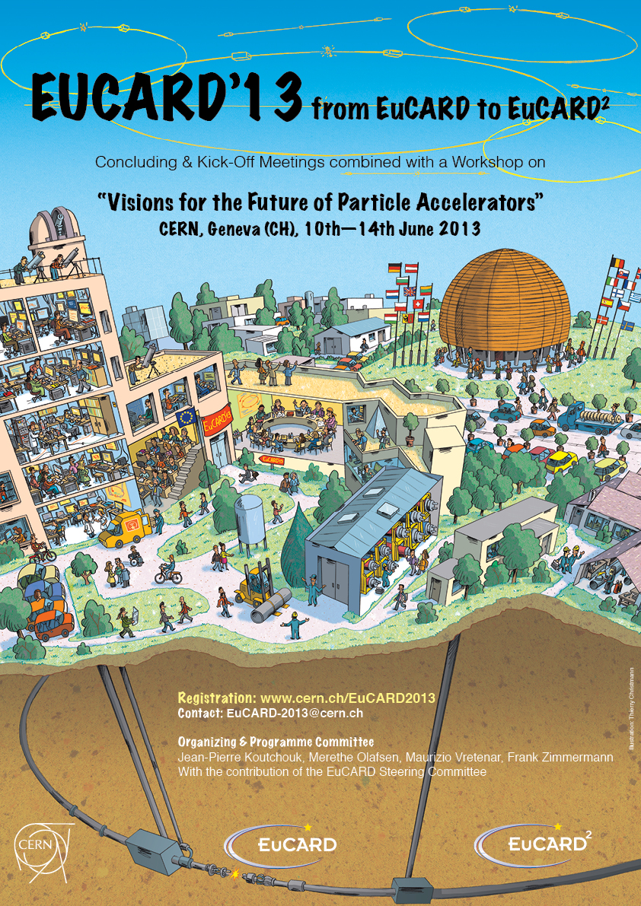
On behalf of EuCARD,
EuCARD/AccNet & EuCARD2,
Welcome to this workshop where the goal is to share views/visions on future of accelerator beyond the existing projects

Slide 2
beyond existing projects
EuCARD
We are sitting here

Slide 3
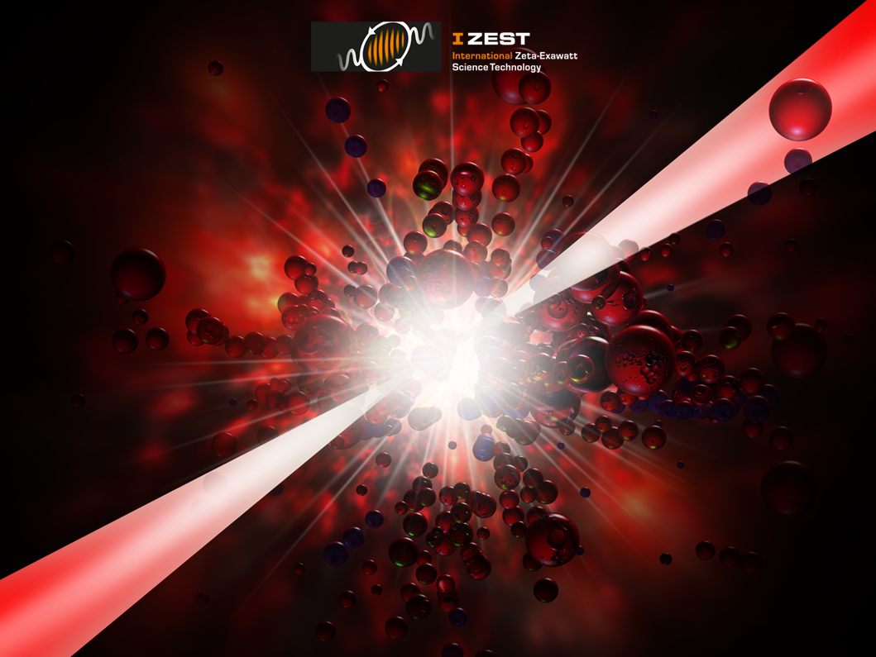
Can the Future of Accelerator Be Fibers?
ICAN Symposium
June 27-28, 2013
CERN, Geneva, Switzerland
https://www.izest.polytechnique.edu
bit.ly/ican-polytechnique
ICAN (International Coherent Amplification Network)

Slide 4


ICAN
A Revolutionary Laser Architecture for plasma wakefield accelerators
ICAN Coordinator: Professor Gerard Mourou
ICAN (International Coherent Amplifying Network) a Coherent Fiber-Based Laser Infrastructure offering:
  Peak Power, Petawatt pulses
  Megawatt Average Power (High Repetition rate >10kHz)
  High wall plug efficiency >30%
  The first «smart» laser capable to modify spot size and pulse duration to optimize the acceleration
Applications: e-p Collider, γγ Collider, Higgs Factory, Relativistic Protons, Neutron Source, Muons Collider, Proton Therapy, …

Slide 5
Changes in agenda
P. Muggli (session 2: alternative bending and focusing ); Frank Zimmermann kindly proposed to make a brief summary of the publications known to him in this field.
Gerhard Materlik (session 3: accelerator needs from Synchrotron Light Sources) givse a presentation to the British House of Lords…and will join us tomorrow to give his talk in session 5.
Consequently, the timings on Wednesday are changed by up to 15 minutes.
Last minute: Dr Tim Bestwick, STFC’s Executive Director for Bussiness & Innovation replaces Dr Kate Ronayne

Slide 6
Workshop dinner
This year, we have been able to do what I would have liked to be able to do every year: suppress the fee of the annual meeting, thanks to the support of EuCARD/WP4 and EuCARD2, where the new CERN policy has been to request EC funding for management (but not for CERN core scientific activities).
In turn, this requires discipline on EuCARD members side: If anyone registered for the workshop dinner could eventually not attend, please do inform Merethe.

Slide 7

EuCARD results and impact
Jean-Pierre Koutchouk, project coordinator, CERN
on behalf of the EuCARD collaboration

Slide 8
Outline
A summary of the EuCARD results in its various activities
Joint research
Open access
Networking
FP7 “Integrating activities”

Slide 9
What is EuCARD?
A collaboration of 40 partners, similar in structure to the HEP collaborations around the LHC detectors.
Specifically oriented accelerator R&D.
With a 4-year budget both significant, yet rather modest for each activity and partner: 31M€ full cost (management offered by CERN), i.e. ~ 20 M€ direct cost.
Funded by the EU as an Integrating Activities with 10 M€
In fact partners have contributed on average 20% more than planned (10 between 50% and 100%!).
Hence, the EuCARD results are those of mostly collaborating teams co-funded by the EC

Slide 10
I- Joint Research
R&D on superconducting High Field Magnets & electrical links
R&D on Collimation and Materials for improved machine protection and beam collimation
R&D on normal-conducting linacs and common issues to future linear colliders
R&D on Superconducting RF
Support to some novel concepts

Slide 11
R&D on High Field Magnets
& links
Preparing for 13 T to 20T magnets with Nb3Sn and HTS insert (see also WS session 2: Gijs de Rijk, for EuCARD)
High-Temperature Superconducting link (see also WS session 7: Amalia Ballarino)
Nb₃Sn undulator

Slide 12
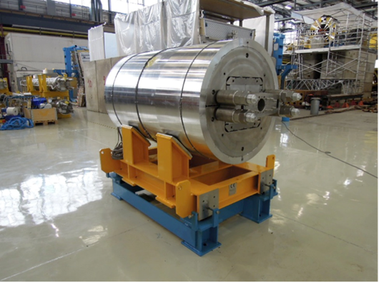
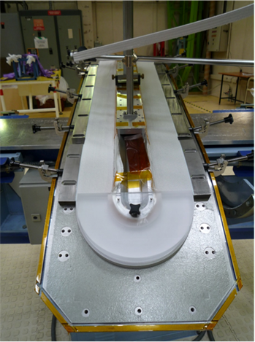
1- Preparing for 13 T to 20T magnets with Nb3Sn and HTS insert:
CEA, CERN, PWR
On the road … that will take longer than initially dreamed:
13 T magnet design done; mechanical structure ready; Nb₃Sn conductor inherits from FP6 CARE NED study; cryogenics test station on order. Dummy Cu coils being wound to test the mechanical design. Completion foreseen end 2014.
Impact: a first in EU, with excellent collaboration with US partners, who have gathered a 15 year experience; FRESCA, LHC luminosity upgrade, LHC energy upgrade, emerging future hadron collider.

Slide 13
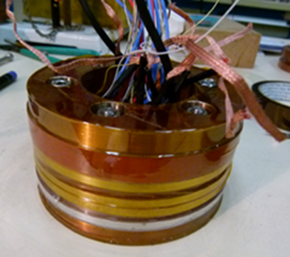
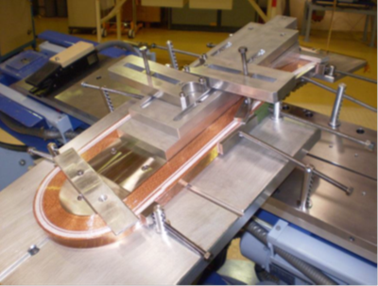
1- Preparing for 13 T to 20T magnets with Nb3Sn and HTS insert:
CEA, CNRS, KIT, INFN, TUT, UNIGE
YBCO (Bi2212) selected for the insert, and experienced gained on solenoids tested in 20T external field; Concept for quench protection developed . Dipole insert ready within weeks.
Impact: a first in EU, LHC energy upgrade, emerging future hadron collider, societal applications of HTS.

Slide 14
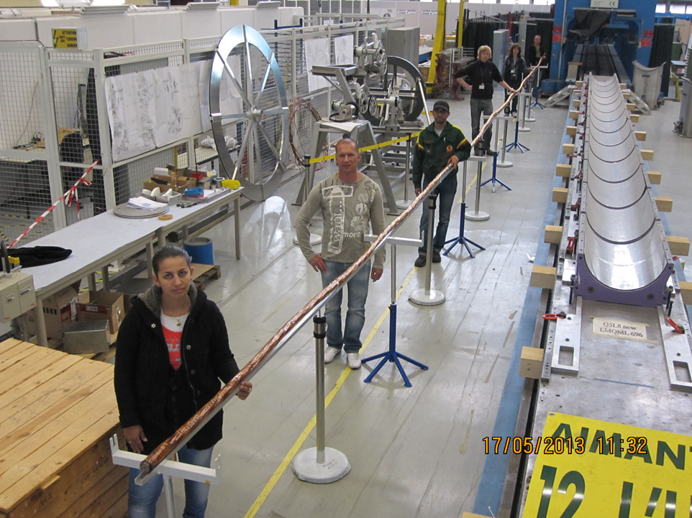
2-High-Temperature Superconducting link
CERN, SOTON, Columbus SpA, BHTS GmbH
20 m flexible HTS cable: 25 conductors to carry 600A dc each, made of MgB2 (others possible), to be cryostated and tested (5 to 70K).
Promising results measured on 5 m long links; boosted by LHC.
Impact: LHC upgrades, other accelerators, …energy applications

Slide 15
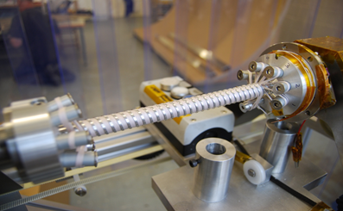
3-Nb3Sn undulator
STFC with support of CERN, INFN-LASA and KIT
Research on higher field short period magnets and innovative design (helical coils); potential impact: positron sources and FEL’s
Learning Nb₃Sn the hard way, using synergies inside WP7:
Instabilities in the first Nb₃Sn wire (low field)
Fractures of Nb₃Sn at transition to helical coil (tensile force after heat treatment + break during cool-down?)
Experience gained calls for new attempt if STFC funds can be allocated. If so, CERN collaboration will be provided.

Slide 16
R&D on Collimation and materials
Understanding effects of radiation shocks and of slow degradation of materials
Novel materials (see also WS session 7: Alessandro Bertarelli)
Smart collimators and cryo-catchers

Slide 17


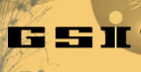











EuCARD partners
+ BNL,
R. Assmann
17

Slide 18
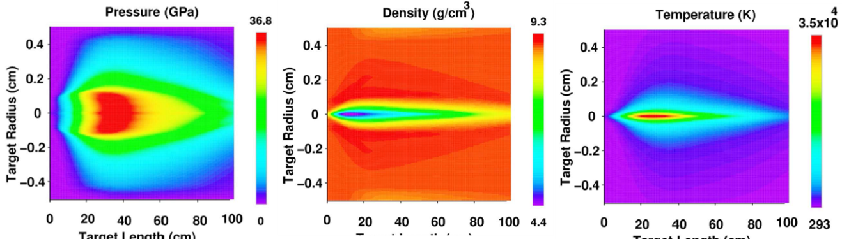
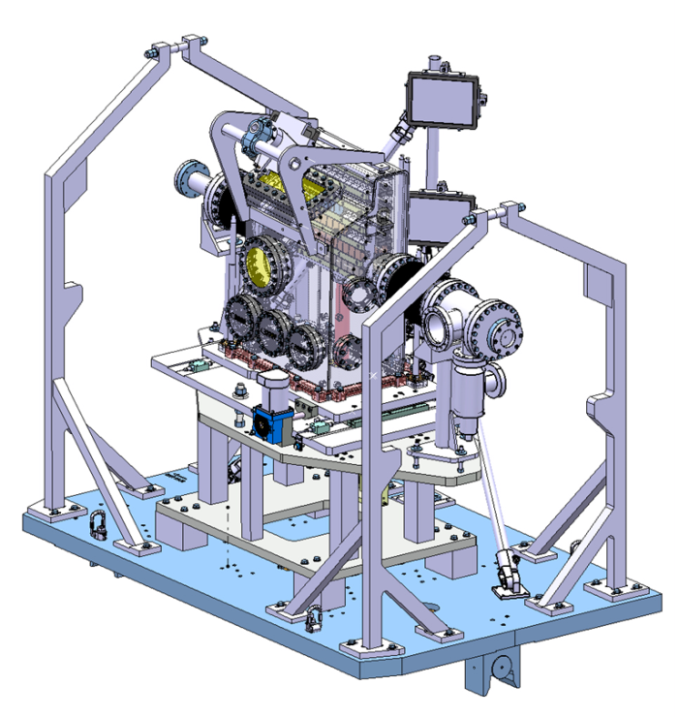
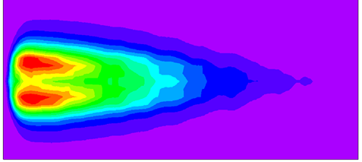
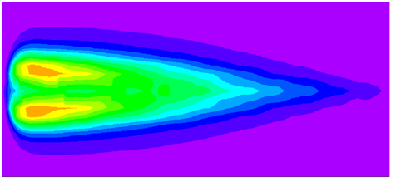
1- Understanding effects of radiation shocks and slow degradation of materials
The key: validation of the simulations of very complex systems and events using hydrocodes by experimental tests in new HiRadMat@CERN (WP5). Measuring the effect of slow degradation under irradiation (Kurtchatov Institute.)

Slide 19
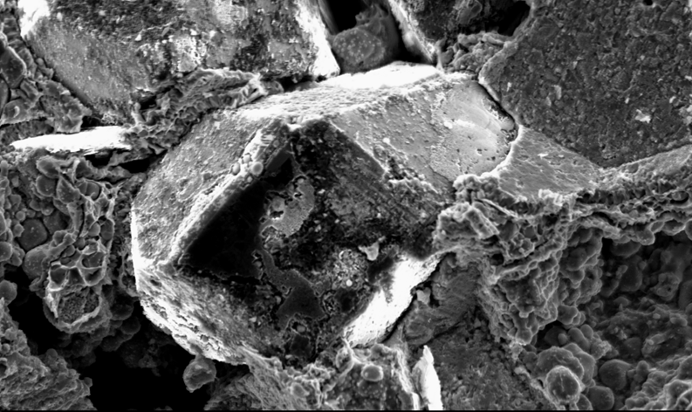
2- Novel materials
The goal: find the ideal collimator material that will protect the machine and allows efficient collimation:
Robust against radiation shocks, against radiation on long term, high electrical and thermal conductivity, highly stable in dimension in all circumstances, can be coated, efficient scatterer.
Metal Matrix Composites (Cu, Mo,…) with Diamond or Graphite, “cooked a ma façon” identified, characterized, with potential gain by a factor 10.

Slide 20
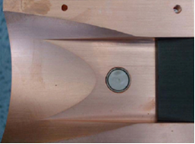
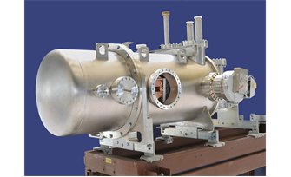
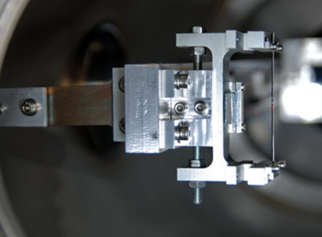
3- Smart collimators and cryocatchers
“smart” collimators to gain in machine efficiency
Ion cryo-catchers to stabilize dynamic vacuum
Crystal channeling as primary collimator

Slide 21
R&D on normal-conducting linacs and common issues to linear colliders
reaching reliably 100 MV/m at 12 GHz (see also WS session 6: Erk Jensen, Flyura Djurabekova)
Handling of nm beams (see also WS session 7: Kurt Artoos)
System integration & specificities of CLIC two-beam acceleration system (see also WS session 6: Erk Jensen)

Slide 22
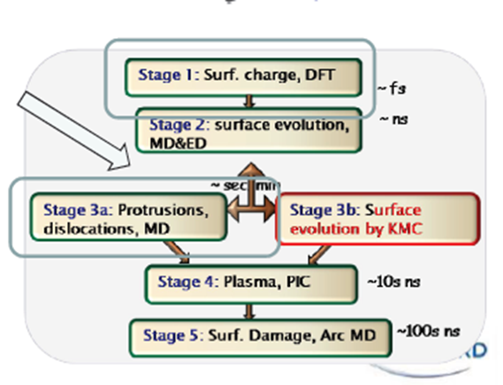
1-Reaching reliably 100 MV/m at 12 GHz
UH, UU, UNIMAN
A high accelerating gradient is only useful if the cavity breakdown rate does not impact the machine performance.
A very ambitious (and spectacular) multi-scale (atomic to macroscopic) simulation is giving new clues at the nucleation of break-down centers, and, hopefully, new approaches to minimize them.
Breakdown simulation and diagnostics, HOM damping
Like for any complex simulation code, benchmarking with experiments is essential: set-up, diagnostics,…
Maximization of HOM damping:
Damping and detuning by interleaved structures

Slide 23
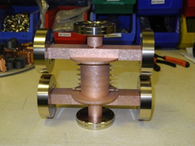
2-Handling of nm beams
CERN, CNRS-LAPP; RHUL, UOXF-DL, STFC; ULANC, UNIMAN
Alignment, stabilization
Beam Delivery Systems: same challenges with two beams + avoidance of beam dilution.
CLIC crab cavity to maximize two-beam overlap: femtosecond synchronization and high power: conceptual system design and model done, for test on CTF3.
~thickness of a one-atom layer, e.g. a graphene layer
 | FF >4Hz | Linac >1Hz
V | 0.2 nm | 1.5 nm
H | 5 nm | 5nm
Simulations,
Instrumentation, procedures, feedbacks

Slide 24
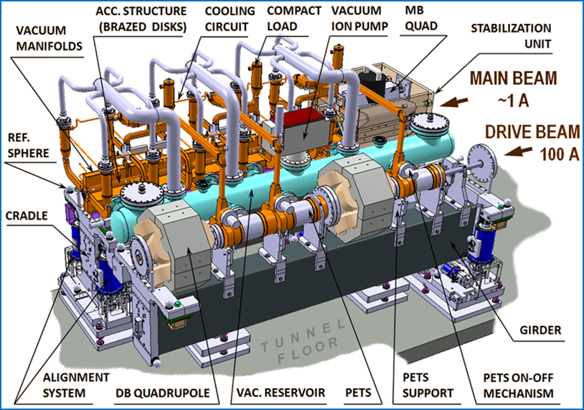
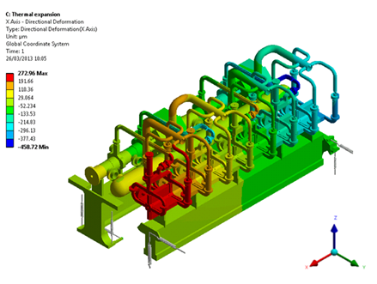
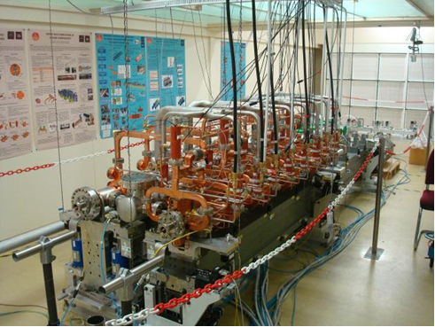
3- System integration & specificities of CLIC two-beam acceleration system
CERN, UH
Experimental validation to be carried on CLIC0 in an environment reproducing that of CLIC tunnel.

Slide 25
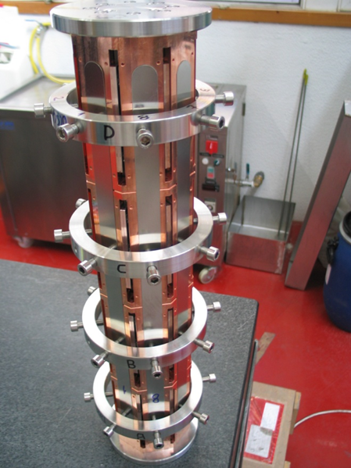
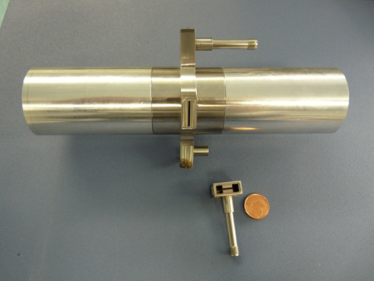
3- System integration & specificities of CLIC two-beam acceleration system
CIEMAT; INFN, PSI, CERN
Transfer of energy from the drive beam to the accelerated beam optimized for CTF3: PETS
20 femto-second synchronization between the two beams: diagnostic (two concepts) and feedback ; already developments beyond EuCARD goals

Slide 26
R&D on Superconducting RF
Processing of proton RF structures and couplers
Novel RF structures: crab cavities for colliders (see also WS session 6: Graheme Burt)
LLRF and diagnostics
Thin film technologies (see also WS session 7: Claire Antoine & Jochen Teichert)

Slide 27
1-Processing of proton RF structures and couplers CEA, CERN, CNRS-LAL, CNRS IPN-Orsay
With the ESS project, the SPL studies, the interest in accelerator driven systems, there has been a strong incentive to develop the competence for proton SC cavities in the 700 MHz range. The secret for high and reproducible performance lies with the art of etching, polishing, washing, rinsing RF structures and couplers.
The impact of EuCARD has been to successfully boost collaborations, studies and lab investments in this area. The bulk of concrete results will be on the medium term. First EuCARD concrete results should come within months with the measurement of SPL-type cavities to be delivered in July to the lab.

Slide 28
2-Novel RF structures: crab cavities for colliders
STFC, ULANC-CI, UNIMAN, CERN
Premiere in EU; proton crab crossing was deemed unrealistic only some years ago, due to the phase noise and the size of cavities too large for the LHC,…
Development in “competitive synergy” with several other solutions by US partners, compared and discussed in WP4 by all actors.

Slide 29
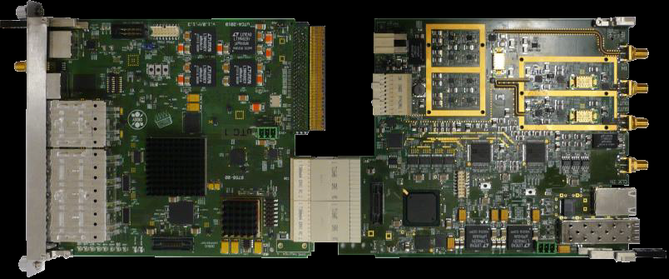
3-LLRF and diagnostics
DESY, TUL, WUT, IFJ-PAN, IPJ
LLRF for FLASH:
An effort towards standardization for optimum availability, modularity, ease of operations and of maintenance:
Custom made →ATCA →μTCA (both telecom standards)
First observations on FLASH should come.
Brings to completion a project initiated in FP6 CARE

Slide 30
3-LLRF and diagnostics
DESY, UNIMAN, UROS
HOM distribution:
“Out of a problem make a solution”
Use the signal of a HOM coupler to derive information on beam-cavity alignment, cell-to-cell alignment and field perturbations by design constraints or imperfections. Simulation to establish the Jacobian matrix, experiments at FLASH
RMS resolution | Beam-pipe | D1 | D2 | D5
f_mode (GHz) | 4.1 | 4.2 | 5.5 | 9
x (μm) | 50-100 | 20-30 | 10-25 | 40-50
y (μm) | 100-150 | 40-60 | 30-40 | 40-80
Intermediate results demonstrated potential as BPM’s; final results will tell us whether more can be extracted from the signals

Slide 31
4-Thin film technologies
CEA, CERN, CNRS, DESY, HZB, INFN-LNL, SINS, ULANC & HZDR
Progress on samples, but the application to cavities is difficult.
Design gradient expected for low frequency QWR cavities (~ 6MV/m), even though not given for granted (magnetron sputtering, HIPIMS,…)
GaAs photocathodes yielding higher QE not yet there, but much hope for the next campaign with new test chamber in HZDR.
WP4 conclusions (D4.3.2) ,W. Weingarten
“The Q-slope issue being solved, accelerating gradient [of cavities coated with Nb3Sn] could go up to about the double of niobium cavities… Another promising topic is the application of sandwich films ”

Slide 32
R&D on Novel Concepts
Design of insertion with crab waist in DAFNE [INFN, CERN]
Diagnostics and support to EMMA NS-FFAG commissioning [STFC, HUDD]
Emittance diagnostics for laser-plasma accelerated beams [CNRS, INFN] ( see also session 6: Victor Malka)

Slide 33
1- Design of insertions with crab waist
[INFN, BINP, CNRS, CERN]
Combine crab-waist IR with an experimental detector in DAFNE
Study relevance and feasibility for the LHC
DAFNE: complete study and implementation, covering all aspects: beam dynamics, lattice design, studies of beam-beam and collective effects, construction of equipment and installation of the IR, upgrade of beam diagnostics, feedback and kickers.
Not in EuCARD: specific luminosity increased by 3…but luminosity has not scaled yet: lifetime issues. Source under investigation.
LHC: Quite unexpectedly (round beams, protons, rather than electrons, constraints of an existing machine), solutions could be identified, requiring though a very special “double half quadrupole”. Could be a candidate concept for the LHC energy upgrade.

Slide 34
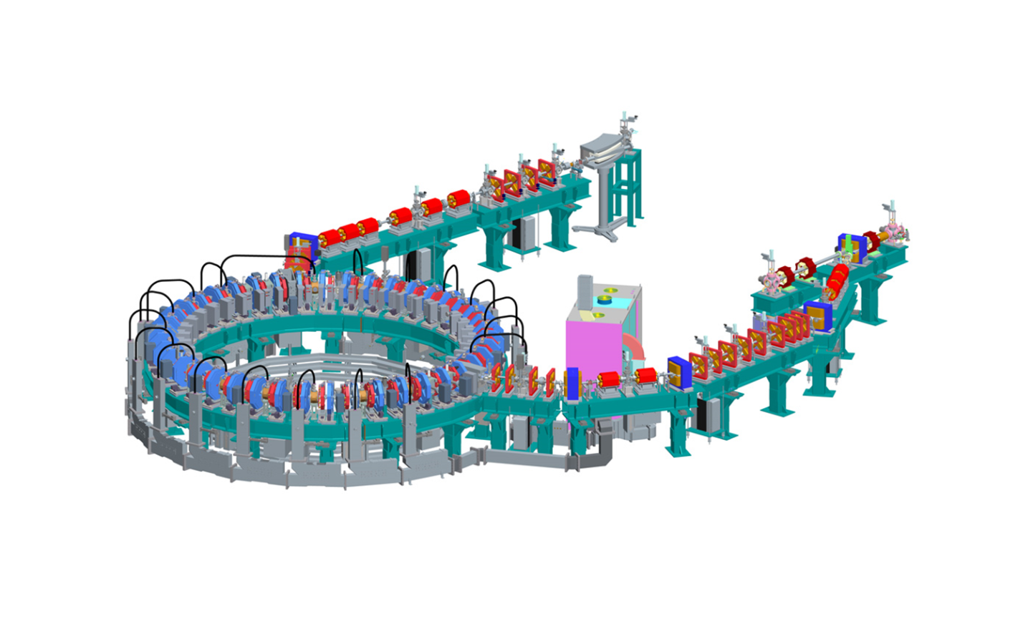
2- support to EMMA diagnostics and commissioning [STFC, HUD]
Contribution to commissioning, especially the diagnostics for assessing the beam behaviour. Success of “serpentine” acceleration reported, and of basic principles of the machine.
Results published in Nature Physics Jan. 2012.

Slide 35
How to measure the beam emittance of a laser-driven plasma wakefield accelerator
[CNRS-X-ENSTA, INFN]
Challenge: small size (μm) and large divergence (1000 μrad), to be measured in single shot, to alleviate shot stability issues.
Principle selected: “betatron” radiation in plasma field, acting as an undulator.
Achieved: proof of principle; error bars large: +/- 50%

Slide 36
II- Open Access / Trans-national Access
HiRadMat@CERN: pulsed irradiation
MICE@STFC: precision beams
A priori not needed by our community who has native TA’s both as a goal or tradition since decades.
In practice, was successful and helped some research teams that could otherwise not have afforded, and helps reserving machine time for R&D.
Their management is heavy and complex, designed or IA’s dominated by TA’s. Thanks to Ilias Efthymiopoulos/CERN, Norman McCubbin/STFC, CERN EU Office: Svetlomir Stavrev, Kate Kahle, Agnes Szeberenyi.

Slide 37
III- Scientific Networks
NEU2012: structuring the EU neutrino community
ACCNet/ EUROLUMI: support and performance of LHC and FAIR
ACCNet/ RFTech: RF technologies
+
ACCNet/EURONNAC: Novel acceleration concepts

Slide 38
1- Network on υ facilities preparing the update of the ESPP
Eu strategy for particle physics
Support for discussions of accelerator, detector, phenomenology experts
in a relatively small (~ 500 ) community vs cost of this physics
of growing recognition from serial discoveries in υ oscillations from 1998→
to the 3rd last υ mixing angle θ₁₃ in 2012, promisingly large
meetings, workshops, “lobbying” for finally revived CERN support
synthesis papers D3.3.1 our proposal to ESPP (next slide) Jul 2012
D3.2.1 survey of the facilities studied Apr 2013
D3.1.2 outlook after the ESPP Jun 2013
Impact: 1) full recognition by ESPP of LBL υ physics case
2) way open to adequate ESPP LBL υ implementations
in Europe and/or America & Asia

Slide 39
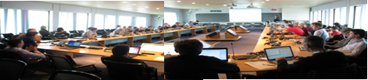
2- Network on LHC and FAIR: EuroLumi brainstorming and proposing significant advances
>20 topical workshops in 4 years, gathering EU, US and Japanese accelerator scientists and more;
Impact:
A recognized place for discussions at a world level, largely sponsored by the participants.
Proved a very important source of proposals for CERN and European HEP:
Turned crab cavities into a realistic possibility for an optimal LHC upgrade: now at the heart of the LHC luminosity upgrade
Launched brainstorming on the LHC energy upgrade
Just launched brainstorming on TLEP as an alternative to LC’s, with large potential for its longer tunnel.
Electron cloud mitigations (with ESA & satellite community)…

Slide 40
3- Networks on RF and PWA exploiting synergies
RF: exchange over all aspects of RF systems: structures, em calculations, LLRF, SS power amplifiers, RF for LHC, for FEL’s, for crab crossing… Important report on strategy for SC technology and test stations.
PWA: initiated as a voluntary EuCARD NA after exchanges with V. Malka (JRA) and others: need to create a stronger link between the PWA and the accelerator communities, need to work together in EU to combine forces, need of infrastructures dedicated to PWA (“from acceleration to accelerators”). 2 successful workshops to prepare a roadmap; PWA network included in EuCARD2, links established with initiatives in lasers and PWA (ICAN/IZEST,…)

Slide 41
Management and communication
Two much communication kills communication.
Yet, EC requested a dedicated network. The next presentation will present how, in a saturated environment, we believe we created added value.

Slide 42
Conclusions
Within its budget limits, EuCARD, like former CARE, has allowed leveraging resources and competences to reach or help reach solid R&D results: either building solid foundations for future developments or providing some “quantum jumps”, in a mix of generic and project-oriented R&D.
EuCARD has shown as well that collaborations “overall” pay dividends: scientific results, motivation and training of PhD students, enhanced scientific exchanges, mutual help…
EuCARD2 now takes over.

