Slide 1






LINAC STABILISATION
(including FF)
Mechanical stabilisation and nano positioning with Angstrom resolution
K. Artoos , C. Collette (ULB), M. Esposito, C. Eymin, P. Fernandez Carmona , S. Janssens, R. Leuxe, H. Mainaud Durand, M. Modena
A. Jeremie, J. Allibe, L. Brunetti, J.-P. Baud, G. Balik , G. Deleglise, S. Vilalte,
B. Caron, C. Hernandez
The research leading to these results has received funding from the European Commission under the FP7 Research Infrastructures project EuCARD

Slide 2
Outline
Ground motion and CLIC Requirements
Obtained results
Short view on ultimate performance limitations

Slide 3
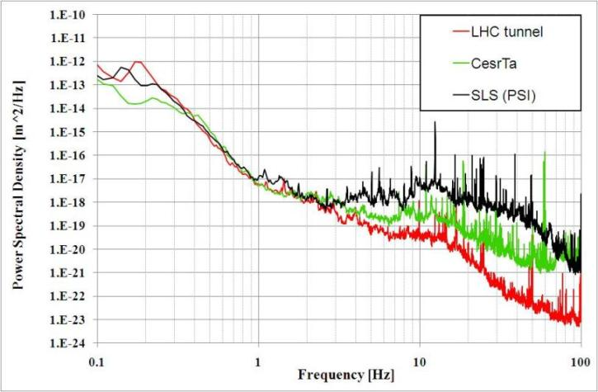
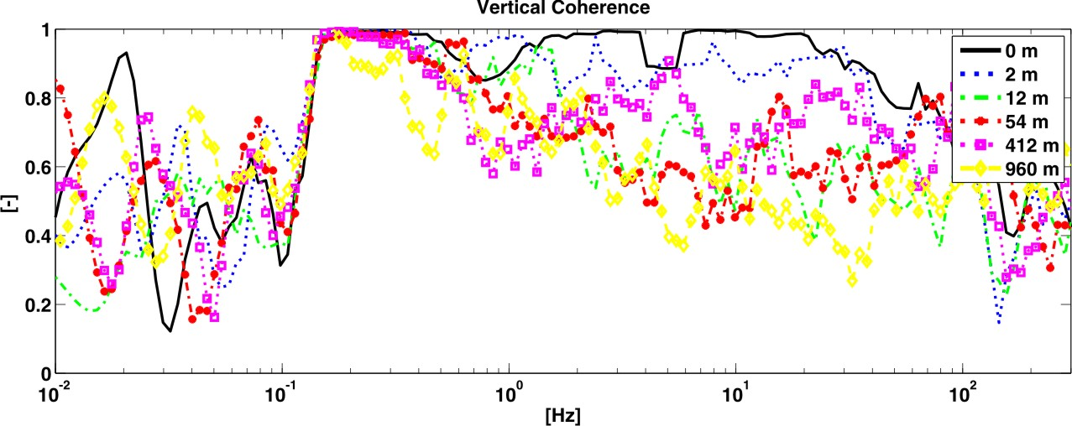
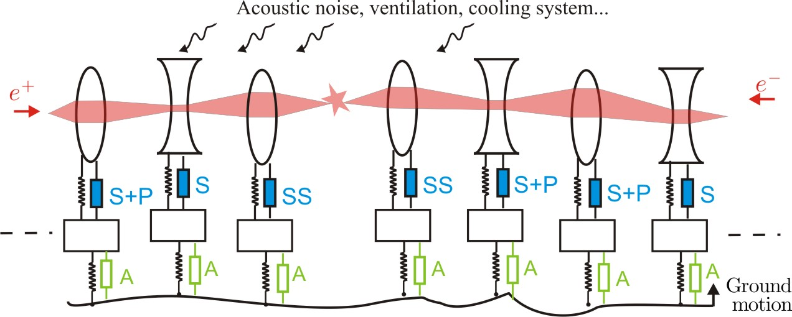
Ground motion
20 km
~40 nm
1 nm

Slide 4
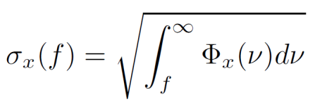
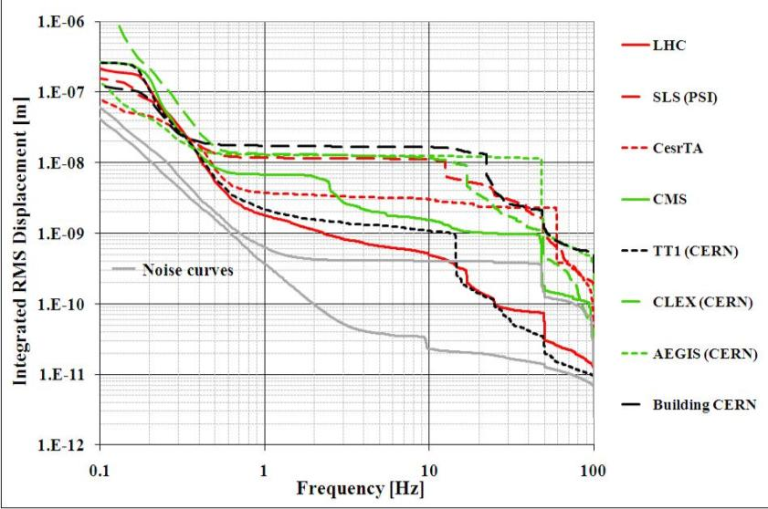
Luminosity, beam size
and alignment
Integrated r.m.s. displacement
Possible mitigation techniques:
Alignment
B.P.M. + dipole correctors
B.P.M. + Nano positioning
Seismometers + Dipole correctors
Mechanical stabilization with seismometers
f
Requirements Mechanical stability:
Vertical MBQ | 1.5 nm at 1 Hz
Vertical Final Focus | 0.2 nm at 4 Hz
Lateral MBQ, FF | 5 nm at 1 Hz 5 nm at 4 Hz
BUT Final requirement is Integrated Luminosity

Slide 5

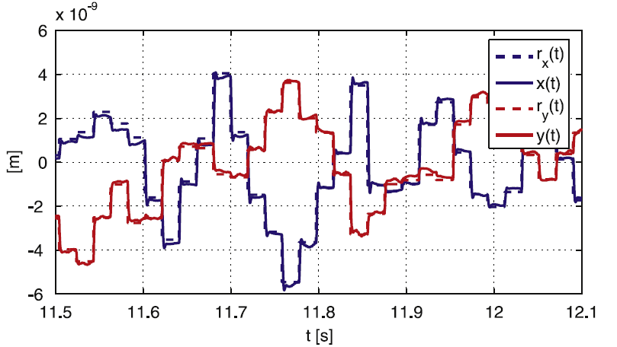
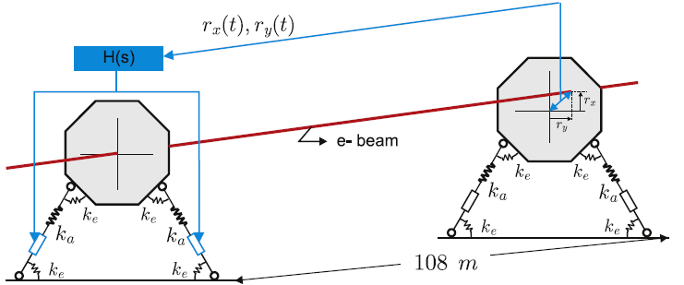
Nano positioning
« Nano-positioning» feasibility study
Modify position quadrupole in between pulses (~ 5 ms)
Range ± 5 μm, increments 10 to 50 nm, precision ± 0.25 nm
Lateral and vertical
In addition/ alternative dipole correctors
Use to increase time to next realignment with cams

Slide 6
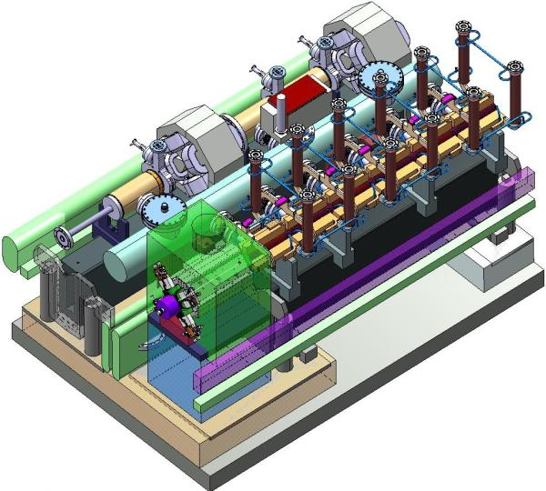
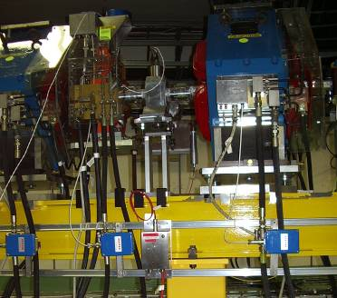
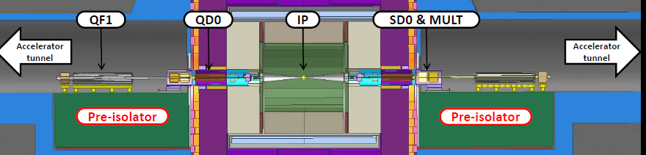
Other requirements stabilisation support
Stiffness-Robustness
Applied forces (water cooling, vacuum, power leads, cabling, interconnects, ventilation, acoustic pressure)
Compatibility alignment
Transportability/Installation
Available space
Integration in two beam module
620 mm beam height
Integration in cantilever tube FF
Accelerator environment
High radiation
Stray magnetic field

Slide 7
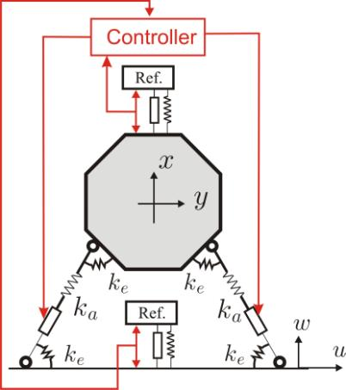
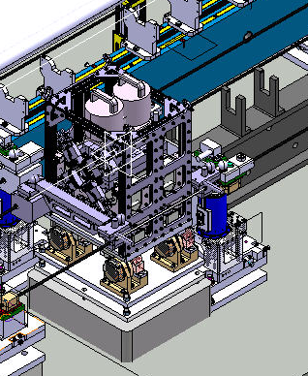
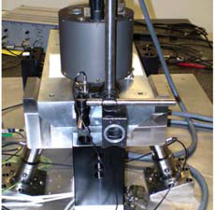
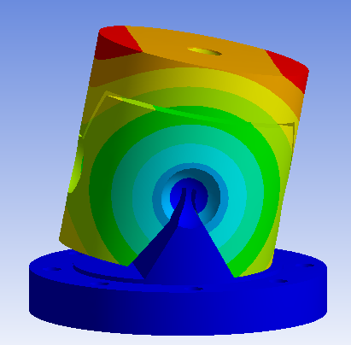
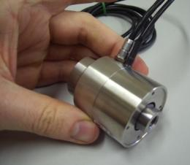
Concept for MBQ
Inclined stiff piezo actuator pairs with flexural hinges (vertical + lateral motion)
(four linked bars system)
X-y flexural guide to block roll + longitudinal d.o.f.+ increased lateral stiffness.
(Seismometers)/ inertial reference masses for sensors
Alignment
Eucard deliverable

Slide 8

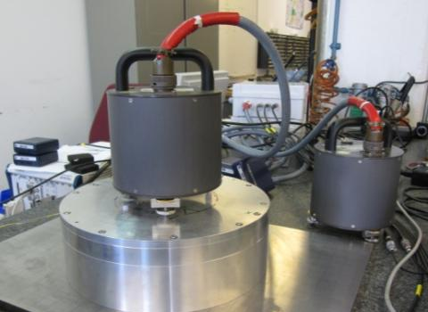
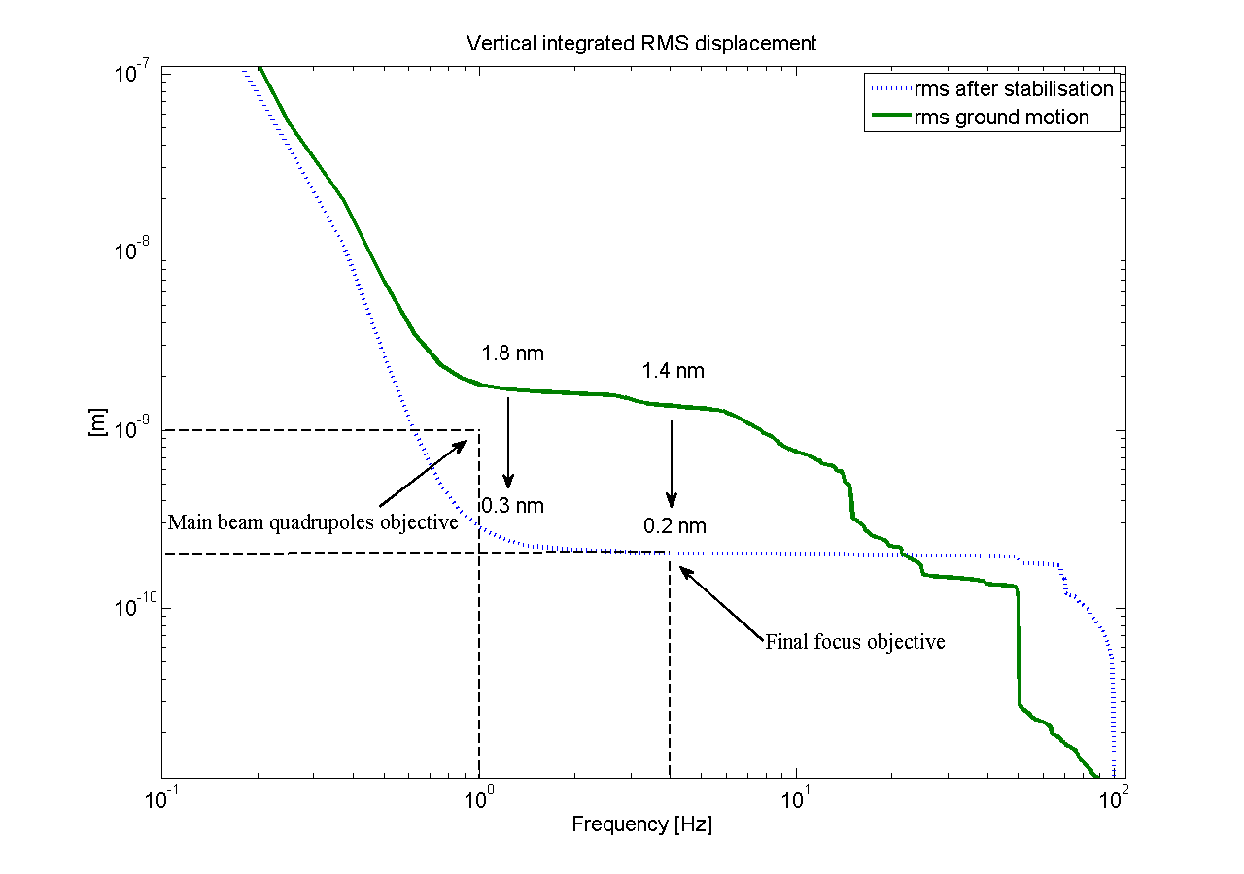
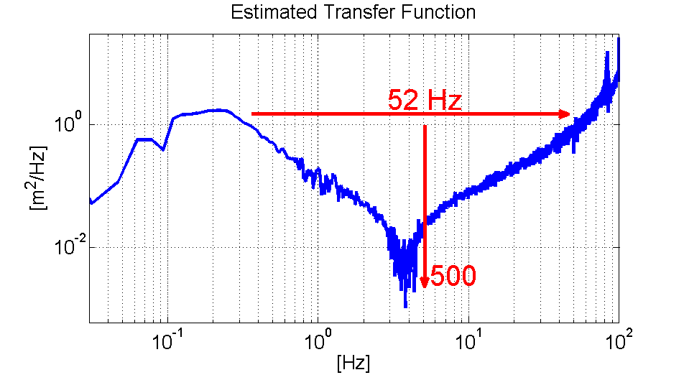
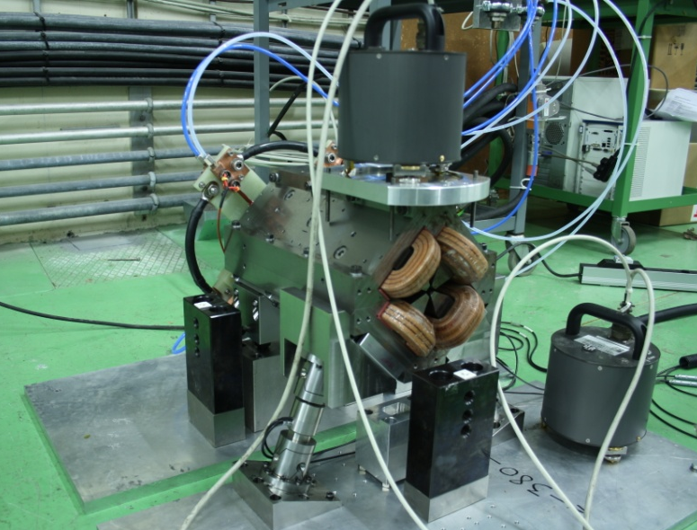
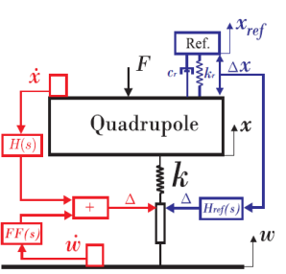
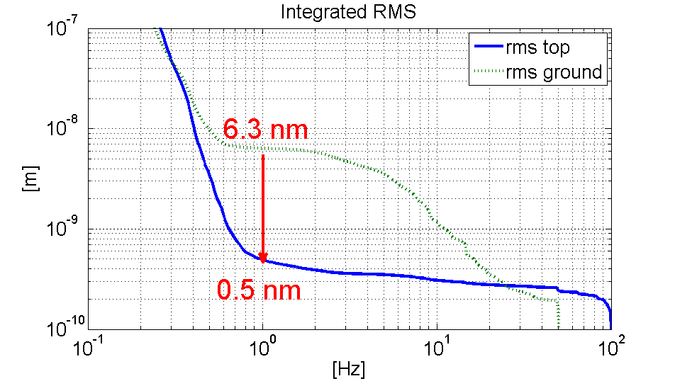
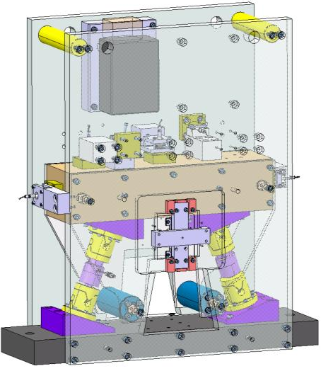
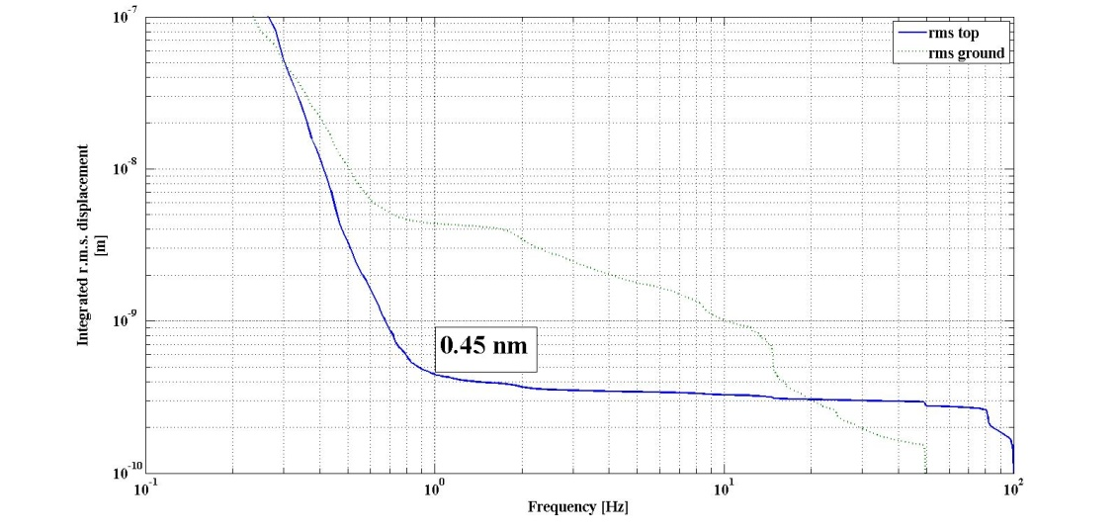
Concept demonstration
actuator support with staged test benches
Collocated pair
EUCARD
deliverable
Type 1
Seismometer FB max. gain +FF
(FBFFV1mod): 7 % luminosity loss
(no stabilisation 68 % loss)
X-y proto

Slide 9
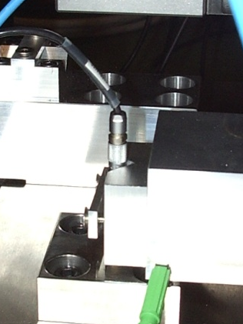

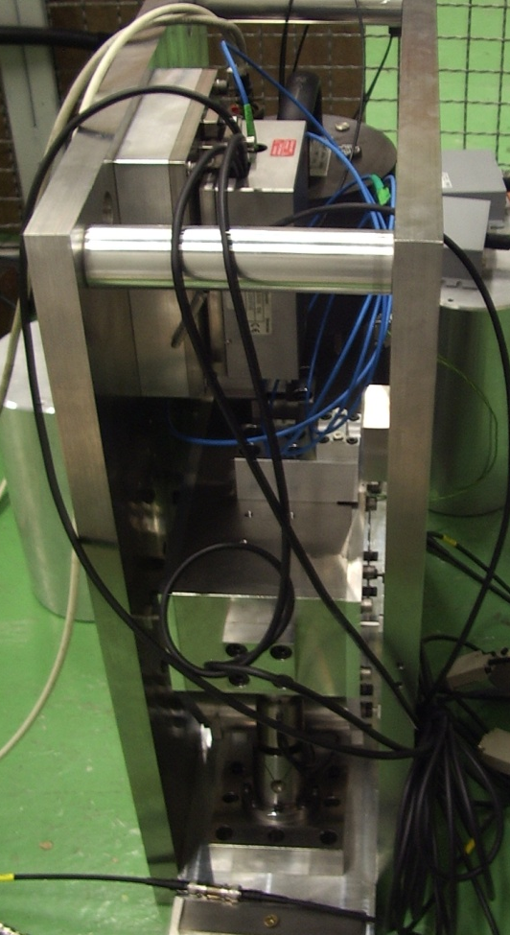
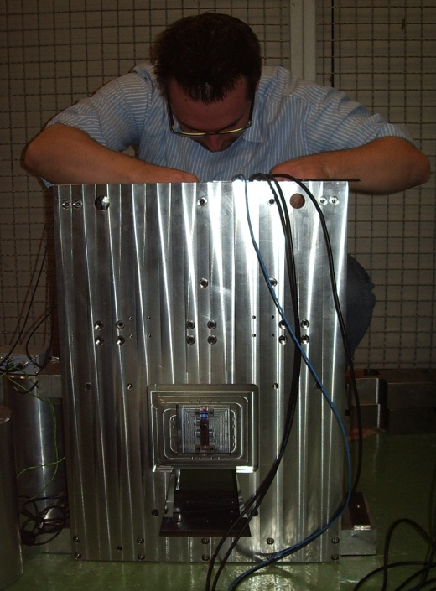
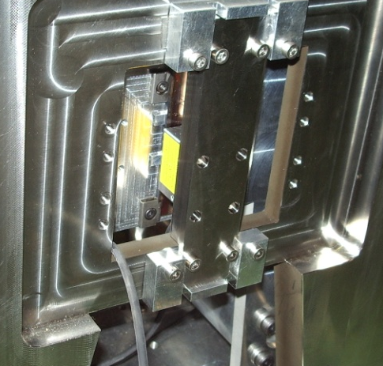
X-y prototype:
Demonstration Nano positioning
Resolution, precision, accuracy
Capacitive sensor
3 beam interferometer
Actuators equipped
with strain gauges
Optical incremental encoder

Slide 10
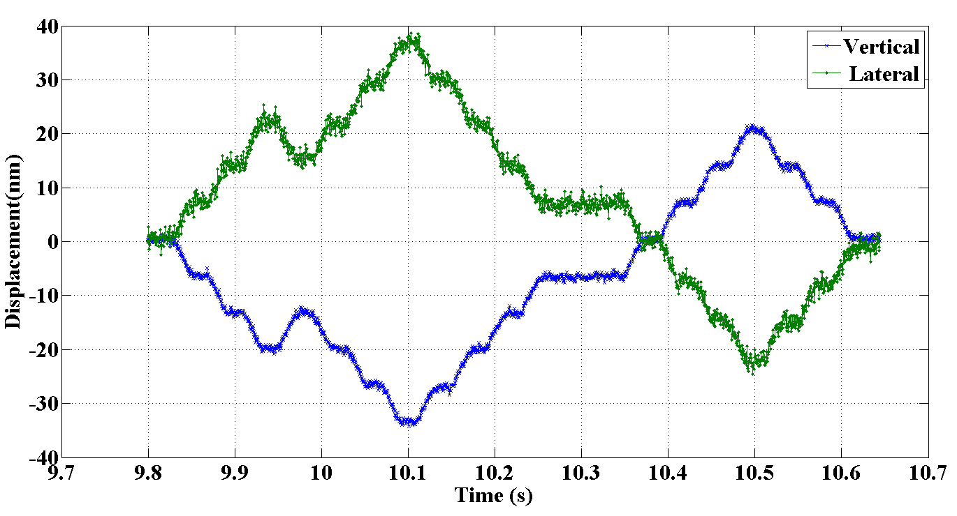
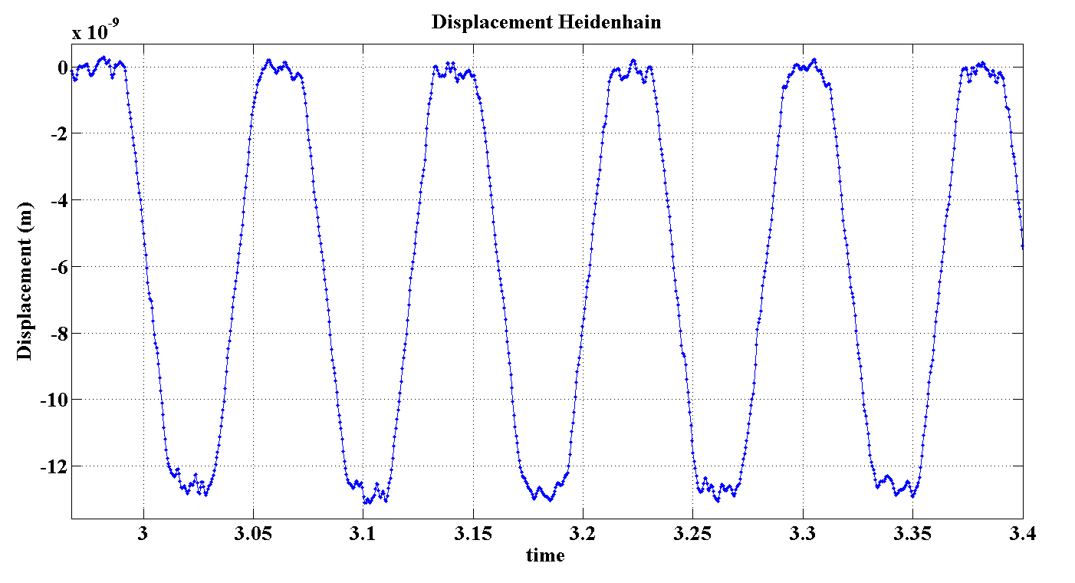
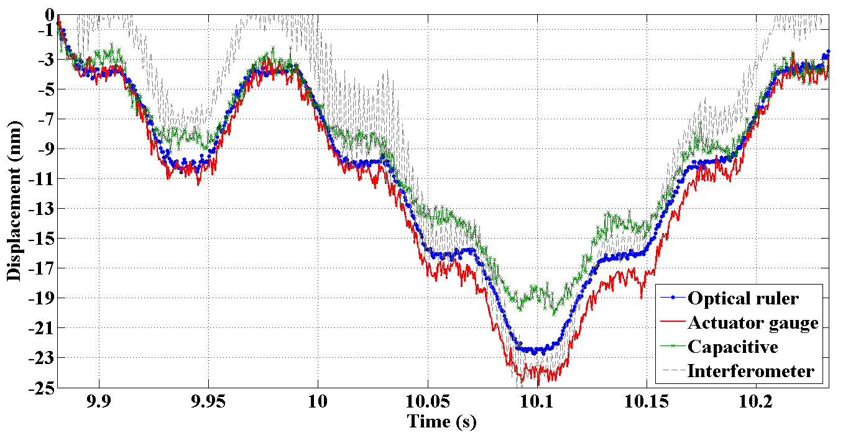
X-y positioning:
Study precision, accuracy and resolution
The precision required (0.25 nm):
demonstrated with optical rulers
in a temperature stable environment , in air
for simultaneous x and y motion.
Still increase speed

Slide 11



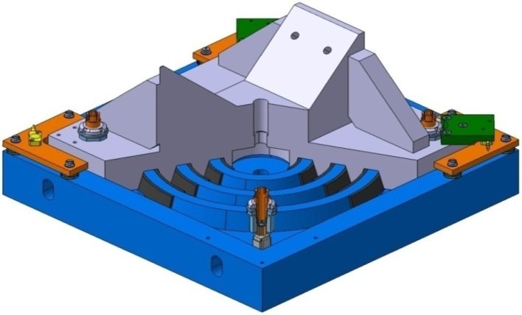
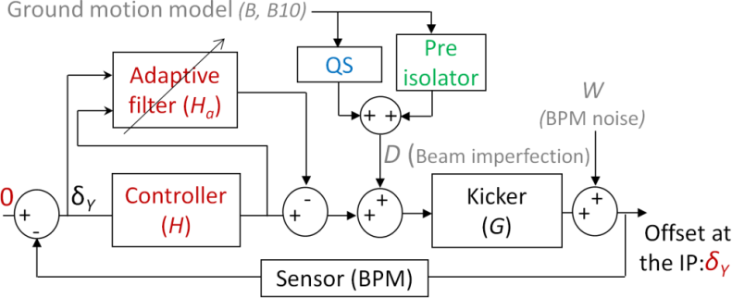
Final focus concept
Direct disturbances:
Acoustic noise, cooling …
Final Focus (FF)
Detector
(FF)
FFM
magnetic axis
QD0 (FF magnet)
Position at I.P.
Post collision BPM
Desired beam position
Beam
(e⁺)
Beam
(e⁻)
KICKER
Active Isolation
      RIGID GRIDER
Pre-isolator

Slide 12
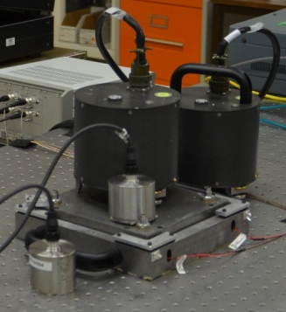
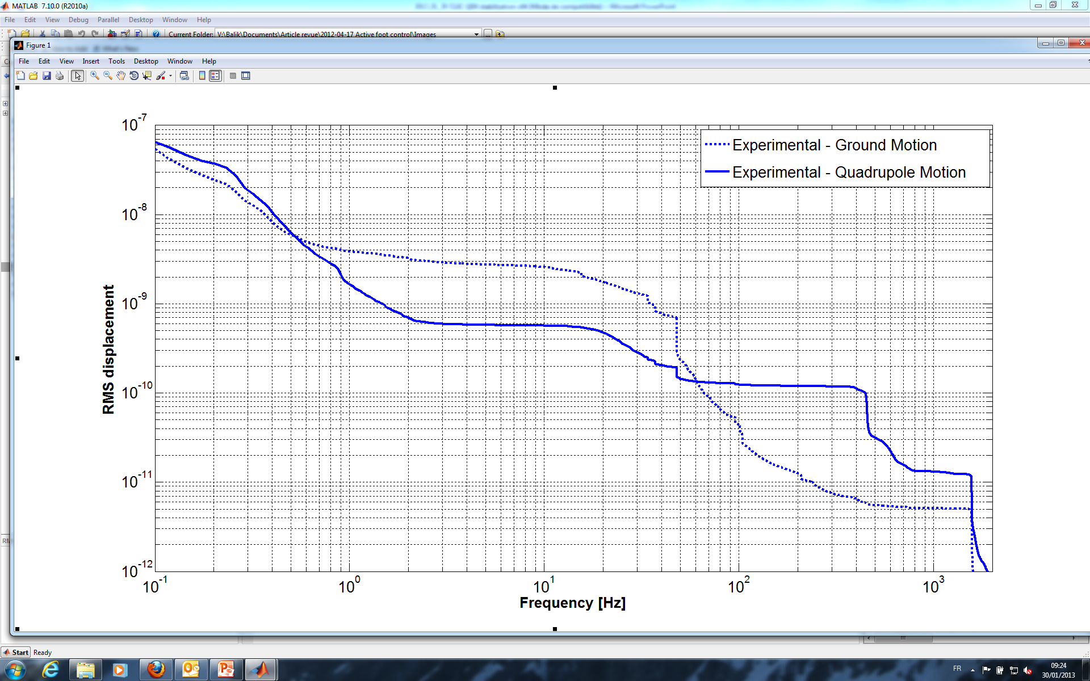
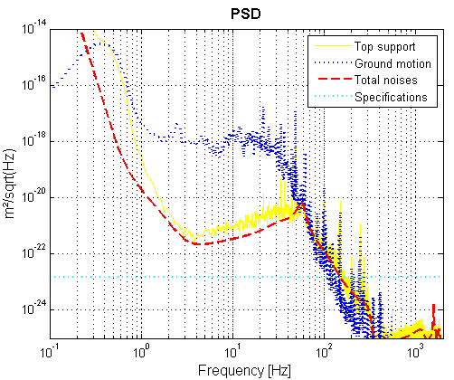
Concept demonstration
Result : 0,6 nm RMS @ 4 Hz
Spec : 0,2 nm RMS @ 4 Hz
Balik et al, “Active control of a subnanometer isolator“, JIMMSS. (accepted)
Indication of sensor limit

Slide 13
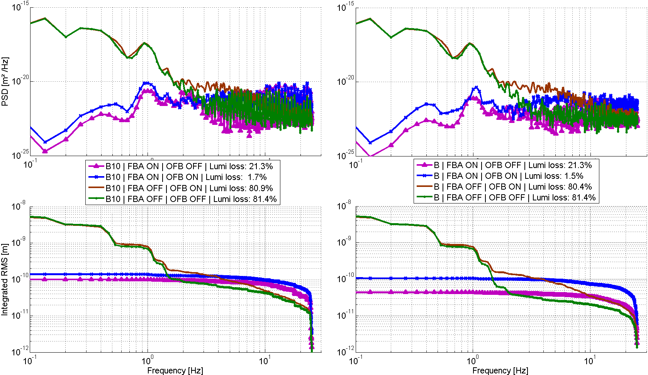
Concept demonstration
GM B10
GM B
B. Caron et al, 2012, 236-247, Contr. Eng. Pract. , 20 (3). ; G. Balik et al, 2012, N.I.M. A., 163-170
Reduction of luminosity losses down to 2% for different GM models
Demonstration feasability for CLIC MBQ and FF, «can we do better ?»

Slide 14
Performance limitations
of a mechatronics system
Freely adapted from J. Moerschell
Noise
Mechanics
Temperature
Electrical noise (Johnson,…)
Electromagnetic noise
SEU
Digitalisation, quantisation
Spurious noise, cross talk
Dimensions, mass, stiffness
Range
Degrees of freedom
Precision guidance
Modal behaviour
Material
Control
Elasticity, elastic limit, stress limit
Damping
Fatigue
Ageing (Radiation, Curie-T, humidity)
Non linearity
Bandwidth, instabilities
Control delay
Parameter uncertainties
Controller authority, collocation

Slide 15
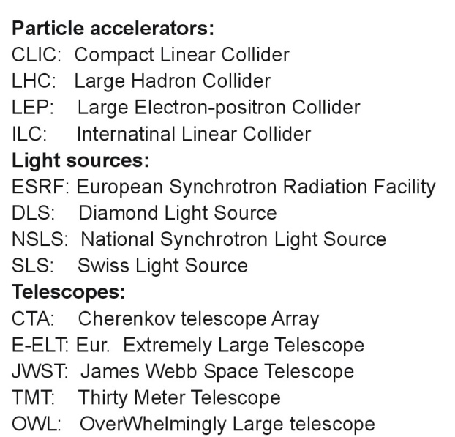
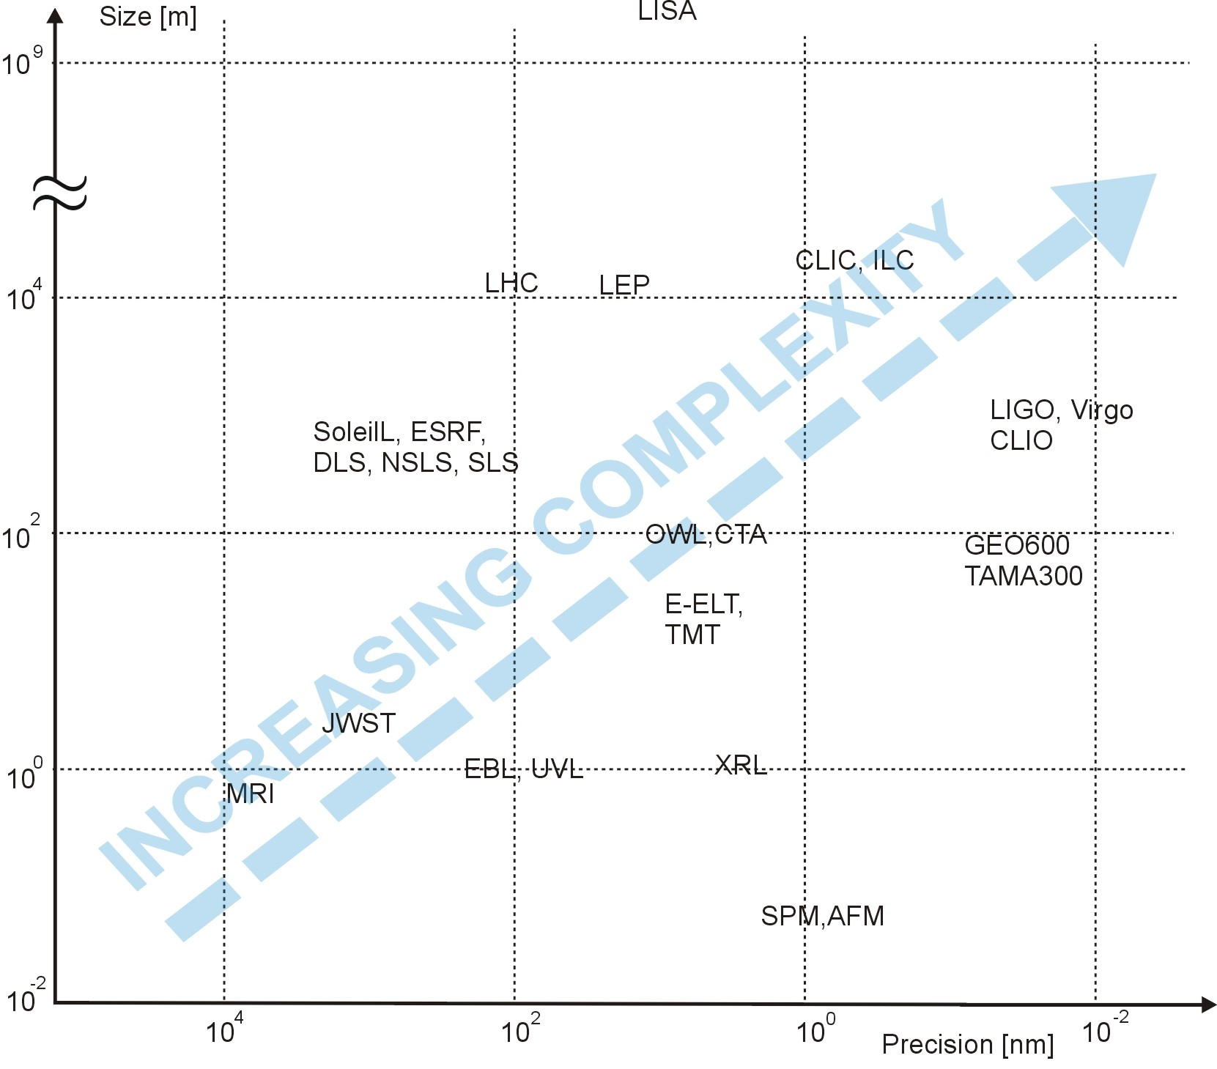
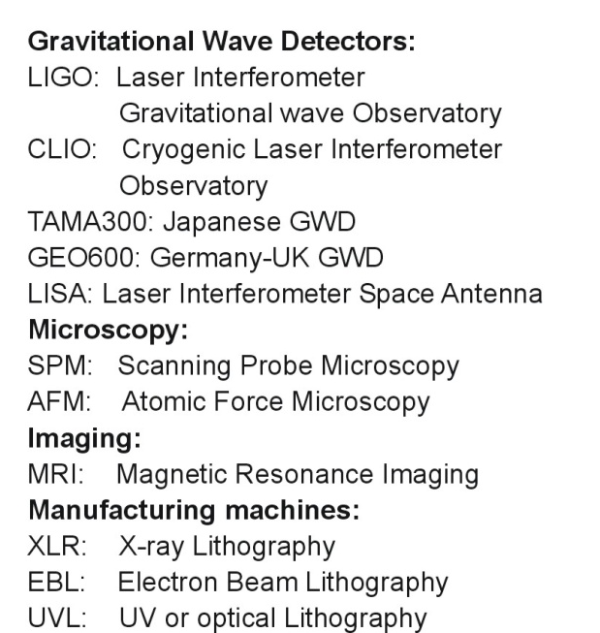
Machine precision vs size
C. Collette

Slide 16
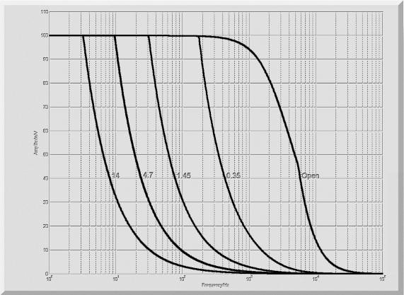
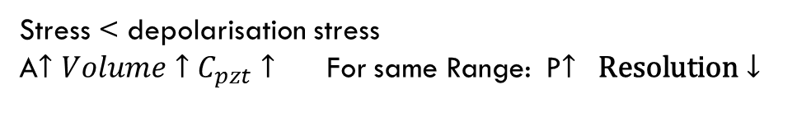
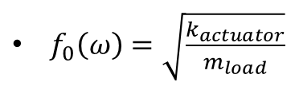
Mass/Actuator Resolution/
Range/k/ Bandwidth
A
Stress < depolarisation stress
A$↑Volume↑$ $C_{pzt}↑$ For same Range: P$↑ \text{Resolution}↓$
$f_{0}\left(ω\right)=\sqrt{\frac{k_{actuator}}{m_{load}}}$
Bandwidth is limited by
Actuator slew rate
Remark about load compensating springs:
Force
Amplitude
Range
Frequency
Load compensation reduces range + bandwidth
Improves resolution *

Slide 17
Machine precision vs size
C. Collette
Technological limitation for larger components

Slide 18
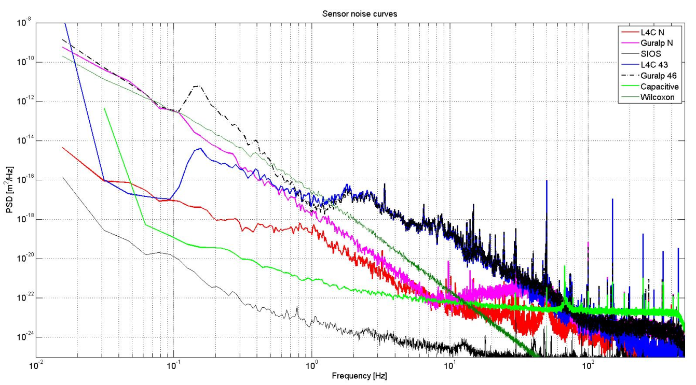
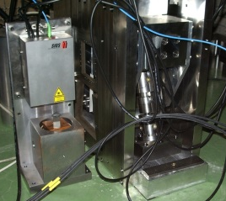
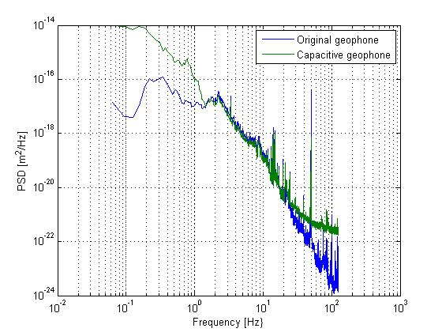
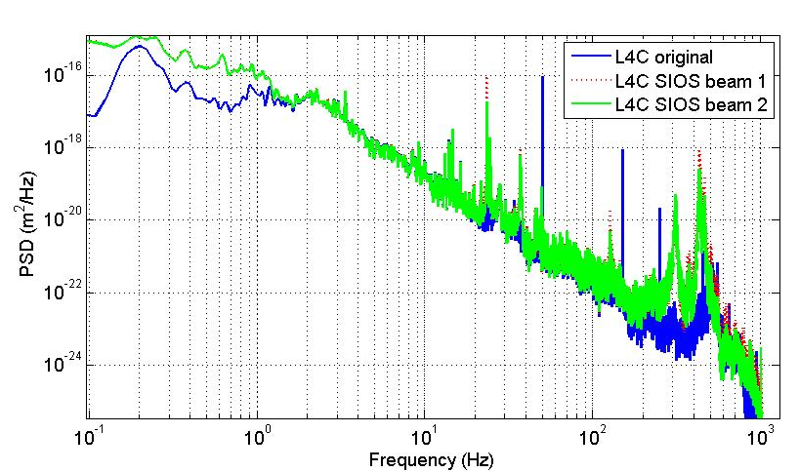
Resolution limitations
Sensors
Stabilisation
Limitations:
Thermal stability (*alignment)
EM stray fields
Sensor resolution (wavelength light)
Michelson
Stabilised LASER
Expected maximum one order of magnitude improvement resolution in next decade (Without major technological innovation)
Low freq. is where you can win the most

Slide 19
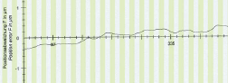

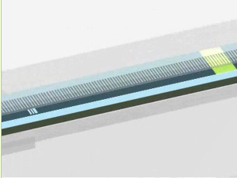
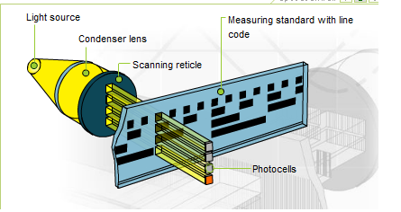
Nano positioning sensors
Technological innovation: digital optical encoders
Heidenhain : 1nm resolution < 1000 CHF
Renishaw: 1 nm resolution < 1000 CHF
Smallest LSB can be used as quadrature …. 0.1 nm resolution is already possible

Slide 20
Conclusion
Noise
Mechanics
Temperature
Electrical noise (Johnson,…)
Electromagnetic noise
SEU
Digitalisation
Spurious noise, cross talk
Dimensions, mass, stiffness
Range
Degrees of freedom
Precision guidance
Modal behaviour
Material
Control
Non linearity
Bandwidth, instabilities
Control delay
Parameter uncertainties
Controller authority, collocation
Elasticity, elastic limit, stress limit
Damping
Fatigue
Ageing (Radiation, Curie-T, humidity)
In the Eucard grant we demonstrated technical feasibility of the CLIC stability requirements
In a laboratory environment one can expect to go an order better in the next decades, in an accelerator environment it is more complicated

Slide 22
Synergies between projects: Generic R&D

Slide 23
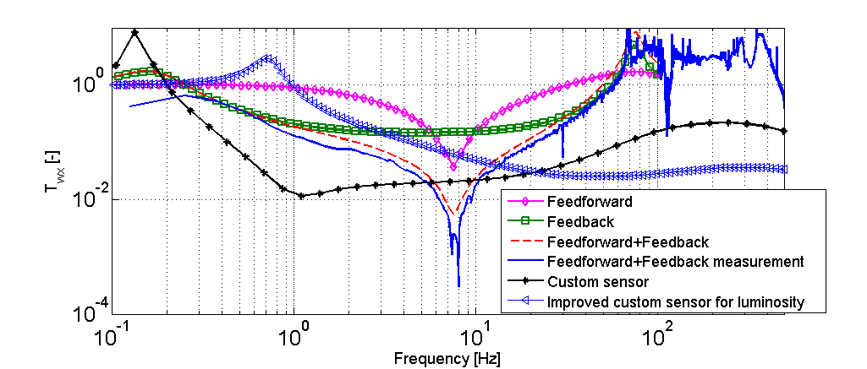


Integrated luminosity simulations
No stabilization | 68% luminosity loss
Seismometer FB maximum gain (V1) | 13%
Seismometer FB medium gain (V1mod) | 6% (reduced peaks @ 0.1 and 75 Hz)
Seis. FB max. gain +FF (FBFFV1mod) | 7%
Inertial ref. mass 1 Hz (V3mod) | 11%
Inertial ref. mass 1 Hz + HP filter (V3) | 3%
Commercial
Seismometer
Custom Inertial Reference mass
Stef Janssens
Courtesy J. Snuverink, J. Pfingstner et al.
Notes:
Compari

Slide 24
Comparison sensors
Sensor | Resolution | Main + | Main -
Actuator sensor | 0.15 nm | No separate assembly | Resolution No direct measurement of magnet movement
Capacitive gauge | 0.10 nm | Gauge radiation hard | Mounting tolerances Gain change w. α Orthogonal coupling
Interferometer | 10 pm | Accuracy at freq.> 10 Hz | Cost Mounting tolerance Sensitive to air flow Orthogonal coupling
Optical ruler | 0.5*-1 nm | Cost 1% orthogonal coupling Mounting tolerance Small temperature drift Possible absolute sensor | Rad hardness sensor head not known Limited velocity displacements
Seismometer (after integration) | < pm at higher frequencies | For cross calibration

