Slide 1



Progress in unconventional RF structures
Dr Graeme Burt
Cockcroft Institute, Security Lancaster, Lancaster University

Slide 2

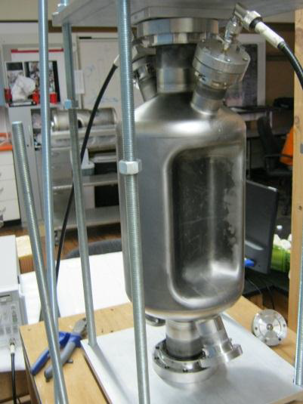
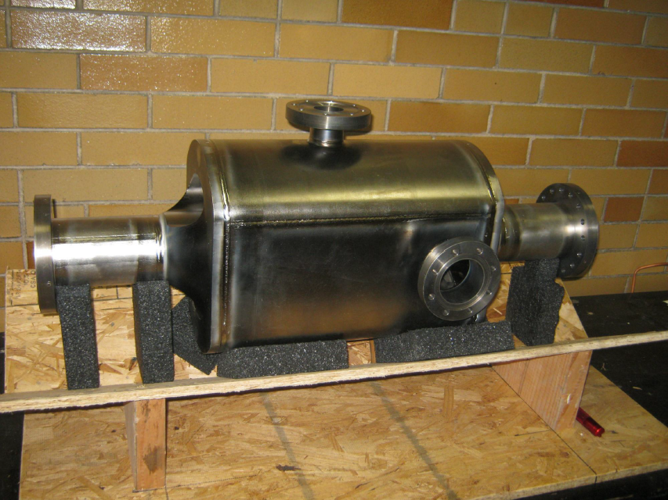

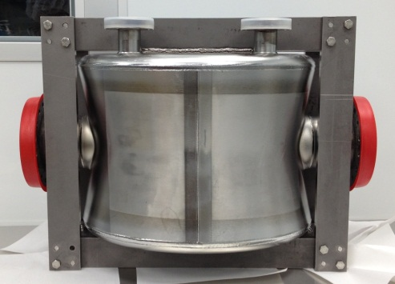


Compact SRF Crab cavities
We start our tour of the weird and wonderful with compact crab cavities.
A few years ago these three designs were considered quite exotic but now we have three prototypes in niobium

Slide 3
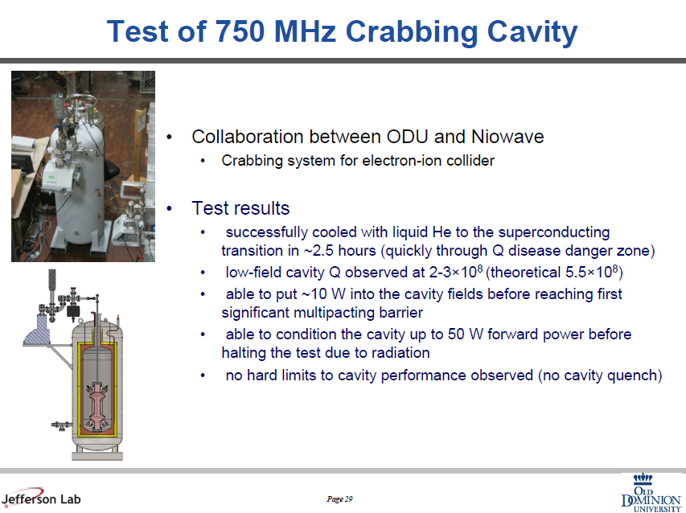

Slide 4
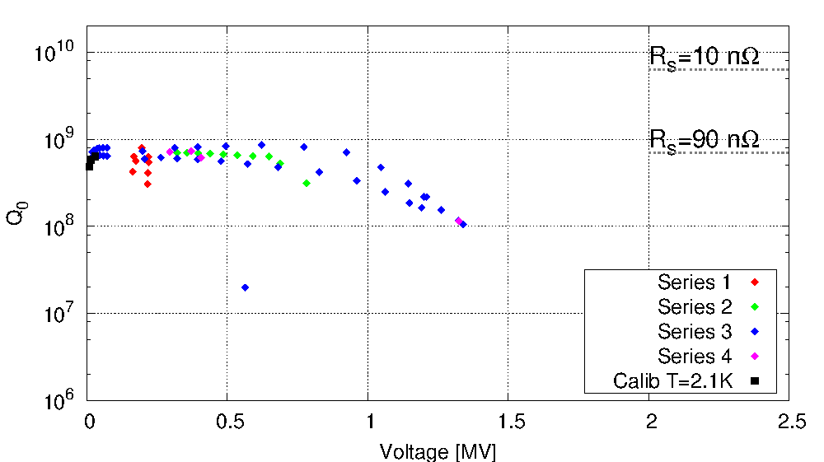
1st test results
Low Q probably due to incomplete cleaning.
Helium processing due to leak?
The first high field tests were with the 4R crab cavity, but this was limited by a severe vacuum leak.

Slide 5
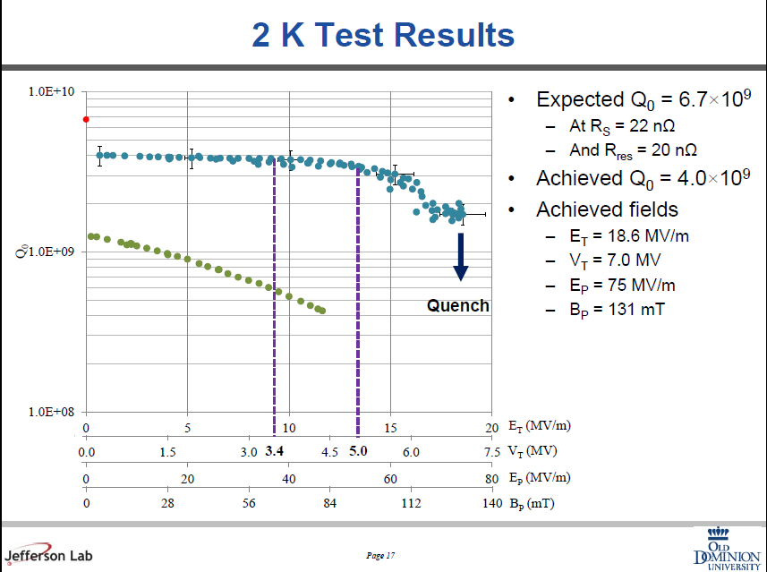

Slide 6
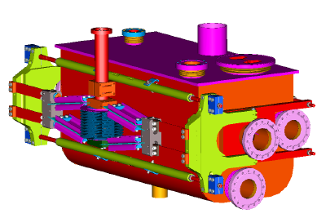
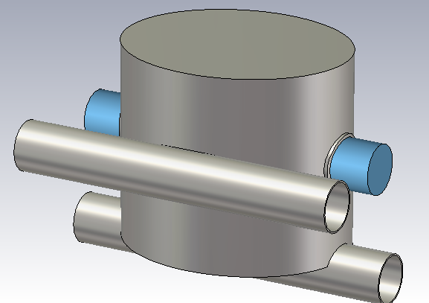
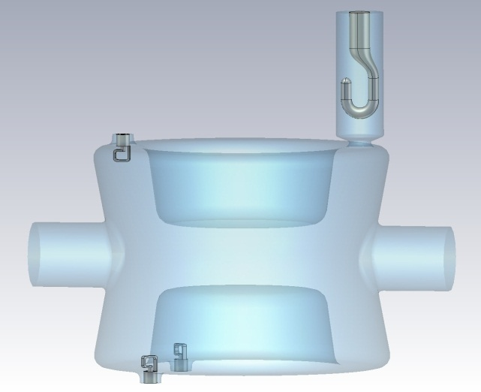
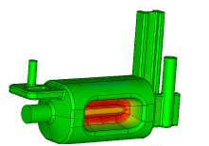
He Jacket Design

Slide 7

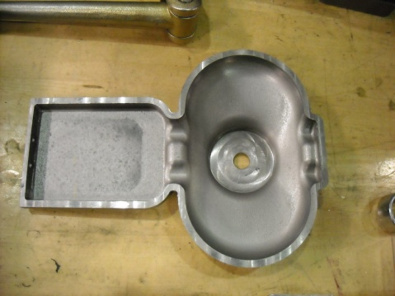
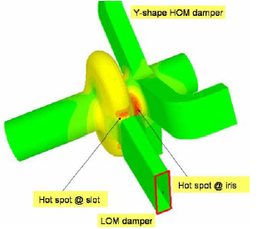
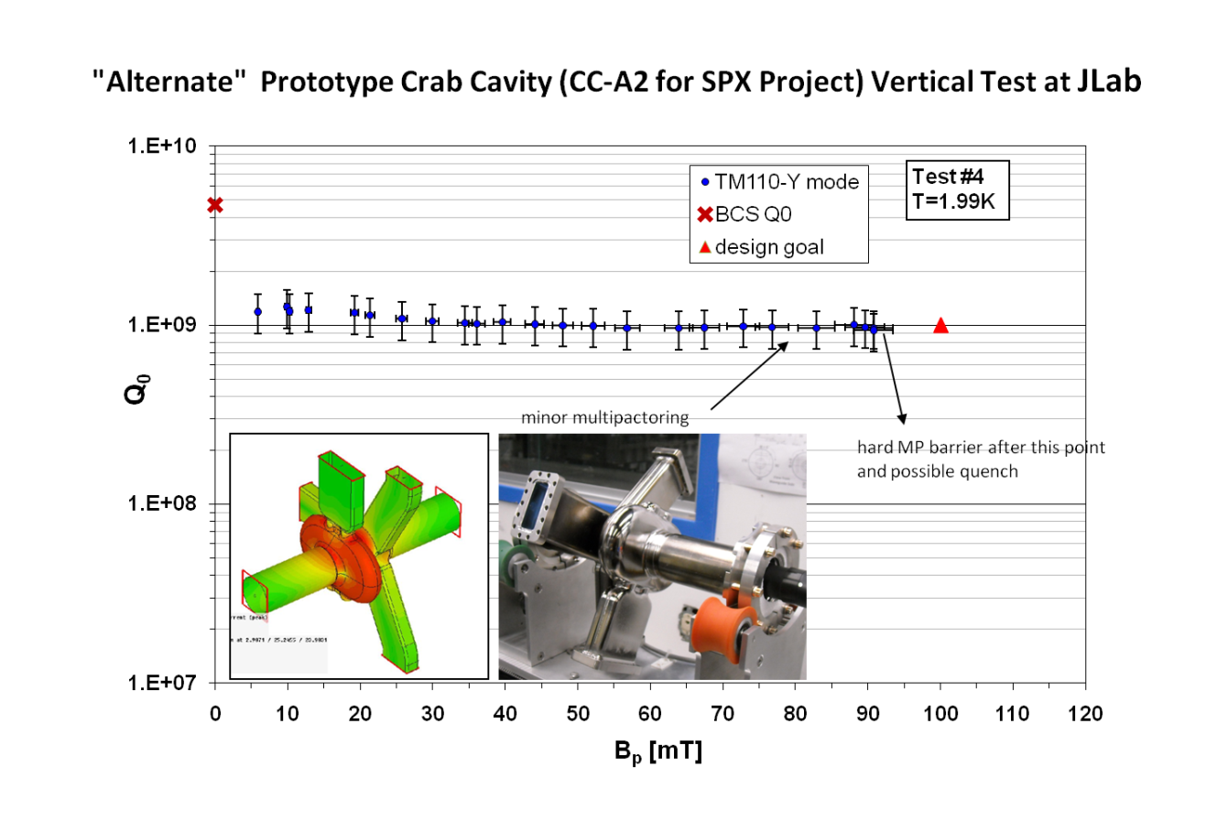
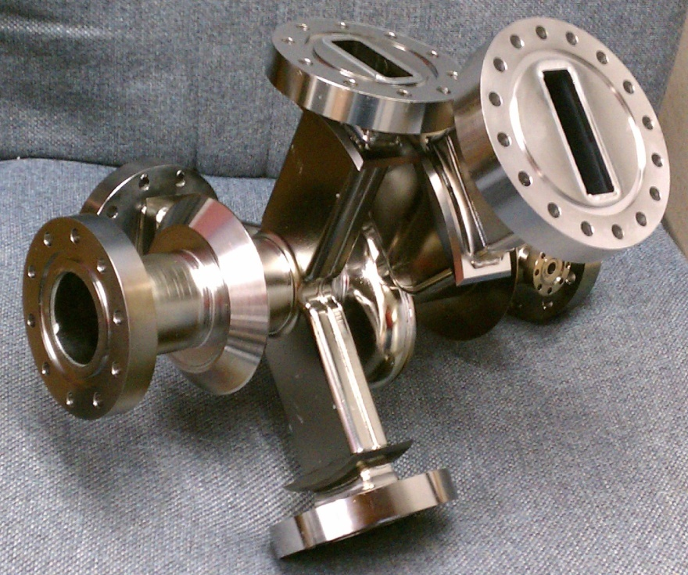
SPX Cavity
Another novel crab cavity is the SPX crab.
This uses on-cell coupling to strongly damp the fundamental monopole mode.

Slide 8

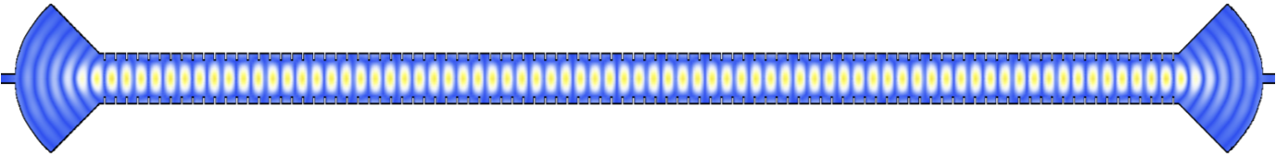
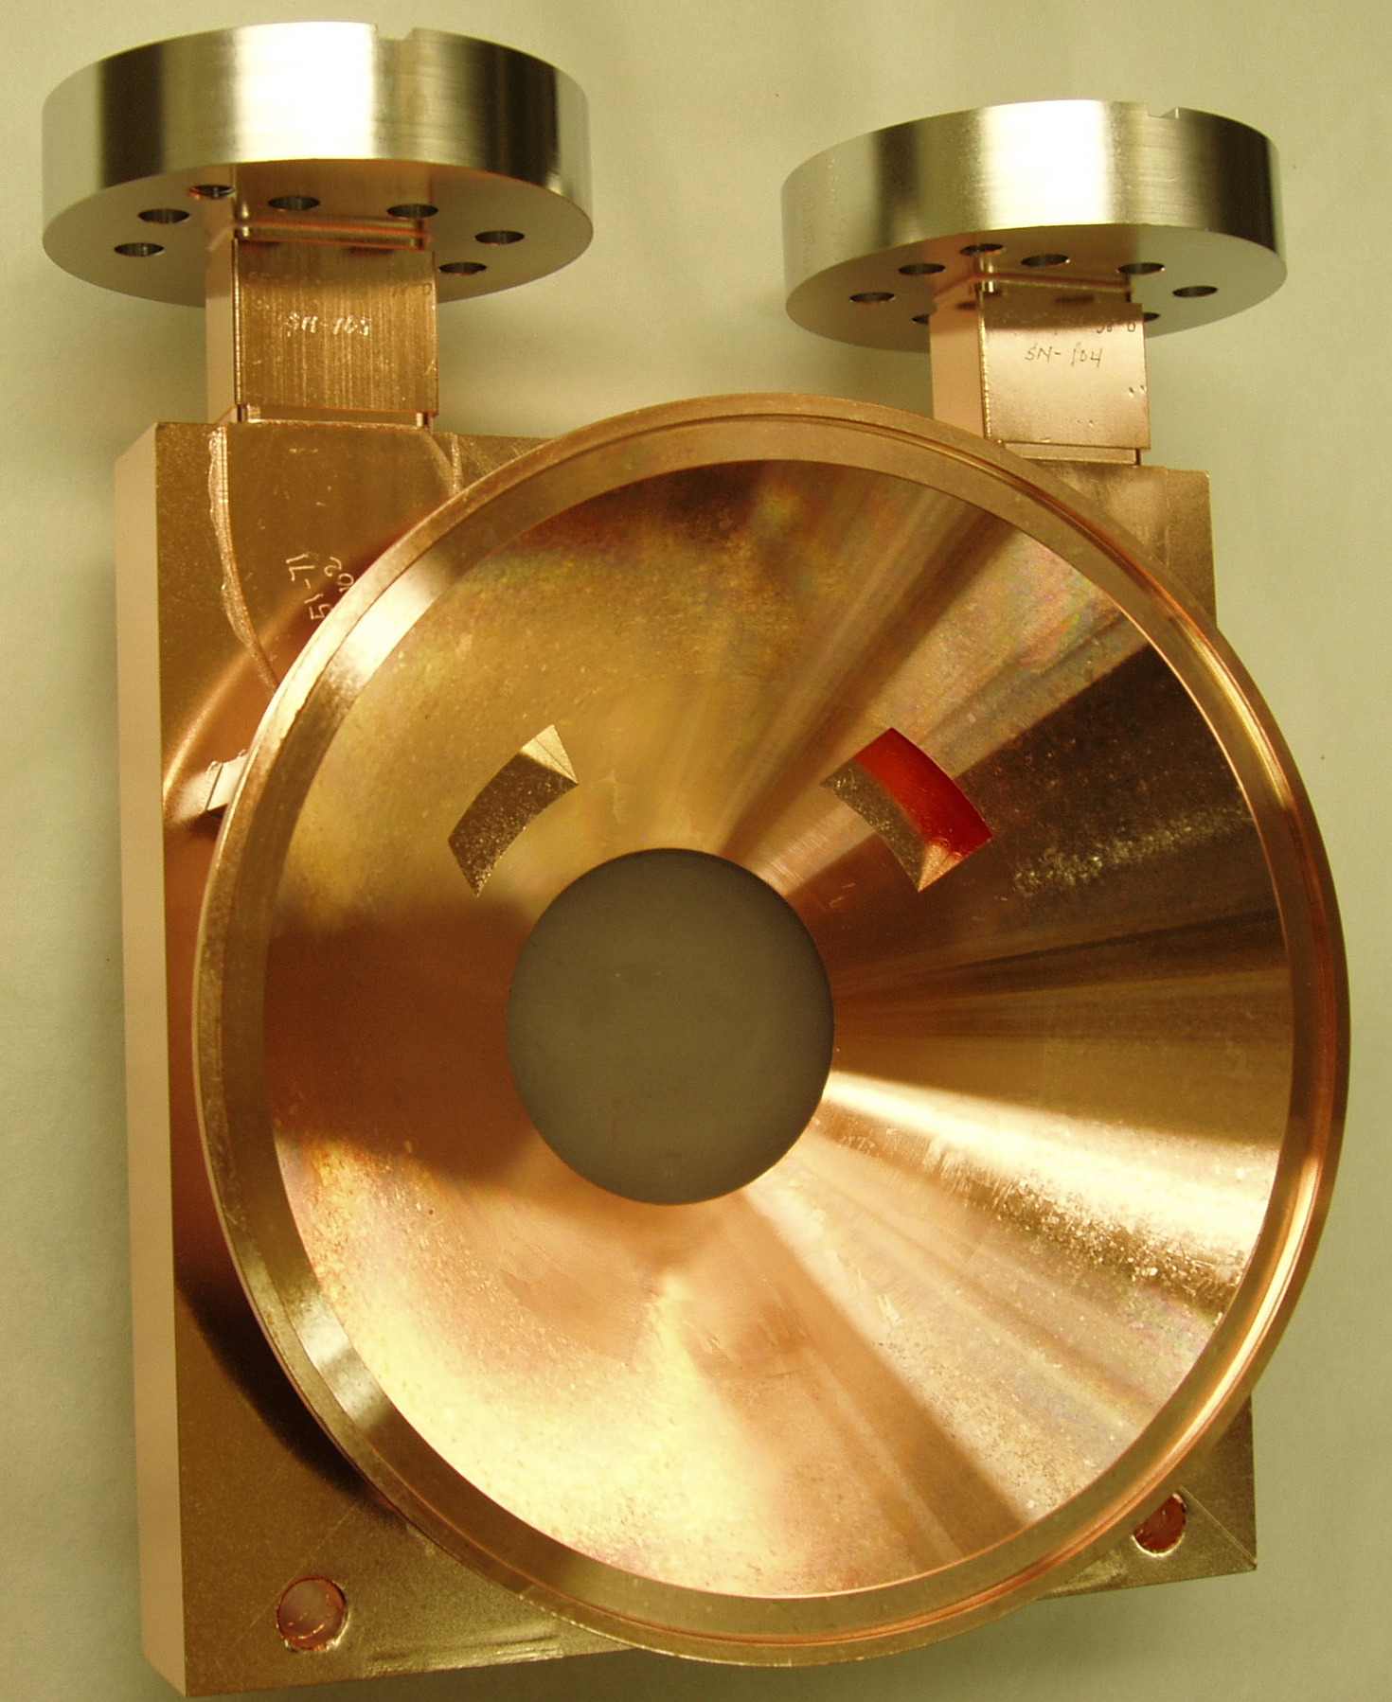
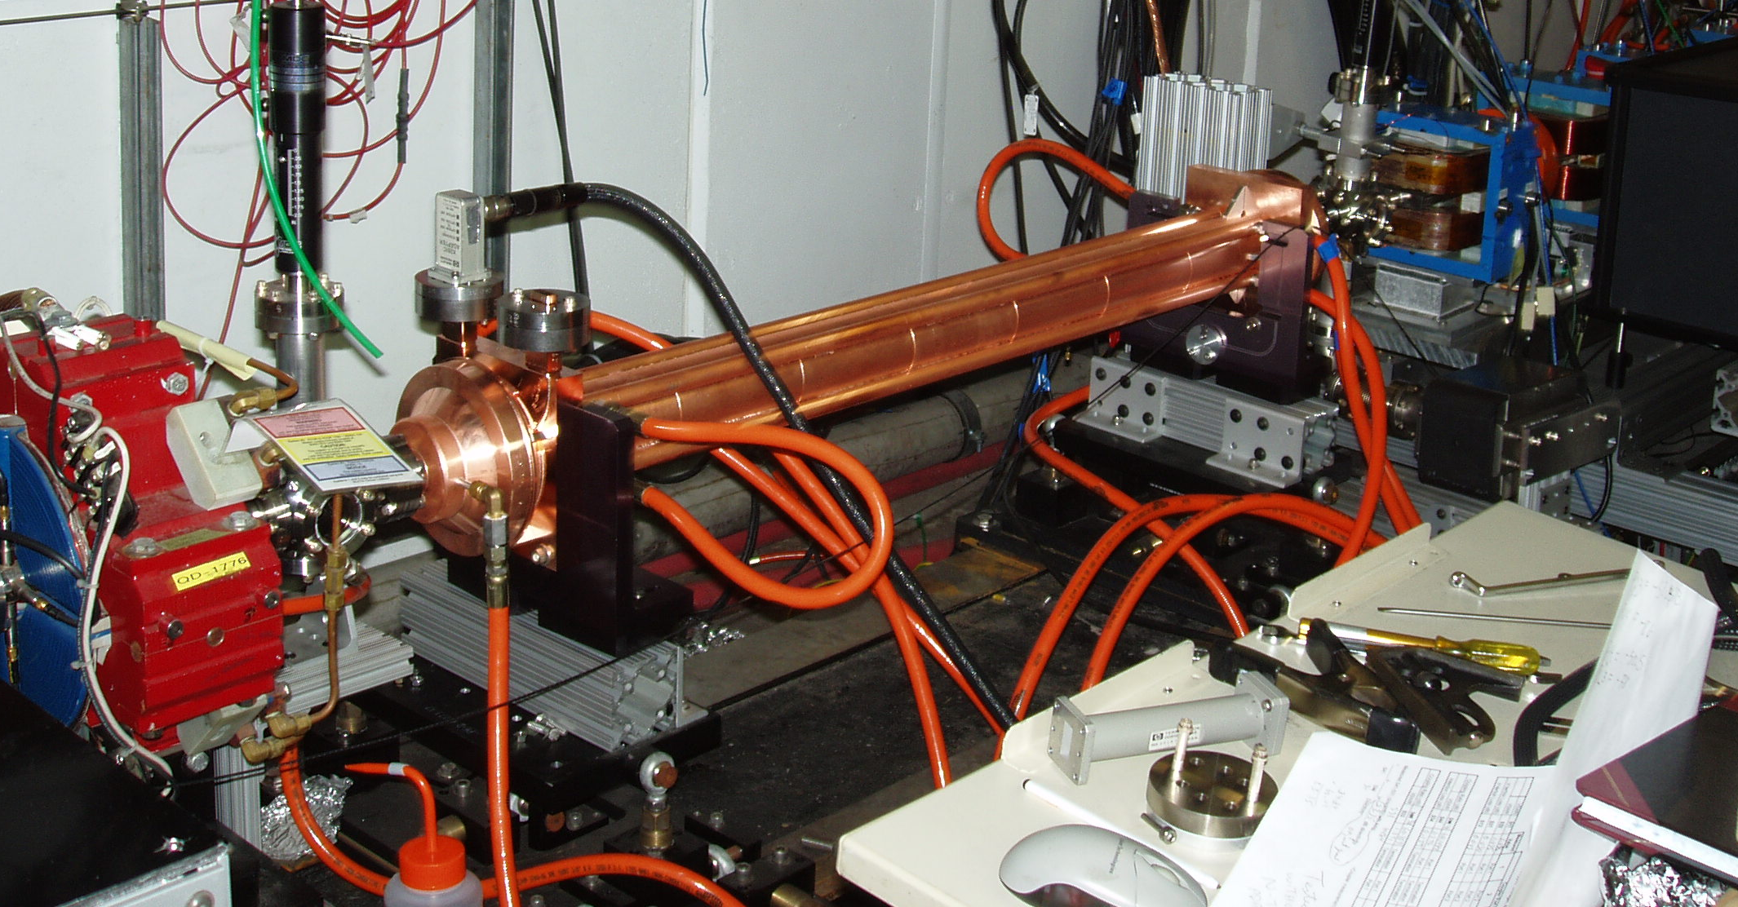
Microwave Undulators
Electric Field Distribution
Another RF device using dipole fields is the Microwave Undulator.
These use the transverse fields to wiggle the electron beam.
The advantage is a small period and dynamically variable polarisation.

Slide 9
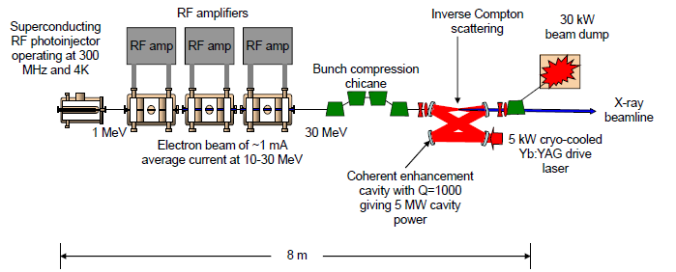
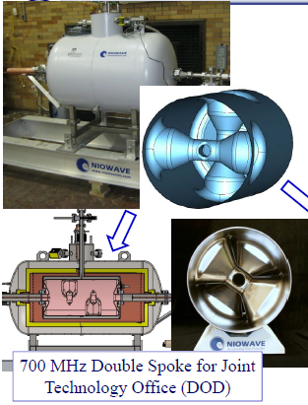
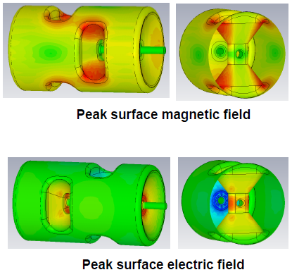
High Beta Spoke Cavities
Spokes are traditionally used for medium beta but ODU propose a spoke for β=1 electrons.
The cavity has a high Q at low frequency while having the same size as an L-band cavity.

Slide 10
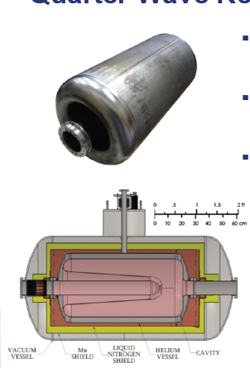
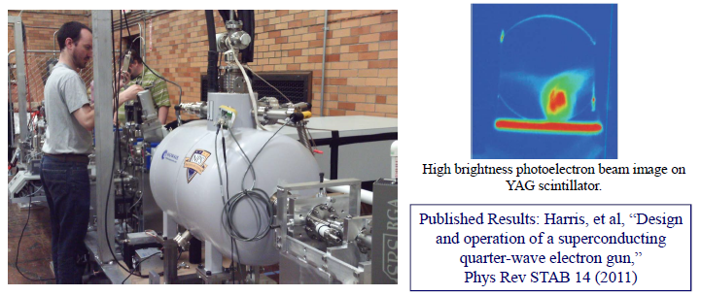
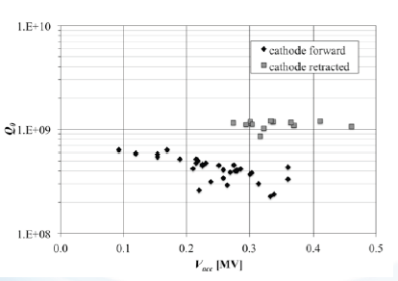
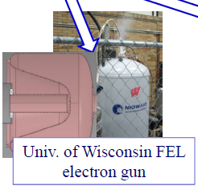
QW Electron Guns
BNL, Niowave, NPS, Univ. Wisconsin are proposing quarter wave SRF guns. The low frequency allows long low space charge beams.

Slide 11
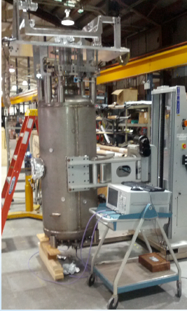
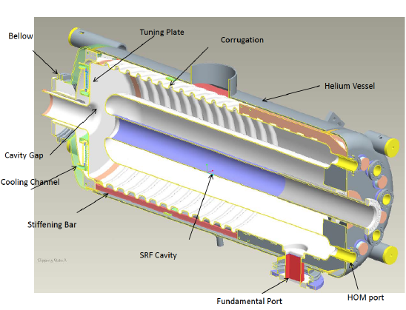
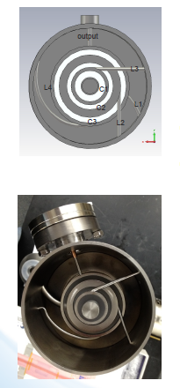
56 MHz cavity
BNL are developing a 56 MHz quarter wave cavity to provide longer RF buckets in RHIC. The very low frequency SRF system is quite uncommon, and the quarter wave is in the longitudinal direction to reduce transverse size.
It also includes a novel Chebyeshev filter on the HOM coupler.

Slide 12

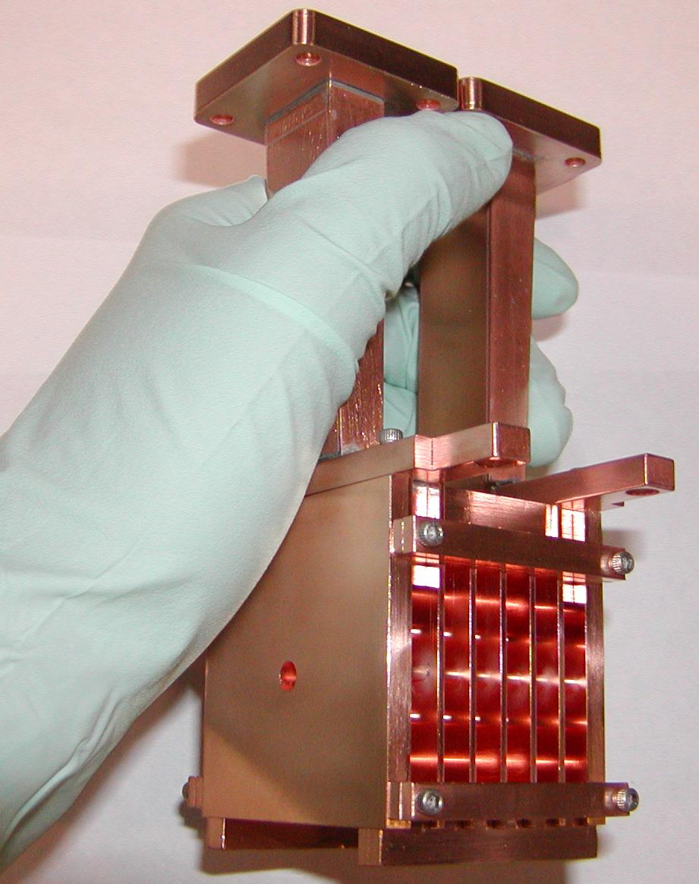
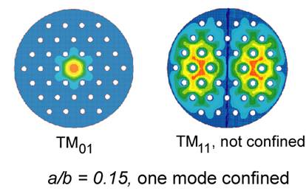
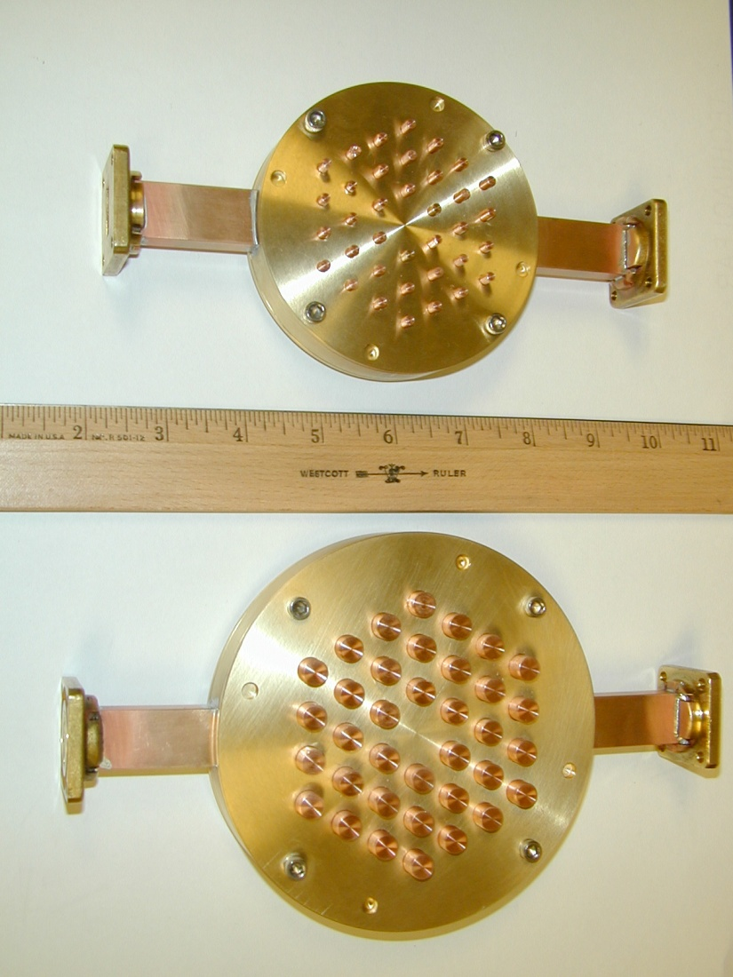
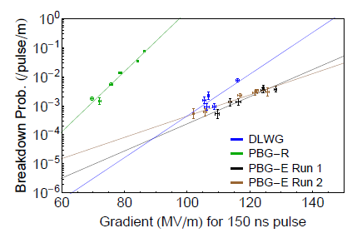
Photonic Bandgap
Photonic bandgaps offer the possibility of confining only a few modes in the cavity.
MIT have been working towards PBG’s with similar performance to normal cavities.

Slide 13
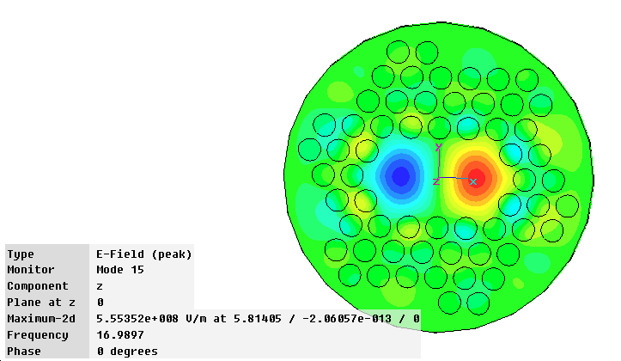
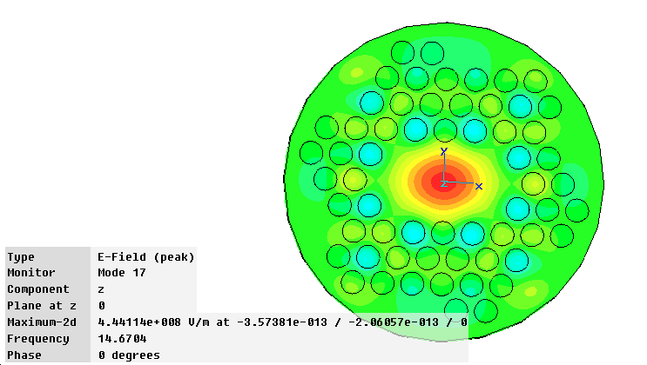
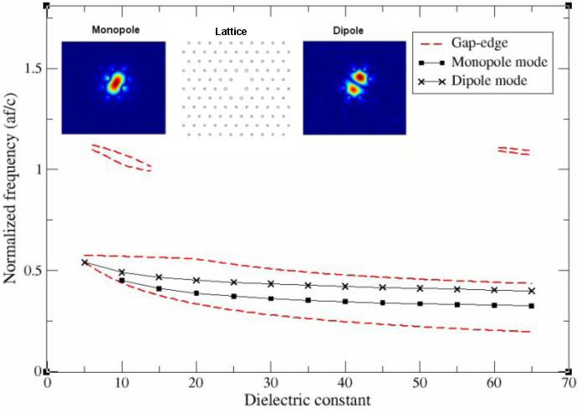

PBG crab cavities
A PBG dipole cavity would allow the construction of a crab cavity with no trapped higher order modes.
However, one must be careful not to trap other modes in the band-gap as well.
Lancaster and Huddersfield

Slide 14
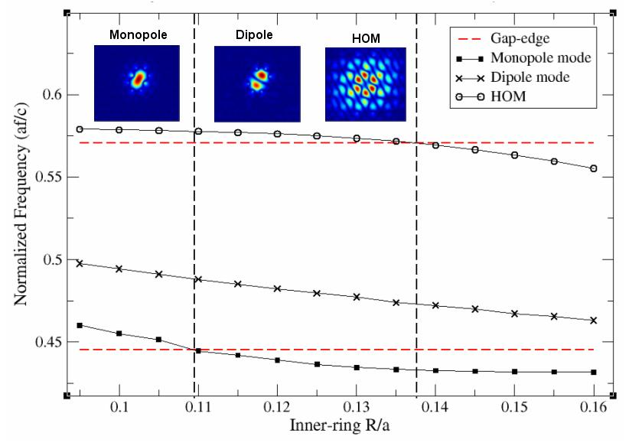
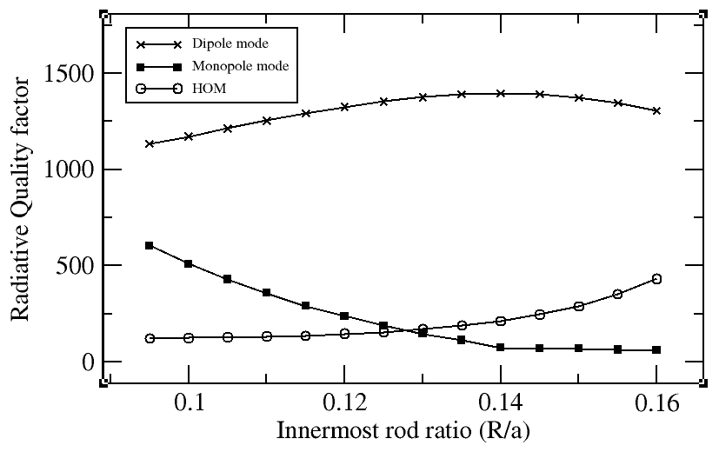
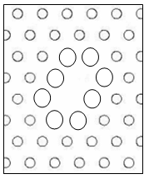

PBG Crab Cavities
A solution was found, where the rods around the defect (two missing rods) where enlarged.
This pushes the modal frequencies down allowing the monopole to be pushed out of the bandgap.
Lancaster and Huddersfield

Slide 15


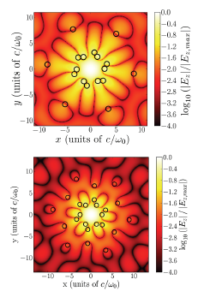
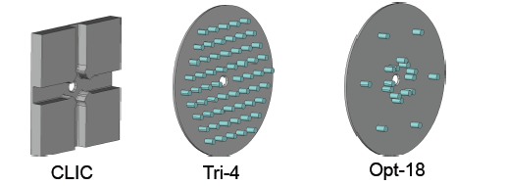
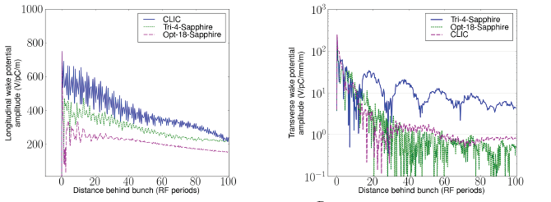
Irregular crystal cavities
Colorado U. and TechX used computation optimisation to find the best lattice and the results were quite surprising.

Slide 16
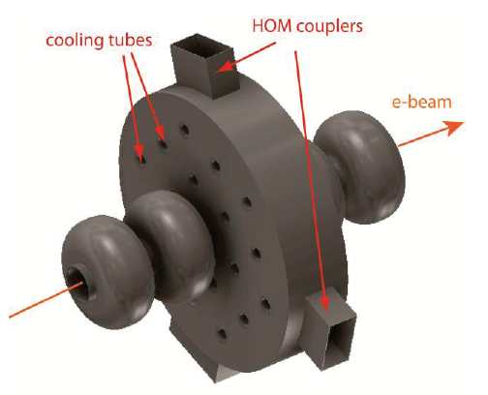

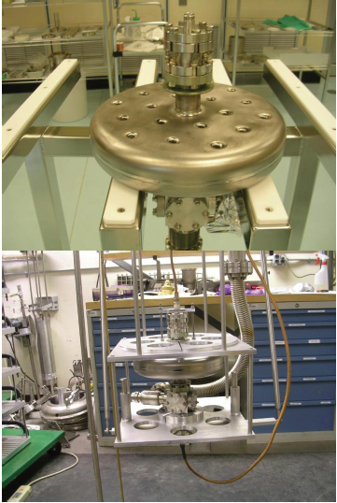
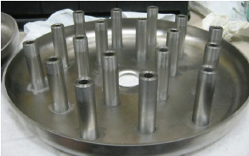
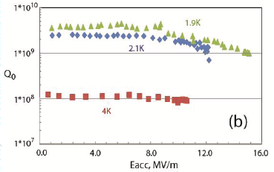
SRF PBG
Los Alamos have been looking at using an SRF PBG as a HOM damper.
Vertical test results look promising.

Slide 17
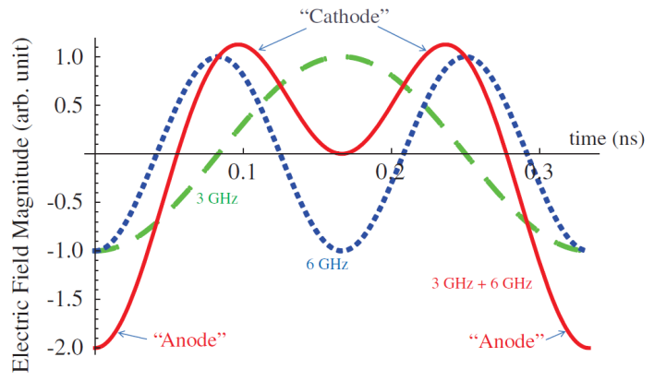
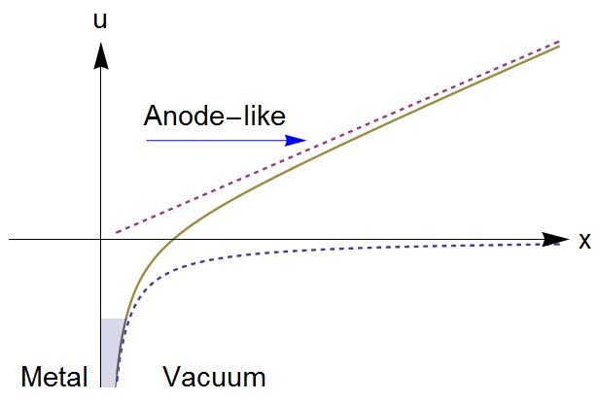
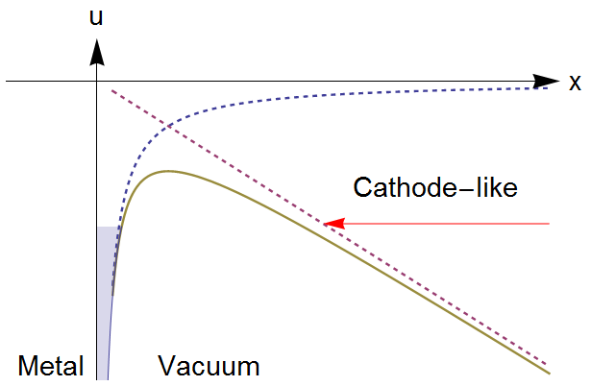
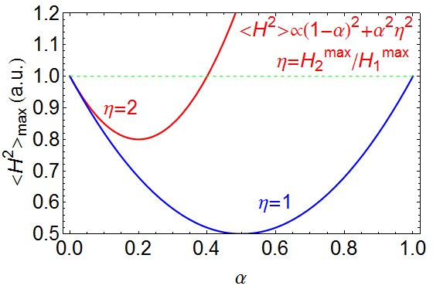




Motivation: Multi-Harmonic to Increase Breakdown Threshold
Superimposing harmonically-related modes
may yield RF electric fields that point into metallic cavity surfaces to be always smaller than fields that point away from the surfaces
Potential energy u of an electron near the surface of a metal with x the distance of electron from surface.
may lower the pulsed surface heating. By superimposing two modes
(Ideal pillbox η=H₂^{max}/H₁^{max}=2)
Y. Jiang, L.R. Carver, R. M. Jones & J.L. Hirshfield
Notes:
Initiated by electron emission driven by the RF electric field directing towards the wall, where electrons can be accelerated to escape from the wall, and stimulate a breakdown event;
Promoted at surface irregularities which are accentuated by stresses induced by pulsed heating due to surface RF magnetic fields.

Slide 18
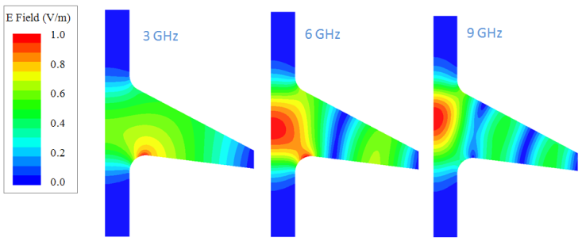
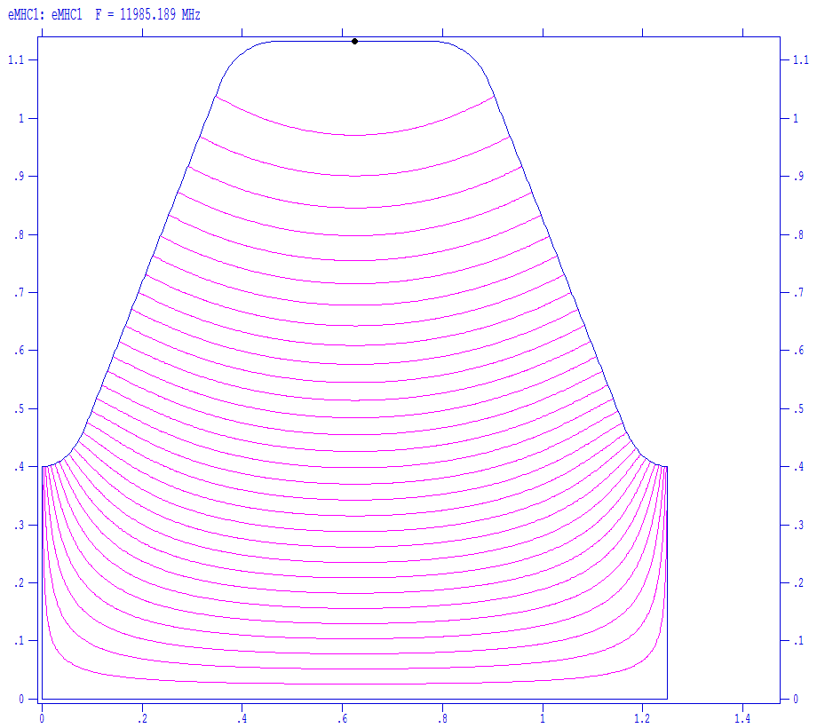




Multi-Harmonic Cavity
TM020 Type MHC:
Superposition of TM₀₁₀ and its 2nd -harmonic TM₀₂₀
Longitudinal non-symmetric
Anode-Cathode effect featured, peak accelerating field can be close to or even higher than the breakdown threshold
TM011 Type MHC:
Superposition of TM₀₁₀ and its 2nd -harmonic TM₀₁₁
Elliptical cavity to lower the surface magnetic field
Pulsed heating temperature rise 20% less than single mode only with the same acceleration gradient
Electric field pattern
Magnetic field pattern
3 GHz
6 GHz
Asymmetric Bimodal Accelerator Cavity for Raising rf Breakdown Thresholds, S.V. Kuzikov, S.Yu. Kazakov, Y. Jiang, and J. L. Hirshfield, PRL 104, 214801 (2010)
Y. Jiang, L.R. Carver, R. M. Jones & J.L. Hirshfield
Notes:
Peak electric field envelope around the cavity periphery as coordinate s advances along the cavity perimeter and along the cavity axis. Red segments are anodelike, while blue segments are cathodelike. Magenta segments are fields along the cavity axis.
The cavity wall is straight tilted for simplicity and E2: E1 = 2: 5.
It has been estimated that the total temperature rise from two mode excitation in similar multi-harmonic cavities driven by CTF3 beam is ~50 ° C.

